Slide 1
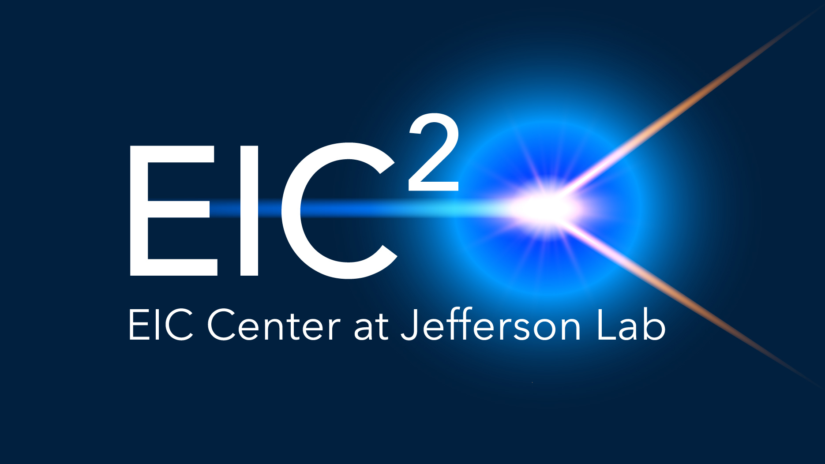
Friday JLab EIC Meeting, October 02 , 2026

Slide 2

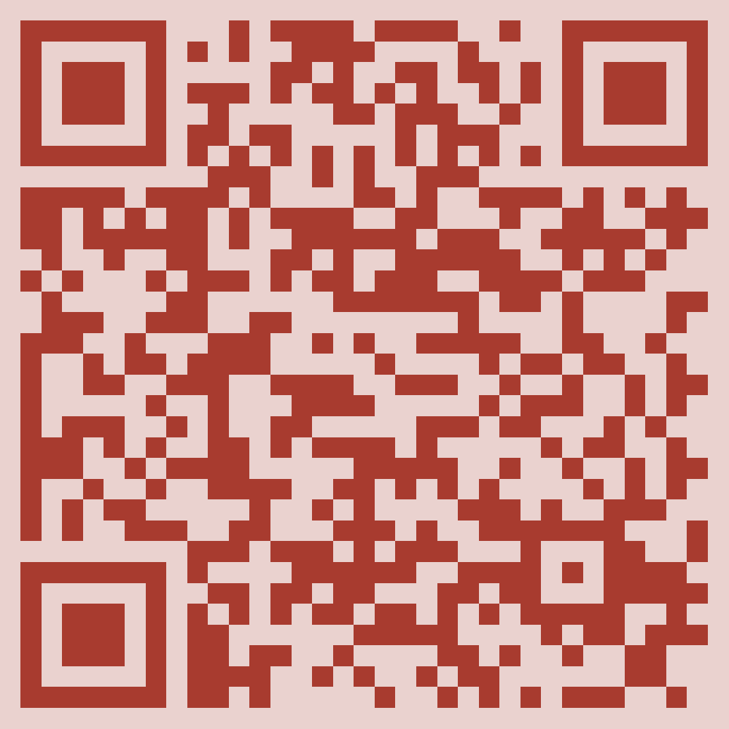



JLab EIC Meetings
News from EIC community and updates on accelerator, detector, advanced scientific computing, and theory.
Fridays at 9:30 a.m. (EDT) .
Intended for staff and Users. Anyone is welcome to attend the JLab EIC Meetings.
To receive our meeting invites, please tell your colleagues to subscribe via https://mailman.jlab.org/mailman/listinfo/jlab-eic-news.
Scan the QR code to subscribe.

Slide 3
JLab EIC Meetings – Some History
In early EIC times, there were EIC workshops once every two years, and further “EIC Collaboration” meetings:
  1999-2001: Pre-EIC Collaboration; EIC Meetings at Indiana, BNL, Yale, MIT
  2002: 1st Electron-Ion Collider workshop at BNL
  2004: 2nd Electron-Ion Collider workshop at JLab
  2006: 3rd Electron-Ion Collider workshop at BNL
  2008: 4th Electron-Ion Collider workshop at Hampton University
        2007-2010: further EIC Collaboration meetings at MIT, Stony Brook, LBNL, GSI/Darmstadt and Stony Brook
  2010: 5th Electron-Ion Collider workshop at Catholic University of America
  Resumed in 2014 with an Electron-Ion Collider workshop at Stonybrook University as Town Meeting for the 2015 NSAC Long-Range Plan
After this, we started the formation of the EIC User Group (2015) and the annual EICUG meetings (2016)
  2016: 1st EICUG meeting at Berkeley (formal formation of EIC User Group)
  2016: 2nd EICUG meeting at Argonne
  2017: 3rd EICUG meeting in Trieste
  2018: 4th EICUG meeting in Washington
  2019: 5th EICUG meeting in Paris, etc.
The “weekly” Friday JLab EIC meetings have been held since 2004 (!).
  The main goal of these meetings has been to discuss topics of relevance to the whole Jlab community interested in EIC, be it accelerator topics, engineering, computing, detector, or theory development.
  In reality the meetings are not weekly, but regularly: we host them on as-need basis, roughly 25 times a year.
  Early on, they were held in person at JLab; around ~2010 they became hybrid; during and after the covid-era they became fully remote.
  They are accessible to all, but we have used a separate mailing list, please sign up.

Slide 4
Today’s Meeting
This meeting originated with discussions on what “AI-readiness” of data (and EIC) really means and how different communities interpret this and link to FAIR data frameworks. It has as main goal a discussion between the various JLab communities.
Today: an extended JLab EIC Meeting, bringing together representatives from accelerator physics, experimental and theoretical nuclear physics, and data science to discuss AI-ready and FAIR data. We will compare how these concepts are defined and approached across the different communities, review ongoing activities and future plans, identify common needs and differences, and explore synergies and collaboration. Short presentations from each area will provide context for an extended discussion on shared challenges and future directions.

Slide 5
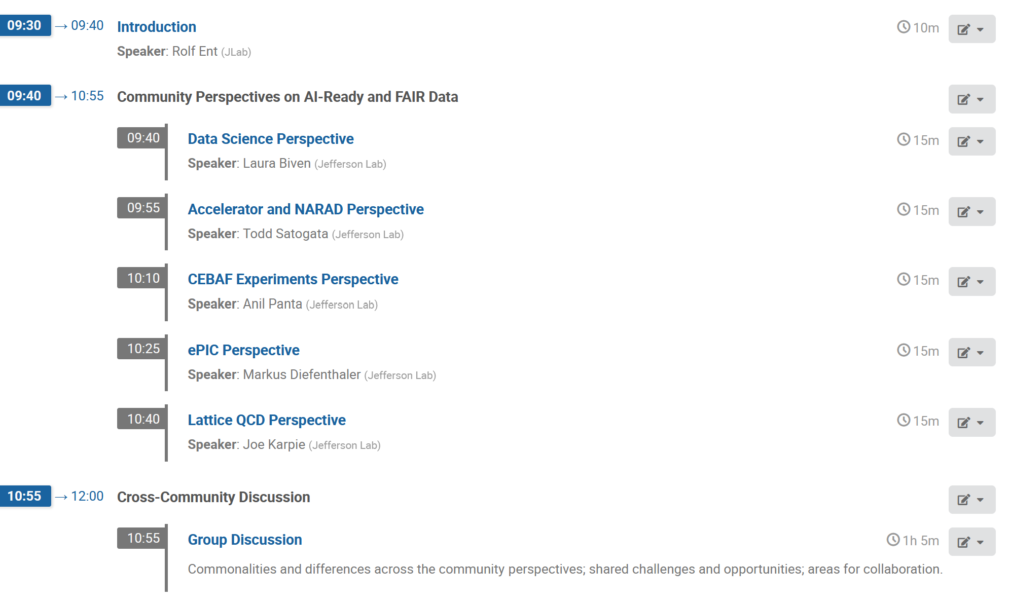
Today’s Agenda, see also https://indico.jlab.org/event/1098/

Slide 6
Backup Slides: Upcoming EIC-Related Conferences and Workshops

Slide 7
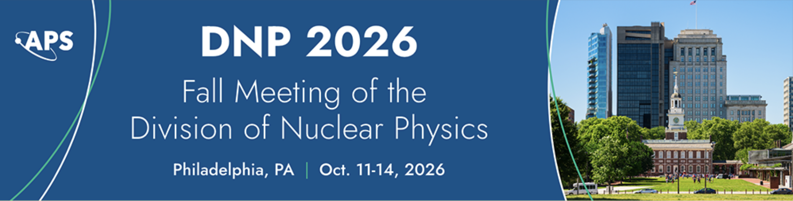

Conferences and Workshops in October
The international symposium on Physics in Collision (PIC)
Oct 5-9, 2026 , Vietnam
http://vietnam.in2p3.fr/2026/pic/
DNP 2026
October 11–14, Philadelphia, PA.
https://indico.bnl.gov/event/30850/
Resummation, Evolution and Factorization (REF) 2026
October 19–23, Santiago de Compostela, Spain
https://indico.global/event/16406/
International Conference on Meson-Nucleon Physics and the Structure of the Nucleon" (MENU 2026)
Oct 19 – 23, 2026 , Center for Frontiers in Nuclear Physics , Stony Brook University
https://indico.cfnssbu.physics.sunysb.edu/event/668/

Slide 8
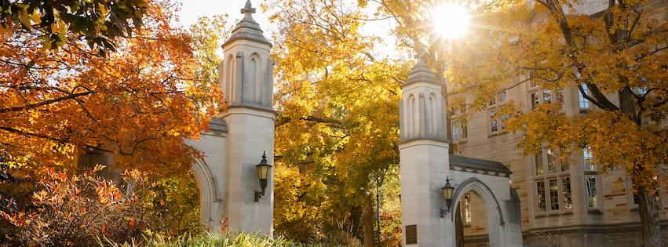
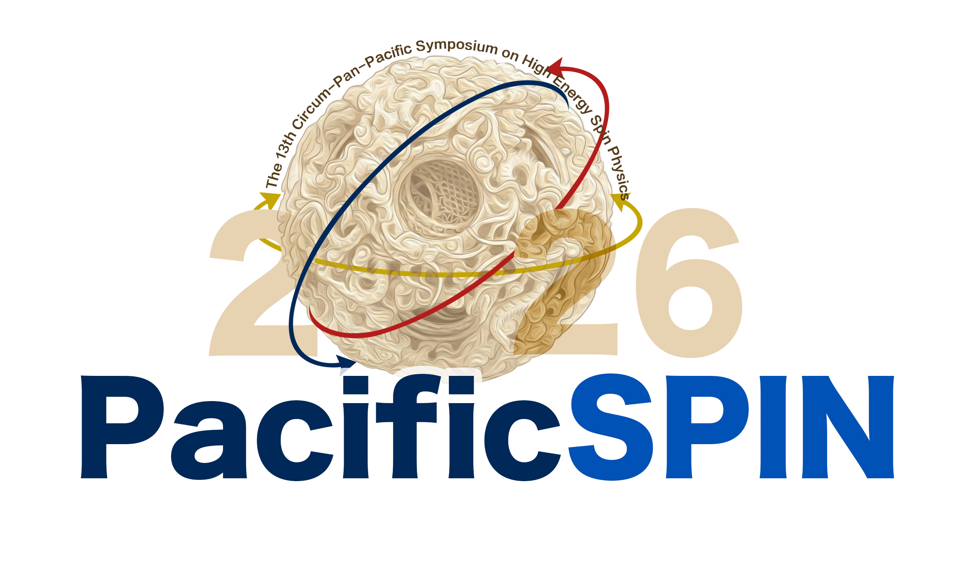
Conferences and Workshops in October, continued
10th International Symposium on Heavy Flavor Production in Hadron and Nuclear Collisions (HF-HNC 2026)
October 26–29, Bloomington, IN.
https://indico.cern.ch/event/1620073/
Rucio Community Workshop
October 26–30, Lyon, France.
https://indico.cern.ch/event/1628935/
Circum-Pan-Pacific Symposium on High Energy Spin Physics (PacificSPIN)
October 27–30, Academia Sinica, Taiwan.
https://indico.phys.sinica.edu.tw/event/371/

Slide 9

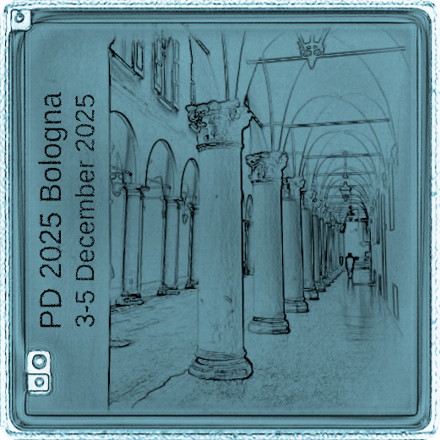
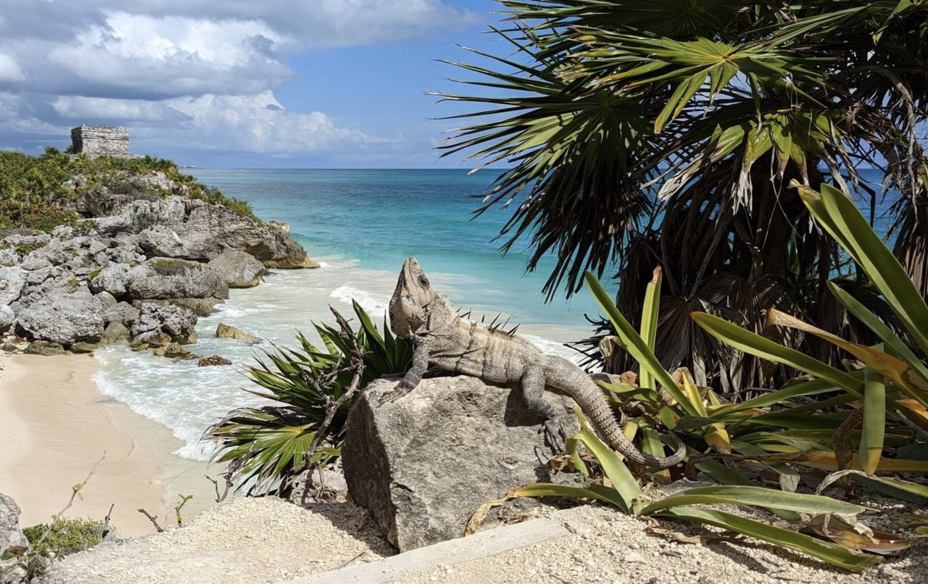
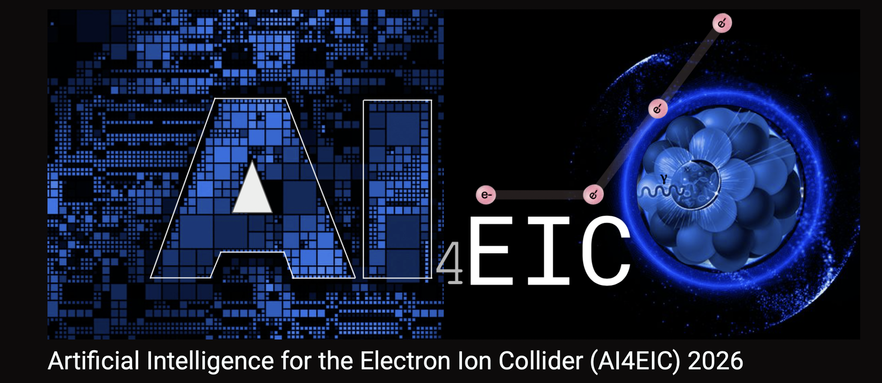
Conferences and Workshops in November , December
WLCG/HSF Workshop
November 2–6, Bologna, Italy.
https://indico.cern.ch/event/1655190/
ECT* Workshop: Quark-Gluon Dynamics in the Nuclear Medium
November 9–13, ECT*, Trento, Italy.
https://www.ectstar.eu/workshops/quark-gluon-dynamics-in-the-nuclear-medium/
UPC 2026: International workshop on the physics of Ultra Peripheral Collisions
Dec 7-13 , 2026 Playa del Carmen, Mexico
https://indico.cern.ch/event/1648300/
5th AI4EIC Workshop - Artificial Intelligence for the Electron-Ion Collider
December 15 -18, 2026, at Duke University in Durham, North Carolina, in a hybrid format.
https://indico.bnl.gov/event/33532/

Slide 10
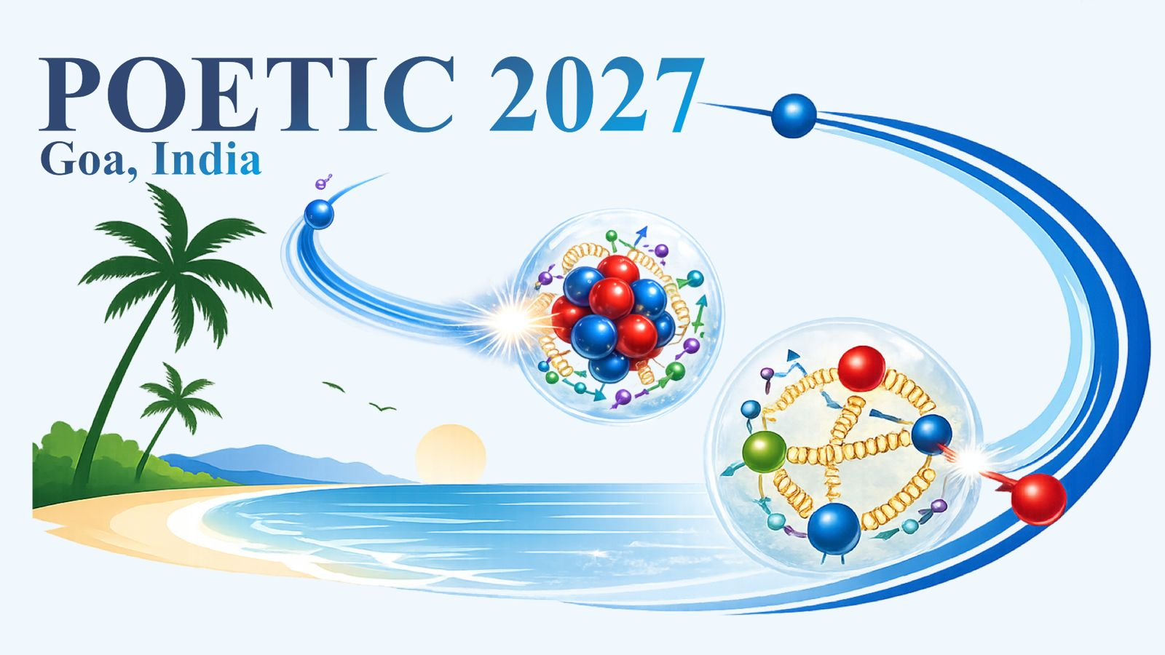
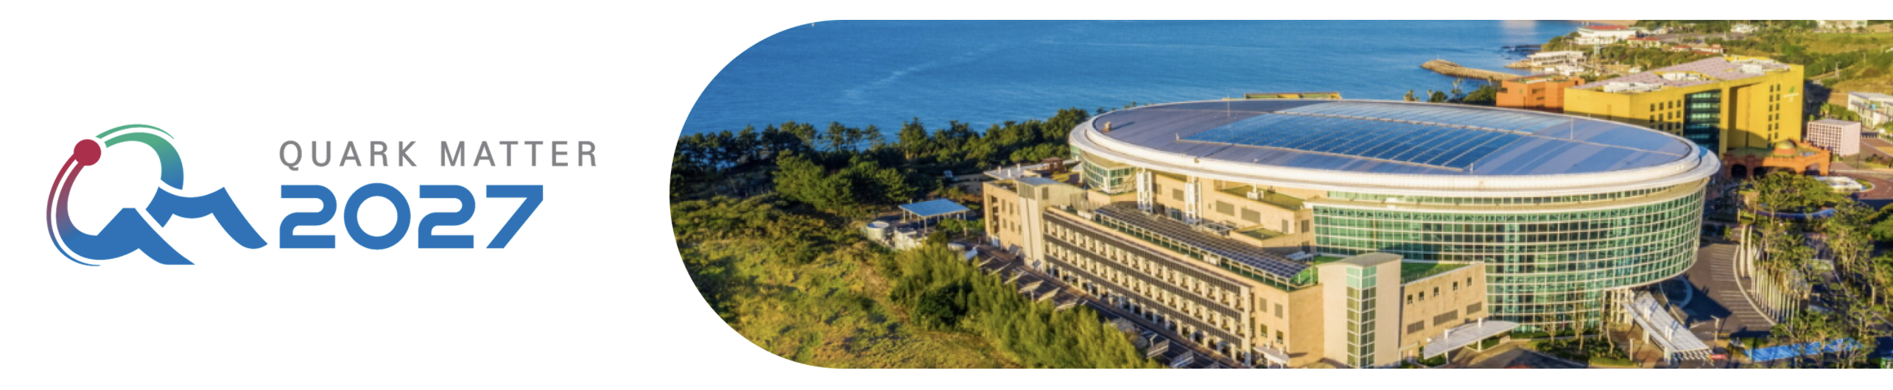
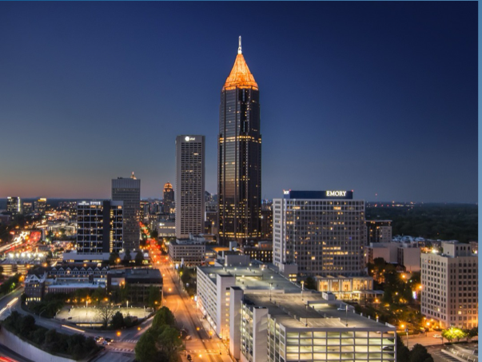
Conferences and Workshops in 2027
Physics Opportunities at an Electron-Ion Collider (POETIC) XII International Conference
Feb 15-19 , 2027 Bambolim Beach Resort, Goa, India.
https://indico.cern.ch/event/1685317/
Quark Matter 2027
March 20-27 Jeju, Korea
https://indico.cern.ch/event/1622375/
GHP2027 - The 12th Biennial Workshop of the APS Topical Group on Hadronic Physics
April 9 - 11, 2027
Atlanta, GA
https://www.jlab.org/indico/e/ghp2027
The abstract submission deadline for contributed abstracts is November 20, 2026.

Slide 11
Conferences and Workshops in 2027, continued
The 15th workshop on picosecond timing detectors, electronics and applications ( FAST 2027)
May 19-23 2027 Elba Island, Italy
https://indico.cern.ch/event/1657938/
3rd European School on the Physics of the EIC and Related Topics
27June - 03 July 2027 at the Centre Paul Langevin in Aussois, France.
https://indico.in2p3.fr/event/39760/overview

