Slide 1
RhizoBeta Bi-Weekly Meeting Update
9-16-26

Slide 2
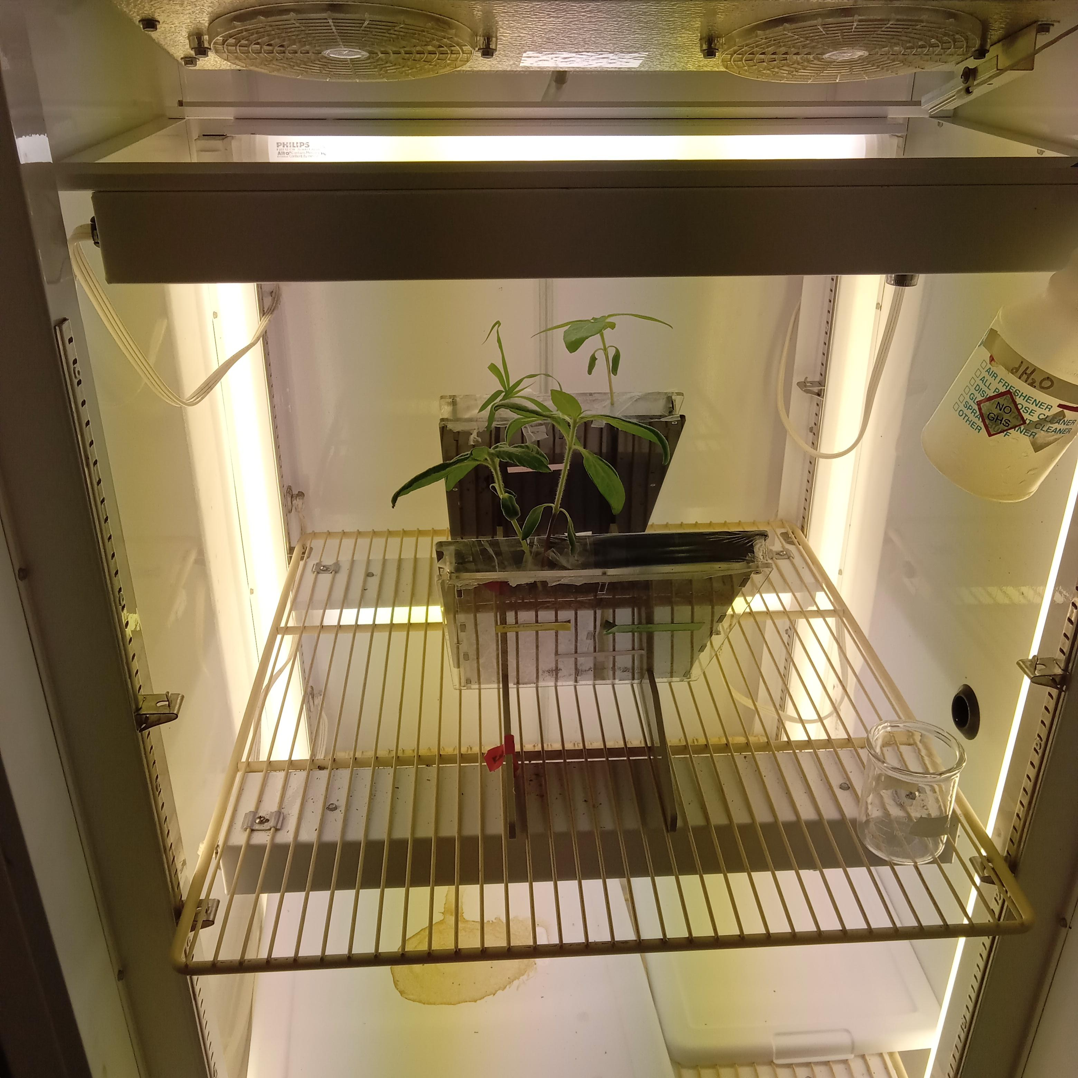
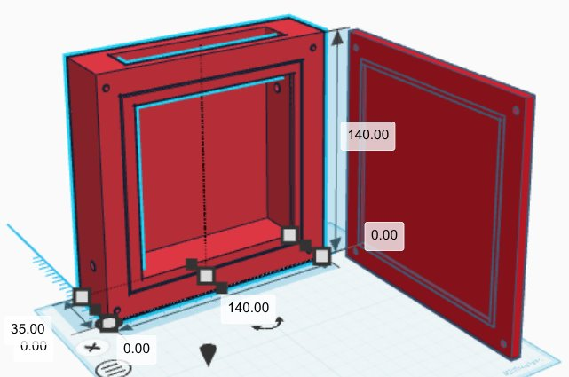
Can we grow plants in rhizoboxes?

Slide 3
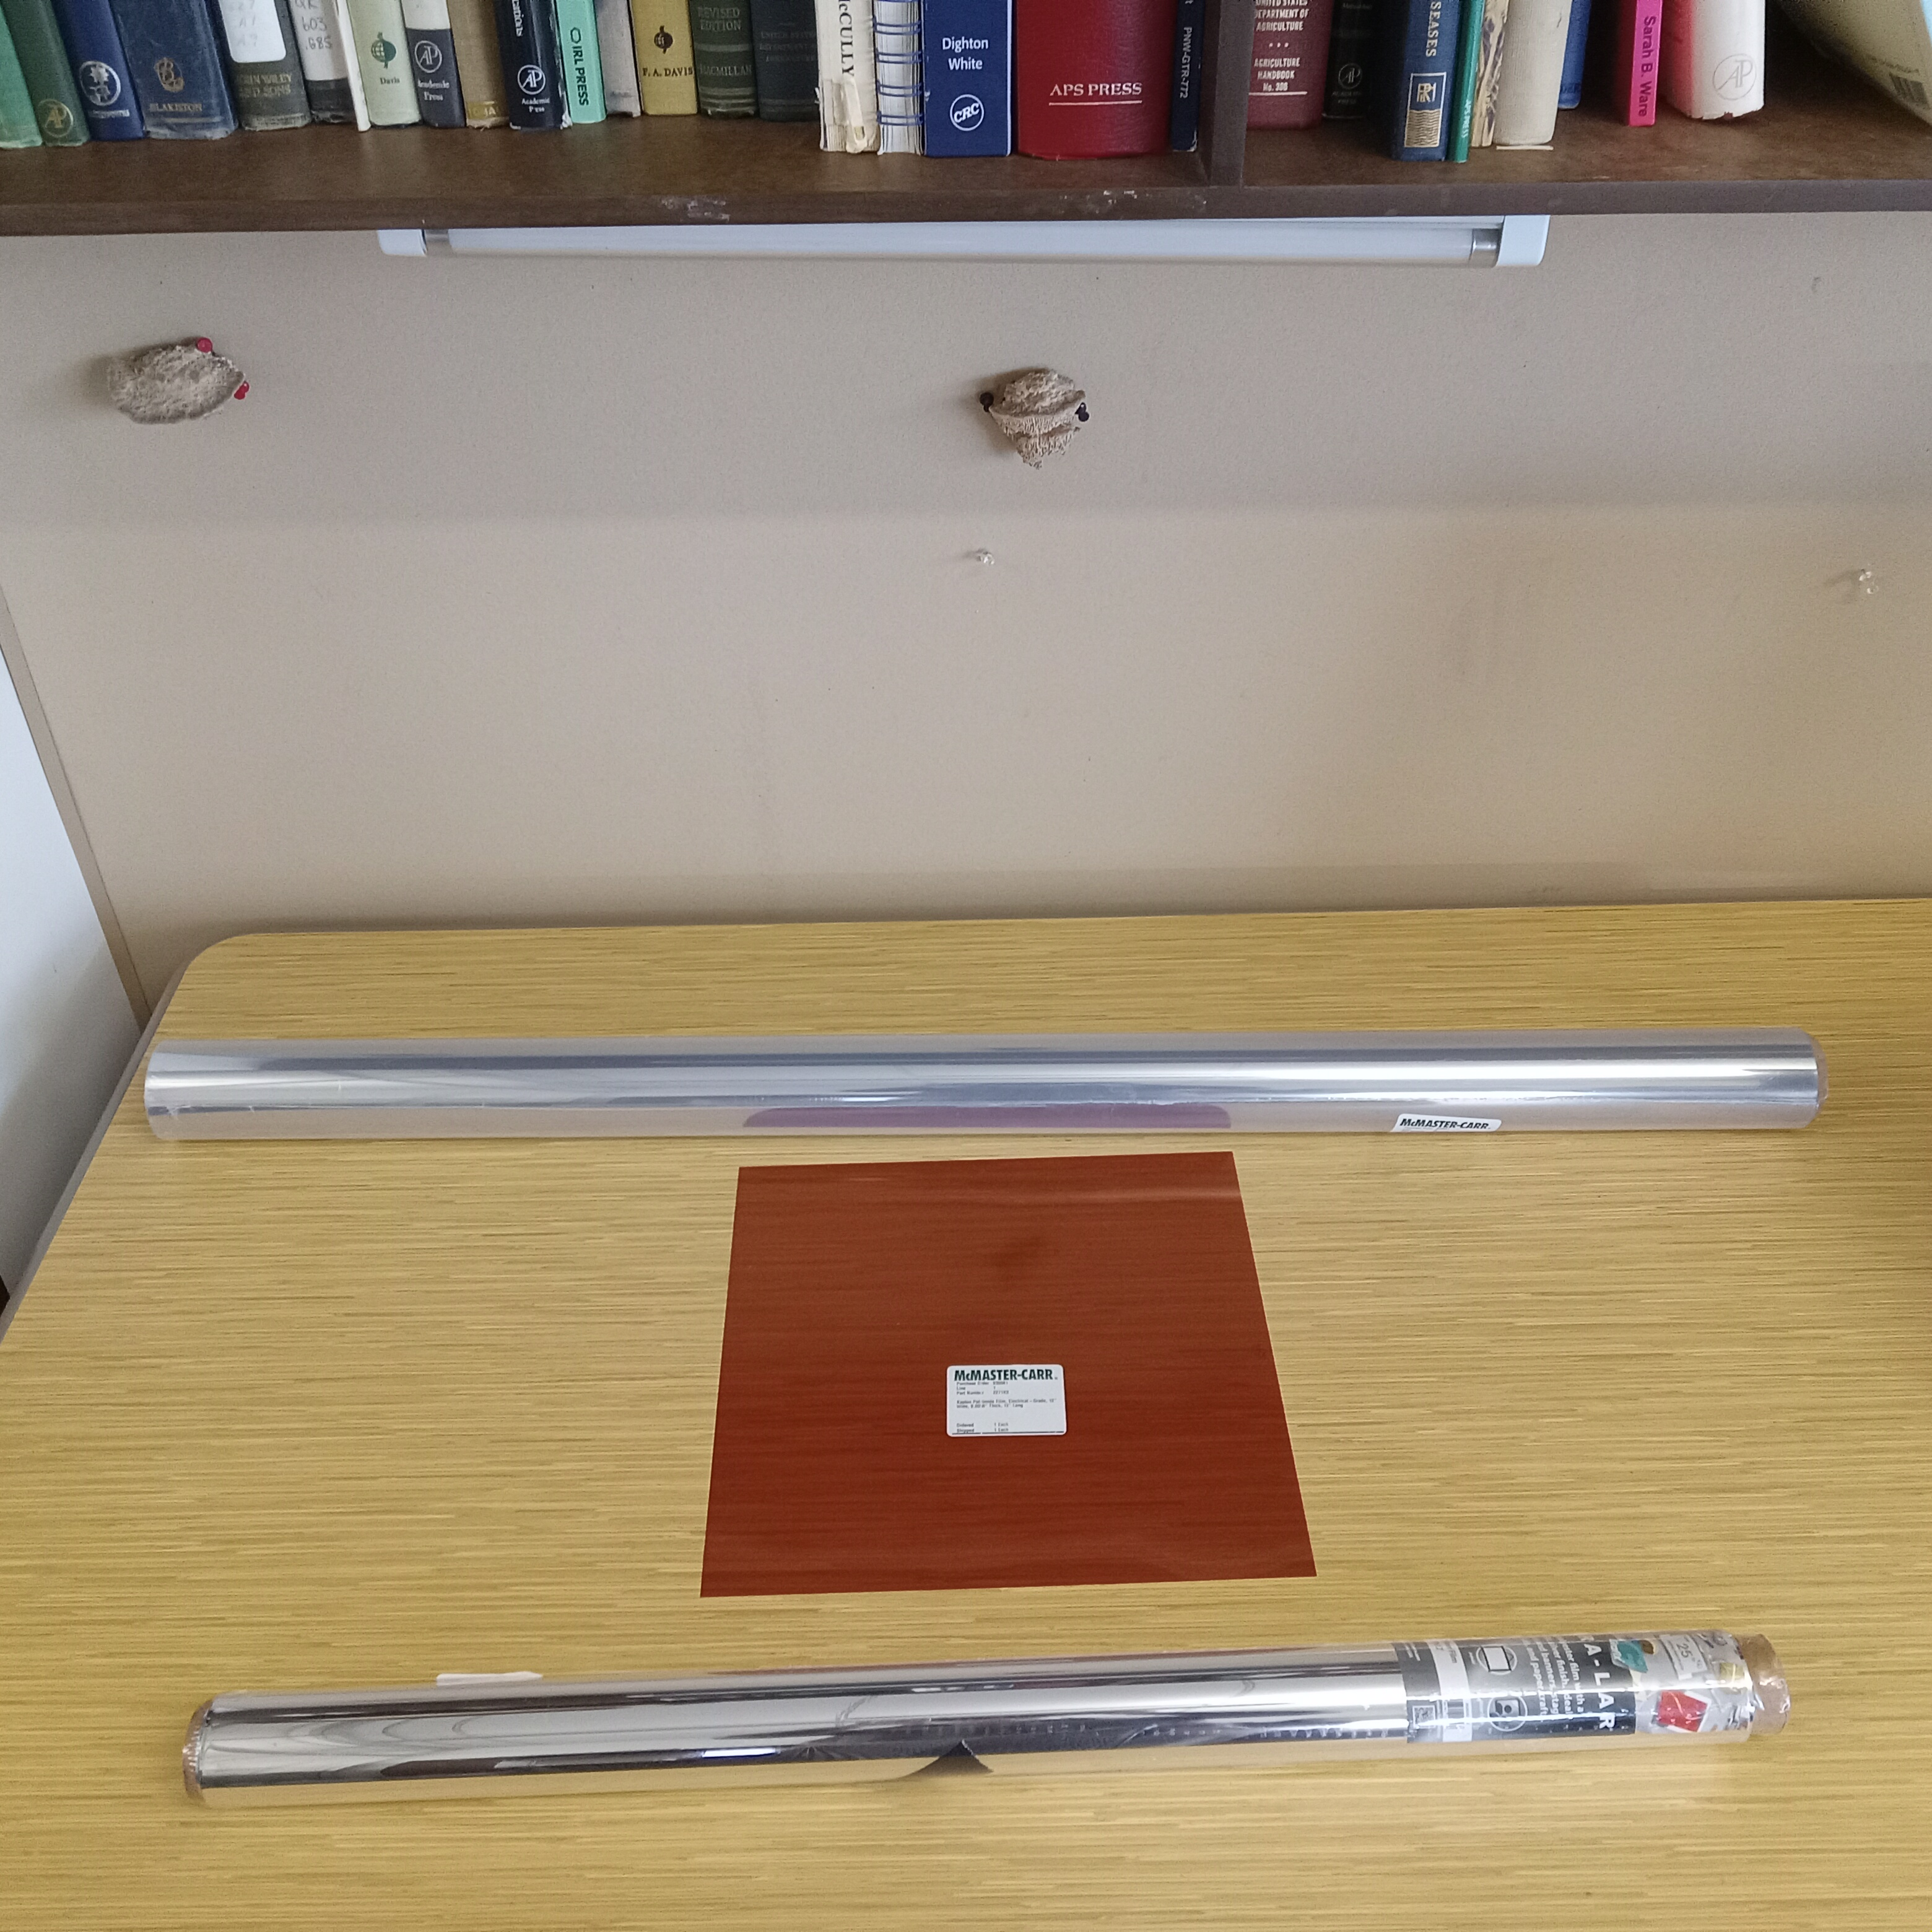
Are proposed window materials toxic to test plants or microorganisms?
Materials to test:
  Kapton
  Mylar
  Aluminized mylar
Organisms to test:
  Fungi
    Simplicillium aogashimaense
    Fusarium proliferatum
    Trichoderma
  Bacteria
    Cupriavidus campinensis
    Pseudomonas koreensis
  Plants
    Helianthus annuus (Sunflower)
    Sorghum bicolor (Sorghum)

Slide 4
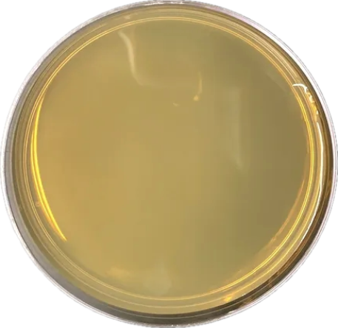
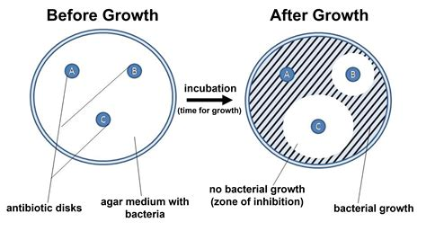


Will Bacteria and Fungi grow with window materials?
Plates inoculated with each bacteria or fungi
Circles of each window material placed on plates
Look for zone of inhibition

Slide 5
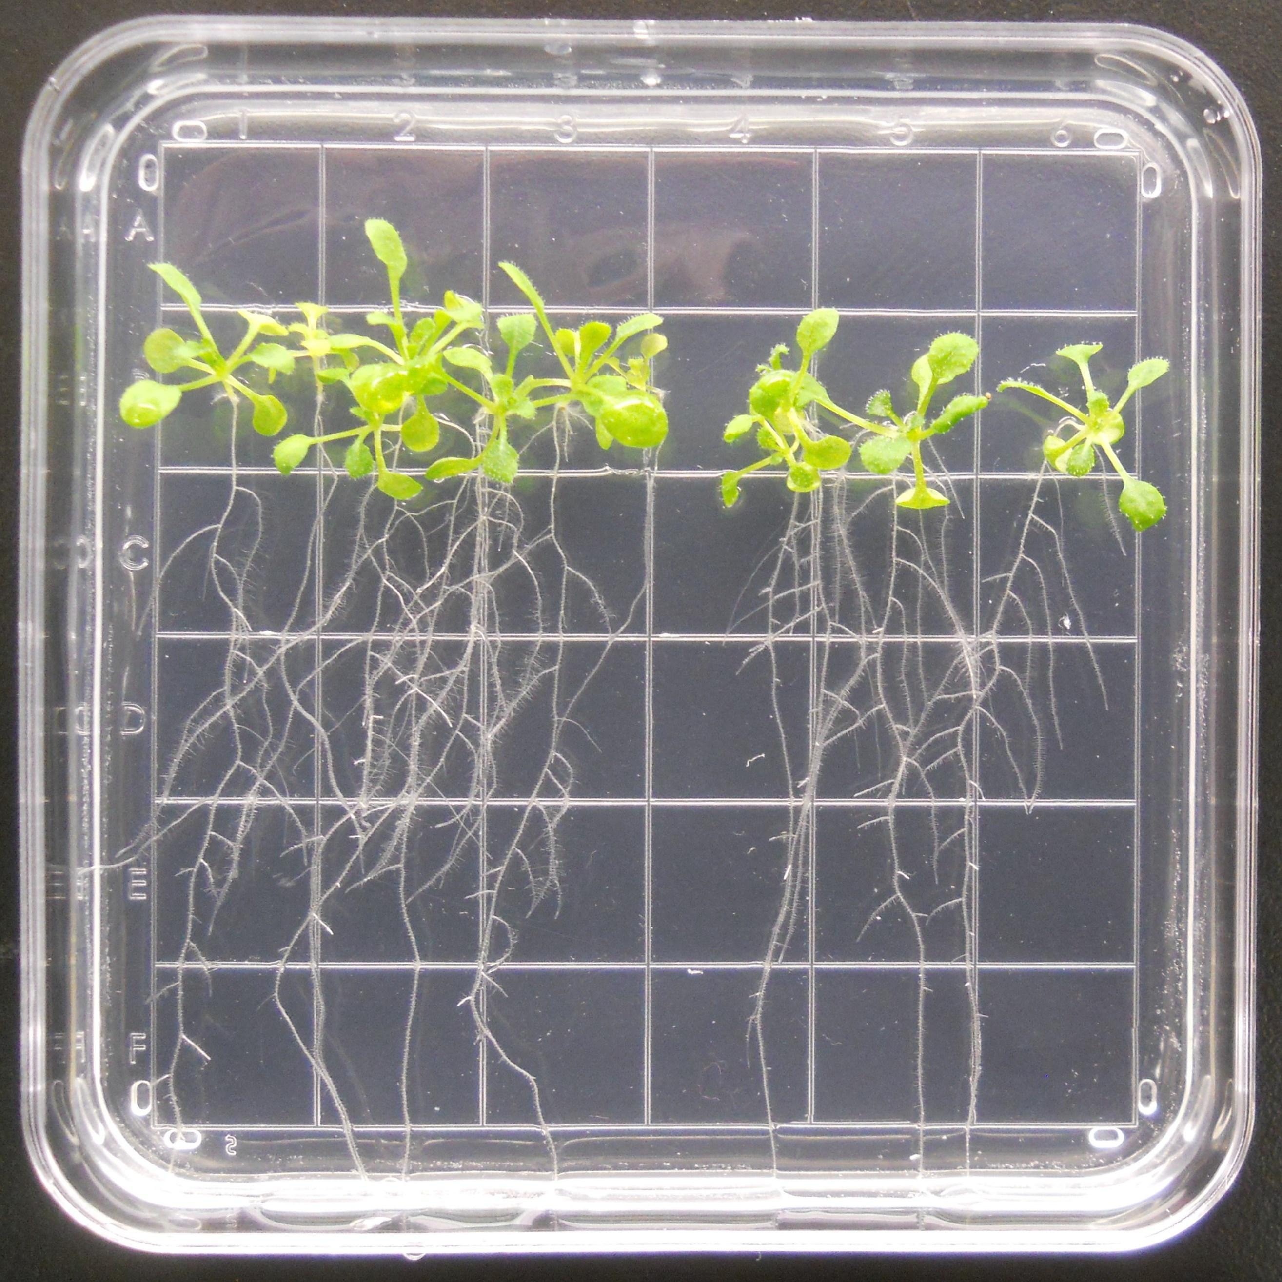
Will plants grow with window materials?
Circles of each window material placed on plates
Germinated seeds grown on plate
Grown for two weeks
Biomass of each plant measured

