Slide 1
Sept 2 meeting updates
Explains past work and updates on box design

Slide 2
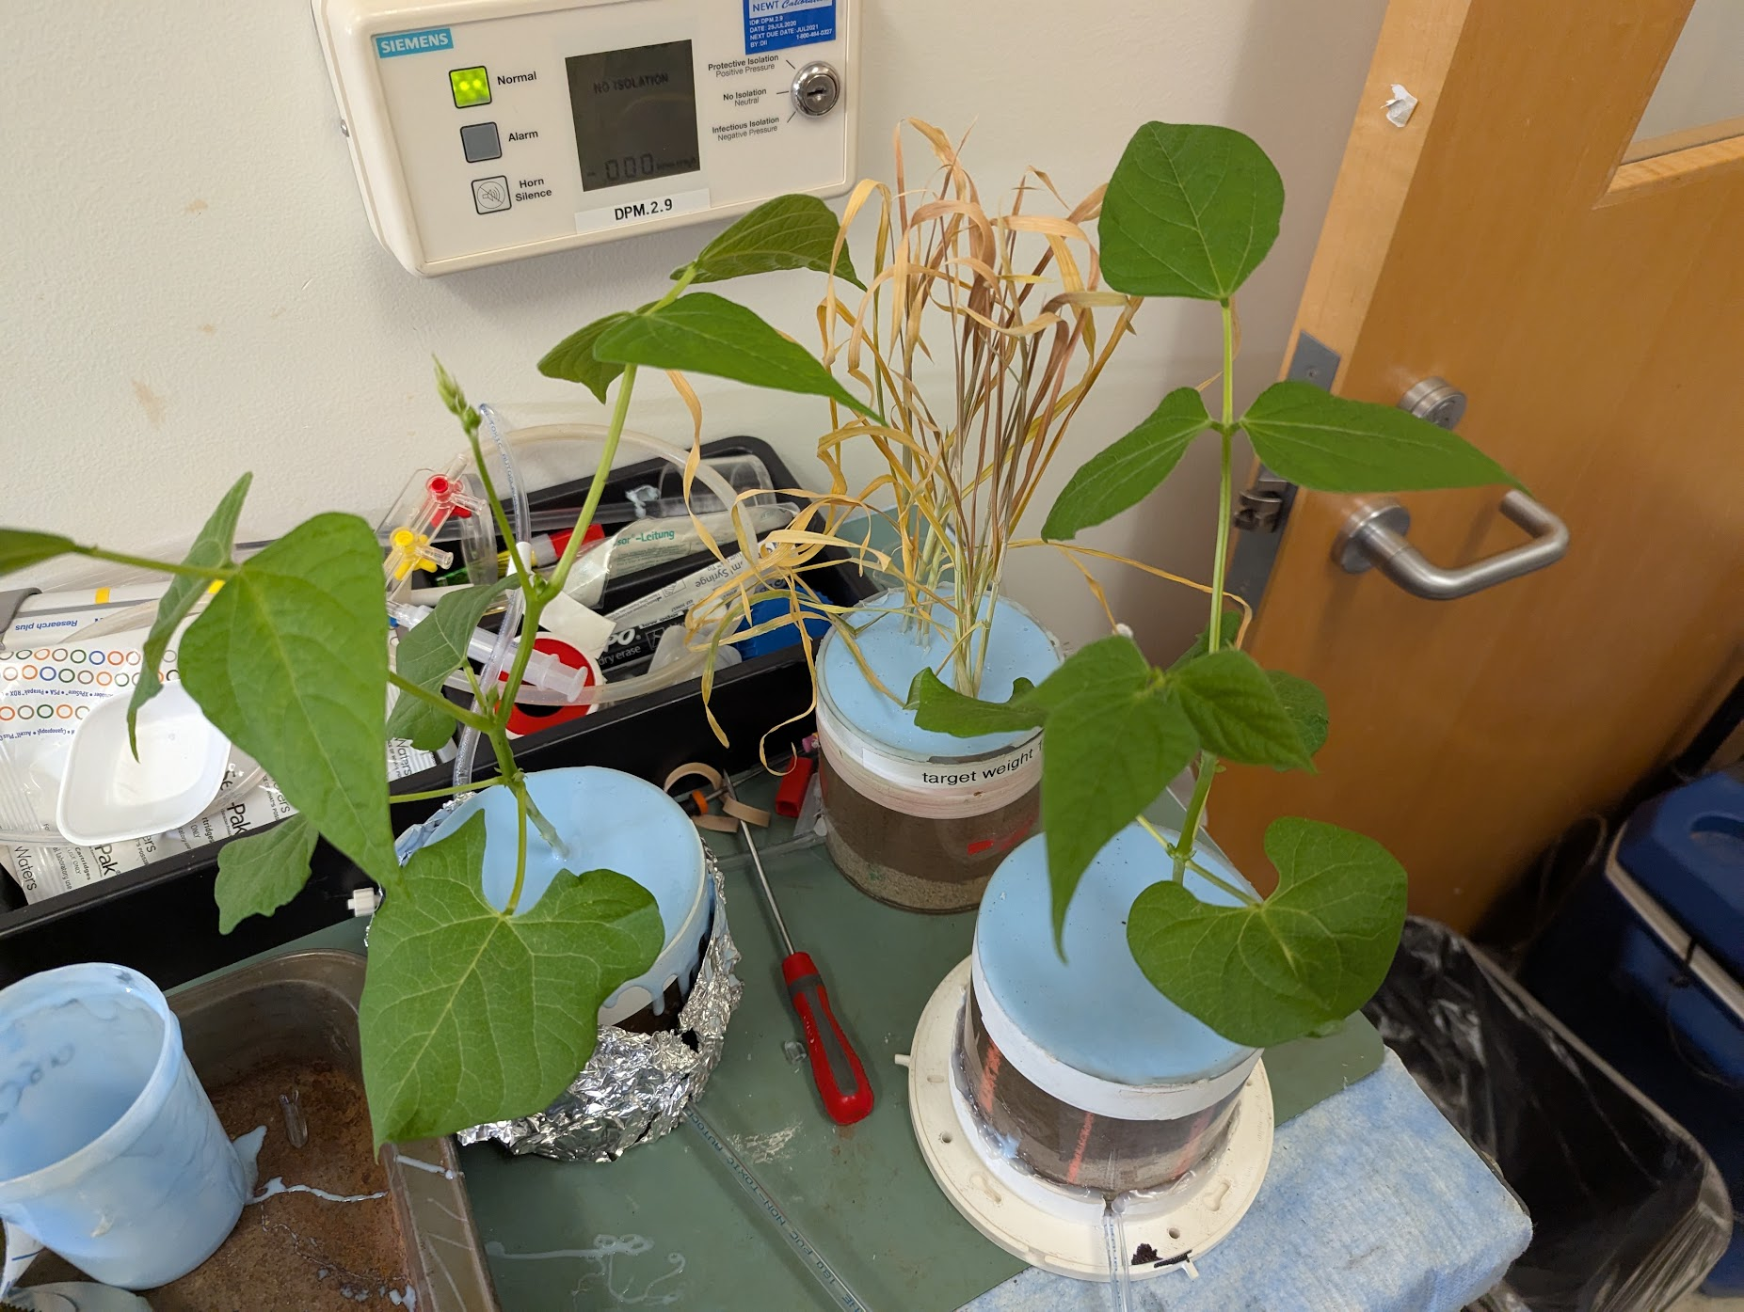
Previous 14C work
Goal: to compare hotspots of activity in 11C PET labeling to 14C Hotspots on film.
  14C adds resolution and corroborates 11C result
  Additional spatial information from added resolution informs interpretation of PET

Slide 3
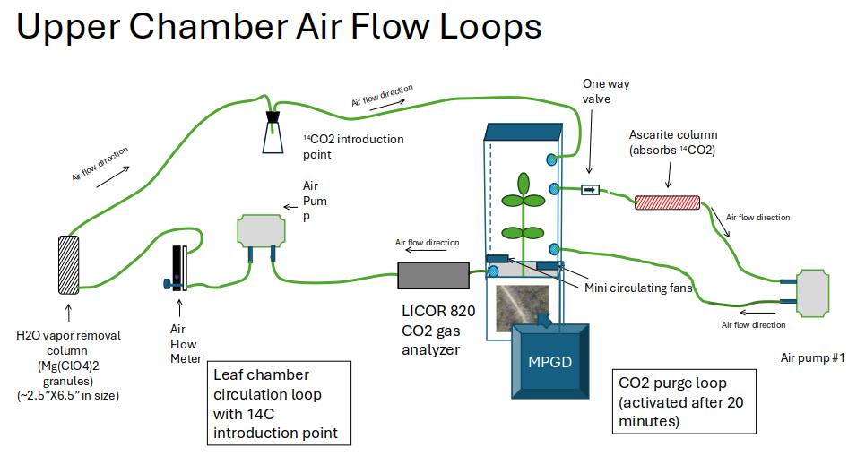

Slide 4
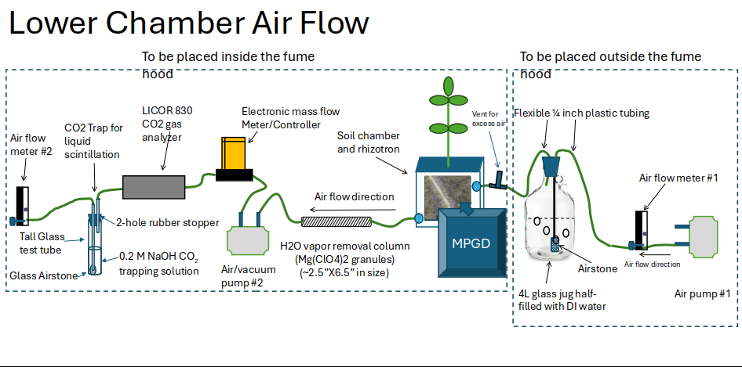

Slide 5
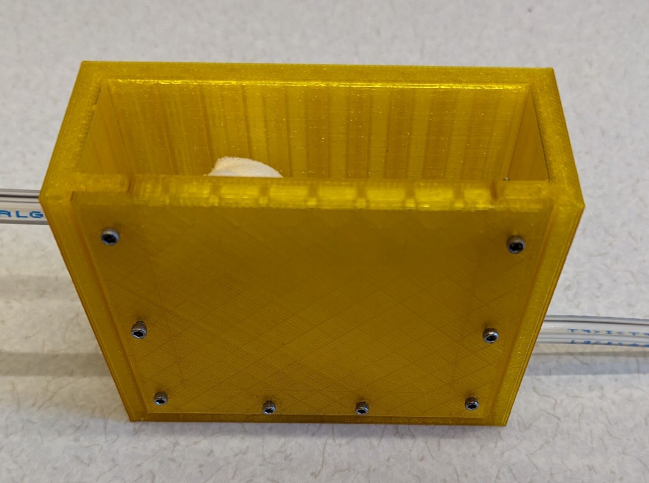
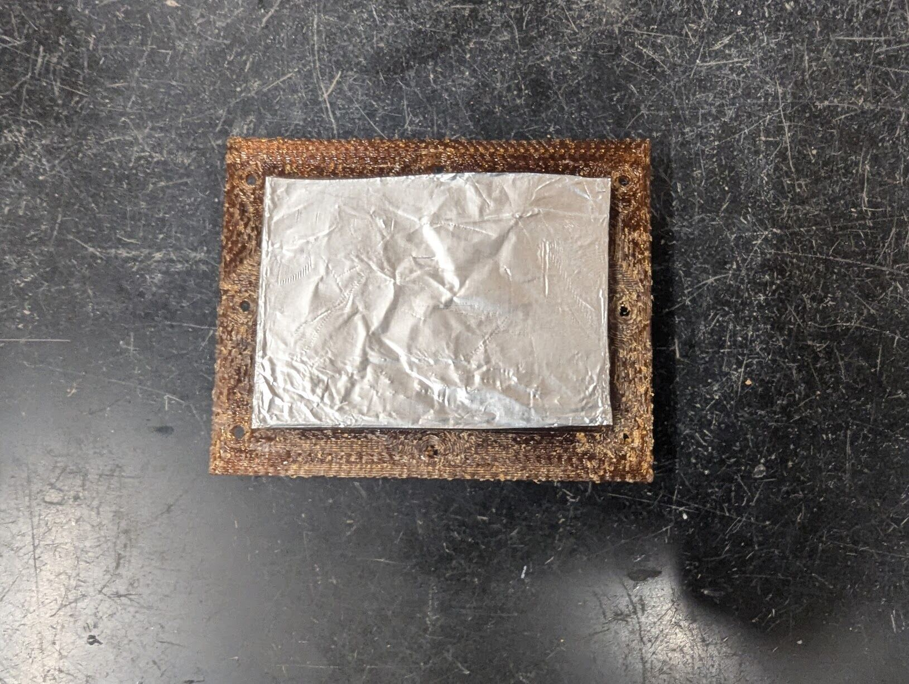
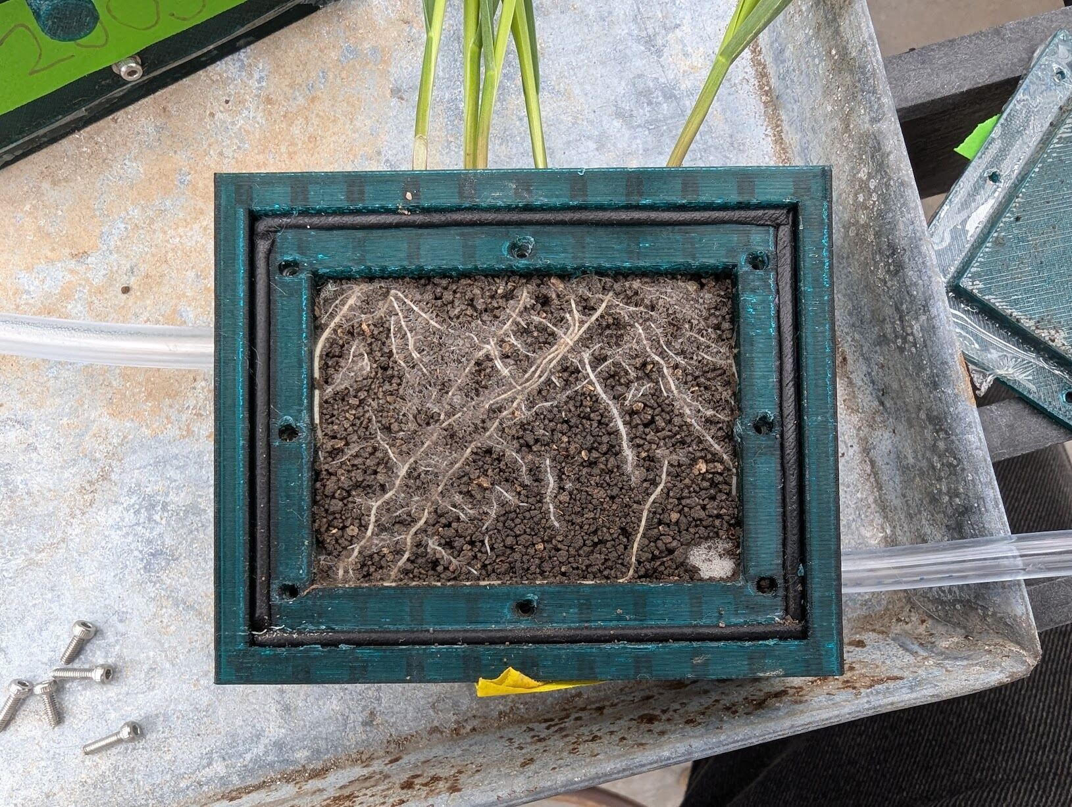
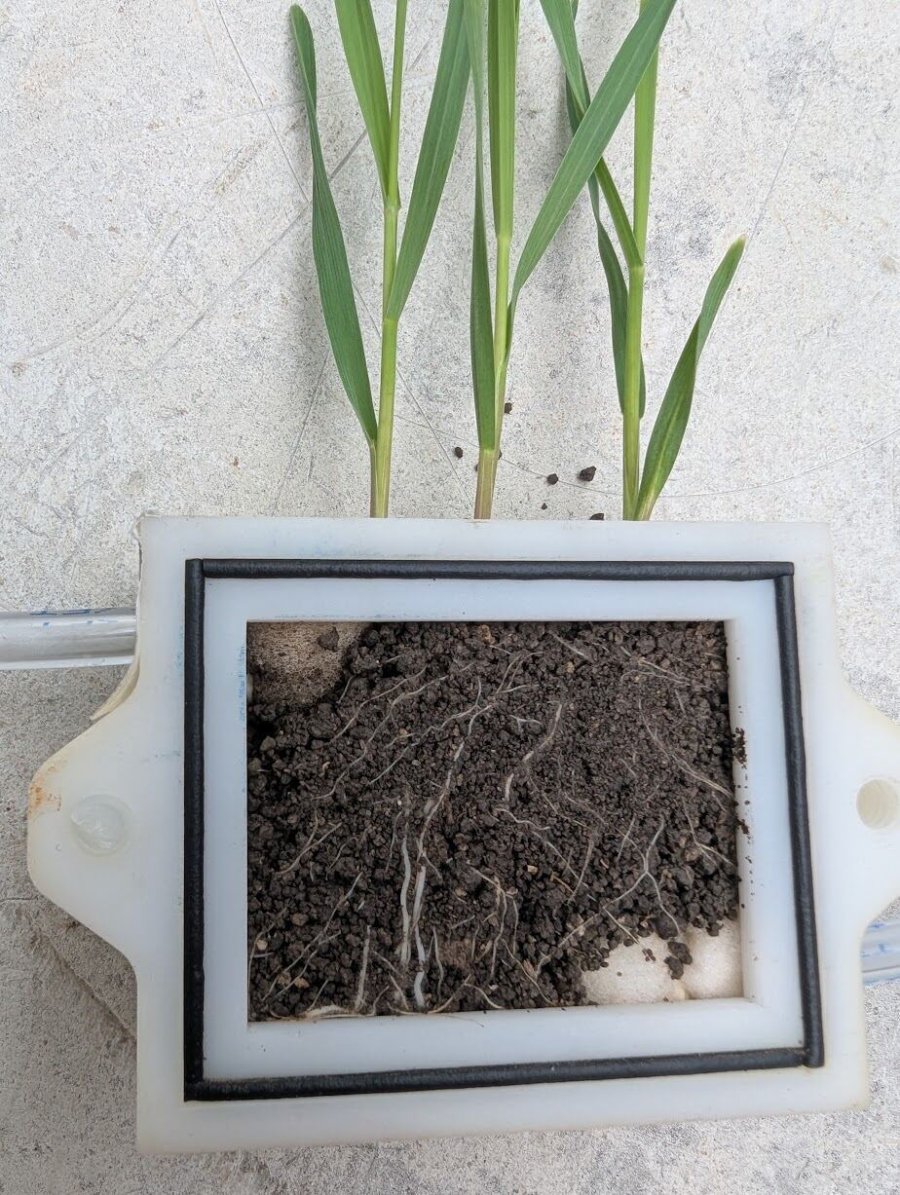
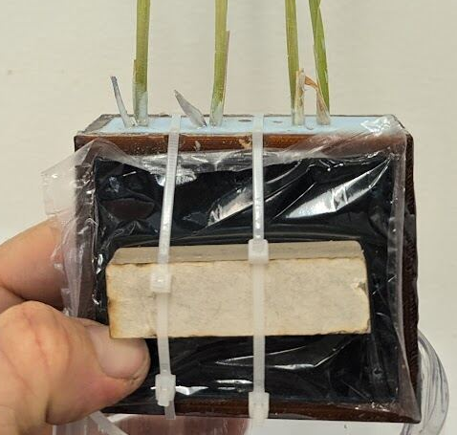
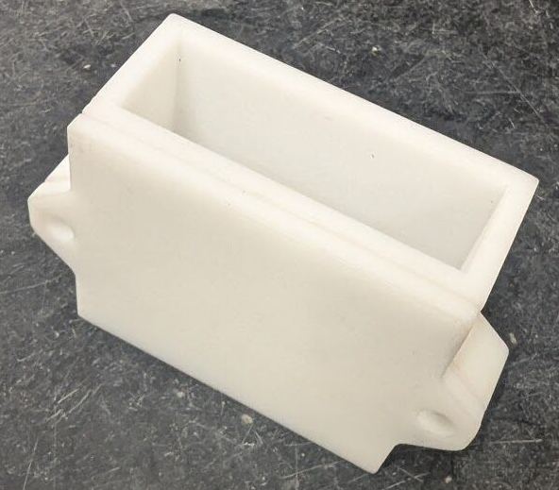
Box iterations
Eventually landed on a design with a gasket within a groove that is pressed in by the door.
Used a piece of aluminum foil as a spacer so the film would not compress soil surface
Foam tipped tubing provides aeration to soil

Slide 6
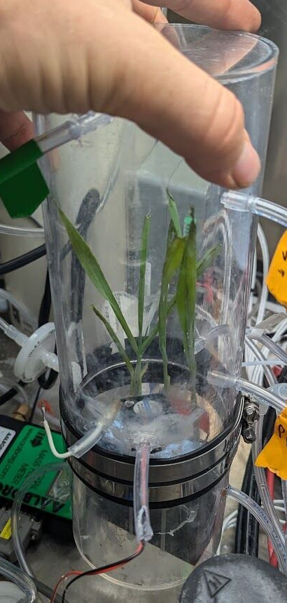
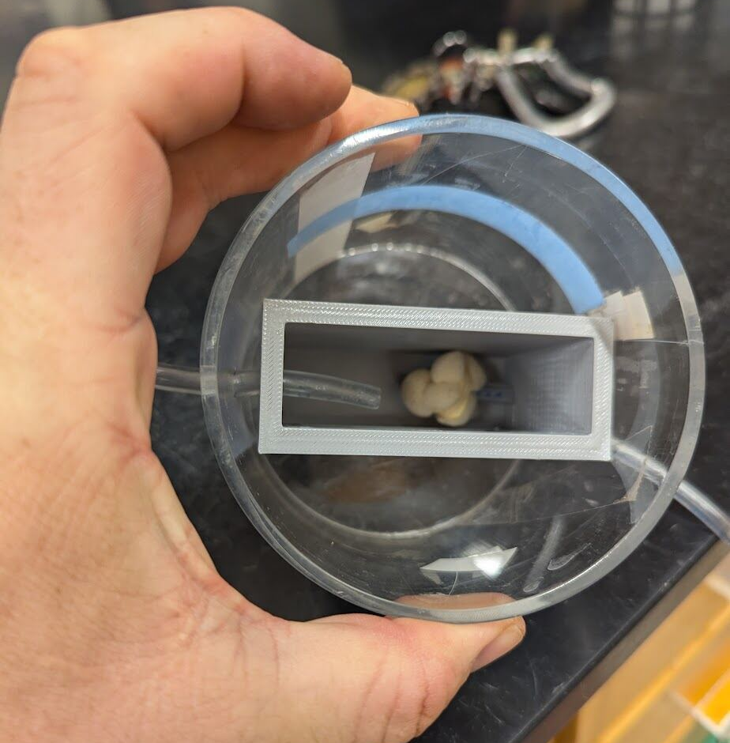
Labeling
Placed rhizobox into an empty 11C labeling pot
Sealed soil surface from air
Plastic acts as shielding during pulse labeling
Downside: was difficult to get box into pot

Slide 7
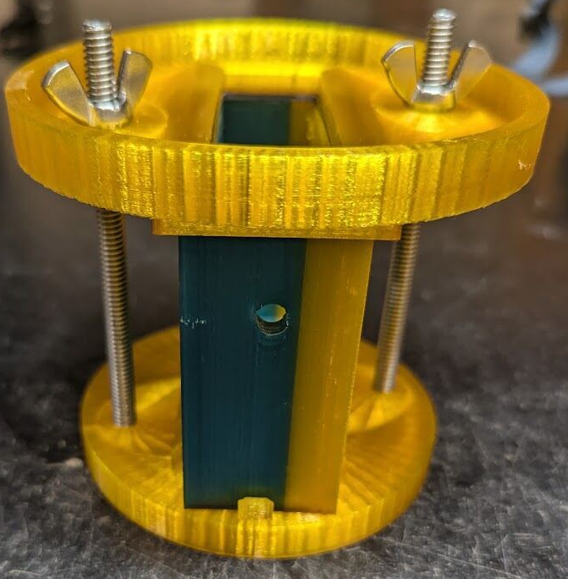
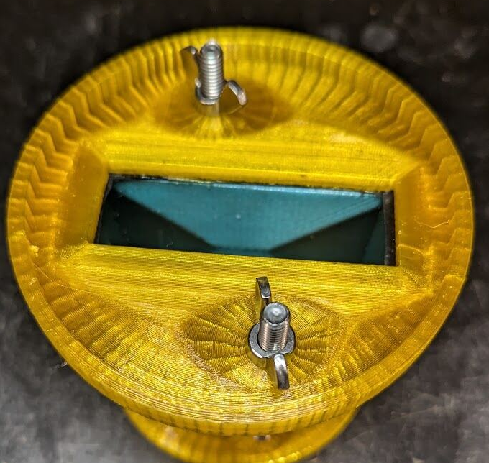
Labeling
I designed an adapter for our existing circular labeling chamber but it was difficult to get a good seal.
Could be revived and perfected.

Slide 8
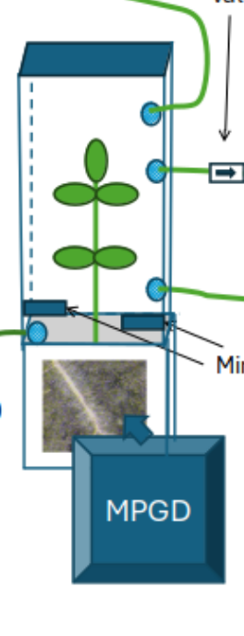
Proposed Labeling Approach 1
Design a chamber for the aboveground portions of the plant that fits exactly onto the top of the labeling box
Downside: This would not leave room for larger leaves- may have to taper.

Slide 9
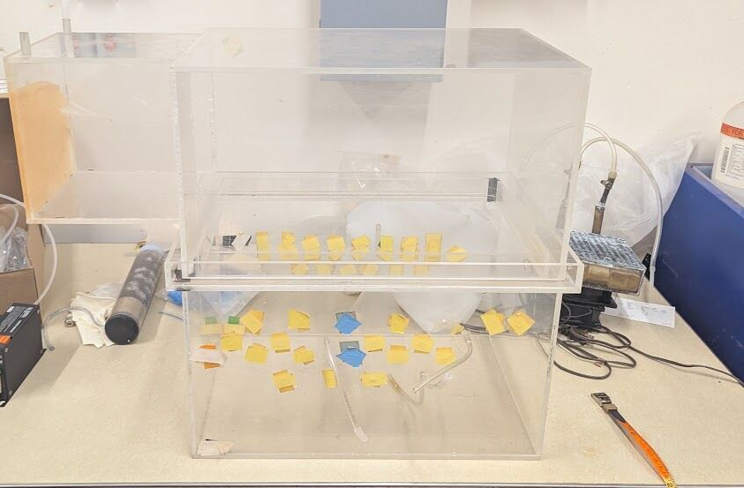
Proposed Labeling Approach 2
Use larger labeling chamber as we are not constrained by PET detector aperture
Downside: Larger volume = longer assimilation time = less sharp pulse

Slide 10
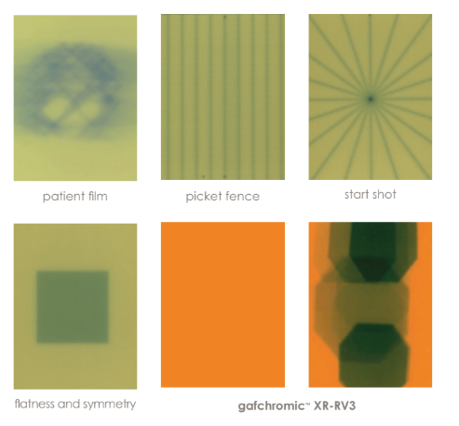
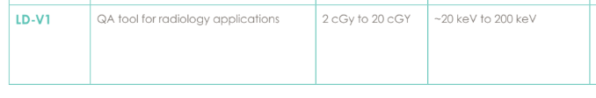
Film
Gafchromatic LD-V1 from Ashland Specialties
  Low dosage film
  Most sensitive version
  Has 122 micron polyester layer protecting active layer
  We did not successfully delaminate the film

Slide 11
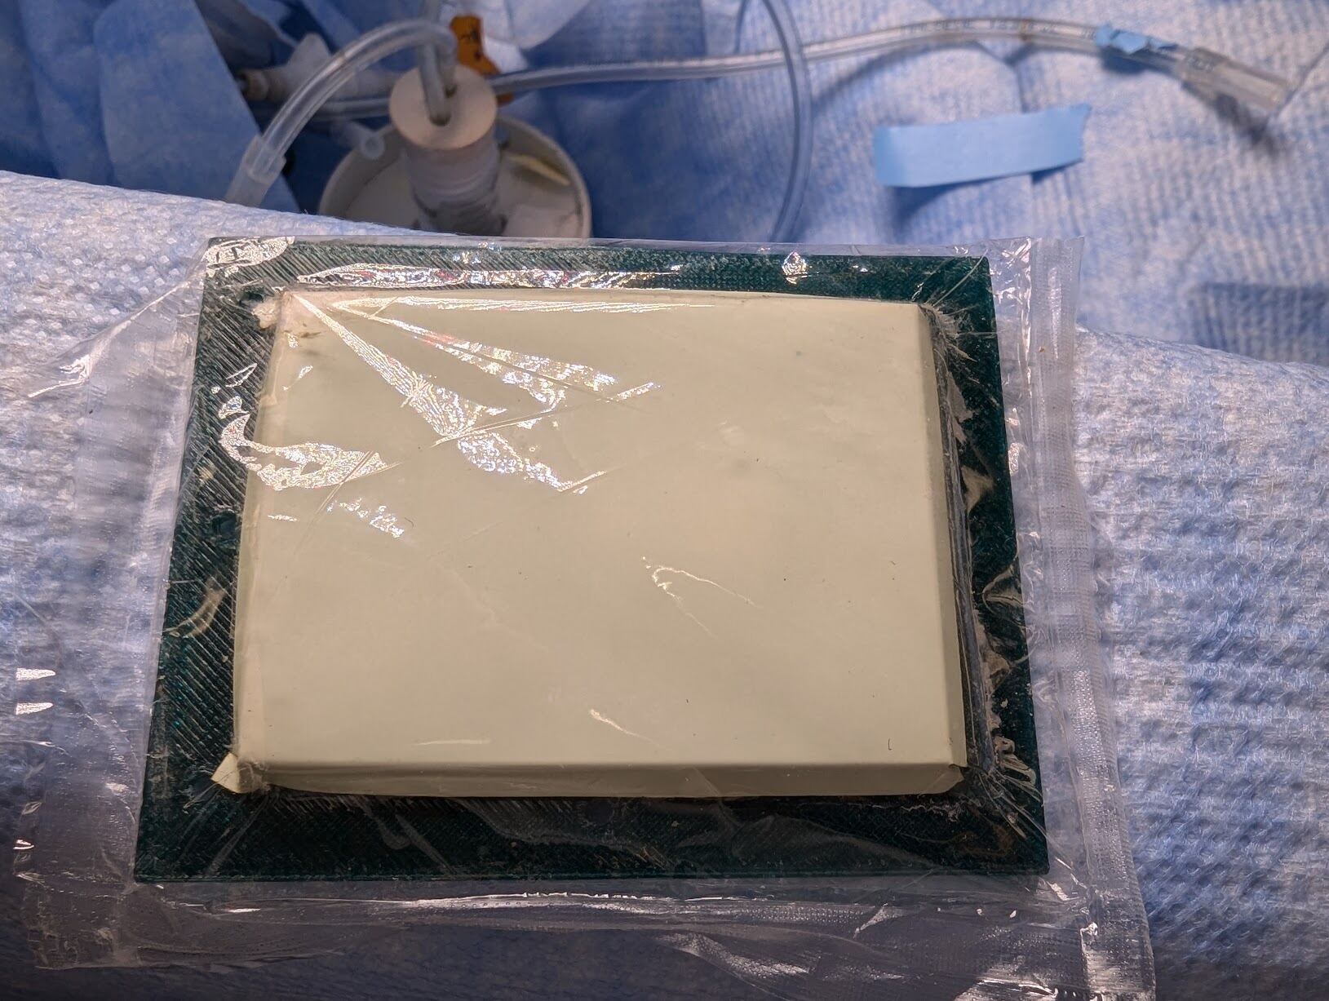
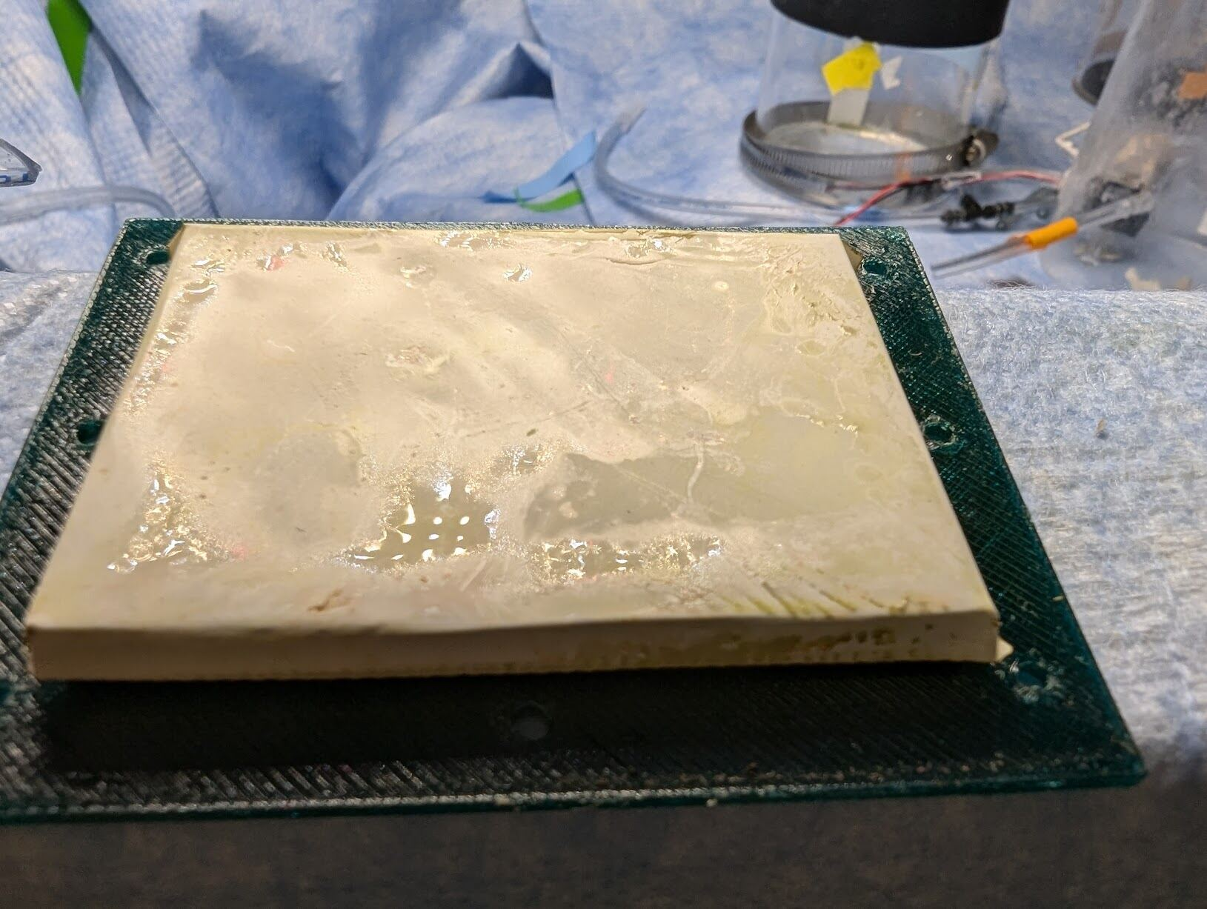
2 trials with live plants
No registration on film either time
Wetness of film on one of the trials

Slide 12
Potential issues
Compromised protective layer or condensation within that layer?
Carbon budget: is enough 14C reaching the surface of these roots to be registered in the time frame
Biggest issue: Film sensitivity – this film was not designed for dosages this low even though this is the most sensitive version

Slide 13
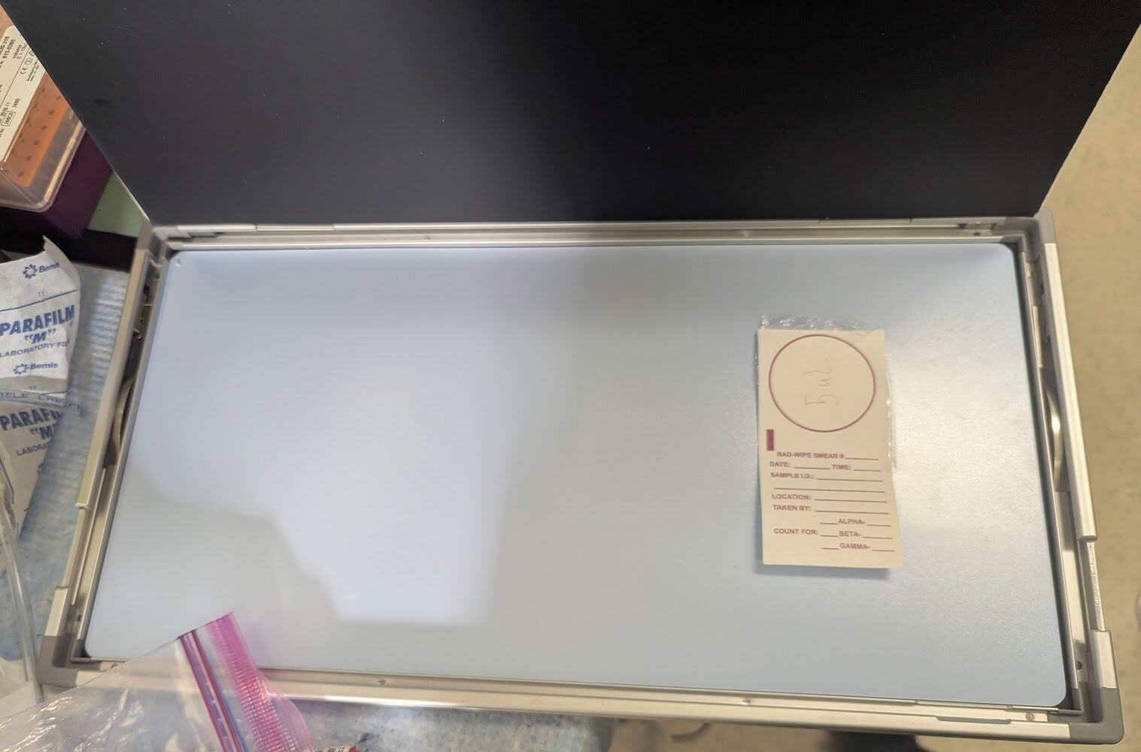
Solution: High sensitivity water resistant phosphor screens
Phoshpor crystals store radiation energy and reemit it when exposed to a laser scanner
Higher sensitivity and high resolution

Slide 14
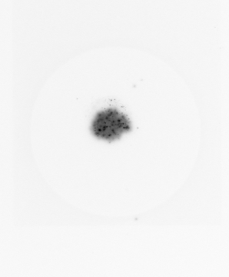
Phosphor screen testing
Were able to register radiation during a 10 hr exposure to 25 micro curies soaked into a cotton radiation swipe with conventional saran wrap (~15 microns).

Slide 15
Previously proposed work with phosphor screen
Continue the exposure testing to get a sense of the necessary exposure times for registering roots
Do a plant test with cut down version of phosphor screen

Slide 16
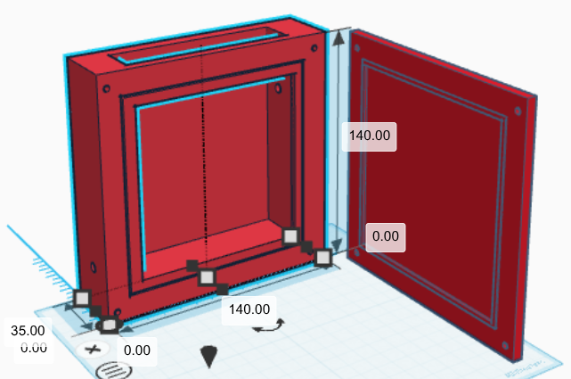
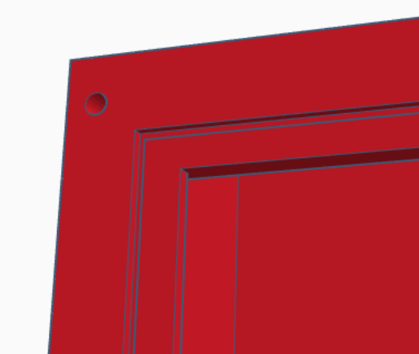
Current Progress
Redesigned Rhizo-box for our current project dimensions
Redesigned gasket bevel so soil will come to the edge of the box

Slide 17
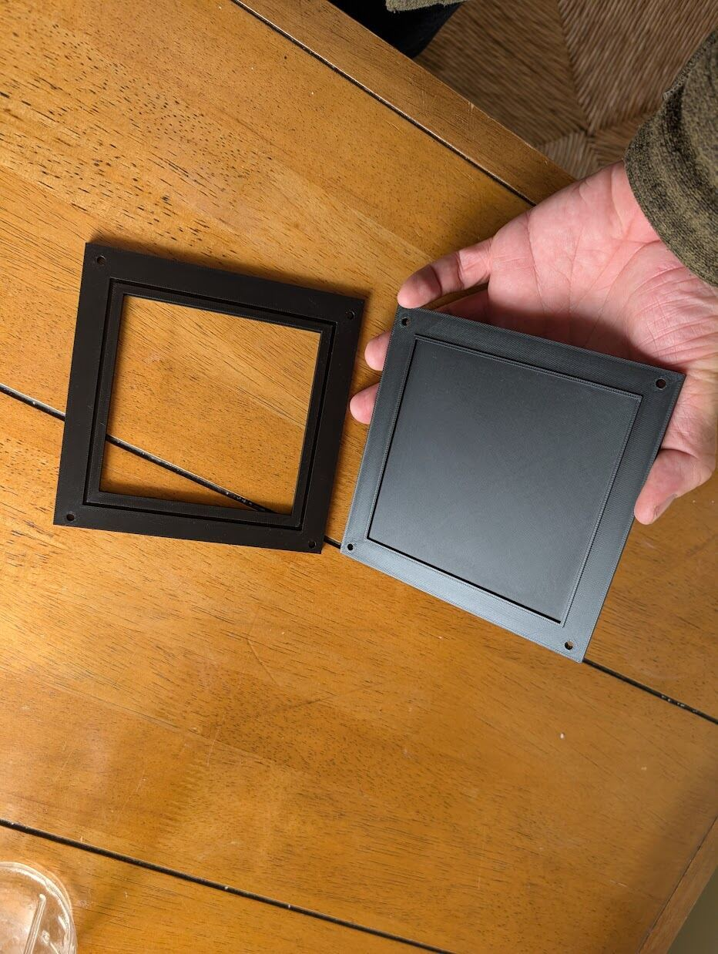
Current Progress
Preliminary print to check fitment of door and gasket size

Slide 18
Upcoming work on box
Cut gasket to fit
Slope upper wall of the window so that roots don’t have to fight right angle
Check seal

Slide 19
Upcoming work on setup
Finish transfer of 14C to UCSC
Test single pixel diodes for sensitivity

