Slide 1
MPGD basics
Seungjoon Lee
8/19/2026

Slide 2
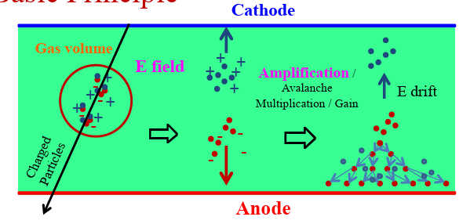
Ionizing Gas Detector
An ionizing gas detector (or gas-filled radiation detector) measures ionizing radiation
by creating and collecting electrical charges (ion pairs) produced when gas molecules are ionized

Slide 3
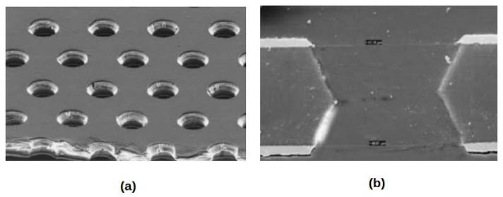
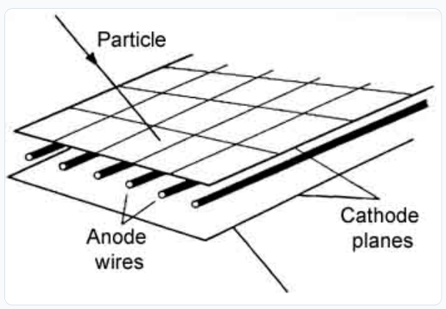
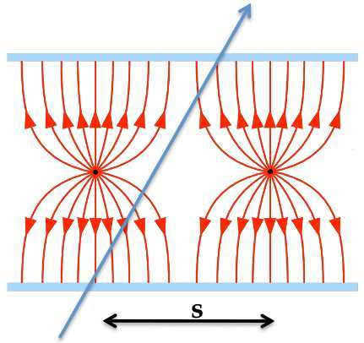
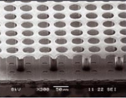
MPGD history
Multi wire proportional chamber (MWPC)
Wire mechanical instability
Spark damage
Resolution/Gain limit
Micro Pattern Gas Detector
Mechanical stability
Finer pitch
Uniformity

Slide 4
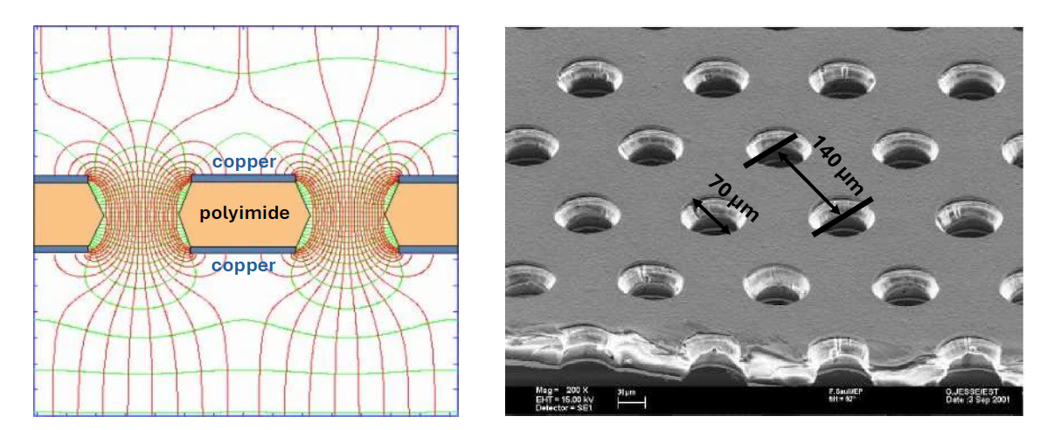
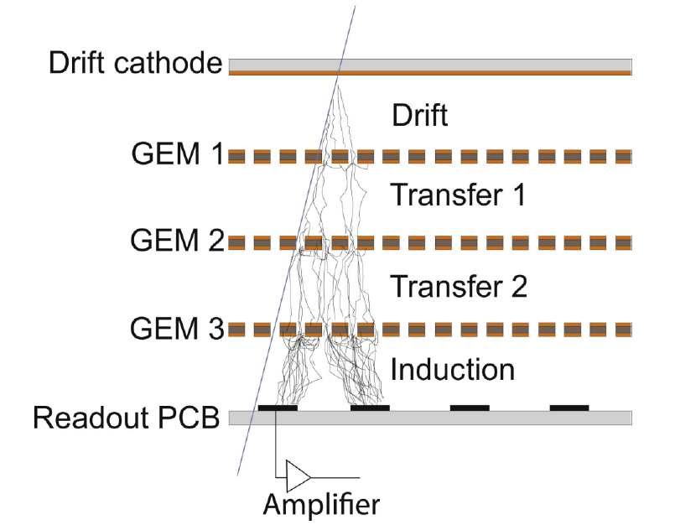
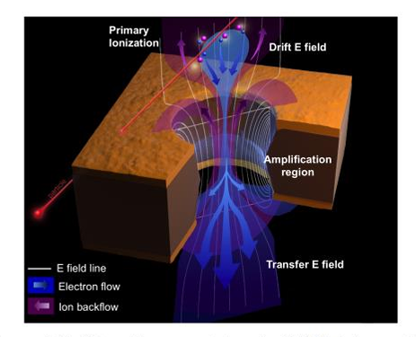
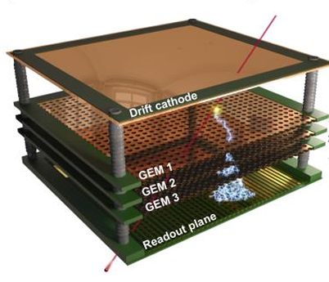
Triple GEM
E field of GEM foil
GEM foil

Slide 5
Suggested Prototype
Typical Prototype
Entrance Window
Cathode
beta
GEMs
Ar/CO2
Readout PCB
RhizoBeta Prototype
Cathode
beta
Ar/CO2
GEMs

Slide 6
Cathode Layer
Conductor material
Copper, Gold, Aluminum, DLC, Chromium …
Film Material
Kapton, Mylar, ROHACELL

Slide 8
backup

Slide 9
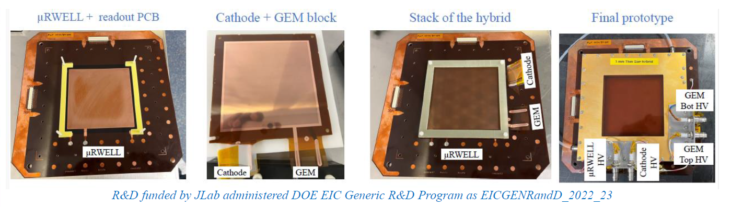
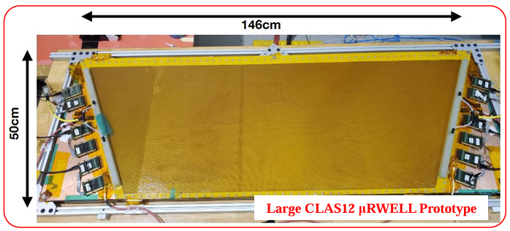
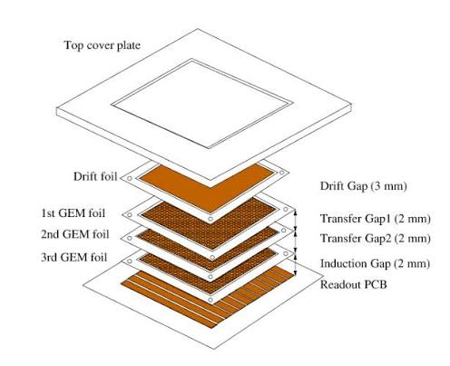
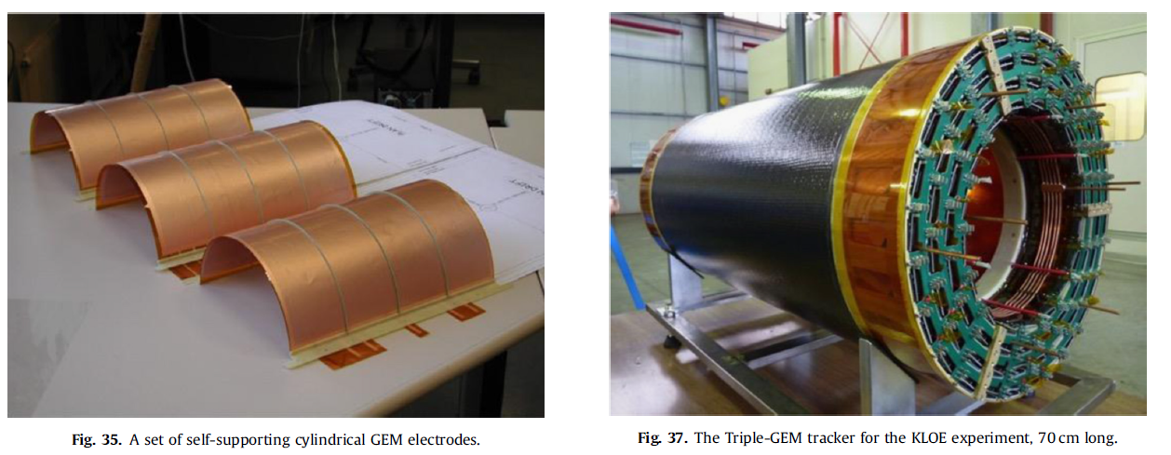

Slide 10
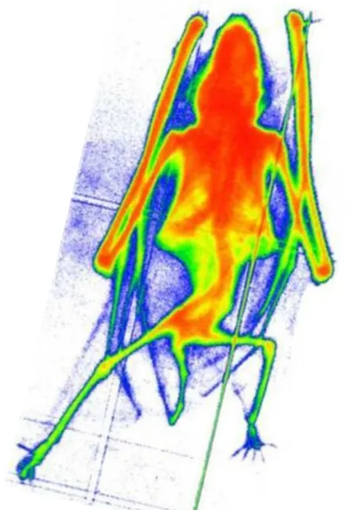
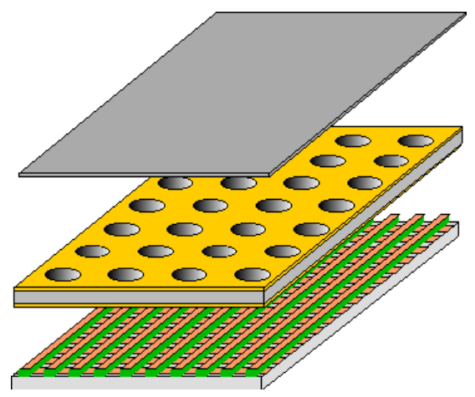
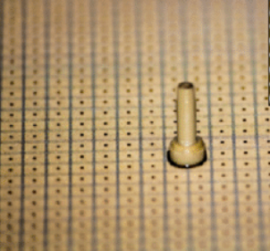
Readout system
Pad (pixel) Readout
-too many readout channel
Strip Readout
Optimal number of channel
Result image using X-ray (mouse)
Ghost event

