Slide 1
Jefferson Lab Hall Work Coordinators
Hall A: Lawrence Hurt, Hall B: Denny Insley, Hall C: Jerry Nines, Hall D: Scot Spiegel
Reminder that all work that is done in the halls needs to go through the hall work coordinators as covered in the CEBAF Experimental Physics Work Governance document SAF116kd and hall walkthrough trainings SAF110: Hall A, SAF111: Hall B, SAF112: Hall C, and SAF113: Hall D.

Slide 2
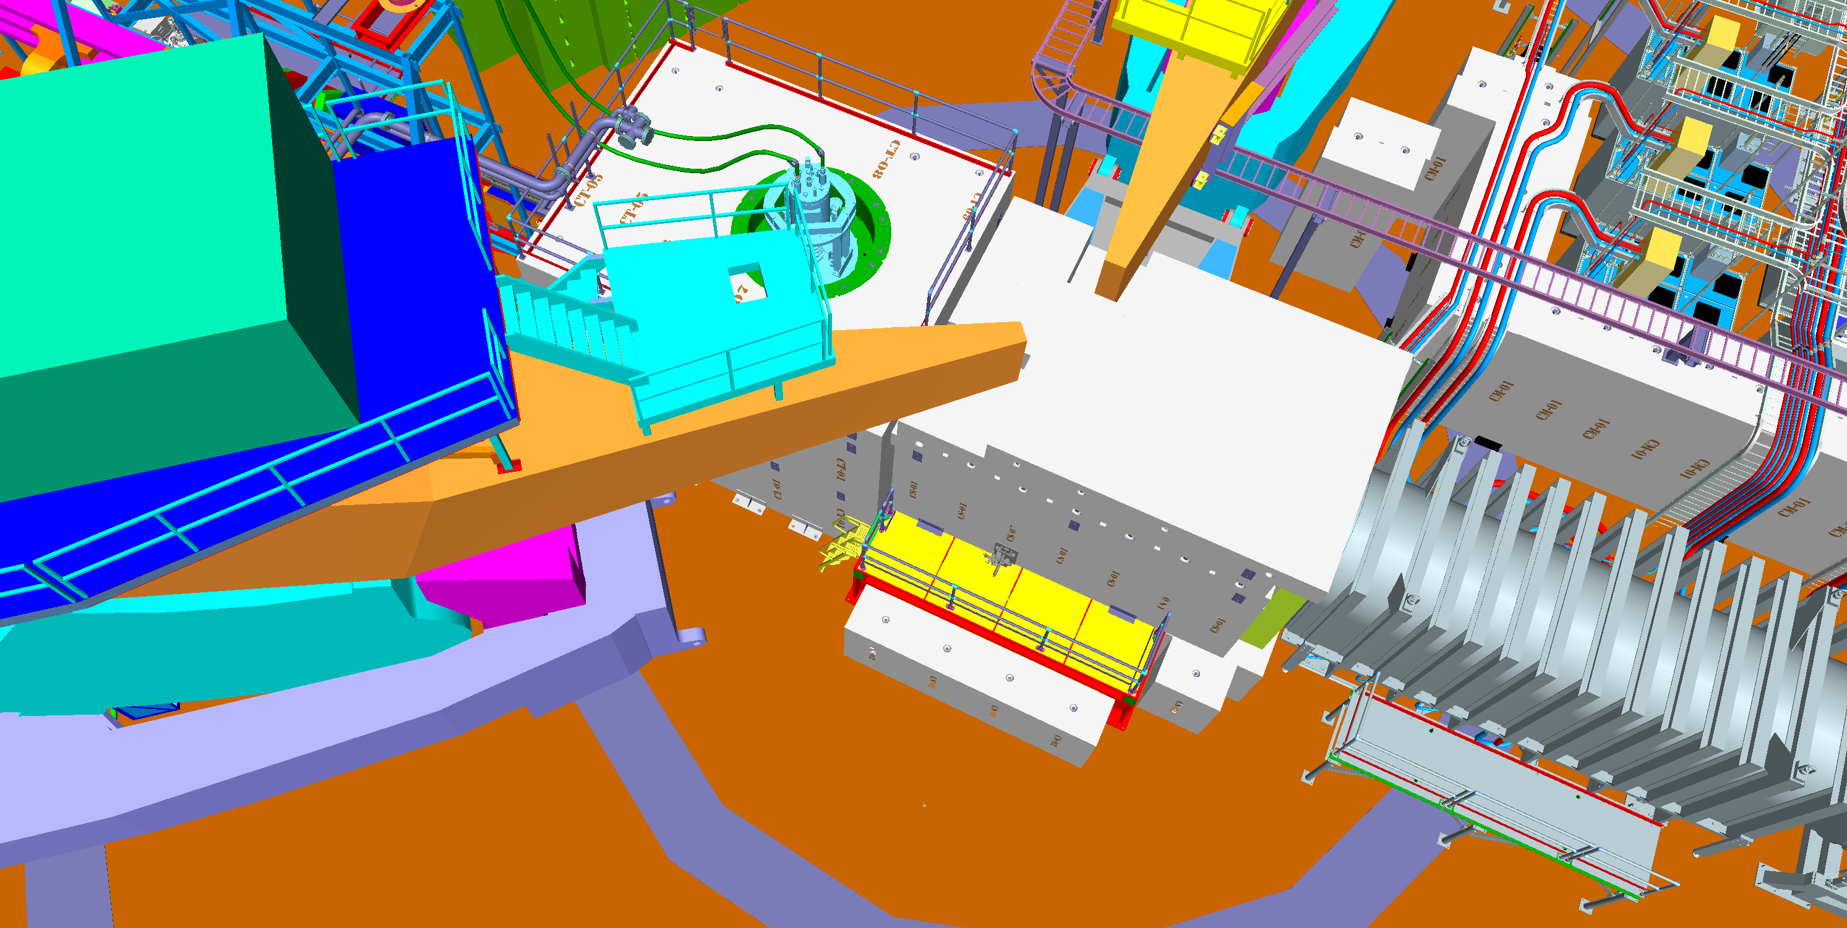
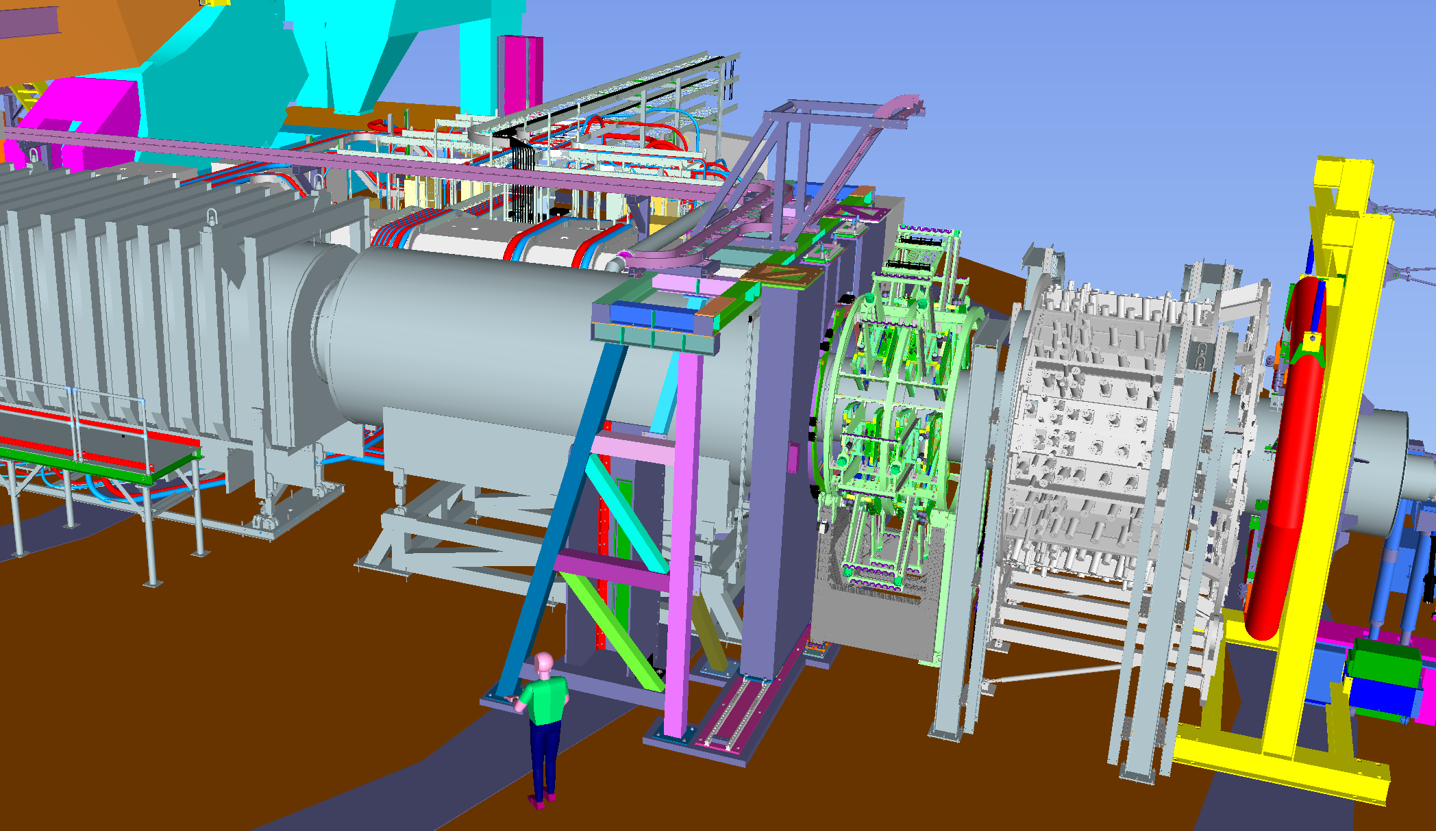
BODY SLIDE - TITLE
Hall A SAM plans
Install target stand
Install upstream spectrometer
Install downstream spectrometer top hat
Install barite wall and support structure
Install GEM rotator
Install remaining shielding blocks
Install cabling
Install upstream beamline components
Testing and commissioning of detector systems
Zachary Remele, Hall A Deputy Work Coordinator
Notes:
Guidelines: 6-8 bullets per slide; Use sentence fragments for bullets
To change the photo: Right-click on photo and select change photo

Slide 3
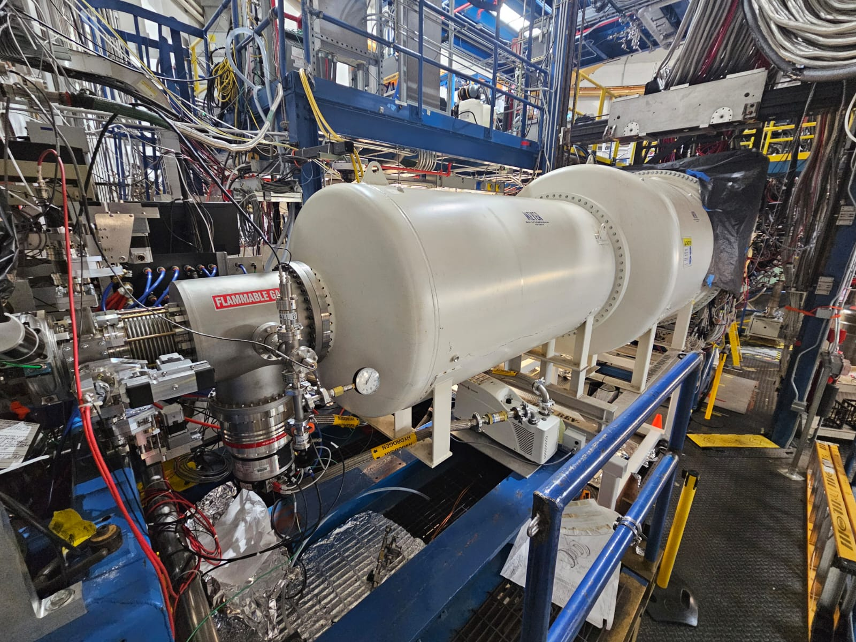
Hall B 2026 SAM Plans
Removal and storage of PRAD II target and equipment.
Magnets and Dewar to 4K operations.
Relief valve inspections.
Faraday cup vacuum.
Tagger vacuum window repair.
X17 modifications.
HyCal chiller repair.
Micromegas tiles replacement on BMT
PMT replacement on EC’s
Test and start RICH compressors
Establish gas flow through drift chambers.
The PRAD II / X17 experiment beamline.
The PRAD II portion of the experiment has ended, X17 wil continue into 2027
Denny Insley, Hall B Work Coordinator
Notes:
Guidelines: 6-8 bullets per slide; Use sentence fragments for bullets
To change the photo: Right-click on photo and select change photo

Slide 4
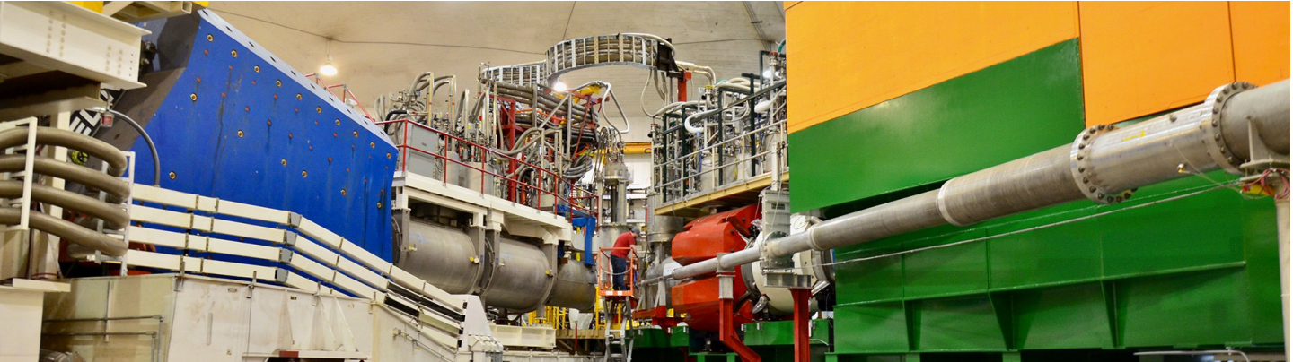
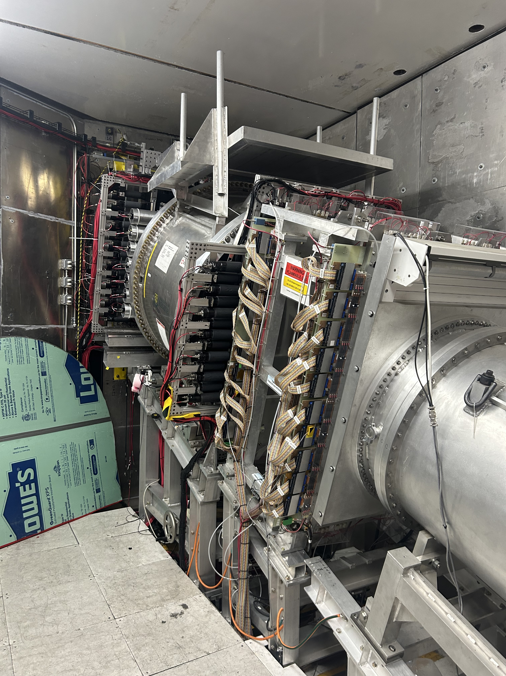
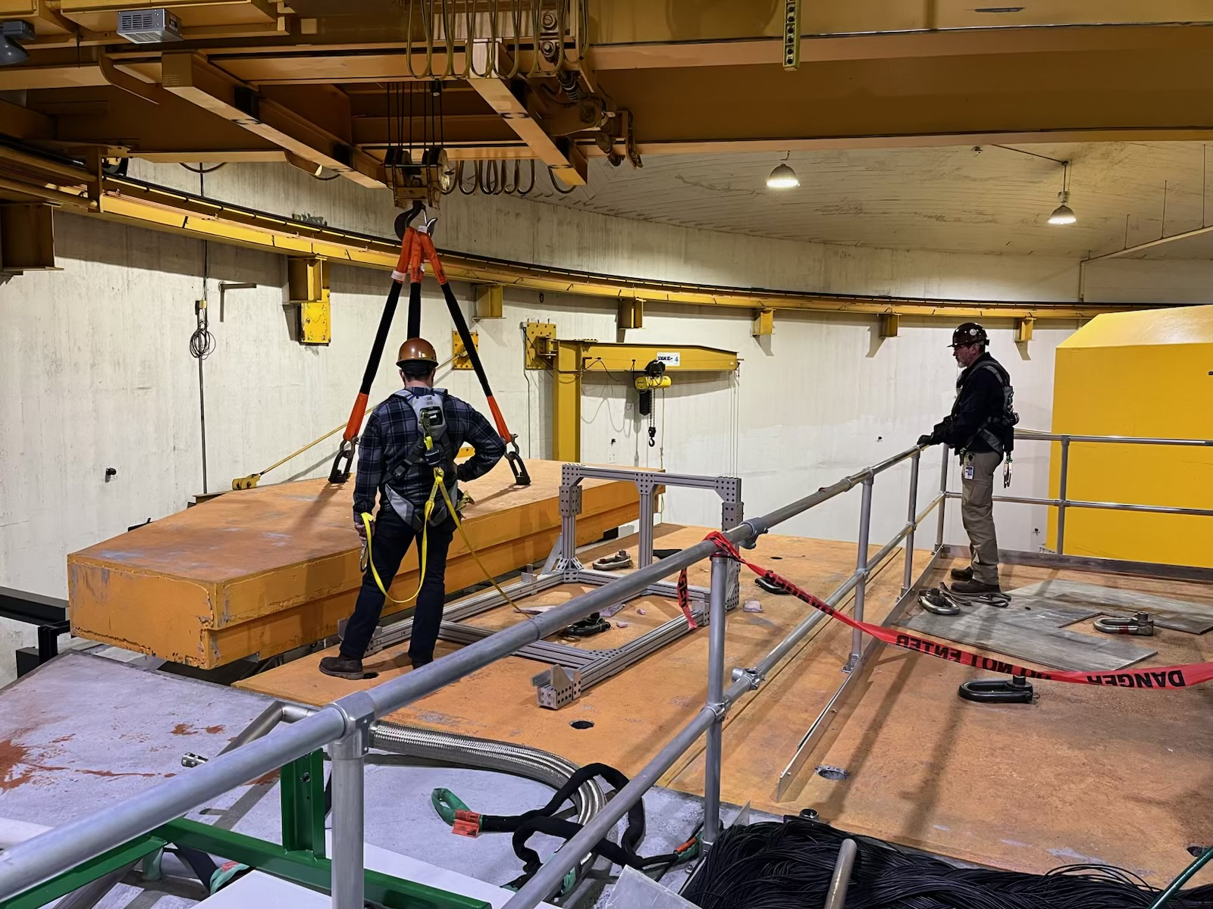
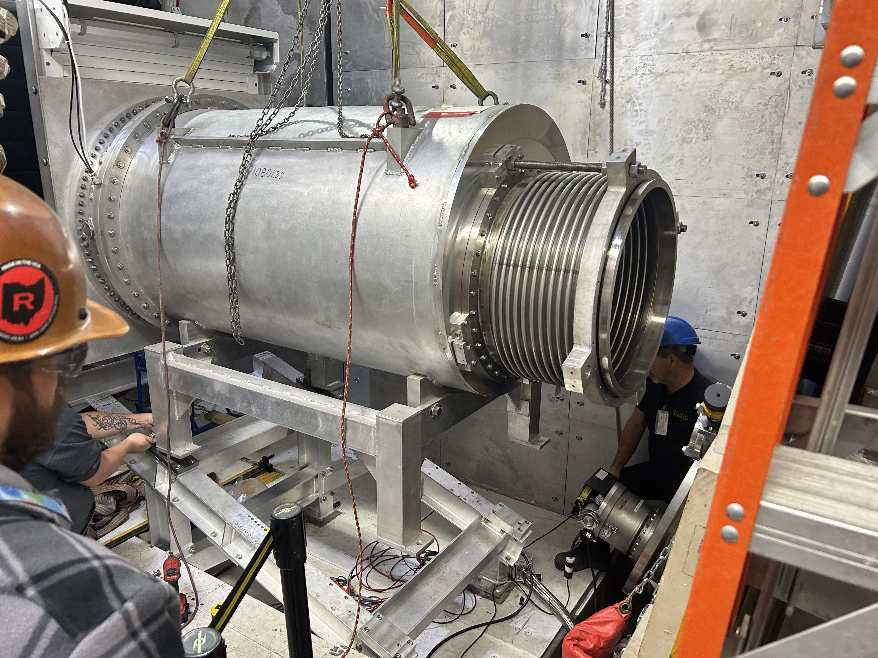
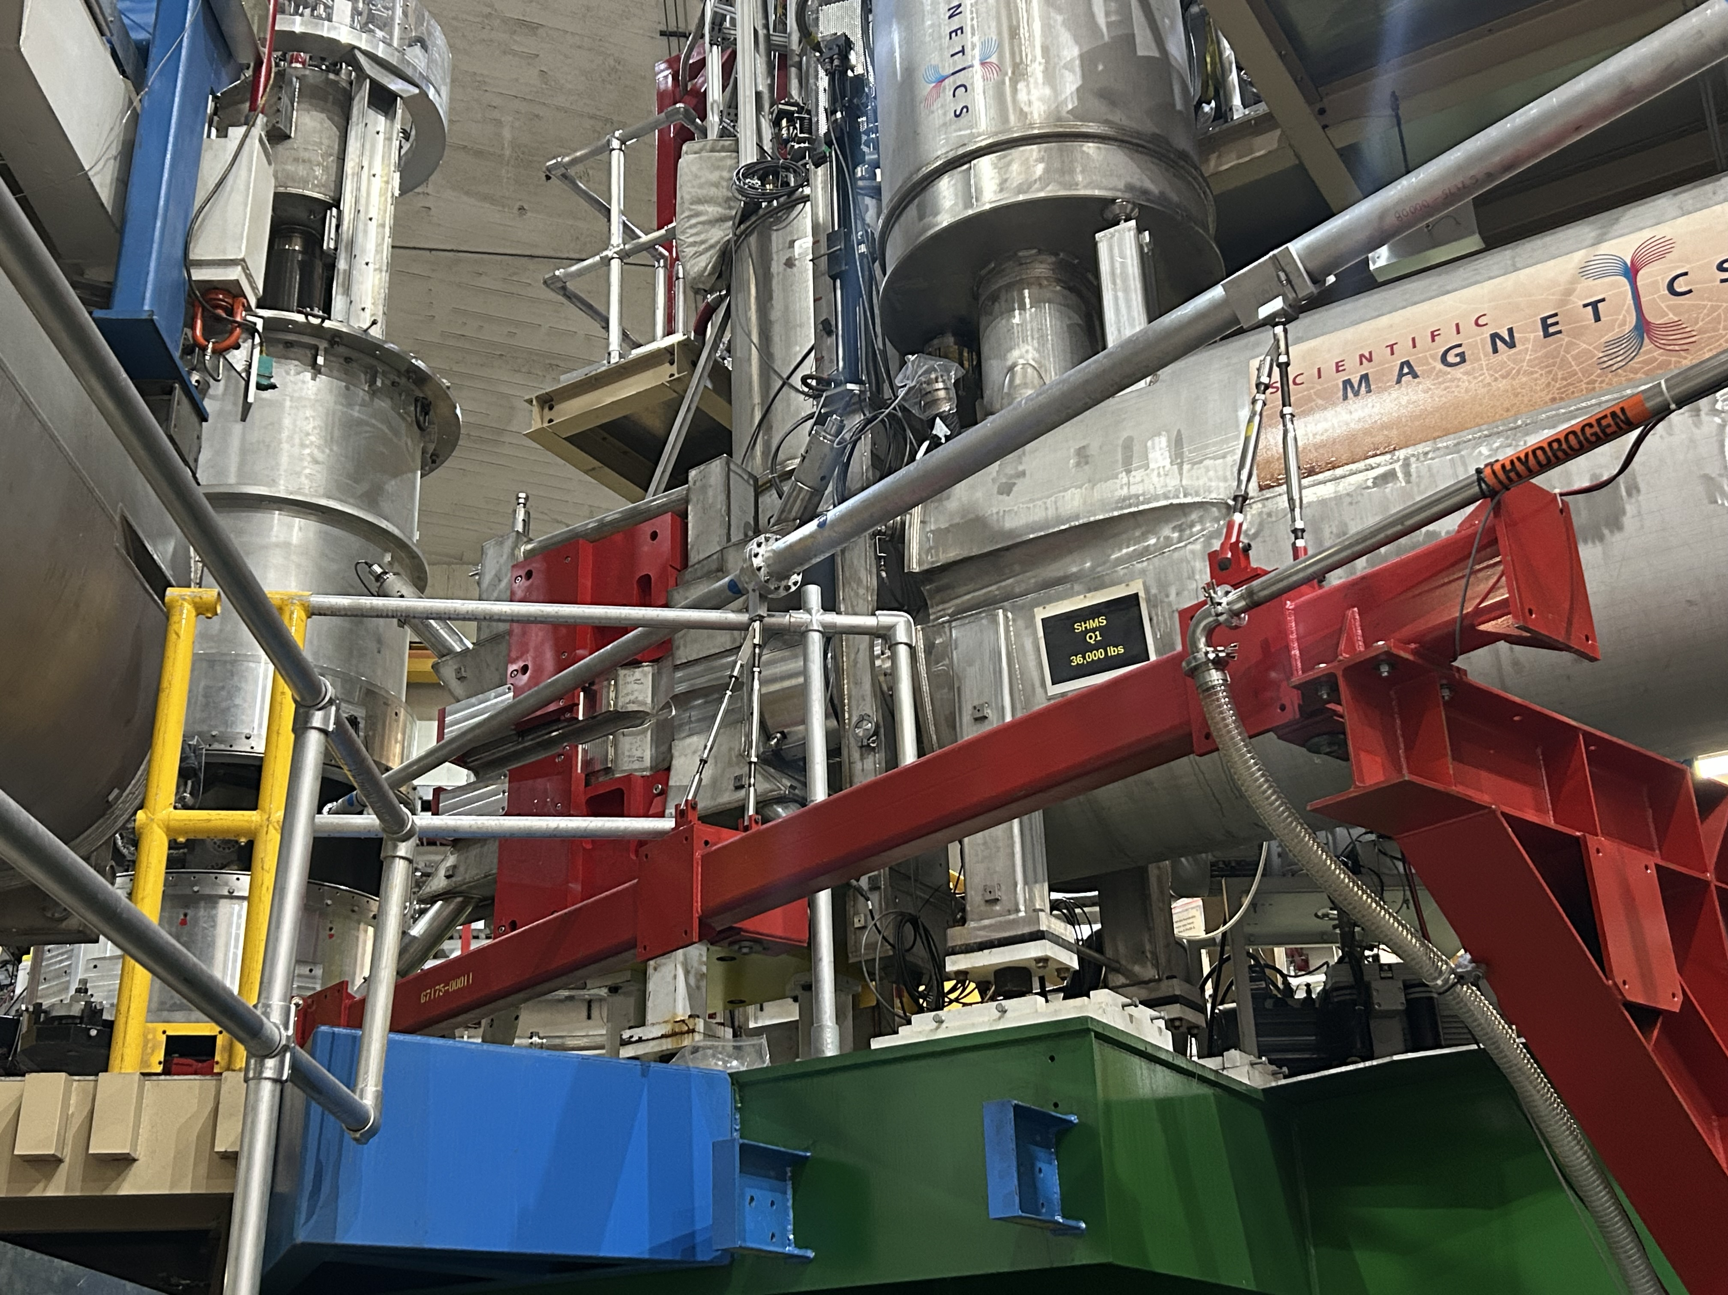
Hall C 2026 SAM Plans
No major installations in Hall C
Experiments will use Super High Momentum Spectrometer (SHMS) and the High Momentum Spectrometer (HMS)
List of main tasks:
Target changeover and maintenance
SHMS/HMS cryo and power supply maintenance
S&A execute global hall survey in preparation for hypernuclear
SHMS S2Y hodoscope work
In SHMS, install detectors needed for transverse asymmetry experiment
Install the small angle beam pipe
Jerry Nines, Hall C Work Coordinator
Notes:
Guidelines: 6-8 bullets per slide; Use sentence fragments for bullets
To change the photo: Right-click on photo and select change photo

Slide 5
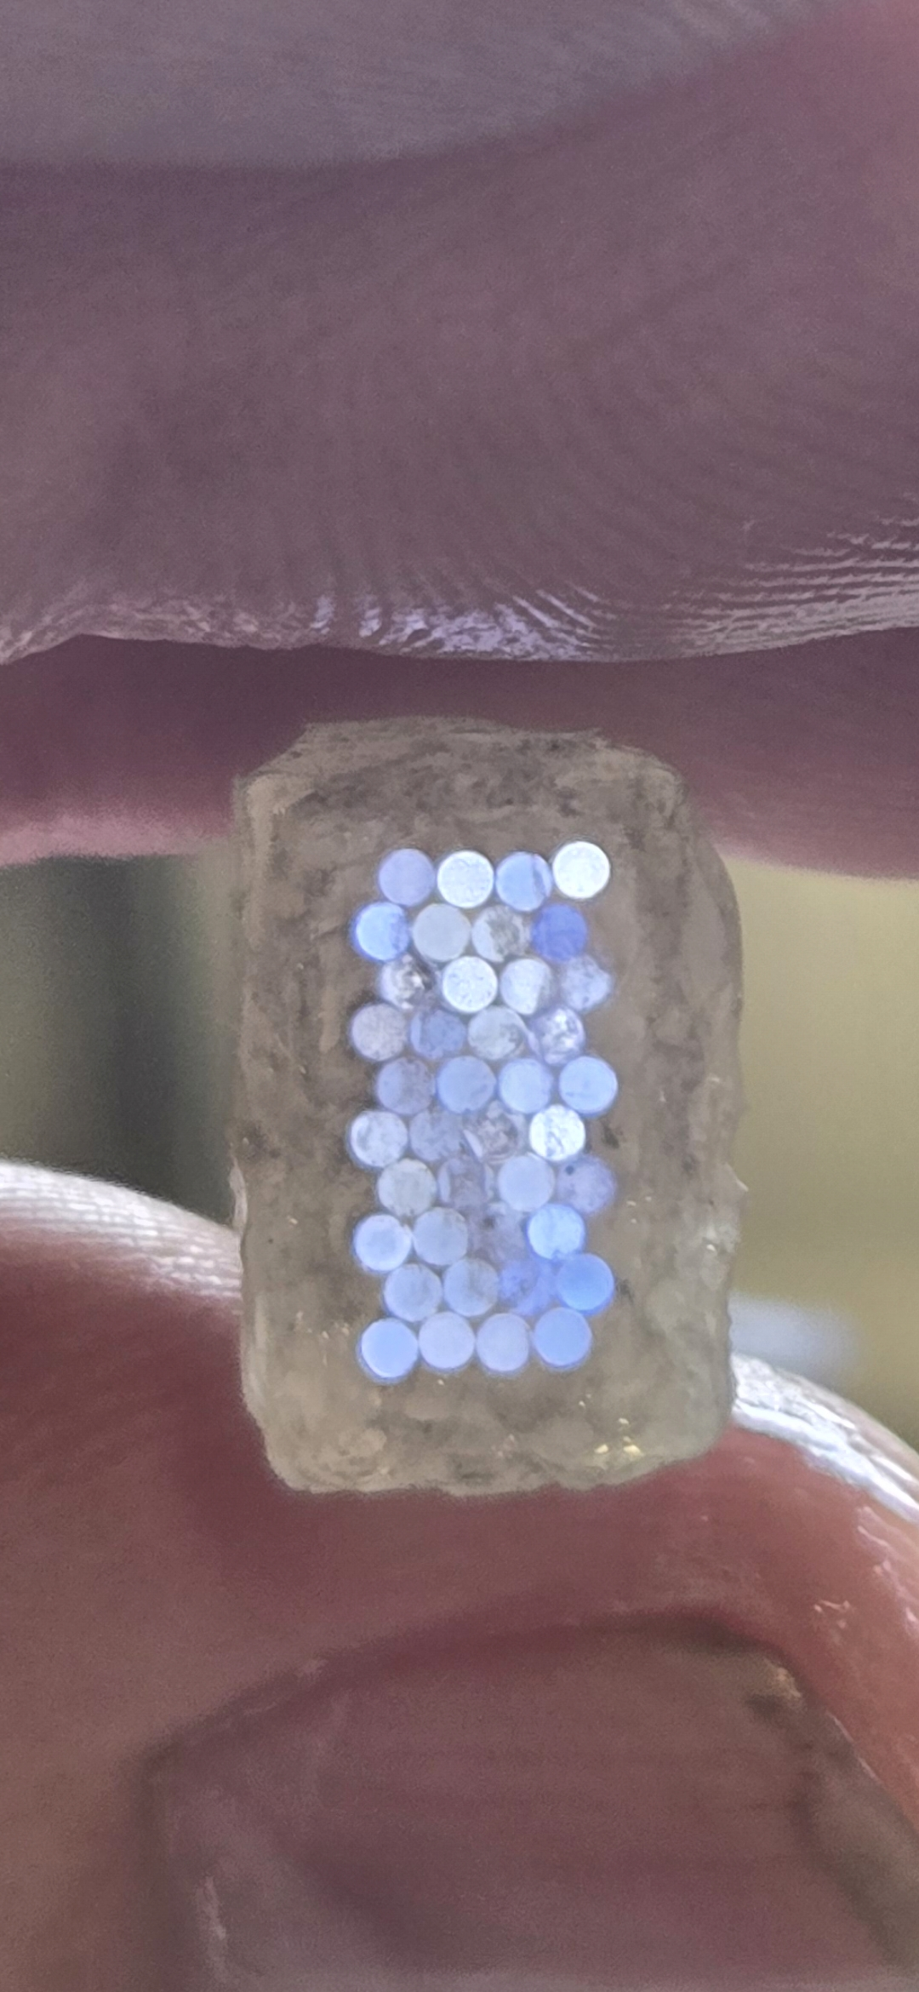
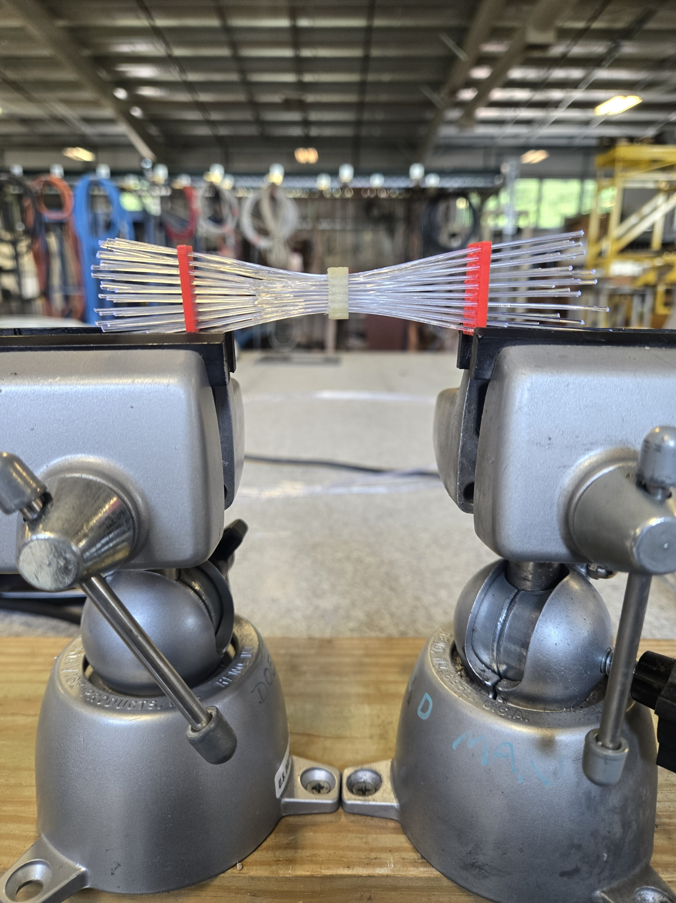
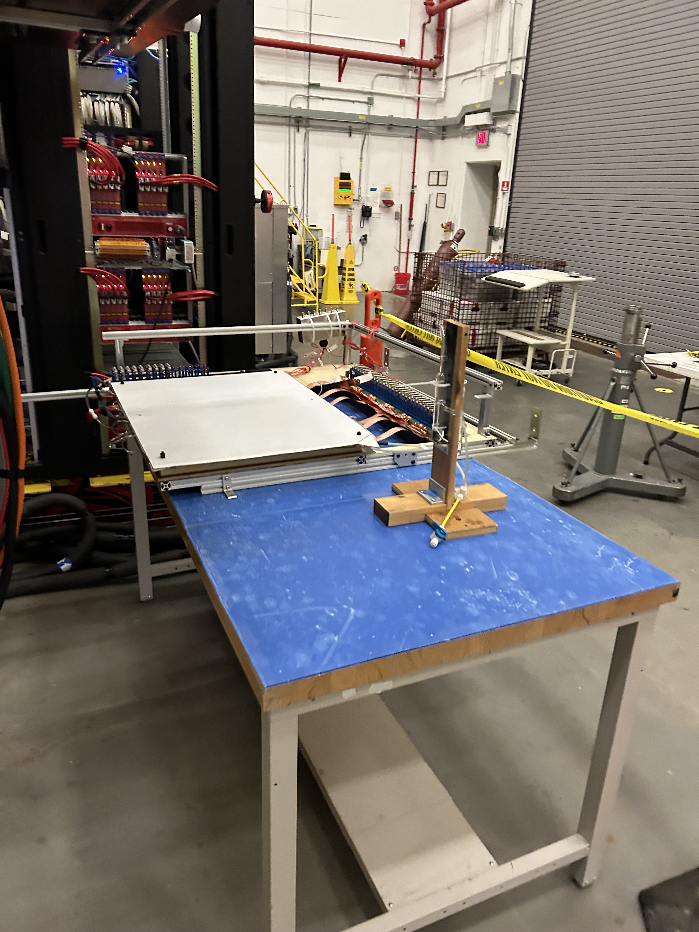
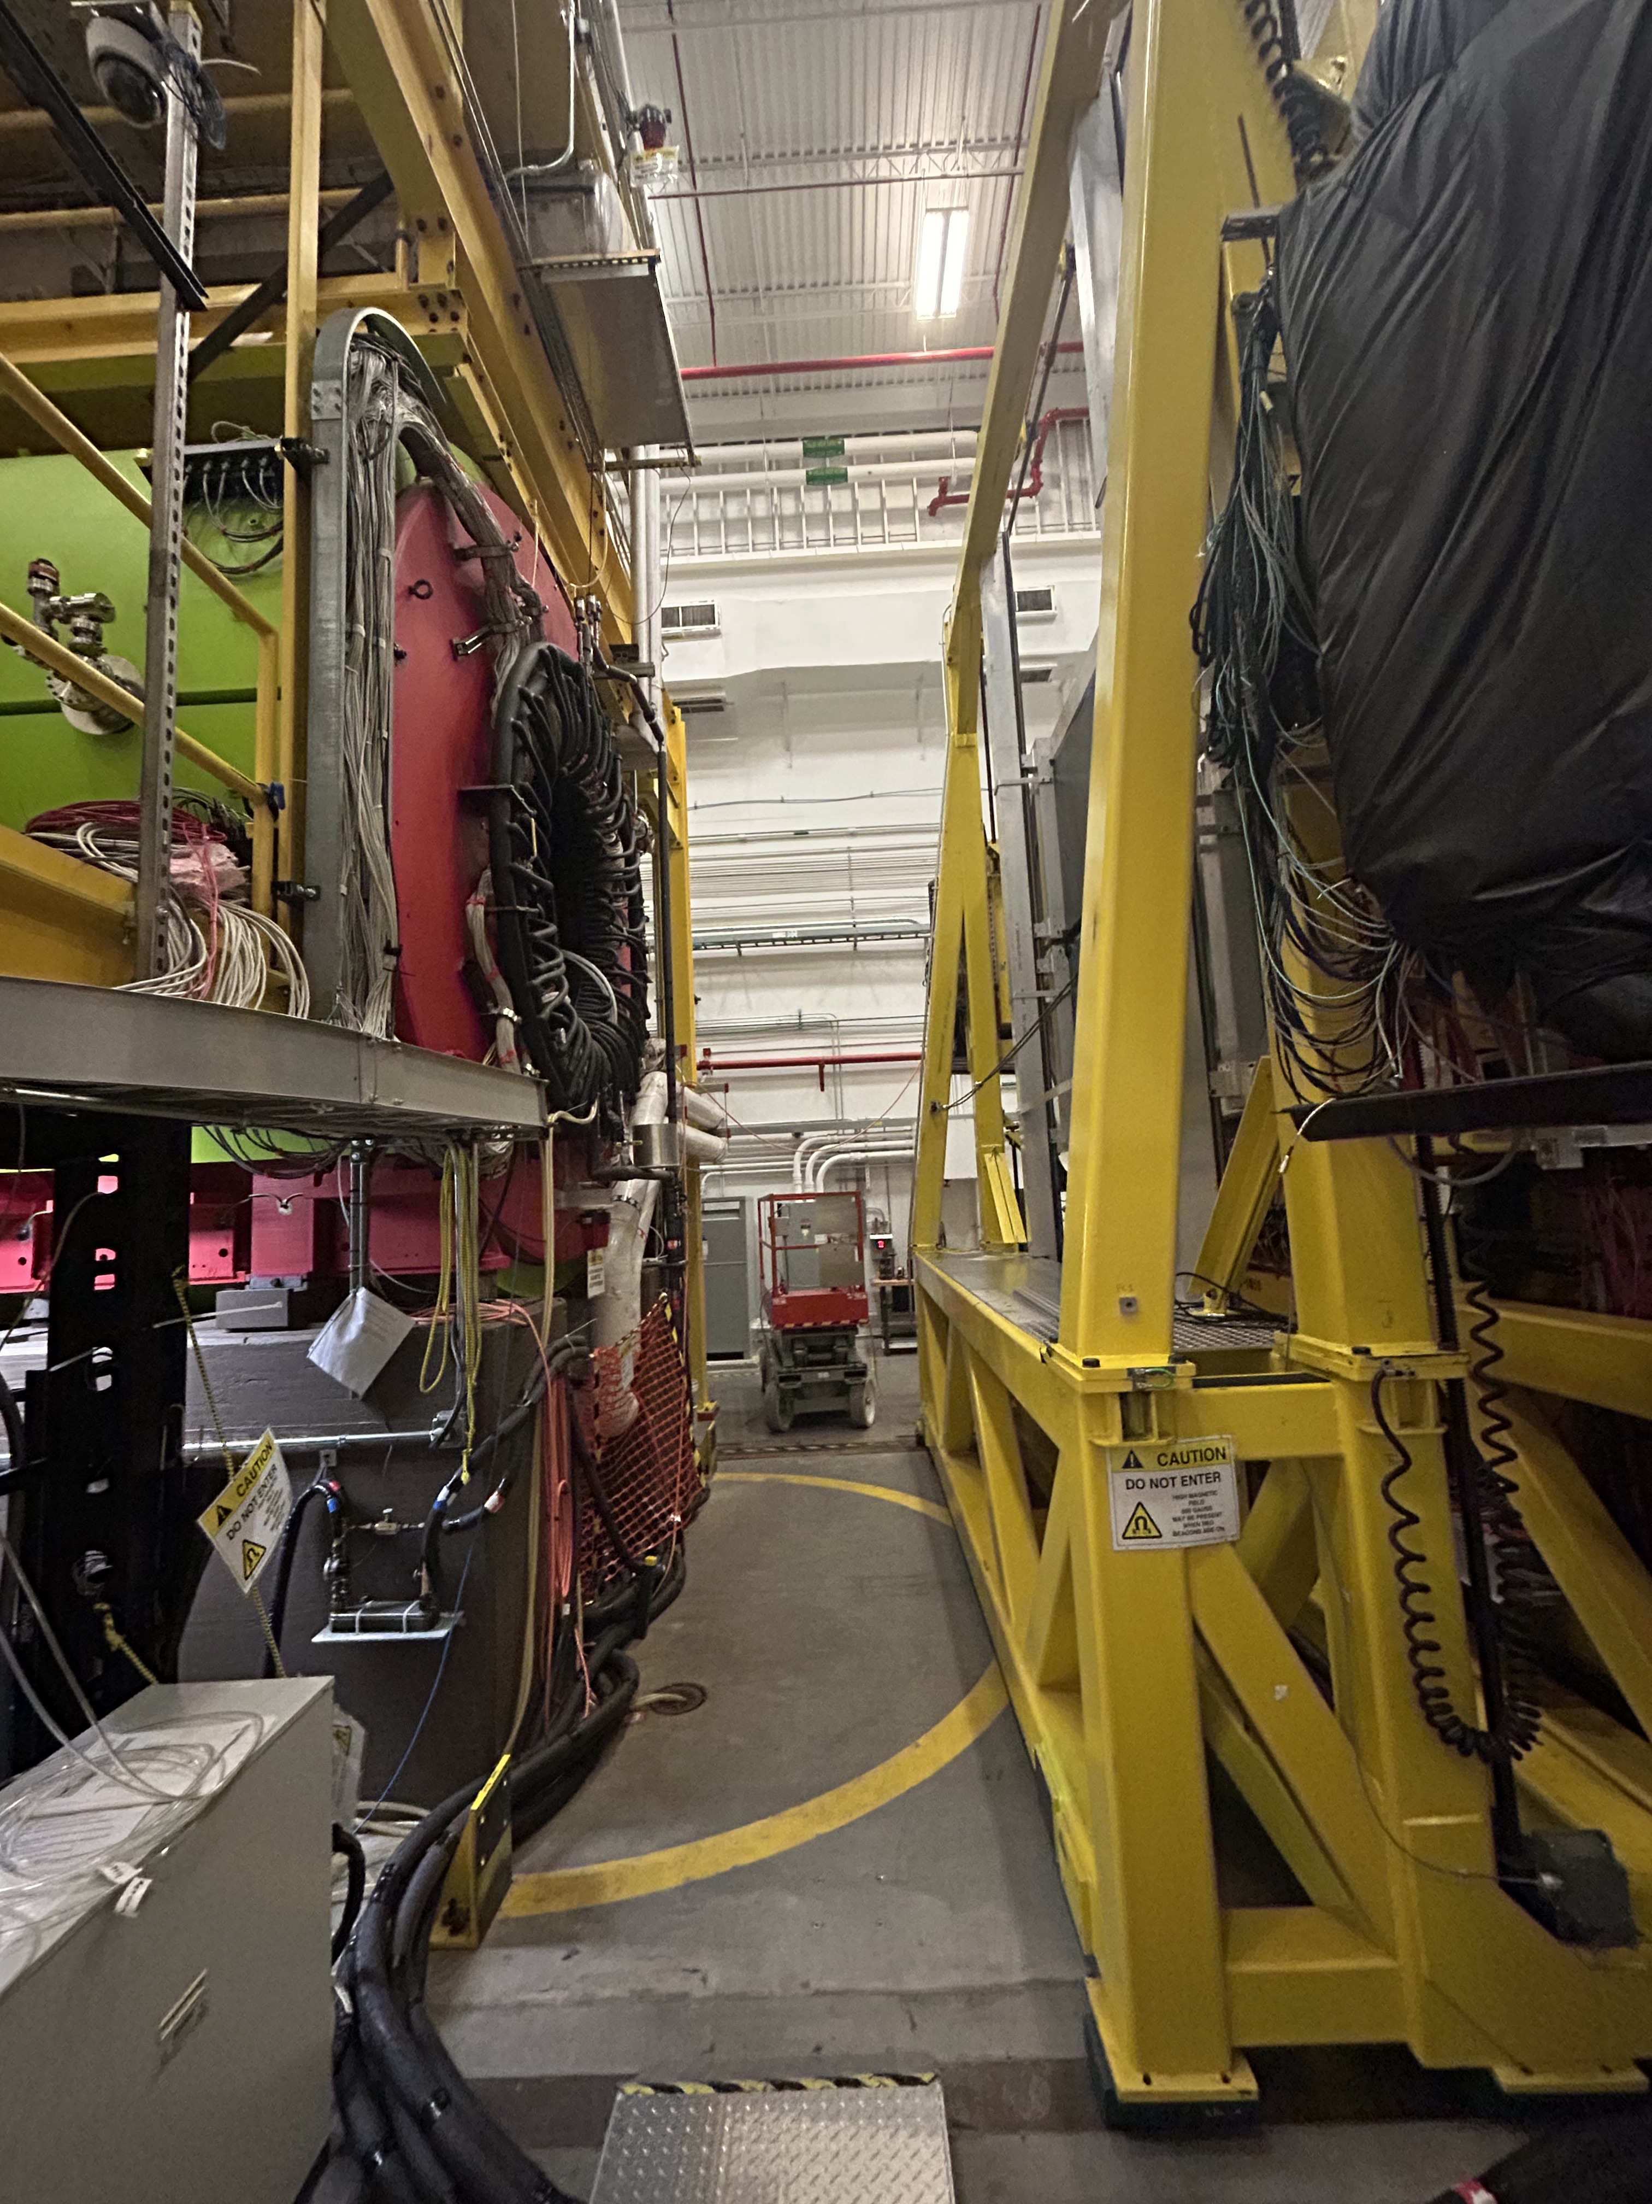
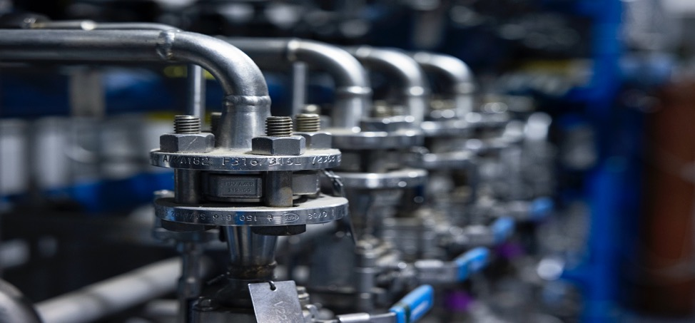
Hall D 2026 SAM Plans
Install new fiber cables in Tagger Microscope
Install GEM -TRD half - chamber
Install & commission GEM gas system
Mount mechanical limit switches to Goniometer motion stages
Inspect Solenoid He relief valves
Install rad-hard turbo pumps in Tagger Vault
Hall D main UPS batteries replacement
General PM’s (filters, lubrication, flushes, etc.)
Scott Spiegel, Hall D Work Coordinator
Notes:
Guidelines: 6-8 bullets per slide; Use sentence fragments for bullets
To change the photo: Right-click on photo and select change photo

Slide 6
QUESTIONS?
Notes:
Before sharing your presentation, confirm:
Fonts are consistent
Images meet quality standards
Charts use template colors
Footer information is current
Spell check completed
Links are working
File size is optimized

