Slide 1

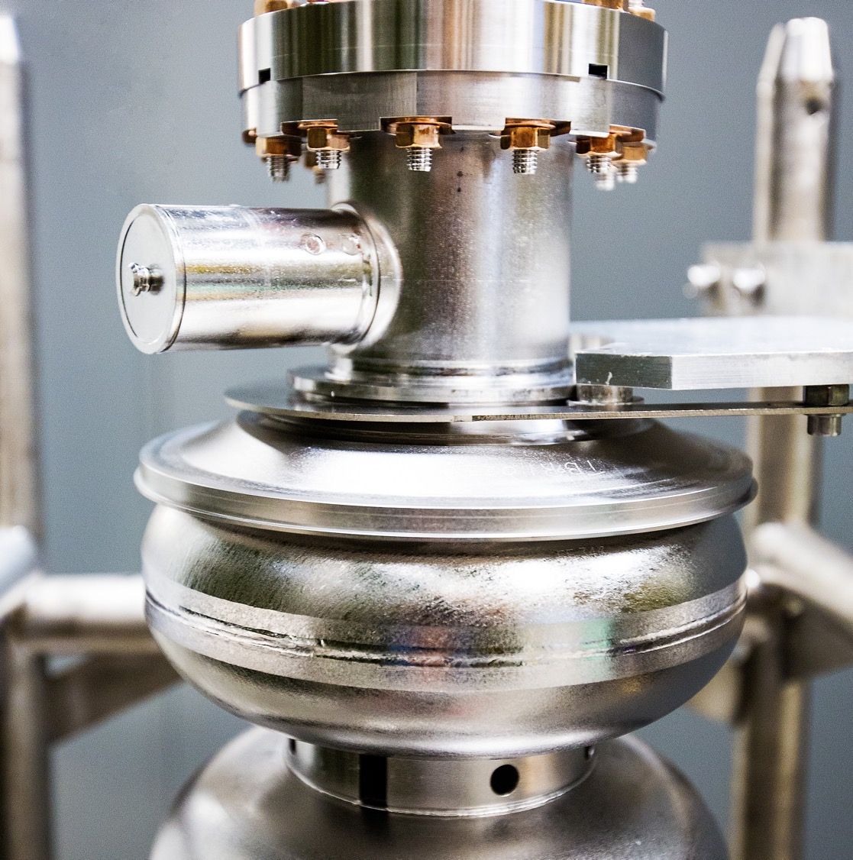
Scheduled Accelerator Maintenance Kick-Off Meeting
Scope of Work – Facilities & Operations
August 20, 2026
David Fazenbaker
Facilities Operations Manager

Slide 2
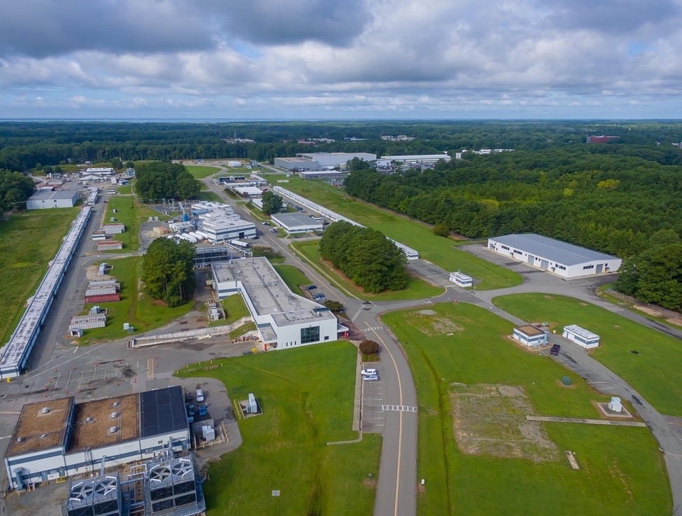
Overview
Facilities & Operations has a fairly broad scope of work planned for this SAM period. For simplicity, items have been grouped into the following four general areas of focus:
Preventive Maintenance
Controls & System Reliability Improvements
Accelerator Infrastructure Projects
Safety and Site Improvements
Will also cover work planning and controls

Slide 3
Preventive Maintenance
Focus: Complete outage-dependent preventive maintenance
Electrical
Panelboard PMs
Switchboard PMs
Switchgear PMs
Substation PMs
Process Cooling
Chillers
Cooling Towers
LCW – filters, pumps, resin bottles, etc.
HVAC / Mechanical
AHUs, CRACs, CRAHs, IUs, RTUs
Air Compressors
Smoke Removal Fans
Condition / Reliability Maintenance
Vibration Analysis
Controls Calibrations
Pressure Relief Valves

Slide 4
Controls & System Reliability Improvements
Focus: Modernize aging controls, expand system monitoring, and improve the reliability of critical accelerator and facility support systems
Controls Modernization
Bldg 92 LCW Flow Analyzer Replacements (2) and Control Door Modifications
Honeywell Virtual Server Upgrade
N Access LCW Makeup System Deox Contactors and Makeup Pump Interlock
N/S Access LON → BACnet Conversion (pending available funds)
Enhanced Monitoring
LCW pH Monitoring – East/West Arc LCW Systems
LCW System Makeup Water Monitoring / Alarms Available to EPICS
Injector Service Building Rack Temperature Sensors (pending available funds)

Slide 5
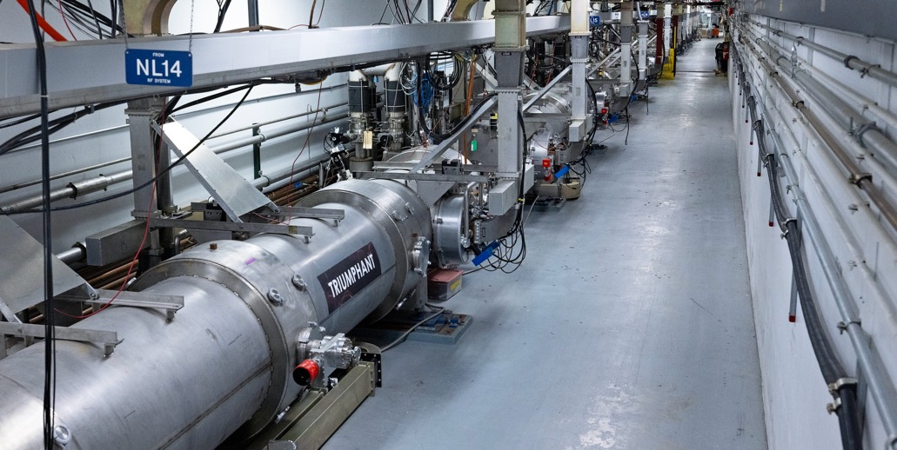
Accelerator Infrastructure Projects
Focus: Take advantage of SAM access conditions to complete projects that address infrastructure deficiencies and improve accelerator operations
CEBAF
LCW System Investigation / Corrective Actions
Underground Crack Repairs / Water Mitigation
Hall A Dome Shielding Improvements
Hall A, B, and C Flood Door Seals
Hall D Chilled Water Variable Frequency Drive (VFD) Replacements
Tunnel Contain and Drain Improvements
LERF
Underground Duct and Berm Repairs
Egress Stair Improvements

Slide 6
Safety and Site Improvements
Focus: Address identified personnel safety, access, and site-condition improvements
Safety and Site Improvements
Campus Sidewalk Repairs and Improvements
Hall C Dome Stair Replacement
Hall D Service Building Retaining Wall Guardrails
Pavement Markings
Sitewide Material Condition Improvements

Slide 7
Work Planning and Controls
Focus: Methodically plan, review, communicate, and approve work before execution while maintaining flexibility as SAM plans mature
Work Planning, Controls, and Integration
F&O work planned and tracked in Maximo, including scope, ownership, status, and scheduled execution
Integration with other directorates' work-control processes (ATLis, CTLis, Outage Management System) and required approvals, coordination, and sequencing
Required safety controls established before execution (ePAS PTWs for in-house work and AHAs, safety plans, and contract-required controls for subcontracted work)
Continuous communication with operations staff from affected directorates throughout planning and execution
Work activities and schedules adjusted as SAM plans mature to accommodate changing operational priorities, system conditions, and other planned work

Slide 8
QUESTIONS?

