Slide 1

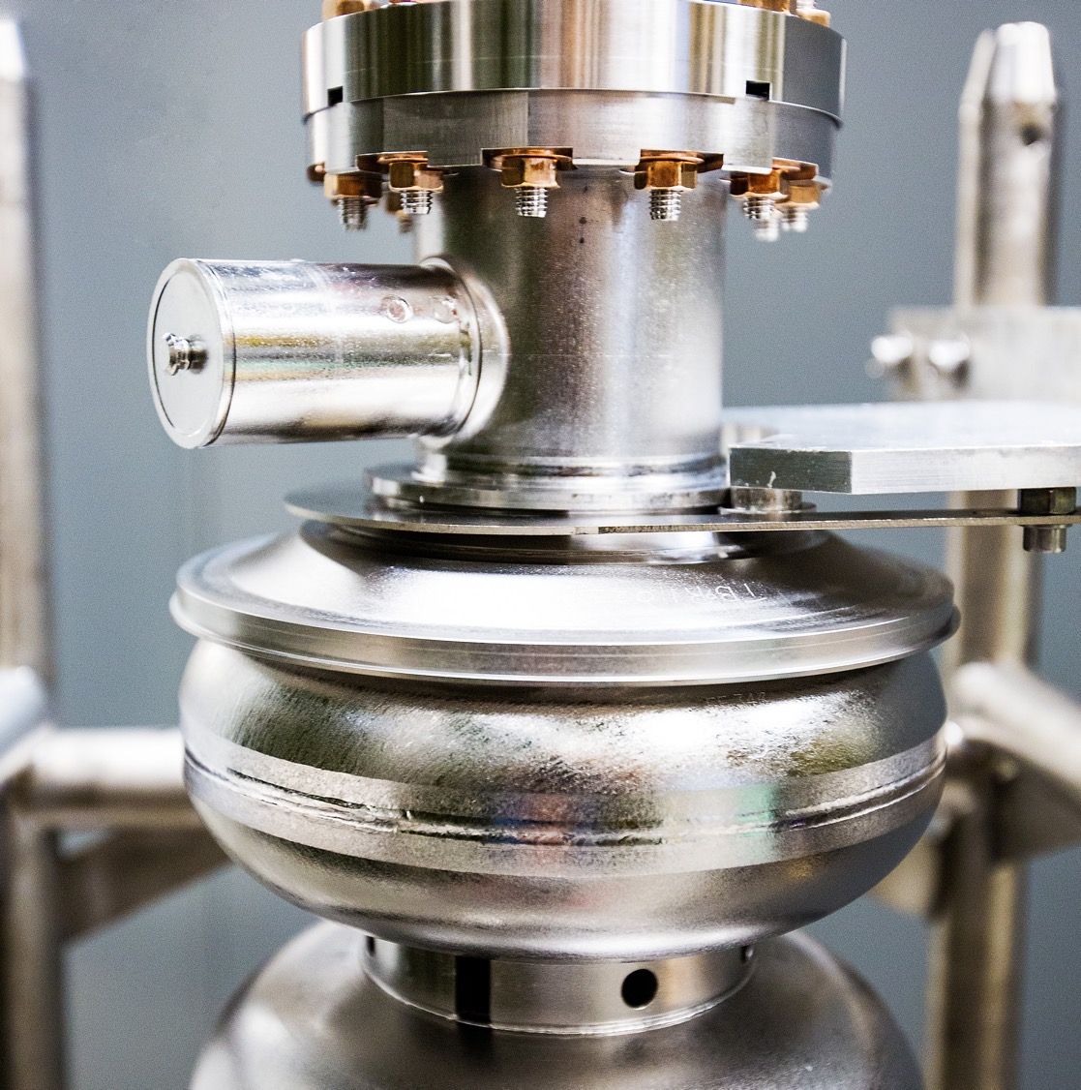
ES&H Essentials for
Safe Operations
2026 SAM Kickoff Meeting
August 20, 2026
Notes:
Tip: Keep titles under 60 characters for readability
To change the photo: Right-click on photo and select change photo

Slide 2
Topics
Historical Context & Reporting Reminders
Exposed Magnet Leads
ODH reminders
ePAS revision update and after-hours support
Radiological Concerns
Working on Accelerator Credited Controls
Q&A
Notes:
Guidelines: 6-8 bullets per slide; Use sentence fragments for bullets
To change the photo: Right-click on photo and select change photo

Slide 3
Historical Context
May 2024 Safety Pause – triggered by Pre-Job and LOTO observations
Fall 2025 SAM – started with 3 RadCon-related events in one week
Recent Injury & Hazardous Energy/LOTO-related events
  Oct/Nov 2025 – worker exposures to induced voltage on LED bulbs
  Dec 2025 – technician doing demolition work cut into a conduit carrying live conductors
  Jan 2026 – burnt hand from space heater cord with an internal short
  April 2026 – 4 separate minor hand injuries from pinching, crushing, cutting
  April 2026 – student finger tingle from an ungrounded power supply cart
  June 2026 – confusing guidance regarding application of "plug and cord" exception
  July 2026 – ARC subcontractor cut into energized conduit not detected in concrete floor
  Aug 2026 – ARC subcontractor worker falls from scaffold and injures knee
We've had multiple events which could have been worse.
Let’s get the 2026 SAM off to a well-controlled start.
Notes:
Guidelines: 6-8 bullets per slide; Use sentence fragments for bullets
To change the photo: Right-click on photo and select change photo

Slide 4
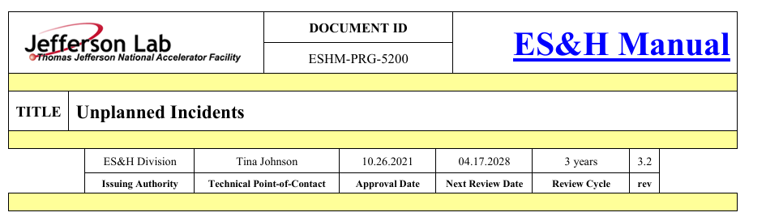
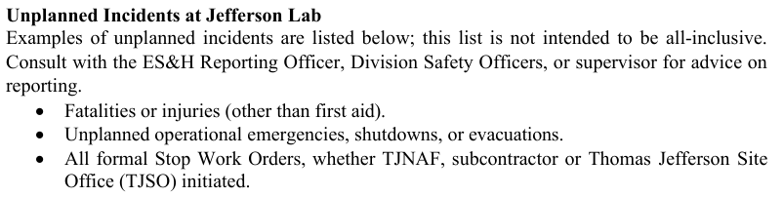
What is an "Unplanned Incident" (per ESH Manual 5200)
ES&H Manual Chapter 5200 provides examples of unplanned incidents
The list is not intended to be all-inclusive
We develop work plans, when work does not go as planned and there is an unplanned incident – REPORT
If in doubt whether an incident needs to be reported – REPORT
Notes:
Fatalities, injuries (other than first aid) and unplanned emergencies, shutdowns, or evacuations.
All formal Stop Work Orders, whether TJNAF, subcontractor or TJSO initiated.
Unplanned activation of a Safety System, whether personnel or equipment related.
Fires, explosions, electrical shocks or any potential worker exposure to hazardous energy.
Exposure to chemical or physical stressor(s) above threshold limit values (TLV) and/or permissible exposure limits (PEL).
Radiation levels exceeding posted criteria, spread of radioactive contamination beyond control boundaries, or loss of control of radioactive materials that exceed applicable DOE limits.
Radiation barrier breach or unauthorized entry.
Personnel radiation exposure or contamination that exceeds applicable DOE limits.
Any radiological event or condition determined to be an infraction of any applicable statutory requirement or DOE Order, or exceeds a condition established by permit
Significant property damage.
Unexpected discovery of hazardous energy, including pressurized or electrical systems.
Discovery of an unreviewed safety issue (USI) or potential inadequacy of a documented safety procedure.
Discovery of reduced effectiveness in a safety system that poses potential for immediate harm or mission interruption and requires prompt mitigative action. (e.g., Personnel Safety System, Fire Protection System, etc.).
Discovery of suspect or counterfeit material.
Environmental release of hazardous material, including during off site transportation.
Any DOE or regulatory body-initiated non-compliance notification.
Management concerns, near misses, and/or an incident that may damage credibility of the Department of Energy.

Slide 5

Unplanned Incident Reporting (per ESH Manual 5200)
EVERYONE
Injury: Report to Occupational Medicine or Call 911 if critical
Place the area in a safe condition
Notify supervisor, sponsor, or technical representative and Security
SUPERVISORS & MANAGERS
Ensure the area is safe and secure the scene from being disturbed.
Notify the following people and provide key details:
  Your ALD/Division Director
  ES&H Reporting Officer (757-876-1750)
  Division Safety Officer
Pamphlet located at First Aid Cabinets
Notes:
Guidelines: 6-8 bullets per slide; Use sentence fragments for bullets
To change the photo: Right-click on photo and select change photo

Slide 6
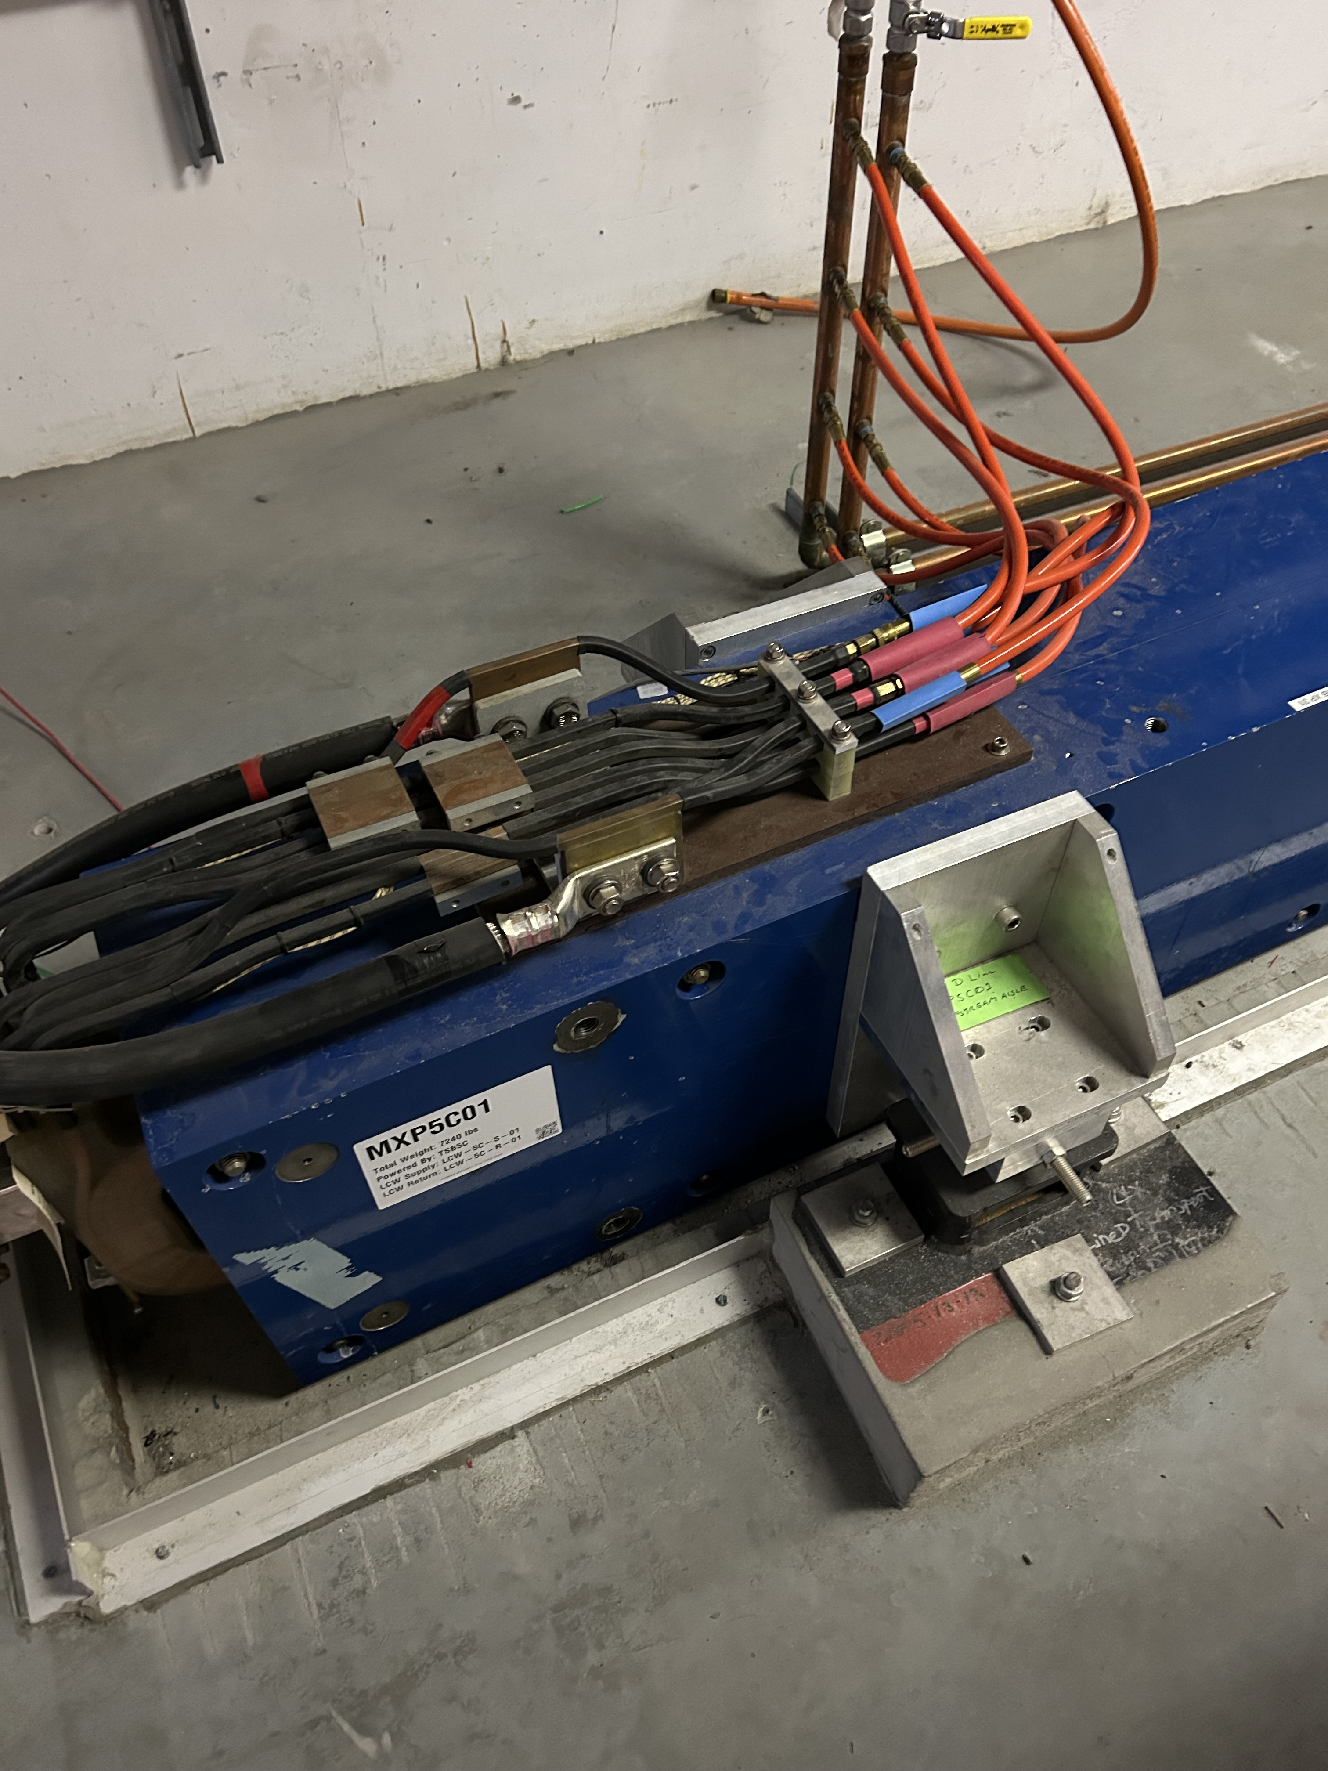
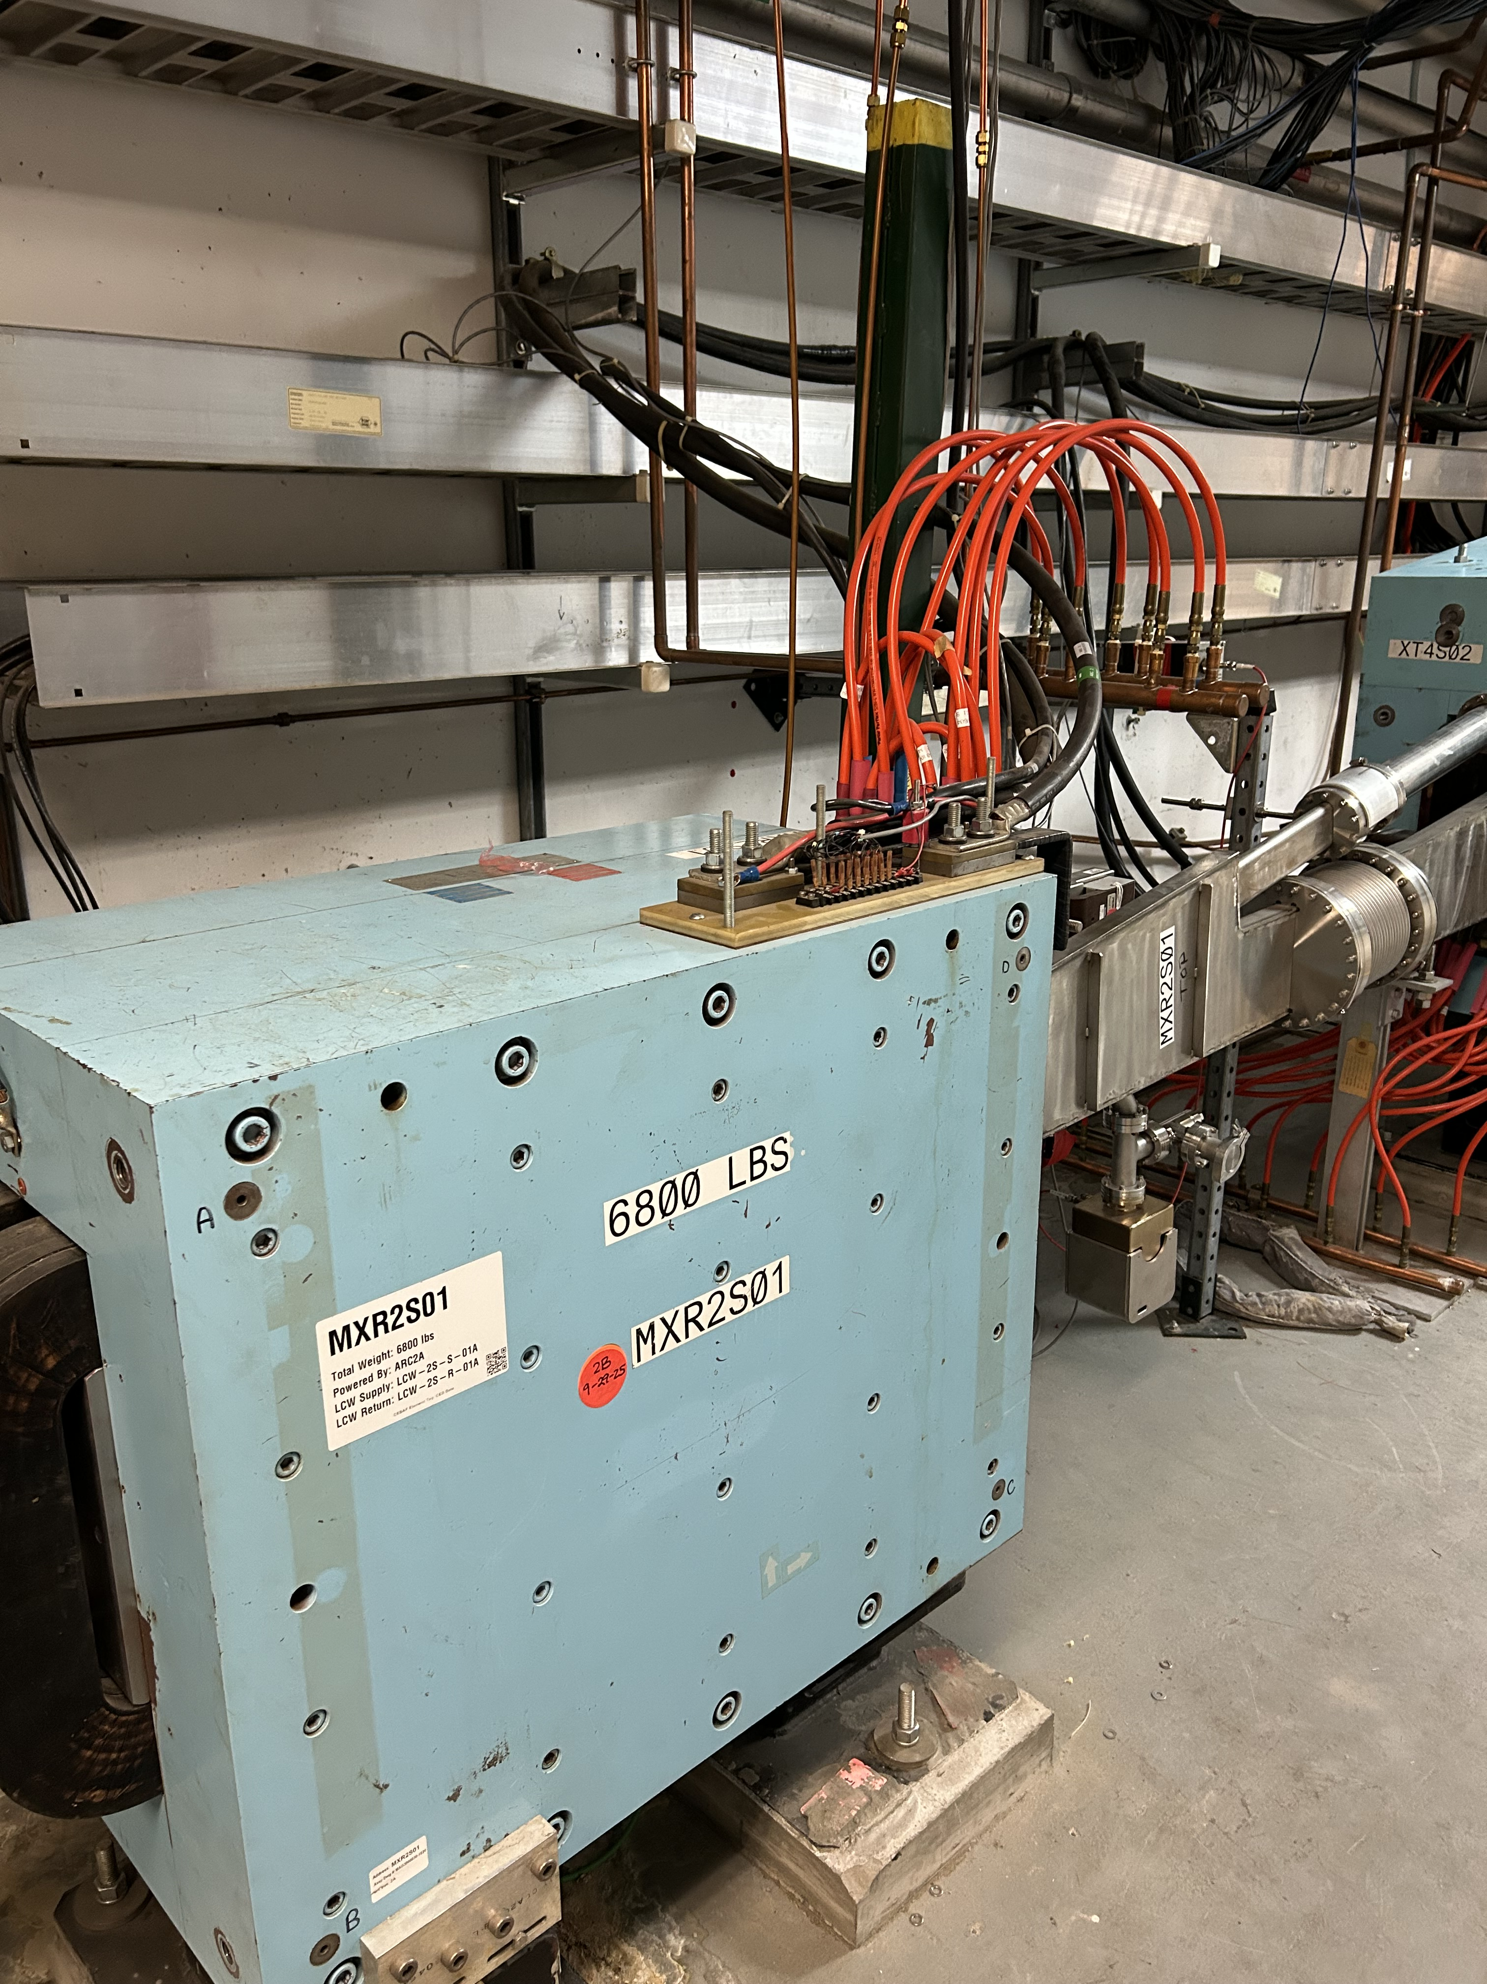
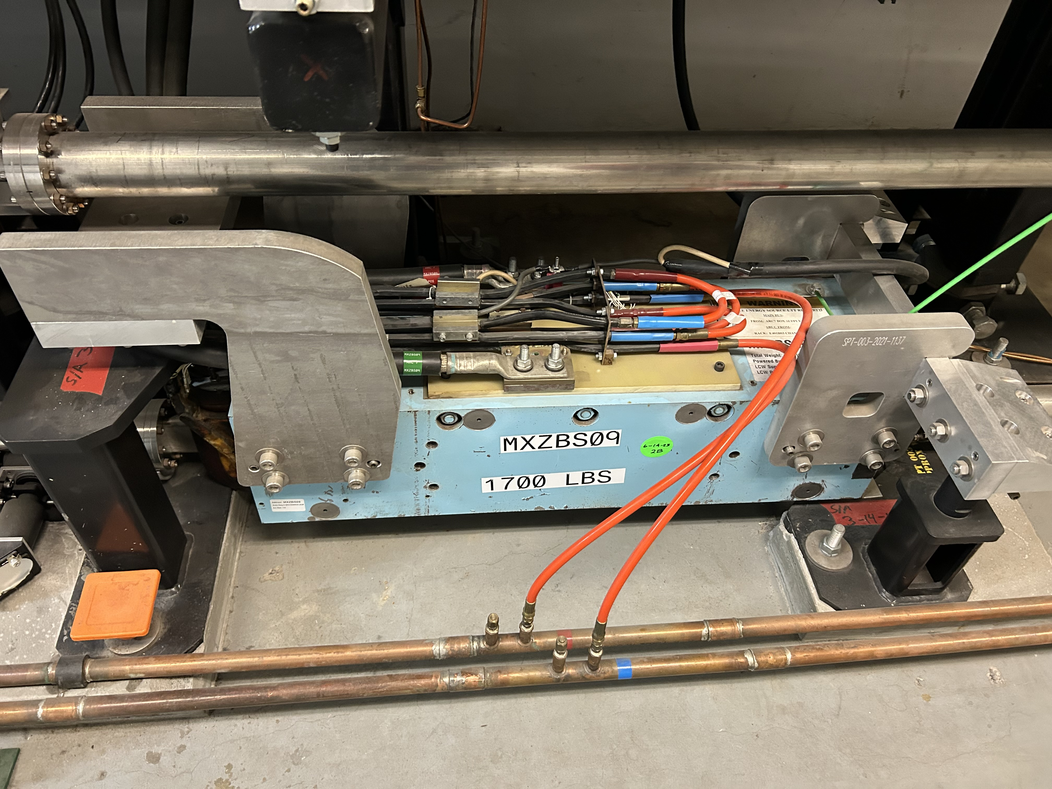
Exposed Large Dipole Magnet Leads
Before the last SAM, we talked about exposed leads on the large dipole magnets in the CEBAF tunnel and the safety requirements to work on those magnets
Continuously improving to ensure OSHA & NFPA70E compliance
Working towards installation of engineering controls (i.e., terminal guards) to isolate the electrical hazard, but will not be ready at the start of the SAM
AES, ACC Ops, CA&Q, and ES&H have developed a draft air-gapping process to provide an electrically safe work condition during the SAM
Until the process is approved & implemented, the tunnel will remain in a locked state.
Next step: Seek Lab Leadership approval of the process and inform TJSO of our approach.
Dedicated information will be provided to you when we proceed.

Slide 7
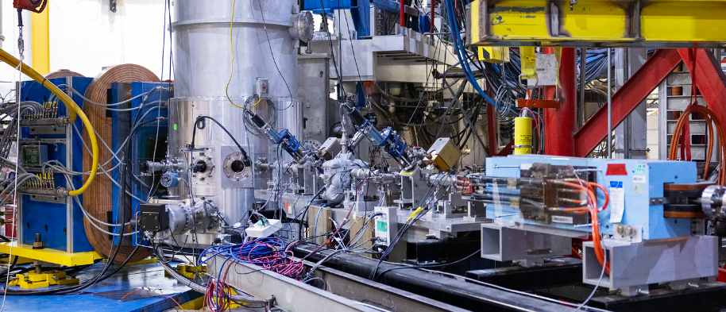
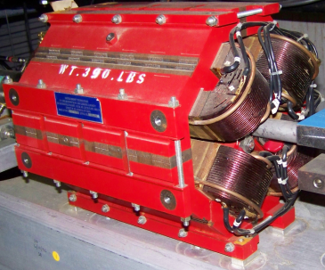

Other Magnets in CEBAF
Quads, correctors (e.g., trim magnets) & Experimental Hall dipoles
ARE NOT included in AIR-GAPPING process
These magnets have covers installed on electrical terminals
Removing covers requires LOTO Training Competency & contacting system owner

Slide 8
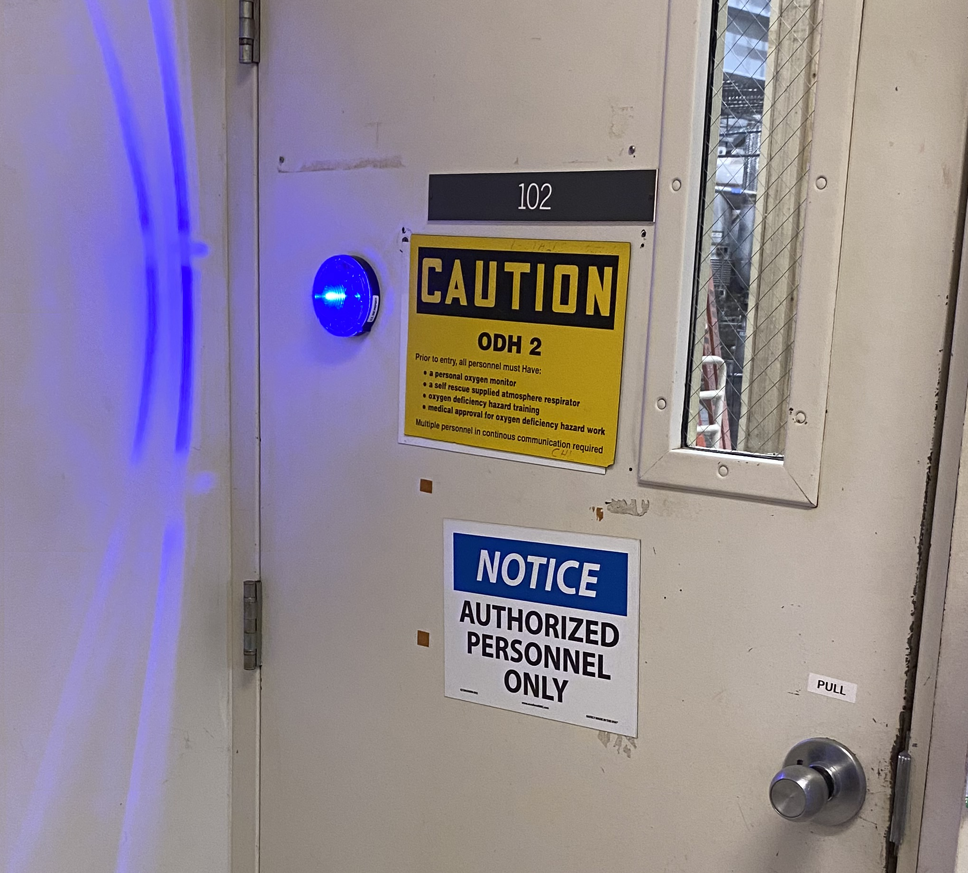
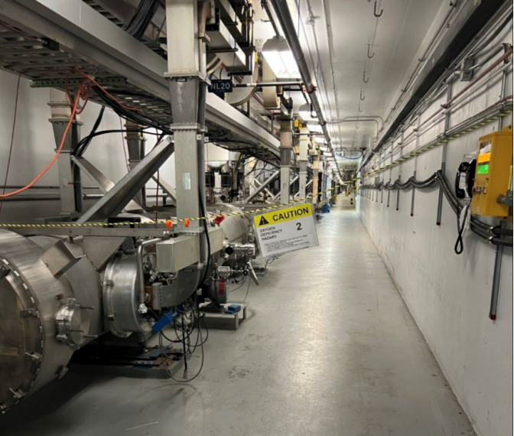
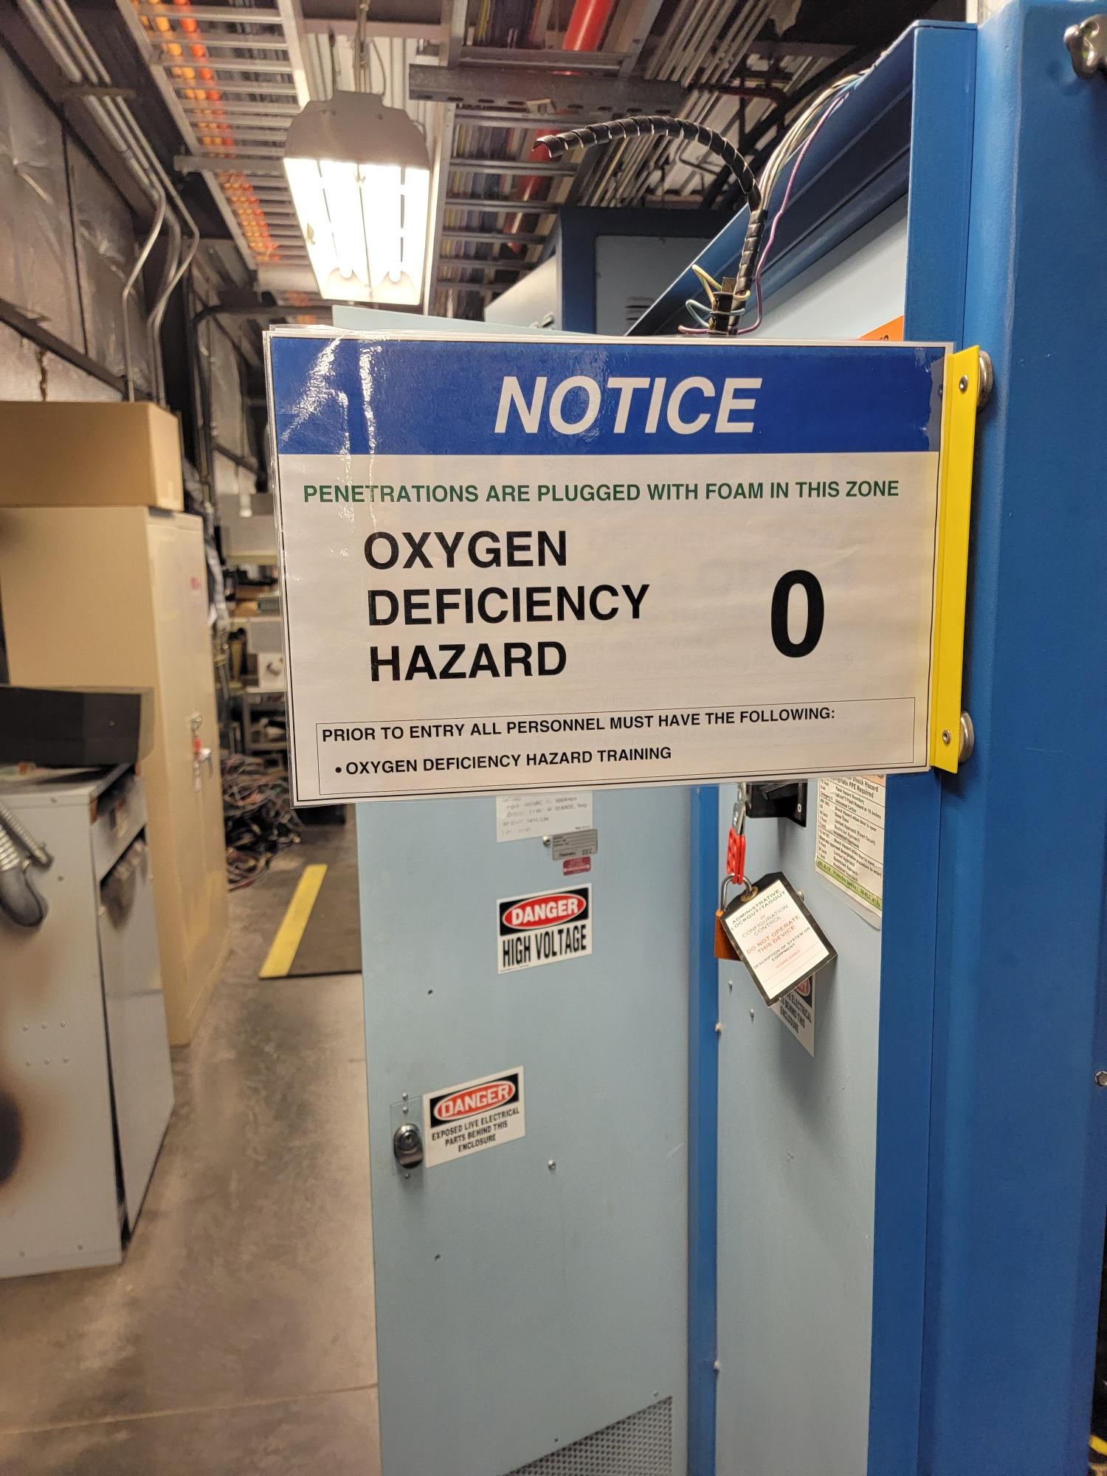
ODH Reminders
SAM activities resulting in temporary reclassification:
  Open penetrations in North/South Linacs
  Maintenance of oxygen monitoring units
(if backup not in-place)
  Manipulating RT Valves
Activities have a work control document, authorizes reclassification
System Owner/Group changing the condition is responsible for the ODH posting
  notify impacted workers
  draw attention to the posting change
Notes:
Guidelines: 6-8 bullets per slide; Use sentence fragments for bullets
To change the photo: Right-click on photo and select change photo

Slide 9
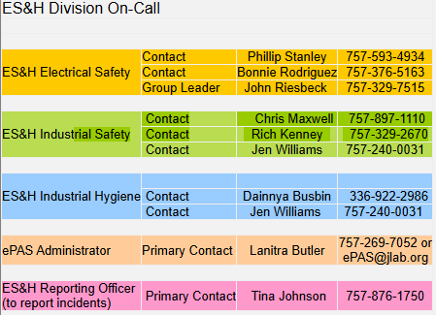
ePAS System Transitioning
Version 5
Task Hazard Analysis (THA) improvement of work categories
Users Training scheduled for October 19-30
Proposed Go-Live: First week of November
  Strategically chosen based on SAM – coordinated with Acc Ops
ePAS Support Availability
Support provided during daytime and after hours
Notes:
Guidelines: 6-8 bullets per slide; Use sentence fragments for bullets
To change the photo: Right-click on photo and select change photo

Slide 10
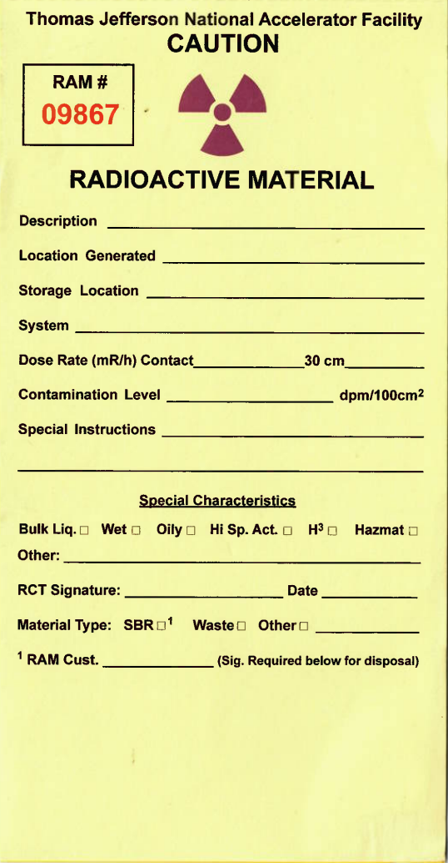
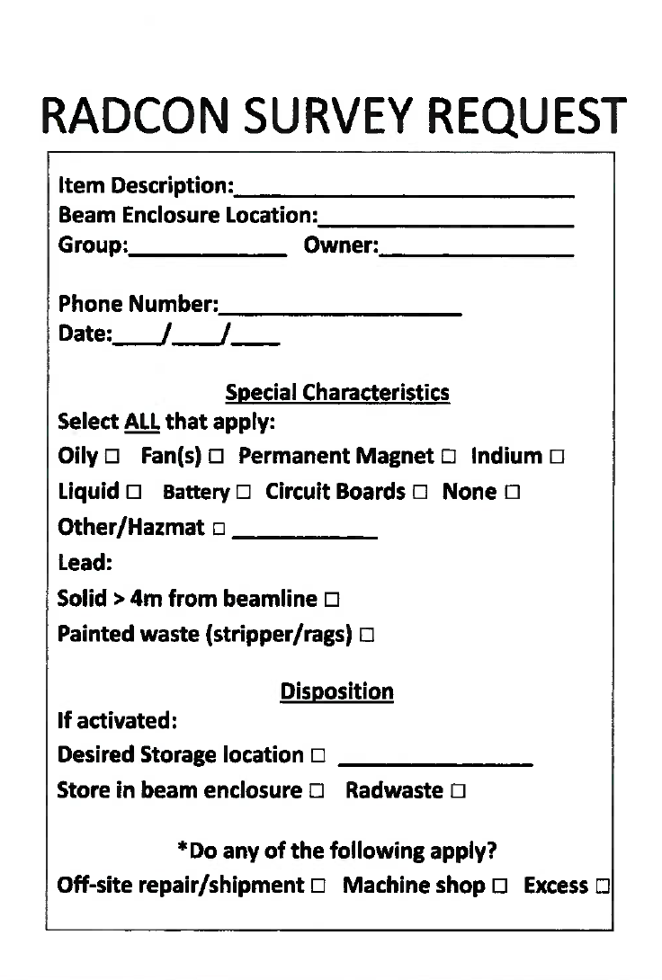

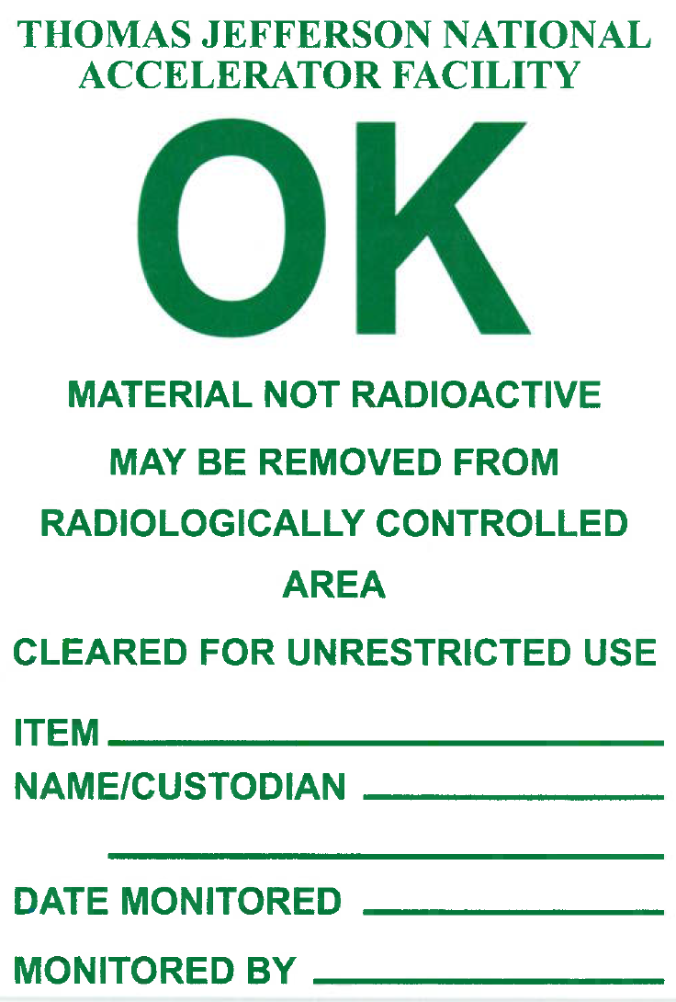
Bringing material outside of the accelerator
Activated
Material requires RCD Authorization for movement
ServiceNow Request
?
Material present during beam/RF operations within:
CEBAF (includes Halls)
LERF
Released
Material removed from the enclosure and tag shall be removed
Completely fill tag and place item on survey rack

Slide 11
RAM Workflow
ServiceNow for RAM Movements
https://jlab.org/ram-move
Request RCD approval
RCD Authorization Granted
Perform work
Verification w/RCD
Disassemble*
Machining
Moving
* Be mindful of equipment with potential for contamination (e.g. water, filters, equipment racks)

Slide 12
Rad Boundaries
Pay Attention
&
DO NOT RELOCATE

Slide 13
Credited Controls
SAF705 training is required to work with Credited Controls
  link to course content for offline review (updated July 2026)
  Contact Christine Clarke clarke@jalb.org and Harry Fanning fanning@jlab.org
If you are not sure if your work could impact a Credited Control
  Contact your supervisor or the appropriate Division Safety Officer (DSO)
    CEBAF Accelerator, UITF, LERF, CMTF, VTA: Harry Fanning fanning@jlab.org
    CEBAF Halls: Neville O'Sullivan nevilleo@jlab.org
If you are in the middle of work when you realize that the work impacts a Credited Control, stop and contact your supervisor and the appropriate Division Safety Officer (DSO)

Slide 14
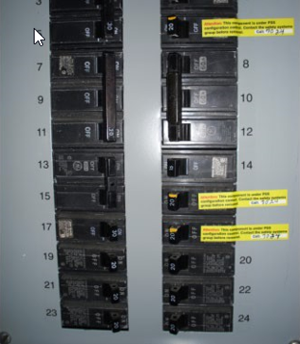
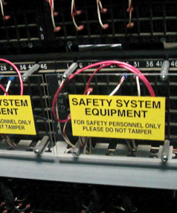
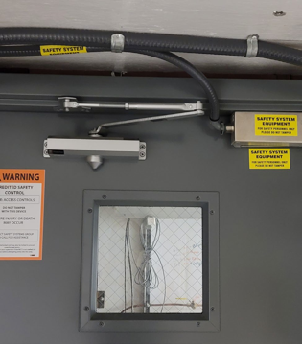
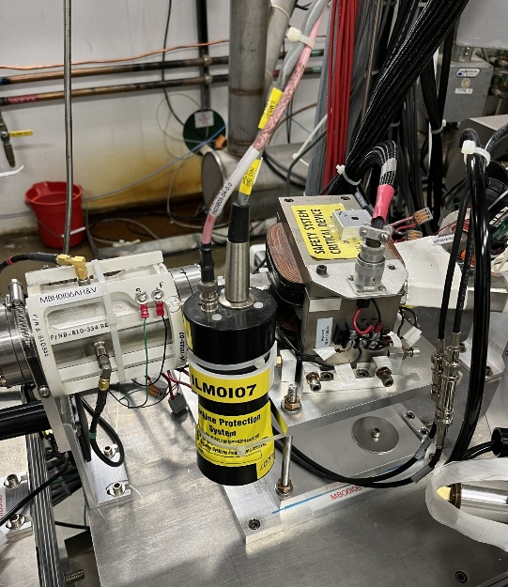
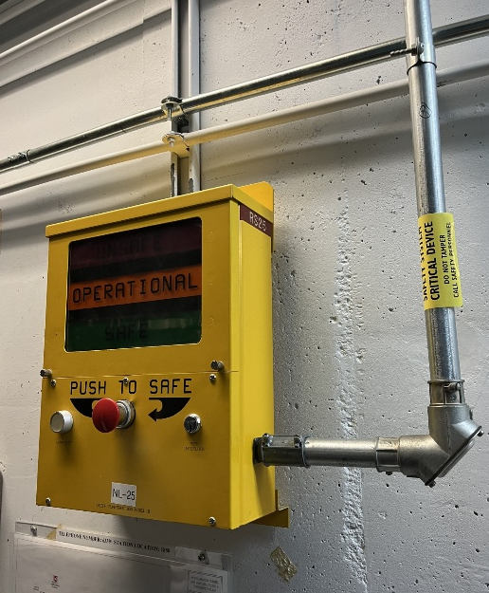
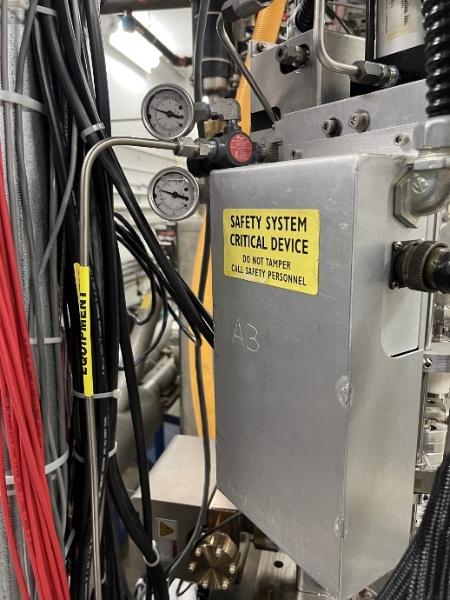
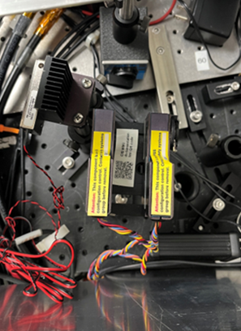
How do I recognize Credited Controls?
PSS Components are labeled with
yellow stickers
Note that the door in the picture AND its interlock hardware COMBINED are the Credited Control
If you remove the door without obtaining SSG permission EVEN IF YOU DON’T MODIFY THE PSS Interlock Sensors, it is still UNAUTHORIZED modification to the Credited Control
If you see something that looks amiss, contact the Safety System Group (SSG)

Slide 15
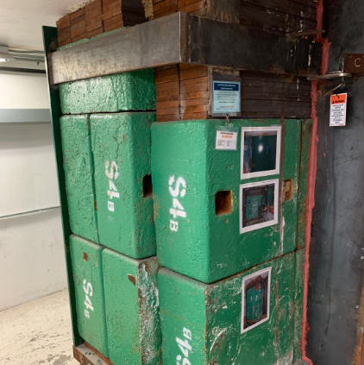
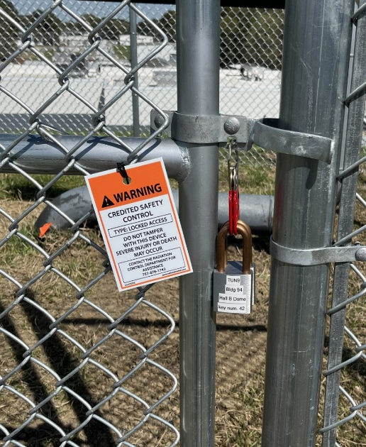
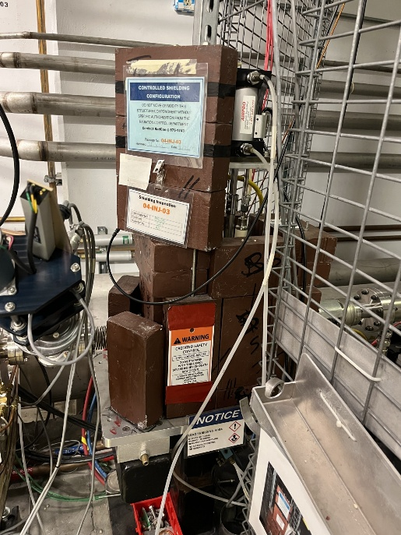
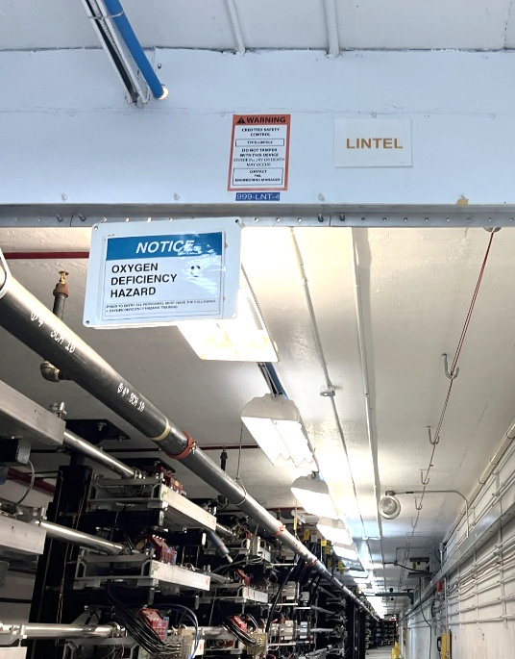
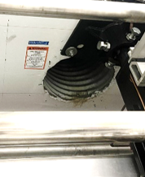
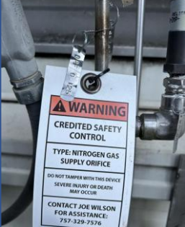
How do I recognize Credited Controls?
White and Orange labels
RadCon, F&O and Cryo/Engineering managed credited controls are labeled with
If you see something that looks amiss, contact RadCon
If you see something that looks amiss, contact F&O
If you see something that looks amiss, contact CRYO

Slide 16
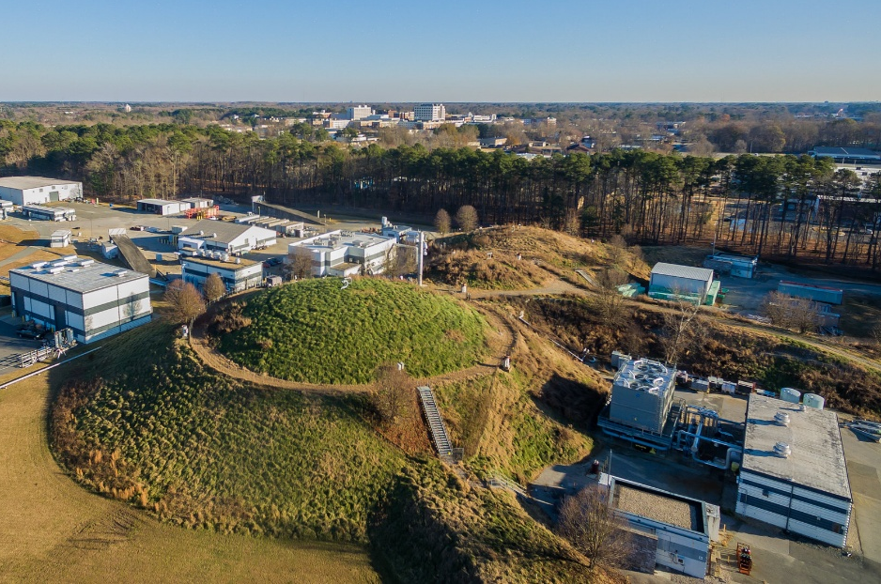
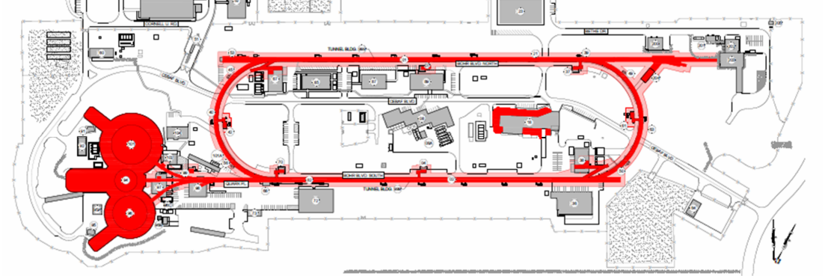
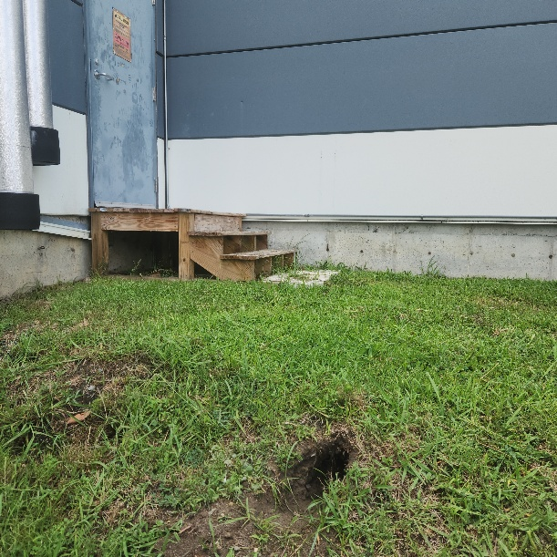
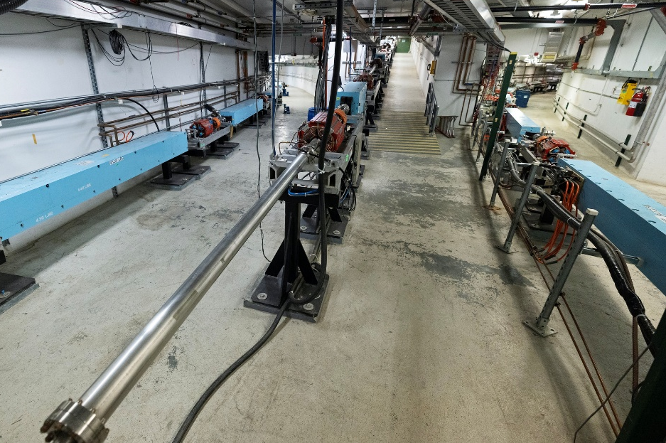
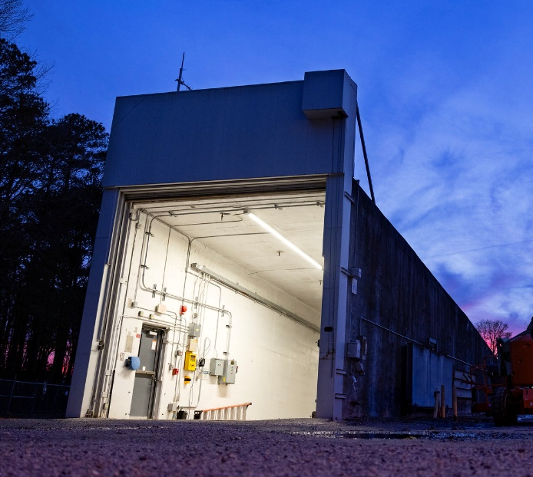
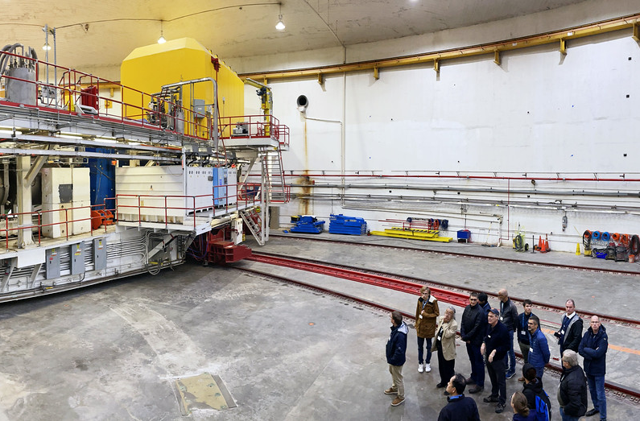
How do I recognize Credited Controls?
Permanent shielding is identified through the dig and penetration permits process by Facilities
If you see something that looks amiss*, contact F&O
* e.g. ground hog holes

Slide 17
Supervisors: Pause to Review SAM Repeat Issues
We tend to rush the first few days of SAMs, which causes people to prioritize schedule above all else.
Following this meeting, supervisors will be provided with a review packet.
Supervisors, pause with your teams to review issues that we typically face at the start of a SAM:
  Review the packet with your teams and how the lessons learned can apply to your work
  Evaluate scheduled work and ensure it can be accomplished safely in the allotted time
    If the work cannot be accomplished or you have questions/concerns, escalate to your Supervisor and ALD
After supervisors have reviewed with their team, send an email confirming completion of this task to your Director and Associate Lab Director, as applicable, with copy to Steve Smith, Director, Contractor Assurance & Quality (sjsmith@jlab.org).
Once the email has been sent, follow normal processes to begin work.
Complete the team pause NLT 8/31/26.

Slide 18
QUESTIONS?
Thank you for your time & attention!

Slide 19
Supervisor Supplemental Notes
Detailed notes on safety incidents that we typically face at the start of a SAM
Supervisors, pause with your teams to review issues that we typically face at the start of a SAM:
  Review the packet with your teams and how the lessons learned can apply to your work
  Evaluate scheduled work and ensure it can be accomplished safely in the allotted time
    If the work cannot be accomplished or you have questions/concerns, escalate to your Supervisor and ALD
After supervisors have reviewed with their team, send an email confirming completion of this task to your Director and Associate Lab Director, as applicable, with copy to Steve Smith, Director, Contractor Assurance & Quality (sjsmith@jlab.org).
Once the email has been sent, follow normal processes to begin work.
Complete the team pause NLT 8/31/26.

Slide 20
Notable Event: ACC-24-0521 Improper Execution of LOTO Procedures Warrants a LOTO Pause (Management Concern)
BLUF: During the PROActive Review from 5/20/2024 - 5/24/2024, the review team observed numerous instances where Hazardous Energy Control (HEC) activities were not performed to requirements. These observations included issues with proper use and condition of PPE, procedures not referenced or not available at the work site, no use of ePAS isolation checklists, inconsistent labeling for arc flash, inconsistent rigor of pre-job briefs, and inconsistent use of ePAS versus legacy OSPs.
HPI Aspects:
Observation stress/distractions, lack of proficiency with ePAS, habit patterns, inaccurate risk perception, mental shortcuts/biases, lack of or unclear standards.
Possible that LTA Change Management has left the QEW's uncomfortable and still unfamiliar with the use of ePAS. Front-line leadership behaviors regarding the quality standards for pre-job briefs may indicate cultural weaknesses.
Root Cause: Supervisory oversight, and specifically the quality of the Pre-Job Brief, is Less Than Adequate
Extend of Condition (EOC): All work requiring the use of HEC (LOTO) has been paused. A LOTO restart plan involving the reevaluation of LOTO proficiency is being developed.
Corrective Actions:
Develop Pre-Job Brief and train the organization on "what good looks like".
Under the direction of the lab's Electrical Authority Having Jurisdiction (EAHJ), all personnel involved in LOTO work and their supervisors will undergo a practical assessment and validation of their knowledge and proficiency with LOTO protocols.

Slide 21

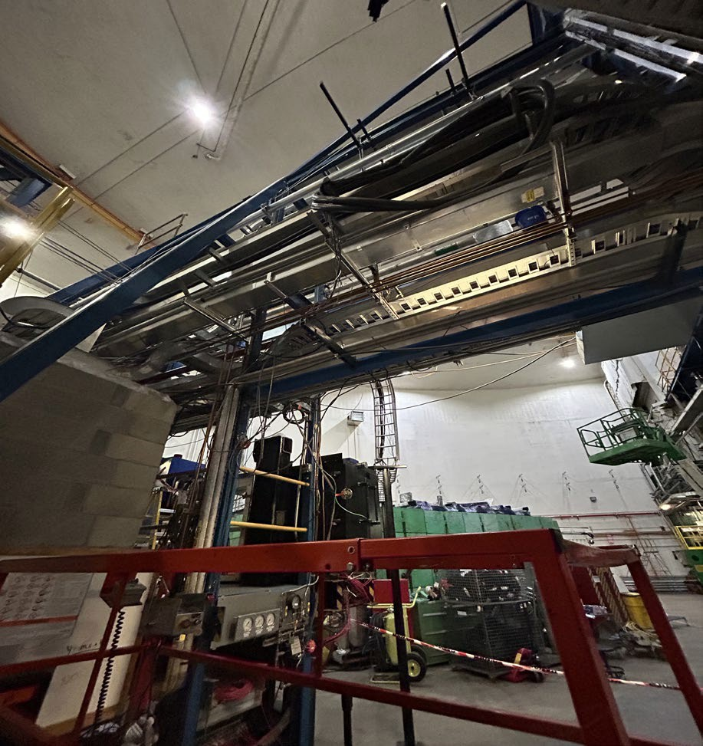
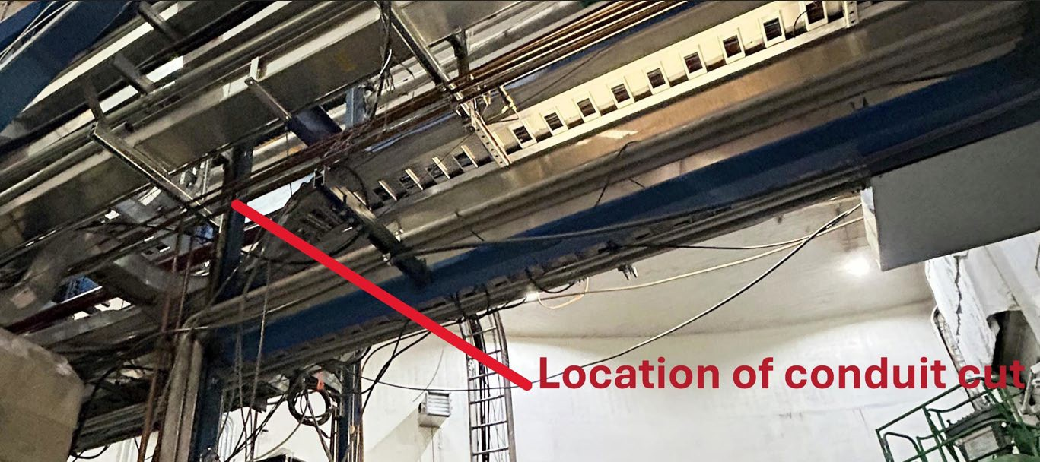
PHY-25-1219: Accidental Cut of Electrical Conduit During Hall A Deinstallation Activities
A Jefferson Lab employee used a pipe cutter to cut into a conduit believed to be empty (subcontractor had removed electrical components from conduit that was to be removed) but accidently cut into conduit containing wiring to energized circuits. The work was immediately paused when the employee observed a 120 VAC spark.
The employee promptly reported the issue and was escorted to the onsite occupational medicine clinic for evaluation. It was determined that the employee was not exposed to any electrical energy and sustained no injuries.
Pertinent Facts:
The work was supported by an ePAS PTW with prior job walkdowns. The planned scope removed electrical hazards before mechanical work (the removal of the decommissioned conduit) commenced.
The task was considered mechanical de-installation rather than electrical work, with earlier work scope focused on removing electrical hazards at the source to allow mechanical technicians to proceed without lockout/tagout.
Previous electrical decommissioning by the subcontractor did not include conduit labeling, and the team acknowledged that marking long runs was not a standard practice. The employee used only visual tracing of the conduit runs from the open electrical boxes.
Apparent Causes:
  WPC did not address conduit identification
  Hazard of cutting into wrong conduit not mitigated
  Loss of visual tracing
NOTE: Likely should have been one job instead of being done by separate teams for the electrical and conduit removal.

Slide 22
CEBAF-26-0608: Potential Improper Application of Plug-and-Cord Exception During Troubleshooting Activities
On the morning of Monday, June 8, 2026, workers performed troubleshooting activities on a plug-and-cord connected equipment (supply) in the Injector Service Building under an approved ePAS work package and Permit to Work. The equipment was disconnected from its power source and the plug-and-cord secured with a clamshell lock prior to troubleshooting.
During an observation of the work activity, the presence of the clamshell device raised questions regarding the applicability of the plug- and-cord exception to Lockout/Tagout (LOTO) requirements, with the immediate concern that multiple workers were involved in the task. A subsequent review determined that workers followed the controls identified in the approved Permit to Work( PTW); which was entered as a plug-and cord, however, the plug-and-cord exception may not have technically applied due to the exclusive-control requirement and the fact there was a 2nd worker present. Once the 2nd worker entered the workspace, they applied their own lock to the clamshell on the cord in an order to control the equipment's cord. This action matched the workers' understanding of how to achieve exclusive control during plug-and-cord work.
The employees were not exposed to uncontrolled hazardous energy, there was not a hazardous energy release, and no injury, near miss, equipment damage, or operational impact resulted from this activity. The fact finding discovered that the issue involved an incorrect procedural interpretation and policy alignment concern rather than a hazardous energy event.
Corrective Actions (in process):
Review and revision to policy and procedures regarding the cord-and-plug exception to electrical LOTO (HEC).
Review and update the ePAS Work Planning and Control application to ensure alignment with current interpretation of LOTO policy.
Develop guidance defining evaluation criteria for non-hazardous stored energy as it pertains to the cord-and-plug exception to LOTO in ESH Manual Chapter 6110.

Slide 23
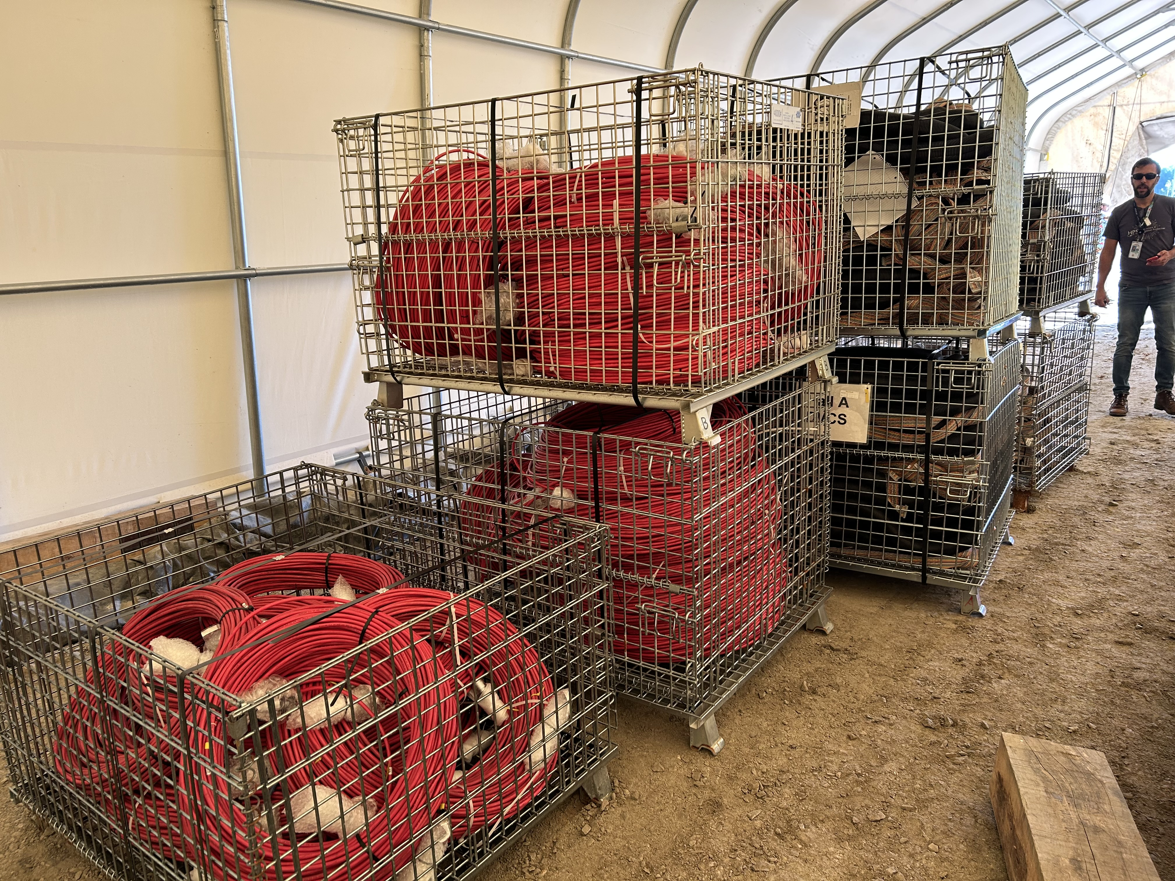
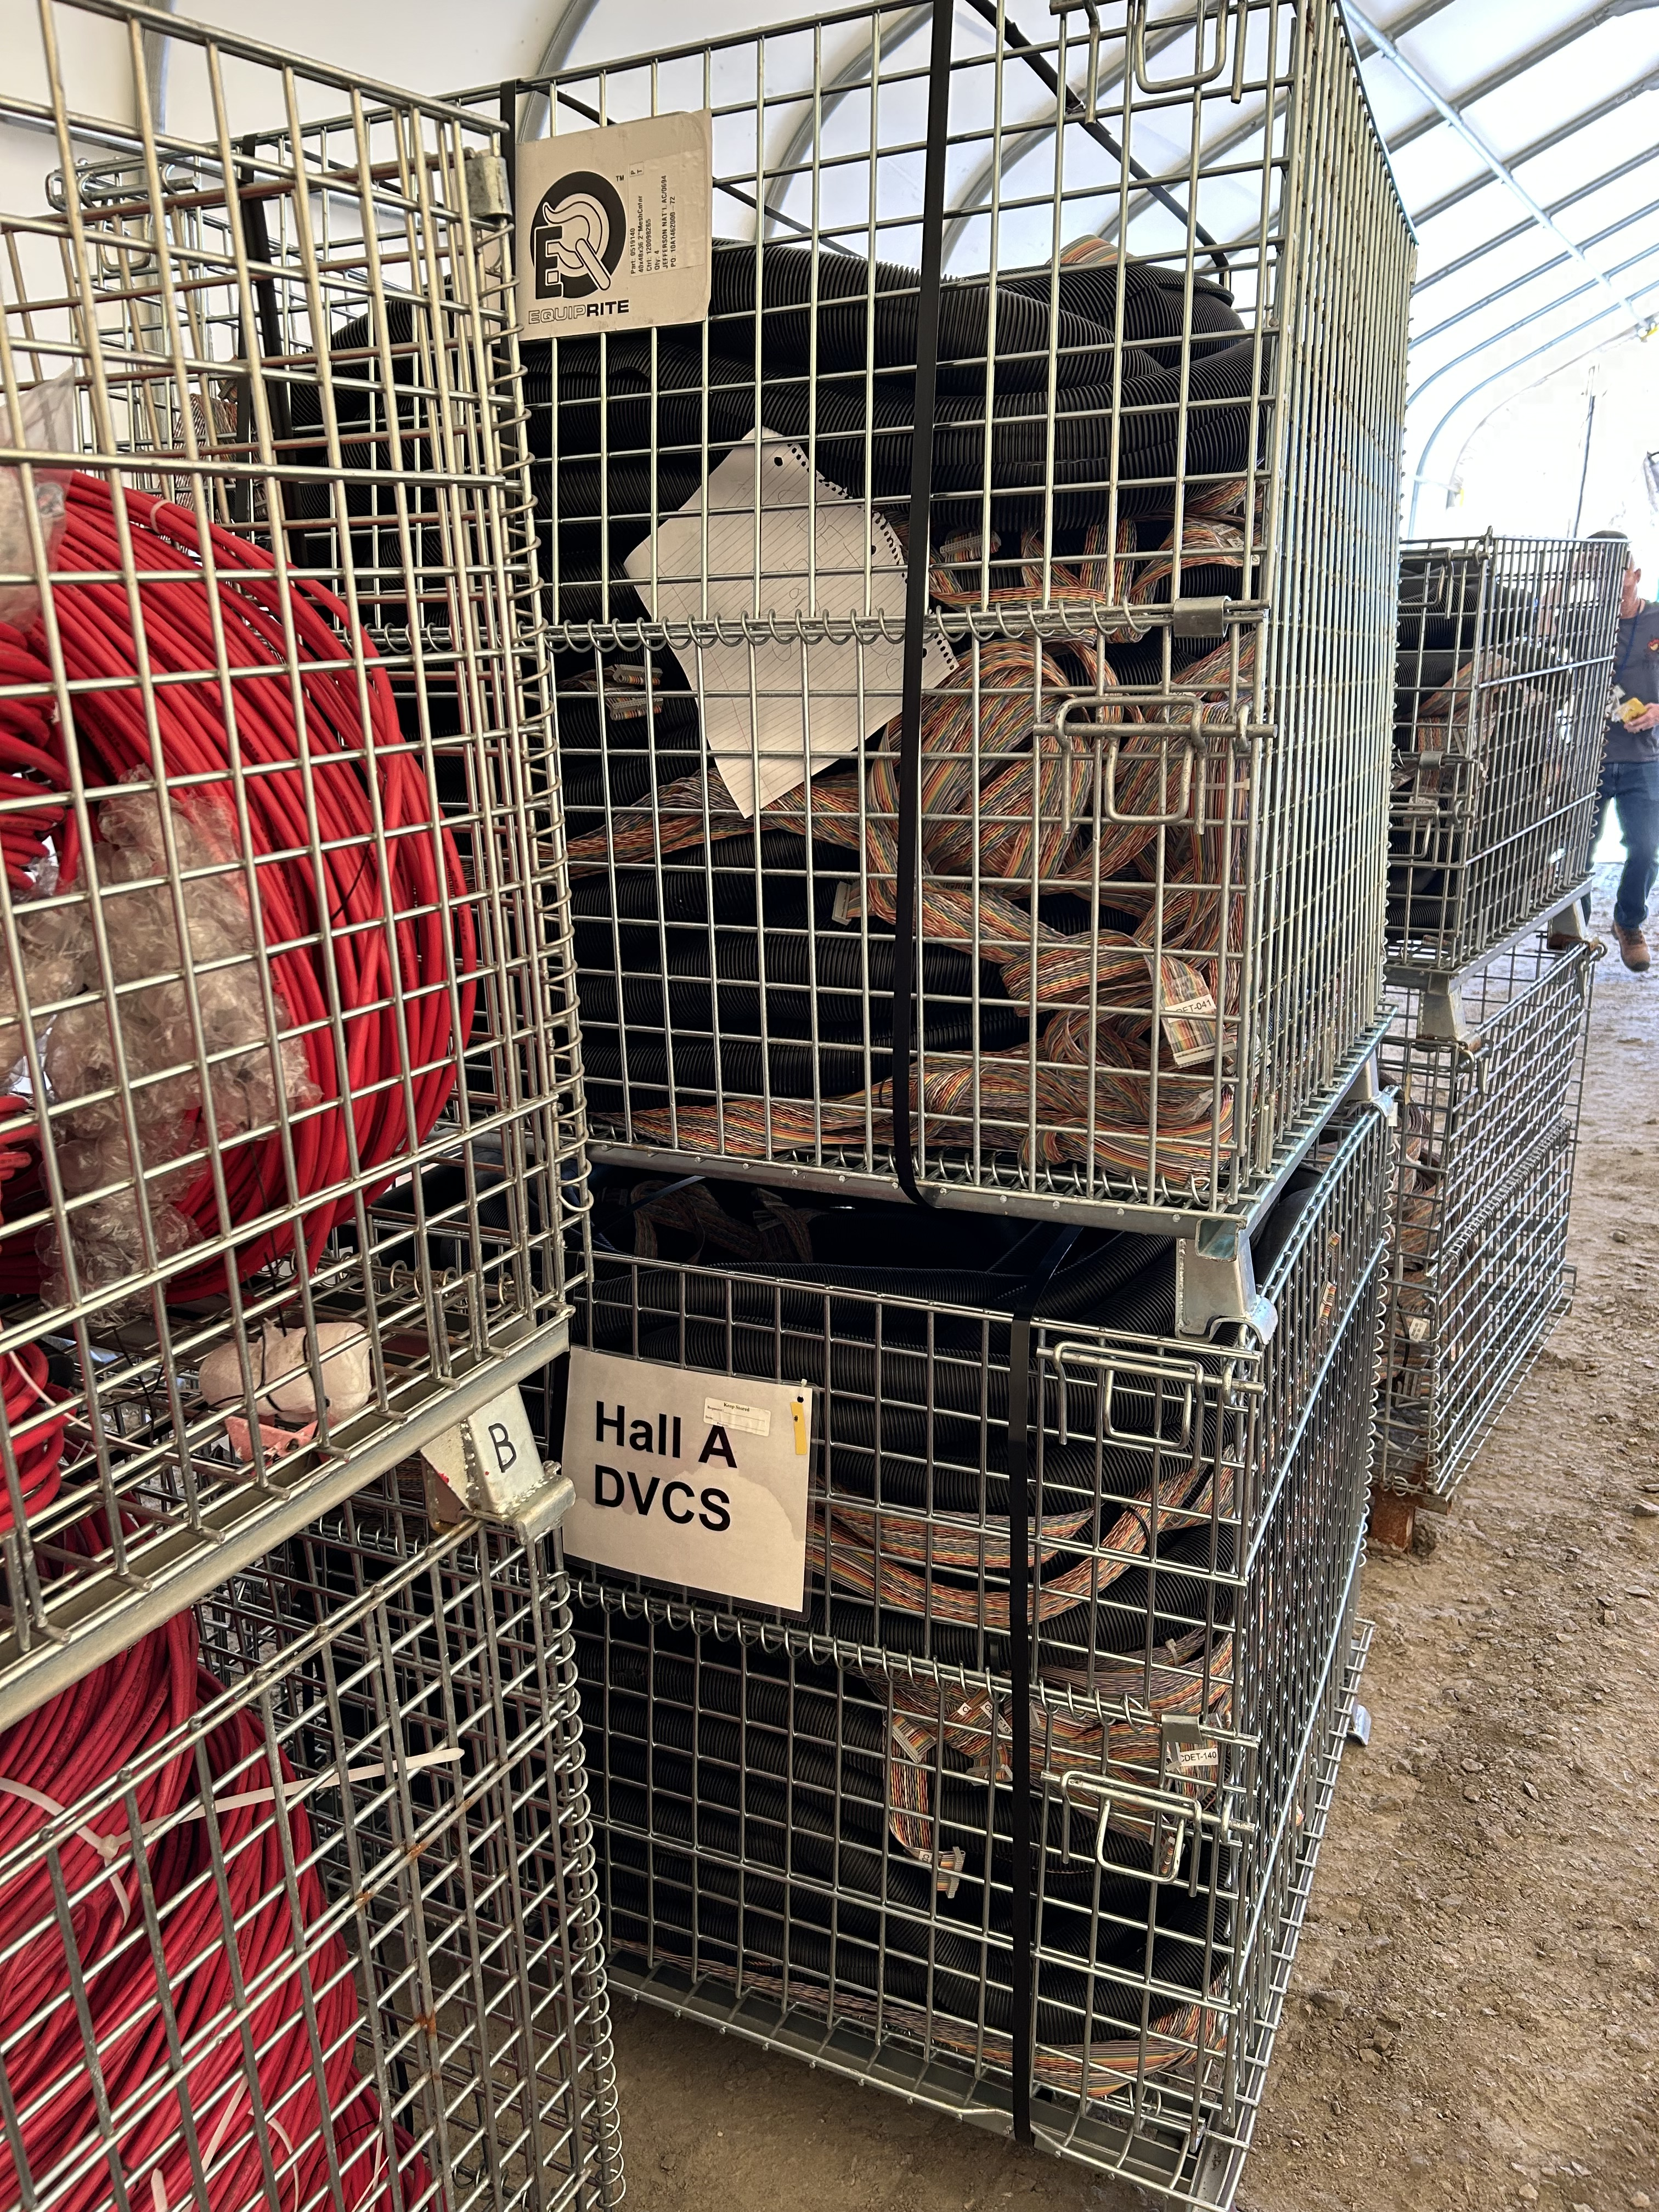
RAM Moved without Survey/Tags
On the afternoon of 8/28, wire baskets containing dismantled cabling were moved by Hall A personnel from Hall A to Tent 4. The radiological survey of the baskets, planned to be performed at the top of the Hall A truck ramp, did not occur. The baskets were loaded onto a truck and taken from Hall A directly to Tent 4 where they were found the next day, without survey tags, by RadCon.
Facts:
Decision to survey the baskets at the top of the truck ramp made earlier that morning in a toolbox/pre-job meeting by the cross-functional participants (Hall A and RadCon).
Work lead for the materials move arrived late to the pre-job meeting - he was coordinating other task discussions with other Hall A personnel.
During the prior 3-days, work lead was involved with the movement of large shielding blocks from Hall A to the Cannon Laydown Yard where they were met by RadCon personnel and surveyed at the destination.
Supervisor knew work lead had arrived late to the pre-job brief, but while observing the loading of the baskets at top of truck ramp, did not inquire whether they had been surveyed.
HP Considerations:
Having missed the details of where the baskets would be surveyed, the work lead assumed they would be surveyed once delivered to the destination.
Perceived Time Pressure / Production Overemphasis.
Failed Barriers: Training, Communications, Supervisor Involvement.
Notes:
Guidelines: 6-8 bullets per slide; Use sentence fragments for bullets
To change the photo: Right-click on photo and select change photo

Slide 24
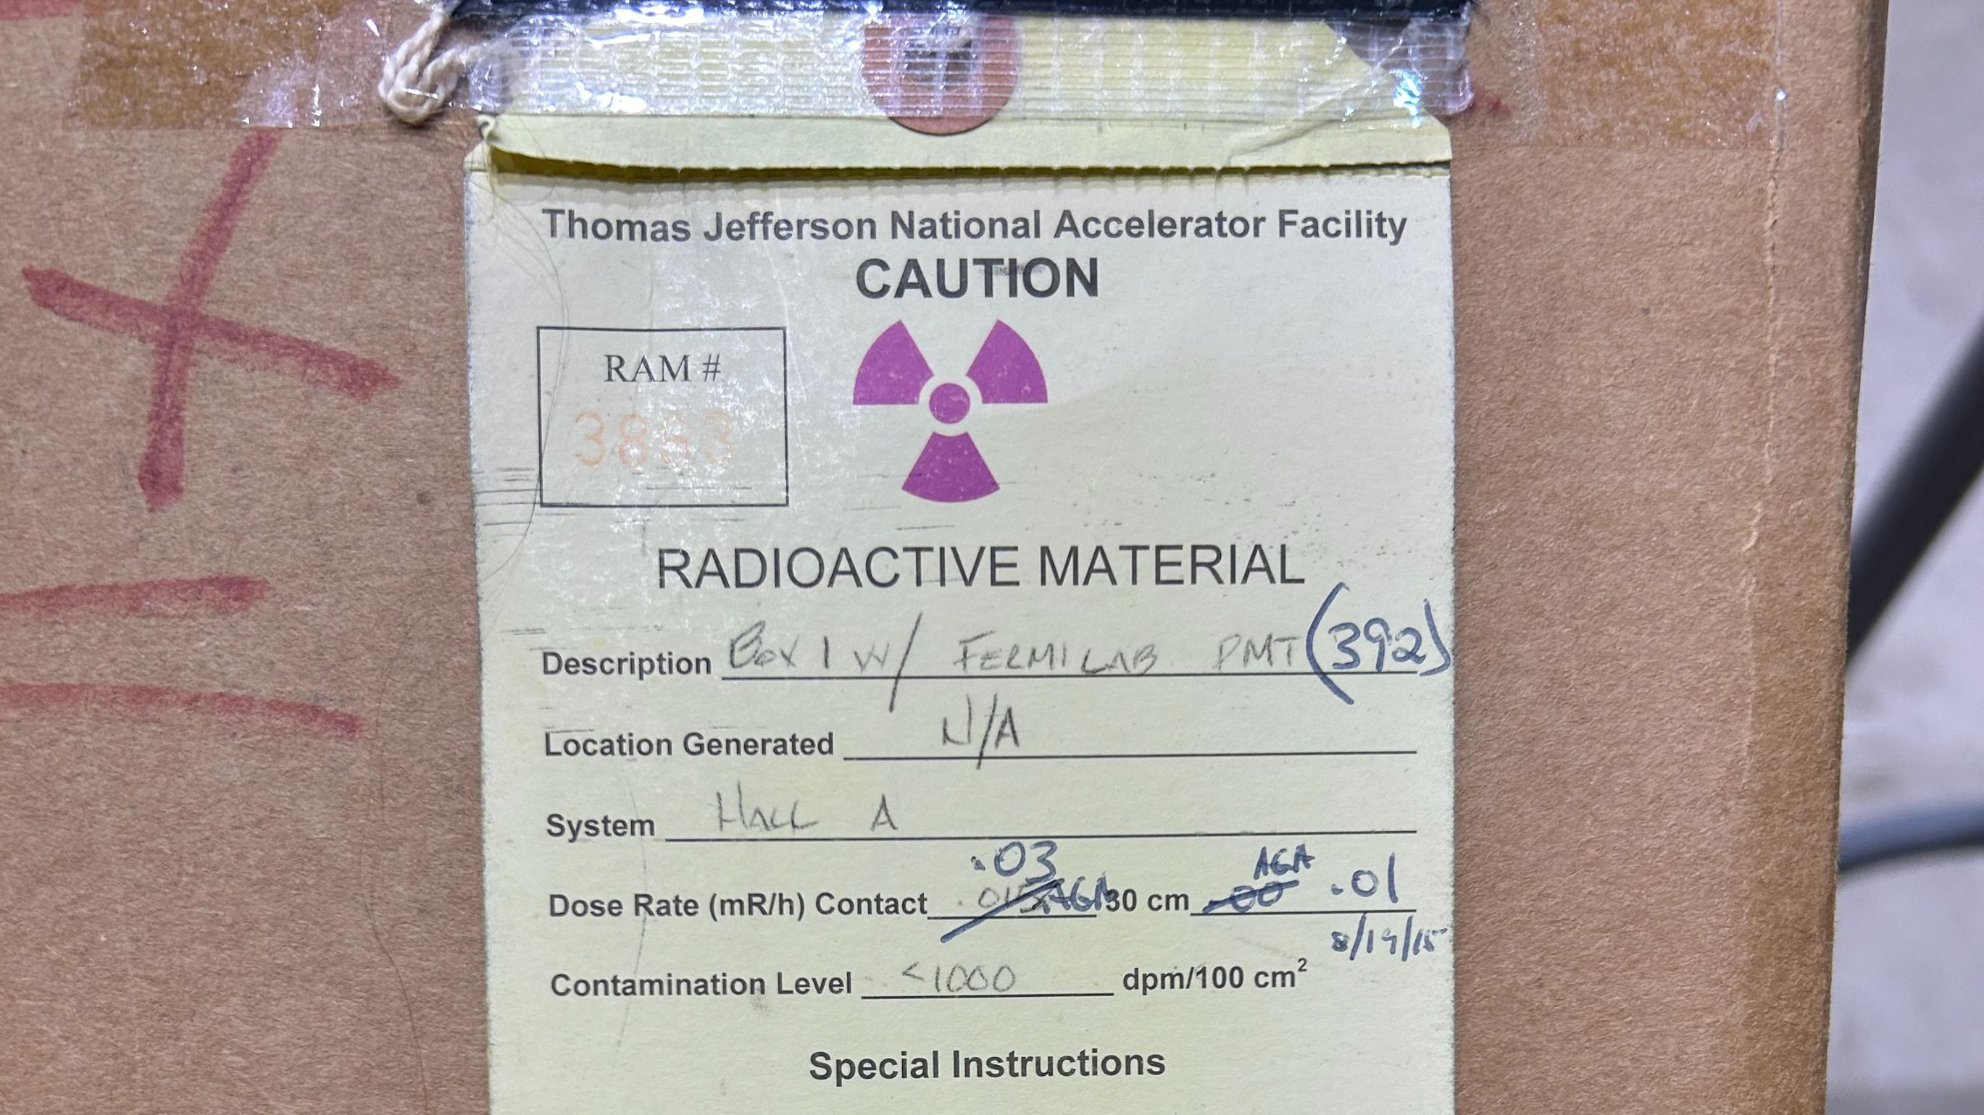
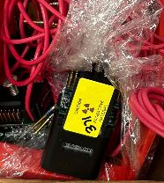
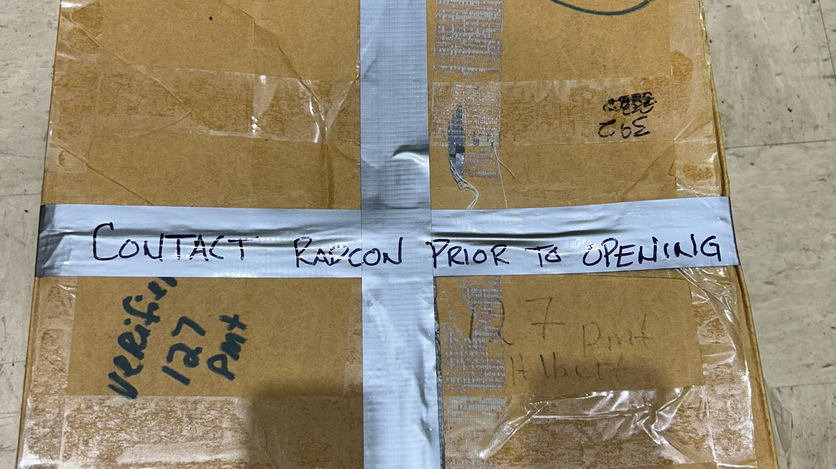
PHYS – RAM Control – Potential RAM placed in Non-Controlled Area
RAM Control – Photomultiplier Tubes (PMTs) marked with RAM stickers and stored in box with RAM Tag were relocated to desk in building 52 and left unattended.
Issue:
The organization's tolerance for unapproved, handwritten labeling to communicate information and instructions to personnel, as well as materials not being stored in a manner for easy visibility, poses potential radiological safety risks and communication barriers. Moreover, the organization does not require boxes to be closed in RAM storage areas.
  Corrective Action:
  Assess the current label and storage requirements within the Radioactive Material Control Procedure, HPP-OPS-014, as well as any corresponding manuals and training materials, to ensure that the labeling and storage of RAM are standardized to be clear, legible, and easily visible. Revise, as necessary.
Issue:
The Shipping Authorization Form used to request the final release survey by RadCon did not include a location field. The absence of this field led to delayed communication of radiological survey requirements, as the RCT had to initially request the location of the items via email.
  Corrective Action:
  Revise the Shipping Authorization Form to include an item location field for enhanced communications for all stakeholders.

Slide 25
ENG – RAM Control – Flushing Solution in Unposted Area
Flushing fluid used to flush power supplies in service buildings was reused within Hall D. Following use in Hall D, the fluid was placed in storage barrel and relocated to an unposted area. The barrel should have been placed in a RAM Storage Area.
Issue:
Due to the repeated routine involving the flushing of “surface-level” systems over the last several weeks, the work crew lost situational awareness and did recognize that the flushing of the Hall D power supply required management of the spent fluid as RAM.
  Corrective Action:
  To the extent feasible, when the Divisions require RadCon SME support beyond inclusion in ePAS review/approval, evaluate a means for these requests to be processed through a database tool, such as use of ServiceNow.
Issue:
The Pre-Job Brief discussion did not include any reminder or call-out that the planned flushing of Hall D would be the first “below surface” flushing of the SAD and would therefore require adherence to RAM protocols for the spent fluid.
  Corrective Action:
  Institutionalize an approach to conducting a QUALITY Pre-Job Brief.

Slide 26
Supervisors: Pause to Review SAM Repeat Issues
We tend to rush the first few days of SAMs, which causes people to prioritize schedule above all else.
Following this meeting, supervisors will be provided with a review packet.
Supervisors, pause with your teams to review issues that we typically face at the start of a SAM:
  Review the packet with your teams and how the lessons learned can apply to your work
  Evaluate scheduled work and ensure it can be accomplished safely in the allotted time
    If the work cannot be accomplished or you have questions/concerns, escalate to your Supervisor and ALD
After supervisors have reviewed with their team, send an email confirming completion of this task to your Director and Associate Lab Director, as applicable, with copy to Steve Smith, Director, Contractor Assurance & Quality (sjsmith@jlab.org)
Once the email has been sent, follow normal processes to begin work.
Complete the team pause NLT 8/31/26.

