Slide 1
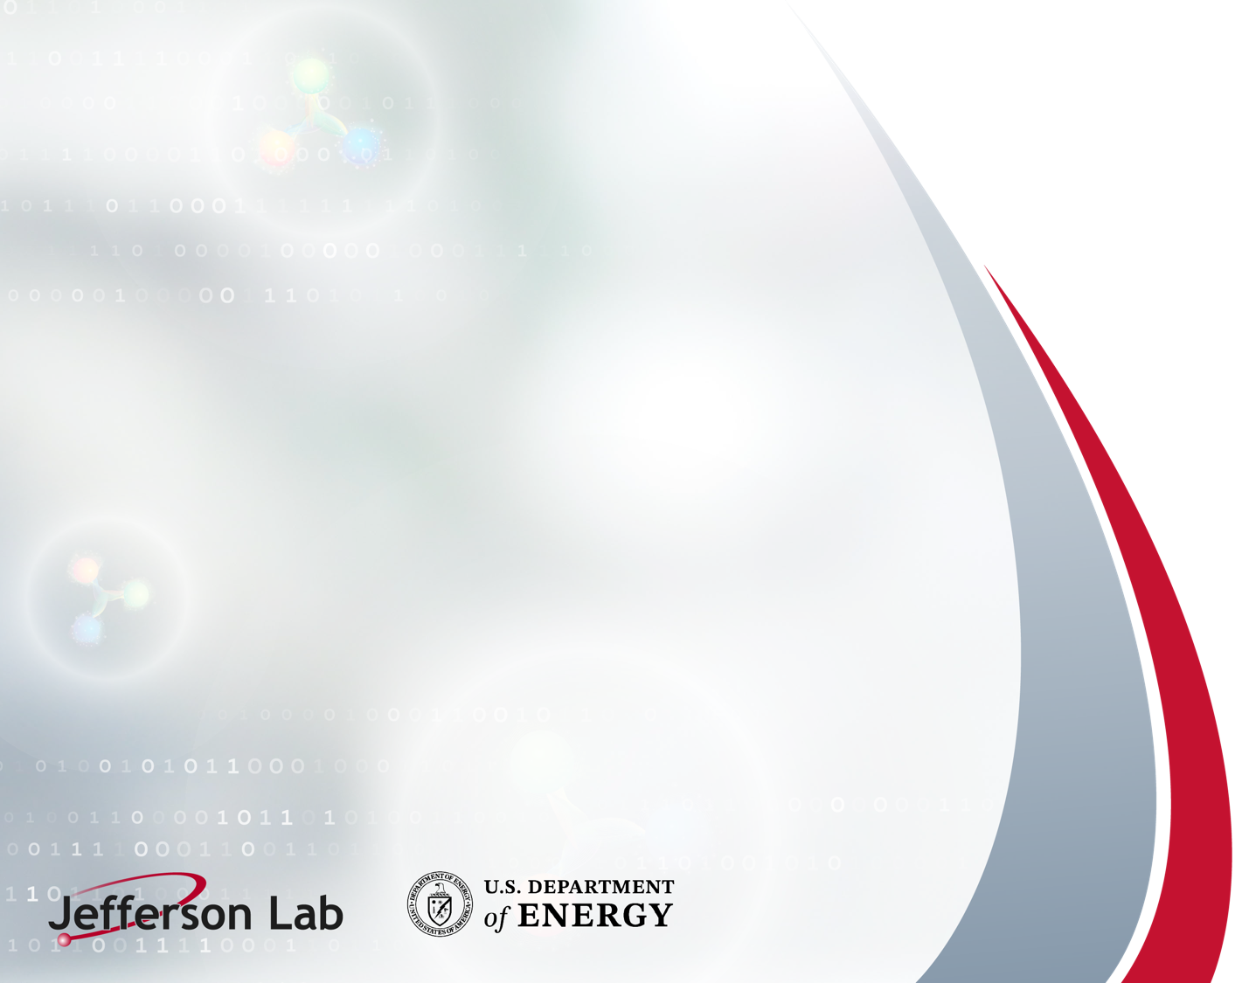
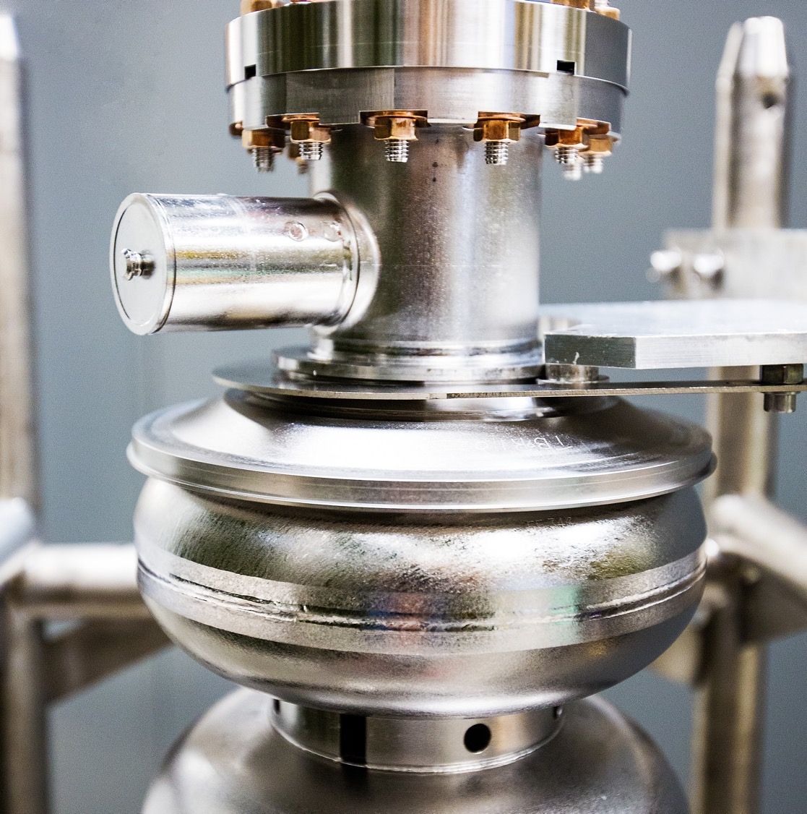
Accomplishments and
Challenges in FY26 Run
Scheduled Accelerator Maintenance
Kick-off Meeting
August 20, 2026
Mike Spata, Acting Division Director
CEBAF Accelerator
Notes:
Tip: Keep titles under 60 characters for readability
To change the photo: Right-click on photo and select change photo

Slide 2
Outline
Run Plan for FY26
FY26 Low Energy Run Performance
FY26 Overall Run Performance
Physics Accomplished
Linac Performance and High Power Running
Challenges:
  MYBBS06 Magnet Overheating Issues
  MZAAS04 Magnet Coil and Vacuum Chamber
  East Arc Magnet Overheating Issues
  Beam Reproducibility During Low Energy Run
  CHL2 Cold Compressor Failure
FY26 Repair Assessment Reports
Summary

Slide 3
Run Plan for FY26
The plan called for 20 weeks of physics with beam to Halls B, C, D at two different linac energies.
Two weeks to restore from the SAM at 345 MeV/linac.
  13 of 25 cryomodules in each linac were brought online for this part of the run.
  Low energy required the removal of in-tunnel magnet shunt resistors for proper system regulation.
Stopped for one week to reconfigure the machine hardware to 1060 MeV/linac.
  Brought all remaining SRF linac systems online.
  Reinstalled all in-tunnel magnet shunt resistors for proper system regulation at top energy.
One week to increase the machine energy to 1060 MeV/linac and complete the tuning.
Despite significant outages that reduced beam delivery to the halls, the FY26 run advanced the physics program and exceeded the 85% overall reliability goal.

Slide 4
FY26 Low Energy Run Performance
The low energy run required 345 MeV/linac, the lowest energy we’ve run since the 4 GeV era.
Three low points for explicit outages are identified on the chart.
A chronic challenge at this low energy was optics reproducibility which required frequent retuning.
Data includes the usage of accumulated accelerator configuration change, tuning, maintenance and beam studies hours to optimize the overall program during periods when unable to deliver Physics.
MYBBS06
Swap-out
RF Issues and
Beam Tuning
West Arc Cooling Tower Leak

Slide 5
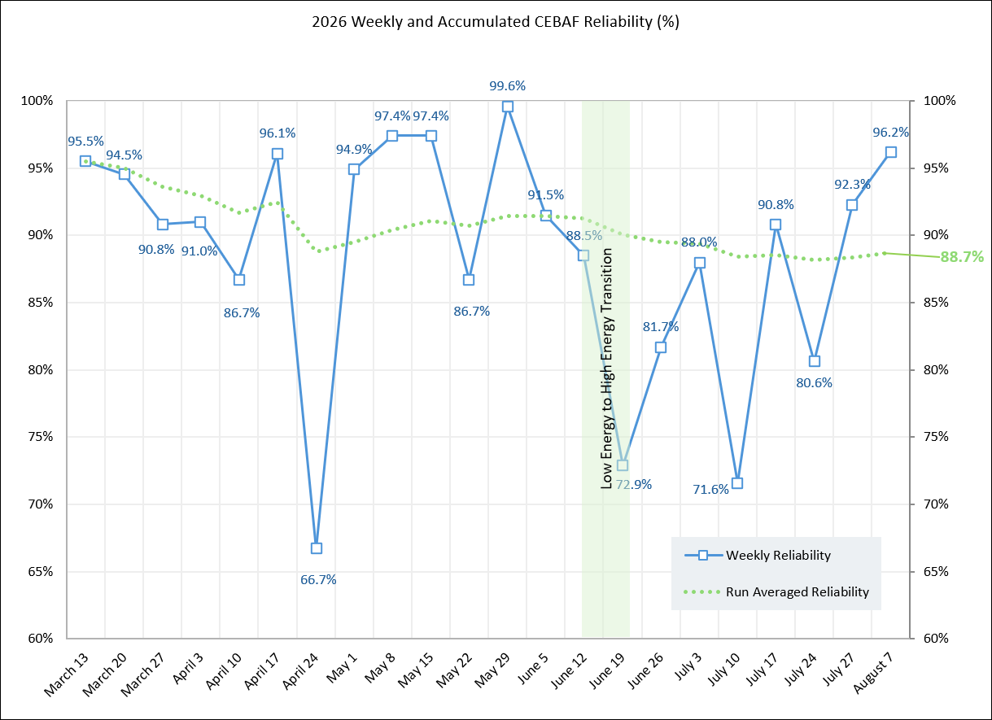
FY26 Overall Run Performance
Transitioned to the high energy run over a two week period. One week to configure the magnet shunt resistors and one week for setting up the higher energy.
Major run outages beyond the transition were dominated by stopping to flush magnets in the East Arc. Unfortunately this tended to limit beam availability to only Hall B on first pass.
Throughout the high energy run the linac performance and optics reproducibility were excellent.

Slide 6
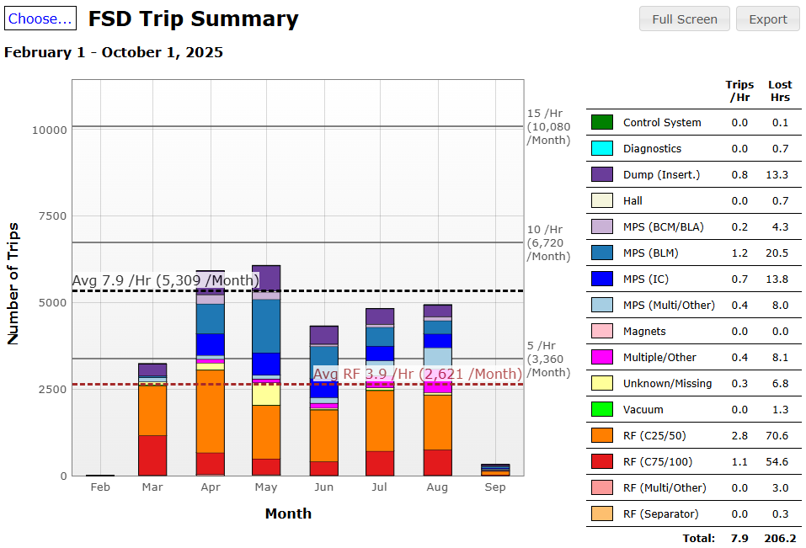
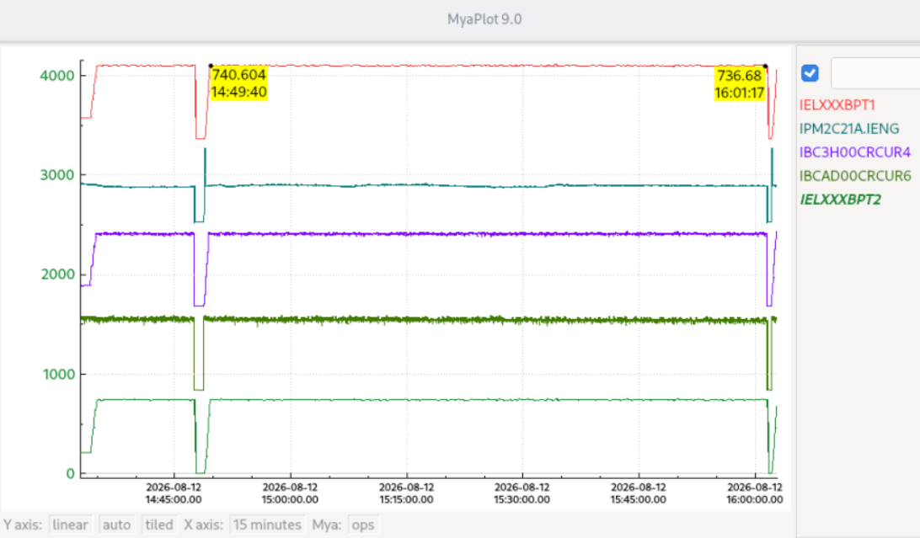
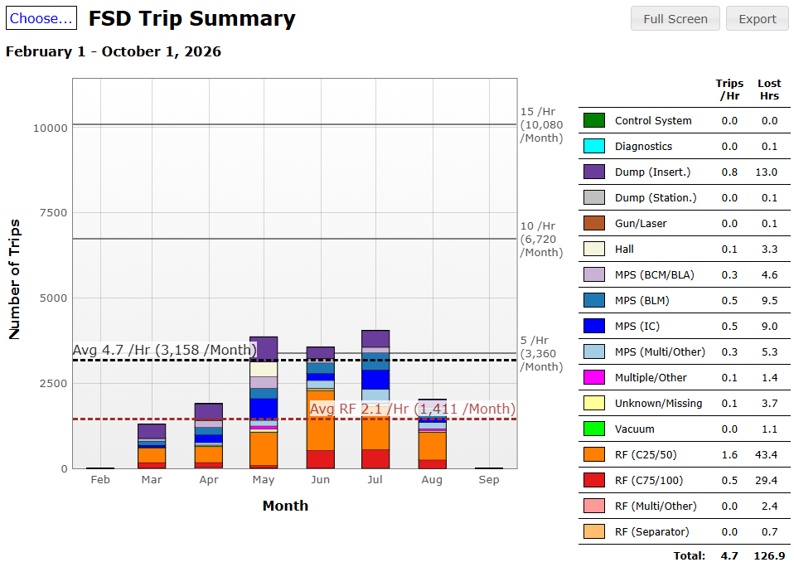
Linac Performance and High Power Running
Fast Shutdown (FSD) short duration trips for the FY25 and FY26 runs show good performance over the run periods.
A few days before the end of the run we achieved an all-time record of one hour and twelve minutes of continuous running at 750 kW.
FY25 Run
FY26 Run

Slide 7
CEBAF Experimental Physics Program Accomplishments
Hall B
E12-20-004: PRad-II (Contact: A. Gasparian (NCSU), D. Dutta (MS), H. Gao (Due), N. Liyanage (UVA), E. Pasyuk(JLab), C. Peng (ANL). W. Xiong (Shandong), and DWH (JLab)). [completed]
E12-21-003: X17 Boson Search: (Contact: A. Gasparian (NCSU), D. Dutta (MS), H. Gao (Due), T. Hague (JLab), N. Liyanage (UVA), R. Paremuzyan(JLab), C. Peng (ANL). W. Xiong (Shandong)) [well underway, continuing next year]
Hall C
E12-22-001: N-> Delta (Contact: N. Sparveris (Temple), H. Atac (Temple), A. Camsonne(JLab), M. Jones(JLab), and M. Paolone (NMS) [ completed ]
E12-23-001: VCS (Contact: N. Sparveris (Temple), H. Atac (Temple), A. Camsonne(JLab), M. Jones(JLab) and M Paolone (NMS)) [ completed scope for FY26 ]
E12-24-001: Nuclear-R SIDIS (Contact: D. Gaskell (JLab), P. Bosted(W&M), W. Brooks (Fed. ST. Maria), R. Ent(JLab), E. Kinney(UC), and H. Mkrtchyan (Yerevan)) [completed]
E12-06-104: Nucleon R SIDIS (Contact: R. Ent(JLab), P. Bosted(W&M), E.Kinny(UC) and H. Mkrtchyan(Yerevan)) [completed ]
E12-06-107: Color Transparency Search (Contact H. Vance(FIU/ODU/JLab), C. Gayoso(W&M), and D. Dutta(MS))
[started, finishing next year]
Hall D
E12-25-005: GlueX with a 1-4 GeV Photon Beam ( contact: M. Dalton(JLab) & F. Afzal (JLab), V. Crude (FSU), P. Hurck (UB), I. Jeagle (ODU), and A. Thiel (UG) ) [ well underway, finishing next year ] NOTE: First low energy Hall D beam.
E12-12-002: GlueX-II (Contact: C. Meyer (CMU) and M. Shepherd (IU)) [200 of 220 days completed, finishing next year]
E12-12-002A: Jefferson Lab Eta Factor (JEF) (Contact: L. Gan (UNCW) & Z. Papandreou, A. Somov(JLab), and S. Tayler(JLab))
[run group experiment with GlueX-II, finishing next year]
Notes:
Fully completed 4 experiments (green) and have six partially completed (yellow). The partially completed will all finish up next year. The item to note is this year was the first time we ran a low energy beam to Hall D.

Slide 8
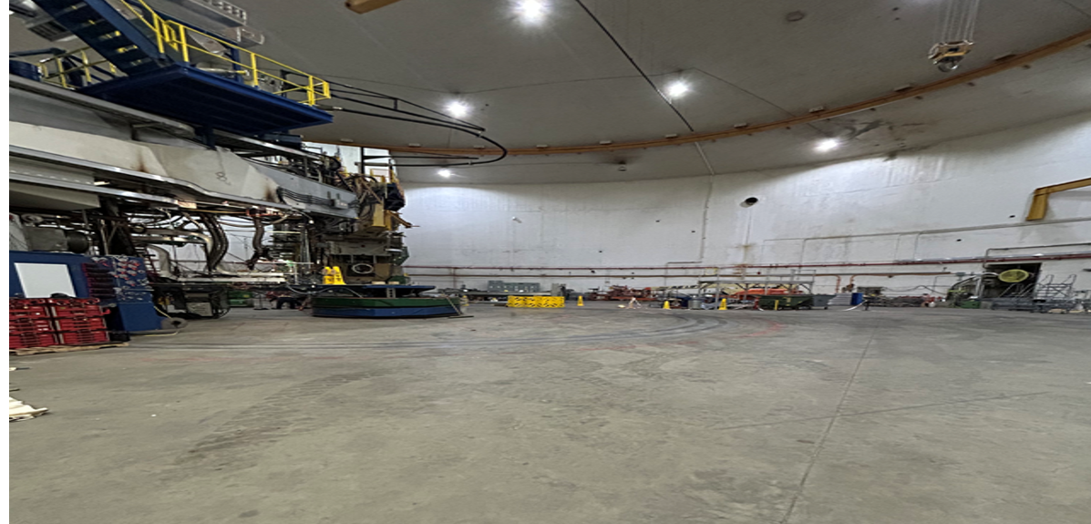
And Hall A has the MOLLER Assembly Now Well Underway
Hall A After SBS Removal in Early 2026
Notes:
Fully completed 4 experiments (green) and have six partially completed (yellow). The partially completed will all finish up next year. The item to note is this year was the first time we ran a low energy beam to Hall D.

Slide 9
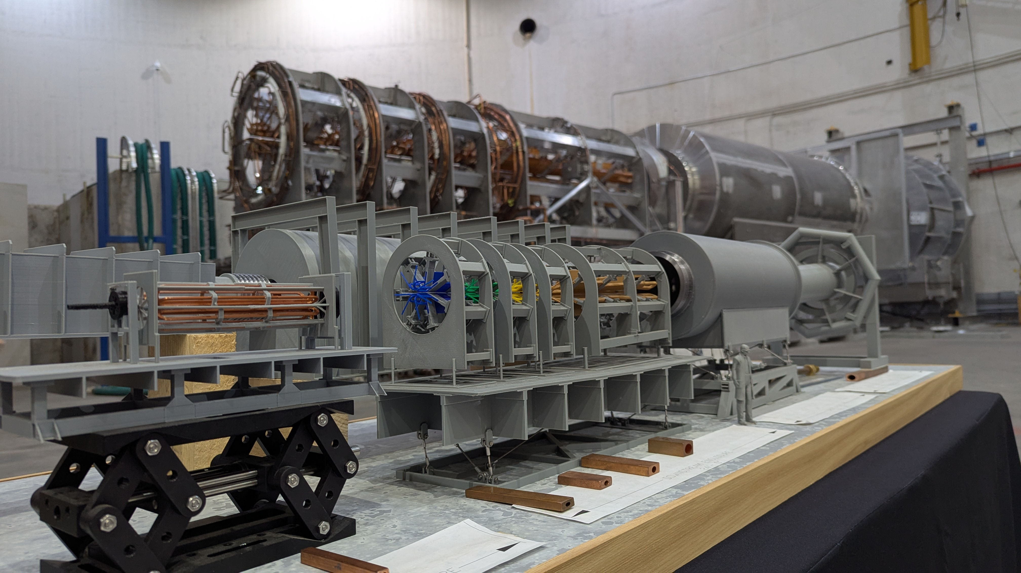
And Hall A has the MOLLER Assembly Now Well Underway
Notes:
Fully completed 4 experiments (green) and have six partially completed (yellow). The partially completed will all finish up next year. The item to note is this year was the first time we ran a low energy beam to Hall D.

Slide 10
MOLLER Preparations
A significant amount of Beam Studies and hardware development in support of MOLLER were accomplished throughout the run.
Getting ready for first beam tests during the latter part of the FY27 run period.

Slide 11
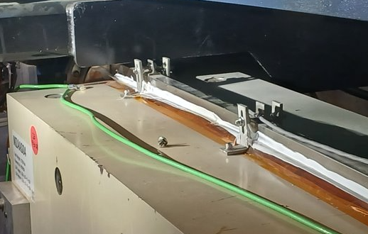
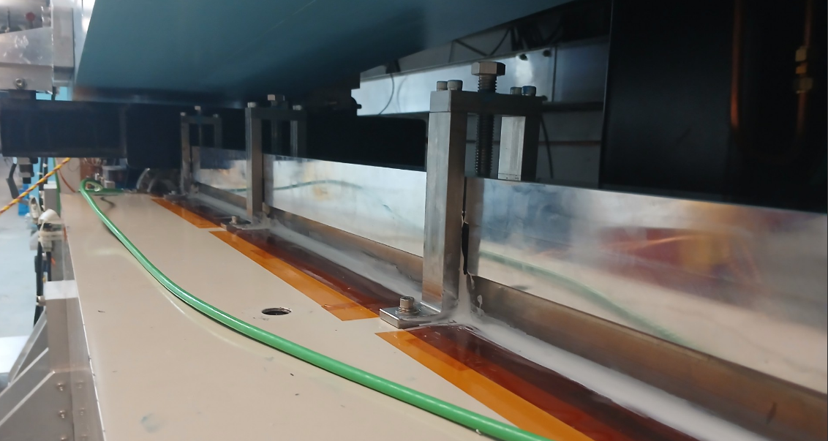
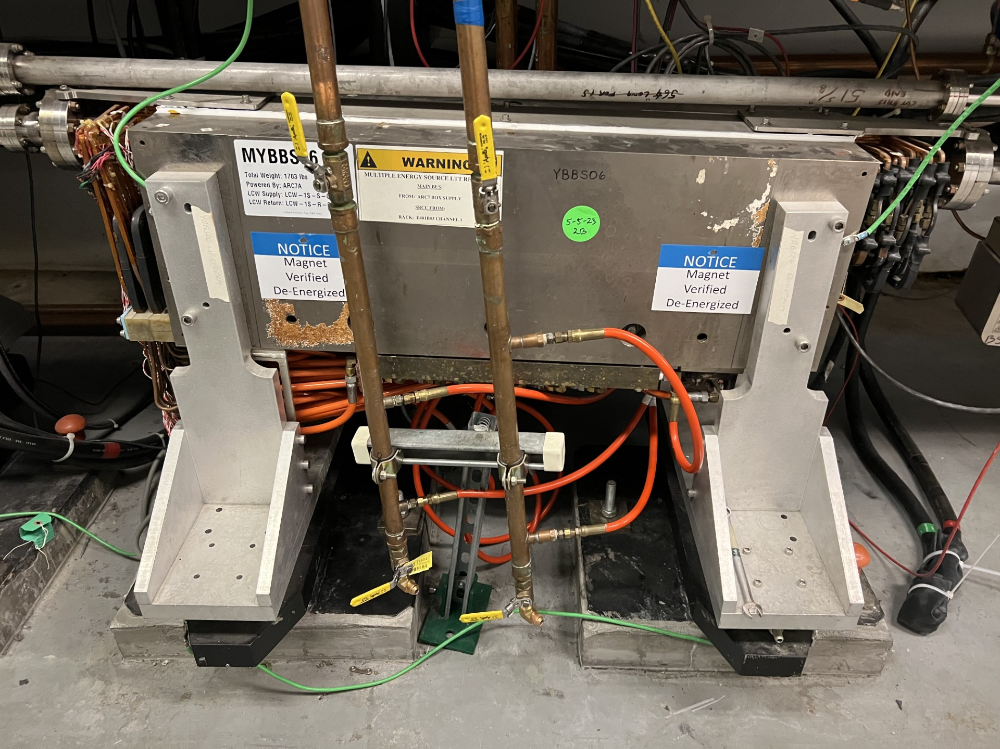
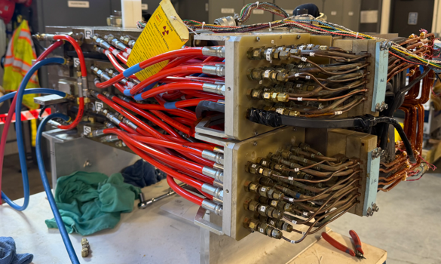
MZAAS04 and MYBBS06 Magnet Issues
Upper coil assembly and vacuum chamber for MZAAS04 failed due magnetic forces straining the retention hardware over many years to failure.
A new design was engineered and installed for this magnet and will be added to similar magnets during the FY27 SAM
MYBBS06 developed water leaks on a single channel that was difficult to repair in the tunnel.
The magnet was removed and rebuilt in the Magnet Measurement Facility with a coil assembly from our Critical Spares inventory.

Slide 12
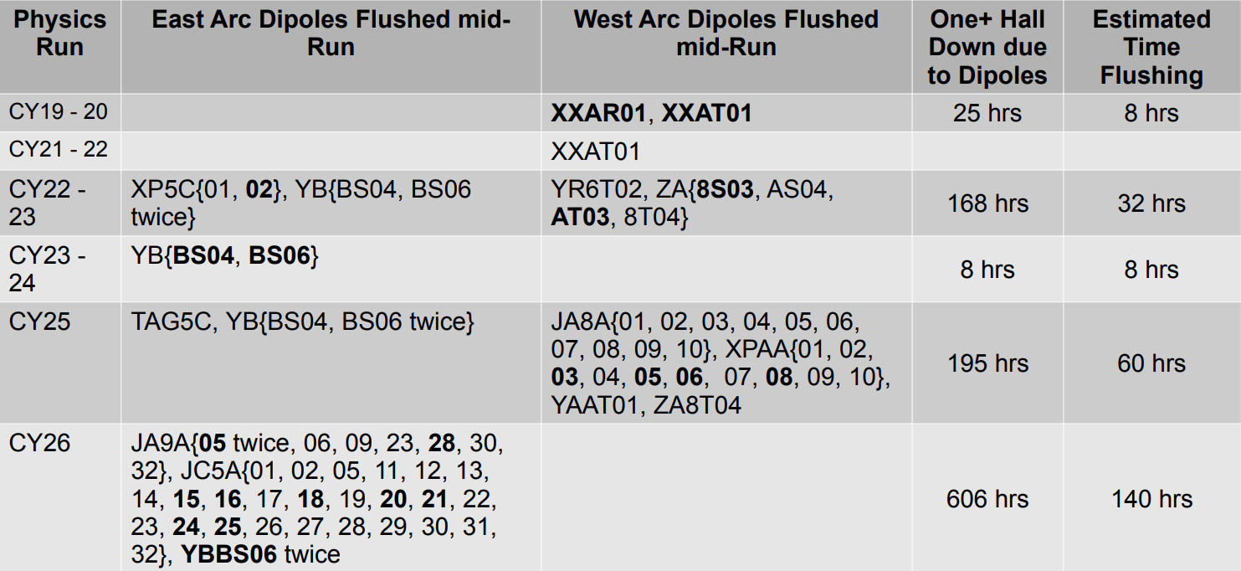
Downtime from Magnet Flushing
The chart shows arc magnet flushing activities over the last seven years.
Early in the FY26 run we experienced LCW overtemperature alarms in MYBBS06 which prevented beam delivery to Hall D.
After the transition to high energy we began to have overtemperature faults in ARC5 and later in ARC9. These outages degraded the full CEBAF program only allowing lower pass beams for the halls.

Slide 13
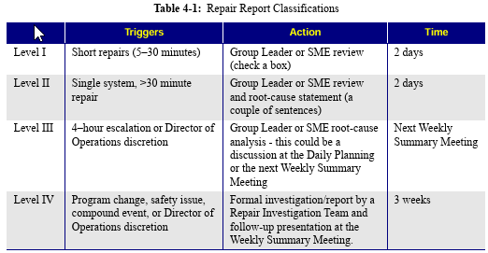
Repair Assessment Reports during the FY26 Run
Levels I & II: Require a simple action or explanation in the Downtime Manager.
Level III: Discussed at the next day's Daily Planning meeting, sometimes requiring a written statement and weekly follow-up.
Level IV: Investigated thoroughly by a dedicated team appointed by the Director of Accelerator Operations, resulting in a formal Repair Assessment Report.
Active FY26 Reports
Cooling Tower Water Leak (opened April 30, report by June 14, delayed until August 24)
Hall B Bleedthrough (opened July 6, report by September 15)
1L12-5 Waveguide Pressure Loss (opened July 29, report by August 21)
Trim Rack W202B13 (opened July 29, report by August 21)
Water-cooled magnets (opened June 14, draft by September 1, final by November 1)
CHL2 Cold Compressor Failure (opened August 19, final by September 30)

Slide 14
Summary
Executed a 20-week physics plan split between a 345 MeV/linac low-energy run and a 1060 MeV/linac high-energy run, targeting 85% overall reliability.
Successfully completed multiple planned experiments across Halls B and C, conducted the first low-energy Hall D beam run, and made significant progress on MOLLER assembly in Hall A and supporting Beam Studies during the run.
Overcame low-energy optics reproducibility issues, a structural MZAAS04 magnet failure, cooling channel issues with MYBBS06, a CHL2 Cold Compressor issue, and 140 hours of mid-run dipole flushing required to resolve magnet LCW overtemperature faults.
Nonetheless, we exceeded targets by achieving 91.0% reliability during the low-energy run and maintaining an 88.7% overall accumulated reliability through the end of the run.

