Slide 1
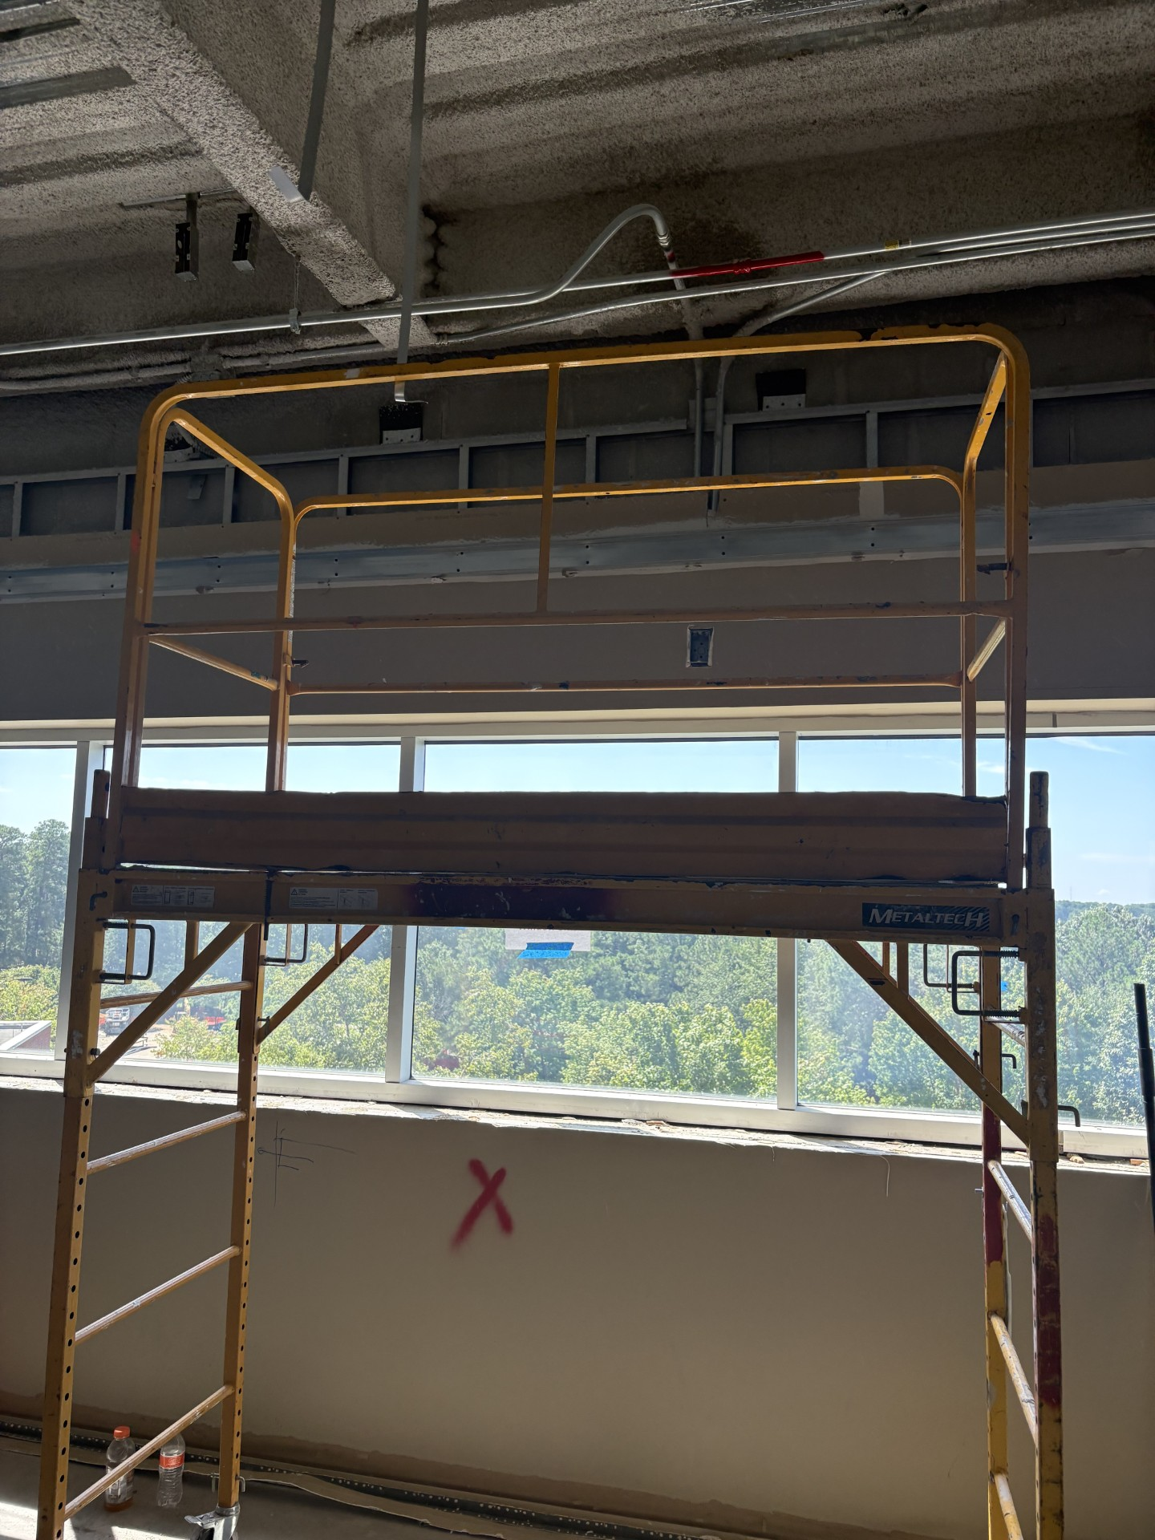
Subcontractor injury from fall at the ARC
Incident Summary:
On 17 August, while installing a ceiling track for a partition wall, a worker tipped the baker scaffold, which had a platform height of approximately 67 inches, and fell to the floor.
Work in the immediate area was paused, 911 was called, and the incident was formally reported.
The worker sustained a fractured knee and a minor laceration to the head. He remained awake and conscious and was transported by ambulance to Riverside Hospital, where he was admitted overnight. Surgery to repair the right knee was scheduled for the following day.
Facts we know:
  The subcontractor’s foreman provided a pre-job briefing to ensure the worker understood the applicable work requirements and hazards.
  An Activity Hazard Analysis (AHA) was reviewed and signed by the employee
  The employee was wearing required PPE
  The daily inspection of the baker scaffold completed by the competent person
  Post inspection of the scaffold found it to be functioning per specification
An investigation is underway to understand how the scaffolding tipped.
A causal analysis will be performed and corrective actions developed.
Extent of Condition
Use of baker scaffolding at the ARC remains paused pending completion of the investigation and staff retraining.

