Slide 1
AIP and Large Projects
Arne Freyberger
OPS 2015 StayTreat

Slide 2
Accelerator Improvement Projects
Accelerator Improvement Projects (AIP):
Large greater than $500k projects
Can span multiple years
Assigned a special B&R code, but more or less funded by moving funds from Accel OPS B&R into AIP account.
Tracked at a high level (DOE), included in the annual budget briefing and S&T reviews.
Must be an improvement, not maintenance.
C50 program is not an AIP project.
High power dump maintenance is not an AIP project.

Slide 3
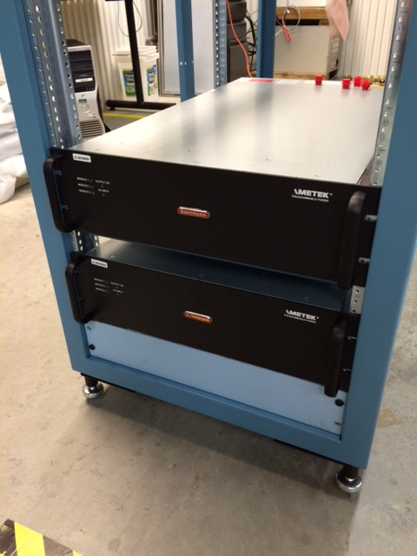
AIP FY13-FY15
AIP work completed FY15
Dogleg Upgrade -- Restores CEBAF path length adjustment to pre-12GeV upgrade range. FY13-FY15
AIP work completed FY14
Injector Upgrade (R100) – Install, commission and operate R100, 100MeV capable cryomodule, effectively doubling the Injector energy gain for compatibility with 12GeV CEBAF.
AIP work completed FY13
Injector Upgrade (Gun portion) – Install 200keV capable DC gun, operate for physics at 130keV FY12-FY13

Slide 4
AIP
 | FY14 | FY15 | FY16 | FY17 | FY18 | FY19 | FY20 | FY21
Dogleg Upgrade | 925 | 639
Full Energy Injector – 1/4 Cryomodule | 375 | 540 | 444
Full Energy Injector – Integration |  |  | 759 | 877 | 645 | 127
C50 RF Power & Controls |  |  |  | 350 | 607 | 725 | 733 | 796
Global Timing System |  |  |  |  |  | 225 | 280 | 283
6D Beam Diagnostics |  |  |  |  |  | 200 | 250 | 250
AIP work planned for FY15 – FY19
Injector Upgrade – Upgrade the CEBAF Injector for 12GeV parity program.
Build ¼ Cryomodule – Establish uncoupled transport in the injector. FY11-FY16
Integration – Commission the new ¼ cryomodule in the Upgrade Injector Test Facility (UITF). Upgrade CEBAF Injector components in the warm RF region to support 200keV operation.
Install the commissioned new ¼ cryomodule. Commission the complete upgraded injector, from the 200keV gun operation through the new ¼ cryomodule and R100. FY15-FY19

Slide 5
The goals of the CEBAF Injector upgrade
Increase the injector final energy from 45 MeV to 123 MeV by upgrading the Cryomodules
To achieve the 12 GeV injector energy requirement
Increase Gun Voltage from 100 keV to 200 keV
Lowers the space charge effect to achieve higher beam current in the early injector
New Cryounit with new SRF design
Eliminates the x/y coupling and improves and simplifies the Parity Quality beam setup.
5 MeV Dump
Synchrotron Light Monitor
Chopper
Cryounit
Cryomodules
Buncher
Capture
Gun#2
Bunchlength
Injection Chicane
PCup
FC#1
Cavity
FC#2
Prebuncher
Apertures
Wien Filter
Gun#3
500 keV Dump
45 MeV Dump/Spectrometer
Add a second 90 deg Wien Filter
Enables 180 deg electron spin flip as required by Parity Quality experiments
Integrate Capture into the Cryounit
Simplifies the acceleration process and lowers the RF power.

Slide 6
The New Booster

Slide 7
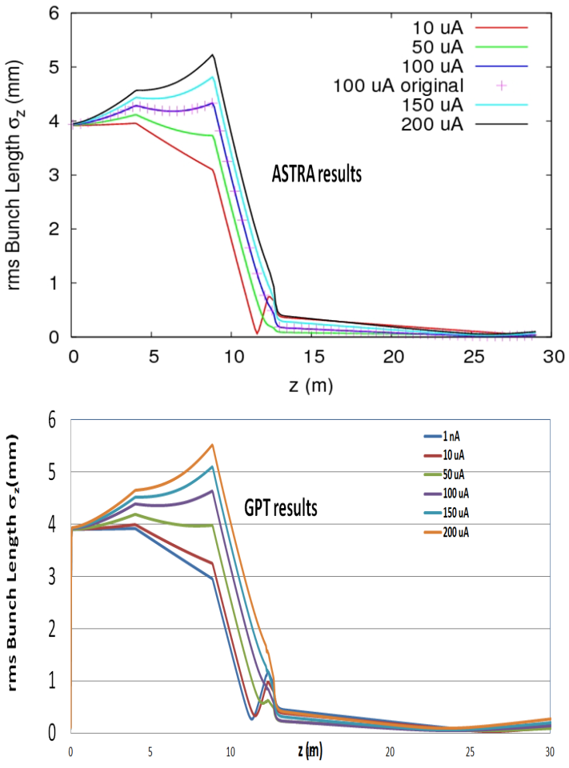
Results – checked with two codes
Bunch length for different currents. This accelerator has to work for both low and high beam currents at the same time!
The currents are for 499Mhz CW beam structure.

Slide 8
Injector Upgrade
New ¼ cryomodule will be ready for initial testing in FY16
Commission at the UITF
Cavities complete
Cryomodule design nearly complete, procurements started.
Need a upgrade team and project leader/manager to manage the many aspects of this upgrade:
Gun 200kV operation
Upgrade warm RF section for 200keV transport
Commissioning new ¼ cryomodule in UITF (FY16/FY17)
CEBAF installation and commissioning FY18 and FY 19

Slide 9
AIP Beyond Injector Upgrade
C50 RF Controls upgrade:
Digital upgrade of the C50 zones, probably about one per year.
AIP Funding starts in FY17.
Use RSR funds to start preliminary design and cost estimates in FY16.
Global Timing System:
Epics synchronous timing system
AIP funding projected to start in FY19
While waiting for AIP funding, small team should start working on the requirements.
Some aspects of this project may already be in progress

Slide 10
Large non-AIP projects
C50 refurbishment
Hall-C dump maintenance

Slide 11
Summary
Need to attach names/teams to the long term AIP projects.
Empowered to work through funding shortfalls.
Maintain project momentum
Project list subject to change
C75 project…..

Slide 12
Stop

Slide 13
Simulation and Optimization
Different designs for the SC Booster was studied. The best results were found with 2+7 quarter design.
Pre-Buncher Cavity
Chopper
SC Booster Cavity
Old
DC Gun
Solenoid
Aperture
Buncher
Cavity
Capture Cavity
New
INJECTOR LAYOUT

Slide 14
A set point
Energy spread gets large with decreasing current. A result of the over bunching before entering the 2 cell in the unit.
Yellow- Red – Magenta – Green - Blue
1 - 10 - 50 – 100 – 200uA

Slide 15
Sensitivity
Limits:
Set points chosen randomly +/-2% around the nominal condition.
Phase in unit +/- 5%
Range:
Bunch length and transverse emittance still within budget
Energy spread and mean energy also reasonable

