Slide 1
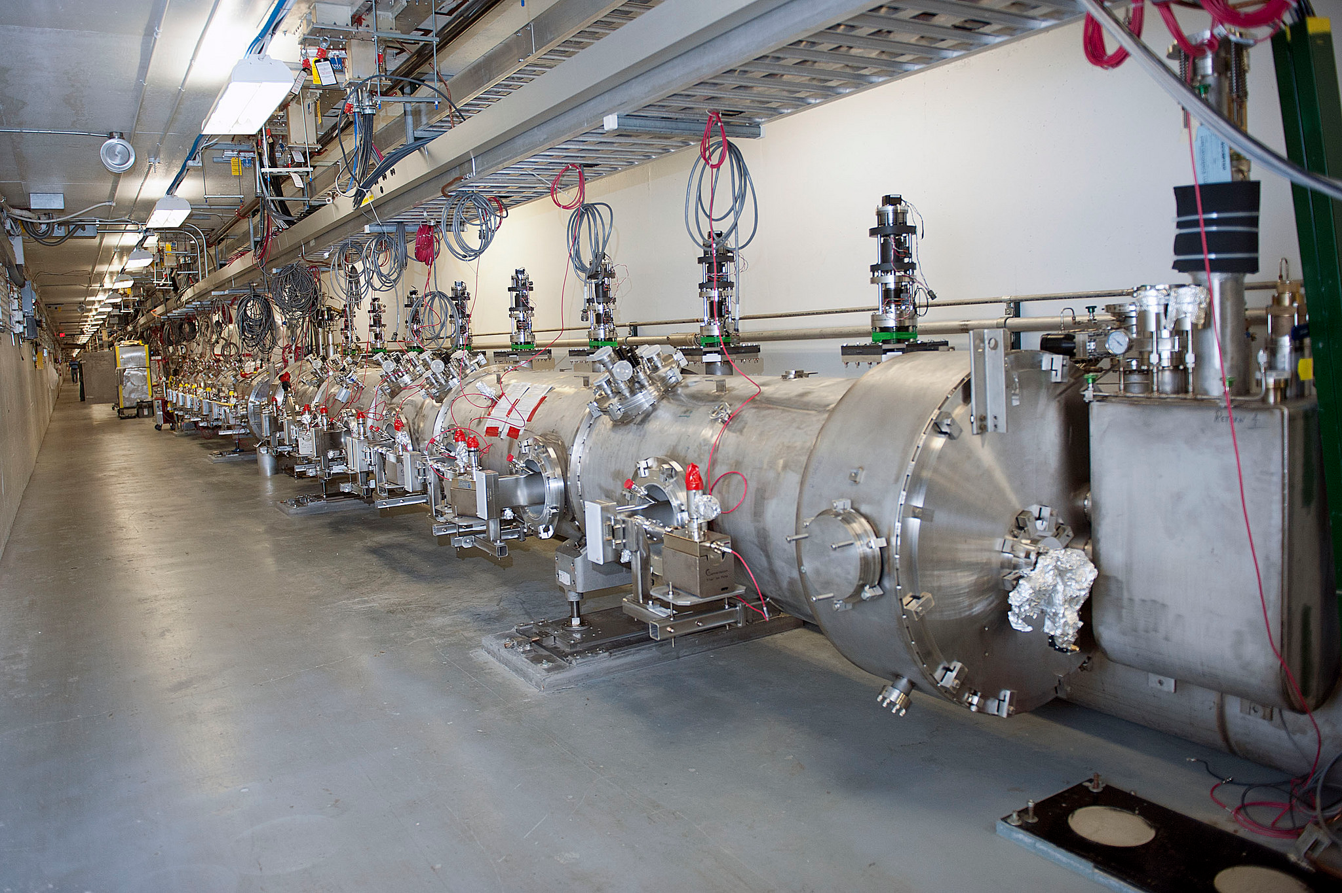
12 GeV CEBAF

Slide 2
Model Development
Not just an interesting exercise:
Must be able to explain observed machine behavior and predict new behavior
Part of this involves designing “ad-hoc” solutions to optics problems as we encounter them (i.e extraction redesign)
Also, focused on achieving certain beam parameters for the needs of the users (PQB team)

Slide 3
Overview
Revisiting Extraction
Magnet Field Quality
Synchrotron radiation effects on upper pass steering
Linac Focusing
Longitudinal phase space tracking
Spin tracking
Hall A raster pattern
Hall A 5T moller target
Future Plans

Slide 4
Revisiting Extraction
Initial commissioning of separators showed they lacked the power to fully extract the beam
Revisited the optics to use the E01,E02 and E03 quadrupoles to compensate for the lesser RF kick.
Successfully tested and utilized to run the beam. The observed position was as predicted.

Slide 5
Revisiting Extraction(cont)
For the 12GeV project, developed an analytical model to calculate the extraction parameters,
Notes:
Can be readily used to modify the extraction for particular cases. This allowed us to be flexible when the need arose. Fast turn around.
Used initially to iterate with ME. Now can be used to do quick changes.

Slide 6
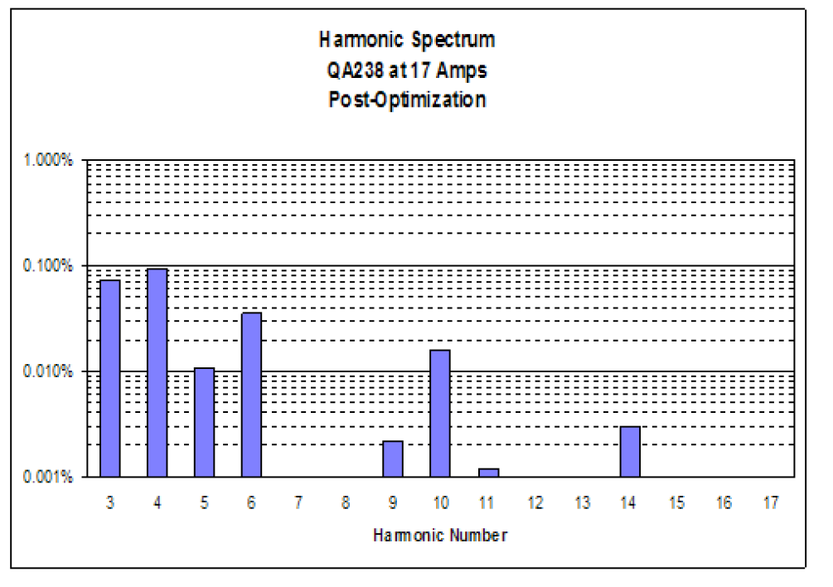
Quadrupoles and dipoles Field quality
Dipoles were converted
From C to H style
Notes:
Typical values for dipoles. We have integrated the body gradient into the model. It is born out by the machine.

Slide 7
Magnet field quality (cont)
We have the measured quadrupole terms for the dipoles in the model. Beam based measurements confirmed they are correct.
It is possible to analyze the data for the sextupole term. Currently in progress.
Comparison with TOSCA calculations (from J. Benesch) in progress.

Slide 8
Linac Focusing
Effect of gradient distribution in linac
Tool developped by D. Turner to load in grad. Distribution in ELEGANT.
Effects are small unless one is at low gain per linac
Effect of cavity Focusing in linac
Just affects the first two quadrupoles in LINAC. Not adjusting them produces a beta beat of a few percents at most.
Effect of gradient calibration in linac
Because of “fudging process”, its has a negligeable effect even with 5% uncertainty.

Slide 9
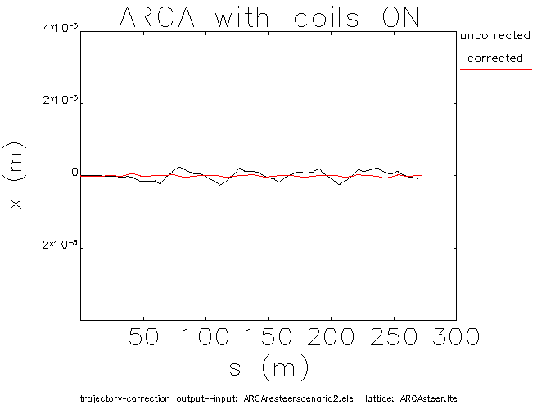
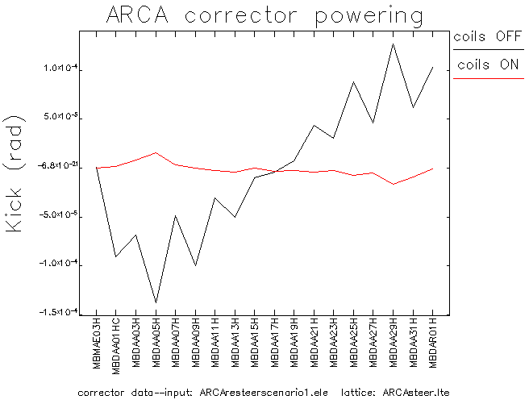
Effect of synchrotron radiation on upper pass steering
Notes:
Will see this fall if we observe that…

Slide 10
Longitudinal Optics
Parity Experiments require tight beam quality.
Longitudinal match of the machine now a concern.
Optimized with LiTrack for fast turnaround
Final tracking in ELEGANT confirms the results.
Initial results suggest installing sextupoles in injector chicane and running off crest in linacs if we keep the non-zero M56 arcs.

Slide 11
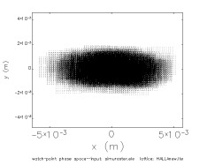
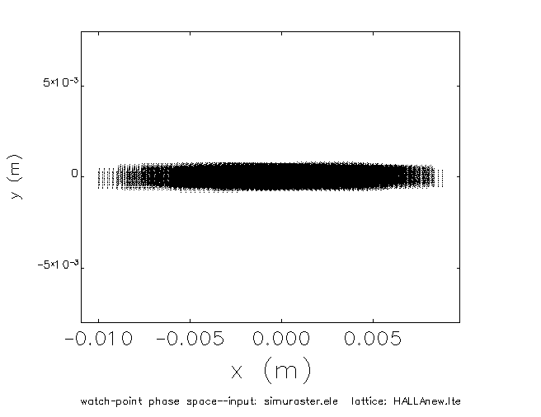
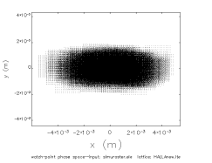
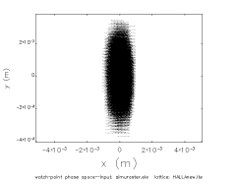
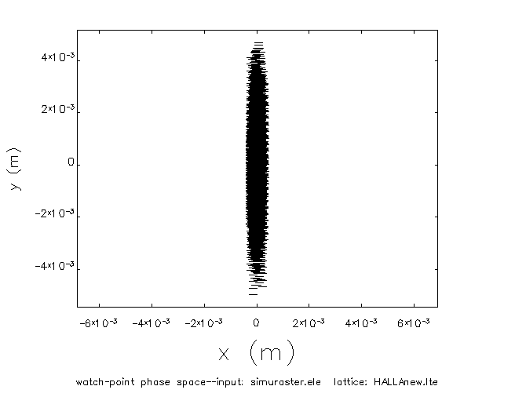
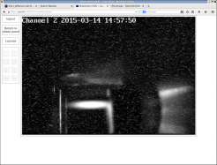
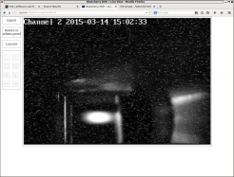
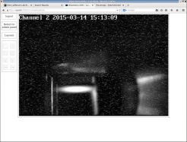
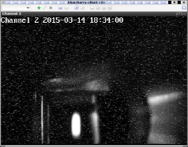
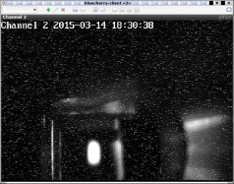
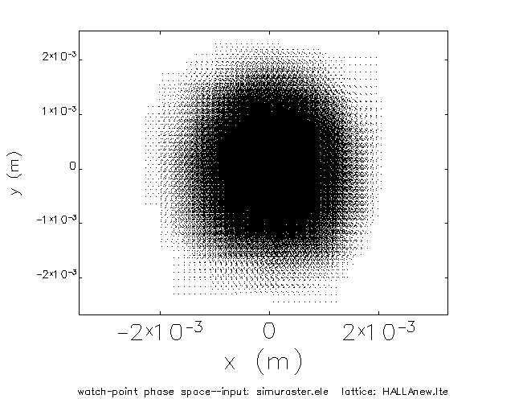
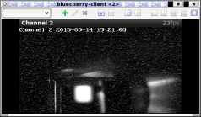
Hall A Raster pattern problem
Model with quad backwards
OTR
Tracked to MQK1H04 wired backwards.
After reversing the polarity we get the expected pattern:

Slide 12
DBA M56 in upper arcs with optimized longitudinal match
275 μm
chicane off.
194 μm
chicane on..
142 μm
Injection chicane on, linacs +4 off crest,
Chicane Sextupoles on
Notes:
That’s the beam in the halla proper after the dipole string. Notice the degradation of de/e and the improvement in beam size.
The DBA optics gave us headroom for the transverse emittance but the degradation in longitudinal emittance is significant.
Might consider backing off from it a little bit.

Slide 13
Zero M56 in upper arcs
298 μm
Chicane OFF
9.5 μm
Chicane ON
No tails in both cases, just longer bunch if we run with the chicane off.

Slide 14
Spin Tracking
Currently Collaborating with F. Meot (Brookaven) to perform 3D spin tracking through the machine
Preliminary estimates of dilution (with ELEGANT) show that one will have to readjust Wien filters and that the optimal setups for multiple hall deliveries will be slightly different.
Putting together a model to do that.

Slide 15
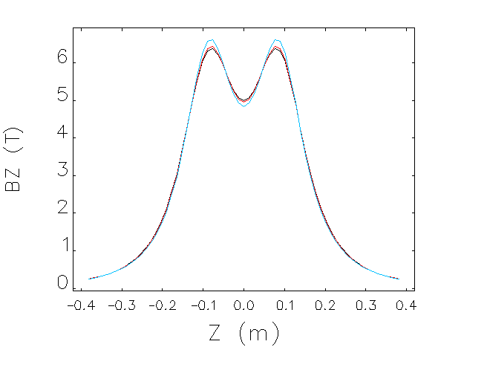
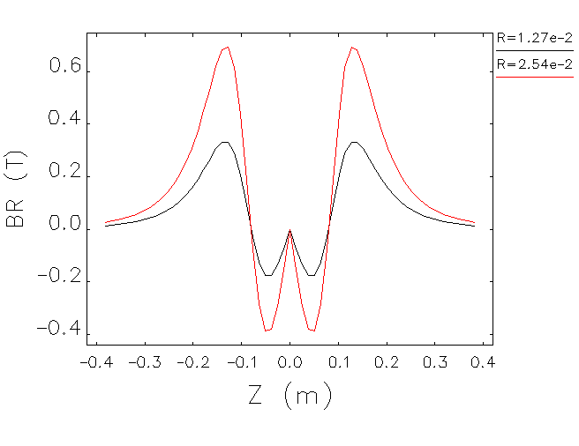
New Moller Target
Hall A is installing a 5 Tesla solenoid.
Manufacturer provided field $B\left(r,θ,z\right)$
Tracked 3D field in ELEGANT
Sample distributions. The real field map is more fine grained.

Slide 16
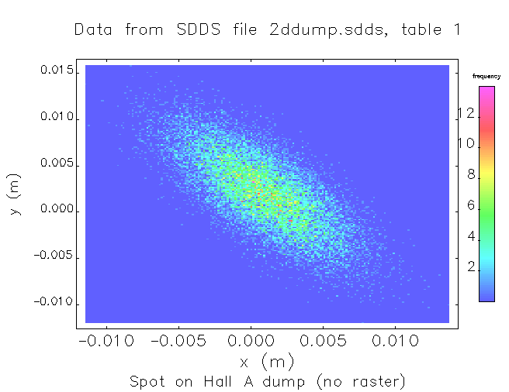
Spot at DUMP
Adjusting MCZ1H04V and MBD1H04H centers beam on dump. MCZ1H04V was added specifically for this purpose.

Slide 17
Plans
Short term
Eliminate step Optim -> ELEGANT
Convert optics to zero M56 in upper arcs
Revert Extraction to nominal
Medium term
Develop strategy for longitudinal matching aimed at minimizing Halo in Halls.
Study chromatic effects (sextupoles?)
Analyze magnet measurements for sextupole component, formulate new measurements, include in model

