Slide 1
High Power Dump – Hall C
Anthony DiPette
Installation / Vacuum Group Leader
7/17/2015

Slide 2
High Power Dump - Hall C
Hall C Project Objective – Dump designed, procured and installed by March, 2016. Will interface to a 24” diameter pipe that is in the Hall.
Lessons Learned
Delta’s - Hall A vs Hall C
FY15 Milestones
Hall C Status
Risks and Potential Mitigations

Slide 3
New Hall A Dump
Hall A Dump – Post New Installation

Slide 4
Lessons Learned from Hall A
Make sure we find the beam center line in the dump tunnel – Survey the Tunnel.
Sealing of the Isolation Wall to the dump tunnel walls – Will improve design.
Diagnostics suite is now finalized in Hall A, can be directly translated into Hall C.
Seal N2 Recirc Blower – Resolved in Hall A – can be directly translated into Hall C.

Slide 5
Hall C Dump vs New Hall A Dump
Hall A Dump – Post New Installation
Hall C Dump – Historic Configuration

Slide 6
Delta’s - Hall A vs Hall C
Tunnel Size – Hall C is 7’x7’, Hall A is 7’x10’
Height of Dump Tunnel from floor of the Hall
Affects lengths of tubes for periscopes
Affects camera focal length
Affects work planning – added work platform, use of cranes
Dose rates in Hall C Tunnel vs Hall A Tunnel are higher.
Use of DeconGel to reduce levels of activation and reduce spread of contamination
More extensive work planning with RadCon
Cooling water system for aperture plate and vacuum window flange does not exist in Hall C Dump

Slide 7
FY 15 Planned Milestones
Dump Demo
Inspection of He Pipes – Testing for leaks, ability to survive another 20 years
Inspection of Dump Face
Removal of Burn Through Detector
Perform a Survey of the Tunnel wrt Beam Center
Transpose the Hall A Dump layout into Hall C Dump tunnel
Procurement of Long Lead Items – Vacuum Pipe and He Pipe (1-3 sections – TBD)

Slide 8
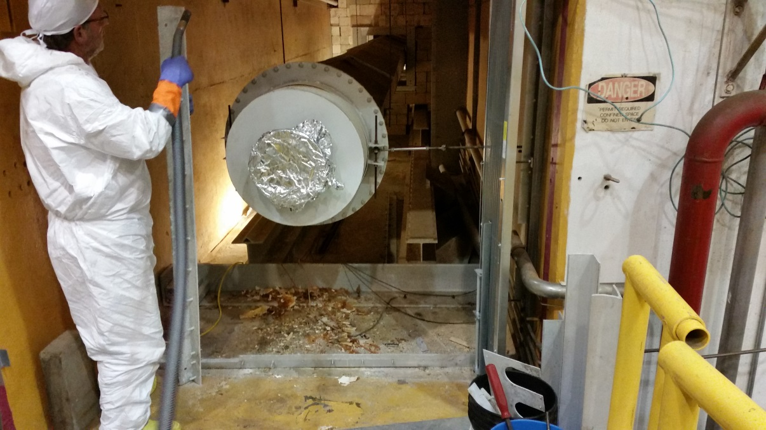
Status of Current Progress
Installed Work Platform.
Removed Isolation wall and installed new Gate.

Slide 9
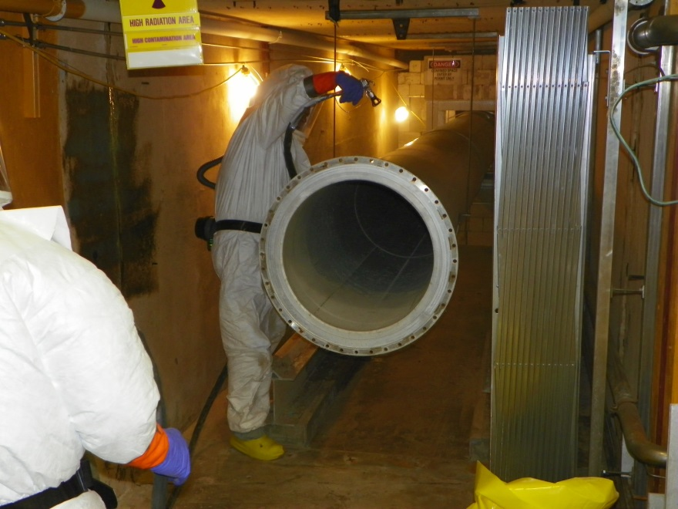
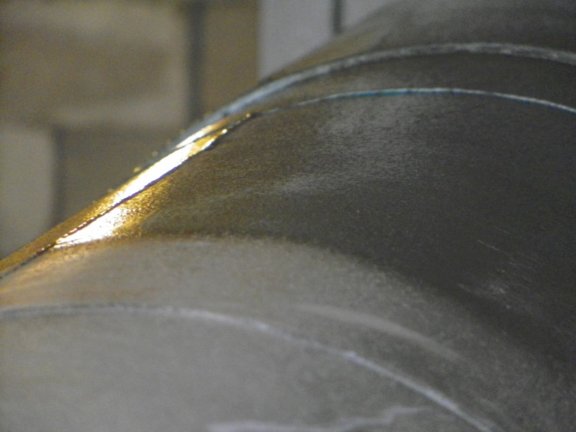
Status of Current Progress
Removed Helium pipe.

Slide 10
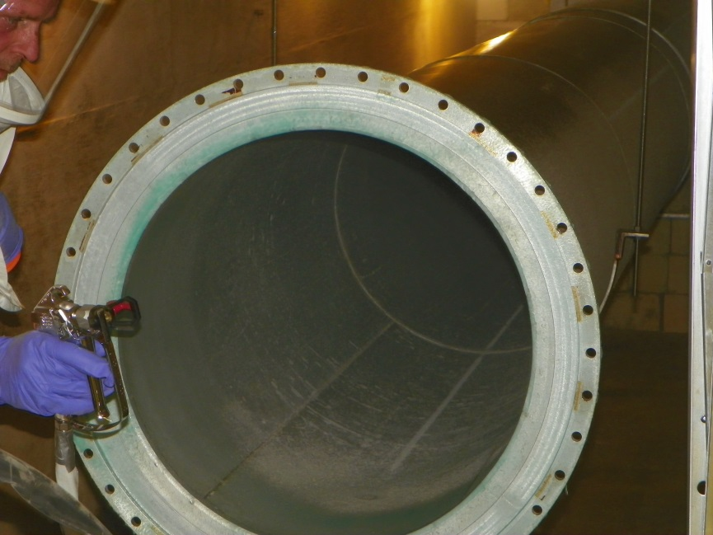
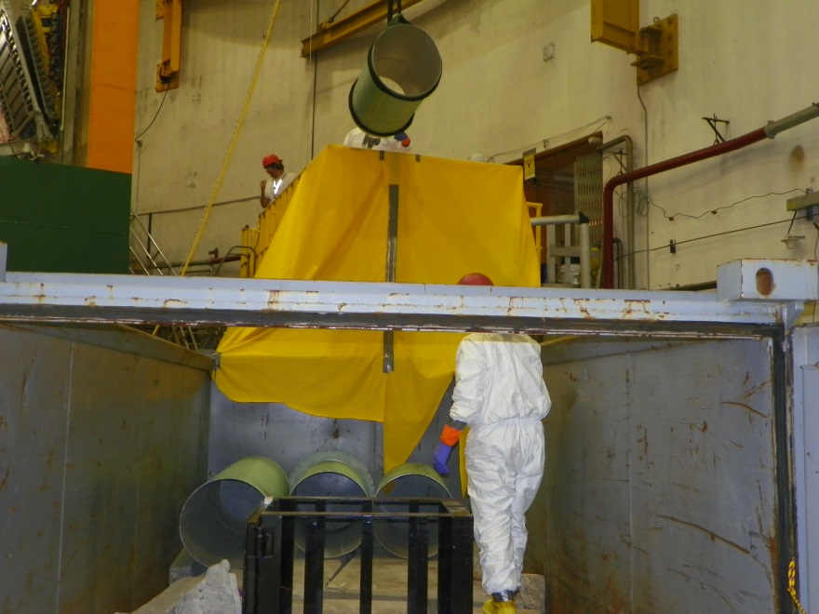
Status of Current Progress
Removed Helium pipe.

Slide 11
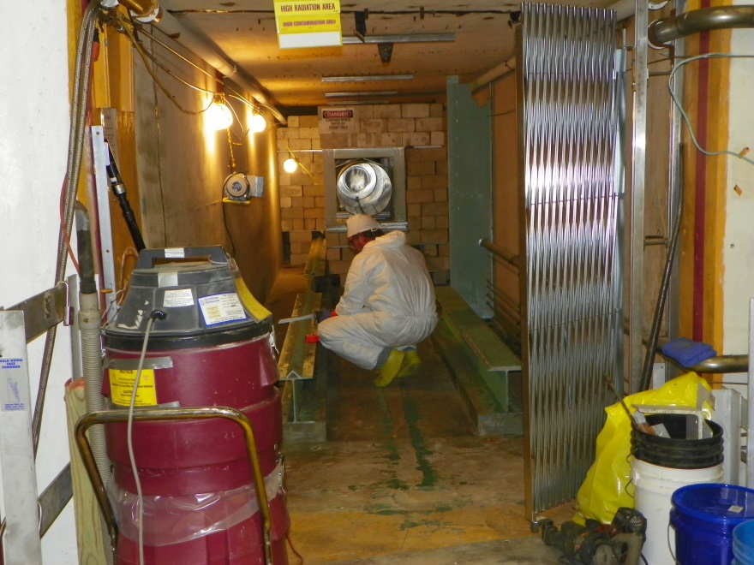
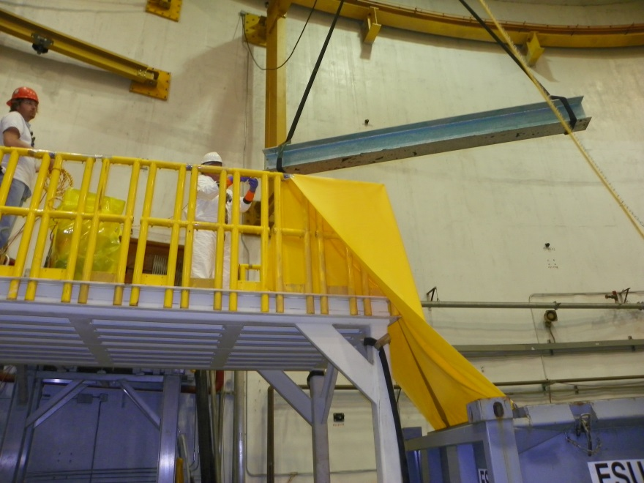
Status of Current Progress
Removed rails and grout.

Slide 12
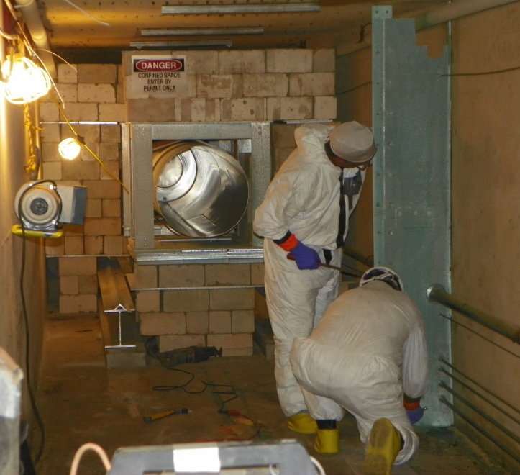
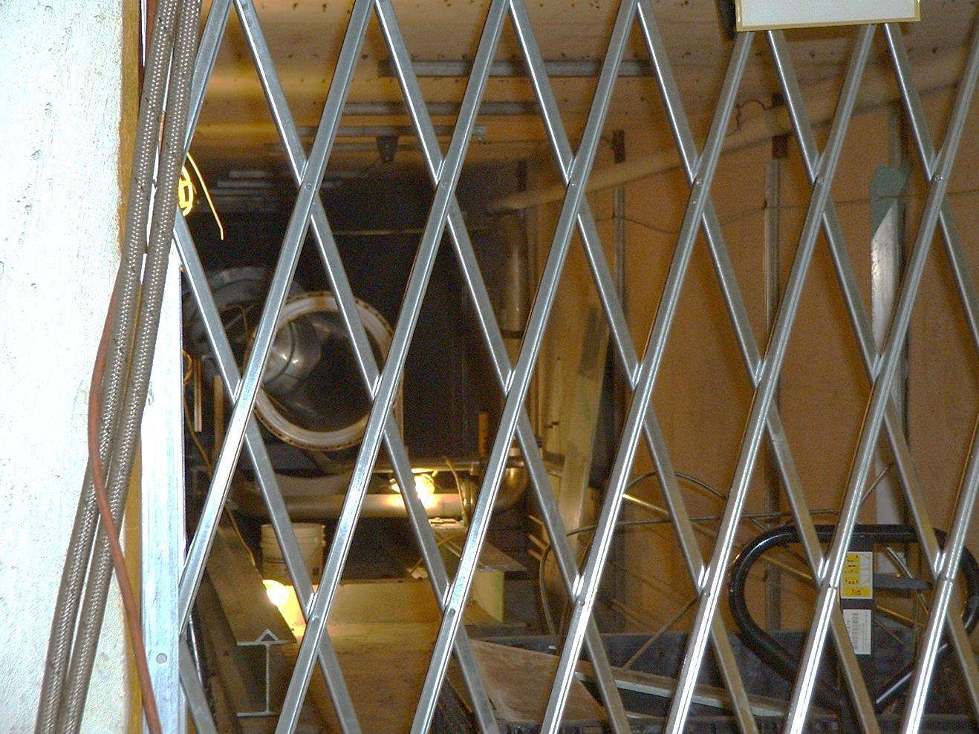
Status of Current Progress
Removed Shielding walls, Diffuser, unused piping and old activated materials.

Slide 13
Current Progress – Next Step
Left to complete Demo phase - Remove piece of rail, grout, misc material and DeconGel walls, ceiling and floor.

Slide 14
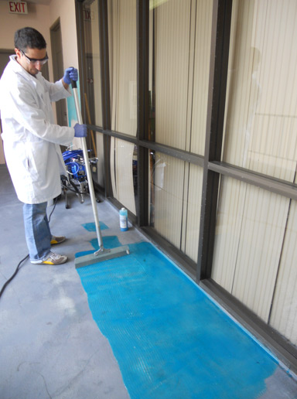
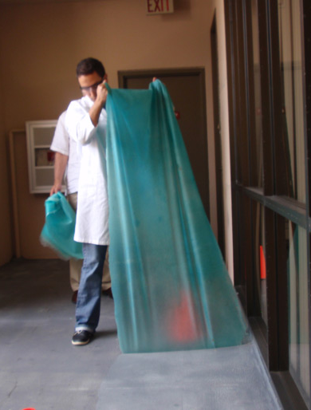
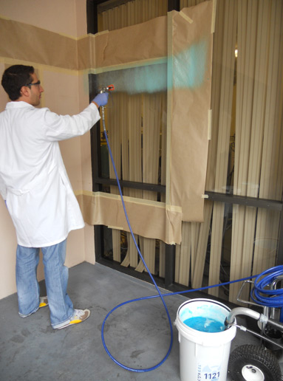
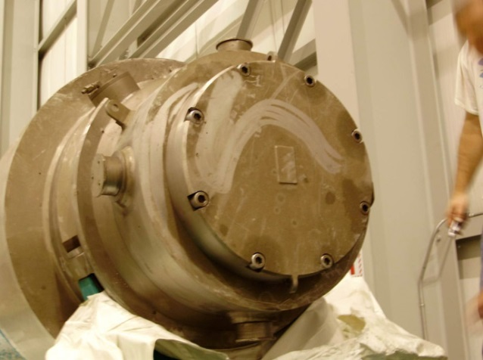
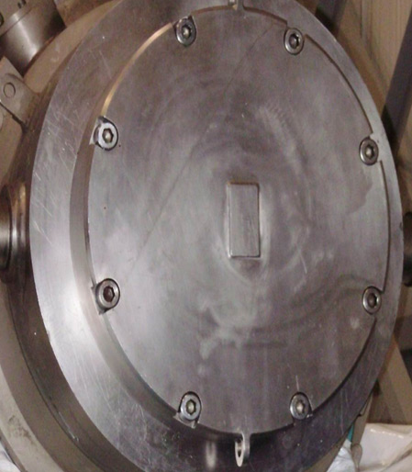
Current Progress – Next Step
DeconGel - Easy and peelable, environmentally friendly, decontamination solution, with a broad spectrum of uses.
Usage should mitigate requirement of most Rad II work – cost of material offsets what we added for labor – reduces worker rad exposure!

Slide 15
Risks and Potential Mitigations
Helium Pipes Leak – $$ are in the budget to replace all of them.
Dump Face needs to be replaced – We'll plan work for replacement – we have spare dump faces.
High Dose rates – Use of DeconGel, continued monitoring of levels by RadCon, assessment of staff accumulated doses – identified additional resources which are Rad II trained.

Slide 16
Risks and Potential Mitigations
Need to get MD assigned now – plan for Gary Hays to start by end of July.
Questions from Hall Physicists regarding placement of items in the dump tunnel – need to look at these items now, resolve by August, 2015 – meeting being scheduled with Physics – agreement from Hall Leadership – no major changes from Hall A.

Slide 17
High Power Dumps
Thank You!!!
Tim Michalski
Keith Welch
Dave Hamlette
Neil Wilson
Ricky Taylor
Mark Weihl
Bern Johnson
All of the RadCon Techs

