Slide 1
System Downtime: Global Analysis
Randy Michaud
“Stay-Treat July 16, 2015”

Slide 2
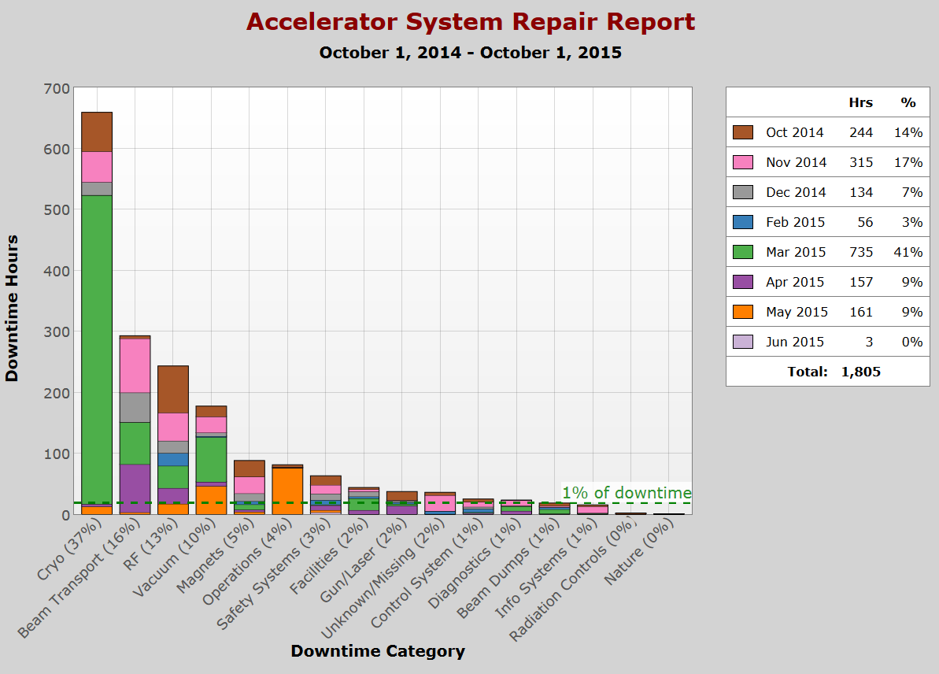
FY2015

Slide 3
Data Driven Decisions
- W. Edwards Deming, engineer, statistician, author, consultant

Slide 4
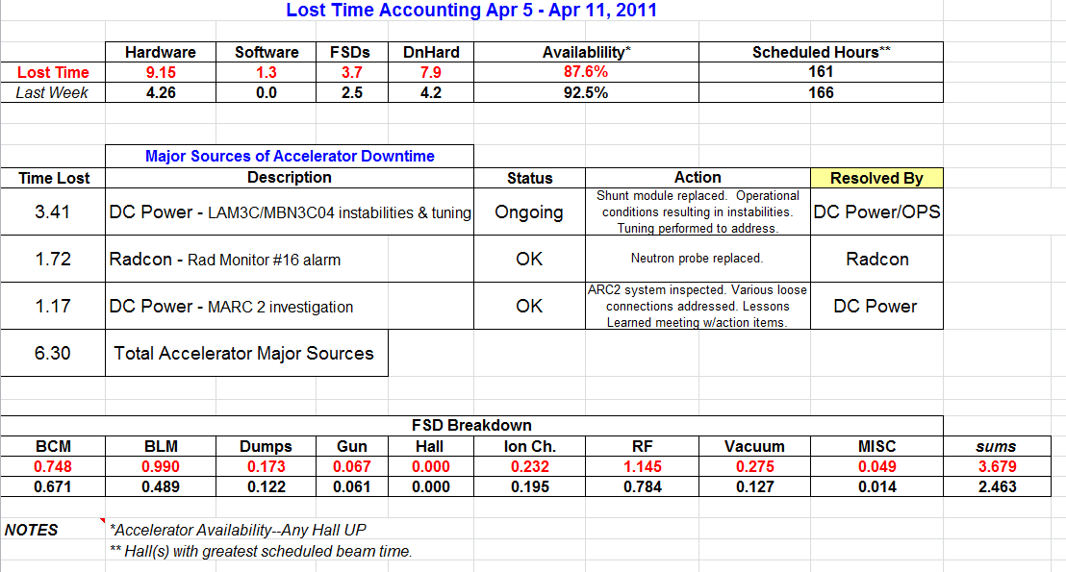
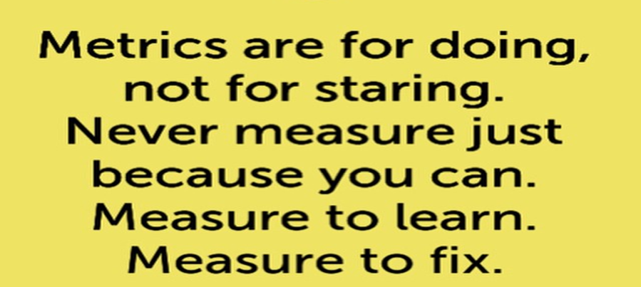
Plan – Do- Check- Act - Repeat

Slide 5
Tracking System Downtime…
Is a major investment.
Is a team effort.
Is controversial.
Is not the same across all machines.
Is not perfect, but improving.
Is how we monitor systems health.
Is where we identify improvements.
Is how we set goals to be better.

Slide 6
Accelerators for America’s Future
The Department of Energy's Office of Science has launched an initiative to encourage breakthroughs in accelerator science and their translation into applications for the nation's health, wealth, and security.
2010 Report highlights topics from an inaugural workshop, sponsored by the Office of High Energy Physics. (Link to Accelerators for America's Future Report)
Potential uses for Accelerator Technology
shrink a tumor | diagnose a disease
produce cleaner energy | reduce nuclear waste
spot suspicious cargo | detect an art forgery
make a better radial tire | implant ions in a semiconductor
clean up dirty drinking water | prospect for oil
map a protein | date an archaeological find
study a nuclear explosion | package a Thanksgiving turkey
design a new drug | discover the secrets of the universe

Slide 7
What’s the big deal?
Reliability – the future will be determined by how we conquer that obstacle.

Slide 8
Challenge the Status Quo

Slide 9
It is up to us
Set system by system goals to improve.
99% reliable? Great – go for 99.1%
Without risk, there is no reward.
Think outside the box; create and innovate.
What you measure, you can improve.
Use the data we collect; help make it better
Pay attention to system and overall performance.
Team work to develop metrics, tools, ideas
If it was easy, everyone would do it.
Overcome challenges; funding, technology, time are always going to be obstacles

Slide 10
Discussion
What are we going to do!?!

