Slide 1
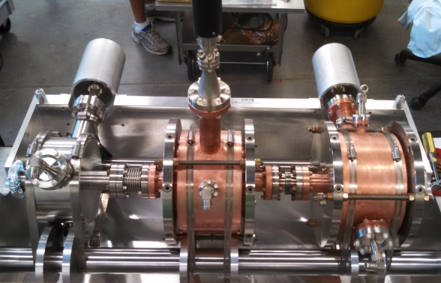
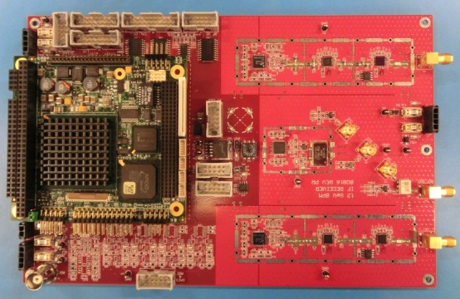
Hall D Fast Feedback
Trent Allison
Ops StayTreat
2015

Slide 2
Hall D FFB Overview
Correctors
Correctors
BPM
BPM
V
H
V
H
X Y
X Y
Control Algorithm
Data from 2 BPMs used to control 2 sets of correctors
Locking position at 1 point does not stabilize the trajectory or downstream position, 2 points are needed
Element locations are selected based on the optics
Main goal is to compensate for 60Hz line motion
Beam Motion
60Hz
120Hz

Slide 3
Based on Halls A & C FFB
BSY Service Building
Beam Sync
VME Crate
n*60Hz
Shared Memory
EPICS IOC
Trim
Rack/ Cards
Magnet
Timing
Magnet
4
3
3
BPM
RF Mod
IF Mod
ADC
FFB IOC
DAC
Magnet
…
…
…
(x8)
4
3
Filter
3
BPM
RF Mod
IF Mod
ADC
DAC
Trim
Rack/ Cards
Magnet
Magnet
A/C Select
Magnet
FFB Control Algorithm: Lebedev & Dickson circa 1996
Targets 60Hz line motion and harmonics
Auto calibration: kick beam, record response and calculate matrix coefficients
Feedback to 180Hz plus feedforward to 720Hz
Position and energy correction
SL Service Building Zone 20
Filter
RFCM 1&2
Vernier Control Chassis
Filter
RFCM 3&4
Filter
RFCM 5&6
Filter
RFCM 7&8

Slide 4
Hall D FFB
Beam Sync
Tagger Service Building
Striplines
E2
FFB Chassis
Correctors
BT02
Cal Cell
BPM RX
BS04V
5C00
Cal Cell
BPM RX
Altera Cyclone V
FPGA/
ARM Cortex-A9 dual-core
FFB IOC
BS04H
5C02
Cal Cell
BPM RX
Trim
Rack/ Cards
5C00V
DACs
5C06
Cal Cell
BPM RX
5C00H
5C07
Cal Cell
BPM RX
5C04V
5C11B
Cal Cell
Fiber RX
5C04H
BPM RX
AD00C
Cal Cell
BPM RX
Cavities*
Beam Sync
NL Service Building Zone 26
5C11A
Cal Cell
BPM RX
LLRF 1
AD00
Cal Cell
BPM RX
Fiber TX
LLRF 2
Beam Sync
LLRF 3
Hall D
Fiber to BNC
LLRF 4
Active Collimator
5H01
VME ADC/ FPGA
PC104 EPICS IOC
LLRF 5
LLRF 6
LLRF 7
* There are only 8 fiber inputs so the Cavity BPMs will replace 2 Striplines
LLRF 8

Slide 5
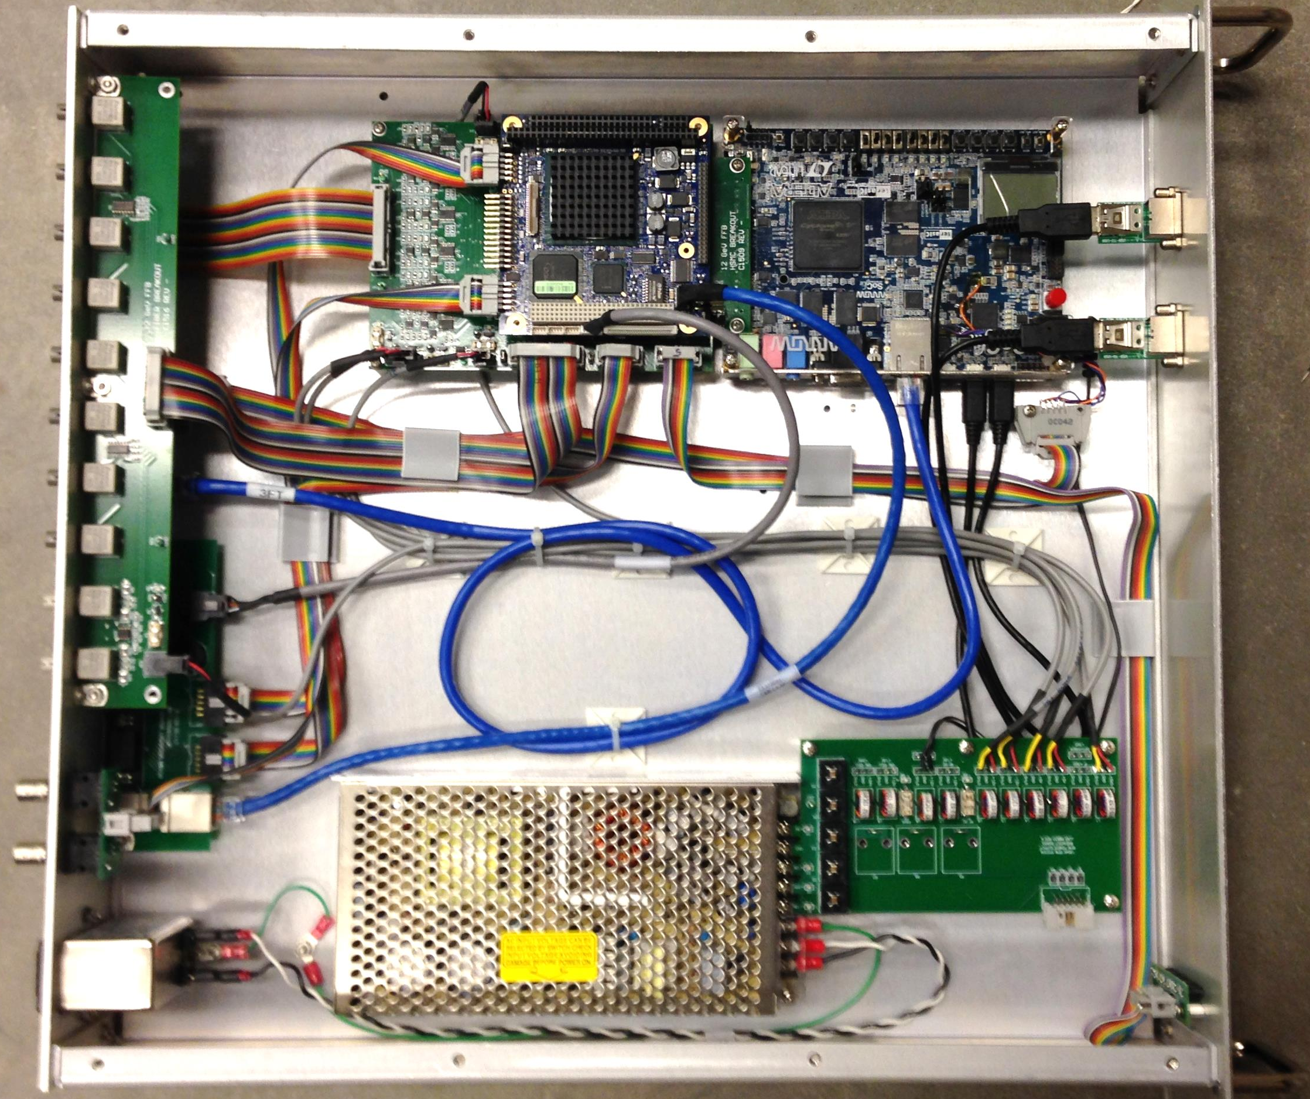
Hall D FFB Chassis
PC104
EPICS IOC
FPGA/ARM
FFB IOC
DACs
Fiber I/O
IOC RS232/Net
Beam Sync
Power Filtering
LEDs

Slide 6
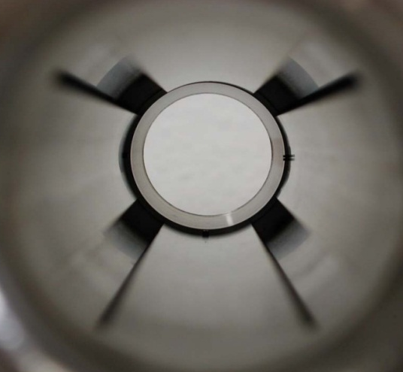
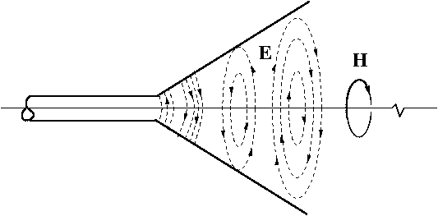
Stripline BPMs
26 Striplines
IPMBS00
IPMBS01
IPMBS02
IPMBS03
IPMBS04
IPMBE01
IPMBE02
IPMBE03
IPMBE04
IPMBT01
IPMBT02
IPMBT03
IPM5C00
IPM5C01
IPM5C02
IPM5C03
IPM5C04
IPM5C05
IPM5C06
IPM5C07
IPM5C08
IPM5C09
IPM5C10
IPM5C11
IPM5C11B
IPMAD00C
Used instead of M15 antenna BPMs
Easier & more precise manufacturing
No hand bending of antennas
Better sensitivity
50 ohm devices
Position calculated as difference-over-sum
Each characterized with Goubau Line BPM Test Stand
Y Stepper
Ladder
Goubau Line
BPM
X Stepper

Slide 7
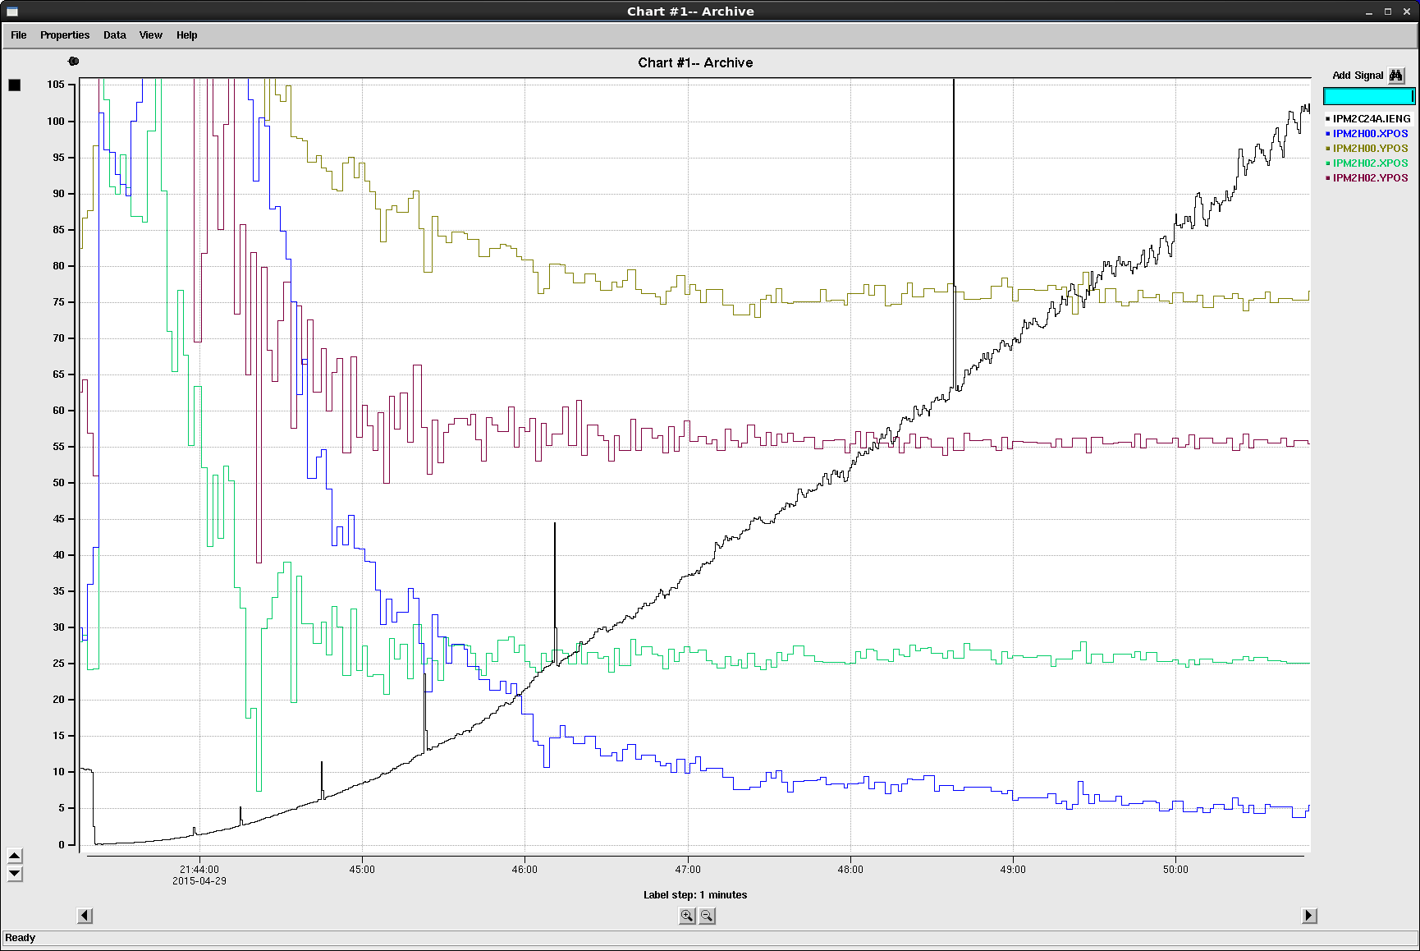
Stripline Bandwidth vs Resolution
Current Ramp from 0 to 100nA with 1Hz Bandwidth
Error at 7 & 30nA
IPM2H00.YPOS
Beam Current (nA)
IPM2H02.YPOS
Beam Position (mm)
30nA
IPM2H02.XPOS
 | 100um | 430um
BW Hz | Beam nA | Beam nA
0.1 | 9 | 2
1 | 30 | 7
60 | 232 | 54
120 | 329 | 77
180 | 402 | 94
240 | 465 | 108
300 | 520 | 121
100um resolution at 330nA with 120Hz BW
IPM2H00.XPOS
7nA
430um
100um

Slide 8
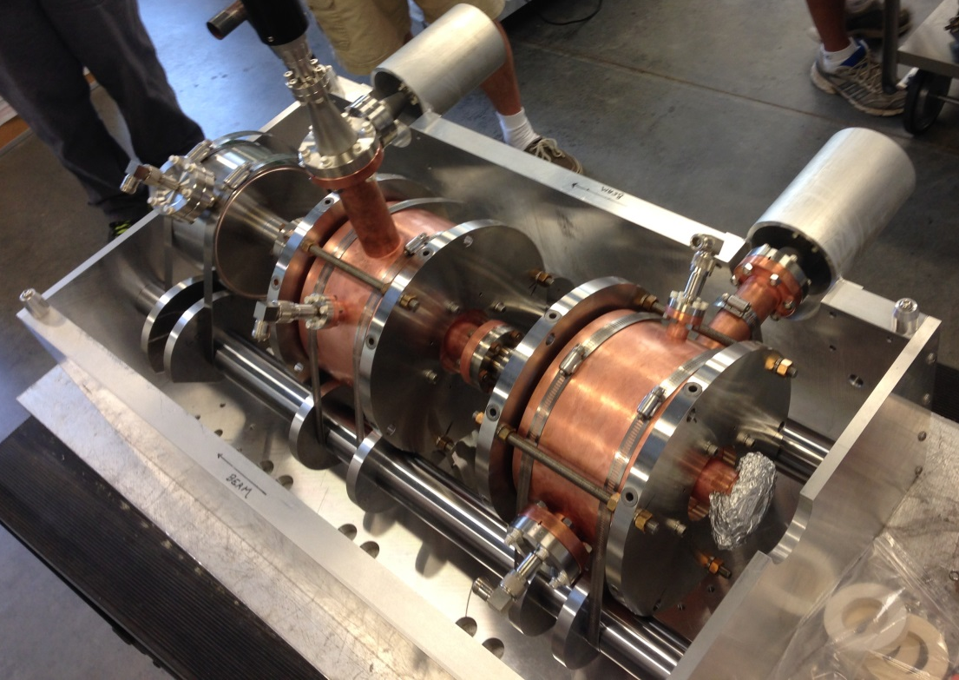
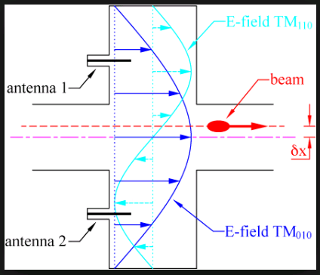
Cavity BPMs
IPM5C11A at shield wall, IPMAD00 at Goniometer
Positions go as X/I & Y/I
Electromagnetic field excited by beam
BCM: TM₀₁₀ Mode
BPM: TM₁₁₀ Mode
Signal disappears at boresight
Tuning port for centering at 1497MHz
Temperature stabilized
Better sensitivity than Striplines
Tuners
Foot
I
Y
X
Probes & Test Ports
Blanket w/ Heat Tape

Slide 9
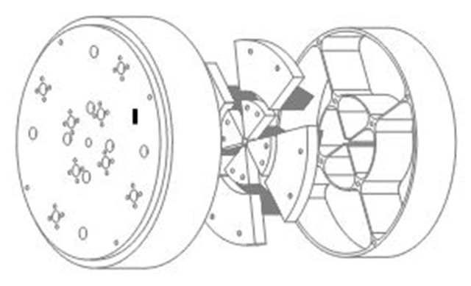
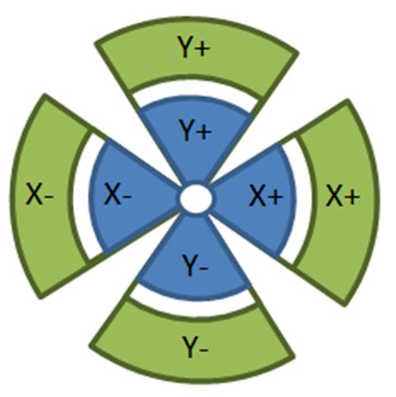
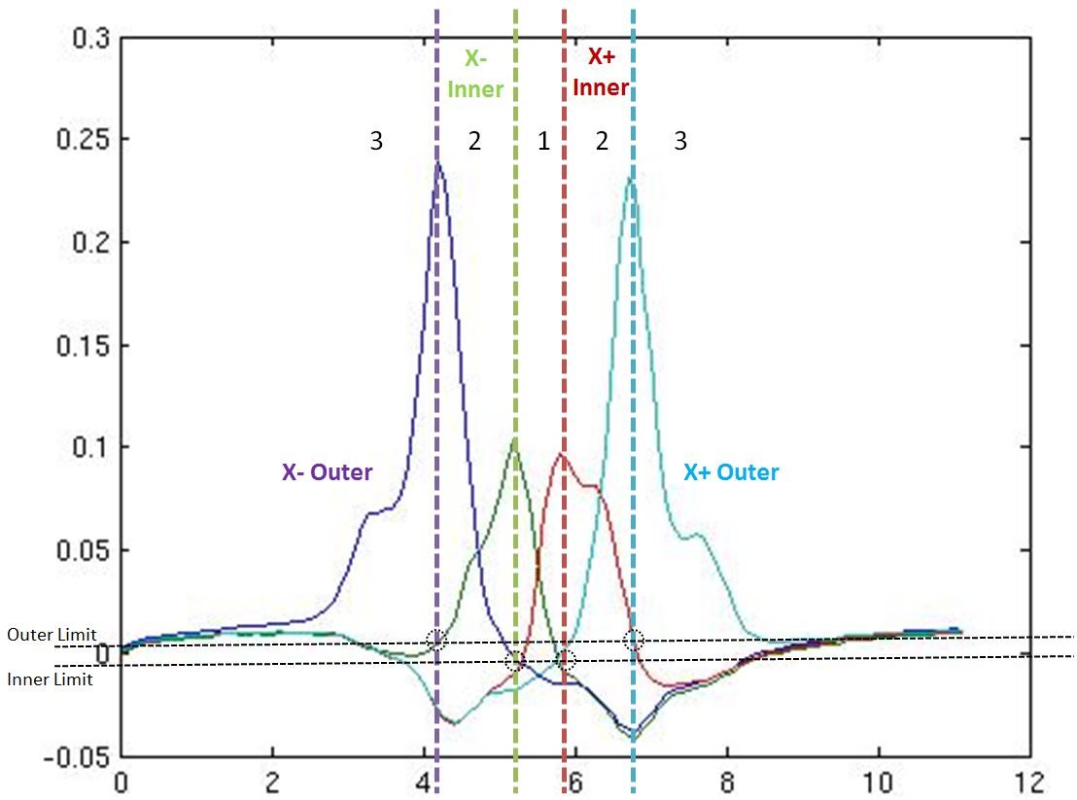
Active Collimator
IPC5H01 in Hall D Alcove
Intercepts photon beam
Tungsten pin-cushion wedges
Current output
Difference-over-sum used on inner wedges for FFB (region 1)
Works at low beam currents
mm

Slide 10
Hall D FFB Algorithm
Correctors up to 1kHz
Hall A&C FFB @ 10uA
Hall D: 5nA to 500nA
SEE: 20um @10uA
Striplines: 100um @ 330nA/120Hz BW
Use Cavity BPMs & Active Collimator for lower currents
Plan A: Hall A&C style feedback and feedforward
1.8ksps data & DACs (due to hardware limitations in A&C)
Plan B: High bandwidth feedback (no feedforward)
Take advantage of 30ksps fiber data and 1MHz DACs
Must have low latency and good signal-to-noise
Plan C: 60Hz line-locked feedforward only (last run)
Gunk
5C03V Corrector
5C03H Corrector

Slide 11
Hardware Testing
Hardware was verified using beam
Fiber data to FFB
Magnet controls
Magnet locations mapped correctly
Good response at 5.5GeV with headroom for 12GeV
1kHz kick on top of 60Hz @ Active Collimator
IPM5C07 Stripline Frequency Response
Active Collimator plot of time domain response to 1kHz FFB magnet kick at BS04V
60Hz
BS04H
BS04V
5C00V
5C04V
5C00H
5C04H

Slide 12
60Hz Suppression (Plan C)
Line-synchronized 60Hz Feedforward suppression algorithm used last 2 days of the run
Also engaged slow EPICS position locks to steady the beam
60Hz Suppression
OFF
60Hz Line Frequency Wanders ~0.14Hz
60.07
IPM5C07 Stripline Frequency Response
Hz
60Hz Suppression
ON
59.93

Slide 13
Hall D FFB To Do
Implement Hall A&C FFB algorithm (Plan A)
Translate into the new electronics
Incorporate Active Collimator
Incorporate Cavity BPMs
Commission Cavity BPMs (beam time)
Finish firmware and software
Measure bandwidth & current limitations
Commission Active Collimator (beam time)
Measure bandwidth & current limitations
Iterative FFB testing and tweaking (beam time)

Slide 14
Hall D Fast Feedback
Questions?
Hall D FFB Team: Trent Allison, Brian Bevins, Keith Cole, John Musson, Todd Satogata & Scott Windham

Slide 15
Hall D Fast Feedback
Backup Slides…

Slide 16
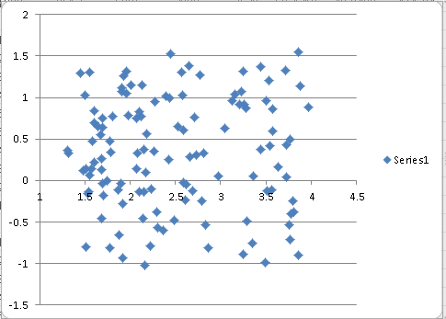
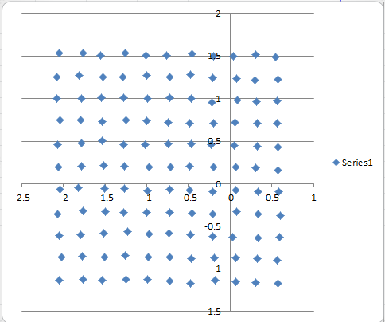
Bandwidth vs Resolution
~30 nA @ 10 Hz
~30 nA @ 1 Hz
250 um
Step Scan
Position map improves by tightening bandwidth
Improving the signal-to-noise improves performance
Filtering down to 1 Hz instead of 10 Hz gives an improvement factor of about 3.2
This square root of bandwidth improvement holds true as long as the noise is Gaussian

Slide 17
FFB Component Locations
Magnets
Stripline BPMs
Cavity BPMs
IPMAd00

Slide 18
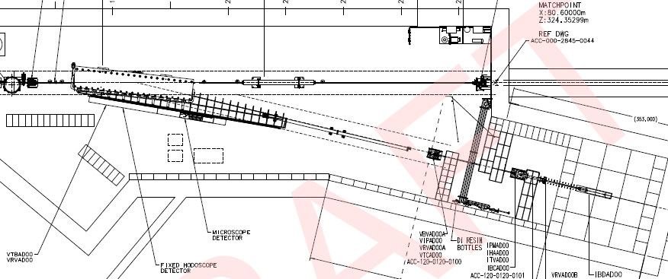
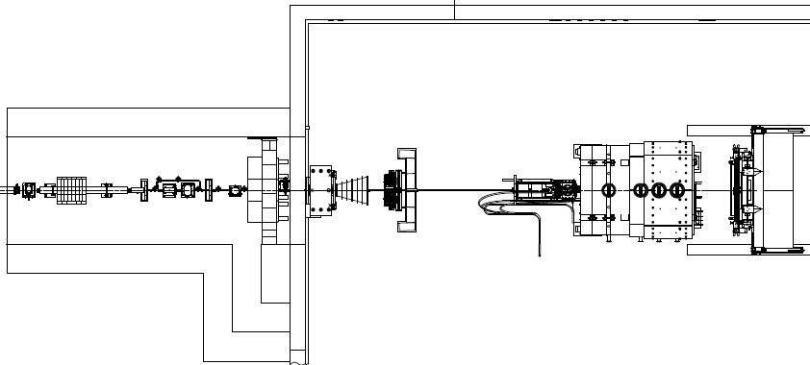
FFB Component Locations
Stripline BPM
Active Collimator

