Slide 1
Repair Assessment Reporting RAR
Randy Michaud
“Stay-Treat…July 16, 2015”

Slide 2
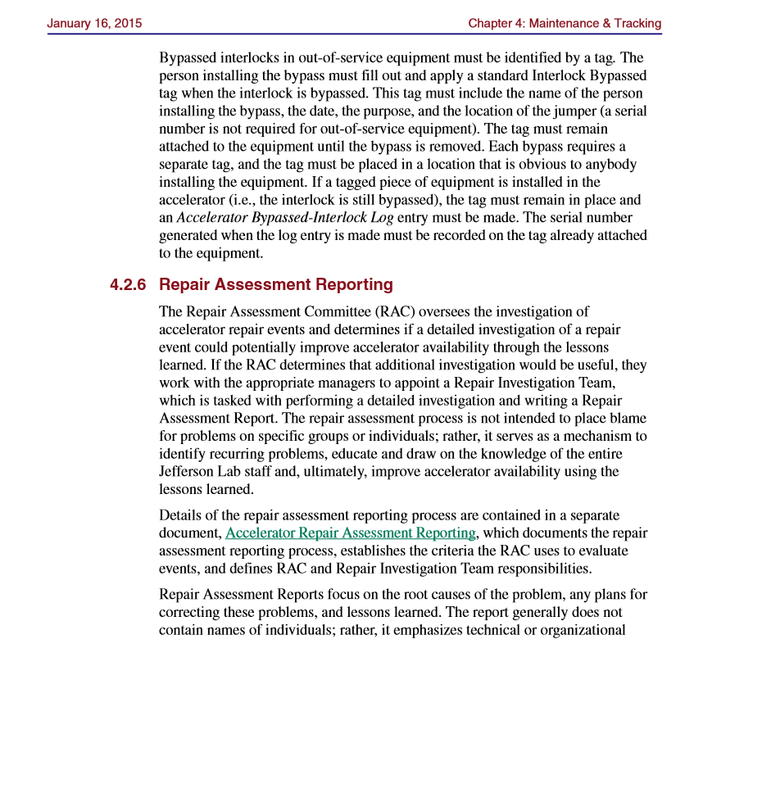
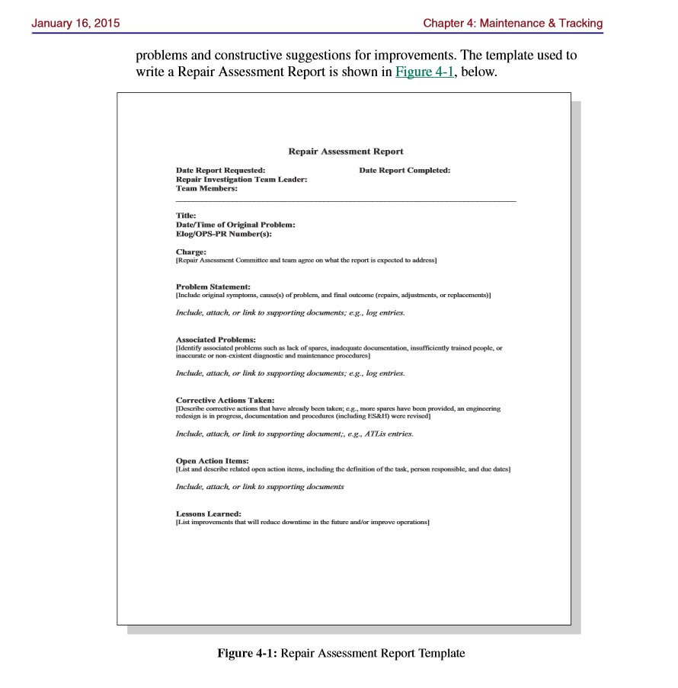
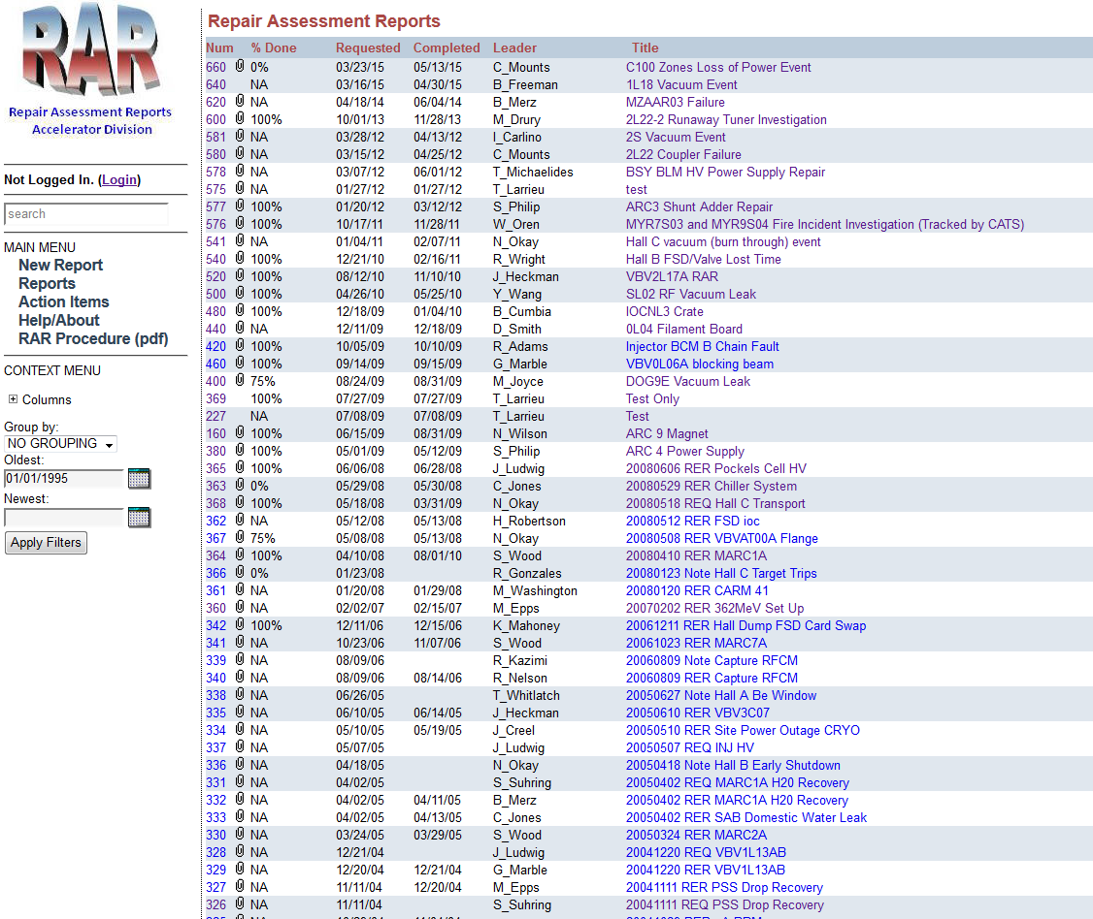
What is it?
Pre-2010, referred to as Escalation Report

Slide 3
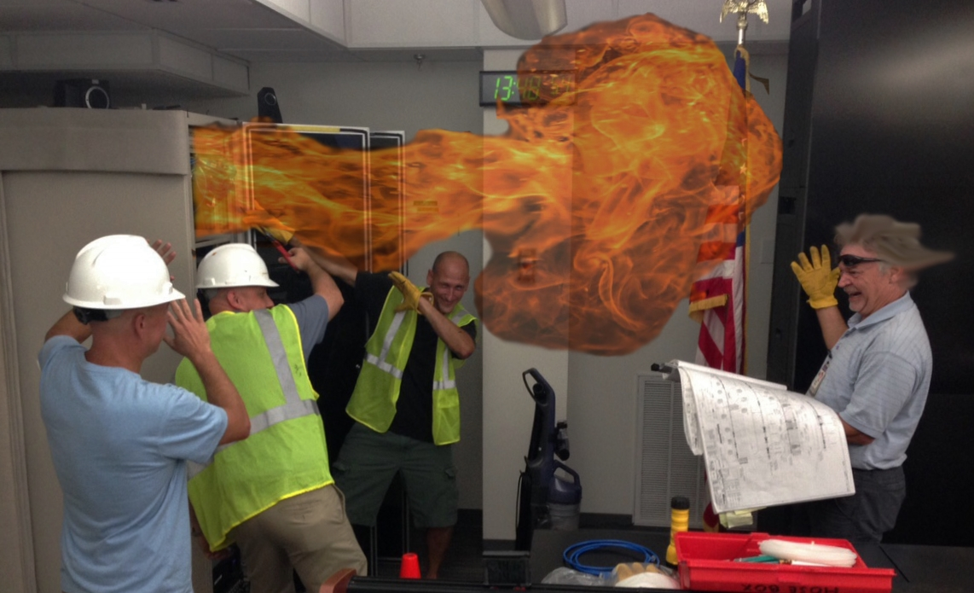
Who is it?
Repair Assessment Committee (RAC)
Brian
Clyde
Randy
Scott
During OPS, review downtime weekly for RAR “opportunities” and make team assignments.
RAR Re-enactment: Not an actual event.

Slide 4
RARs
Recent Process Improvements | Continued Improvement Opportunities
Quality of written reports | 100% report team engagement
Short, direct action items | Long, vague, unassignable action items
Tracking completed actions | Completing assigned action items
Defined process | Inconsistent use of process
Root Cause/Direct cause focus | Root Cause tools not fully utilized

Slide 5
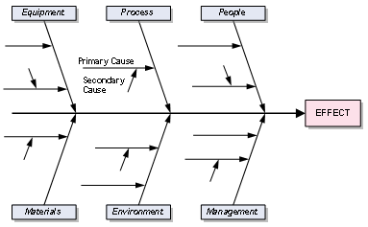
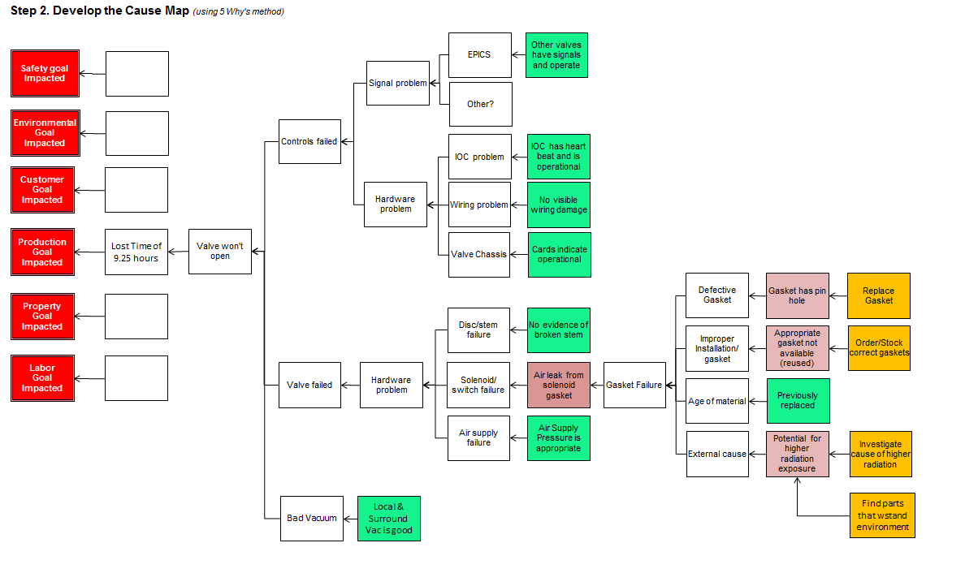
Focus on Root Cause Analysis
WHY?
WHY? WHY?
WHY?
WHY?
Fix the problem – use root cause analysis to understand how to prevent the event from happening again.
If a team “knows the answer” without working through the tools or investigation, secondary factors may become primary factors when the failure happens again ;)

Slide 6
Machine Improvement Examples
Vacuum valve control boxes to the VAC Group, proactive replacement of gaskets, switches, and air lines.
C100 tuner controls software, firmware, and mechanical upgrades.
Hot Checkout Process developed.
ABIL Process developed.
Linac viewer bellows replacement.

Slide 7
Continuous Improvement

Slide 8
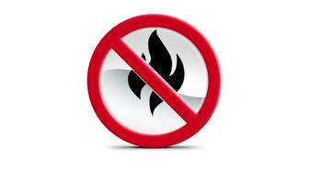
Discuss - “Arsonist-Fireman Syndrome”
“Arsonist-Fireman Syndrome is a cultural phenomenon…Its most prominent symptom is a focus on “firefighting” (i.e. troubleshooting a problem once it has happened) rather than “fire prevention” (i.e. preventing the problem in the first place).” –Robert Reid, PEX, 2012
Does our culture?
Celebrate the fireman vs. those who prevented a fire?
Use resources to create new value vs. put out fires?
Focus mostly on daily priorities vs. long term priorities?
Interesting article:
“Reward Firefighting And You'll Create A Culture Of Arsonists”
Forbes, Jimmy Leppert -Kotter International Contributor, July 2013

