Slide 1
QCM and C50-12 Status Update
Accelerator Operations
2015 StayTreat
15JUL2015

Slide 2
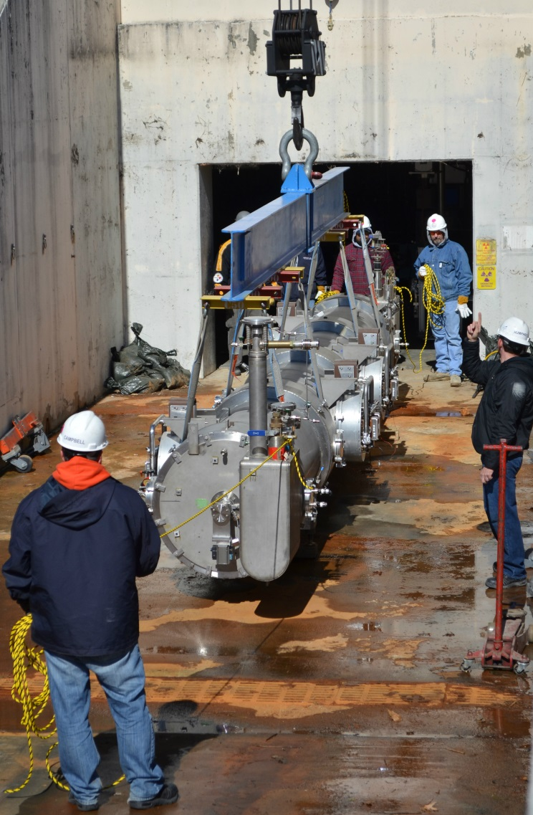
C50-12 Rebuild
General
Rebuild FEL02 (older C20)
Reuse most major components
Cavities, HOM loads, gate valves, etc.
  Cavities will receive light EP
  Cavity recipe is same as used for C50-11
Leverage Qo improvements as proven
FY15 Scope
Disassemble cryomodule
Qualify two cavity pairs
Buyout primary procurements
FY16 Scope
Qualify two cavity pairs
Cryo unit assembly
Cryomodule assembly
Cryomodule acceptance test
Cryomodule install and commission

Slide 3
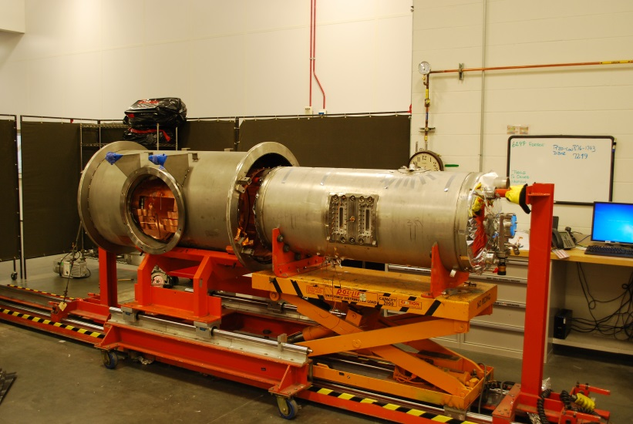
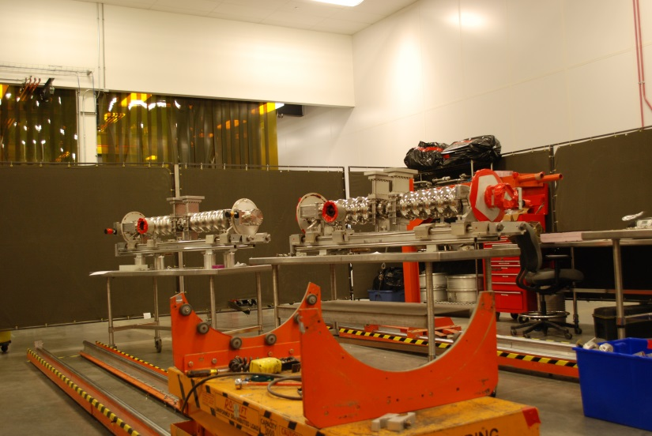
C50-12 Status
Cryomodule
Disassembly is done
HOM cans are built
Rotary feed-throughs are being worked
Helium vessels have been prep’d
All primary procurements have been made with exception of $10K
Cavity Pairs
One pair is completely disassembled
Disassembly of second pair is in progress
12 dog legs and 112 warm windows have been fabricated
  Warm windows are intended to replace 106 older style currently installed
  Windows need to be RF tested

Slide 4
C50-12 Plans
FY15
Qualify first cavity pair
Continue to progress on second pair
  Potential to qualify second pair, depends on LCLS II
Buy out last $10K of procurements
FY16
Qualify remaining cavity pairs
RF test all warm windows
Assemble cryomodule
Complete acceptance test in CMTF
Available to install in late summer 2016

Slide 5
High Level SRF Production Plan
For Planning Only

Slide 6
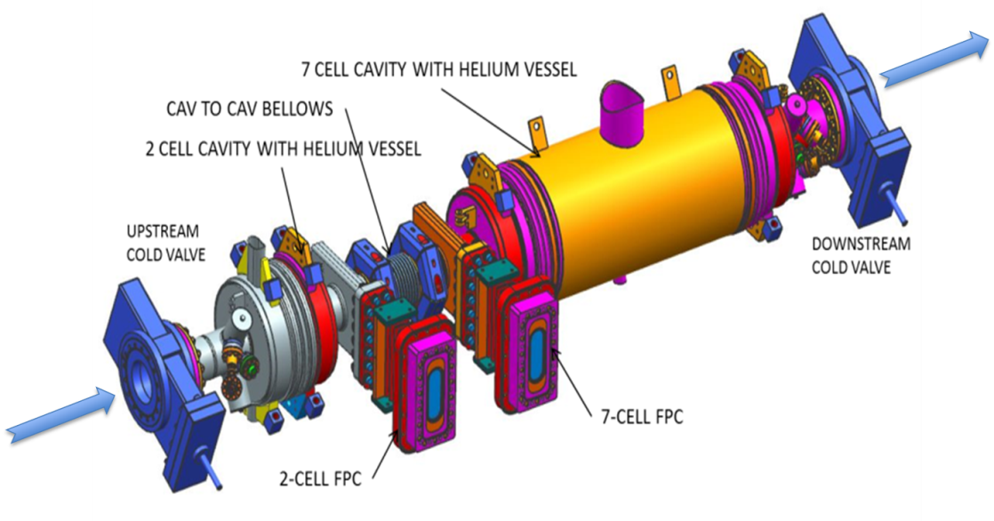
New CEBAF QCM
General Scope
Design and build a new quarter cryomodule (QCM) for CEBAF utilizing a new 2-cell elliptical and a modified elliptical 7-cell cavity
FY15 Scope
Complete cavity qualification
Procure components
Assemble cavity string
Complete cryomodule design
FY16 Scope
Close out CM procurements
Cryomodule assembly
Cryomodule acceptance test
Cryomodule install and commission
H. Wang et al. “Injector Cavities Fabrication, Vertical Test Performance and Primary Cryomodule Design”

Slide 7
QCM Status
Cavities
Both the 2-cell and 7-cell have been fabricated
Vertical test of the unjacketed two cell is complete
First vertical test on unjacketed 7-cell is done, needs one more round before welding of helium vessel
String
String tooling is 95% completed
Procurements of string components is 95% done
Cryomodule
Design is in progress
Long lead items purchased, some are in house
  Cold and warm tuners, vacuum vessel, space frame, end cans and helium vessels are here

Slide 8
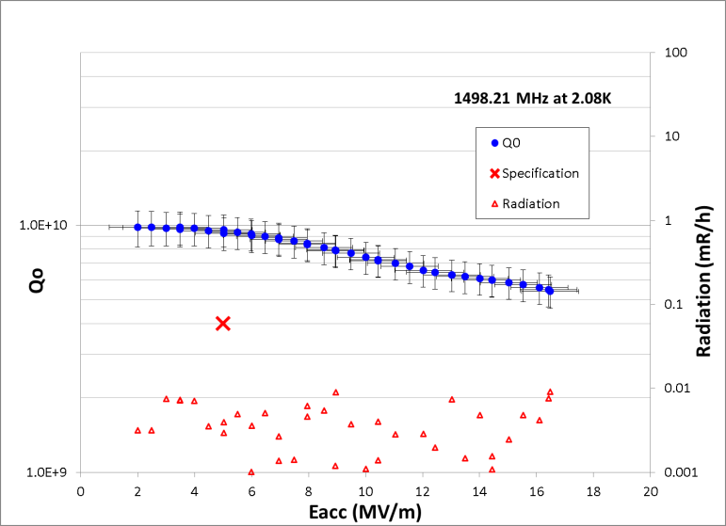
2-cell Cavity 2nd vertical test Q_{o} vs E_{acc} curve.
H. Wang et al. “Injector Cavities Fabrication, Vertical Test Performance and Primary Cryomodule Design”

Slide 9
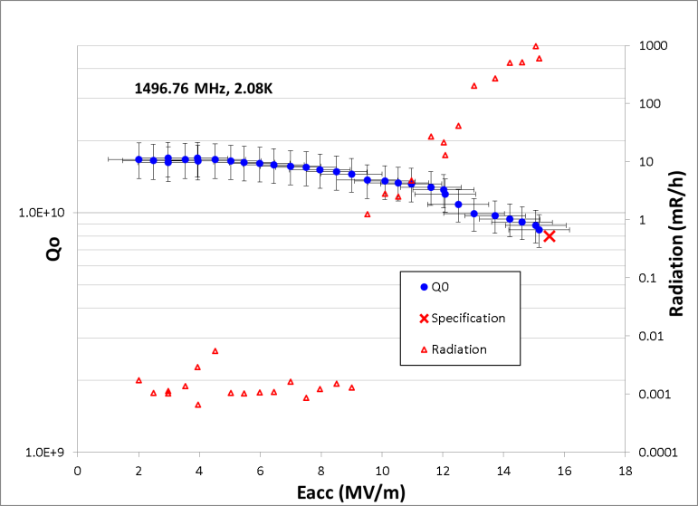
7-cell Cavity 1st vertical test Q_{o} vs E_{acc} curve
H. Wang et al. “Injector Cavities Fabrication, Vertical Test Performance and Primary Cryomodule Design”

Slide 10
QCM Plans
FY15
Weld on helium jackets to 2-cell and 7-cell
Complete the cavity qualification of jacketed cavities
Complete string assembly
  Delays in cavity qualification are putting SA in competition with LCLS II
  Intention is to complete QCM string ahead of LCLS II
Complete cryomodule design
Continue to procure long lead cryomodule components
FY16
Procure any remaining cryomodule components
Assemble cryomodule
Complete acceptance test in CMTF
Available to install in early summer 2016

Slide 11
Summary
C50-12 is tracking slightly behind plan for FY15
  Will be ready to install by late summer of FY16
  Can be pulled to early summer
CEBAF QCM is tracking per current schedule
  Available to install early summer
LCLS II is stretching staffing, plan in place and being worked
  Added process engineer and an electronics tech
  Will add 3-4 term mechanical techs in FY15 to support prototype CM assembly
  More will be added in FY16 for production

Slide 12
Backup

Slide 13
Primary Differences with FEL02
As compared to CEBAF C20 → C50
Inner adapters are larger in diameter
HOM loads are different and are heat sunk to shield circuit
End dishes are welded to gate valve
Gate valves ID are larger
Bellows in between cryo units are larger bore and RF shielded

