Slide 1
C75 options
F. Marhauser, J. Henry, R. Rimmer,
J. Benesch

Slide 2
Options for “C75”
Goal is to investigate something between C50 and C100 with more “bang for the buck”
Cost like C50, performance like C100
“magic bullet”: some process to transform old cavities
N₂ Doping, Nb₃Sn, ???
New cavities in old CM
Add cost, but gain performance*
Could fix coupling kicks
Significant engineering required
What about “cell transplant”?
New less expensive C100 CM
Major re-engineering needed. Synergy with MEIC?
* Need to find and fix the cause of Q loss to make this worthwhile

Slide 3
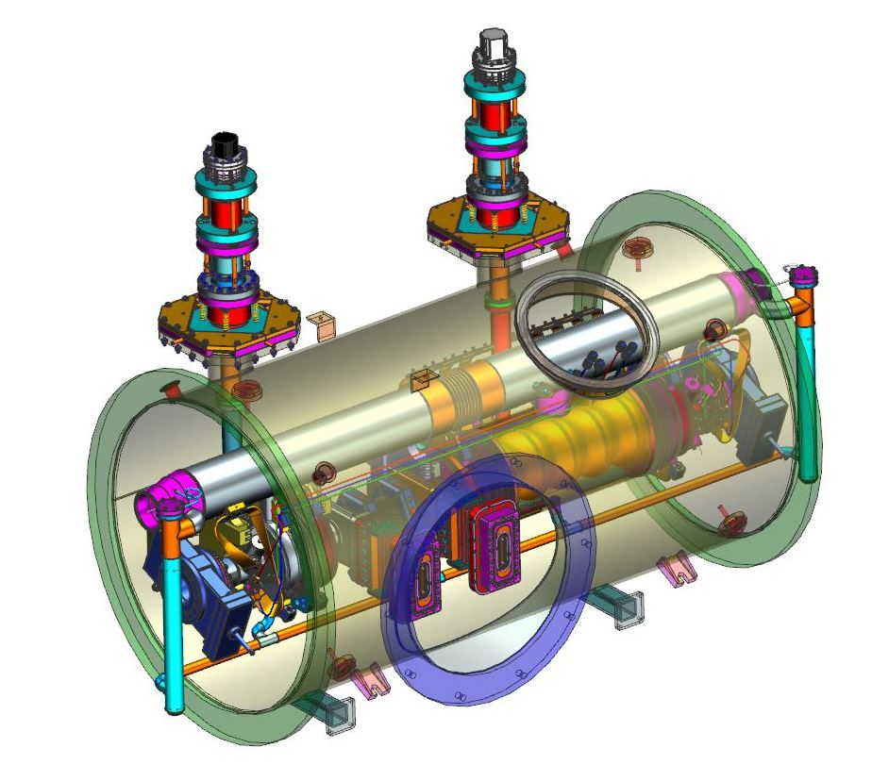
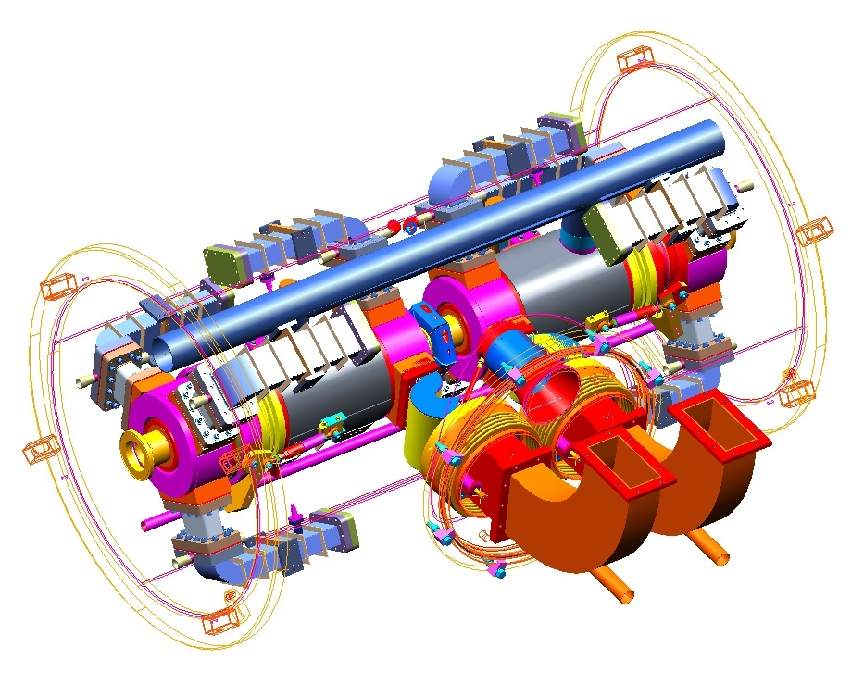
FEL HC design study
For FEL upgrade we looked at a new high-current 5-cell cavities that would fit in old cryounits
Also for new CEBAF cryounit (same insertion length)

Slide 4
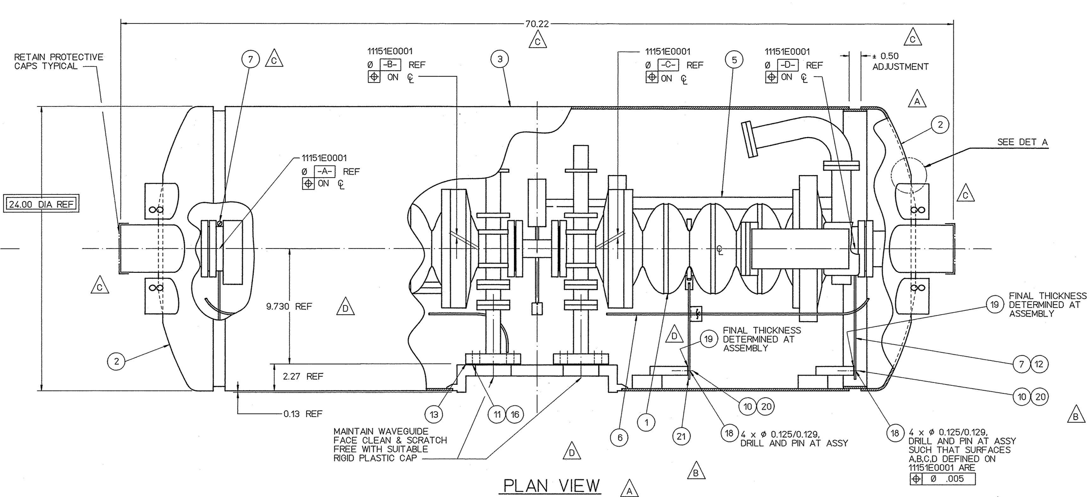
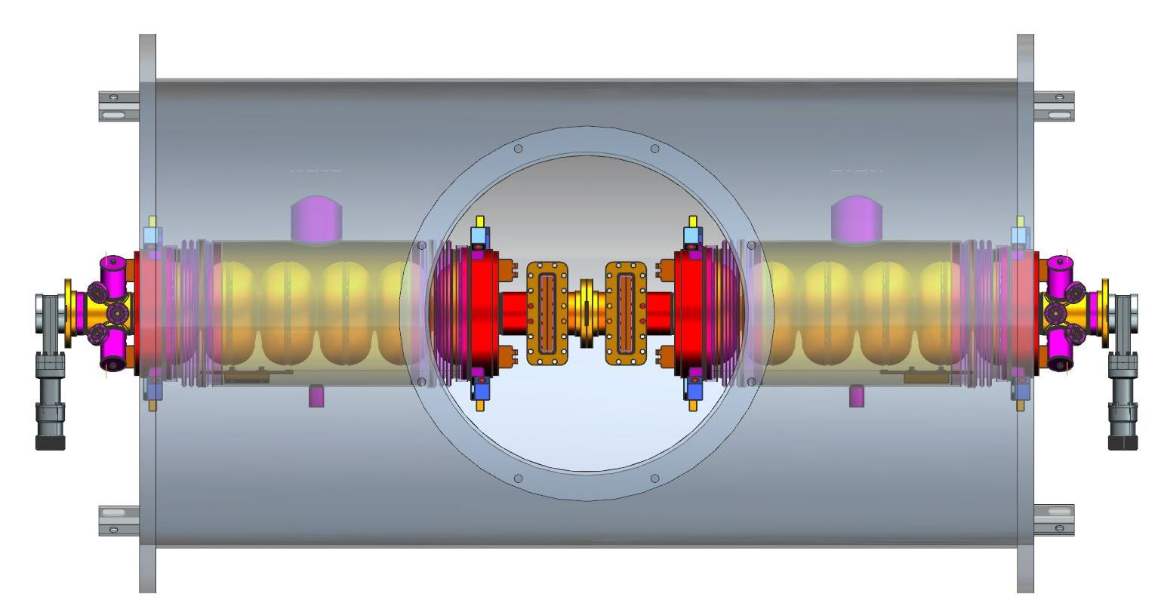
6-cell C75 cavity
Squeeze 6-cell cavity into space in pair
Eliminate separate helium vessel hubs
Use C100 center type waveguide interface
Use C100 type HOM cans instead of waveguides
Significant engineering needed to make it real
New tuner required? (Rock-crusher or blade type?)
Separate helium vessels

Slide 5
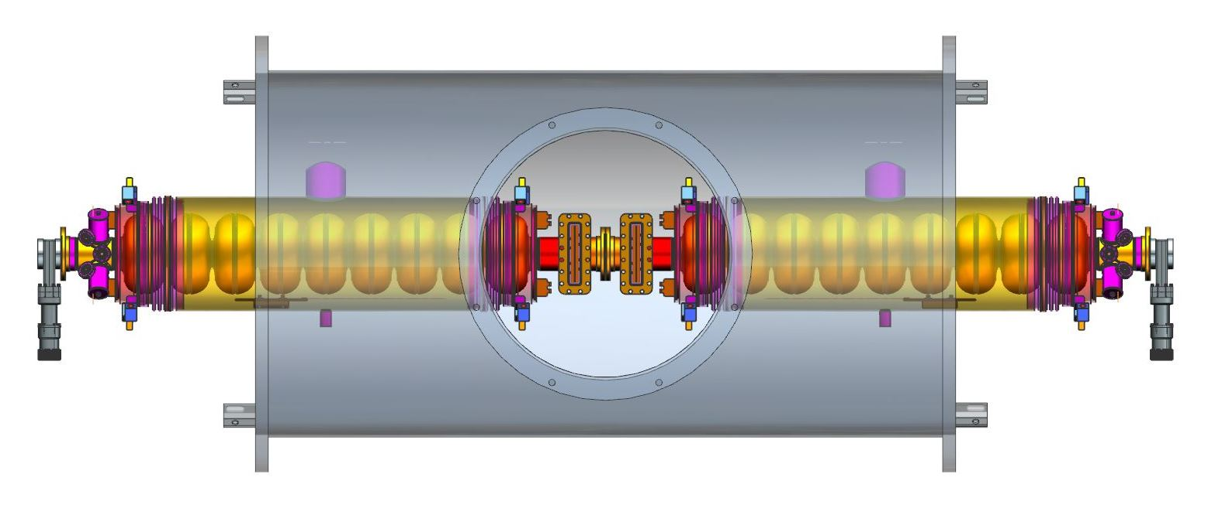
“J100”
Jay’s 12 GeV proposal:
6 x 9-cell cavities
~18.5 MV/m average
Stretched CEBAF type pairs, extended vessels
Higher power ~17 kW FPC, klystrons (but fewer)
What about J75?
~14 MV/m, ~13 kW tubes, 12 GeV LLRF

Slide 6
CEBAF energy maintenance options
Summary of options and estimated costs
 | cavities | cells/cav | cav length m | Act. length m | fill factor % | voltage (MV) | volts/cav (MV) | gradient (MV/m) | klystron power | unit cost (FY16 M$) | voltage gain (MV) | V/$
C50 | 8 | 5 | 0.5 | 4 | 48.1 | 50 | 6.25 | 12.5 | 6 | 1.51 | 20 | 13.3
C100 | 8 | 7 | 0.7 | 5.6 | 64.4 | 100 | 12.5 | 17.9‡ | 13 | 4.77 | 70 | 14.7
C75† | 8 | 5 | 0.5 | 4 | 48.1 | 75 | 9.4 | 18.8‡ | 8 | 1.91 | 45 | 23.6
C75†* | 8 | 6 | 0.6 | 4.8 | 57.8 | 75 | 9.4 | 15.6 | 8 | 2.31* | 45 | 19.5
J100* | 6 | 9 | 0.9 | 5.4 | 65.0 | 100 | 16.7 | 18.5‡ | ~17 | ??? | 70 | ???
J75* | 6 | 9 | 0.9 | 5.4 | 65.0 | 75 | 12.5 | 13.9 | 13 | ??? | 45 | ???
†New cells or new processing required to achieve higher Q’s and gradients
*Engineering required at additional cost (not included)
‡Digital LLRF required

Slide 7
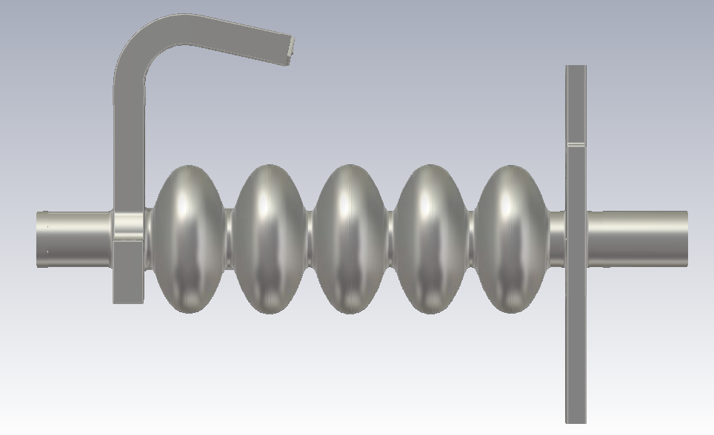
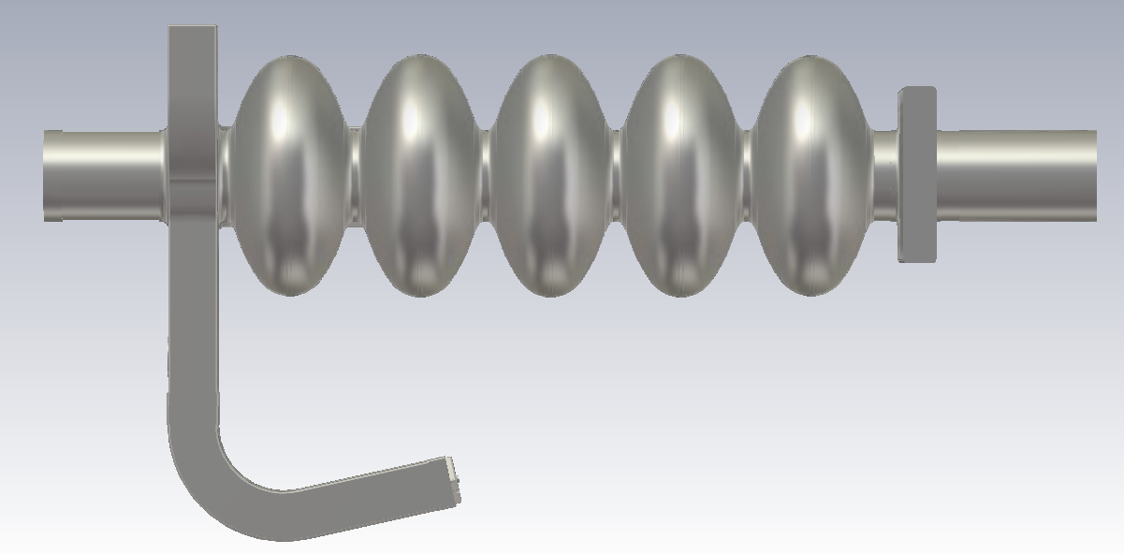
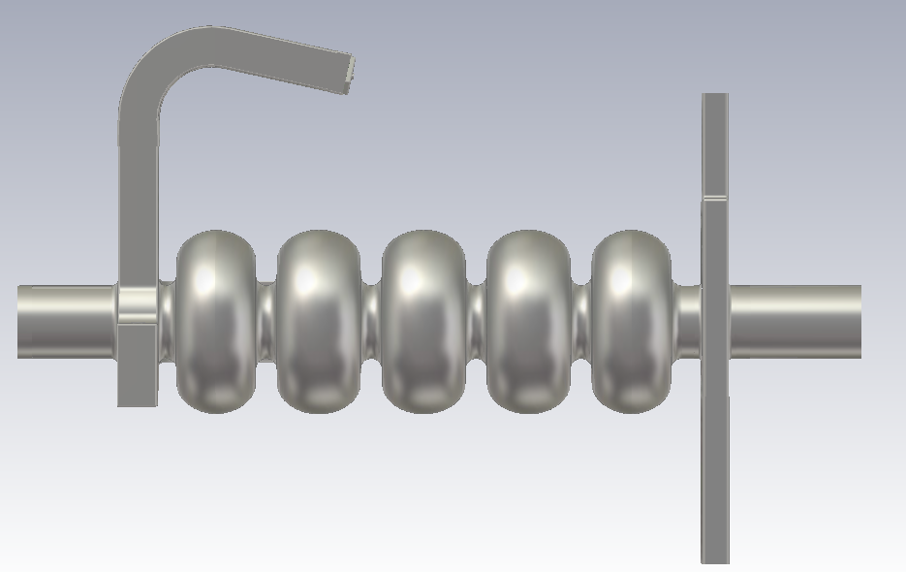
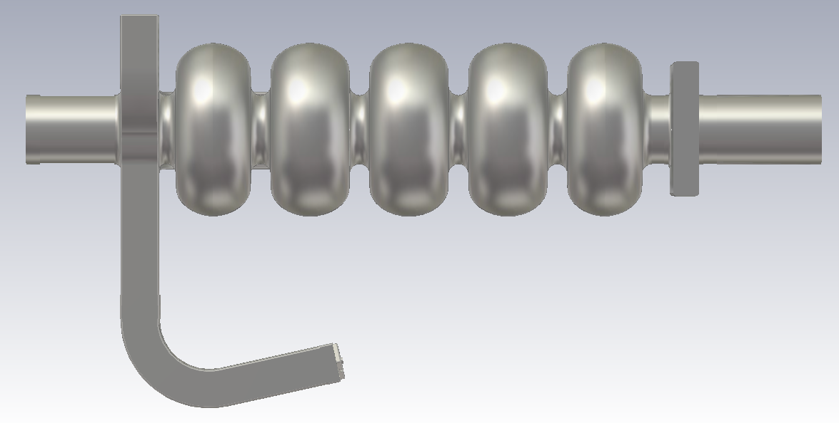
Opt. 3:High Current (HC) Cavity for C50 Cryomodules?
OC 5-cell cavity
HC 5-cell cavity using C50 HOM and FPC endgroup - “HC50”

Slide 8
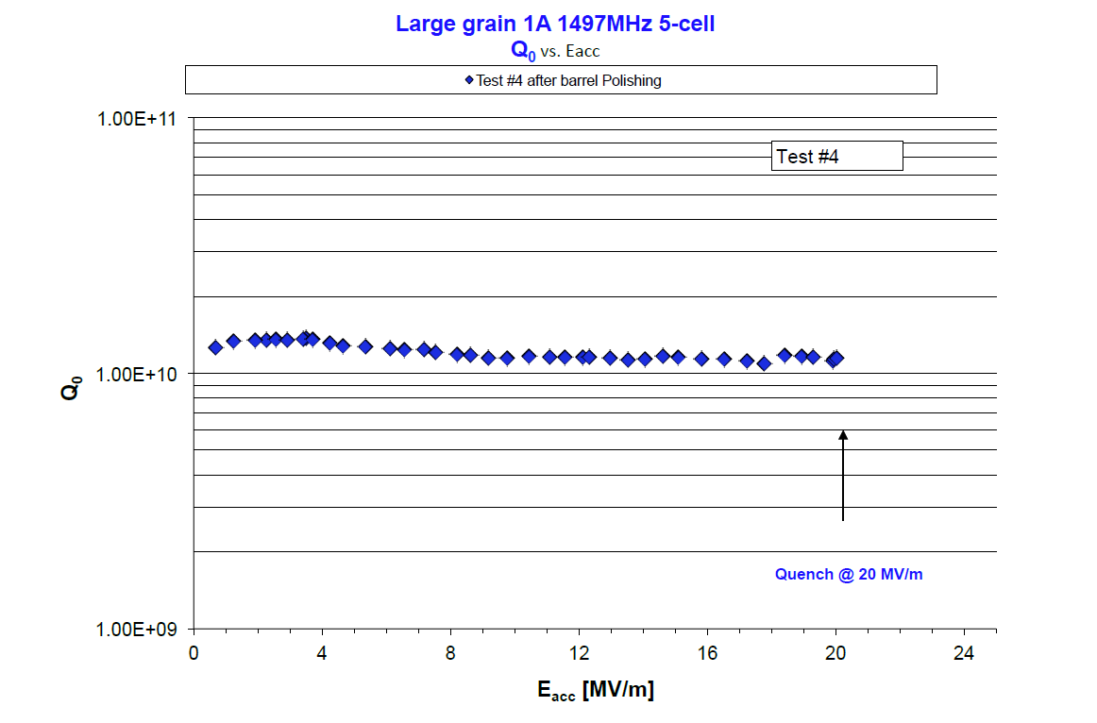
VTA test 1497 MHz HC 5-cell cavity
Large grain with damaged cell from CBP, final BCP
Q₀ ~ 1.1e10 up to 20 MV/m

Slide 9
Cavity Parameters
Parameter | Unit | C50 | HC50
Frequency @ 2 Kelvin | MHz | 1497 | 1497
R/Q (β = 1) | Ω | 482.5 | 525.4
G | Ω | 274.0 | 275.6
R/Q*G | Ω² | 132205 | 144802
tube/iris ID | mm | 70/70 | 70/70
TE11/TM01 cutoff | GHz | 2.51/3.28 | 2.51/3.28
cell-to-cell coupling | % | 3.15 | 3.15
U_{acc} (nominal, on crest) | MV | 6.25 | 6.25
L_{active} (nominal) | mm | 499.855 | 491.600
E_{acc} (nominal @ 50 MeV) | MV/m | 12.50 | 12.71
E_{peak}/E_{acc} |  | 2.56 | 2.45
B_{peak}/E_{acc} | mT/(MV/m) | 4.56 | 4.18
E_{peak} | MV/m | 32.0 | 31.1
B_{peak} | mT | 57.0 | 52.3
P_{cav} (@ Q₀ = 6.8e9) | W | 11.9 | 10.9
P_{CM} (@ Q₀ = 6.8e9) | W | 95.2 | 86.9
At same Q₀ about 1 W reduction of dynamic losses per cavity at 2 K (~10%) at 50 MeV based on cavity design

Slide 10
Cavity Parameters
Parameter | Unit | C50 | HC50
Frequency @ 2 Kelvin | MHz | 1497 | 1497
R/Q (β = 1) | Ω | 482.5 | 525.4
G | Ω | 274.0 | 275.6
R/Q*G | Ω² | 132205 | 144802
tube/iris ID | mm | 70/70 | 70/70
TE11/TM01 cutoff | GHz | 2.51/3.28 | 2.51/3.28
cell-to-cell coupling | % | 3.15 | 3.15
U_{acc} (nominal, on crest) | MV | 6.25 | 6.25
L_{active} (nominal) | mm | 499.855 | 491.600
E_{acc} (nominal @ 50 MeV) | MV/m | 12.50 | 12.71
E_{peak}/E_{acc} |  | 2.56 | 2.45
B_{peak}/E_{acc} | mT/(MV/m) | 4.56 | 4.18
E_{peak} | MV/m | 32.0 | 31.1
B_{peak} | mT | 57.0 | 52.3
P_{cav} (@ Q₀ = 1.1e10) | W | 7.4 | 6.7
P_{CM} (@ Q₀ = 1.1e10) | W | 58.9 | 53.7
At same Q₀ about 1 W reduction of dynamic losses per cavity at 2 K (~10%) at 50 MeV based on cavity design

Slide 11
Dynamic RF losses
Parameter | Unit | C50 | HC50 | ΔP_{RF} (W) | ΔP_{RF} , max (W)
E_{acc} (nominal @ 50 MeV) | MV/m | 12.5 | 12.7 | - | -
P_{cav}(@ Q₀ = 6.8e9) | W | 11.9 | 10.9 | 1.0 | -
P_{cav} (@ Q₀ = 1.1e10) | W | 7.4 | 6.7 | 0.64 | 5.2
50 MeV gain
max.
1.04 W/cav. reduction at same low Q₀ (8.3 W per CM)
0.62 W/cav. reduction at same high Q₀ (5.2 W per CM)
5.19 W/cav. max. reduction with Q₀ gain (41.5 W per CM)
Parameter | Unit | C50 | HC50 | ΔP_{RF} (W) | ΔP_{RF} , max (W)
E_{acc} (nominal @ 70 MeV) | MV/m | 17.5 | 17.8 | - | -
P_{cav} (@ Q₀ = 6.8e9) | W | 23.3 | 21.3 | 2.0 | -
P_{cav} (@ Q₀ = 1.1e10) | W | 14.4 | 13.2 | 1.3 | 10.2
70 MeV gain
max.
2.04 W/cav. reduction at same low Q₀ (16.4 W per CM)
1.26 W/cav. reduction at same high Q₀ (10.1 W per CM)
10.17 W/cav. max. reduction with Q₀ gain (81.4 W per CM)

Slide 12
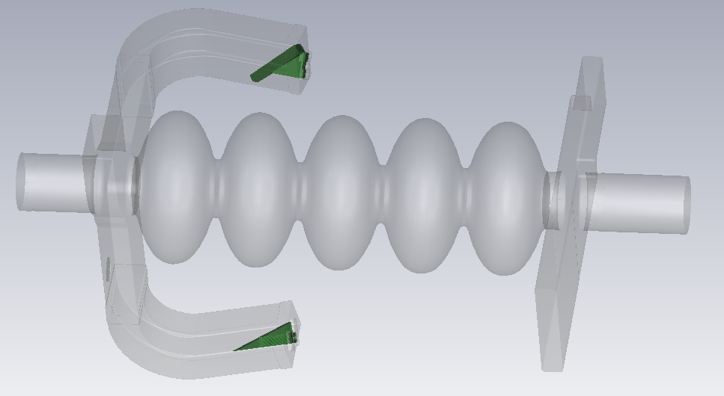
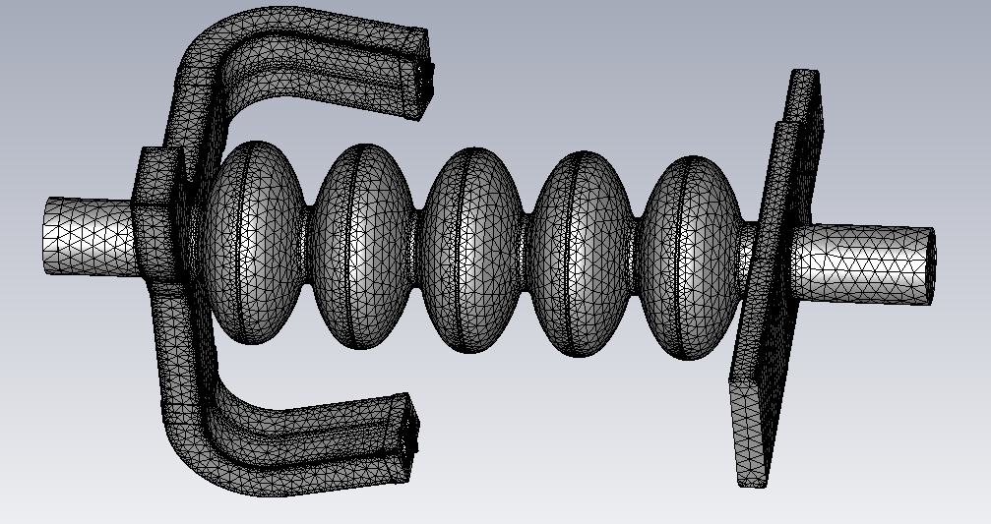
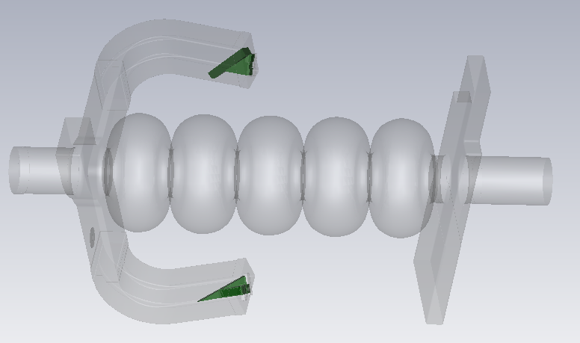
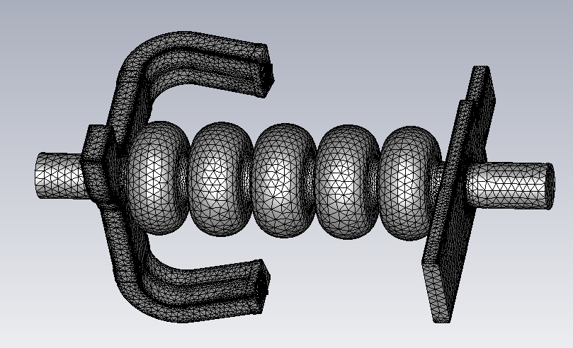
What about HOMs?
C50
“HC50”
Can now model in CST Microwave Studio including HOM loads

Slide 13
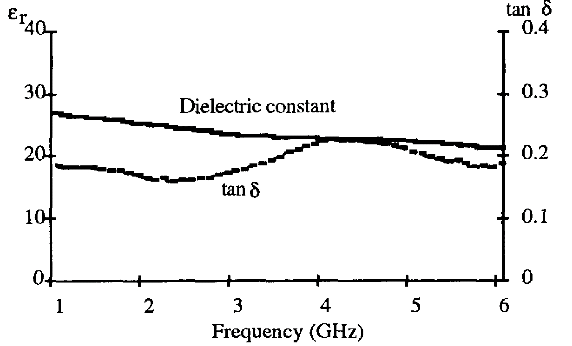
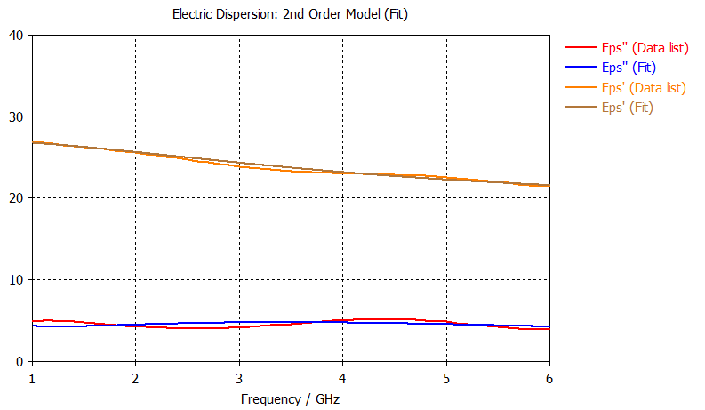
C50-style load
Include material properties in calculation instead of perfect match
material data (I.E. Campisi 1993)
model data (ε‘, ε‘‘)

Slide 14
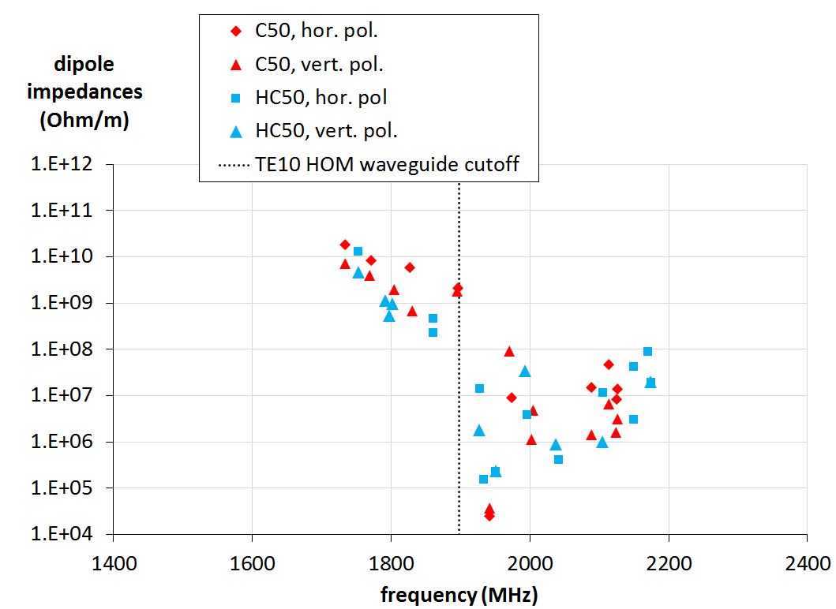
HOM Damping
Damping slightly improved for crucial dipole modes
Modes below HOM waveguide cutoff rely on evanescent field and FPC mode damping

Slide 15
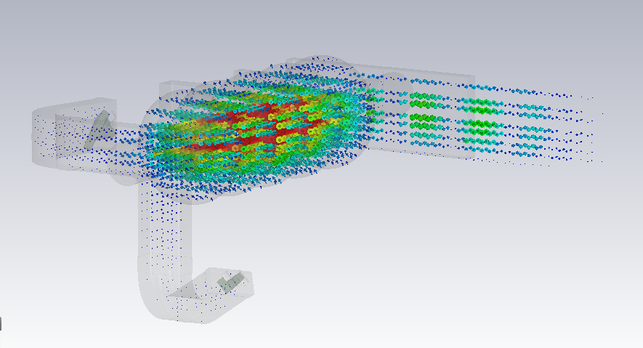
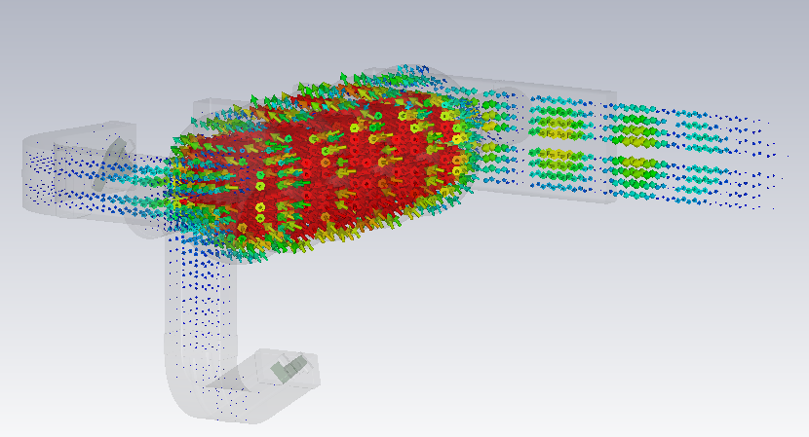
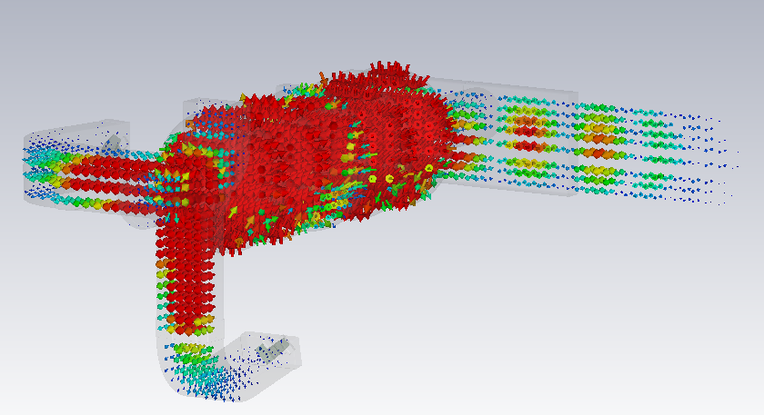
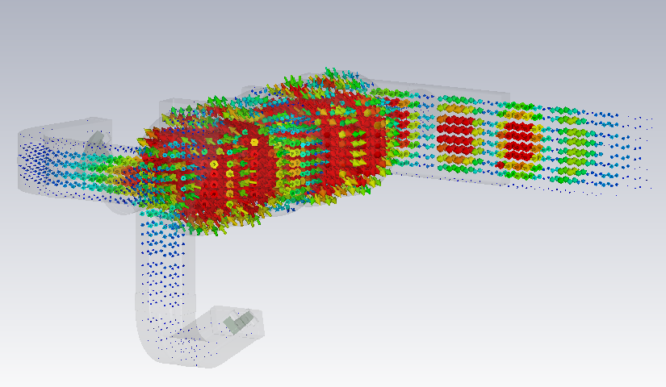
TE111 HOMs below HOM Waveguide Cutoff
1st TE₁₁₁ mode pair (π/7): ~1725 MHz
scale similar throughout (electrical RF field)
FPC TE10 cutoff: 1.1 GHz
more vertically polarized
more horizontally polarized
2nd TE₁₁₁ mode pair (2π/7): ~1760 MHz
more vertically polarized
more horizontally polarized

Slide 16
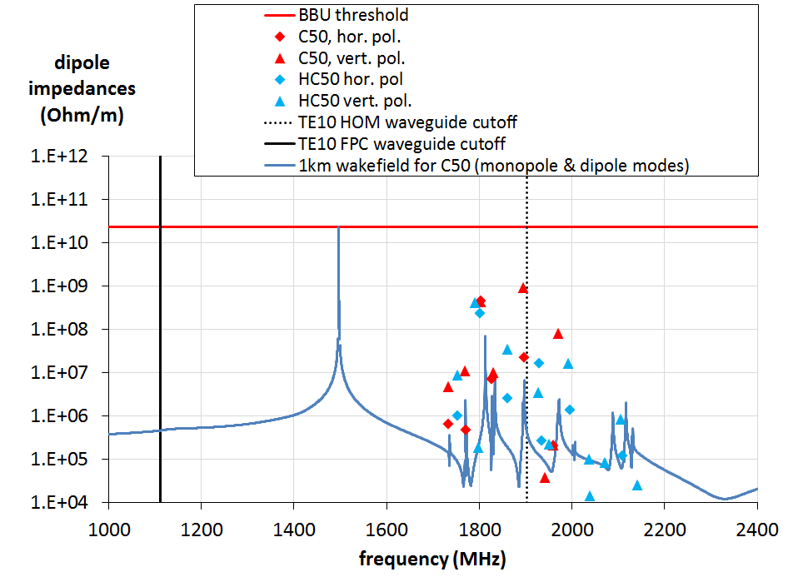
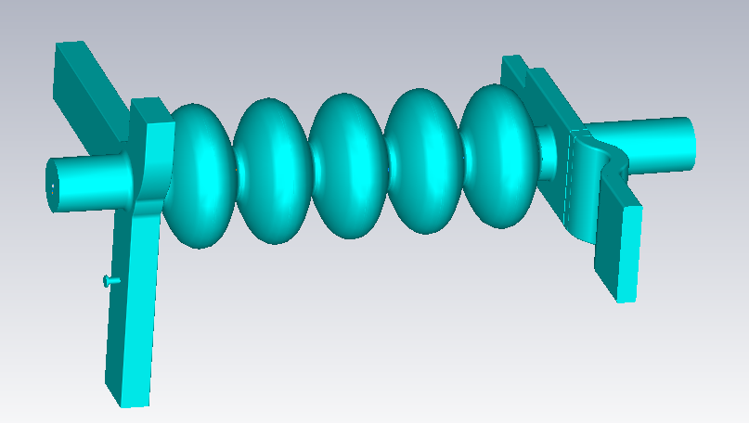
HOM Damping (with FPC damping)
Damping by FPC has impact on modes close to BBU threshold
Monopole Impedances (Ohms)
damping through FPC waveguide included

Slide 17
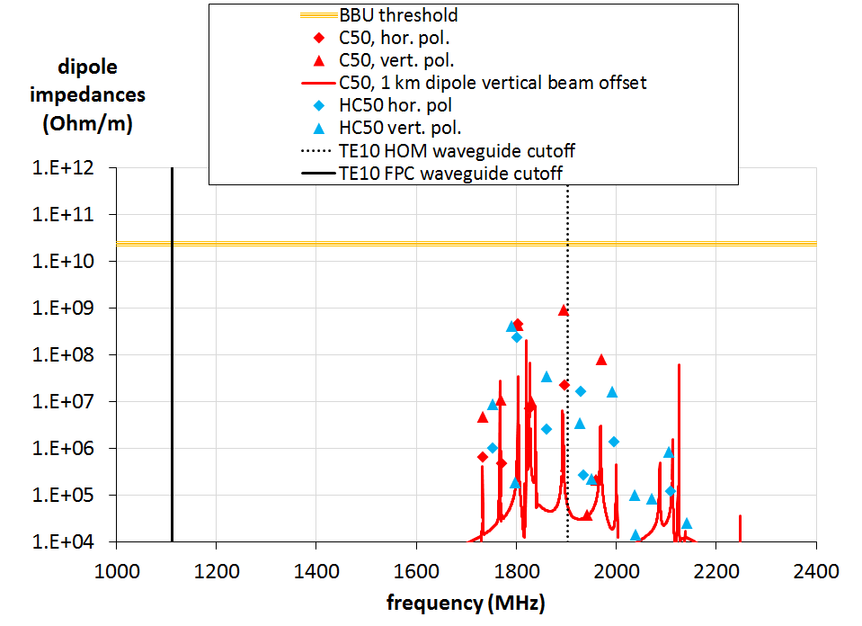
HOM Damping (with FPC damping)
Damping by FPC has impact on modes close to BBU threshold
damping through FPC waveguide included

Slide 18
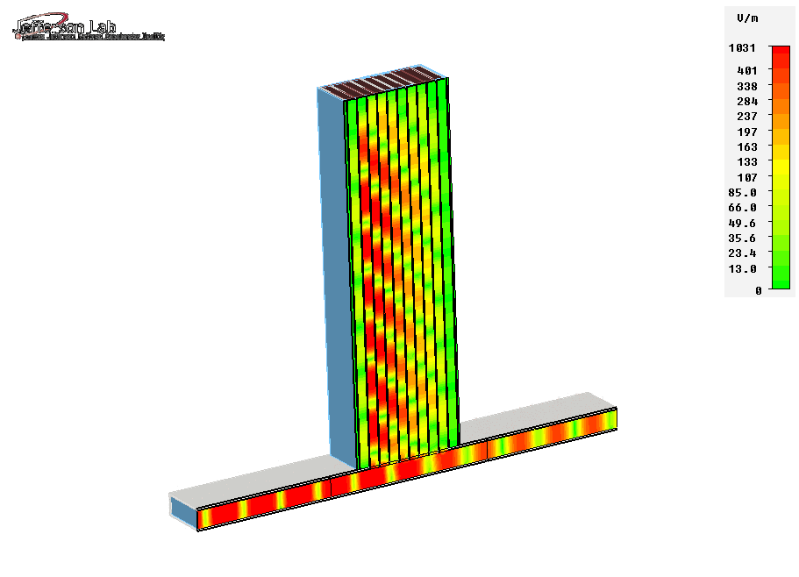
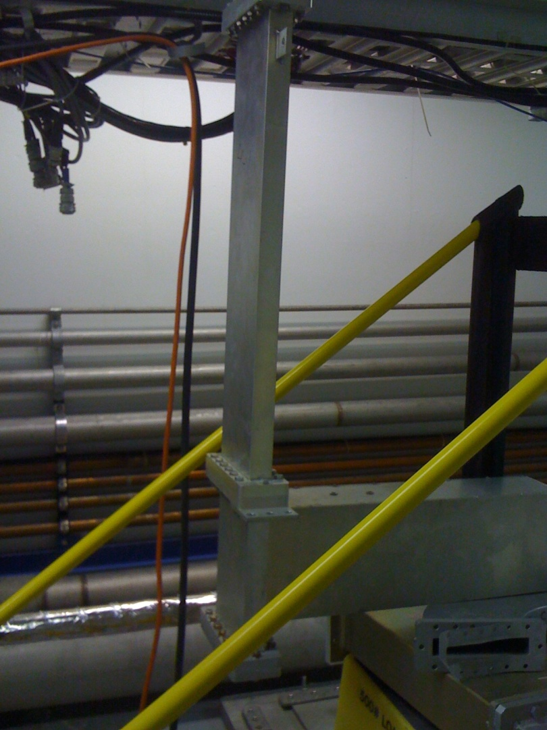
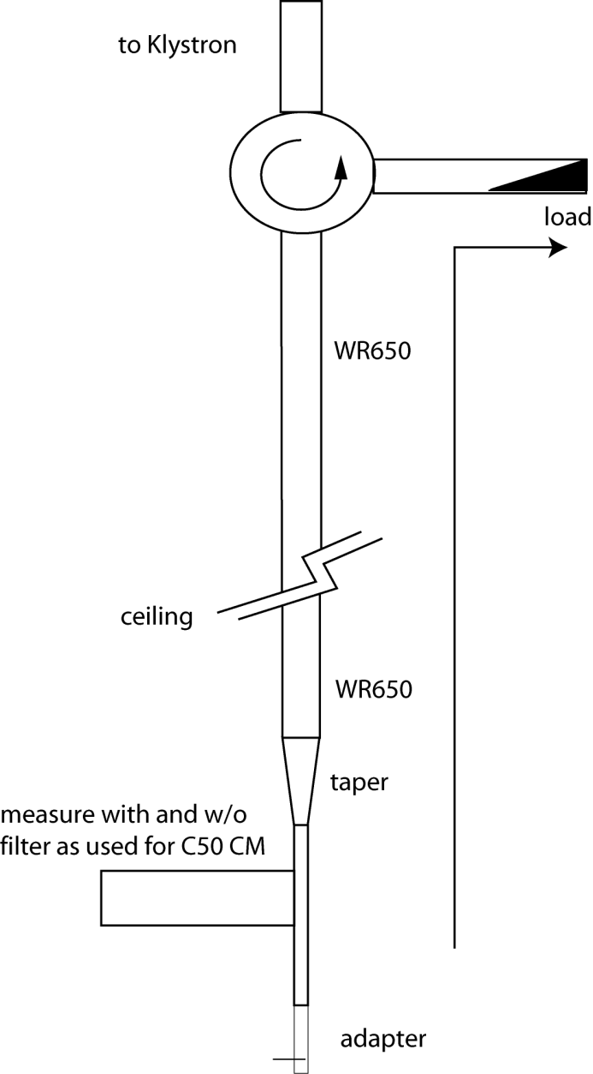
C50 external HOM filters
This was one reason to utilize the CM-external CEBAF filters

Slide 19
Conclusions
Numerous options for improved cost-effectiveness
Magic bullet (still looking…)
Cell transplant
minimum perturbation
Best near term “bang for the buck”?
New cavities
engineering required
Can fix other problems
New cryomodule
more engineering required
May have synergy with MEIC
Possibly cost–effective long term

Slide 20
Proposal
Build two “HC50” cavities using in-stock ingot material and existing spare end groups
We have the dies
We have the material but needs slicing (~15k)
Process and test in VTA
If good insert into next available C50
Cost ~50k, mostly shop, e-beam welding and chemistry/VTA

Slide 21
Back up

Slide 22
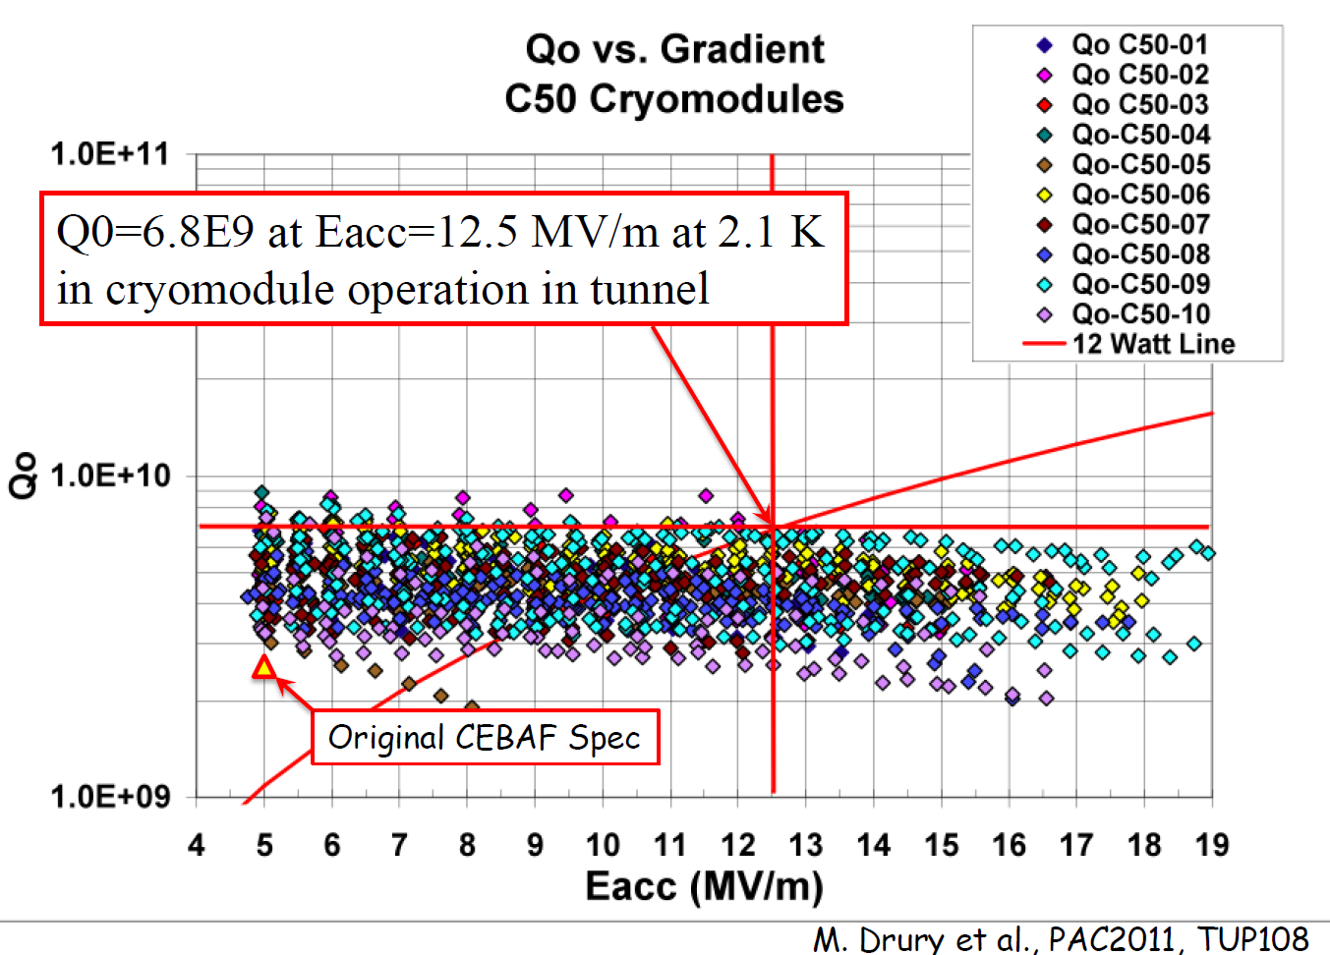
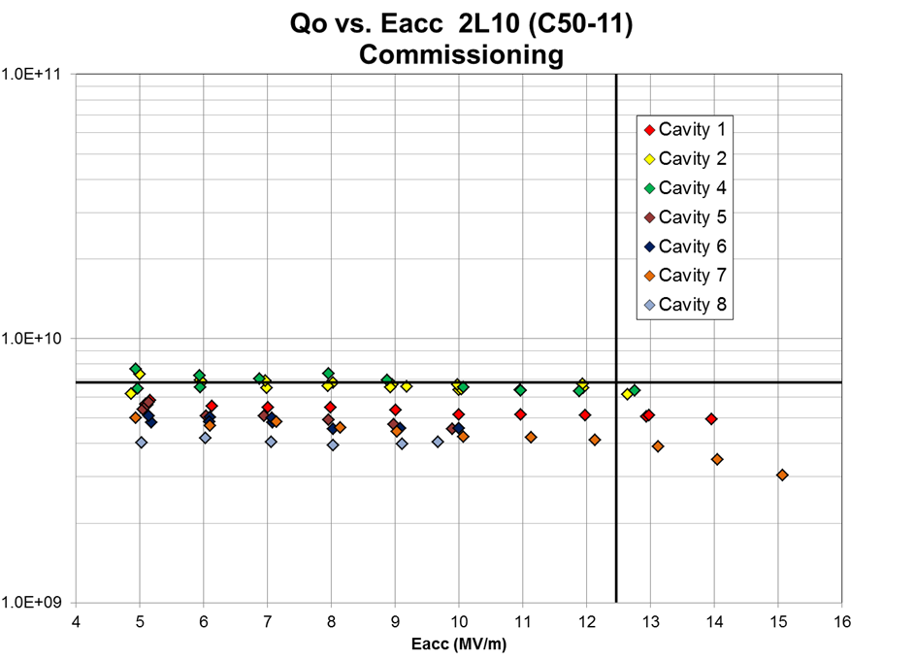
CEBAF SRF Workshop (April 2014)
C20: met Q₀ = 2.4e9 at 5 MV/m at 2K → 45 W dynamic load per CM
C50: Q₀ target 6.8e9 at 12.5 MV/m at 2.1 K →~100 W dynamic per CM (M. Drury, PAC07, WEPMS059)
C50-11 Q0 Analysis (Rongli Geng): No cavity reached target Q₀ in CEBAF tunnel during commissioning, on average factor 2 lower Q₀
Observation: Q₀ = 5e9 at 6 MV/m similar to 1992 commissioning, i.e. no improvement by refurbishment at 6 MV/m
But Q₀ > 1e10 at 12.5 MV/m in VTA)

Slide 23
CEBAF SRF Workshop (April 2014)
C50-11 Q0 Analysis (Rongli Geng)
At same Q₀ about 1 W reduction of dynamic losses per cavity at 2 K (~10%) at 50 MeV based on cavity design

