Slide 1
Upgrade Injector Test Facility: UITF
Why Build It?
HDIce commissioning
Bubble chamber physics with Bremsstrahlung x-rays: photo-disintegration of oxygen into helium and carbon
In support of parity violation experiments, and CEBAF operations in general: pockels cell improvements, low noise floor current monitors, low current beam position monitors, etc.,
Commission the new ¼ cryomodule before installation at CEBAF
Polarized positron source development
MEIC related: magnetized beam at high current/high bunch charge, fast kicker
THz light source, drive an SRF cavity with magnetrons?
Isotope production experiments? Beam with orbital angular momentum?
CEBAF related

Slide 2
UITF Beam Specifications
Approved for HDIce beam conditions: up to 100nA average current at 10 MeV
Working with RadCon to find a shielding solution for 100uA average current at 10 MeV (e.g., for Bubble Chamber): additional global shielding, local shielding at dumps, beamloss monitors for quick shutdown
Expect photogun to provide milliampere average beam current: a proving ground for demonstrating feasibility of polarized beam physics at JLab FEL/ERL
85% polarization, Wien filter for spin manipulation, accurate Mott polarimeter
350kV gun, so higher bunch charge capability compared to CEBAF, 100pC instead of 1pC. Beam quality should be improved, too (energy spread, emittance and bunchlength)
Discretely variable bunch repetition rates 1497/2n MHz

Slide 3
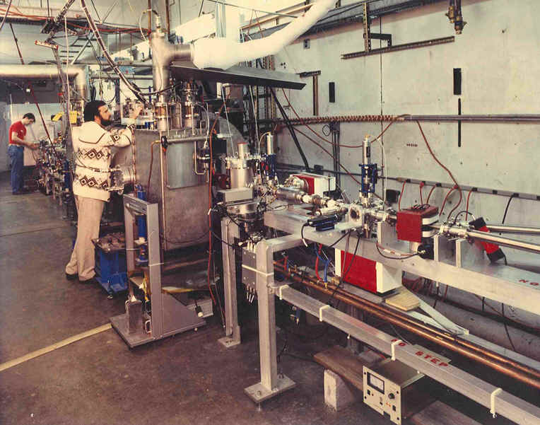

Slide 4
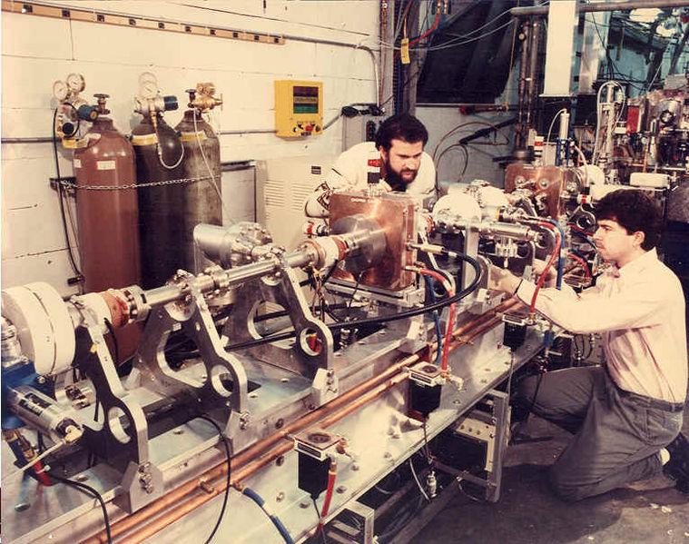

Slide 5
Schedule
Schedule Milestones
Civil Work Complete | November, 2015
(select demolition, stairs to Cave1, Electric, HVAC, installation of concrete block, structural support added, poured in place concrete, ceiling tiles can be installed later)
Demonstrate Gun happy at 350 kV at FEL GTS | December, 2015
(need new insulators and Carlos Hernandez-Garcia)
Commission cold 1/4 CM, no beam | January, 2016
(requires LHe, ODH system, high power and low level RF to 1/4 CM, software, PSS and Safety approval)
Beam from Gun to Cup in front of 1/4 CM | March, 2016
(requires gun and HV power supply inside SF6 tank, baked beamline, powered racks above Cave1, select I&C, select DC Power, no RF necessary but would be nice to have, more software, PSS, approved shielding and procedures)
Beam through 1/4 at MeV energy delivered to cup in front of HDIce | June, 2016
(requires all the above + MPS, all RF control, all magnets, all I &C, all software, all required documentation)
Beam to HDIce | August, 2016
Physics is OK with this date

Slide 6
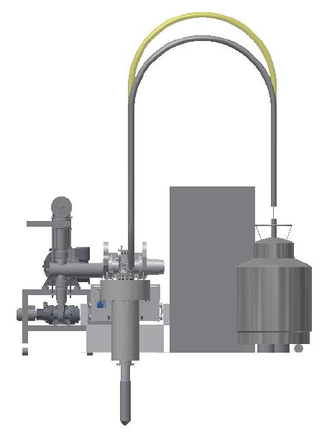
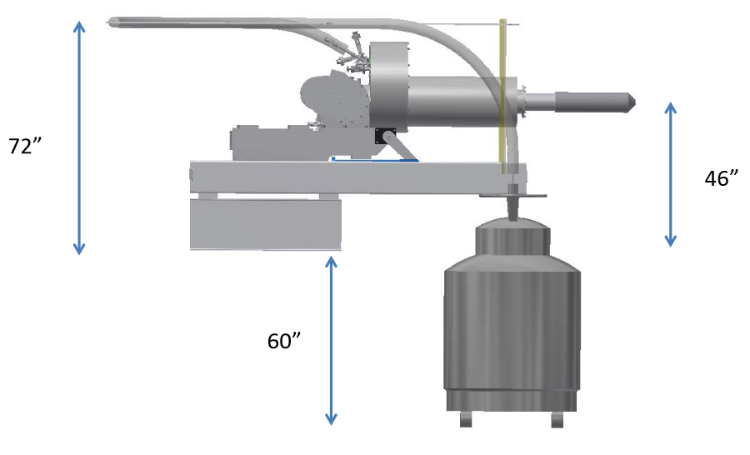
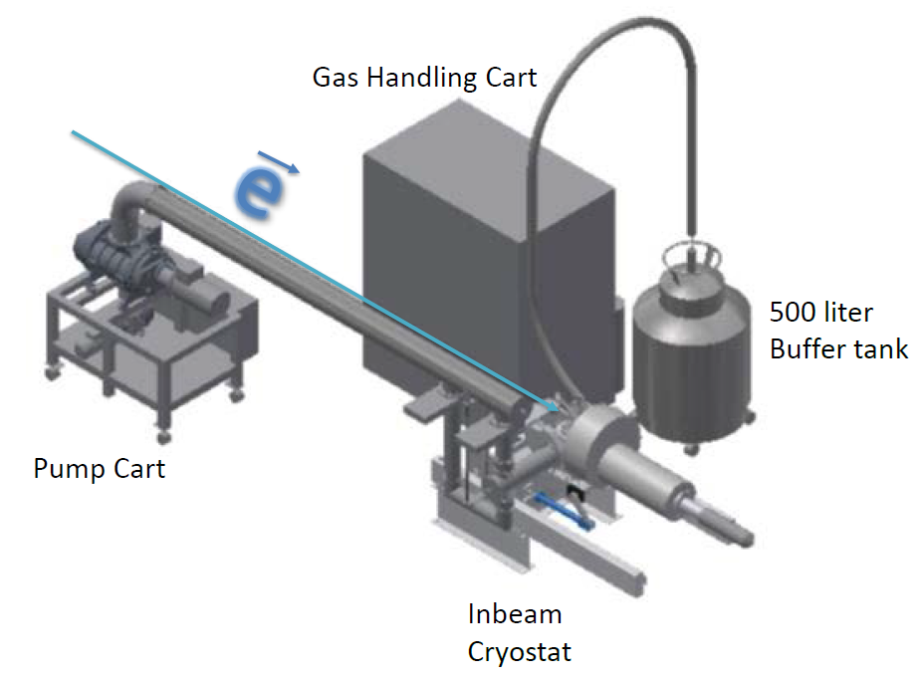
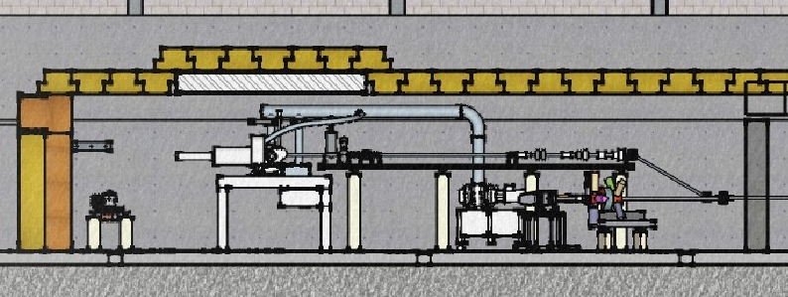
HDIce
Horizontal to take beam, Vertical for “loading” into cryostat
Unwieldy plumbing, Lots of ancillary equipment
We chose “No Pit” option, build a vertical chicane, taller section added to Cave

Slide 7
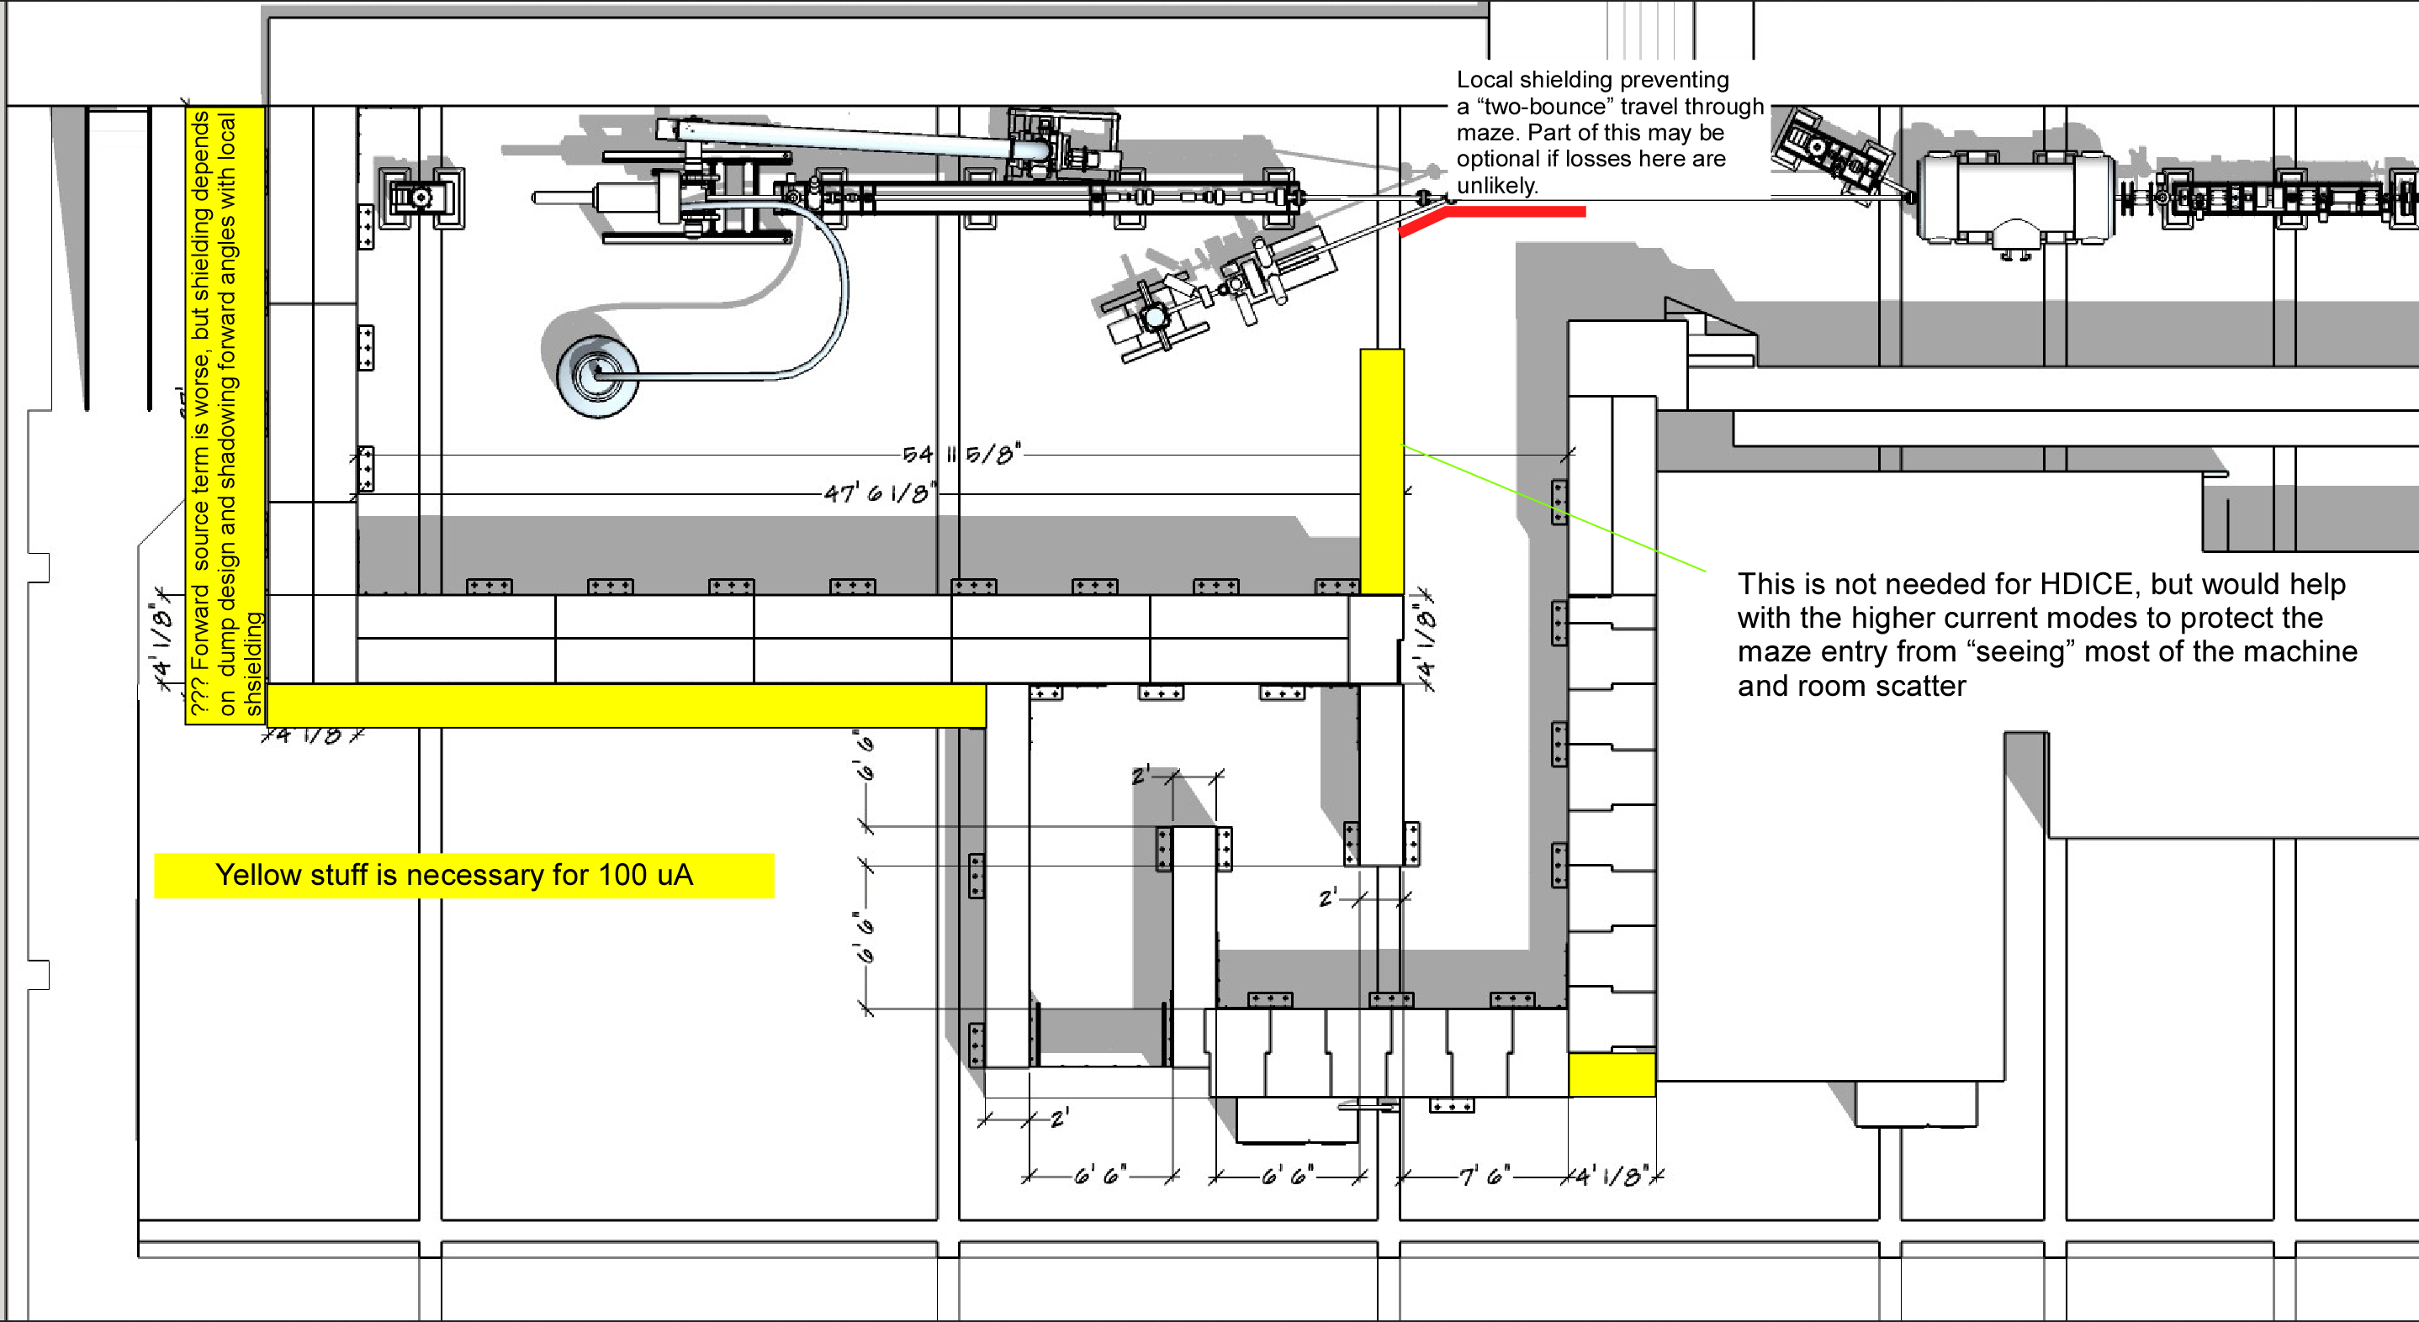

Slide 8
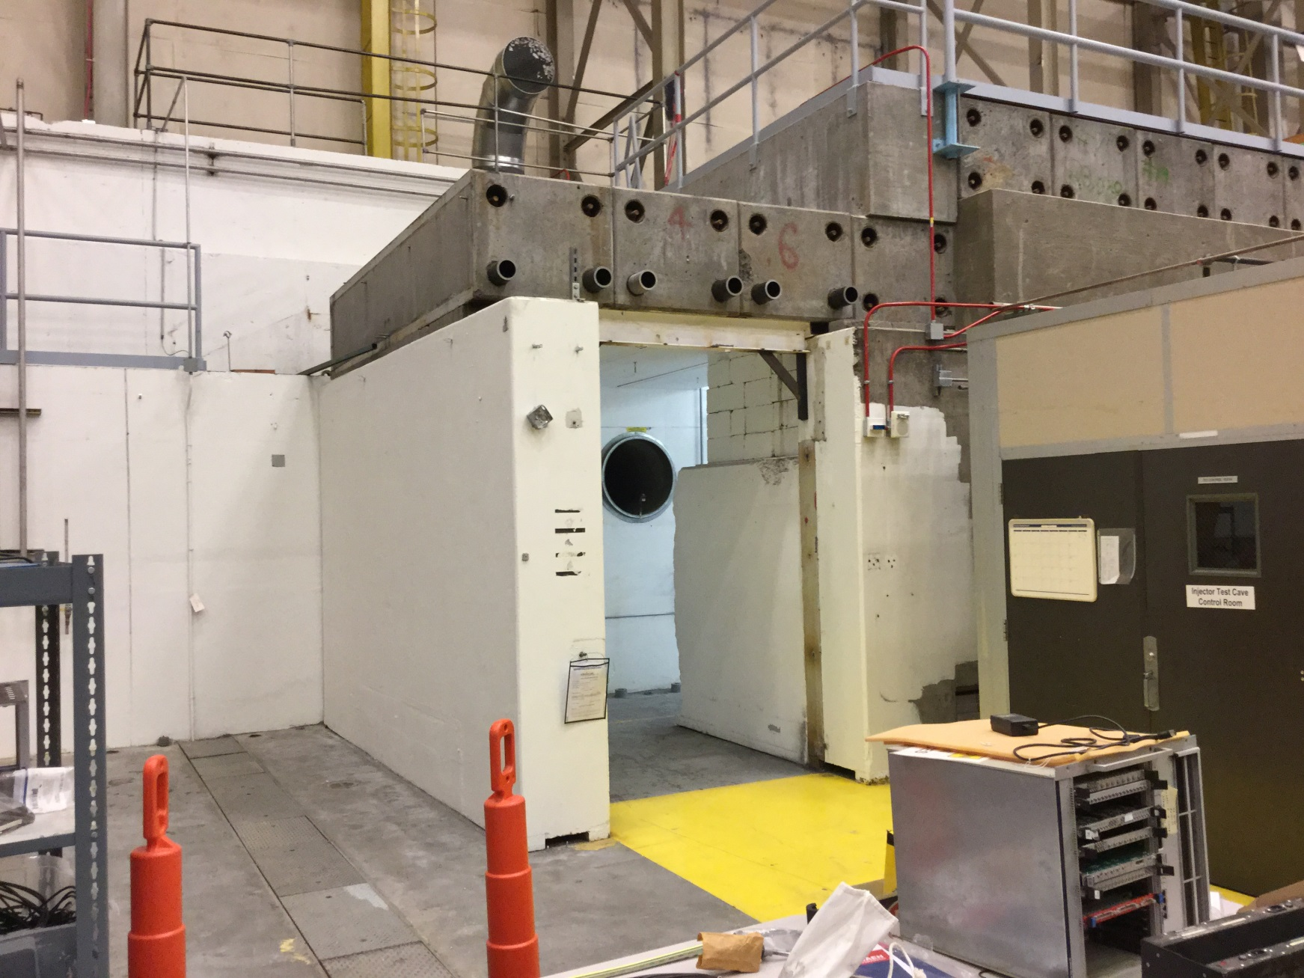
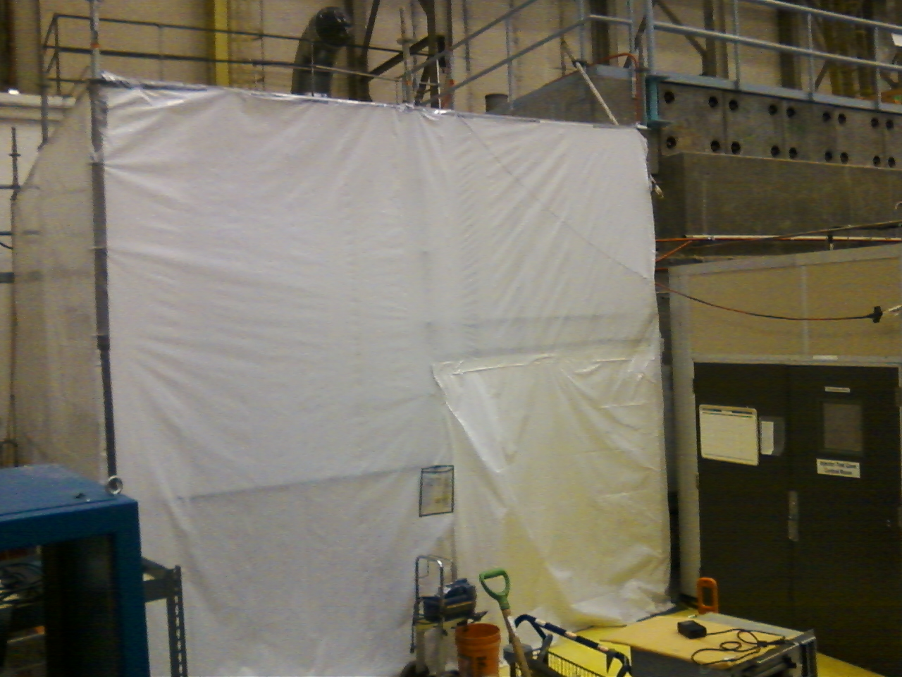

Slide 9
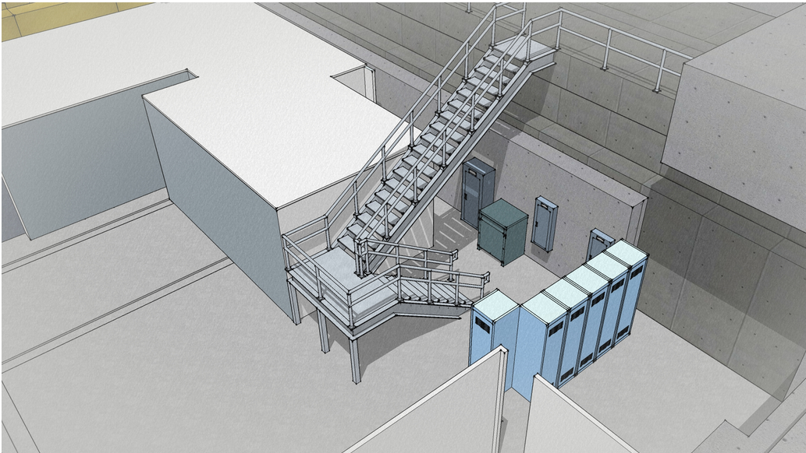
New stairway happens end of Summer

Slide 10
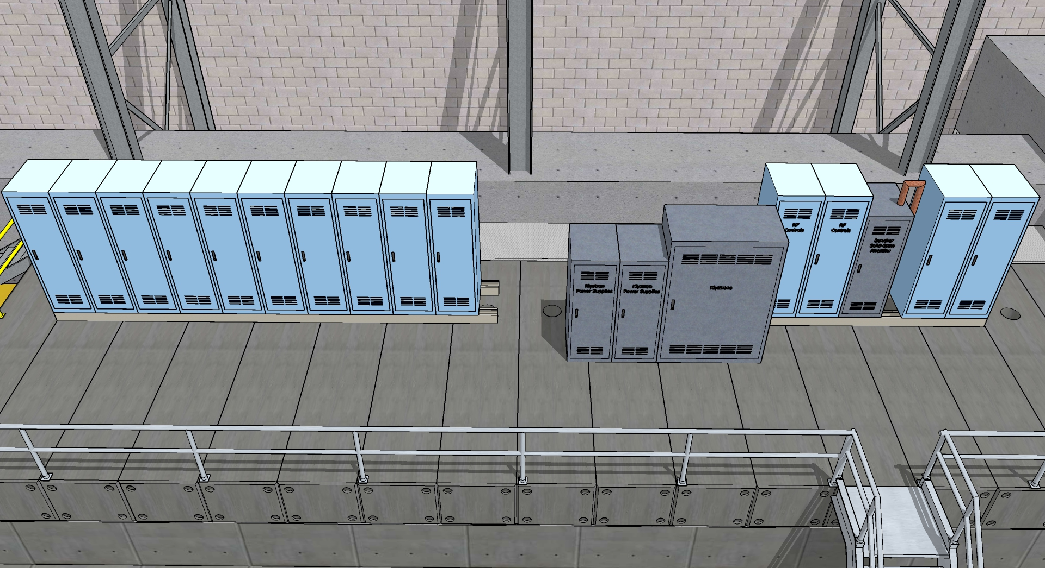
Rack layout, version 1

Slide 11
Today’s layout, ready to cut metal…..
Cryo lines hug the wall, waveguides on same side as cryo lines
Heat exchanger added to the mix, Rao says this will make things more efficient and stable

Slide 12
Cryo lines compatible with old and new ¼ CM…
Looks similar to our “upgrade injector” front end

Slide 13
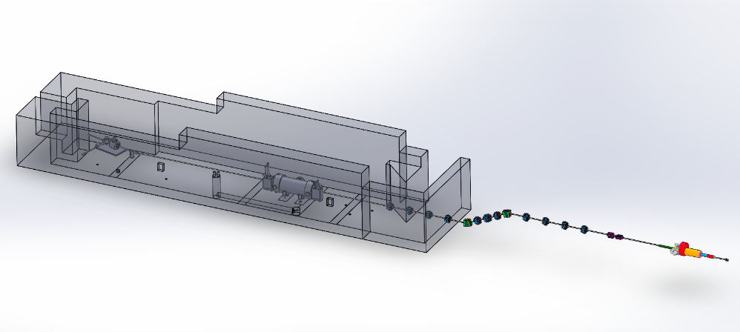
Haven’t started designing the MeV beamline yet…

Slide 14
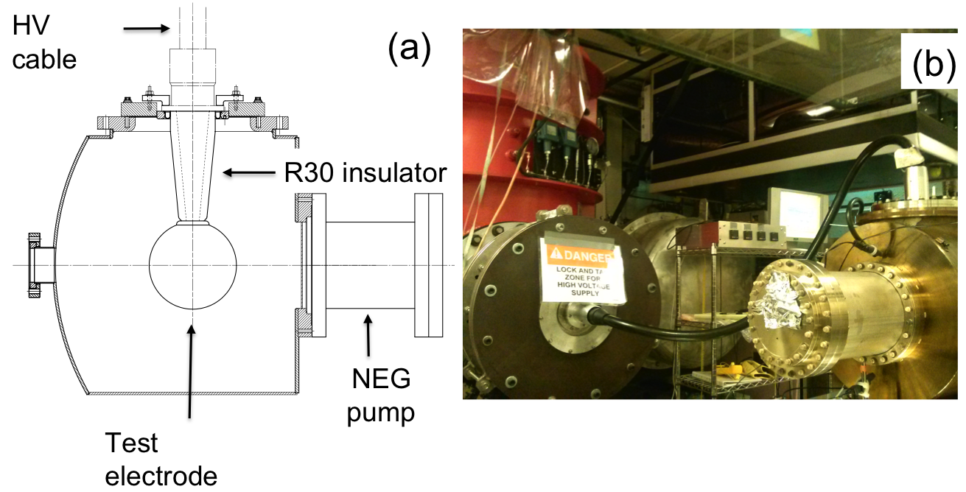
Building the 350 kV Gun
Start with “dummy” electrodes and test different insulators and cathode screening electrode
Notes:
Interior Page Design 2

Slide 15
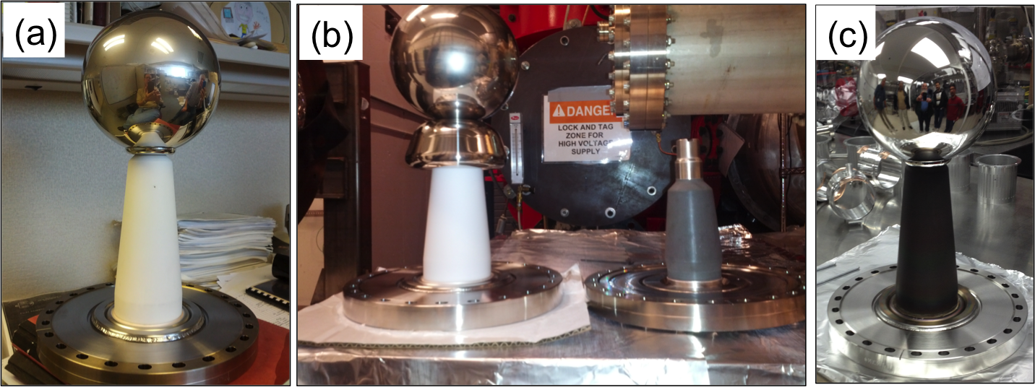
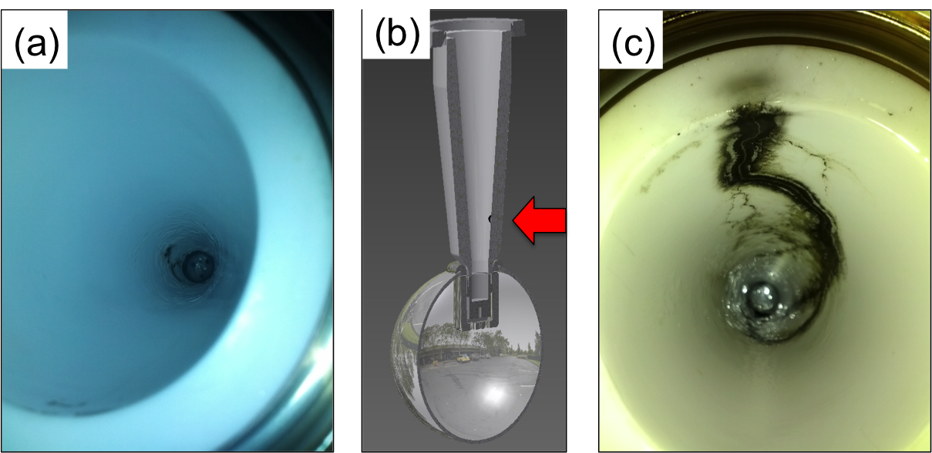
Notes:
Interior Page Design 2

Slide 17
5 MeV electrons on thin gold foil
12 ns round trip time
499 MHz (2ns)
Gold
0.1 um
Won’t things be worse for HDIce?
Gold
1.0 um
Gold
10 um

Slide 18
Resources Needed
Facilities: Demolition and Cave2 structural integrity, AC power and lighting, HVAC, fire suppression, LCW and stairway to top of Cave1, door or gate to new Cave2 (0.8 FTE)
Engineering: Cryo, helium to ¼ CM and HDIce (2 FTE)
Engineering: Mechanical design of beamline (1.5 FTE)
Engineering: Instrument & Control, viewers, BPMs, valves, etc., (1 FTE)
Engineering: DC Power for magnets (~ 60 magnet channels) (0.3 FTE)
Engineering: Low level and high power RF (up to 8 devices) (4 FTE)
Engineering: Safety System Group – ODH, PSS and MPS (0.3 + ~ 2FTE)
Engineering: Survey and Alignment (0.5 FTE)
Accelerator Operations: Software control of all elements, network connections and terminals in control room (1.25 FTE)
Accelerator CIS: dc high voltage gun, beamline optics modeling, beamline construction, make and deliver the beam to User (1.25 FTE)
Physics: Cave design, concrete block placement, and HDIce team
and EHS&Q….

Slide 19
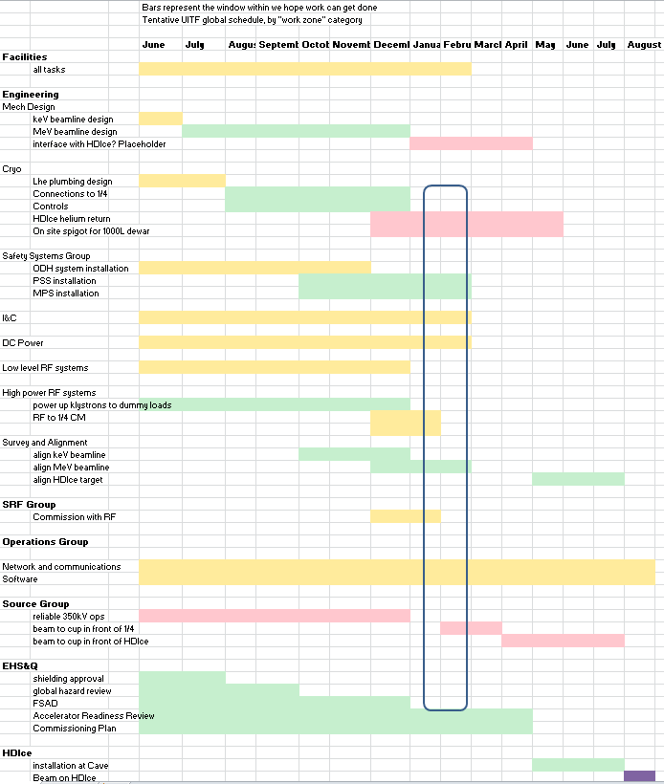

Slide 20
AWP Planned FY15 activities
Facilities: Cave1 demolition, electric, assess Cave2 proposed design, HVAC, fire suppression, new stairway to Cave1 roof. Civil work to extend into FY16
Engineering Mechanical Design of beamline
Engineering Cryo: LHe to the cave, supply and return lines, controls: plus heat exchanger, more in FY16.
Engineering Safety System Group: ODH system
RF procurements, magnets, BPM electronics. We have budget for other stretch goals…
AWP Planned FY16 activities
All the rest of the work

Slide 21
Concerns
Adding another LHe User to the already-taxed CTF refrigerator
Need to vet beamline design with on-site experts, it’s got to work….
Hopefully we appreciate all HDIce requirements (raster, low energy e-beam through 5T solenoid – will beam make it to dump?, what about scattered electrons from dump? Do they return to de-polarize target?). Team HDIce meets with us regularly
Rad Con approval, adequate shielding, for projects beyond HDIce?
Documentation: FSAD, ODH, OSPs, Physics and Accelerator Readiness Reviews, etc.,
After construction, there will be costs to operate it

Slide 22
On the other hand…
What a great opportunity for us. Hope you feel enthusiastic about working on this project…

Slide 23
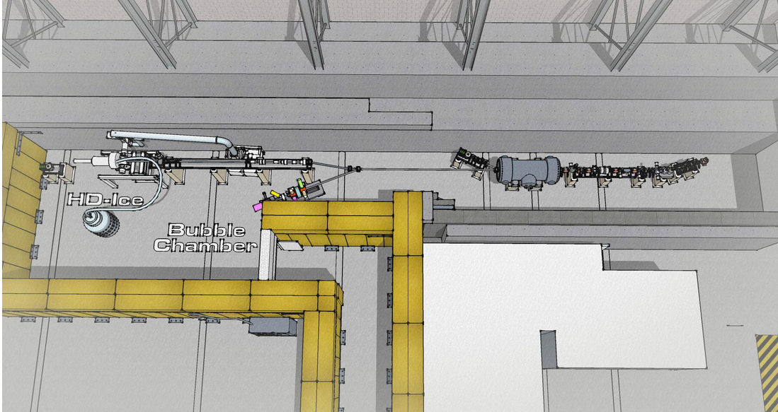
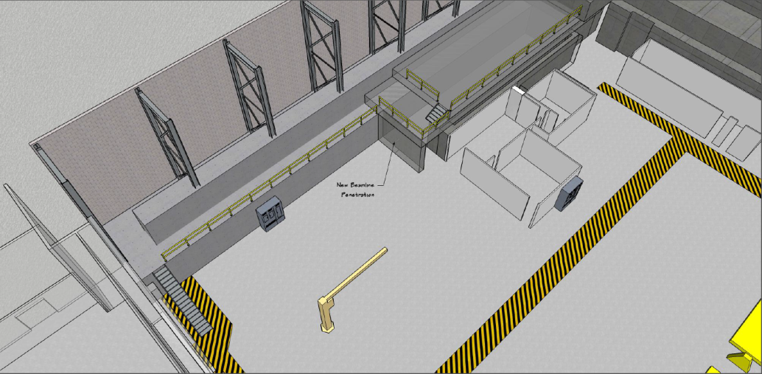
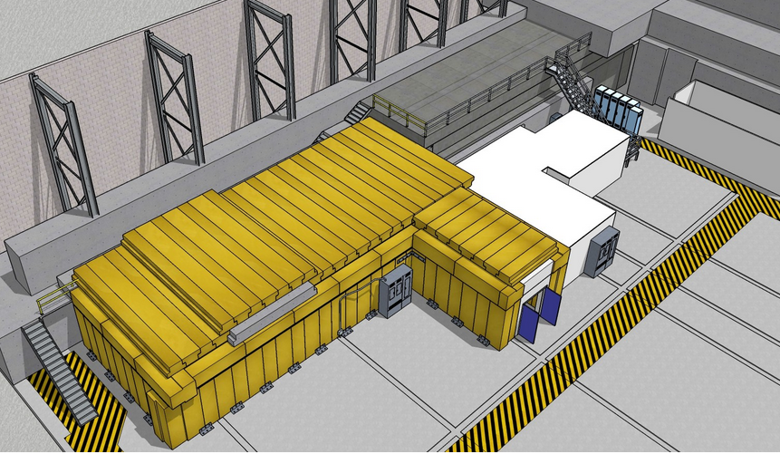
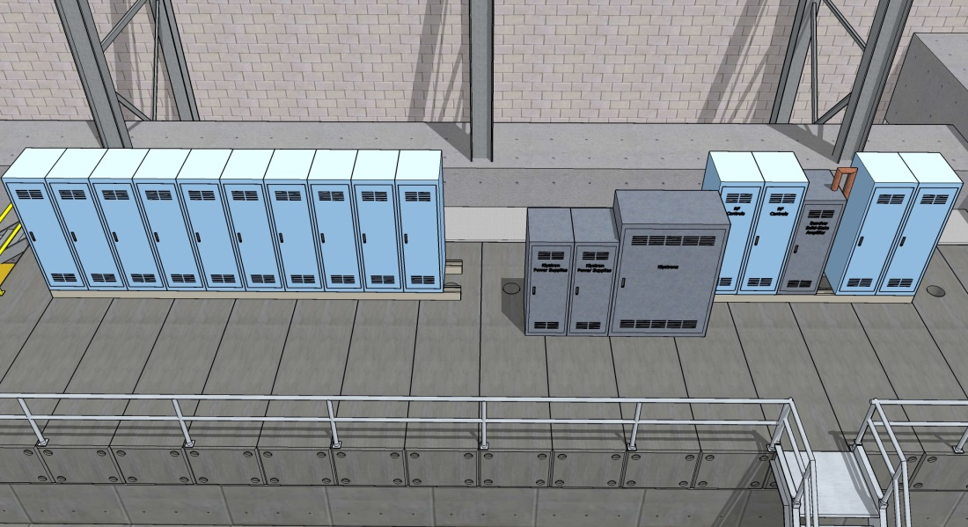
drawings by Walt Akers
beamline design and entry/exit need work
Today
UITF as imagined
need to refine rack layout, AC power, add stairs

