Slide 1
New Ideas & Approaches to Raise CEBAF Q₀
- Initial Results and Proposed Studies
Rongli Geng, Gigi Ciovati
July 15, 2015
2015 OPS StayTreat

Slide 2
Outline
Introduction
Factor of 2 change in Q₀ from evaluation at VTA to placement in CEBAF
Sources of change and mitigation
  Understanding from past and present effort
  Mitigations implemented and planned
New opportunities
  Frozen flux reduction by Cryogenic Thermal Annealing (CTA)
  Whole-module degaussing
  Impurity doping refurbishment cavities?
Proposal for new studies and tests
Conclusion

Slide 3
Introduction
Upgrade done. CEBAF has entered into new era of operation for NP.
  320 5-cell cavities plus 80 7-cell cavities in north- & south- linacs
  High gradient (15-20 MV/m) in CW operation
    Unprecedented
    Unique large SRF linac – pushing reliability envelope
Energy reach is crucial for CEBAF capability
  Ultimate energy reach is constrained by Q₀ given fixed cavity shape and cryo-plant capacity (also RF source and LLRF)
Energy efficiency is critical for sustainability
  CEBAF needs to catch up in next few years for efficiency competitiveness
    CEBAF: 2 GeV, 10 kW @ 2K
    LCLS-II: 4 GeV, 8(4) kW @ 2K
Seeking for establishment of new project to raise Q₀ of installed cavities in CEBAF: (a) without moving cryomodules out of tunnel;(b) within on-going C50 refurbishment effort.

Slide 4
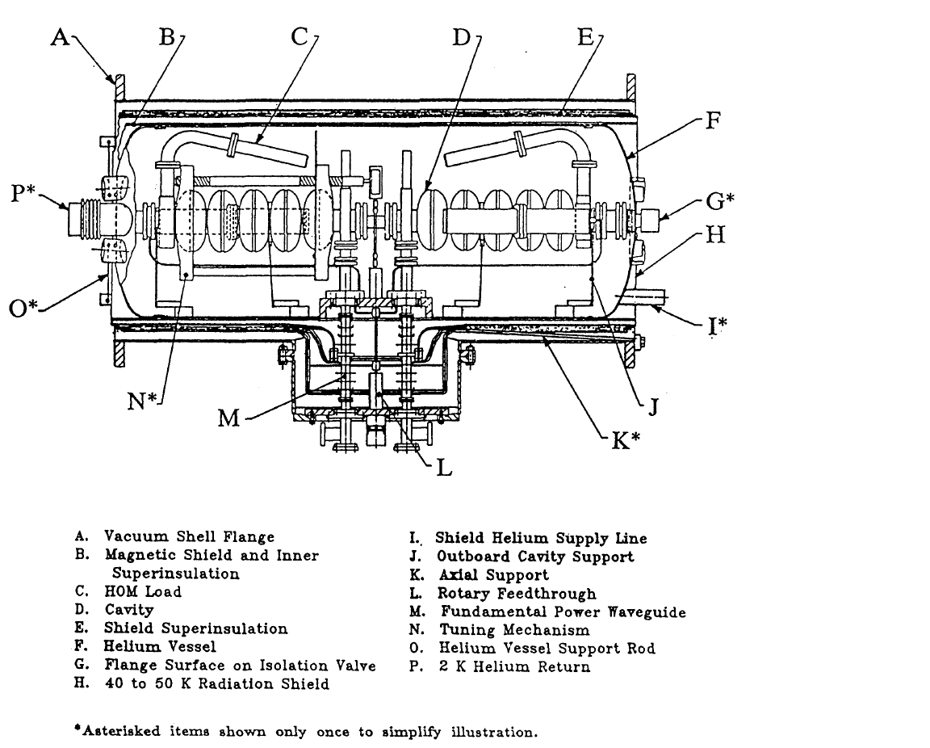
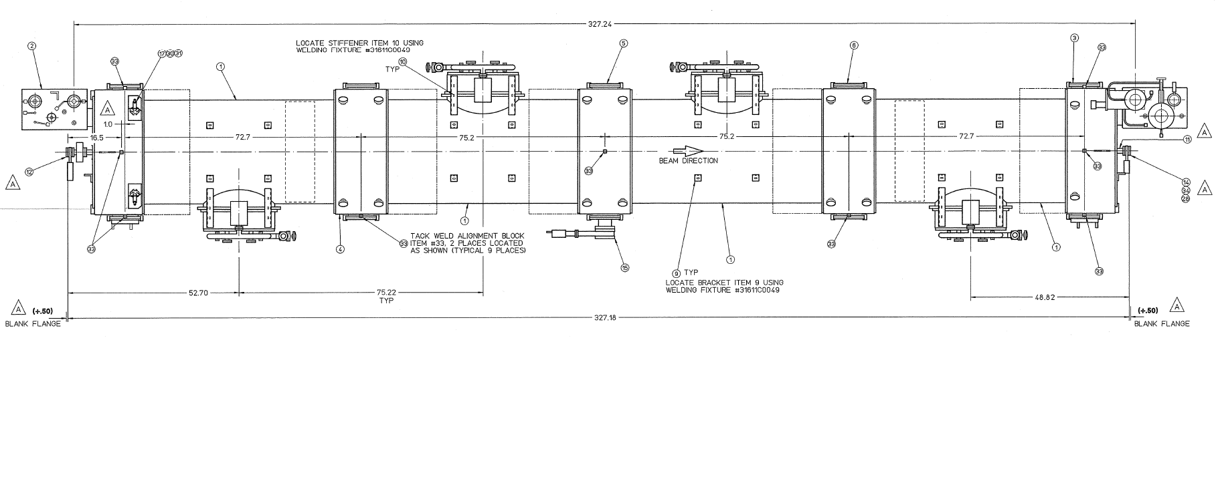
Original Cavity and Cryomodule
 | Design | Vertical testing | Cryomodule testing
<Eacc> | 5 | >5 | >5
Q₀ at 2K at 5 MV/m | 2.4×10⁹ | ~ 1×10¹⁰ | ~ 5×10⁹
Factor of 2 loss in Q₀
Q₀ met construction spec of 2.4×10⁹
Cryo unit
4x cryo unit -> cryomodule (8.25 m long)

Slide 5
Sources of Q₀ Change and Mitigation
Confirmed magnetic sources
Source | Understanding | Mitigation | Mitigation implemented?
Magnetic strut springs | 302 SS, remanent magnetic flux, worse case 6 G at contact | Replace them by 316 SS springs | YES
Magnetic tuner drive shaft | 17-4 PH SS, remanent magnetic flux, worse case 1.7 G at contact | Replace them by 316 SS shaft | NO
Magnetic bearing | 440C SS, remanent magnetic flux typical 0.5 G at contact | Degauss first then re-use | YES
Other sources
Source | Ruled out?
“Q-disease” from hydrogen in niobium material | YES
Window loss | TBD
Work published at IPAC14 as a contributed talk, THOBB01
“Pursuing the Origin and Remediation of Low Q0 observed in the Original CEBAF Cryomodules”

Slide 6
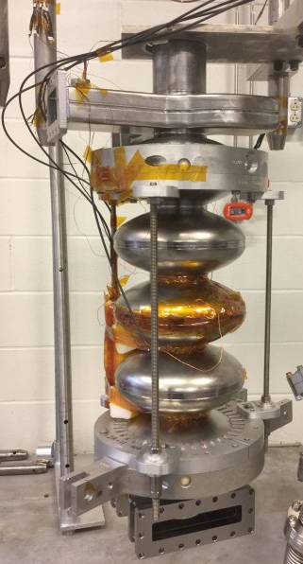
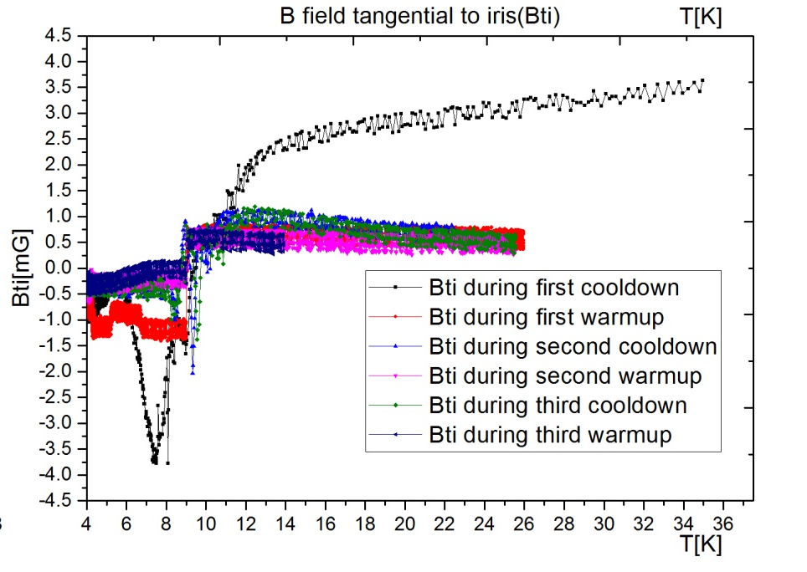
Sources of Q₀ Change and Mitigation (cont.)
New
Sources under investigation/to be investigated
Source | Testing result in hand? | Further test needed? | Potential benefit
Generated flux from thermal current effect | Initial testing result measured in VTA using a 5-cell dummy cavity | YES | May lead to a “thermal therapy” of in-situ Q₀ recovery in CEBAF tunnel
Additional flux trapping from repeated quenching events | NO | YES | May lead to an improved cryomodule testing procedure for full preservation of cavity Q₀ from VTA to tuunel
Thermally generated flux during initial cool down
Presently:
Examination of magnetic flux thermally generated inside the loop formed between niobium cavity and stainless steels rods
Developing a thermal current model for prediction of generated flux of cavity pair in a cryo-unit.
A potential “thermal therapy” is being developed for zero out the thermally generated flux.
Niobium cavity
After 20K warm up followed by
Re-cool down
magnetometers
Flux jump
near 9.25K,
Tc of Nb
Stainless steel rod
Series test of thermal current and generated flux
using a 5-cell CEBAF cavity
Shichun Huang

Slide 7
Additional flux trapping from repeated quenching events
JLAB-TN-14-021

Slide 8
Impact Factors
SRF Machine | Duty Factor [%] | Design Q₀ [10¹⁰] | Surface resistance [nΩ] | Relative increase for 4 nΩ added surface resistance | Number of high Q₀ cavities | Impact level
CEBAF-original | 100 | 0.24 | 114 | 4% | 338 | Negligible
CEBAF-upgrade | 100 | 0.72 | 39 | 10% | 80 | Low
XFEL | 0.65 | 1.0 | 27 | 15% | 800 | Medium
LCLS-II | 100 | 2.7 | 10 | 40% | ~300 | High
ILC-baseline | 0.65 | 1.0 | 27 | 15% | 16000 | Medium
ILC- low loss | 0.65 | 2.0 | 14 | 30% | 16000 | High

Slide 9
New Opportunities
Frozen flux reduction by CTA
Whole-module degaussing
Impurity doping of re-furbished cavities

Slide 10
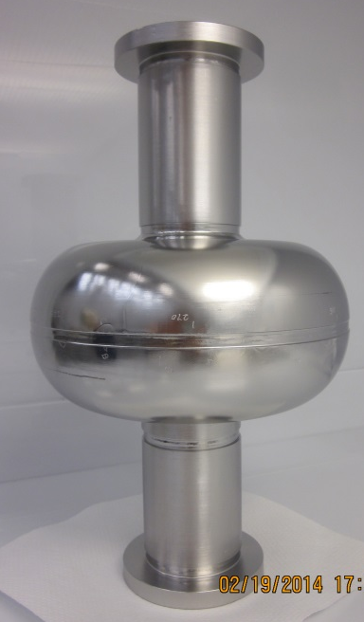
1-Cell Cavity Testing of CTA
30% increase in Q₀
LSF1-3
1.3 GHz
LSF Shape
Large-Grain Nb
Cavity processing:
BCP 60 um + 800Cx2hr + BCP 20 um + 120Cx9hr

Slide 12
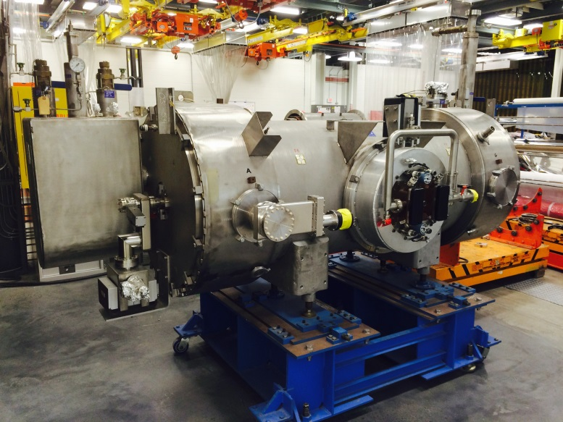
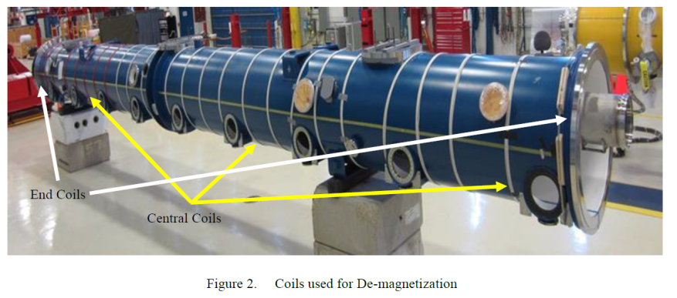
Whole-module degaussing
De-magnetize whole cryomoudle
  Could lead to a solution applicable to cryomodules placed in CEBAF without moving them out of tunnel.
Feasibility test with a cryo-unit or a quarter module
A. Crawford, Superconducting RF Cryomodule Demagnetization, arXiv:1503.04736

Slide 13
Impurity Doping of Re-furbished Cavities
Impurity doping (Ti, N) has shown benefit of raising Q₀.
A workable procedure is now available in-house for nitrogen doping due to work for LCLS-II.
A number of 9-cell XFEL/ILC cavities have been treated with nitrogen doping and tested at JLAB with good Q values up to the regime of 20 MV/m.
A 7-cell C100-style was nitrogen doped and tested horizontally in a one-cavity cryomodule, with good Q values.
Therefore…

Slide 14
Impurity Doping of Re-furbished Cavities (cont.)
At September 22, 2014 C50-12 pre-kickoff meeting, a decision was made to test Nitrogen doping on a CEBAF 5-cell cavity.
The goal is to raise cavity Q₀ in a CEBAF re-work cryomodule beyond what can be imagined before by exploitation of nitrogen doping technique that was made available in-house for LCLS-II Q₀ R&D.
Cavity IA009 was chosen for this study.

Slide 15
New goal:
Q0=2E10
@ 12.5 MV/m
Triple Q₀
Original C50 goal:
Q0=6.8E9
@ 12.5 MV/m
Achieved Q0
In C50-1…11

Slide 16
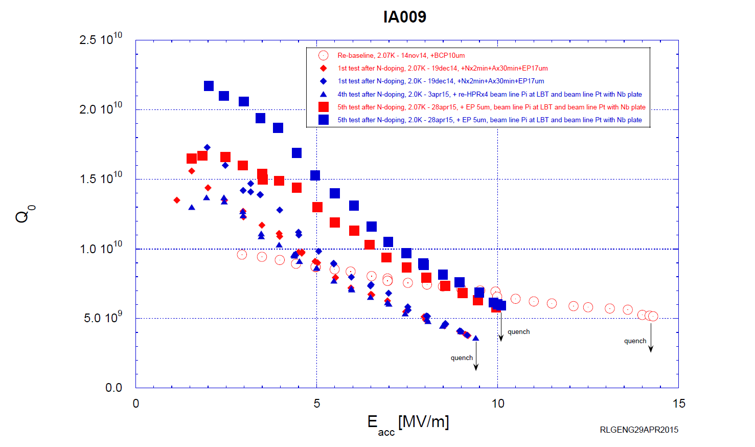
IA009 Performance Evolution since Re-baseline

Slide 17
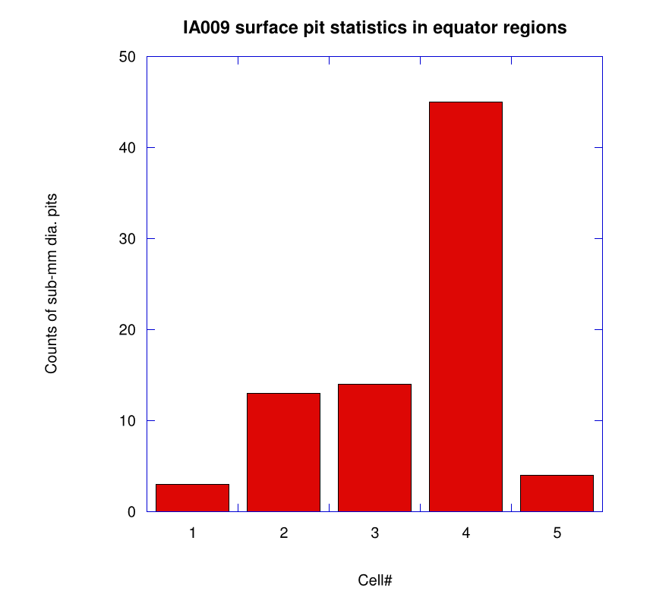
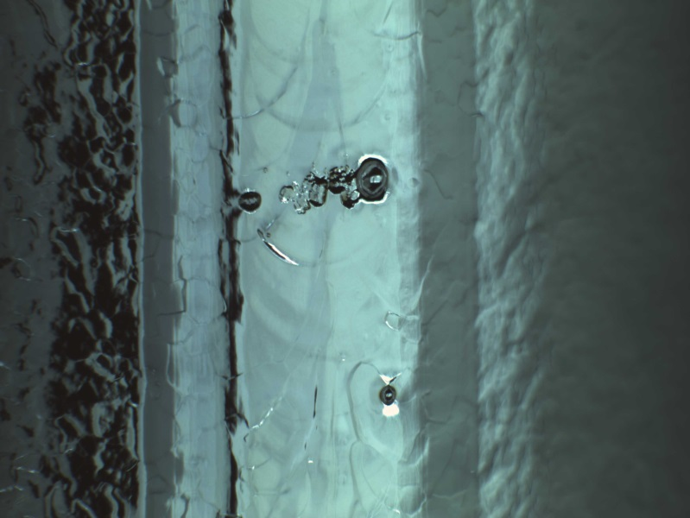
Discovery of Surface Defects
Pit ~400 µm dia.
Connected with extended bark regions
Pit ~100 µm dia.
4 mm fusion zone
Outstanding defects in fusion zone
of equator weld of cell #4

Slide 18
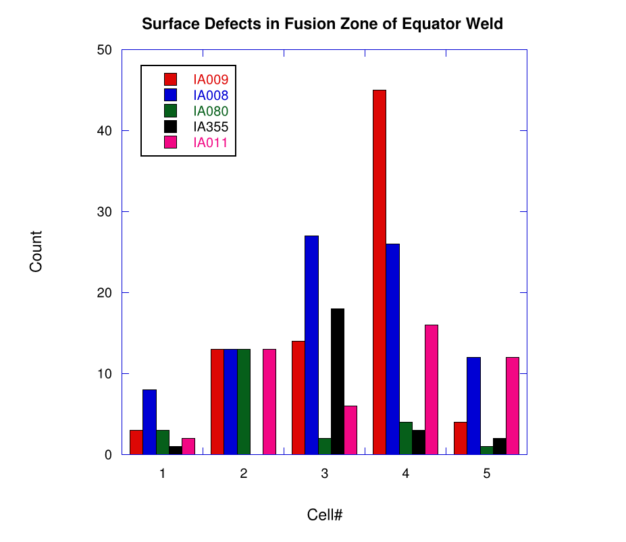
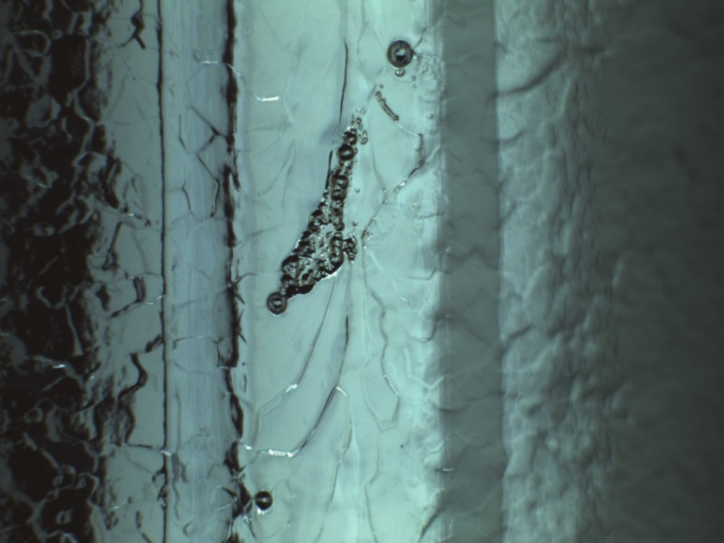
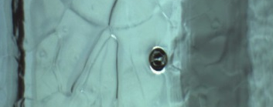
Expanded Inspection of Surface Defects
Only Pit and large flaw counted

Slide 19
Conclusion on Preliminary 5-Cell N-doping
First attempt in raising Q₀ by N-doping (IA009) is not successful, as a result of “grave” Fusion Zone Defect (FZD).
Optical inspection of 4 more 5-cell cavities revealed similar FZD’s in similar amount.
FZD’s can be classified into three types: (1) pit; (2) ripple; (3) “large flaw”. They are believed to originate from material/fabrication and therefore can be considered “genetic”.
FZD is rarely observable on modern-day Nb cavities.
It seems that “any attempt to further raise the Q₀ of these cavities by re-processing may face a brick wall”.
  Nature FZD and their interplay with N-doping deserve studies.
  Cure FZD by barrels polishing may help and should be evaluated.

Slide 20
Proposal for New Studies and Tests
Systematic VTA cavity testing for frozen flux effect.
  Test the CTA procedure for recovering Q₀ of cavities under the standard cavity pair configuration. (High impact potential)
    Verify the thermal current model that has been developed from one 5-cell dummy cavity test.
    Develop a CTA recipe of “thermal therapy” to be applied in-situ over all 5-cell cavities currently placed in tunnel.
  Complete the unfinished C50-12 activities. (Impact the future re-furbishment cryomodules)
    Progressive component addition to cavity pair to pin-point magnetized components.
    Experiment “local shielding” over the center cells.
    Assess window loss contribution.

Slide 21
Proposal for New Studies and Tests (cont.)
Test the feasibility of “whole module” de-magnetization.
  Test with dummy cryo-unit.
    Series tests with progressively added components around cavity.
    Assess shielding factors of the inner shield and the outer shield
    Characterize the magnetization of the shielding itself.
  Cryogenic test of a cavity pair in a short cryomoudle
    Mini-test of CTA.
    Study added frozen flux from repeated quench events.

Slide 22
Proposal for New Studies and Tests (cont.)
Further evaluation of nitrogen-doping for raising Q₀ 5-cell cavities, including possible re-doping after barrel polishing.
  Two cavites in hand:
    IA008 (N-doping completed)
    IA011
  A clear conclusion on N-doping is useful
    Positive answer sets solid ground for possible future path of Nb₃Sn re-treatment.
    Negative answer sets solid ground for possible future path of “LG cell transplant”
Fundamental studies of defects in IA009
  Dissect cavity, make 5 each 1-cell cavities, test with T-mapping, cut out quench area for material studies.
  Recycle end groups for “C75” cavities with transplanted cells.

Slide 23
Conclusion
The low Q₀ issue of 5-cell CEBAF cavities remains outstanding.
  Understanding of Q₀ damage from magnetized components in hand, one change implemented in C50-11. One more change is to be implemented in C50-12.
The effort in raising Q₀ of placed cavities in CEBAF has led us to explore inexpensive solutions applicable in-situ for raising average Q₀.
  Cryogenic Thermal Annealing.
  Whole-module degaussing.
The effort in raising Q₀ for C50 refurbishment by N-doping 5-cell cavities met the issue of genetic FZDs. Further studies needed.
Effort in Q₀ improvement and field emission reduction is related.
Proposal is to establish a new project, whose objective is to raise Q₀ of installed cavities in CEBAF: (a) without moving cryomodules out of tunnel;(b) within on-going C50 refurbishment effort.
A detailed cost of the proposed studies is being developed (< $150K).

Slide 24
Backup Slides

Slide 25
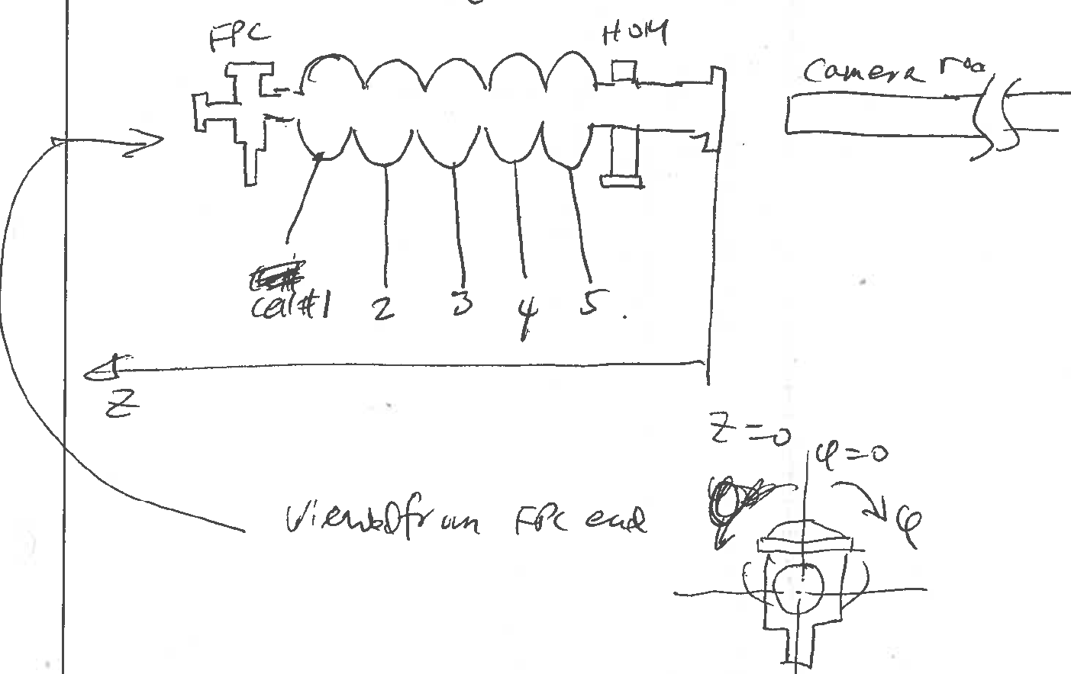
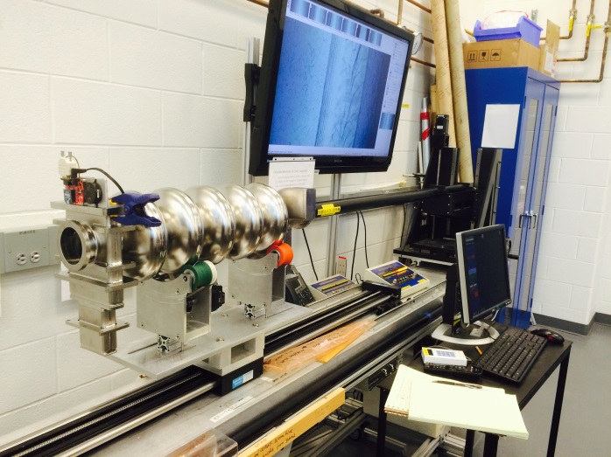
IA009 Actions since 5/5/15
Cavity vented, removed from test stand, fully dis-assembled.
Optical inspection of equator regions.
  Cell number starting at input power coupler side
  Angle definition: 0°= 12 o’clock, direction=clock-wise

Slide 26
Pit ~400 µm dia.
Connected with extended bark regions
Pit ~100 µm dia.
4 mm fusion zone
Outstanding defects in fusion zone
of equator weld of cell #4

Slide 27
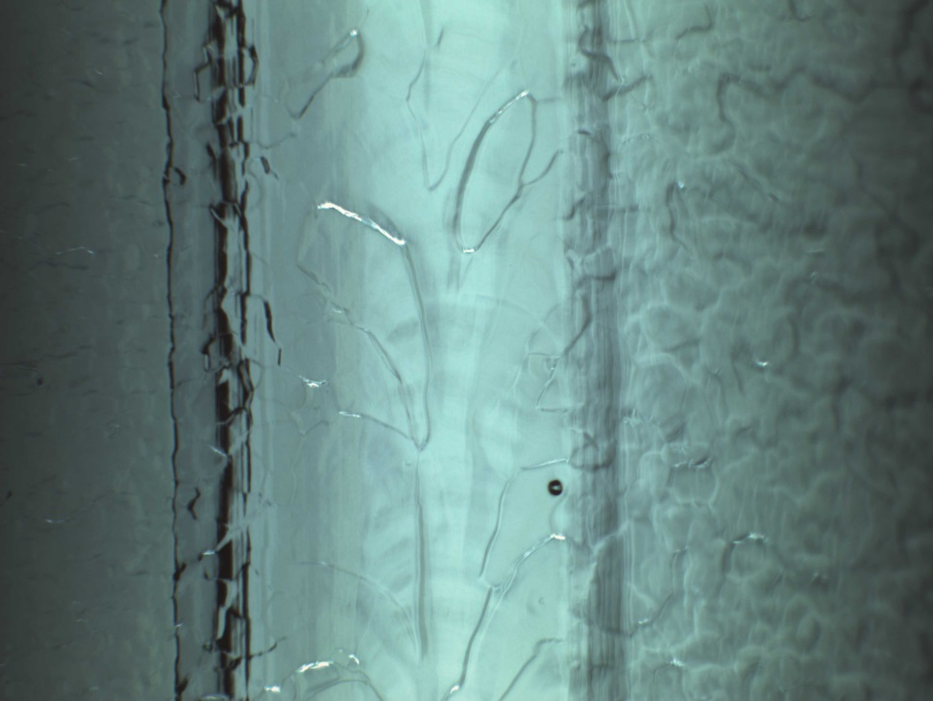
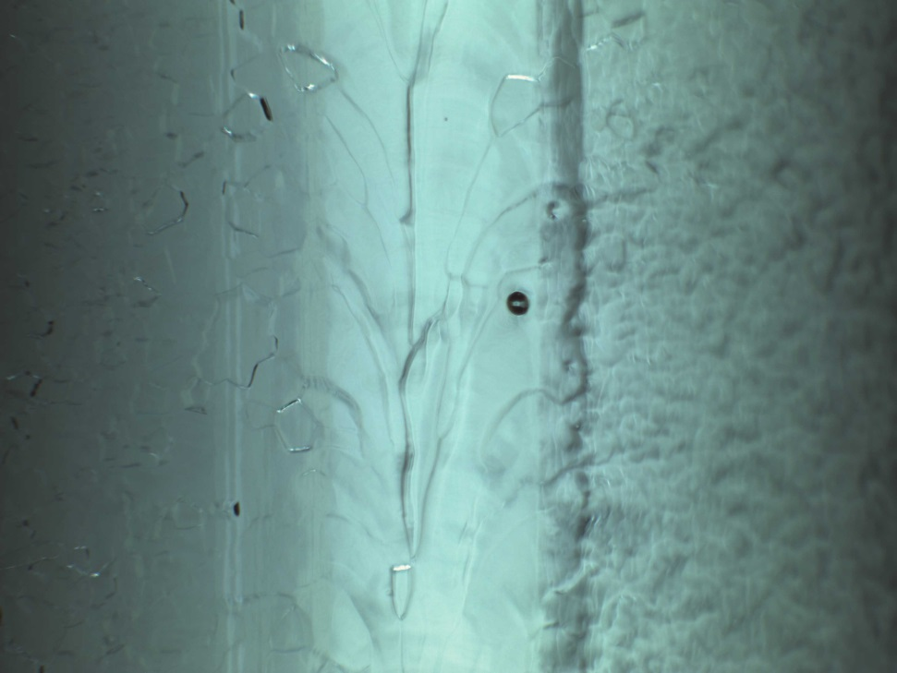
Cell #1 Equator Weld
Pits (3 in total, smaller than average)
Φ=174°
Φ=346°

Slide 28
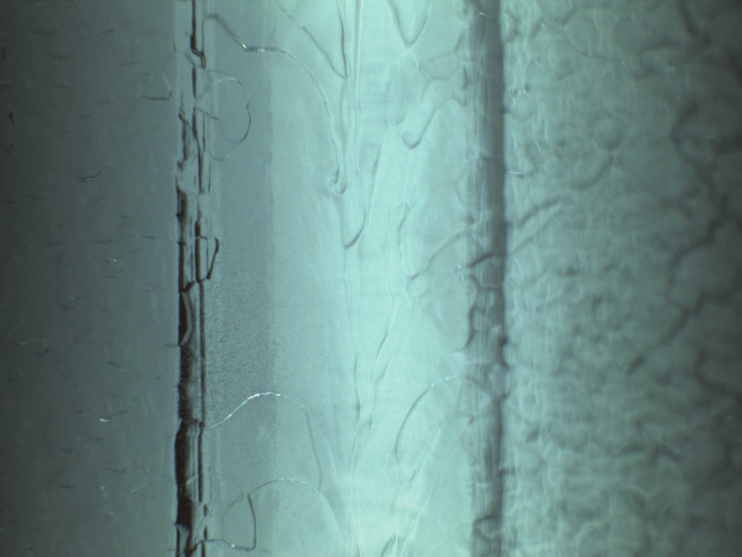
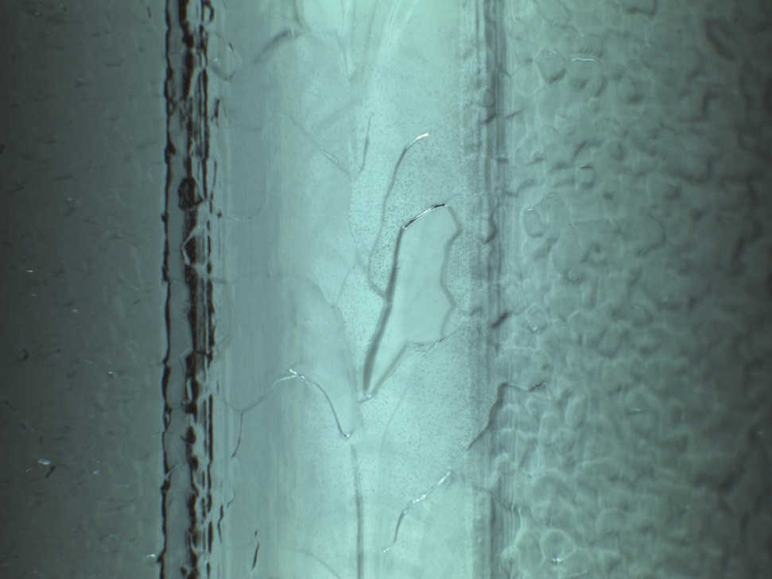
Cell #1 Equator Weld
speckles (clustered in a few regions, only cell showing this)
Nitrogen-rich islands due to insufficient surface removal?
Φ=56°
Φ=159°

Slide 29
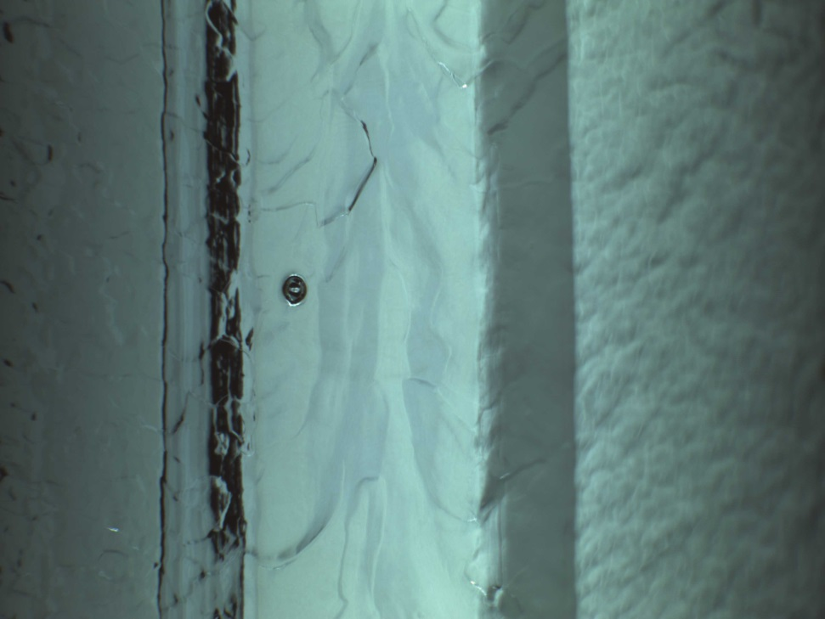
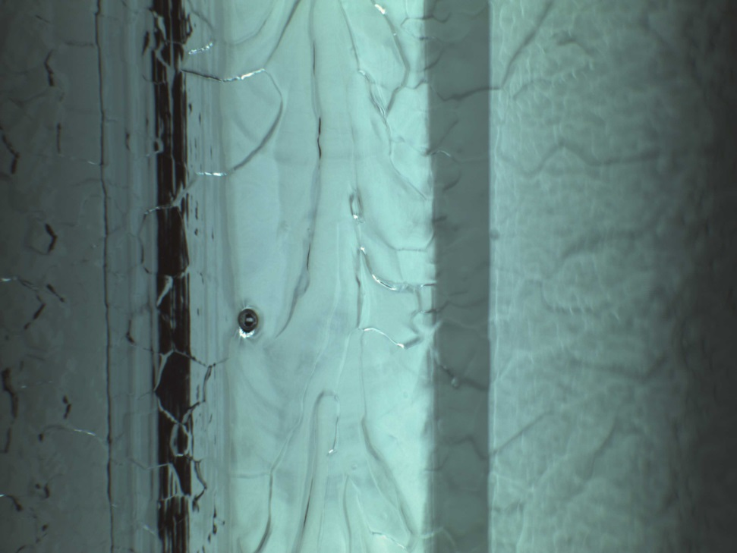
Cell #2 Equator Weld
Pits (13 in total, 2 typical examples shown)
Φ=185°
Φ=263°

Slide 30
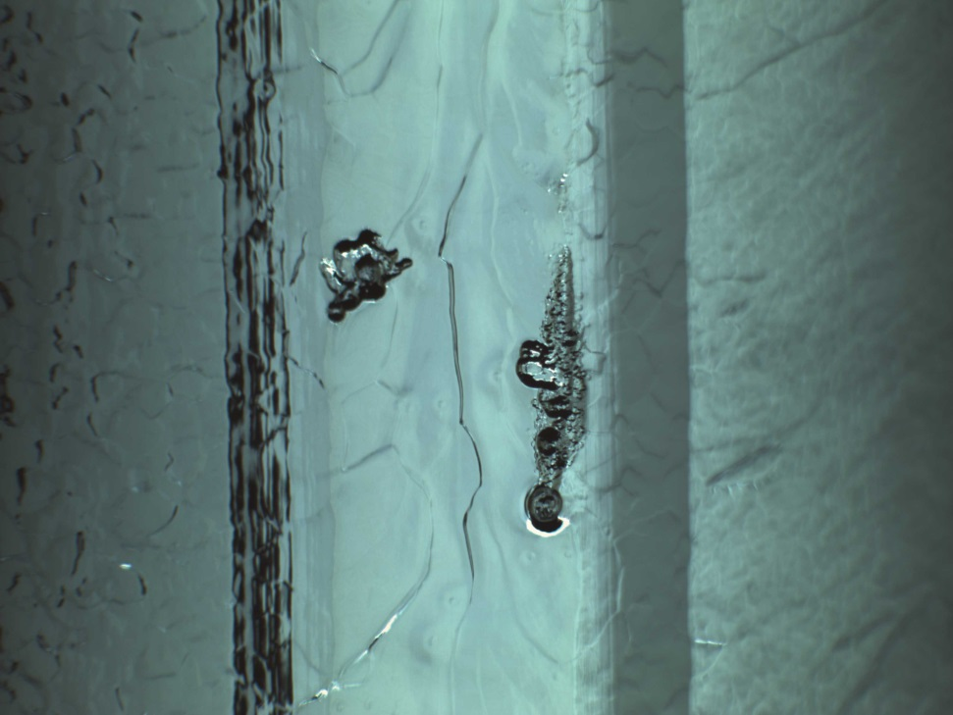
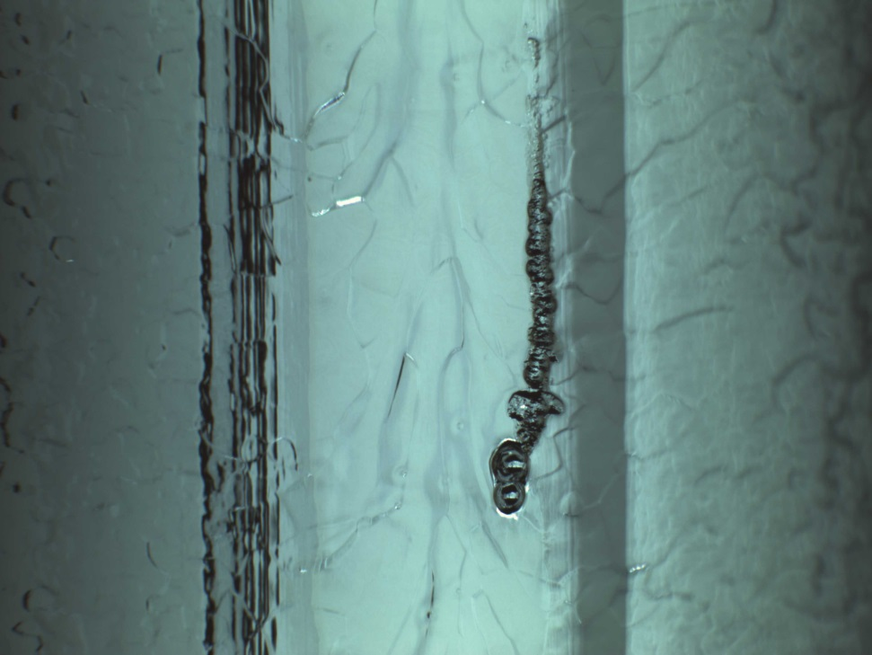
Cell #2 Equator Weld
Large flaws
Φ=14°
Φ=32°

Slide 31
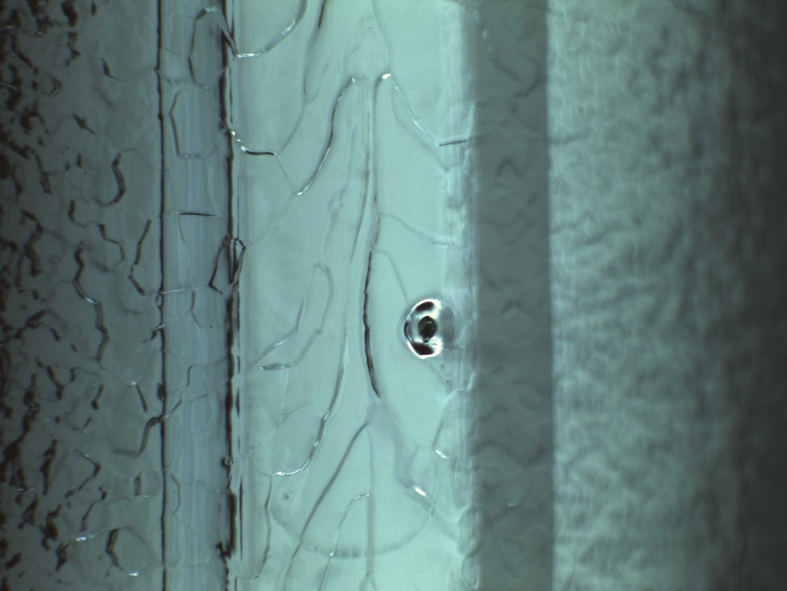
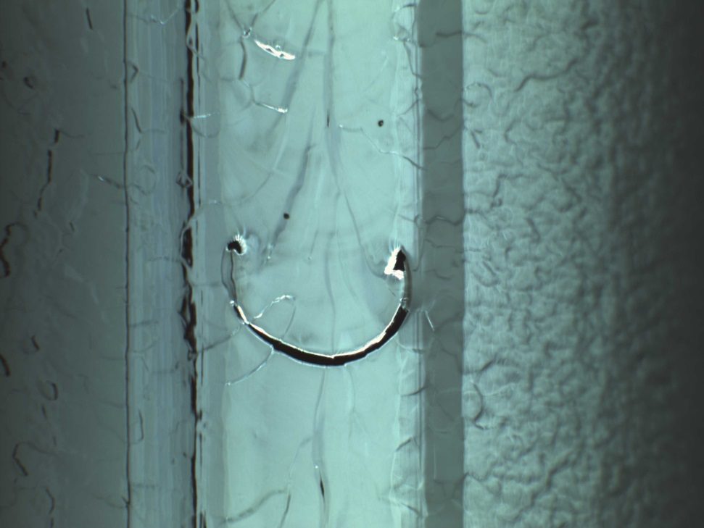
Cell #3 Equator Weld
Curved linear feature
(ripple of molten Nb?)
Pits (14 total, largest shown)
Φ=215°
Φ=332°

Slide 32
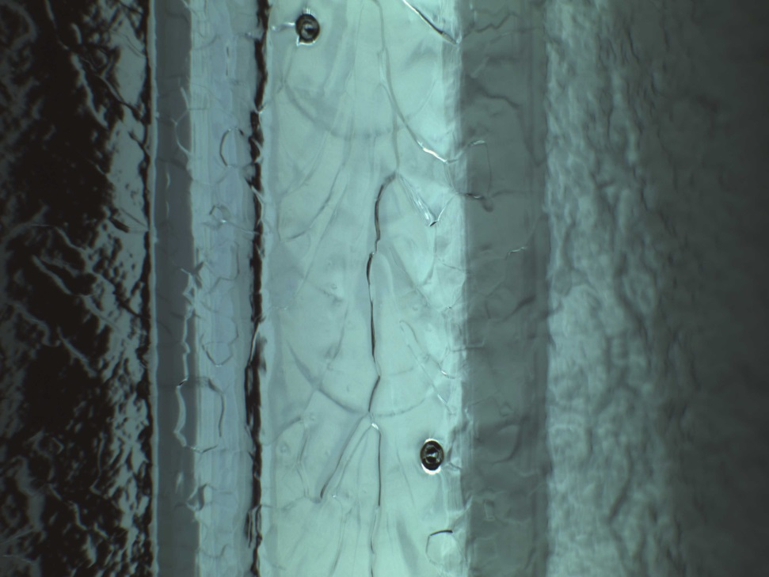
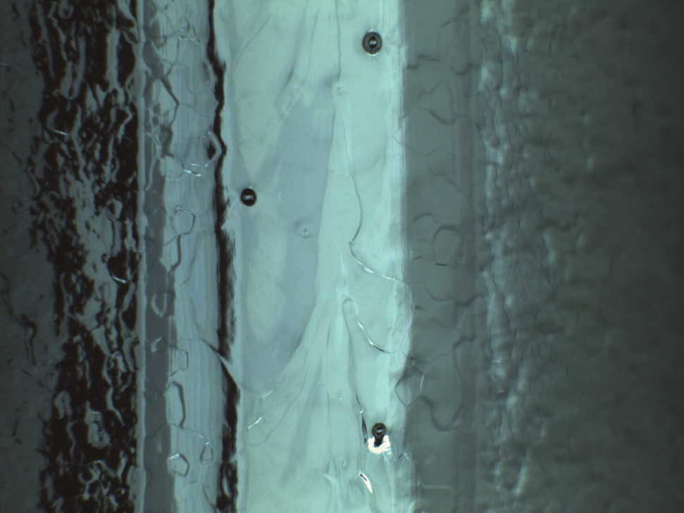
Cell #4 Equator Weld
Pits (45 total, a few typical shown)
Φ=0°
Φ=35°

Slide 33
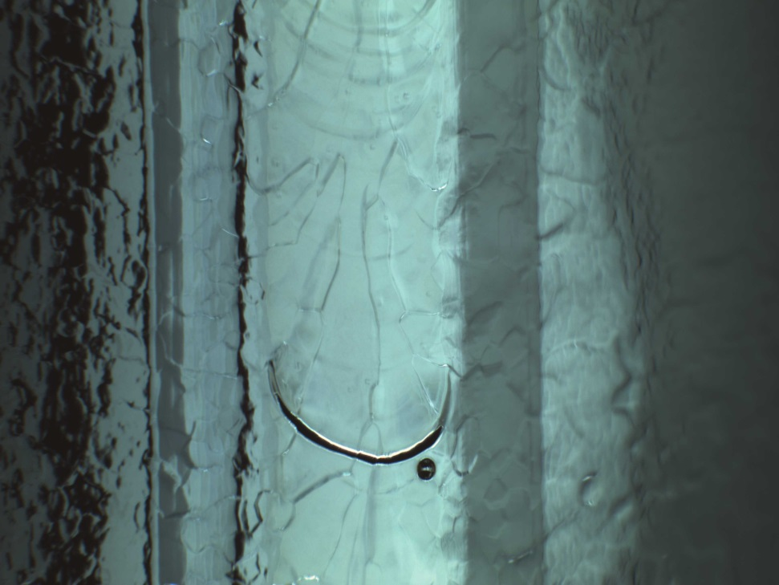
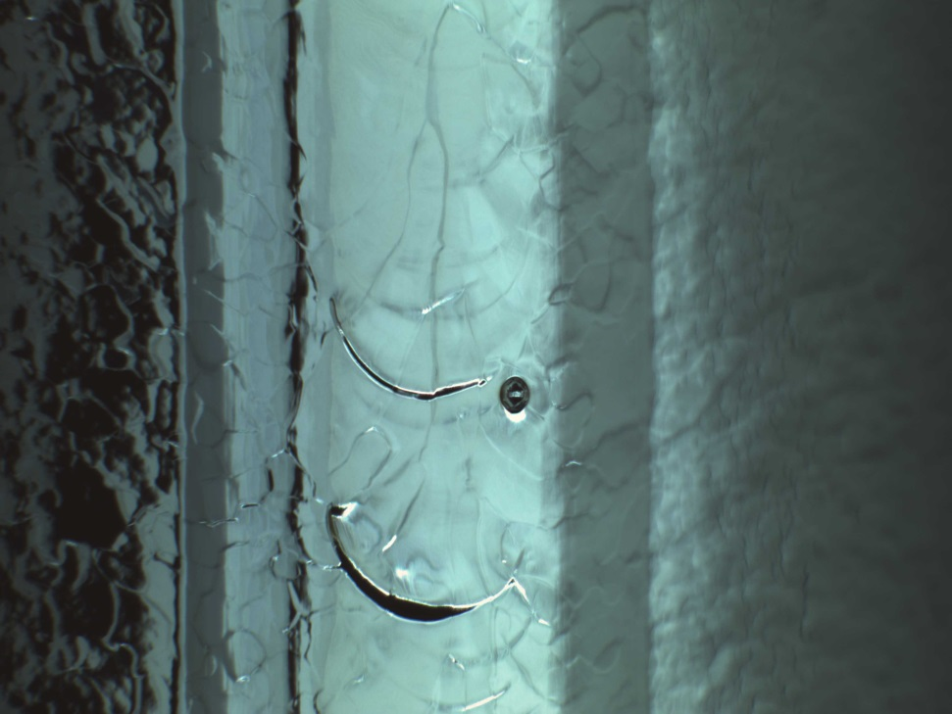
Cell #4 Equator Weld
Pits next to ripple
Φ=15°
Φ=73°

Slide 34
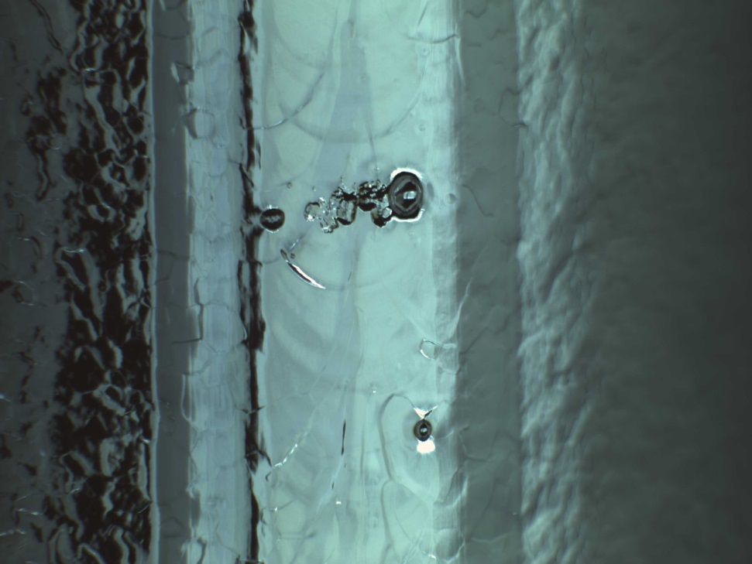
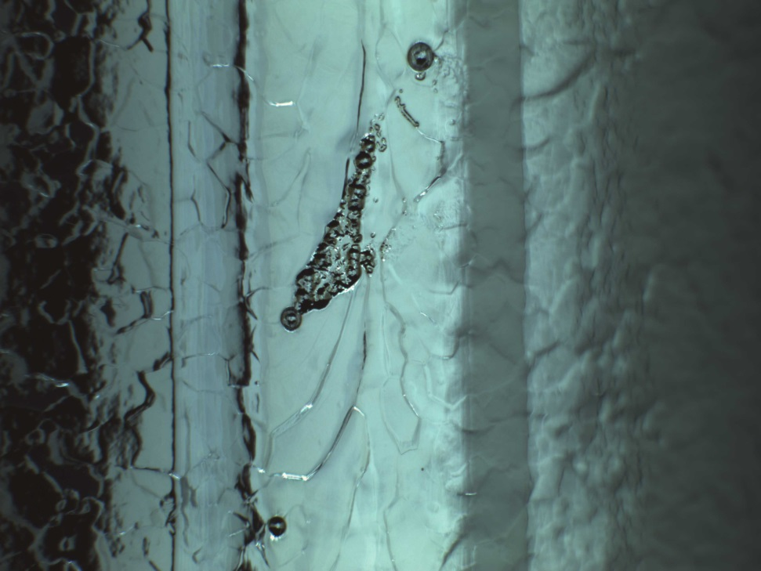
Cell #4 Equator Weld
Large flaws
Φ=52°
Φ=334°

Slide 35
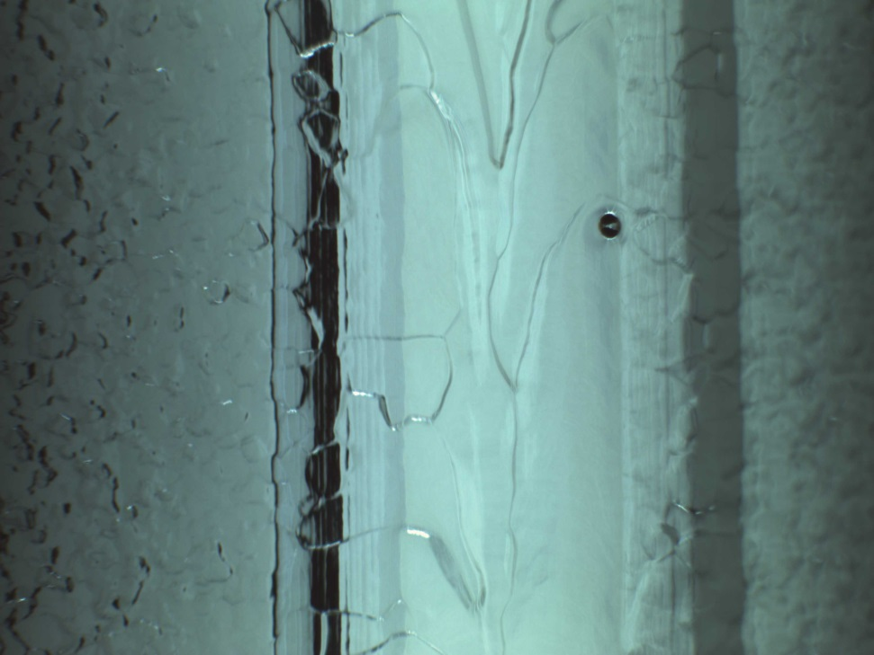
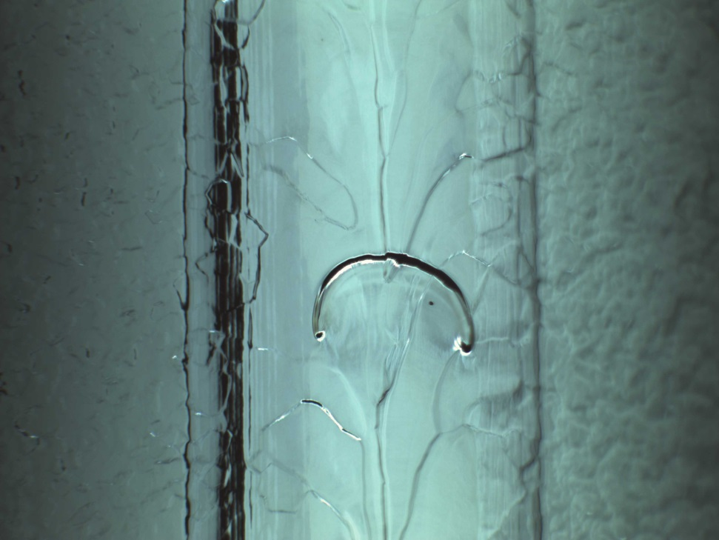
Cell #4 Equator Weld
Curved linear feature
(ripple of molten Nb?)
Pits (4 total, largest shown)
Φ=62°
Φ=200°

Slide 36
5/14/15 Conclusion
Post VTA optical inspection revealed surprisingly large number of defects (pits, ripples and large flaws).
Cell #2 & #4 are the worst – both have large flaws
Cell #1 & #5 are the best; #3 in the middle.
The heavy defect in cell #2 & #4 is consistent with previous finding of cell #2/4 being the most lossy; is also consistent with previous finding of cell #2/4 are among candidate cells responsible for quench at 9 MV/m.
“Cloudy” speckles observed on cell #1 equator weld surface. We suspect these are nitrogen-rich islands due to insufficient EP removal.

Slide 37
5/14/15 Conclusion (cont.)
Based on good correlation between pass-band measurements and optical inspection results, we conclude both the premature quench and the strong Q-slope of IA009 after nitrogen doping was caused by grave defects in fusion zone of cell #2/4 equator welds.
From RG’s past experience, there is little chance of further improving the cavity performance by another EP.
Based on optical inspection data of IA009 (2015) and IA015 (2008), we conclude the “fusion zone defect (FZD)” is a genetic character in all original CEBAF cavities, due to the then cavity EBW technology. Therefore, any attempt to further raise the Q₀ of these cavities by re-processing may face a brick wall. We propose to terminate the N-doping CEBAF cavity experiment. Instead, start to evaluate a cure to pit first.
We seem to have a case of insufficient EP removal in cell #1 of a CEBAF 5-cell cavity.

Slide 38
Actions since May 14
Carried out optical inspection of four 5-cell CEBAF cavities
Cavity | Last surface treatment and performance | Note
IA011 | Unknown (most likely BCP) | Cavity received from LP
IA080 | Unknown (most likely BCP) | Cavity dis-assembled from a cryomodule (FEL?) to be re-worked and become C50-12. Cavity have “large grains” all over places – apparently heat treated to high temperature (at least 1250 °C) in its past life.
IA355 | Unknown (most likely BCP) | ibid
IA008 | Nitrogen doping (no cryogenic RF test after nitrogen doping) | Pre-nitrogen doping processing history unknown. Latest cold test on 4/8/2013; 3/12/2013; 10/15/2008

Slide 39
Only Pit and large flaw counted

Slide 40
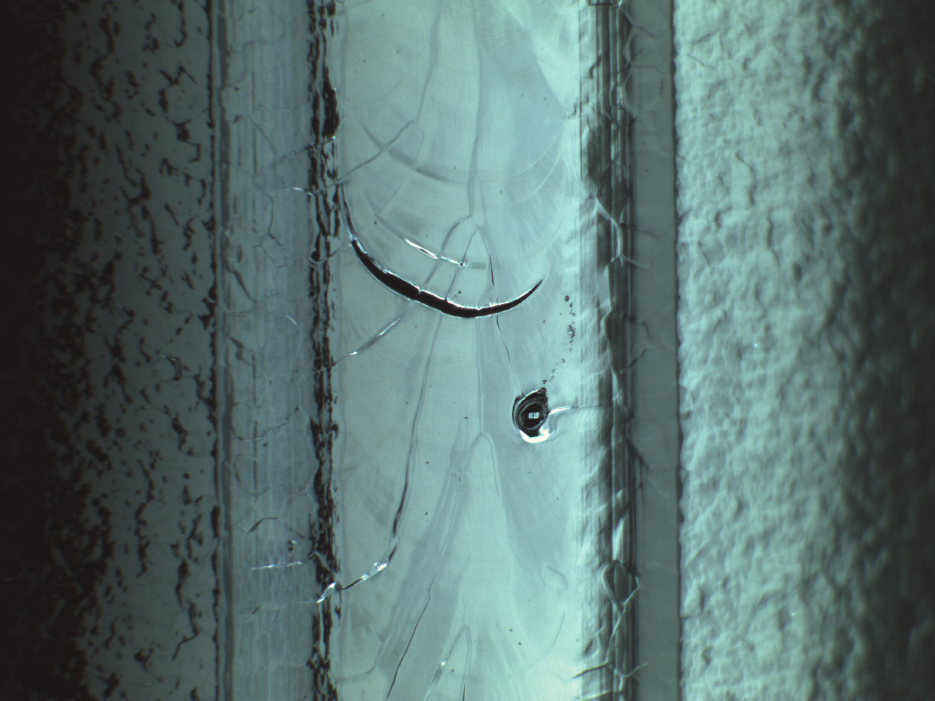
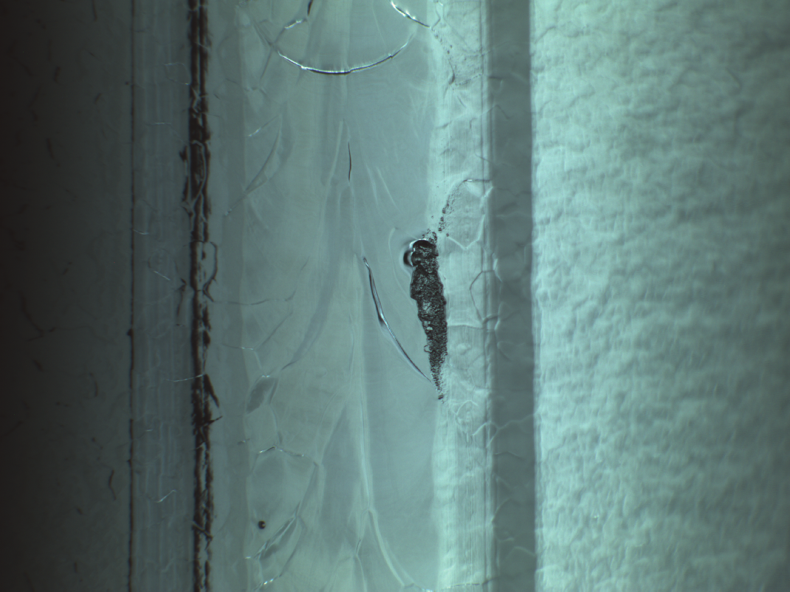
IA008 (Nitrogen doped)
pit
Large flaw
Cell 2 Φ=132°
Cell 4 Φ=334°

Slide 41
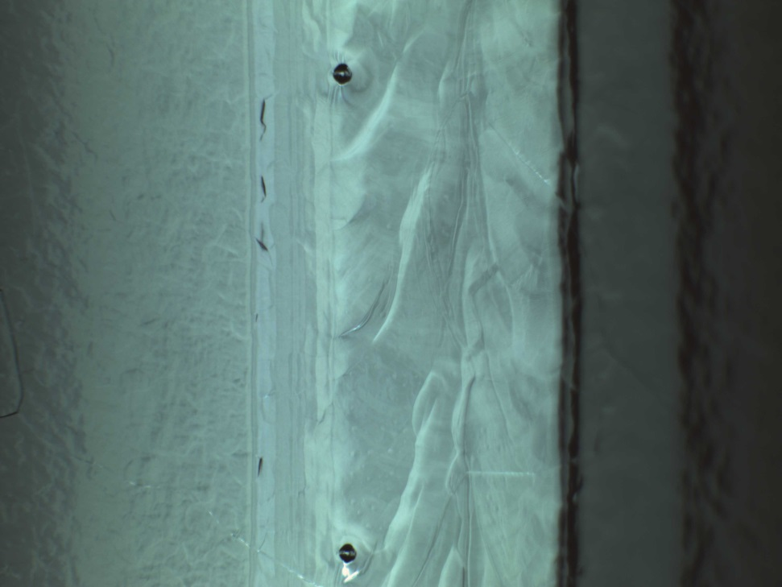
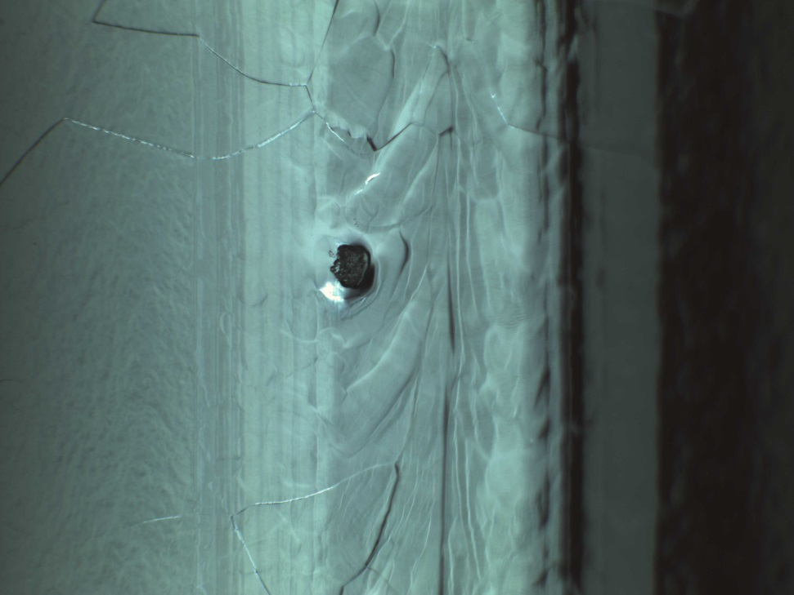
IA080
(removed from module to be re-worked and become C50-12, “Large grain”)
pit
Large flaw
Cell 2 Φ=146-148°
Cell 1 Φ=204°

Slide 42
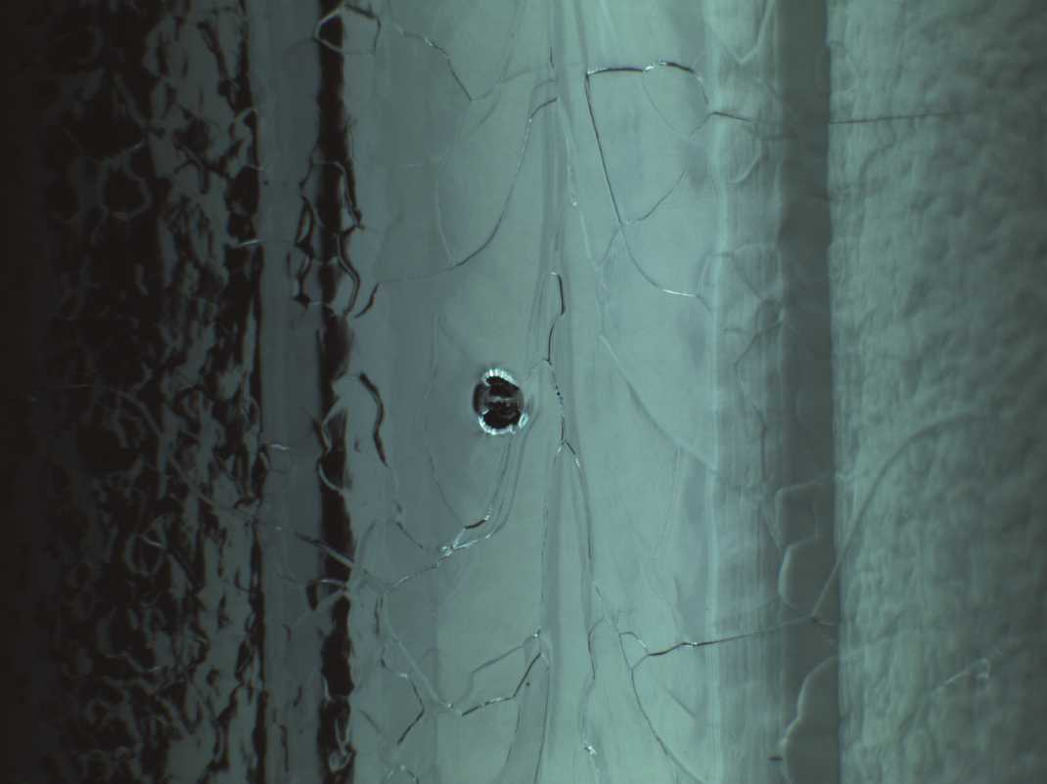
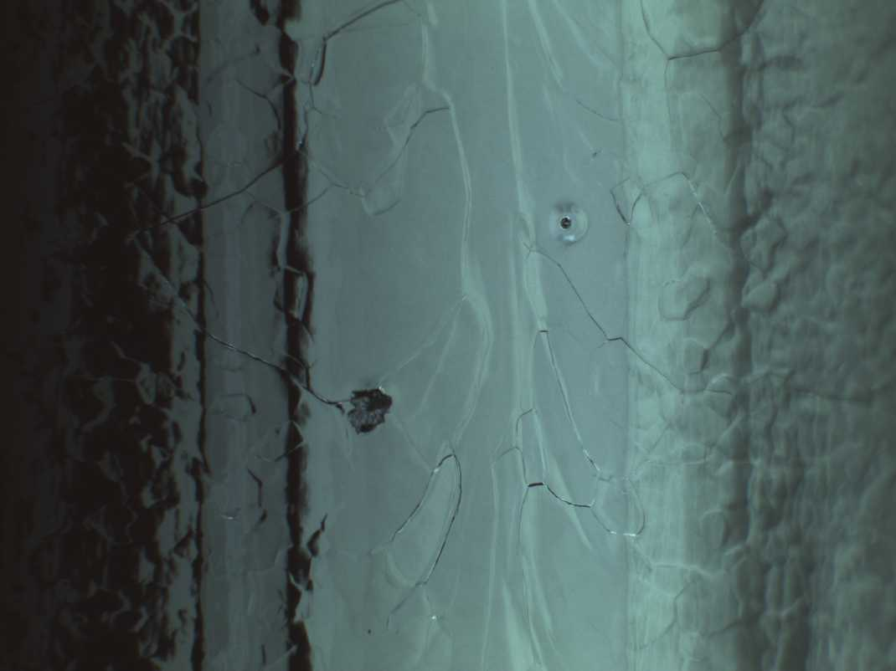
IA355
(removed from module to be re-worked and become C50-12, “Large grain”)
pit
Large flaw
Cell 3 Φ=154°
Cell 4 Φ=215°

Slide 43
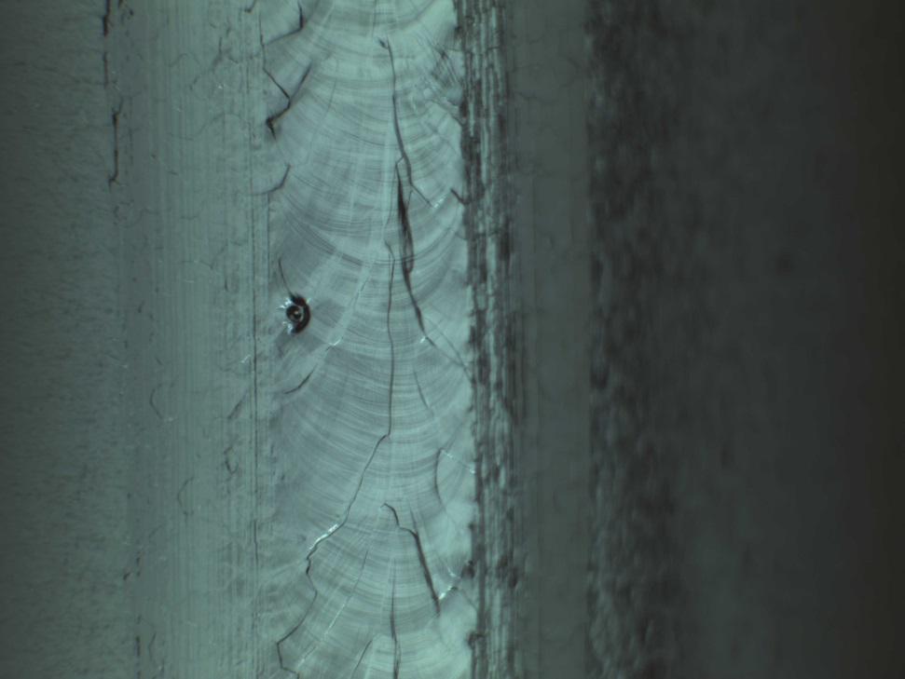
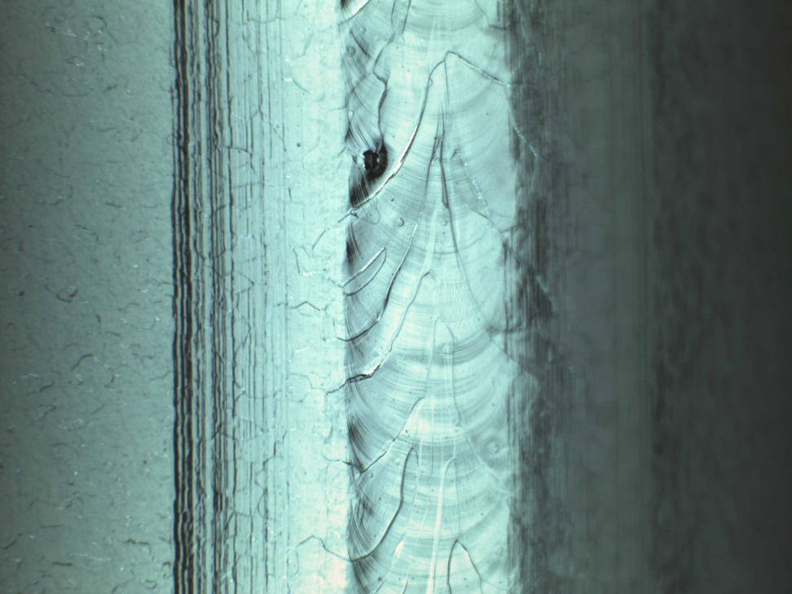
IA011
pit
Pre-cursor large flaw?
Cell 2 Φ=355°
Cell 4 Φ=88°
No apparent large flaw observed
BCP etching of inner surface seems much less than other inspected cavities
  Visible molten pool ripples
  Visible “blisters” on fusion zone surface

