Slide 1
RF Separation Status
Mark Wissmann
July, 2015

Slide 2
Outline
History
Update Of Three Tasks:
  • Resonant Control
  • Cavity Tuning
  • IOT Power Output Adjustment/Test

Slide 3
Spring History
During the spring run we extracted ~9.6 GeV beam
and problems and concerns were uncovered.
Large Frequency Shift During Operations
- Water Control System Limited
- Cavity Tuning Not Optimized
The IOT Amplifier Near Its Set Power Limit.
A bit Less Separation Than Expected

Slide 4
Water Controls Update
Preliminary test was performed for two weeks after suspending machine operations.
FINDINGS: (Tomasz Plawski’s ELOG 3343104)
- Operated 2.2 kW into a cavity.
- The cavity was controlled using an upgraded
heater chassis.
- Startup and operation to 2.1 power achieved
- Build of upgraded water system scheduled for completion by mid-August

Slide 5
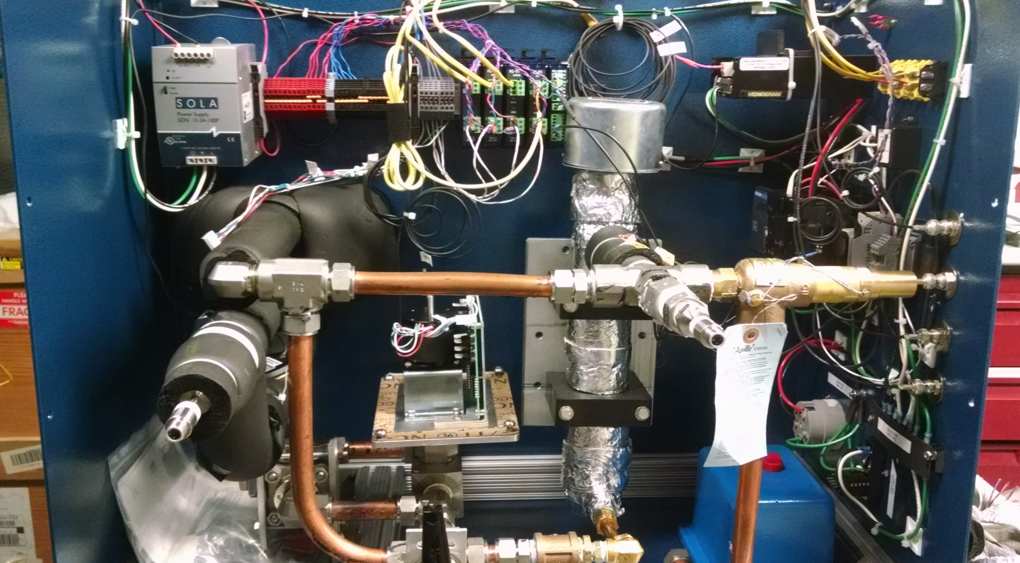
TEST Water Enclosure

Slide 6
Cavity Setup Update
After water controls testing, all four cavities were removed for bench tuning and setup.
  Tasks:
  - Establish field flatness in each cell
  - Install a second pickup loop
  - Fiducialize each cavity
  - Reinstall Cavities

Slide 7
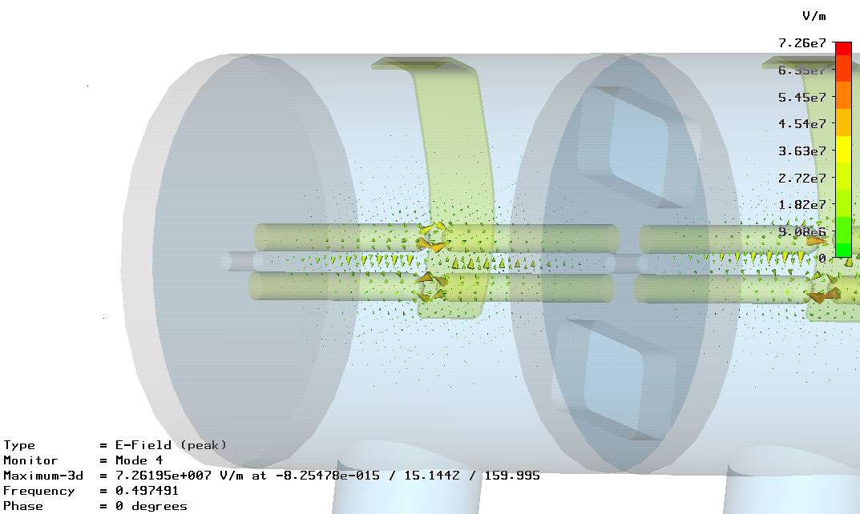
Simulation Results
E-Field at Crest

Slide 8
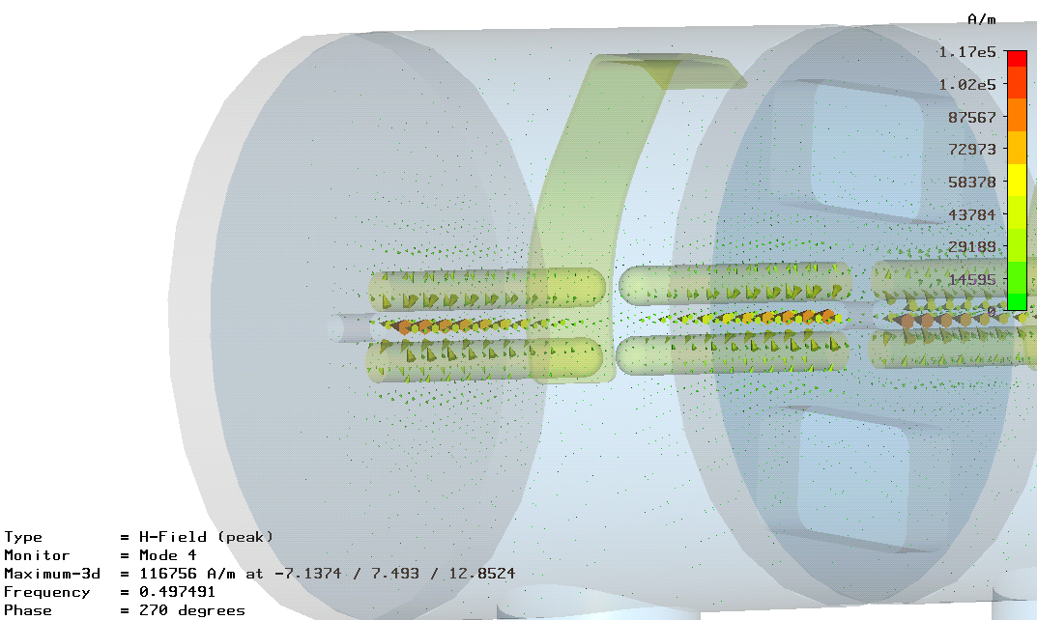
Simulation Results
H-Field at Crest

Slide 9
Typical Spring Run Cavity Setup

Slide 10
Cavity Setup With Fields Flat

Slide 11
RRFAE00A’s Final Bench Setup

Slide 12
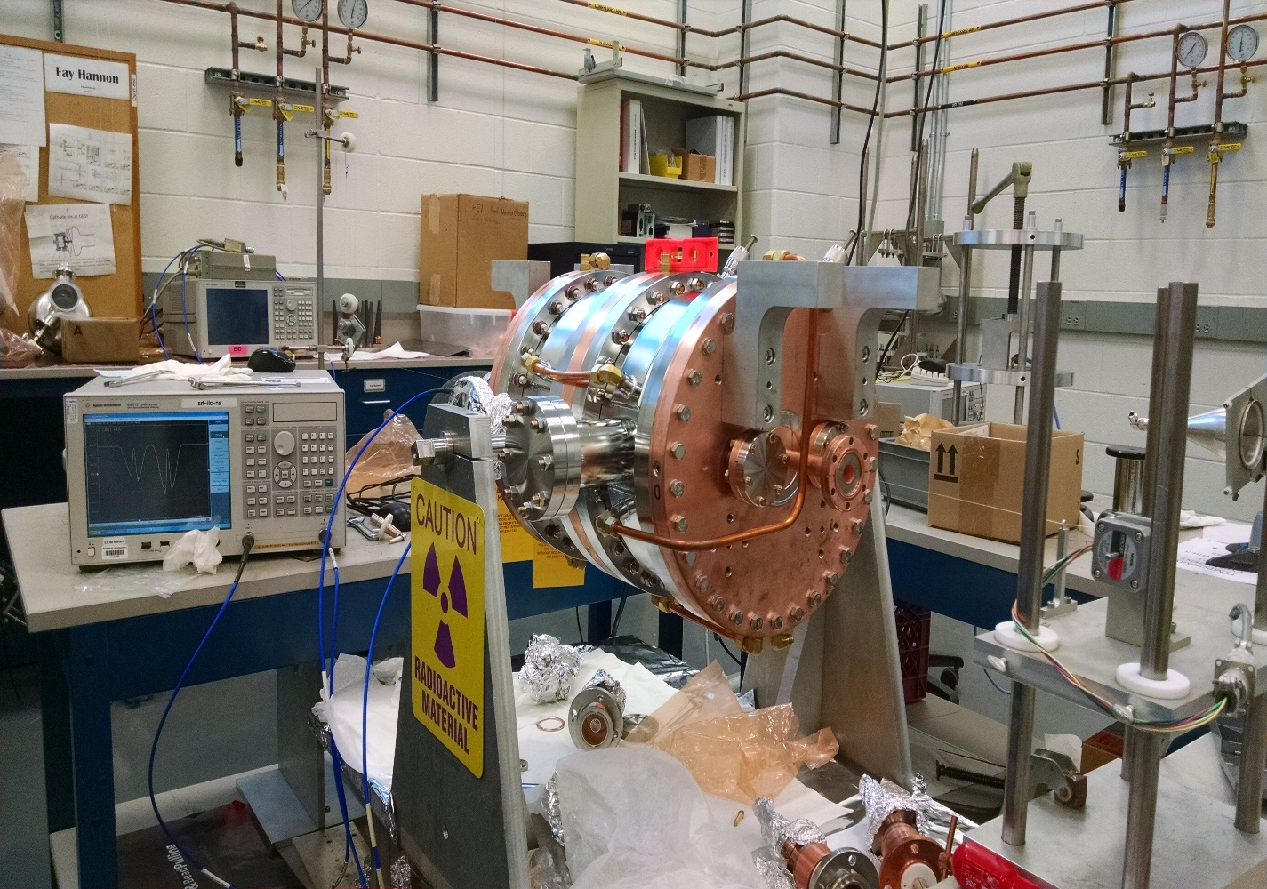
Bead Pull In RF Structures Lab
RRFAE00A Setup For Beadpull
Notes:
On the highlights slide you mentioned that this was done with ARRA funds. They may miss that or they may not remember at this point. Please add the “part of ARRA project” into the first bullet.
In first bullet you mention “high power testing”. In the 2nd bullet you say “rf measurements”. My brain assumed you were talking about high-power “rf measurements”. I suggest you add “low-power” in the 2nd bullet.

Slide 13
Cavity Setup Update
  - Establish field flatness in each cell
  RRFAE00A set and in high power test
  RRFAE00D set and soon on Alignment Stand
  RRFAE00B & RRFAE00C awaiting Pickup Loops
  - Install a second pickup loop
  RRFAE00A, RRFAE00B and RRFAE00C need pickups. They arrived from MDC yesterday.
  - Fiducialize each cavity
  RRFAE00A, RRFAE00B and RRFAE00C complete.
  - Reinstall Cavities
  Plan to be ready by first week in August

Slide 14
IOT Power Update
  - Goal is 14 kW Steady Power
  To do this the HVPS needs to provide ~24 kV
  The transformer taps where changed and the power supply is at 22 kV.
  At 22 kV 14 kW has been achieved but it drifts.
  This drift is believed to be from IOT Cavity heating
  Drift can also be addressed by IOT tuning
  Possible HVPS transformer tap change

Slide 15
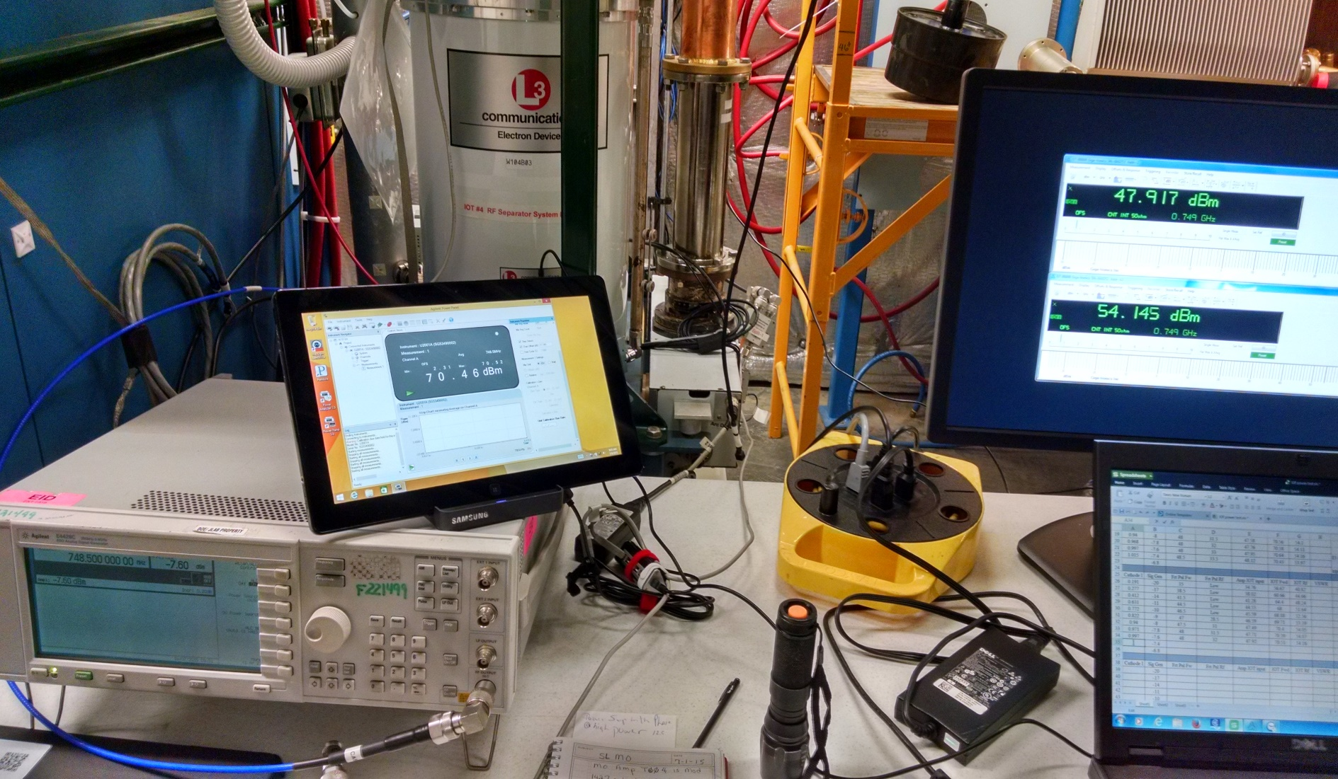
IOT Power RUN

Slide 16
Summary
Resonance Control Test complete and construction of chassis on schedule for Mid August Delivery
Cavity tuning optimization on schedule but benefit is in question.
IOT power upgrade is still in progress and it appears power is achievable and can be stabilized with IOT tuning at the higher powers.
Questions?

Slide 17
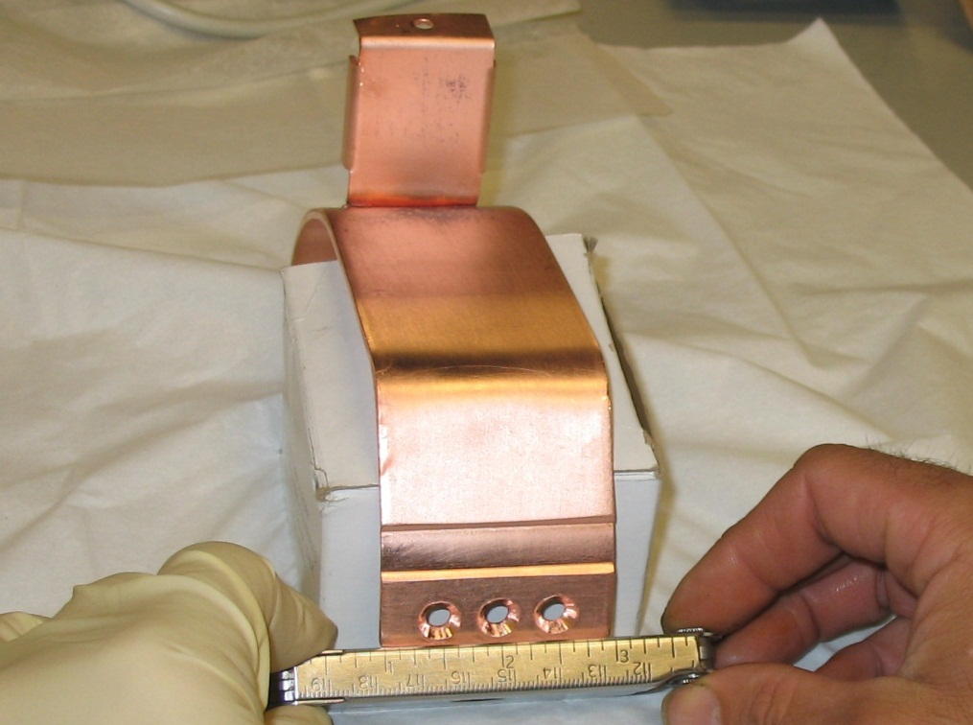
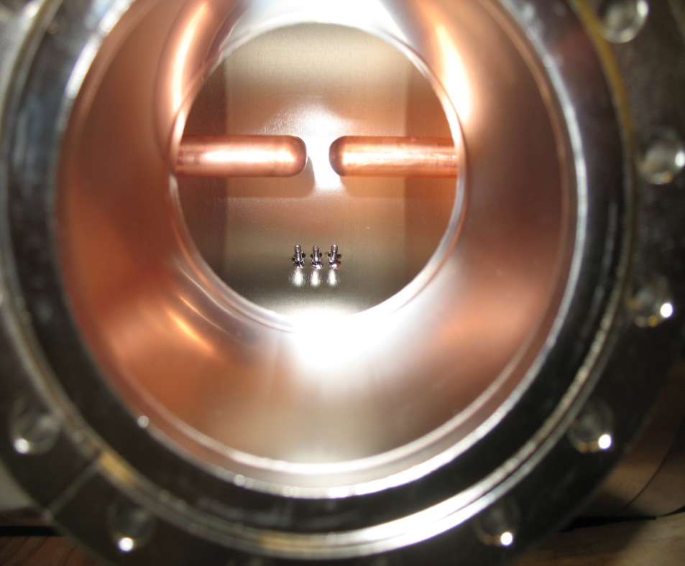
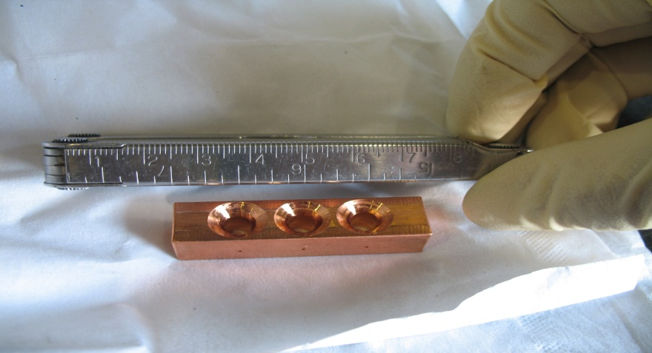
Inside A Separator Cavity
Tuning Plate Removed

Slide 18
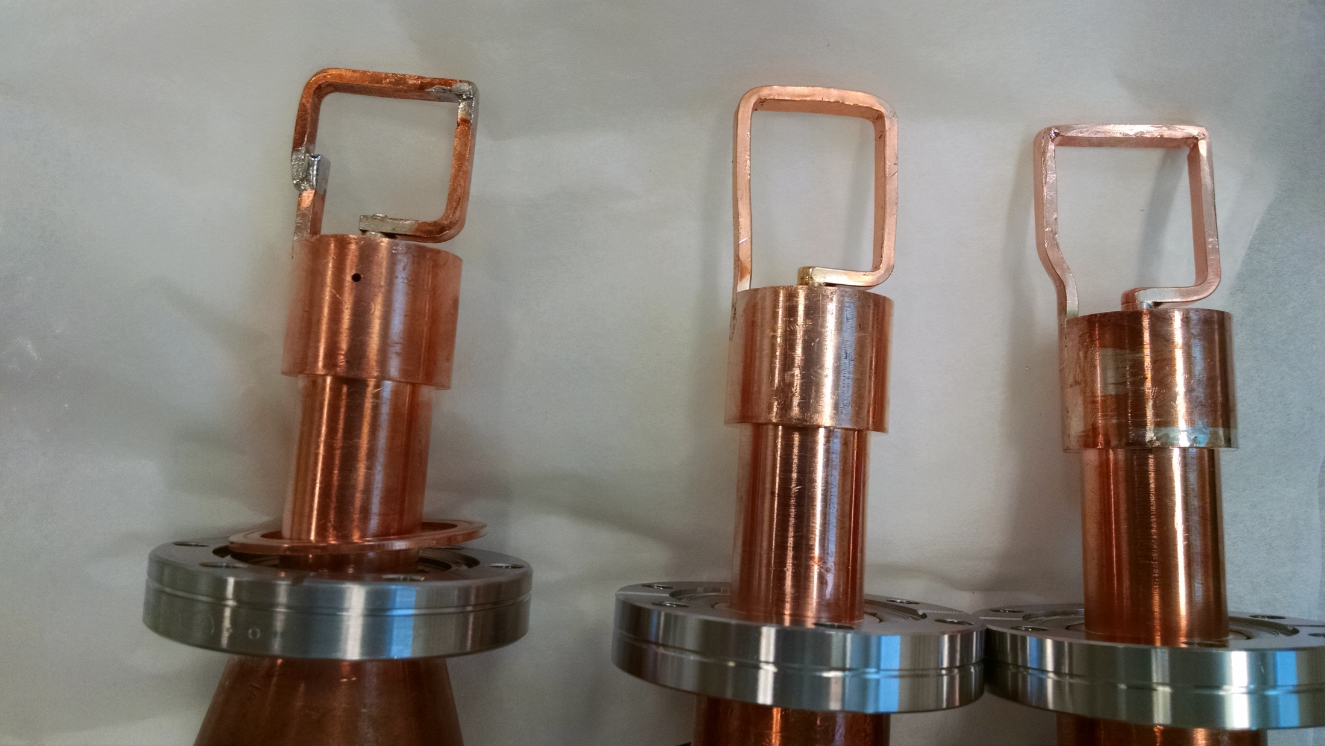
750 MHz Cavity Couplers

Slide 19
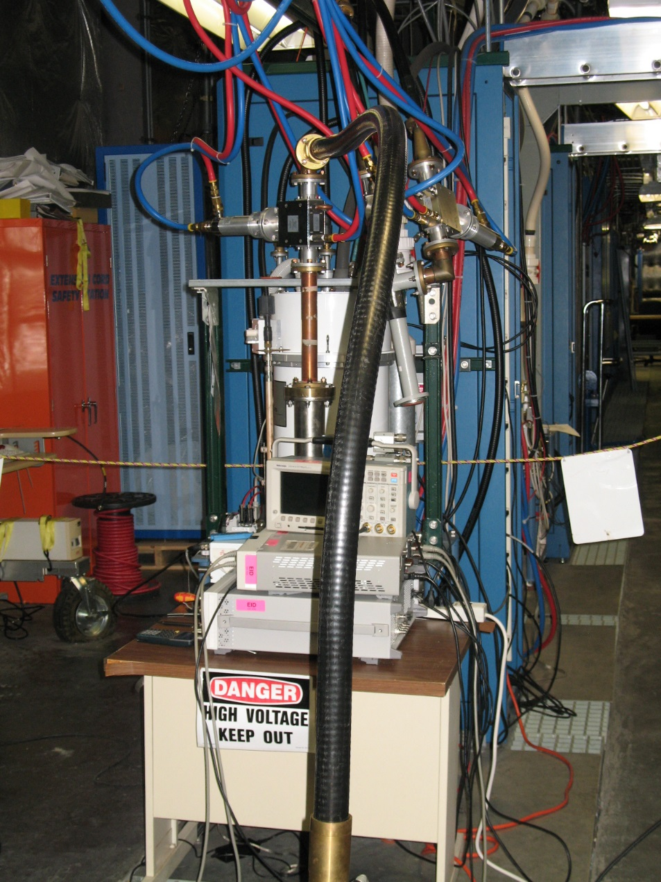
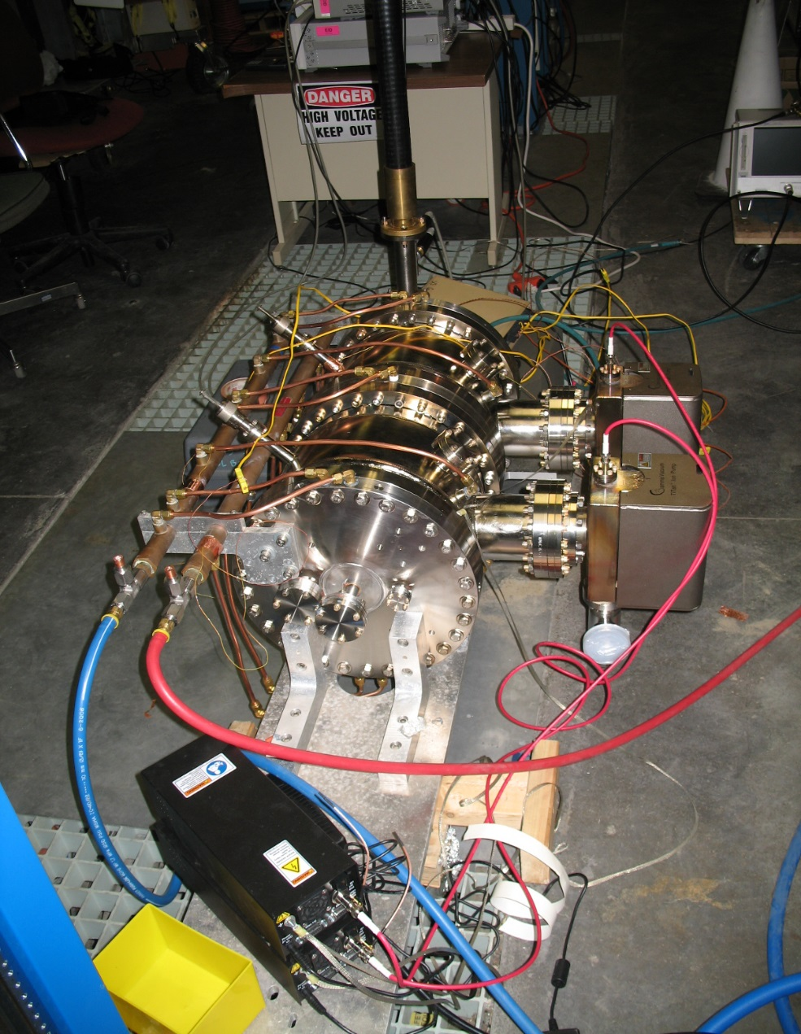
Prototype Under High Power Test

Slide 20
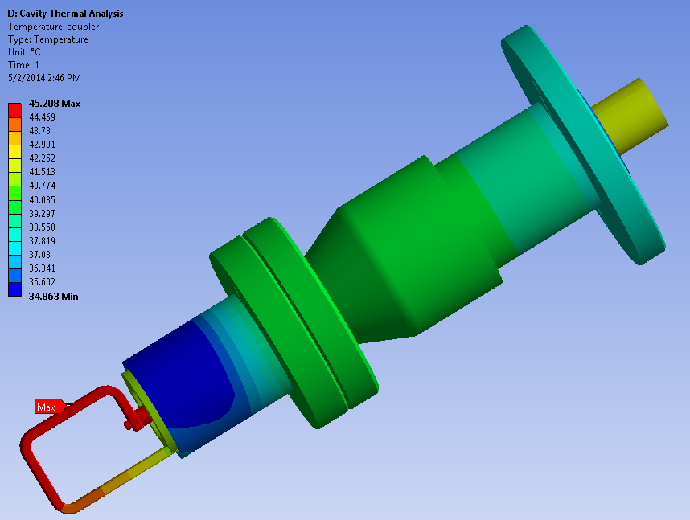
Temperatures in the Power Coupler

Slide 21
RESONANCE CONTROL CRITERIA
Cavity Temp and Frequency Response

Slide 22
Powering A Cavity With Solid State Amp

Slide 23
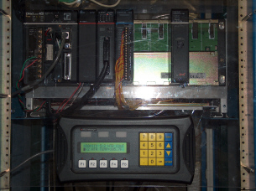
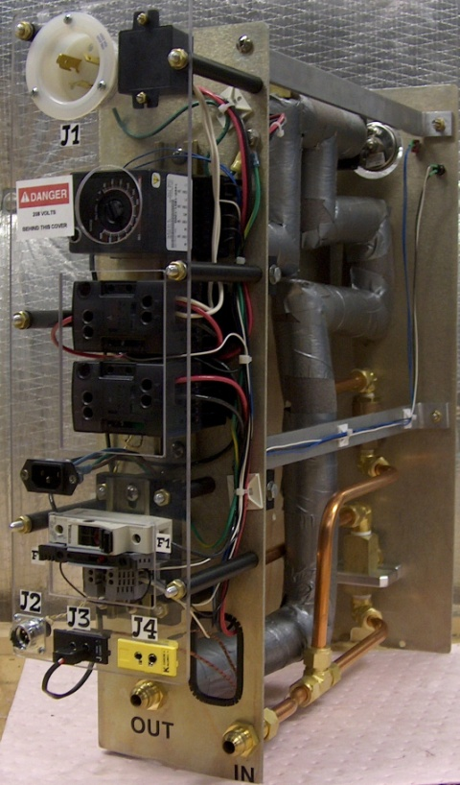
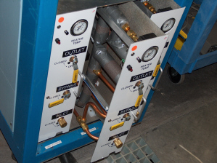
Resonance Control
Cavity Temp. vs. Frequency Response
PLC Controller
Heater Module
Heater System

