Slide 1
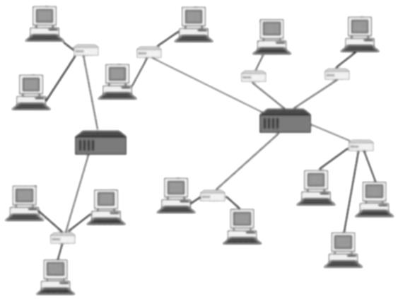
Getting the Most From Your Software Requests
ioc | ioc | ioc | ioc | ioc | ioc | ioc | ioc | ioc | ioc
ioc | ioc | ioc | ioc | ioc | ioc | ioc | ioc | ioc | ioc
ioc | ioc | ioc | ioc | ioc | ioc | ioc | ioc | ioc | ioc
ioc | ioc | ioc | ioc | ioc | ioc | ioc | ioc | ioc | ioc
ioc | ioc | ioc | ioc | ioc | ioc | ioc | ioc | ioc | ioc
ioc | ioc | ioc | ioc |  |  | ioc | ioc | ioc | ioc
ioc | ioc | ioc | ioc |  |  | ioc | ioc | ioc | ioc
ioc | ioc | ioc | ioc | ioc | ioc | ioc | ioc | ioc | ioc
qsUtility
eDT
ELOG
Michele Joyce
HLAPS
July 17, 2015

Slide 2
User Requests
Software On-Call
Escalates as appropriate
Impacts Program
OPS
CASA
EEG
EES
SGG
……
OPS-PR
email
Napkin
Machine Critical
swreq@jlab.org
OPS-PR
Assigned as appropriate
Controls
Sys Admin
Not Machine Critical
ALHA
ACE-PR
Assigned as appropriate
> 15 min
New
Existing
JIRA:
New Task
Requirements
Discussion
Priority
Due Date
JIRA:
ExistingProject
Feature Requests
Problem Reports
Comments
Status
Ready

Slide 3
AHLA Project Status

Slide 4
Requirements
Proportional to scale of project
Minimum i.e. screen/feature requests, Ops-PRs
Clear description of problem to be solved.
Clear identification of specific tasks
Approximate due date.
Medium i.e. qsUtility, AutoQuad, ArcSteer
In addition to the above:
Equations and exceptions
Priority (beam time?)
Full i.e. Alarm Handler, Jtabs, HCO
Requirements document
Functionality (vs implementation)
Usability
Reliabilty
Speed constraints
Deadline constraints.
Use cases – roles/stakeholders
ALL –
Partner with developer to fulfill all requests.
Thorough, Early Information gets you a better product.

Slide 5
Problem Reports
Screen captures
Errors
EDM screen
Running conditions
Computer name
User
How program launched (Jtabs, Monticello, xterm)
Is the problem reproducible?
Keep in mind: Problem reports may not be seen until a few days after
Respond to requests for additional information

Slide 6
Summary
Keep the Feedback Coming

