Slide 1
Content of a Good Log Entry
Ron Lauzé
Electrical Engineering
Deputy Department Head

Slide 2
There are Many Types of Entries
Automated
QuickPic
TaskList
Follow-up
Downtime
Readme
‘Non-routine’
Etc.

Slide 3
There is No Perfect Log Entry
I acknowledge up front that realistically there is no perfect log entry and especially one that spans all log books and types of entries.

Slide 4
Gathering Data
I will attempt to describe what readers of the logs would like to see in mostly what the Accelerator Operations Directives calls ‘Non-routine’ entries.
From the AOD
These are entries that describe events as they unfold and should contain enough detail to describe: Who, What, When, Where, and Why.
From group feedback
Operators, Operability, Engineering, Software, CASA, Installation, and others.
Notes:
Who- the names of specific individuals or groups involved in such information is important to understanding the event.
What- a description of what happened. Links to other log entries should be provided as necessary.
Where- The location of the event or the accelerator system(s) affected.
When- The time stamp on the entry may not be sufficient. It may be appropriate to include a timeline of when specific parts of the event occurred.
Why- If there is a discernable cause for the event, it should be included.

Slide 5
Attributes of a Good Log Entry
Document in the correct location(s)
Unless I miscounted there are 54 logbooks available from the “Jefferson Lab Electronic Logbook” page.
Should the information be logged in a single place or multiple locations? Sending it to the correct location(s) will:
Get the attention of the correct person(s)
Likely generate a quicker response (sense of priority)
Make searching for repeat offenders easier
Should it be a Down Time (DT) entry?

Slide 6
Attributes of a Good Log Entry (cont.)
Descriptive Keywords
Keywords must describe what is written in the body of the log. The first decision a reader must make is to:
Read this entry or not?
Important information can be skipped or time wasted by the reader based on poor Keywords.
In addition, Keywords are often used when searching for past problems that are similar. Poor Keywords can lead to missing the entry and possibly crucial information.

Slide 7
Text or Body of the Entry
Body should be sufficiently informative to enlighten the reader
What preceded the problem, what process was running when the problem occurred, who was working on the problem, what workstation was being used, error messages, beam conditions, etc.
Short text entries
Get to the point but don’t leave out critical information that the reader will need.
Long text entries
Sometimes it’s necessary to write very long entries. When this is the case it’s very helpful to put a summary statement at the top.
Entries that include screen grabs
Entries typically capture the writers view or symptom when the reader is ultimately looking for the problem. Screen grabs are very helpful in this case (picture is worth a 1000 words).
‘Educational entries’. Not all entries have to describe what went wrong or what problem was observed. The logbook can also be used to convey information that others can learn from.

Slide 8
Short Vs. Long Entries
Entries should only be as long as necessary. Novels can be interesting but usually not as a log entry. While writing an entry try to take the perspective of the reader and give them what they need, nothing else.
Not all entries can be short. Entries that must be long should start with a 1-2 line summary. This allows those interested, but not in the gory details, to get the bottom line quickly. Similar to Keywords: you may loose a critical reader if they loose interest solely due to the length of an entry.
Long entries with lots of ‘technical speak’ can sometimes be improved by stating a conclusion for clarification.
Entries should almost always stand alone. Too many references to other locations can get confusing.

Slide 9
Pretty Good Short Entry
COMMENT ON RF System Repair & Recovery
Log number:
Submitted by:
Last updated on:
Logbooks: ELOG RFLOG
External References: ATLis: *RF System Repair & Recovery (OK)
2L23-4 IFPWP Fault. Removed and replaced FCC.
References the ATLis
Acronyms can be confusing to the casual reader. And this could benefit from an outcome (e.g., system checked good)

Slide 10
Poor Short Entry
Keywords "Attempted CW to Hall D, Ion Chambers say "No""
Lognumber:
Last updated:
Logbooks: ELOG
Entry Makers:
Doesn’t state which Ion Chambers. Adding some text would be very helpful.

Slide 11
Should Avoid
CW Beam to Hall D at 50 nA. x: -1mm y: -4mm
Lognumber:
Submitted by:
Last updated:
Logbooks: ELOG HDLOG
Entry Makers:
CW Beam to Hall D at 50 nA. x: -1mm y: -4mm
Same

Slide 12
Good Long Entry
No cryotargets this weekend - solid target running only
Lognumber:
Submitted by:
Logbooks: HALOG
References: XXXXX - No target cooldown today (Thursday)
The issue with the Hall A cryotarget has been found and a fix is in progress. Unfortunately, investigation and correction of the problem required letting up the vacuum in the scattering chamber. By the time the vacuum would be good enough to try and cool down, it would be too late in the day on Friday.
The good news is that the scattering chamber vacuum should be good enough for us to begin to receive beam Friday evening. We will run solid targets until early next week, when we can hopefully try another cooldown.
Please note that even though we will not be running with cryogenic targets this weekend, we will still need someone on shift who is able to operate the target motion mechanism. After consulting with J-P, he said that this function could be handled by anyone who has sat through the classroom target training. So those collaborators who took the classroom target training today, but have not had the practical, should feel free to sign up for "target" shifts over the weekend.
Good Keywords
Good Summary

Slide 13
Good Summary at the Top
HCO Complete to BSY Dump
Lognumber:
Submitted by:
Last updated on:
Logbooks: ELOG
Entry Makers:
HCO to BSY Dump (1 Pass) Complete
HCO to BSY Dump Complete :1 "Checked" Item pending run completion - LAM3C should be upgraded to "Ready" when run completed.
Document ID:
Group: HCO Committee
Subsystem: Acceptance
Author:
Submitted By:
Revision Number: 2
Revision Date:
Revision Comment: complete checklist
1. Verify there are no checklists missing from HCO (See Group Responsibility Report)
A
B
C
D
Etc., etc., etc.
Summary
Much more to this entry

Slide 14
Poor Educational Entry
Lognumber:
Submitted by:
Logbooks: ELOG POLOG
Entry Makers:
Good progress...
1. Joe Boxofdonuts did some magic and now QE Tool plots appear.
2. Tom Tiptoe found/repaired bad ADC connection and now data is collected.
3. Verified good home/reset reproducibility w/ Spirion
4. Verified 12000/12000 appears at usual location on Spiricon
5. Good QE scan, no signs of clipping or distress.
At least state what kind of magic (e.g., black)
Where was the connection? What was the repair? Etc.

Slide 15
Good Educational Entry
Lognumber:
Submitted by:
Logbooks:
Entry Makers:
Joe Boxofdonuts has upgraded both the V-Wien and H-Wien filter DAC's to 16-bit resolution to improve upon beam steering and spin manipulation.
The old DAC range meant: 0-15,000V = 0-100 input value (numerically 10x the old low-res 10V DAC)
The new DAC range means: 0-15,000V = 0-65535 input value (numerically 16-bits of the new 10V DAC)
This means we'll enter values 655.35x larger than before to get the same effect, but we'll have better than 100x improved resolution. Pretty cool, eh?!
How does this affect us? Each of the two Wien filters uses a single DAC channel to determine its electric field. Fig. 1 shows the INJTWF spin controls screen. Each yellow box contains the new DAC; the blue box to the left of each shows the old DAC which SW will soon remove from the screen, as it is now defunct.

Slide 16
Entries With Variable Changes
Entries that state “Changed Y to Y+” yield very little useful information. You know what was done but not why.
Example: Changed MBD0L07V from Y to Y+.
A better more informative entry would be: Observed orbit offset at IPM0L08 – IPM0L10 of about -1.5mm. Adjusting MBD0L07V from Y to Y+ removed the offset.
Observation/Adjustment/Result
Screen grabs of before and after could also be helpful.

Slide 17
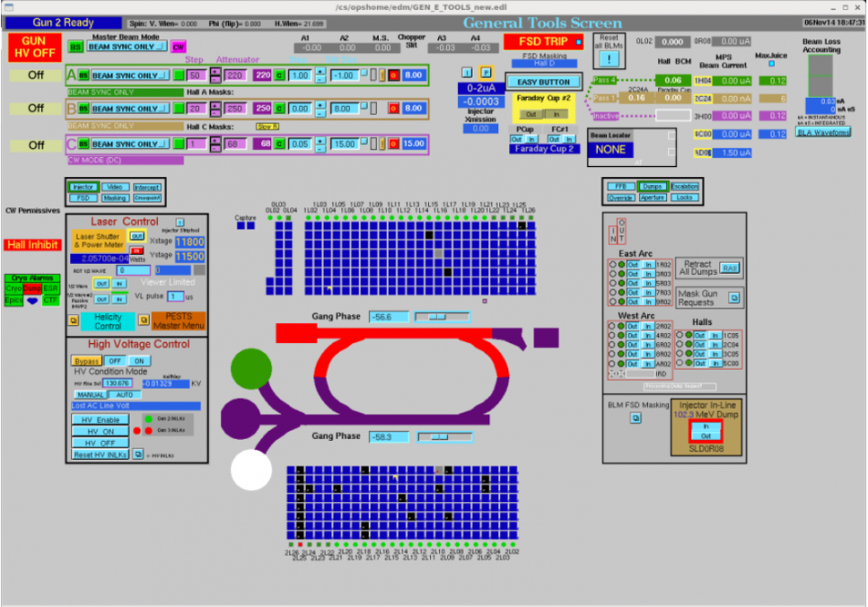
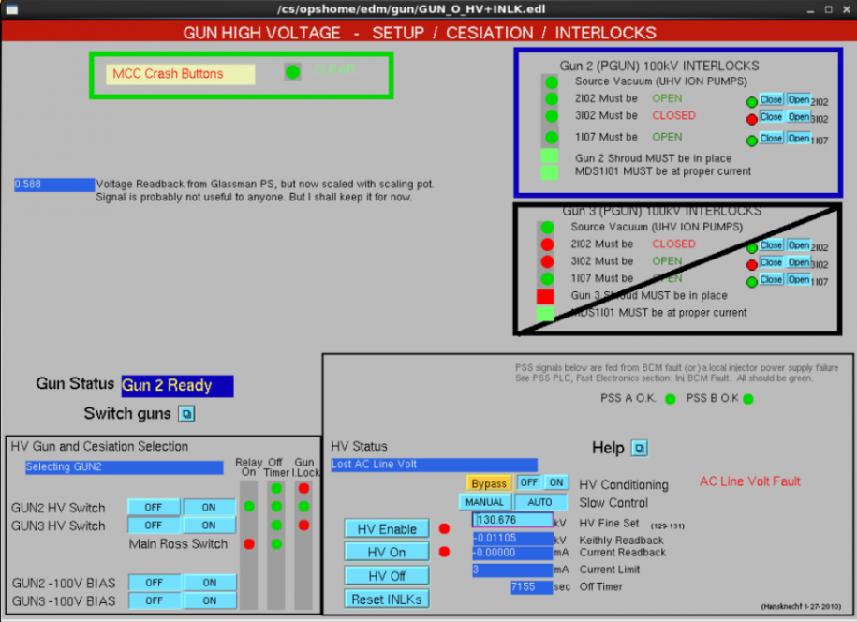
Not as Good as it Could Be
QuickPic - RM05 Neutron dropped NL & INJ to Power Permit
Log number:
Submitted by:
Last updated on:
Logbooks: ELOG
No text. Potentially lots of info for non-expert to dig through to get the beam conditions.

Slide 18
Downtime (DT) Entries
DT entries can lack key elements making troubleshooting difficult. DT entries generally benefit from one or more of the following symptoms
Screen captures showing the faults, error messages, beam conditions, etc.
References to other entries
Timeline of what was tried
What other operations were taking place at the time
Who was called or is actively working the problem
Additional data (files, etc.)

Slide 19
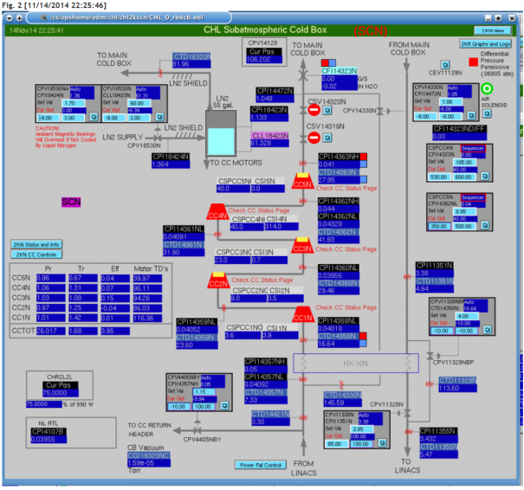
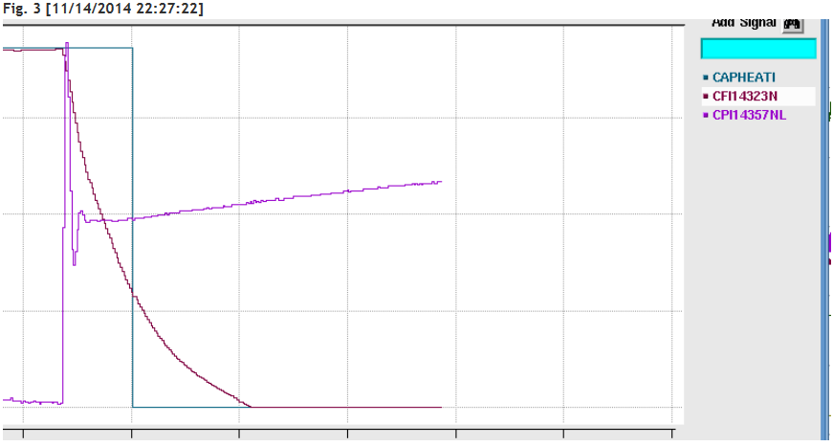
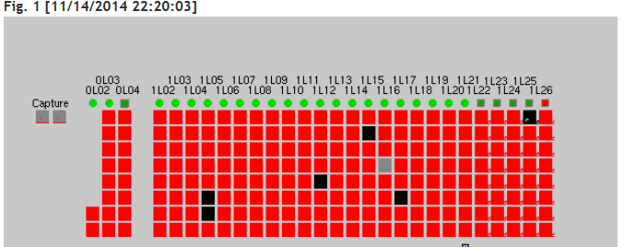
DT Entry to Diagnose a Problem
Figure 1 Shows that the RF for the Injector and North LINAC turned off.
Figure 2 shows the SCN Cold Box.
Figure 3 Shows a drop in flow and a rise in pressure (signals) for the NL.

Slide 20
Repairs Associated With a DT Entry
It’s just as important to correctly document what was done to fix a problem. DT entries typically document a symptom. Addressing or closing a DT is the time to state the actual problem.
Put enough information so that others can determine exactly what the repair was. Consider including the troubleshooting process.
DT entries typically document to the chassis or board level but could benefit from detail as to what components were replaced. Doing so stores valuable information for possible future use.

Slide 21
Conclusions
There is no single example of a good entry for all situations. Consider the reader when making an entry.
Document in the correct log book(s) and use Keywords that describe the body of the log. Both are very important to the reader.
Long entries benefit from having a summary at the top.
When changing variables, state the observation, what was adjusted, and the result (include the before and after conditions).
Screen grabs are often critical for DT entries. Details of the repair should be included in the entry as well.
Entries are not always about what went wrong. They can also be used as educational tools.
Entries should be capable of standing alone.
Not discussed BUT be mindful of what you write as ‘outsiders’ may take you 100% seriously and come to incorrect conclusions.

Slide 22
Questions?

Slide 23
Other Log Considerations
Running entries
Plan for the day entries
Keyword tips
Naming conventions

Slide 24
Running Entries
Running entries are a good way of displaying and tracking a timeline as events unfold during a problem.
They do have a problem in that they are only viewable (Check on this) once the entry is logged.
Not sure how to fix this. Perhaps making entries every 30 minutes and link the entries.

Slide 25
Good ‘Plan’ Entry
Run plan for today and tomorrow
Lognumber:
Submitted by:
Last updated on:
Logbooks: HDLOG
Tags: ShiftSummary
Entry Makers:
Run plan for today and tomorrow:
1) x-collimator scan with the 2*10^-5 radiator and 50 nA of e- beam current. (30 min). Hovanes. Done
2) x-y beam scan with the 2*10^-5 radiator and 50 nA of e- beam current. (1:30h min). Shift Crew. Ongoing (it isn now 1pm)
3) x-y beam scan with the 10^-4 radiator and 50 nA of e- beam current. (1h30 min). Shift Crew.
4) x-collimator scan with the 10^-4 radiator and 50 nA of e- beam current. (30 min). Hovanes.
In parallel to the above:
a)DAQ crash studies (40min) Sergey
b)TDC fix (2h) Benni
5) Pair Spec. commissioning, including runs without PS magnetic field (2h) Sacha
6) Trigger calibration (2h) Sacha
7a) Controlled access to install the triangle target, pointing UP (2h)
7b) x-scan with the collimator with 3 mm collimator hole and 5mm collimator hole. Once the target center is found, do a pair spec. harp scan (1h) Hovanes
7c) Controlled access to rotate the triangle target, now pointing DOWN (2h)
7d) x-scan with the collimator with 3 mm collimator hole and 5mm collimator hole. Once the target center is found, do a pair spec. harp scan (1h) Hovanes

Slide 26
Keyword Tips
Using specific keywords when performing specific types of work makes searching much easier.
HCO
PM
Checklist
Location; SL, NL, Inj., Hall A, Hall B, etc.
System; ESR, CHL, CTF, etc.
Status update
Phone call
Tour
Etc.

Slide 27
Improper Use of Naming Conventions
Striptool showing MBL0R03 hysteresis cycle
Lognumber:
Last updated on:
Logbooks: ELOG
Entry Makers:
References:
Strip tool shows both MBL0r03 and MBL0R04 chicane dipoles. MBL0R04 cycled normally but MBL0R03 did not.

Slide 28
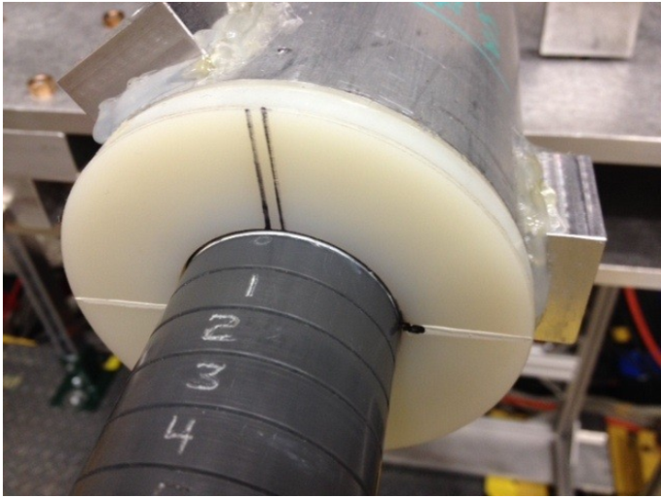
Good Entry
Logbooks: HDLOG HDTARGET
References: XXXXXX - 10mm Target installed
The target was installed with the holding tube at its nominal 0 angle. Although the target is a symmetric cylinder, this matters because the survey determined that the target is not perfectly centered on the beam line axis, see entry 3304514.
The attached photo (11/11/14, 11am) shows the orientation and z-value for the target.

Slide 29
Good Short Entry (text only)
Investigated Hall A PA not functioning correctly. Found out that it appears to be an amplifier overheating issue. Internal heat sinks have allot of dirt/dust on them. Plan to clean unit and retest.
Adding an ATLis number (if existing) would be helpful

