Slide 1
DOE Metrics
Arne Freyberger
OPS 2015 StayTreat

Slide 2
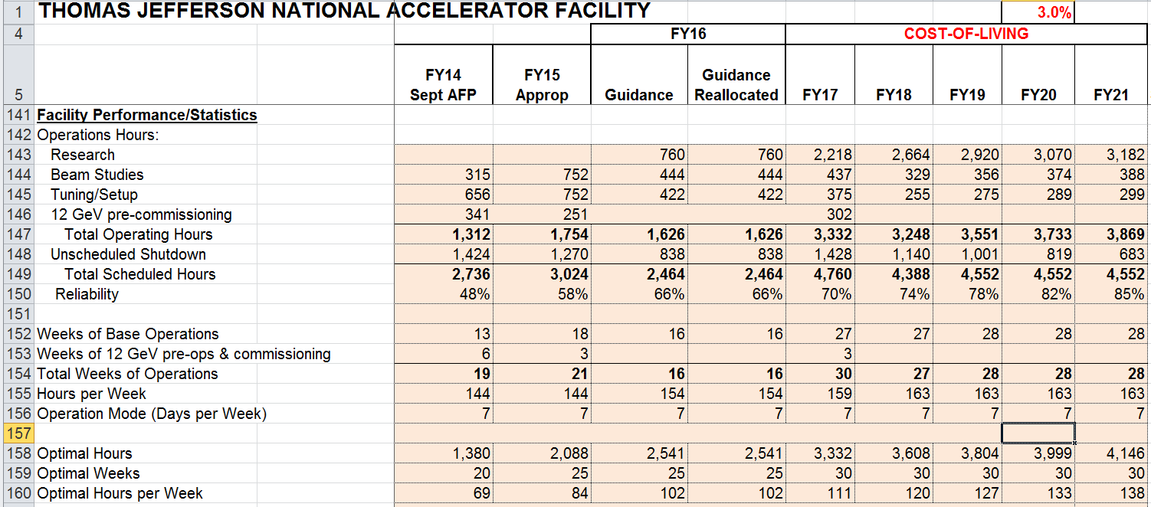
DOE Annual Budget Briefing
FY14 (the past) values are actuals. In this case, a best guess by me using DTM, elogs and other tools
FY15 and beyond are expected hours based on Weeks of Operations, Reliability target.

Slide 3
DOE Hours
DOE NP Office requires quarterly updates and tracks:
Delivered Research Hours
Delivered Beam Study Hours
Delivered Tuning/Restored Hours
The sum of these three hours is equal to the Total Delivered Hours.
Expected Delivered Hours: During the annual budgetary briefings expected targets are determined.

Slide 4
Reliability
Reliability = Total Delivered Hours/Total Scheduled Hours
Total Delivered Hours = Delivered Research Hours + Delivered Beam Study Hours + Delivered Tuning/Restored Hours
Total Scheduled Hours = Total Delivered Hours + Unscheduled Failures

Slide 5
CEBAF DOE Hours 12GeV era
 | Research Week | Restore Week
Scheduled Research Hours | 144 | 0
Scheduled Beam Studies Hours | 12 | 72
Scheduled Tuning/Setup Hours | 8 | 72
Maintenance Hours | 4 | 24
Scheduled Beam Hours per Week | 164 | 144
Maintenance Hours per Week | 4 | 24
Scheduled hours per week less than 168 hours, and for the year the Scheduled hours per week is 163h.
My interpretation of Unscheduled Hours per Week is that the first 4 hours of Downtime during a Research Week are free.
Unscheduled Failures = Downhard – N_{weeks}*4h (assuming research week)

Slide 6
CEBAF Reliability
Reliability = Total Delivered Hours/Total Scheduled Hours
Total Scheduled Hours = Total Delivered Hours + Unscheduled Failures
Unscheduled Failures = Downhard – 4h*N_{weeks}
Total Delivered Hours = Delivered Research Hours + Delivered Beam Study Hours + Delivered Tuning/Restored Hours
While tracking of these hours is required, there might be an easier path to Reliability.
Total Delivered Hours = Total Scheduled Hours – Unscheduled Failures
Total Schedule Hours = Nweeks*163h
Reliability = (N_{weeks}*163h – (Downhard – 4h*N_{weeks}))/N_{weeks}*163h
= 1 – (Downhard – 4h*Nweeks)/Nweeks*163h

Slide 7
CEBAF Reliability
 | Scheduled Weeks | Operated Weeks | Reliability Target | Reliability Achieved
FY14 | 13 | 10.3 | 50 | 48
FY15 | 18 | 19.7 | 58 | 68 | Received additional funds for more operating weeks
FY16 | 16 |  | 66
FY17 | 27 |  | 70
FY18 | 27 |  | 74
FY19 | 28 |  | 78
FY20 | 28 |  | 82
FY21 | 28 |  | 85
Long term schedule is based on “Cost of Living” scenario.
Additional funding will generally add more operating weeks and may also result in an increase to the reliability target.
Reliability session this afternoon
Metrics presentation on Friday

Slide 8
Availability
Beam metric based on the users assessment of beam delivery.
Physics to work out the details.

Slide 9
Summary
Reliability can be derived from the Scheduled Hours, Downtime hours, and hours per week.
Reliability improved significantly from FY14 to FY15.
Improved Cryo performance even with the CC4 failure.
No ZA event in FY15.
Reliability for FY15 is above the target for FY15 and FY16.
Tracking of DOE Hours is required and a pain.
Operations would rather not be involved.

