Slide 1
SoLID-lite J/psi
scenario comparisons
Six configurations: geometry, acceptance, and projected yields
SI-Generated Presentation

Slide 2
Configuration Names and Reference Masks
CONFIGURATIONS
Nested azimuth masks: WA outer ring at z = -60 cm; FA inner ring at LGC mirror z = +270 cm
Projection assumption: GEM coverage = 2π
Luminosity assumption: 2× for reduced-acceptance scenarios
2FA / 4FA: two / four 24° forward sectors | WA: two 90° sectors
Aligned WA centers: 0°, 180° | Rotated WA centers: 90°, 270°
Source: scripts/detector_config.h; nested azimuth-mask schematics, not radial acceptance or hit distributions
2
Notes:
Configuration key:
Baseline = baseline
2FA = seg2_24deg_fa
2FA + WA aligned = seg2_24deg_fa_wa2x90_aligned
2FA + WA rotated = seg2_24deg_fa_wa2x90_rotated
4FA = seg4_24deg_fa
4FA + WA aligned = seg4_24deg_fa_wa2x90_aligned
WA azimuth measured at z=-60 cm; FA azimuth at LGC mirror z=270 cm. Nested-ring radii are schematic only. Baseline luminosity multiplier 1; all alternatives 2.

Slide 3
Photoproduction Phase Space
COMPARISON PHYSICS
Six production projections; table shows luminosity-weighted counts and % baseline
Scenario | p_ee count (% baseline)
Baseline | 713,294 (100.0%)
2FA | 355,468 (49.8%)
2FA + WA aligned | 107,017 (15.0%)
2FA + WA rotated | 61,212 (8.6%)
4FA | 498,914 (69.9%)
4FA + WA aligned | 128,398 (18.0%)
Baseline
2FA
2FA + WA aligned
Baseline: 1× luminosity
Alternatives: 2× luminosity
2FA + WA rotated
4FA
4FA + WA aligned
Sources: plots/kin/{scenario}/p_ee_t_W.pdf; counts: production data/xsec CSV n_accepted
3

Slide 4
Electroproduction Phase Space
COMPARISON PHYSICS
Six production projections; table shows luminosity-weighted counts and % baseline
Scenario | e_ee count (% baseline)
Baseline | 16,861 (100.0%)
2FA | 2,796 (16.6%)
2FA + WA aligned | 1,221 (7.2%)
2FA + WA rotated | 994 (5.9%)
4FA | 6,140 (36.4%)
4FA + WA aligned | 2,512 (14.9%)
Baseline
2FA
2FA + WA aligned
Baseline: 1× luminosity
Alternatives: 2× luminosity
2FA + WA rotated
4FA
4FA + WA aligned
Sources: plots/kin/{scenario}/e_ee_t_W.pdf; counts: production data/xsec CSV n_accepted
4

Slide 5
Photoproduction Egamma Comparison
COMPARISON PHYSICS
Projected cross sections, not event counts; uncertainties reflect 1× / 2× luminosity
Baseline
2FA
2FA + WA aligned
2FA + WA rotated
4FA
4FA + WA aligned
Blue points: projected cross sections, sigma (nb), from holographic model (photo scale 1.40)
Black solid: 2+3-gluon fit reference | Black dashed: sigma_sum_gluex reference
Black data: Cornell open triangle, SLAC filled triangle, CERN open diamond, GlueX filled square
Source: regenerated official-scenario PDFs in plots/kin or plots/xsec; proportional fit, no cropping.
5

Slide 6
Electroproduction Egamma Comparison
COMPARISON PHYSICS
Projected cross sections, not event counts; uncertainties reflect 1× / 2× luminosity
Baseline
2FA
2FA + WA aligned
2FA + WA rotated
4FA
4FA + WA aligned
Red points: projected cross sections, sigma (nb), from holographic model
Black solid: 2+3-gluon fit reference | Black dashed: sigma_sum_gluex reference
Black data: Cornell open triangle, SLAC filled triangle, CERN open diamond, GlueX filled square
Source: regenerated official-scenario PDFs in plots/kin or plots/xsec; proportional fit, no cropping.
6

Slide 7
Photoproduction t Comparison: Bin 05
COMPARISON PHYSICS
Egamma bin 05: 8.607-8.707 GeV | Projection model: holographic in tprime
Baseline
2FA
2FA + WA aligned
2FA + WA rotated
4FA
4FA + WA aligned
Blue filled circles: projected accepted points, d sigma/dt (nb/GeV^2) | Black solid: holographic raw-|t| theory
Egamma-bin suffixes; fixed tprime bins | x: weighted raw |t| | Dashed verticals: kinematic t limits
Source: regenerated official-scenario PDFs in plots/kin or plots/xsec; proportional fit, no cropping.
7

Slide 8
Photoproduction t Comparison: Bin 14
COMPARISON PHYSICS
Egamma bin 14: 9.504-9.604 GeV | Projection model: holographic in tprime
Baseline
2FA
2FA + WA aligned
2FA + WA rotated
4FA
4FA + WA aligned
Blue filled circles: projected accepted points, d sigma/dt (nb/GeV^2) | Black solid: holographic raw-|t| theory
Egamma-bin suffixes; fixed tprime bins | x: weighted raw |t| | Dashed verticals: kinematic t limits
Source: regenerated official-scenario PDFs in plots/kin or plots/xsec; proportional fit, no cropping.
8

Slide 9
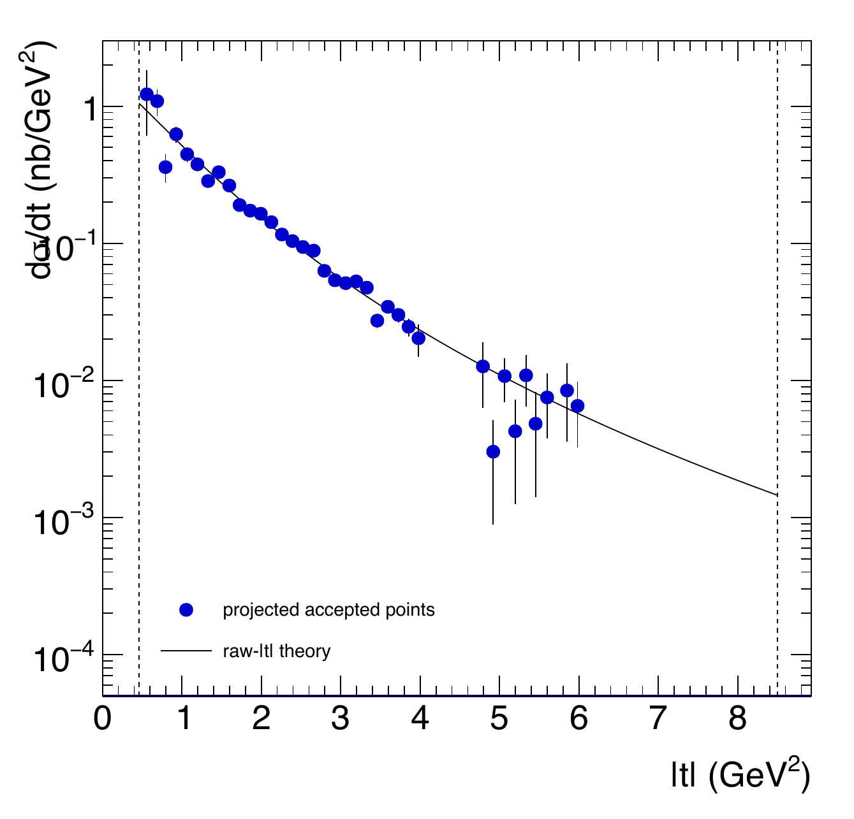
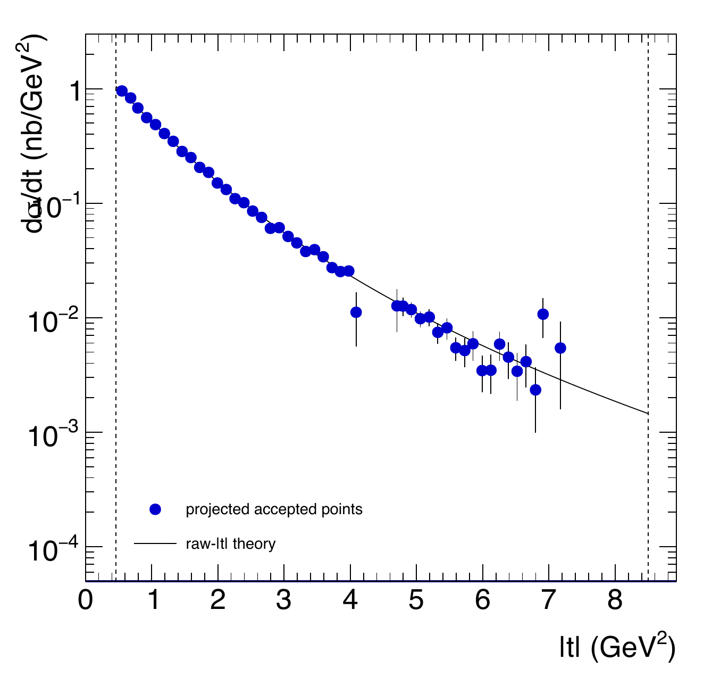
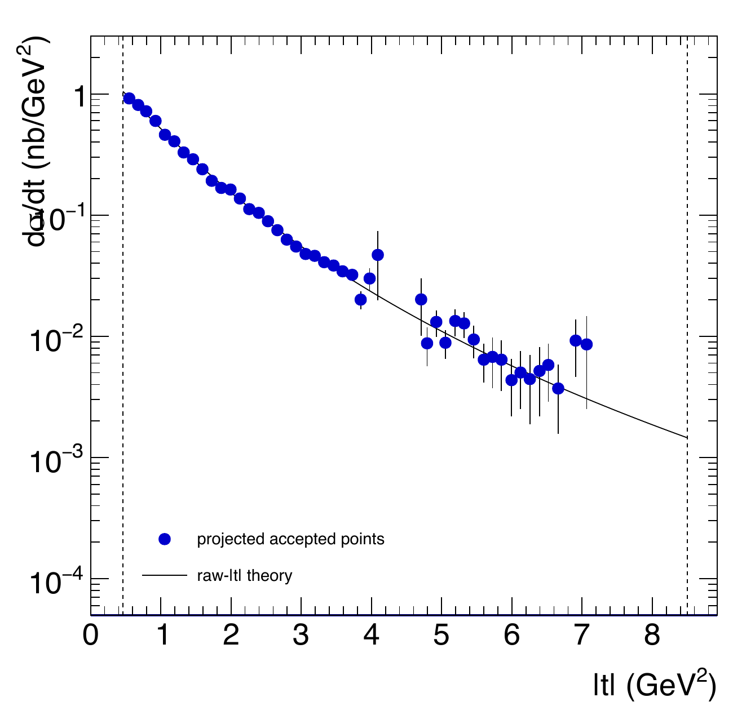
Photoproduction t Comparison: Bin 24
COMPARISON PHYSICS
Egamma bin 24: 10.501-10.601 GeV | Projection model: holographic in tprime
Baseline
2FA
2FA + WA aligned
2FA + WA rotated
4FA
4FA + WA aligned
Blue filled circles: projected accepted points, d sigma/dt (nb/GeV^2) | Black solid: holographic raw-|t| theory
Egamma-bin suffixes; fixed tprime bins | x: weighted raw |t| | Dashed verticals: kinematic t limits
Source: regenerated official-scenario PDFs in plots/kin or plots/xsec; proportional fit, no cropping.
9

Slide 10
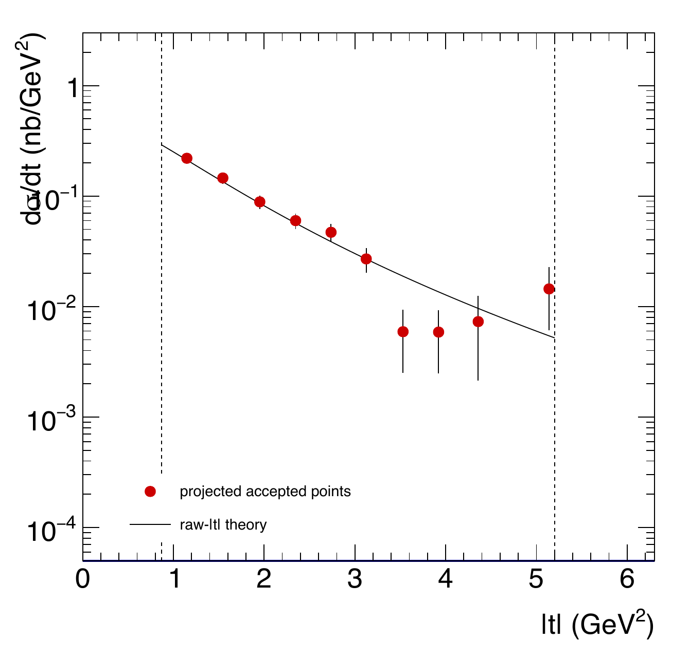
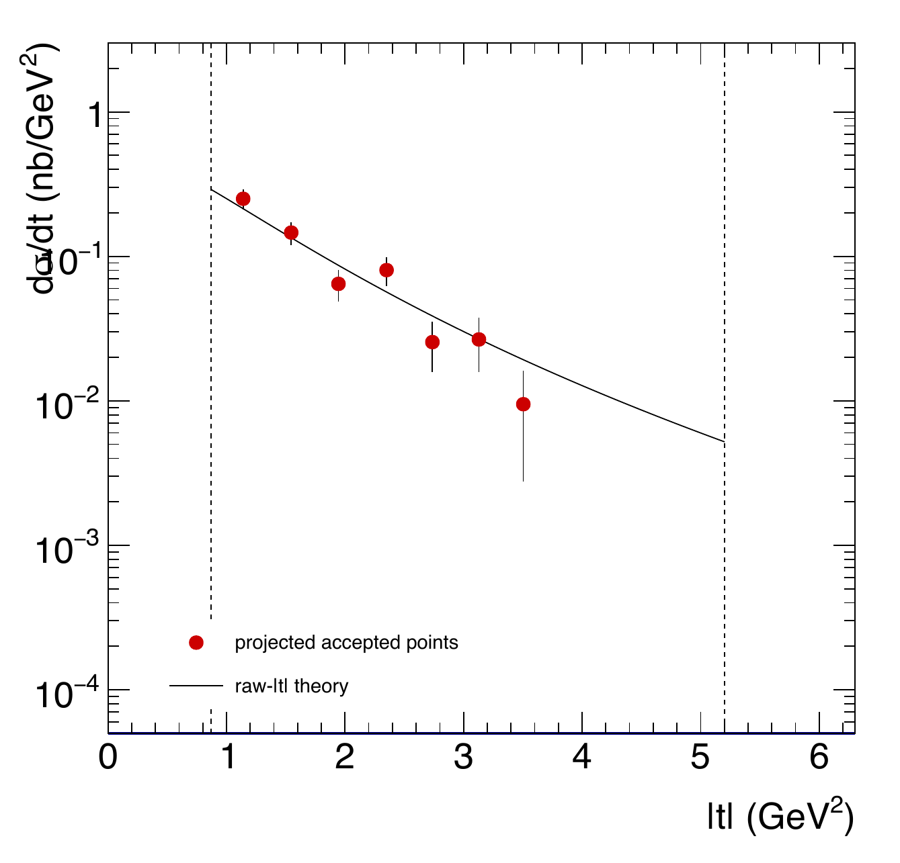
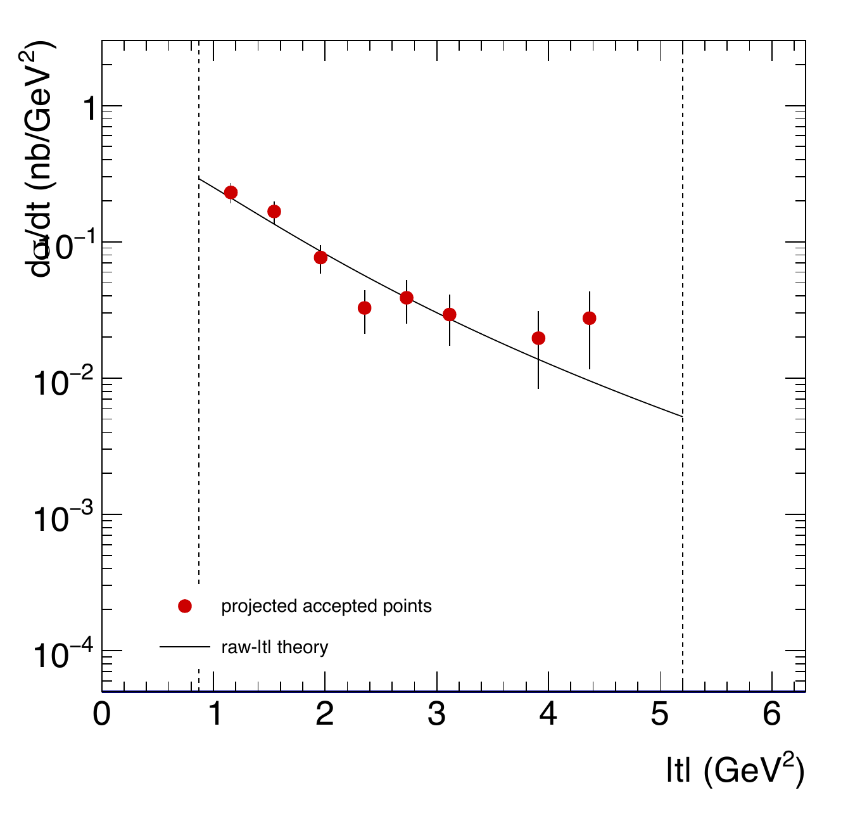
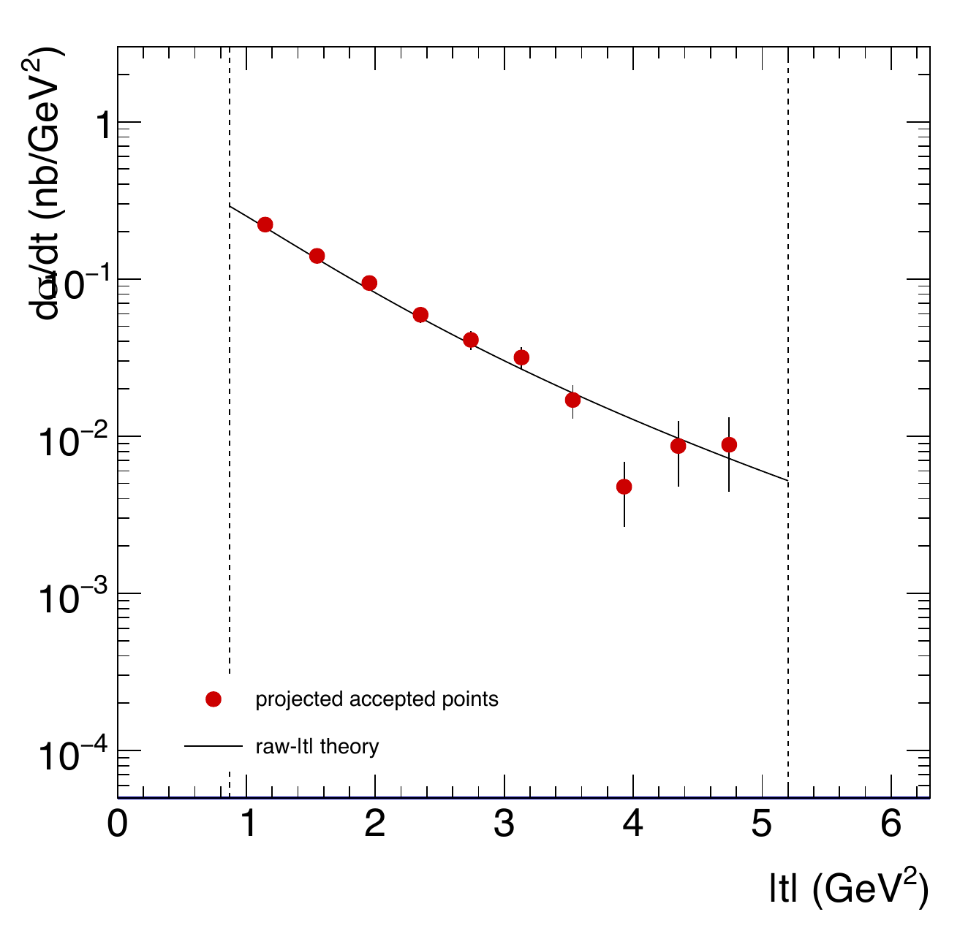
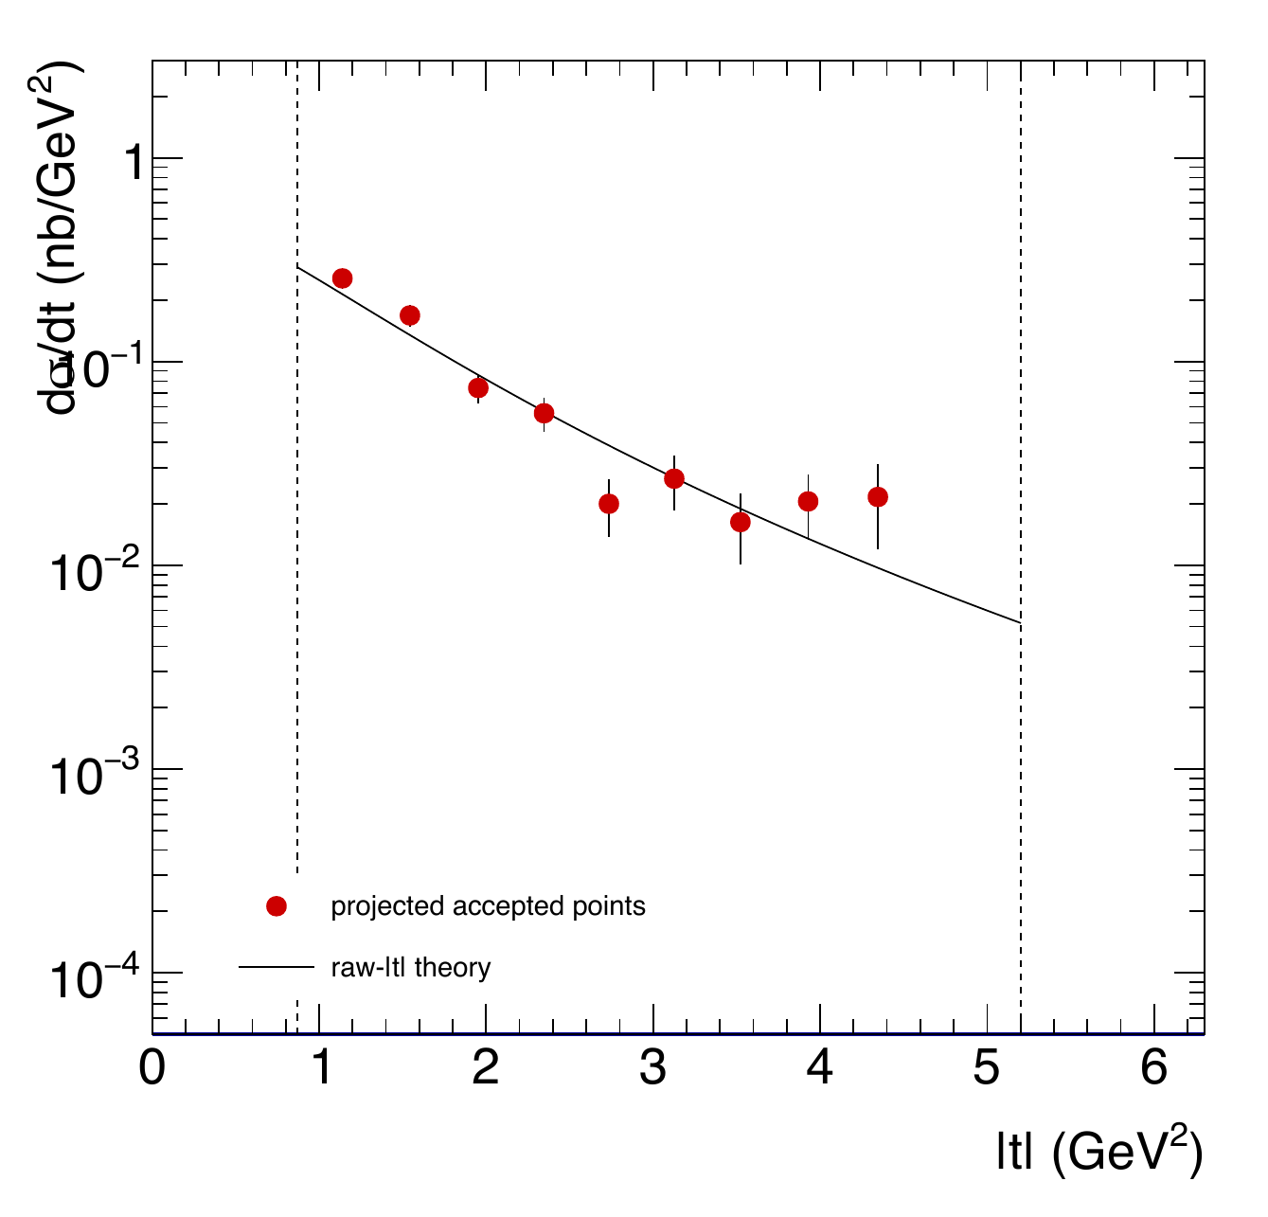
Electroproduction t Comparison: Bin 05
COMPARISON PHYSICS
Egamma bin 05: 8.953-9.139 GeV | Projection model: holographic in tprime
Baseline
2FA
2FA + WA aligned
2FA + WA rotated
4FA
4FA + WA aligned
Red filled circles: projected accepted points, d sigma/dt (nb/GeV^2) | Black solid: holographic raw-|t| theory
Egamma-bin suffixes; fixed tprime bins | x: weighted raw |t| | Dashed verticals: kinematic t limits
Source: regenerated official-scenario PDFs in plots/kin or plots/xsec; proportional fit, no cropping.
10

Slide 11
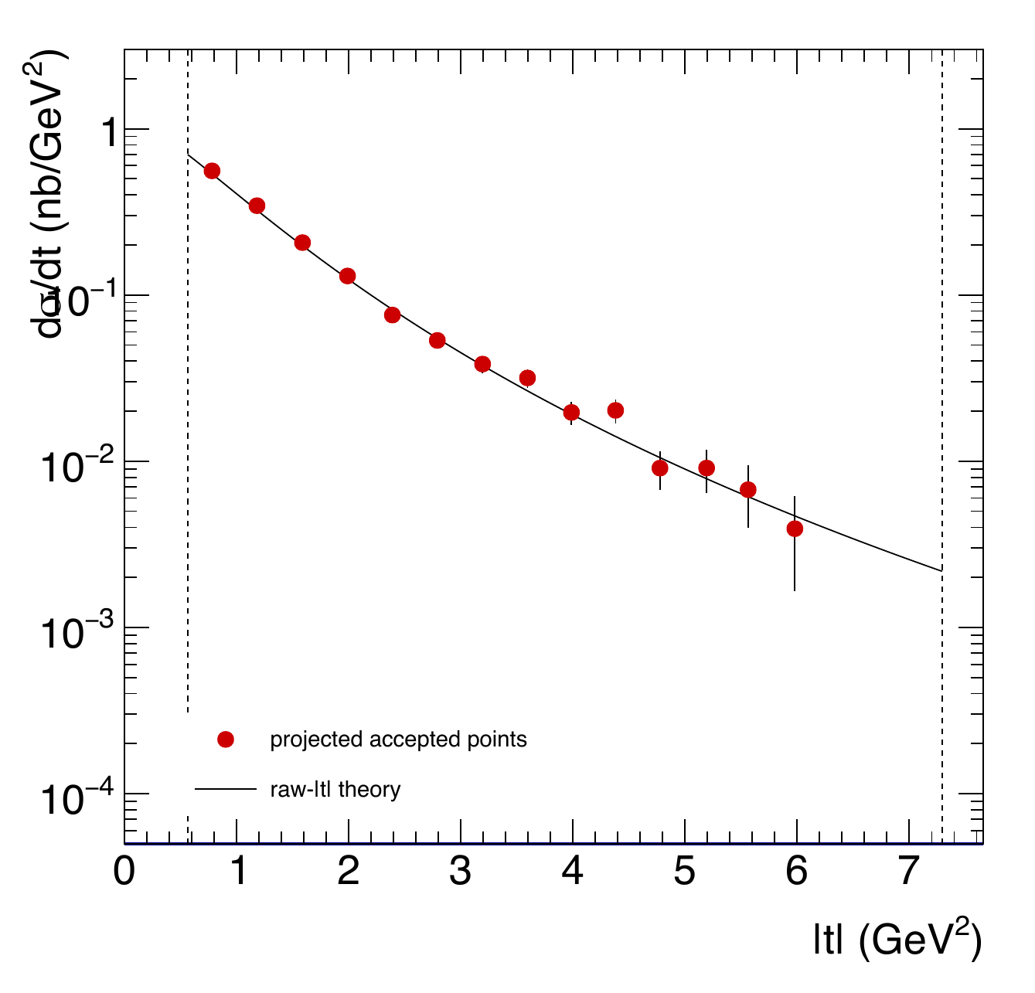
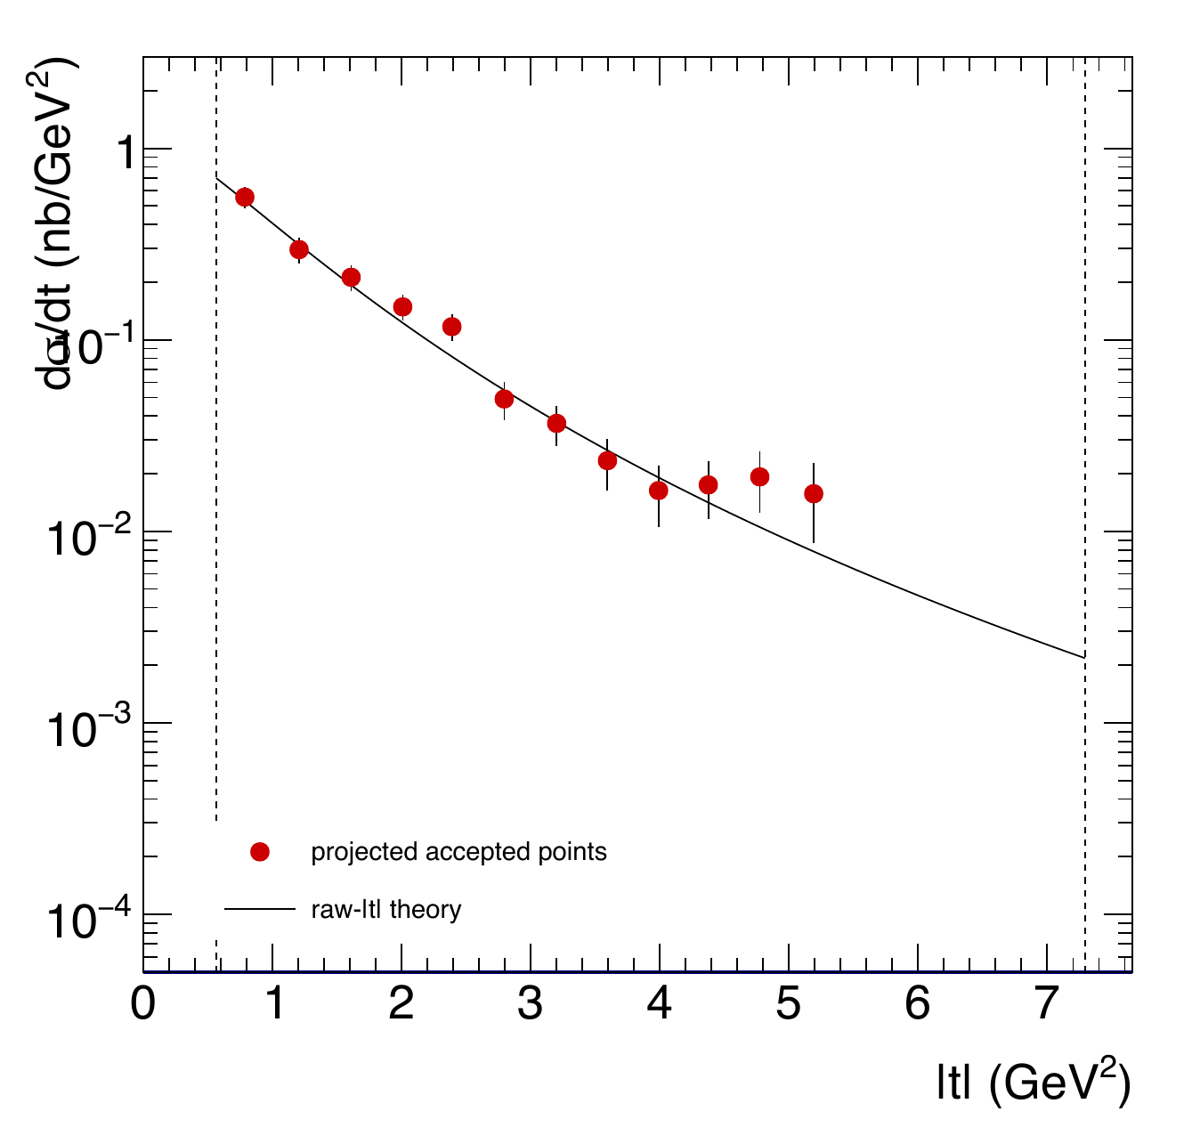
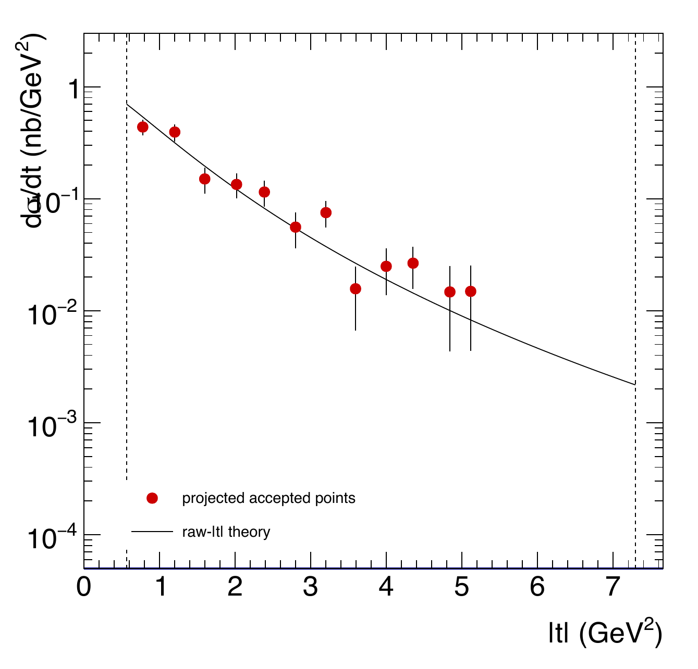
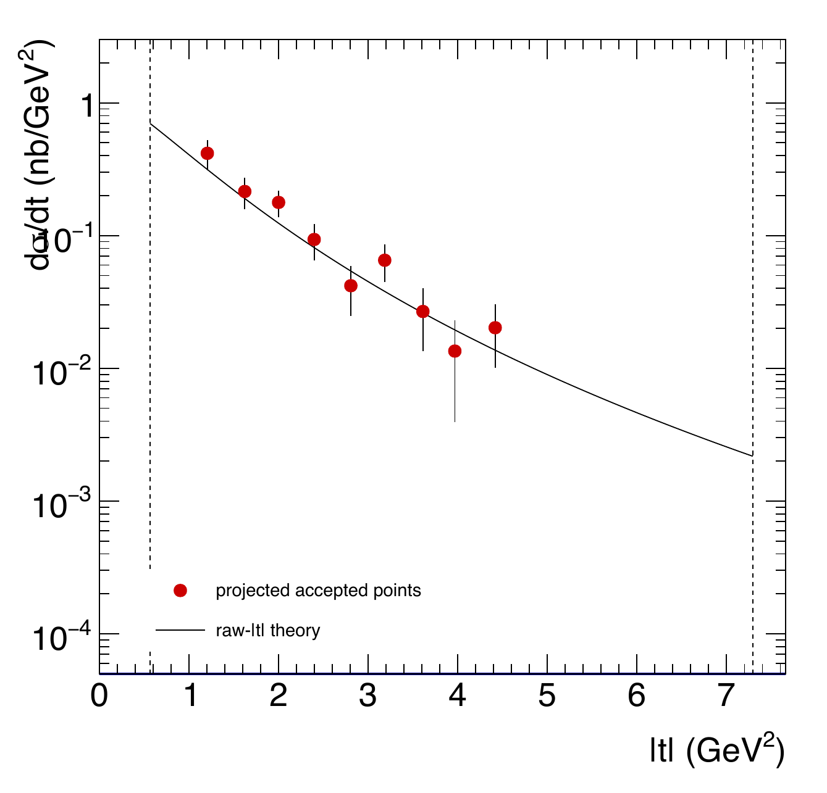
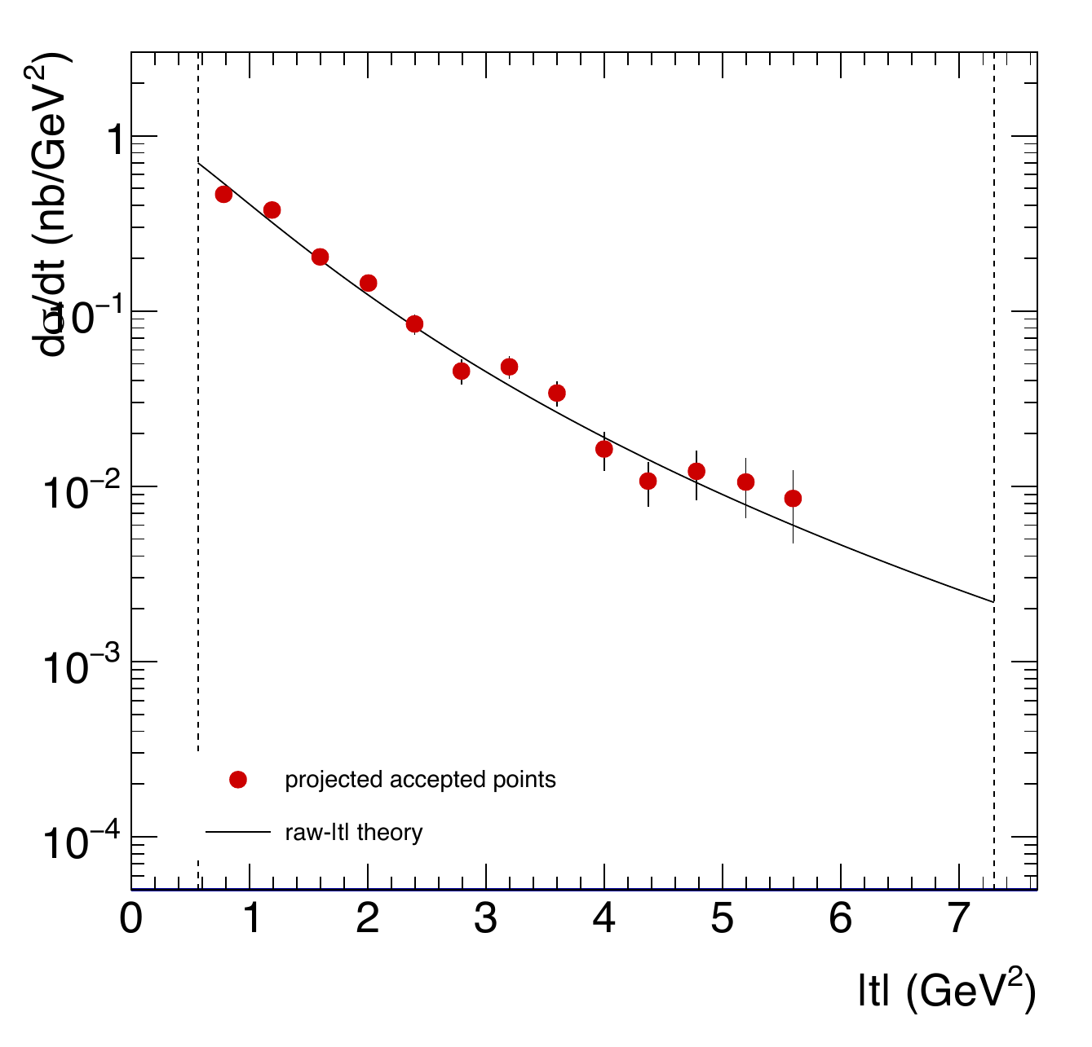

Electroproduction t Comparison: Bin 10
COMPARISON PHYSICS
Egamma bin 10: 9.883-10.069 GeV | Projection model: holographic in tprime
Baseline
2FA
2FA + WA aligned
2FA + WA rotated
4FA
4FA + WA aligned
Red filled circles: projected accepted points, d sigma/dt (nb/GeV^2) | Black solid: holographic raw-|t| theory
Egamma-bin suffixes; fixed tprime bins | x: weighted raw |t| | Dashed verticals: kinematic t limits
Source: regenerated official-scenario PDFs in plots/kin or plots/xsec; proportional fit, no cropping.
11

Slide 12
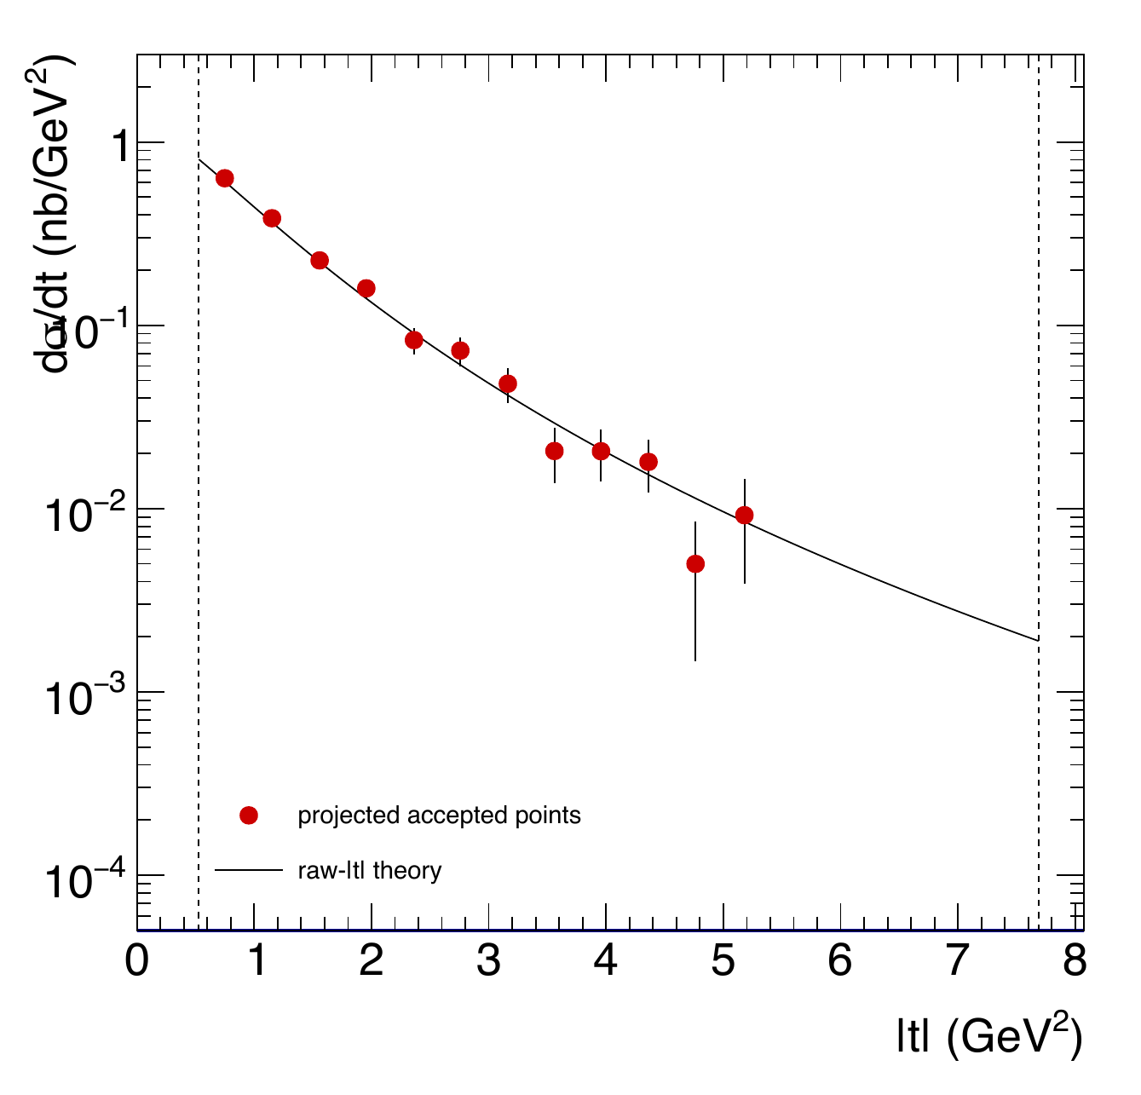
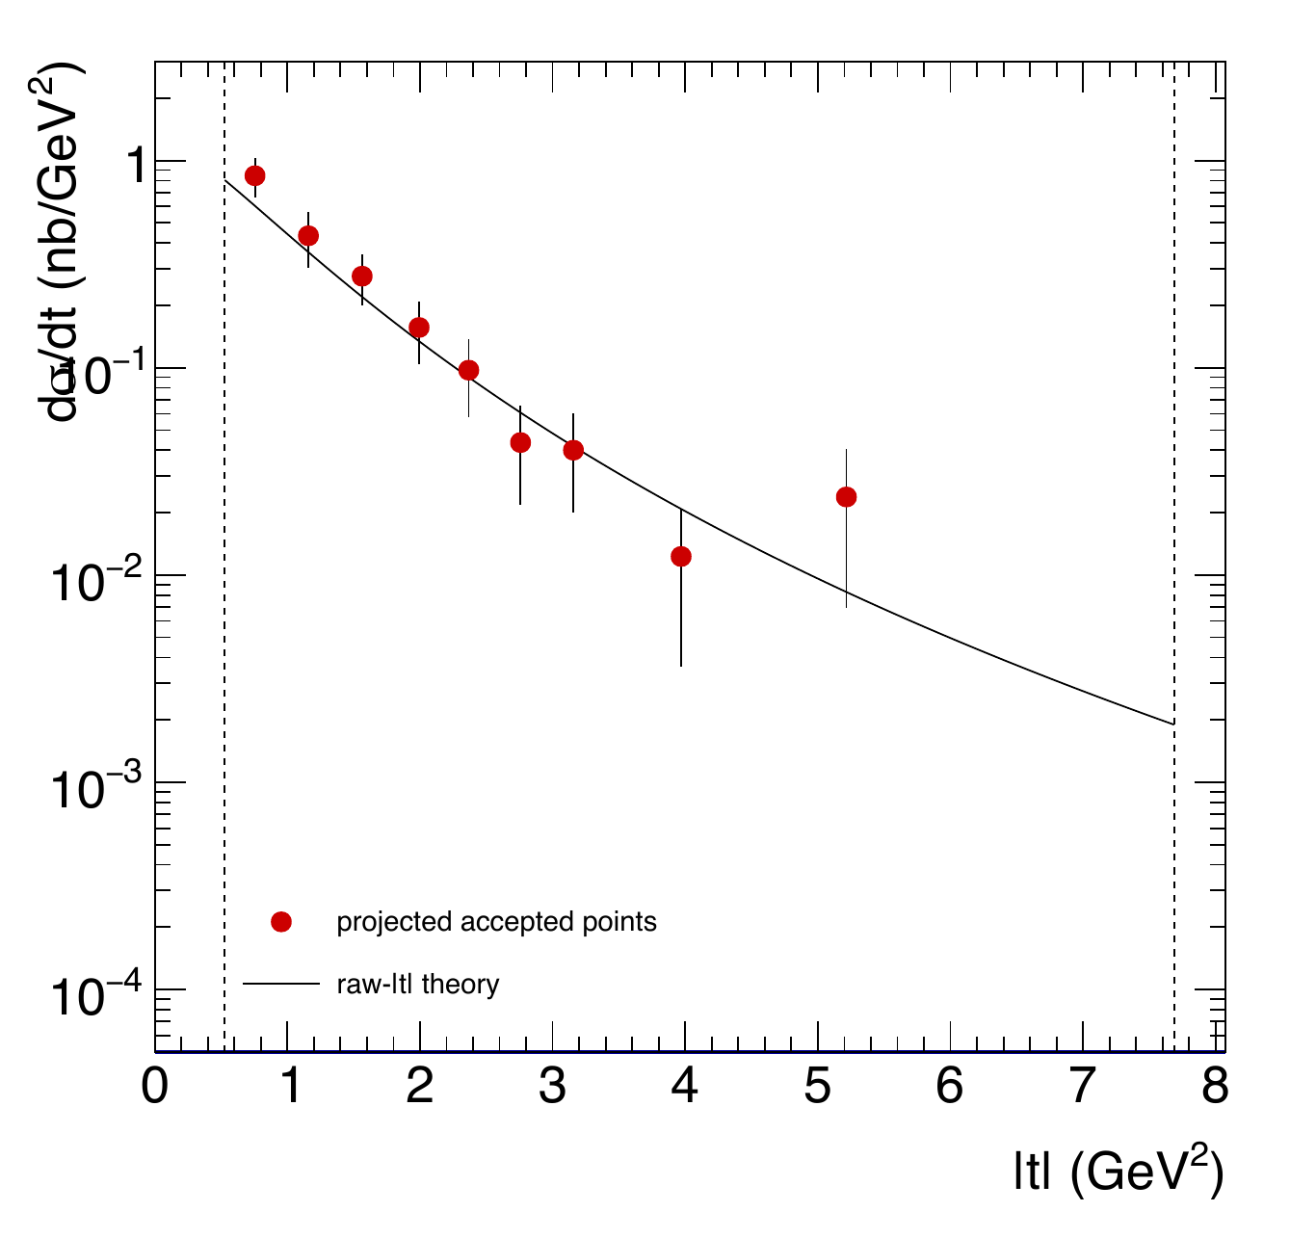
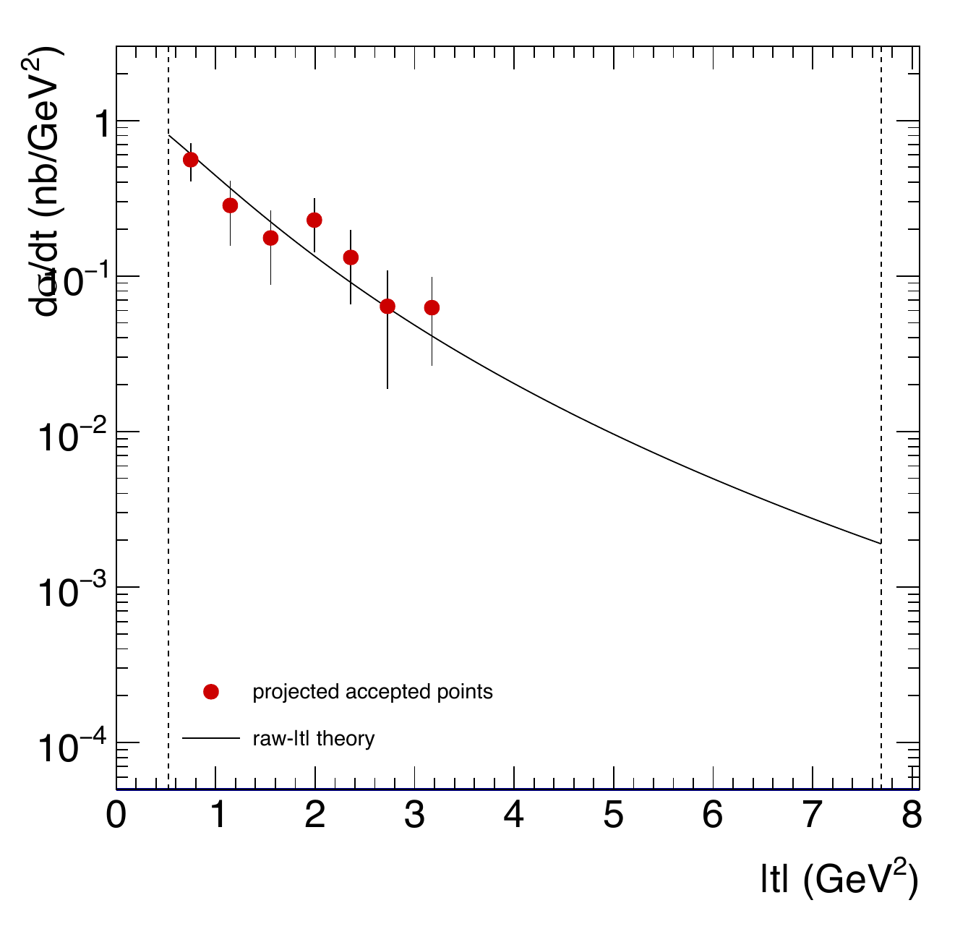
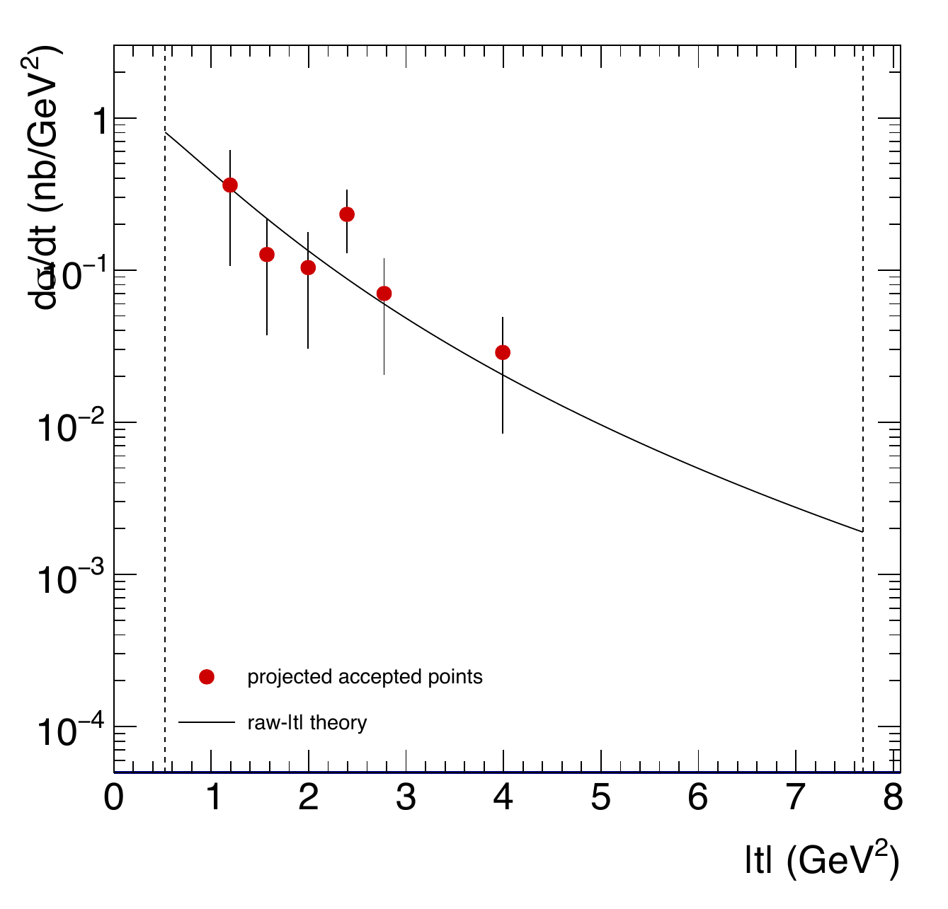
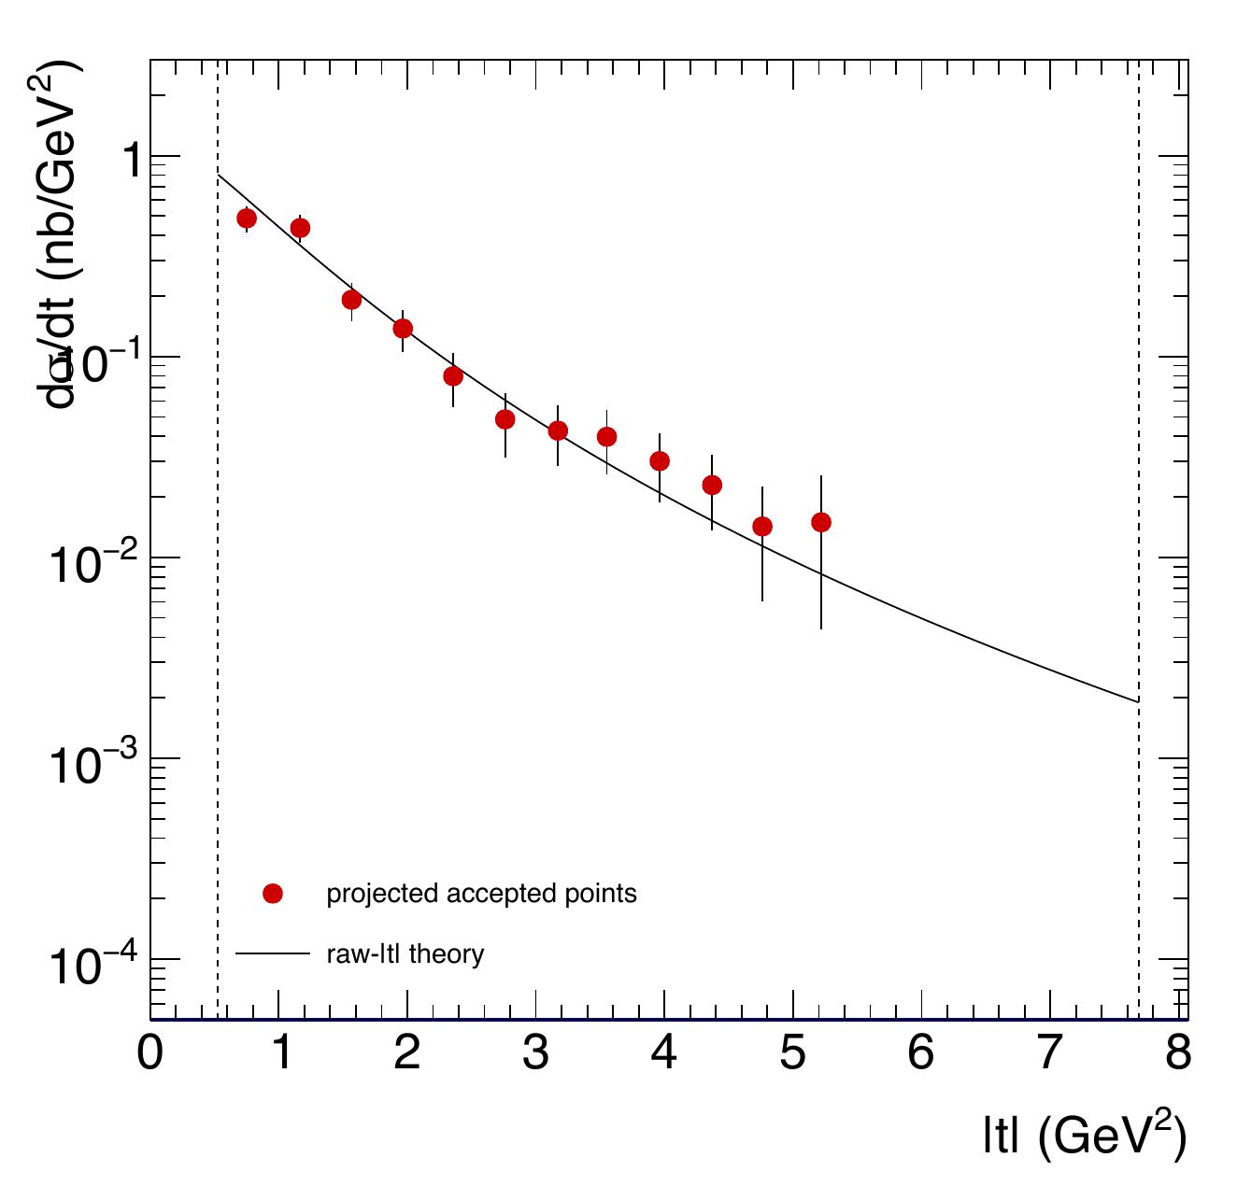
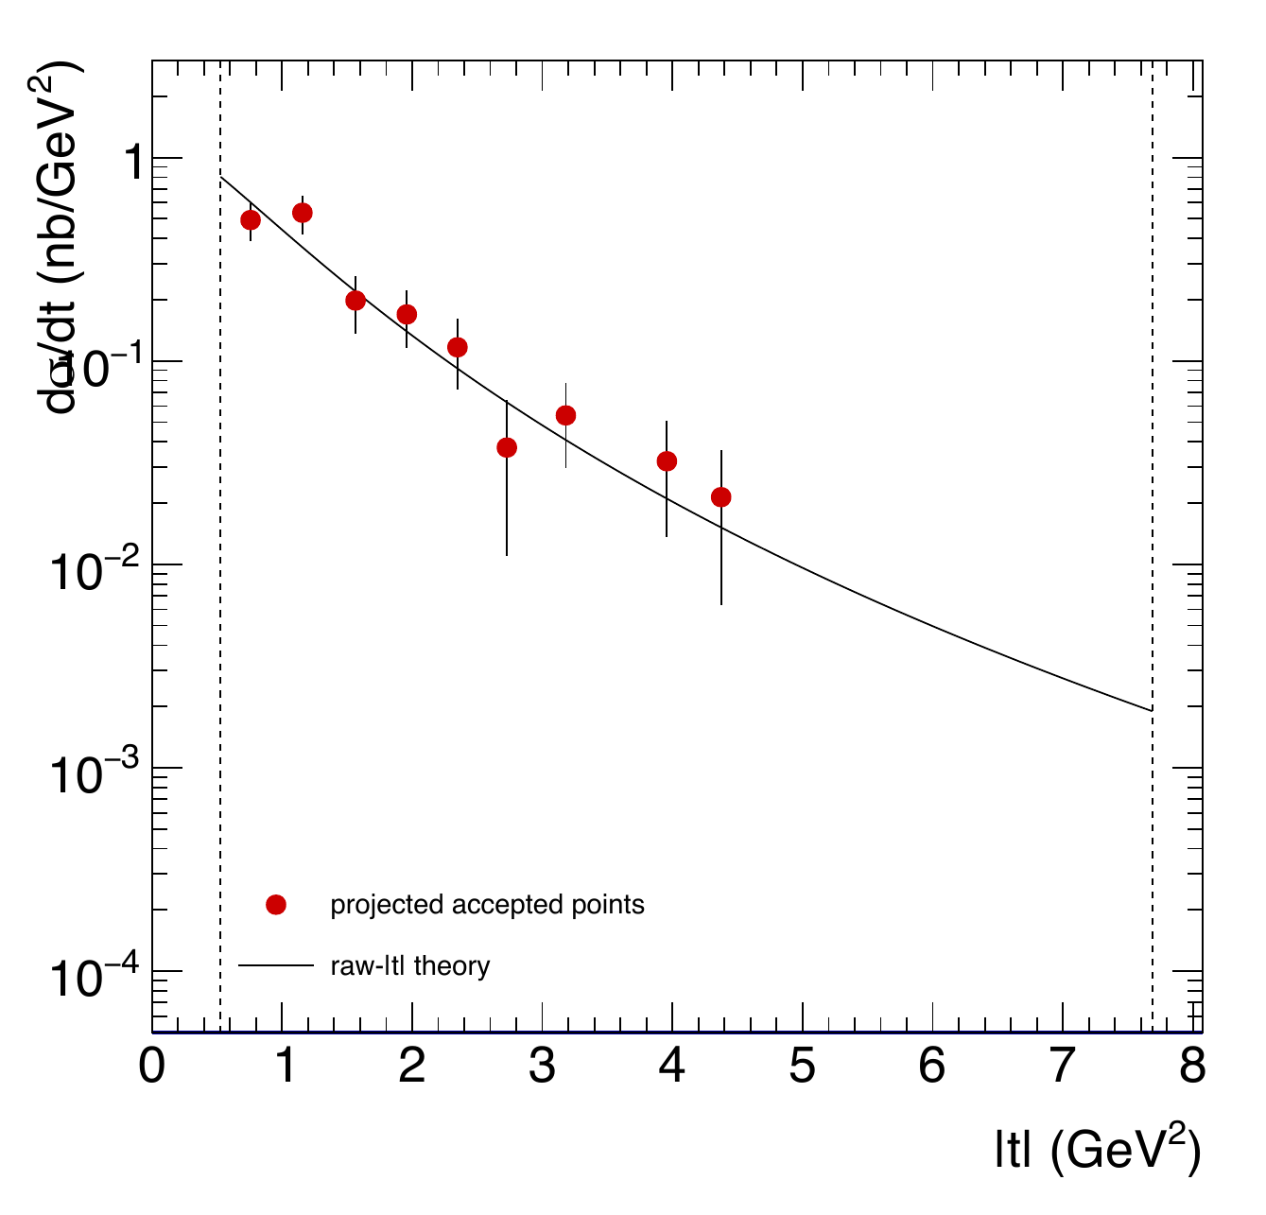
Electroproduction t Comparison: Bin 11
COMPARISON PHYSICS
Egamma bin 11: 10.069-10.255 GeV | Projection model: holographic in tprime
Baseline
2FA
2FA + WA aligned
2FA + WA rotated
4FA
4FA + WA aligned
Red filled circles: projected accepted points, d sigma/dt (nb/GeV^2) | Black solid: holographic raw-|t| theory
Egamma-bin suffixes; fixed tprime bins | x: weighted raw |t| | Dashed verticals: kinematic t limits
Source: regenerated official-scenario PDFs in plots/kin or plots/xsec; proportional fit, no cropping.
12

Slide 13
Counts Across All Configurations
STATISTICS
Production n_accepted sums; percentages relative to the channel baseline
Scenario | p_ee count (% baseline) | e_ee count (% baseline)
Baseline | 713,294 (100.0%) | 16,861 (100.0%)
2FA | 355,468 (49.8%) | 2,796 (16.6%)
2FA + WA aligned | 107,017 (15.0%) | 1,221 (7.2%)
2FA + WA rotated | 61,212 (8.6%) | 994 (5.9%)
4FA | 498,914 (69.9%) | 6,140 (36.4%)
4FA + WA aligned | 128,398 (18.0%) | 2,512 (14.9%)
Raw yields include luminosity: Baseline 1×, all alternatives 2×
Counts and % baseline are relative to the baseline
Source: sum of n_accepted in production data/xsec/{scenario}/solid-2d-{channel}.csv
13

Slide 14
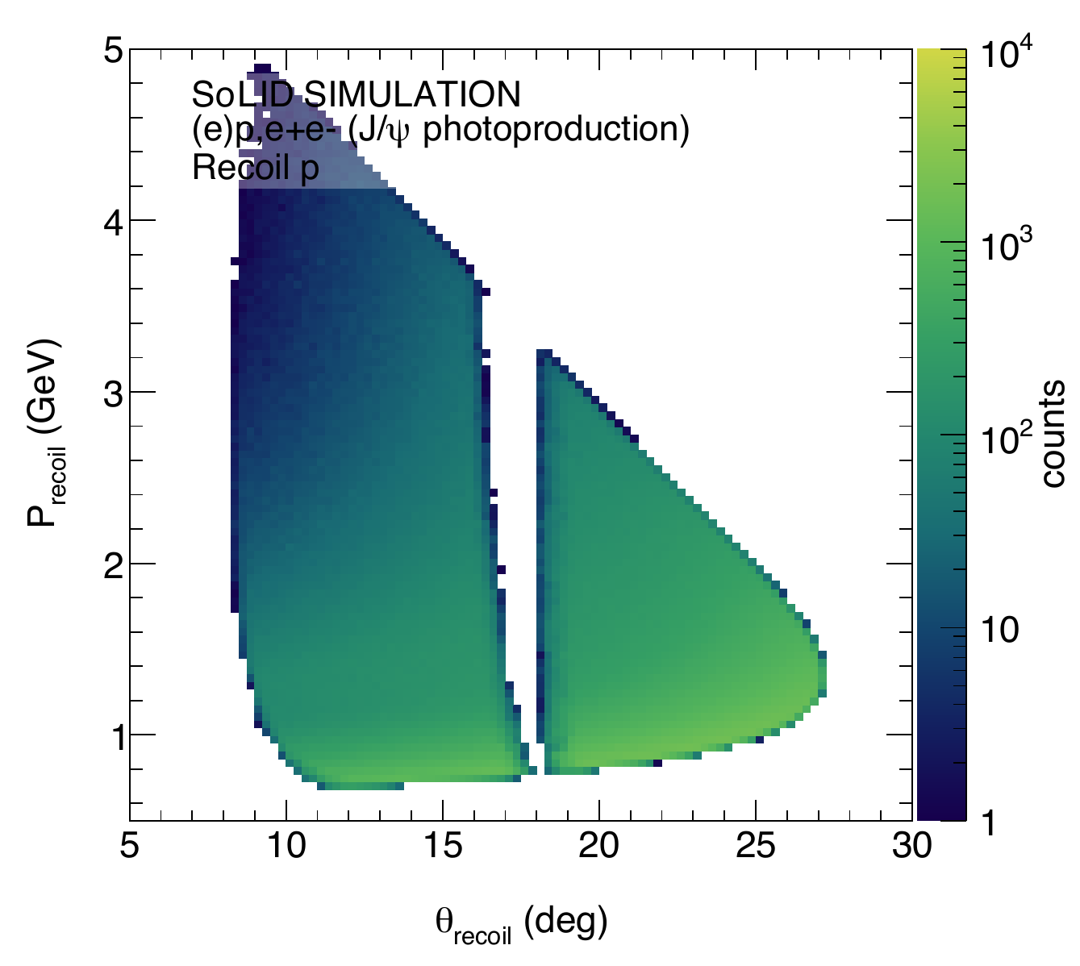
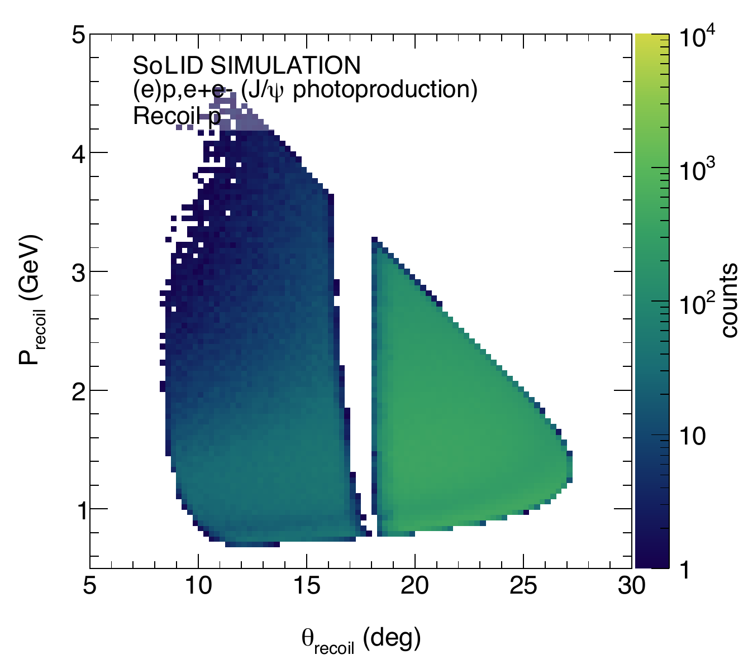
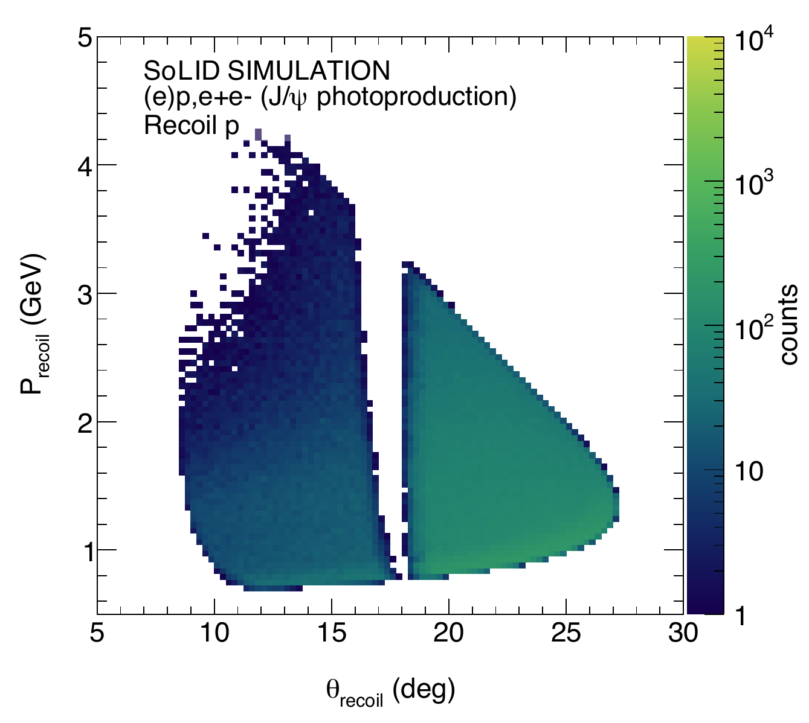
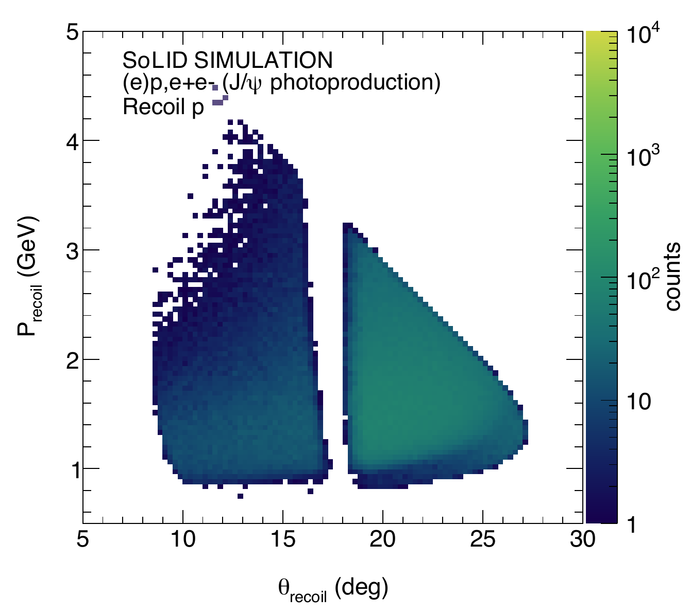
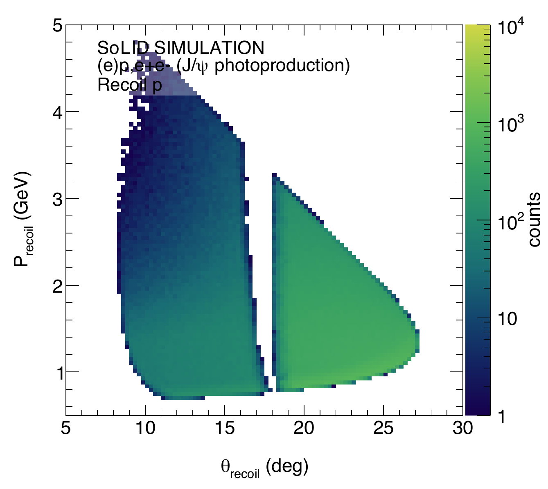
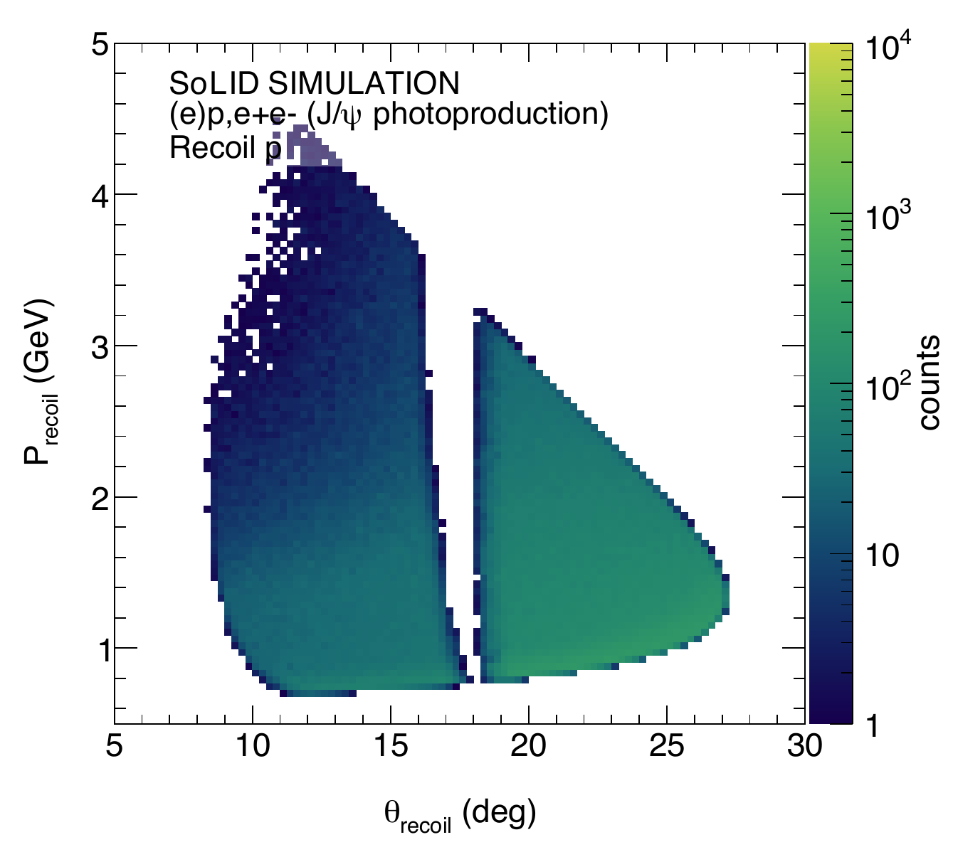
Photoproduction Acceptance: Recoil proton
COMPARISON GEOMETRY
Theta versus momentum: available production acceptance maps
Baseline
2FA
2FA + WA aligned
2FA + WA rotated
4FA
4FA + WA aligned
Source: regenerated official-scenario PDFs in plots/kin or plots/xsec; proportional fit, no cropping.
14

Slide 15
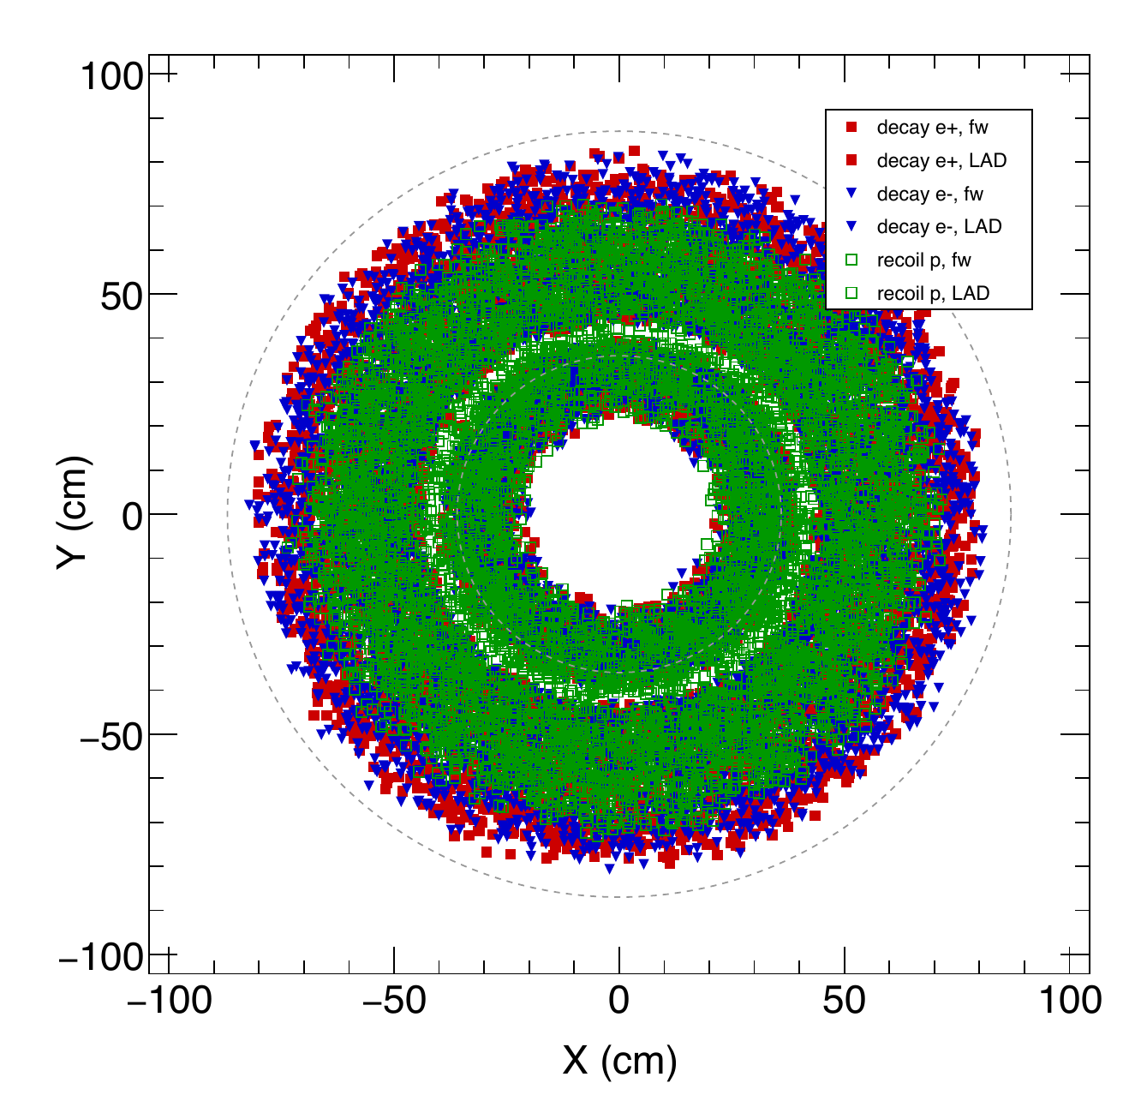
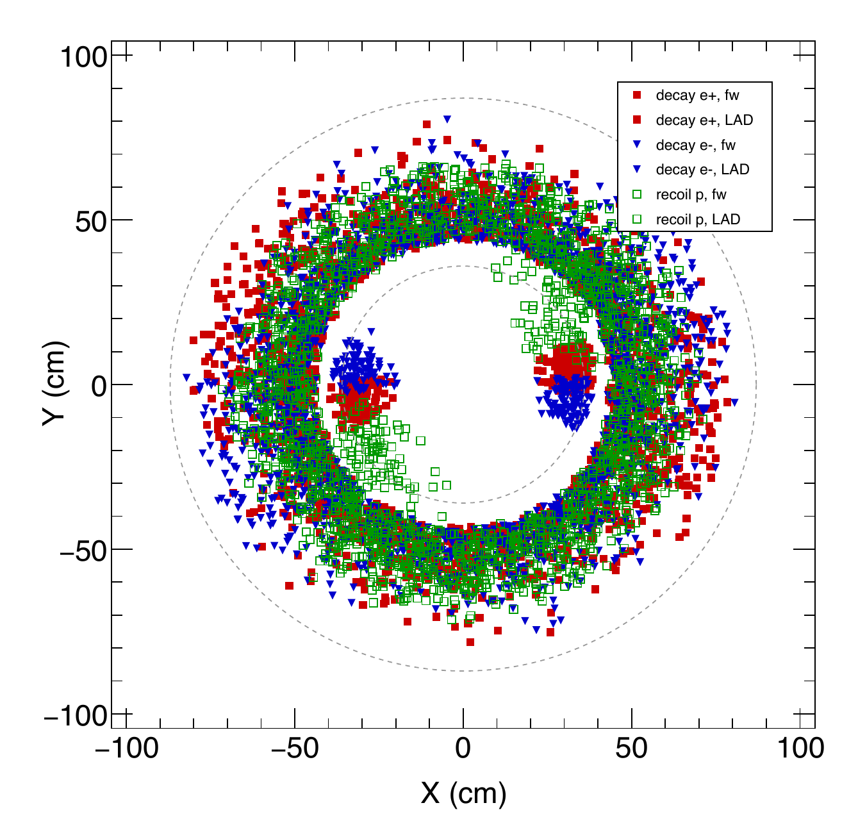
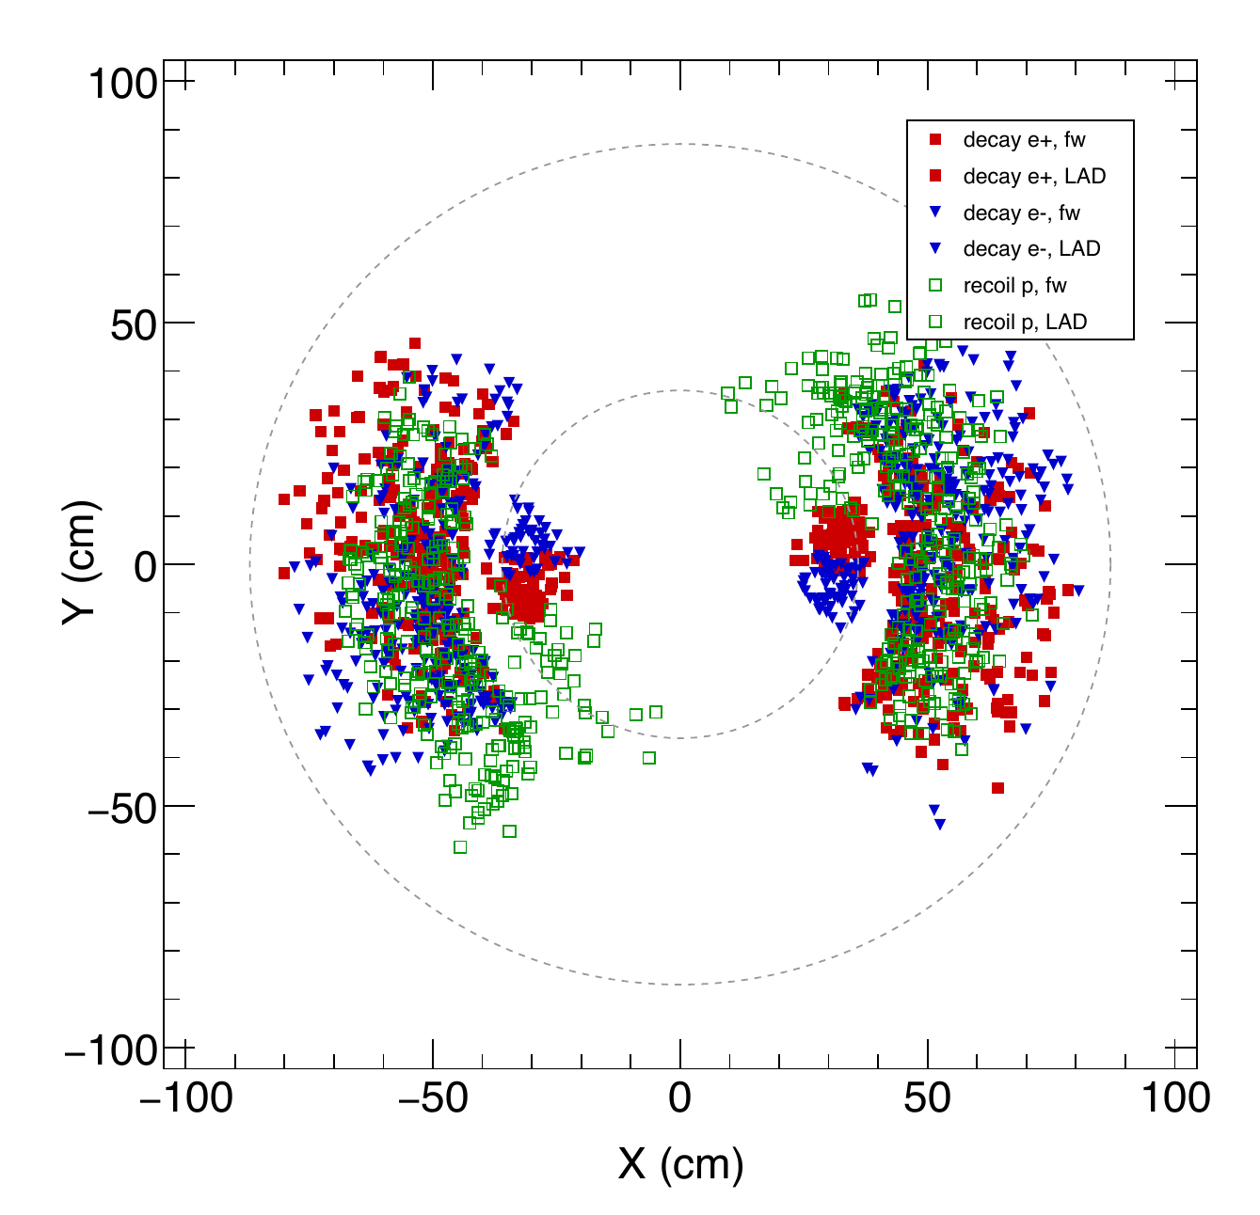
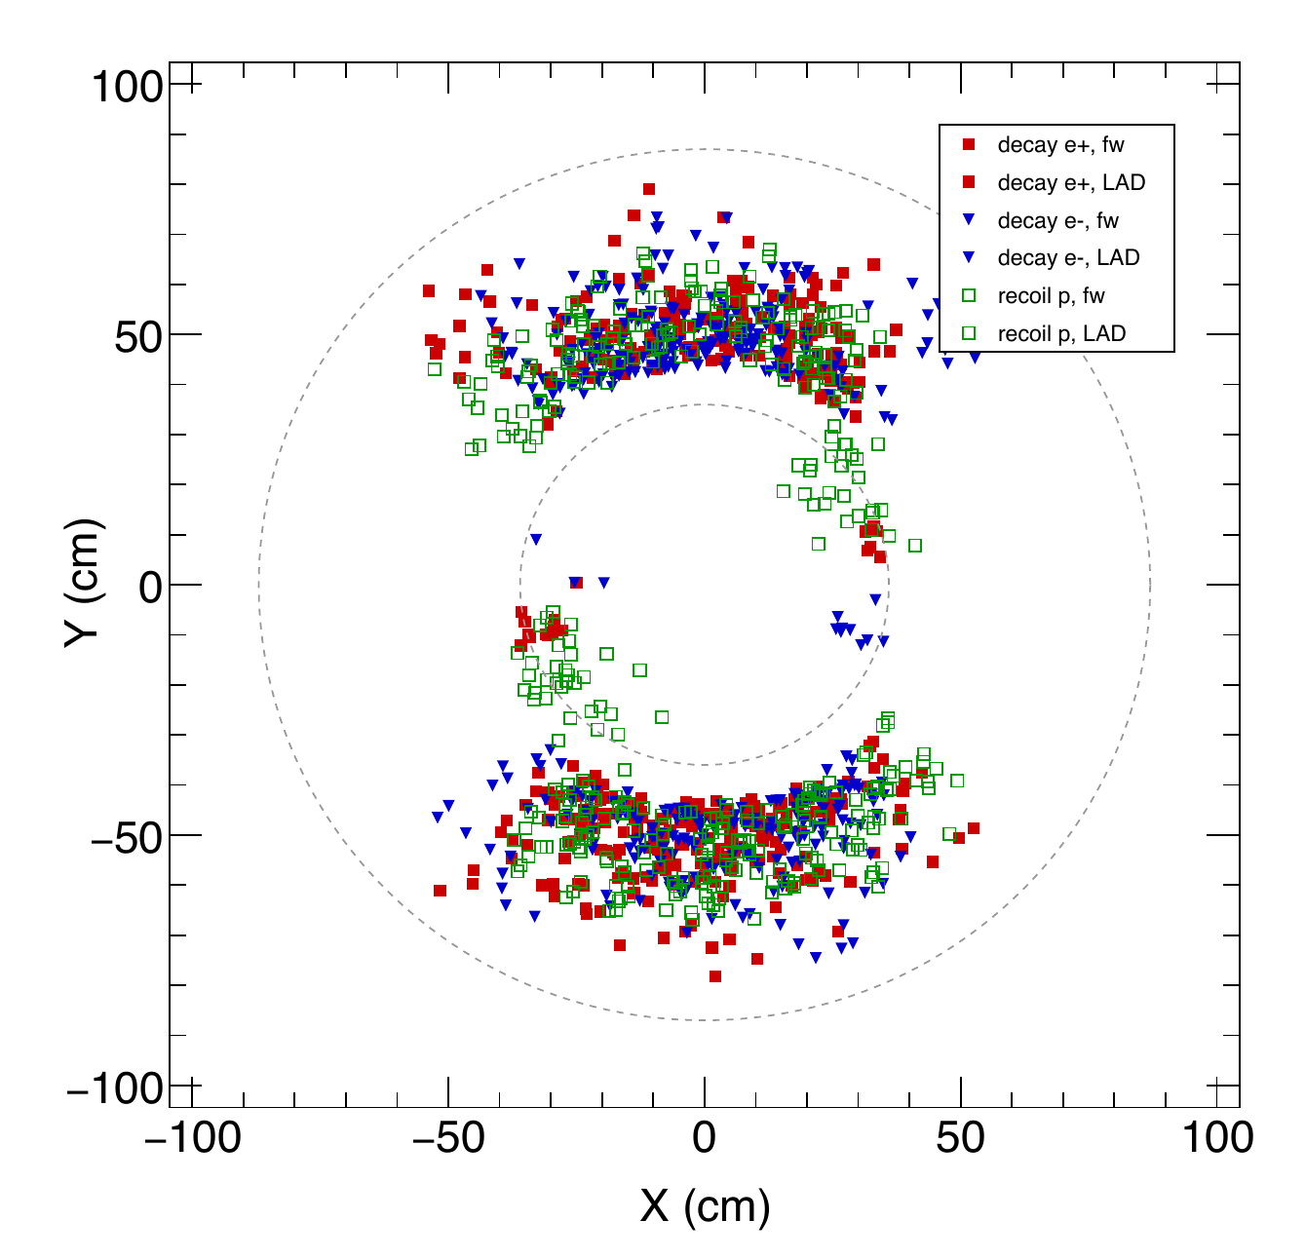
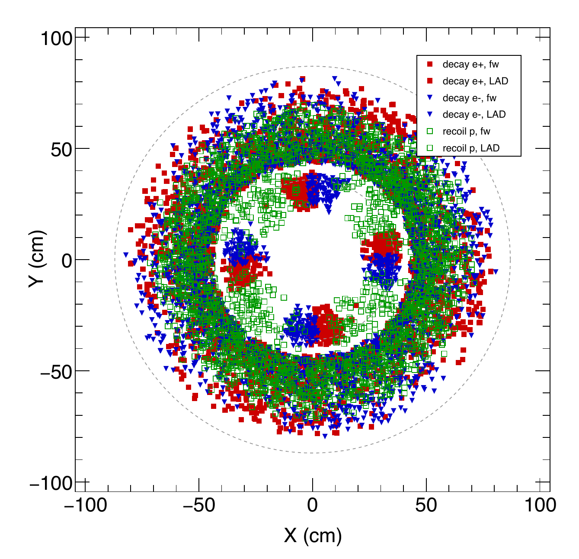
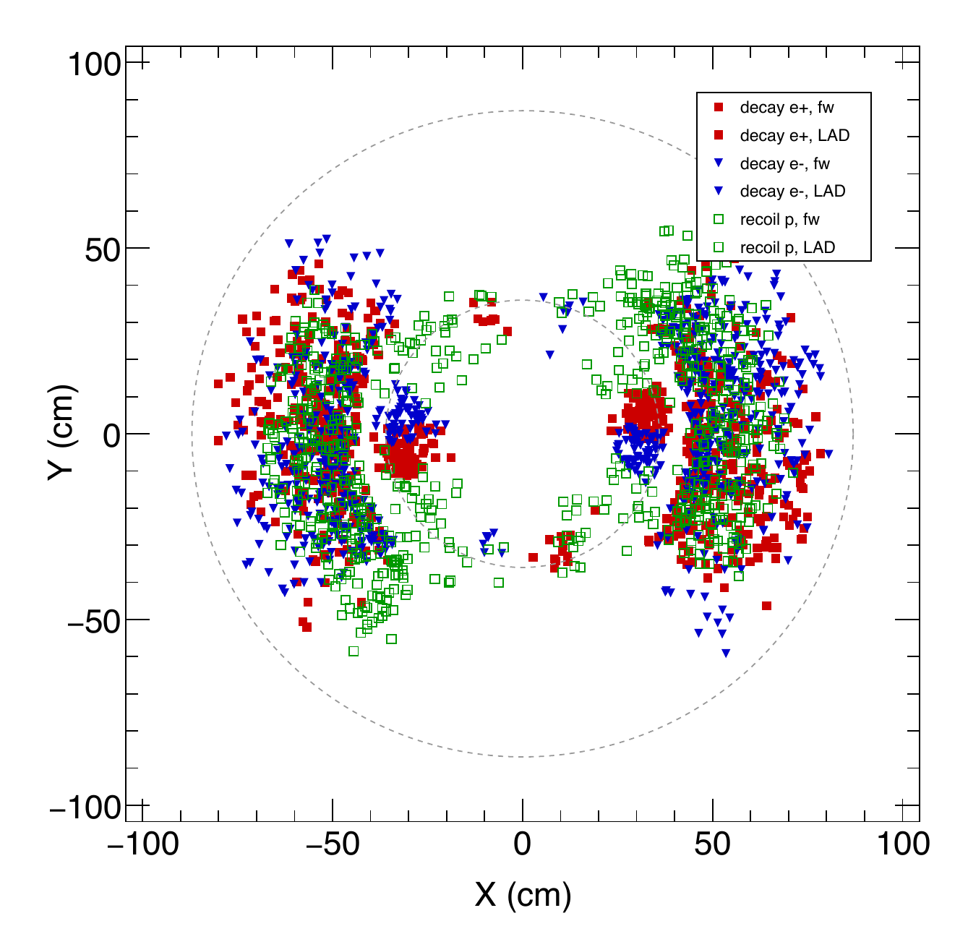
Photoproduction GEM / Reference: GEM 0, z = -175 cm
COMPARISON GEOMETRY
Same reference plane across configurations; channel-specific trajectories
Baseline
2FA
2FA + WA aligned
2FA + WA rotated
4FA
4FA + WA aligned
Red: decay e+ | Blue: decay e- | Green: recoil p
GEM: e+ filled square, e- filled down triangle, p open square
GEM 0-3: FA and LAD use the same particle markers; GEM 4-5: FA only
Source: regenerated official-scenario PDFs in plots/kin or plots/xsec; proportional fit, no cropping.
17

Slide 16
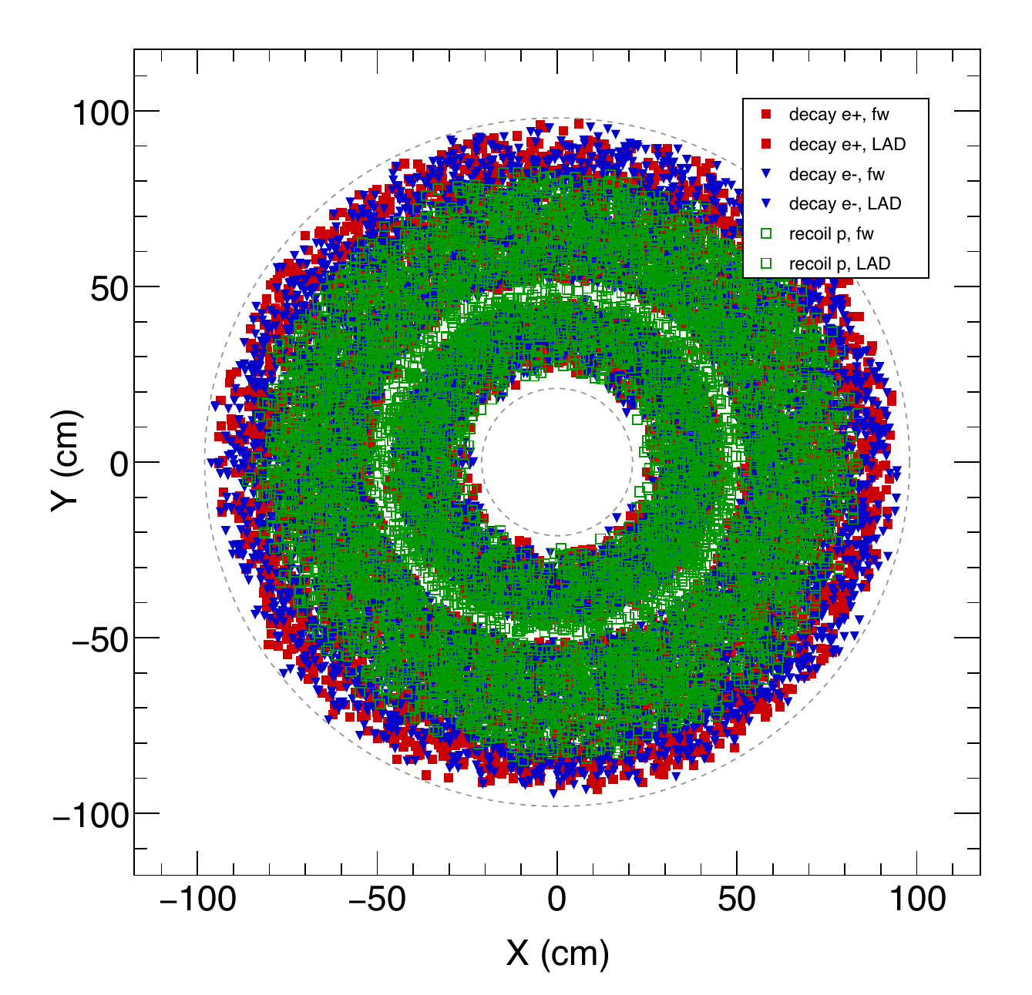
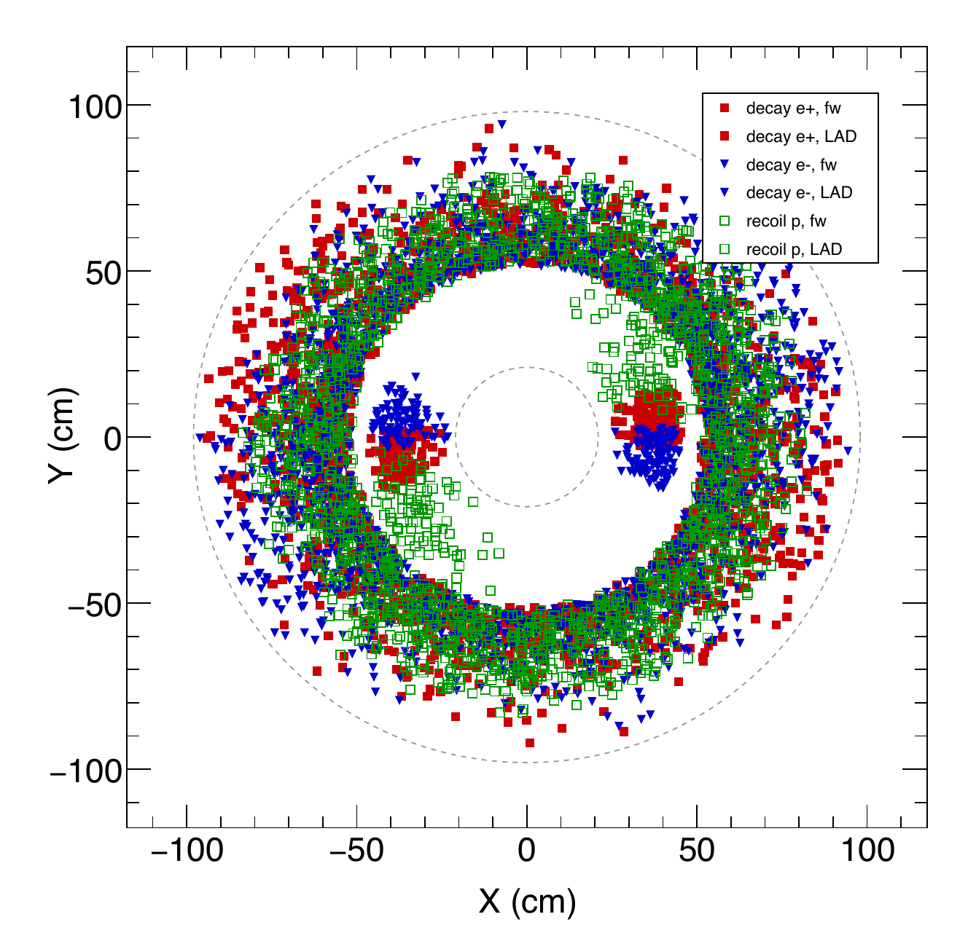
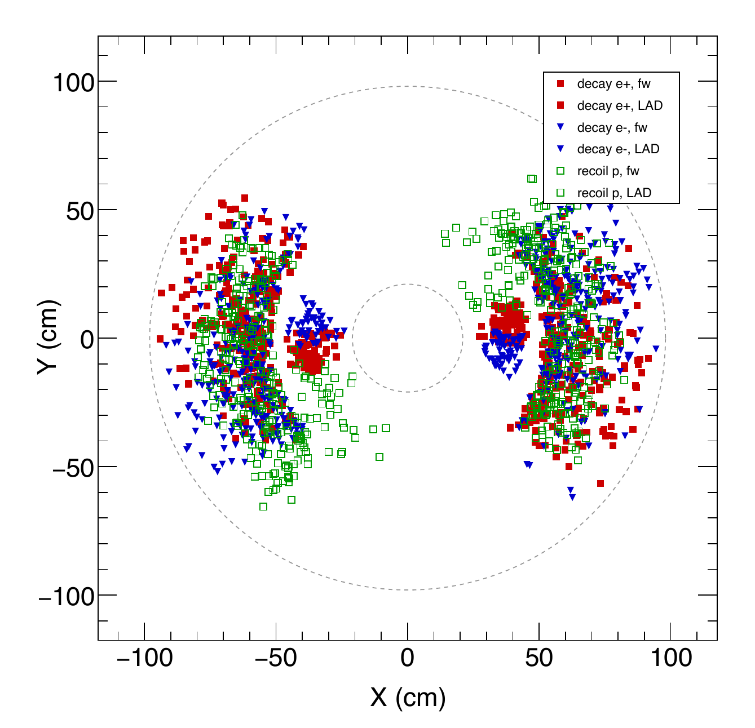
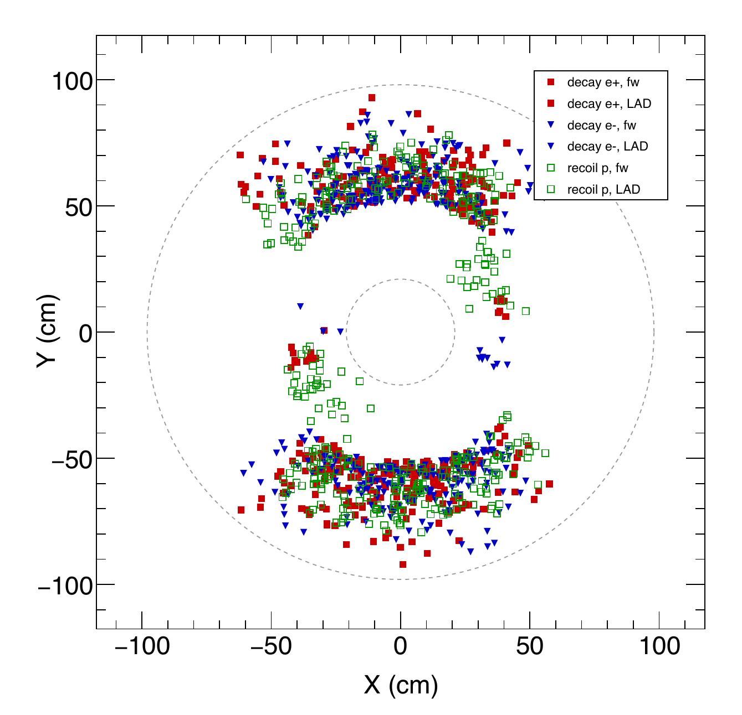
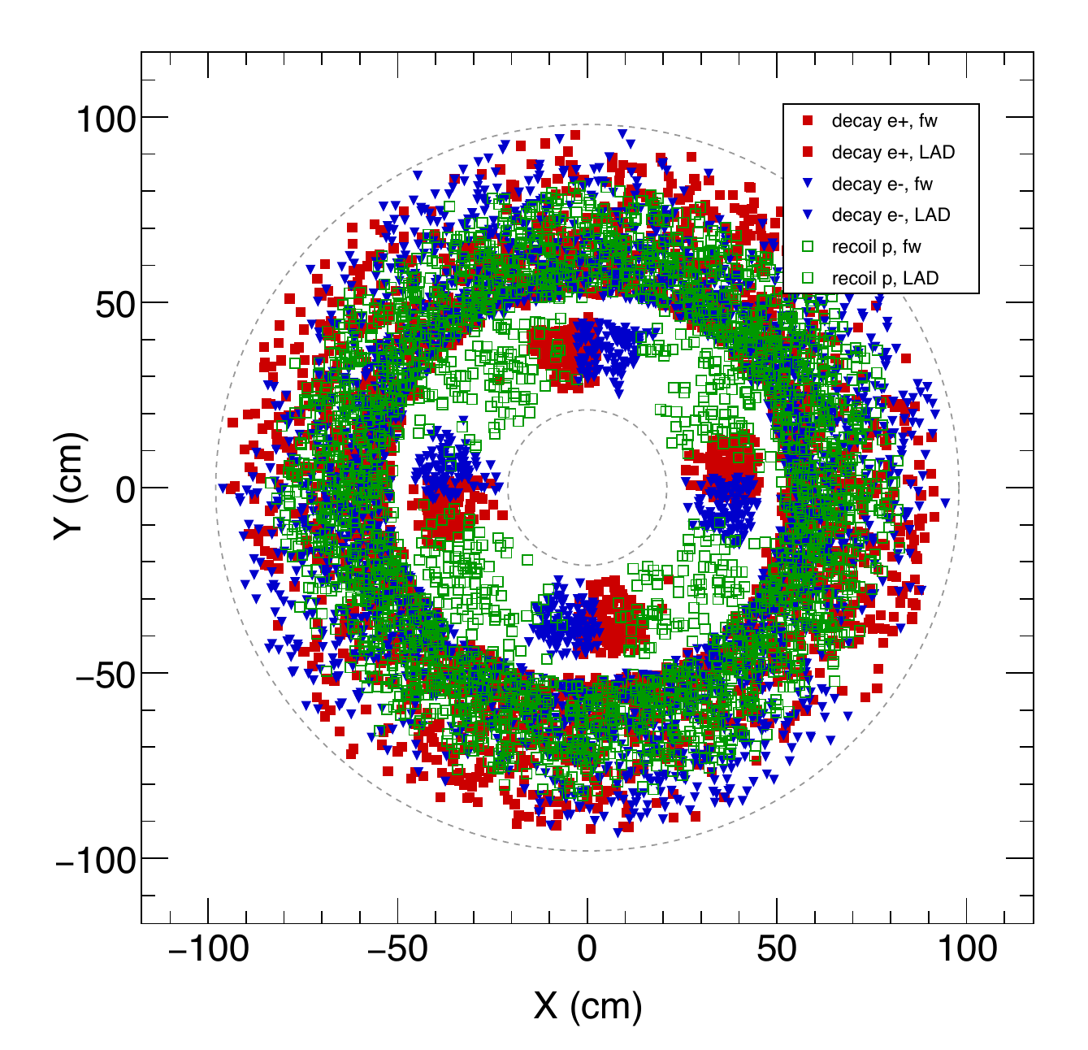
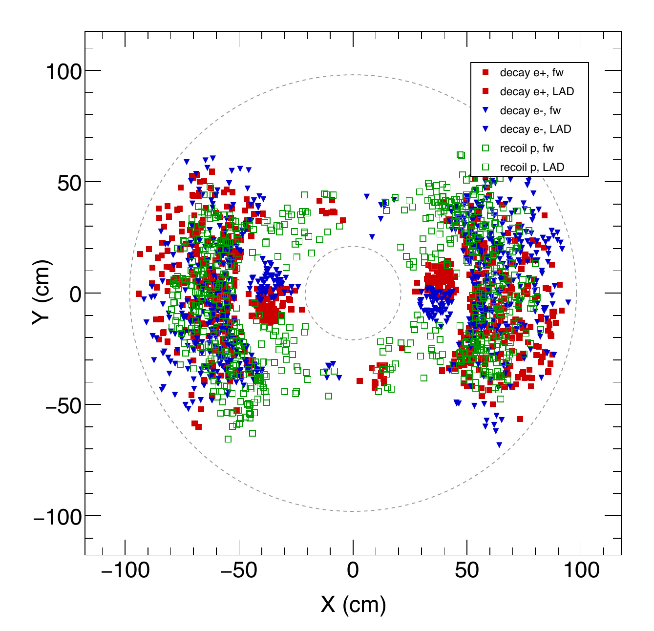
Photoproduction GEM / Reference: GEM 1, z = -150 cm
COMPARISON GEOMETRY
Same reference plane across configurations; channel-specific trajectories
Baseline
2FA
2FA + WA aligned
2FA + WA rotated
4FA
4FA + WA aligned
Red: decay e+ | Blue: decay e- | Green: recoil p
GEM: e+ filled square, e- filled down triangle, p open square
GEM 0-3: FA and LAD use the same particle markers; GEM 4-5: FA only
Source: regenerated official-scenario PDFs in plots/kin or plots/xsec; proportional fit, no cropping.
18

Slide 17
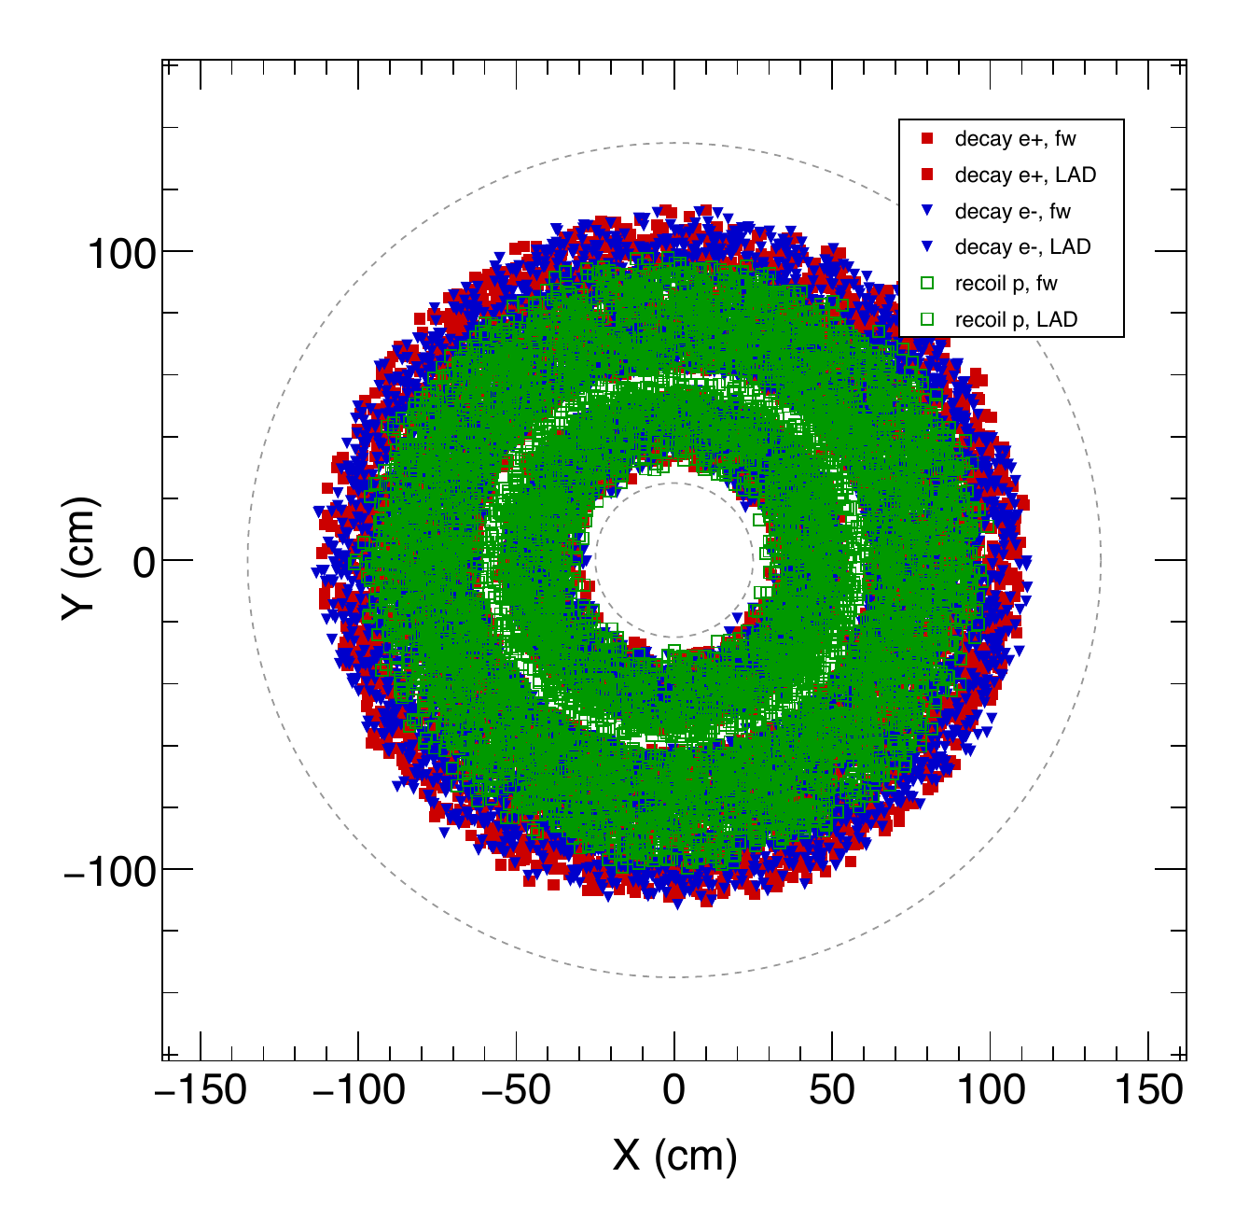
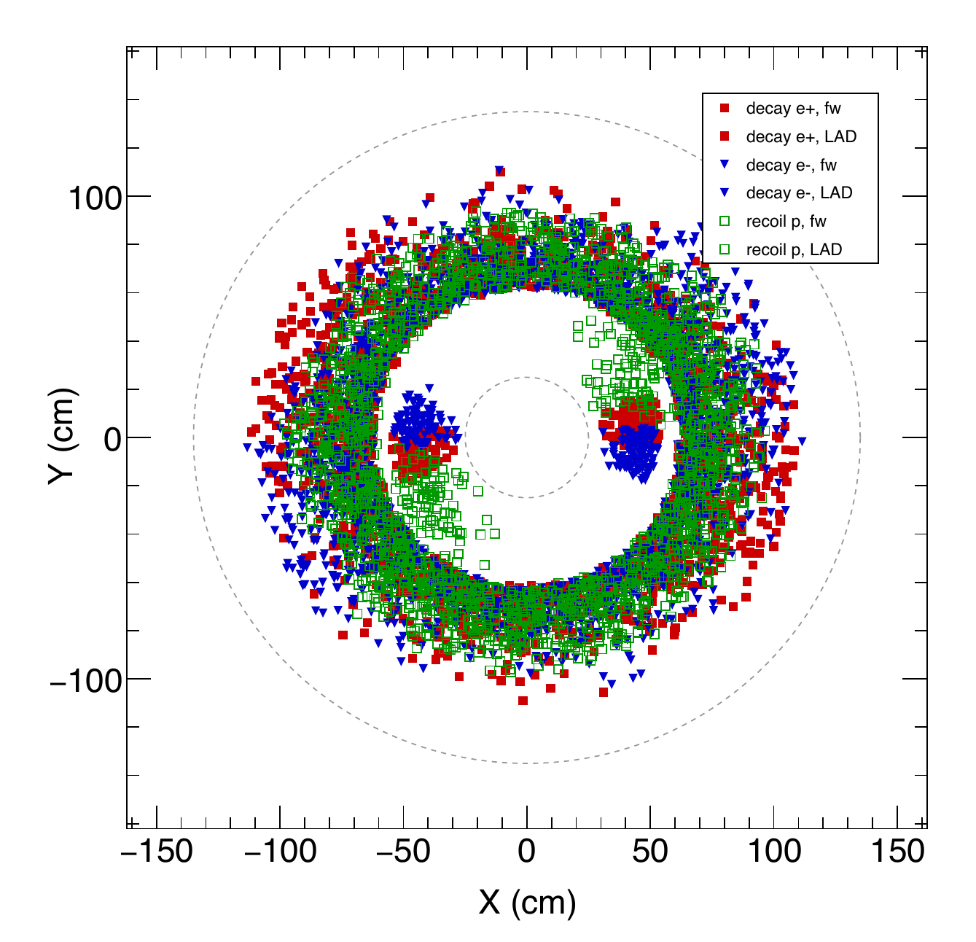
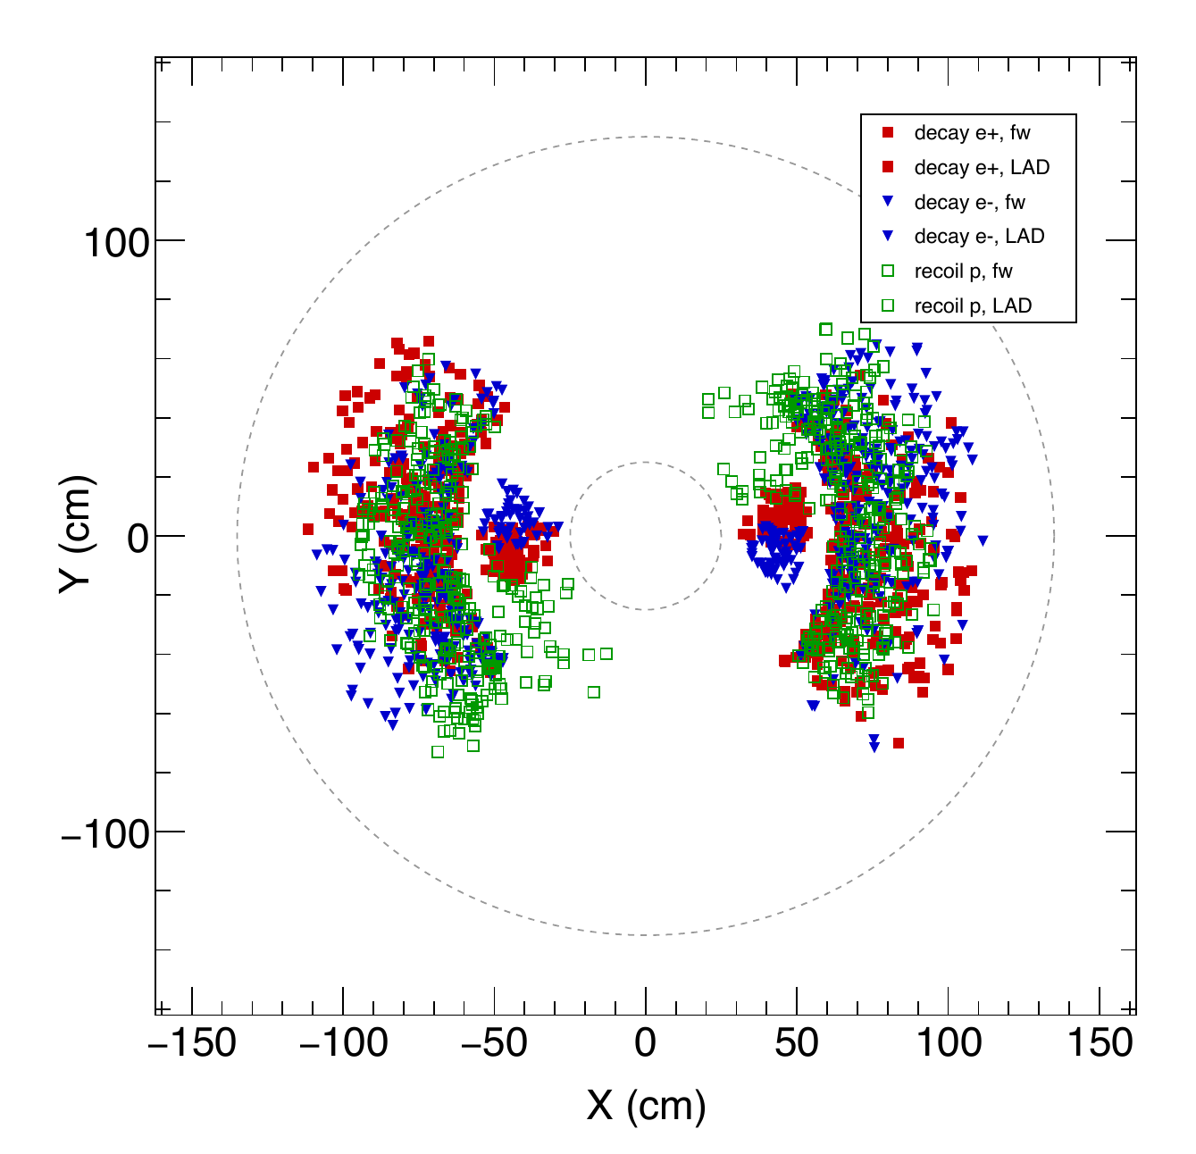
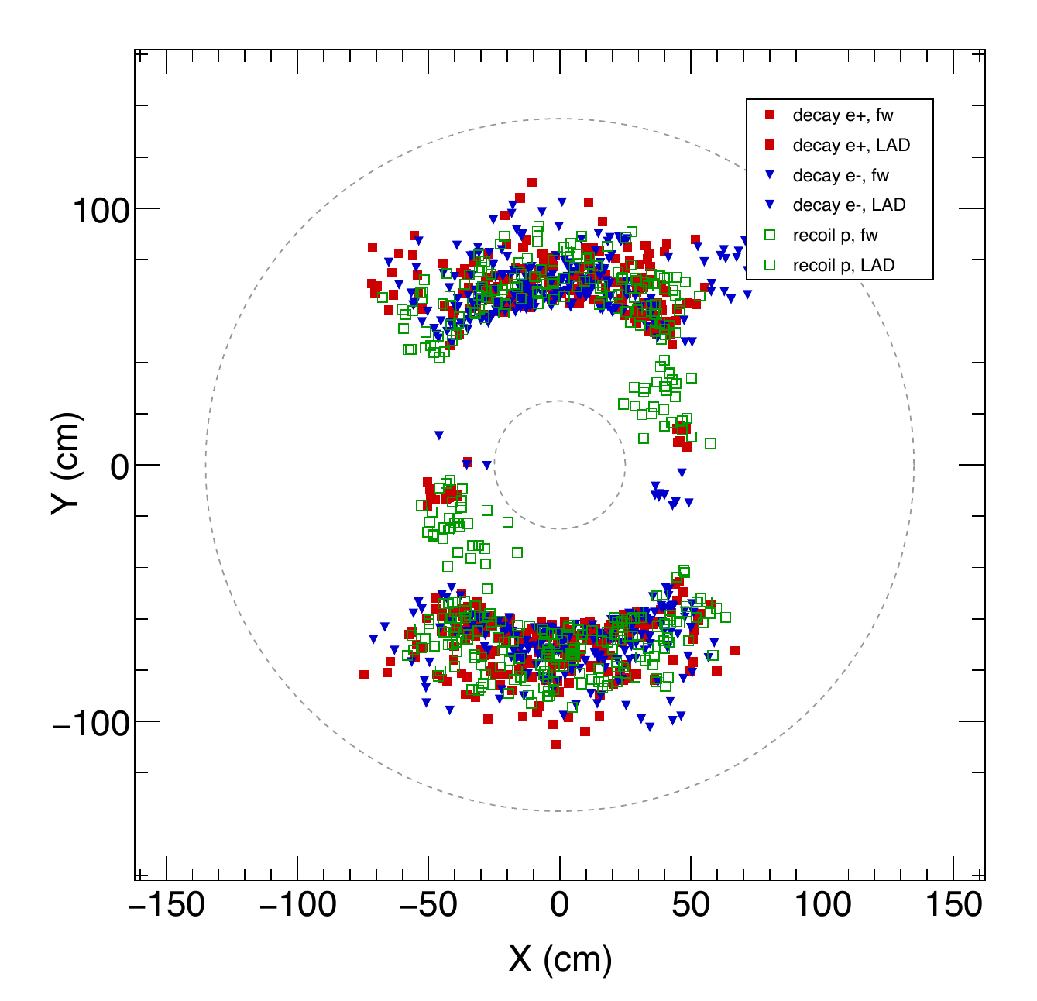
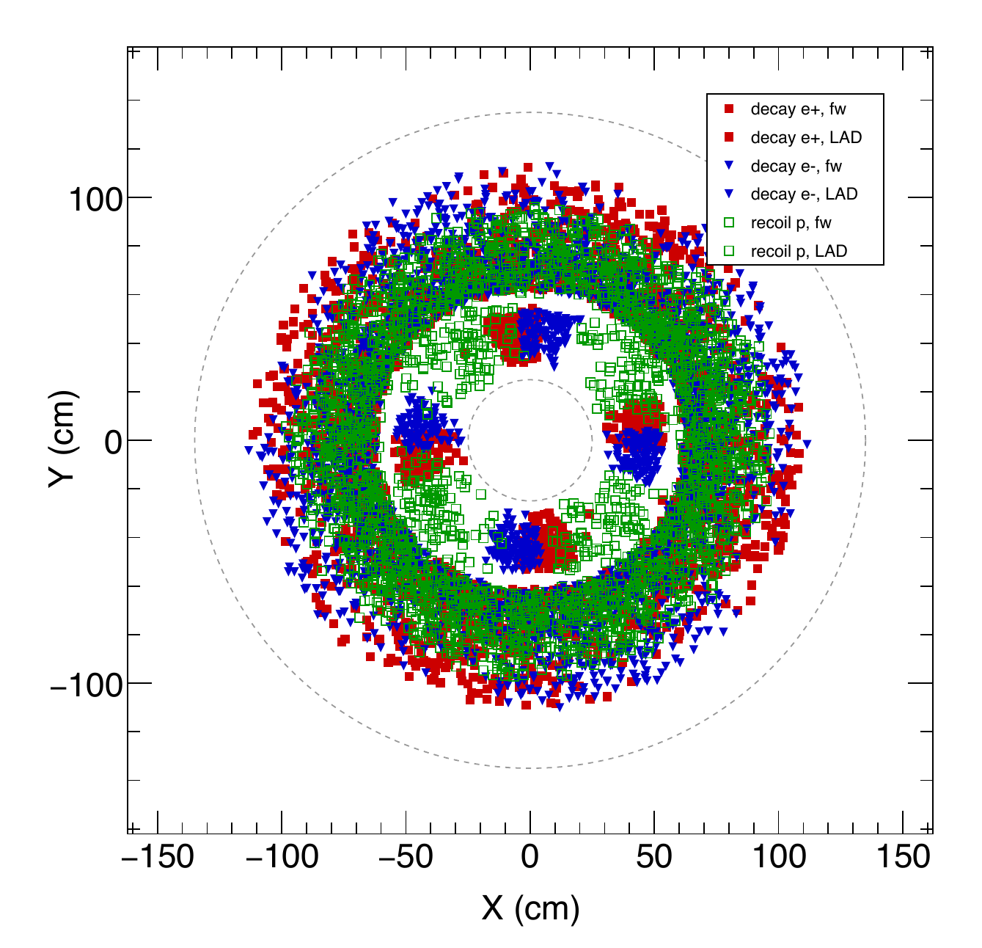
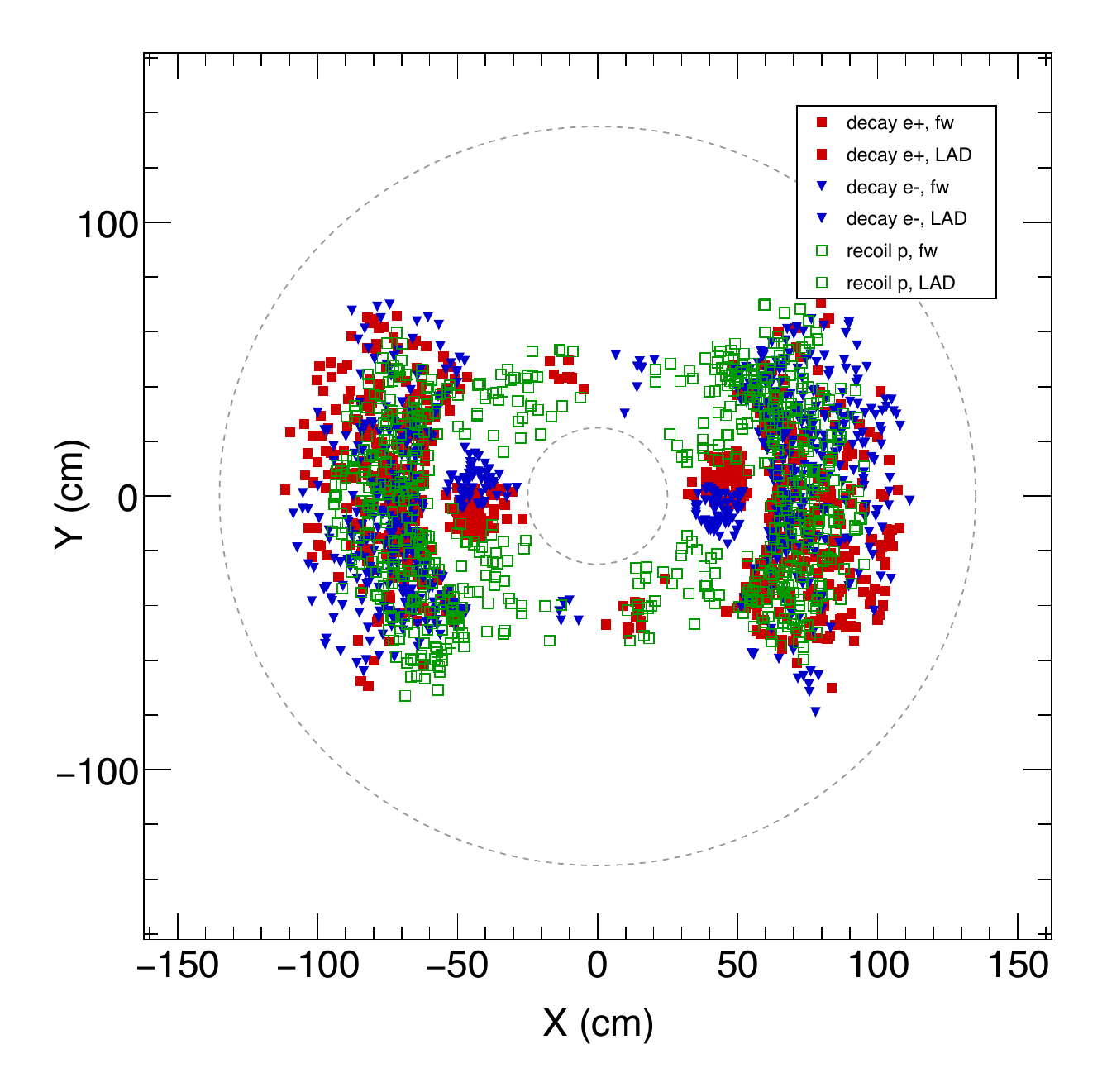
Photoproduction GEM / Reference: GEM 2, z = -119 cm
COMPARISON GEOMETRY
Same reference plane across configurations; channel-specific trajectories
Baseline
2FA
2FA + WA aligned
2FA + WA rotated
4FA
4FA + WA aligned
Red: decay e+ | Blue: decay e- | Green: recoil p
GEM: e+ filled square, e- filled down triangle, p open square
GEM 0-3: FA and LAD use the same particle markers; GEM 4-5: FA only
Source: regenerated official-scenario PDFs in plots/kin or plots/xsec; proportional fit, no cropping.
19

Slide 18
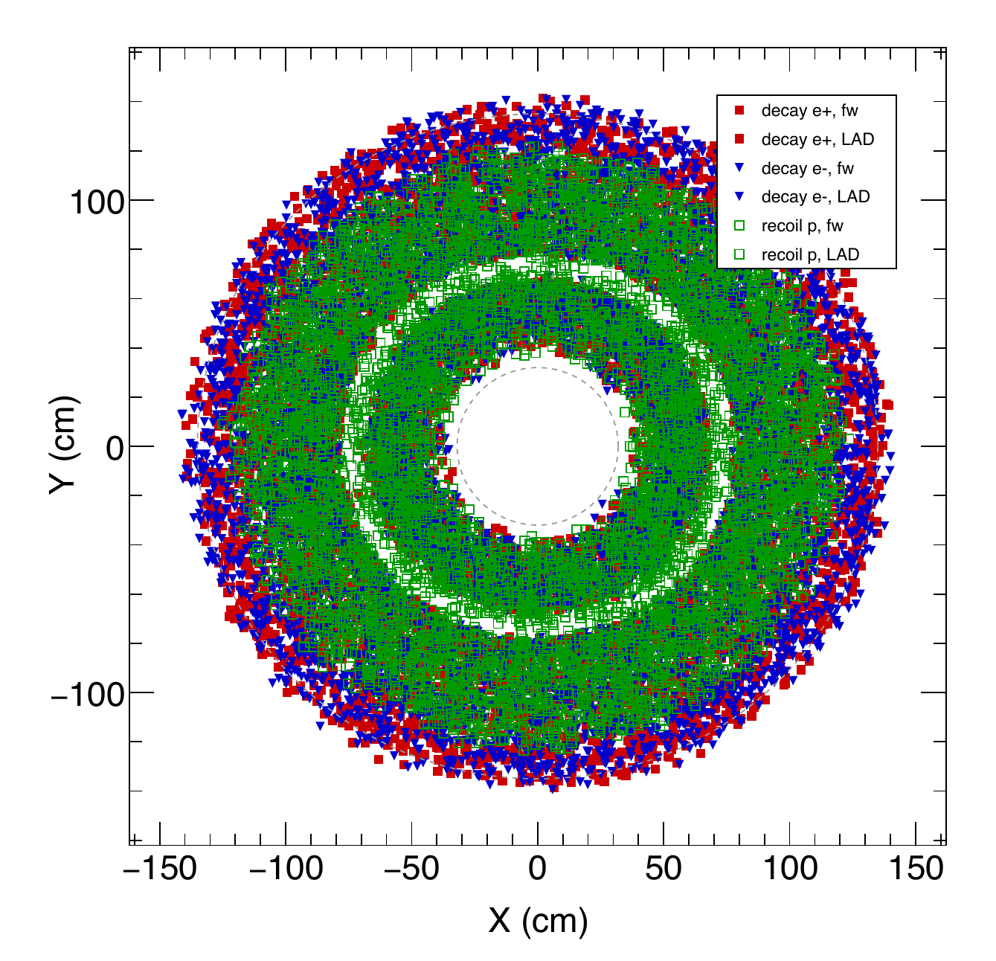
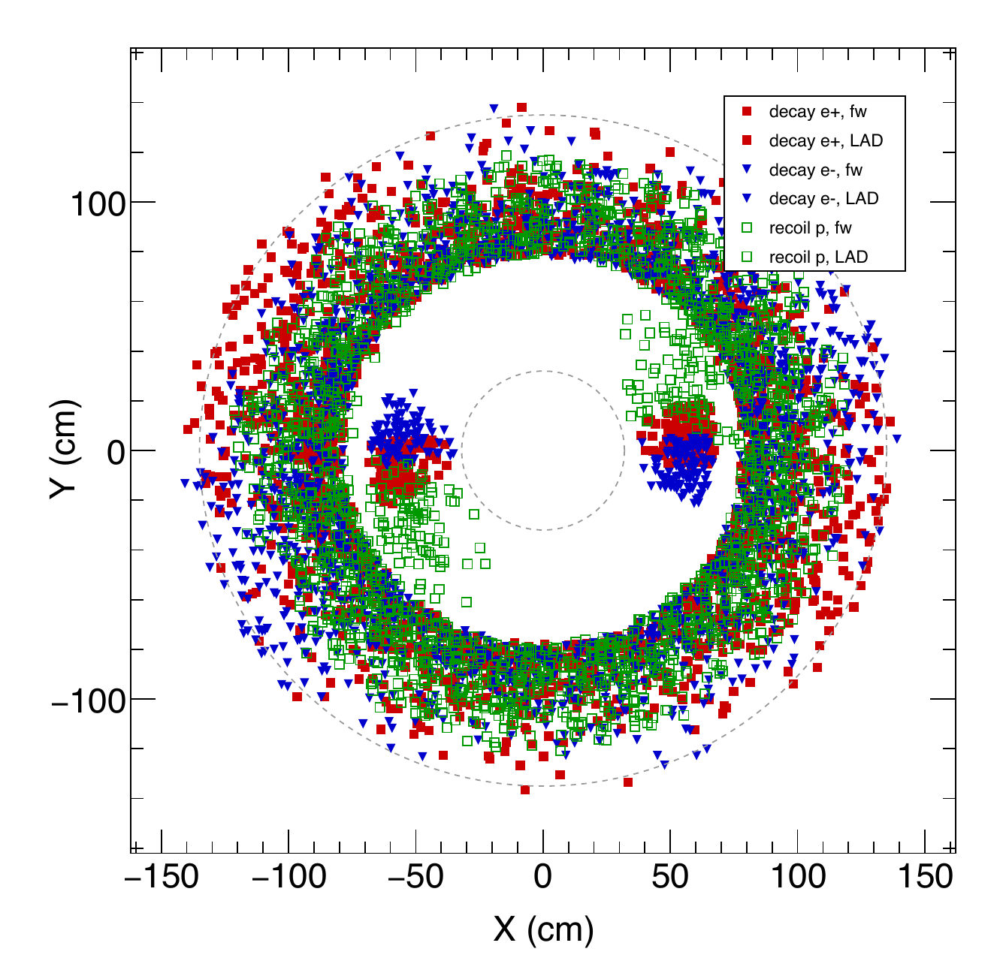
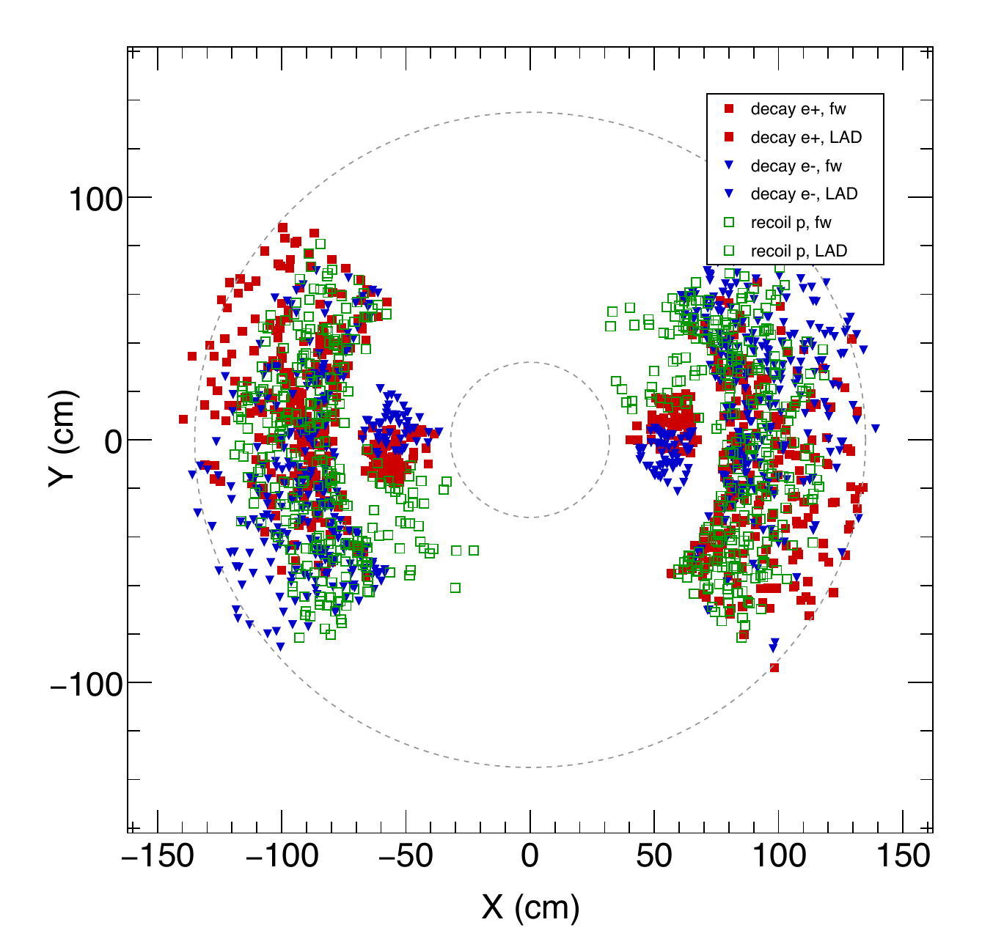
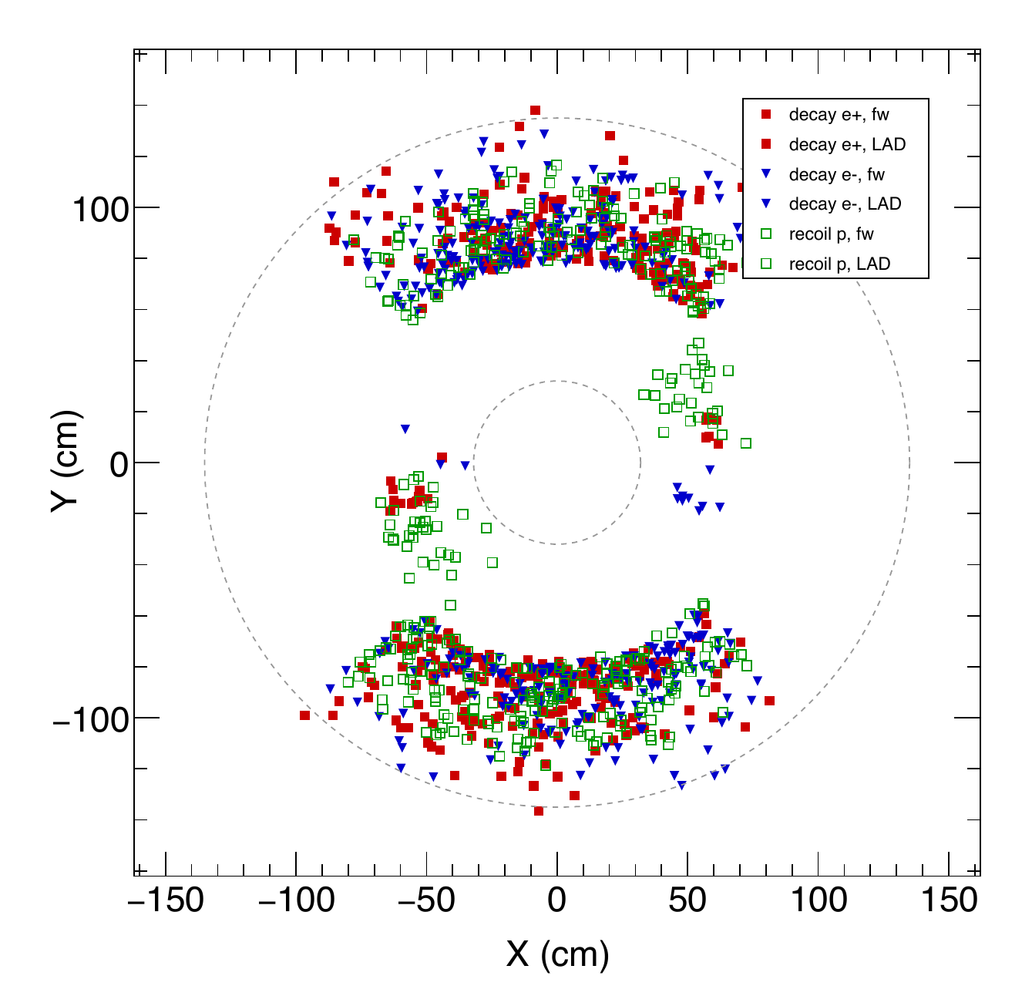
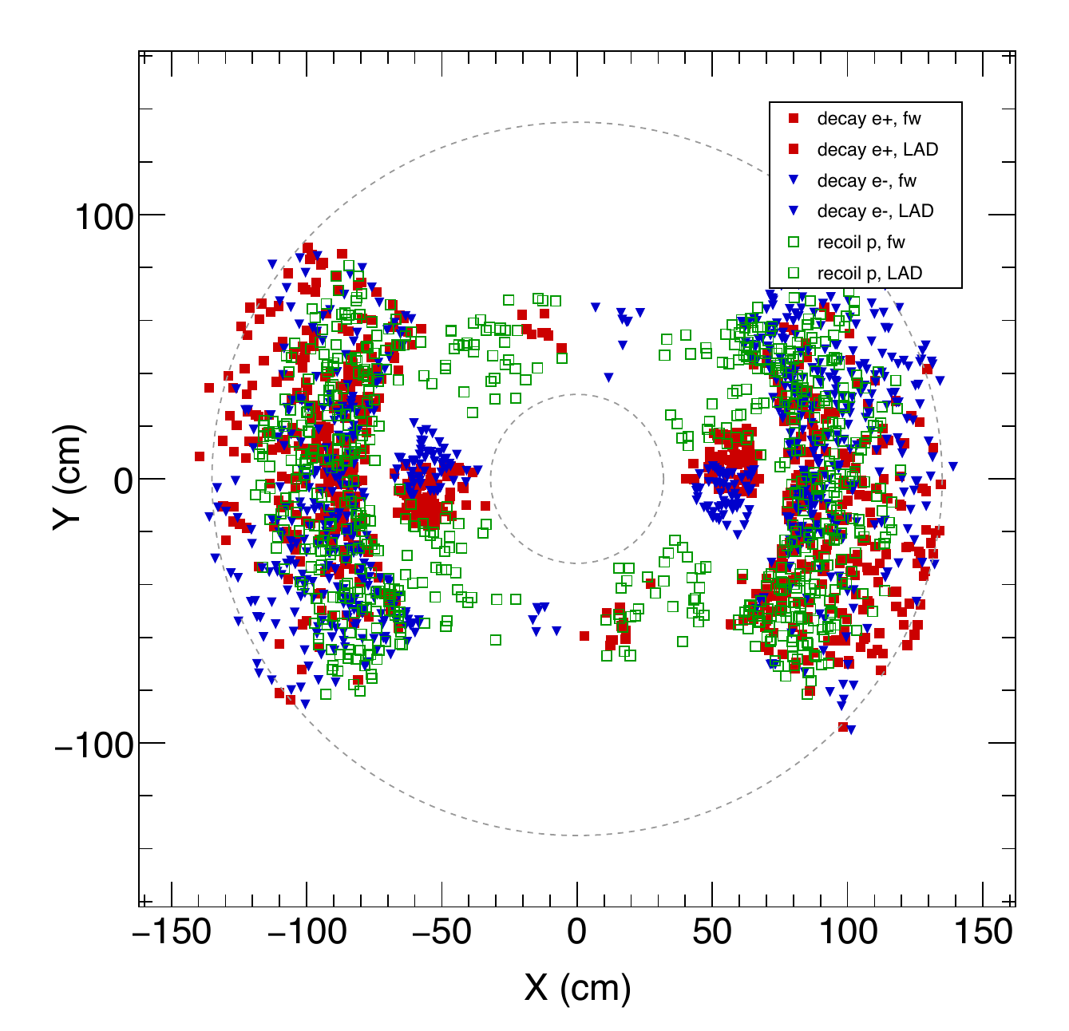
Photoproduction GEM / Reference: GEM 3, z = -68 cm
COMPARISON GEOMETRY
Same reference plane across configurations; channel-specific trajectories
Baseline
2FA
2FA + WA aligned
2FA + WA rotated
4FA
4FA + WA aligned
Red: decay e+ | Blue: decay e- | Green: recoil p
GEM: e+ filled square, e- filled down triangle, p open square
GEM 0-3: FA and LAD use the same particle markers; GEM 4-5: FA only
Source: regenerated official-scenario PDFs in plots/kin or plots/xsec; proportional fit, no cropping.
20

Slide 19
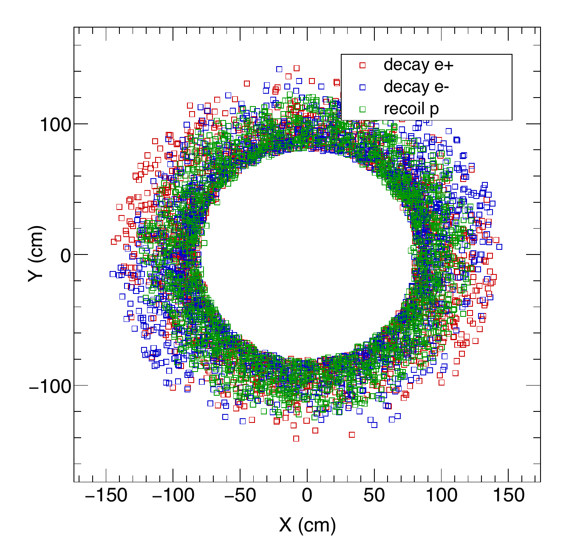
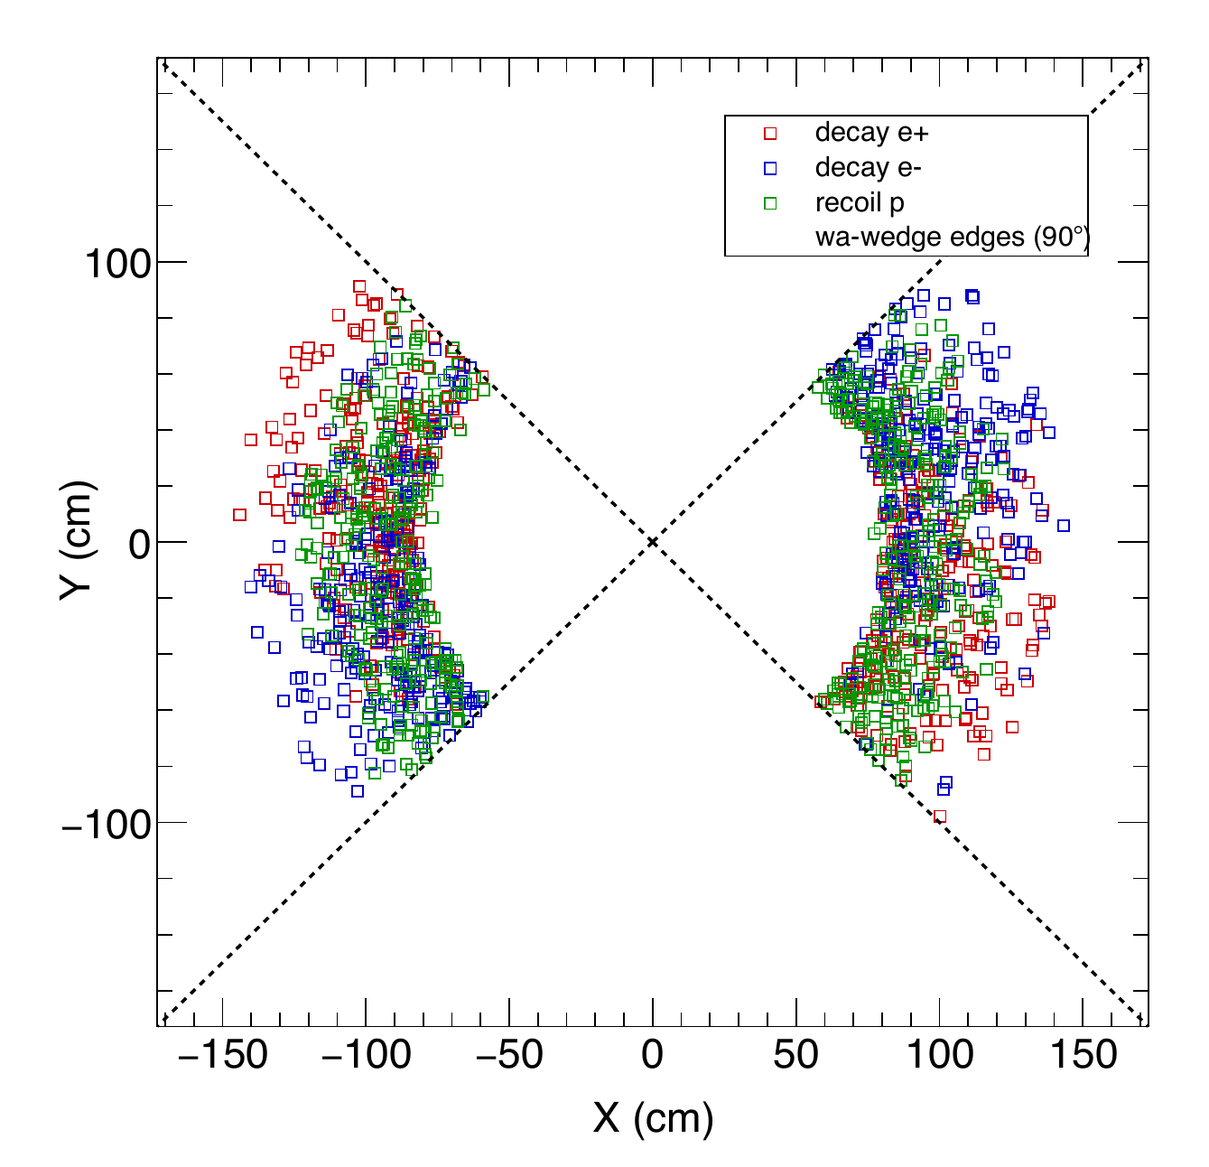



Photoproduction GEM / Reference: WA reference
COMPARISON GEOMETRY
Same reference plane across configurations; channel-specific trajectories
Baseline
2FA
2FA + WA aligned
2FA + WA rotated
4FA
4FA + WA aligned
Red: decay e+ | Blue: decay e- | Green: recoil p
Reference planes: LGC mirror FA = filled circles; WA LAD = open squares | Dashed rays: wedge edges
Source: regenerated official-scenario PDFs in plots/kin or plots/xsec; proportional fit, no cropping.
21

Slide 20






Photoproduction GEM / Reference: GEM 4, z = +5 cm
COMPARISON GEOMETRY
Same reference plane across configurations; channel-specific trajectories
Baseline
2FA
2FA + WA aligned
2FA + WA rotated
4FA
4FA + WA aligned
Red: decay e+ | Blue: decay e- | Green: recoil p
GEM: e+ filled square, e- filled down triangle, p open square
GEM 0-3: FA and LAD use the same particle markers; GEM 4-5: FA only
Source: regenerated official-scenario PDFs in plots/kin or plots/xsec; proportional fit, no cropping.
22

Slide 21






Photoproduction GEM / Reference: GEM 5, z = +92 cm
COMPARISON GEOMETRY
Same reference plane across configurations; channel-specific trajectories
Baseline
2FA
2FA + WA aligned
2FA + WA rotated
4FA
4FA + WA aligned
Red: decay e+ | Blue: decay e- | Green: recoil p
GEM: e+ filled square, e- filled down triangle, p open square
GEM 0-3: FA and LAD use the same particle markers; GEM 4-5: FA only
Source: regenerated official-scenario PDFs in plots/kin or plots/xsec; proportional fit, no cropping.
23

Slide 22






Photoproduction GEM / Reference: Mirror plane
COMPARISON GEOMETRY
Same reference plane across configurations; channel-specific trajectories
Baseline
2FA
2FA + WA aligned
2FA + WA rotated
4FA
4FA + WA aligned
Red: decay e+ | Blue: decay e- | Green: recoil p
Reference planes: LGC mirror FA = filled circles; WA LAD = open squares | Dashed rays: wedge edges
Source: regenerated official-scenario PDFs in plots/kin or plots/xsec; proportional fit, no cropping.
24

Slide 23






Electroproduction Acceptance: Scattered electron
COMPARISON GEOMETRY
Theta versus momentum: available production acceptance maps
Baseline
2FA
2FA + WA aligned
2FA + WA rotated
4FA
4FA + WA aligned
Source: regenerated official-scenario PDFs in plots/kin or plots/xsec; proportional fit, no cropping.
25

Slide 24






Electroproduction Acceptance: Decay l+
COMPARISON GEOMETRY
Theta versus momentum: available production acceptance maps
Baseline
2FA
2FA + WA aligned
2FA + WA rotated
4FA
4FA + WA aligned
Source: regenerated official-scenario PDFs in plots/kin or plots/xsec; proportional fit, no cropping.
26

Slide 25






Electroproduction Acceptance: Decay l-
COMPARISON GEOMETRY
Theta versus momentum: available production acceptance maps
Baseline
2FA
2FA + WA aligned
2FA + WA rotated
4FA
4FA + WA aligned
Source: regenerated official-scenario PDFs in plots/kin or plots/xsec; proportional fit, no cropping.
27

Slide 26





Electroproduction GEM / Reference: GEM 0, z = -175 cm
COMPARISON GEOMETRY
Same reference plane across configurations; channel-specific trajectories
Baseline
2FA
2FA + WA aligned
2FA + WA rotated
4FA
4FA + WA aligned
Red: decay e+ | Blue: decay e- | Black: scattered e (FA only)
GEM: e+ filled square, e- filled down triangle, scattered e filled circle
GEM 0-3: FA and LAD use the same particle markers; GEM 4-5: FA only
Source: regenerated official-scenario PDFs in plots/kin or plots/xsec; proportional fit, no cropping.
28

Slide 27






Electroproduction GEM / Reference: GEM 1, z = -150 cm
COMPARISON GEOMETRY
Same reference plane across configurations; channel-specific trajectories
Baseline
2FA
2FA + WA aligned
2FA + WA rotated
4FA
4FA + WA aligned
Red: decay e+ | Blue: decay e- | Black: scattered e (FA only)
GEM: e+ filled square, e- filled down triangle, scattered e filled circle
GEM 0-3: FA and LAD use the same particle markers; GEM 4-5: FA only
Source: regenerated official-scenario PDFs in plots/kin or plots/xsec; proportional fit, no cropping.
29

Slide 28






Electroproduction GEM / Reference: GEM 2, z = -119 cm
COMPARISON GEOMETRY
Same reference plane across configurations; channel-specific trajectories
Baseline
2FA
2FA + WA aligned
2FA + WA rotated
4FA
4FA + WA aligned
Red: decay e+ | Blue: decay e- | Black: scattered e (FA only)
GEM: e+ filled square, e- filled down triangle, scattered e filled circle
GEM 0-3: FA and LAD use the same particle markers; GEM 4-5: FA only
Source: regenerated official-scenario PDFs in plots/kin or plots/xsec; proportional fit, no cropping.
30

Slide 29






Electroproduction GEM / Reference: GEM 3, z = -68 cm
COMPARISON GEOMETRY
Same reference plane across configurations; channel-specific trajectories
Baseline
2FA
2FA + WA aligned
2FA + WA rotated
4FA
4FA + WA aligned
Red: decay e+ | Blue: decay e- | Black: scattered e (FA only)
GEM: e+ filled square, e- filled down triangle, scattered e filled circle
GEM 0-3: FA and LAD use the same particle markers; GEM 4-5: FA only
Source: regenerated official-scenario PDFs in plots/kin or plots/xsec; proportional fit, no cropping.
31

Slide 30






Electroproduction GEM / Reference: WA reference
COMPARISON GEOMETRY
Same reference plane across configurations; channel-specific trajectories
Baseline
2FA
2FA + WA aligned
2FA + WA rotated
4FA
4FA + WA aligned
Red: decay e+ | Blue: decay e- | Black: scattered e (FA only)
Reference planes: LGC mirror FA = filled circles; WA LAD = open squares | Dashed rays: wedge edges
Scattered-electron series appears at the mirror, not at WA
Source: regenerated official-scenario PDFs in plots/kin or plots/xsec; proportional fit, no cropping.
32

Slide 31






Electroproduction GEM / Reference: GEM 4, z = +5 cm
COMPARISON GEOMETRY
Same reference plane across configurations; channel-specific trajectories
Baseline
2FA
2FA + WA aligned
2FA + WA rotated
4FA
4FA + WA aligned
Red: decay e+ | Blue: decay e- | Black: scattered e (FA only)
GEM: e+ filled square, e- filled down triangle, scattered e filled circle
GEM 0-3: FA and LAD use the same particle markers; GEM 4-5: FA only
Source: regenerated official-scenario PDFs in plots/kin or plots/xsec; proportional fit, no cropping.
33

Slide 32






Electroproduction GEM / Reference: GEM 5, z = +92 cm
COMPARISON GEOMETRY
Same reference plane across configurations; channel-specific trajectories
Baseline
2FA
2FA + WA aligned
2FA + WA rotated
4FA
4FA + WA aligned
Red: decay e+ | Blue: decay e- | Black: scattered e (FA only)
GEM: e+ filled square, e- filled down triangle, scattered e filled circle
GEM 0-3: FA and LAD use the same particle markers; GEM 4-5: FA only
Source: regenerated official-scenario PDFs in plots/kin or plots/xsec; proportional fit, no cropping.
34

Slide 33
Electroproduction GEM / Reference: Mirror plane
COMPARISON GEOMETRY
Same reference plane across configurations; channel-specific trajectories
Baseline
2FA
2FA + WA aligned
2FA + WA rotated
4FA
4FA + WA aligned
Red: decay e+ | Blue: decay e- | Black: scattered e (FA only)
Reference planes: LGC mirror FA = filled circles; WA LAD = open squares | Dashed rays: wedge edges
Scattered-electron series appears at the mirror, not at WA
Source: regenerated official-scenario PDFs in plots/kin or plots/xsec; proportional fit, no cropping.
35

