Slide 1
Physics with High-Luminosity Facilities
BSM summary · High Luminosity workshop, Oct 5–9, 2026
Talks by: Mantry · Zheng · Gaskell · Graham · Furletova · Cappuzzello
Conveners: Ciprian Gal, Rafayel Paremuzyan, Xiaochao Zheng
Slides generated by Claude AI

Slide 2
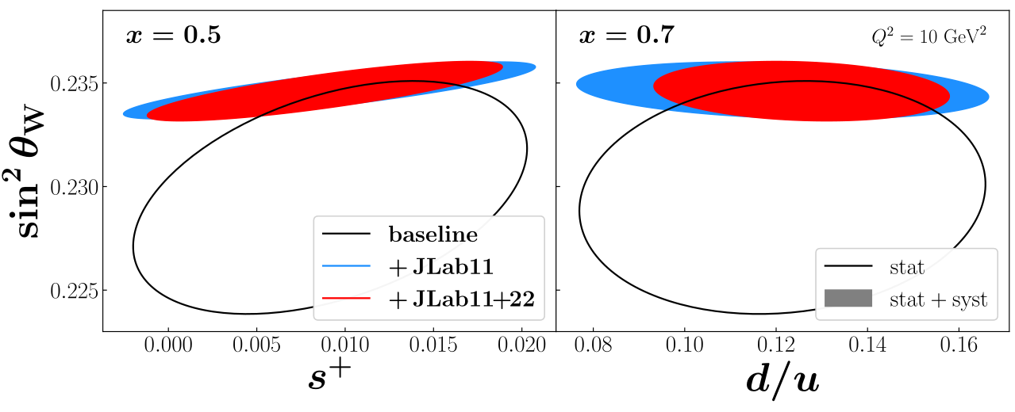
PVDIS probes new physics
1 · Sonny Mantry (UNG)
Parity-violating DIS on a deuteron target measures the electron-quark couplings C1q and C2q
11 GeV polarized beam, 40 cm LD2, 120 days: sub-percent asymmetries over a wide x, Q² range
BSM reach of roughly 10–20 TeV for contact interactions (Z′, leptoquarks, RPV SUSY)
Constrains leptophobic Z′, dark photons and a light dark Z through shifts in the Ciq
In global SMEFT fits, SoLID lifts flat directions that LHC Drell-Yan, Qweak, P2 and APV
Simultaneous fit of PDF and SM parameters possible
2 / 15

Slide 3
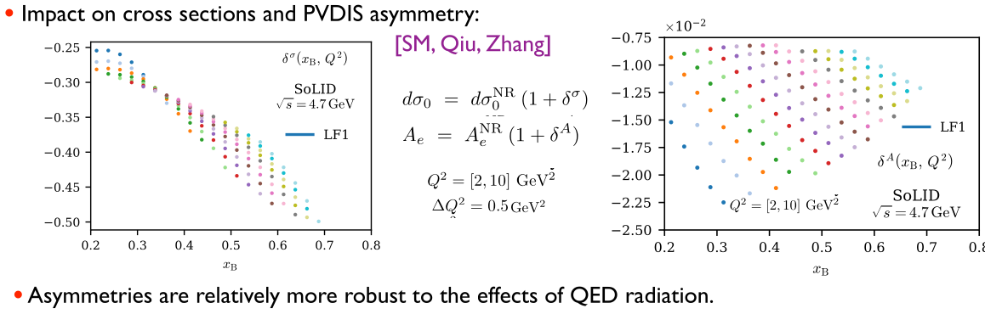
Radiative Corrections
1 · Sonny Mantry (UNG)
Hadronic and QED radiative effects must be under control
3 / 15

Slide 4
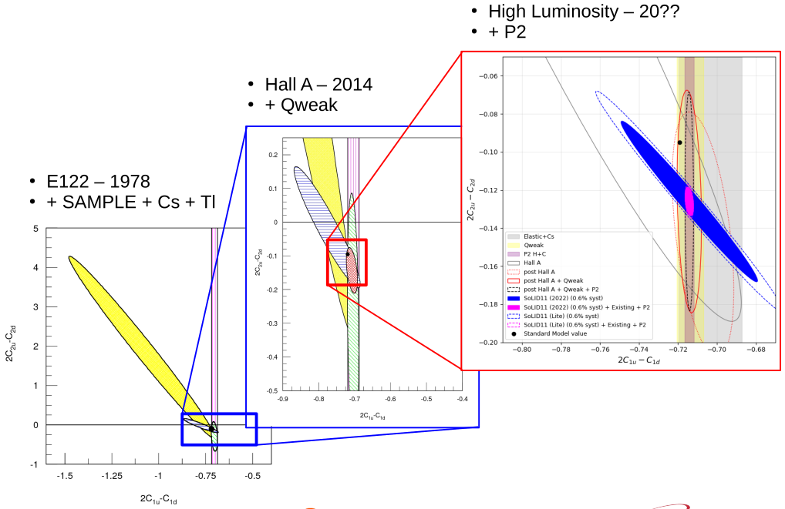
PVDIS with the next-generation spectrometer
2 · Zheng (UVA)
Hall A 6 GeV PVDIS made the first non-zero determination of 2C2u − C2d
With SoLID: Luminosity of 10³⁷–10³⁹ cm⁻²s⁻¹ → wide coverage allows simultaneous fits of the two hadronic effects, higher twist and charge-symmetry violation
Strong-interaction parity violation: baseline α = (−1.01 ± 0.66)×10⁻⁴, improving to ±0.21 (d) and ±0.15 (p) with SoLID
Program arc: E122 (1978), Hall A (2014), high-luminosity precision (with P2) (20??)
4 / 15

Slide 5
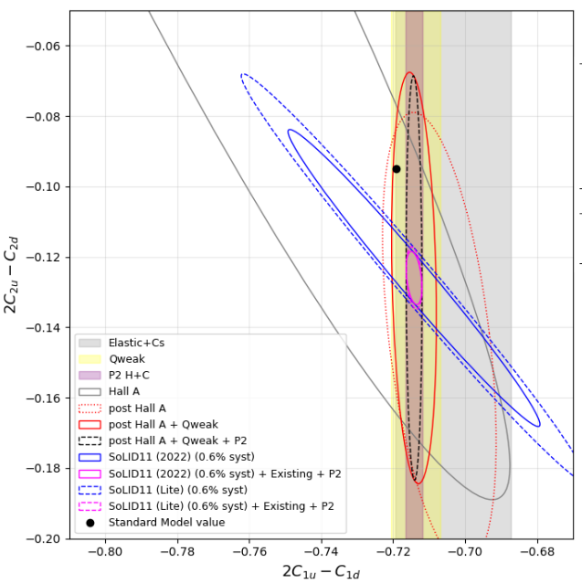
PVDIS-Lite
2 · Zheng (UVA)
SoLID-Lite: with ½ of statistics, the C1, C2 SoLID ellipse grows 40%, but the +P2 combined C2 uncertainty grows only 20%
5 / 15

Slide 6
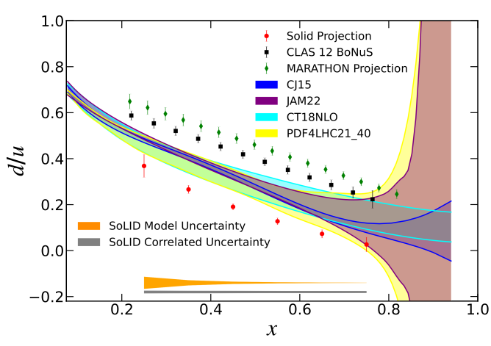
SoLID PVDIS and the d/u ratio at large x
3 · Dave Gaskell (JLab)
d/u extractions from H and D are complicated by nuclear effects at large x
MARATHON (³He/³H) and BONuS12 (spectator tagging) have run; global fits suggest MARATHON speaks more to an isovector EMC effect
A PVDIS proton target gives d/u with no nuclear effects, a different systematic path
6 / 15

Slide 7
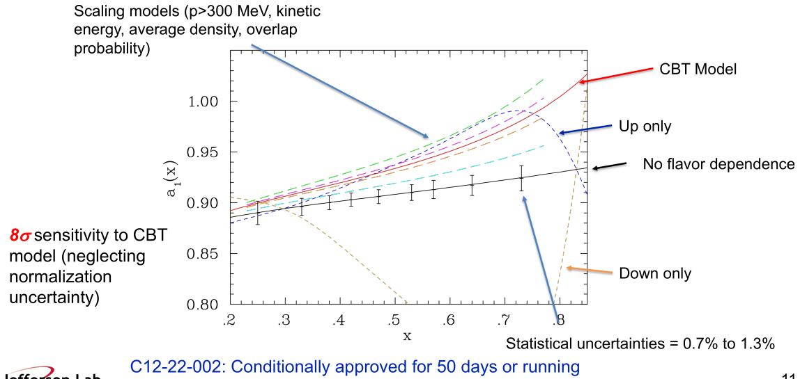
Flavor-dependent EMC, two-photon exchange and SoLID-Lite
3 · Dave Gaskell (JLab)
PVDIS on ⁴⁸Ca is directly sensitive to up versus down quark differences in nuclei
8σ sensitivity to the CBT model (C12-22-002, conditionally approved, 50 days)
BNSSA (E12-22-004, 38 days) accesses the imaginary part of two-photon exchange
SoLID-Lite: half the calorimeter acceptance; d/u and PVEMC tolerable, BNSSA harder
7 / 15

Slide 8
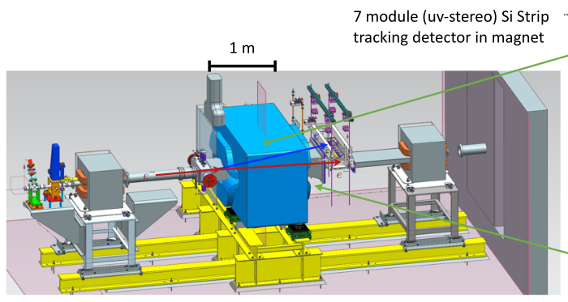
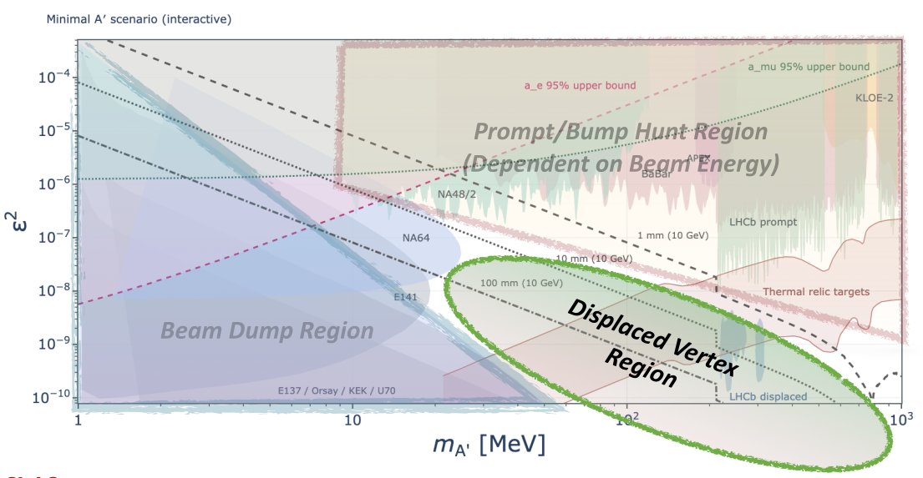
Dark photon searches at fixed-target electron beams
4 · Matthew Graham (SLAC)
Dark photons A’ are well motivated as a mediator between dark matter particles, can mix with photons
Try producing dark photons and measure decay product → set limit on mass (mA’) and coupling (ε)
Three regions: prompt bump hunt, displaced vertex, beam dump
HPS (heavy photon search) already taking data, but bump hunts are limited by silicon occupancy near the beam; reach improves only as √ℒ
8 / 15

Slide 9
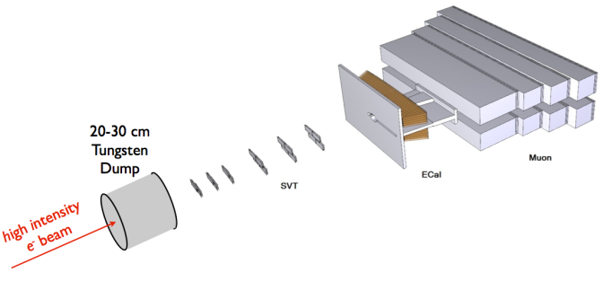
New concepts: two-armed HPS and dump HPS
4 · Matthew Graham (SLAC)
Two-armed HPS moves detectors off the beam; 30 days at 4 GeV could reach new low-mass parameter space
Dump HPS uses a 20–30 cm tungsten dump with a detector behind it; it needs only about 1 µA
Challenges: dump cooling and fast neutrons; the crowded field includes NA64, FASER and SHIP
High-luminosity CLAS: forward kinematics limit it, though SIMP and iDM models may suit it
9 / 15

Slide 10
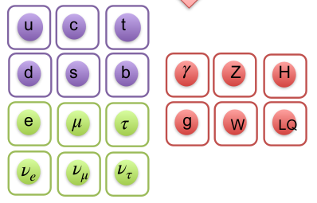
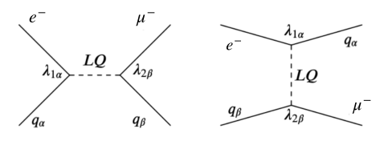
Charged lepton flavor violation: why look
5 · Yulia Furletova (JLab)
Flavor is not a conserved quantity in weak interactions
Neutrinos mix, quarks mix, but charged-lepton mixing is unobserved and tiny in the SM (below 10⁻⁵⁴)
Best limit: MEG II μ → eγ below 1.5×10⁻¹³; Mu3e, Mu2e and COMET (μN→eN) push further; τ channels also being studied at Belle II
Complementary route: eN → μN in lepton-hadron scattering, current limit <10⁻⁸ fb, probing lepton-quark couplings at high momentum transfer
Leptoquarks give a direct mechanism; HERA already showed the approach works
EIC: e→ τ channel (ep → τX) studied
10 / 15

Slide 11
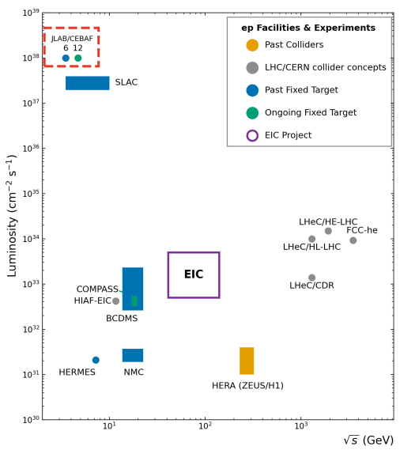
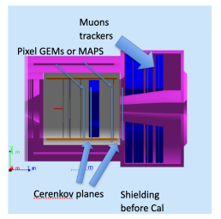
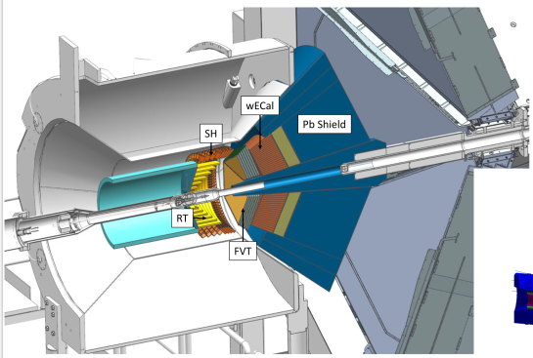
eN → μN at high luminosity
5 · Yulia Furletova (JLab)
Signature: one isolated high-pT muon plus hadrons and no scattered electron
JLab/CEBAF luminosity is 10⁷–10⁸ above HERA, against 10²–10³ for the EIC
At 5×10⁶ fb⁻¹, cross sections near 0.2 zb become reachable: a factor of 100 beyond HERA
Positron beams would sharpen sensitivity to specific leptoquarks (|F|=2 vs. |F|=0, with F=3B+L)
11 / 15

Slide 12
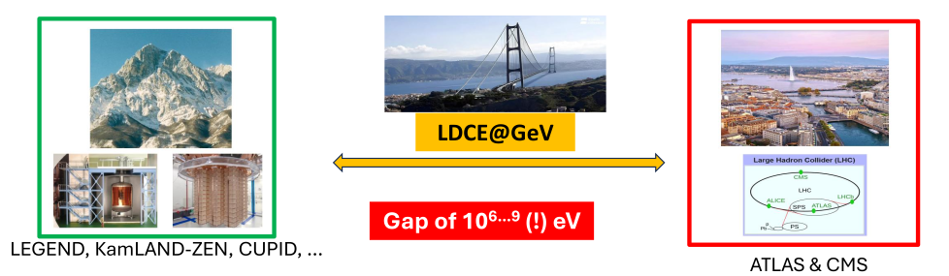
Lepton double charge exchange as an LNV probe
6 · Francesco Cappuzzello (Catania)
Lepton number violation could explain the matter-antimatter asymmetry via leptogenesis
The GeV-scale reaction A(e⁻, e⁺)X bridges 0νββ (MeV) and collider ℓℓjj (TeV), a gap of 10⁶–10⁹ eV
The Black Box Theorem: observing any of them shows neutrinos are Majorana fermions
Cross sections are lower limits; JLab has little competition for years
13 / 15

Slide 13
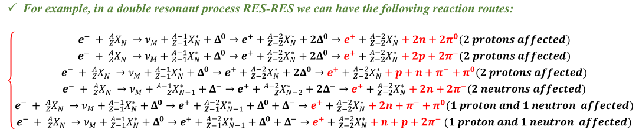
LDCE signatures, backgrounds and roadmap
6 · Francesco Cappuzzello (Catania)
Signature: a forward positron near the full beam energy plus nucleons and pions with the right momenta
Electromagnetic backgrounds dominate inclusive e⁺ spectra and are hard to simulate
Existing CLAS12 data (RG-D) are key for background studies; a dedicated trigger is desirable
Roadmap: CLAS12 first, (e⁻, μ⁺) channel, polarization observables, Hall A/C, EIC
14 / 15

Slide 14
Summary
Across the talks
Luminosity is the shared lever: rare processes and small asymmetries require luminosity 10³⁶–10³⁹
Four BSM routes: contact interactions, dark sectors, CLFV and LNV
Controlling backgrounds and hadronic effects decide what can be claimed
SoLID-Lite, muCLAS12, and many other ideas/possibilities
White Paper Planning
Each speaker provides a 1-1.5 page contribution, with figures
conveners put the contributions in a coherent picture.
describe both “PAC-vetted” experiments and “just ideas”.
15 / 15

