Slide 1
GPDs & related physics
Conveners:
Garth Huber
Volker Burkert
Zhiwen Zhao
Possible procedure to involve authors:
The convenors select figures from the presentations that best emphasizes the importance of the physics and the required precision & luminosity & detectors.
Draft a narrative based on the presented slides.
Send the draft to authors of the slides for review and to make changes.

Slide 2
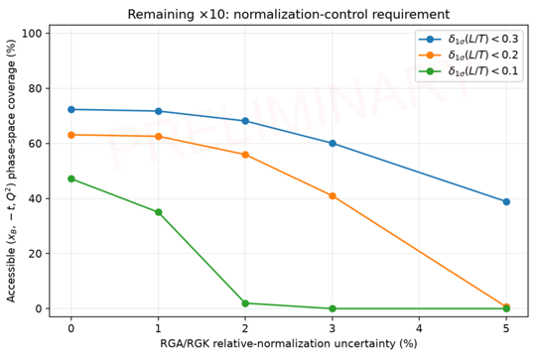
DVCS flavor sensitivity and precision control
Proton and neutron DVCS, with longitudinal and transverse target spin, constrain complementary CFFs. Higher Q² and |t| extend sensitivity to E and the D-term.
π⁰, ρ⁰ and φ production adds chiral-odd, quark and gluon information. Multiple beam energies enable L/T separation and factorization tests.
In the illustrated L/T study, about 1% relative normalization preserves much of the reach. At 2–3%, projected δ(σL/σT) < 0.1 largely disappears. Accepted statistics must grow with normalization control.
L/T precision reach versus relative normalization uncertainty
Notes:
Source:image(20261008-200725).png,Hayward summary. Chart is preliminary and applies to its illustrated L/T study,not a universal normalization tolerance. Retained source projection and statistical/normalization distinction. Full source summary:proton/neutronDVCS,targetspin,CFFs,E,Dterm;pi0,rho0,phiadd complementaryinformation;beamenergiesenableL/T andfactorization tests. Figure retained from suppliedimage. No presenter header/footer orbottomtakeawayline.

Slide 3
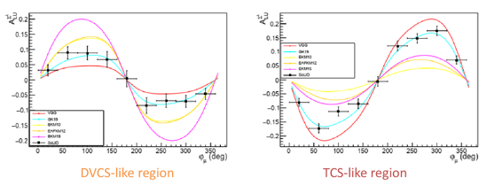
TCS and DDVCS: complementary GPD constraints
TCS spin and charge-odd observables constrain real and imaginary CFF combinations, adding D-term sensitivity. DDVCS varies Q² and Q′² to probe x = ξ′ at fixed ξ and test shadow GPDs and sign changes.
μCLAS12 projects 7.7M TCS and >0.5M DDVCS + BH events in 200 days at 10³⁷ cm⁻² s⁻¹. SoLIDμ studies use 100 days at 1.2 × 10³⁷ cm⁻² s⁻¹ for five-dimensional binning.
Muon identification, exclusivity and angular acceptance govern precision. Electron / muon reference channels check efficiency. SoLID-lite studies retain reach with reduced electron coverage, but require full forward muon acceptance.
Projected DDVCS beam-spin asymmetries in two virtuality regimes
Notes:
Sources:image(20261008-200612).png andimage(20261008-200644).png,Paremuzyan andZhao summaries. Figure fromZhao suppliedimage showsDVCS-like andTCS-like regimes,not aTCS crosssection. DDVCS accesses offdiagonalGPDinformation;shadowGPD scenarios fromParemuzyan aremodeltests. Counts/runperiods/luminosities aredifferent proposals andcannotbecompared ascommonaccepted event samples. >0.5M isDDVCS+BH,notpureDDVCS. SourceSoLIDmuoncharge moments supplyexploratoryrealCFF sensitivity;retain as supplementarydetail. BetheHeitler andacceptance controlessential. Allnumbers areprojections.

Slide 4
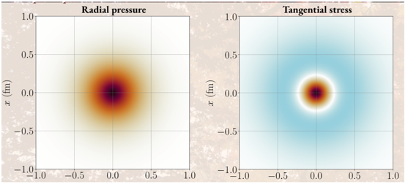
Lattice GPD moments and internal forces
GPD Mellin moments give local-operator form factors. The second moment yields A(t), J(t) and D(t). Gradient flow offers a route around higher-moment operator mixing, demonstrated with pion PDF ratios at m_{π} ≈ 400 MeV.
D(t) and c̄(t) enter the stress tensor. Subsystem c̄ describes momentum exchange and forces; its total cancels for the conserved EMT. Radial and tangential light-front stresses distinguish compression and tension.
Reliable interpretation requires controlled continuum / flow-time limits and full lattice systematics. Total pressure satisfies the von Laue condition. Negative D is a hadronic pattern, rather than a universal stability theorem.
Illustrative 2D light-front radial and tangential stress maps
Notes:
Sources:image(20261008-200707).png andimage(20261008-200814).png,Freese andPefkou summaries. Figure fromFreese depictsillustrativemodel,notmeasuredprotonstress. Freese advocatesrelativistically exact2Dlightfrontdensities;spatialreconstruction retains assumptions. cbarindividualsubsystems neednotsatisfyconservedtotalEMTrelations,sumcbarcancels. Pefkou:n=2momentflavor/gluondecomposition supports globalanalyses;highermomentpowerdivergentmixing,gradientflowsuppressUVnoise andshortflowtimematching. DemonstrationpionPDF ratiosup to<x5>/<x> at400MeVpions;forwardheavy-pionstudyisnotphysicalmassnucleonoffforwardGPD determination. Fullmatching,continuum andflowtimelimitcontrolneeded. Figuremapcolorstructurewithoutcolorbarshouldnotbeusedtoreadoffabsolutepressure.

Slide 5
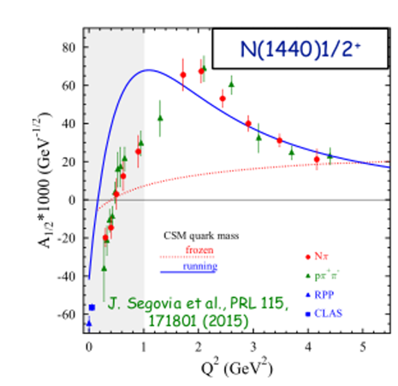
High-Q² N* structure and mass generation
Extract transition electrocouplings from πN, ηp, π⁺π⁻p and KY. Independent final states test reaction models and distinguish quark-core from meson–baryon dynamics.
Continuum Schwinger methods relate several transitions to a common dressed-quark mass function. Higher Q² tests this description across excited states.
The projected reach is Q² ≈ 12–13 GeV² at 2–3 × 10³⁵ cm⁻² s⁻¹. Larger accepted samples enable finer bins, with reaction-model extraction and acceptance errors requiring control.
Roper electrocoupling: data and dressed-quark mass-function comparison
Notes:
Source:image(20261008-200836).png,Mokeev summary. Figure comparesRoperN1440A1/2 datawithcontinuumSchwingermethod runningversusfrozenquarkmassmodel;SegoviaetalPRL115,171801(2015). Figuredataextendonly~5GeV2 anddo notshowprojected12–13GeV2reach. HigherQ2reach/luminosityareprojection. Multi-finalstateconsistencyvalidatesextractionmodels andcommonmassfunctioninterpretation. Moreacceptedstatisticsrequireacceptance/systematiccontrol.

Slide 6
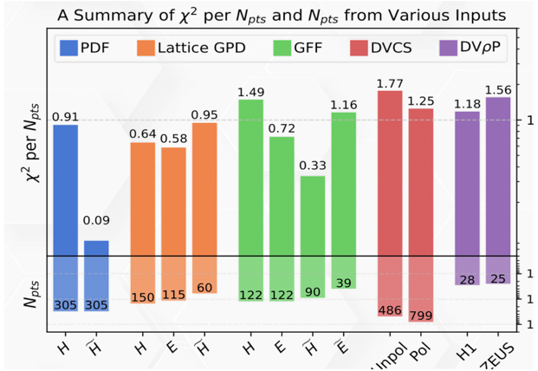
Global GPD analyses and mechanical structure
GUMP1.0 combines DVCS and meson data with lattice GPDs through conformal moments and NLO calculations, including J/ψ mass corrections. The fit reports χ²/Npts = 1.09 for 2,646 points.
Holographic models generate A(t) and D(t) through spin-2 and scalar exchanges, predicting a negative, approximately tripole D-term and stress profiles.
Tomography, spin estimates and inferred gluon radii retain model assumptions. Parameterization bias is unquantified, and lattice-GFF tensions remain. Polarized and complementary channels strengthen the tests.
Reported fit quality across experimental and lattice inputs
Notes:
Sources: supplied image(20261008-194502).png and image(20261008-194634).png, summarizing Guo and Zahed talks. Chart retained from first supplied image. Guo: GUMP1.0,nonzero-skewness lattice inputs,conservative cuts and added uncertainties,chi2/Npts1.09,2646points. NLOevolution/hard amplitudes and J/psi mass corrections. Parameterization bias not quantified, some lattice-GFF tension. Zahed: holographic spin2/scalar exchanges,negative approximately tripoleDterm; comparison to near-thresholdJ/psi andlattice. GluonGFFs,radii and stress depend on production model and spatial-density conventions. Proposed trace-anomaly reconstruction combines quark/gluonEMT and scalarquark contribution at compatible scales/conventions; retained here as supplementary detail. These are model predictions and fit inferences, not model-independent measured densities.

Slide 7
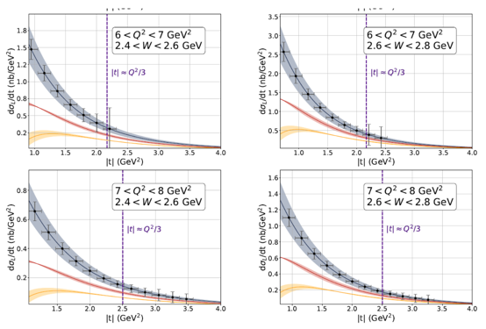
Vector-meson probes of gravitational form factors
Longitudinal φ production adds strange-quark D-term sensitivity complementary to J/ψ. At large skewness, amplitudes involve A + ξ²D, with controlled Q² and |t| required.
SoLID simulations at Q² ≈ 6–8 GeV² project D_{s} sensitivity from longitudinal cross sections. L/T separation and joint φ / J/ψ fits constrain competing contributions.
Near-threshold J/ψ cross sections admit GPD-inspired, holographic and coupled-channel descriptions. Polarization, spin-density matrix elements and open-charm energy scans test helicity and rescattering assumptions.
SoLID φ projections at 43.2 ab⁻¹; theory assumptions affect D_{s} inference
Notes:
Sources: image(20261008-194735).png and image(20261008-194818).png, Hatta and Winney summaries. Figure retained from Hatta image:SoLIDphi longitudinal cross-section projections at43.2ab^-1,Q2~6–8GeV2. Large-skewness A+xi^2D approximation andkinematic/power corrections mustbe tested. StrangeDterm sensitivity is model-based. Supplementary Hatta point:Sullivan process offers futurepionGFF access;in chiral limit total spin0pionEMT D(0)=-A(0)=-1. Winney:fitquality cannot identify uniqueproductionmechanism;analyticity/unitarity requirecomplexrescattering phases;polarization/SDMEs probe helicityconservation,scalar/tensor assumptions;opencharm andenergyscans testcusp/coupledchannel mechanisms. Sourcephotos are summaryslides,notprimarydata files.

Slide 8
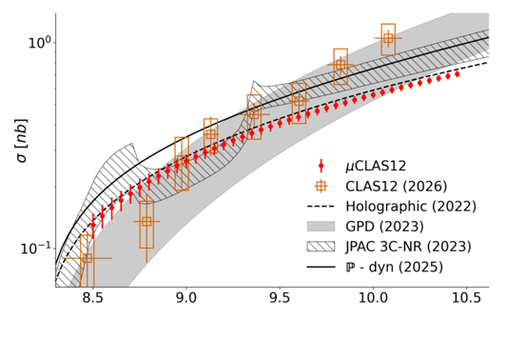
Precision tests with μCLAS12 charmonium
At 10³⁷ cm⁻² s⁻¹, a 200-day μCLAS12 run projects about 30,000 J/ψ → μ⁺μ⁻ events. Finer energy and t bins improve model discrimination and slope constraints.
A good cross-section fit does not establish a unique mechanism. Differential data need polarization and independent channel tests before supporting precise gluon-GFF extraction.
Neutron, polarized and nuclear measurements add complementary tests. A Stage-II neutron study projects about 4,600 events, with tracking and nuclear corrections requiring control.
Projected μCLAS12 precision, existing CLAS12 data and competing models
Notes:
Sources:image(20261008-194852).png andimage(20261008-194818).png,Chatagnon andWinney summaries. Figure retainedfromChatagnon image. 30,000J/psi->mu+mu- events in200days at1e37cm^-2s^-1 areprojections,notobservedcounts. StageII neutron~4600events projection;tracking/nuclearcorrections affectprecision. Existingdata leavecompeting production models viable. Figureincludes μCLAS12projection,CLAS12(2026),holographic(2022),GPD(2023),JPAC3C-NR(2023),P-dyn(2025). Theorybands belongtodifferentmodelassumptions andshouldnotbereadasacommonconfidenceinterval. Winney mechanism tests complement differentialcrosssection precision. No presenter names,headers,footers orbottom takeawayline added.

Slide 9
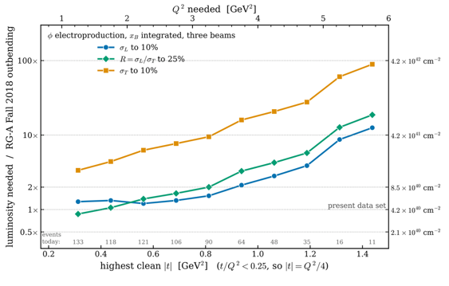
Precision vector-meson amplitudes and strange D-term
Longitudinal φ and ρ⁰ amplitudes connect to GPDs under factorization. Polarized targets constrain helicity-flip amplitudes and E. Multiple beam energies enable Rosenbluth separation and ambiguity tests.
Detector-folded diffusion inference extracts correlated amplitudes, SDMEs and σL / σT. Near |t| ≈ 1.4 GeV², simulated 10% precision needs about 10× exposure for σL and 100× for σT, excluding analysis systematics.
Exclusive e′pK⁺K⁻ reconstruction and decay angles support longitudinal φ extraction. Hall C φ-007 projects Ds(0) resolution of 0.1–0.2 within its assumed theory. SoLID uses 43.2 ab⁻¹ and assumed 10% systematics.
Simulated exposure for separated φ cross sections relative to RG-A Fall 2018 out-bending data
Notes:
Sources: uploaded image(20261008-210041).png (Bhawani Singh, 5 October 2026) and image(20261008-210106).png (Henry Klest, 6 October 2026). Singh figure is a statistical exposure projection, excluding analysis systematics. The 10× and 100× values are approximate at |t|≈1.4 GeV² relative to the RG-A Fall 2018 outbending sample. Hall C φ-007 resolution is model dependent. Full-SoLID integrated luminosity 43.2 ab⁻¹, assumed systematic uncertainty 10%; SoLID-lite estimates remain approximate. Signal extraction and theory errors determine final Ds precision. No presenter name/date header or bottom summary line.

Slide 10
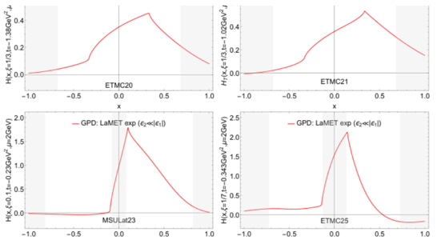
Lattice GPDs and nucleon tomography
Large momentum Effective Field Theory matches boosted equal-time correlators to x-dependent GPDs. At ξ = 0, a transverse Fourier transform gives impact-parameter distributions.
Non-zero-skewness calculations extend input beyond Mellin moments. Asymmetric frames, NNLO matching and resummation improve coverage and perturbative control.
Finite boost, lattice spacing, volume and excited states limit precision. Endpoint and crossover regions require care. Combining lattice and experiment requires quantified matching and lattice uncertainties.
Nonzero-ξ lattice examples with shaded regions of limited theoretical control
Notes:
Sources: image(20261008-210123).png and image(20261008-210205).png, identical Huey-Wen Lin summaries, 7 October 2026. These are lattice examples, not experimental GPD measurements. LaMET large-momentum effective theory connects boosted Euclidean equal-time matrix elements through matching to light-cone GPDs. Impact-parameter interpretation applies at zero skewness. Shaded regions mark uncontrolled regions in the supplied examples. Preserve finite boost, discretization, volume, excited-state and matching limitations. Duplicate content retained once.

Slide 11
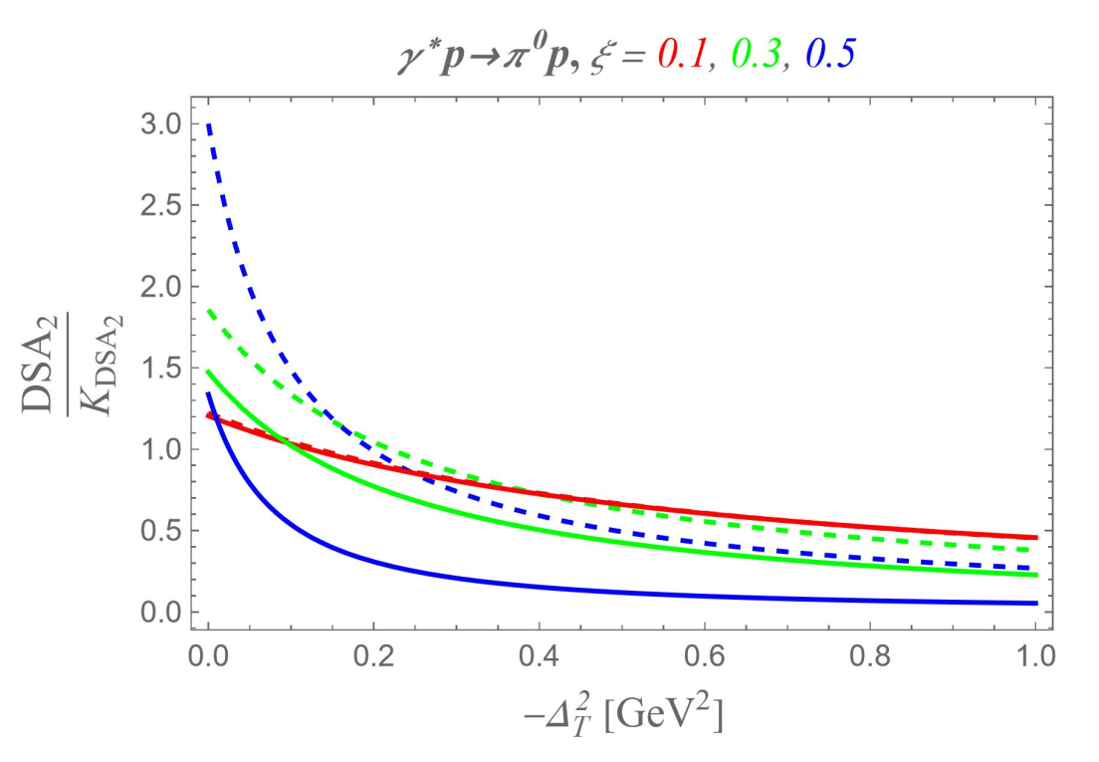
Backward hard exclusive reactions and TDAs
The backward limit, u ≈ 0, provides a complementary factorization regime for hard meson production.
Transition distribution amplitudes (TDAs) are the u-channel analog of GPDs in the t-channel.
Tests of the TDA mechanism
A backward cross-section peak, dσ/dt ∝ Q⁻¹⁰ scaling and transverse dominance, σ_{T} ≫ σ_{L}.
Polarization: beam-spin, transverse-target-spin (A_{UT}) and double-spin (A_{LL}) asymmetries.
Double-spin asymmetry: TDA model comparison
Cross-channel universality and color transparency provide additional tests.
Notes:
Reformatted from Garth-Huber-GPD_summary.pptx, source slide1. All stated mechanism tests retained. Plot retained from the source embedded image. Curves are theory models, not measurements. Preserve source differential scaling convention d sigma/dt~Q^-10. The source labels beam-spin asymmetry A_UU; this requires physics review because usual beam-spin notation is A_LU. The reformatted body retains beam-spin wording without carrying that questionable subscript. This is a formatting pass. No author names or bottom takeaway line appear.

Slide 12
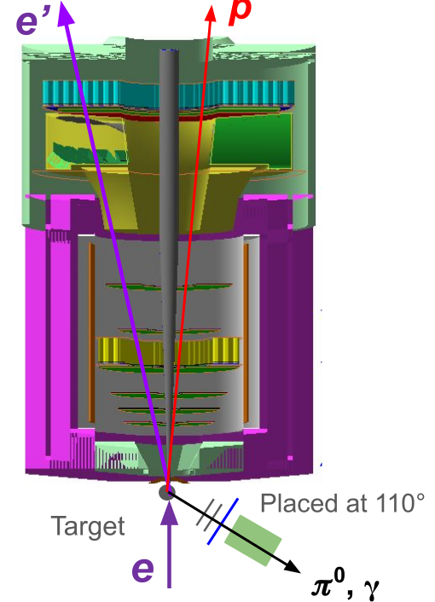
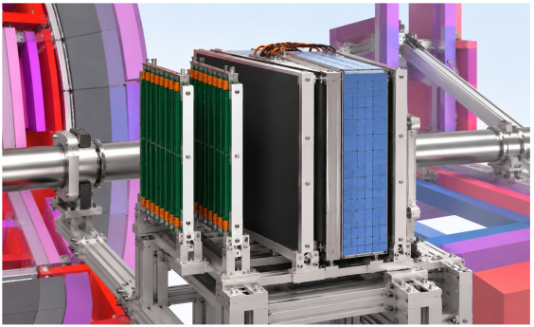
Probing TDAs through backward exclusive reactions
Backward-peak and scaling tests require a recoil detector combined with high luminosity and large acceptance. Polarization measurements require broader recoil acceptance.
Possible SoLID-lite configuration using existing detectors
Backward tagging of π⁺ and π⁰
Two tracking layers tag momentum.
Scintillator provides a charged-particle trigger and neutral-trigger veto.
Calorimeter measures particle energy.
Notes:
Reformatted from source slide2. Source embedded configuration image split into detector-layout and hardware crops. Original main statements retained, with embedded detector descriptions made editable. Equipment reuse and integration costs remain a proposal. Source layout puts backward tagger at110degrees. Original image credits and source scientific context remain in the supplied deck. No standalone headline names, bottom takeaway or page footer added.

Slide 13
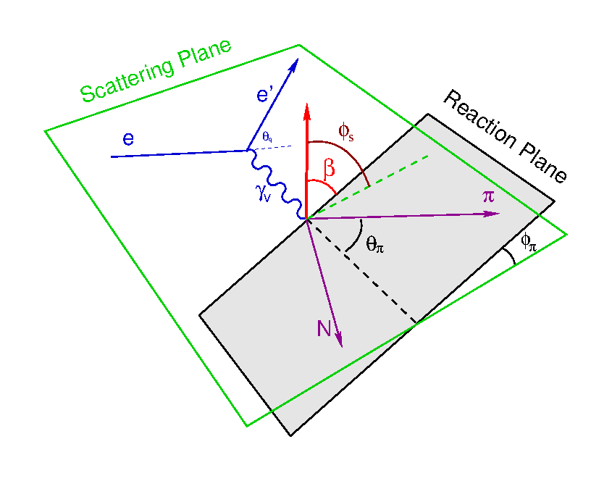
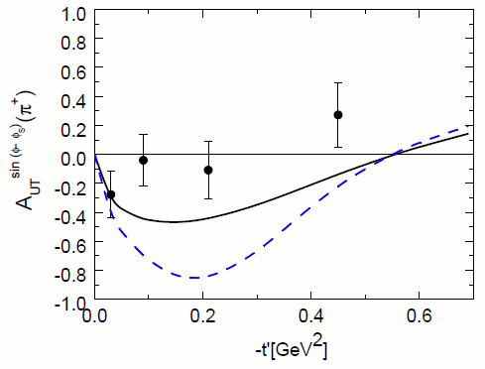
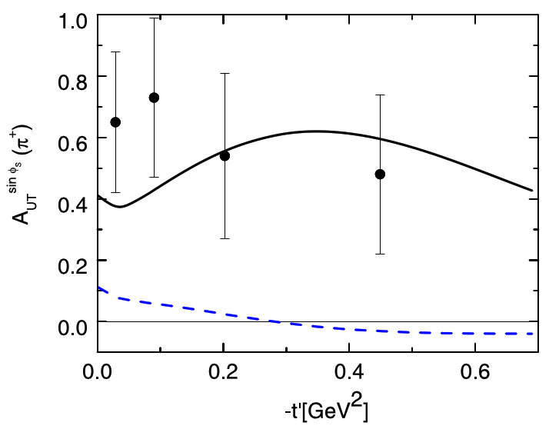
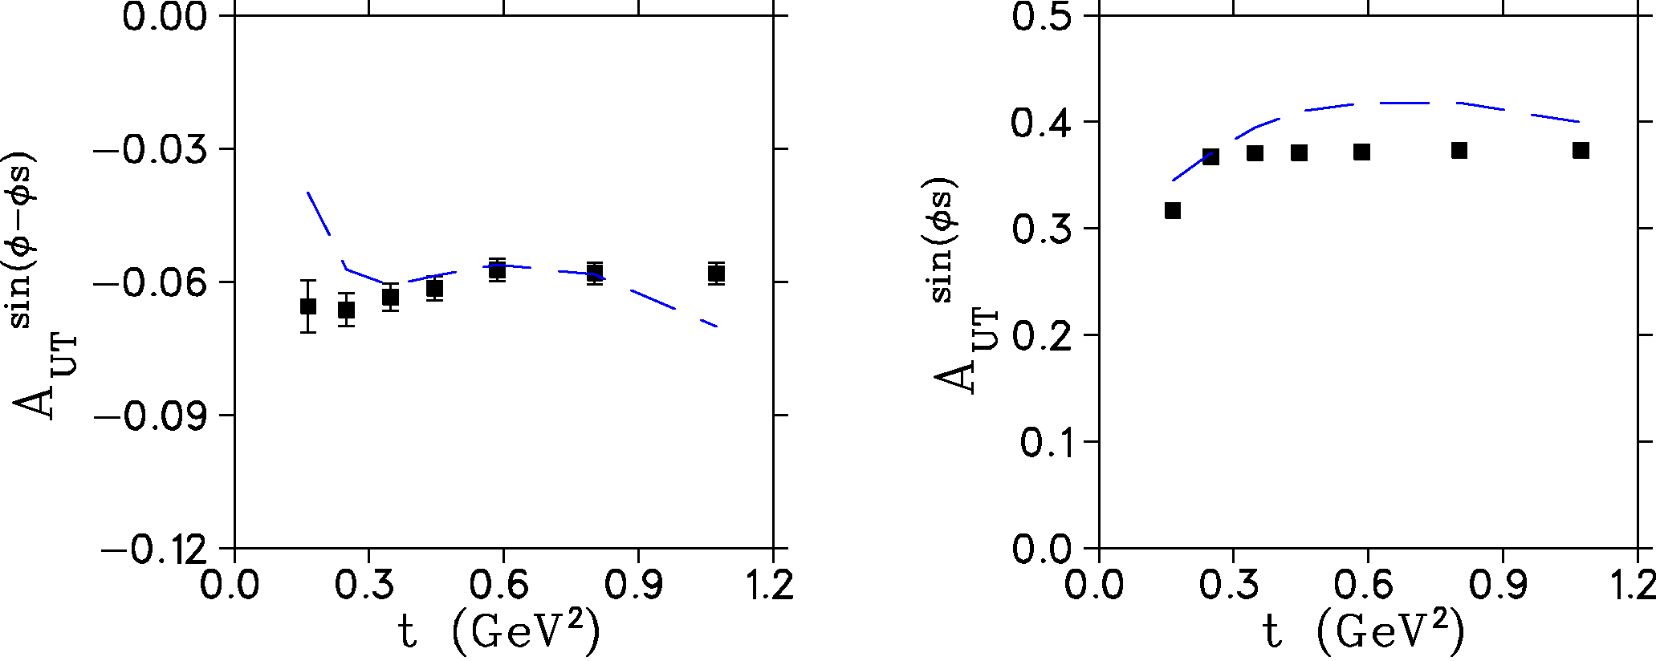
Exclusive π⁻ from transversely polarized ³He
Tag the proton to isolate exclusive π⁻ events on a polarized neutron in ³He.
Scattering and reaction planes
The sin(φ − φs) moment probes helicity-flip GPDs. The sin(φ_{s}) moment probes transversity GPDs.
Large acceptance and high luminosity enable the measurement. SoLID-lite has similar coverage with about twice the uncertainties.
HERMES world data
SoLID projected uncertainties
Notes:
Reformatted from source slide3. HERMES pioneering measurement: Phys.Lett.B682(2010)345. Retains HERMES proton pi+ measurements and proposed neutron pi- measurements on polarized3He as comparison, not the same target/channel. Original source describes sin(phi-phis) as helicity-flip GPD sensitive and sin(phis) as transversity sensitive. Longitudinal/transverse and nuclear-extraction qualifications will need physics review in a later content pass. SoLID-lite factor-two uncertainty and similar coverage statement retained from the original bottom line in editable body text. Projection image retains source horizontal-axis sign convention as provided. Both HERMES panels, SoLID projection pair and angular diagram are retained.

Slide 15
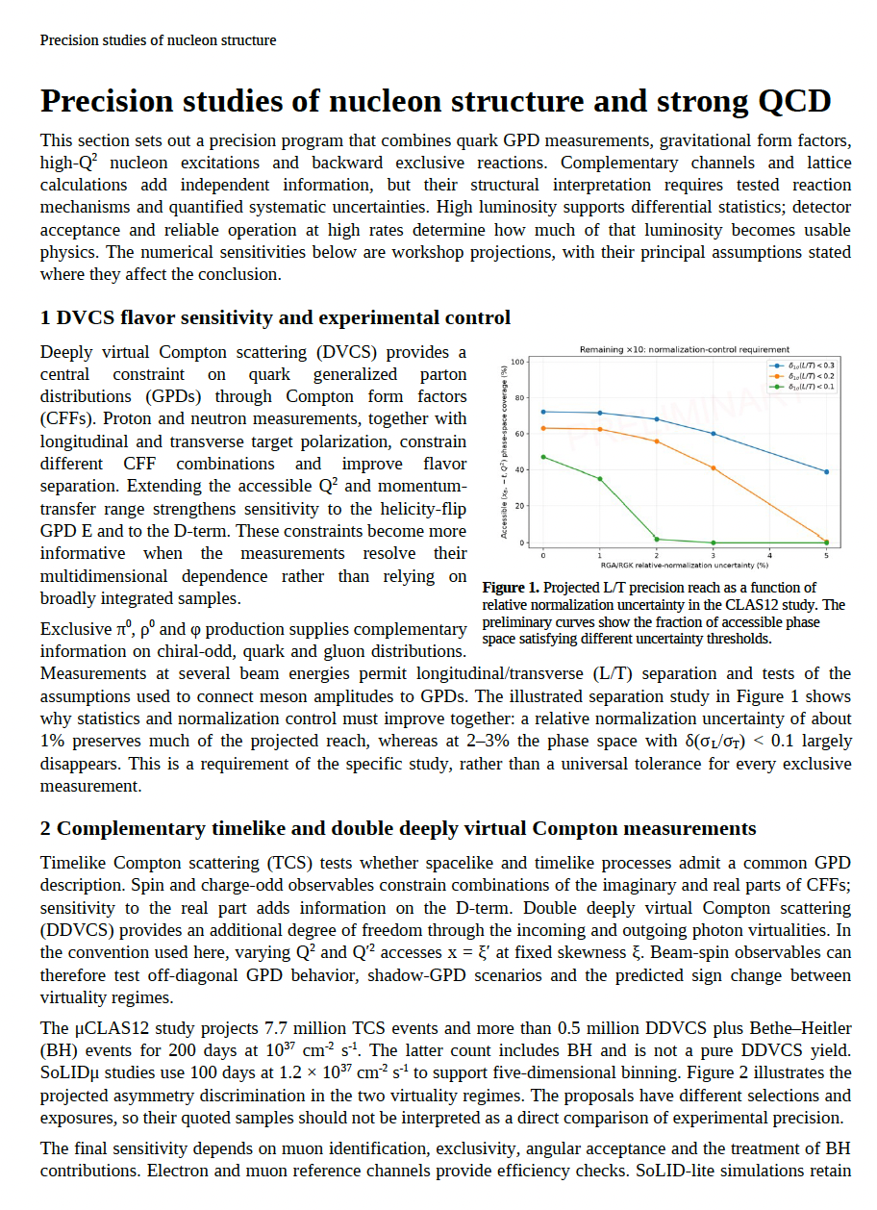
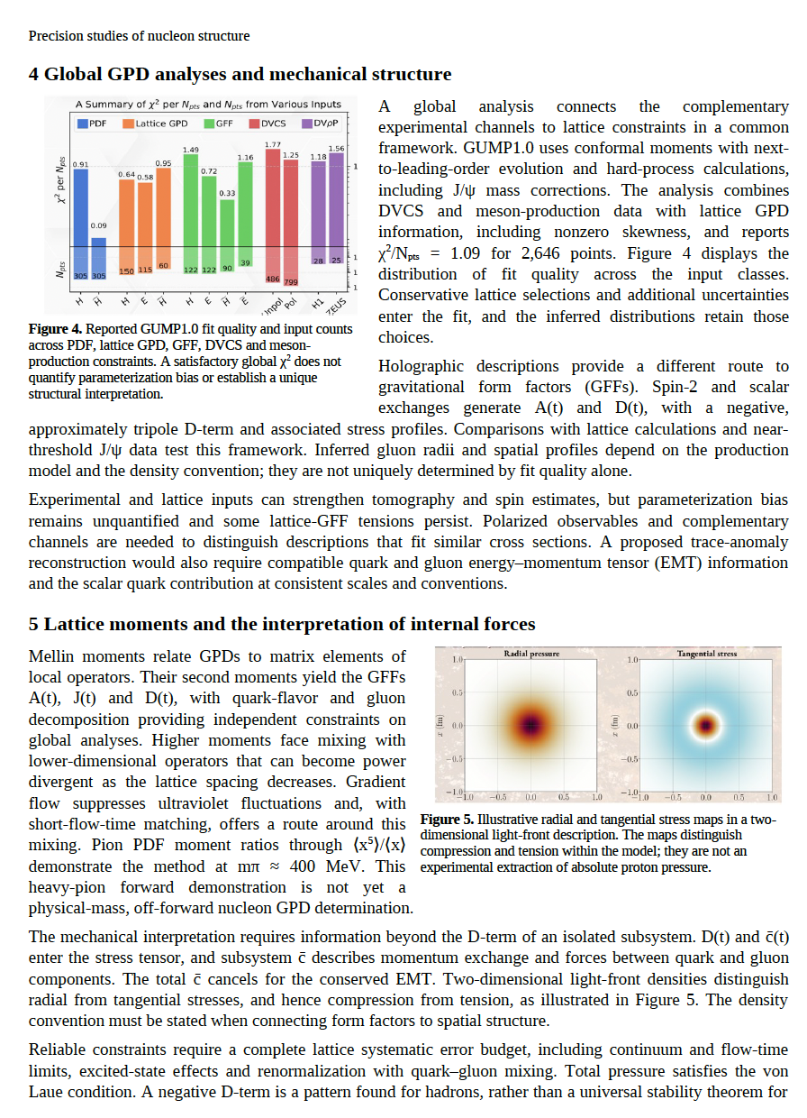
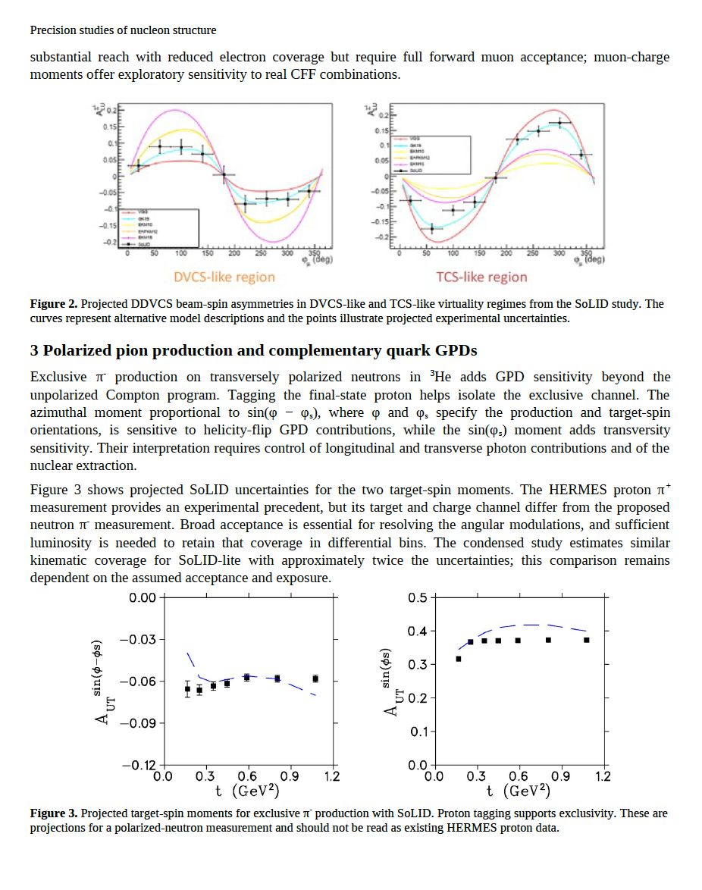
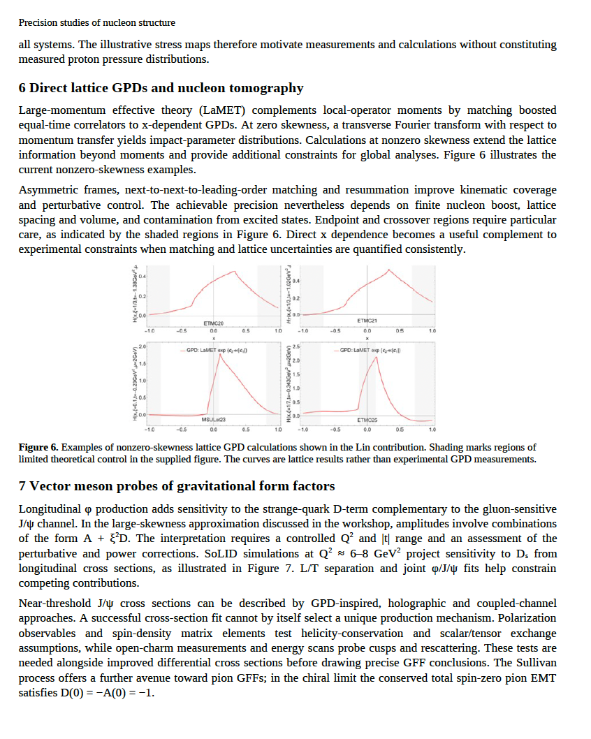
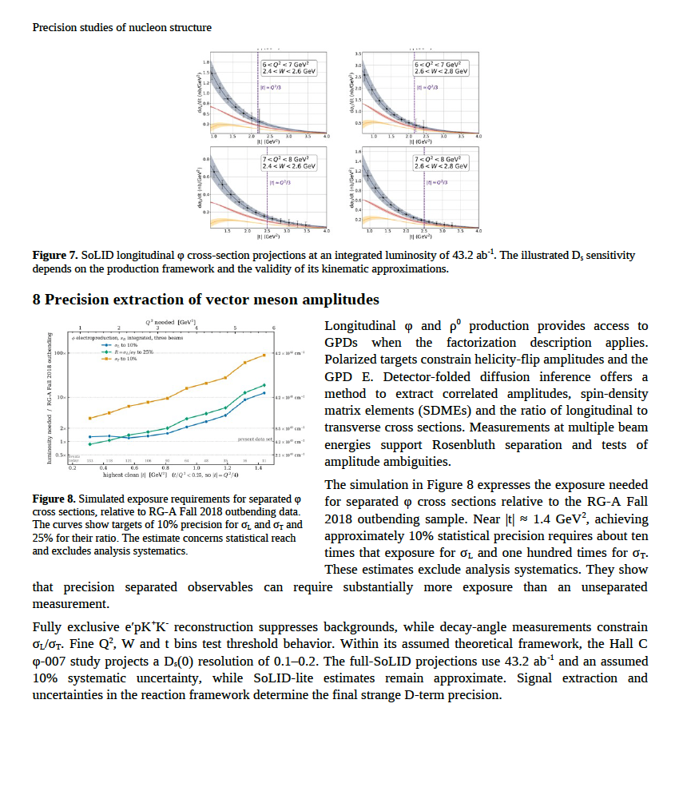
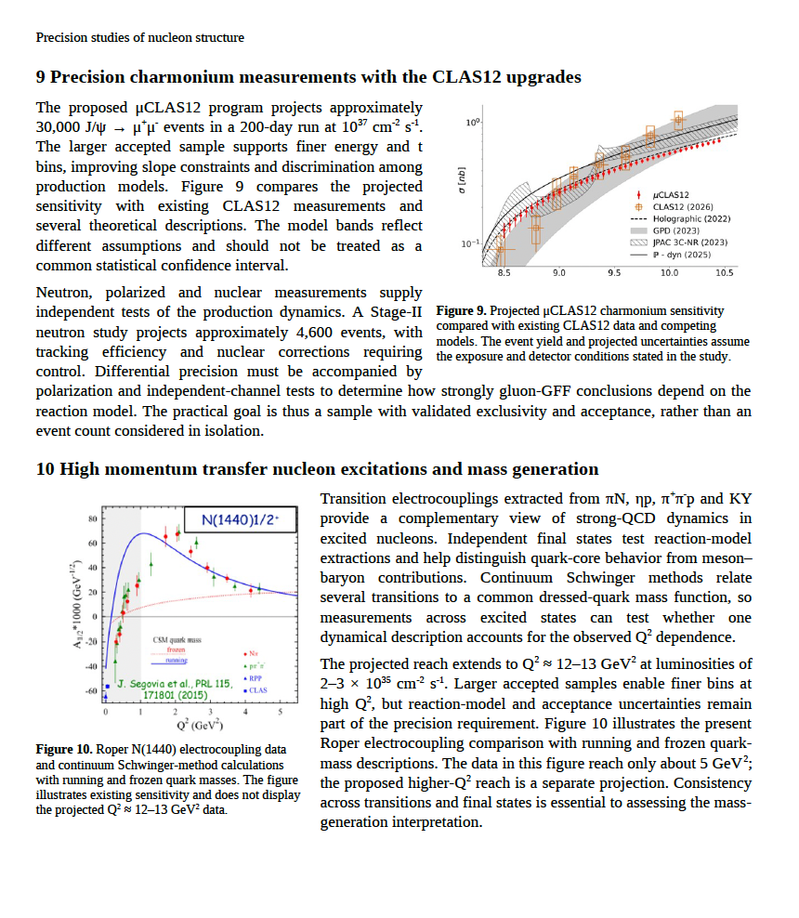
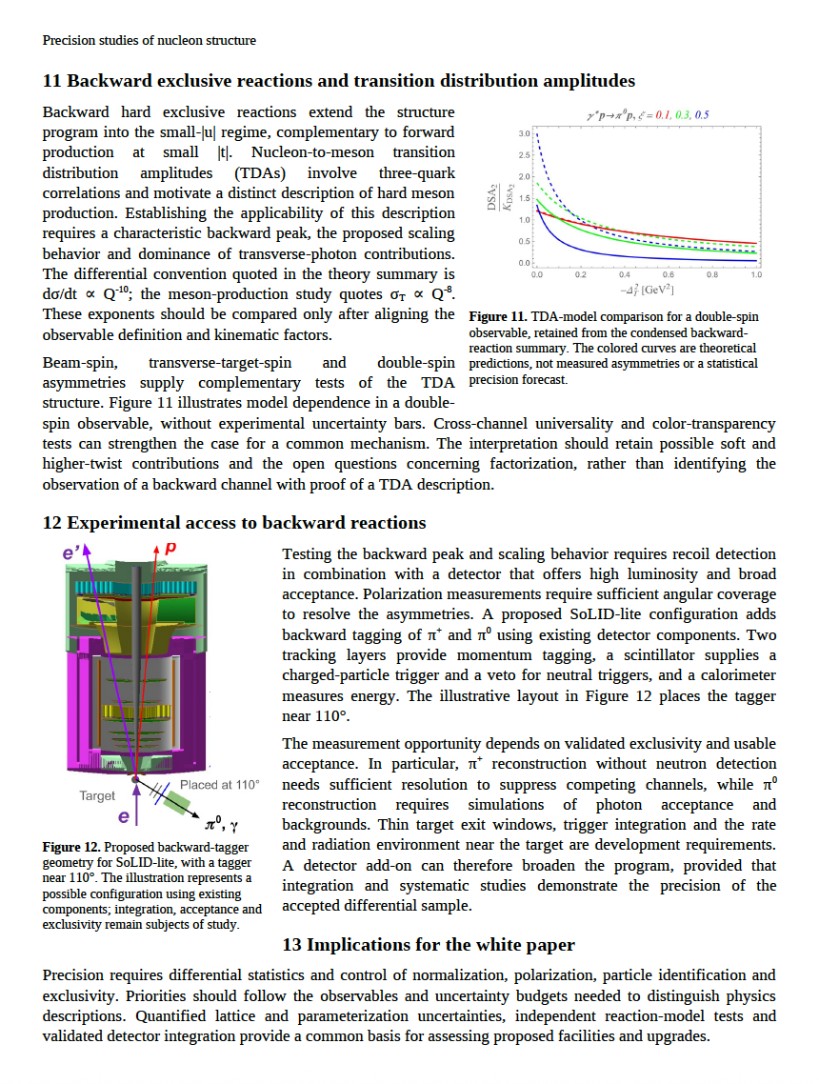

Slide 16
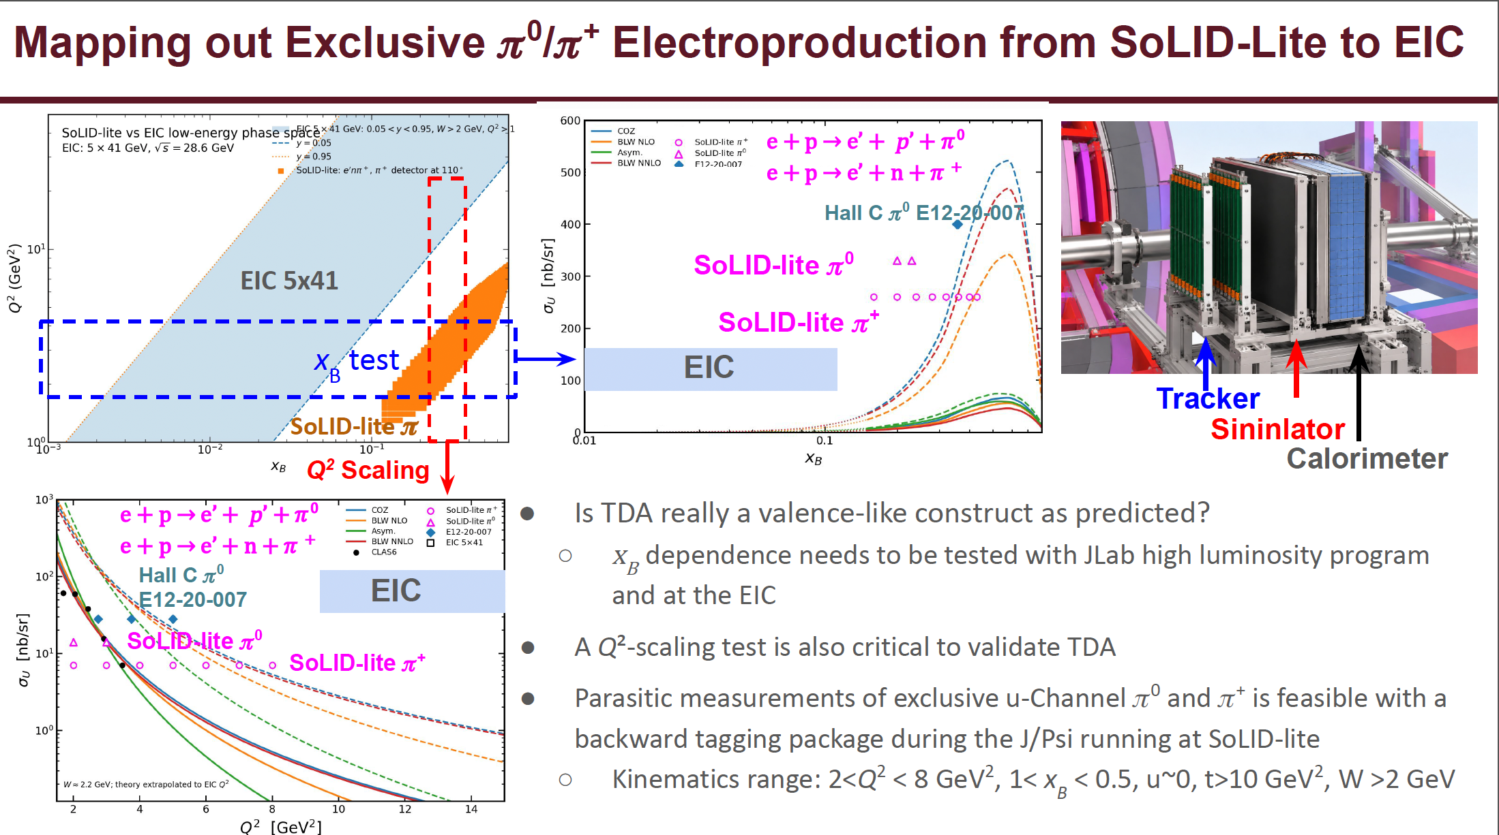

Slide 17
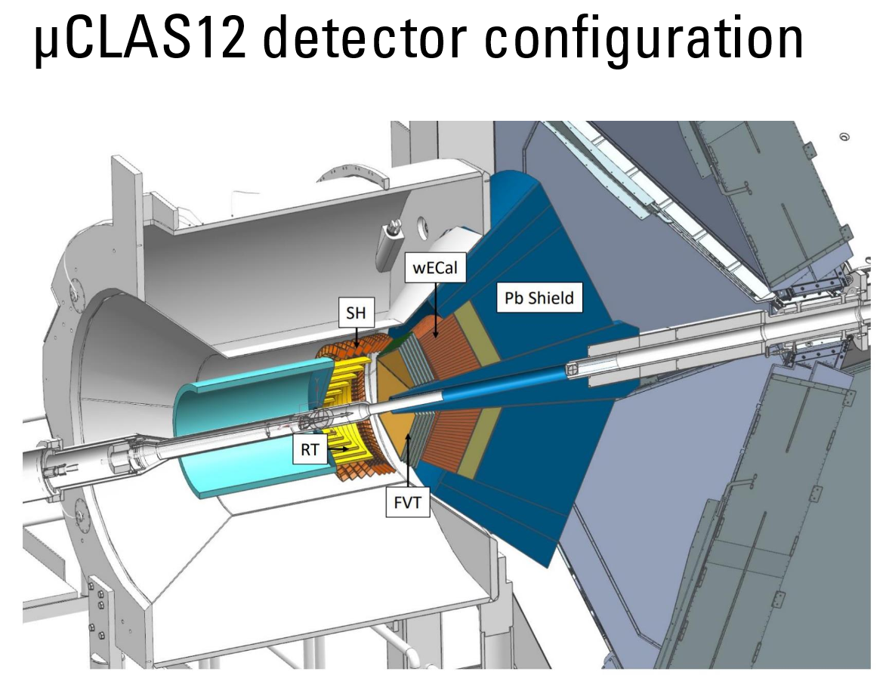
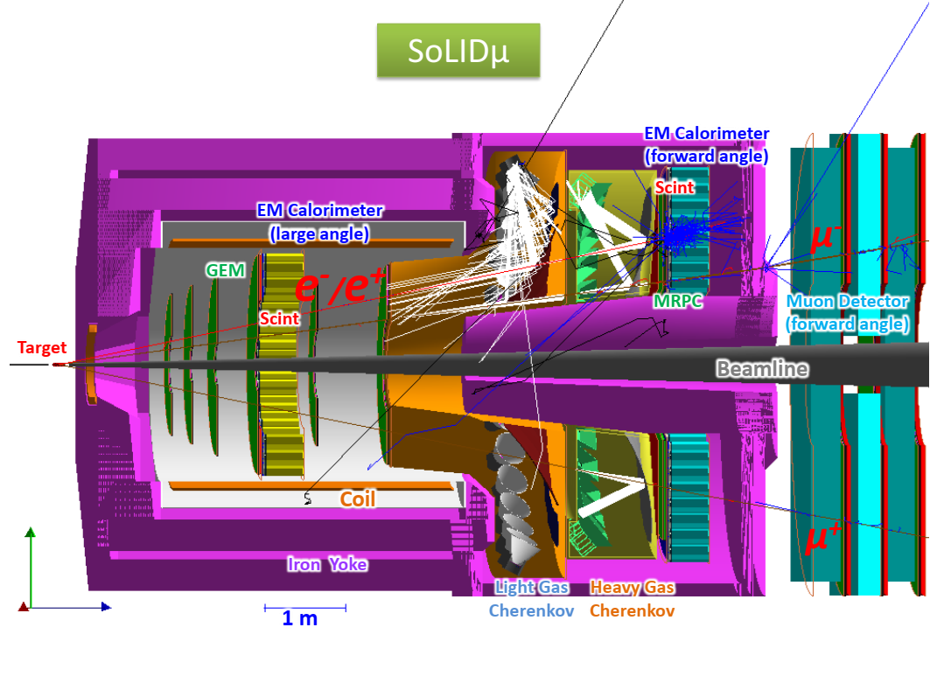
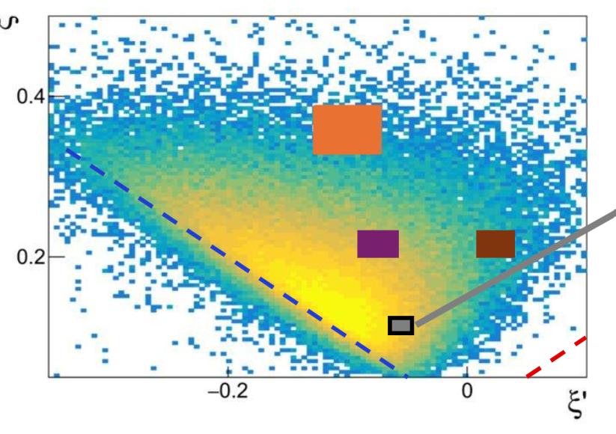
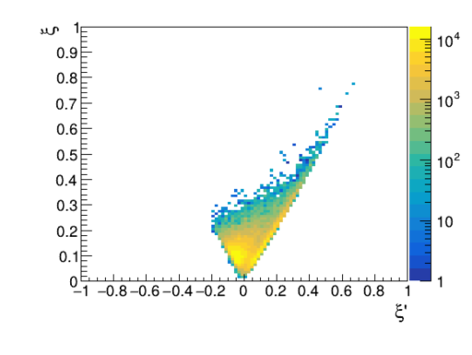
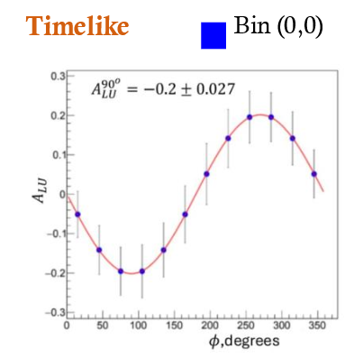
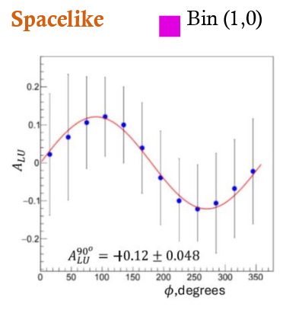
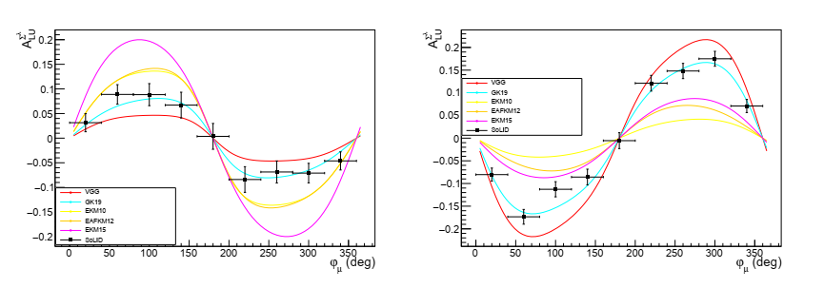
GPD: TCS and DDVCS (whitepaper writing flow)
Why we need them
TCS provides new observables and accesses new GPD kinematic region, comparing to DVCS
DDVCS provides new observables and covers GPD in its full kinematic region
Both test universality and possible NLO effect, and add critical input to global fitting
Both are exclusive measurement with multiple final state particles and very small cross-section. Large acceptance detectors with high luminosity capability beyond any existing detector are needed
μCLA12 and SoLIDμ at JLab are the only two high lumi nosily and large acceptance detectors to study both at the valance region ever and will do first time measurement in multidimensional binning
The two detectors are complementary in term of kinematic coverage and systematics
μCLAS12 has a well planned staged upgrade path to increase luminosity from CLAS12,while SoLIDμ will start new with high luminosity and has potential for further upgrade
SoLIDμ has di-electron and di-muon measurement at the same time to save beam time, increase counts and check systematics
Maybe merge style them similarly
Why only we can measure them well

