Slide 1
Possibilities in GPD Physics with Increased CLAS12 Precision
Timothy B. Hayward
October 7th, 2026

Slide 2
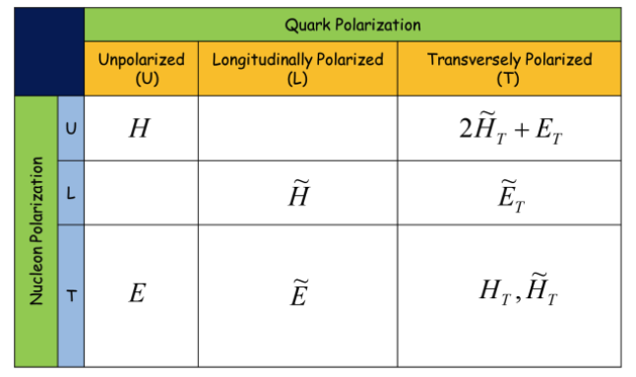
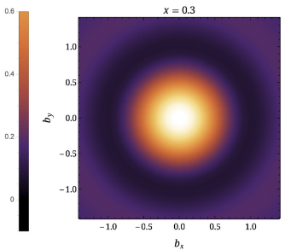
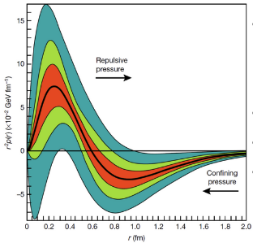

Nucleon Structure through Generalized Parton Distributions
Generalized Parton Distributions (GPDs) unify form factors and parton distribution functions and provide a more complete 3D picture of the nucleon.
Give access to information on the correlations between transverse position and longitudinal momentum of quarks and gluons inside the nucleon.
Accessible experimentally through measurements of exclusive processes such as Deeply Virtual Compton Scattering (DVCS) or Deeply Virtual Meson Production (DVMP).
Nucleon Tomography
Contributions to the total nucleon spin
Gravitational Form Factors
Mass/energy distribution inside the nucleon.
Nucleon mass radius.
Shear forces and pressure distributions.
X. Ji, Phys. Rev. Lett. 78,610 (1997)
Quark contribution; not the main contribution → spin crisis.
Quark’s orbital angular momentum, accessed through GPDs.
Gluon spin contributions.
H.W. Lin, Phys. Rev. Lett. 127 (2021) 182001.
2
V. D. Burkert et al., Nature 557.7705 (2018): 396

Slide 3
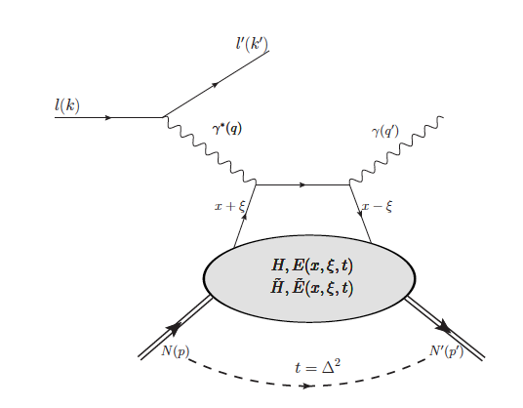
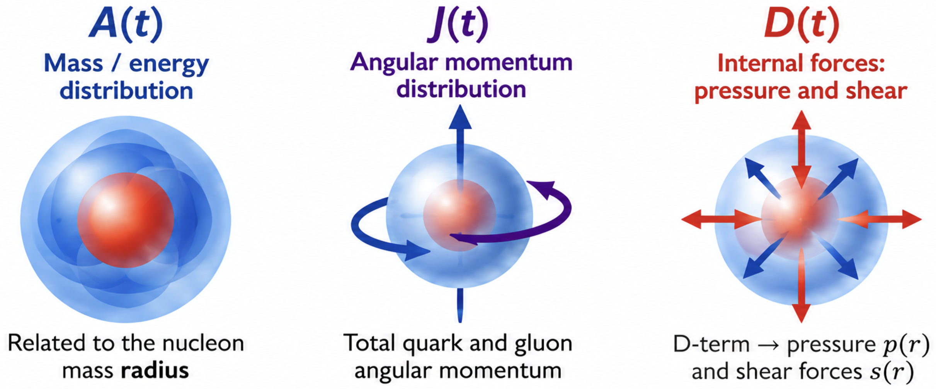
DVCS and the Mechanical Structure of the Proton
DVCS provides access to CFFs
GPD moments relate to GFFs
Matrix elements of the QCD energy-momentum tensor are parametrized by gravitational form factors (GFFs).
The GFFs encode fundamental properties of the nucleon:
In DVCS the hard photon interaction factorizes from the nonperturbative nucleon structure described by chiral even GPDs.
DVCS observables constrain the corresponding CFFs through interference with BH.
The real part of 𝓗 provides sensitivity to the D-term through a dispersion relationship.
DVCS Observables → CFFs → D(t) → p(r), s(r)
3

Slide 4
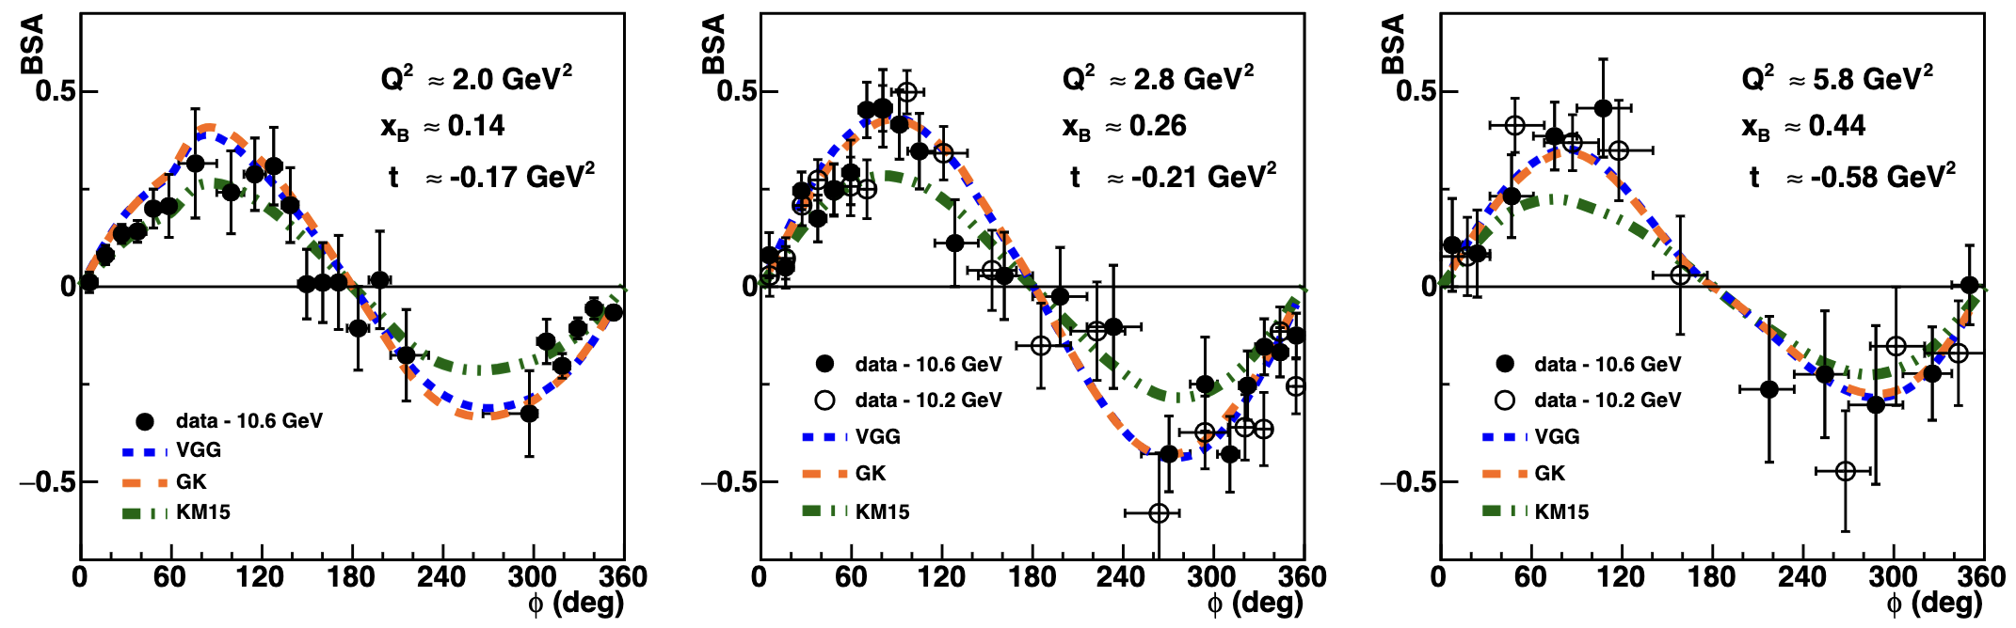
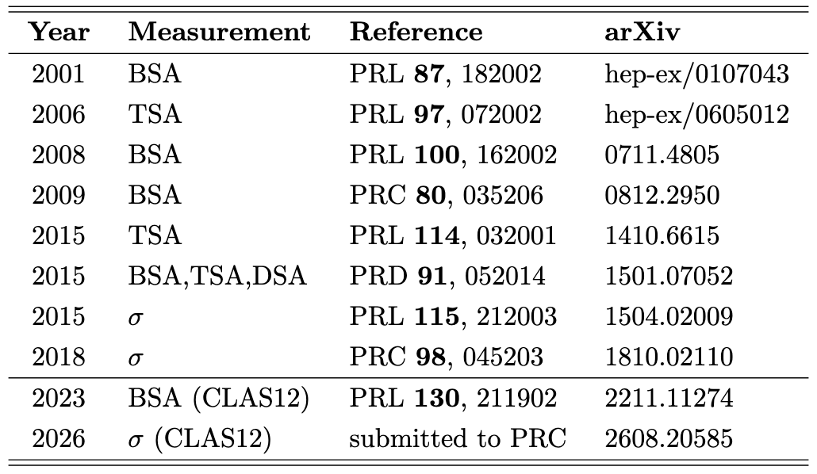

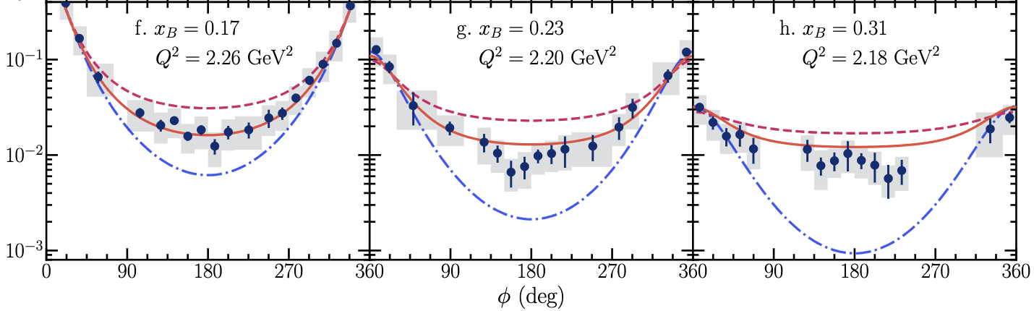
pDVCS Measurements in Hall B
Many generations of complementary DVCS observables at CLAS and CLAS12
PRELIMINARY
CLAS12:
>2000 BSA and >1300 4-fold differential BSA/σ measurements extending the Q²-x_{B} reach in the valence region.
Greatly enhanced sensitivity to Re and Im parts of 𝓗 with indications of tension in previously unexplored phase space.
Data represents ~1/2 collected statistics.

Slide 5
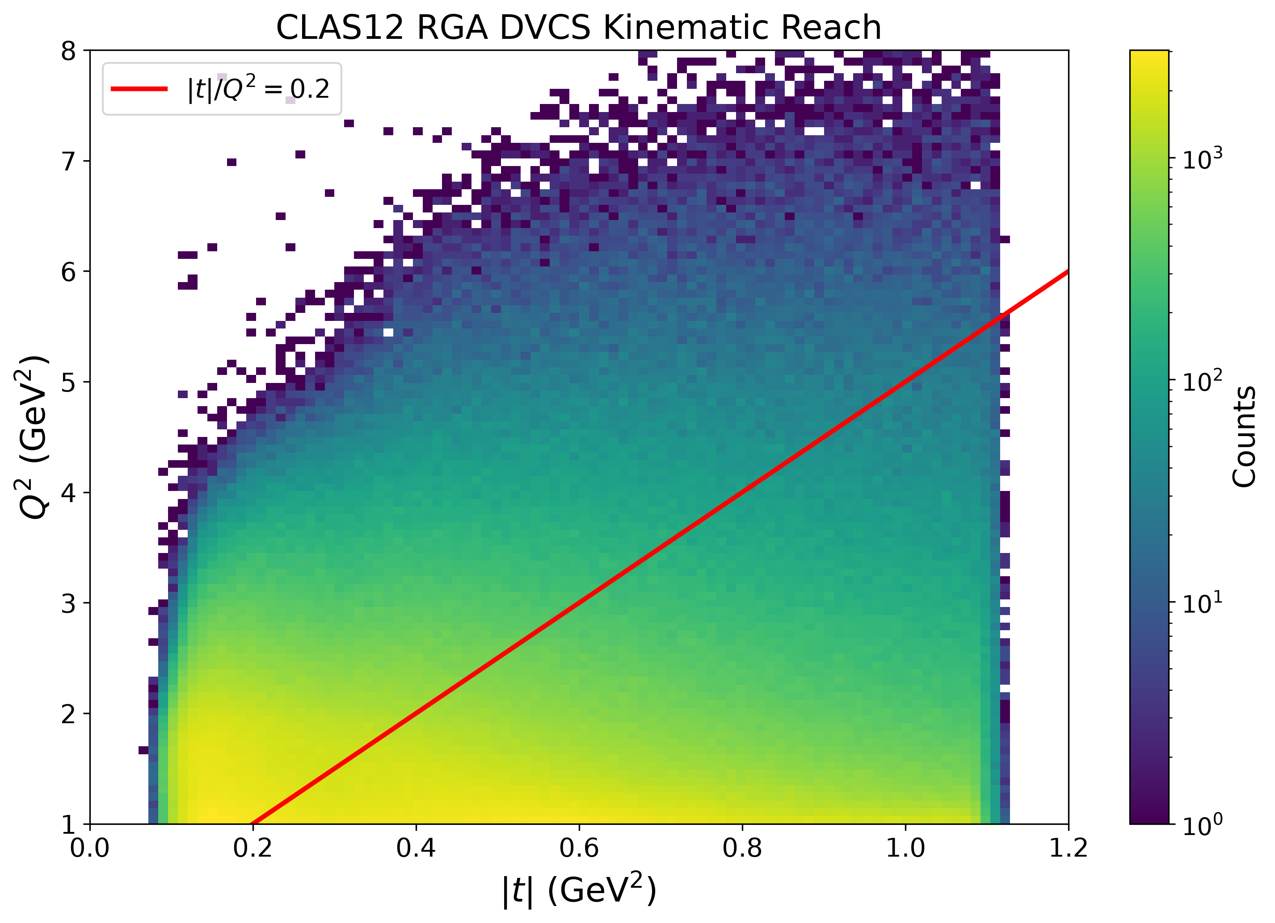
High Luminosity Extends the |t| Lever Arm
Mechanical structure needs a broad |t| lever arm
(access t-dependence of D term)
GPD “Safe” Region
Factorization regime:
*
* preferences vary
Large |t| therefore requires large Q²:
Cross sections fall rapidly with Q².
High luminosity could buy new controlled reach in |t|, not just smaller error bars.

Slide 6
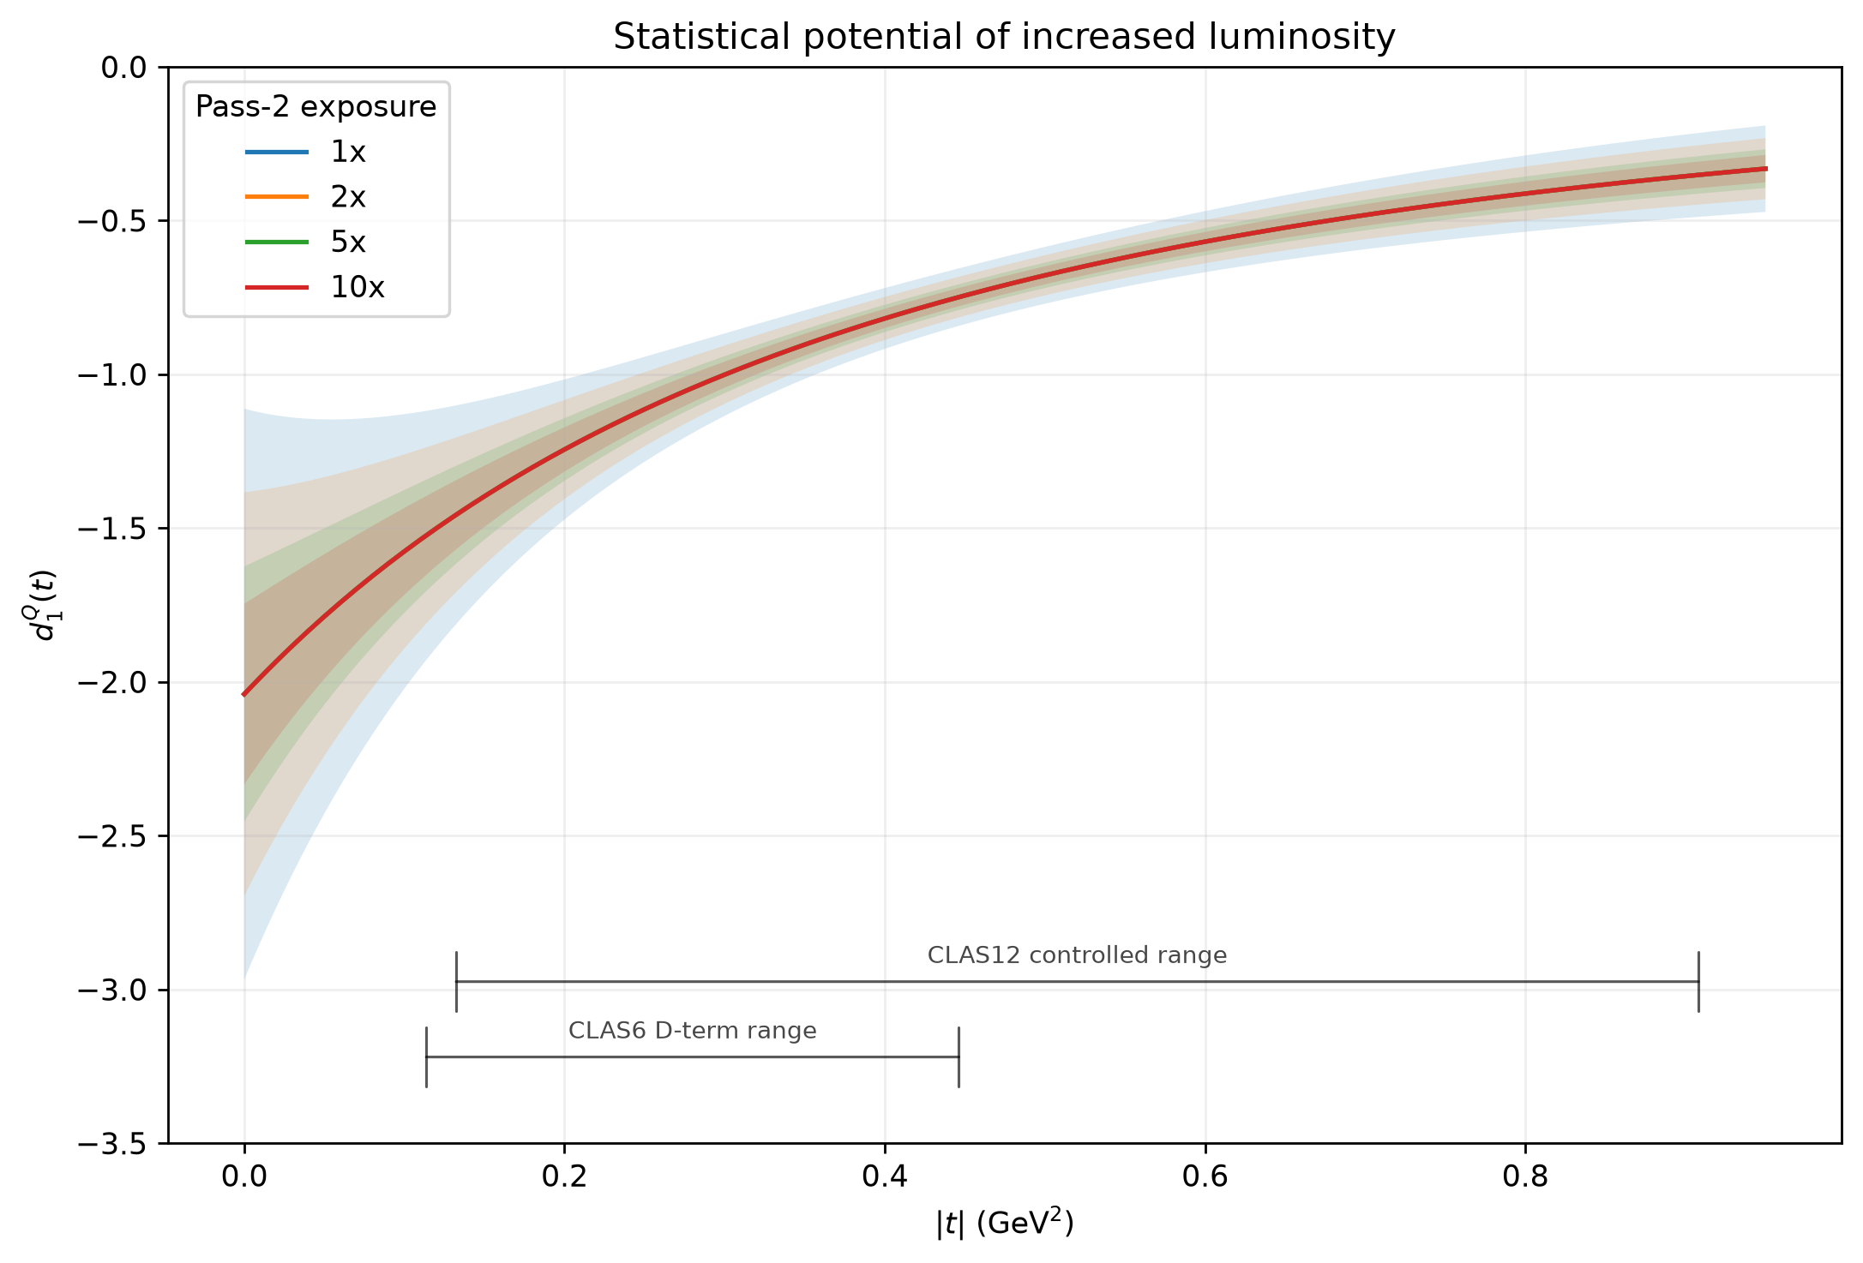
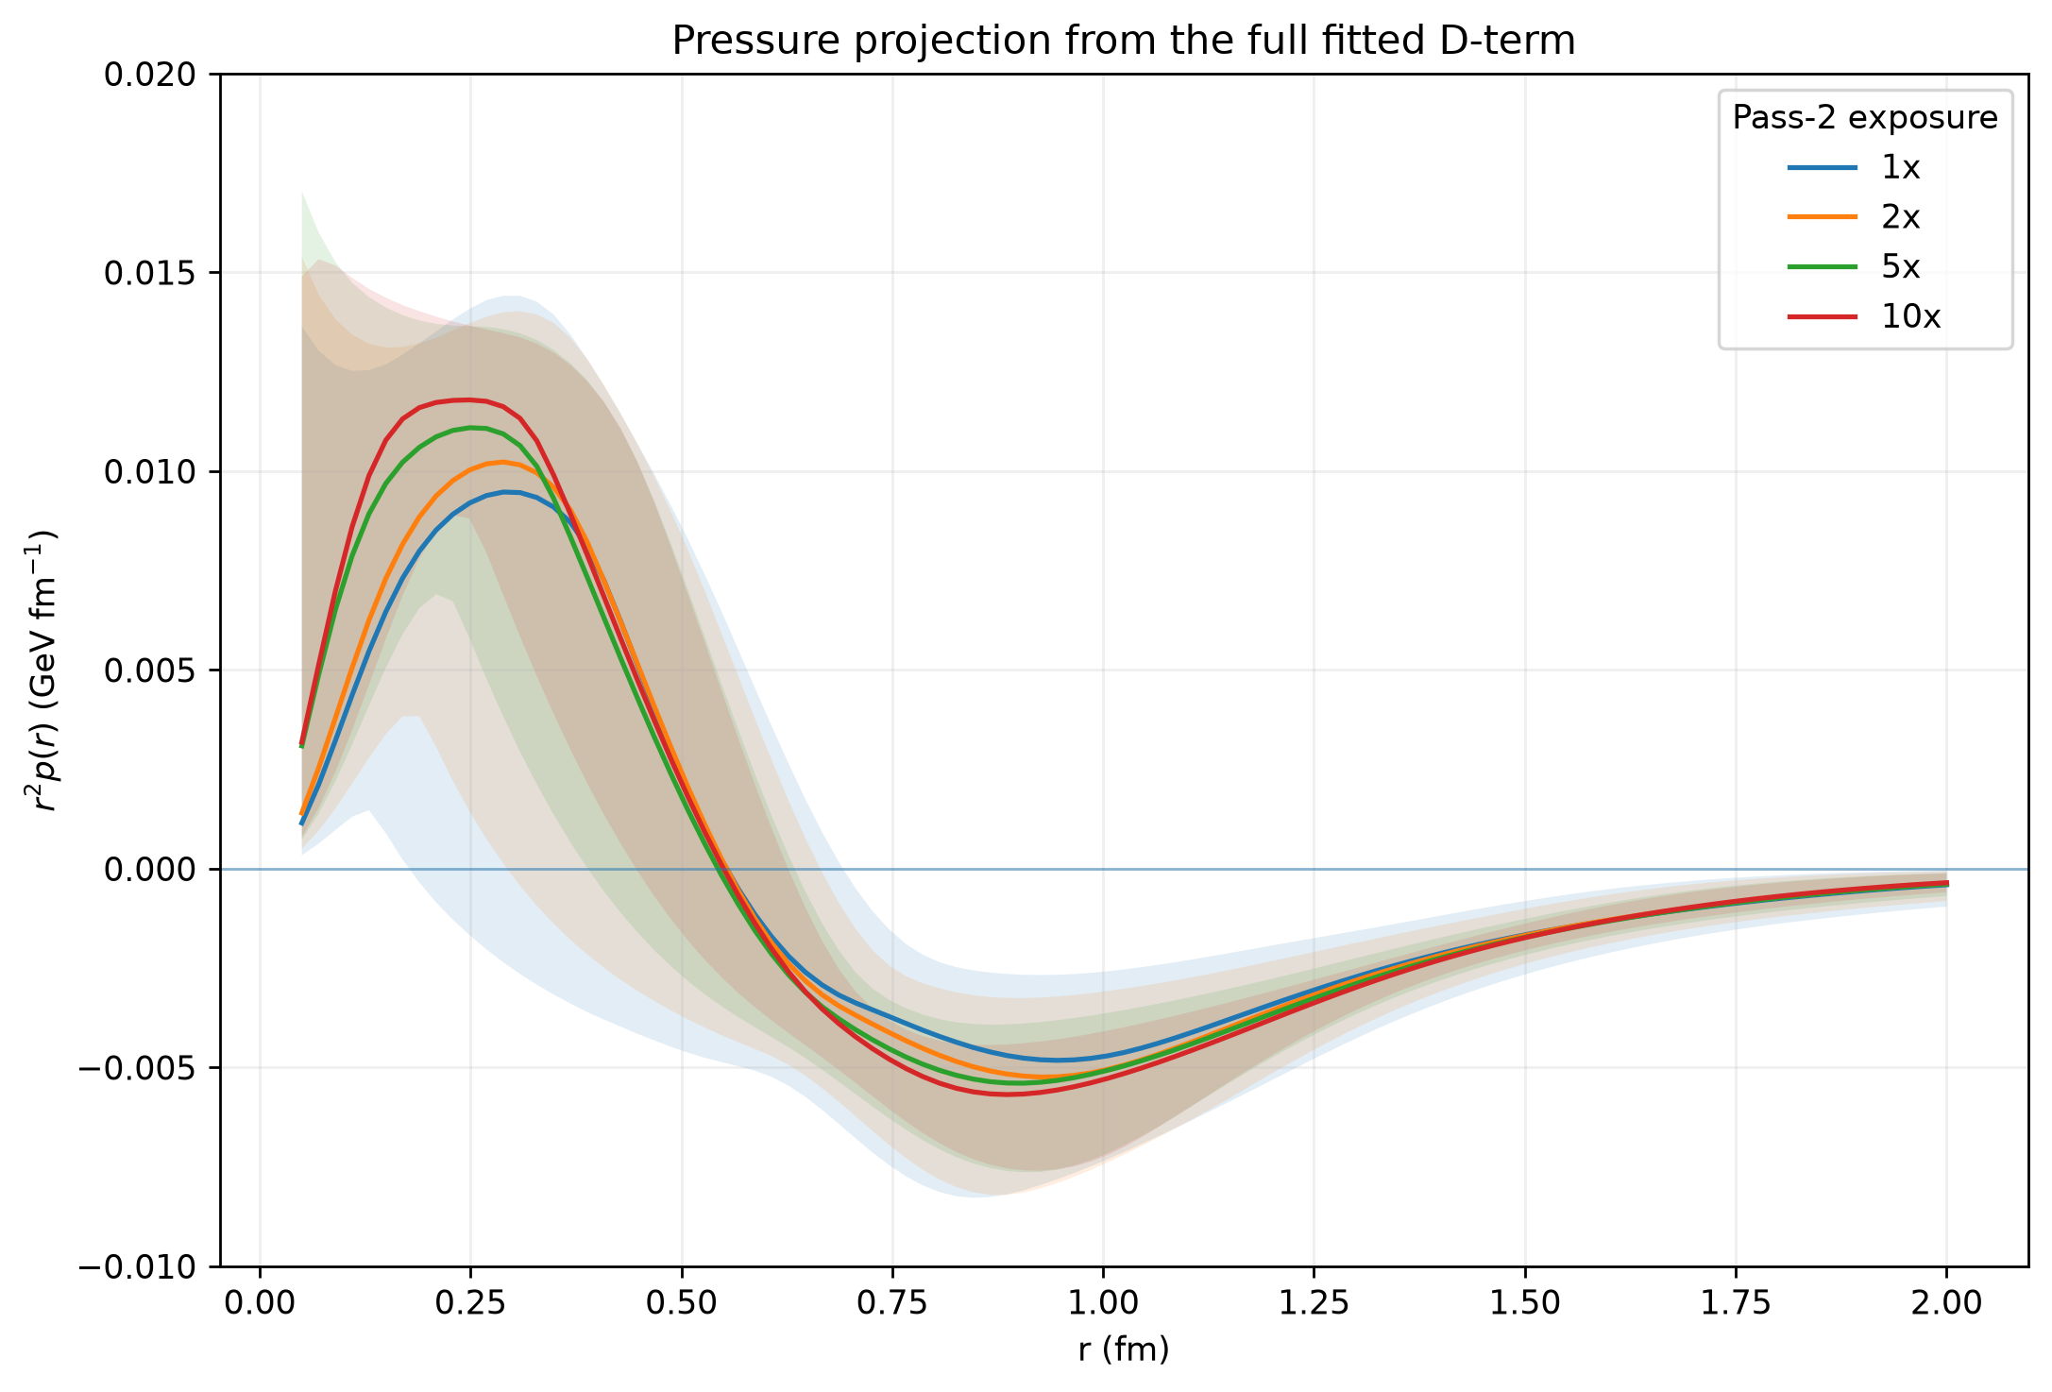
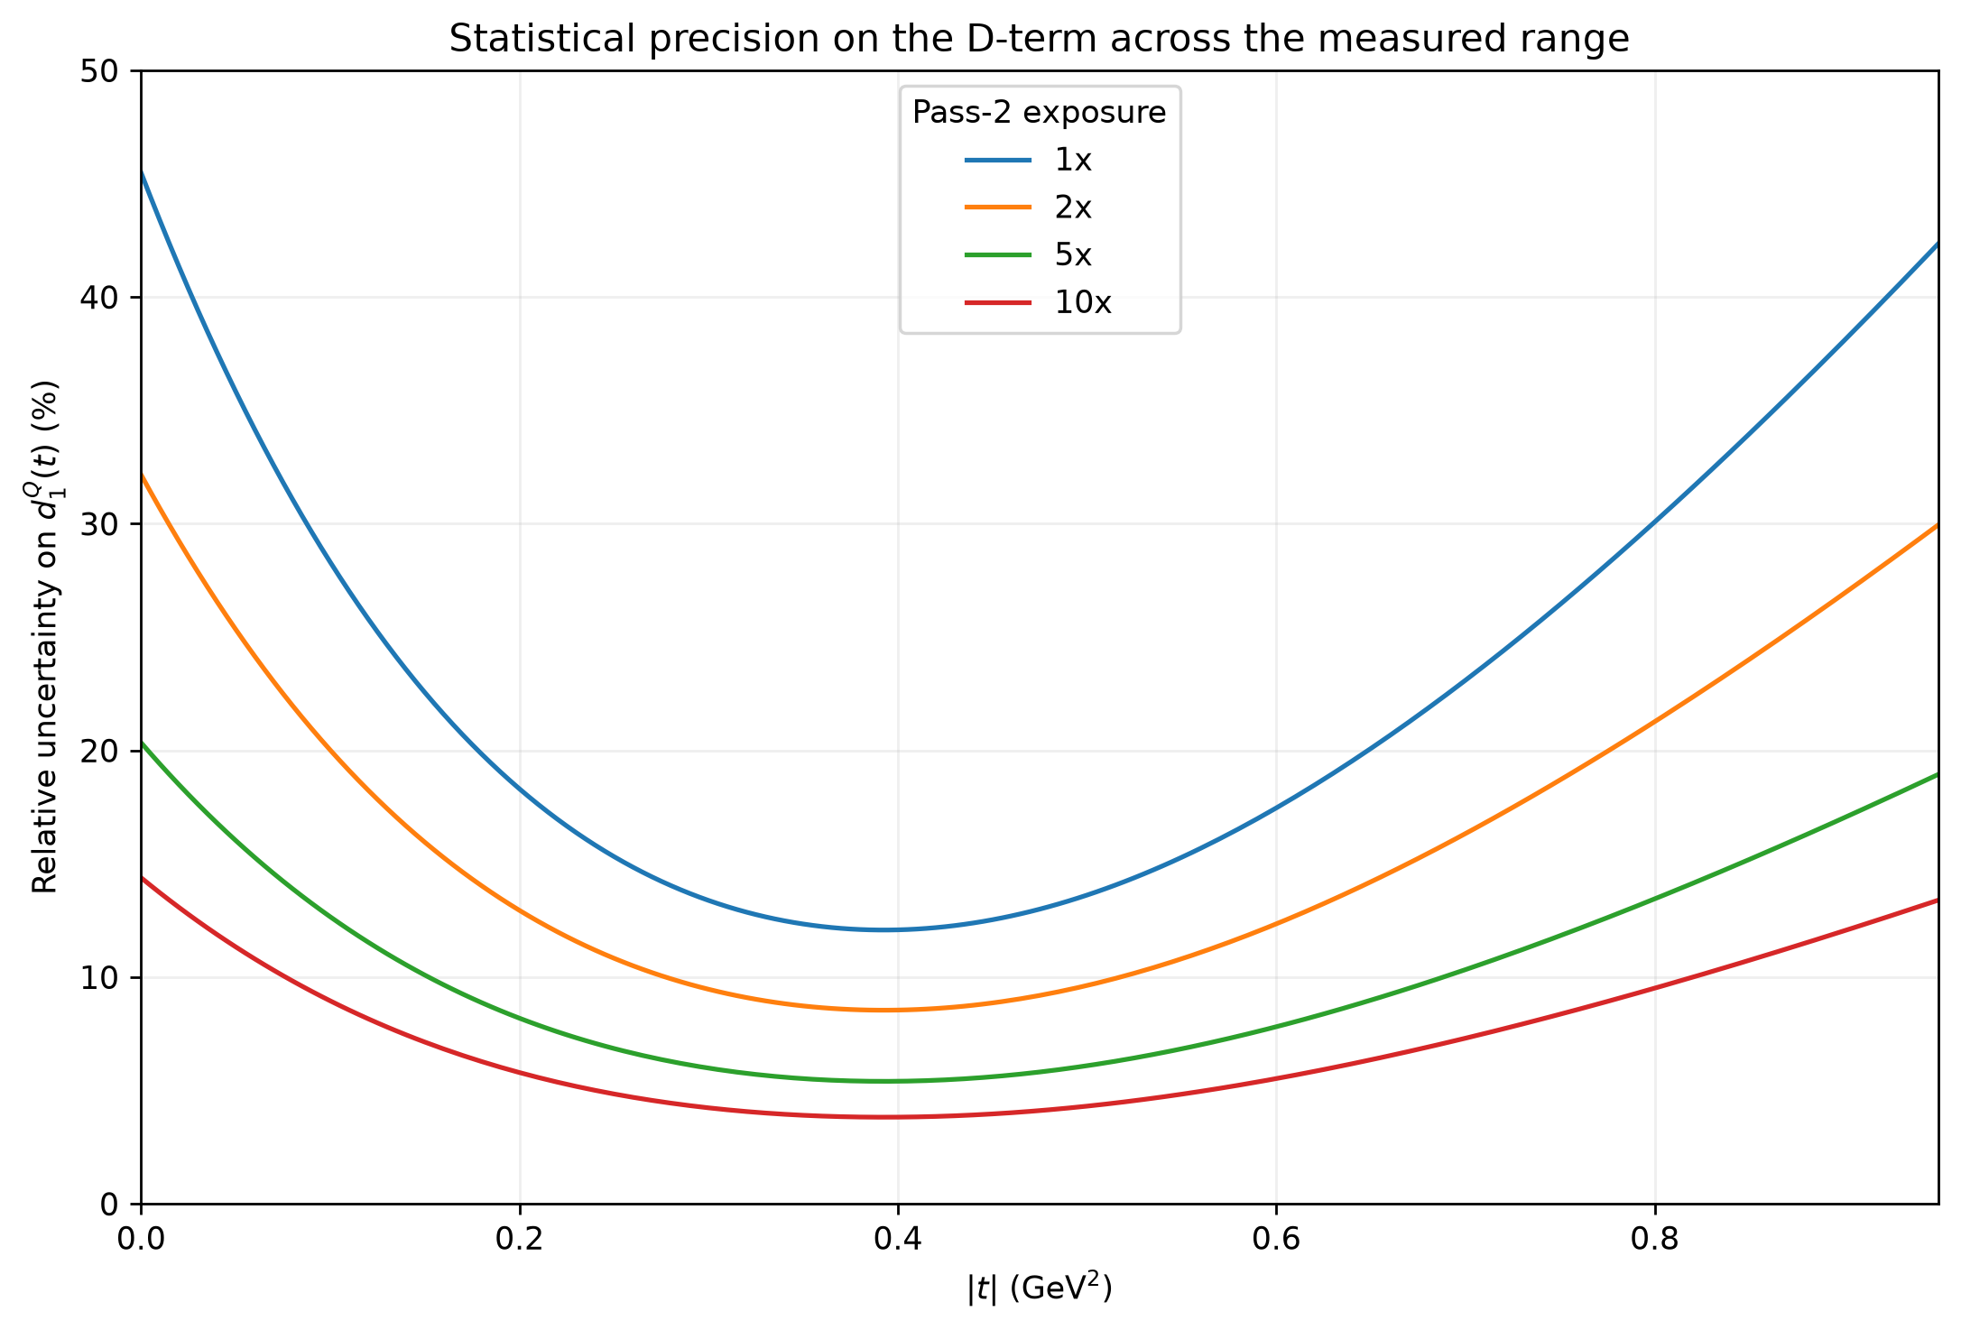
From DVCS to pressure: what luminosity buys
DVCS Observables → CFFs → D(t) → p(r), s(r)
Distributions derived from model predictions with statistical uncertainties dictated by CLAS12 measurements.
PRELIMINARY
PRELIMINARY
More statistics constrain D(t) and lead to sharper determinations of the proton’s internal distributions.

Slide 7
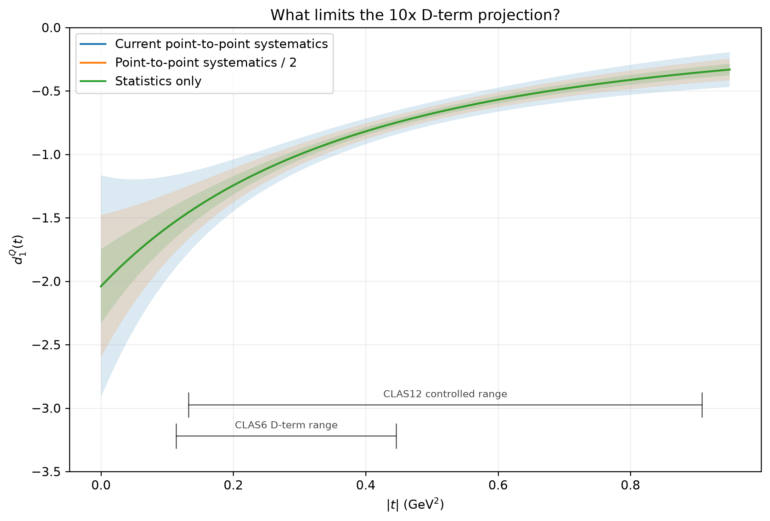
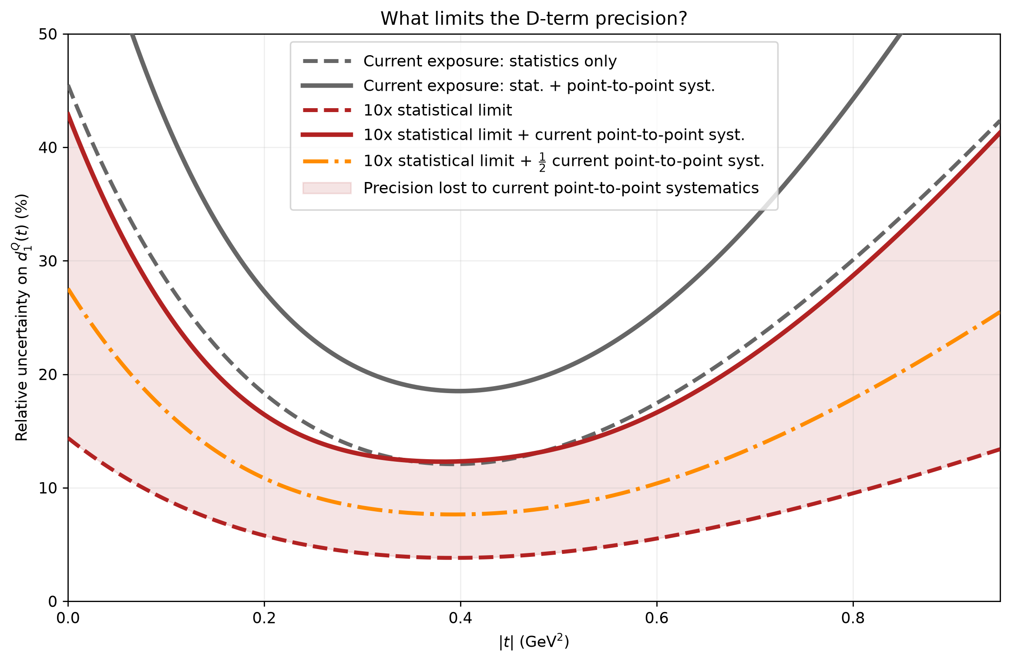
But Luminosity Alone is Not Enough
At high exposure, point-to-point systematics become the floor.
PRELIMINARY
PRELIMINARY
Current CLAS12 DVCS measurements have σ_{stat} ~ σ_{sys}. Future measurements quickly become systematics limited.
Systematic improvement is attainable: acceptance, π⁰ background subtraction, efficiencies (statistics limited!) etc.

Slide 8
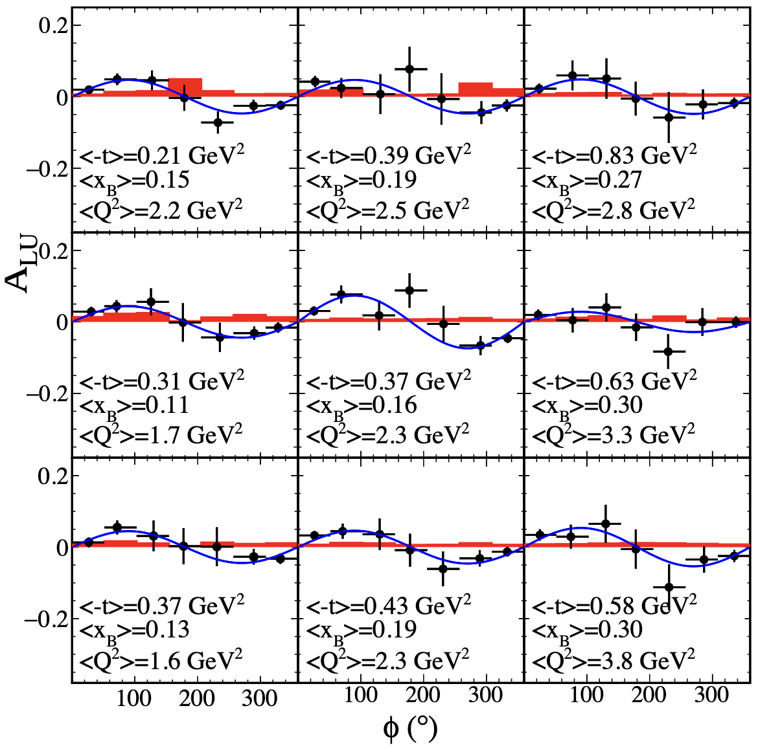
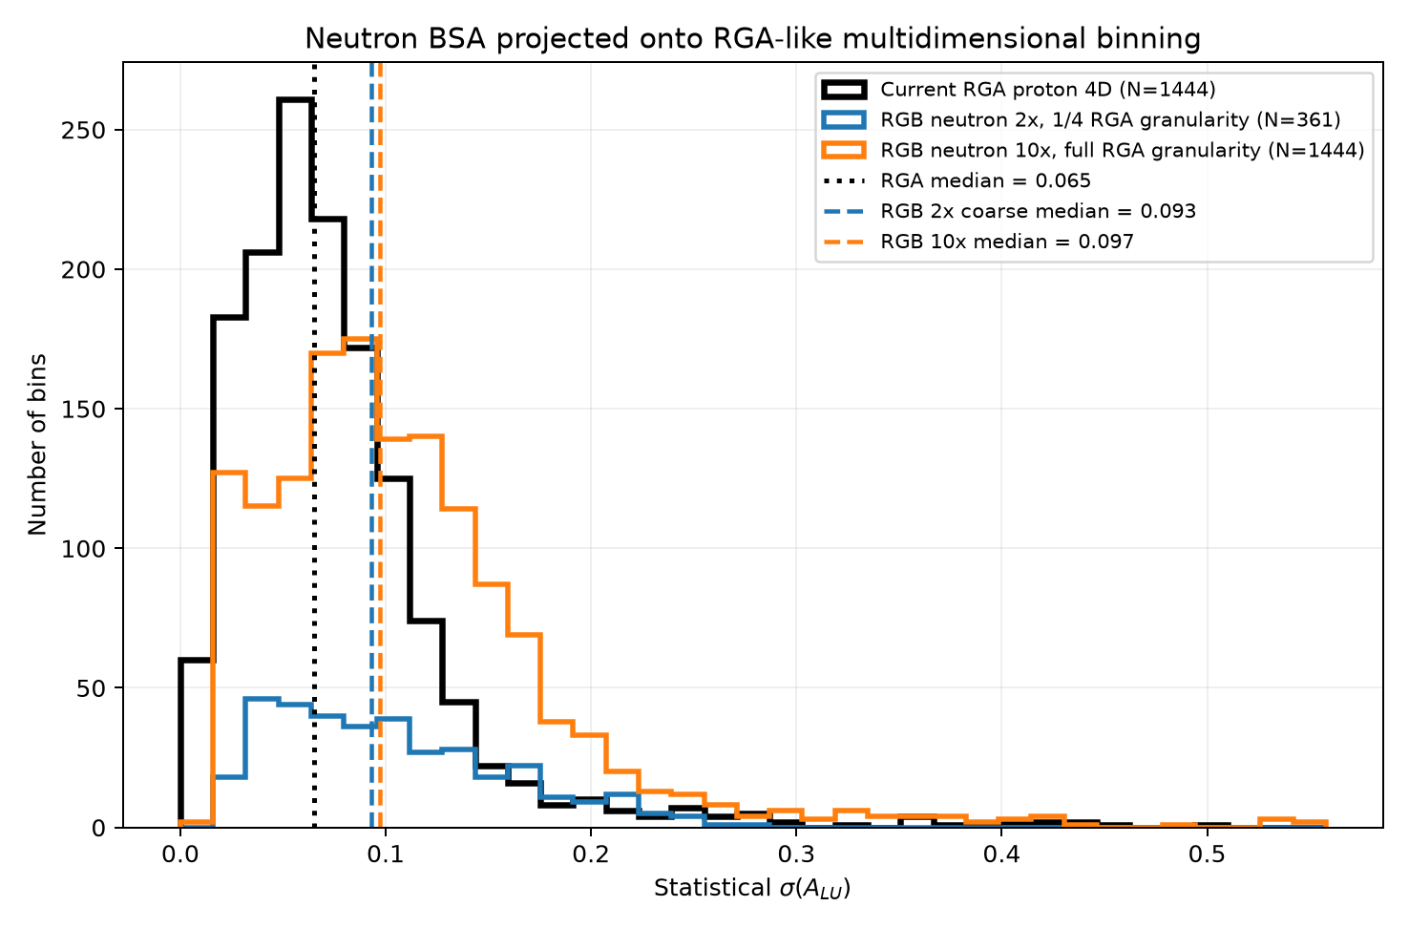
Unpolarized nDVCS
CLAS12 has published the first measurement of DVCS on the neutron with detection of the active neutron.
Current measurement limited to 1D binning in φ and either |t|, Q² or x_{B}.
Projecting onto the existing RGA 4D (Q², x_{B}, t, φ):
  10x statistics → median σ(A_{LU}) ~ 0.1, about 1.5x the current RGA 4-D precision
High luminosity could move nDVCS from 1-D projections toward precise multidimensional binning comparable with current pDVCS measurements.
Phys.Rev.Lett. 133 (2024) 21, 211903; 2406.15539
PRELIMINARY
8

Slide 9
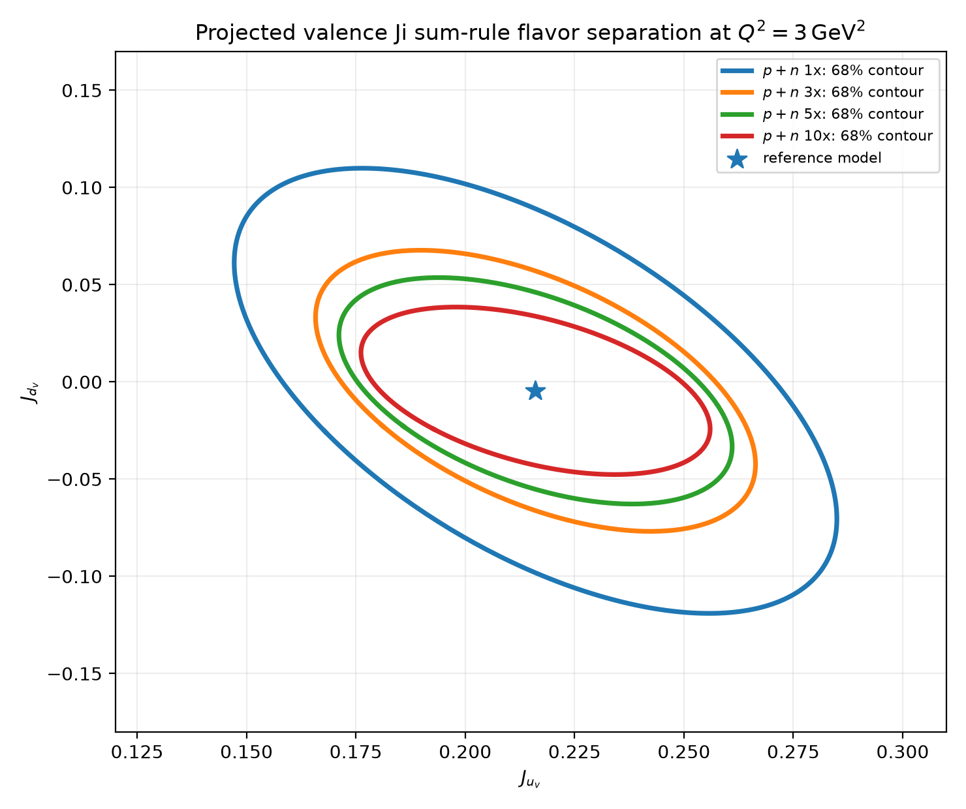
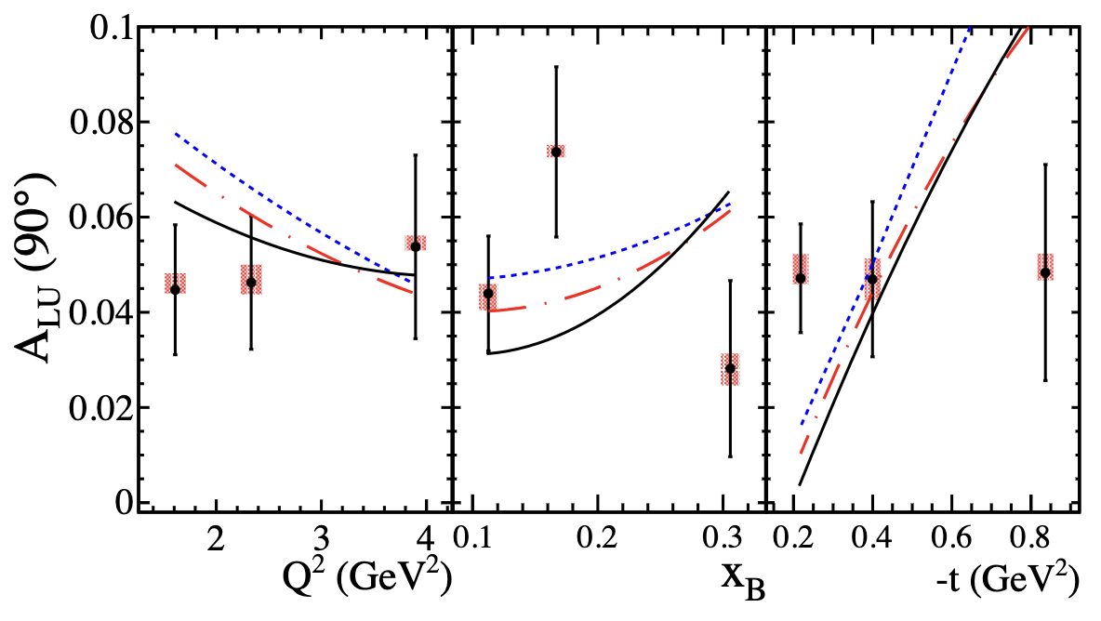
Flavor Separation and J_{q}
simplified DFJK-inspired valence-E parameterization
Proton + neutron DVCS provides complementary sensitivity to E^{u} and E^{d} enabling flavor separation through the Ji sum rule.
High precision substantially tightens the (model dependent, preliminary) flavor separated constraint, 1x → 5x: σ(J_{u}) = 0.045 → 0.030, σ(J_{d}) = 0.075 → 0.038.
Already with RGA+RGB alone projected precision approaches the scale of modern valence-GPD determinations and future EIC/EicC possibilities.
DVCS statistics constraint β_{u} and β_{d}
Phys.Rev.Lett. 133 (2024) 21, 211903; 2406.15539
PRELIMINARY
VGG model predictions for combinations of J_{u} and J_{d} yielding the best match to data.
J_{u} = 0.35, J_{d} = 0.05
J_{u} = -0.20, J_{d} = 0.15
J_{u} = -0.45, J_{d} = 0.20
Synthetic central value; not extraction of data.
9

Slide 10
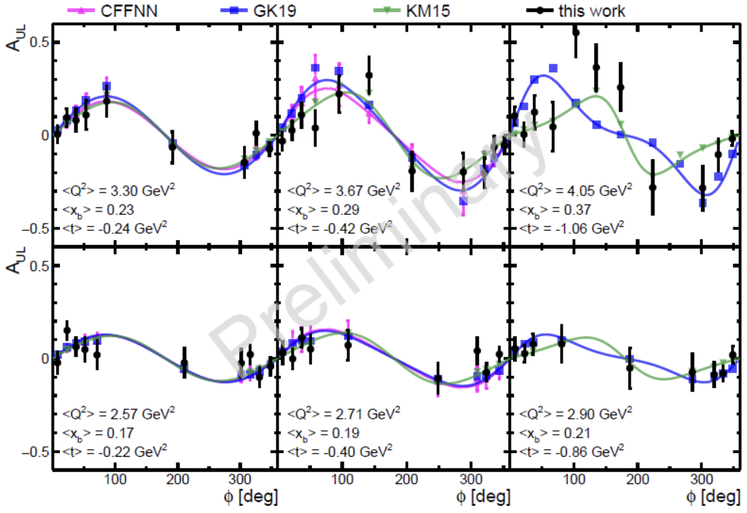
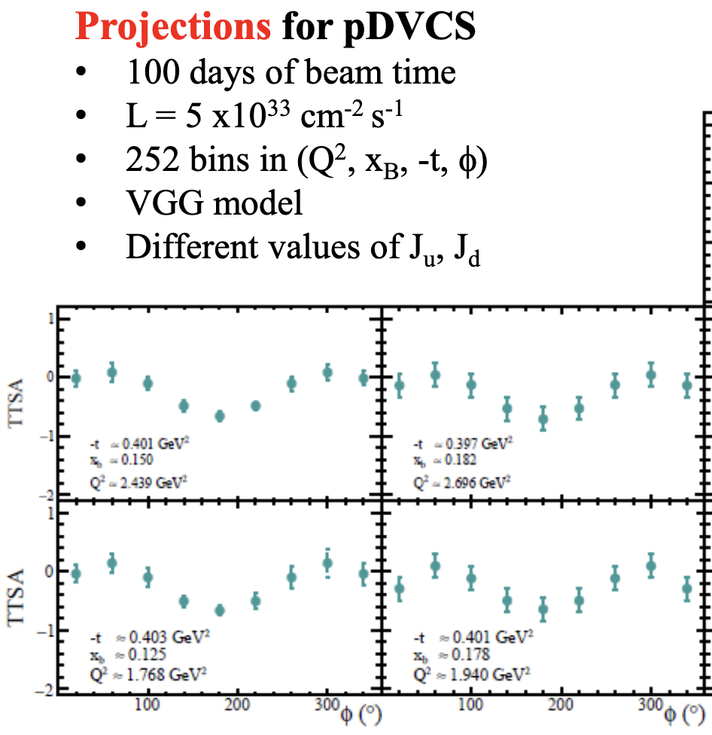
Polarized DVCS: Longitudinal RGC + Transverse RGH
RGC: longitudinal target — A_{UL} and A_{LL}
RGH: transverse target — direct leverage on E
A_{ᵁᵀ} gives the key transverse-target constraint on GPD E.
The approved program is intrinsically 4-D in x_{B}, Q², t and φ.
RGC + RGH provide complementary CFF combinations rather than redundant asymmetries.
RGC nDVCS: first neutron A_{UL}/A_{LL} (E sensitivity), but present statistics may be insufficient for a publishable multidimensional result.
First CLAS12 longitudinal-target pDVCS asymmetries; even the 1-D result remains statistics dominated.
N. Pilleux, Ph.D. thesis (2024), RGC p/nDVCS; E12-12-010 / RGH proposal, Fig. 19.
S. Polcher Rafael, PoS(QNP2024)070 (1-D A_{UL})
pDVCS + nDVCS, longitudinal + transverse spin → substantially stronger H, E, H̃, Ẽ constraints and flavor separation.
10

Slide 11
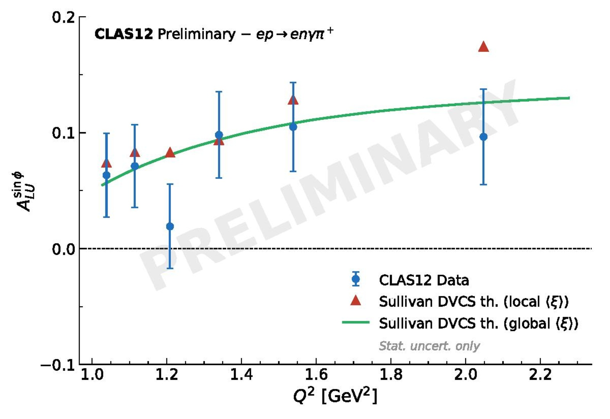
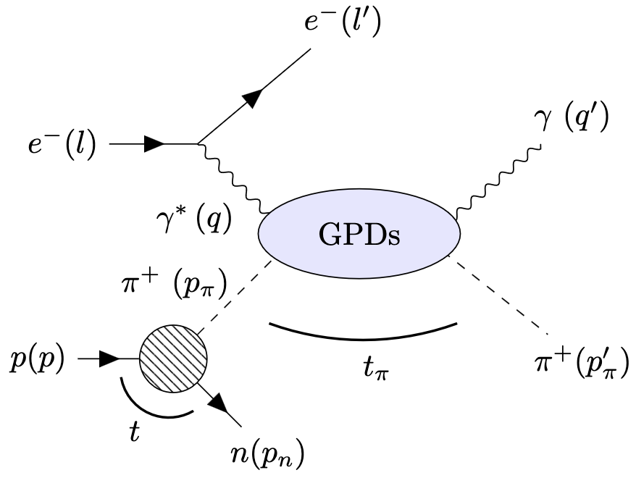
Pion GPDs through Sullivan DVCS
Sullivan DVCS Mechanism
CLAS12 Preliminary Result
Why high luminosity?
No free pion target → use the pion cloud (p → n + π⁺).
Near the pion pole (small –t): access to pion GPDs and 3D partonic structure.
Pion is spin-0 → simple GPD structure.
Work by Elouan Ferrand
Sullivan DVCS cross section << proton DVCS cross section.
Exclusive four-body final state (e’,γ,π⁺,n).
Current result is largely kinematically integrated, ~30,000 events.
Accessing pion GPDs will require differential measurements.
Increased precision may enable detailed pion tomography!
(preliminary)
Measurement using only a subset of unpolarized H₂ data. Strongly prefers “outbending” torus configuration.

Slide 12
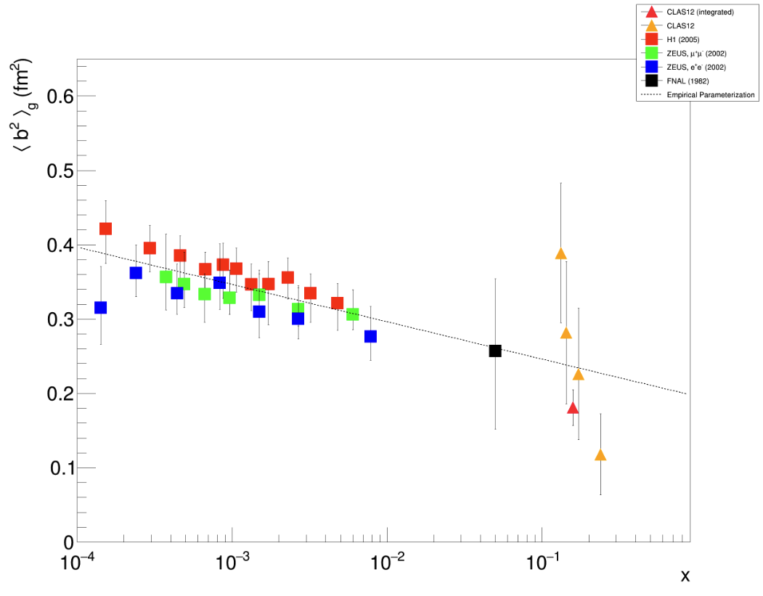
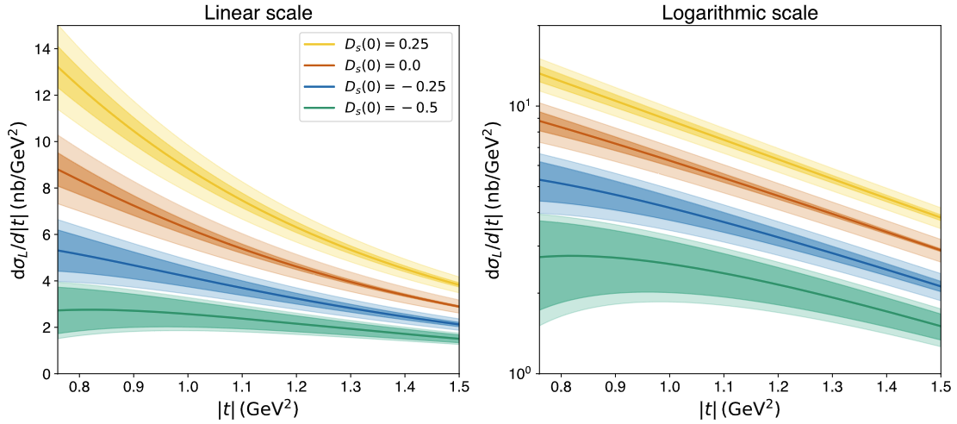
Exclusive φ Production: Gluon and Mechanical Structure
RGA: gluon imaging in the valence region
High-luminosity opportunity: strange D-term
PRELIMINARY
Near-threshold φ: Dₛ(t) changes the low-|t| shape.
Narrow Q², W and t selections make this intrinsically statistics hungry.
Original analysis used ~½ of collected RGA; current reconstruction should already provide a much larger baseline.
See Bhawani and Henry’s talks.
t-slope → transverse gluon distribution; first valence-region gluonic-radius extraction
Hall C E12-25-007 proposal, Fig. 4 (strangeness D-term sensitivity).
P. Moran, MIT Ph.D. thesis (2025), Fig. 5.18;
High luminosity converts an established gluon-imaging channel into a possible flavor-resolved mechanical-structure measurement.
12

Slide 13
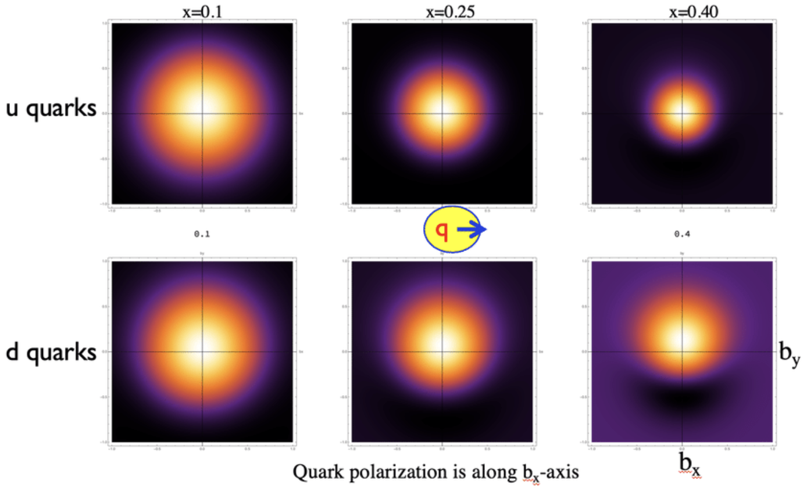
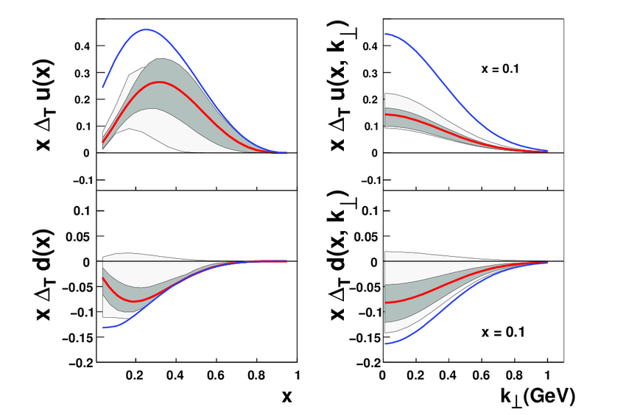
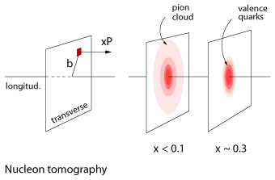
Nucleon Structure through (Chiral Odd) Generalized Parton Distributions
Chiral odd GPDs encode how transversely polarized quark spins are distributed in position and momentum inside the nucleon and can be directly linked to the nucleon tensor charge and transverse-spin structure.
Less experimentally constrained than chiral-even counterparts.
Only appear when the hard scattering amplitude contains a chiral-odd partner (twist-3 meson distribution amplitude, transverse meson exchange, etc.)
Transversity Tomography
Flavor Separation
Pion Cloud and Chiral Symmetry
V. Kubarovsky, IWHSS/QCD-N 2025 (2025).
Access to transversity/tensor charge
Tensor charge is a key constraint in BSM searches (e.g. β decay, supersymmetry, leptoquarks etc.)
H. Gao, The European Physics Journal, Vol 126, 2 (2011).
Access to the pion cloud through the pion pole term;
Dependent on the pion-nucleon coupling and long-range structure of the nucleon (flavor asymmetry, nucleon charge radius, axial structure)
13

Slide 14
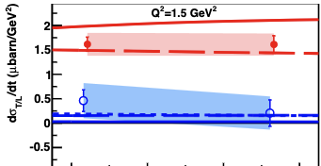


σ_{L}/σ_{T} in Pseudoscalar Mesons
Published π⁰ Rosenbluth separation
Why separate L and T?
Hall A E07-007: x_{B} = 0.36, Q² = 1.5–2.0 GeV²
σ_{T} dominates, σ_{L} → far from the asymptotic longitudinal regime.
Nonzero σ_{LT} still signals a longitudinal amplitude and transverse–longitudinal interference.
• Collinear leading-twist DVMP factorization applies to longitudinal photons.
• At JLab kinematics, π⁰ data instead show strong transverse-photon dominance.
• That transverse strength is precisely what makes pseudoscalar DVMP sensitive to chiral-odd / transversity GPDs.
M. Defurne et al., Phys. Rev. Lett. 117, 262001 (2016)
σ_{U}(ε) = σ_{T} + ε σ_{L} → σ_{L} is the slope in ε
The experimental opportunity: RGA (10.2, 10.6 GeV) + RGK (6.5, 7.5, 8.5 GeV) provide a large ε lever arm at matched kinematics.
14
Context: CLAS6 π⁰ measurements also require large transverse contributions; I. Bedlinskiy et al., Phys. Rev. C 90, 025205 (2014).

Slide 15
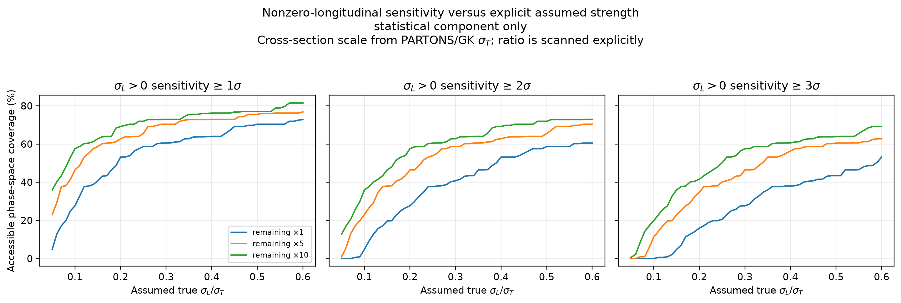
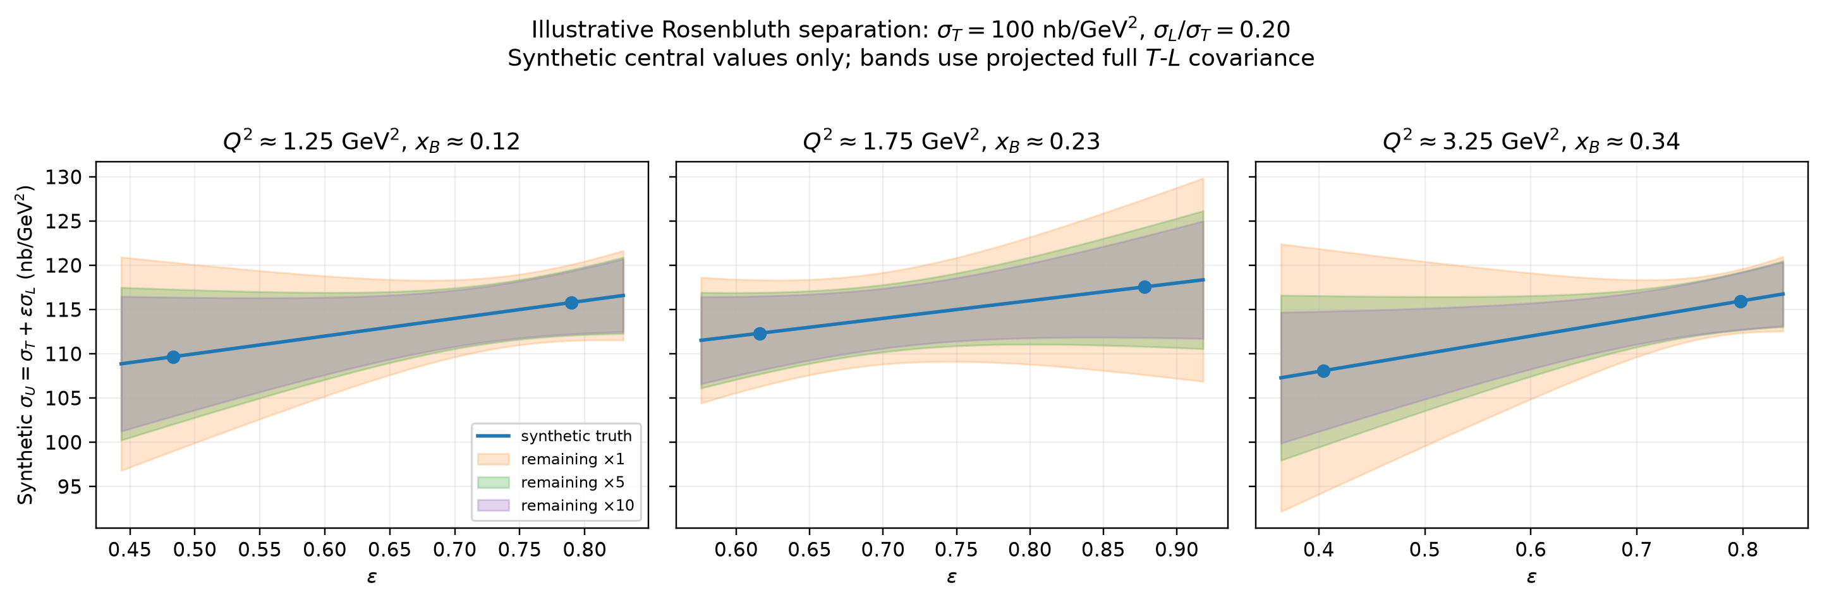
Statistical Reach of CLAS12 for π⁰
Simplified L/T separation sensitivity test:
  Start from the existing RGA (10.6 GeV) and RGK (6.5 GeV) cross-section uncertainties in matched (Q²,x_{B},t,φ) bins; project the remaining running at 1x, 5x, 10x the present effective statistical yield.
  Fit the two beam energies simultaneously to σ_{U}=σ_{T}+ εσ_{L} (together with the measured φ harmonics), then propagate the full T–L covariance to δ (σ_{L}/σ_{T}).
PRELIMINARY
PRELIMINARY
(synthetic central values shown)
Statistics-only projection: higher effective yield converts the RGA–RGK ε lever arm into broad sensitivity to nonzero σ_{L}.
15
Assumed L/T is scanned explicitly; PARTONS/GK σT is used only to set the absolute cross-section scale for significance.

Slide 16
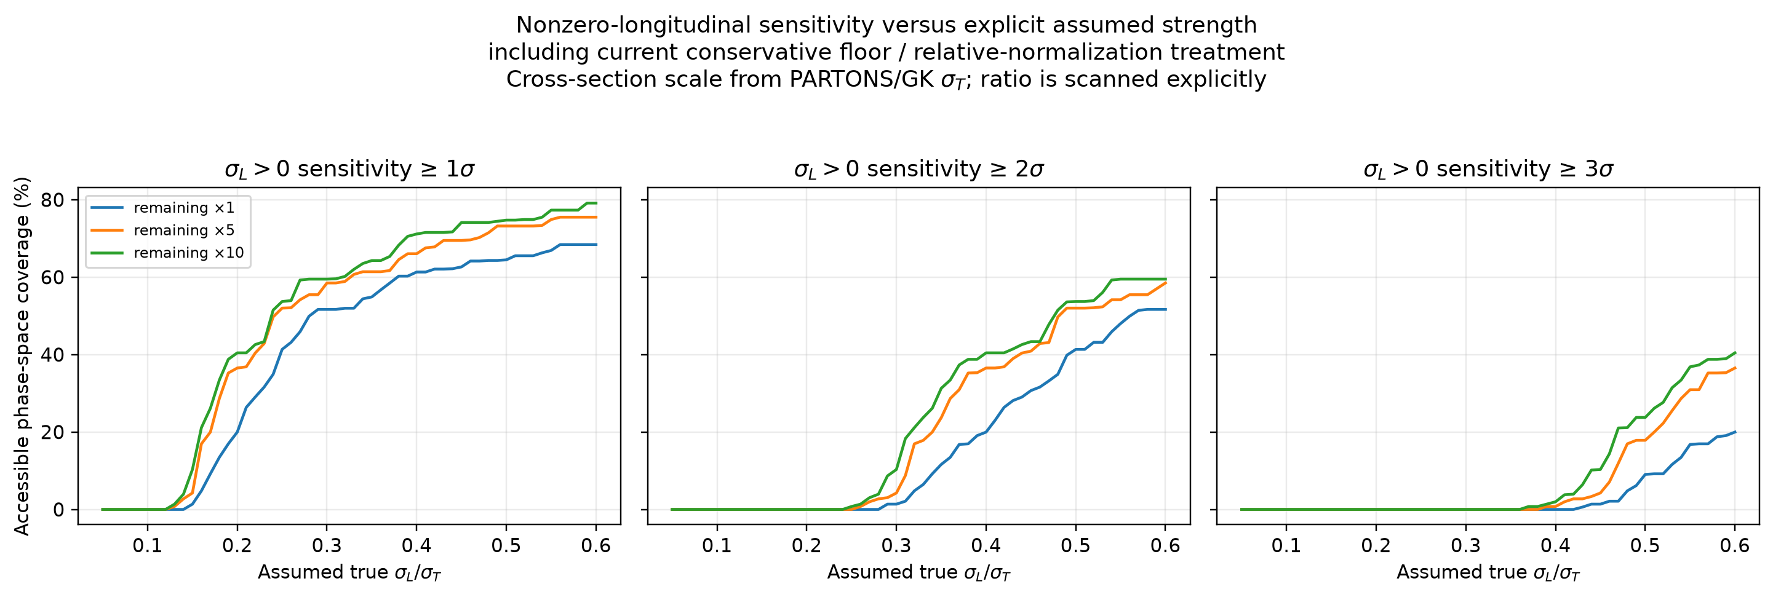
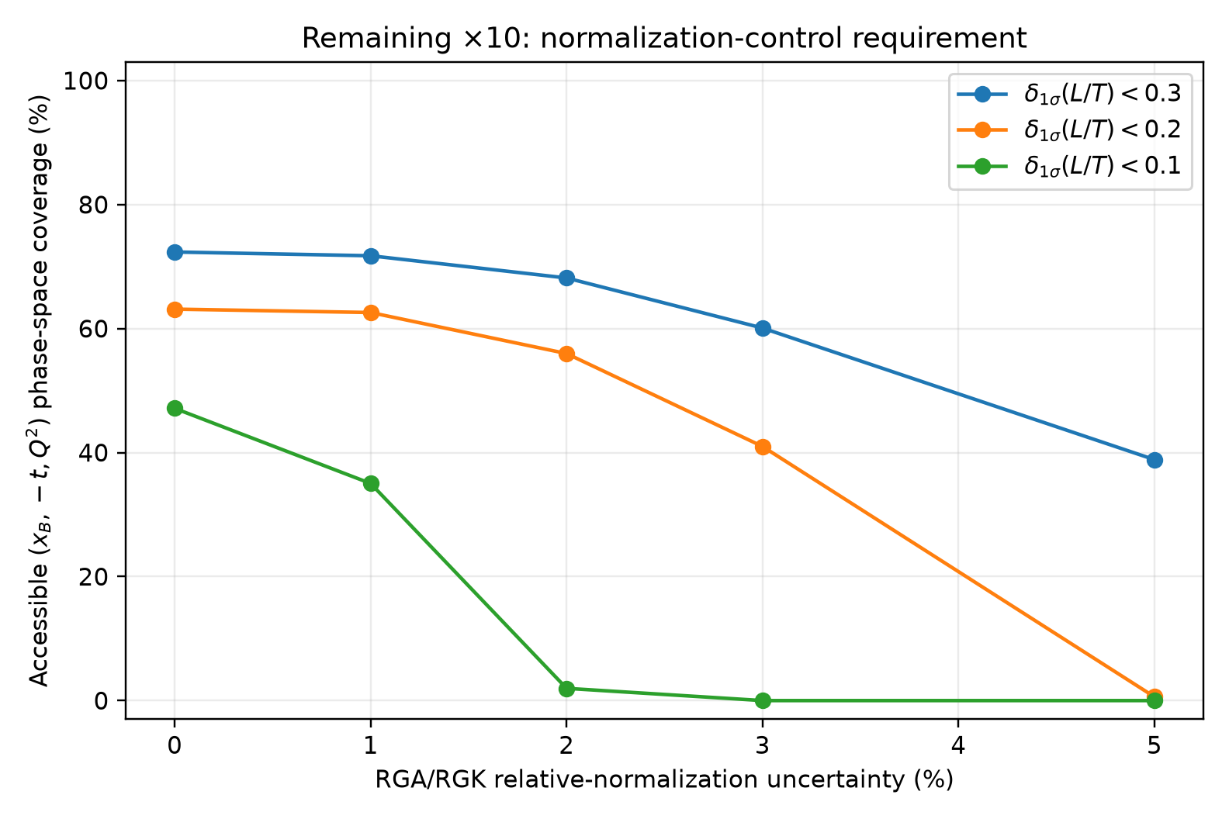
Relative Normalization Requirement
But Rosenbluth separation is a difference of absolute cross sections: relative normalization between beam-energy data sets directly limits σ_{L}.
PRELIMINARY
PRELIMINARY
1% normalization: much of the statistical reach is retained.
2-3% normalization: the aggressive δ(L/T) < 0.1 reach is largely lost.
5% normalization: even δ(L/T) < 0.2 becomes limited.
16

Slide 17
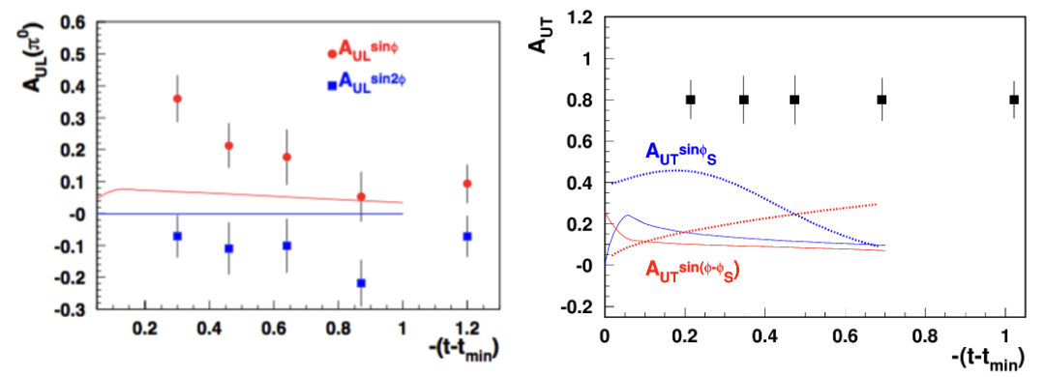
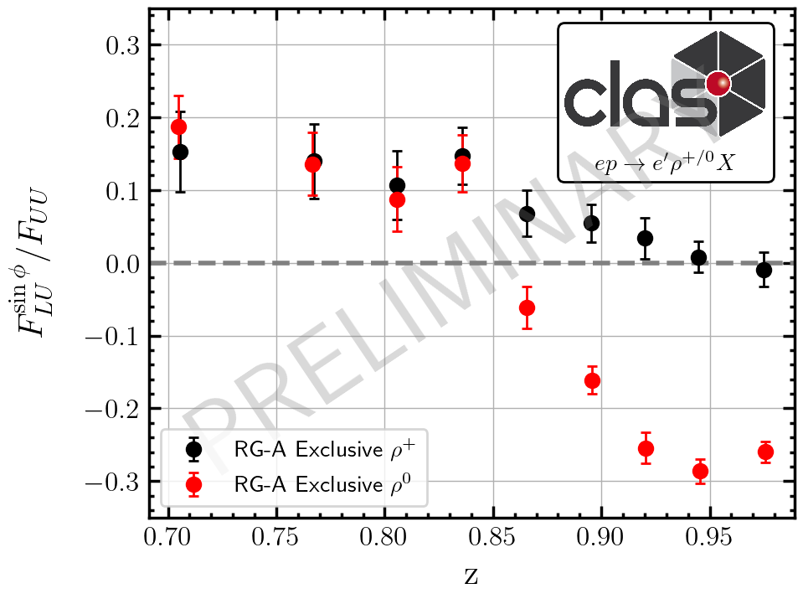
Exclusive π⁰ and ρ⁰: Completing the Polarized DVMP Program
π⁰: RGC longitudinal data → RGH transverse-target projection
ρ⁰: do not leave the vector channel behind
Longitudinal ρ⁰ production gives access to H and E; transverse-target A_{ᵁᵀ} is particularly valuable for E.
RGC already provides the empirical baseline used for the RGH ρ⁰ projections.
ρ⁰ is a crucial physics background for all kinds of SIDIS measurements and interpretations!
Preliminary
G. Matousek (Duke)
& N. Trotta (UCONN)
π⁰ provides access to the chiral-odd/transversity sector, including H_{T} and Ē_{T}.
Longitudinal and transverse target asymmetries provide complementary interference combinations.
High-luminosity unpolarized LH₂ data should supply the precision cross-section baseline.
RGH Run-Group Addition E12-11-111A (2025), especially Fig. 13 for π⁰ and Sec. 2.1 / Fig. 9 for exclusive ρ⁰.
High-L unpolarized cross sections + RGC longitudinal spin + RGH transverse spin = a much more complete meson-GPD program.
17

Slide 18
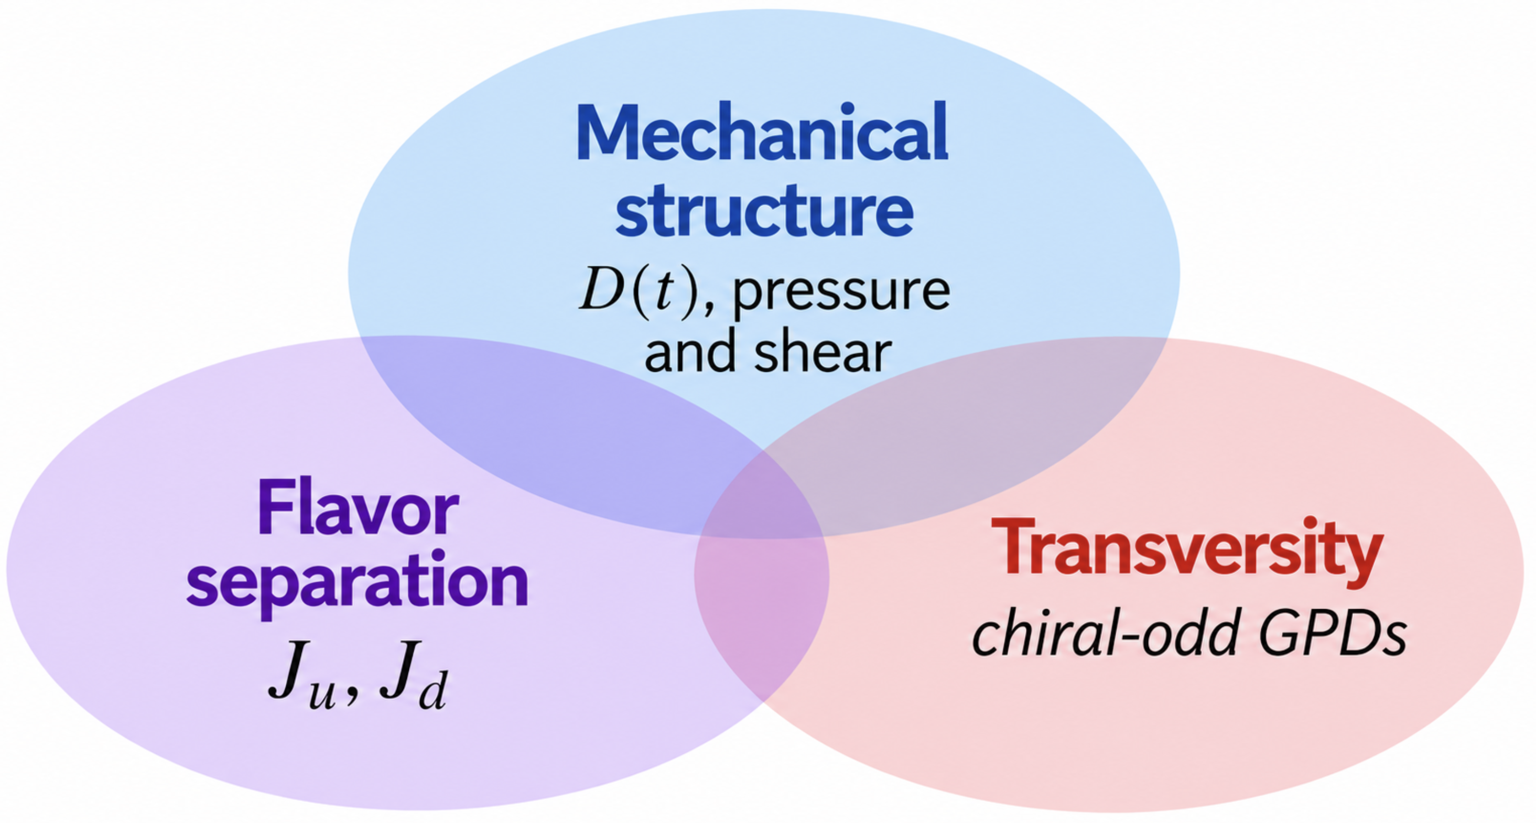
Conclusions
High luminosity enables precision measurements.
A broader and more complete picture of the nucleon.
Extends DVCS further into the high-Q², large |t| region needed to constrain the D-term and improve understanding of mechanical structure.
Moves neutron and polarized DVCS/DVMP toward genuinely multidimensional measurements that are currently out of reach.
Enables precision L/T separated DVMP measurements in both the chiral-odd and chiral-even sectors.
Luminosity alone is not enough!
As statistical precision improves, the limiting uncertainty shifts from event yield to experimental control.
Realizing the full physics potential in the GPD sector from increased luminosity would require improved control of the normalization and point-to-point systematics.
18

Slide 19
Ancillary Slides

Slide 20
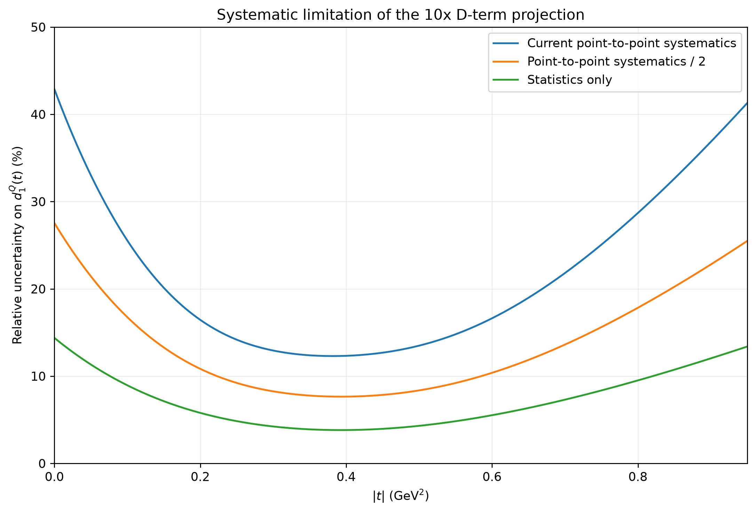
What controls the mechanical-structure precision?
Pressure and shear are derived quantities: they amplify uncertainty in the shape of D(t), not just its overall normalization.
Need simultaneously: t lever arm + statistical precision + controlled point-to-point systematics
This is why a luminosity upgrade is most valuable when paired with analysis improvements that reduce the present RGA/RGB systematic floor.

Slide 21
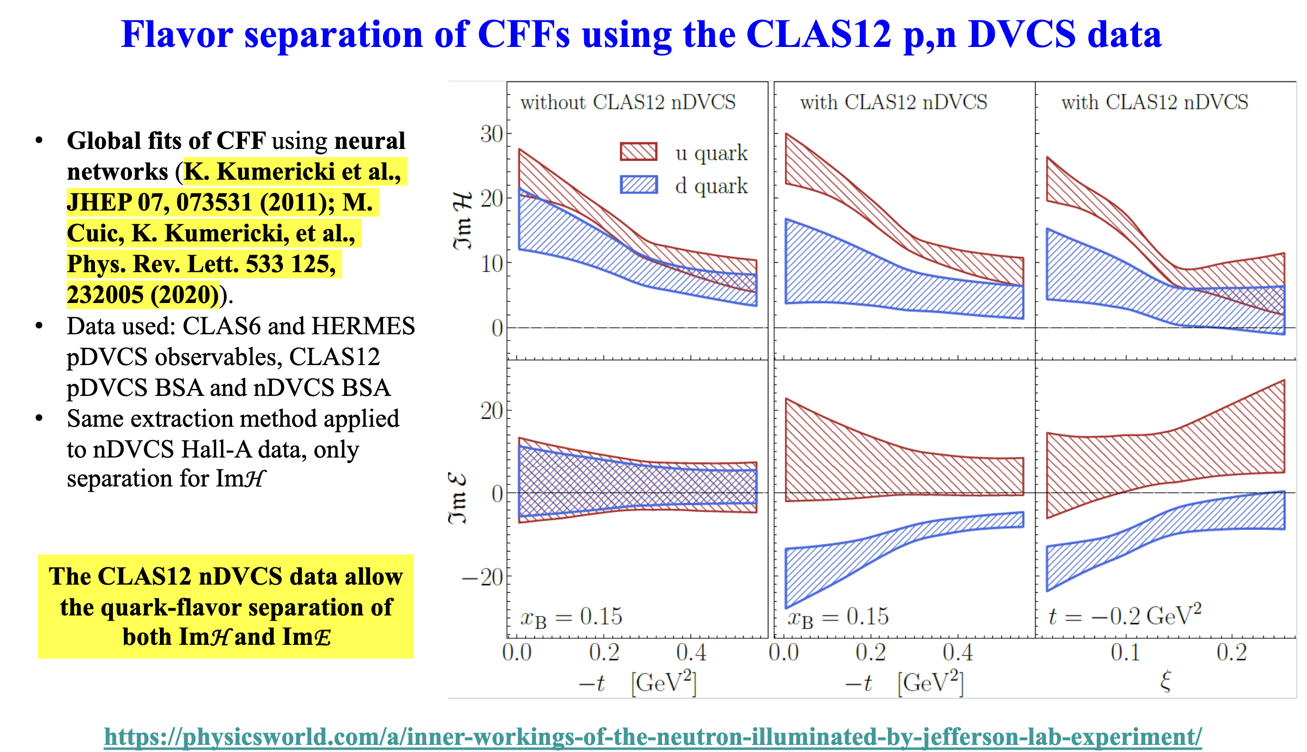
(Slide from S. Niccolai)

Slide 22
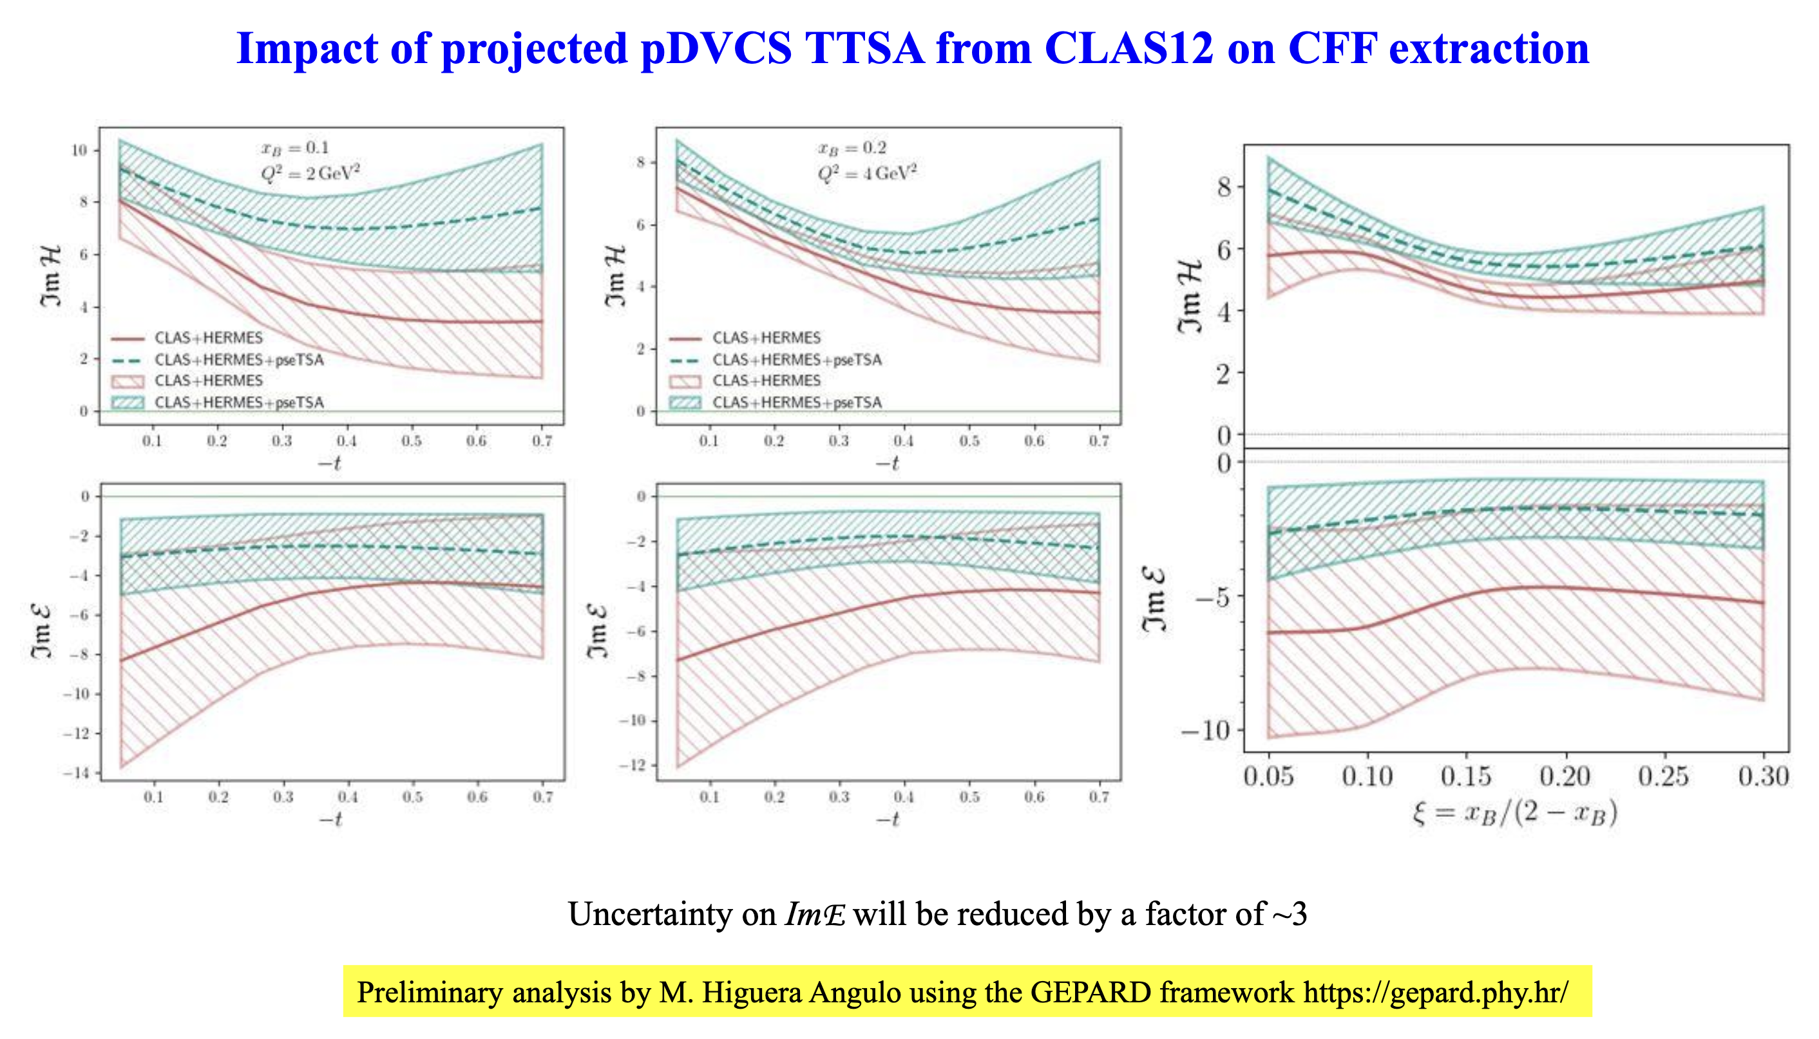
(Slide from S. Niccolai)

Slide 23
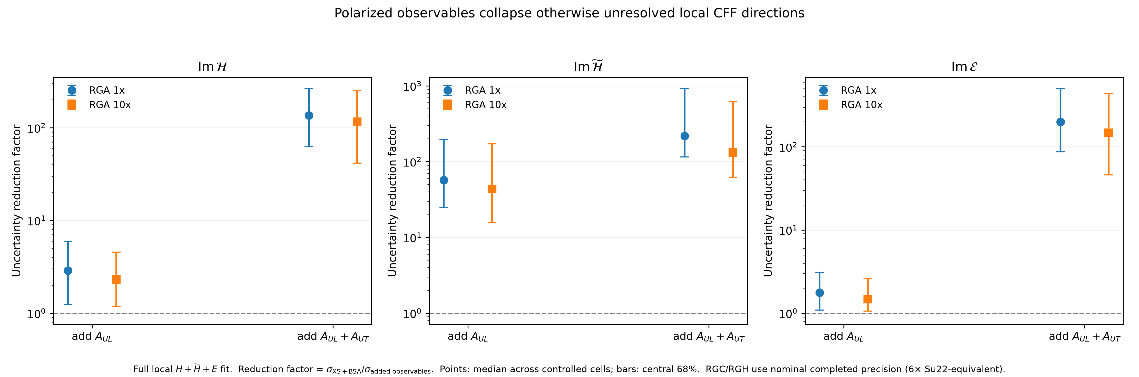
ImH and E?

Slide 24
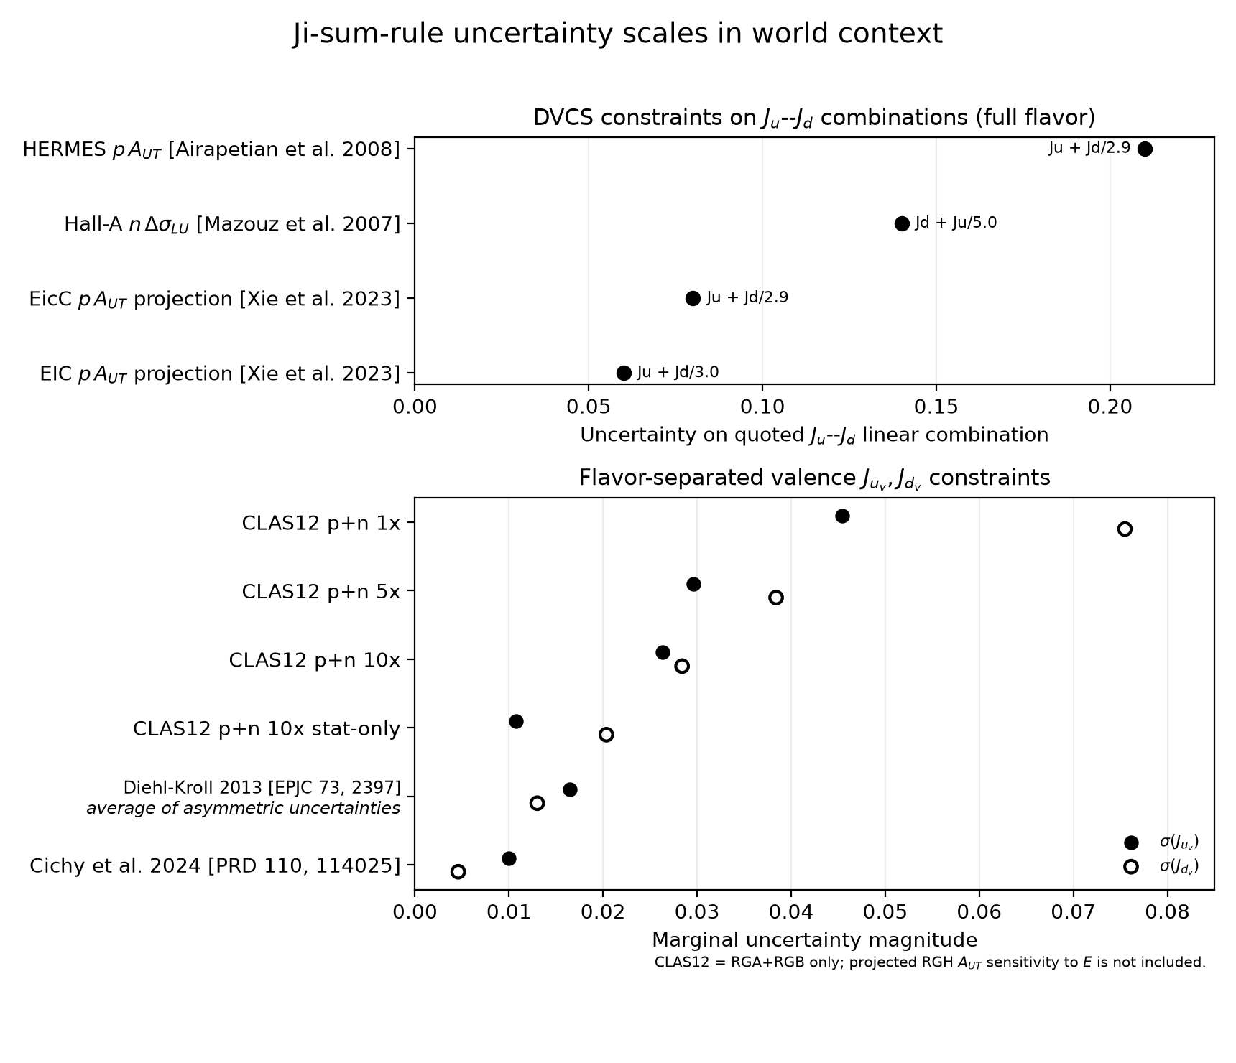
PRELIMINARY
PRELIMINARY
Synthetic central value; not extraction of data.

Slide 25
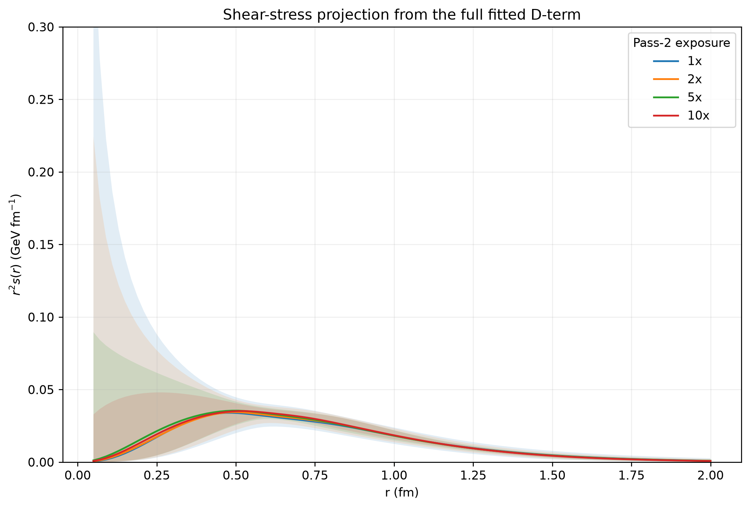
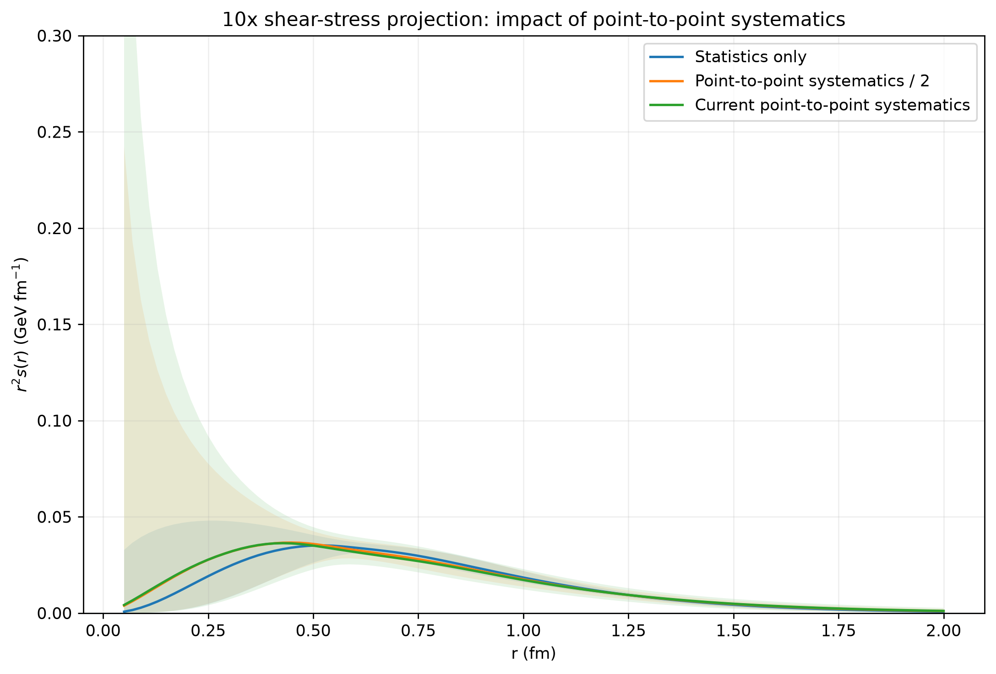
Shear forces: complementary mechanical information
The same fitted D-term also determines the shear-force distribution, providing an independent view of how internal stresses are spatially organized.
Pressure and shear are therefore not separate measurements: both test whether the extracted D(t) is sufficiently precise and stable for spatial interpretation.

Slide 26
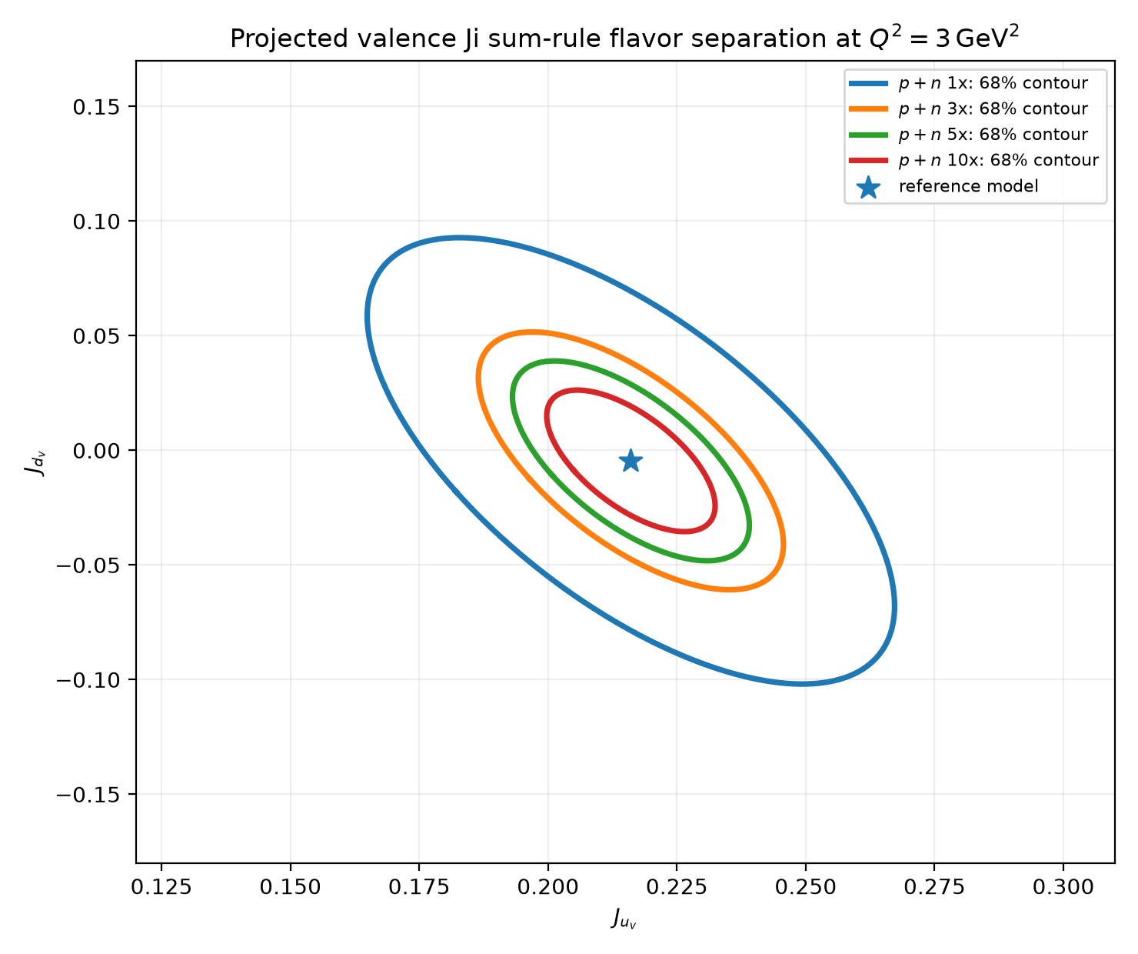
High luminosity only pays off if systematics follow
The same pattern appears in flavor-separated Ji constraints: statistics tighten the contours rapidly, while realistic systematics set the eventual precision floor.
Statistics Only
Statistics + Measured RGA/Projected RGB Systematics

Slide 27

CLAS12 Preliminary
Exclusive π⁺ production off a longitudinally polarized NH₃ target.
PRELIMINARY

Slide 28
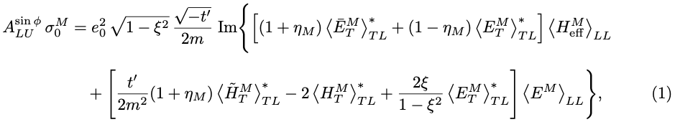
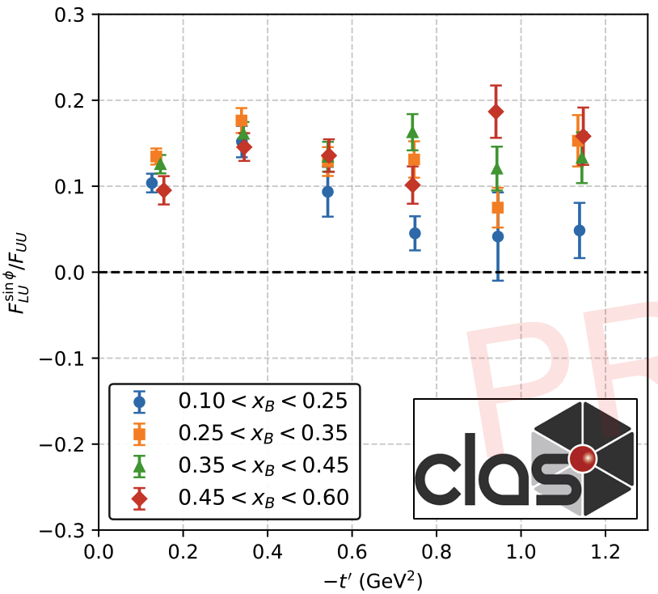
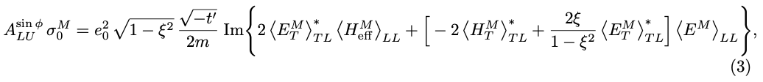
BSA
Goloskokov & Kroll, Eur. Phys. J. C 65 (2010) 137; [arXiv:0906.0460]
η_{M} = -1 for pseudoscalar mesons
3
1
4
3
2
Helicity-conserving longitudinal amplitude built primarily from , encodes the quark helicity transverse distribution
Nucleon helicity-flip longitudinal amplitude built from ; describes how axial charge (helicity density) is displaced when the nucleon flips its spin
Describes the transverse shift of quarks with a given transverse spin inside an unpolarized nucleon, analogous to sideways shift from Sivers
Generalized transversity GPD (reduces to h₁(x) in the forward limit), encodes information on the correlation between transversely-polarized quarks in a transversely-polarized nucleon
Notes:
HM~ is H~ convolved with hard kernel and meson DA; same structural role as H in DVCS
As
e.g. if one picks quarks with spin pointing along +x then the center of their impact-parameter distribution is shifted in the +y direction by a moment proportional to E_{T}(x,0,0);

Slide 29
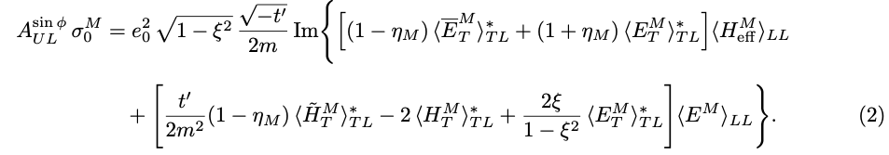
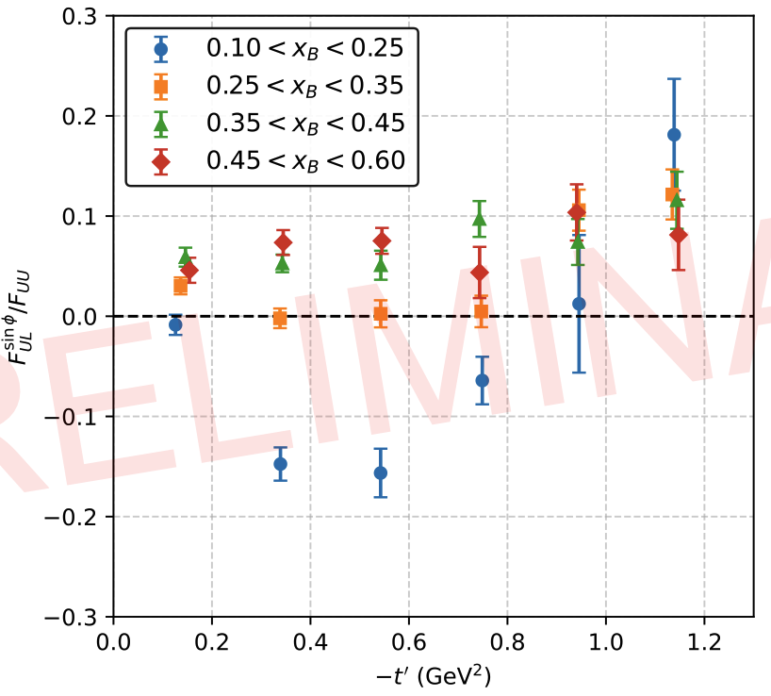
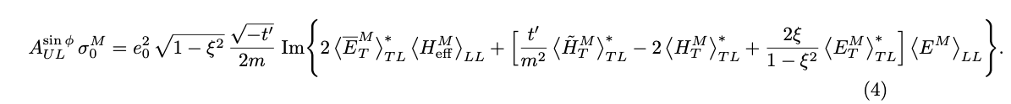
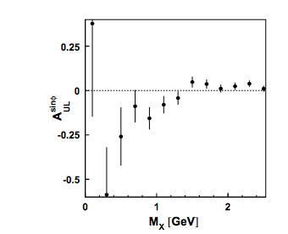
Twist-3 TSA
Goloskokov & Kroll, Eur. Phys. J. C 65 (2010) 137; [arXiv:0906.0460]
η_{M} = -1 for pseudoscalar mesons
6
1
5
4
3
2
5) Partner to H_{T}, akin to pretzelosity, associated with quadrupole deformation in the distribution of quark transverse spin when the nucleon is transversely polarized
6)

Slide 30


TT Interference
Goloskokov & Kroll, Eur. Phys. J. C 65 (2010) 137; [arXiv:0906.0460]
The sin2φ TSA is TT interference, built purely from chiral-odd GPDs (as opposed to the LT asymmetries being generated from interference between chiral-even and chiral-odd GPDs).
Clear nonzero asymmetry indicates nonzero chiral-odd GPDs. In particular:
First observation!
π⁺ accesses u-d isovector distribution
u and d quarks show opposite-signed quadrupole anisotropy in transverse spatial distributions
spatial distribution
longitudinal momentum

