Slide 1


Polarized SIDIS at CLAS12
Anselm Vossen
w/ input from
T. Hayward
H. Avakian
C. Dilks
N. Wickramaarachchi
A. Liu
Research Supported by

Slide 2
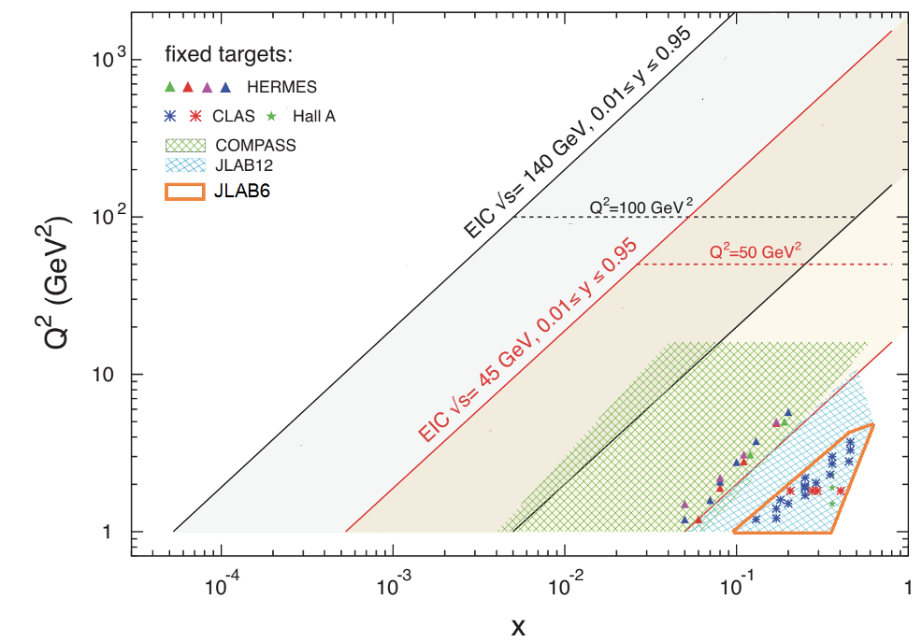
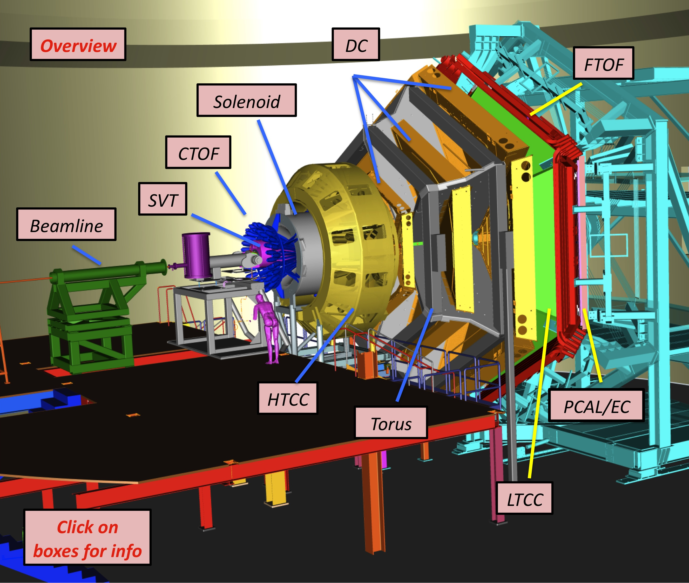
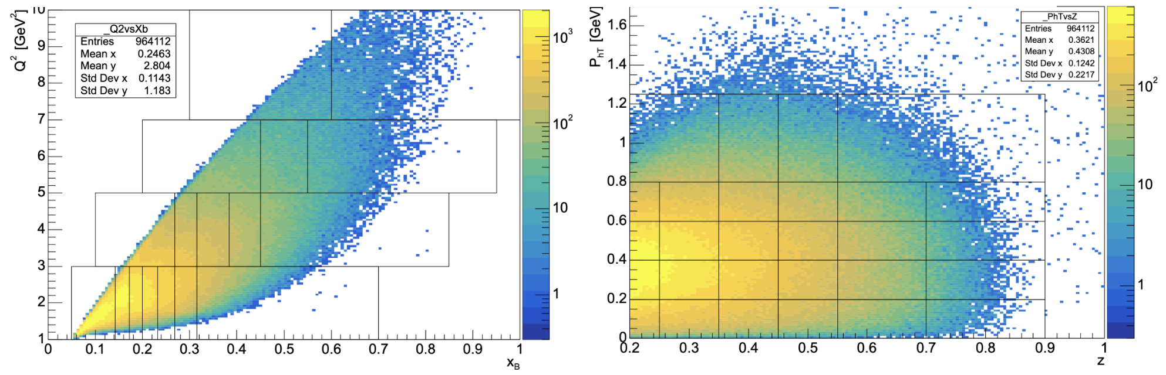




CLAS12 Spectrometer
CLAS12: high luminosity (10³⁴), wide acceptance, low Q² (higher twist measurements)
Began data taking in Spring 2018 – many “run periods” now available: liquid H₂, D₂, polarized NH₃ and ND₃ etc.
~10.5 GeV electron beam, longitudinally polarized beam.
$$Q^{2}$$
$$p_{T}$$
1.0
5.0
https://www.jlab.org/Hall-B/clas12-web/
0.5
$$x$$
$$z$$

Slide 3
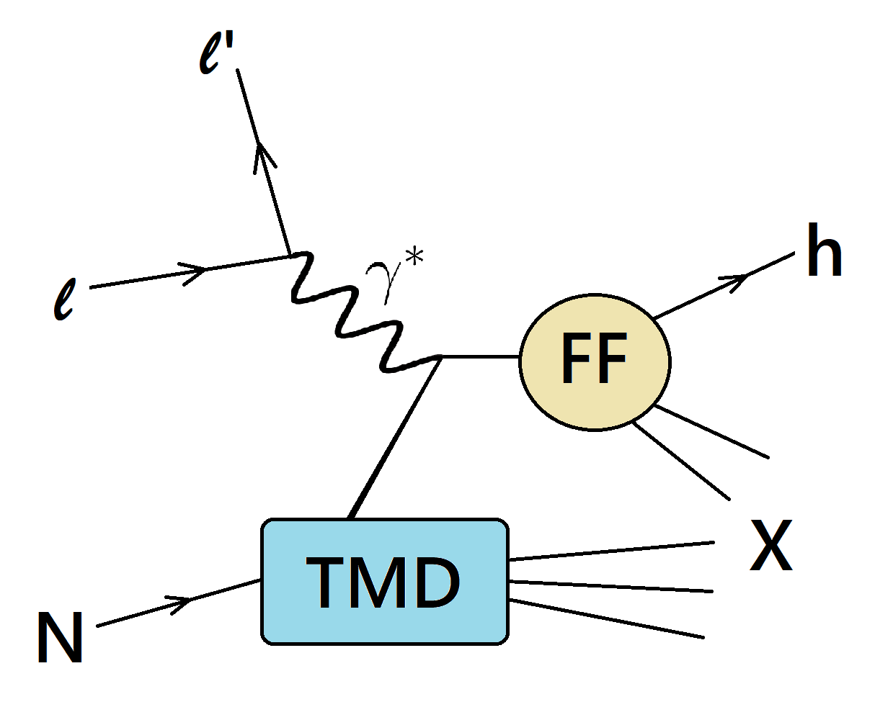
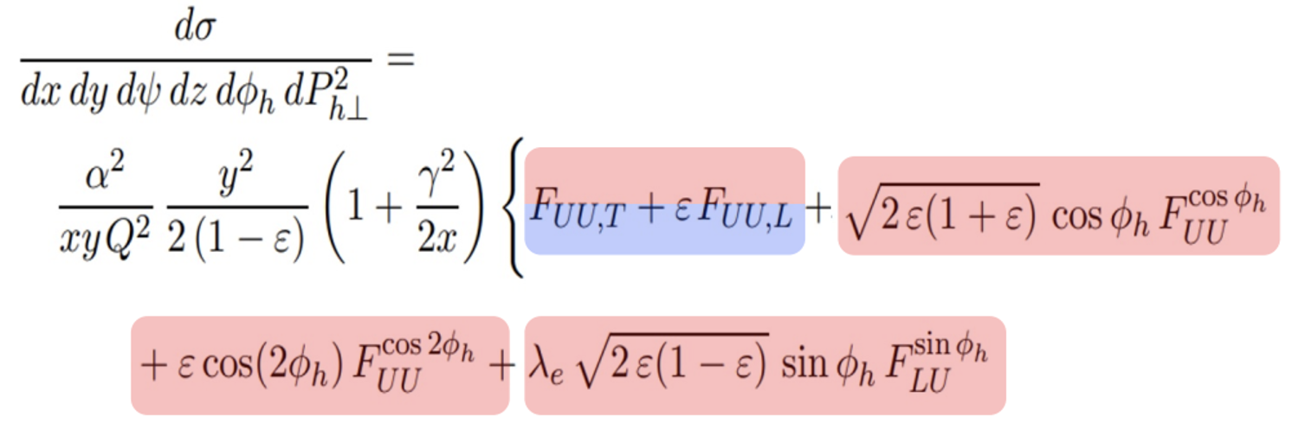
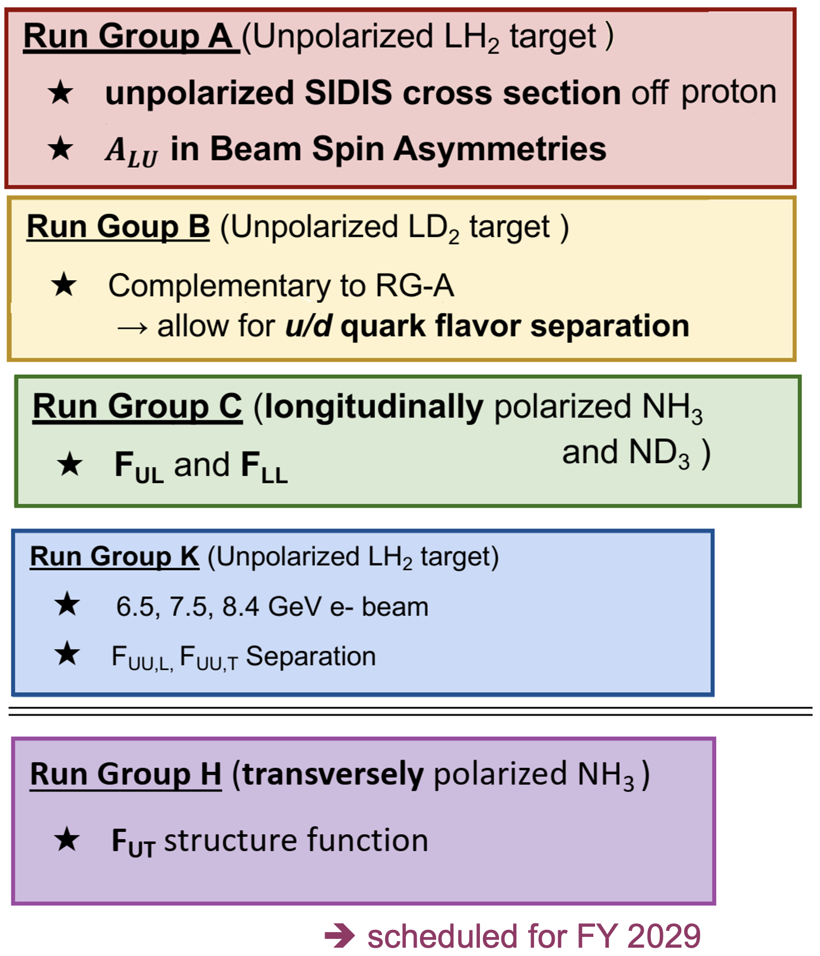
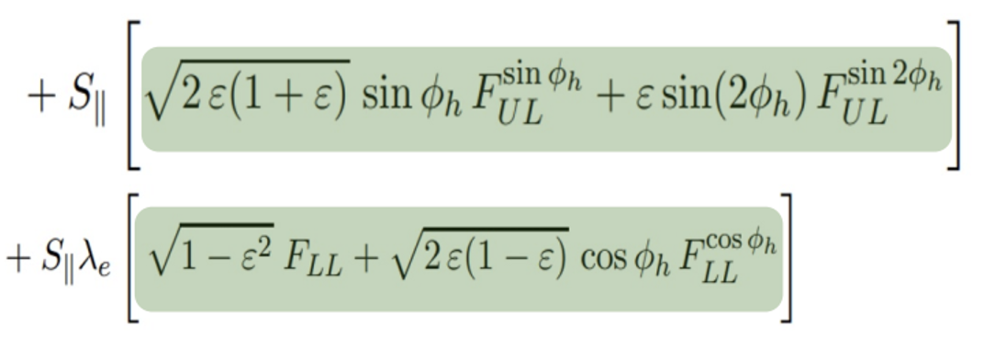
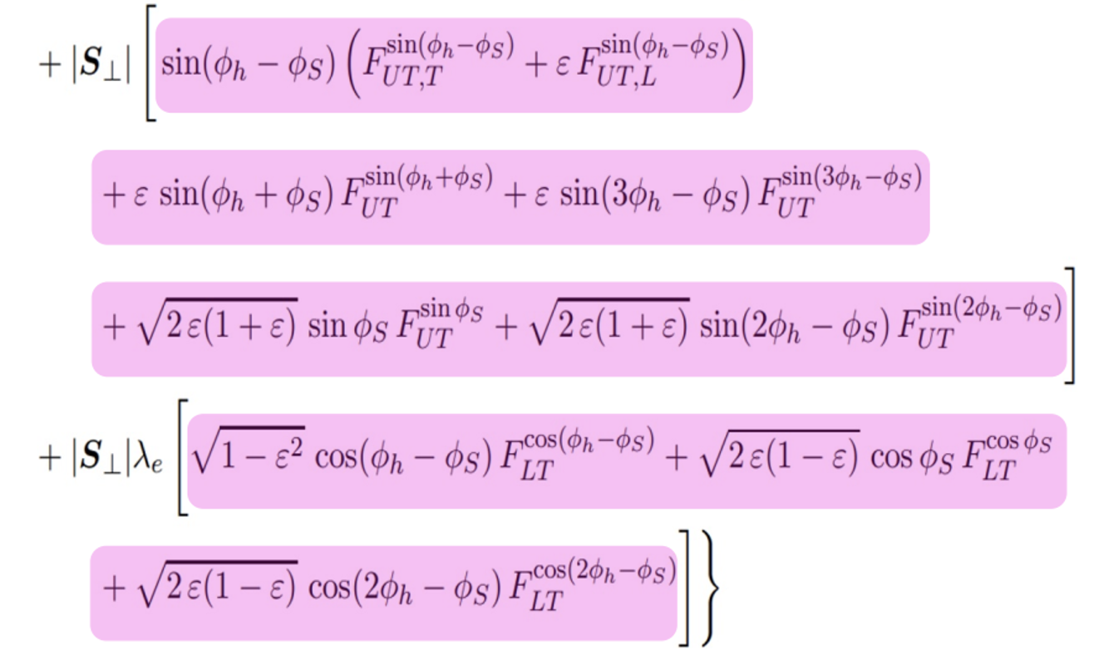
SIDIS Observables at CLAS12
The CLAS12 physics program will have access to the full SIDIS cross section including all observables in a variety of flavors.

Slide 4
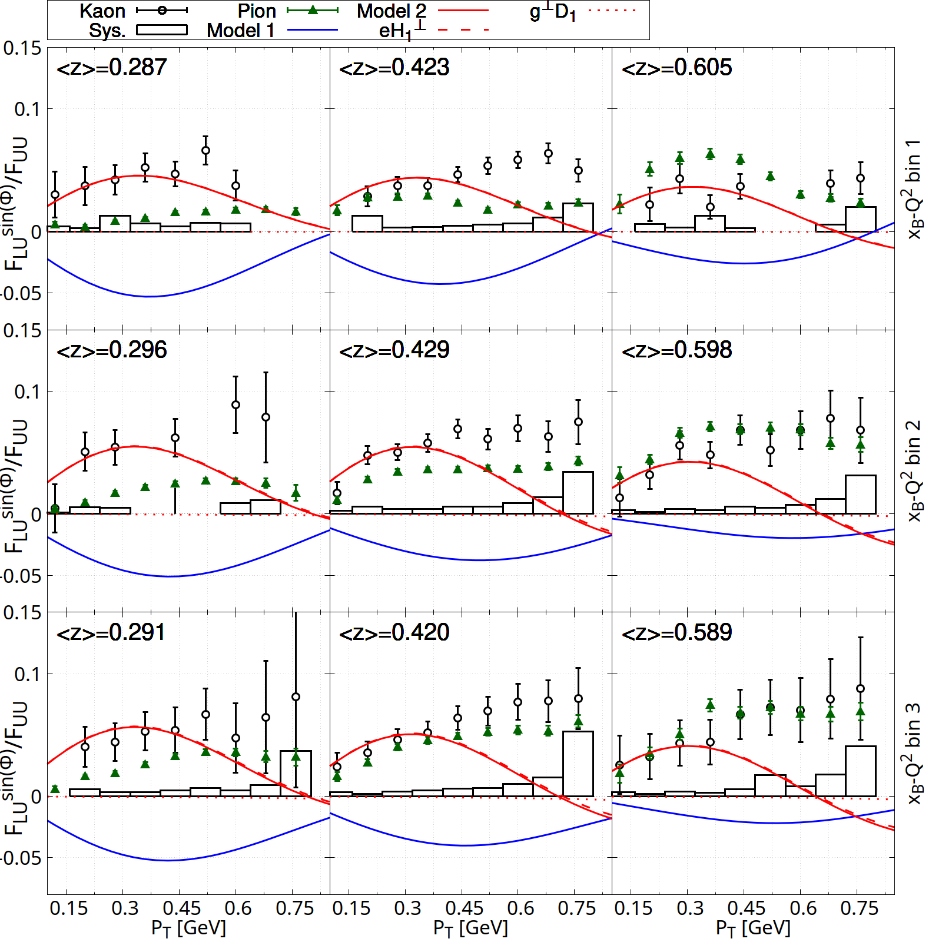
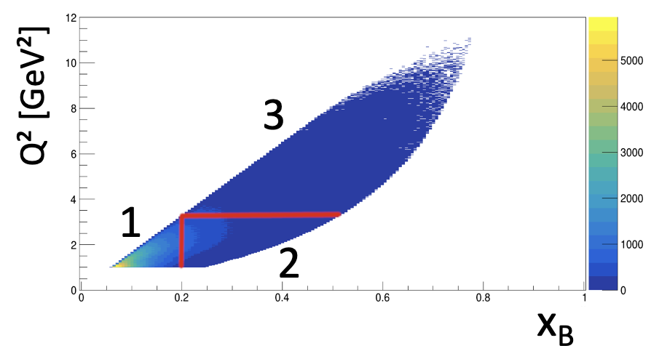
Beam Spin Asymmetries of Single Hadrons
eK⁺X
K⁺
π⁺
PRELIMINARY
model 1 (Mao et al., EPJ C 73)
model 2 (Mao et al., EPJ C 74)
Reasonable assumption of u-quark dominance
Differences either from fragmentation functions or distinct VM contributions
twist-3 chiral odd pdf
unpolarized PDF
twist-3 t-odd PDF
Boer-Mulders
Collins FF
twist-3 FF
unpolarized FF

Slide 5
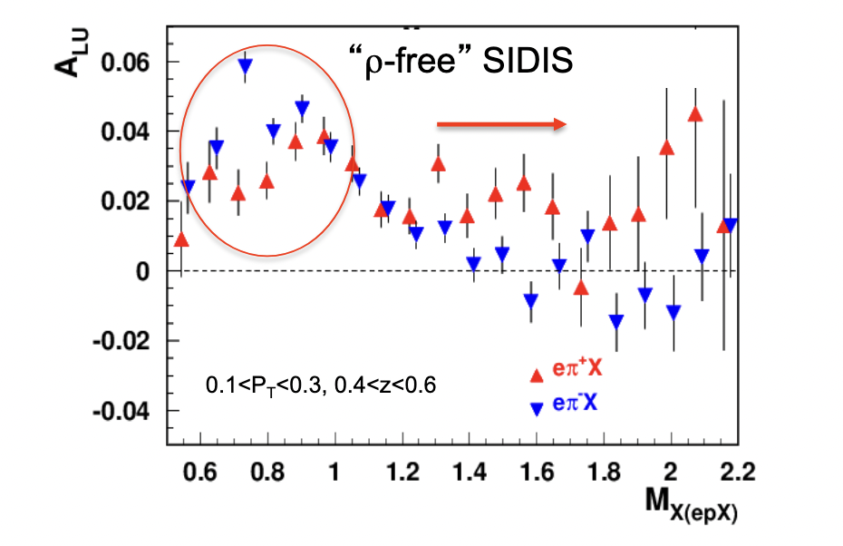
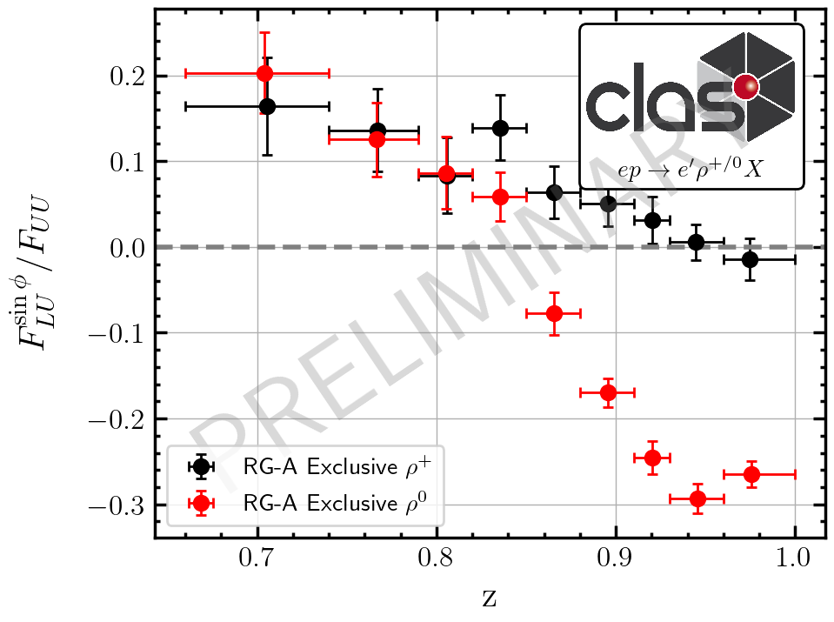

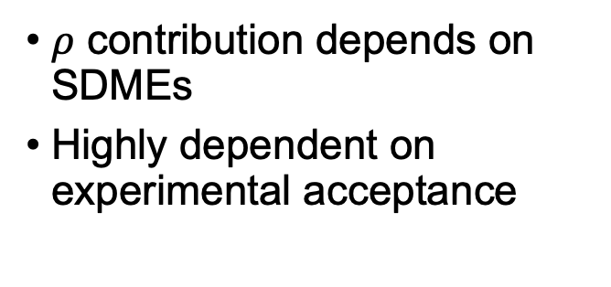
Background from Exclusive Vector Meson Production
$$ρ_{L}?$$
$ρ$ contribution depends on SDMEs
Highly dependent on experimental acceptance
Different production mechanisms for $ρ^{0}$ and $ρ^{±}$

Slide 6

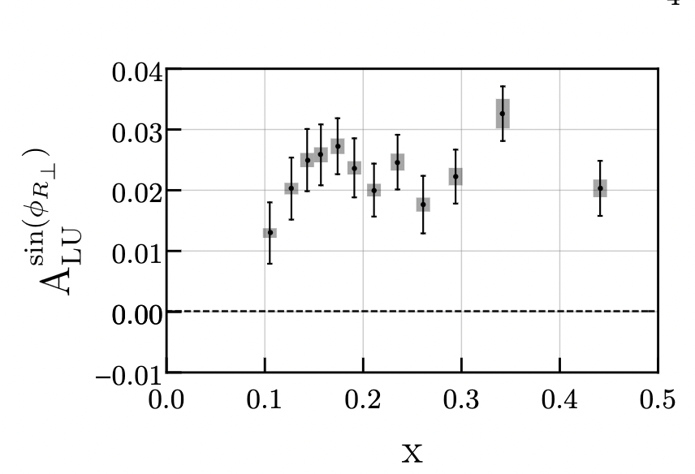
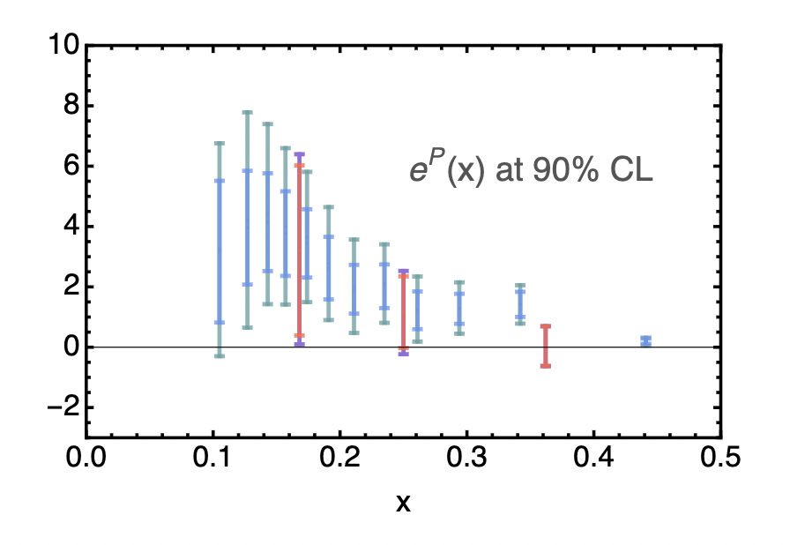
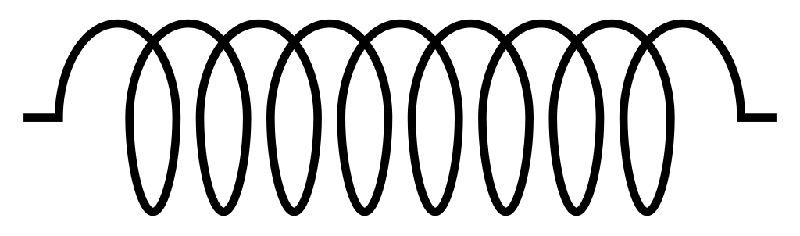
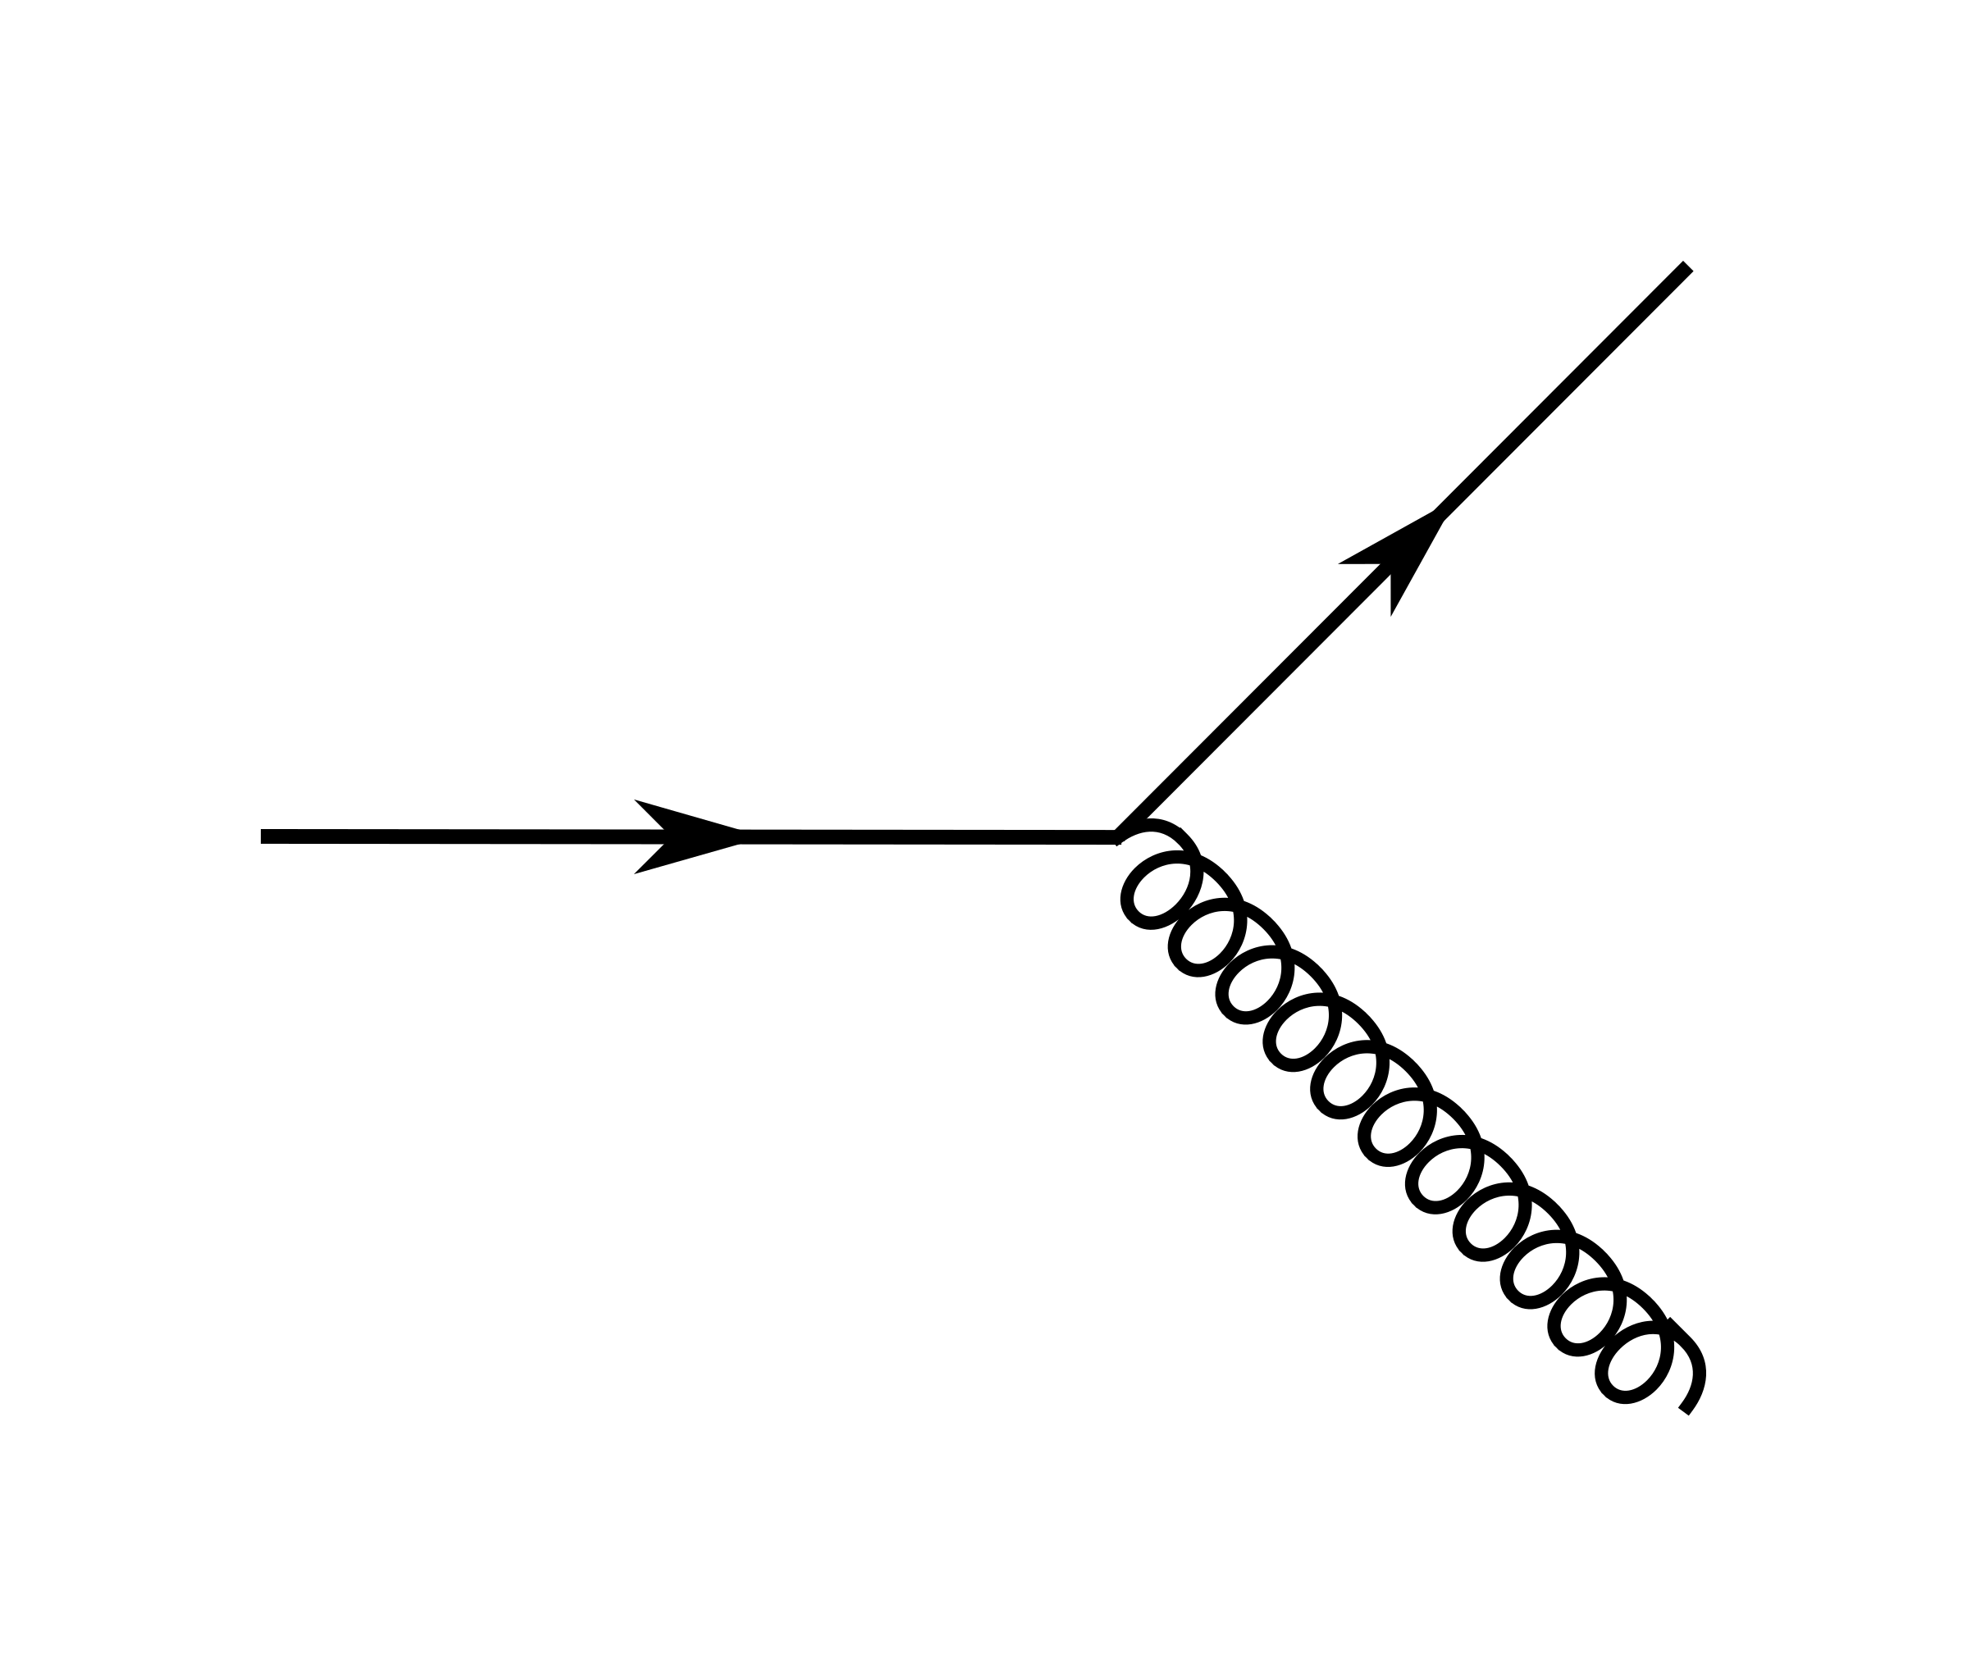

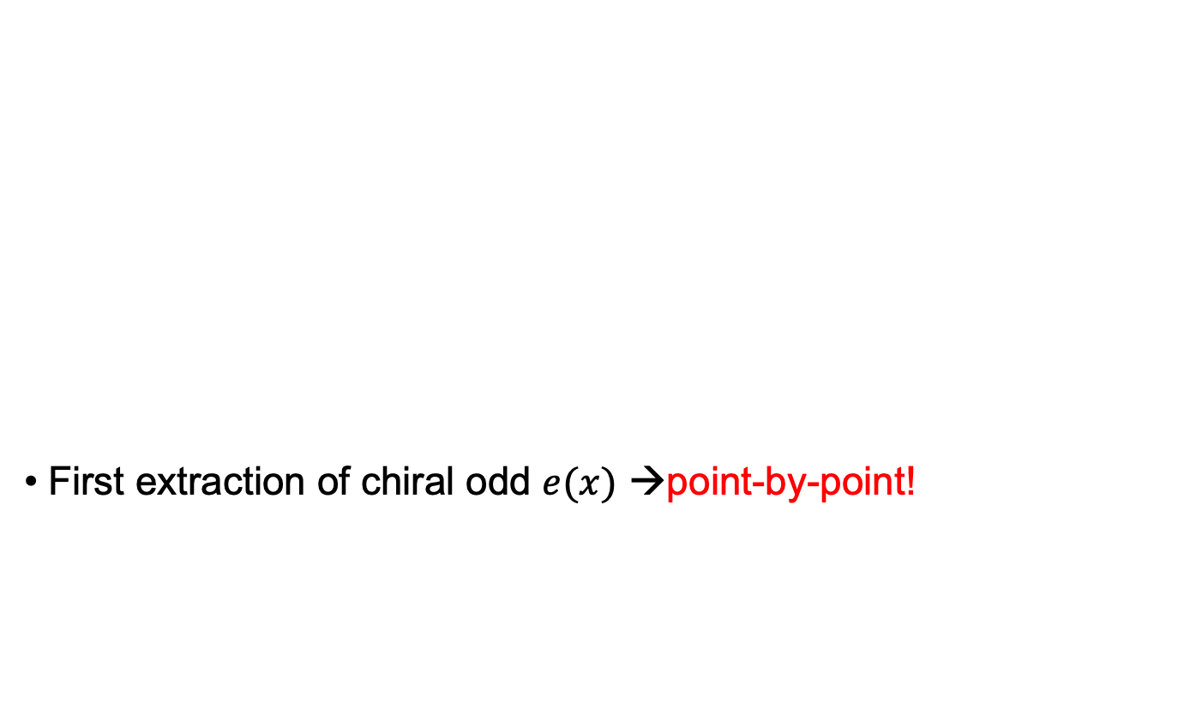
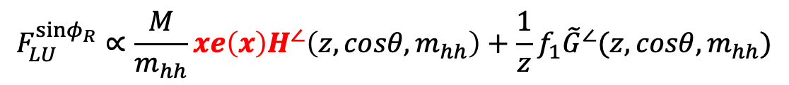
Better: di-hadrons
π⁺
π–
First extraction of chiral odd $e(x)$ →point-by-point!
$$∝e⋅H_{1}^{∠}$$
Phys.Rev.Lett. 126 (2021) 152501
Phys.Rev.D 106 (2022) 1, 014027
$$F_{LU}^{sinφ_{R}}∝\frac{M}{m_{hh}}xe\left(x\right)H^{∠}\left(z,cosθ,m_{hh}\right)+\frac{1}{z}f_{1}{\tilde{G}}^{∠}(z,cosθ,m_{hh})$$
-
+
+

Slide 7
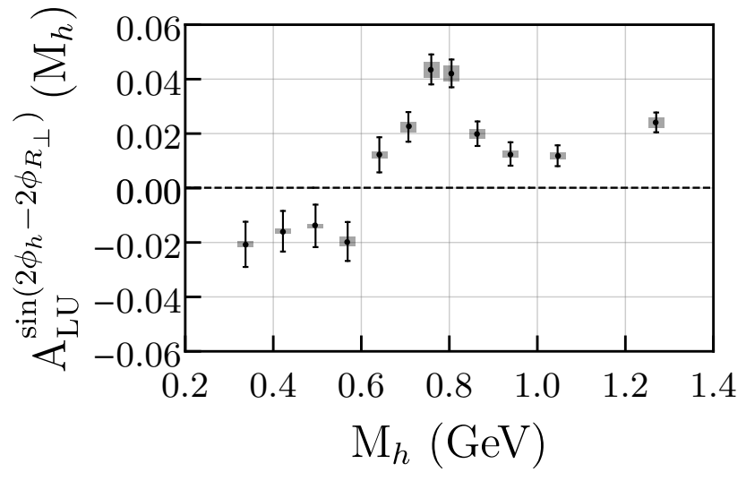
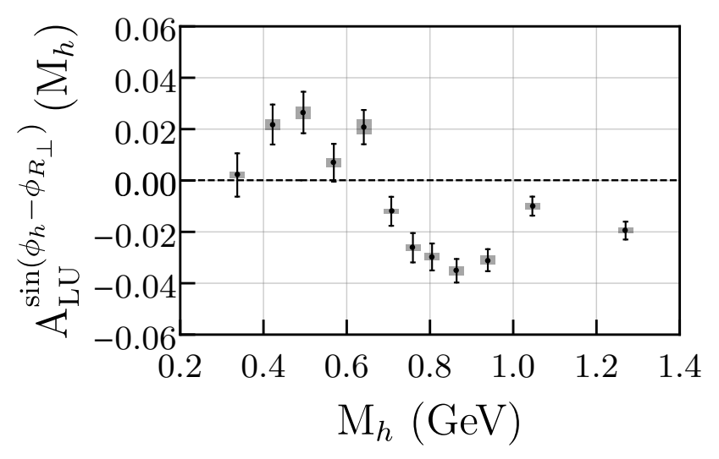
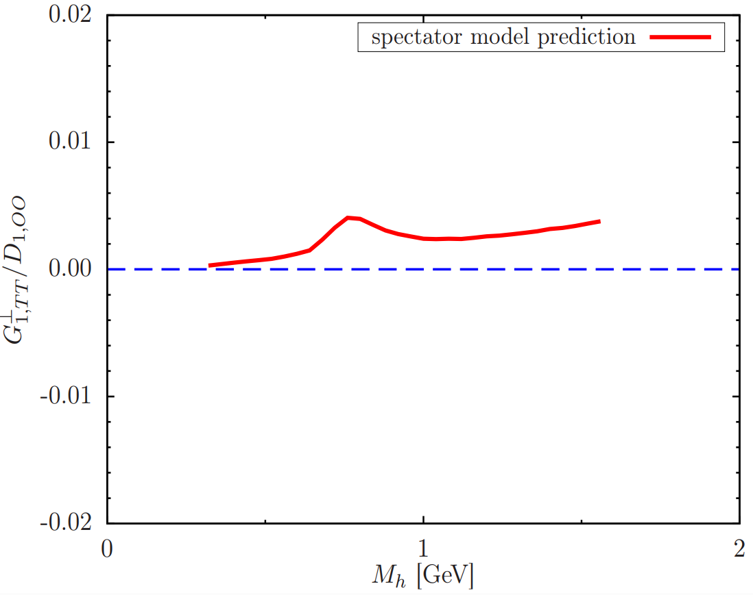
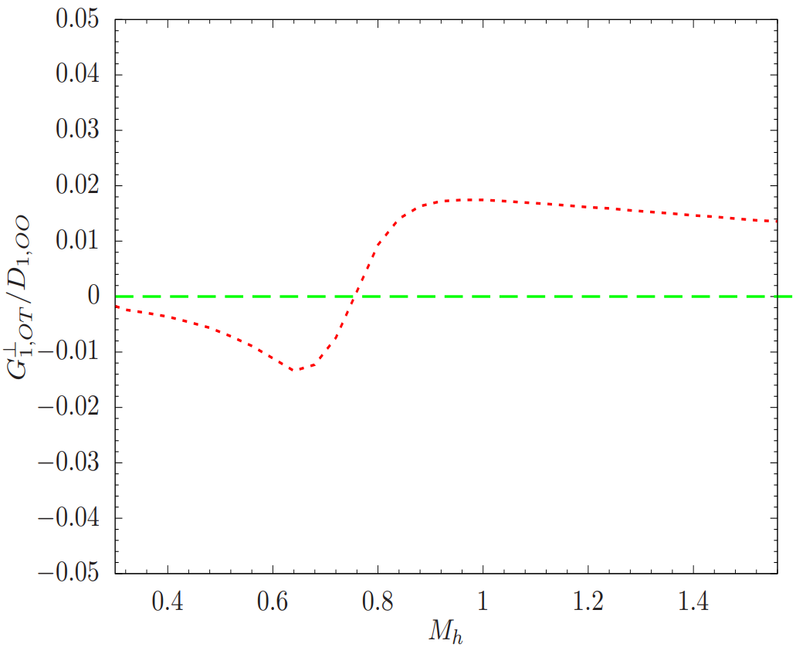
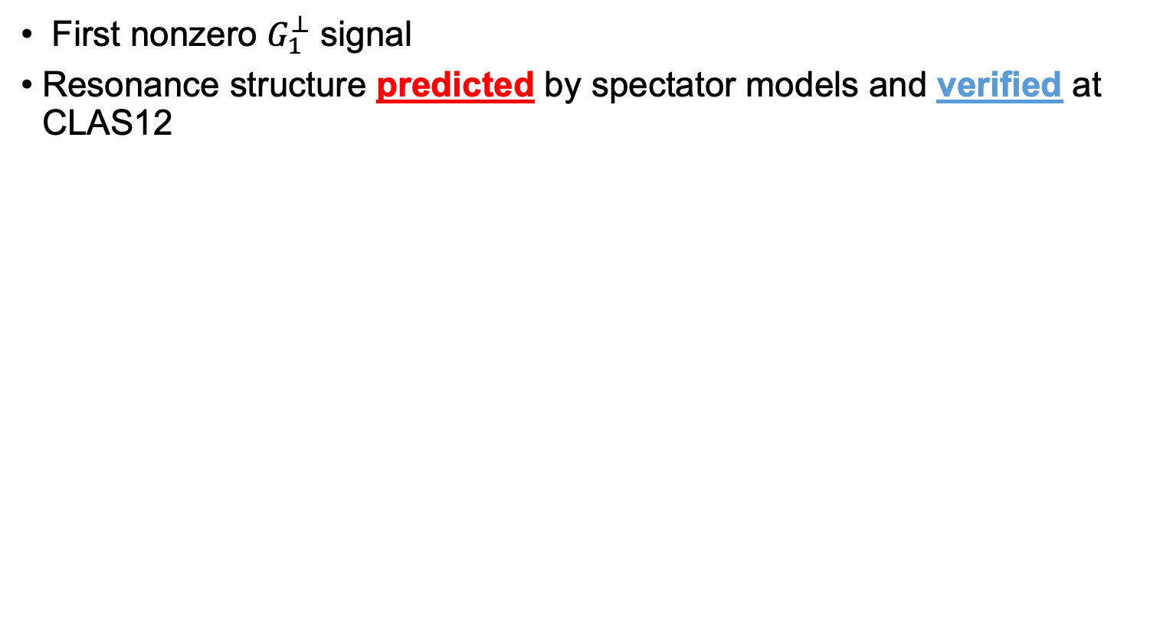
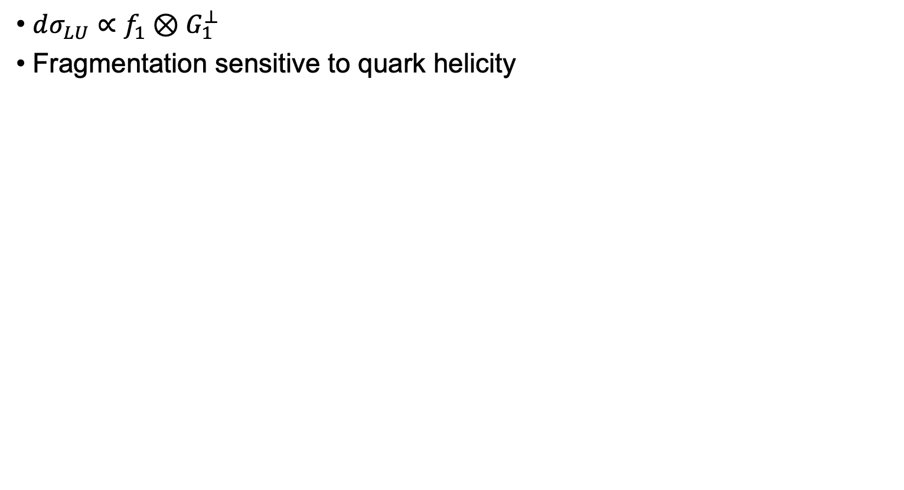



First Measurement of $G_{1}^{⊥}$ →no 1h equivalent
$dσ_{LU}∝f_{1}⊗G_{1}^{⊥}$
Fragmentation sensitive to quark helicity
$$dσ_{LU}$$
PRL 126, 152501 (2021)
$$G_{1,OT+LT}^{⊥}$$
$$G_{1,TT}^{⊥}$$
PRD 102, 014044
First nonzero $G_{1}^{⊥}$ signal
Resonance structure predicted by spectator models and verified at CLAS12
T. Hayward (MIT)
PRD 101, 054020

Slide 8
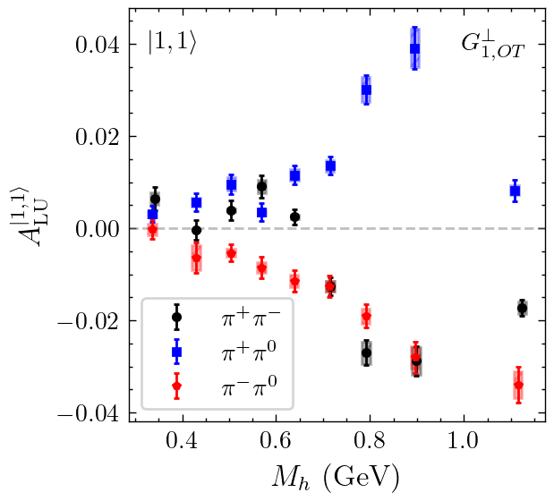
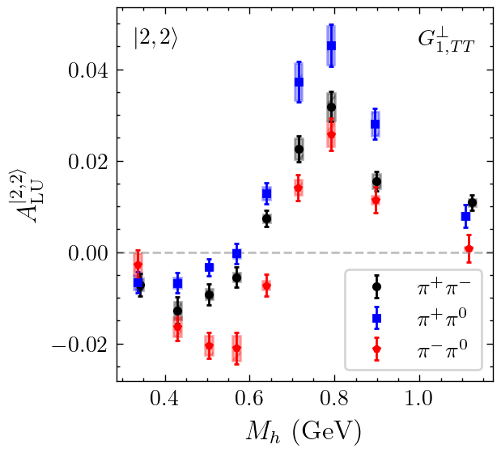


Flavor dependence of Different Partial Waves
Preliminary
Preliminary
$$A_{LU}^{|1,1⟩}∝f_{1}\left(x\right)⊗G_{1,OT}^{⊥}$$
$$A_{LU}^{|2,2⟩}∝f_{1}\left(x\right)⊗G_{1,TT}^{⊥}$$
Partial Waves are Flavor dependent
  Different Decay Channels contribute to different PWs

Slide 9
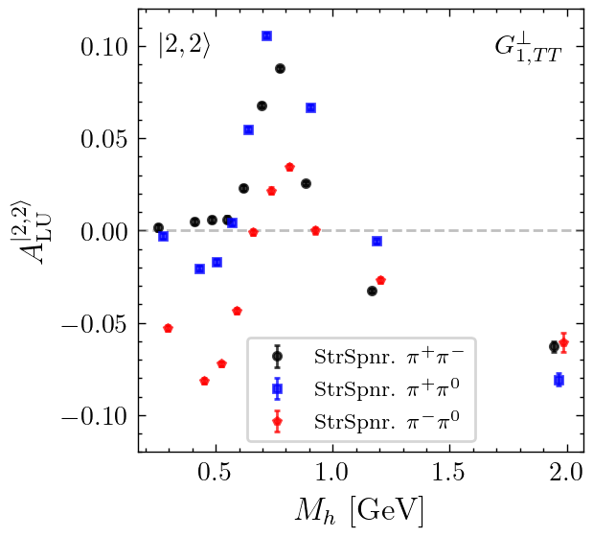


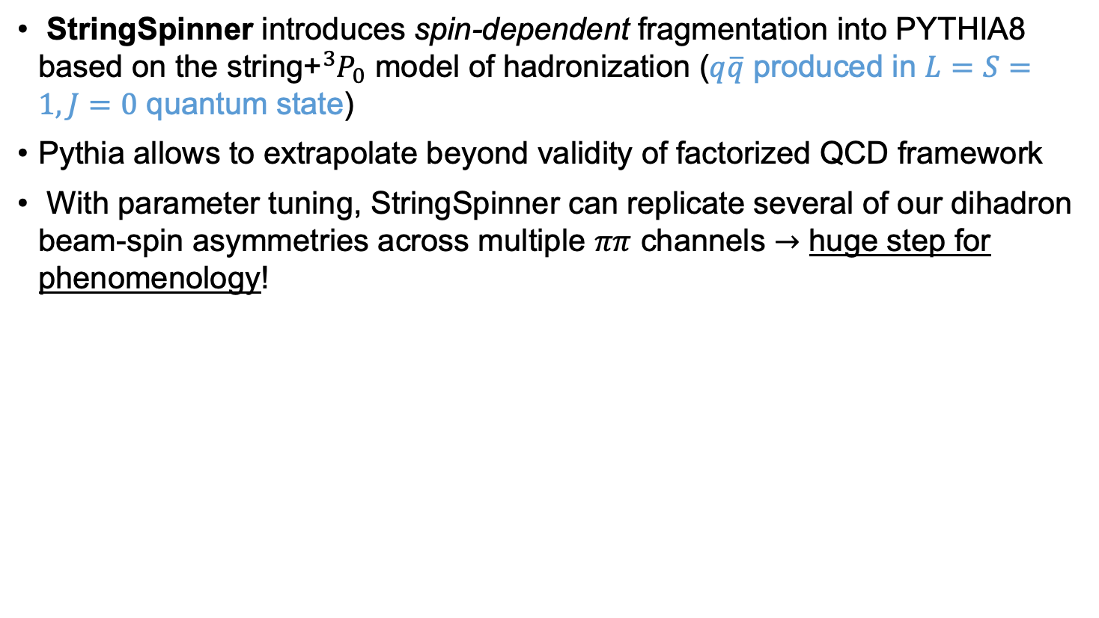
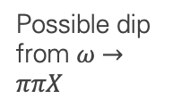
Reproduction in Event Generator Models
StringSpinner introduces spin-dependent fragmentation into PYTHIA8 based on the string+${}_{ }^{3}{P_{0}}$ model of hadronization ($q\overline{q}$ produced in $L=S=1, J=0$ quantum state)
Pythia allows to extrapolate beyond validity of factorized QCD framework
With parameter tuning, StringSpinner can replicate several of our dihadron beam-spin asymmetries across multiple $ππ$ channels $→$ huge step for phenomenology!
Preliminary
Preliminary
StringSpinner Modeling
Possible dip from $ω→ππX$
G. Matousek (Duke)

Slide 10
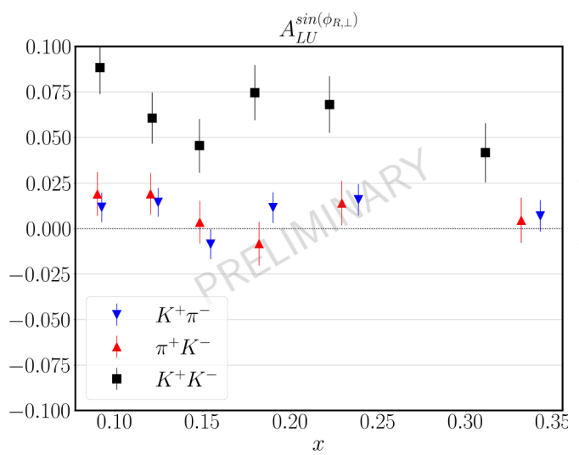
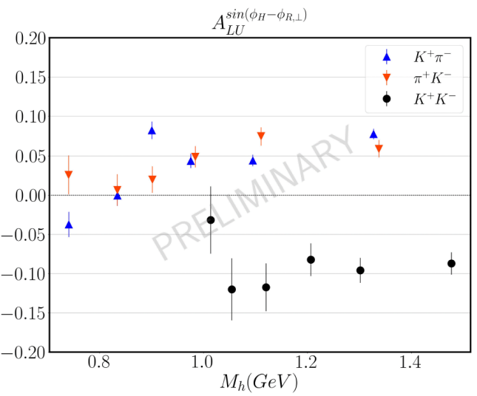


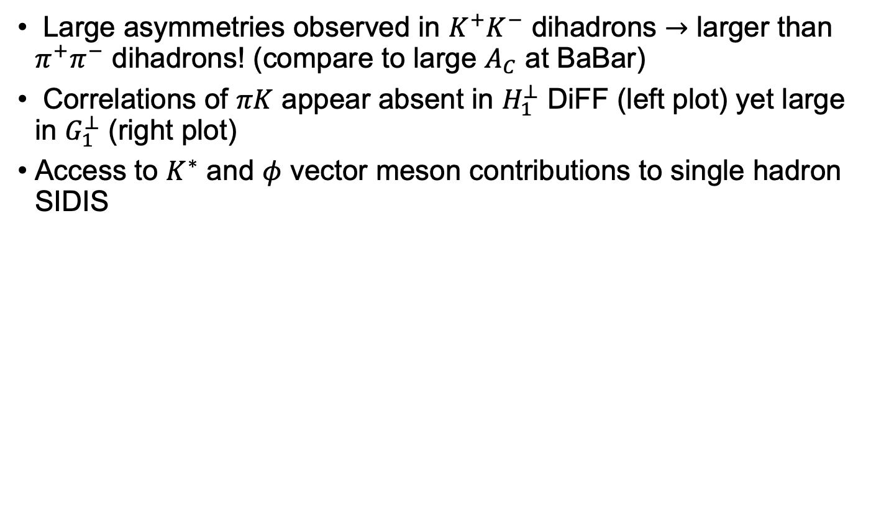

Large Kaon Asymmetries Currently not understood
Large asymmetries observed in $K^{+}K^{−}$ dihadrons $→$ larger than $π^{+}π^{−}$ dihadrons! (compare to large $A_{C}$ at BaBar)
Correlations of $πK$ appear absent in $H_{1}^{⊥}$ DiFF (left plot) yet large in $G_{1}^{⊥}$ (right plot)
Access to $K^{∗}$ and $φ$ vector meson contributions to single hadron SIDIS
$$f_{1}\left(x\right)G_{1}^{⊥}(z,M_{h})$$
$$e\left(x\right)H_{1}^{⊥}(z,M_{h})$$
C. Pecar (Duke)
$$dσ_{LU}$$

Slide 11
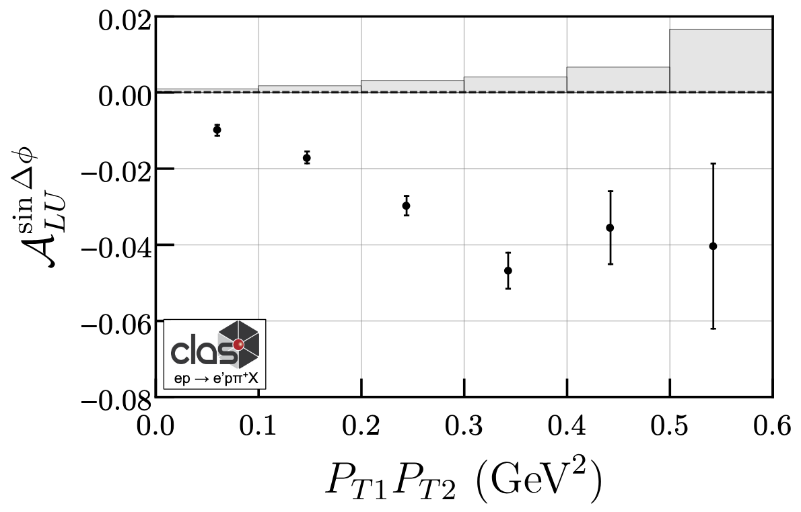
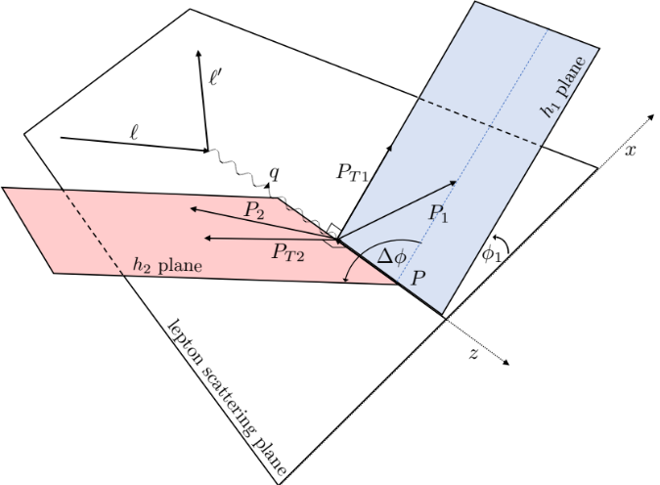
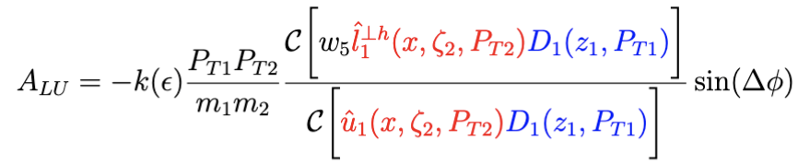
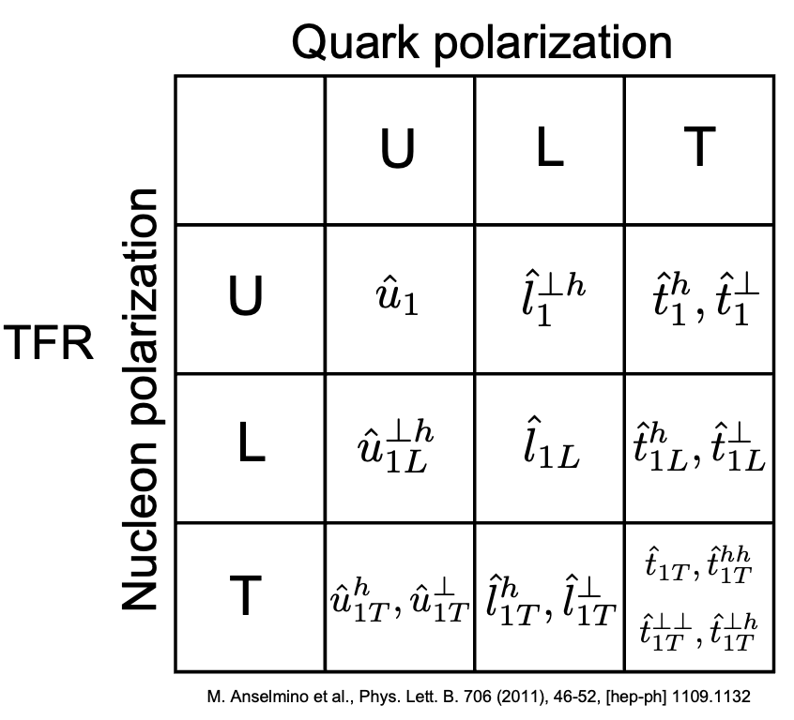
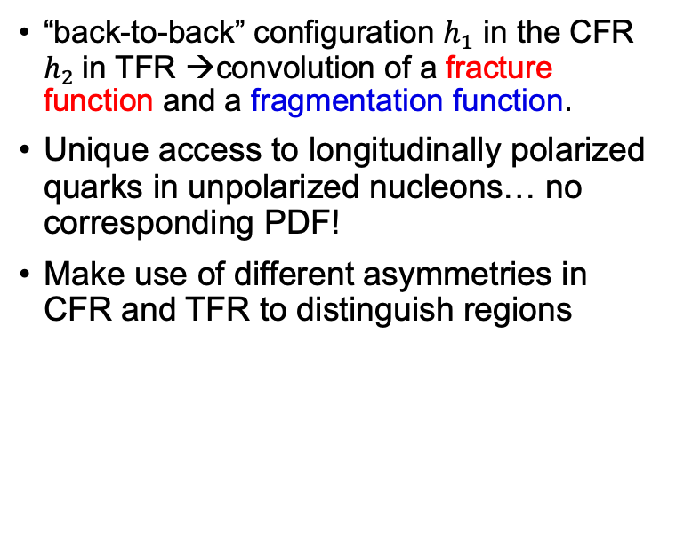
First observation of correlations between Current and target region
“back-to-back” configuration $h_{1}$ in the CFR $h_{2}$in TFR →convolution of a fracture function and a fragmentation function.
Unique access to longitudinally polarized quarks in unpolarized nucleons… no corresponding PDF!
Make use of different asymmetries in CFR and TFR to distinguish regions

Slide 12
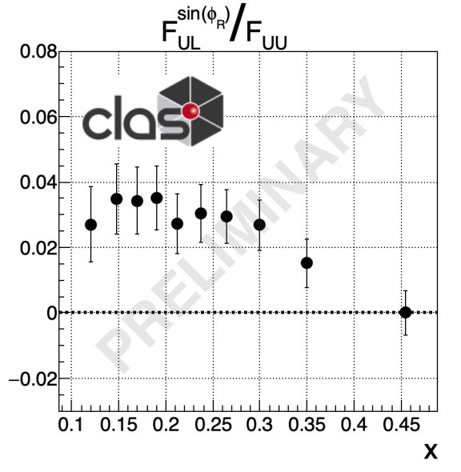
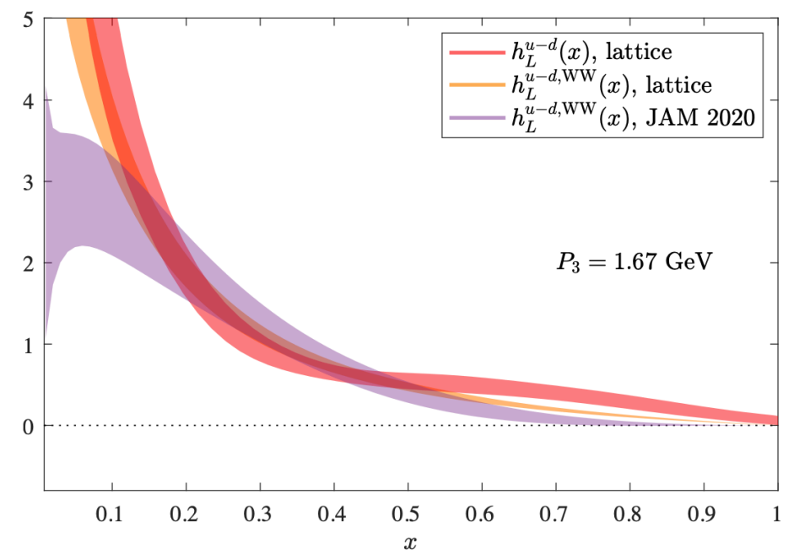
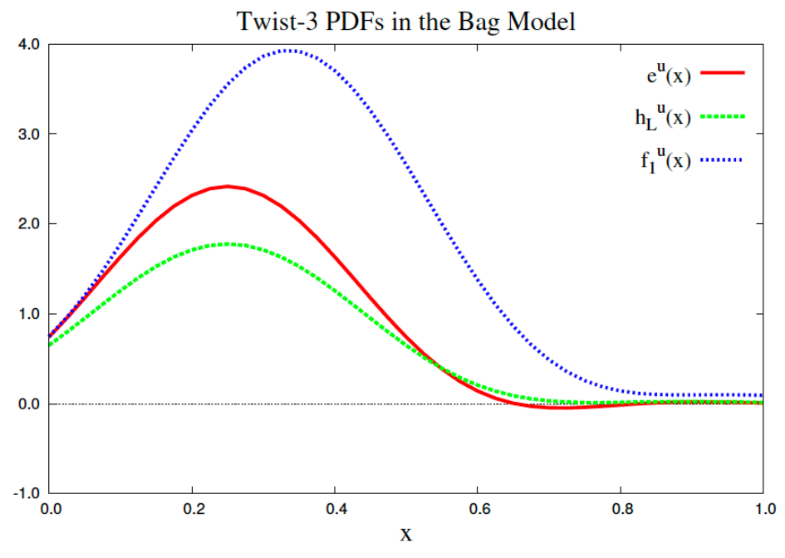

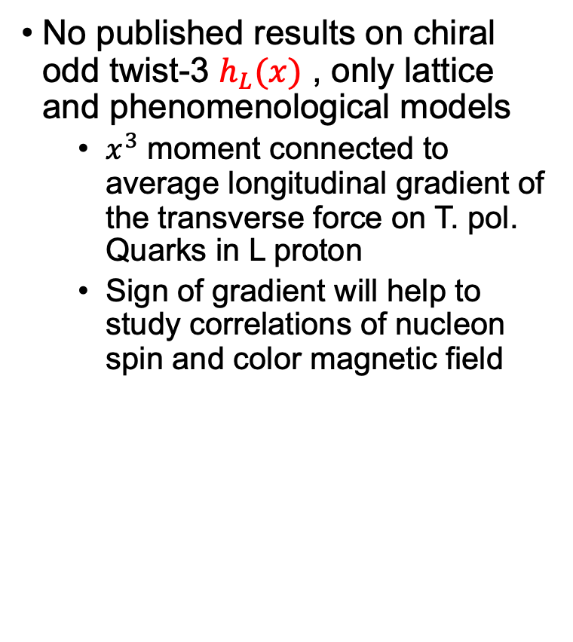

New: Longitudinal Target SSAs
$$dσ_{UL}$$
No published results on chiral odd twist-3 $h_{L}(x)$ , only lattice and phenomenological models
  $x^{3}$ moment connected to average longitudinal gradient of the transverse force on T. pol. Quarks in L proton
  Sign of gradient will help to study correlations of nucleon spin and color magnetic field
Nucl. Phys. B375, 527 (1992)
$$F_{UL}^{\sin{φ_{R}}}∝h_{L}\left(x\right)H_{1}^{⊥}(z,M_{h})$$
arXiv:2111.01056

Slide 13
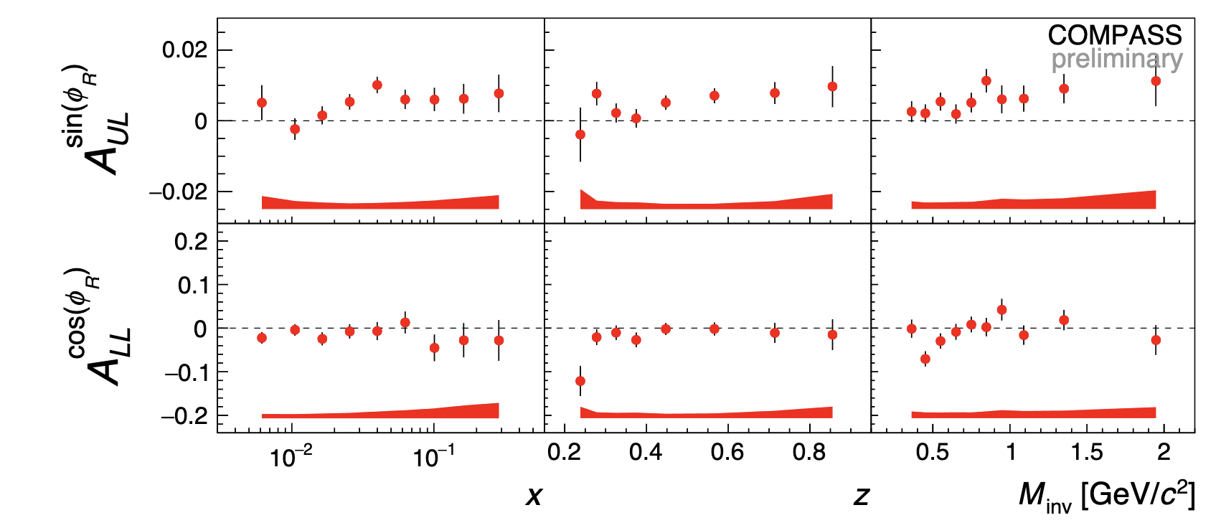

New: Longitudinal Target SSAs
$$dσ_{UL}$$
No published results on chiral odd twist-3 $h_{L}(x)$ , only lattice and phenomenological models
  $x^{3}$ moment connected to average longitudinal gradient of the transverse force on T. pol. Quarks in L proton
  Sign of gradient will help to study correlations of nucleon spin and color magnetic field
Nucl. Phys. B375, 527 (1992)
$$F_{UL}^{\sin{φ_{R}}}∝h_{L}\left(x\right)H_{1}^{⊥}(z,M_{h})$$
arXiv:2111.01056
$$x$$
Compare to COMPASS (arXiv:1702.07317 [hep-ex])

Slide 14
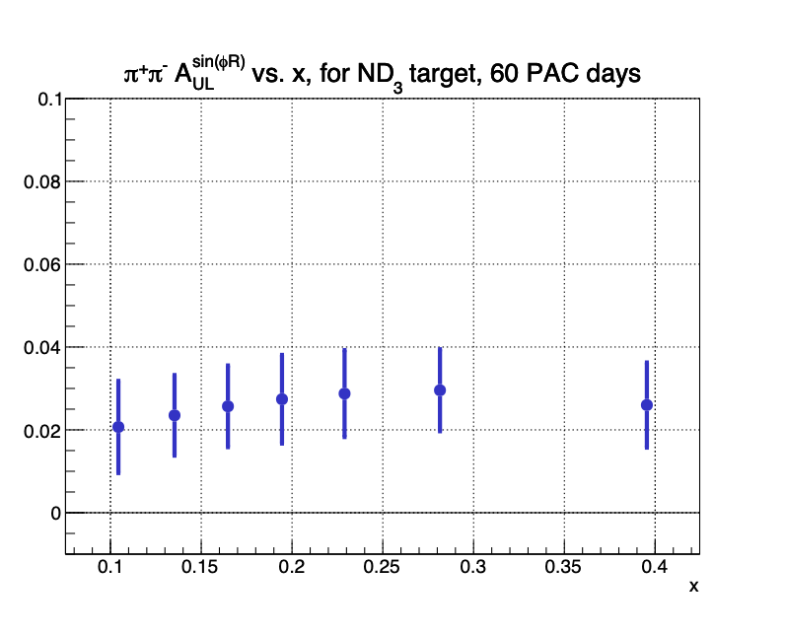
New: Longitudinal Target SSAs
$$dσ_{UL}$$
No published results on chiral odd twist-3 $h_{L}(x)$ , only lattice and phenomenological models
  $x^{3}$ moment connected to average longitudinal gradient of the transverse force on T. pol. Quarks in L proton
  Sign of gradient will help to study correlations of nucleon spin and color magnetic field
Nucl. Phys. B375, 527 (1992)
$$F_{UL}^{\sin{φ_{R}}}∝h_{L}\left(x\right)H_{1}^{⊥}(z,M_{h})$$
arXiv:2111.01056
Deuteron projections
From the proposal for the RG Addition to PAC48 (C. Dilks)

Slide 15
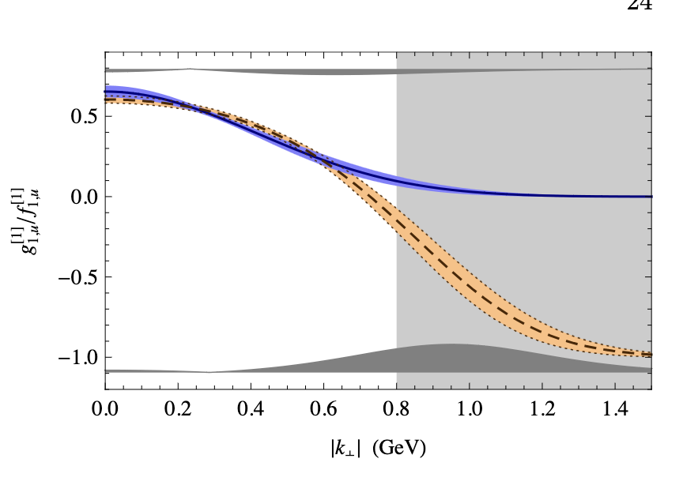
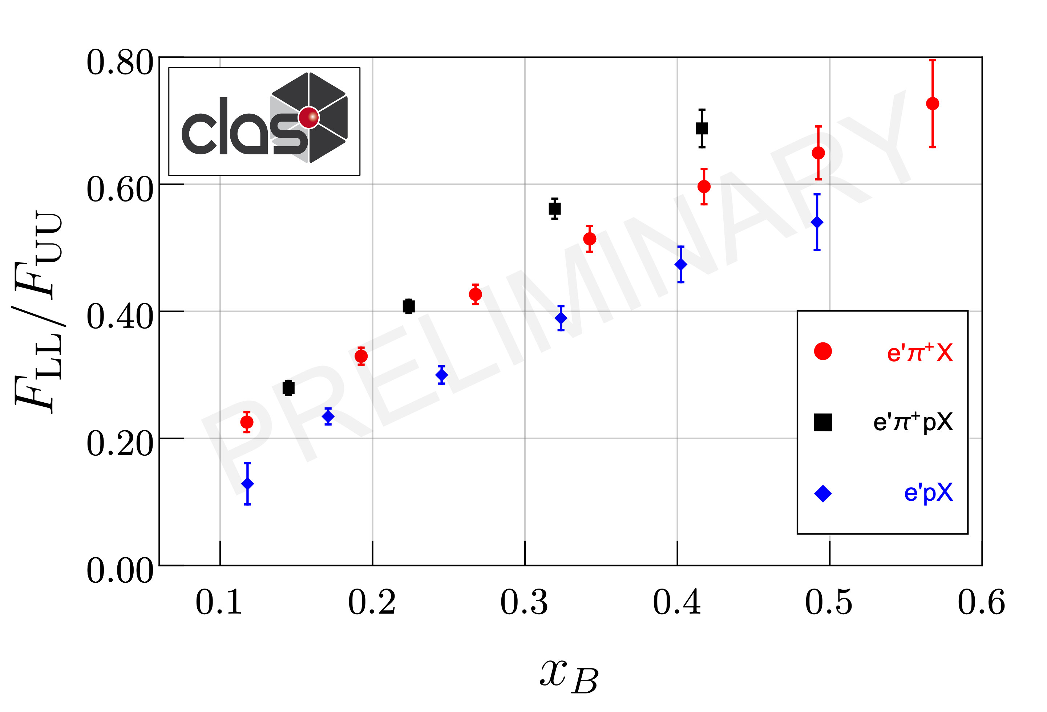
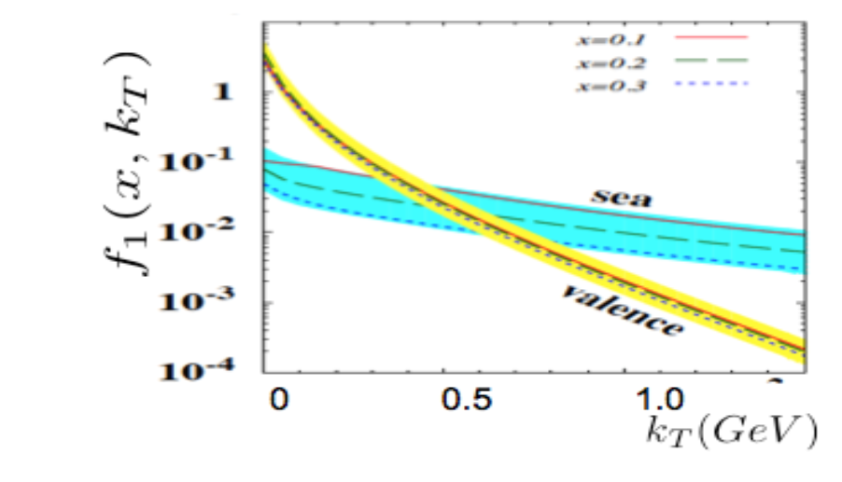
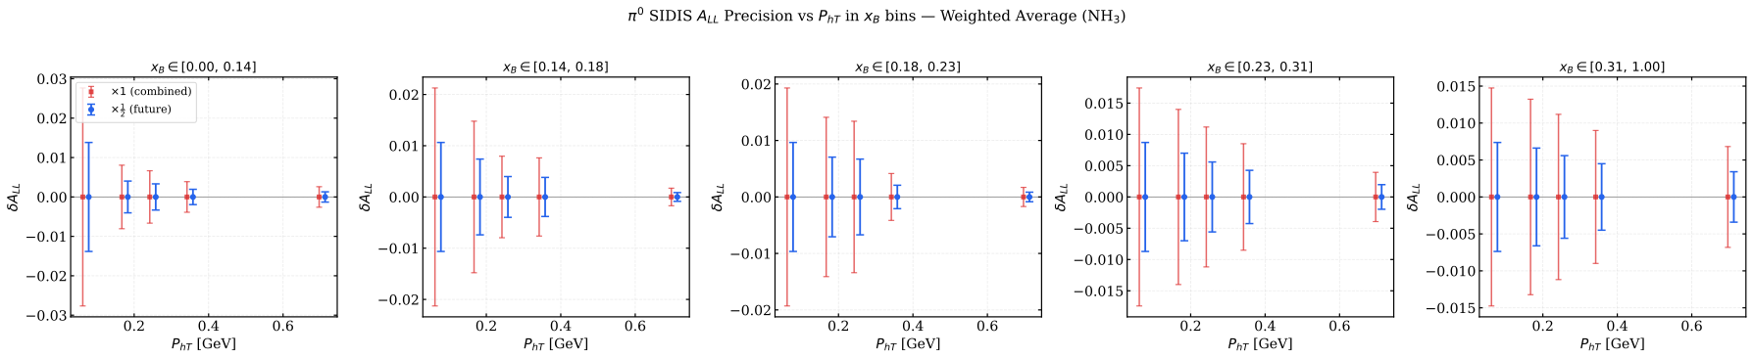
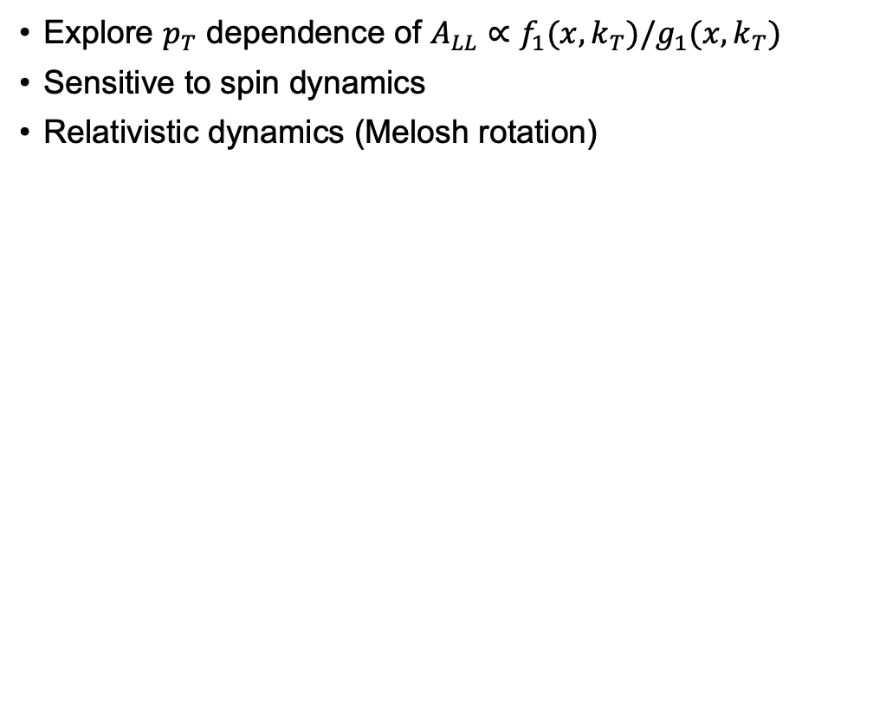

Longitudinal DSAs for single hadrons
Explore $p_{T}$ dependence of $A_{LL}∝f_{1}(x,k_{T})/g_{1}(x,k_{T})$
Sensitive to spin dynamics
Relativistic dynamics (Melosh rotation)
B. Musch et al (arxiv 1011.1213)
M_{x(π}⁺₎ > 1.5 GeV, M_{x(p)} > 1.35 GeV
M_{x(π}⁺₎ > 1.5 GeV, M_{x(p)} > 1.35 GeV
P.Schweitzer et al. arXiv:1210.1267
M_{x(π}⁺₎ > 1.5 GeV, M_{x(p)} > 1.35 GeV
M_{x(π}⁺₎ > 1.5 GeV, M_{x(p)} > 1.35 GeV
$Projections of A_{LL}^{π^{0}}$ current data 4xstatistics

Slide 16
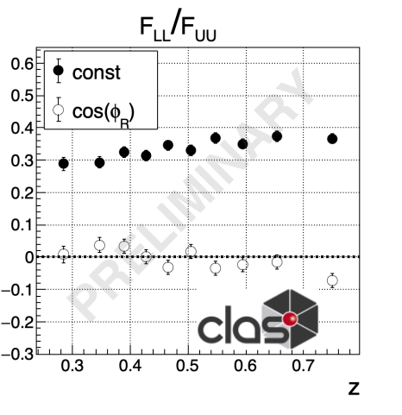




Access to Twist3 FFs in
Longitudinal Double Spin Asymmetries
$$π^{+}π^{−}$$
$$X$$
$$F_{LL}/F_{UU}$$
$F_{LL}^{const}/F_{LL}^{\cos{φ_{R}}}$ sensitive to $g_{1L}D_{1}/g_{1L}\tilde{D}$
→probe of twist-3 DiFF $\tilde{D}$ size
Preliminary results indicate $\tilde{D}$ is
roughly one order of magnitude smaller than $D_{1}$
  Different than PDFs!

Slide 17

Access to Twist3 FFs in
Longitudinal Double Spin Asymmetries
$$π^{+}π^{−}$$
$$X$$
$F_{LL}^{const}/F_{LL}^{\cos{φ_{R}}}$ sensitive to $g_{1L}D_{1}/g_{1L}\tilde{D}$
→probe of twist-3 DiFF $\tilde{D}$ size
Preliminary results indicate $\tilde{D}$ is
roughly one order of magnitude smaller than $D_{1}$
  Different than PDFs!

Slide 18



$$e^{−}p→e^{−}π^{+}π^{−}X$$
Run Group H: 1st transversely polarized target experiment at CLAS12
Recently approved with rating A by the Program Advisory Committee (PAC) – awaiting beam-time
Recent projections from the JAM group show RG-H will be competitive with lattice efforts to constrain the tensor charge [8]
M. McEneaney (Duke)
Sawaya et al (Phys.Rev.D 114 (2026) 7, 074009)

Slide 19


Impact with 5x Statistics
Yorgo Sawaya
(Temple)

Slide 20






Polarized $Λ$’s as a tool to Learn about Spin Structure
Theory: X. Zhao et al., cf., Zhao et al., PRL 134, 231901 (2025)
CFR predictions come from pQCD fits to $e^{+}e^{−}$ data
TFR predictions come from a spectator quark-diquark model calculation
Image from arXiv:2304.03302v1
First measurement of $A_{LUT}$
Future:
  Precision $Λ$ program at CLAS12
  Comparison with MC models
Phys.Rev.D 113 (2026) 9, 092019

Slide 21

Summary & Conclusion
CLAS12 has a rich program to study TMDs
Large acceptance makes correlation studies possible
Large acceptance enable program to explore correlations in hadronization
“High Luminosity” would help extend $p_{T}, Q^{2}$ reach
Will increase impact of RGH
Additional deuterium data will be helpful for flavor separation
  Possibly helpful to explain surprising Kaon results
Improvements enabling higher luminosity in software might have disproportional effect on $Λ$ reconstruction →rich program on polarized $Λ$ in SIDIS

Slide 23


Slide 24





Flavor dependence + String Spinner
$$A_{LU}^{|1,1⟩}∝e\left(x\right)H_{1}^{⊥}(z,M_{h})$$
Preliminary
Preliminary
$$A_{LU}^{|1,1⟩}∝f_{1}\left(x\right)⊗G_{1,OT}^{⊥}$$
$$A_{LU}^{|2,2⟩}∝f_{1}\left(x\right)⊗G_{1,TT}^{⊥}$$
CLAS12 Data
Preliminary
Preliminary
StringSpinner Modeling
2402.13105
Possible dip from $ω→ππX$

Slide 25



$$e^{−}p→e^{−}π^{±}π^{0}X$$
$$dσ_{LU}$$
StringSpinner introduces spin-dependent fragmentation into PYTHIA8 based on the string+${}_{ }^{3}{P_{0}}$ model of hadronization ($q\overline{q}$ produced in $L=S=1, J=0$ quantum state)
With parameter tuning, StringSpinner can replicate several of our dihadron beam-spin asymmetries across multiple $ππ$ channels $→$ huge step for phenomenology!
[6]
CLAS12 Data
Preliminary
Preliminary
StringSpinner Modeling
Possible dip from $ω→ππX$
G. Matousek (Duke)
Note that e(x) is also reprpoduced… unclear now

Slide 26







$$e^{−}p→e^{−}KπX \\ e^{−}p→e^{−}K^{+}K^{−}X$$
$$dσ_{LU}$$
Large asymmetries observed in $K^{+}K^{−}$ dihadrons $→$ larger than $π^{+}π^{−}$ dihadrons!
Correlations of $πK$ appear absent in $H_{1}^{⊥}$ DiFF (left plot) yet large in $G_{1}^{⊥}$ (right plot)
Access to new flavor dependence of $G_{1}^{⊥}$
Access to $K^{∗}$ and $φ$ vector meson contributions to single hadron SIDIS
$$K^{+}π^{−}$$
$$π^{+}K^{−}$$
$$f_{1}\left(x\right)G_{1}^{⊥}(z,M_{h})$$
$$e\left(x\right)H_{1}^{⊥}(z,M_{h})$$
Invariant Masses
$$K^{+}K^{−}$$
C. Pecar (Duke)

Slide 27

From the proposal for the RG Addition to PAC48 (C. Dilks)

Slide 28


Slide 29



Slide 30




Helicity TMD (and the effect from ρ⁰)
g₁(x,k_{T}) will be heavily kinematically suppressed at EIC.
JLab22, with extension to higher P_{T}, would be critical for studies of g₁ in the valance quark region.
Measurements of epX A_{LL} systematically higher after M_{x} cut to remove VMs
Semi-exclusive e’π⁺pX with ρ removed larger than e’π⁺X double-spin asymmetries
Measurements of A_{LL} for “diffractive” ρ⁰ indicate very small values (probably negative)
Contributions from VM may have caused underestimations of g₁!
1.
2.
M_{x(π}⁺₎ > 1.5 GeV, M_{x(p)} > 1.35 GeV
M_{x(π}⁺₎ > 1.5 GeV, M_{x(p)} > 1.35 GeV
3.
Exclusivity cuts, z_{ππ} > 0.9
M_{x} > 0 GeV, M_{x} > 1.35 GeV

Slide 31


Slide 32



















Better: Dihadron Fragmentation Functions
Correlations in $h_{1}$ and $h_{2}$ as functions of $z, M_{h}$ and $p_{T}^{2}$ accumulated during fragmentation
Couple to fragmenting quark properties – ex: ${\vec{S}}_{q} , {\vec{k}}_{T}$
DiFF’s expand into partial waves $\left|ℓ,m\right\rangle$ w.r.t $θ$
Unpolarized
$$D_{1}(z,M_{h},p_{T}^{2})$$
$$h_{1}$$
$$h_{2}$$
Helicity-dependent
$$G_{1}^{⊥}(z,M_{h},p_{T}^{2})$$
$$h_{1}$$
$$h_{1}$$
$$−$$
2-Point Correlations
In phase space
→insight into hadronization
→connection to models
$$h_{2}$$
$$h_{2}$$
$S_{qT}$/$k_{T}$-dependent
$$H_{1}^{⊥}(z,M_{h},p_{T}^{2})$$
$$h_{1}$$
$$h_{1}$$
$$−$$
[2]
$$h_{2}$$
$$h_{2}$$

Slide 33


Depolarization Factors
Twist 2
Suppressed at EIC
Twist 3
Slide from C. Dilks

Slide 34








Target Fragmentation → Fracture Functions
Sum rule with $g_{1}$
Correlations between CFR-TFR allows to extract fracture functions coupled to FFs

Slide 35



Better: Dihadron Fragmentation Functions
Correlations in $h_{1}$ and $h_{2}$ as functions of $z, M_{h}$ and $p_{T}^{2}$ accumulated during fragmentation
Couple to fragmenting quark properties – ex: ${\vec{S}}_{q} , {\vec{k}}_{T}$
DiFF’s expand into partial waves $\left|ℓ,m\right\rangle$ w.r.t $θ$
$$P_{h}$$
Unpolarized
$$D_{1}(z,M_{h},p_{T}^{2})$$
$$h_{1}$$
$$h_{2}$$
Helicity-dependent
$$G_{1}^{⊥}(z,M_{h},p_{T}^{2})$$
$$h_{1}$$
$$h_{1}$$
$$−$$
$$h_{2}$$
$$h_{2}$$
$S_{qT}$/$k_{T}$-dependent
$$H_{1}^{⊥}(z,M_{h},p_{T}^{2})$$
$$h_{1}$$
$$h_{1}$$
$$−$$
[2]
$$h_{2}$$
$$h_{2}$$

Slide 36


Comparison with Theory
Predictions by X. Zhao et al., cf., Zhao et al., PRL 134, 231901 (2025)
CFR predictions come from pQCD fits to $e^{+}e^{−}$ data
TFR predictions come from a spectator quark-diquark model calculation
Lambda also Spin transfer to Lambda
Also additional vector in final state
→azimuthal asymmetires
Future: More lambda program at CLAS…
Also Stringspinner

