Slide 1

hQCD @ Jlab @ eIC
I. Zahed
JLAB 26’
Notes:
I will discuss a way of understanding the strong interaction using an unexpected connection between QCD and string theory. The goal is to use this connection to describe properties of protons and other strongly interacting particles

Slide 2
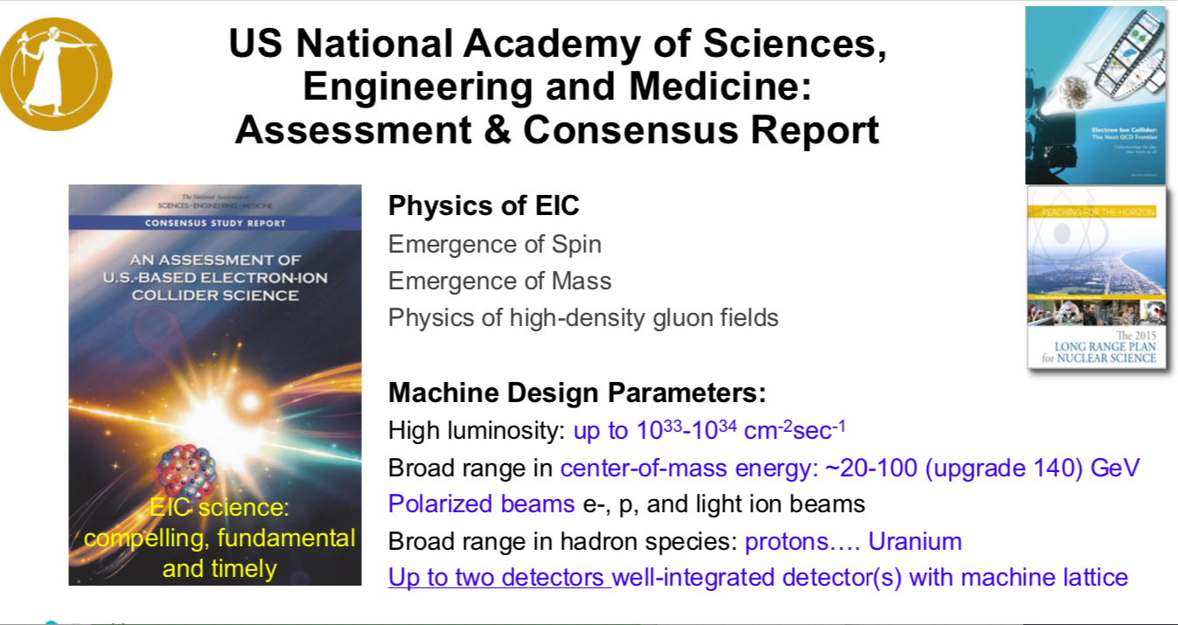
Deshpandhe 26’

Slide 3
Outline
Why strings and hQCD
EMT, Jpsi, GPDs, low-x
Notes:
There are three questions: Why do strings naturally emerge in QCD? Why is holography useful for describing them? And what can this framework tell us about experiments relevant to the EIC

Slide 4
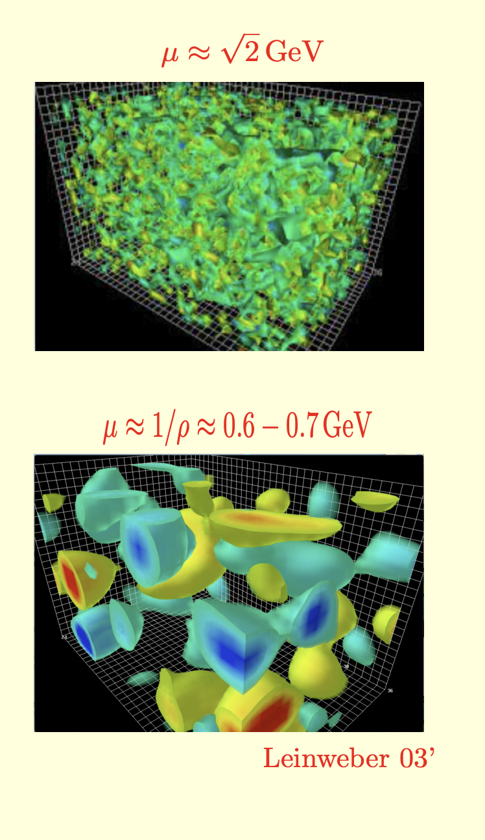
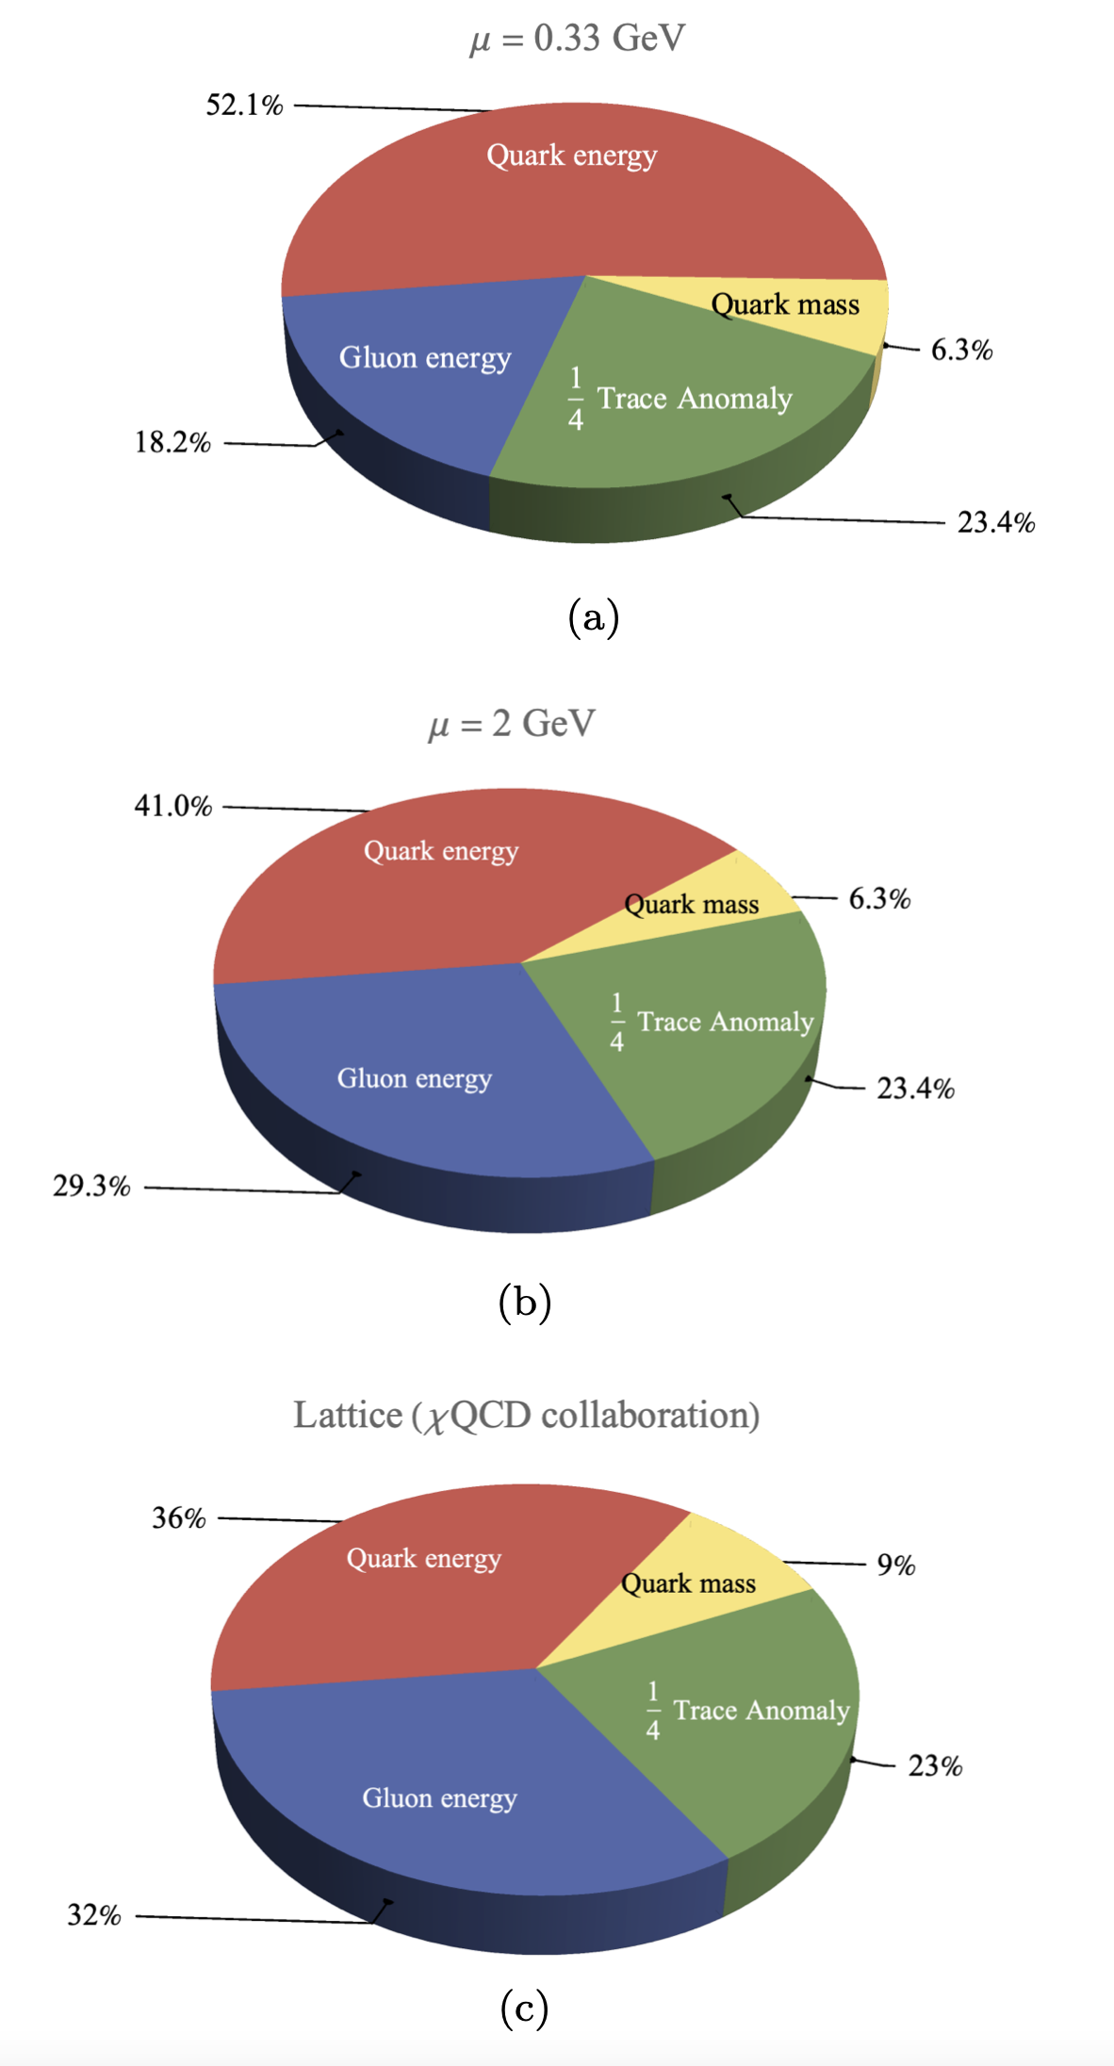
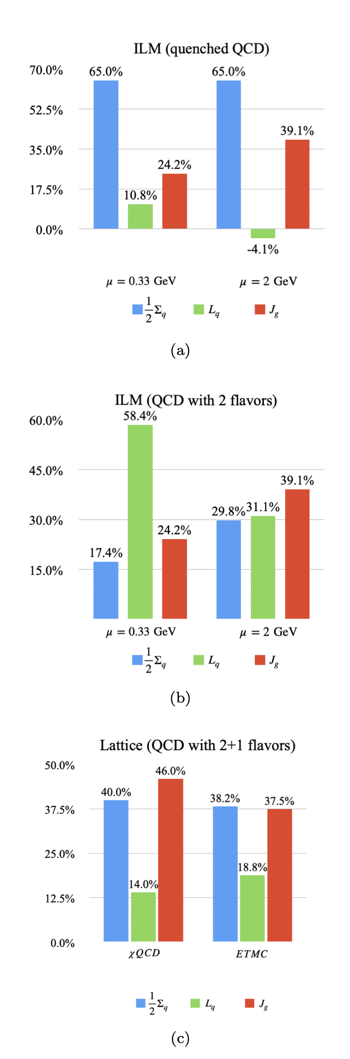
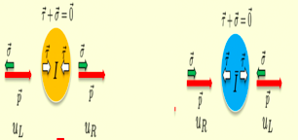
4D topological vacuum: ILM
mass and spin
Ji mass SR
Ji spin SR
Liu-Shuryak-Zahed 23’
Notes:
4D topological vacuum: mass and spin — “Finally, the QCD vacuum itself has a nontrivial topological structure. These vacuum fluctuations can contribute to two of the deepest questions about the proton: where its mass comes from and how its spin is assembled.” JLAB-26

Slide 5
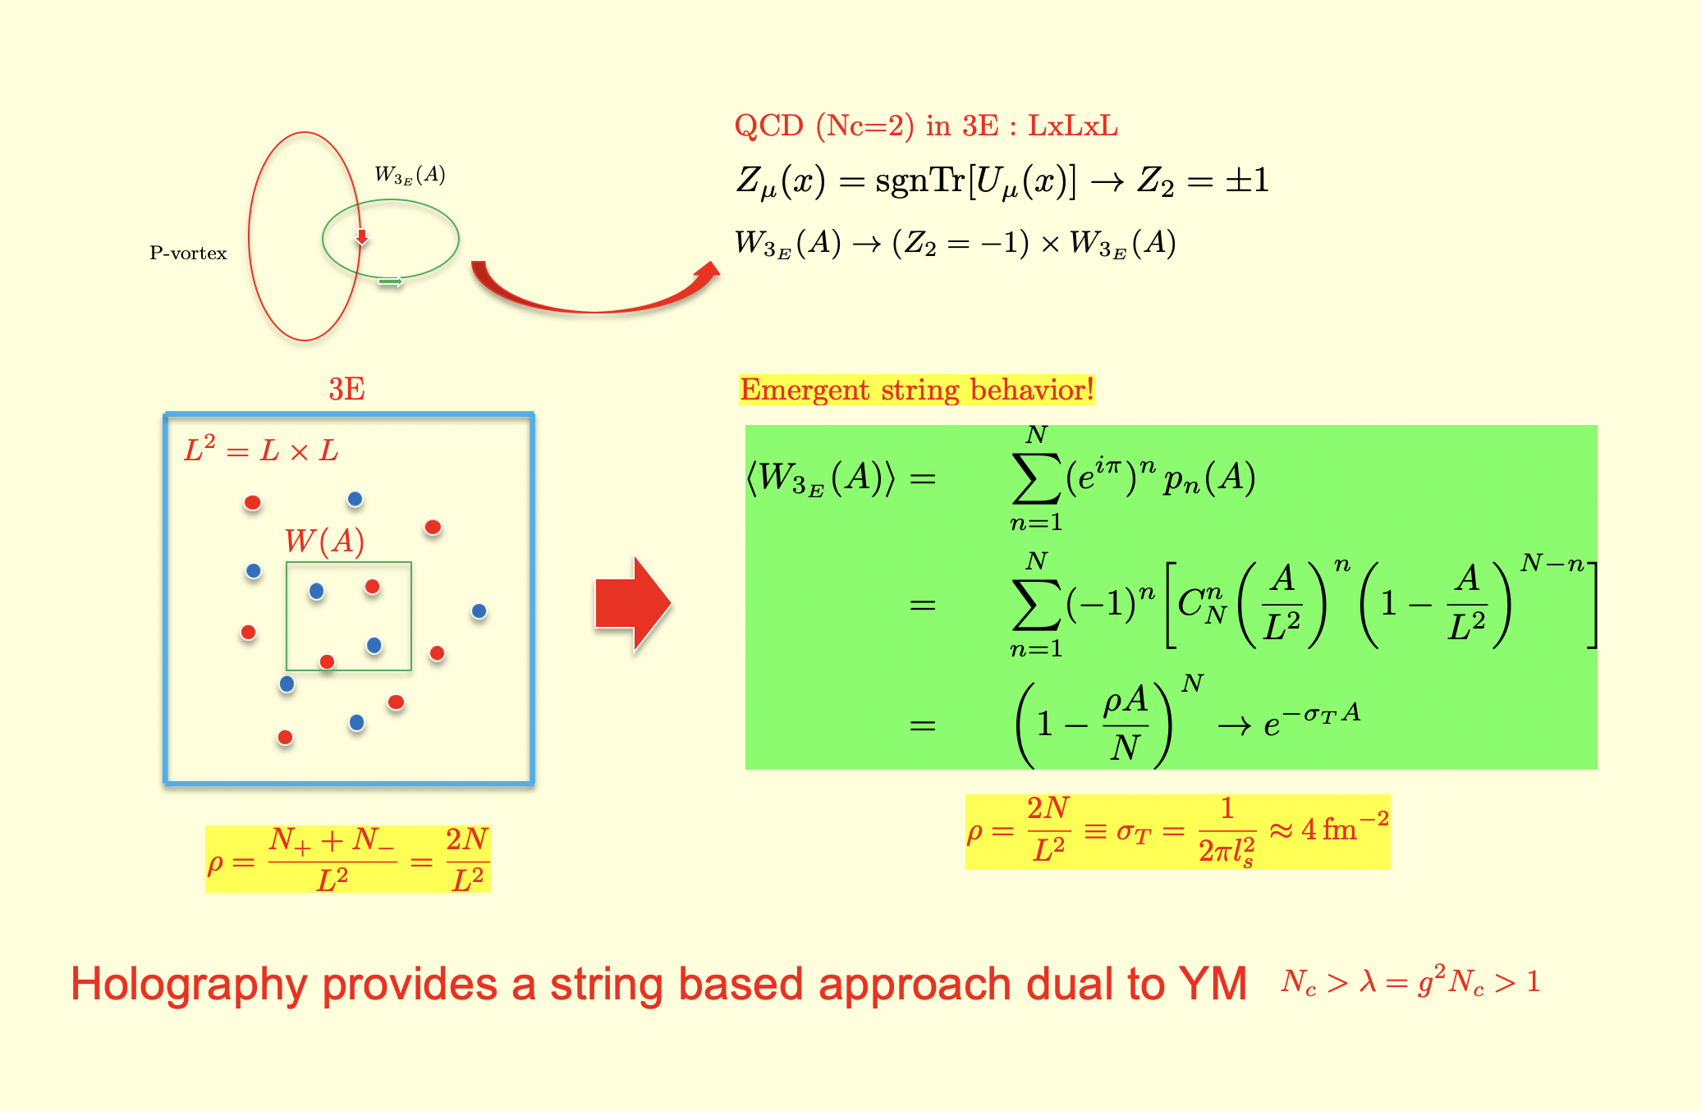
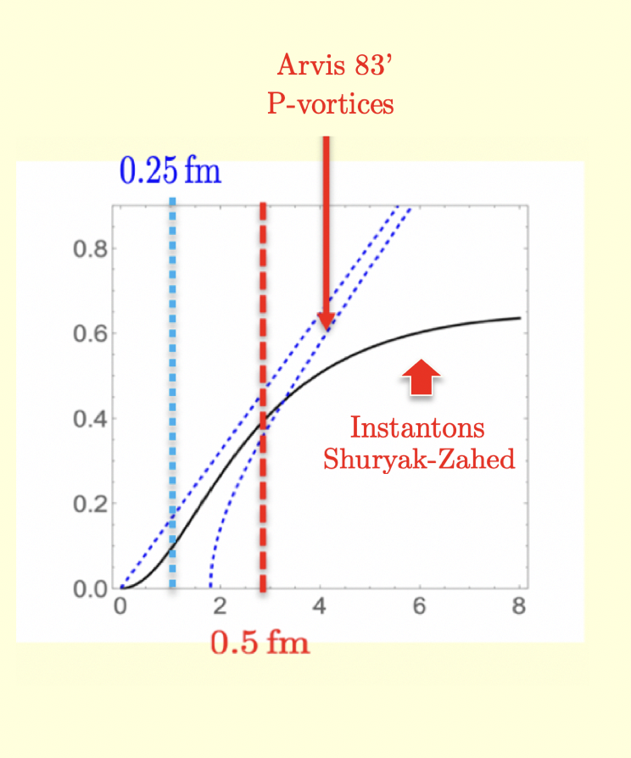
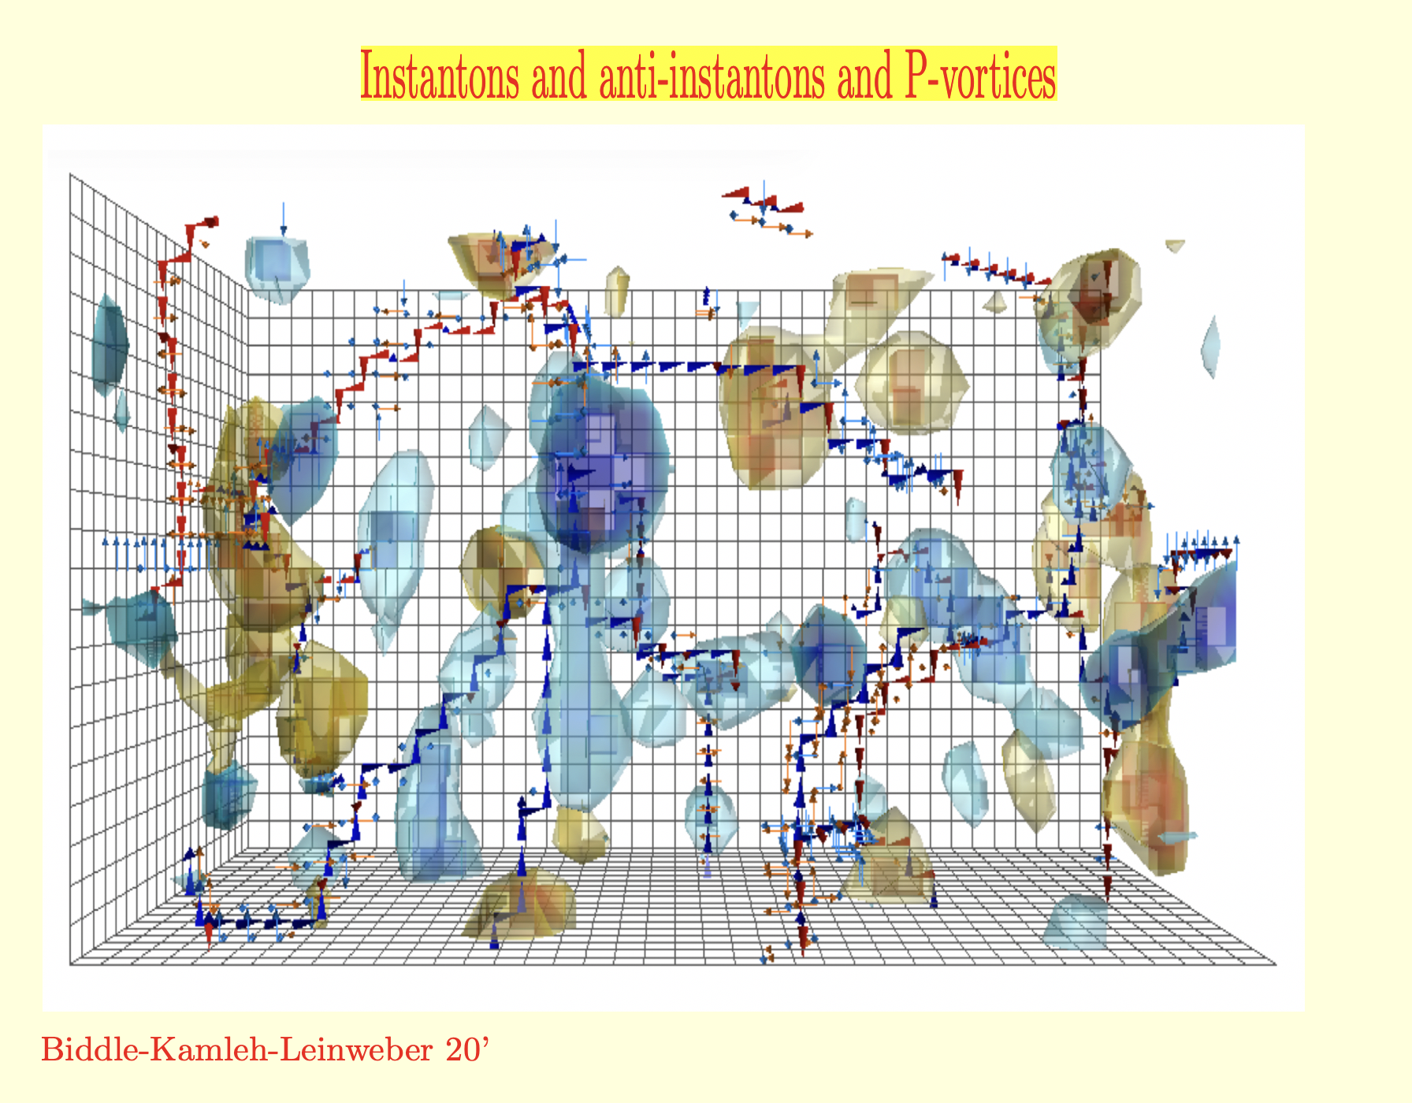
Topology: 2D, 3D, 4D
Mechanism of Confinement
Genealogy of linear Potential
Notes:
Slide 3 — Topology: 4D and 2D / Emergent strings:
“The QCD vacuum contains topological structures of different dimensions. There are 2D center vortices or P-vortices, responsible for disordering large Wilson loops and hence confinement; 3D monopole structures, important for the dual-confinement picture; and 4D instantons, associated with chiral symmetry breaking. Today I concentrate mainly on the 2D, string-like component.”

Slide 6
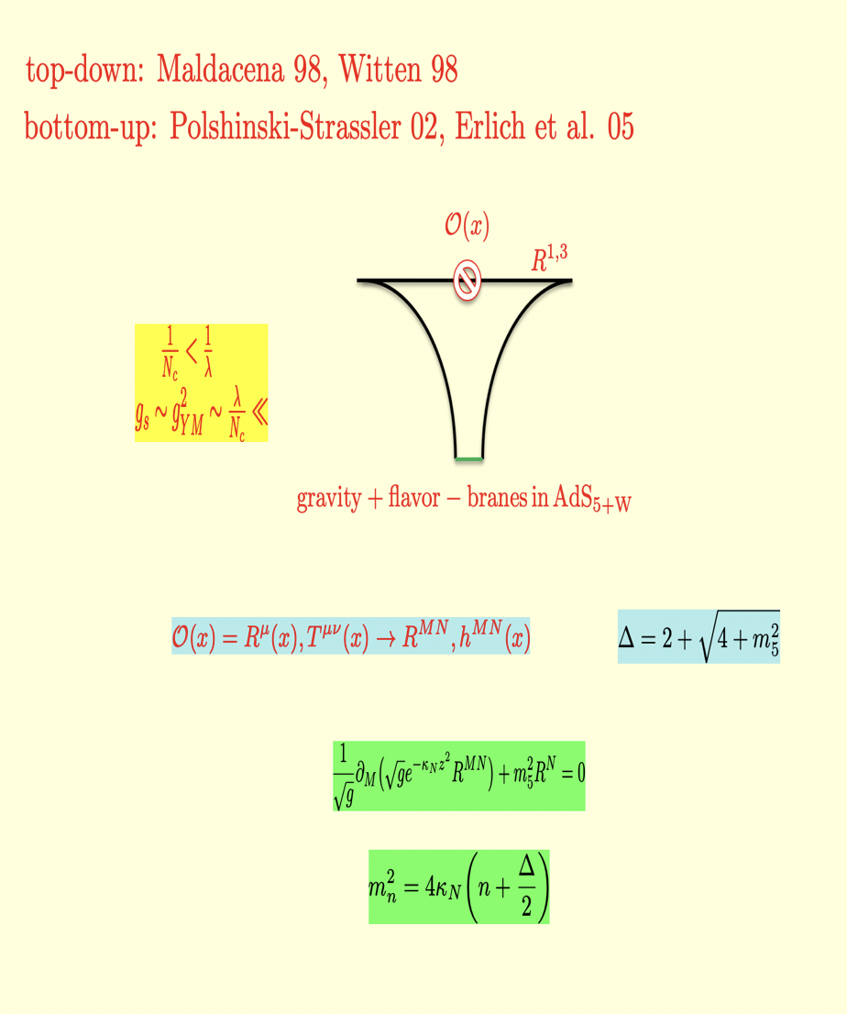
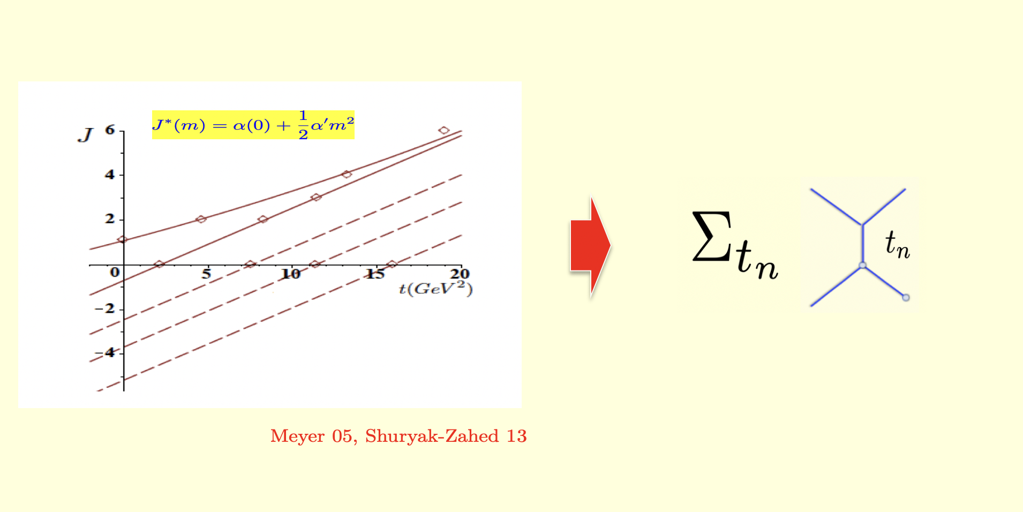
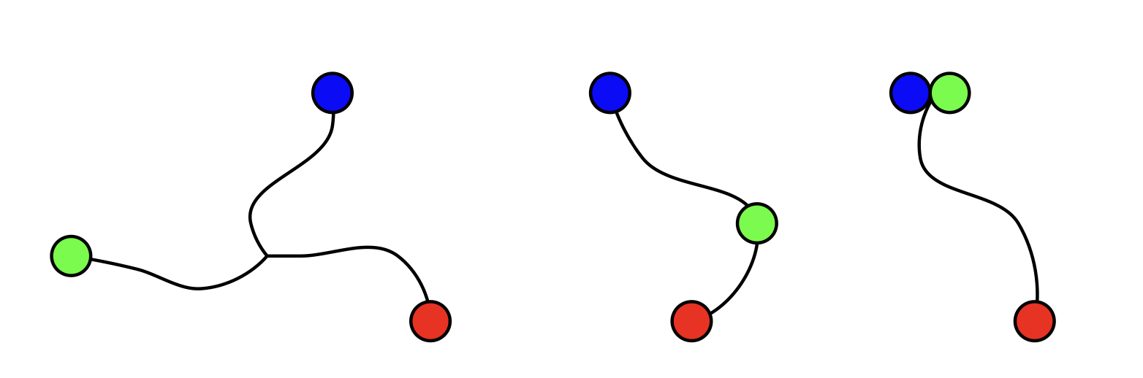
hQCD as an effective
string field theory nxm
Linear Regge spectra: Resonance dual model 2x2
Notes:
Slide 4 — Emerging strings and resonance duality:
“These strings are not restricted to the vacuum. When quark worldlines become widely separated—as in highly orbitally excited hadrons—the confining flux between them becomes effectively string-like. This is why the hadron spectrum itself points toward an effective string description, and motivates holography.”

Slide 7
Outline
Why strings and hQCD
EMT, Jpsi, GPDs, low-x
Notes:
There are three questions: Why do strings naturally emerge in QCD? Why is holography useful for describing them? And what can this framework tell us about experiments relevant to the EIC

Slide 8
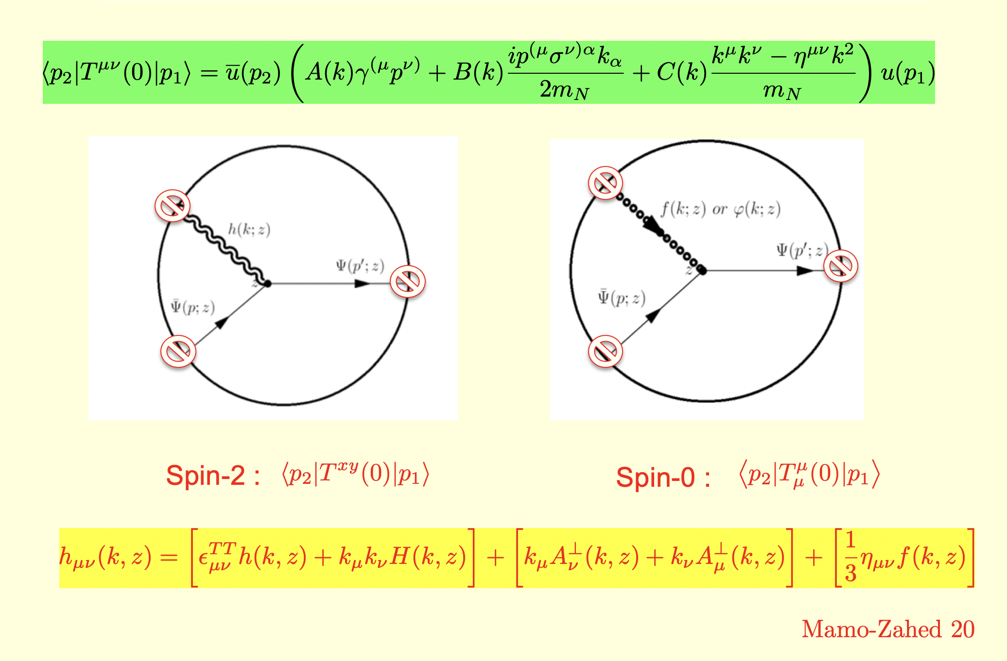
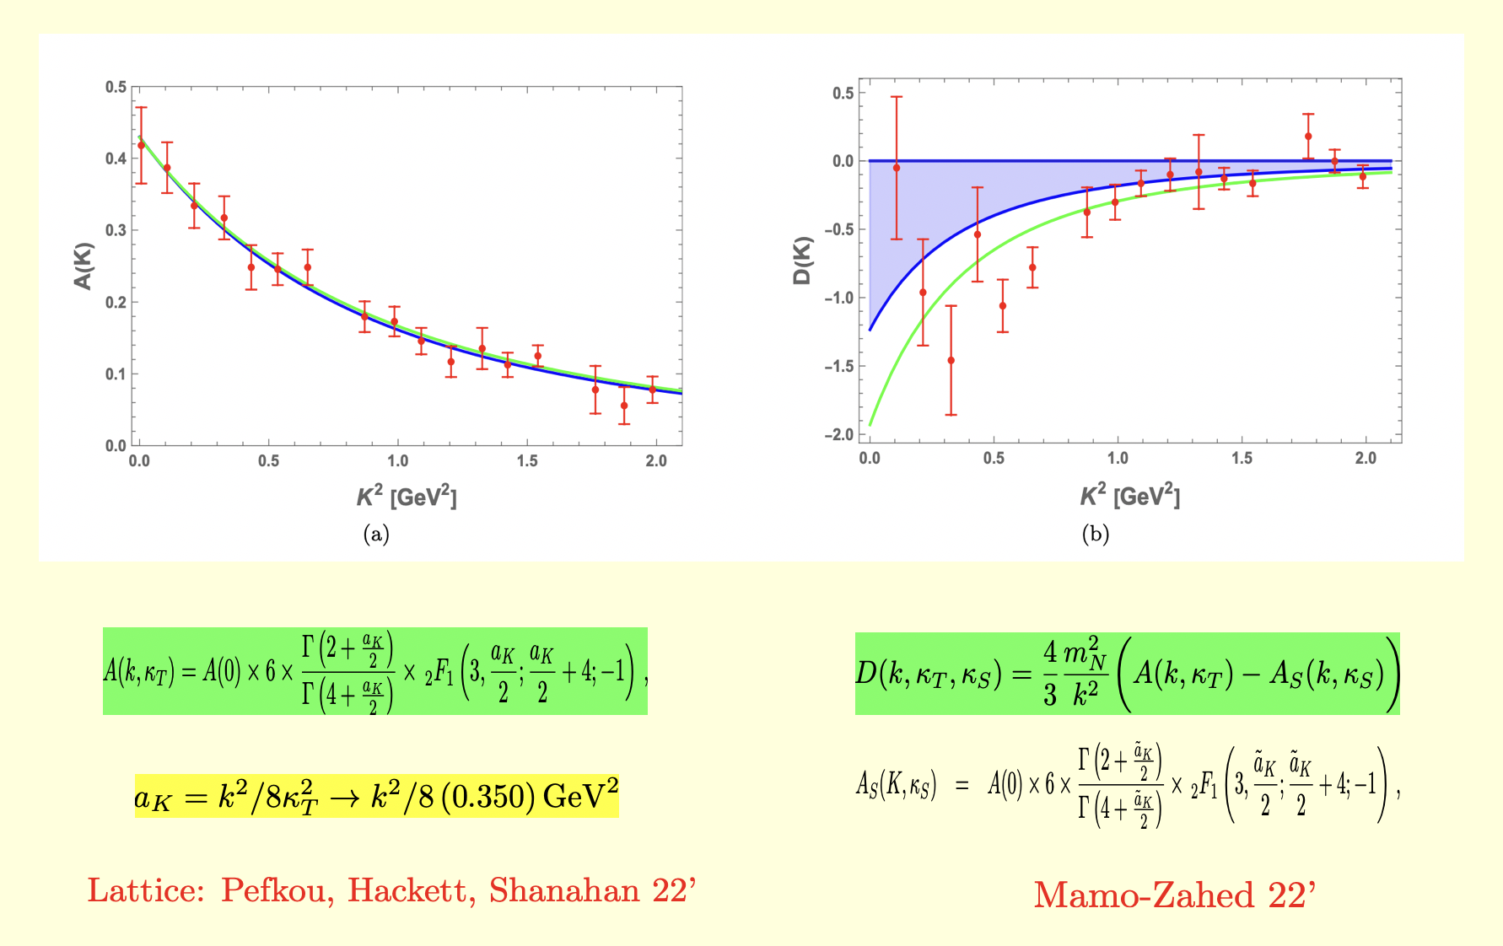

GFs from hQCD 2x1
GFs holography vs Lattice
Notes:
Gravitational FFS: holography versus lattice — “A basic test is whether holography reproduces quantities that can also be calculated directly with lattice QCD. The comparison shows that this relatively simple string description captures important features of the full strongly coupled theory.”

Slide 9
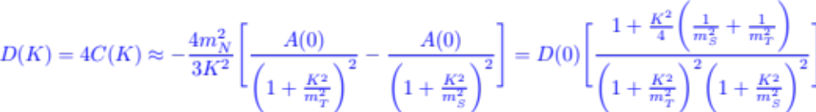
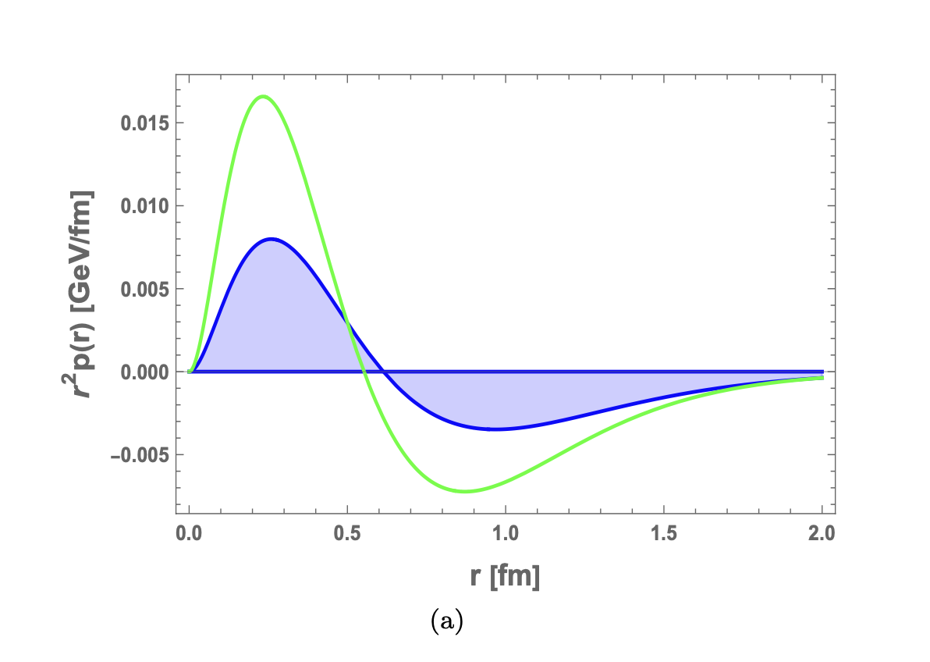


Genealogy of D=4C-term and radial Force
Negative!
Tripole!
Notes:
D-term and pressure — “We now use this framework to ask how forces are distributed inside a proton. The so-called D-term encodes its internal pressure and mechanical forces; importantly, its negative sign is associated with the mechanical stability of the proton.”

Slide 10
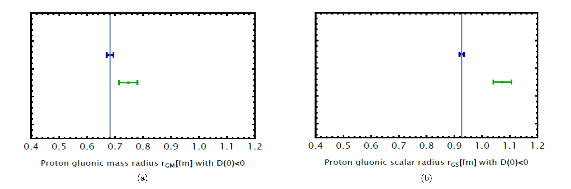




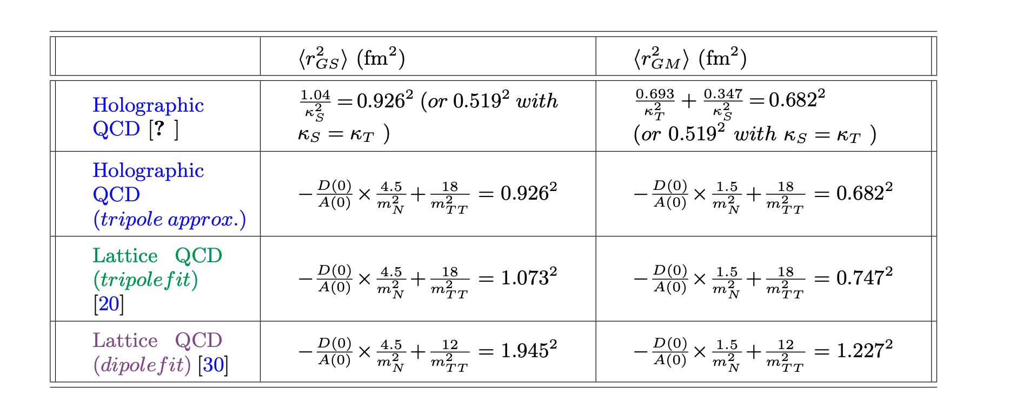
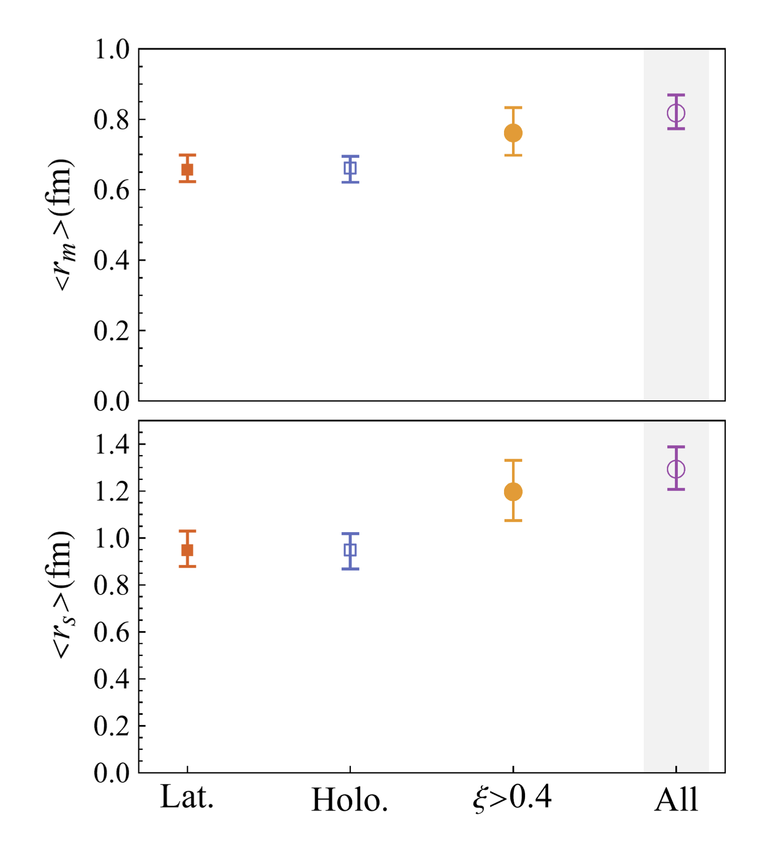

Gravitational radii
Notes:
Gravitational radii — “Just as the electric radius tells us how electric charge is distributed, gravitational form factors tell us how mass, energy, pressure and stress are distributed. They therefore provide a new kind of map of the proton.”

Slide 11
Outline
Why strings and hQCD
EMT, Jpsi, GPDs, low-x
Notes:
There are three questions: Why do strings naturally emerge in QCD? Why is holography useful for describing them? And what can this framework tell us about experiments relevant to the EIC

Slide 12
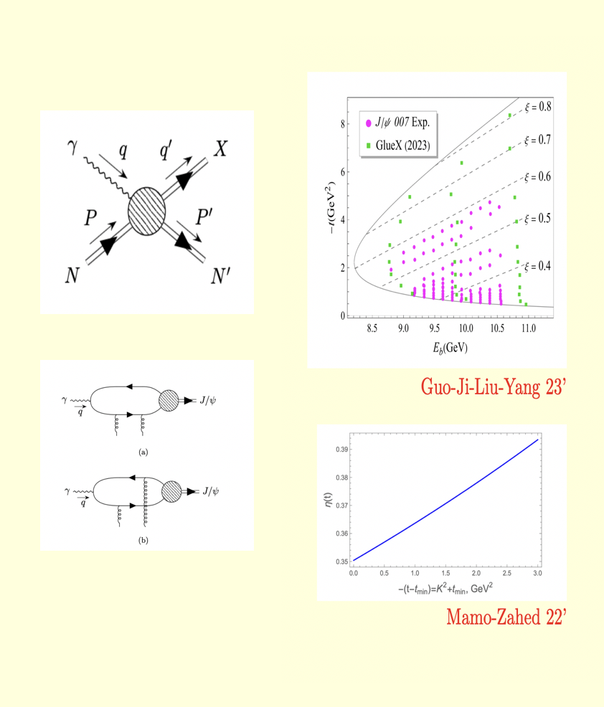
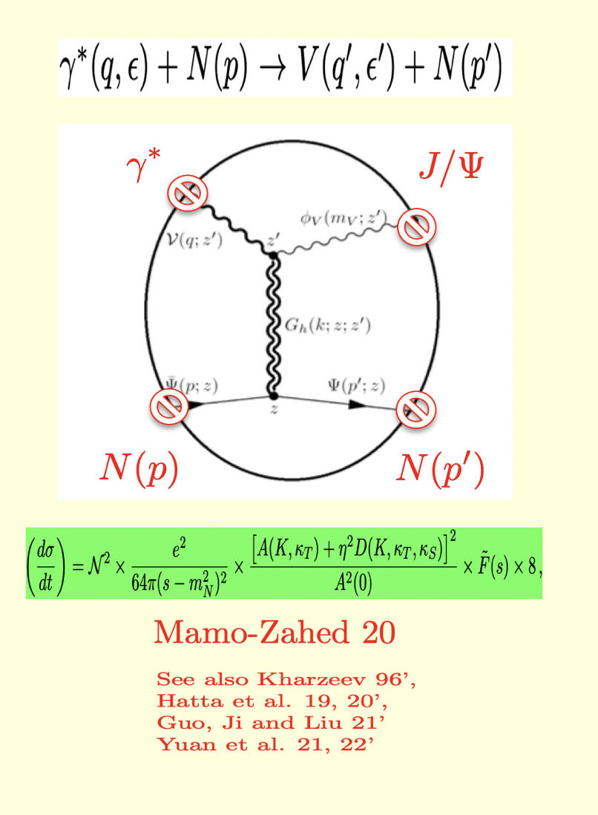

J/psi photoproduction at Jlab
hQCD 2x2
Notes:
J/ψ photoproduction at Jefferson Lab — “This may sound very theoretical, but it can be tested experimentally. Producing a heavy J/ψ particle with photons at Jefferson Lab gives access to the proton’s gluonic structure, which holography can describe.”

Slide 13
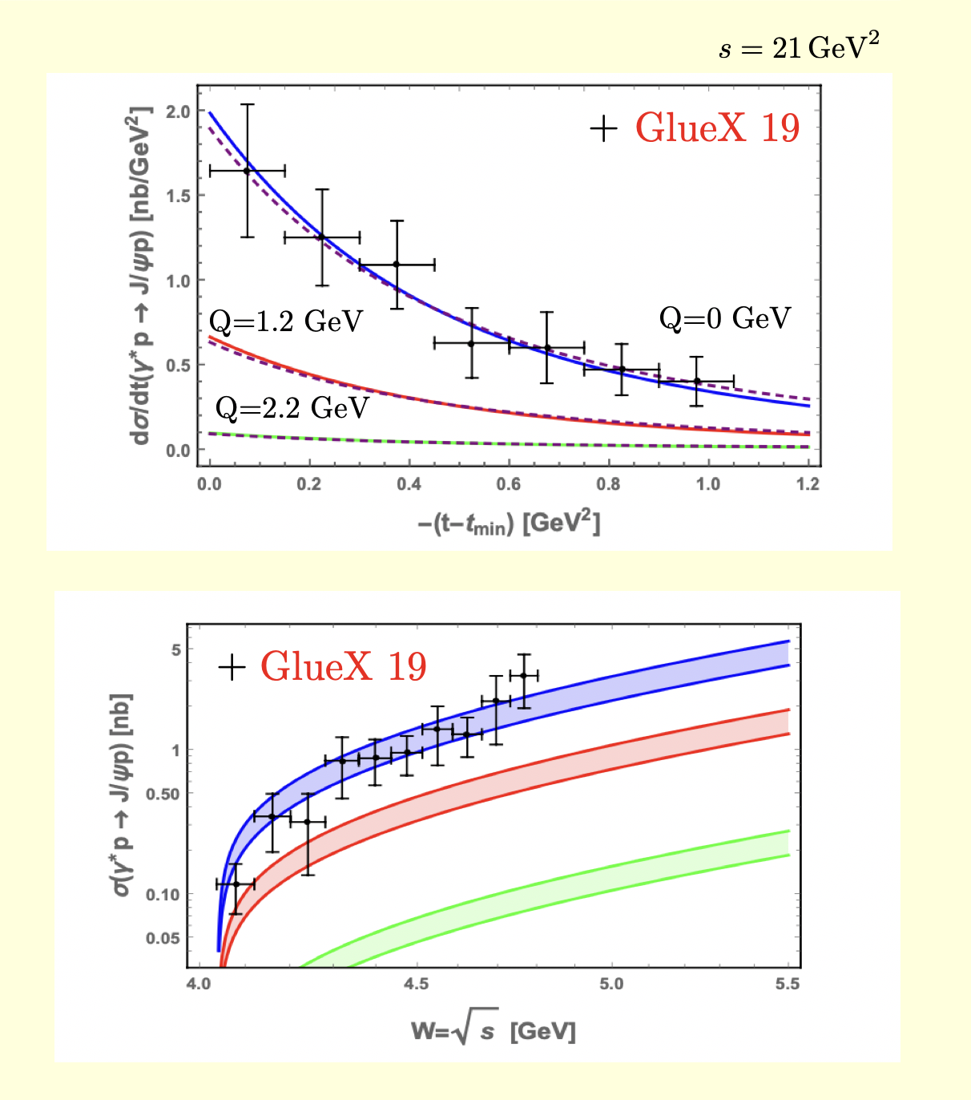
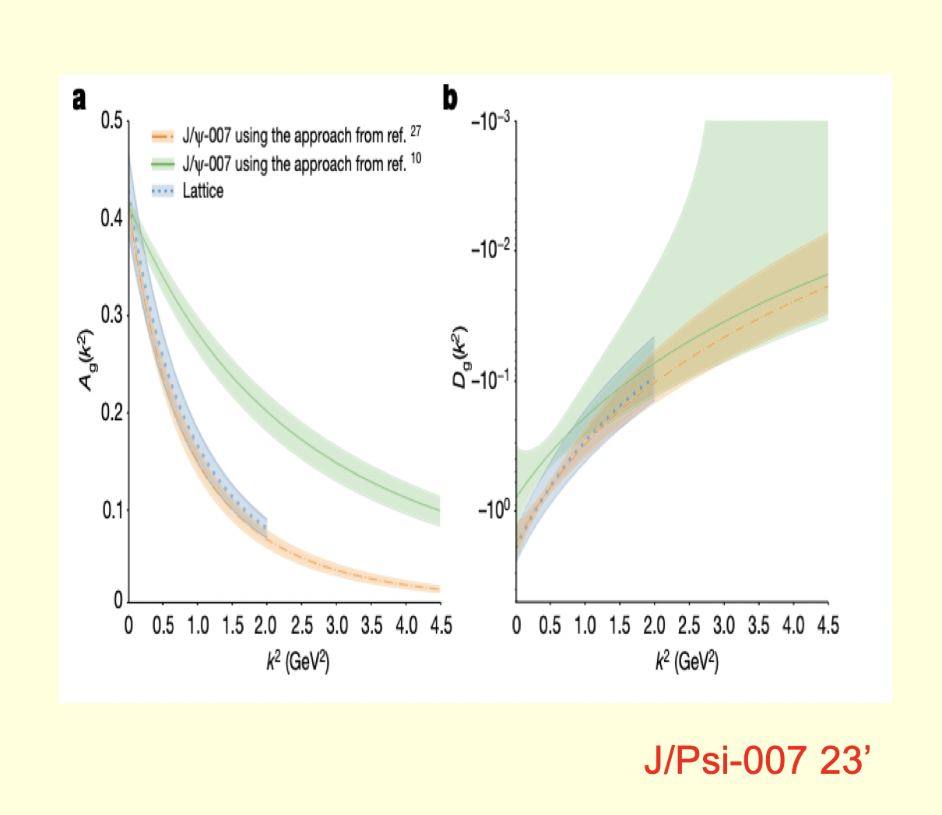
A-FF measured by GlueX 19’
A-FF and D-FF measured by 007 23’
Notes:
GlueX measurements — “These experiments have begun extracting the proton’s gravitational form factors. So quantities that once seemed purely theoretical—related to the distribution of mass and pressure—are becoming experimentally accessible.”

Slide 14
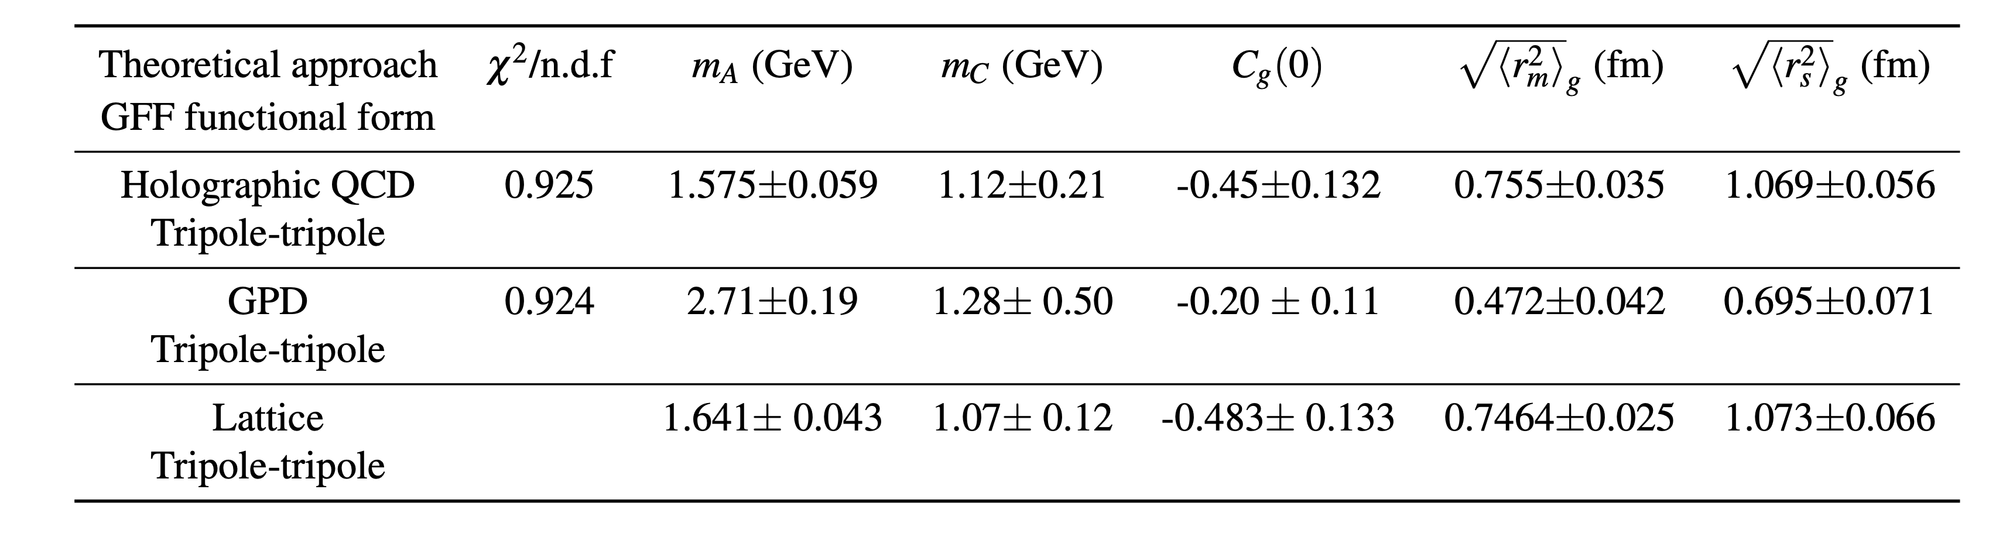
A-FF and D-FF measured by 007 23’
Extracted mass radii by 007 23’
Notes:
Extracted mass radii — “From these measurements one can infer a characteristic radius associated with the proton’s mass distribution. It need not be the same as the familiar electric charge radius, because we are probing a different aspect of the proton.”

Slide 15
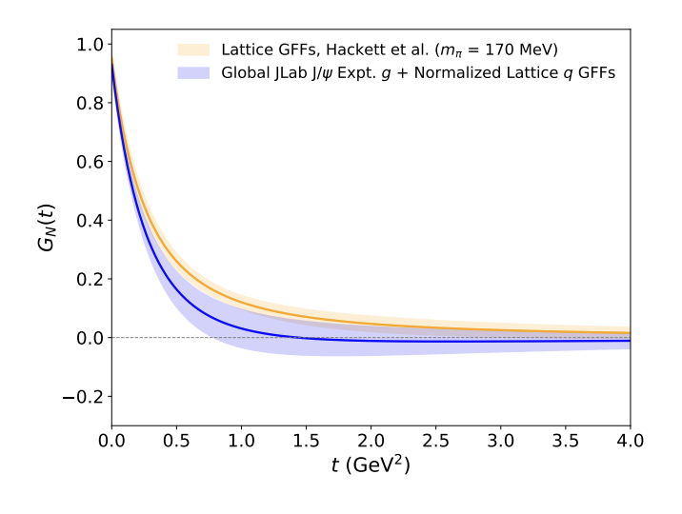
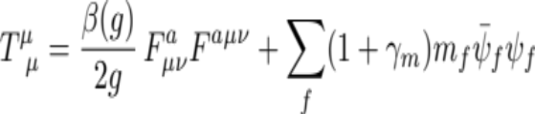

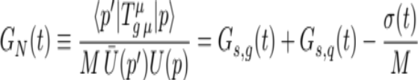
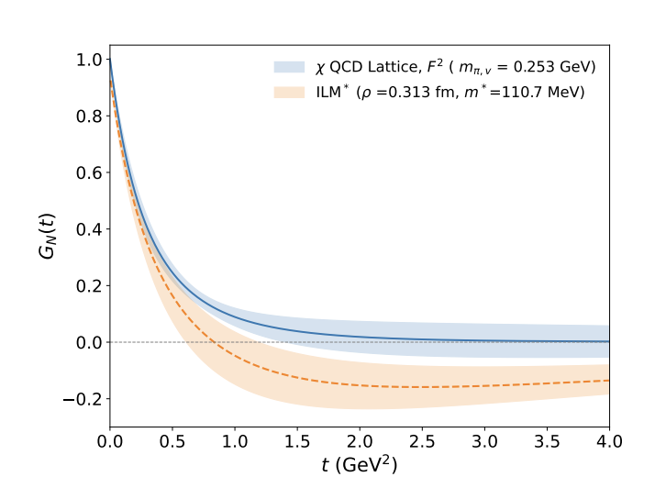


Experimental proposal for reconstruction of the trace anomaly FF
Meziani-Zahed 26’
Notes:
Experimental reconstruction — “The next step is to combine experimentally accessible information to reconstruct the proton’s internal mechanical structure more completely. The objective is essentially a three-dimensional picture of where its mass and forces reside.” JLAB-26

Slide 16
Outline
Why strings and hQCD
EMT, Jpsi, GPDs, low-x
Notes:
There are three questions: Why do strings naturally emerge in QCD? Why is holography useful for describing them? And what can this framework tell us about experiments relevant to the EIC

Slide 17
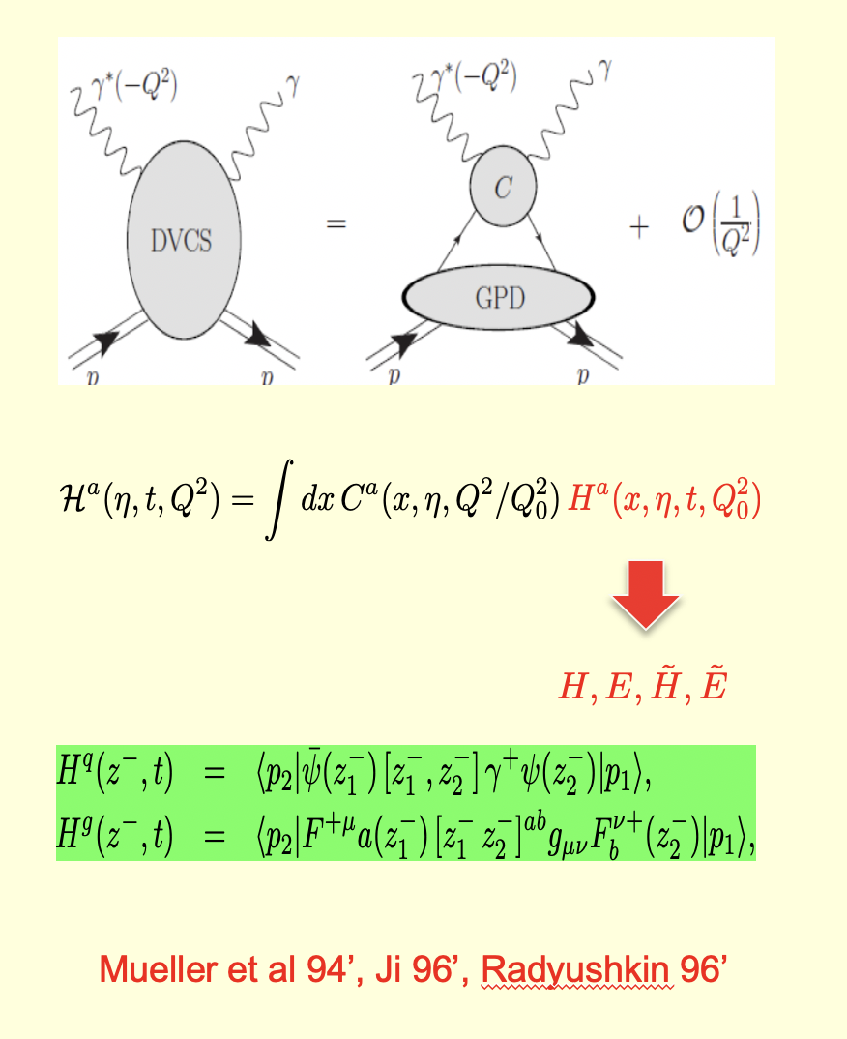
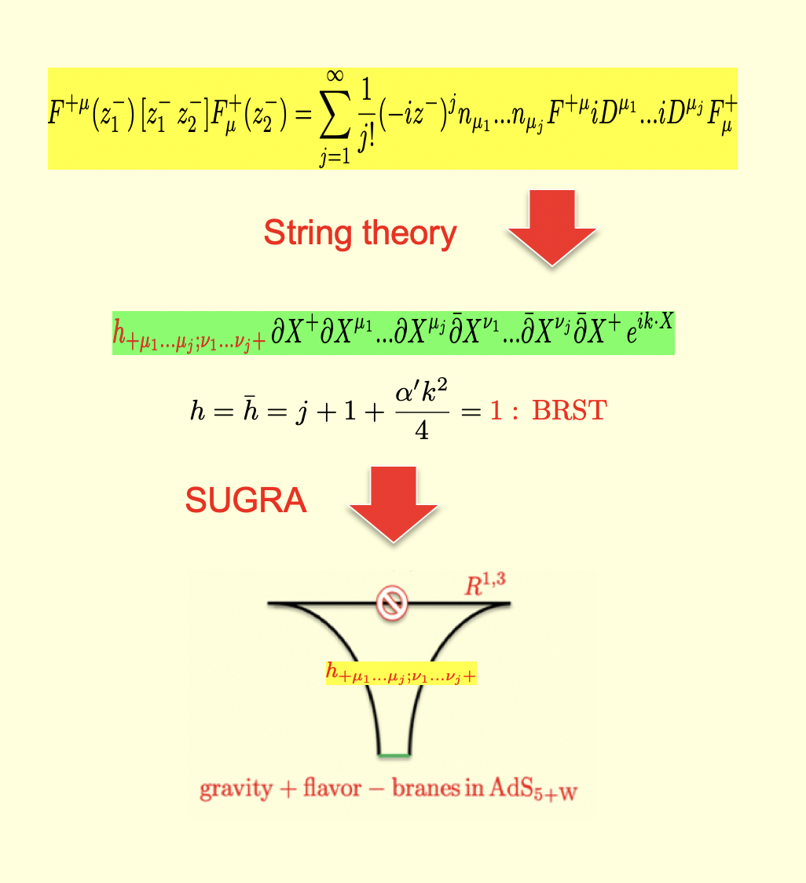
GPDs and light rays in DVCS
Light rays/string vertices in hQCD
Notes:
GPDs, DVCS and light rays — “Another way to image the proton uses generalized parton distributions, or GPDs. In high-energy scattering, quarks and gluons propagate almost along light rays, and holographically these light-ray structures acquire a natural string interpretation.”

Slide 18
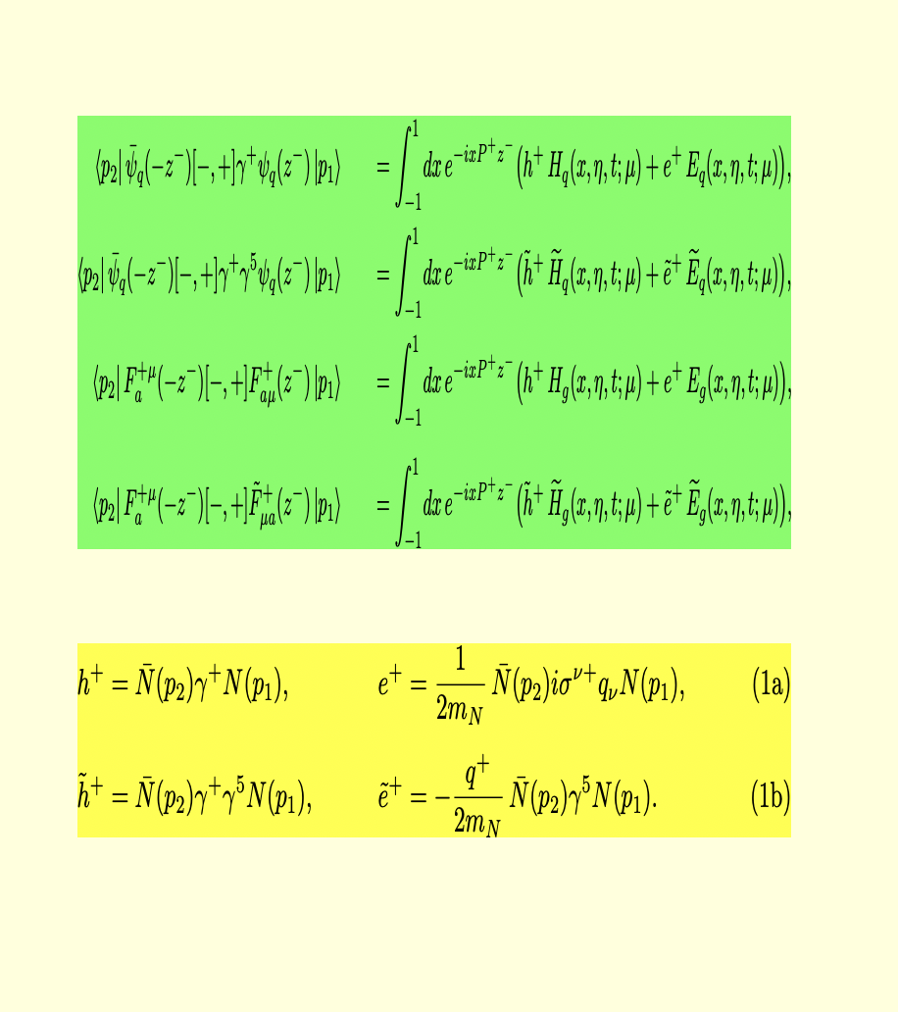
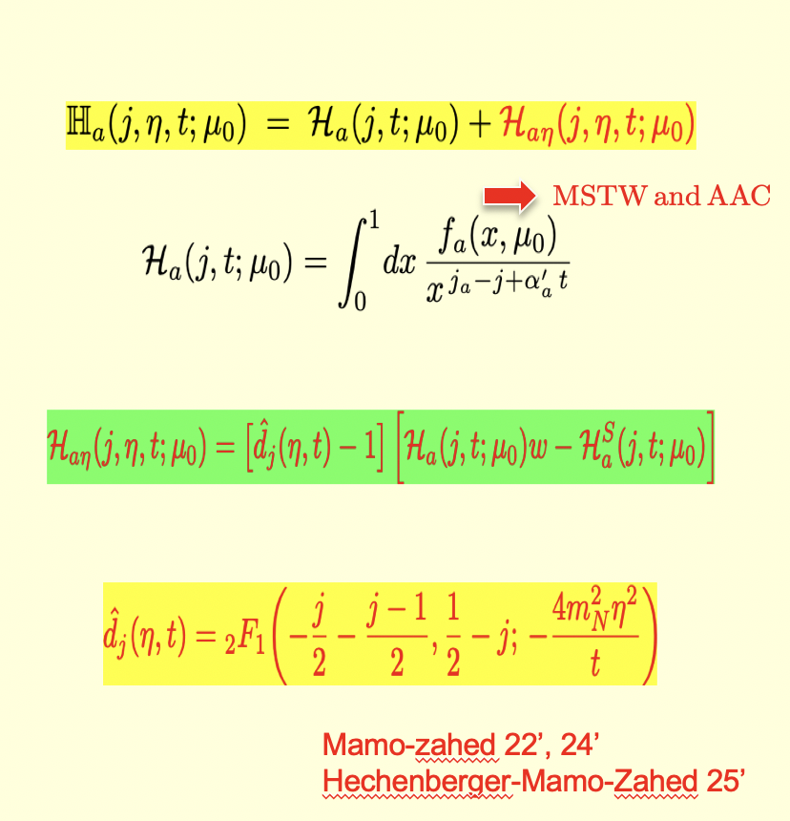
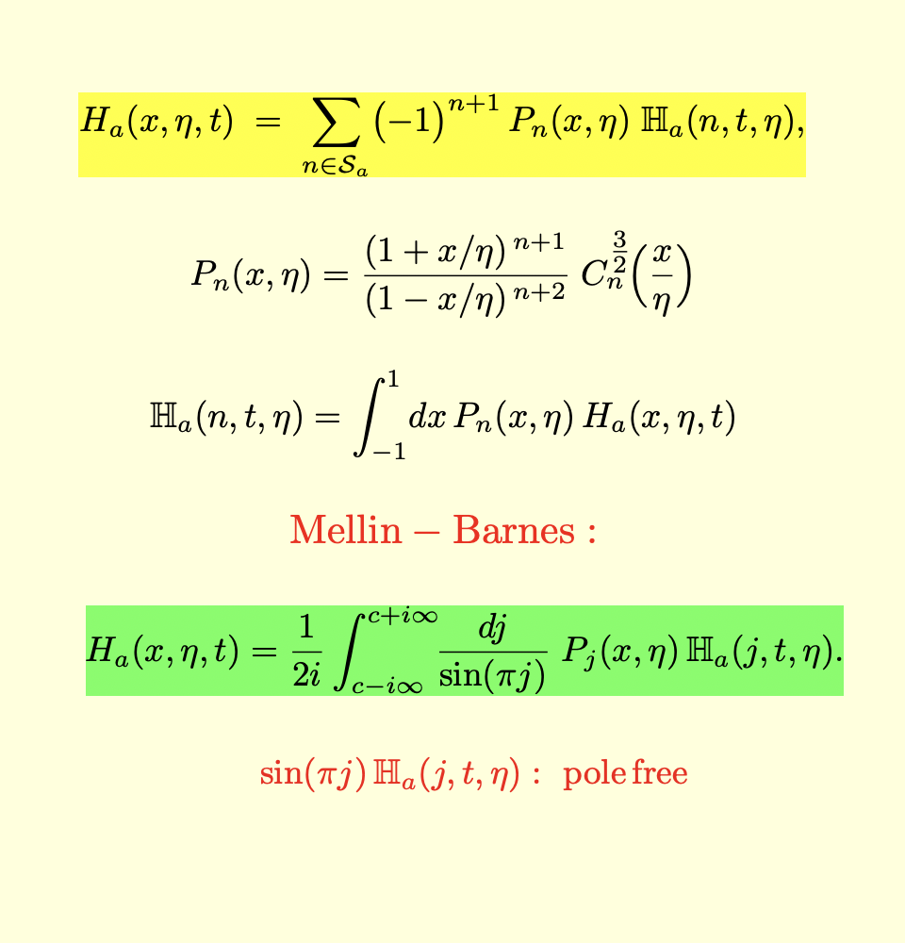
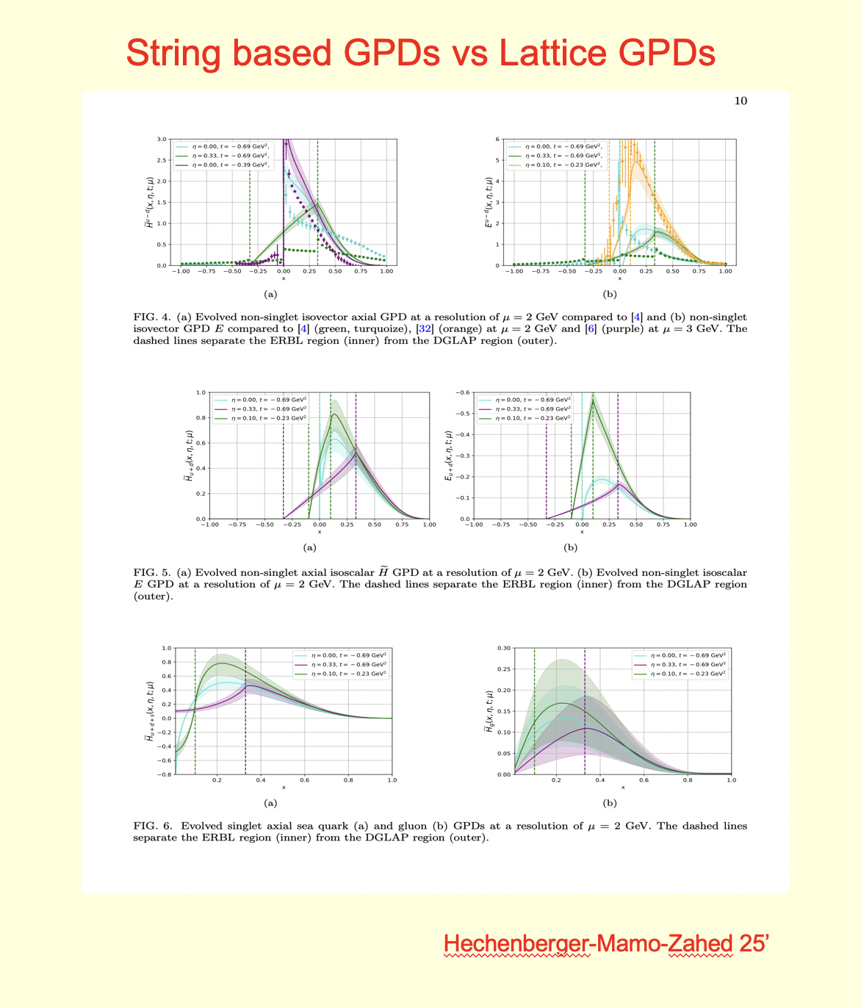
Unpolarized and polarized GPDs
GPDs conformal expansion in hQCD
Radyushkin-Beletsky 05’
Muller-Schafer 06’
Guo-Ji-Santiago-Shiells-Yang 23’
Notes:
Unpolarized and polarized GPDs — “GPDs contain much more information than ordinary parton distributions: they correlate momentum with spatial structure and can also tell us about spin. Their mathematical expansion provides a bridge between experimental observables and the underlying QCD dynamics.”

Slide 19
Outline
Why strings and hQCD
EMT, Jpsi, GPDs, low-x
Notes:
There are three questions: Why do strings naturally emerge in QCD? Why is holography useful for describing them? And what can this framework tell us about experiments relevant to the EIC

Slide 20
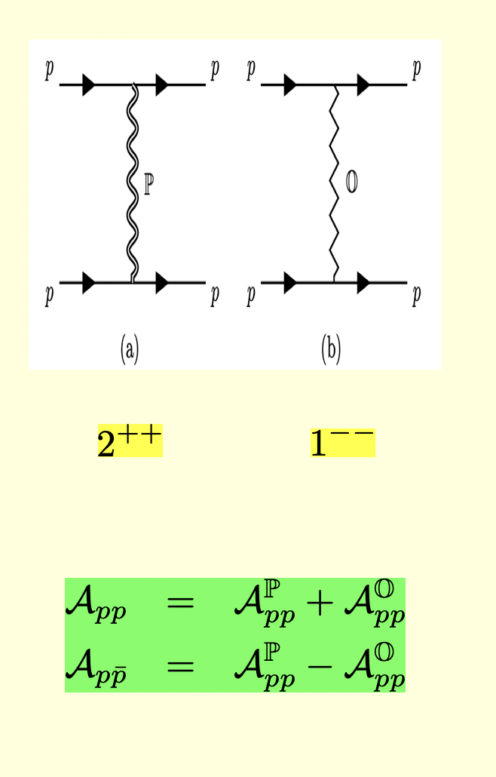
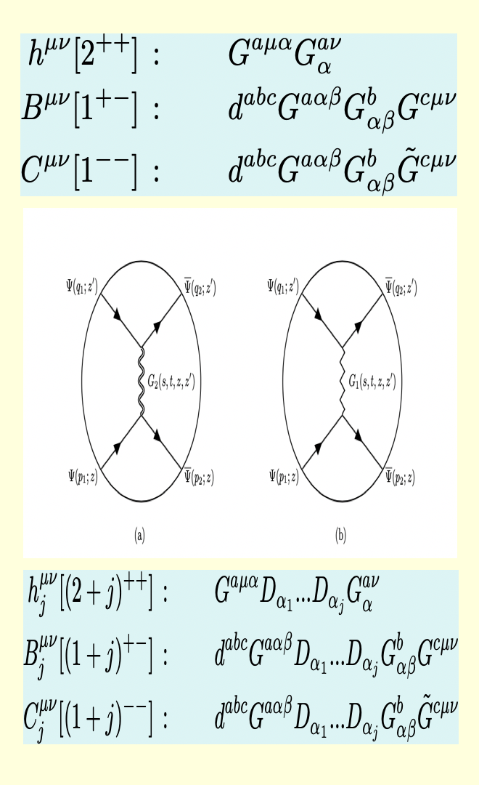
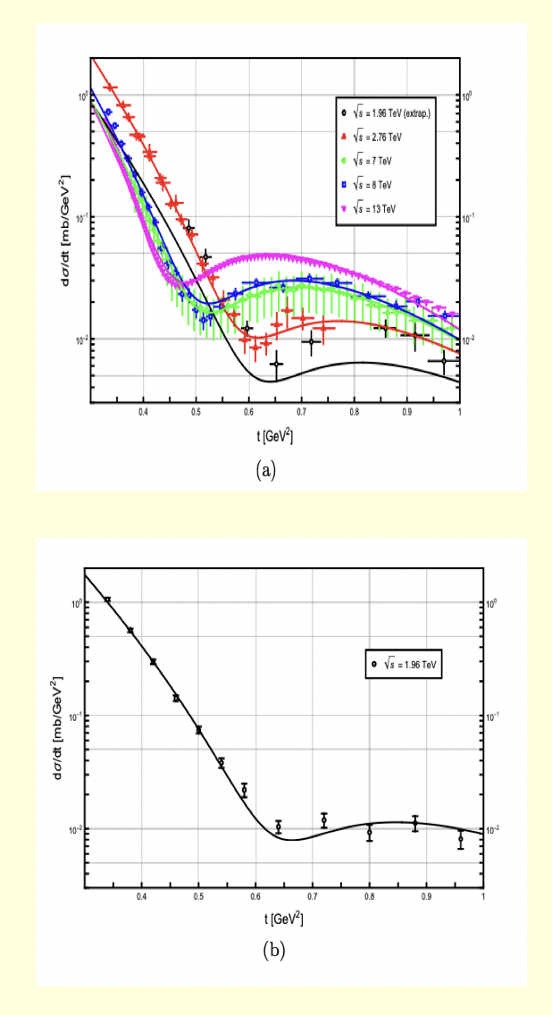


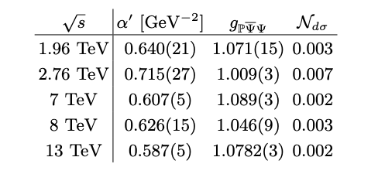
pp at large s
pp in hQCD
hQCD @ TOTEM/DO
Hechenberger-Mamo-Zahed 23’
Notes:
High-energy proton–proton scattering — “We can push the same holographic picture to very high-energy proton collisions. Here the interaction can be viewed as an exchange of string-like excitations, which can be compared directly with collider measurements.”

Slide 21
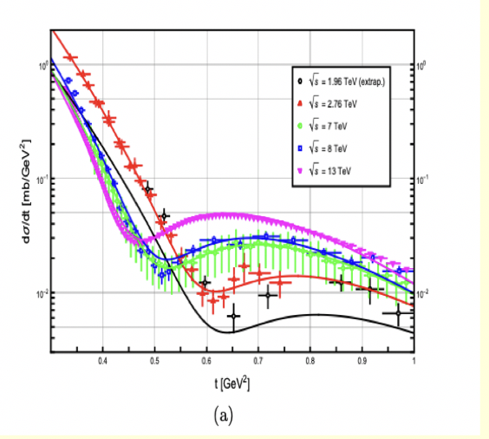
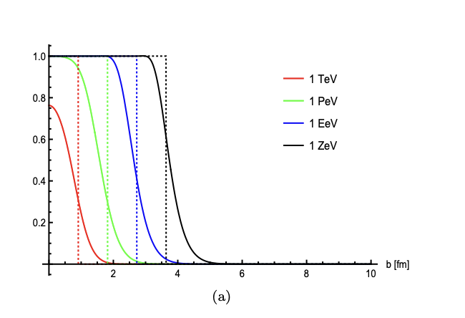
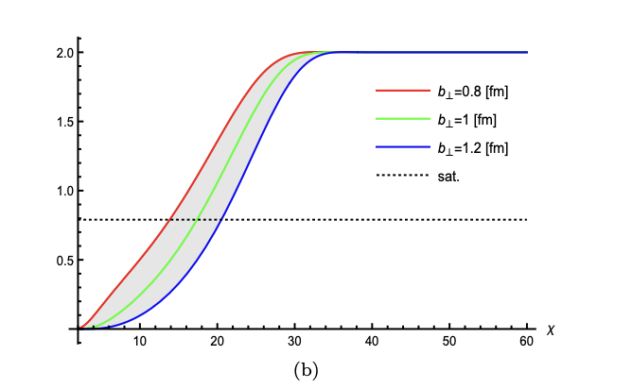
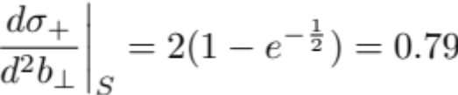
hQCD Saturation:
Low-x ‘matter’
hQCD/TOTEM/DO
hQCD Black-disc
PTev
Hechenberger-Mamo-Zahed 23’
Notes:
Black disk, saturation and low-x matter — “At extremely high energies, the proton becomes densely populated by gluons. Eventually the interaction approaches a saturated or ‘black-disk’ regime, and holography provides a geometric string description of this low-x matter.”

Slide 22
Summary
Vacuum : 2D,3D,4D
4D : spin-mass
2D,3D : Reggeized string
Notes:
Summary — “The common message is that strings appear repeatedly in strongly coupled QCD: in the vacuum, in hadron structure, and in very high-energy scattering. Holography gives us one framework connecting these apparently different phenomena.”

