Slide 1

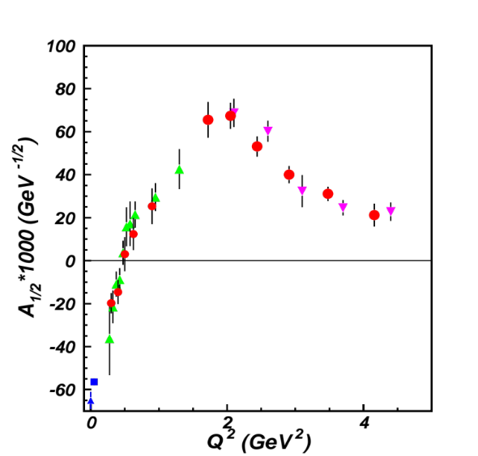
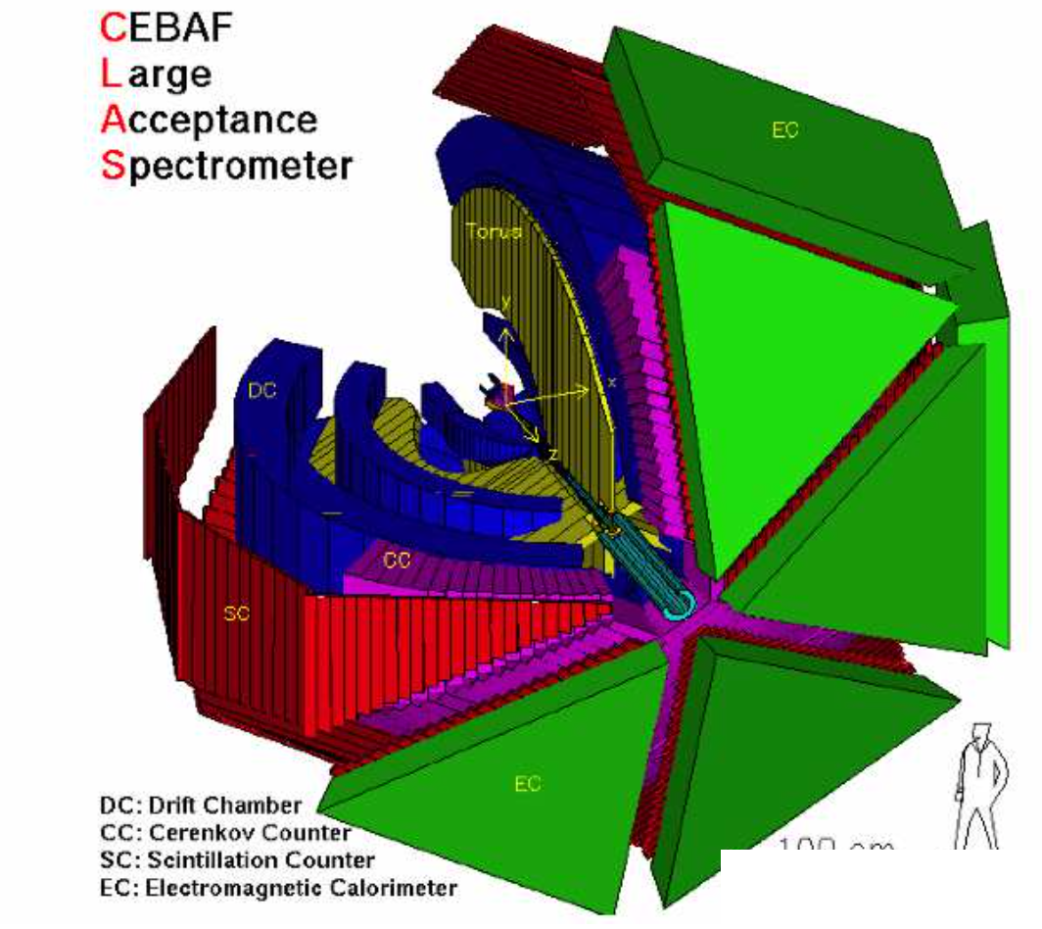
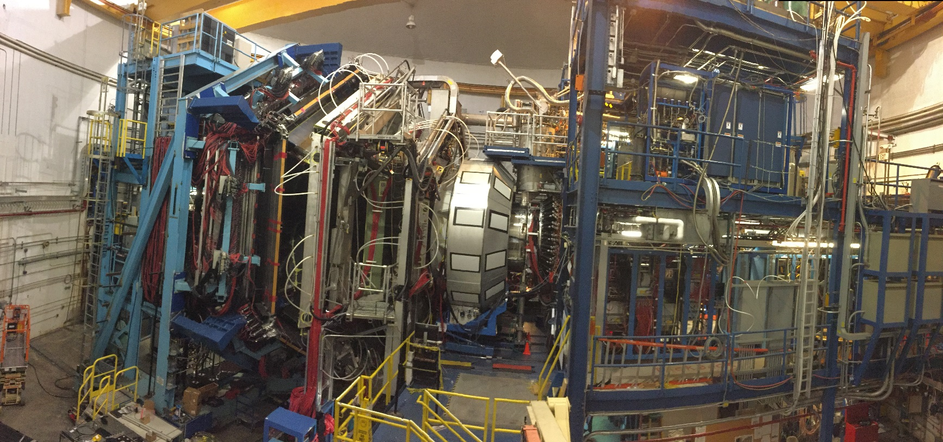
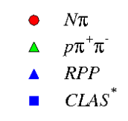
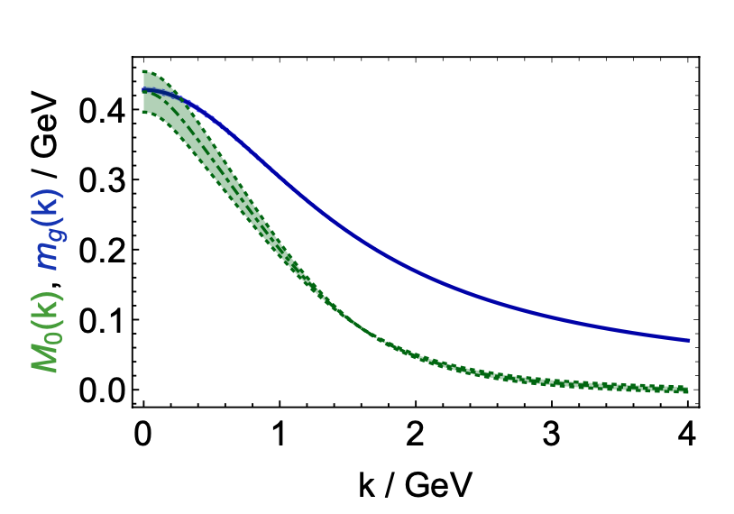


High Q² Nucleon Resonance Study
N(1440)1/2⁺
N* electroexcitation amplitudes (γ_{v}pN* electrocouplings) as a window into strong interaction dynamics in the non-perturbative regime
γ_{v}pN* electrocouplings from exclusive meson electroproduction with CLAS
Insight into emergence of hadron mass
New opportunities with CLAS12
Gains foreseen from experiments with increased luminosity over large acceptance
Mass (GeV)
Dressed
gluons
CLAS12
Dressed
quarks
CLAS
k (GeV)
Higher luminosity operations with large acceptance CLAS12 detector enable significant gains in extracting γ_{v}pN* electrocouplings for Q² to 13 GeV². These studies, combined with pseudoscalar-meson and ground-state nucleon structure, address a challenging Standard Model problem: understanding the origin of >98% of hadron mass and the emergence of hadron structure from strong interactions.
V.I. Mokeev, University of South Carolina
and Jefferson Lab (CLAS Collaboration)
1

Slide 2
N* Structure in Experiments of 6/12 GeV Eras at Hall B
The experimental program on studies of N* structure in exclusive meson photo- and electroproduction with CLAS/CLAS12 seeks to determine:
  γ_{v}pN* electrocouplings at Q² up to 10 GeV² for most excited proton states up to 2.5 GeV by analyzing the data of meson electroproduction channels in the N* region.
  search for new states of baryon matter, so-called hybrid baryons with glue as an active structural component.
A unique source of information on many facets of strong QCD (sQCD, when α_{s}/π is comparable with unity) in generating excited nucleon states with different structural features:
V.D. Burkert et al, Prog. Part. Nucl. Phys. 146, 104214 (2026)
P. Cheng, L. Liu, Ya Lu, and C.D. Roberts, Acta Phys. Polon. B57 2-A13 (2026)
V.I. Mokeev and D.S. Carman Few Body Syst. 63, 59 (2022)
4. P. Achenbach, D.S. Carman, R.W. Gothe, K. Joo, V.I. Mokeev, and C.D. Roberts, Symmetry 7,1106 (2025)
5. M. Ding, C.D. Roberts, and S.M. Schmidt, Particles 6, 57 (2023)
6. D.S. Carman, R.W. Gothe, V.I. Mokeev. and C.D. Roberts, Particles 6, 416 (2023)
Explore emergence of hadron mass (EHM) and structure in the transition from
the pQCD to the sQCD regime

Slide 3
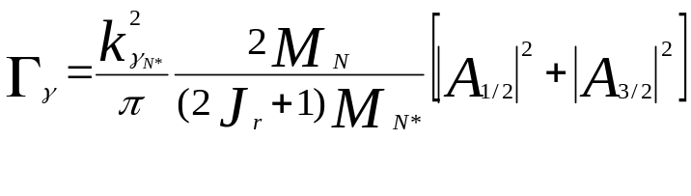
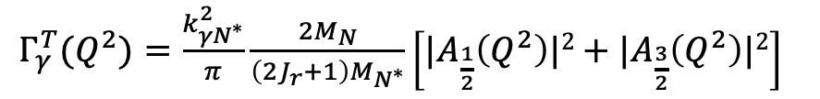
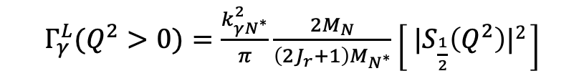
N* Photo-/Electrocouplings and their Extraction from Exclusive Data
Resonant amplitudes
Non-resonant amplitudes
e’
π, η, ππ, KY,…
π, η, ππ, KY,…
γ_{v}
e
*
N*,△
+
N
N’
N
N’
Definition of N* photo-/electrocouplings in CLAS analyses:
Real A_{1/2}(Q²), A_{3/2}(Q²), S_{1/2}(Q²)
I.G. Aznauryan and V.D. Burkert, Prog. Part. Nucl. Phys. 67, 1 (2012)
$Γ_{γ}^{T}(Q^{2})=\frac{k_{γN^{∗}}^{2}}{π}\frac{2M_{N}}{\left(2J_{r}+1\right)M_{N^{∗}}}\left[{|A}_{\frac{1}{2}}\left(Q^{2}\right)|2+{|A}_{\frac{3}{2}}\left(Q^{2}\right)|2\right]$
$Γ_{γ}^{L}(Q^{2}>0)=\frac{k_{γN^{∗}}^{2}}{π}\frac{2M_{N}}{\left(2J_{r}+1\right)M_{N^{∗}}}\left[{ |S}_{\frac{1}{2}}\left(Q^{2}\right)|2 \right]$
  Consistent results on the γ_{r,v}pN* photo-/electrocouplings from different meson photo-/electroproduction channels allow us to validate the capabilities of the reaction models for reliable extraction of these quantities.

Slide 4
Nucleon Resonance Electrocouplings from Data on Exclusive Meson Electroproduction of 6 GeV Era with CLAS
Exclusive meson electroproduction channels | Excited proton states | Q²-ranges for extracted γ_{v}pN* electrocouplings, GeV²
π⁰p, π⁺n | Δ(1232)3/2⁺ N(1440)1/2⁺,N(1520)3/2⁻, N(1535)1/2⁻ | 0.16-6.0 0.30-4.16
π⁺n | N(1675)5/2⁻, N(1680)5/2⁺,N(1710)1/2⁺ | 1.6-4.5
ηp | N(1535)1/2⁻ | 0.2-2.9
π⁺π⁻p | N(1440)1/2⁺, N(1520)3/2⁻ N(1440)1/2⁺, N(1520)3/2⁻, Δ(1600)3/2⁺, N(1675)5/2⁻, N(1680)5/2⁺, Δ(1700)3/2⁻, N(1720)3/2⁺, N’(1720)3/2⁺ | 0.25-1.50 2.0-5.0 2.0-5.0 0.5-5.0
The γ_{v}pN* electrocouplings have become available from analysis of CLAS data for most N* states in the mass range <1.8 GeV and in the range of Q² < 5 GeV².
Numerical results can be found at https://userweb.jlab.org/~mokeev/resonance_electrocouplings23/
A.N. Hiller Blin et al, PRC100, 035201 (2019), V.I. Mokeev et al., arXiv:2608.04997

Slide 5
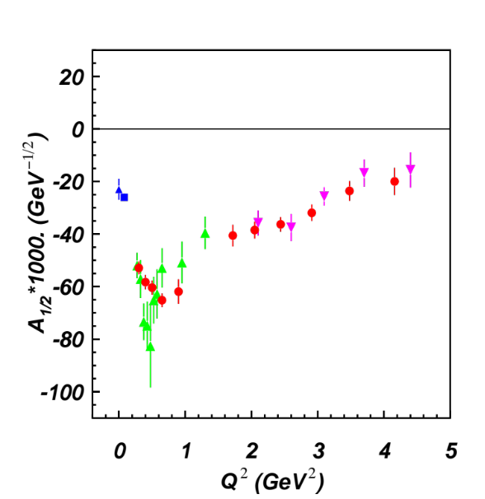
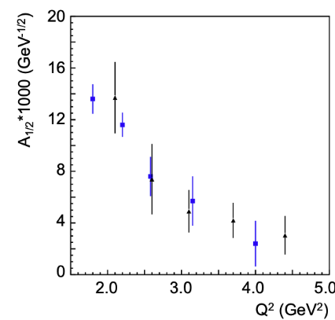
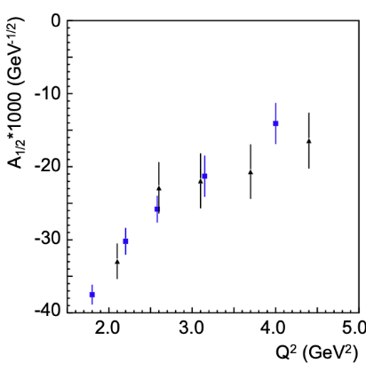
N* Electrocouplings from πN and π⁺π⁻p CLAS Electroproduction Data
N(1440)1/2⁺
N(1520)3/2⁻
I.G. Aznauryan et al. (CLAS), PRC 80, 055203 (2009)
V.I. Mokeev et al., PRC 86, 035203 (2012)
V.I. Mokeev et al., PRC 93, 025206 (2016)
V.I. Mokeev et al., PRC 108, 025204 (2023)
A_{1/2}
A_{1/2}
pπ⁺π⁻ CLAS
2023
N(1675)5/2⁻
N(1680)5/2⁺
A_{1/2}
I.G. Aznauryan et al. (CLAS), PRC 91, 045203 (2015)
black: CLAS π⁺π⁻p
V.I. Mokeev et al., arXiv:2608.04997
A_{1/2}
Consistent results on the γ_{v}pN* electrocouplings from independent studies of the two major πN and π⁺π⁻p electroproduction channels with different non-resonant contributions demonstrated the reliability of the JANR/JM reaction models and allow for evaluation of their systematic uncertainties.

Slide 6
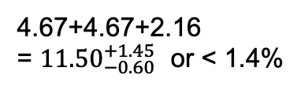
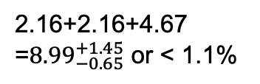
How do the Ground/Excited Nucleon Masses Emerge?
Composition of the Nucleon Mass:
M_{p}, MeV (PDG23)
proton
M_{n}, MeV (PDG23)
neutron
938.2720813
±0.0000058
939.5654133
±0.0000058
Sum of bare quark
masses, MeV
Sum of bare quark
masses, MeV
2.16+2.16+4.67
=${8.99}_{−0.65}^{+1.45}$ or < 1.1%
4.67+4.67+2.16
= ${11.50}_{−0.60}^{+1.45}$ or < 1.4%
$\overline{\text{MS}}\text{ scheme}$ at a renormalization scale of 2.0 GeV
The Higgs mechanism only generates the renormalization-group-invariant masses of bare quarks relevant to the pQCD regime.
The dominant part of N/N* masses is generated in processes other than the Higgs mechanism.
6

Slide 7
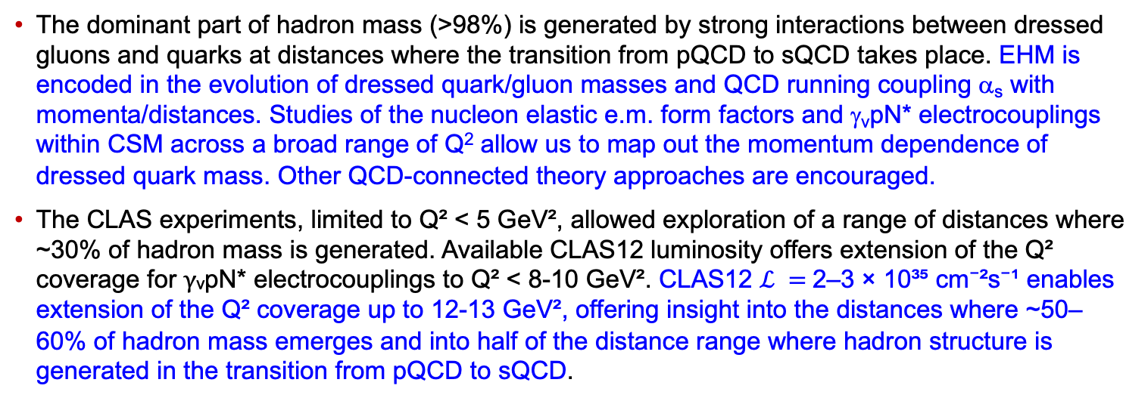
CSM Concept on EHM and Insight from γ_{v}pN* Electrocoupling Data
Mass (GeV)
P. Achenbach, D.S. Carman, R.W. Gothe, K. Joo, V.I. Mokeev, and C.D. Roberts, Symmetry, 17, 1106 (2025)
M. Ding, C.D. Roberts, and S.M. Schmidt, Particles 6, 57 (2023)
Dressed
gluons
CLAS12
Dressed
quarks
CLAS
k (GeV)
The dominant part of hadron mass (>98%) is generated by strong interactions between dressed gluons and quarks at distances where the transition from pQCD to sQCD takes place. EHM is encoded in the evolution of dressed quark/gluon masses and QCD running coupling α_{s} with momenta/distances. Studies of the nucleon elastic e.m. form factors and γ_{v}pN* electrocouplings within CSM across a broad range of Q² allow us to map out the momentum dependence of dressed quark mass. Other QCD-connected theory approaches are encouraged.
The CLAS experiments, limited to Q² < 5 GeV², allowed exploration of a range of distances where ~30% of hadron mass is generated. Available CLAS12 luminosity offers extension of the Q² coverage for γᵥpN* electrocouplings to Q² < 8-10 GeV². CLAS12 $ℒ =$2–3 × 10³⁵ cm⁻²s⁻¹ enables extension of the Q² coverage up to 12-13 GeV², offering insight into the distances where ~50–60% of hadron mass emerges and into half of the distance range where hadron structure is generated in the transition from pQCD to sQCD.
7

Slide 8
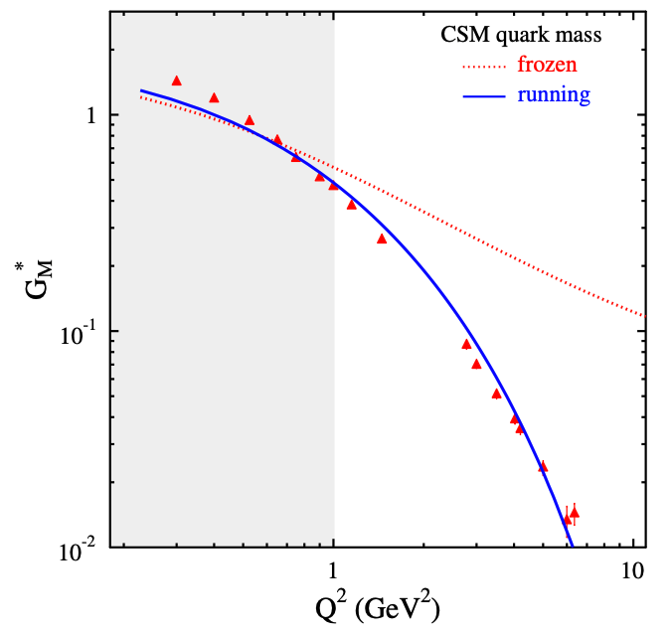
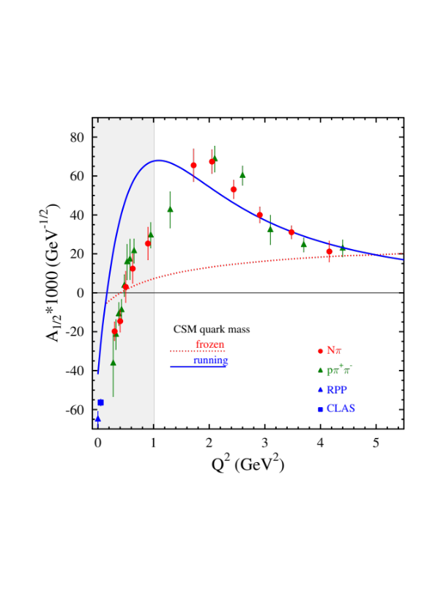
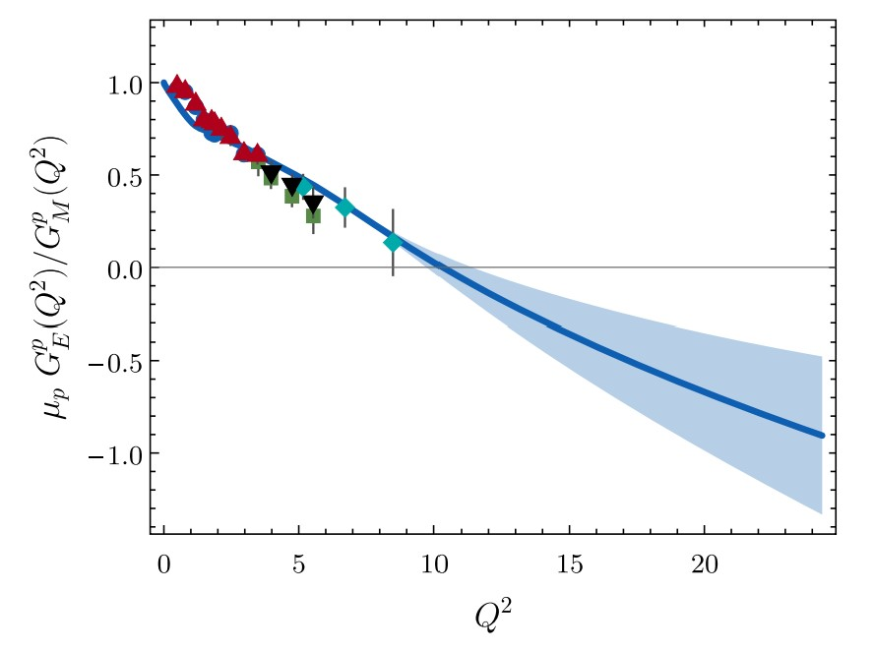
Insight into Dressed Quark Mass Function from Experimental Results
CLAS/Hall A/C results vs. CSM expectations
N→Δ(1232)3/2⁺ magnetic FF
N(1440)1/2⁺
A successful description of the pion and nucleon elastic FFs and the electrocouplings of the Δ(1232)3/2⁺ and N(1440)1/2⁺ has been achieved in CSM with the same dressed quark/gluon mass functions.
Dressed quarks with dynamically generated masses represent active degrees of freedom in the structure of the pion, nucleon, and the Δ(1232)3/2⁺, N(1440)1/2⁺.
Strong evidence for insight into momentum dependence of dressed quark mass
Substantial contributions from M-B cloud
J. Segovia et al., FBS 55, 1185 (2014)
J. Segovia et al., PRL 115, 171801 (2015)
Pion Elastic FF
C.D. Roberts et al., Prog. Part. Nucl Phys. 120, 103883 (2021)
Nucleon Elastic FF
M. Barabanov et al., Prog. Part. Nucl. Phys. 103835 (2021)
Q² F_{π} / GeV²
μ_{p}G_{E}^{p}(Q²)/G_{M}^{p}(Q²)
Data points: JLab F_{π} Collaboration
Hall A/C data
Q² (GeV²)
Q² (GeV²)
One of the most important achievements in hadron physics of the last decade
in synergistic efforts between experimentalists, phenomenologists, and theorists.
8
Notes:
- The picture of a quark inside of a hadron is a dynamical picture - what we effectively see depends on the quark momentum - review the picture and the importance of scale
- Model calculations of form factors and electrocouplings are sensitive to the evolution of the dressed quark mass function.
- Review the model calculations
- The data from CLAS12 will cover for the first time the range of Q2 where the dominant part of the hadron mass is generated addressing the key open problems of what is the nature of confinement and how is more than 98% of the visible mass in the Universe generated?

Slide 9
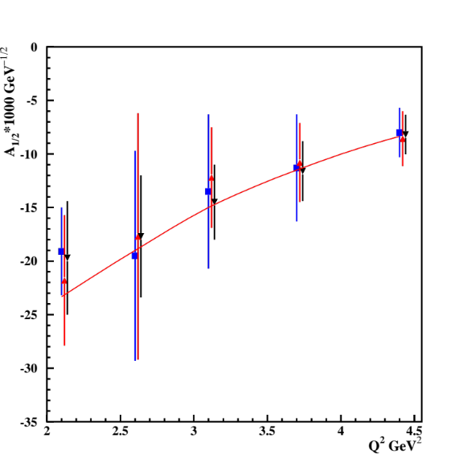
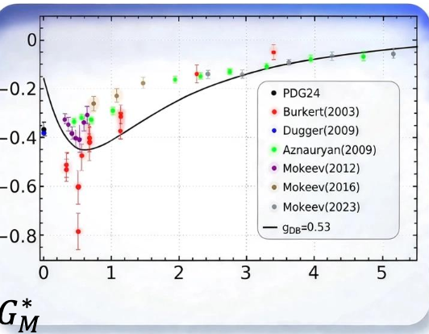
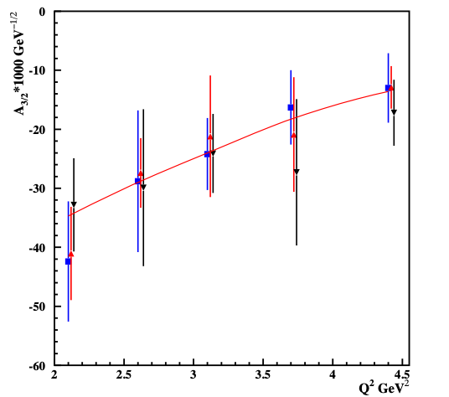
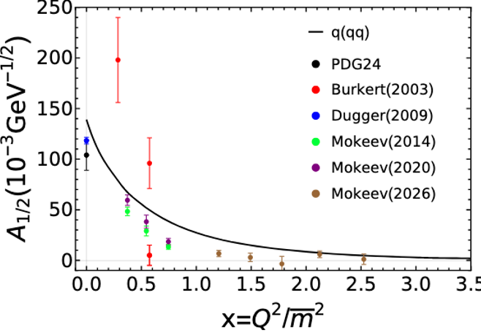

CSM Prediction vs. Data Determination
P. Cheng, L. Liu, Ya Lu, and C.D. Roberts. Acta Phys. Pol., B57, A13 (2026)
N(1520)3/2⁻
Δ(1600)3/2⁺
A_{1/2}
x
Ya Lu et al., PRD 100, 034001 (2019)
Δ(1700)3/2⁻
$2\overline{m}$=m_{N}+m_{N*}
Δ(1600)3/2⁺
A_{3/2}
CLAS results on N(1520)3/2⁻, Δ(1600)3/2⁺, and Δ(1700)3/2⁻ electrocouplings confirmed the CSM prediction across Q²>2 GeV², solidifying evidence for insight into dressed quark mass function and, consequently, into EHM from studies of γ_{v}pN* electrocouplings.
9

Slide 10
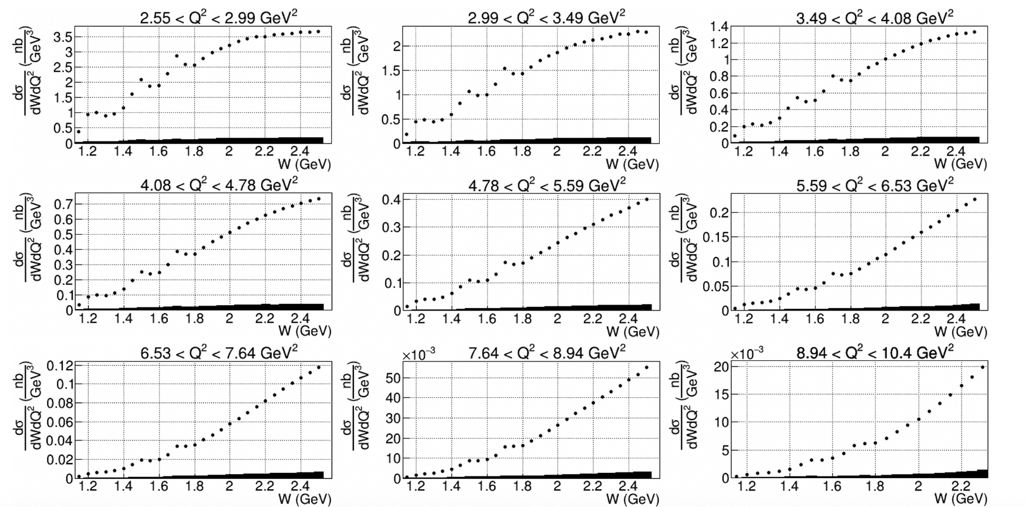
Extension in N* Structure Studies with CLAS12
CLAS12: Extension of the results on γ_{v}pN* electrocouplings of most N* states in the range W < 2.5 GeV and Q² up to 10 GeV² from exclusive channels: πN, ππN, KY, K*Y, KY*.
Measurements of inclusive (e,e′X) cross section with CLAS12. V. Klimenko et al. (CLAS Collaboration), PRC 112, 025201 (2025)
Resonance-like structures are clearly seen in the first, second and third resonance regions for Q²<10 GeV²
10

Slide 11
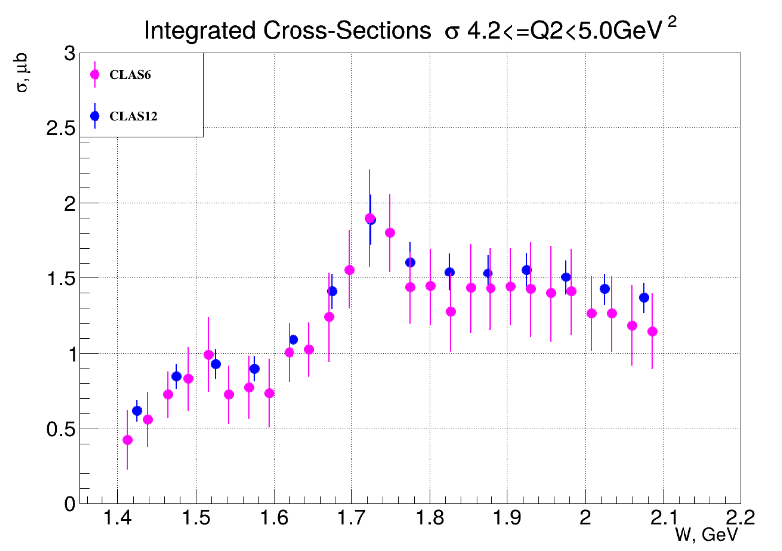
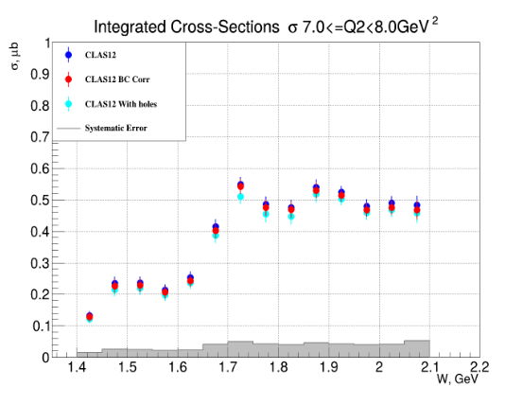
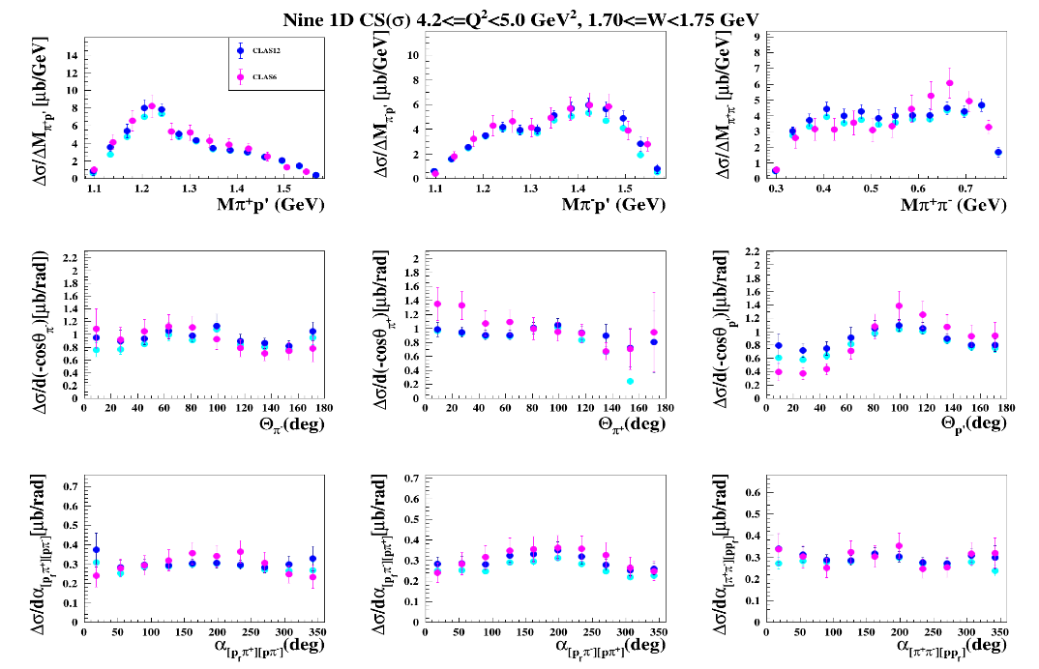
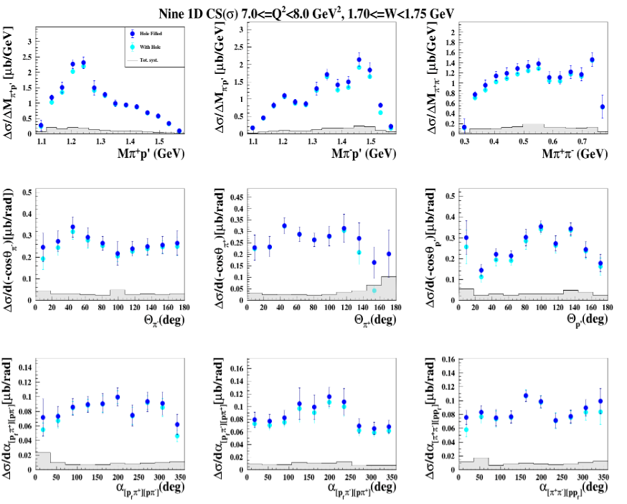
Results on CLAS12 π⁺π⁻p Electroproduction Cross Sections
K. Neupane, R.W. Gothe, D.S. Carman V.I. Mokeev et al., (CLAS Collaboration) arXiv:2609.19395, submitted to PRC
Integrated and nine 1D differential π⁺π⁻p cross sections are available for W=[1.4-2.1] GeV, Q²=[2.4-8.0] GeV²
Consistency with the CLAS data in the overlapping range of Q²<5.0 GeV²
Allows us to extend the JM model over the mass range up to 2 GeV for Q²<8 GeV², paving the way to obtain the γ_{v}pN* electrocouplings over a much broader range compared to existing CLAS data
11

Slide 12
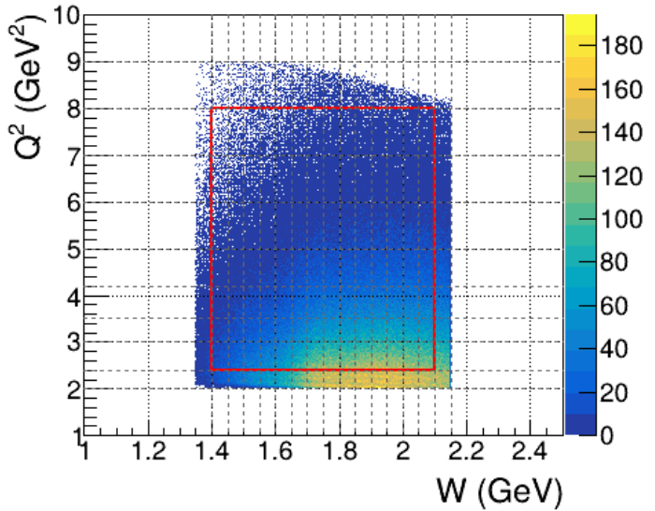
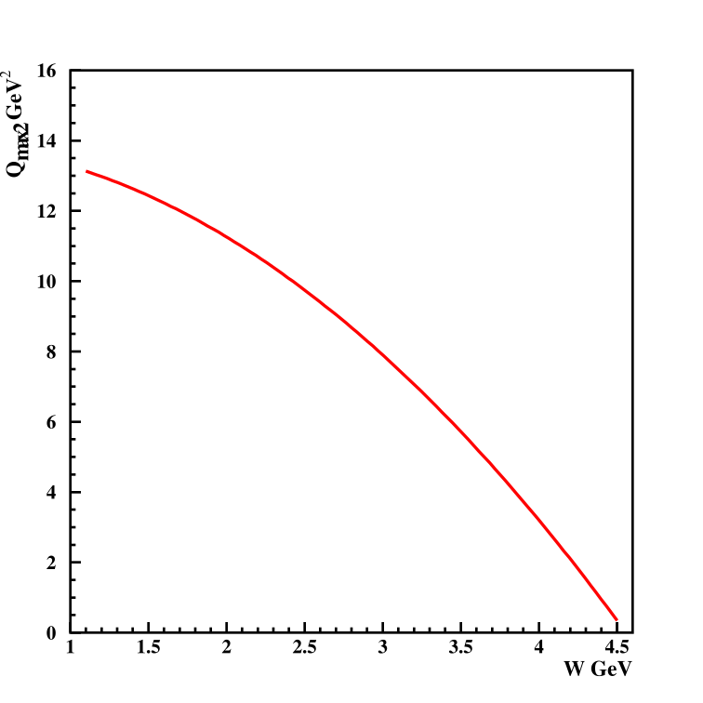
Prospects for Extension of π⁺π⁻p Electroproduction Data after CLAS12 Luminosity Increase
Q² vs. W coverage for π⁺π⁻p electroproduction data with CLAS12
Allowed Q² vs. W coverage for beam energy of 10.6 GeV
Available CLAS12 data cover Q² to 8.0 GeV² (left plot), while the kinematically allowed Q² range in the resonance region extends up to 13 GeV² for a 10.6 GeV beam and maximum detected electron angle of 35° (right plot).
An increase in luminosity is critical for extending the Q² coverage of π⁺π⁻p electroproduction data, reducing the Q² bin widths, or increasing statistics in broader Q² bins. This will provide more extensive and precise information on the Q² evolution of γᵥpN* electrocouplings.
Detailed MC simulations are in progress. The potential gains from an increase in luminosity, assuming a 10.6 GeV beam, have been evaluated using a simplified approach.

Slide 13
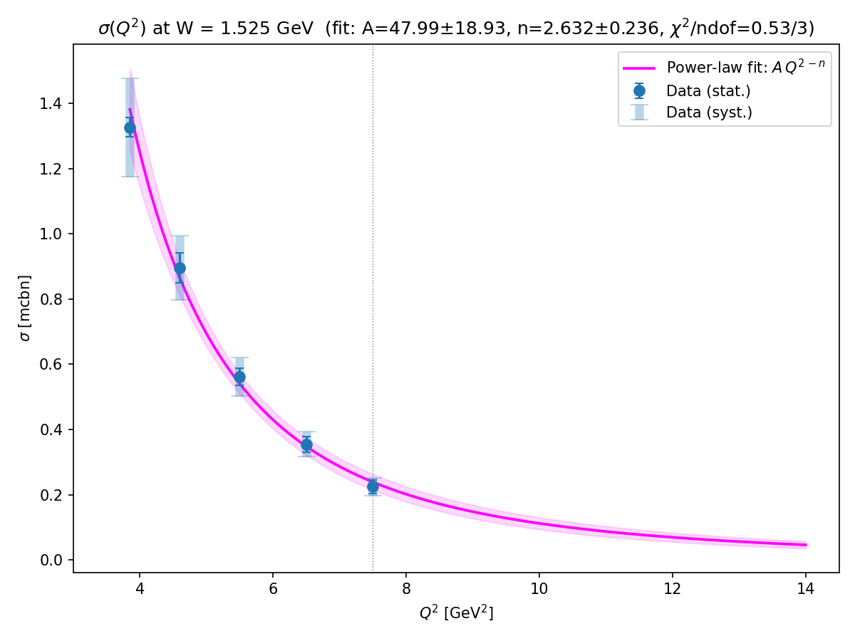
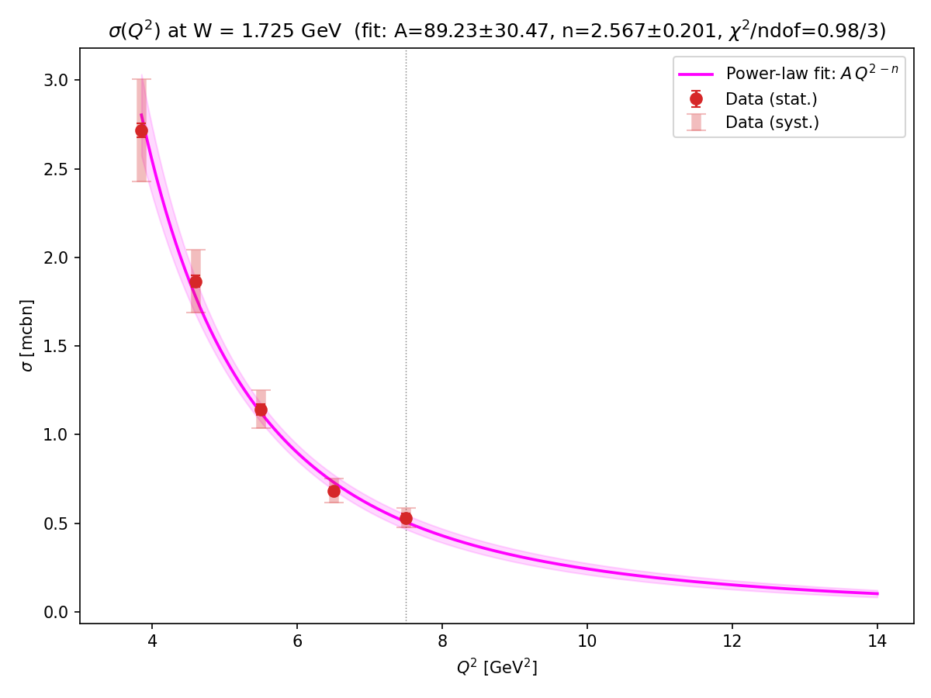
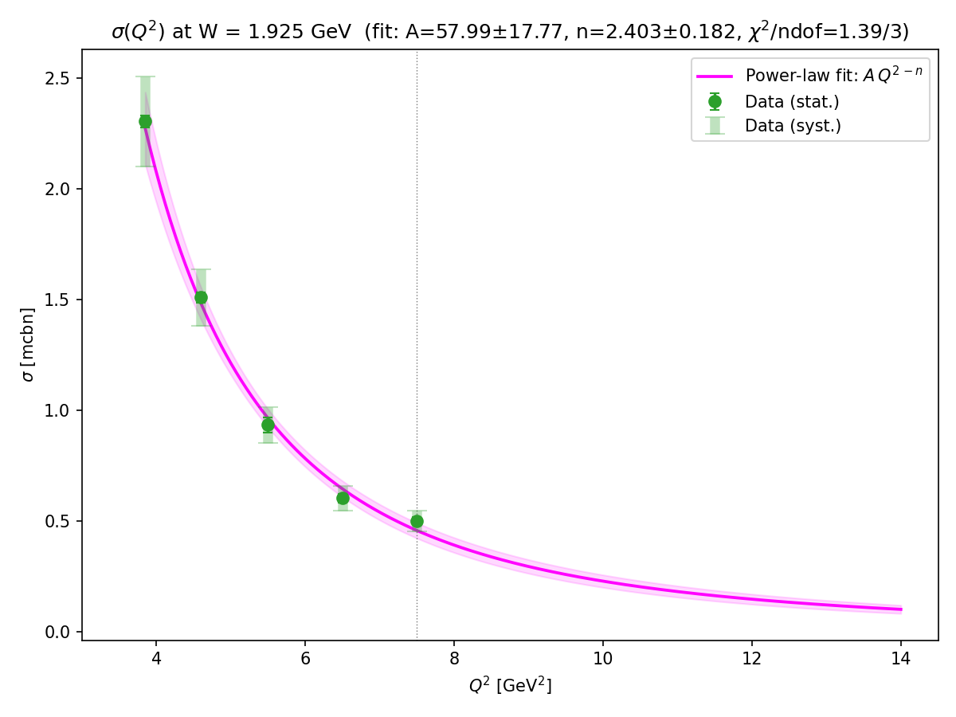
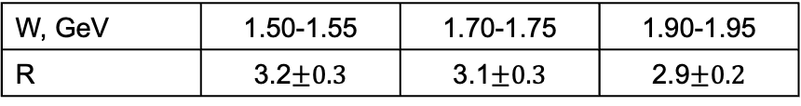
Potential Gains in π⁺π⁻p Electroproduction after CLAS12 Luminosity Increase
(simplified approach)
W=1.50-1.55 GeV
W=1.70-1.75 GeV
W=1.90-1.95 GeV
Q²-evolution of fully integrated π⁺π⁻p electroproduction cross sections measured with CLAS12 and extrapolated across Q²<14 GeV² - K. Neupane et al., arXiv:2609.19395
Results from CLAS12 available with a Q²-bin size of 1.0 GeV² for 6.0 < Q² < 8.0 GeV², based on a relatively small dataset. An increase in luminosity by a factor of 3 and beam time by a factor of 3–4 would enable π⁺π⁻p electroproduction cross sections to be measured with sufficient statistics to extract γ_{v}pN* electrocouplings in a Q²-bin size of 0.1 GeV² over Q² < 8.0 GeV².
Reduction factor in fully integrated cross section from the data fit R=σ(Q²=11.8 GeV²)/σ(Q²=7.5 GeV²)
W, GeV | 1.50-1.55 | 1.70-1.75 | 1.90-1.95
R | 3.2$±0.3$ | 3.1$±0.3$ | 2.9$±0.2$
The Q²-bin size at Q²=12 GeV² needed to collect statistics sufficient for extraction of γ_{v}pN* electrocouplings was determined as: ΔQ²_{stat}=0.1 (GeV²)*R
W, GeV | 1.50-1.55 | 1.70-1.75 | 1.90-1.95
ΔQ²_{stat}, GeV² | 0.32 | 0.31 | 0.29

Slide 14
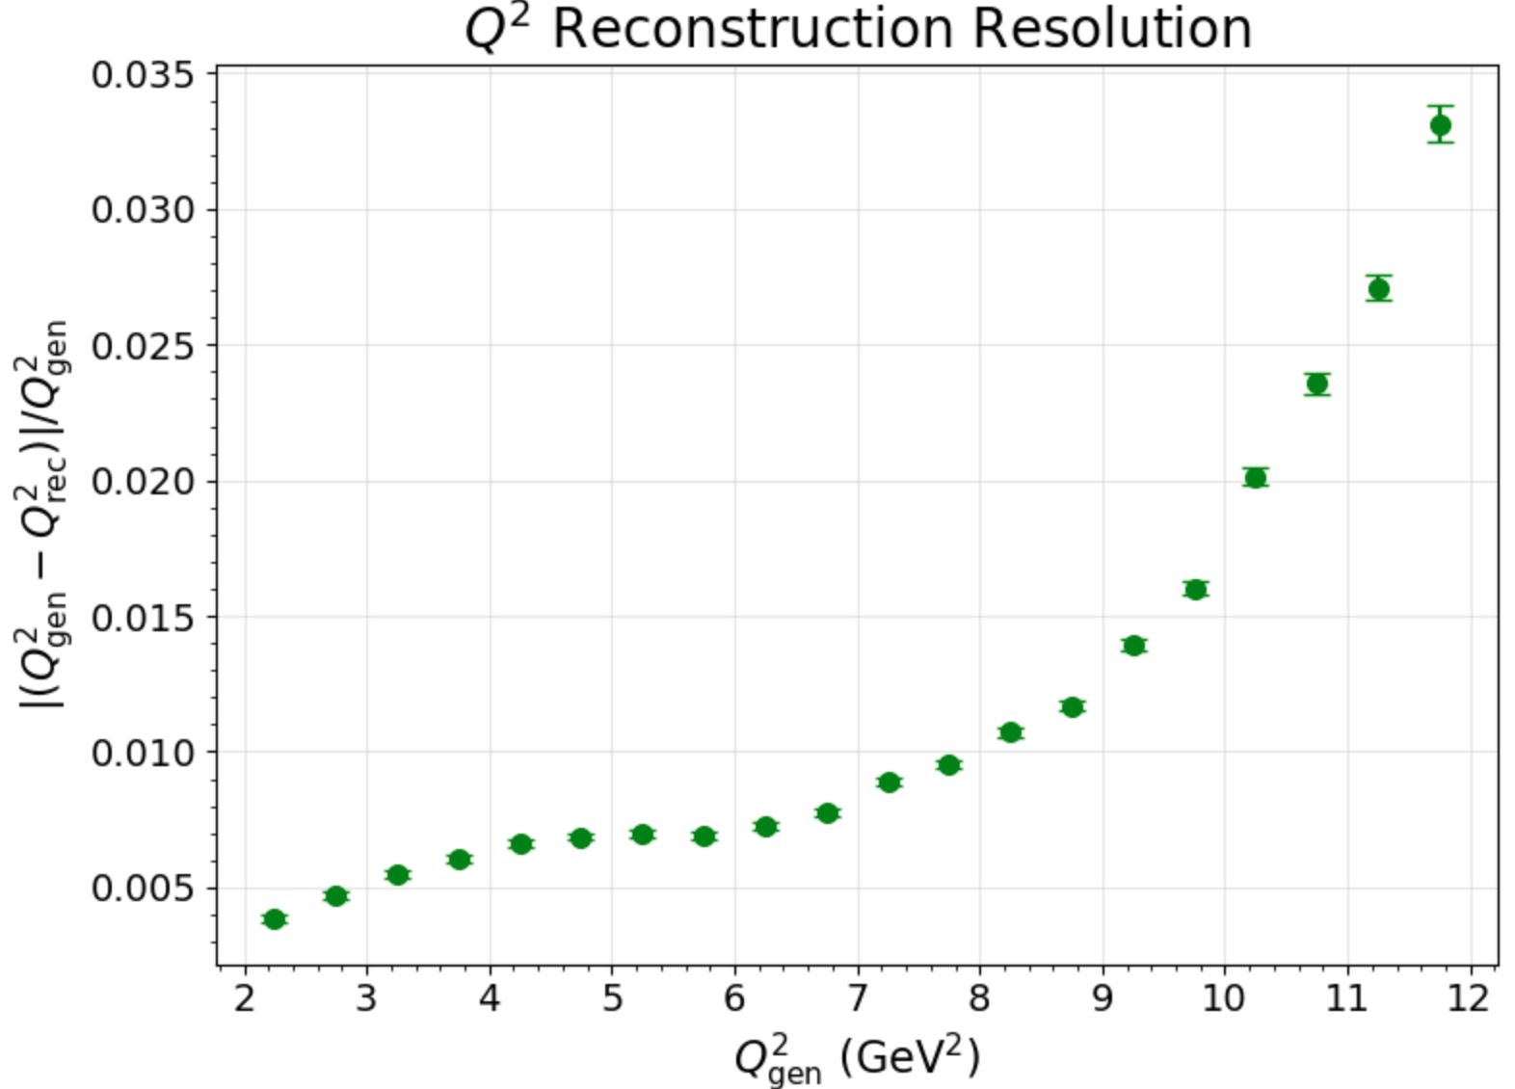
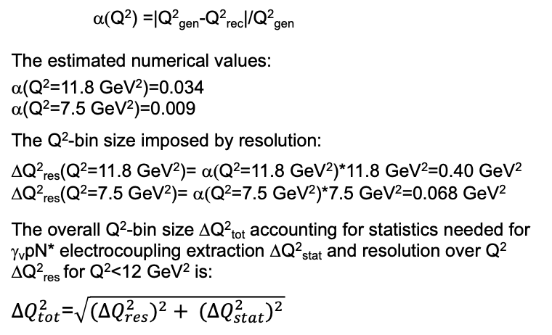
Potential Gains in π⁺π⁻p Electroproduction after CLAS12 Luminosity Increase
(simplified approach)
MC results for relative Q² resolution averaged over the N* region of W=[1.4-2.0] GeV for E_{beam}=10.6 GeV.
R.W. Gothe, A. Osmond (USC)
α(Q²) =|Q²_{gen}-Q²_{rec}|/Q²_{gen}
The estimated numerical values:
α(Q²=11.8 GeV²)=0.034
α(Q²=7.5 GeV²)=0.009
The Q²-bin size imposed by resolution:
ΔQ²_{res}(Q²=11.8 GeV²)= α(Q²=11.8 GeV²)*11.8 GeV²=0.40 GeV²
ΔQ²_{res}(Q²=7.5 GeV²)= α(Q²=7.5 GeV²)*7.5 GeV²=0.068 GeV²
The overall Q²-bin size ΔQ²_{tot} accounting for statistics needed for γ_{v}pN* electrocoupling extraction ΔQ²_{stat} and resolution over Q² ΔQ²_{res} for Q²<12 GeV² is:
${∆Q}_{tot}^{2}$=$\sqrt{(∆Q_{res}^{2})^{2}+ (∆Q_{stat}^{2})^{2}}$
An increase in luminosity by a factor of 3 and beam time by a factor of 3–4 will allow us to extend the Q² coverage of π⁺π⁻p electroproduction cross sections to Q² < 12.0 GeV², with Q²-bin sizes of < 0.5 GeV² over the nucleon resonance region up to 2 GeV.
After the luminosity increase, for Q² < 8 GeV², the π⁺π⁻p electroproduction cross sections can be measured with Q²-bin sizes of 0.12 GeV² across the entire resonance region. Alternatively, broader Q² bins, up to 0.5 GeV², will provide more statistics and may improve the precision of the extracted γᵥpN* electrocouplings.

Slide 15
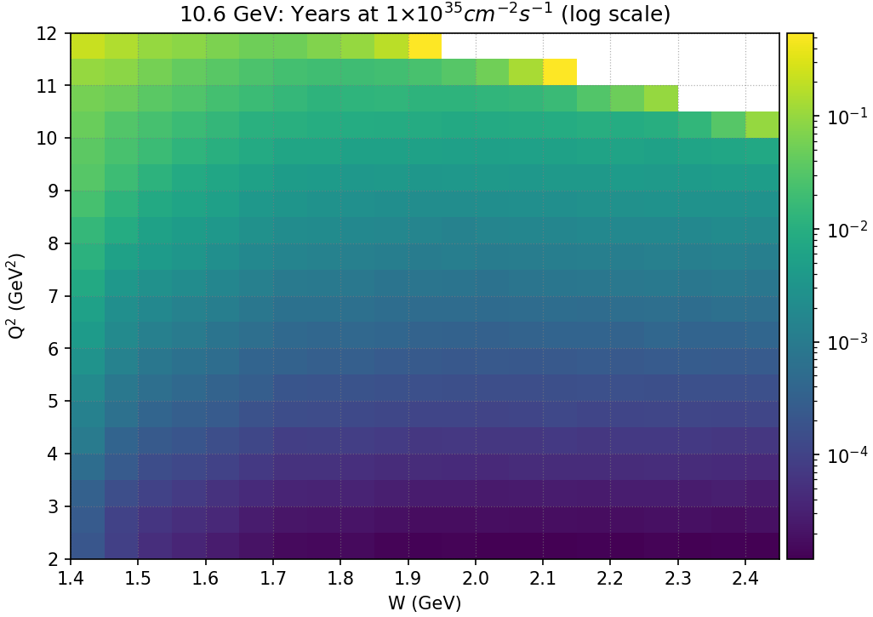
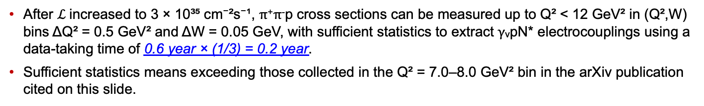
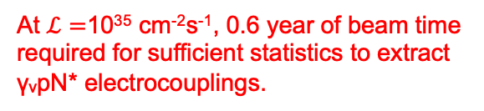
Beam Time Evaluation for Sufficient Statistics to Extract γ_{v}pN* Electrocouplings from π⁺π⁻p Electroproduction Data in Full MC Simulation
Beam time (in years) needed for sufficient statistics vs. bins in (Q²,W) to extract γ_{v}pN* electrocouplings
Rate estimates for the accepted events using TWOPEG EG with CLAS12 (eff*ACC) employing event selection as:
K. Neupane et al. (CLAS Collaboration) arXiv:2609.19395, submitted to PRC
At $ℒ=$10³⁵ cm⁻²s⁻¹, 0.6 year of beam time required for sufficient statistics to extract γᵥpN* electrocouplings.
R.W. Gothe, A. Osmond (USC)
After $ℒ$increased to 3 × 10³⁵ cm⁻²s⁻¹, π⁺π⁻p cross sections can be measured up to Q² < 12 GeV² in (Q²,W) bins ΔQ² = 0.5 GeV² and ΔW = 0.05 GeV, with sufficient statistics to extract γᵥpN* electrocouplings using a data-taking time of 0.6 year × (1/3) = 0.2 year.
Sufficient statistics means exceeding those collected in the Q² = 7.0–8.0 GeV² bin in the arXiv publication cited on this slide.

Slide 16
Conclusions and Outlook
High-quality data from the 6-GeV era with CLAS have allowed for the determination of the electrocouplings of most N*s in the mass range up to 1.8 GeV for Q²<5 GeV².
A good description of the N(938)1/2⁺, N(1440)1/2⁺, Δ(1232)3/2⁺, Δ(1600)3/2⁺, N(1520)3/2⁻, and Δ(1700)3/2⁻ electrocouplings for Q²<5 GeV² achieved within CSM with the same dressed quark mass function inferred from the QCD Lagrangian offers sound evidence for insight into the momentum dependence of the dressed quark mass, but in a range of distances where <30 % of hadron mass is generated.
An increase in luminosity by a factor of 3 (with unchanged beam energy and maximum polar scattering angle for detected electrons), would enable CLAS12 to uniquely access the electrocouplings of all prominent N* states in the unexplored Q² range of 5–12 GeV², providing the only foreseen opportunity to map out the dressed-quark mass function and study the transition from pQCD to sQCD dynamics at distances where up to 60% of hadron mass is generated.
Q²-bin sizes for measured observables and extracted γᵥpN electrocouplings will be substantially reduced, down to 0.12–0.5 GeV², or the precision of the extracted electrocouplings will be improved in broader Q² bins. Therefore, a luminosity upgrade is particularly important for exploring sQCD dynamics that underlie the N* structural complexity.
17

Slide 17
Back up

Slide 18
Summary of Published CLAS Data on Exclusive Meson Electroproduction off Protons in N* Excitation Region
Hadronic final state | Covered W-range, GeV | Covered Q²-range, GeV² | Measured observables
π⁺n | 1.1-1.38 1.1-1.55 1.1-1.70 1.6-2.00 | 0.16-0.36 0.3-0.6 1.7-4.5 1.8-4.5 | dσ/dΩ dσ/dΩ dσ/dΩ, A_{b} dσ/dΩ
π⁰p | 1.1-1.38 1.1-1.68 1.1-1.39 1.1-1.80 | 0.16-0.36 0.4-1.8 3.0-6.0 0.4-1.0 | dσ/dΩ dσ/dΩ, A_{b},A_{t},A_{bt} dσ/dΩ dσ/dΩ, A_{b}
ηp | 1.5-2.3 | 0.2-3.1 | dσ/dΩ
K⁺Λ | thresh-2.6 | 1.40-3.90 0.70-5.40 | dσ/dΩ P⁰, P′
K⁺Σ⁰ | thresh-2.6 | 1.40-3.90 0.70-5.4 | dσ/dΩ P′
π⁺π⁻p | 1.3-1.6 1.4-2.1 1.4-2.0 | 0.2-0.6 0.5-1.5 2.0-5.0 | Nine 1-fold differential cross sections
dσ/dΩ−CM angular
distributions
A_{b},A_{t},A_{bt}-longitudinal
beam, target, and
beam-target asym-
metries
P⁰, P′ –recoil and
transferred polarization
of strange baryon
Around 150,000
data points!
Almost full coverage
of the final state hadron emission angles in CM-frame
The measured observables from CLAS are stored in the
CLAS Physics Data Base http://clas.sinp.msu.ru/cgi-bin/jlab/db.cgi
Notes:
Исследования процессов электровозбуждения N* во всех эксклюзивных каналах электророждения мезонов в резонансной области стало возможным в экспериментах на детекторе CLAS , где была получена доминирующая чеать результатов по реакциям эксклюзивного электророждения мезонов на нуклонах.

Slide 19
Approaches for Extraction of γ_{v}pN* Electrocouplings from the Meson Electroproduction Data
Analyses of different meson electroproduction channels independently:
π⁺n and π⁰p channels:
Unitary Isobar Model (UIM) and Fixed-t Dispersion Relations (DR)
I.G. Aznauryan, Phys. Rev. C67, 015209 (2003)
I.G. Aznauryan et al. (CLAS), Phys. Rev. C80, 055203 (2009)
I.G. Aznauryan et al. (CLAS), Phys. Rev. C91, 045203 (2015)
ηp channel:
Extension of UIM and DR
I.G. Aznauryan, Phys. Rev. C68, 065204 (2003)
Data fit at W<1.6 GeV, assuming N(1535)1/2⁻ dominance
H. Denizli et al. (CLAS), Phys. Rev. C76, 015204 (2007)
π⁺π⁻p channel:
Data driven JLab-MSU meson-baryon model (JM)
V.I. Mokeev, V.D. Burkert et al., Phys. Rev. C80, 045212 (2009)
V.I. Mokeev et al. (CLAS), Phys. Rev. C86, 035203 (2012)
V.I. Mokeev, V.D. Burkert et al., Phys. Rev. C93, 054016 (2016)
V.I. Mokeev et al., Phys. Rev. C108, 025204 (2023)=JM23
Global coupled-channel analysis of γ_{r,v}N , πN, ηN, ππN, KΛ, KΣ exclusive channels:
H. Kamano, Few Body Syst. 59, 24 (2018) Argonne-Osaka
H. Kamano, JPS Conf. Proc. 13, 010012 (2017) Argonne-Osaka
See T. Sato talk on Monday, September 7 at 10:30 am
M. Mai et al., Phys. Rev. C106, 015201 (2022)=Julich-Bonn-Washington
Yu-Fei Wang et al, Phys. Rev. Lett. 133, 101901 (2024)=Julich-Bonn-Washington.
See M. Mai talk on Tuesday, September 8 at 10:30 am, M. Doering talk on Tuesday, September 8 at 6:00 pm
JANR
JM
Notes:
Для извлечания амплитуд электровозбуждения N* из сечений и поляризационных асимметрий реакций эксклюзивного электророждения мезонов на
протонах были развиты как подходы для извлечения параметров N* из независимого анализа различных эксклюзивных каналов, так и из совместного анализа данных всех каналов в рамках многоканальных моделей реакций

Slide 20
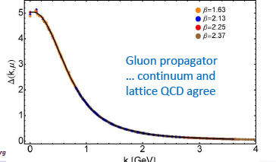
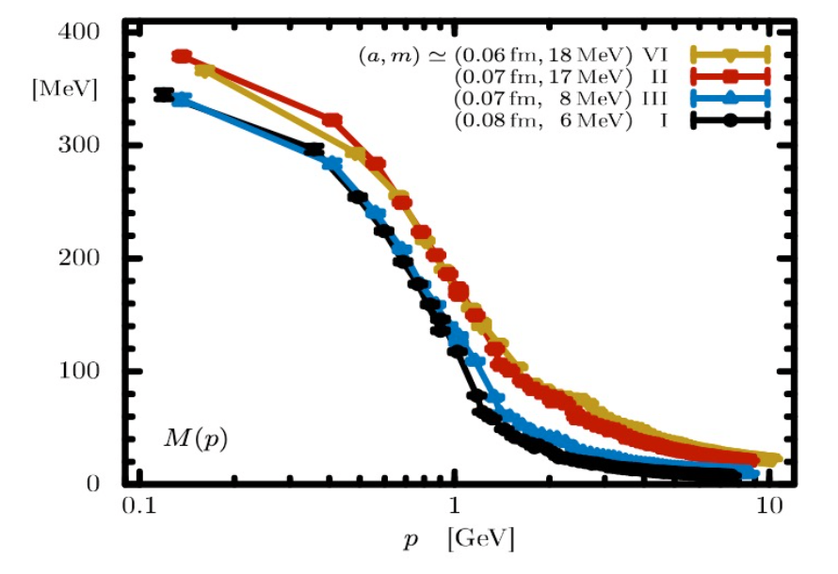
Continuum/Lattice QCD and Experiment Synergy for Insight into EHM
Dressed quark/gluon masses converge at the complete QCD mass scale of 0.43(1) GeV.
Express the fundamental feature: emergence of the quark and gluon masses even in the case of massless quarks in chiral limit and massless QCD gluons.
LQCD confirms continuum QCD results.
The sensitivity of N* electroexcitation amplitudes to the dressed quark propagator allows us to map out the quark mass function.
Dressed Quark/Gluon Masses (continuum QCD)
C.D. Roberts, Symmetry 12, 1468 (2020), AAPS Bull 31, 6 (2021)
Dressed
gluons
Dressed
quarks
Inferred from QCD Lagrangian with only the Λ_{QCD} parameter
Dressed Quark Mass (lattice QCD)
O. Olivera et al., Phys. Rev. D 99, 094506 (2019)
k [GeV]
13

Slide 21
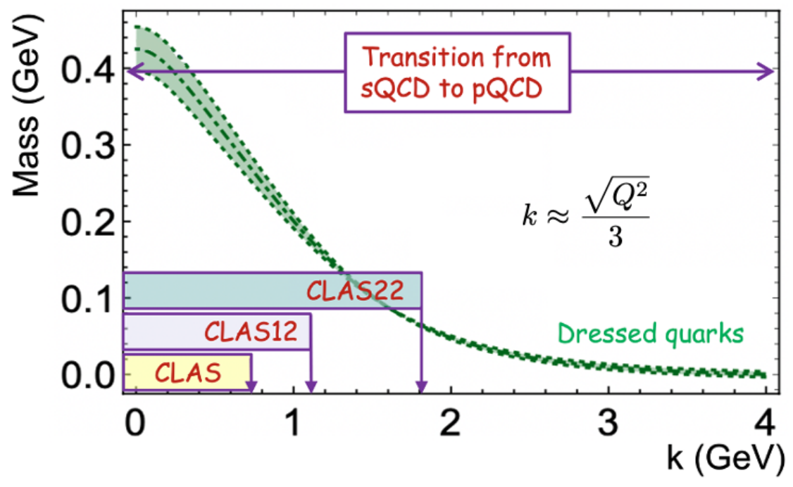
Impact of the Extension of γ_{v}pN* Electrocouplings Results for Q²>5.0 GeV² on Insight into EHM
P. Achenbach, D.S. Carman, R.W. Gothe, K. Joo, V.I. Mokeev, and C.D. Roberts, Symmetry, 17, 1106 (2025)
To resolve the challenging problem on EHM, the dressed quark mass function M_{q}(k) should be mapped out in experiments over the entire range of quark momenta to ~2 GeV, where the transition from strongly coupled to perturbative QCD takes place, and the dominant part of hadron mass and N* structure emerge.
The CLAS experiments, limited to Q² < 5.0 GeV², allow exploration of a restricted range of distances where ~30% of hadron mass is generated. Extending the Q² coverage up to 10 GeV² with measurements from CLAS12 will offer insight into the distance scales where ~50% of hadron mass emerges.
A potential increase of CEBAF energy to 22 GeV would provide a unique opportunity to explore the full range of distance scales over which the dominant portion of hadron mass and the structure of excited nucleon states are generated.
21

Slide 22
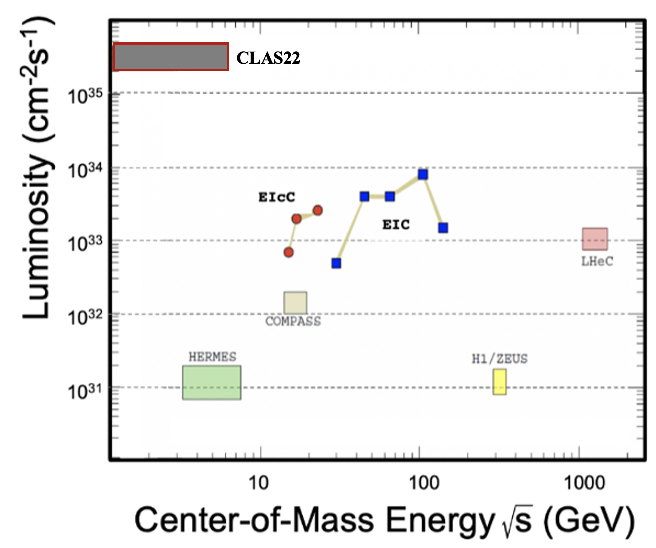
Unique Opportunities for Gaining Insight into EHM through Studies of N* Structure within a Potential CEBAF 22 GeV Energy Upgrade Including CLAS22
Simulations of πN, KY, and π⁺π⁻p electroproduction with CEBAF@22 GeV show:
γ_{v}pN* electrocouplings can be determined up to Q² ~ 30 GeV² for 𝓛 ~ 2 - 5 ⨉ 10³⁵ cm⁻²s⁻¹
Both EIC and EIcC would need much higher luminosity to carry out such a program
The luminosity “frontier” is a unique advantage of JLab
Beam energy 22 GeV
Large acceptance
High luminosity
Studies of exclusive reactions
Extending the γ_{v}pN* electrocoupling results into the Q² range from 10 - 30 GeV² after the CEBAF energy increase and pushing the capabilities of CLAS12 to measure exclusive electroproduction to the highest possible luminosity within a large acceptance, will offer the only foreseen opportunity to explore how the emergent part of the hadron mass and N* structures are coming from QCD and will make CEBAF@22 GeV unique and the ultimate QCD-facility at the luminosity frontier.
29

Slide 23
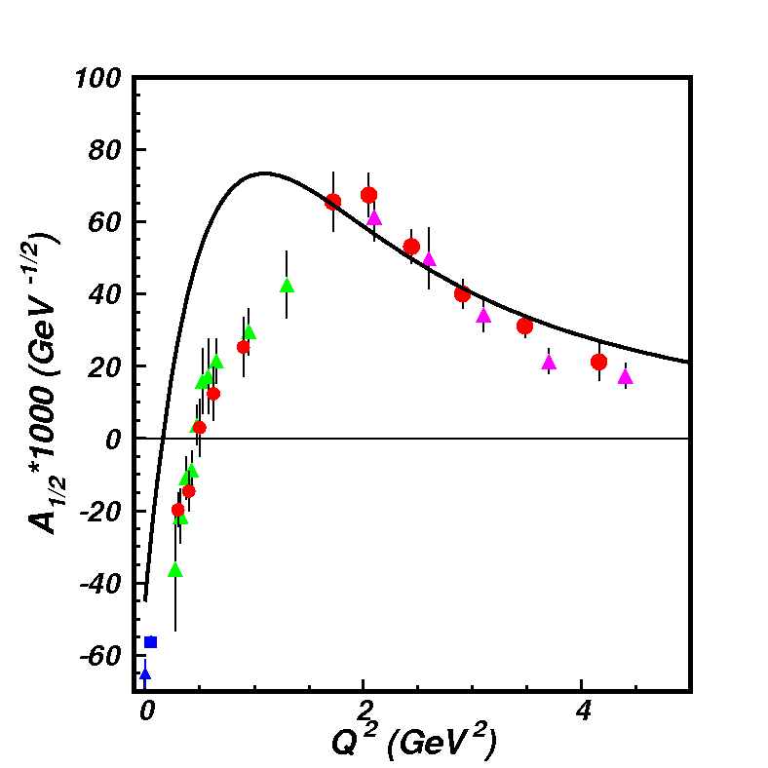
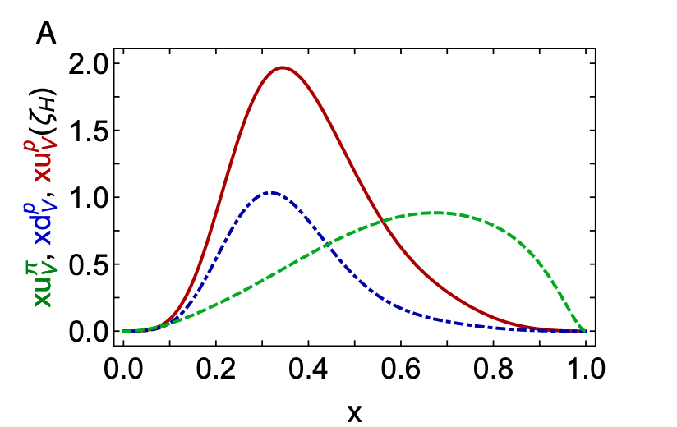
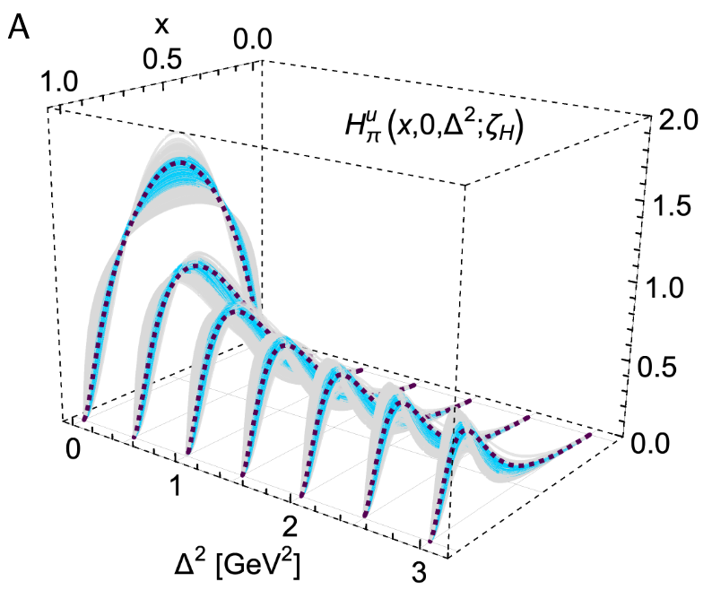
EHM from Global Hadron Structure Analysis within CSM
This will be extended by the future data on γ_{v}pN* electrocouplings from CLAS12 in the 12 GeV era
Nucleon Elastic FF
γ_{v}pN* Electrocouplings
Proton and pion PDF for valence quarks
N(1440)1/2⁺
μ_{p}G_{E}/G_{M} (Q²)
in DSEQCD
Pion GPDs
New data from studies of D-Y at AMBER and Sullivan processes at JLab
Pion Elastic FF
Pion PDF
CSM is currently the only approach that offers insight into EHM from combined studies of meson/baryon structure with connection to QCD. Ref. C.D. Roberts, FBS 64, 51 (2023).
17

Slide 24
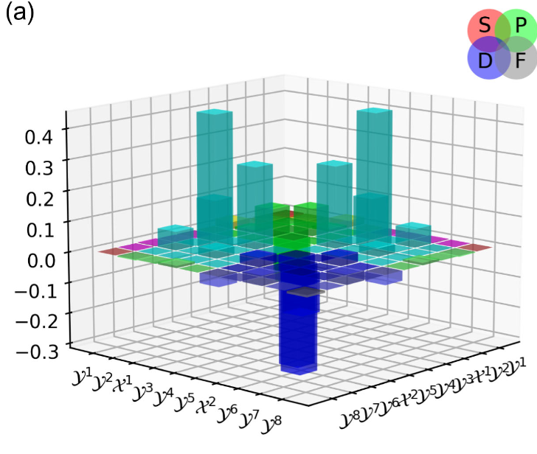
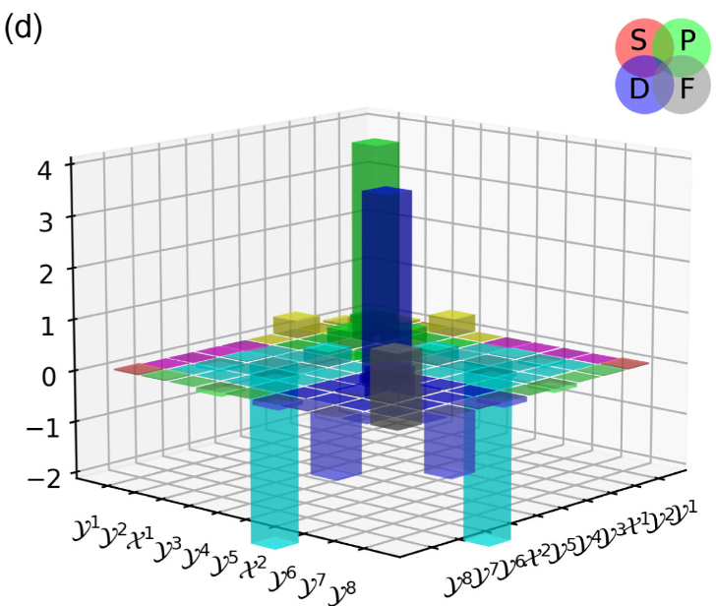
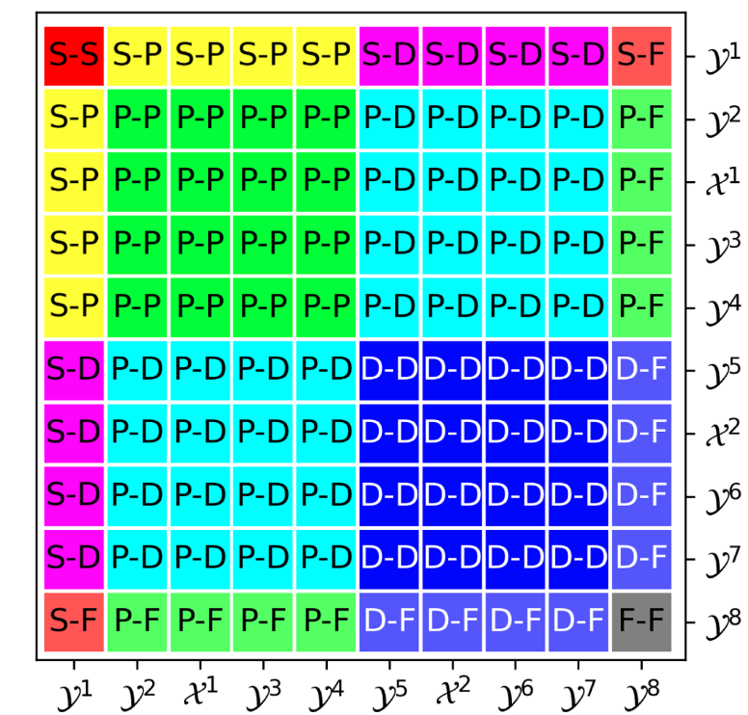
HiLumi Impact on Physics: Extended Insight into the N* Faddeev Amplitudes from γ_{v}pN* Data
N(1520)3/2⁻
N(1900)3/2⁺
Rest-frame quark-di-quark orbital momentum content of
N(1520)3/2⁻ and N(1900)3/2⁺ resonances
Legend for interpretation
of the two plots on the left
L. Liu, Ch. Chen, and C.D. Roberts, Phys. Rev. D107, 014002 (2023)
CSM predictions of the rest-frame dressed-quark–diquark orbital-angular-momentum (L) content demonstrated significant off-diagonal mixed L–L′ components, revealing a level of structural complexity far beyond that anticipated from quark models. Should be tested in confronting with the results on Q² evolution of γ_{v}pN* electrocouplings
Experimental results on the Q² evolution of γᵥpN* electrocouplings over a Q² range up to 12–13 GeV², with finer Q² binning at Q² < 8.0 GeV² than currently achieved, or with improved precision of the γᵥpN* electrocouplings, are critical for testing these QCD-connected predictions.

