Slide 1
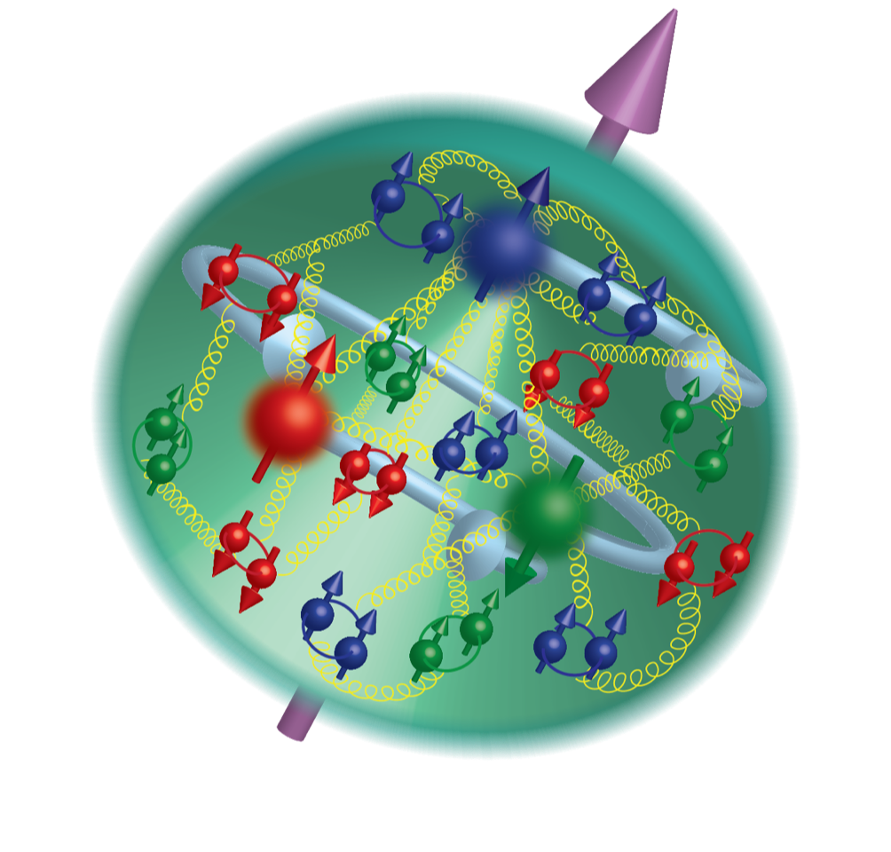
SoLID-SOLID-Lite
A SCIENCE FOCUS ON THE ORIGIN OF MASS AND CONFINEMENT
erhtjhtyhy
Zein-Eddine Meziani
Argonne National Laboratory
With thanks to the SoLID collaboration
See details in the talks of Sylvester Joosten for J/ψ and Vladimir Katchatryan for SIDIS
Jefferson Lab, Newport News, October 05, 2026

Slide 2

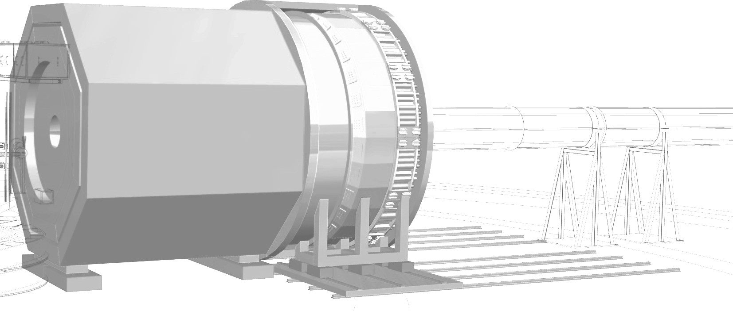
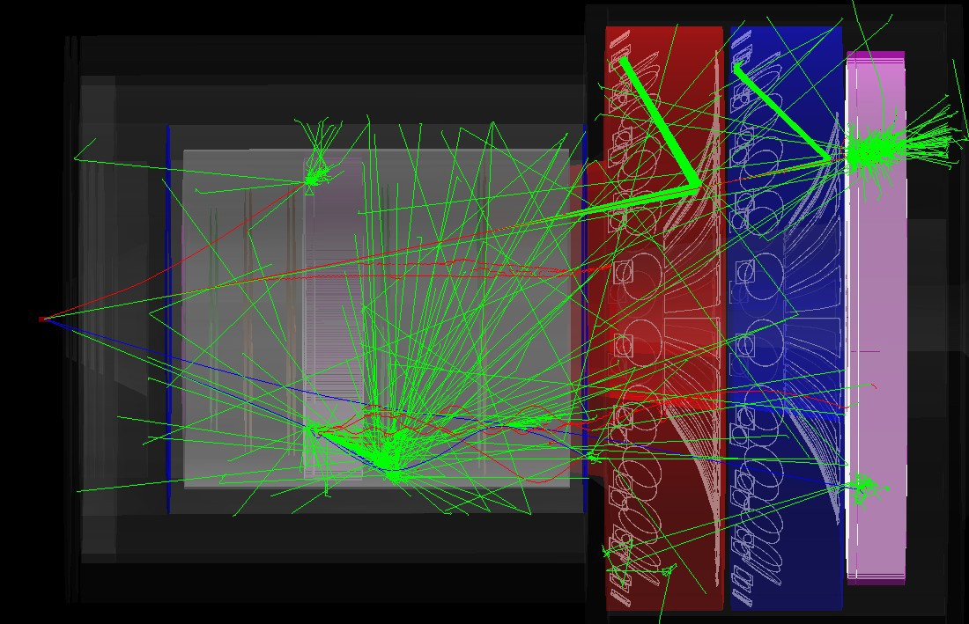
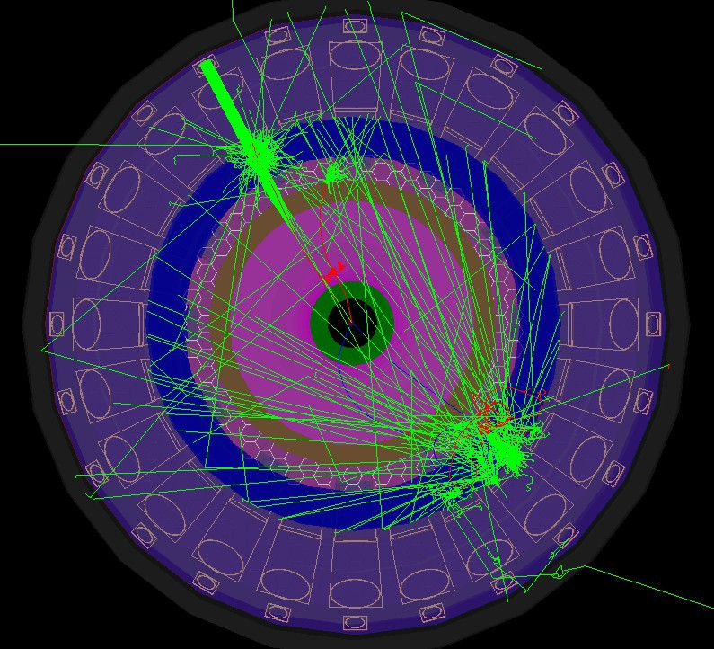


Electron Scattering at the Intensity Frontier with SoLID
Zein-Eddine Meziani
Argonne National Laboratory
Hot & Cold QCD Town Hall Meeting, MIT
September 23-25, 2022
A charmonium production and decay event in SoLID
Side view
Front view
With thanks to:
Jian-Ping Chen, Haiyan Gao, Paul Souder
and Xiaochao Zheng and the SoLID collaboration
J. Arrington et al. [Jefferson Lab SoLID],
``The solenoidal large intensity device (SoLID) for JLab 12 GeV,''
J. Phys. G 50 (2023) no.11, 110501, doi:10.1088/1361-6471/acda21
[arXiv:2209.13357 [nucl-ex]].
e-’
e-

Slide 3
SOLID: A Science Program at the Intensity Frontier
SoLID is a large acceptance device which can handle very high luminosity to allow full exploitation of the JLab 12 GeV scientific potential
SoLID has rich and vibrant science program complementary and synergistic to the proposed EIC science program. Three pillars include SIDIS, PVDIS and J/Psi threshold production.
SoLID offers an important training ground for the next generation of science leaders in EIC
After a decade of hard work, we have a mature pre-conceptual design with expected performance to meet the challenging requirements for the three major science pillars
Completed the DOE Science Review (March 8-10, 2021)
270+ collaborators, 70+ institutions from 13 countries

Slide 4
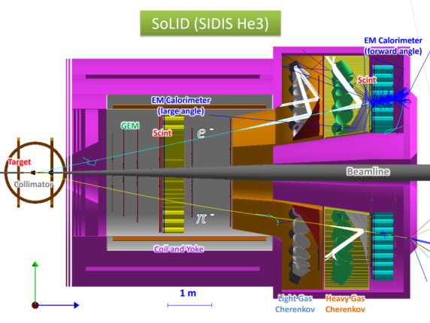
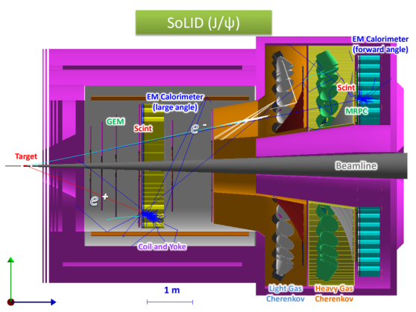
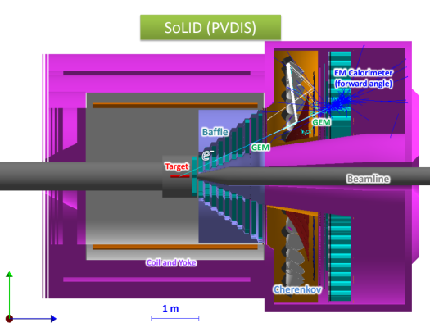
SoLID Physics Program: Approved Experiments
SIDIS: (3) Transversely Polarized ³He (n): Transversity, Sivers, Pretzelosity TMDs
Longitudinally Polarized ³He (n): Worm-gear TMDs
Transversely Polarized Proton: Transversity/Sivers, Pretzelocity TMDs
Threshold J/ψ Production: Gluon Field, Gluonic Gravitational FFs, Proton Mass
PVDIS: Test of the Standard Model & nucleon structure
Run group experiments (6) approved for GPDs, TMDs, and spin
New approved/conditionally approved experiments (DDVCS...
Rating: A
Rating: A
Rating: A

Slide 5

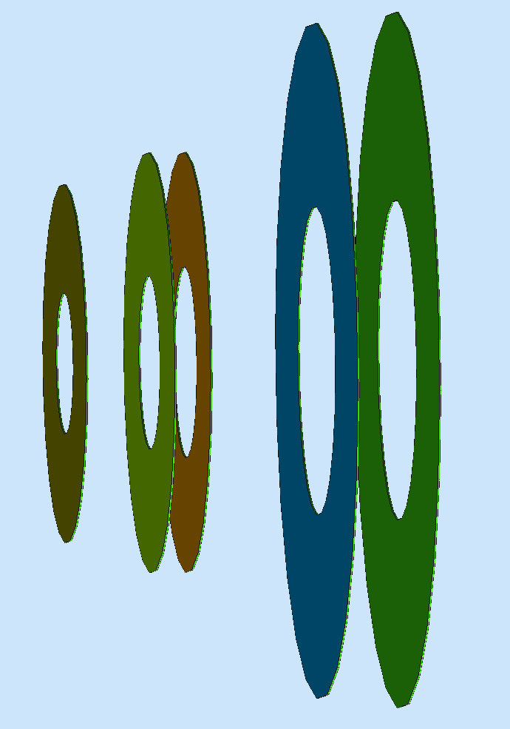
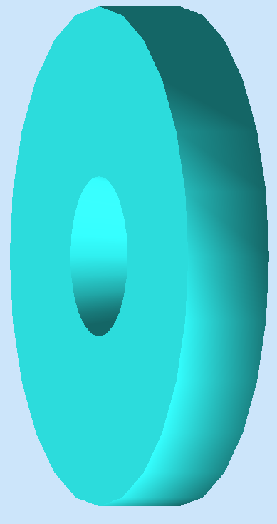
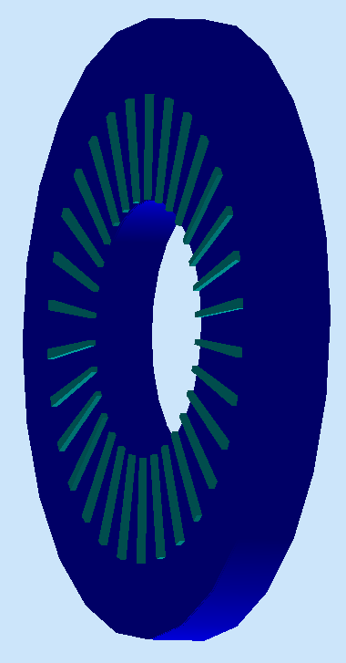
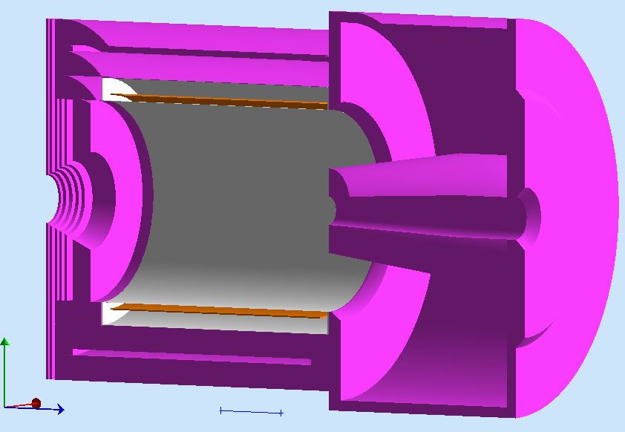
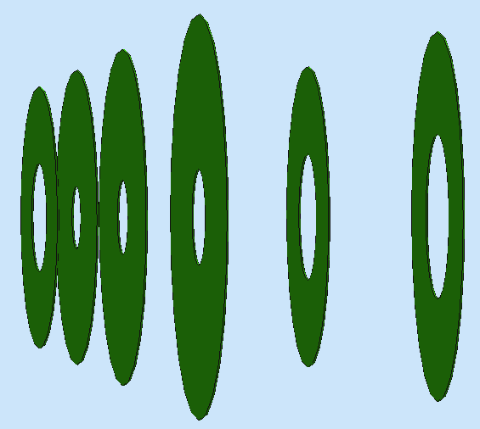
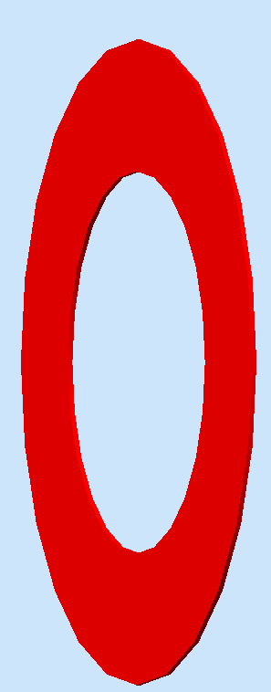
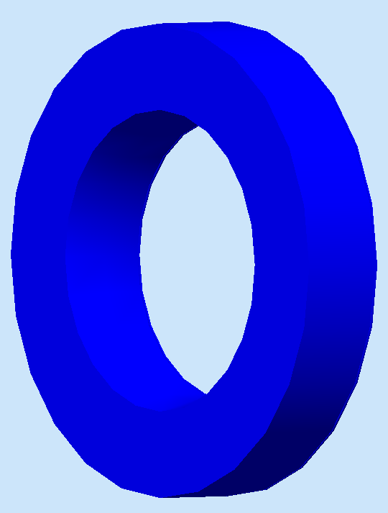
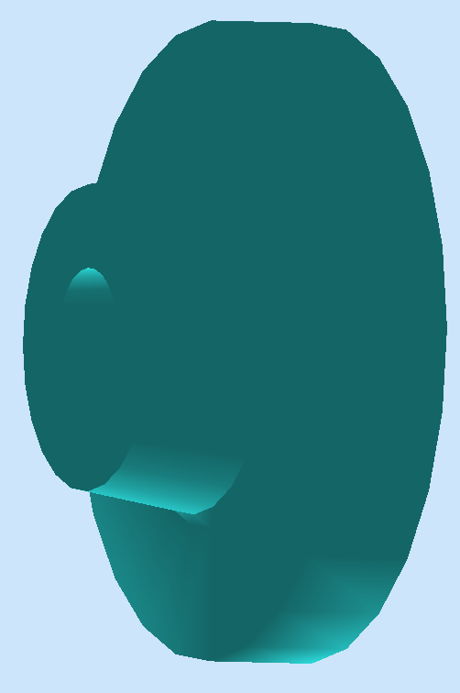
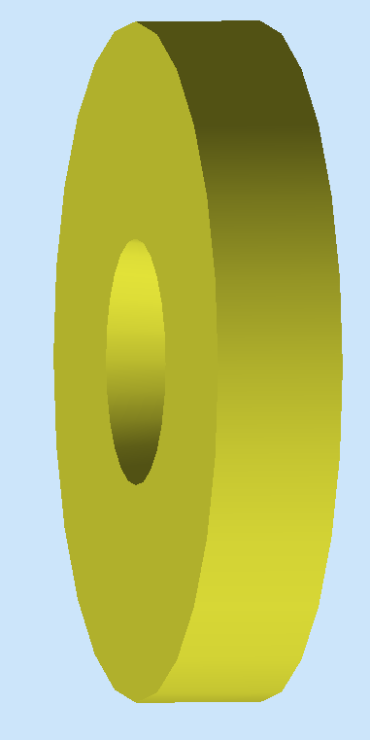

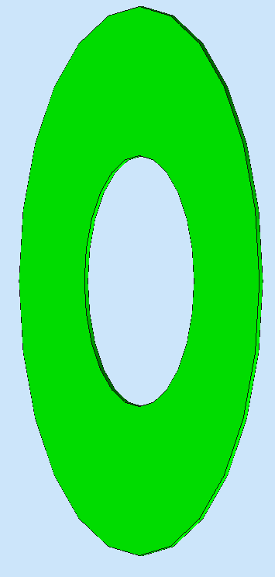
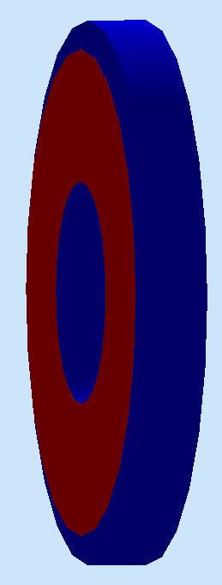
SoLID Detector Subsystems
PVDIS: Baffle 3xGEMS LGC 2xGEMs EC
Uses full capability of JLab electronics
SIDIS& J/psi:
4xGEMs LASPD LAEC 2xGEMs LGC HGC FASPD (MRPC) FAEC
Pre-R&D items: Beam tests, LGC, HGC, GEM’s, DAQ/Electronics, Magnet

Slide 6
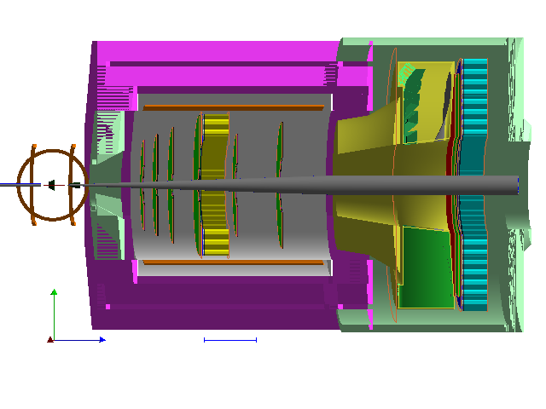
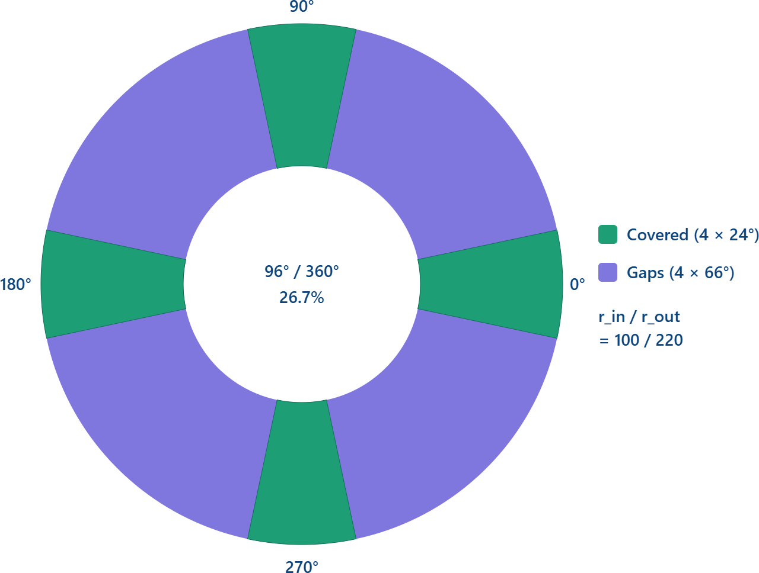
SoLID-Lite
An option that delivers on the science program with a first focus on near-threshold J/ψ production & then a modest enhancement for SIDIS
SoLID light option (“4seg24degFA”)
  Works for both J/ψ and polarized ³He SIDIS
  Reduce Forward Angle into 4 segments of 24 deg each while keeping Large Angle full
  Solenoid magnet using CLEO iron (purple) without modification for J/ψ, then add front piece and endcap (green) for SIDIS, no magnet endcap nose
  One Cherenkov with CO₂, with the reuse of the sPHENIX ECAL to populate the Large Angle and 4 sections of the Forward Angle
4seg24degFA

Slide 7
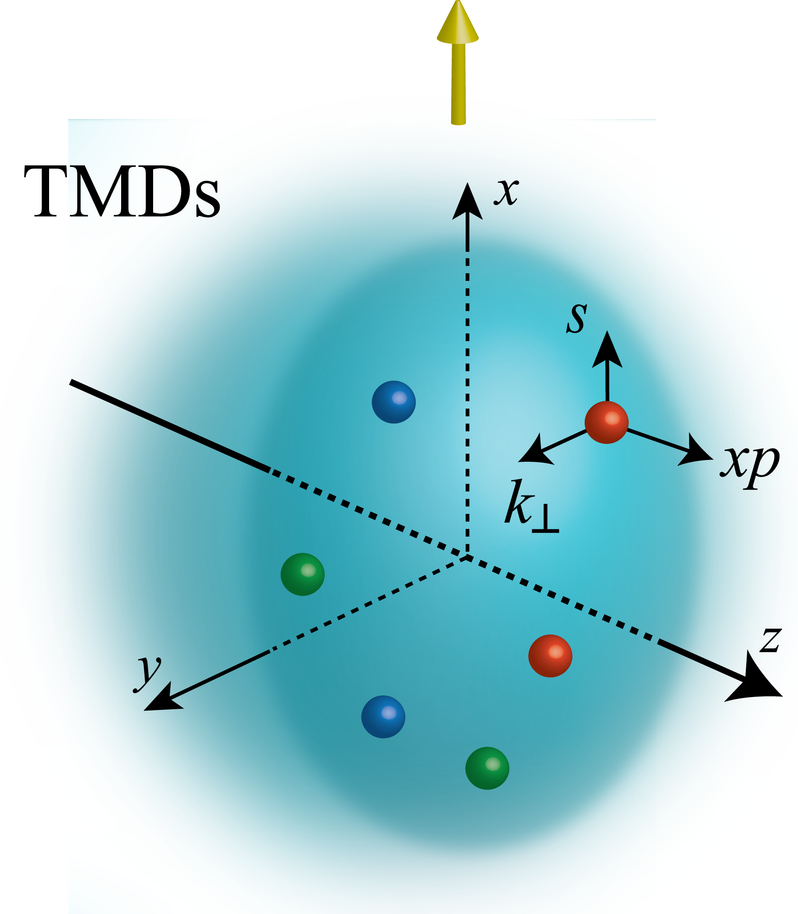
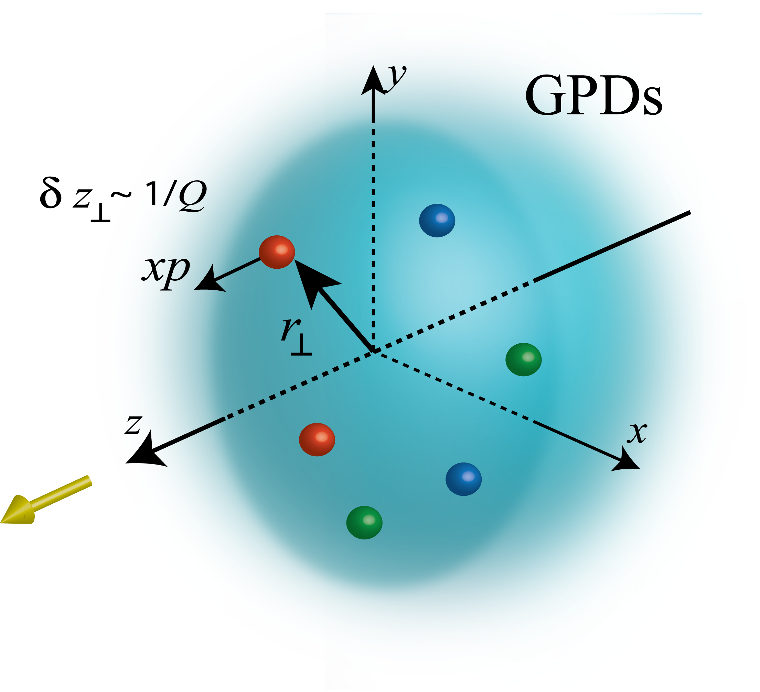
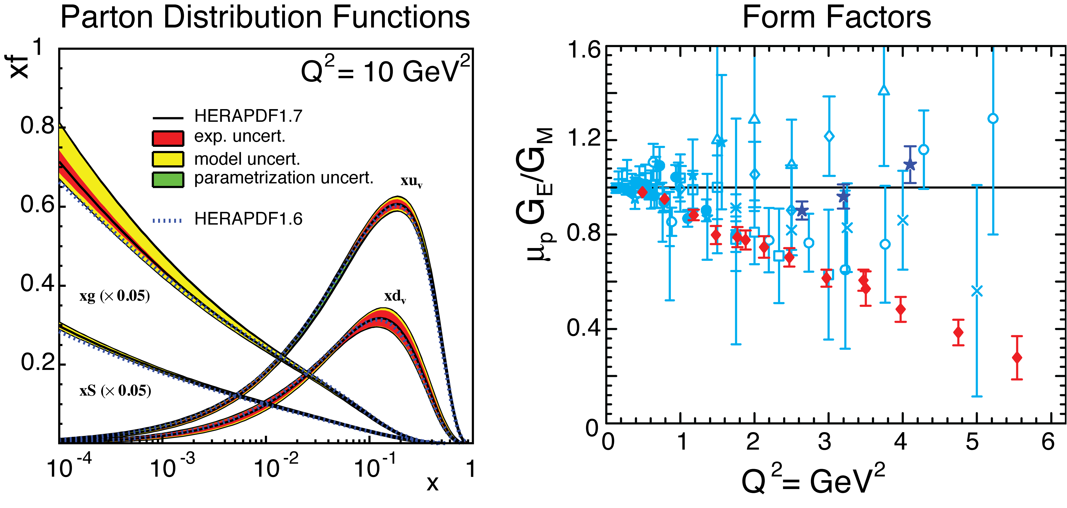
Unified View of Nucleon Structure
W_{p}^{u}(x,k_{T},r_{T} ) Wigner distributions
Transverse Momentum Dist. (TMD)
Tomography
Generalized Parton Dist. (GPD)
dr_{T}
d²k_{T}
TMD f₁^{u}(x,k_{T}), h₁^{u}(x,k_{T})‏
GPD
dx & Fourier Transformation
d²k_{T}
d²r_{T}
Electromagnetic Form Factor G_{E}(Q²), G_{M}(Q²)‏
PDFs
f₁^{u}(x), .. h₁^{u}(x)‏
1D

Slide 8
Unified View of Nucleon Structure
W_{p}^{u}(x,k_{T},r_{T} ) Wigner distributions
Transverse Momentum Dist. (TMD)
Tomography
Generalized Parton Dist. (GPD)
dr_{T}
d²k_{T}
TMD f₁^{u}(x,k_{T}), h₁^{u}(x,k_{T})‏
GPD
dx & Fourier Transformation
d²k_{T}
d²r_{T}
Electromagnetic Form Factor G_{E}(Q²), G_{M}(Q²)‏
Nucleon gravitational form factors A, B, C and C_bar; (quarkonic & gluonic)
Mass density, Scalar-mass Pressure density, Shear Forces density
PDFs
f₁^{u}(x), .. h₁^{u}(x)‏
1D

Slide 9
Near threshold photoproduction of J/ψ

Slide 10
Two mysteries of the proton
Why is the proton massive — and why are its quarks never observed in isolation?
Origin of mass
Color confinement
Most of the proton mass is not the sum of the light current-quark masses.
Quarks and gluons remain localized inside color-singlet hadrons.
Classical massless QCD contains no intrinsic mass or distance scale.
Quantum fluctuations
β(g) ≠ 0 → ΛQCD
Trace anomaly
→ hadronic mass scale
Strong infrared color dynamics
→ confinement

Slide 11
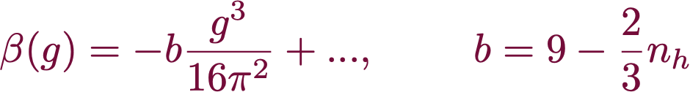
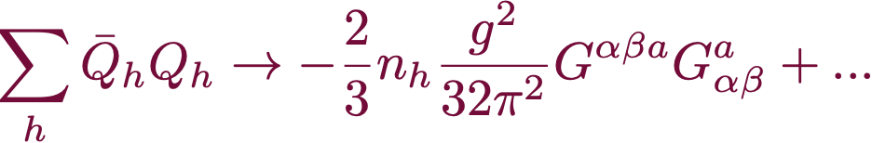
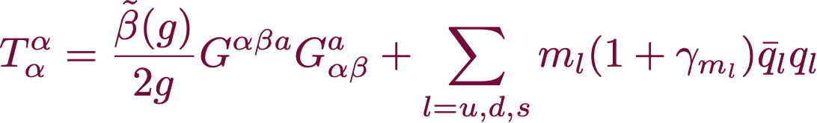

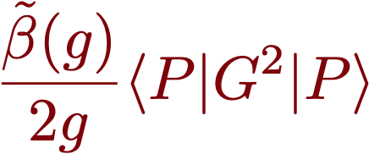
How does QCD generates most of the nucleon mass?
Mass from broken scale symmetry
Textbook: M. E. Peskin and D. V. Schroeder, An Introduction to quantum field theory, Addison-Wesley, Reading (1995)
Trace of the QCD energy-momentum tensor:
D. Kharzeev Proc. Int. Sch. Phys. Fermi 130 (1996)
QCD trace anomaly
At small momentum transfer, heavy quarks decouple:
M. Shifman et al., Phys. Lett. 78B (1978)
with
Gross, Wilczek & Politzer
Trace anomaly, chiral symmetry breaking, …
In the chiral limit we have a finite number for the nucleon (~800 MeV) and zero for the pion
Chiral limit

Slide 12
Higgs Mass Contribution to the proton
Pion-Nucleon Sigma Term
Strangeness content
A talk by Ulf-G Meißner at the 3rd Proton Mass Workshop, Jan 14-2021
https://indico.phy.anl.gov/event/2/
Consequence for the proton mass: About 100 MeV from the Higgs, the rest is gluon field energy
Hoferichter, Ruiz de Elvira, Kubis, Ulf-GMeißner Phys. Rev. Lett. 115 (2015) 092301 [arXiv:1506.04142] Phys. Rev. Lett. 115 (2015) 192301 [arXiv:1507.07552] Phys. Rept. 625 (2016) 1 [arXiv:1507.07552]

Slide 13

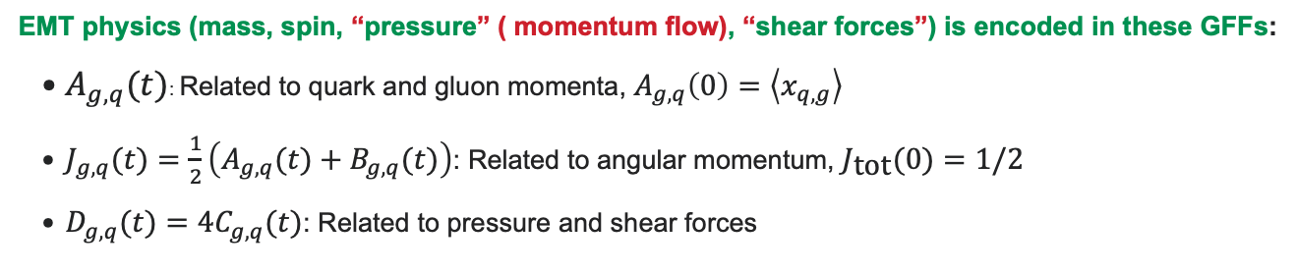
Gravitational form factors (GFFs)
Towards observables of the energy density structure of the proton
GFFs are matrix elements of the QCD energy-momentum tensor (EMT) for quarks and gluons
$$⟨N^{′}∣T_{q,g}^{μ,ν}∣N⟩=\overline{u}(N^{′})\left(A_{g,q}(t)γ^{\{μ}P^{ν\}}+B_{g,q}(t)\frac{iP^{\{μ}σ^{ν\}}ρΔ_{ρ}}{2M}+C_{g,q}(t)\frac{Δ^{μ}Δ^{ν}−g^{μν}Δ^{2}}{M}+{\overline{C}}_{g,q}(t)Mg^{μν}\right)u(N)$$
EMT physics (mass, spin, “pressure” ( momentum flow), “shear forces”) is encoded in these GFFs:
  $A_{g,q}(t)$: Related to quark and gluon momenta, $A_{g,q}\left(0\right)=\left\langle x_{q,g}\right\rangle$
  $J_{g,q}(t)=\frac{1}{2}\left(A_{g,q}(t)+B_{g,q}(t)\right)$: Related to angular momentum, $J_{\text{tot}}(0)=1/2$
  $D_{g,q}(t)=4C_{g,q}(t)$: Related to pressure and shear forces
Heinz Pagels Phys.Rev. 144 (1966) 1250-1260
X. Ji, Phys. Rev. Lett. 78, 610-613 (1997) (eq.12)
Notes:
A full description would require. Do not know how to measure C_bar but this would be my goal.

Slide 14
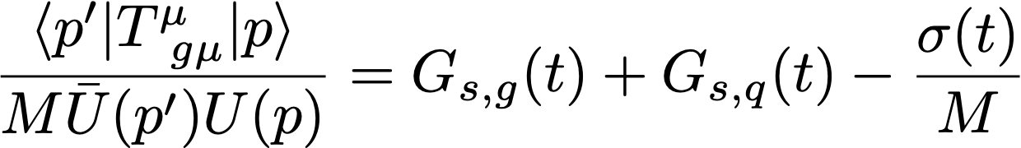
It is possible to reconstruct the scalar gluonic trace form factor
The nonconserved quark/gluon EMT pieces cancel in the sum, leaving a measurable trace-anomaly combination.
Near-threshold J/ψ
→ gluon GFFs
DVCS / global analysis
→ quark GFFs
σ(t)
→ explicit quark mass
• The left-hand side is the gluonic
contribution to the trace anomaly.
• The right-hand side is built from quantities with experimental access.
• At t = 0: G_{s}(0) = 1 − σ(0)/M_{N}.
Why it matters
This turns “the gluonic origin of visible mass” from a formal statement into a quantity that can be confronted with data and lattice QCD.
ZEM & I. Zahed e-Print: 2607.07969 [hep-ph]

Slide 15
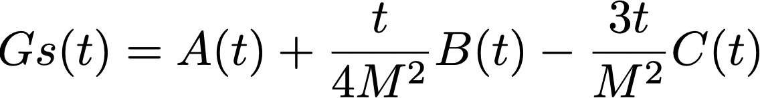
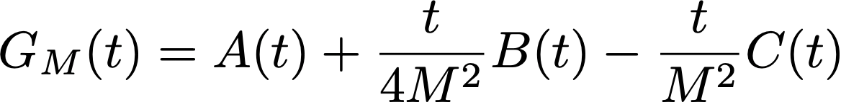
ScalaR EnerGy and SCALAR Form Factors
Total = Quark + Gluon = DVCS + Heavy quarkonium production near threshold
Ji, Front. Phys.(Beijing) 16 (2021) 6, 64601
K. Goeke, Phys. Rev. D 75 (2007) 094021

Slide 16
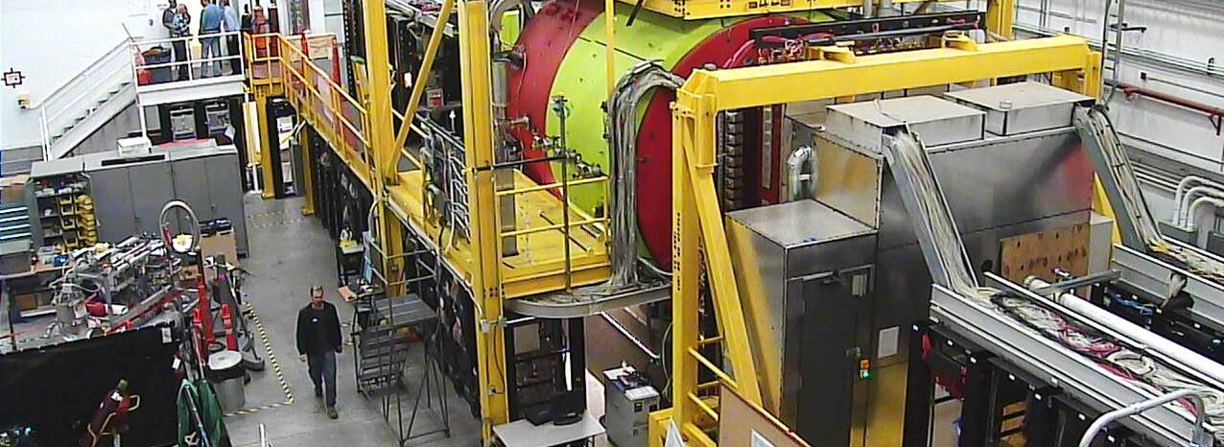
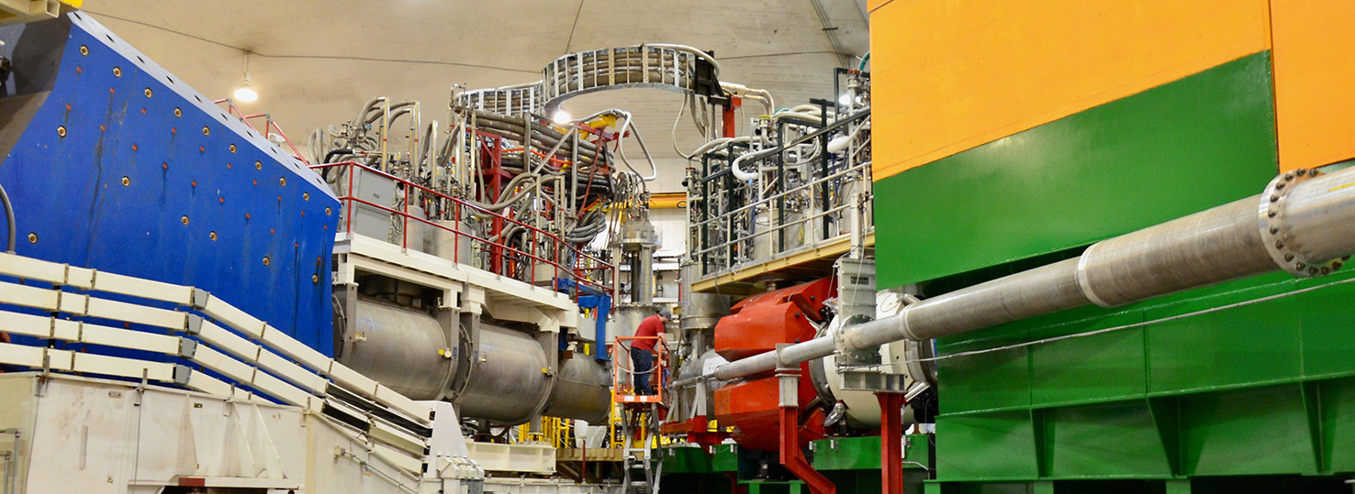
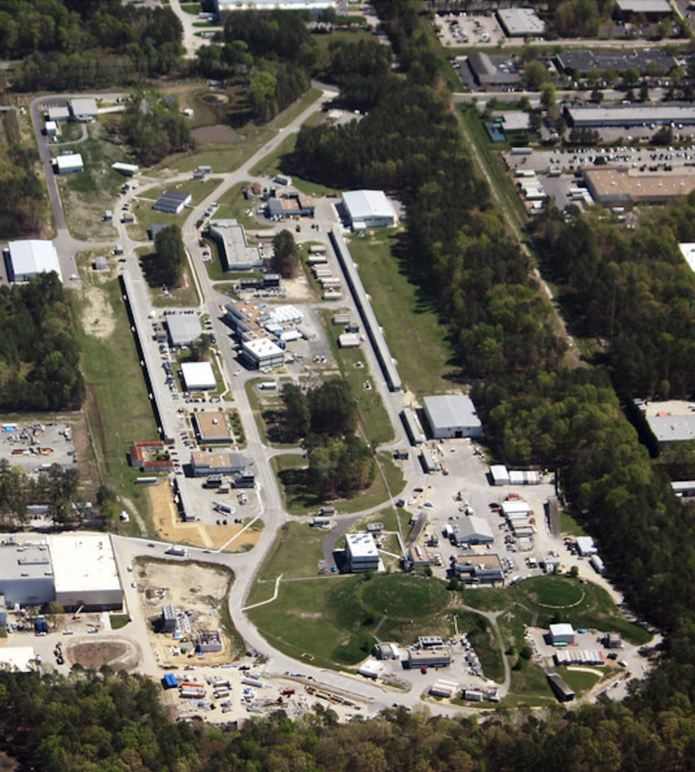
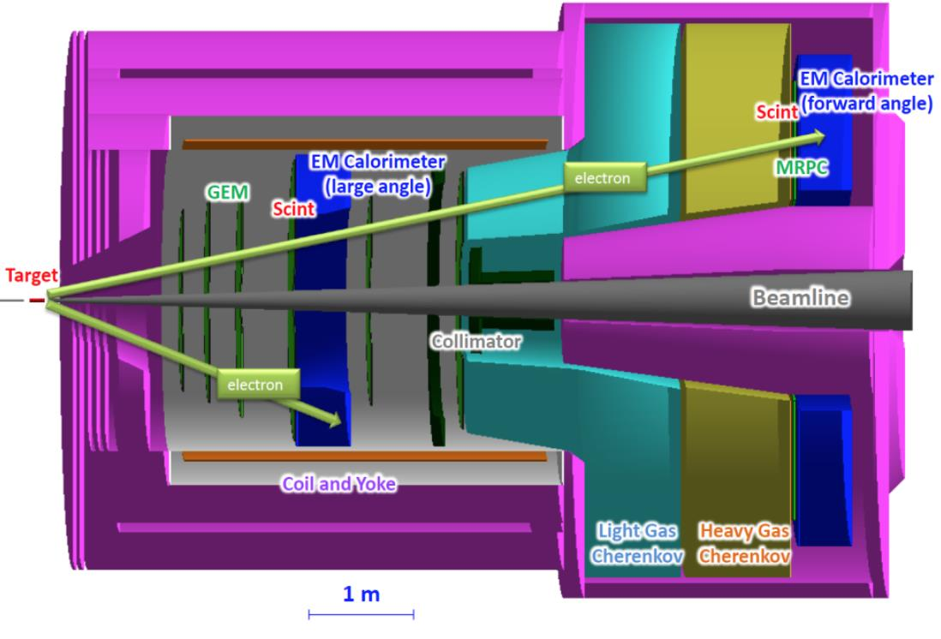
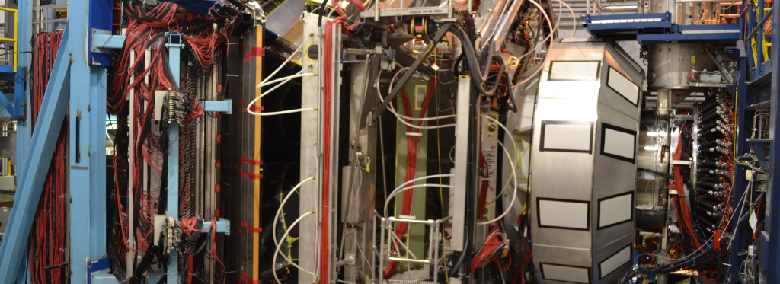
12 GeV J/ψ experiments at Jefferson Lab (Hall D,B,C)
Hall D - GlueX observer the first J/ψ at JLab
Hall C has the J/ψ-007 experiment (E12-16-007)
LHCb hidden-charm pentaquark search
Hall A has experiment E12-12-006 at SoLID to measure J/ψ in electro- and photoproduction, and an LOI to measure double polarization using SBS
Hall B - CLAS12 has experiments to measure TCS + J/ψ in photoproduction as part of Run Groups A (hydrogen) and B (deuterium): E12-12-001, E12-12-001A, E12-11-003B

Slide 17
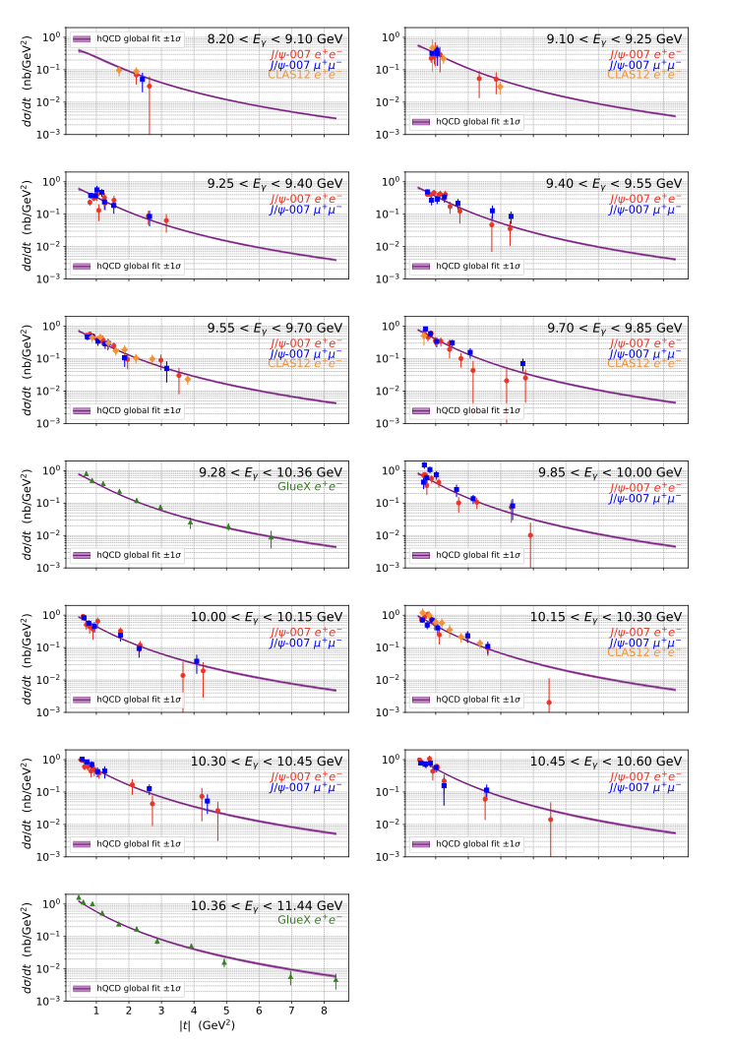
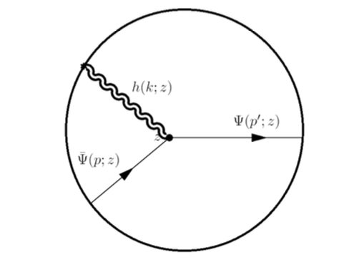
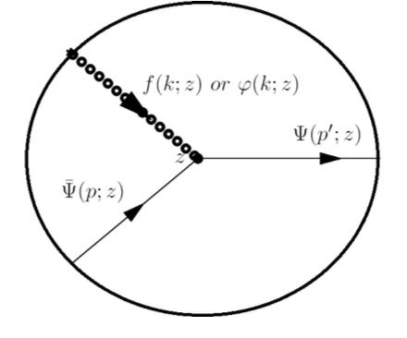


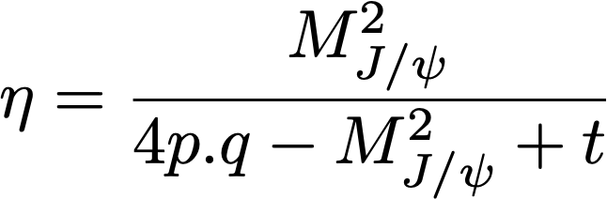
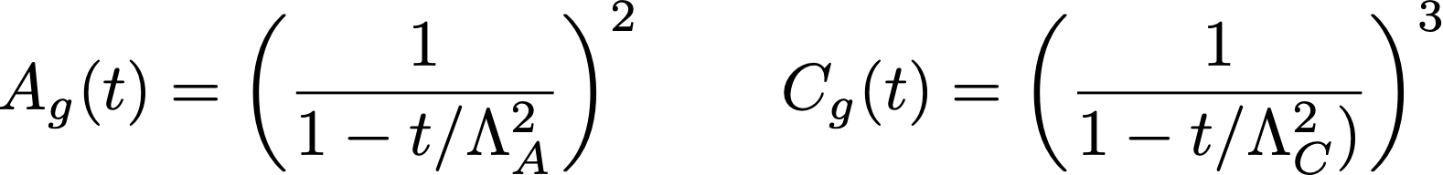


Jlab J/$ψ$ Data: Global fit in the Holographic Model
J/$ψ−007 (e , μ$), GlueX (2023) & CLAS12 (e)
2D fit to extract the A(t) & C(t) assuming B(t) negligible
K. Mamo & I. Zahed, PRD 106, 086004 (2022) and PRD 101, 086003 (2020)
Tensor
Scalar
Spin-2⁺⁺ :
Spin-0⁺⁺ :
χ² = 201.054
ndf = 200
χ²/ndf = 1.005
Λ_{Α} = 1.159 ± 0.017
C(0)= -1.937 ± 0.751
Λ_{C} = 0.914 ± 0.151
A(t) and D(t) shapes are fully calculated; However, dipole- tripole forms are
assumed as very good approximations and are used in the fits to the data.
A_{g}(0)= <x_{g}> is fixed to the DIS value from global fit CT18.
B(t) is neglected and is normalized to the first GlueX (2019) cross section.

Slide 18
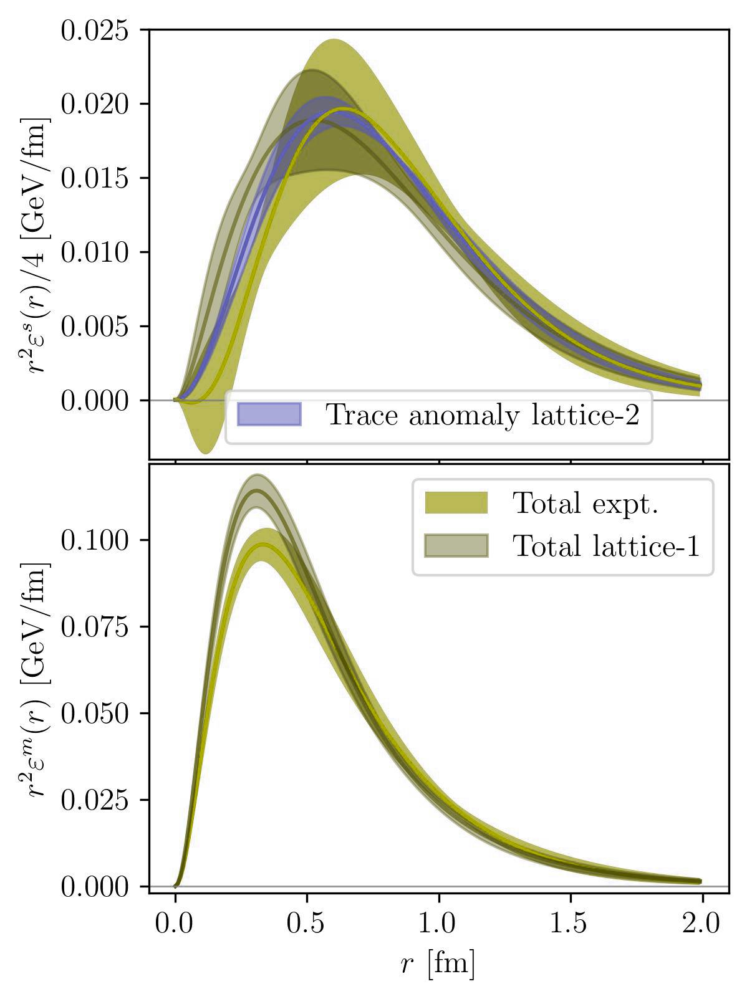
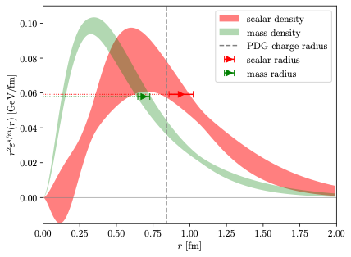
BREIT FRAME Scalar and Mass “Densities”
Scalar
Global analysis from DVCS (q) & J/ψ (g) Expts. compared to lattice-1 and lattice-2
Lattice-1: D.C. Hackett, D.A. Pefkou and P.E. Shanahan, Phys. Rev. Lett. 132, no.25, 251904 (2024)
Lattice-2:B. Wang et al. [$χ$QCD], ' Phys. Rev. D 109, no.9, 094504 (2024) doi:10.1103/PhysRevD.109.094504 [arXiv:2401.05496 [hep-lat]].
Quark contribution to experiment: Y. Guo, F. Yuan and W. Zhao, ``Bayesian Inferring Nucleon Gravitational Form Factors via Near-Threshold J/psi Photoproduction,'' Phys. Rev. Lett. 135 (2025) no.11, 111902 doi:10.1103/3x7r-ythq [arXiv:2501.10532 [hep-ph]].
Mass
Ji, ZEM, Joosten and Pefkou
2609.09318

Slide 19

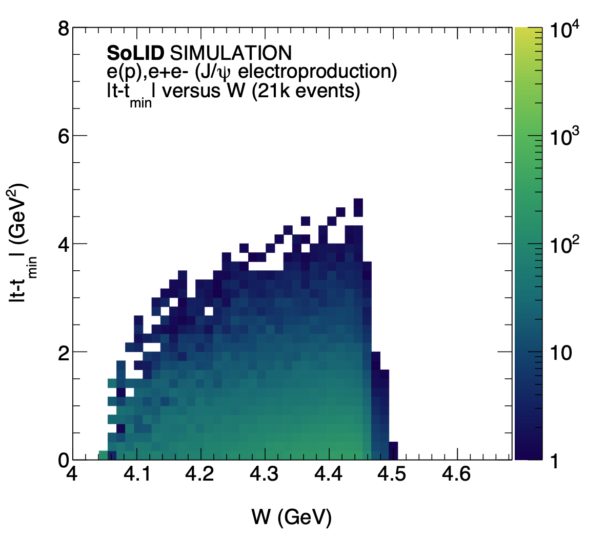
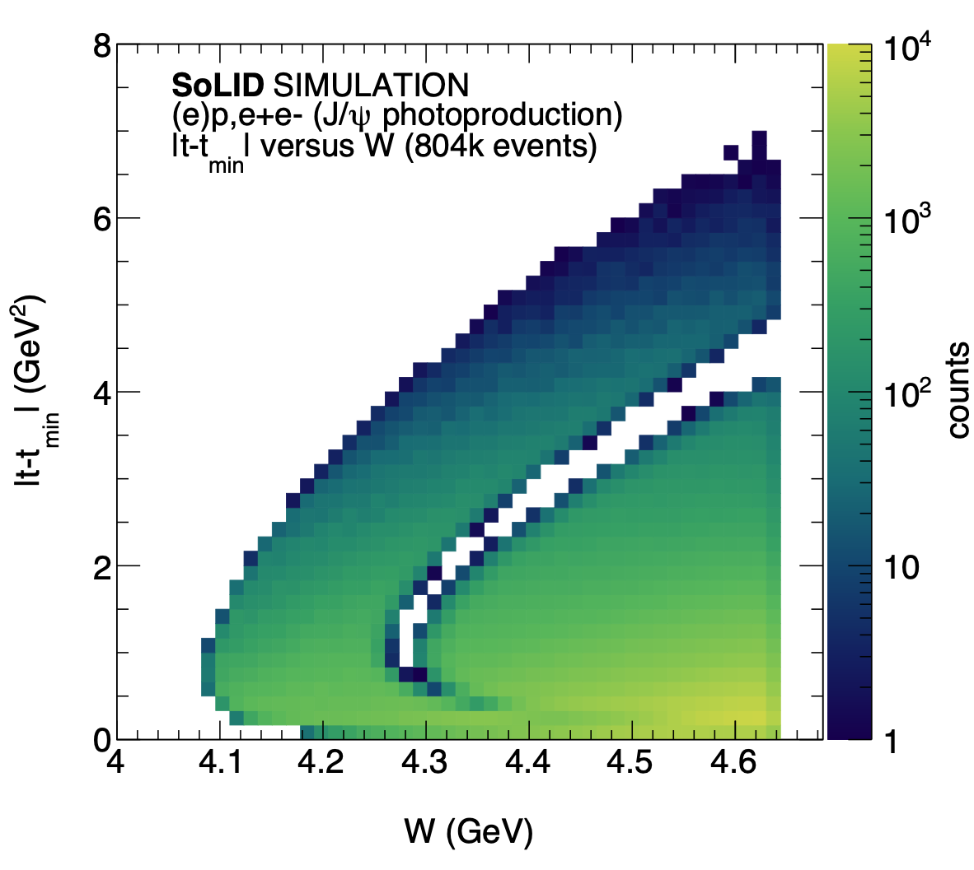
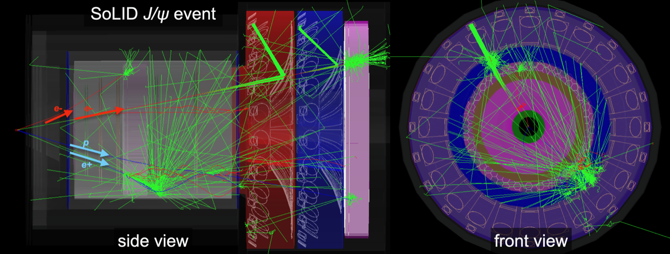

Future solid experiment at JLab
Ultimate experiment for near-threshold J/ψ production
General purpose large-acceptance spectrometer
50 days of 3µA beam on a 15cm long LH2 target (1.2 10³⁷/cm²/s)
Ultra-high luminosity: 43.2ab⁻¹
4 channels:
  Electroproduction (e, e-e+)
  Photoproduction (p, e-e+)
  Inclusive (e-e+)
  Exclusive (ep, e-e+)

Slide 20
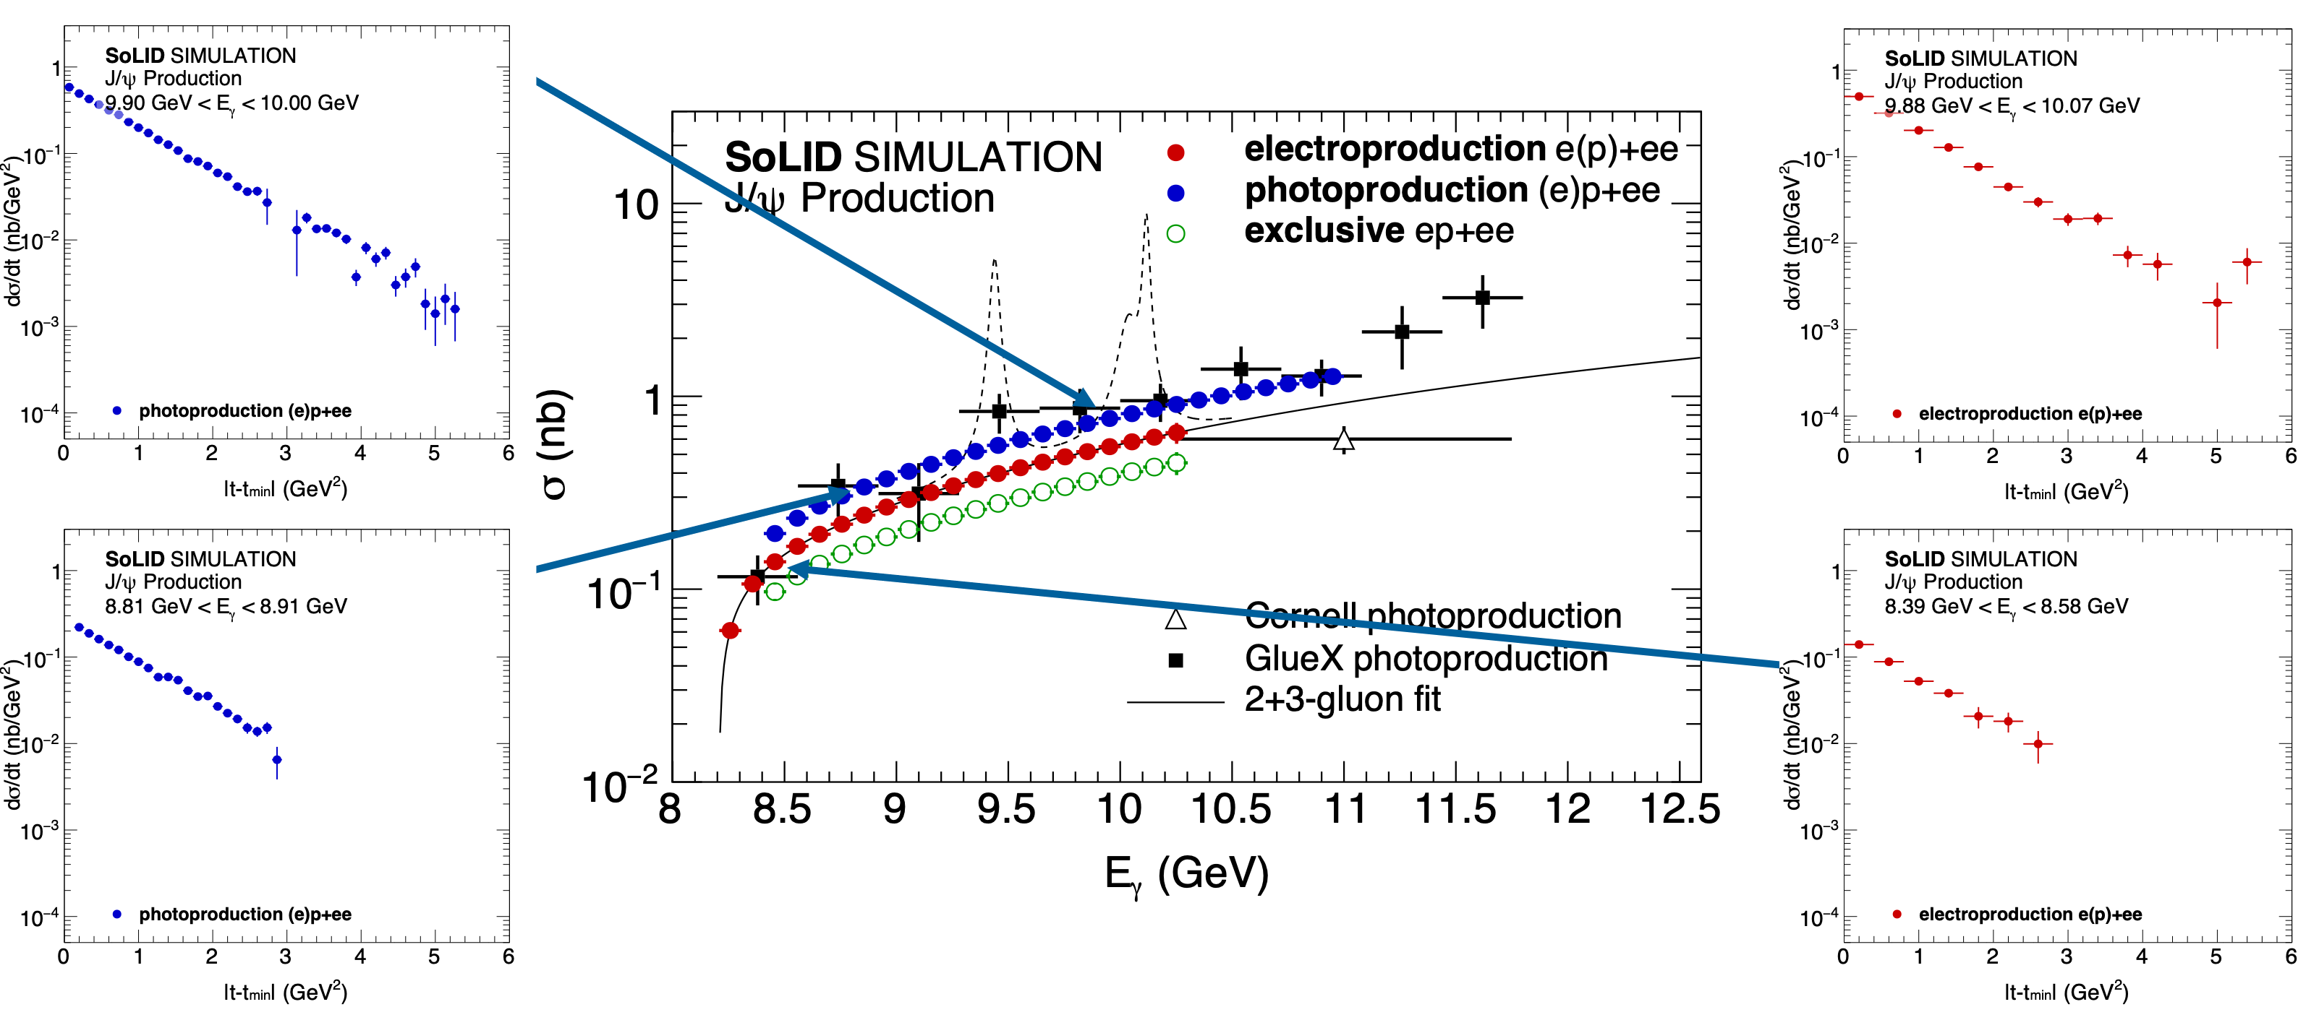
Future solid experiment at JLab
Precision measurement of J/ψ near threshold

Slide 21
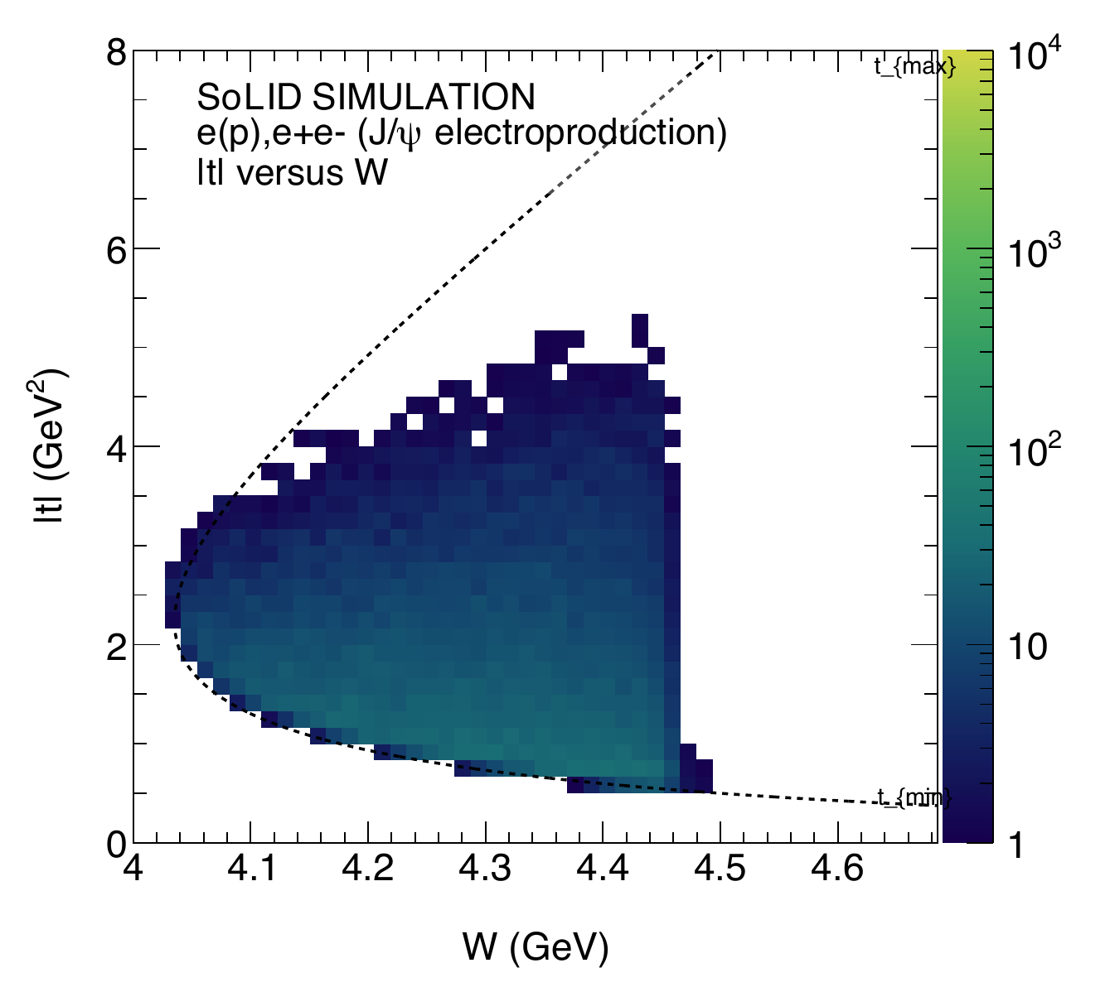
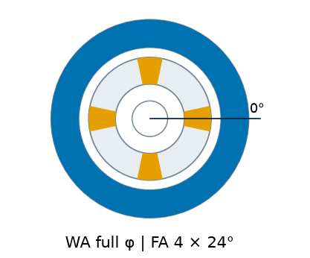
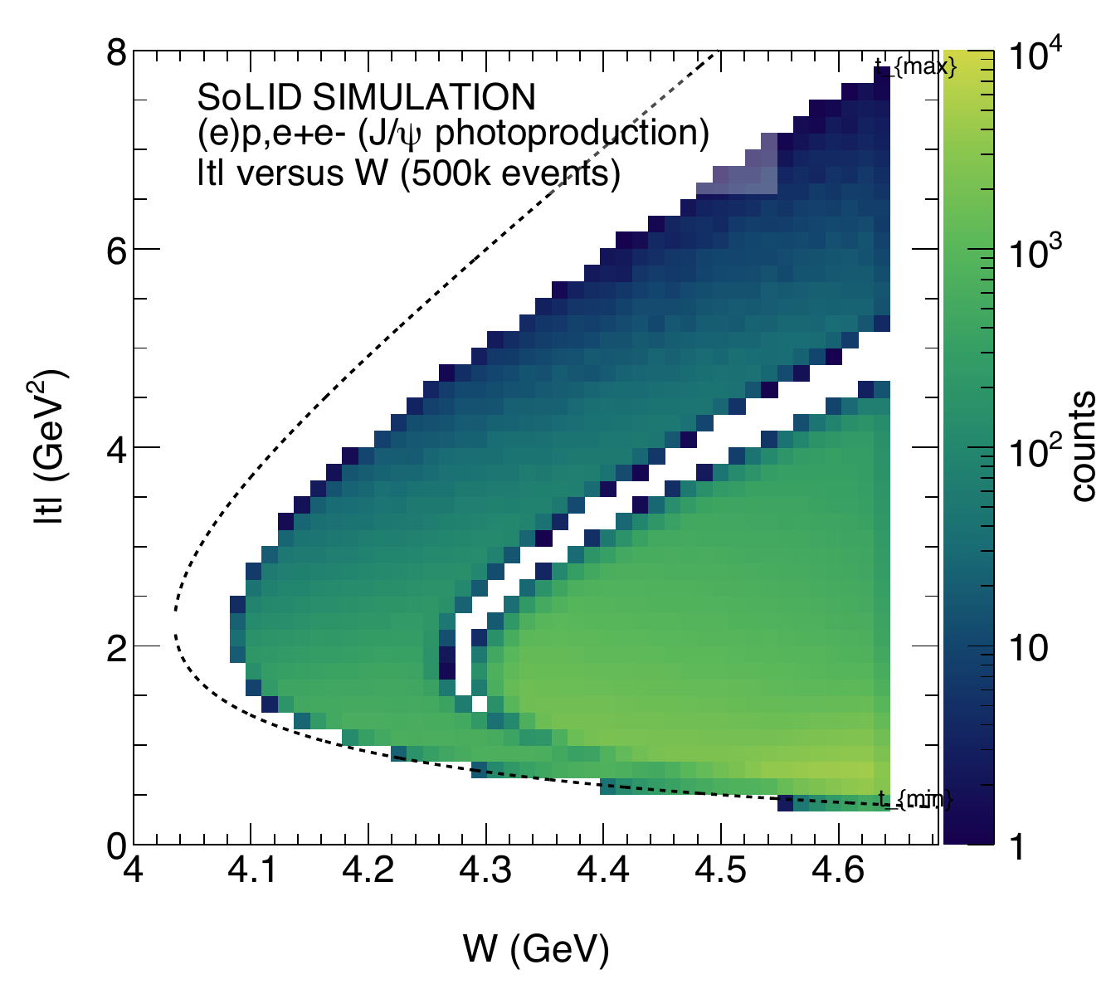
Solid-Lite experiment at JLab
-Lite
Ultimate experiment for near-threshold J/ψ production
Large-acceptance spectrometer
50 days of 6µA beam on a 15cm
long LH2 target (2.410³⁷/cm²/s)
Ultra-high luminosity: 86.4ab⁻¹
4 channels:
  Electroproduction (e, e-e+)
  Photoproduction (p, e-e+)
  Inclusive (e-e+)
  Exclusive (ep, e-e+)
LA

Slide 22


Solid-LITE experiment at JLab
-Lite
Precision measurement of J/psi near threshold

Slide 23




Solid-LITE experiment at JLab
-Lite
Precision measurement of J/ψ near threshold- hQCD fit with error band

Slide 24


Jlab J/$ψ$ Data: fit using the Holographic Model
GlueX (2023, $e+e−$) & CLAS12 (2026, $e+e−$), J/$ψ−007 \text{(}e+e− , μ+μ−$)
2D fit to extract the A_{g}(t) & D_{g}(t) assuming B(t) negligible
A_{g}(t)
A_{g}(t)
D_{g}(t)
D_{g}(t)

Slide 25



SoLID/SoLID-Lite impact on ToTAL scalar density
Scalar density in the Breit Frame / Comparison with lattice
Lattice-1
D. C. Hackett, D. A. Pefkou and P. E. Shanahan, Phys. Rev. Lett. 132 (2024) no.25, 251904 doi:10.1103/PhysRevLett.132.251904

Slide 26

Universality Test with Y(1S) at EIC
Upsilon production and J/ψ production at large Q²
Y(1S) at EIC trades statistical precision of J/ψ at SoLID for lower theoretical uncertainties, and extra channel to study universality.
Large Q² reach at EIC an additional knob to study production, near- threshold J/ψ production at large Q² may be experimentally feasible!
Upsilon at EIC

Slide 27
SoLID-SIDIS: Transversity/Tensor Charge
and TMDS

Slide 28









Separation of Collins, Sivers and Pretzelosity
(2$π azimuthal coverage)$
SIDIS SSAs depend on 4-D variables (x, Q², z, P_{T}) and small asymmetries demand large acceptance + high luminosity. Allows precision measurements of asymmetries in 4-D binning!
$$A_{UT}\left(φ_{h},φ_{S}\right)=\frac{1}{P_{t,pol}}\frac{N^{↑}−N^{↓}}{N^{↑}+N^{↓}}$$
Leading twist formalism
(higher-twist terms can be included)
Collins fragmentation function from e⁺e⁻ collisions
Unpolarized fragmentation function
28
Notes:
28

Slide 29



SoLID-SIDIS Projections and Impact
Transversity
Sivers
JLab 6-GeV X. Qian et al., PRL107, 072003(2011) & 12 GeV SoLID projections
Fit Collins and Sivers asymmetries in SIDIS and e⁺e⁻ annihilation
World data from HERMES, COMPASS
e⁺e⁻ data from BELLE, BABAR, and BESIII
Monte Carlo method is applied
Includes both systematic and statistical uncertainties
World data according to SoLID (2019) preCDR https://solid.jlab.org/DocDB/0002/000282/001/solid-precdr-2019Nov.pdf
D'Alesio et al., Phys. Lett. B 803 (2020)135347
Anselmino et al., JHEP 04 (2017) 046
29

Slide 30





SoLID-Lite SIDIS ³He, Transversity
Compares TMD fitting error for SoLID full and SoLID-Lite with same binning and statistical error only.
Assume 4x luminosity, the same as SBS target and current.
Error ratio reduced by ~2x
Tensor charge: An intrinsic nucleon property as fundamental as the electric charge, the axial charge…

Slide 31


SoLID-Lite SIDIS ³He, Sivers
Compare TMD fitting error for SoLID full and SoLID-lite with same binning and statistical error only
Assume 4x luminosity, the same as SBS target and current
Error ratio reduced by ~2x

Slide 32

Conclusion
SoLID-Lite is a path forward to realize the full science potential of Jefferson Lab starting with a focus on J/ψ near threshold photoproduction.
  Impact on the question of the origin of the proton mass and strong interaction size of the proton is significant.
  Impact on the structure of the confined motion of quarks in the proton through SIDIS in the valence region is also significant
We are at the dawn of an exciting avenue of nucleon’s gluonic structure research through the determination of the gluons GFFs of the nucleon.
Present photoproduction of J/$ψ$ data suggest a scalar radius around 1 fm consistent with lattice QCD.
We have a sneak preview of the strong interaction size of the proton. Scalar gluons configurations, at the origin of the nucleon mass, seem to define the size of the proton.
The trace anomaly at the origin of the nucleon mass is the limit for t=0 of the scalar form factor
Statistical precision will enable an understanding of the systematic uncertainties in the extractions of the mass radius and the scalar radius with controlled approximations.
EIC $Υ$ photoproduction measurements are critical for validating the universality of the gluonic GFFs independent of models.

Slide 33
Thank you!
This was was supported in part by DE-AC0206CH11357

