Slide 1

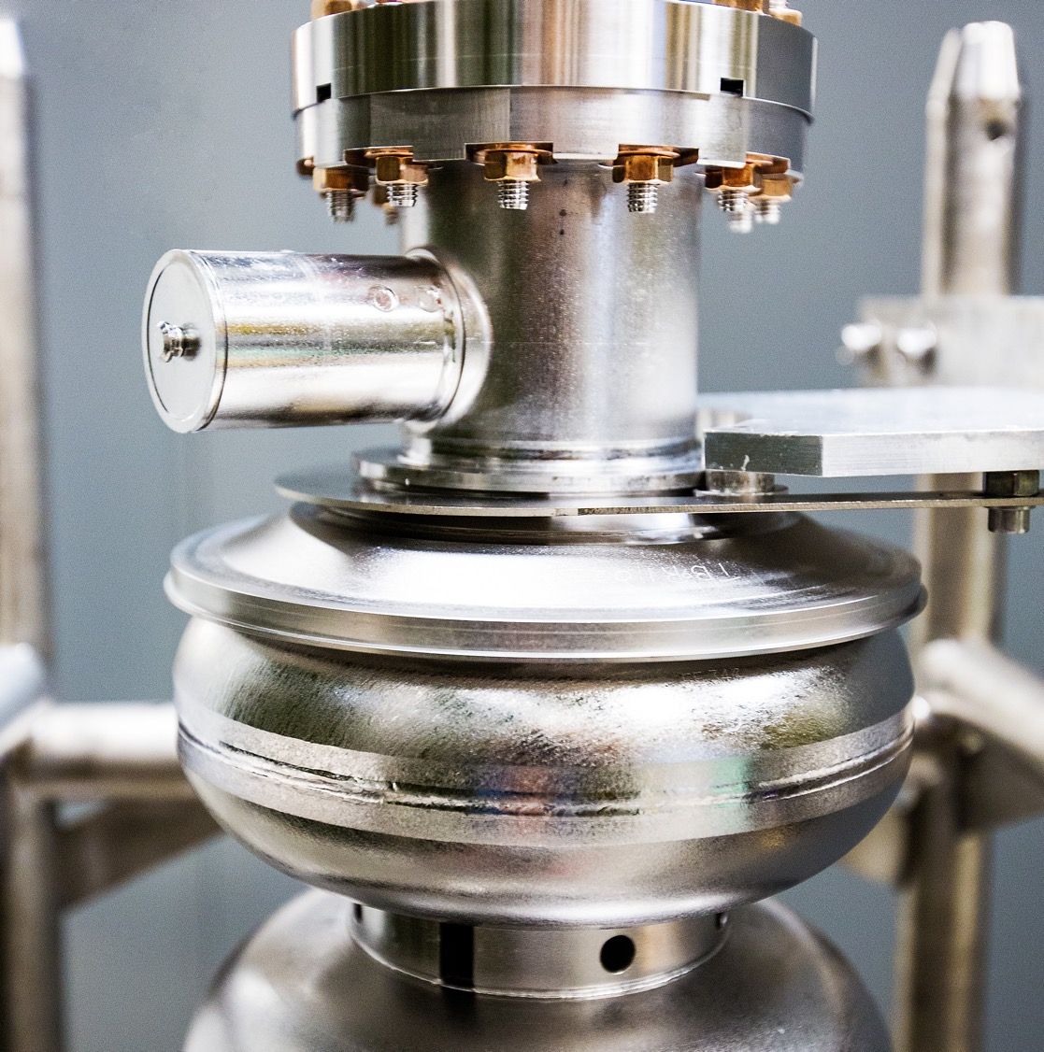
Workshop on the Physics Program with High Luminosity Facilities
October 05, 2026
Mike Spata, Acting Division Director
CEBAF Accelerator
Notes:
Tip: Keep titles under 60 characters for readability
To change the photo: Right-click on photo and select change photo

Slide 2
Outline
FY26 Run Highlights
FY27 CEBAF Support and Repair
FY27 Reliability Investments
FY27 Linac Energy Performance Investments
Moller Preparations
Accelerator Improvement Projects
Artificial Intelligence Investments
Accelerator Management Plan
CEBAF Configuration Control Committee
Summary

Slide 3
FY26 Low Energy Run Performance
The low energy run required 345 MeV/linac, the lowest energy we’ve run since the 4 GeV era.
Three low points for explicit outages are identified on the chart.
A chronic challenge at this low energy was optics reproducibility which required frequent retuning.
Data includes the usage of accumulated accelerator configuration change, tuning, maintenance and beam studies hours to optimize the overall program during periods when unable to deliver Physics.
MYBBS06
Swap-out
RF Issues and
Beam Tuning
West Arc Cooling Tower Leak

Slide 4
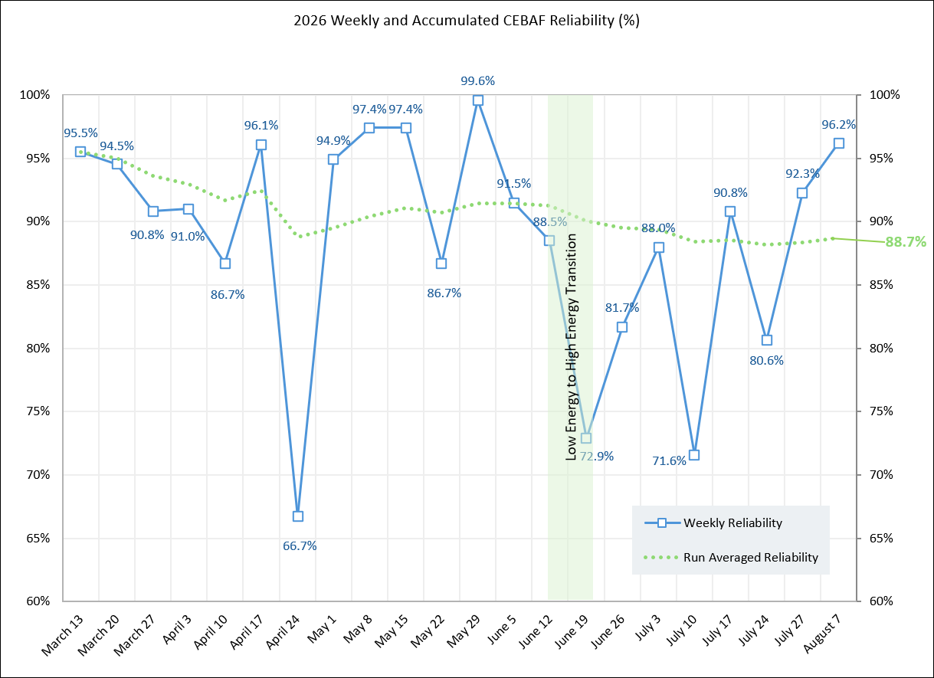
FY26 Overall Run Performance
Transitioned to the high energy run over a two week period. One week to configure the magnet shunt resistors and one week for setting up the higher energy.
Major run outages beyond the transition were dominated by stopping to flush magnets in the East Arc. Unfortunately this tended to limit beam availability to only Hall B on first pass.
Throughout the high energy run the linac performance and optics reproducibility were excellent.

Slide 5
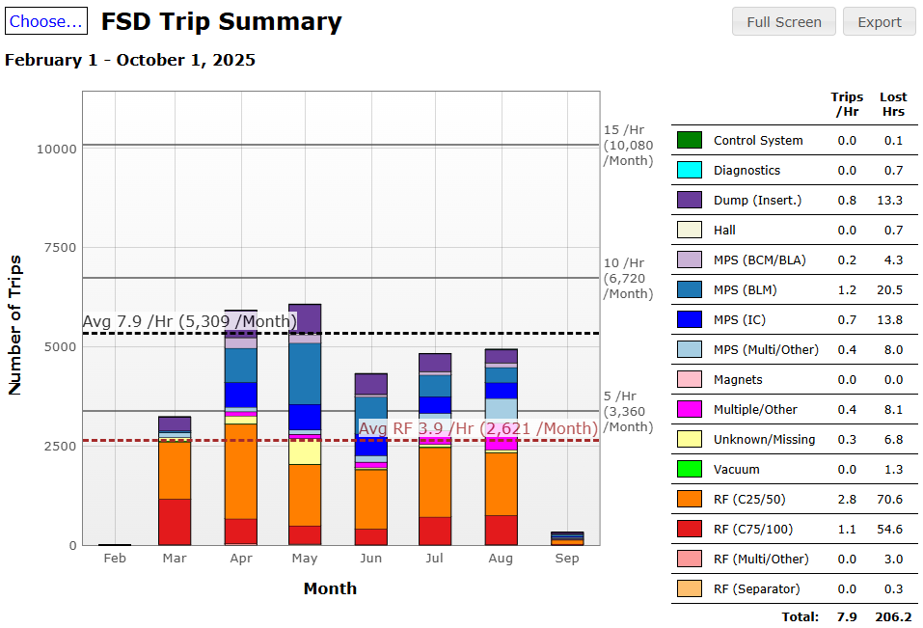
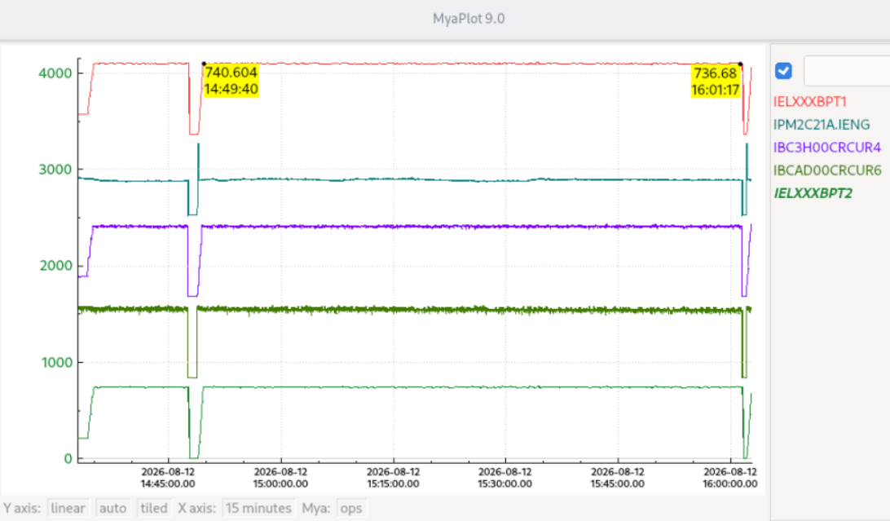
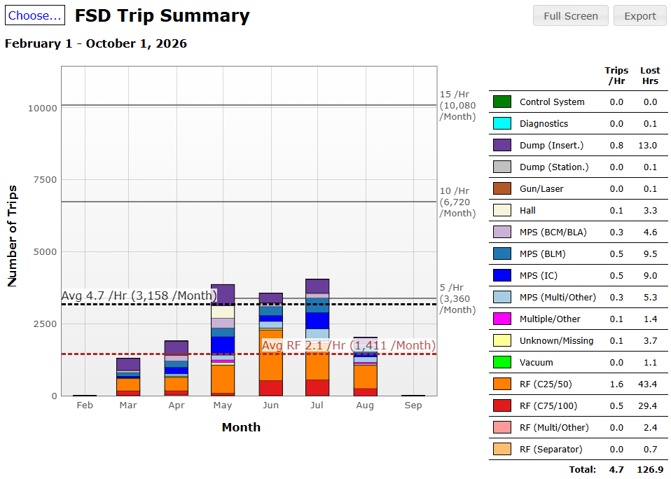
Linac Performance and High Power Running
Fast Shutdown (FSD) short duration trips for the FY25 and FY26 runs show good performance over the run periods.
A few days before the end of the run we achieved an all-time record of one hour and twelve minutes of continuous running at 750 kW.
FY25 Run
FY26 Run

Slide 6
CEBAF Experimental Physics Program Accomplishments
Hall B
E12-20-004: PRad-II (Contact: A. Gasparian (NCSU), D. Dutta (MS), H. Gao (Due), N. Liyanage (UVA), E. Pasyuk(JLab), C. Peng (ANL). W. Xiong (Shandong), and DWH (JLab)). [completed]
E12-21-003: X17 Boson Search: (Contact: A. Gasparian (NCSU), D. Dutta (MS), H. Gao (Due), T. Hague (JLab), N. Liyanage (UVA), R. Paremuzyan(JLab), C. Peng (ANL). W. Xiong (Shandong)) [well underway, continuing next year]
Hall C
E12-22-001: N-> Delta (Contact: N. Sparveris (Temple), H. Atac (Temple), A. Camsonne(JLab), M. Jones(JLab), and M. Paolone (NMS) [ completed ]
E12-23-001: VCS (Contact: N. Sparveris (Temple), H. Atac (Temple), A. Camsonne(JLab), M. Jones(JLab) and M Paolone (NMS)) [ completed scope for FY26 ]
E12-24-001: Nuclear-R SIDIS (Contact: D. Gaskell (JLab), P. Bosted(W&M), W. Brooks (Fed. ST. Maria), R. Ent(JLab), E. Kinney(UC), and H. Mkrtchyan (Yerevan)) [completed]
E12-06-104: Nucleon R SIDIS (Contact: R. Ent(JLab), P. Bosted(W&M), E.Kinny(UC) and H. Mkrtchyan(Yerevan)) [completed ]
E12-06-107: Color Transparency Search (Contact H. Vance(FIU/ODU/JLab), C. Gayoso(W&M), and D. Dutta(MS))
[started, finishing next year]
Hall D
E12-25-005: GlueX with a 1-4 GeV Photon Beam ( contact: M. Dalton(JLab) & F. Afzal (JLab), V. Crude (FSU), P. Hurck (UB), I. Jeagle (ODU), and A. Thiel (UG) ) [ well underway, finishing next year ] NOTE: First low energy Hall D beam.
E12-12-002: GlueX-II (Contact: C. Meyer (CMU) and M. Shepherd (IU)) [200 of 220 days completed, finishing next year]
E12-12-002A: Jefferson Lab Eta Factor (JEF) (Contact: L. Gan (UNCW) & Z. Papandreou, A. Somov(JLab), and S. Tayler(JLab))
[run group experiment with GlueX-II, finishing next year]
Notes:
Fully completed 4 experiments (green) and have six partially completed (yellow). The partially completed will all finish up next year. The item to note is this year was the first time we ran a low energy beam to Hall D.

Slide 7
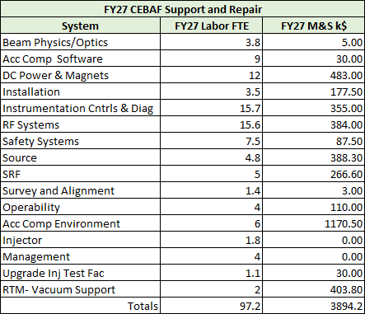
FY27 CEBAF Support and Repair
The CEBAF Support and Repair program continues to capture the resources needed for all of the technical systems owners.
FY27 Support and Repair includes 97.2 FTE and $3.9M in M&S across the CEBAF technical systems.
The largest resource requirements remain in RF, I&C/Diagnostics, DC Power & Magnets and the Accelerator Computing Environment.
FY27 priorities focus on sustaining aging systems, maintaining critical repair and spares capability, and providing the technical support required for reliable CEBAF operations.

Slide 8
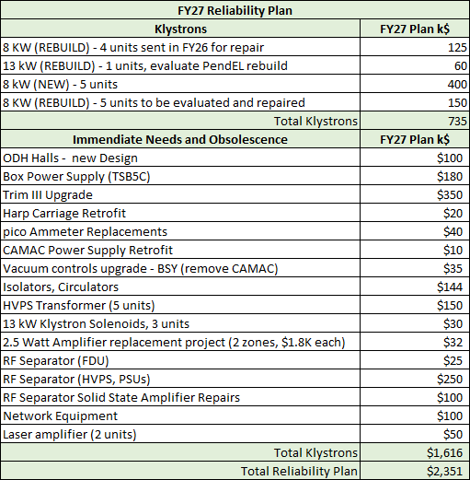
FY27 Reliability Investments
The reliability program continues to be focused on Klystrons and Obsolescence
Maintaining sufficient inventory of 8 kW and 13 kW Klystrons continues to be a challenge due to the escalating cost of new units.
A campaign to establish a klystron refurbishment programs with two established vendors is established. Also looking into cost benefit analysis of refurbishing in-house.
The Obsolescence program continues to support the multi-year magnet upgrade, I&C upgrades for Harps, nA BPM, and pico-ammeters, RF HV hardware and Separator amplifiers and Network equipment.

Slide 9
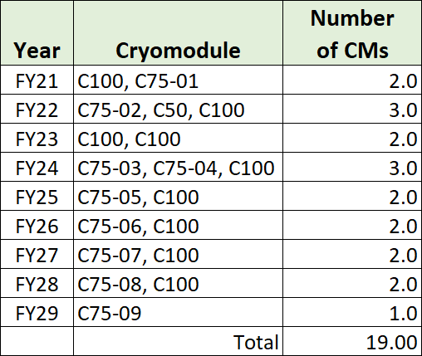
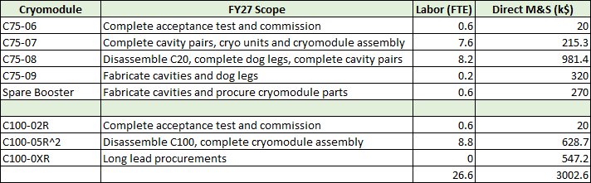
FY27 Linac Energy Performance Investments
The multi-year plan for converting original C20 cryomodules to C75 style and refurbishing C100 cryomodules is shown at right.
Scope of work for FY27 includes:
  Complete acceptance test and delivery of C75-06 and C100-02R into the north linac
  Continue the development of C75-07, C75-08, C75-09 and the Spare Booster
  Continue the development of C100-05R and C100-XR
  Continue multi-year plan to build a Spare Booster Cryounit for the CEABF Injector
Plasma processing continues to be applied during SAMs.
Ozone cleaning continues to be evaluated (Proposal submitted to NP NOFO)
Evaluating optimal approach for FY28 and beyond that may pivot to C60

Slide 10
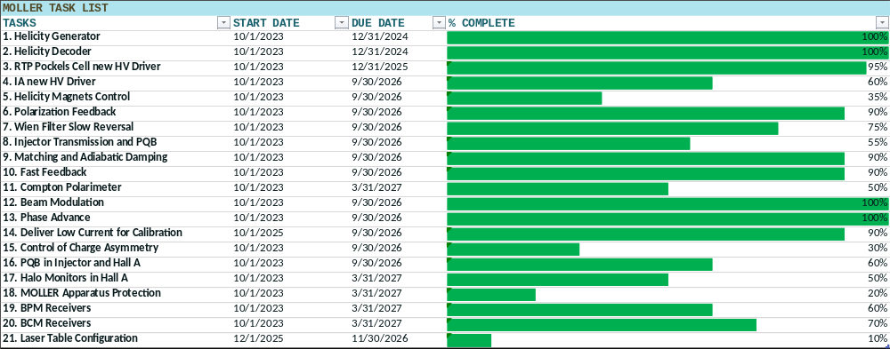
MOLLER Preparations
A significant amount of Beam Studies and hardware development in support of MOLLER were accomplished throughout the FY26 run.
Getting ready for first beam tests during the latter part of the FY27 run period.

Slide 11
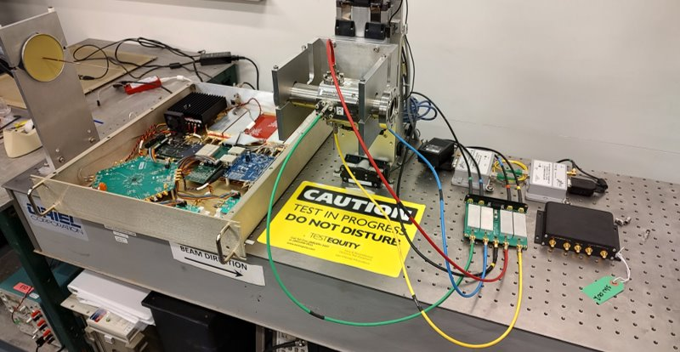
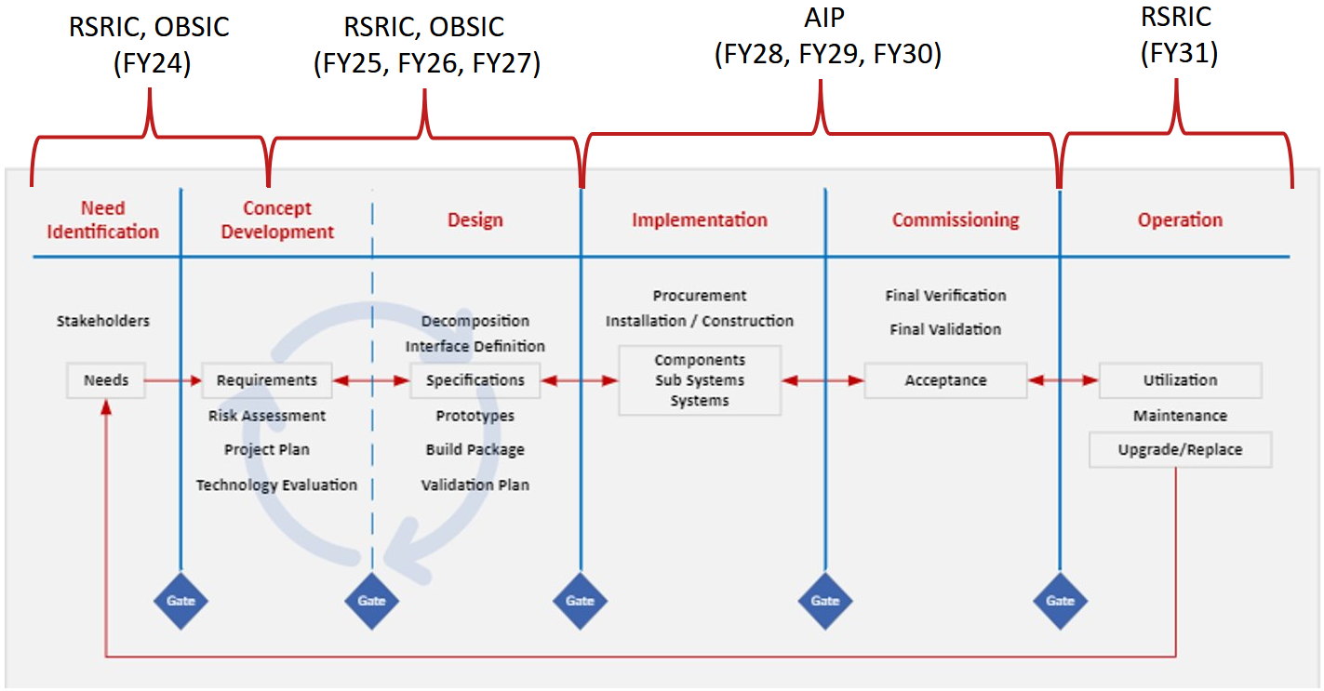
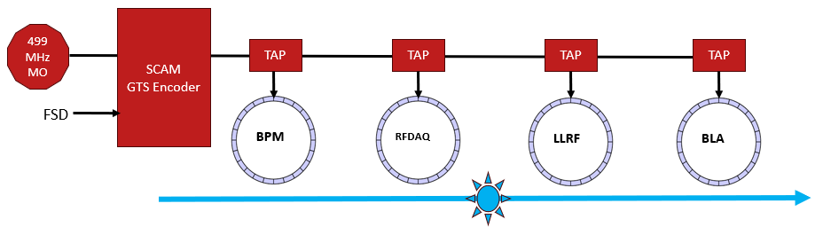
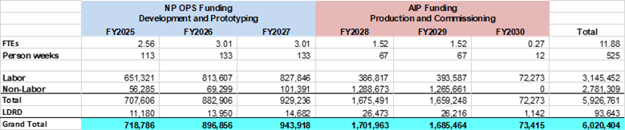
Accelerator Improvement Projects
Next Generation Beam Position Monitor:
New system being developed to replace the existing 4 Channel and SEE BPM systems
Addresses obsolescence and provides enhanced functionality
High bandwidth, synchronized position data collection across the accelerator
AI and ML enabled algorithms for improved beam delivery
Global Timing System:
Site wide synchronization of diagnostic systems
Design of prototype end point underway

Slide 12
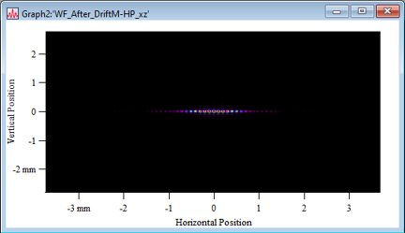
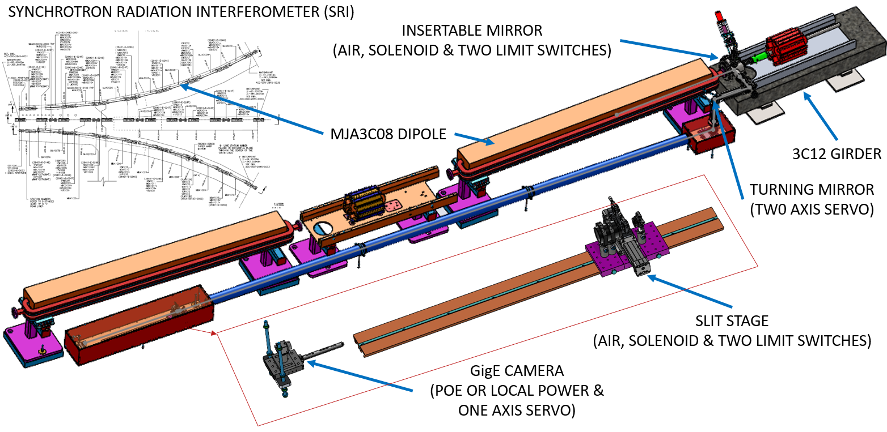
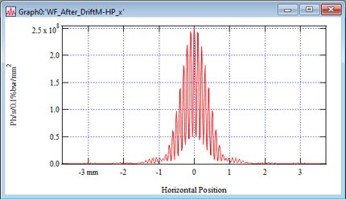
Advanced Diagnostics
“Study of charge symmetry breaking in p-shell hypernuclei” (2026) requires < 3x10⁻⁵ (FWHM) energy spread in Hall C.
Developed a synchrotron radiation interferometer to meet the requirements.
Equipment procured and bench assembled in 2024, Installed in FY25 and will complete the commissioning during the FY27 run.

Slide 13
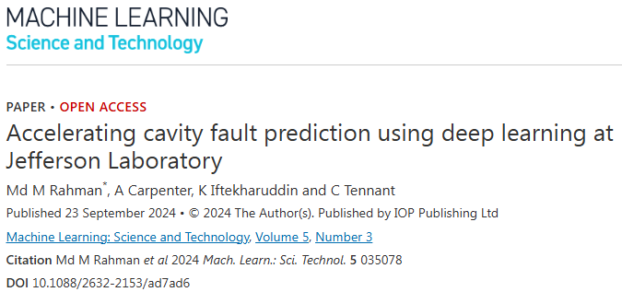
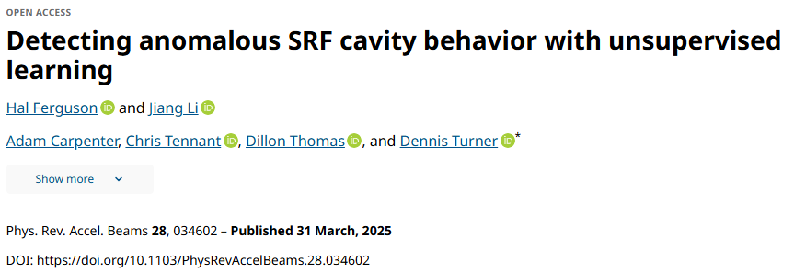
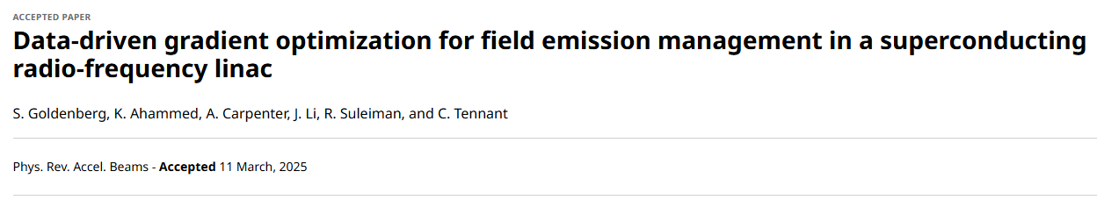
Artificial Intelligence R&D - Foundational Work
A four year program, funded by NP-R&D, has enabled us to achieve important foundational work and to move towards developing a core competency in ML/AI.
Three areas of focus on improving SRF Linac Performance:
Cavity Fault Prediction - use deep learning to identify features in pre-fault data in C100 cavities to predict slowly developing cavity faults.
Anomalous Cavity Detection - automate the process of identifying RF cavities that exhibit anomalous behavior, but do not present as a fault. Adds digitizing systems to legacy analog RF systems (C20/C50 cryomodules).
Field Emission Management – reduce radiation due to SRF cavities through gradient redistribution within a specific cryomodule while maintaining the same energy gain.
Peer-reviewed papers published for each project.
Notes:
Guidelines: 6-8 bullets per slide; Use sentence fragments for bullets

Slide 14
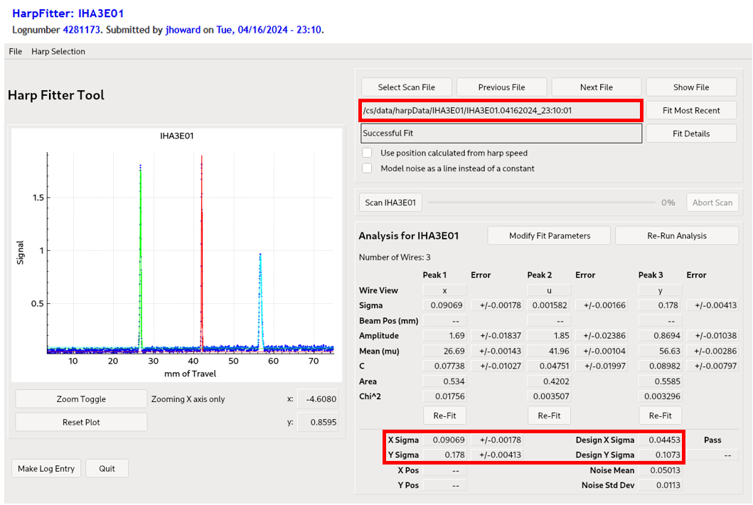
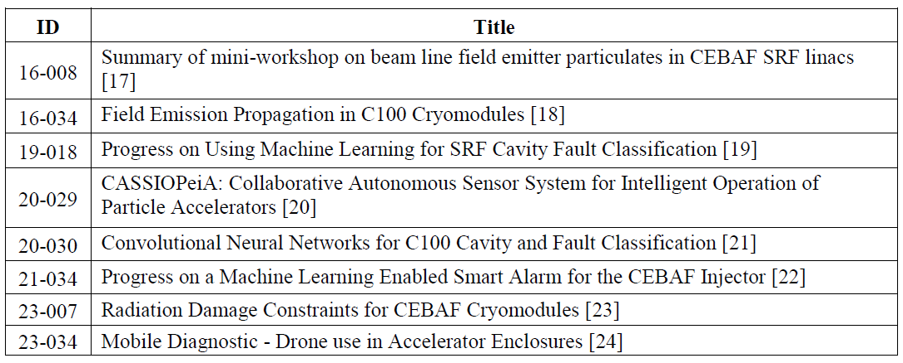
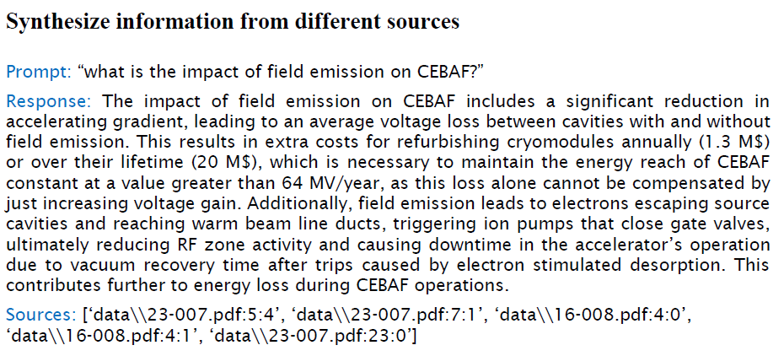
Artificial Intelligence R&D – Knowledge Management
Two proof of concept initiatives under development to retrieve information from technical publications and electronic logbook entries.
The JLab Tech Note database has over 2500 documents spanning 40 years. The first two images below demonstrate the use of retrieval augmented generation (RAG) systems to synthesize information across multiple documents using a simple prompt.
The second example utilizes multimodal LLMs to extract data from tables and images in logbook entries. Wire scanner data for measured beam sigma and design sigma was extracted from 521 unique logbook entries spanning 4 years. A 25 minute task that would take many hours otherwise.
Collaborating with several other labs to develop potential applications of data/knowledge retrieval.
Notes:
Guidelines: 6-8 bullets per slide; Use sentence fragments for bullets

Slide 15
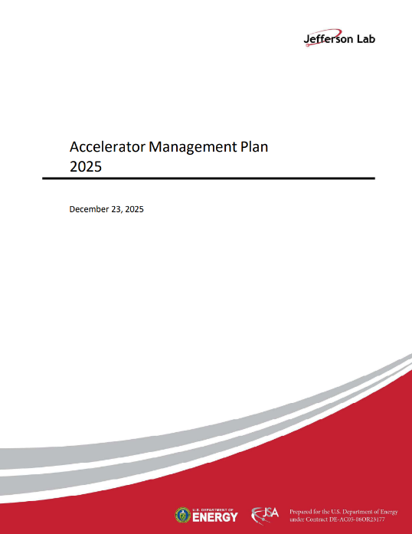
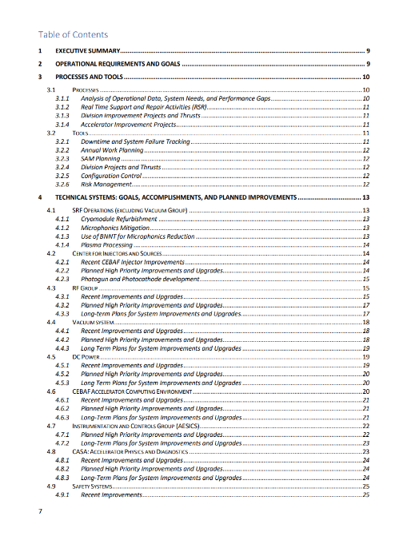
Accelerator Management Plan (AMP)
Provides a framework for managing CEBAF performance, reliability, and future upgrades
Aligns investments with mission needs and future program requirements
Integrates Operations-funded activities:
  CEBAF Sustainment Program, Accelerator Improvement Projects (AIP), Capital Equipment (CE), Obsolescence Mitigation and Critical Spares Strategy
Provides Risk-informed Prioritization
  Reliability and availability
  Supply chain and obsolescence issues
  Performance margin and capability gaps
Balances near-term operations with long-term capability development

Slide 16
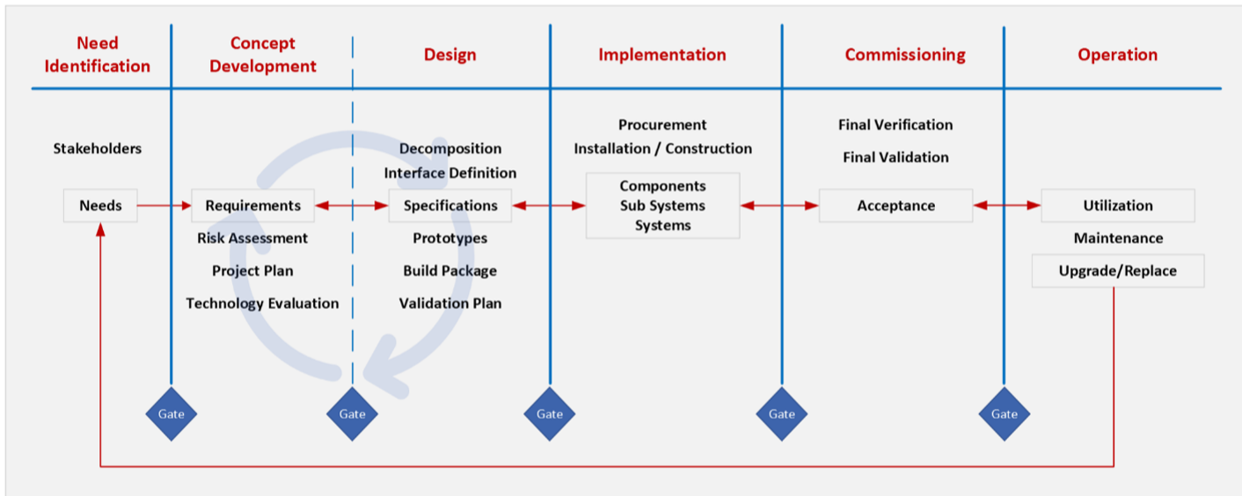
4C – CEBAF Configuration Control Committee
The goal of the committee is to serve as a configuration control board for proposed upgrades and modifications to the CEBAF Accelerator and ensure that modifications follow established engineering processes.
The 4C validates that projects follow established engineering processes, including required reviews, tests, documentation, etc.
All CEBAF modifications must be graded according to their impact (impact matrix). The level of scrutiny depends on the grade. Reviewing minor modifications and repairs is counterproductive.

Slide 17
Summary
FY26 demonstrated excellent reliability and linac performance at high energy, establishing a new high-power milestone of 72 minutes of continuous operation at 750 kW.
Sustaining reliable operation requires continued investment in aging infrastructure, critical spares, obsolescence mitigation, and klystron availability.
The multi-year cryomodule program continues to preserve CEBAF energy capability while developing the path for future performance improvements.
MOLLER preparations are well underway, with first beam tests planned during the latter part of the FY27 run.
New diagnostics, next-generation BPMs, and global timing will provide improved measurement, synchronization, and beam-delivery capability.
AI/ML investments are moving from foundational R&D toward practical tools for accelerator performance and knowledge management.
The Accelerator Management Plan and strengthened configuration control provide the framework to prioritize investments and manage CEBAF capability over the long term.

