Slide 1
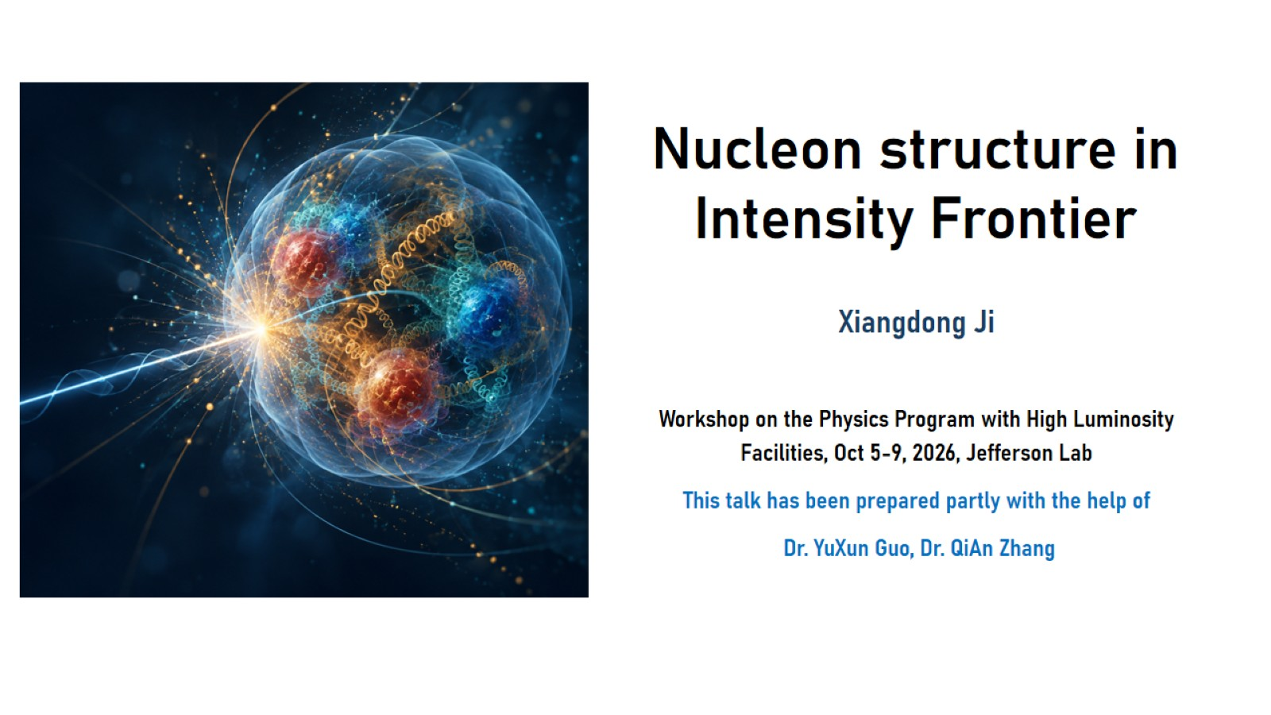
Nucleon structure in
Intensity Frontier

Slide 2
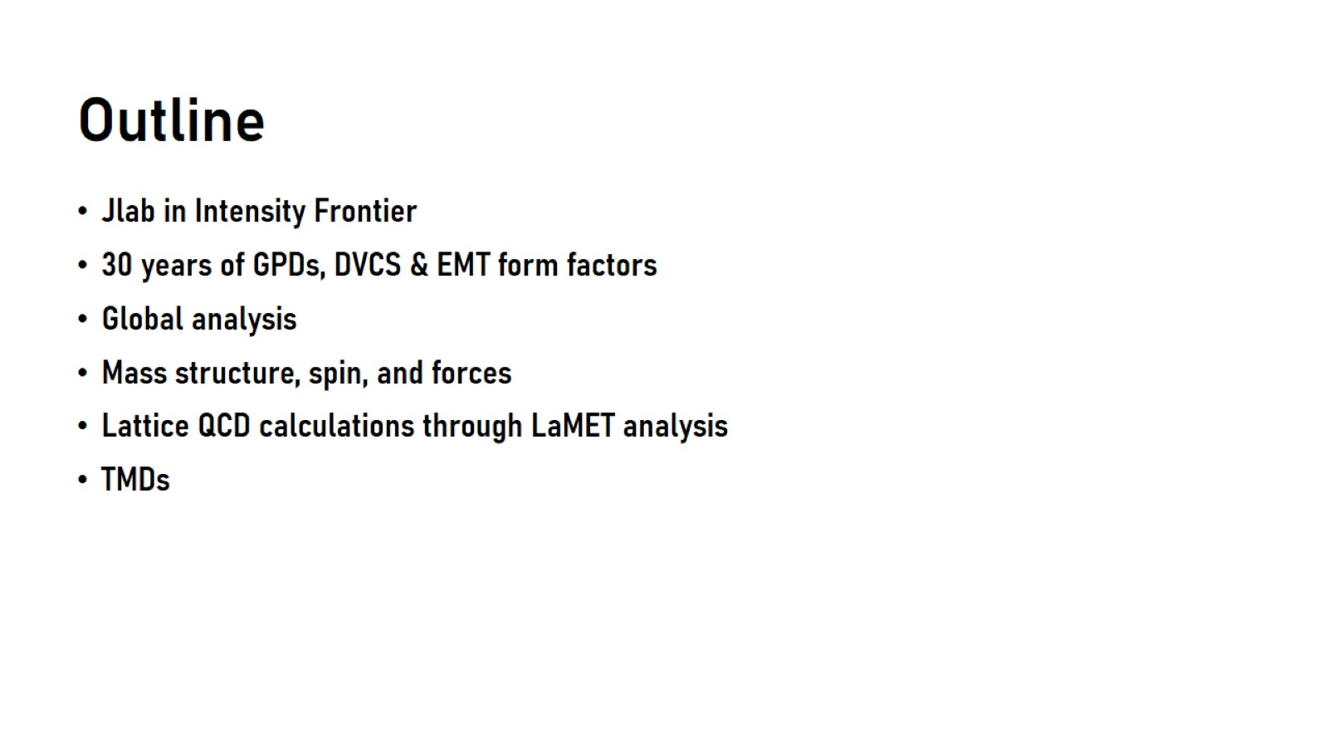
Outline

Slide 3
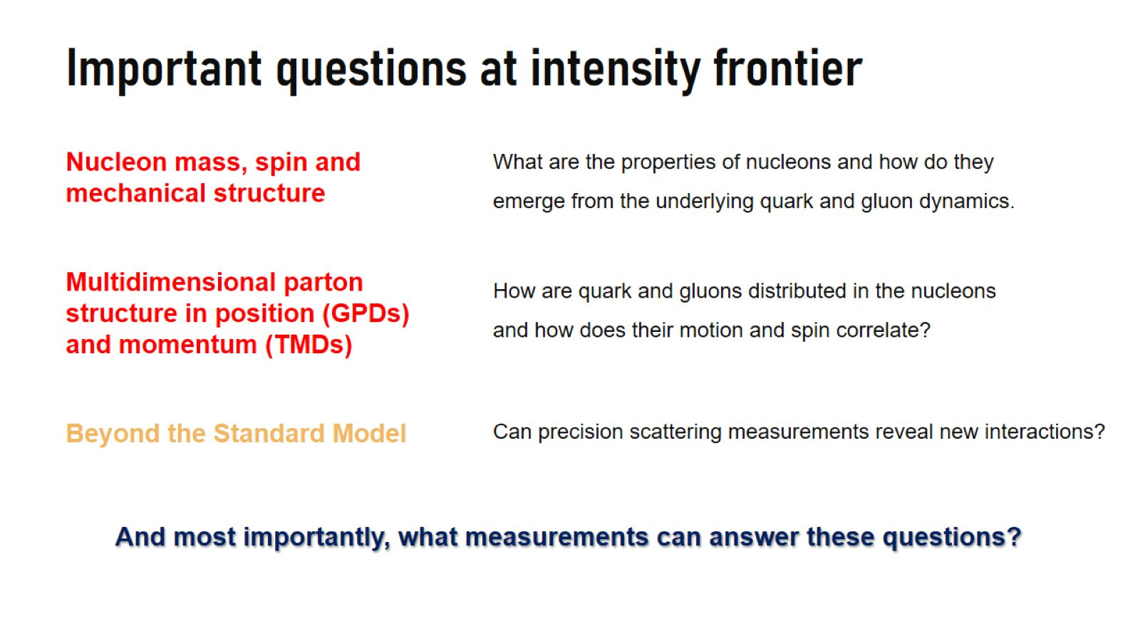
Important questions at intensity frontier

Slide 4
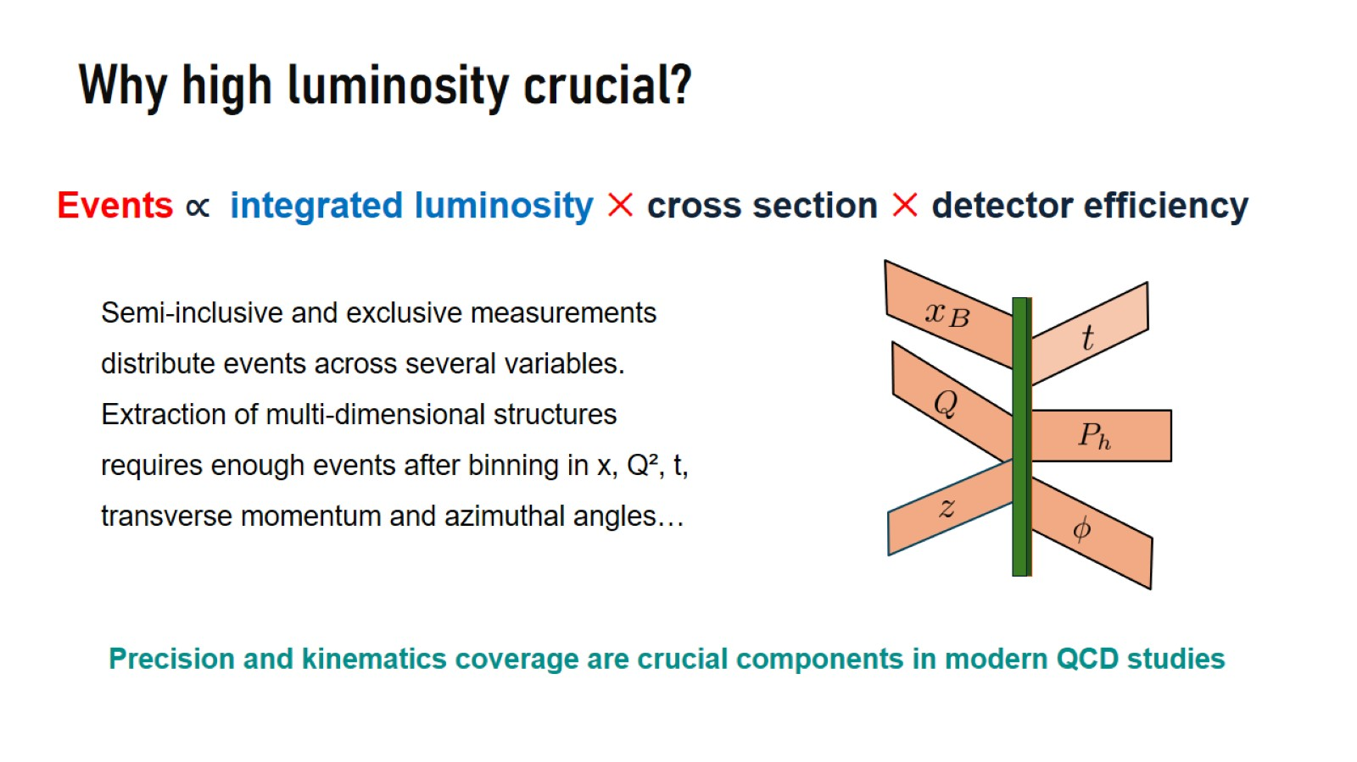
Why high luminosity crucial?

Slide 5
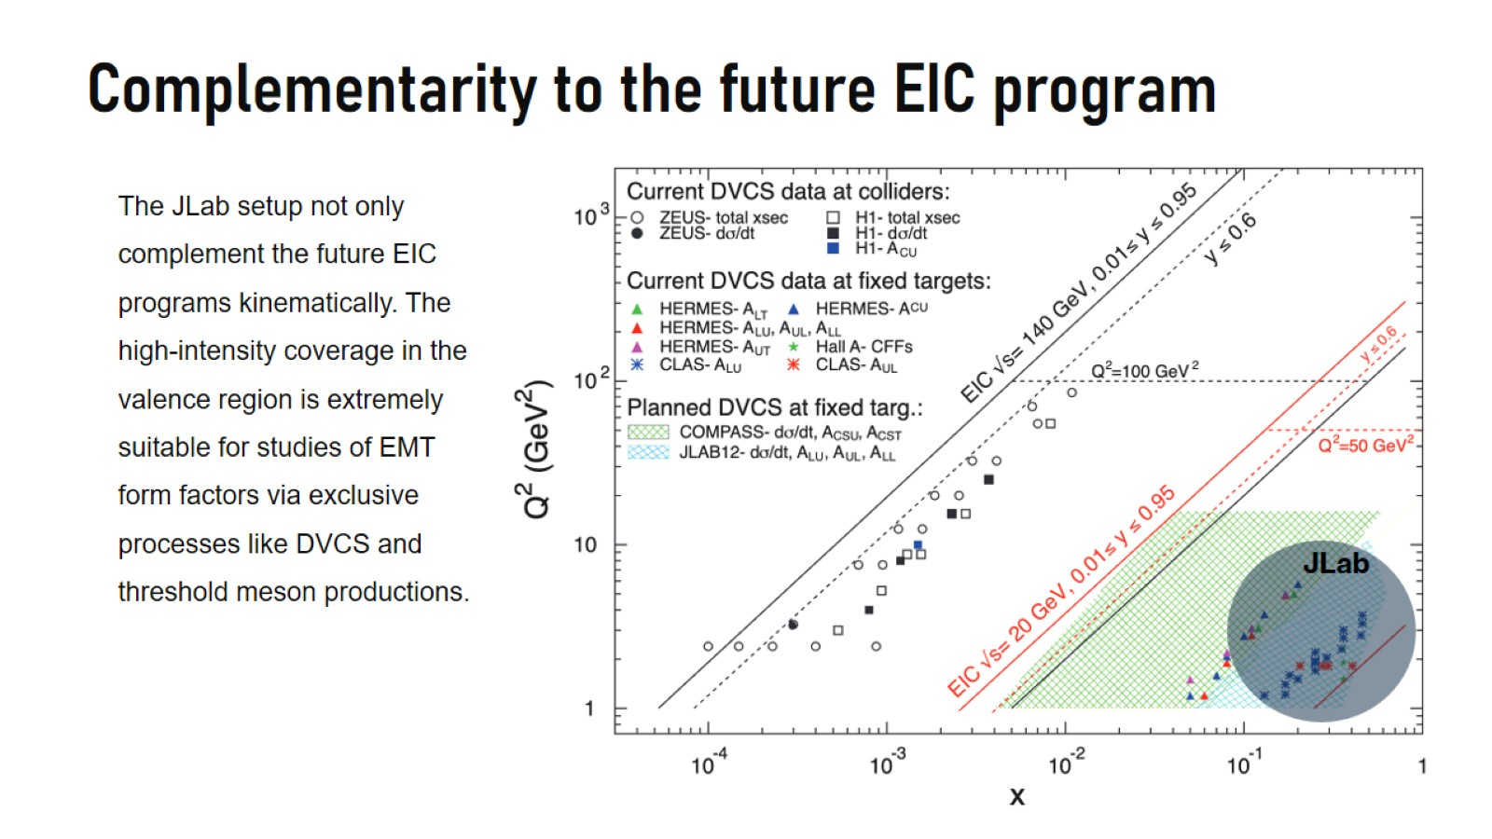

Slide 6

30 years GPDs, DVCS and EMT form factors

Slide 7
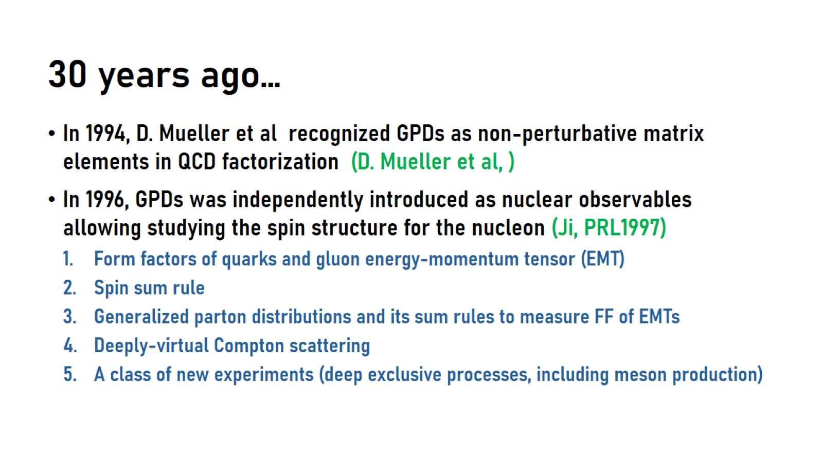
30 years ago…

Slide 8
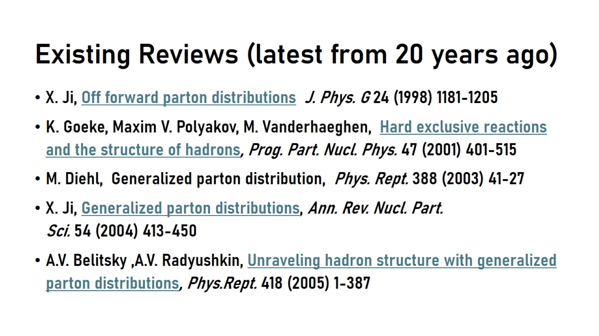
Existing Reviews (latest from 20 years ago)

Slide 9
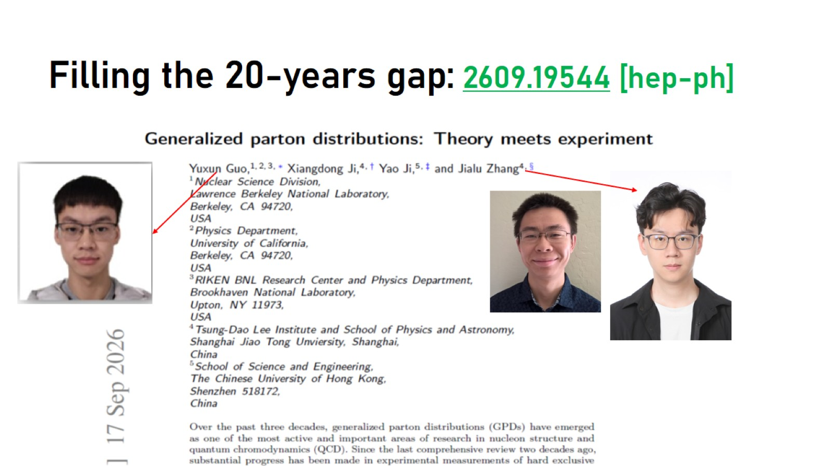
Filling the 20-years gap: 2609.19544 [hep-ph]

Slide 10
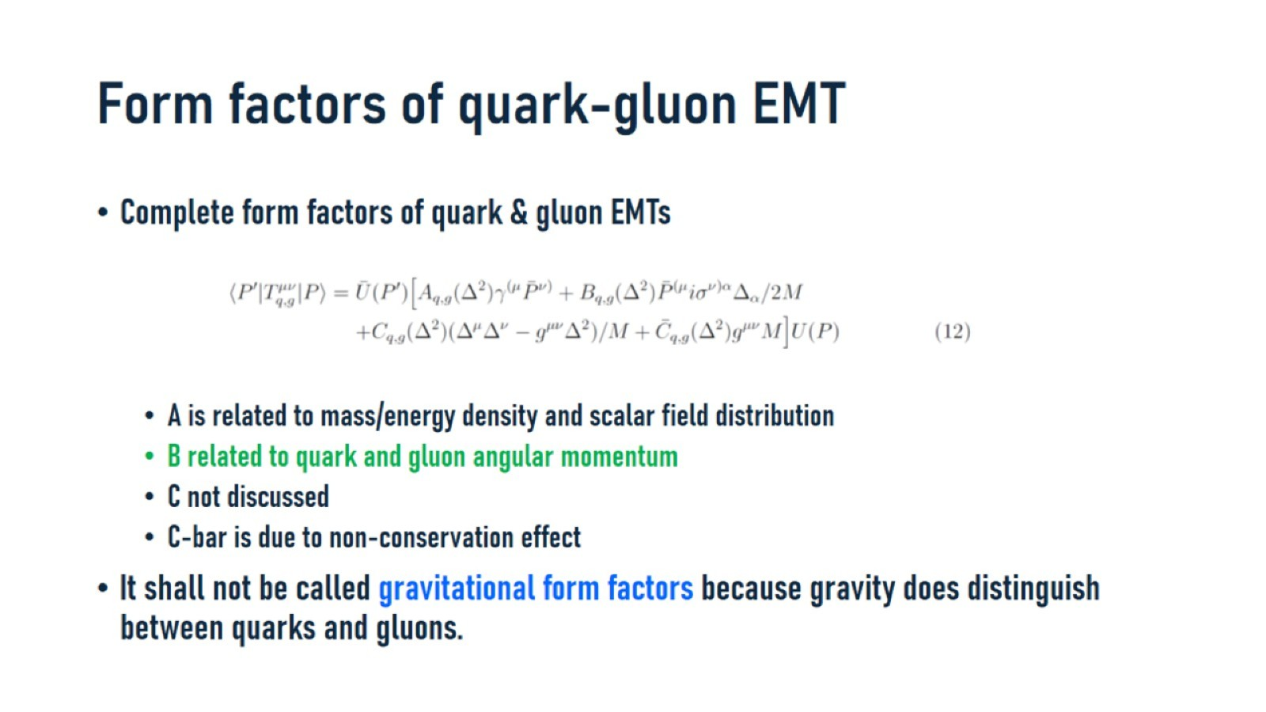
Form factors of quark-gluon EMT

Slide 11
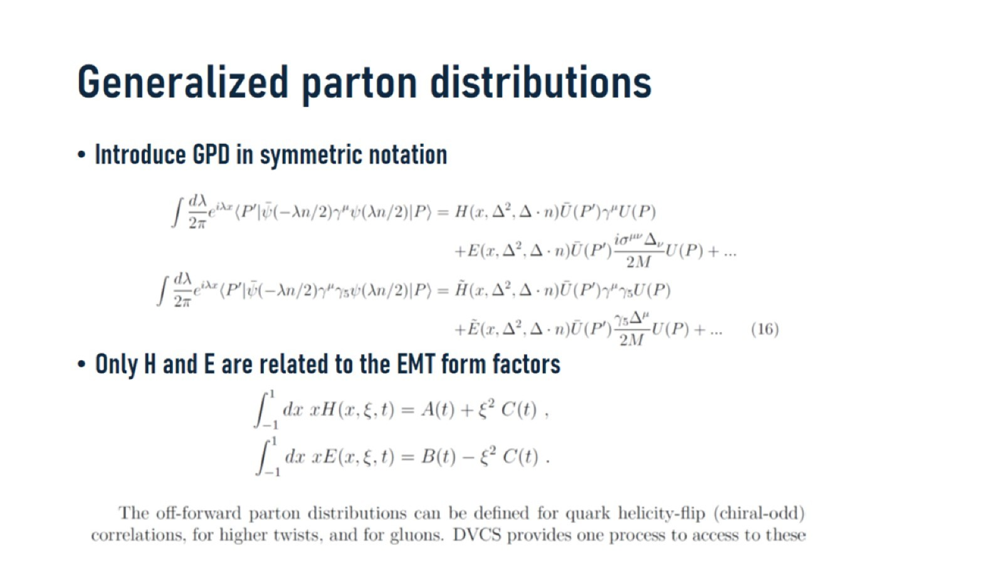
Generalized parton distributions

Slide 12
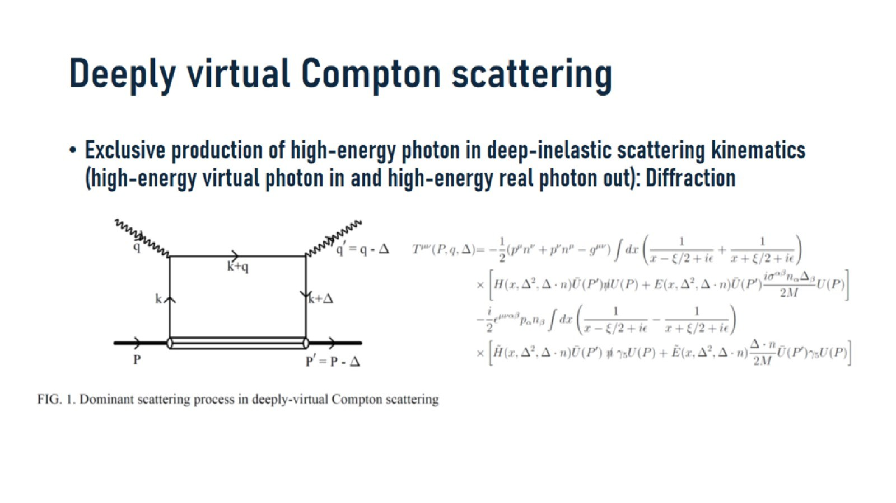
Deeply virtual Compton scattering

Slide 13
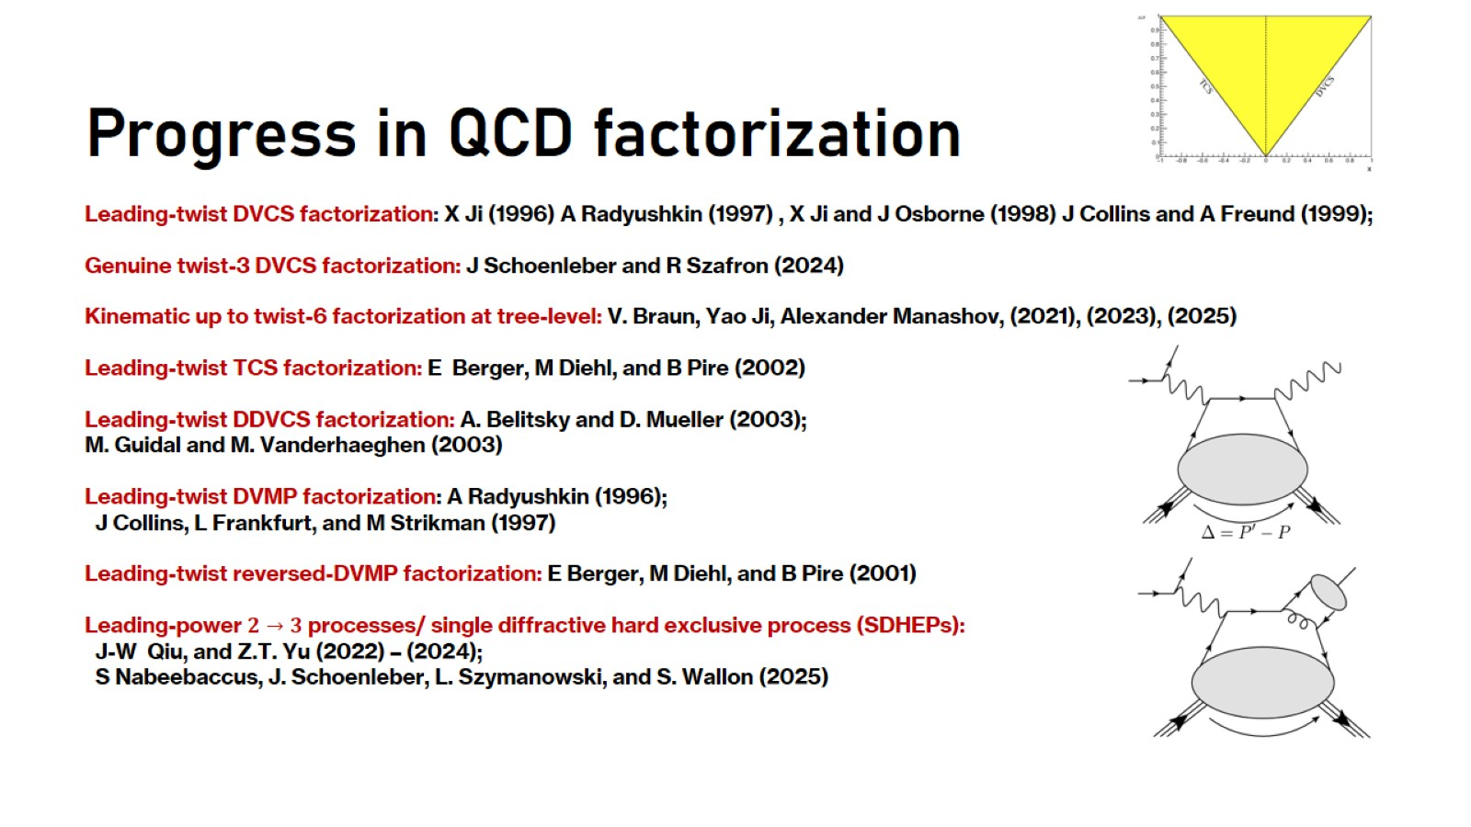
Progress in QCD factorization

Slide 14
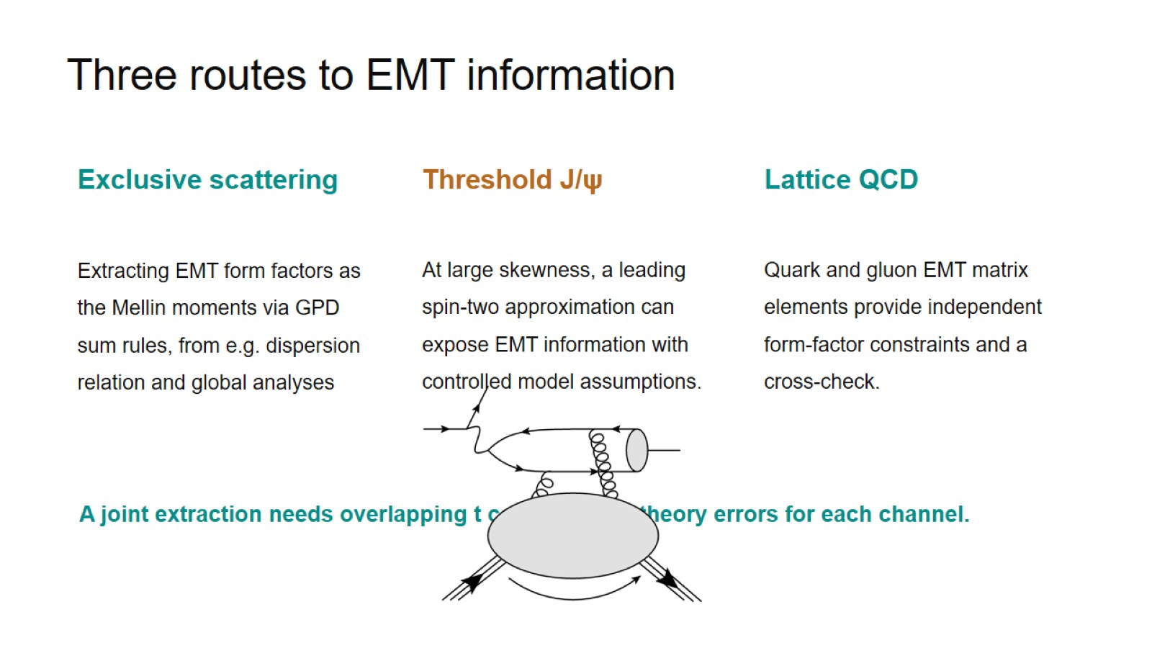

Slide 15
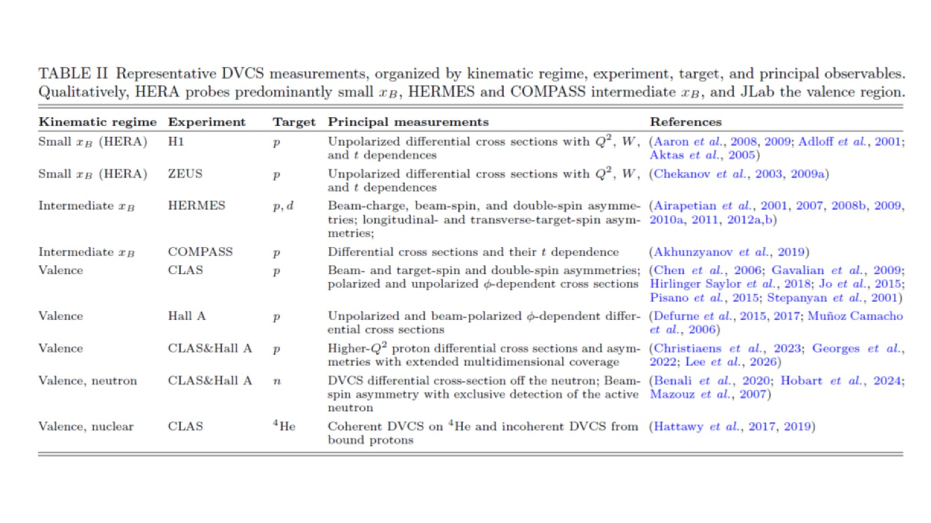

Slide 16
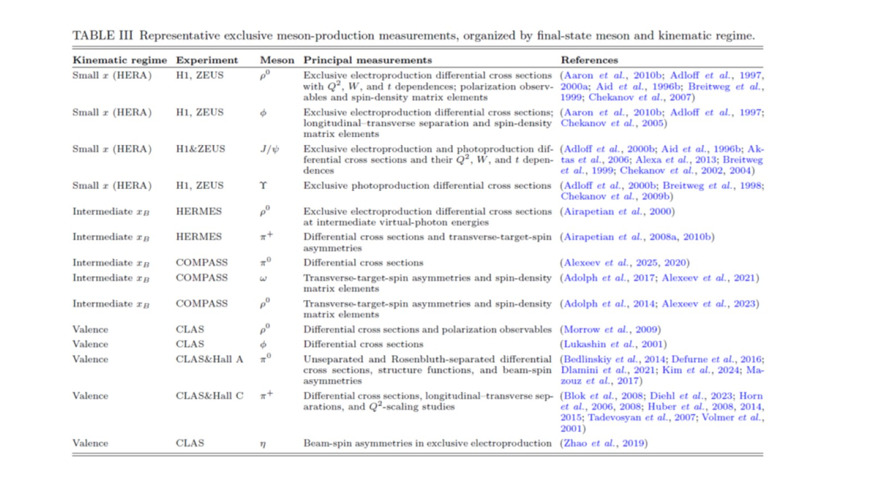

Slide 17
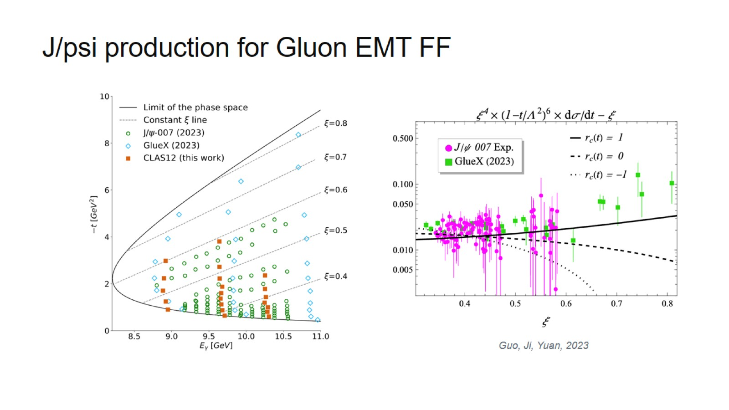

Slide 18

GPD Global Analysis

Slide 19
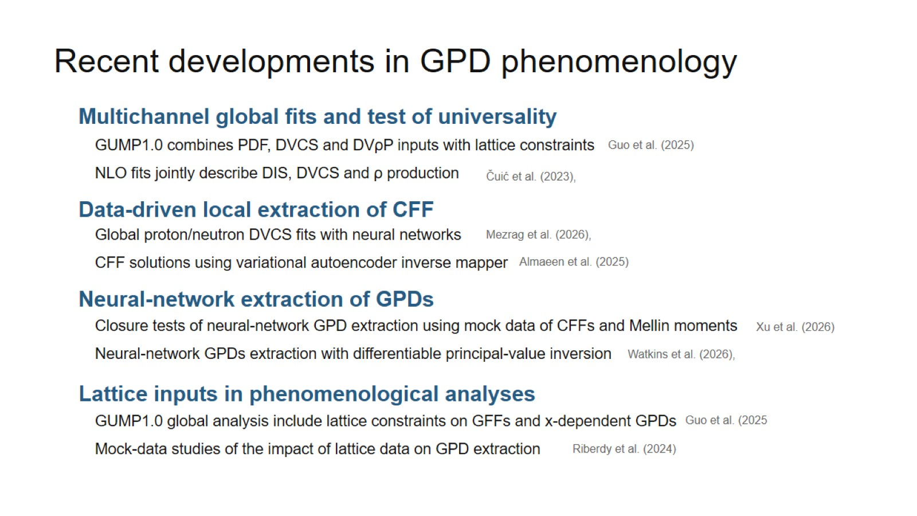

Slide 20
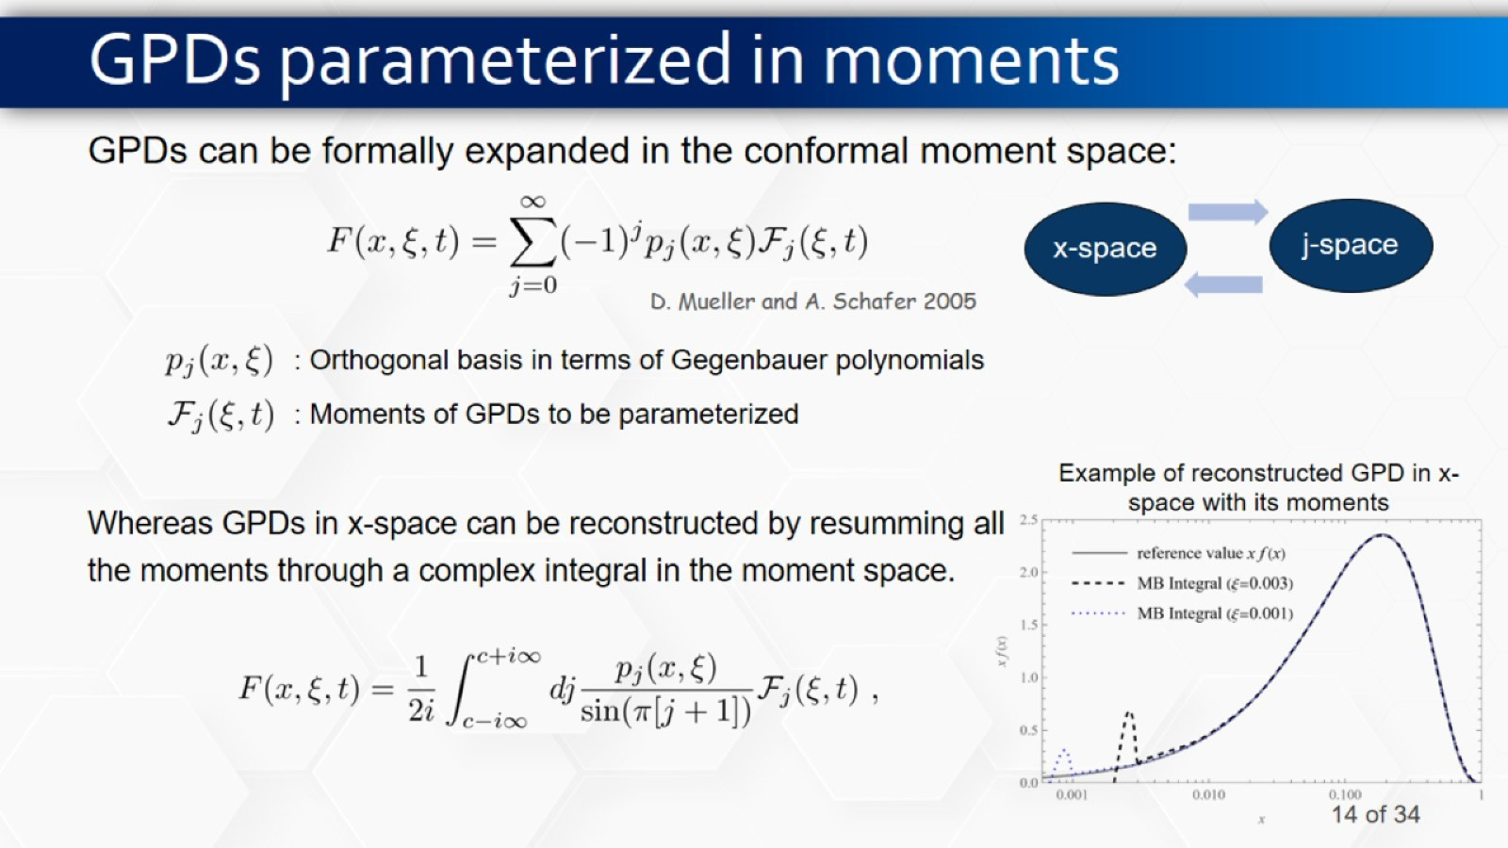
GPDs parameterized in moments

Slide 21
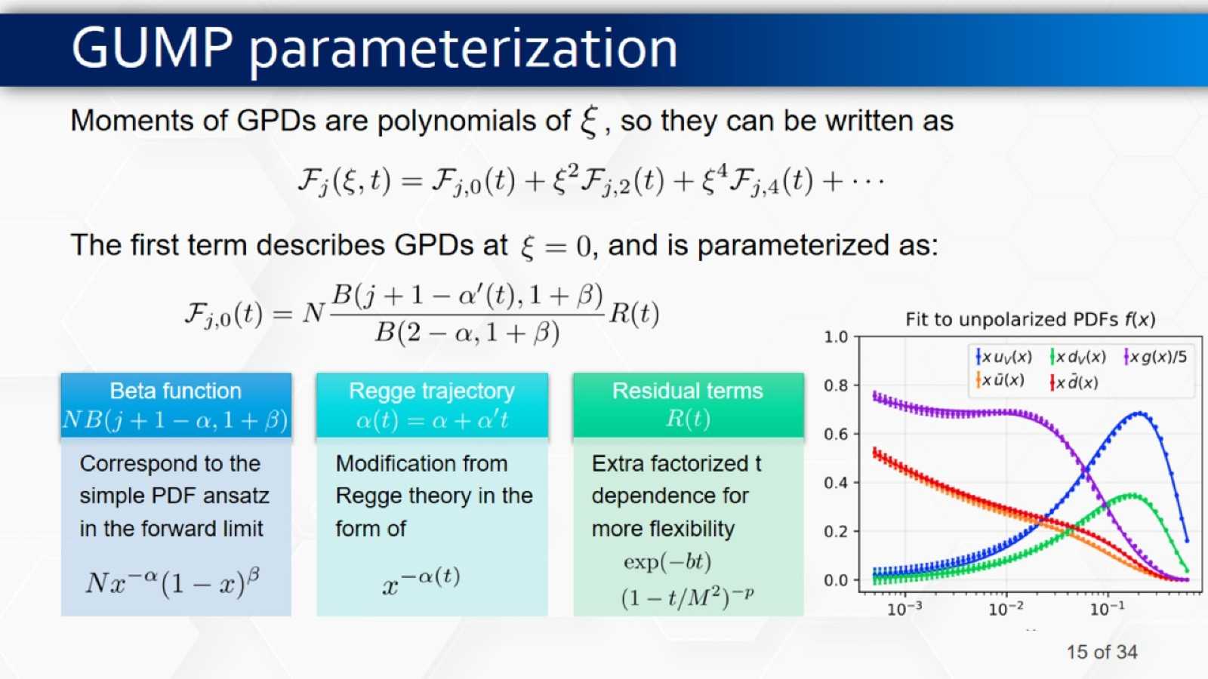
GUMP parameterization

Slide 22
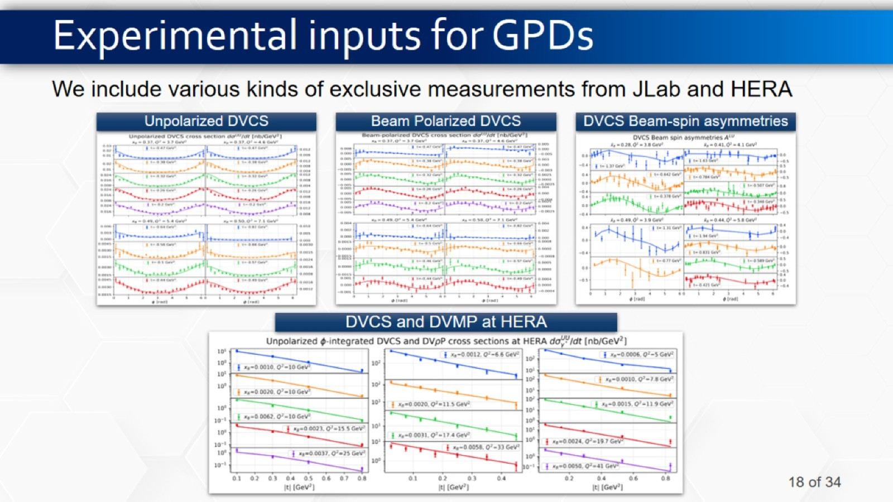
Experimental inputs for GPDs

Slide 23
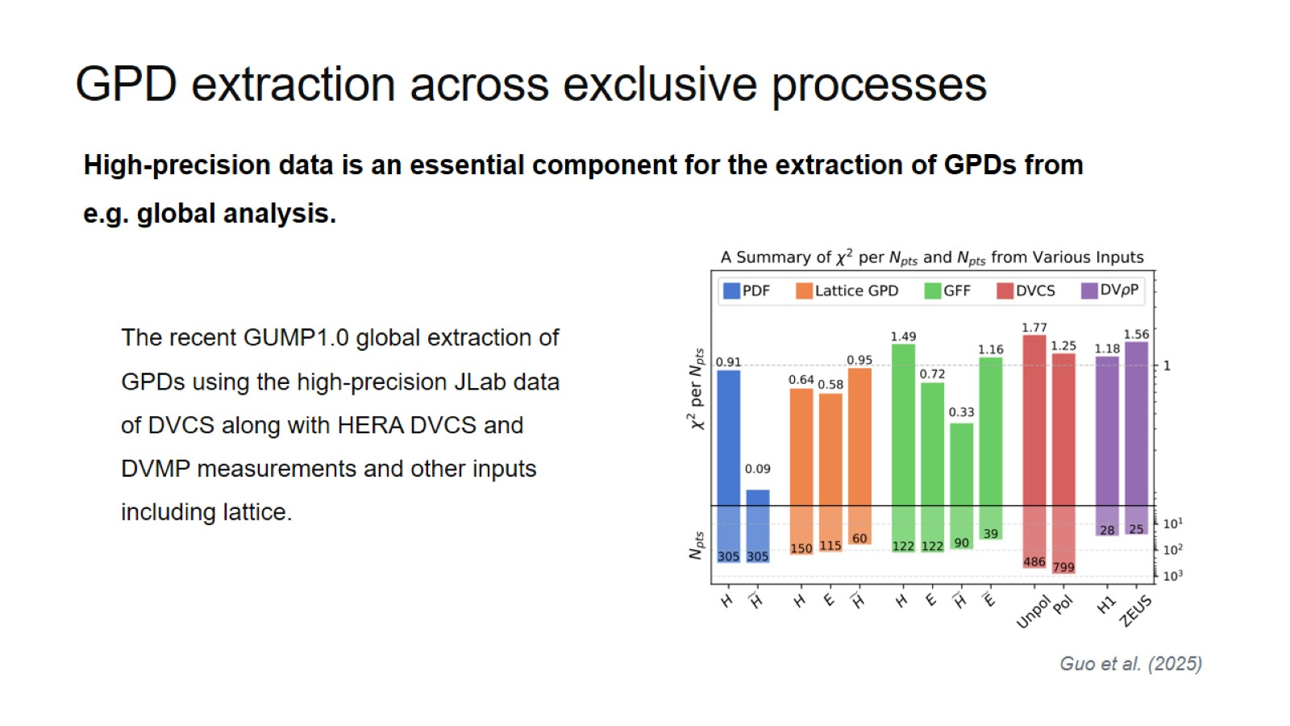

Slide 24
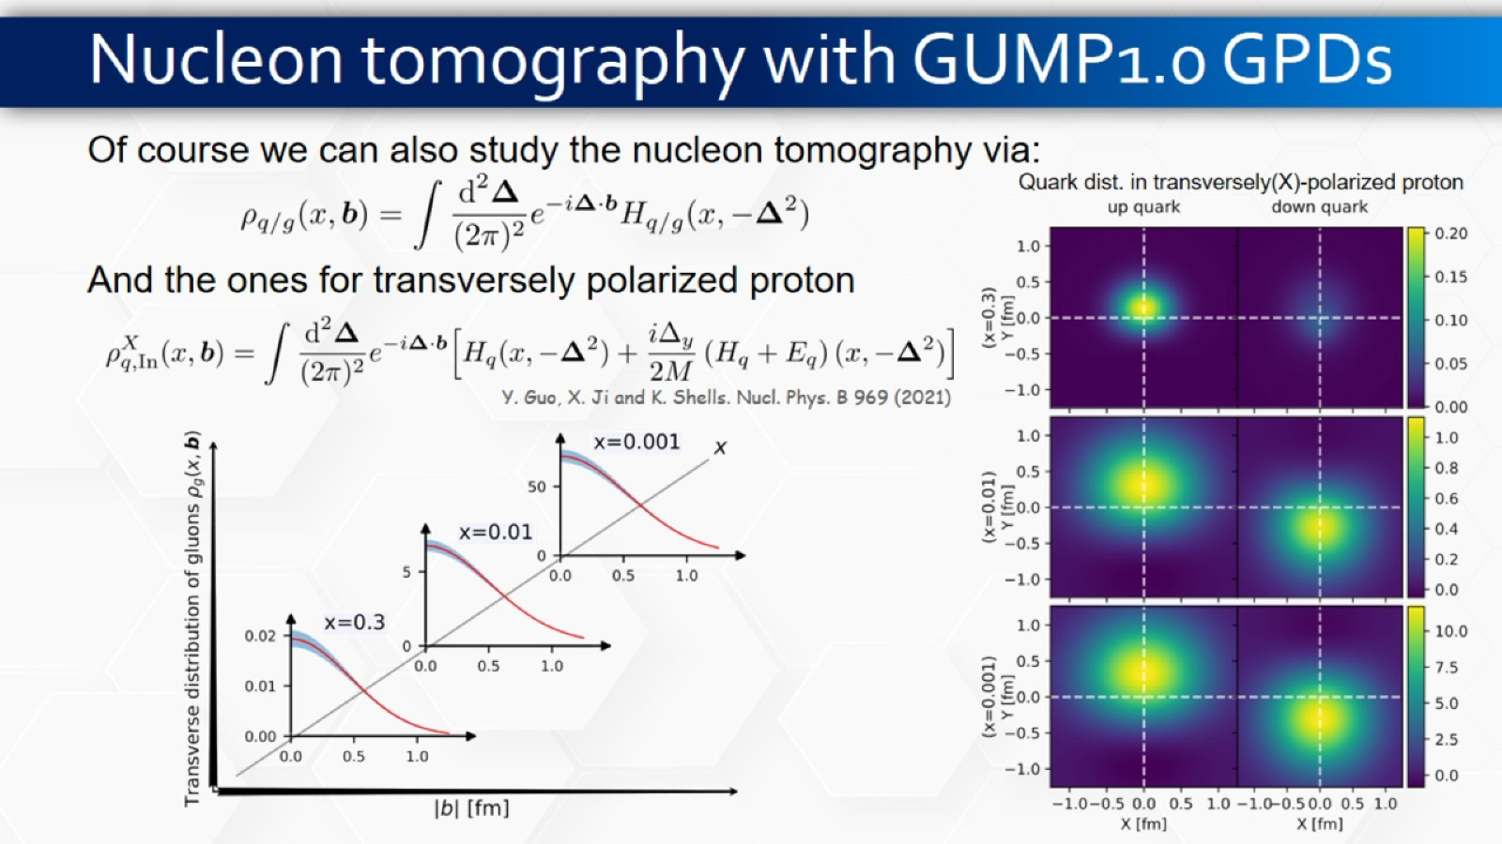
Nucleon tomography with GUMP1.0 GPDs

Slide 25
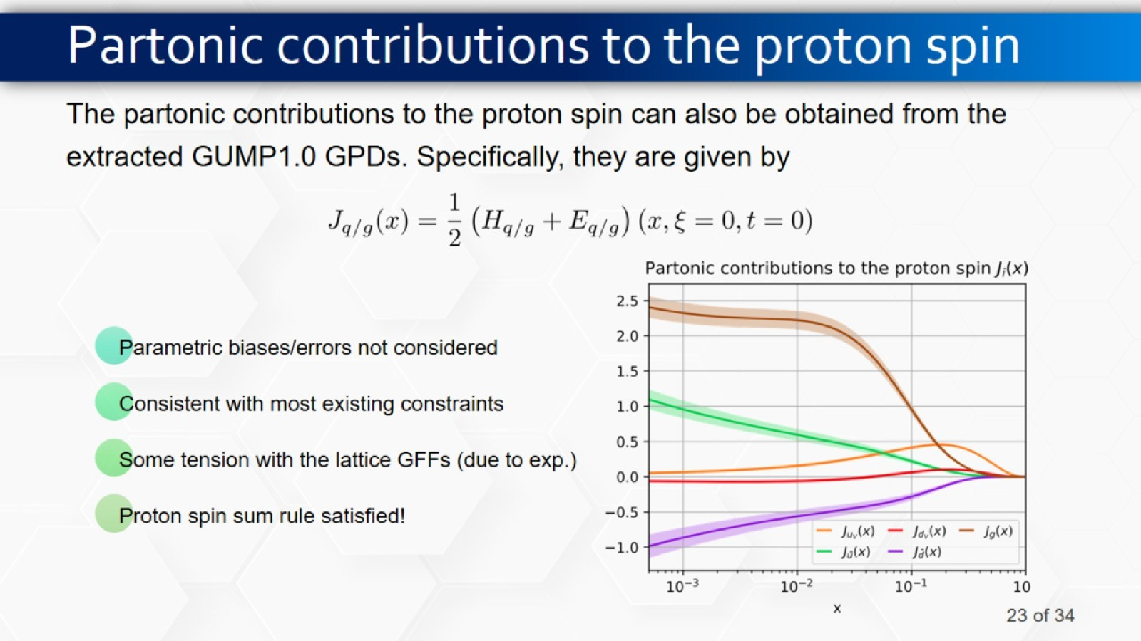
Partonic contributions to the proton spin

Slide 26
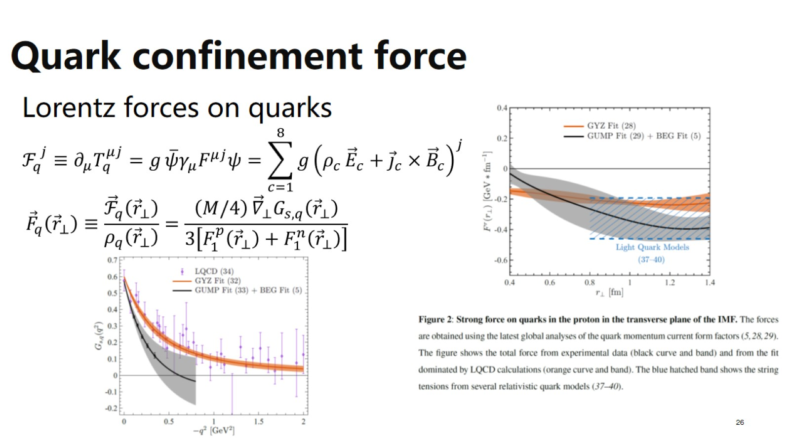
Quark confinement force

Slide 27
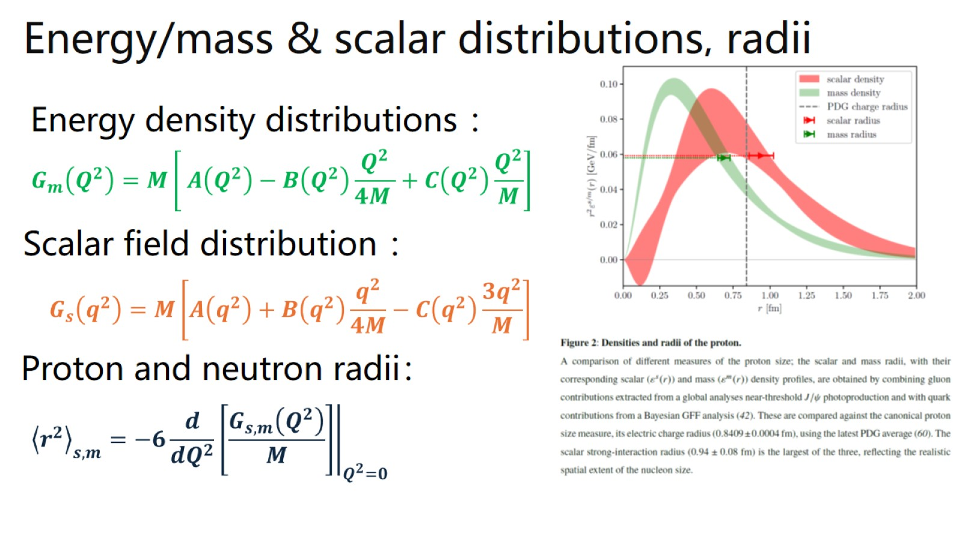

Slide 28
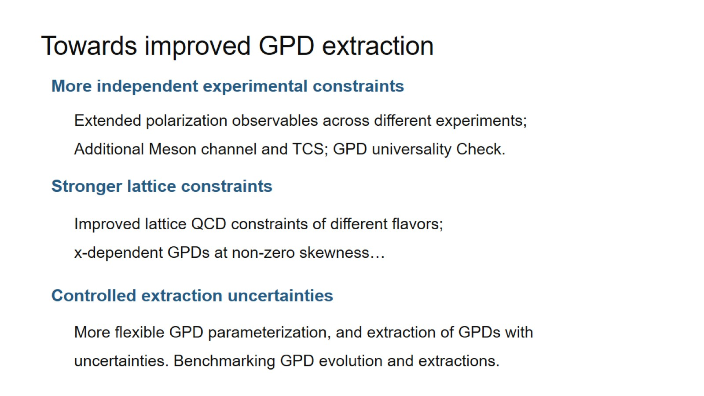

Slide 29
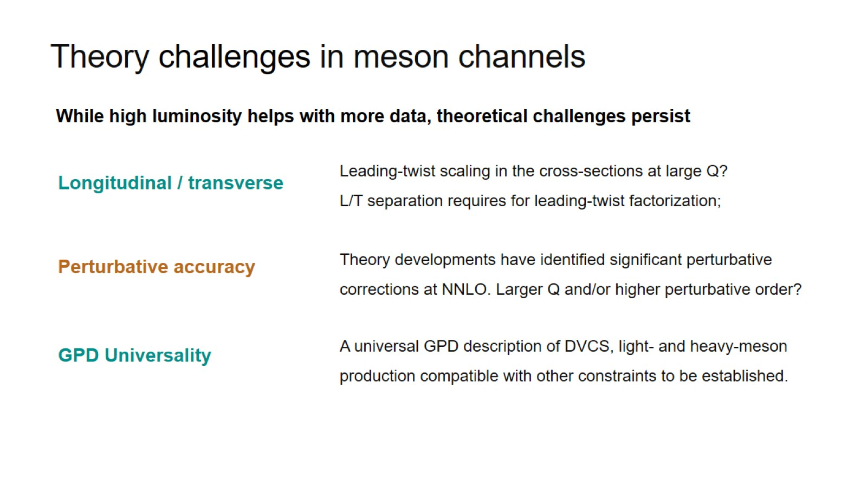
Theory challenges in meson channels

Slide 30
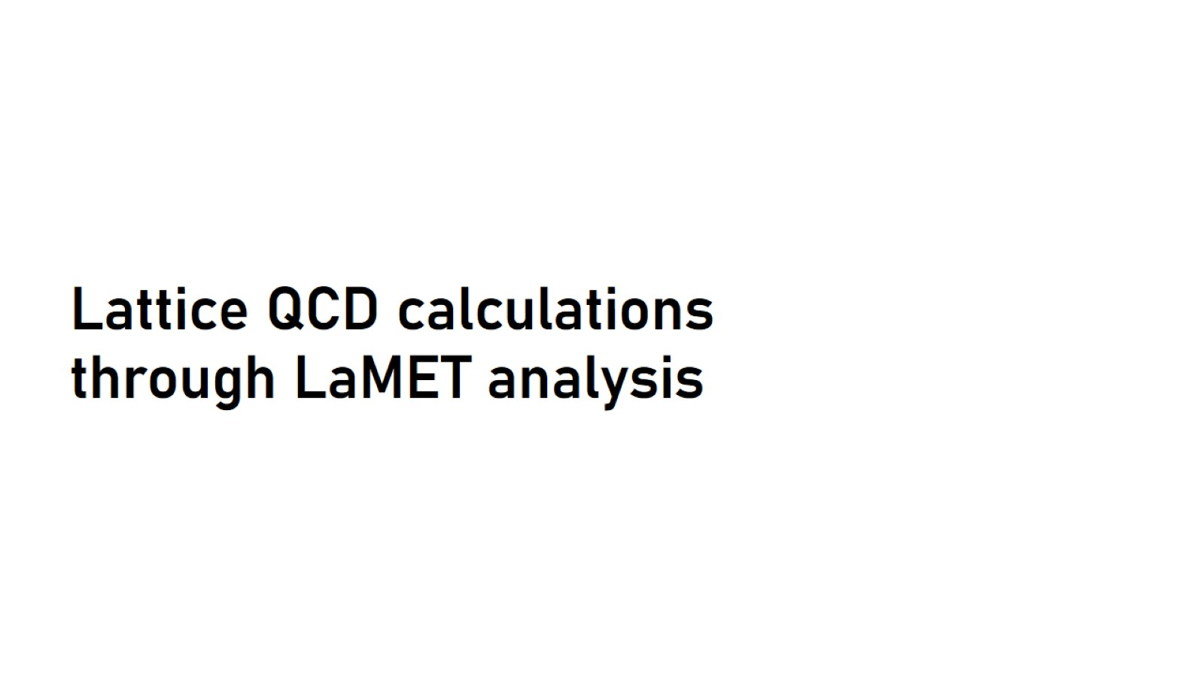
Lattice QCD calculations through LaMET analysis

Slide 31
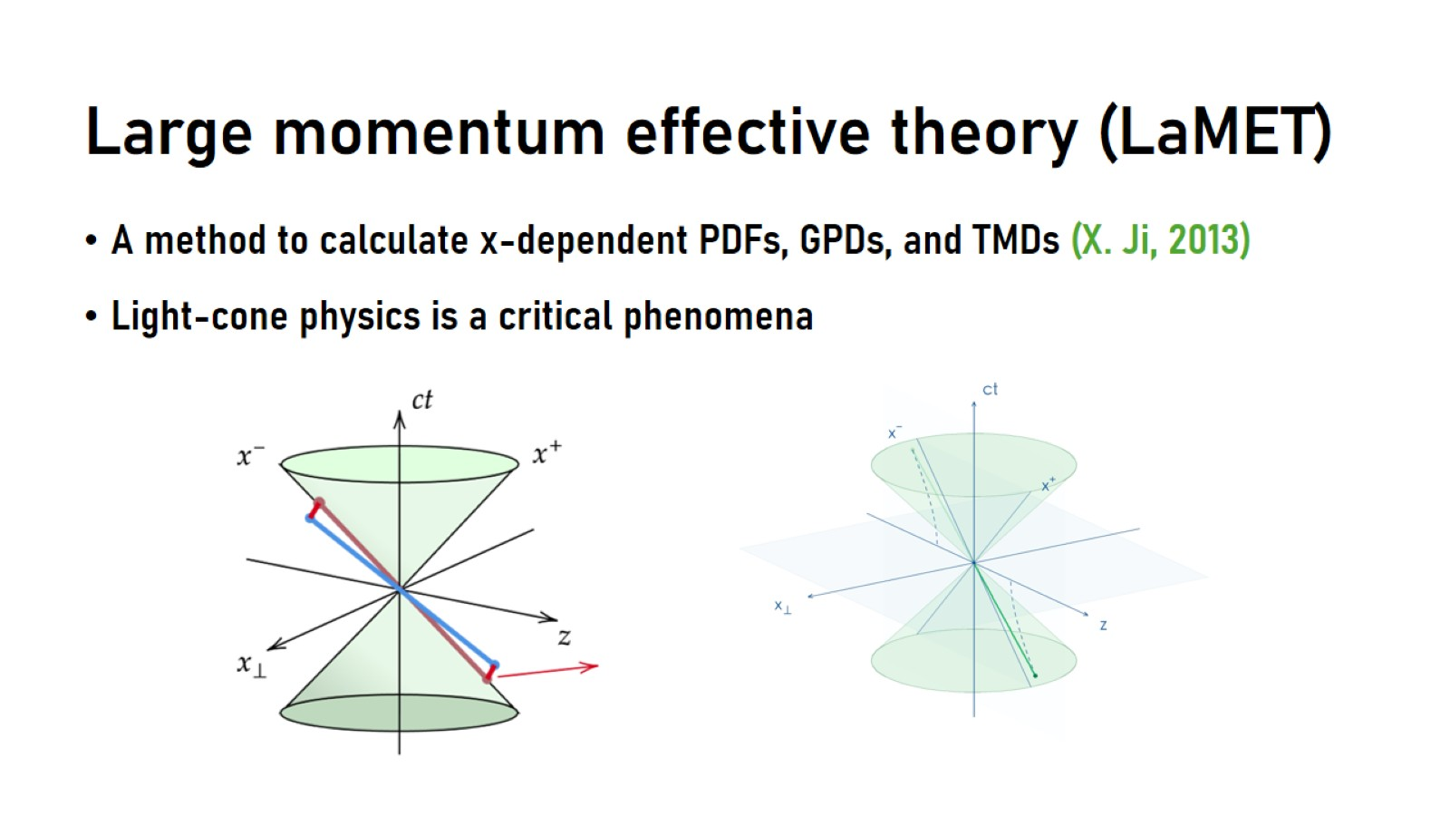
Large momentum effective theory (LaMET)

Slide 32
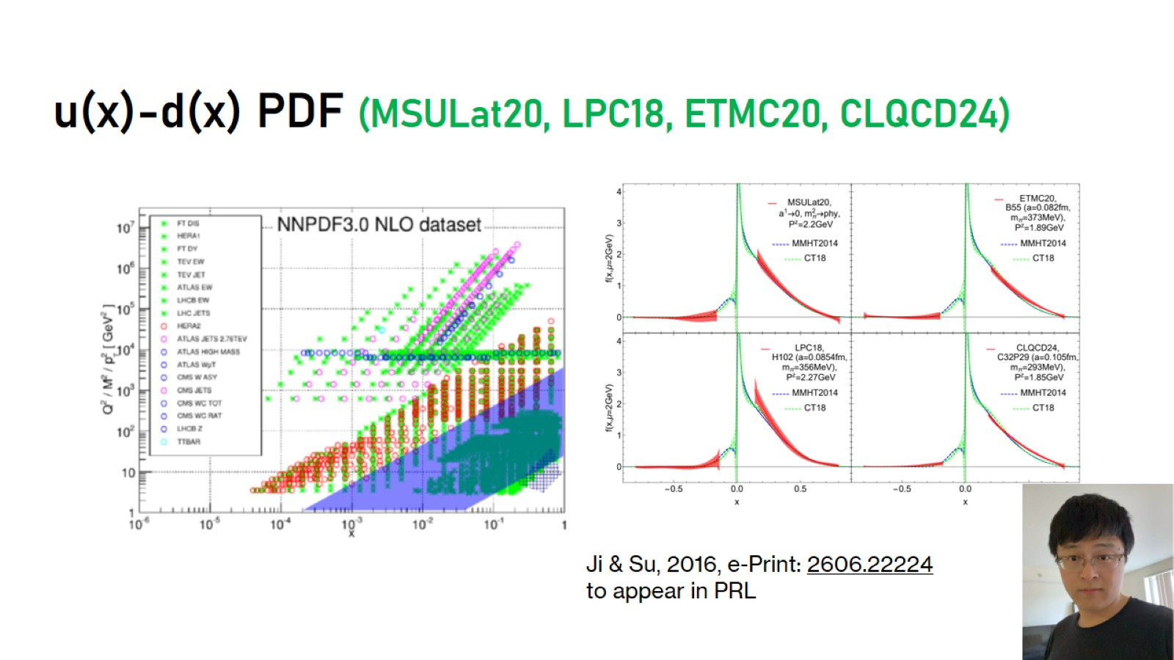
u(x)-d(x) PDF (MSULat20, LPC18, ETMC20, CLQCD24)

Slide 33
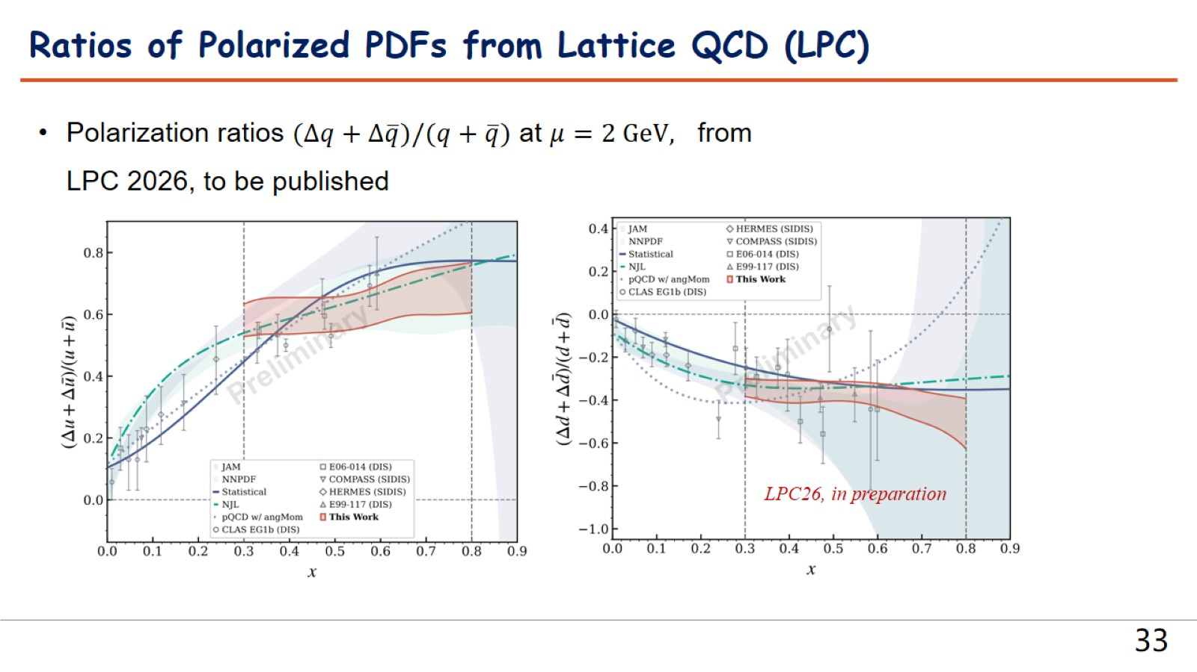

Slide 34
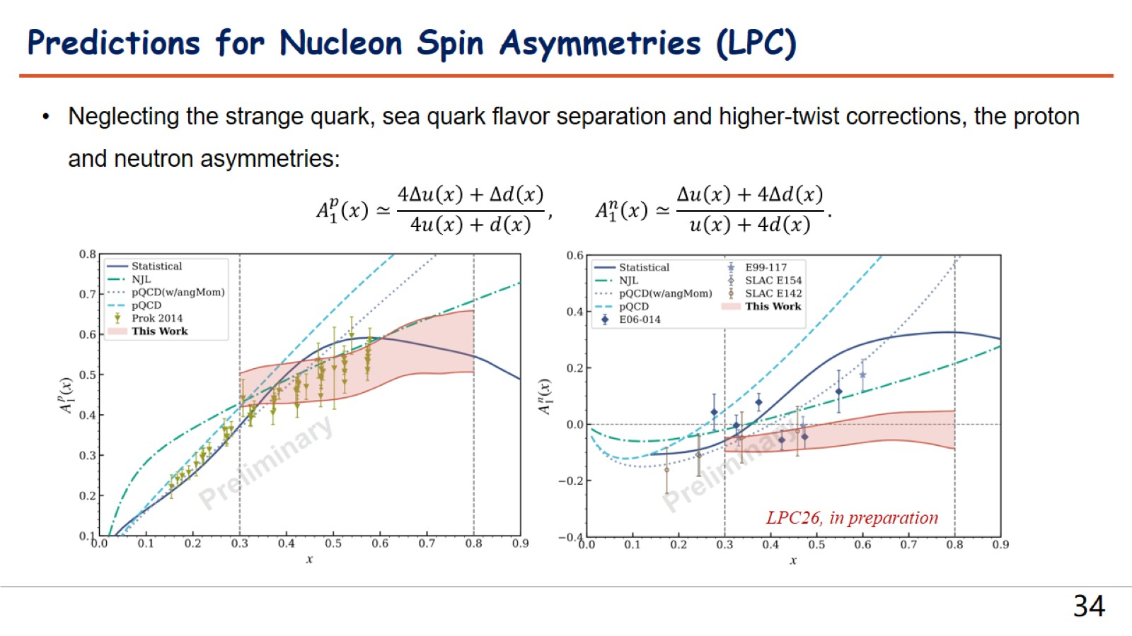

Slide 35
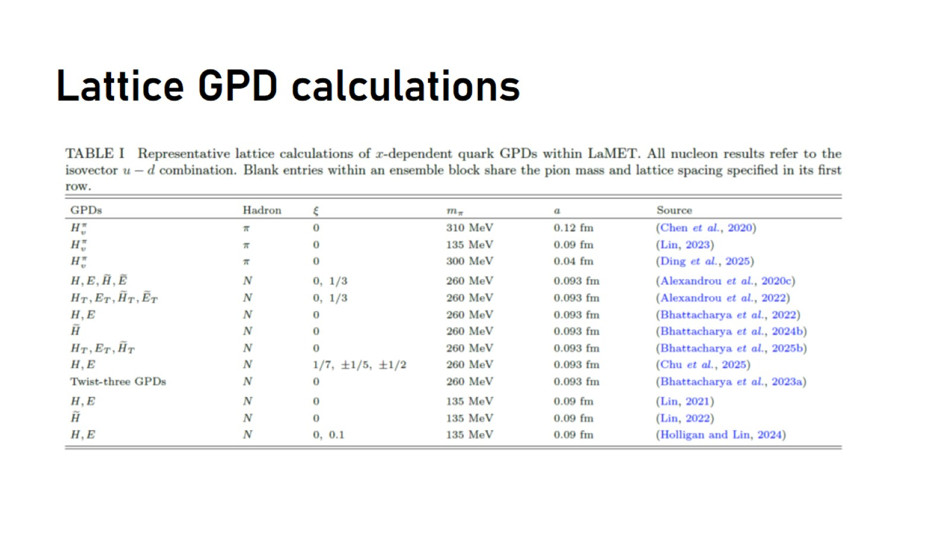
Lattice GPD calculations

Slide 36
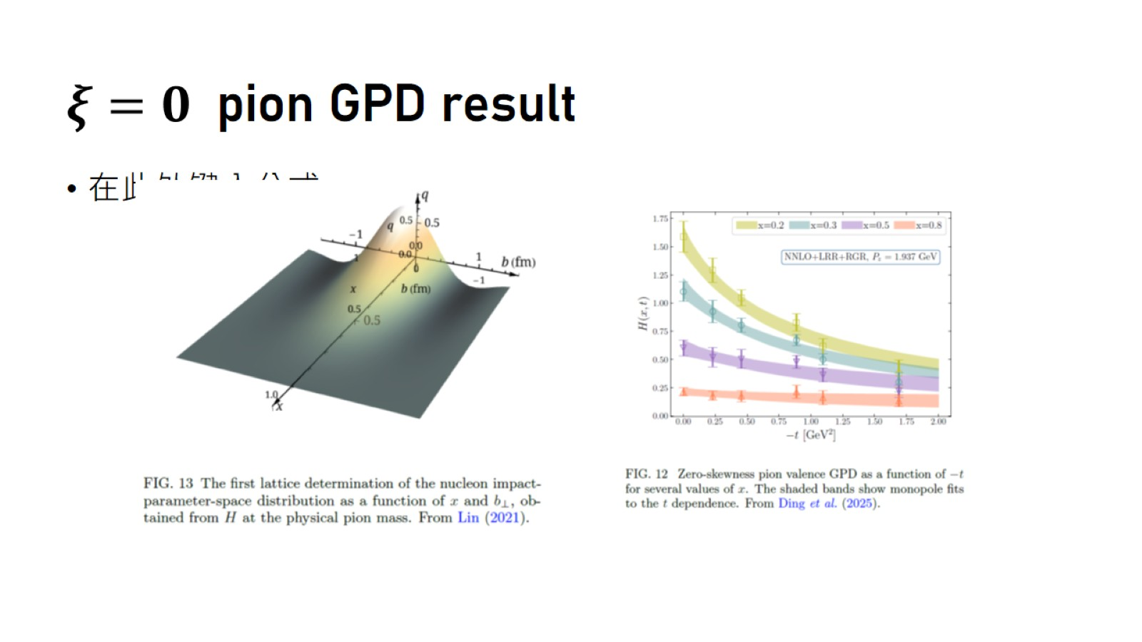
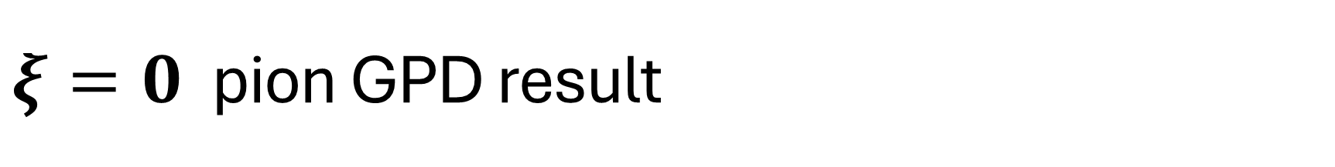
$ξ=0$ pion GPD result

Slide 37
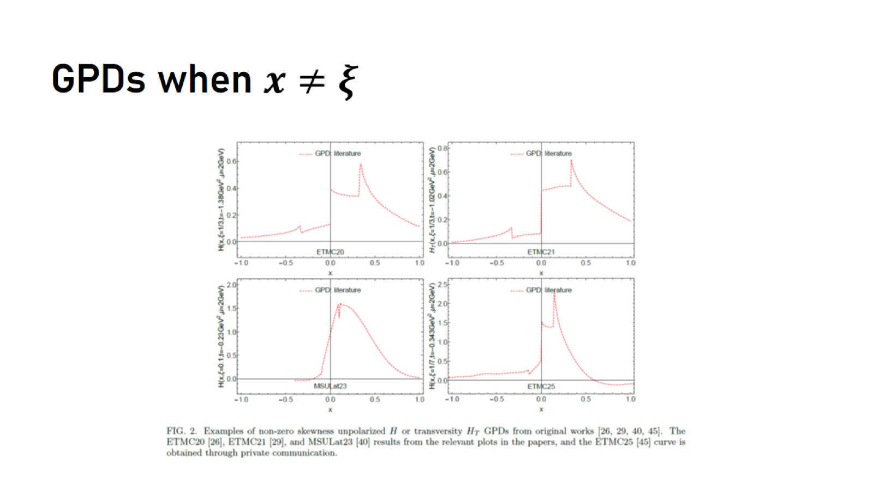

GPDs when $x≠ξ$

Slide 38
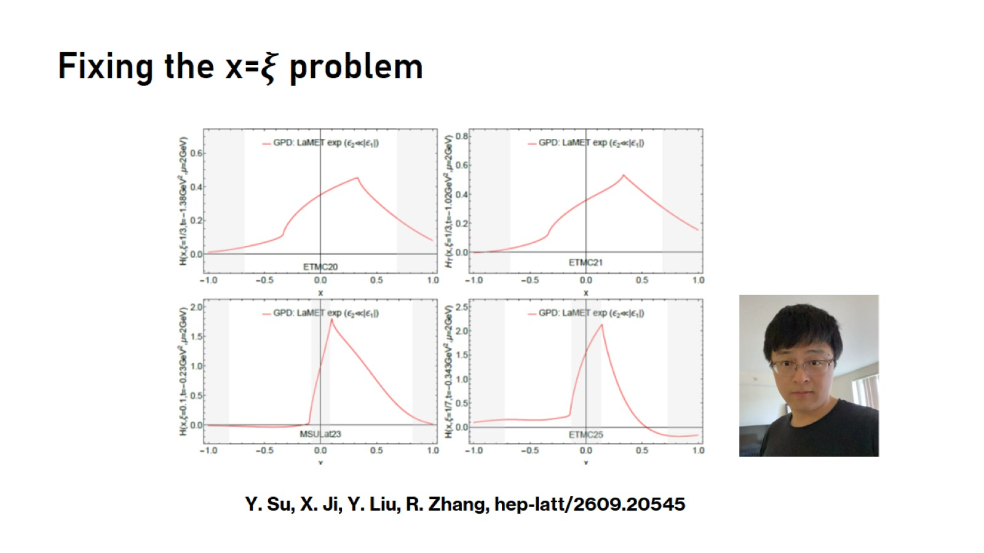

Fixing the x=$ξ$ problem

Slide 39

TMDPDFs

Slide 40
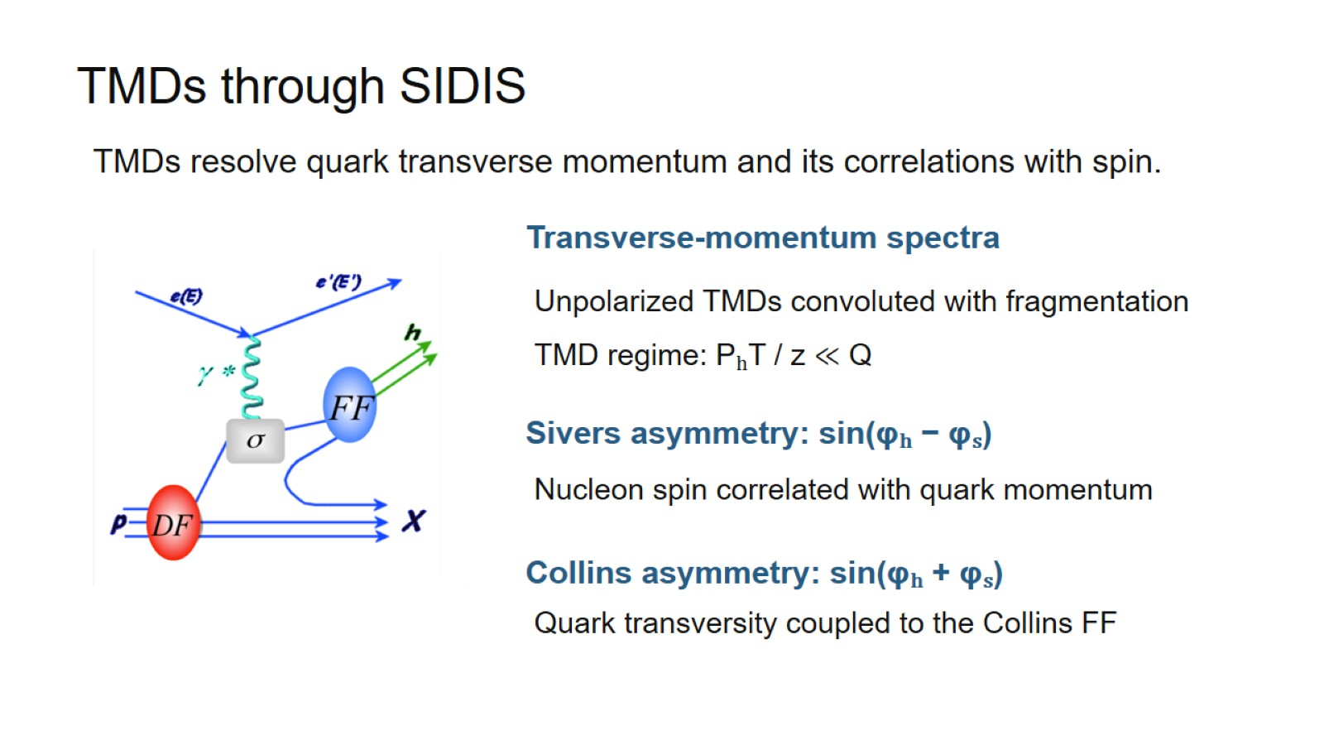
TMDs through SIDIS

Slide 41
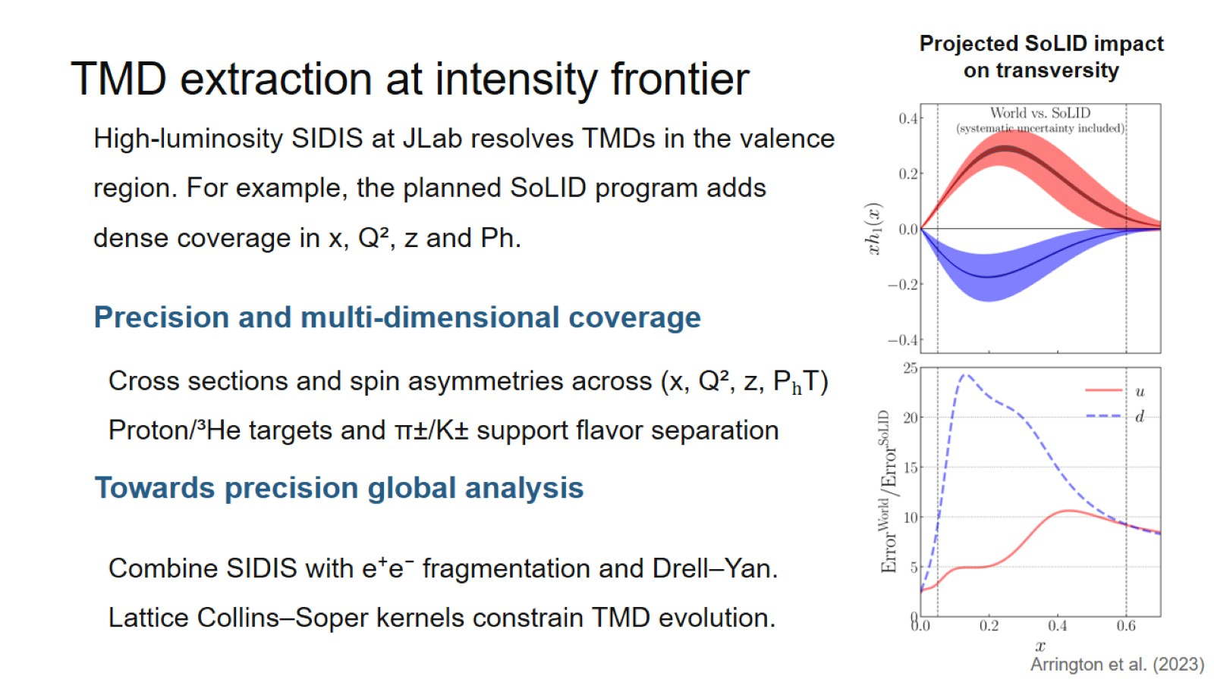
TMD extraction at intensity frontier

Slide 42
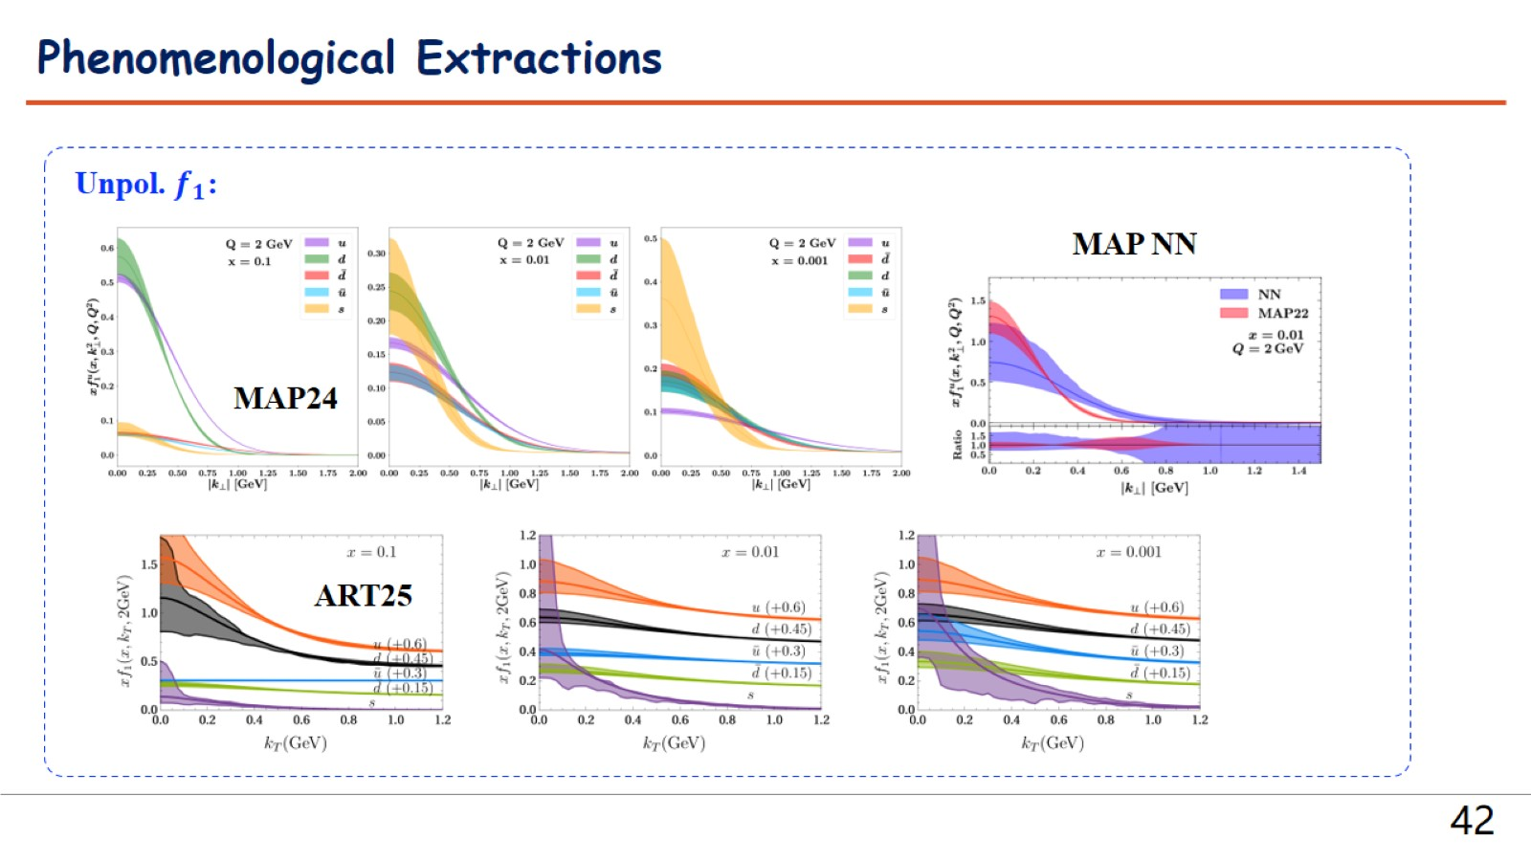

Slide 43
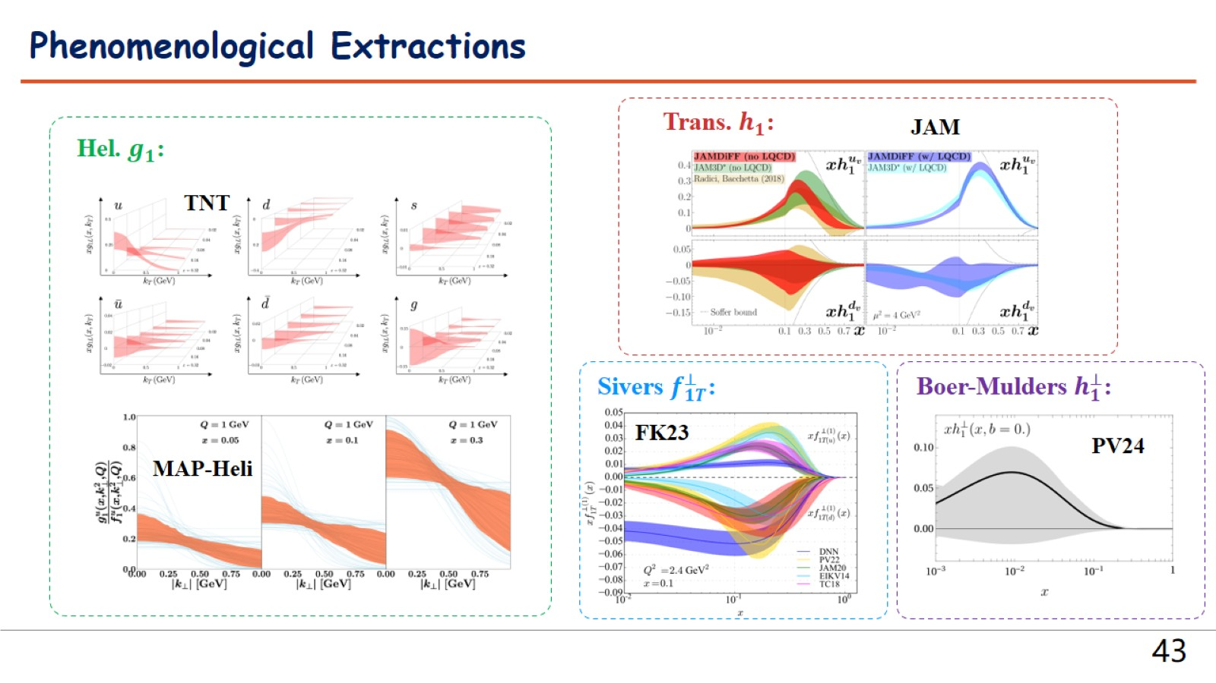

Slide 44
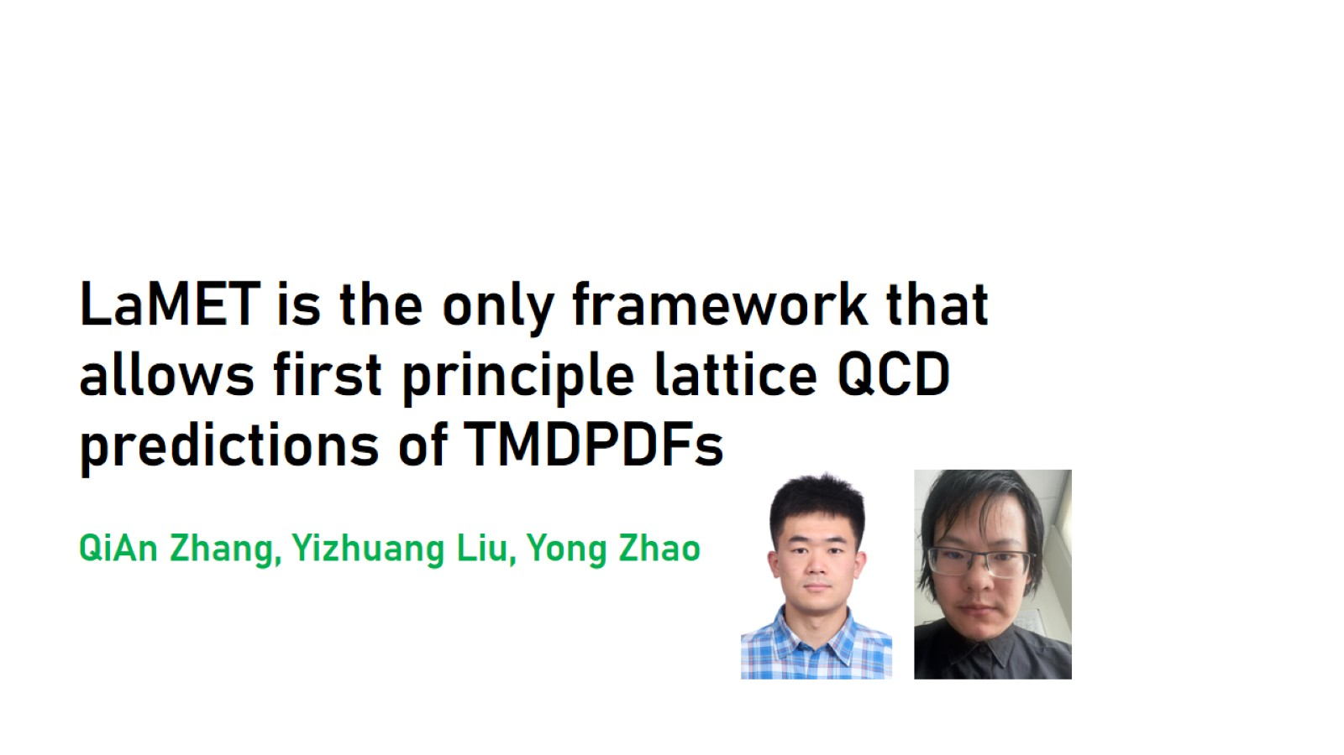
LaMET is the only framework that allows first principle lattice QCD predictions of TMDPDFs
QiAn Zhang, Yizhuang Liu, Yong Zhao

Slide 45
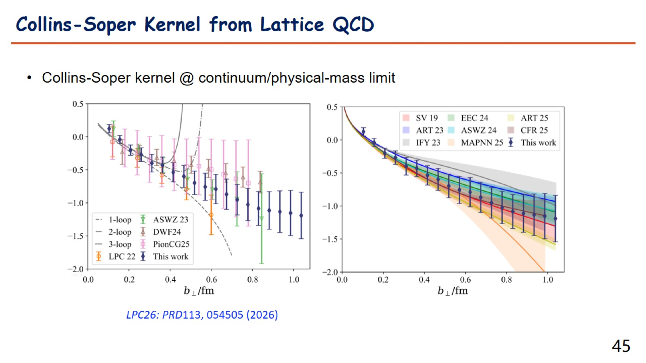

Slide 46
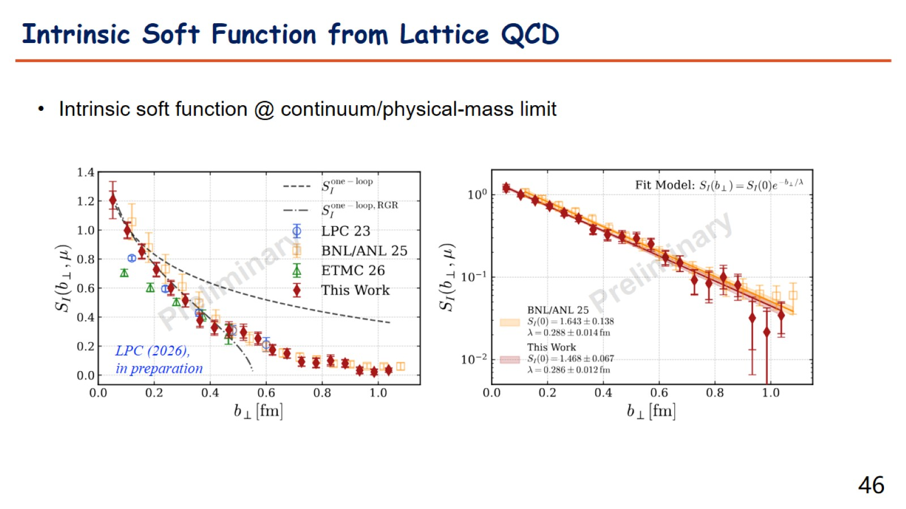

Slide 47
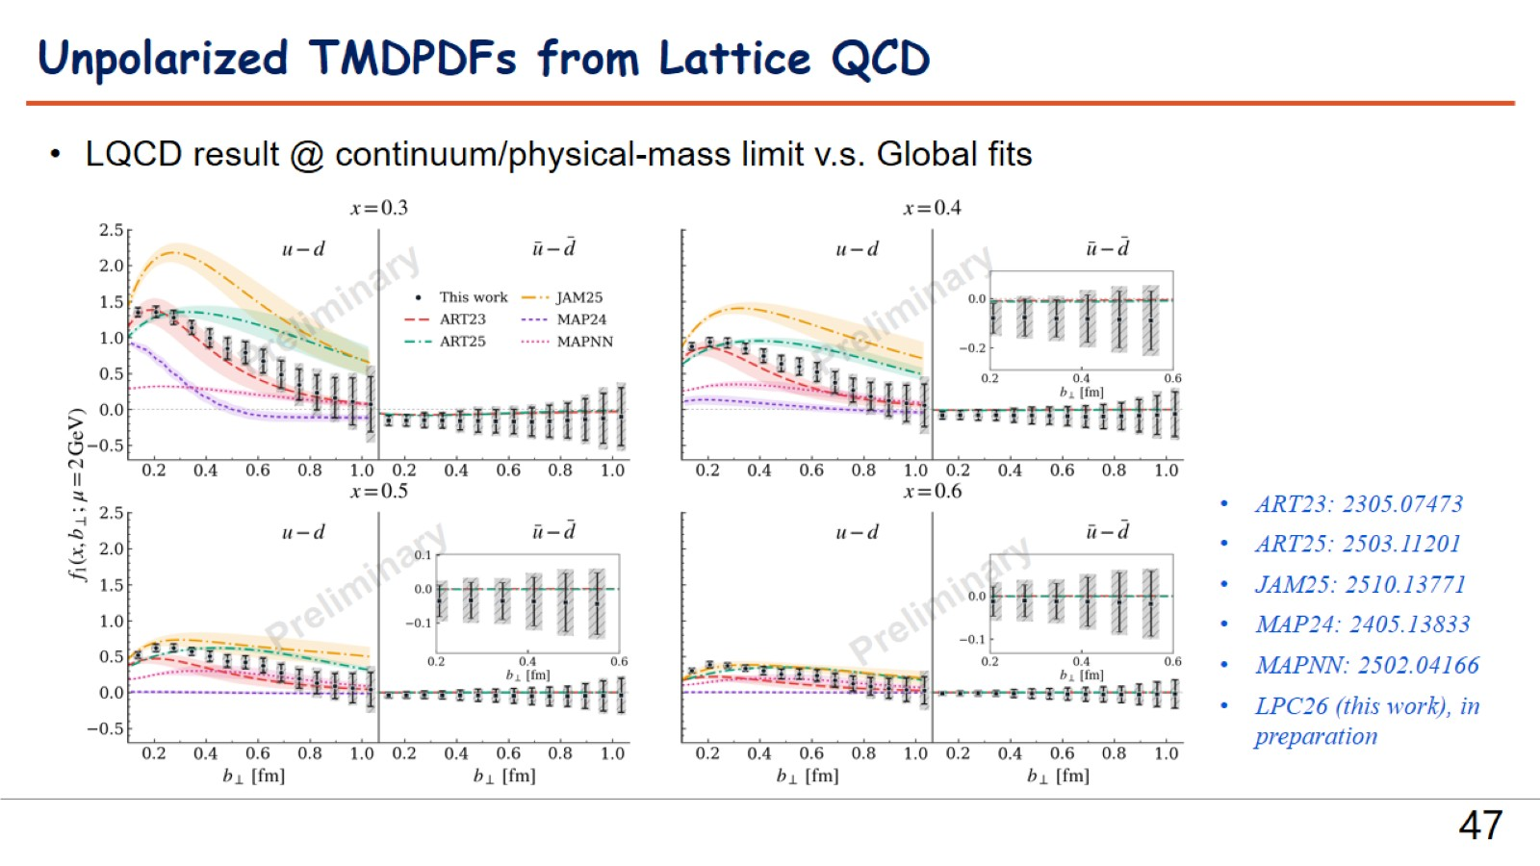

Slide 48
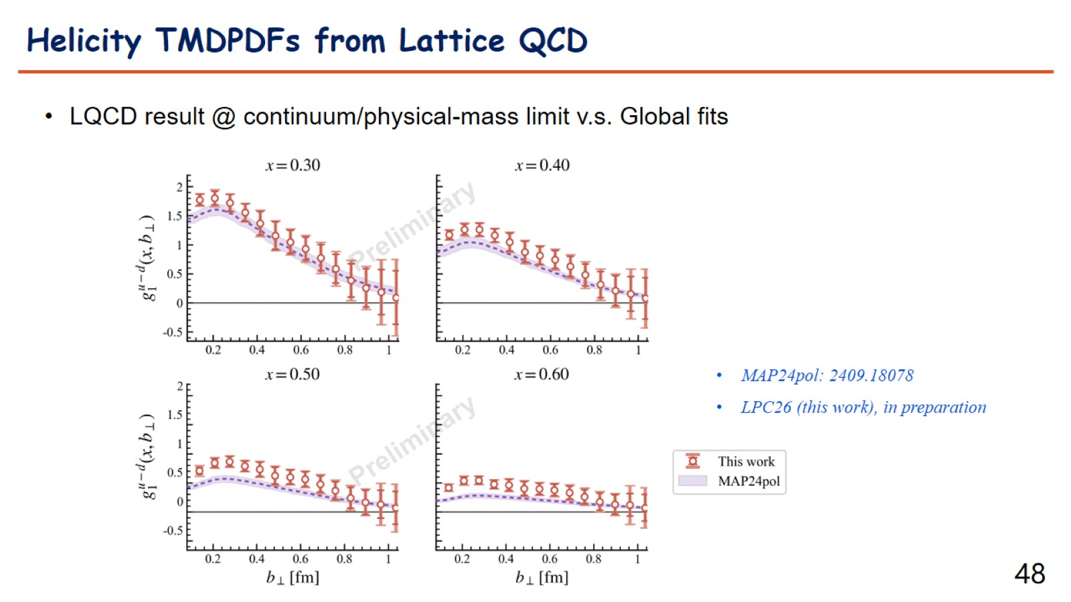

Slide 49
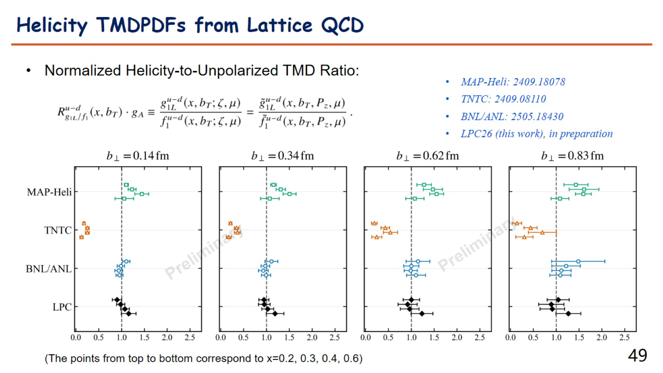

Slide 50
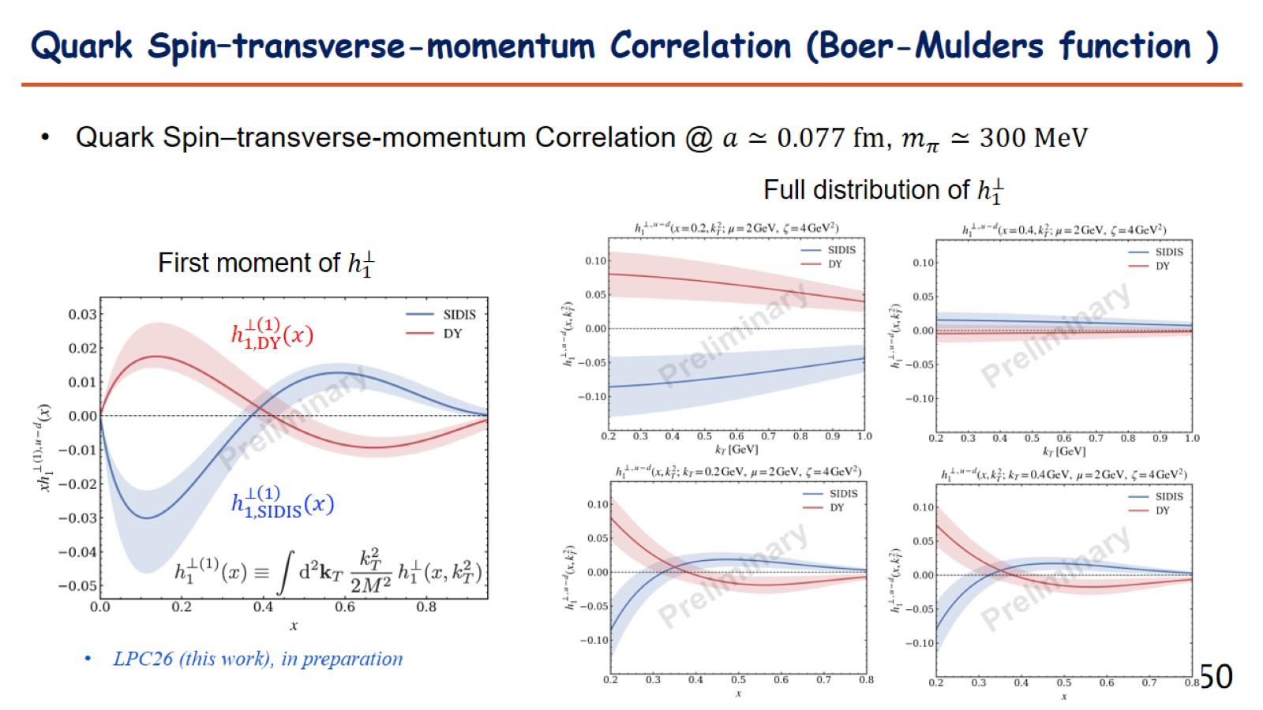

Slide 51
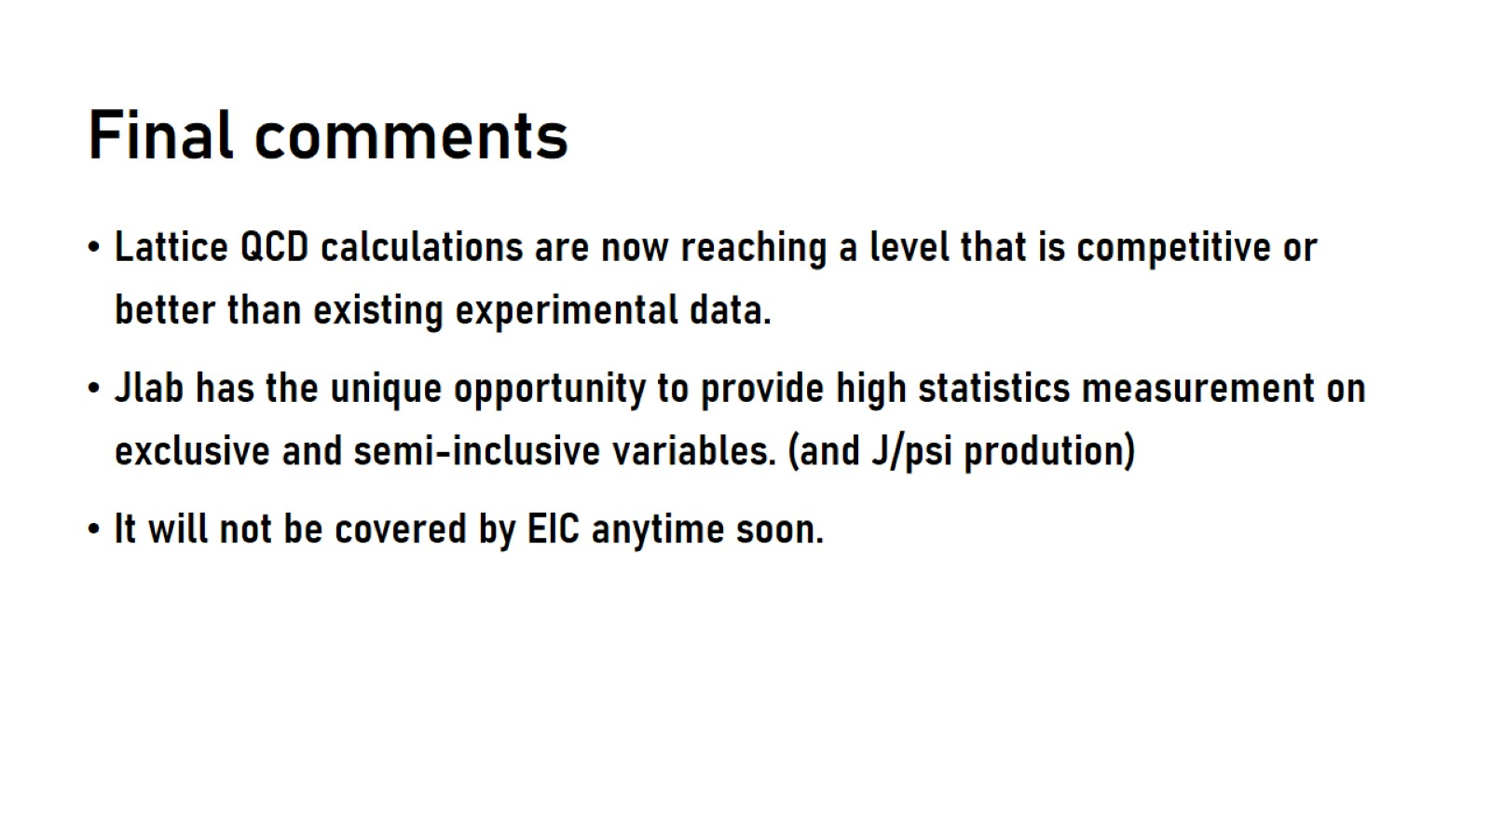
Final comments

