Slide 1
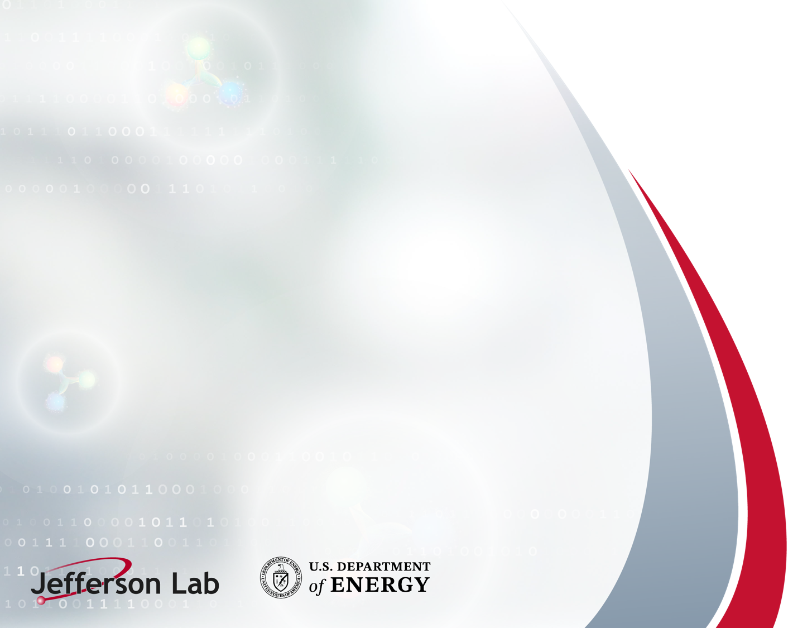
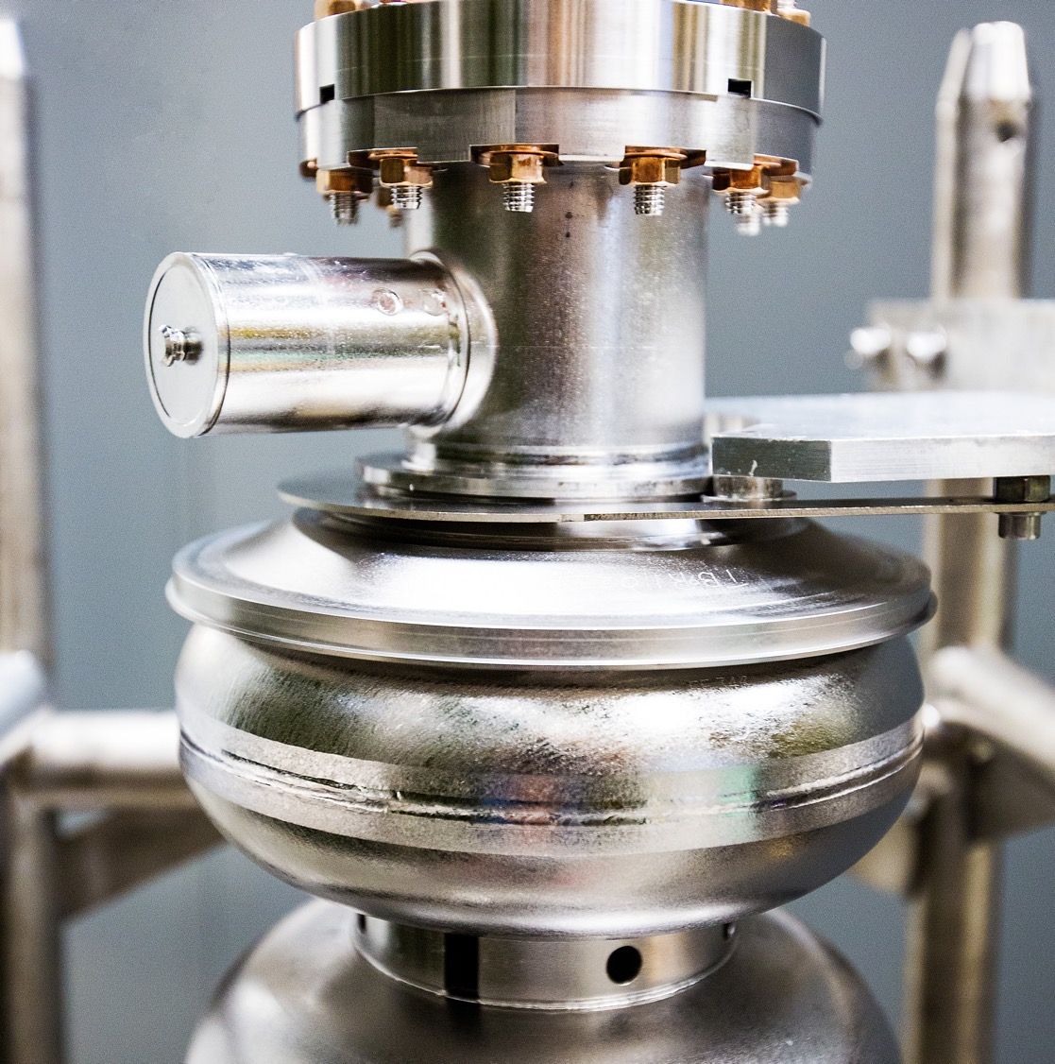
Input from Physics Division
and a discussion of the current & future program
Douglas Higinbotham, Acting Division Director
CEBAF Experimental Physics
Notes:
Tip: Keep titles under 60 characters for readability
To change the photo: Right-click on photo and select change photo

Slide 2
CEBAF FY26 Experimental Physics Program
The linacs and optics ran great and were reproducible, FY26 was a year of ”simple” iron magnets having various issues.
Hall B
E12-20-004: PRad-II (Contact: A. Gasparian (NCSU), D. Dutta (MS), H. Gao (Due), N. Liyanage (UVA), E. Pasyuk(JLab), C. Peng (ANL). W. Xiong (Shandong), and DWH (JLab)). [completed]
E12-21-003: X17 Boson Search: (Contact: A. Gasparian (NCSU), D. Dutta (MS), H. Gao (Due), T. Hague (JLab), N. Liyanage (UVA), R. Paremuzyan(JLab), C. Peng (ANL). W. Xiong (Shandong)) [well underway, continuing FY27]
Hall C
E12-22-001: N-> Delta (Contact: N. Sparveris (Temple), H. Atac (Temple), A. Camsonne(JLab), M. Jones(JLab), and M. Paolone (NMS) [ completed ]
E12-23-001: VCS (Contact: N. Sparveris (Temple), H. Atac (Temple), A. Camsonne(JLab), M. Jones(JLab) and M Paolone (NMS)) [ completed scope for FY26 ]
E12-24-001: Nuclear-R SIDIS (Contact: D. Gaskell (JLab), P. Bosted(W&M), W. Brooks (Fed. ST. Maria), R. Ent(JLab), E. Kinney(UC), and H. Mkrtchyan (Yerevan)) [completed]
E12-06-104: Nucleon R SIDIS (Contact: R. Ent(JLab), P. Bosted(W&M), E.Kinny(UC) and H. Mkrtchyan(Yerevan)) [completed ]
E12-06-107: Color Transparency Search (Contact H. Vance(FIU/ODU/JLab), C. Gayoso(W&M), and D. Dutta(MS))
[started, finishing FY27]
Hall D
E12-25-005: GlueX with a 1-4 GeV Photon Beam ( contact: M. Dalton(JLab) & F. Afzal (JLab), V. Crude (FSU), P. Hurck (UB), I. Jeagle (ODU), and A. Thiel (UG) ) [ well underway, finishing in FY27 ] NOTE: First low energy Hall D beam!
E12-12-002: GlueX-II (Contact: C. Meyer (CMU) and M. Shepherd (IU)) [200 of 220 days completed, finishing FY27]
E12-12-002A: Jefferson Lab Eta Factor (JEF) (Contact: L. Gan (UNCW) & Z. Papandreou, A. Somov(JLab), and S. Tayler(JLab))
[run group experiment with GlueX-II, finishing FY27]
Notes:
Fully completed 4 experiments (green) and have six partially completed (yellow). The partially completed will all finish up next year. The item to note is this year was the first time we ran a low energy beam to Hall D.

Slide 3
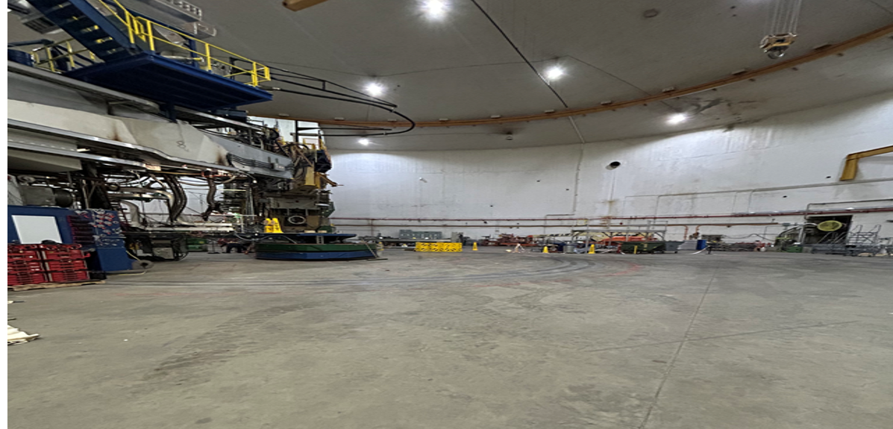
And Hall A has the MOLLER Assembly Now Well Underway
Hall A After SBS Removal in Early 2026
Notes:
Fully completed 4 experiments (green) and have six partially completed (yellow). The partially completed will all finish up next year. The item to note is this year was the first time we ran a low energy beam to Hall D.

Slide 4
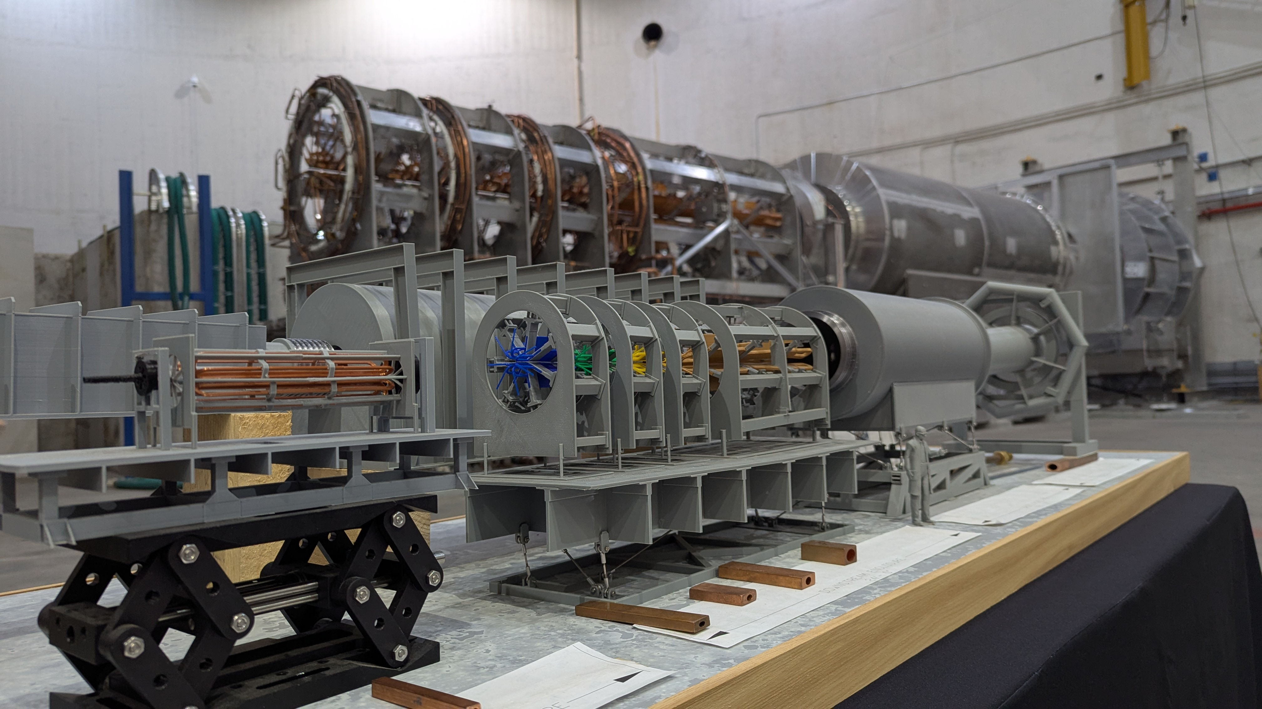
And Hall A has the MOLLER Assembly Now Well Underway
Notes:
Fully completed 4 experiments (green) and have six partially completed (yellow). The partially completed will all finish up next year. The item to note is this year was the first time we ran a low energy beam to Hall D.

Slide 5
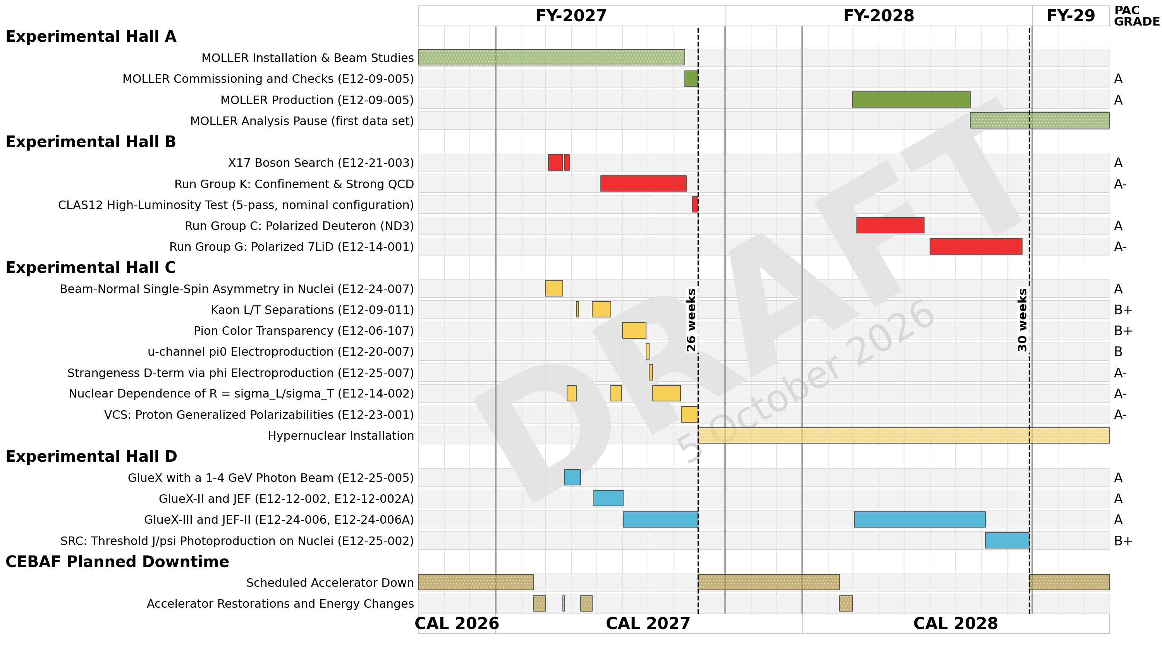

Slide 6
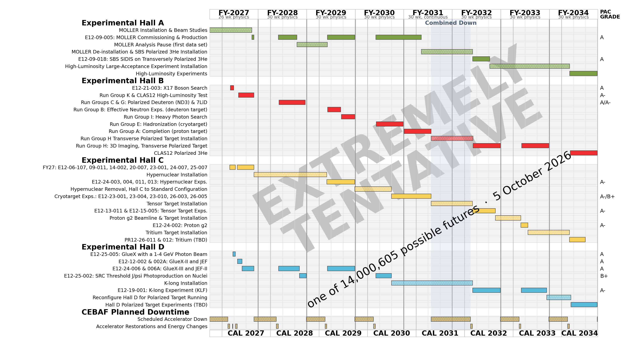

Slide 7
My Goals For This Workshop
Work towards the best possible high luminosity physics program at Jefferson Lab
SoLID unfortunately did not receive a Critical Decision 0 (CD0) from DOE HENP
  Without a CD0 no path to move forward with SoLID after MOLLER
  SoLID, or even SoLID-light, carries the baggage of trying to get to CD0
  EIC is likely going to remain the focus for the NP part of HENP project dollars for the next MANY years
Focus on the positives and what we can control and what equipment we have (e.g. CLAS12) and equipment that we can bring to the lab or re-use (SBS, sPHENIX, etc.)
The science in the SoLID program is world class and EIC isn’t going to address it.
The high luminosity program at JLab (high-x) is very synergistic with the (low-x) EIC program.
Looking forward to the creative ideas that will get the science done!
Personal note: My own thesis data came from the non-funded SPITFIRE proposal at NIKHEF. Kees de Jager did what we are doing here and found a way to get the science done anyway!

