Slide 1



$KLF$ hypernuclei station
Mikhail Bashkanov, Takehiko Saito, Dan Watts

Slide 2
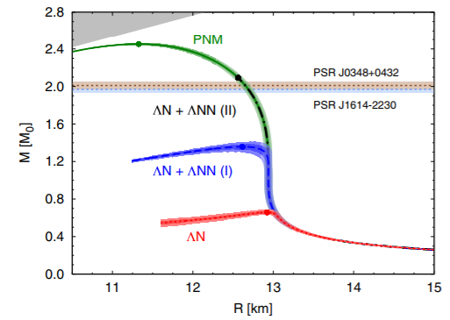
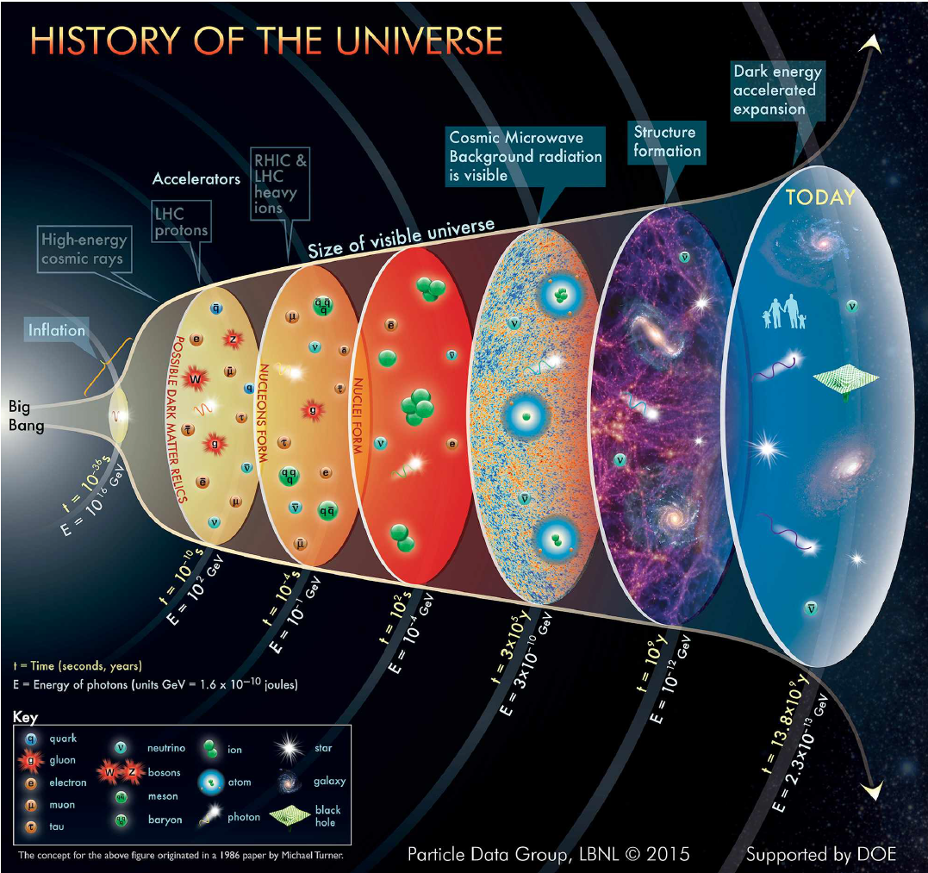
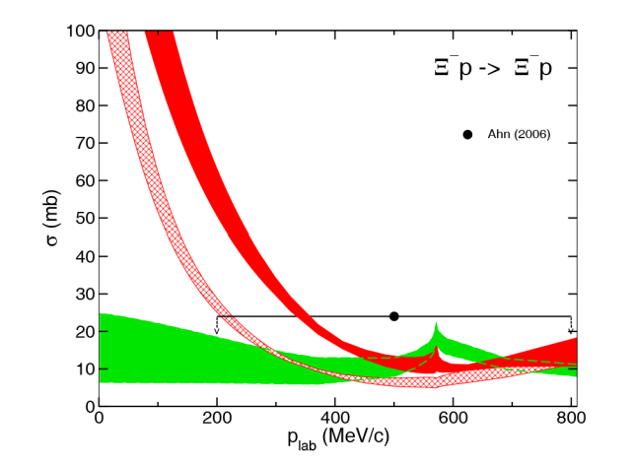
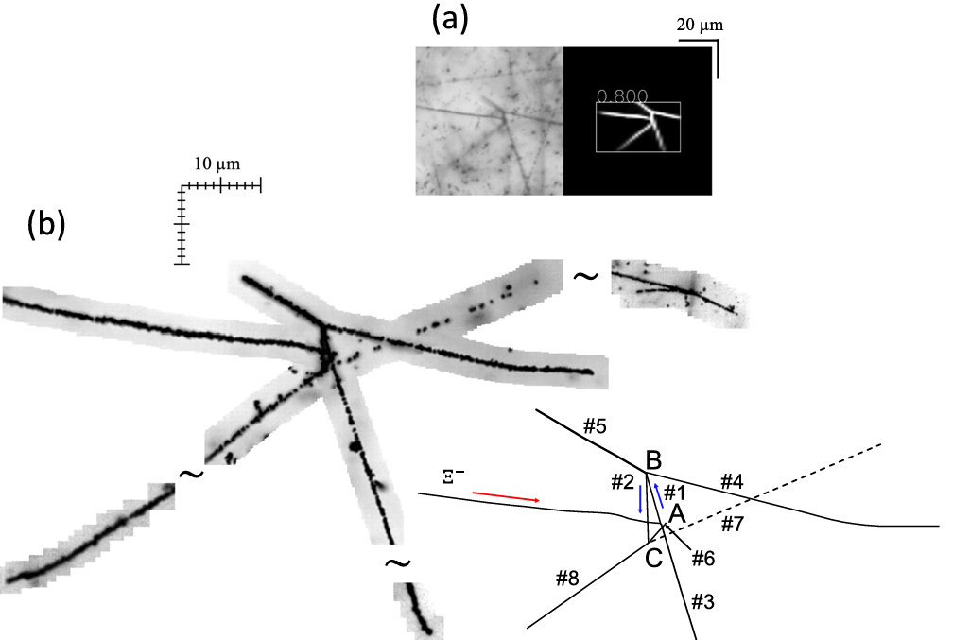
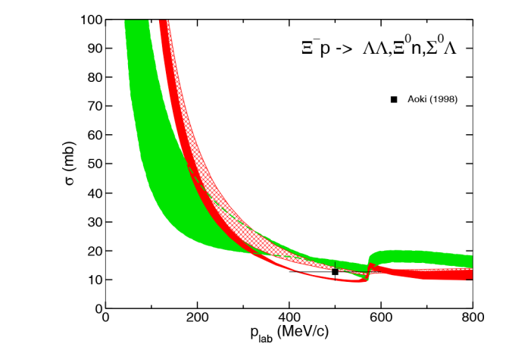
Strangeness is hot!
Early universe
Strangeness in neutron stars
Hypernuclei
Hyperon-nucleon interactions
J. Haidenbauer, U.-G. Meißner,
Eur. Phys. J. A 55, 23 (2019).
2

Slide 3
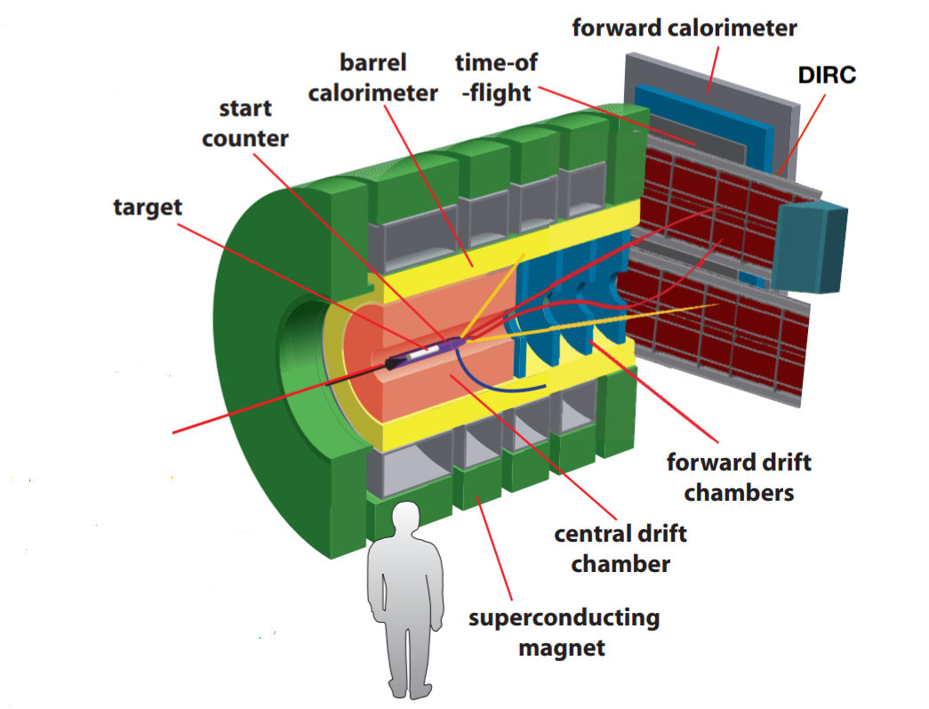
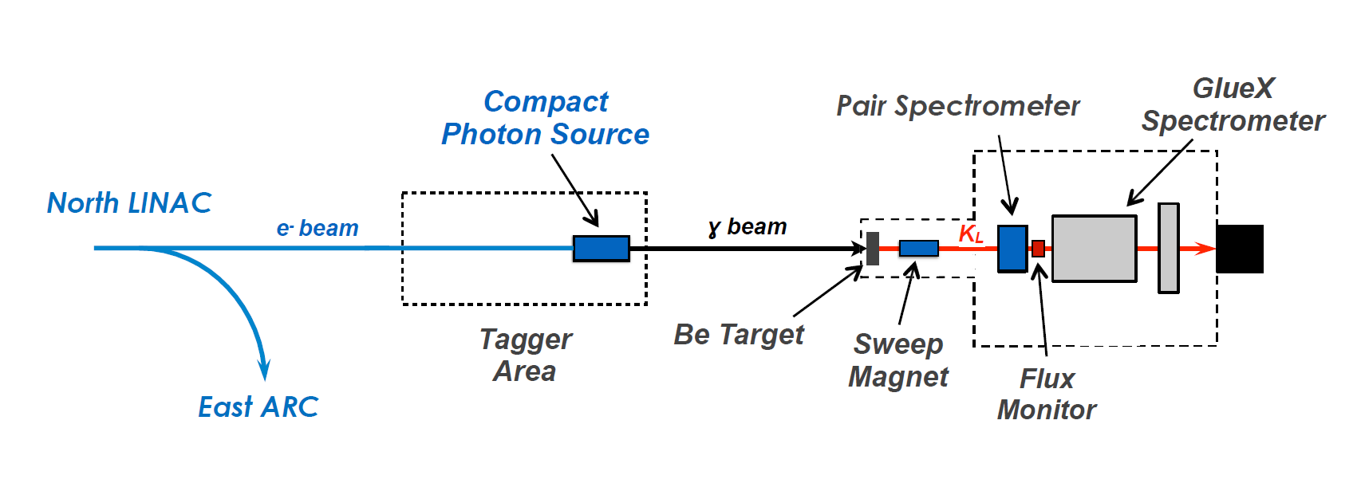
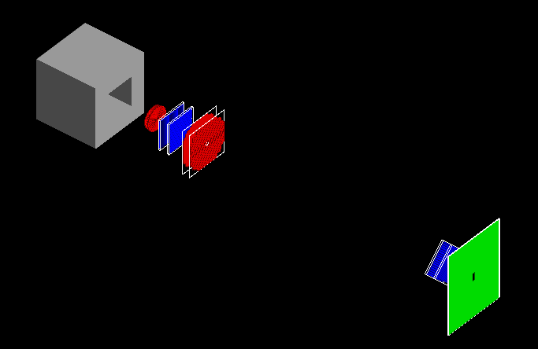
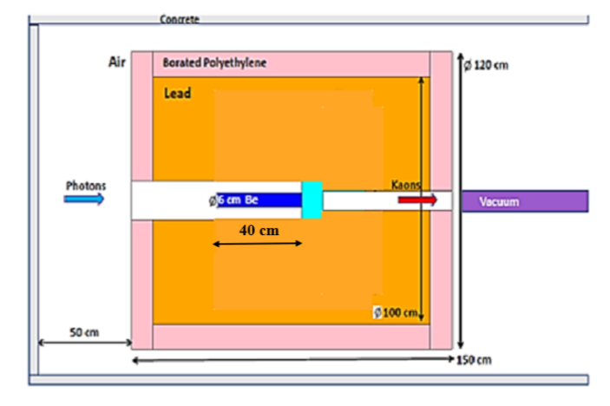
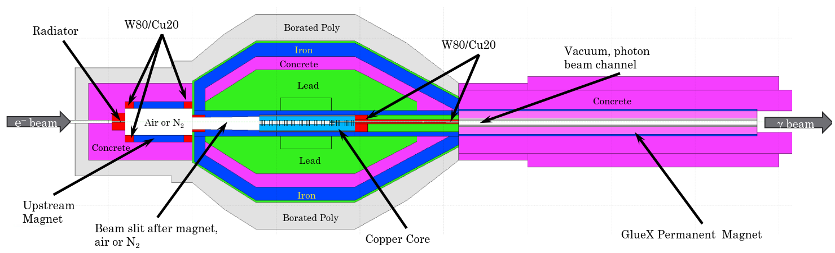
KLF
3

Slide 4
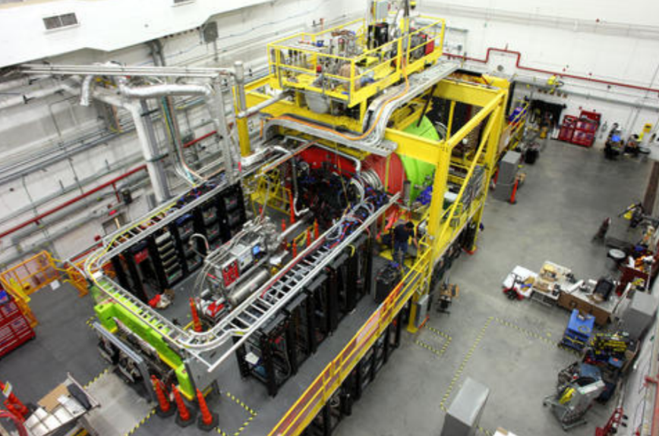
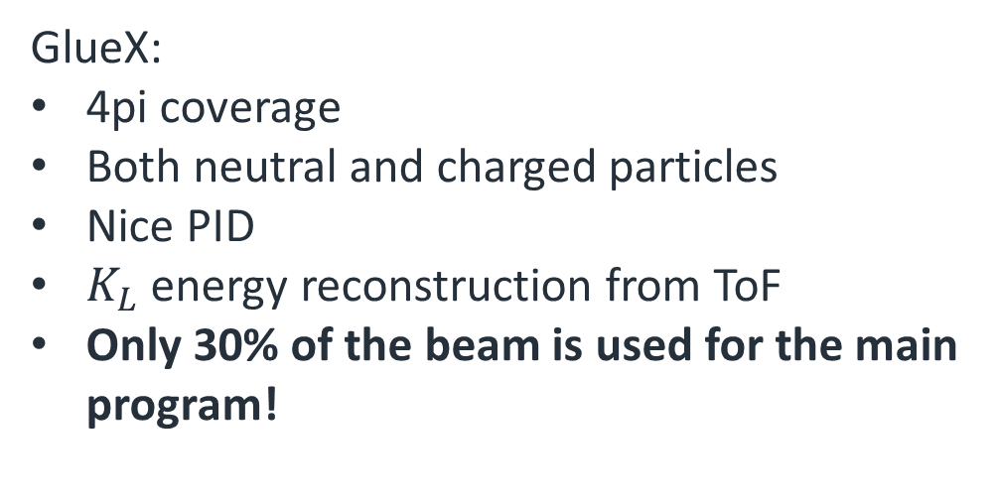



KLF, step 4 (GlueX)
$$Λ$$
$$K_{L}$$
$$π^{+}$$
24m time-of -flight
GlueX:
4pi coverage
Both neutral and charged particles
Nice PID
$K_{L}$ energy reconstruction from ToF
Only 30% of the beam is used for the main program!
4

Slide 5
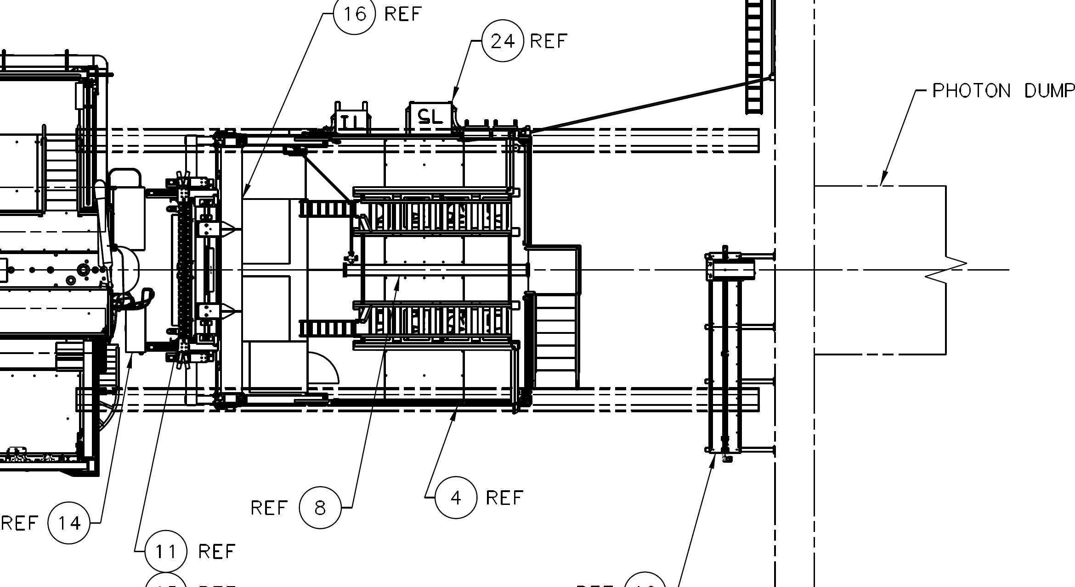
Hypernuclei platform
Hypernuclei station platform 2m x 2m
Can be moved away
Attachable to FD for stability during beamtime
5

Slide 6
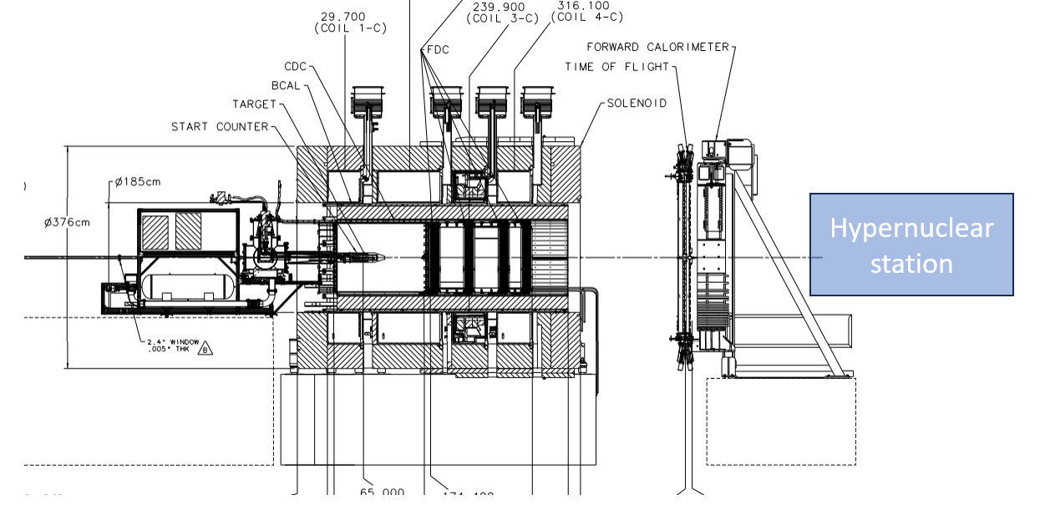
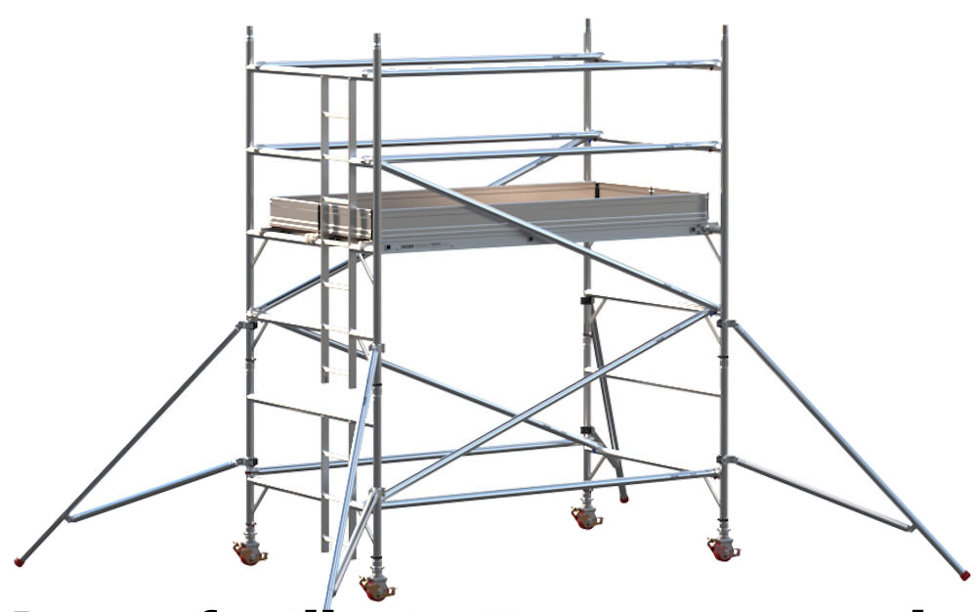
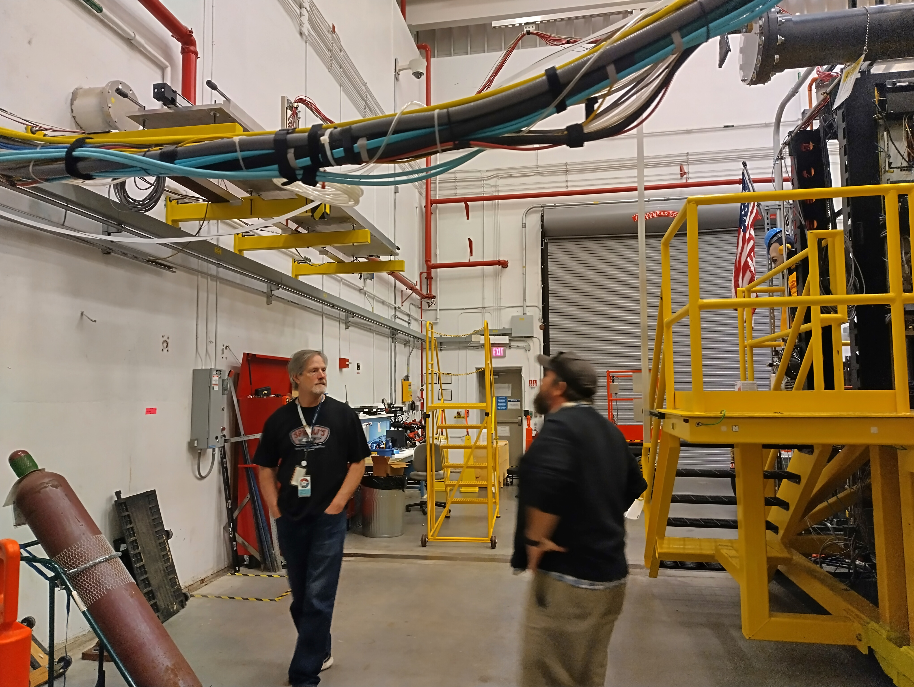
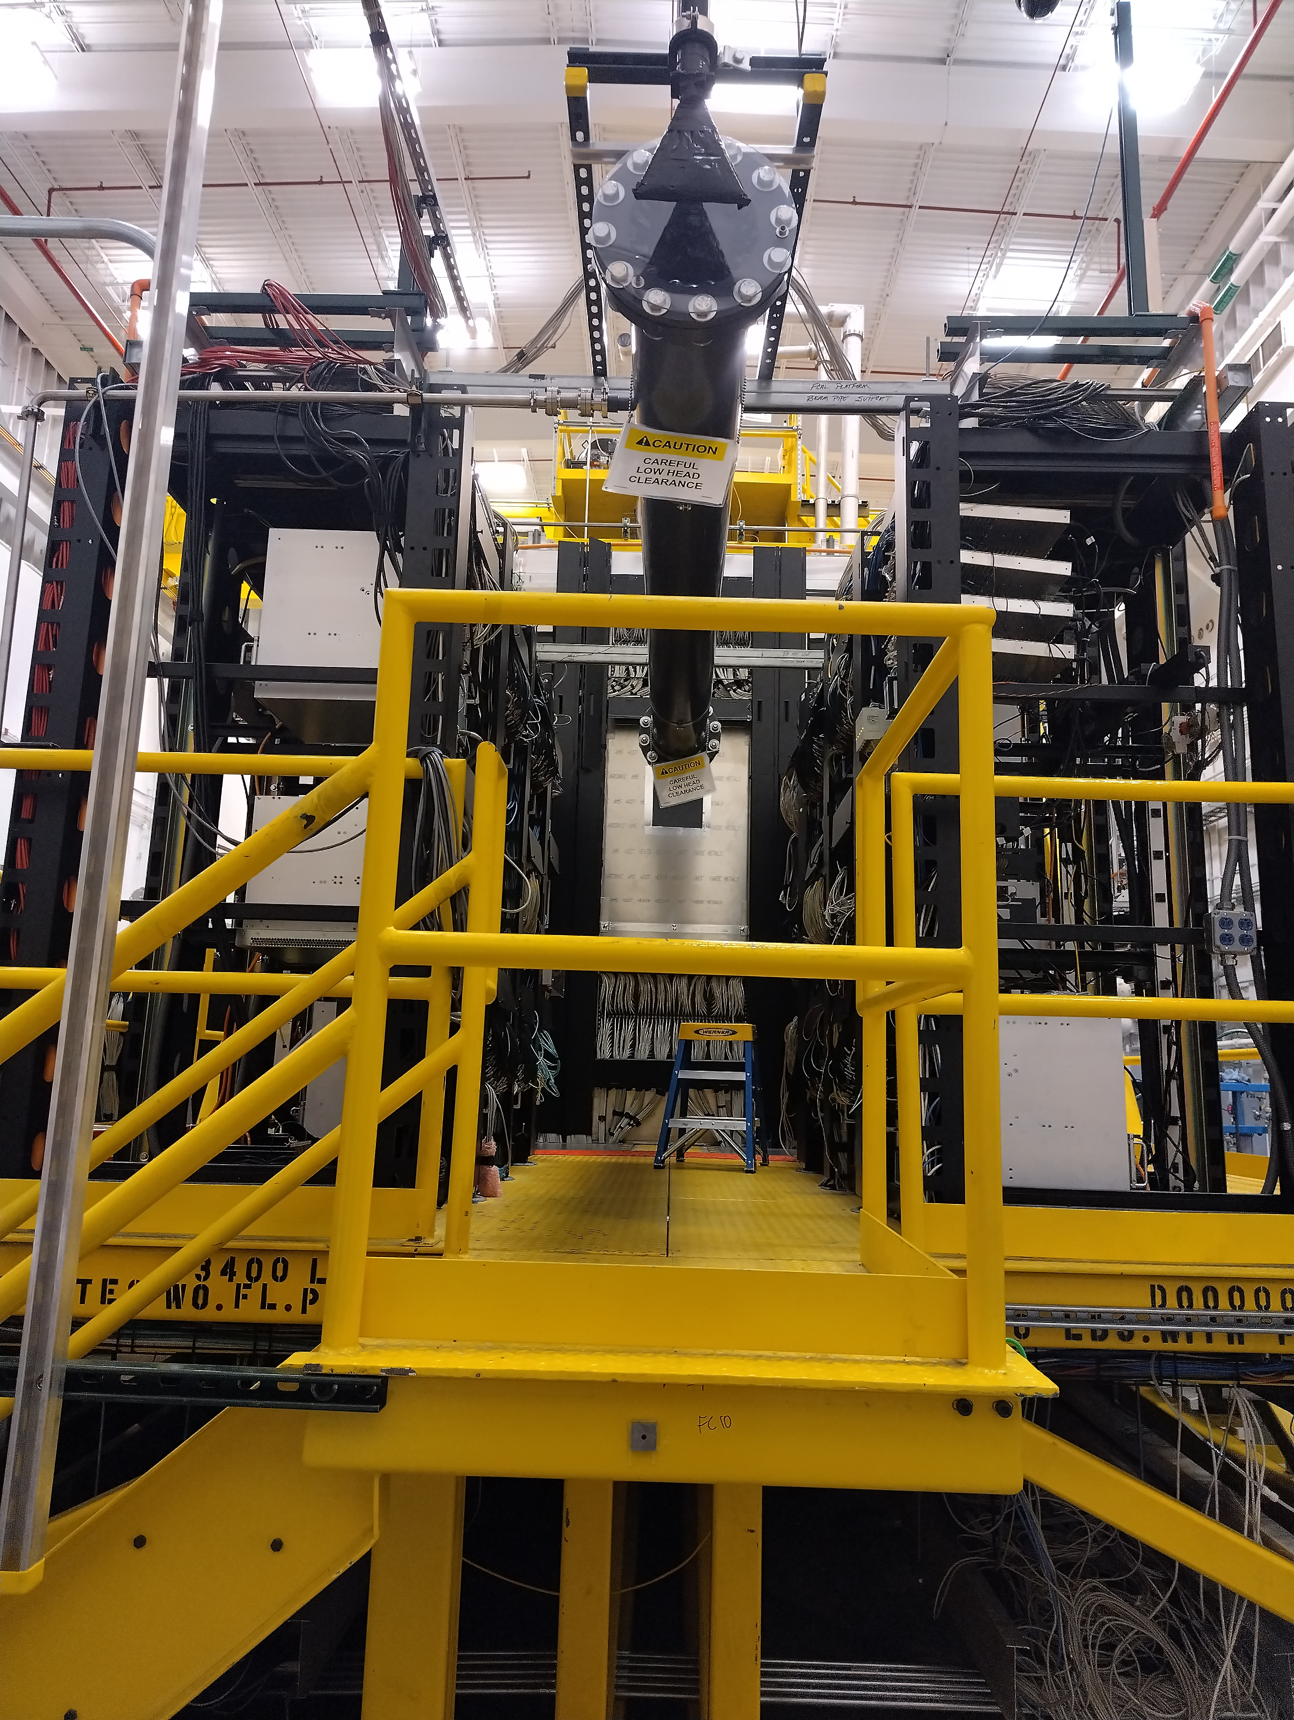
Hypernuclei platform
6

Slide 7
Hypernuclei platform
Emulsion station
Germanium station
beam
2m
Both stations are about 1m x 1m
7

Slide 8
Emulsion station
beam
1m
Emulsion stack
Emulsion Stack 12.5cm x 12.5 cm, 200 layers
8

Slide 9
Emulsion Station

Slide 10
Emulsion station:
Physics Motivation
Baryon interaction with S=-2
Λ−Λ interaction
  Deduced from the structure of double-Λ hypernuclei
  Till 2025, only one event of ⁶_{ΛΛ}He was discovered and the interaction information is obtained only from this ONE EVENT
  In 2025, the analyses of AI on the nuclear J-PARC E07 emulsion data revealed another double-Λ hypernucleus, ¹³_{ΛΛ}B, within 10-months-rowks
  We need more data with better quality!!!
  The KLF ↦ opportunity to obtain more and better data
10

Slide 11
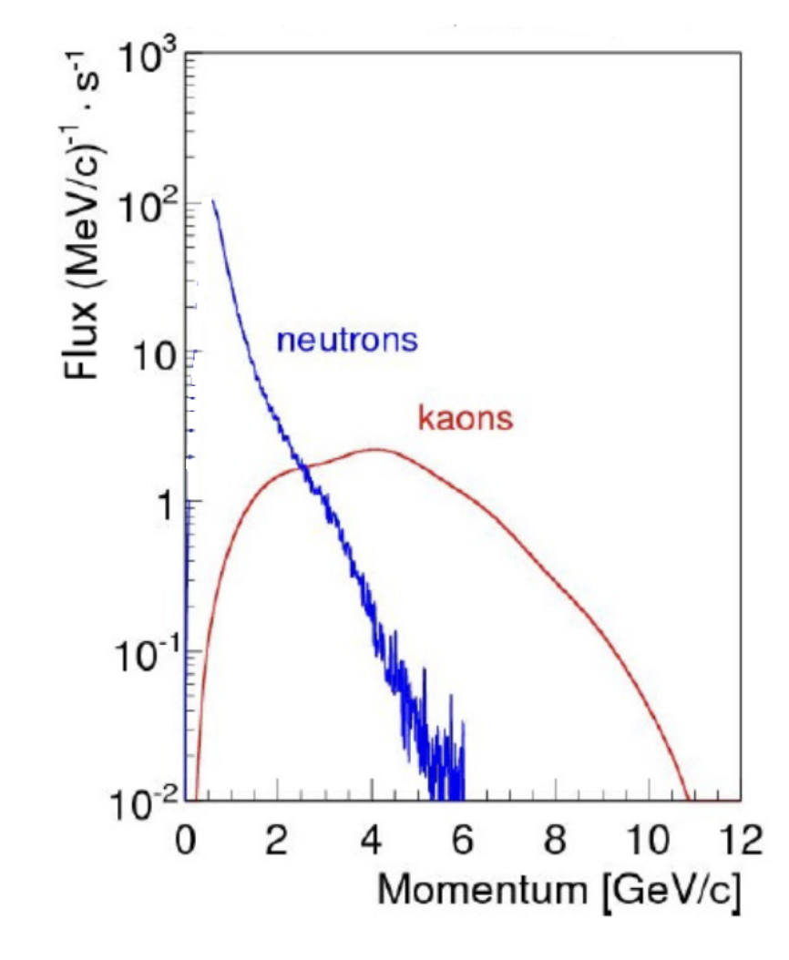
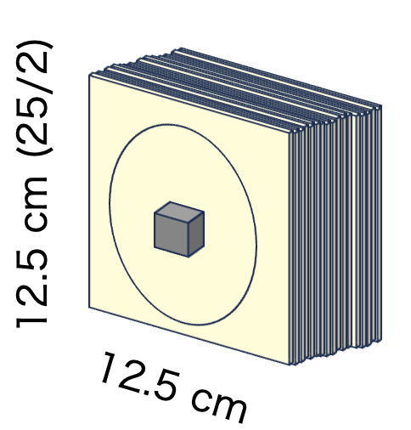
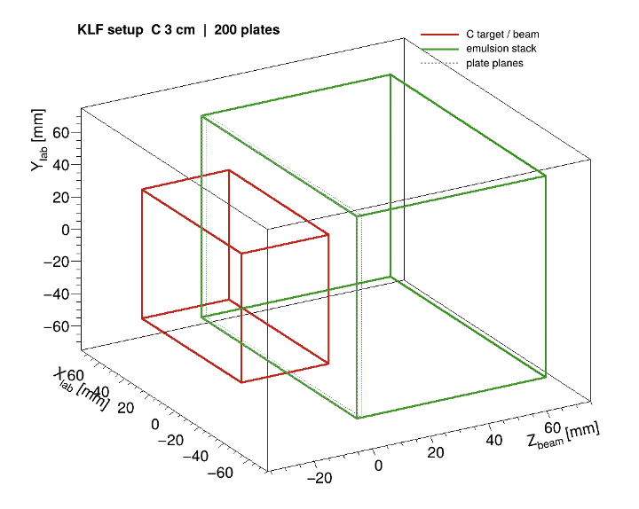
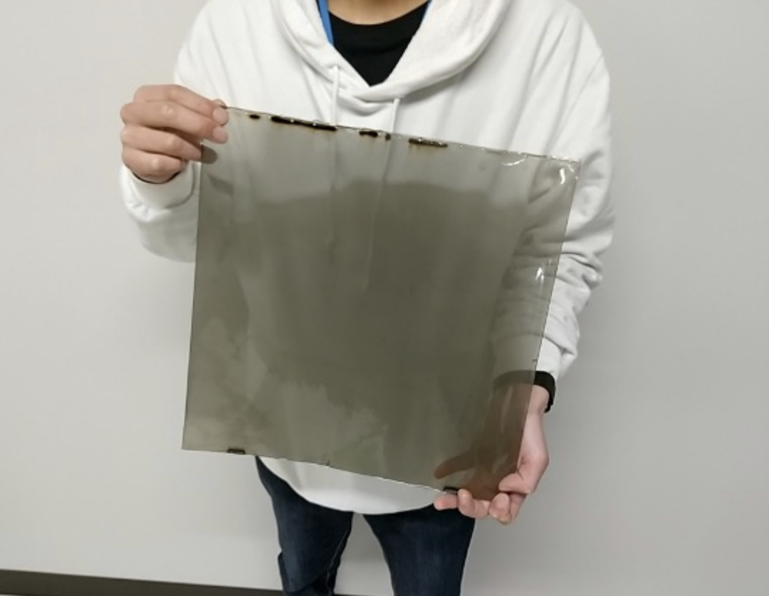
Emulsion station: Setup
3-cm-thick diamond target
200 Nagoya-type thin emulsion sheets
11

Slide 12
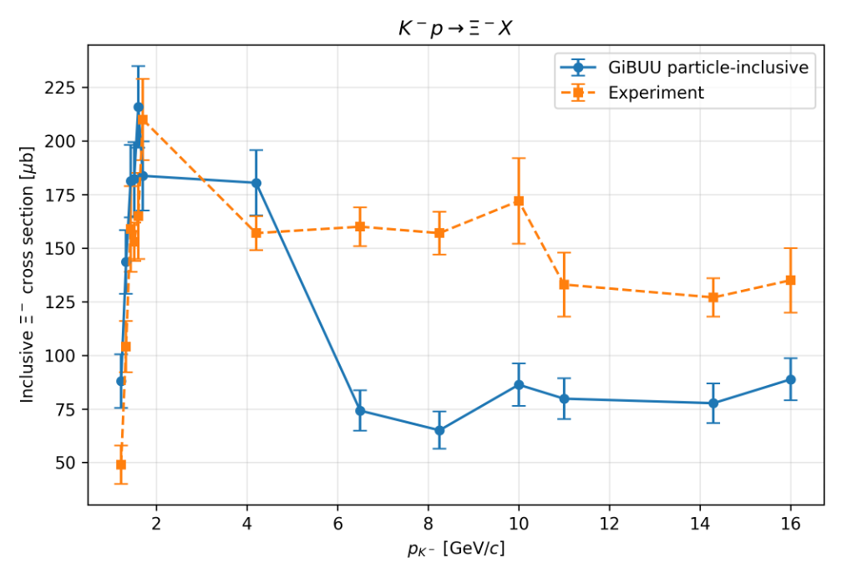
GIBBU cross-sections
12

Slide 13
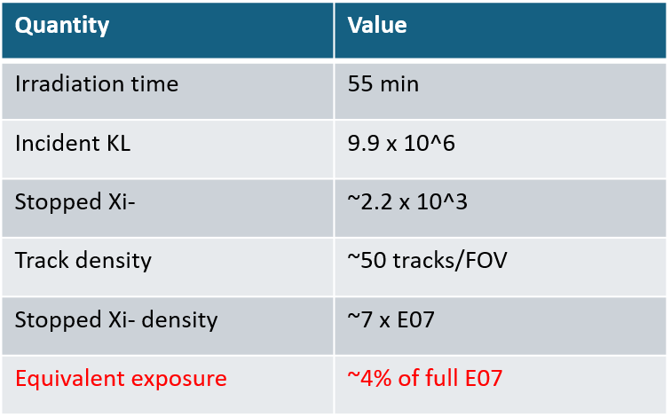

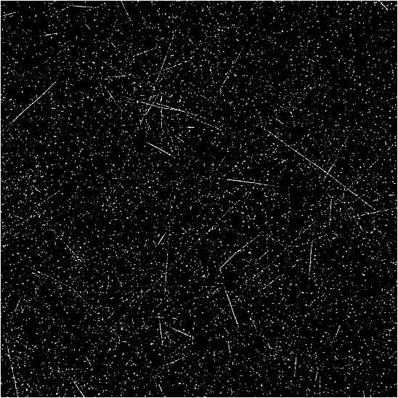
Rate estimate for a 55-minute KLF irradiation
Experimental conditions
KL beam: 3 x 10³ KL/s
Diamond target: 3 cm
200 Nagoya thin-type emulsion plates
GiBUU + Geant4
Realistic KL momentum spectrum and beam profile
effective exposure to E07: 0.7/118*7
40 % of E07 with 550 minutes
(500 tracks in FOV (our challenge)
Expected image with 50 tracks in FOV
Corresponding E07 image
13

Slide 14
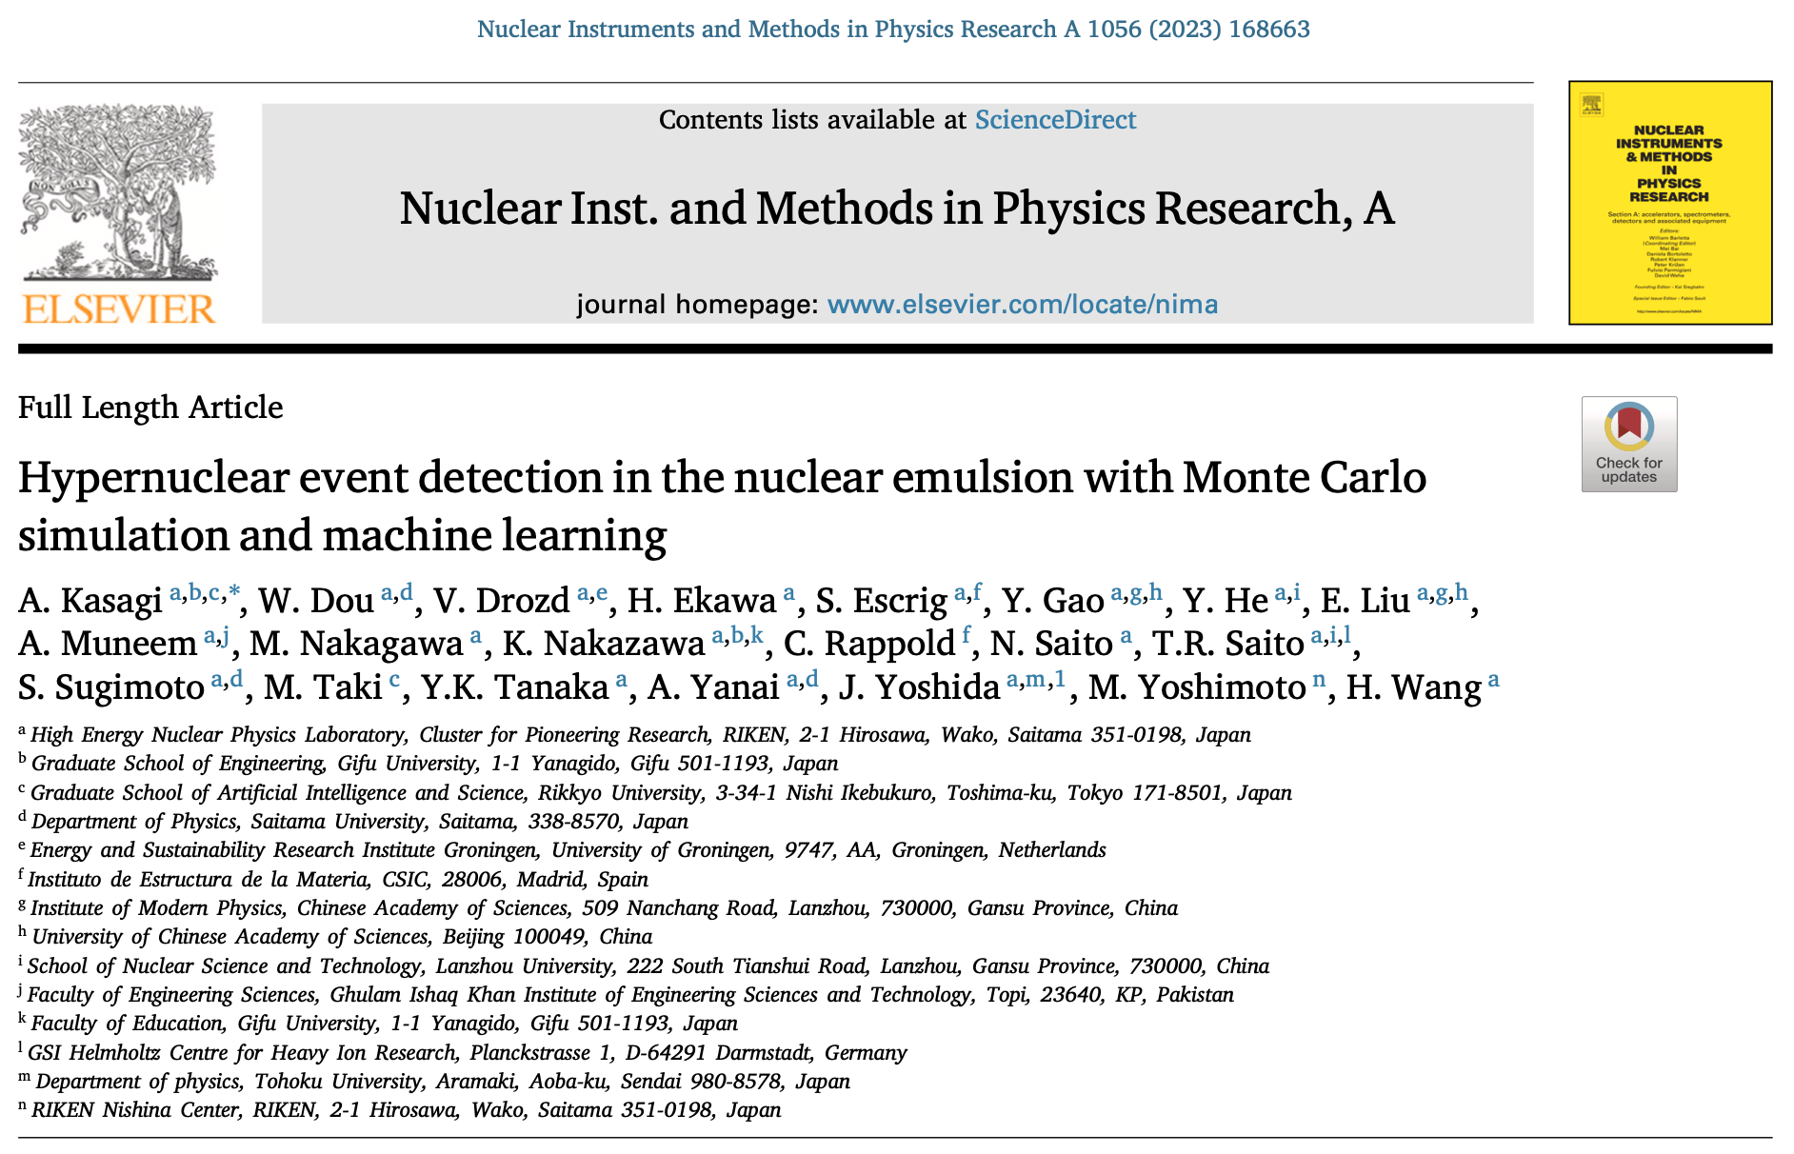
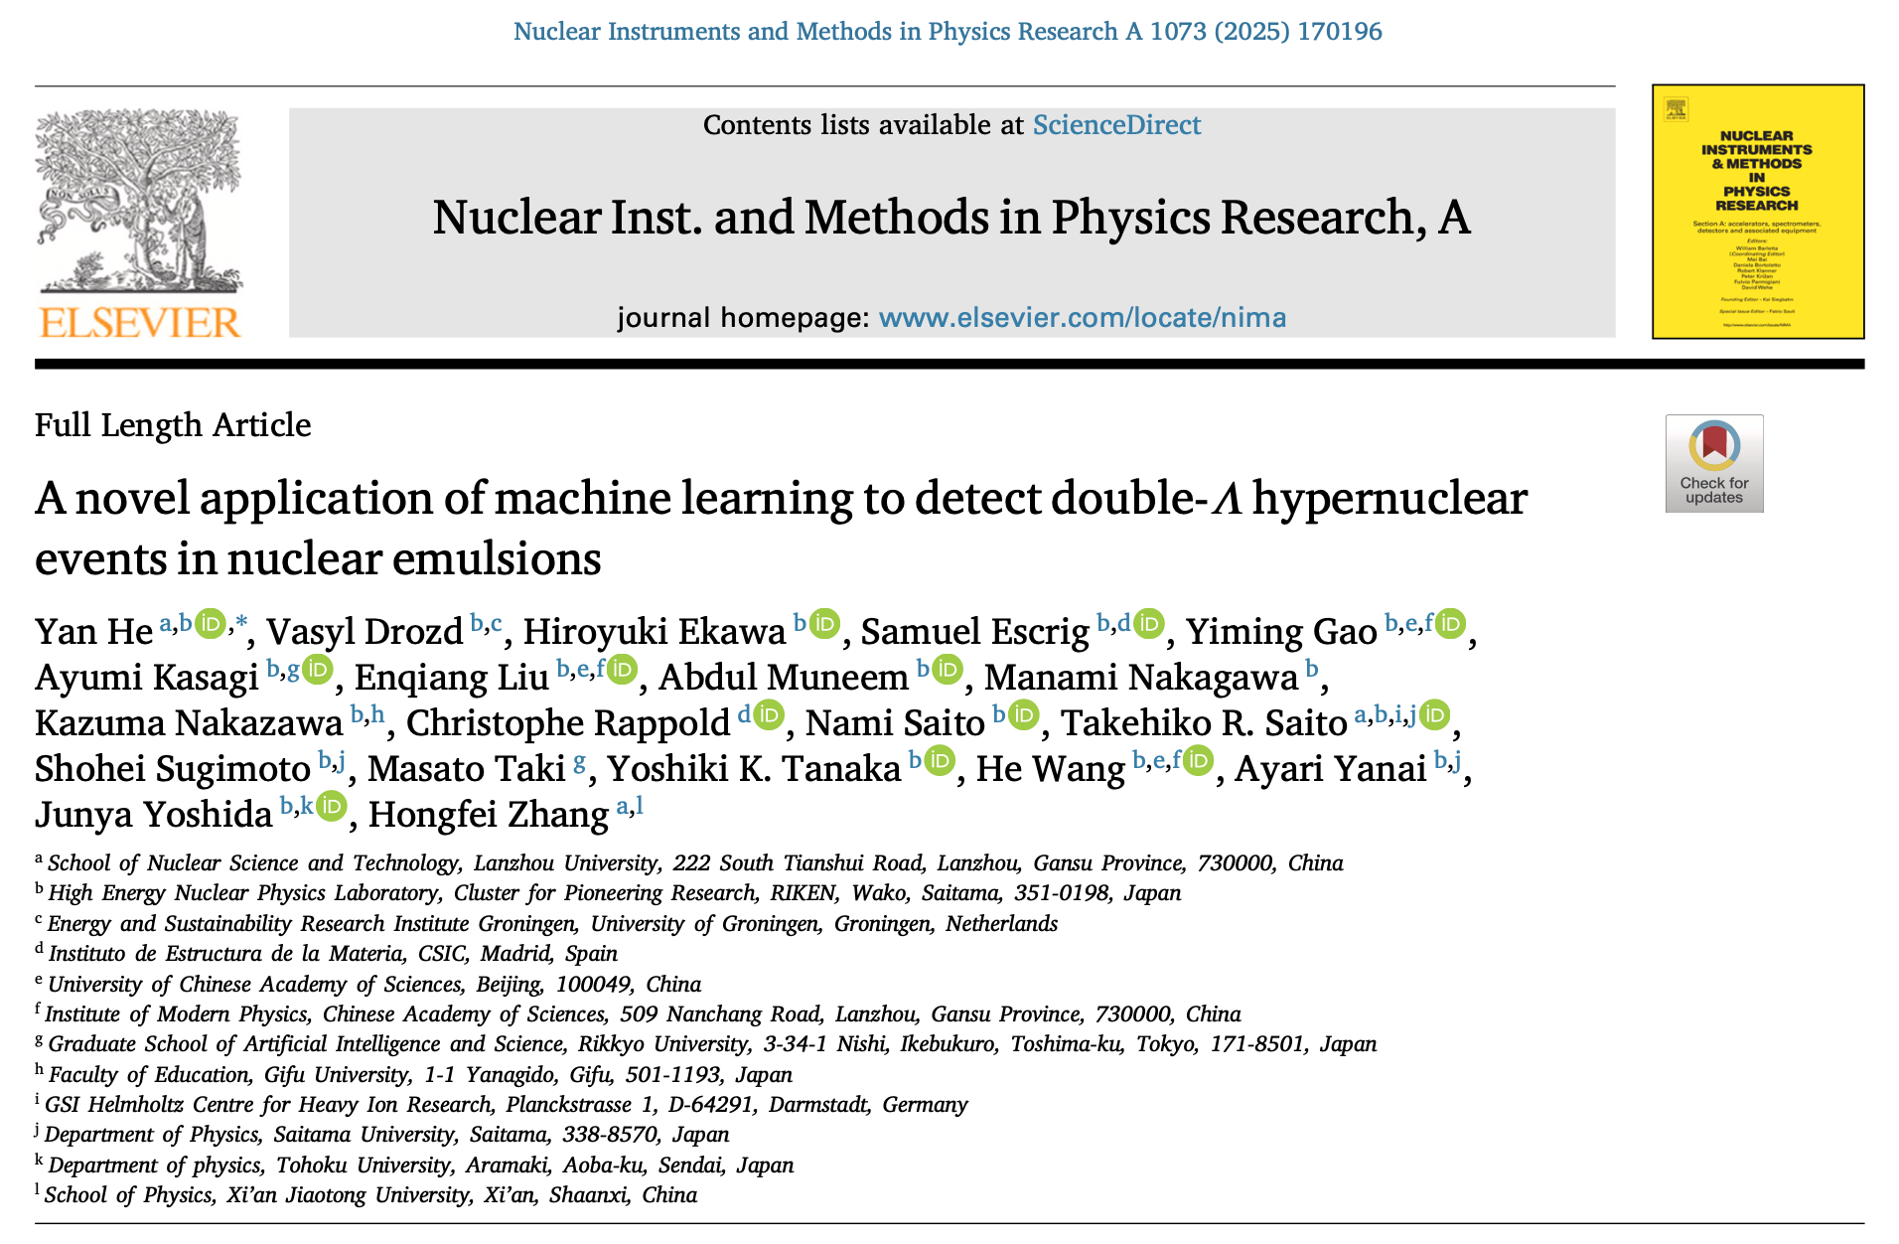
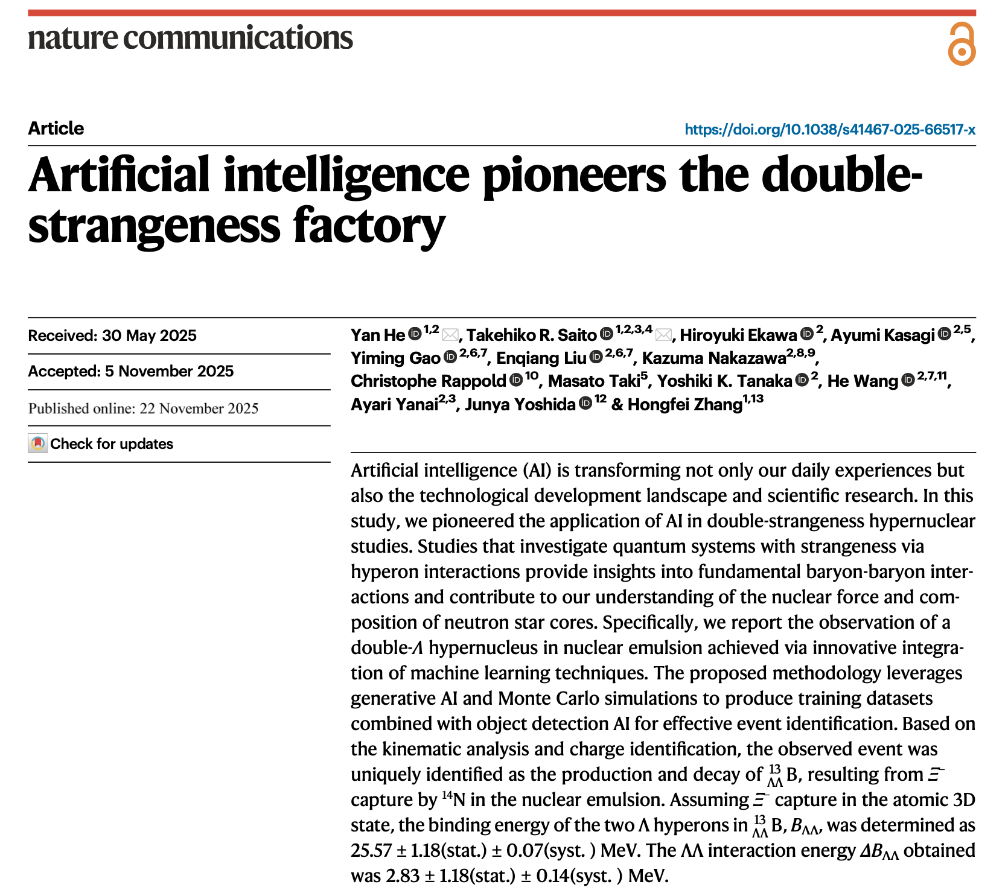
Our existing technique with Machine learning
Training data
With Monte Carlo simulations and the image transfer technique
Detection of hypernuclear detection
Using Mask-R CNN model
  We are also developing a new model with segmentation techniques
We are ready for the KLF data analyses
We also have sufficient expertise on nuclear emulsions
14

Slide 15
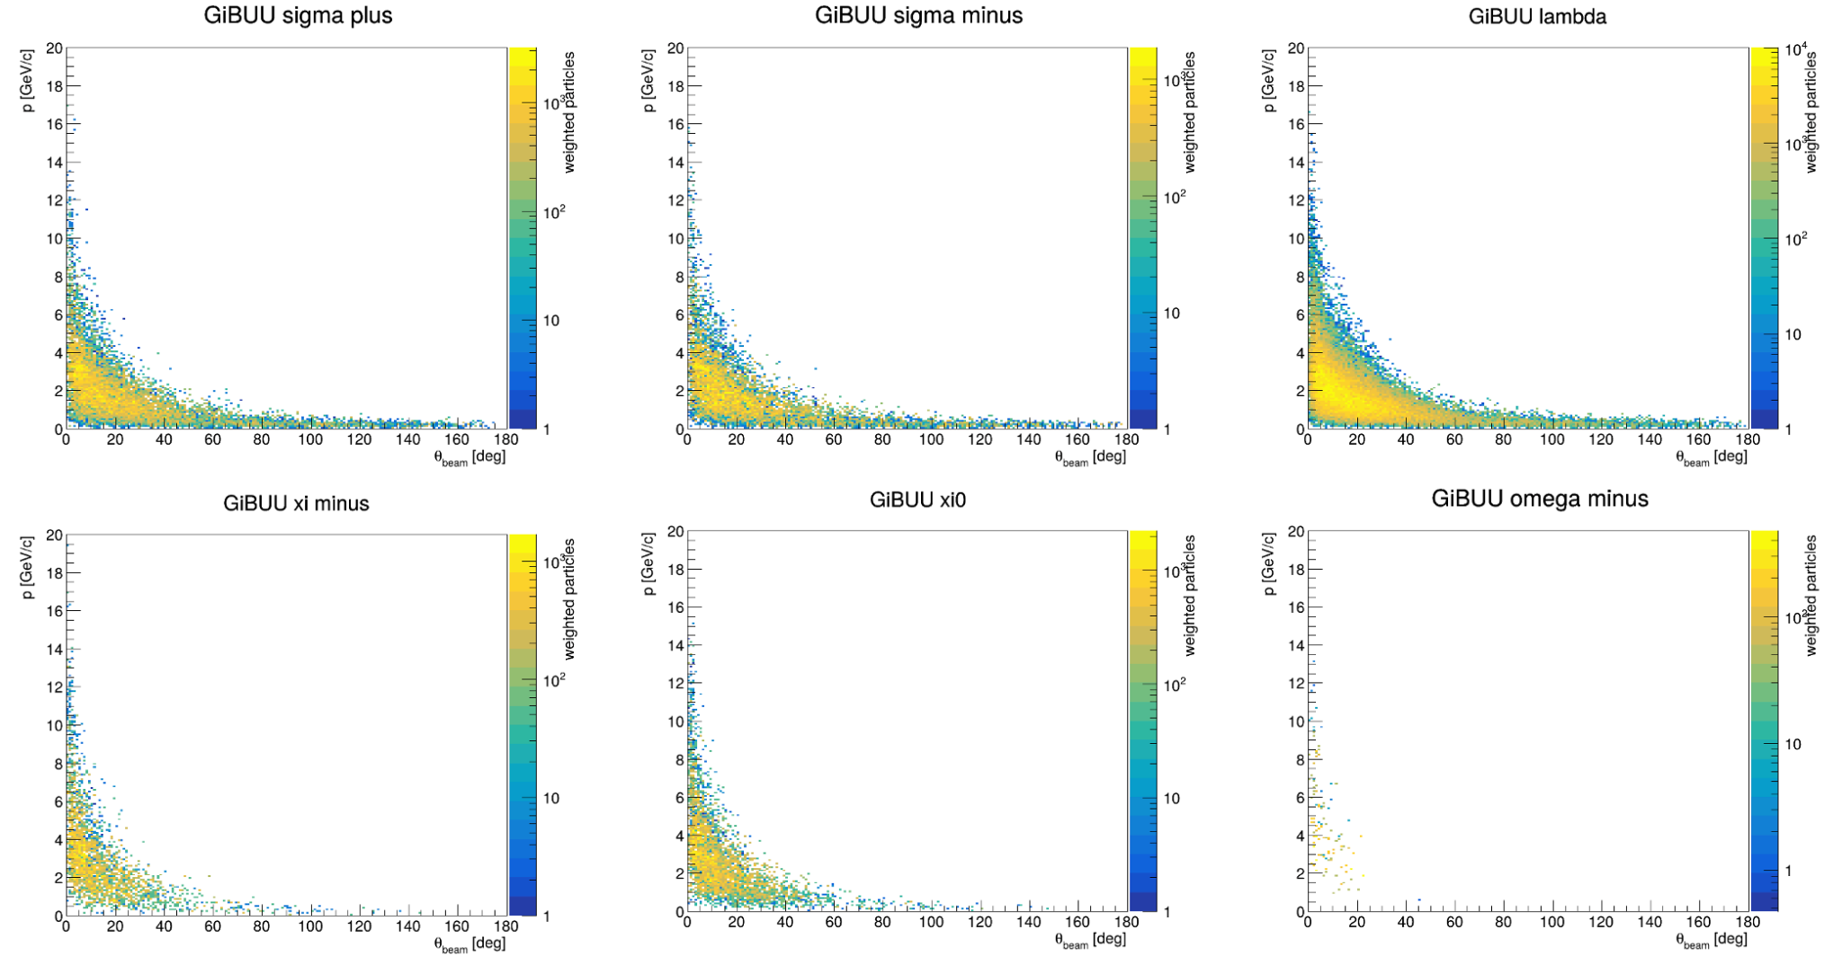
Particle distributions with GiBUU

Slide 16
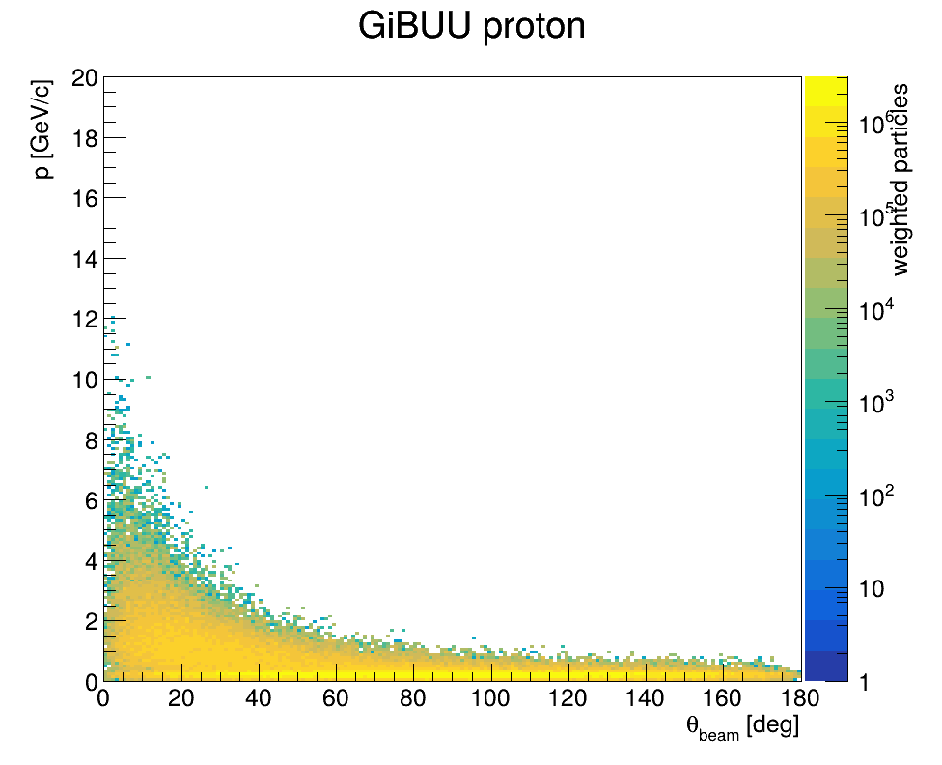
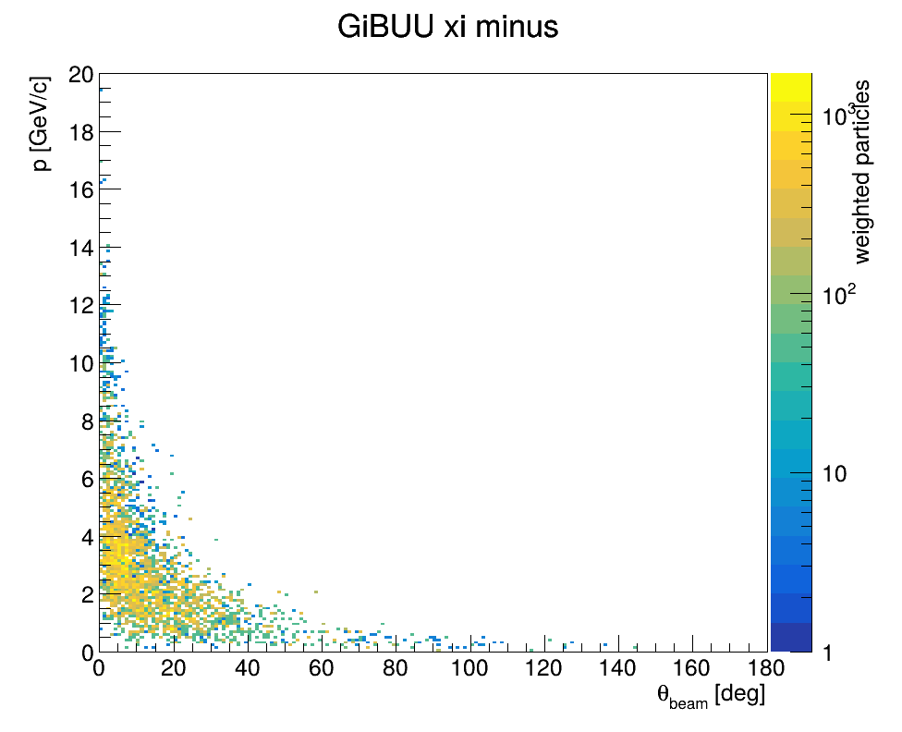
Estimated particle yields entering emulsion stacks
Normalized to stopped X-
particle | Ratio(Xi-) | Cut_fraction
k_minus | 7.7 | 0.697
k0bar | 241.2 | 0.899
pi_minus | 13.8 | 0.249
pi0 | 15.5 | 0.239
6 | 15.7 | 0.256
k0 | 261.1 | 0.909
k_plus | 14.2 | 0.627
neutron | 762.2 | 0.209
proton | 568.6 | 0.157
sigma_minus | 1.50 | 0.698
lambda | 11.2 | 0.743
sigma0 | 2.1 | 0.682
sigma_plus | 2.4 | 0.726
xi_minus | 1 | 0.904
xi0 | 1.4 | 0.885
omega_minus | 0.04 | 0.996
Rough assumption: < 45 degrees & > 1 GeV/c
We consider protons as most sever background

Slide 17
Germanium Station

Slide 18
Germanium station (minimal configuration)
beam
1m
LN
Segmented GE6
Plastic barrel
18

Slide 19
Germanium station (full)
LN
LN
beam
LN
LN
LN
19

Slide 20
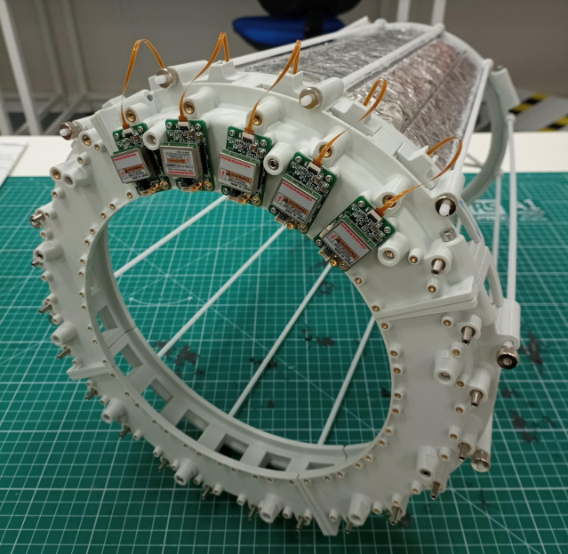
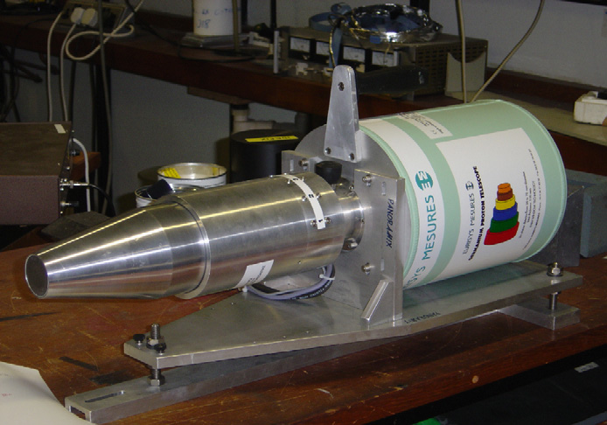
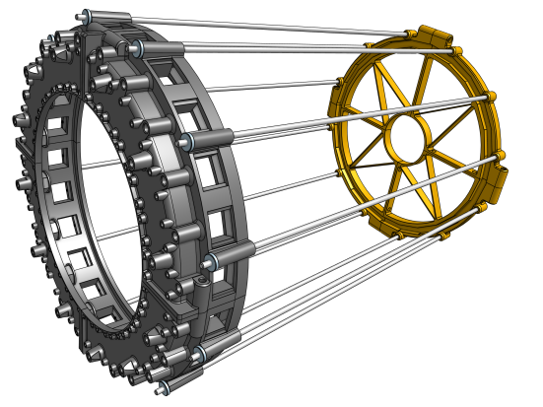
Germanium station: plastic
The central Ge detector will be surrounded by plastic barrel
24 elements
7mm thick
SiPM readout
Possible electric cooling for GE6 (Mirion)
20

Slide 21
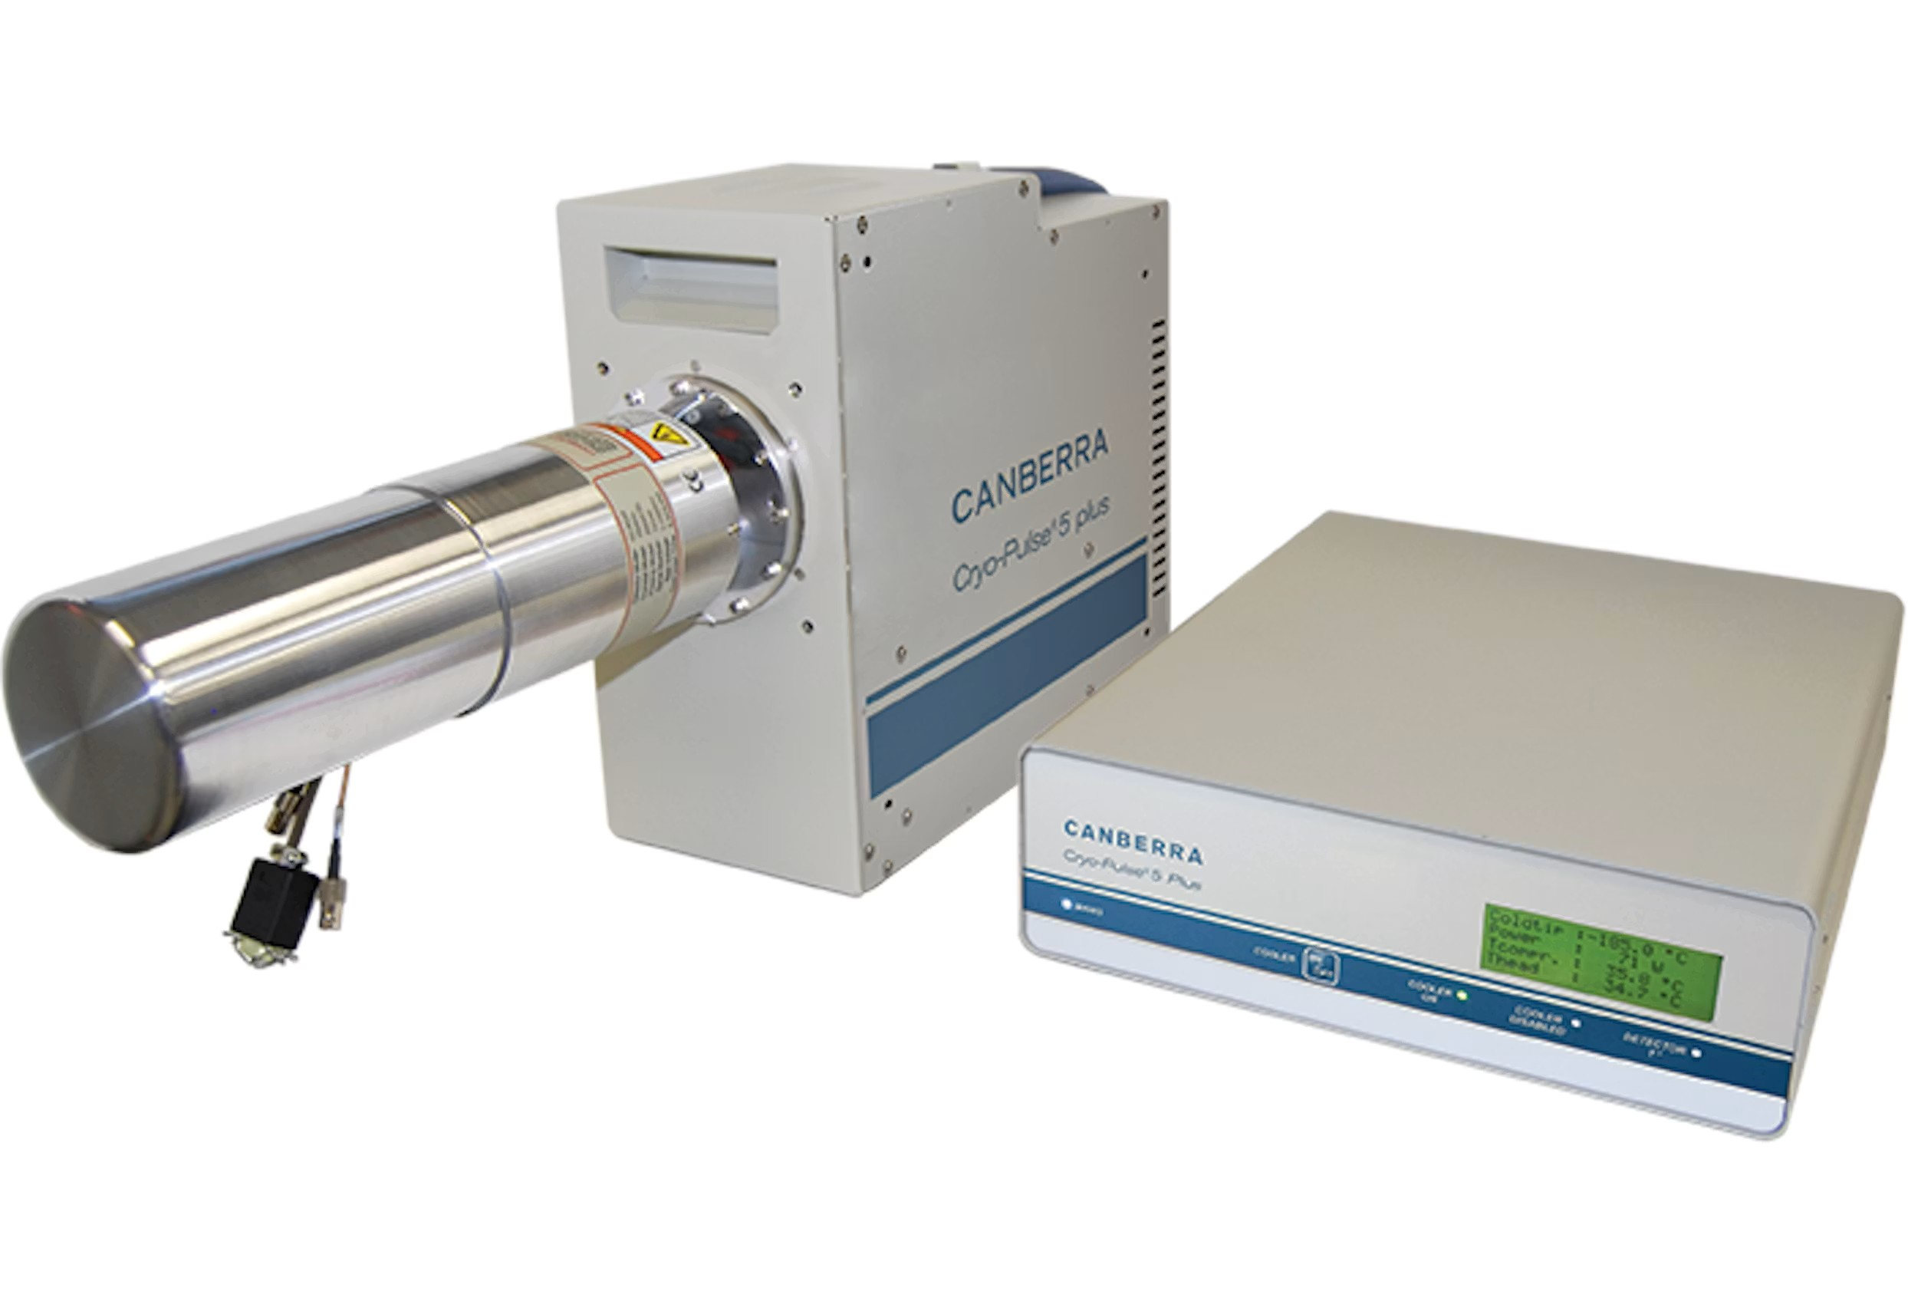
Germanium station: plastic
The central Ge detector will be surrounded by plastic barrel
24 elements
7mm thick
SiPM readout
Possible electric cooling for GE6 (Mirion)
21

Slide 22
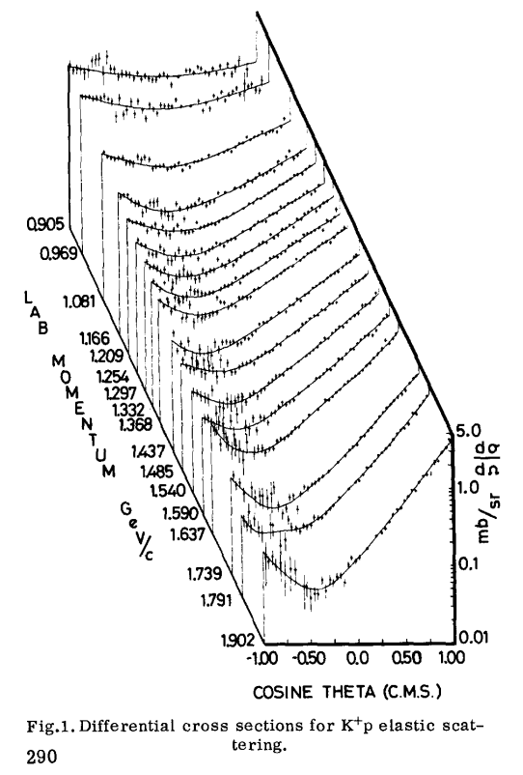
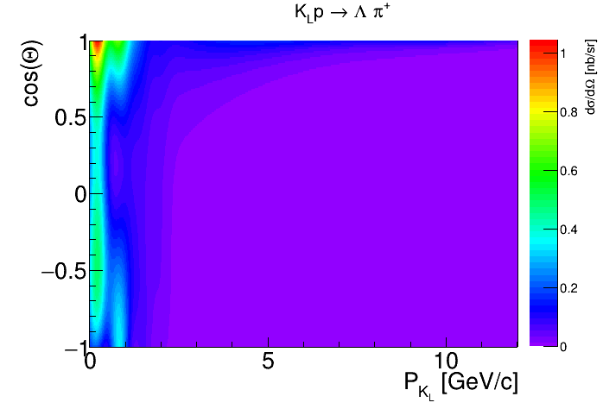
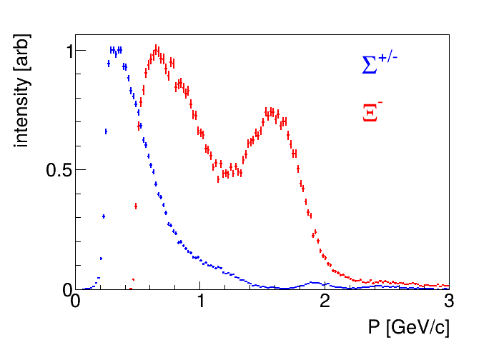

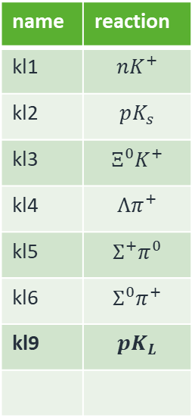



GE6 backgrounds
name | reaction
kl1 | $${nK}^{+}$$
kl2 | $$pK_{s}$$
kl3 | $${Ξ^{0}K}^{+}$$
kl4 | $${Λπ}^{+}$$
kl5 | $${Σ^{+}π}^{0}$$
kl6 | $${Σ^{0}π}^{+}$$
kl9 | $$pK_{L}$$
PLB 40, 289, (1972)
$$K^{+}$$
$$K_{L}$$
LN
$$Ξ^{−}$$
$$γ$$
22

Slide 23
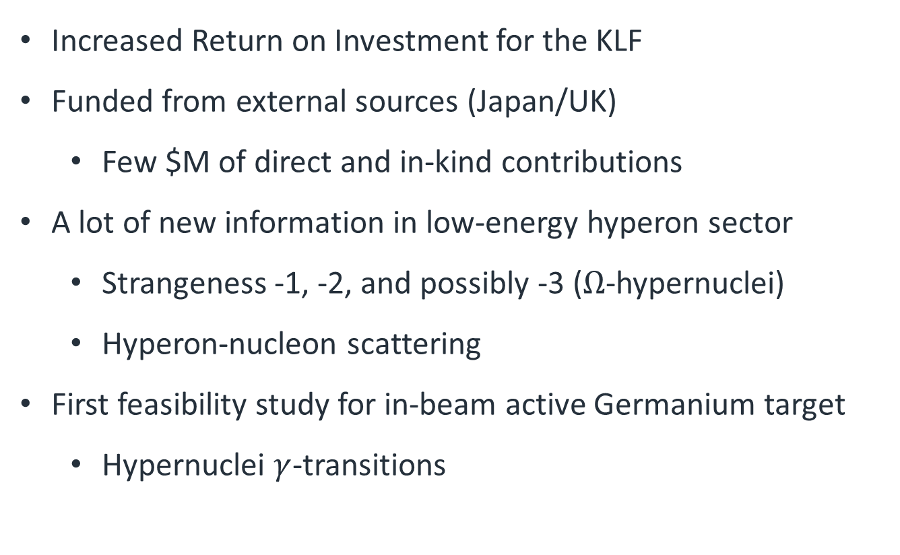
Conclusion
Increased Return on Investment for the KLF
Funded from external sources (Japan/UK)
  Few $M of direct and in-kind contributions
A lot of new information in low-energy hyperon sector
  Strangeness -1, -2, and possibly -3 ($Ω$-hypernuclei)
  Hyperon-nucleon scattering
First feasibility study for in-beam active Germanium target
  Hypernuclei $γ$-transitions
23

Slide 24
Why did the yield estimate change?
Original proposal
Simple conservative scaling from J-PARC E07.
No dedicated KLF simulation was available.
Goal: demonstrate feasibility and order of magnitude.
Not yet included: KL momentum spectrum, beam profile, Xi- stopping probability, charged-particle background.
PAC response
Dedicated simulation performed following the reviewers' request.
Included: measured KL spectrum, realistic beam profile, GiBUU (KL+C), full Geant4 transport, Xi- stopping probability, background estimation.
The new estimate replaces the original simplified scaling.
Detailed estimations
Key message: The physics goal has not changed. Only the yield estimation has evolved from a conservative E07 scaling to a realistic GiBUU + Geant4 simulation.

Slide 25
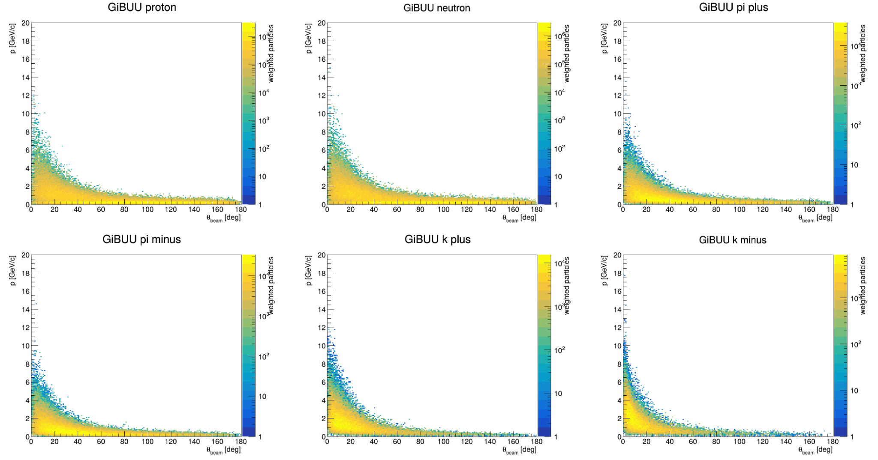
Particle distributions with GiBUU

Slide 26
Our reply to the latest PAC comments
The yield estimate presented in the proposal was intentionally a simplified and conservative estimate based on a direct scaling from the J-PARC E07 experiment. At that stage, we had not yet performed a dedicated simulation for the KLF beam conditions. Our objective at the proposal stage was simply to demonstrate that the expected hypernuclear yield would be of the correct order of magnitude and that the proposed experiment was feasible.
After receiving the PAC comments, we realized that such a simplified estimate was insufficient for a quantitative evaluation. We therefore constructed a dedicated simulation chain based on the realistic KLF conditions. The new estimate includes the measured KL momentum spectrum, the simulated beam profile at the hypernuclear station, GiBUU calculations of KL + C reactions, and full Geant4 transport through the diamond target and emulsion stack, including the stopping probability of Ξ⁻ hyperons and the charged-particle backgrounds. Accordingly, the numbers presented in our PAC response should be regarded as a replacement of the original simplified scaling rather than as an extension of it. We will explicitly explain this point in our PAC presentation.
Regarding the comparison with E07, we realize that our explanation was not sufficiently clear. Our intention was not to compare the total number of incident kaons, but rather the effective stopped-Ξ⁻ density per unit emulsion volume, which directly determines the expected hypernuclear yield. We will clarify this point more carefully during the presentation.
Thank you also for pointing out the ambiguity in Table 1. The table was intended to provide a first estimate of the forward charged-particle background originating from the upstream target. The momentum cut of p > 1 GeV/c was introduced because, in the GiBUU calculation, particles emitted in the forward angular region, which predominantly contribute to the emulsion background, are typically in this momentum range. It was therefore used as a representative selection for estimating the background from forward-going particles.
We agree, however, that lower-momentum particles can also enter the emulsion and that this was not sufficiently explained in the response. Table 1 should therefore not be interpreted as the complete charged-particle multiplicity entering the emulsion. We will carefully recheck the normalization used in Table 1 and clarify exactly what is being normalized. We will also evaluate the contribution of lower-momentum particles and explain more clearly the limitations and purpose of this particular selection in our presentation.
Finally, regarding the physics output, we agree that our written response focused too much on the expected event yield and detector performance. In our PAC presentation, we will put much greater emphasis on the physics impact of a large sample of double-Λ and Ξ hypernuclei, including new constraints on the ΛΛ interaction, the ΞN interaction, the ΛΛ–ΞN coupling, and the behavior of S = −2 baryonic matter relevant to neutron-star physics.

Slide 27
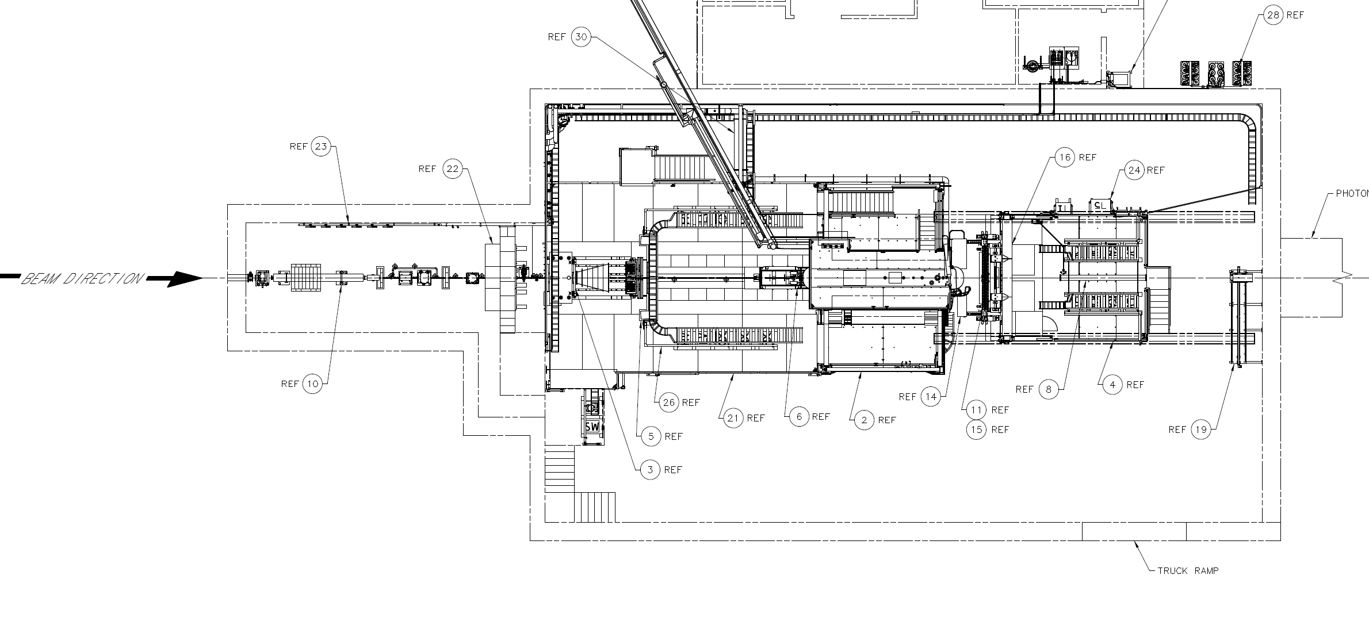
Hall-D
27

Slide 28
Hall-D
28

Slide 29
Forward Detector
29

Slide 30
Permanent Magnets
Permanent magnets, deflecting charge particles UP or DOWN, reducing radiation on crates
30

Slide 31
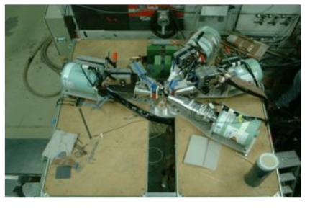
Germanium station
31

Slide 32
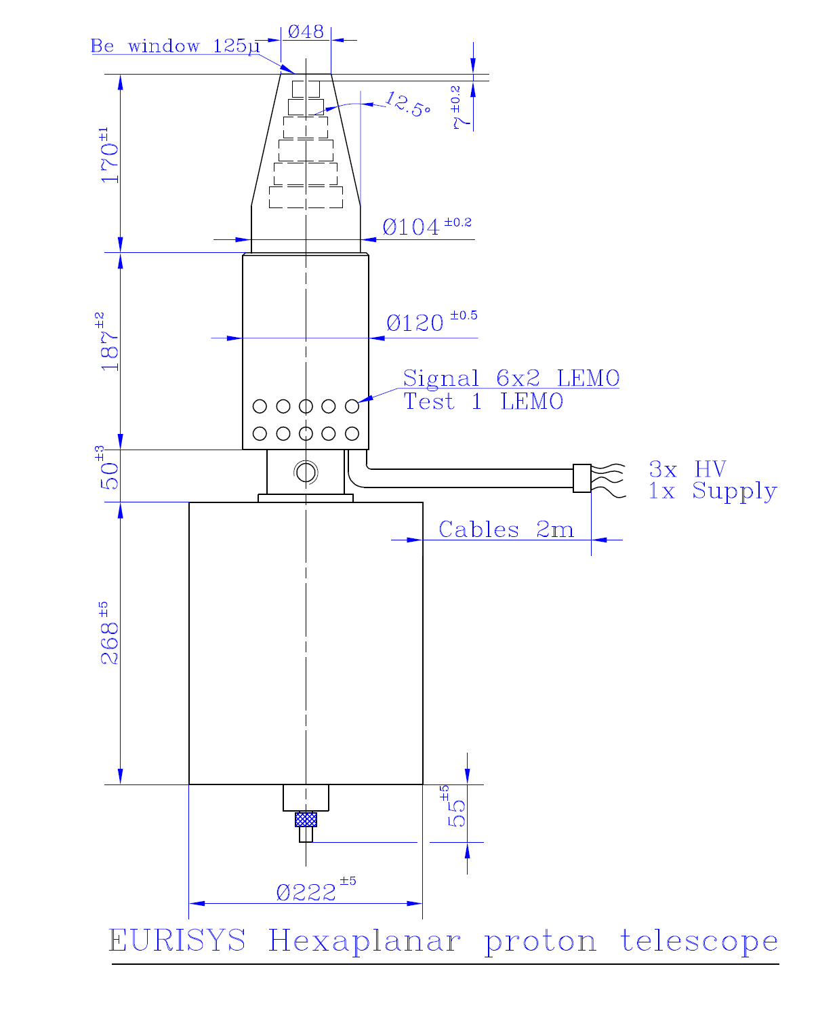
Germanium station
68cm x 22cm
32

Slide 33
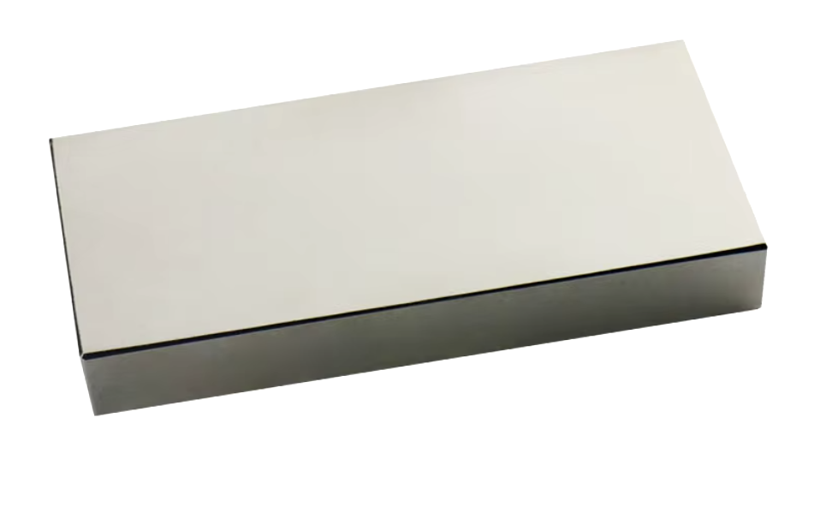
Permanent Magnets
N52 NdFeB 100mm x 50mm x 20mm ~$40 per piece.
10 on the left, 10 on the right – 1m of magnetic field.
33

