Slide 1
PAC 54: Introduction and Charge
Notes:
Guidelines: 6-8 bullets per slide; Use sentence fragments for bullets

Slide 2

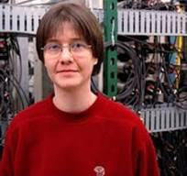
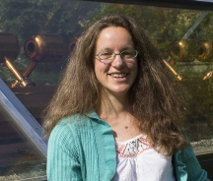

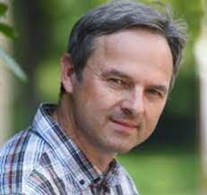

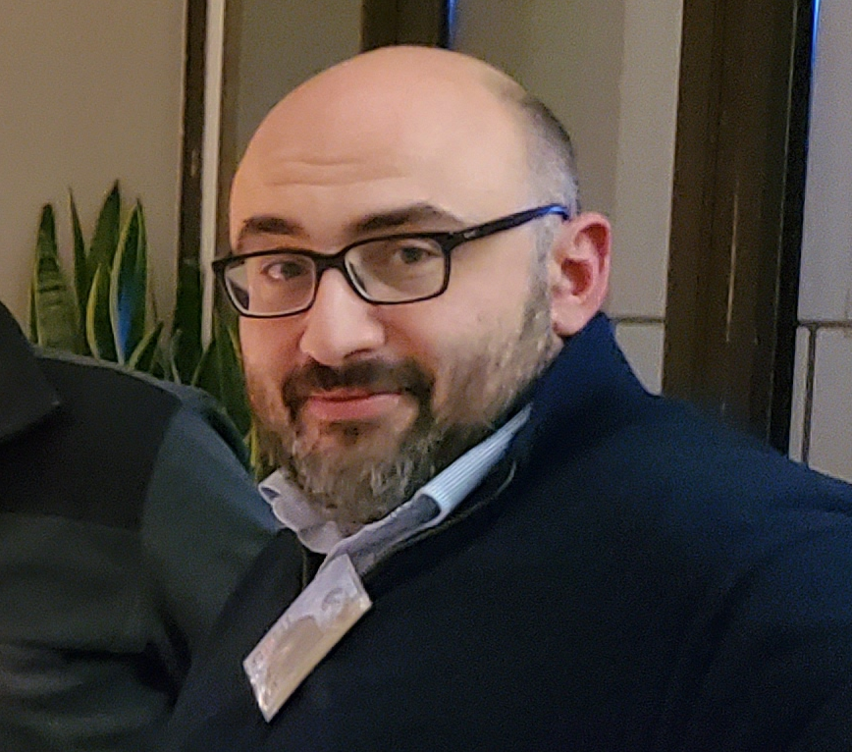

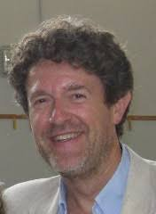
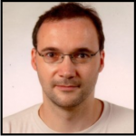

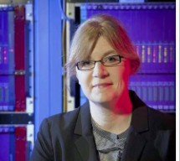
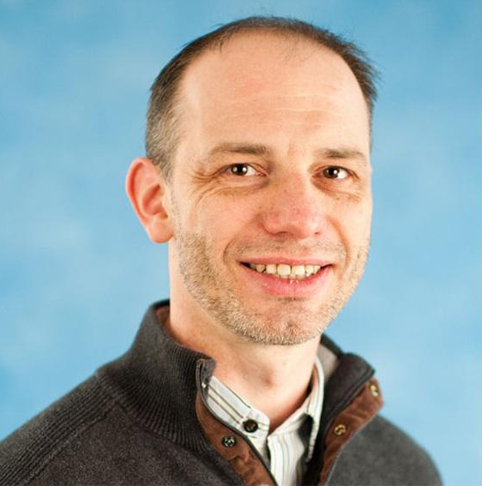

PAC: Role and Functions
The Program Advisory Committee advises Laboratory management on the scientific merit, technical feasibility, and prioritization of research to ensure the CEBAF program delivers world-class results and realizes the laboratory’s scientific mission.
A huge thank you to you!
Your service on the PAC is incredibly important and highly valued. The success of the Jefferson Lab program relies on your essential, expert input.
PASQUALE DI NEZZA, CHAIR
ALEXANDRA GADE
CYNTHIA HADJIDAKIS
BERNHARD KETZER
KRESIMIR KUMERICKI
CURTIS A. MEYER
BAKUR PARSAMYAN
CHRIS POLLY
MARCO RADICI
PETER SCHWEITZER
HIROKAZU TAMURA
SAM) ZELLER
MICHAEL GERICKE - JLUO Chair Elect

Slide 3
Role of User Chair and Chair elect on PAC
Monitor communications between PAC and spokespersons – identify issues.
Monitor PAC meeting proceedings for conflicts of interest.
Monitor PAC meeting proceedings to identify issues of fairness and ethical behavior.
Participate in all scientific discussions to provide additional expertise (except where there is a conflict of interest).
Should not vote on grading

Slide 4
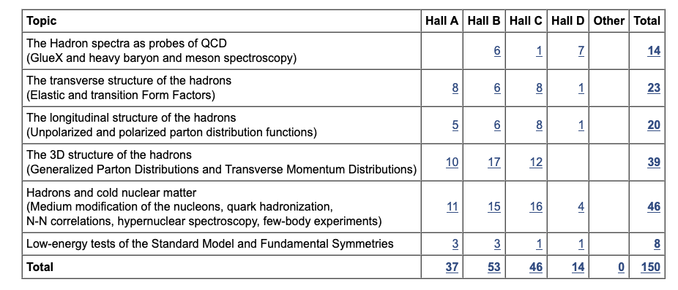
12 GeV Approved Experiments by Physics Topics
E12-11-105 has not been counted with the experiments since it is considered a test
https://misportal.jlab.org/ul/ul_office/ExperimentDB/rptApprovedExperimentsByHallAndTopic.cfm

Slide 5
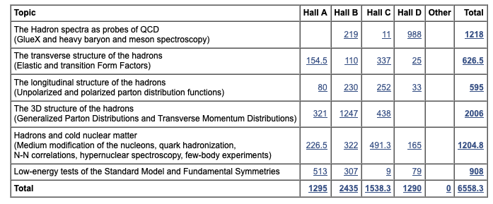
12 GeV Approved Experiments by PAC Days
https://misportal.jlab.org/ul/ul_office/ExperimentDB/rptApprovedExperimentsByHallAndTopicDays.cfm
~ 40% complete, with well over a decade of scheduled runtime ahead

Slide 6
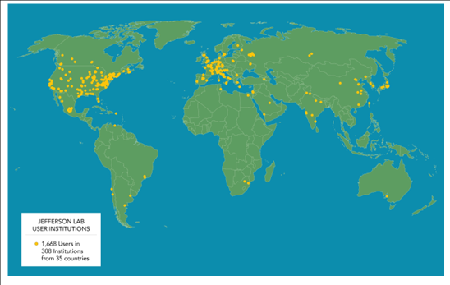
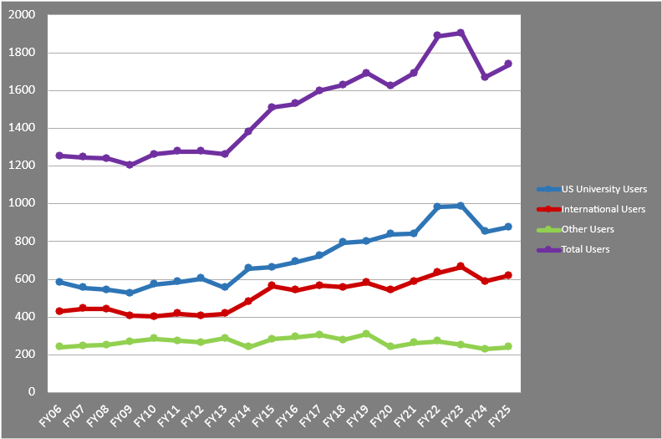
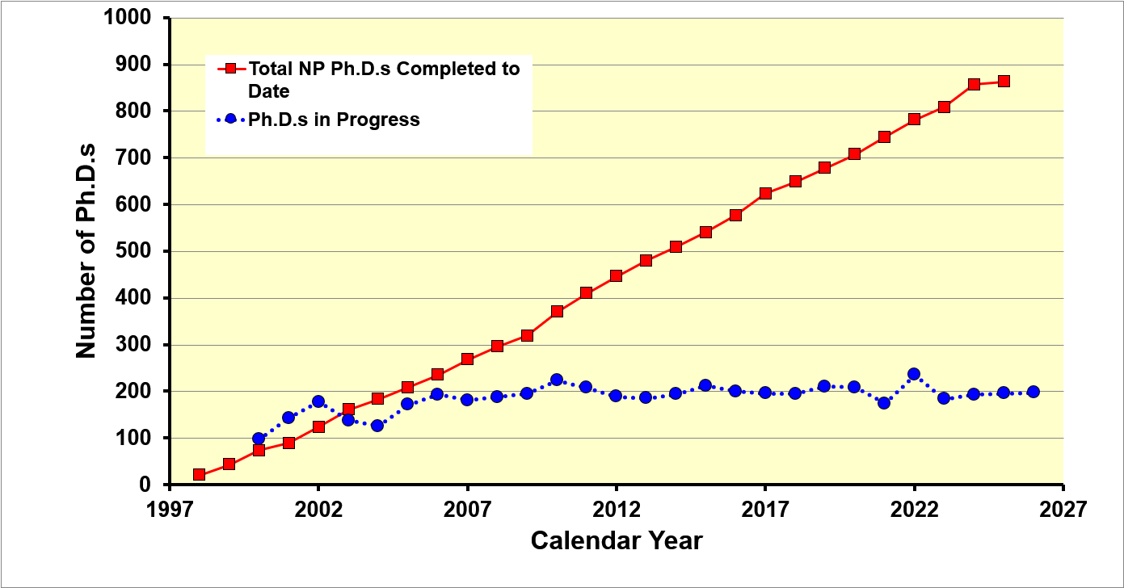
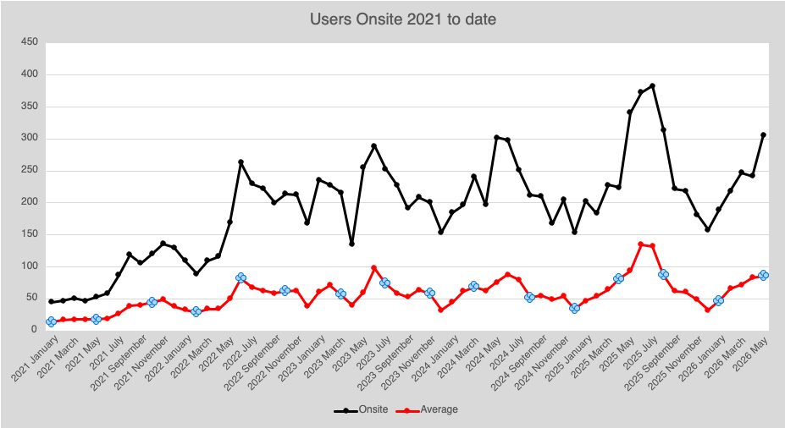
User Driven Science
PAC54
New Proposals | 9
Conditional | 0
New Run Group | 2
Run Group | 2
Letter of Intent | 8
Jeopardy | 2
~1/3 of US nuclear physics PhDs
200+ users on site on average

Slide 7
PAC54 Charge
Review new proposals, run group proposals, jeopardy proposals, and letters of intent and provide advice on their scientific merit, technical feasibility and resource requirements.
For new proposals/run group proposals recommended for approval, the committee provides guidance on scientific ratings and beamtime allocation, helping to establish the laboratory's long-term research schedule.
Run groups consist of experiments sharing beam time and equipment. Proposals added to existing run groups, will be evaluated but not rated. The PAC will provide a written comment for each of these in the report.
The PAC may conditionally approve proposals when additional requirements must be fulfilled before full approval is granted. There are two categories of conditional approval:
      C2 - must return to the PAC to address concerns or issues to obtain approval,
      C1 - must meet designated technical requirements to obtain approval from laboratory management. A further PAC review is not required.

Slide 8
Policy on Equipment Availability
Categories for resource availability:
– Stage I: resources need to be identified/obtained
– Stage II: resources are essentially available
This will be considered a Laboratory issue and addressed by the Experimental Readiness Review process

Slide 9
Jeopardy
To ensure the relevancy of approved experiments which haven’t run or completed within -4-year window of time, the Jefferson Lab Program Advisory Committee is asked to review experiments in a jeopardy process to ensure the experiments are still world class and can reject, defer, approve or adjust the letter grade of the experiment as deemed appropriate.
  Is there any new information that would affect the scientific importance or impact of the Experiment since it was originally proposed?
  Should the beam time allocation and experiment grade be reconsidered?
  What is the status of the collaboration in terms of institutes, committed staff, and prospective students?
New beam time or major changes to configurations should come back as new proposals
This PAC 54 focuses on Hall A excluding SoLID.

Slide 10
Letter of Intent
Letters of Intent will be given the same “rights” to their scientific ideas as are currently afforded to deferred experiments, i.e.:
  LOI has established a claim to a physics measurement that lasts for the next two successive PAC meetings.

Slide 11
PAC REPORT
Draft report text must be complete before closeout on Friday. We will review the draft text Friday at 11:00 am (closeout)
Pamela Cole will assemble the draft text into a report for a final round of edits by email during the 2 weeks following the PAC meeting.

