Slide 1
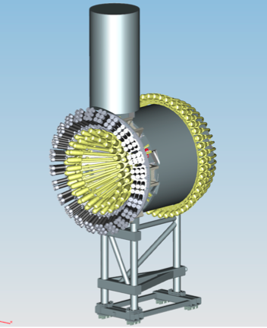
CLAS12 Central Time-of-Flight
CTOF Detector Assessment
Group Leader:
Daniel S. Carman
Outline:
  Overview
  Project Status
  Remaining Tasks
    On Project
    Off Project

Slide 2
Overview

Slide 3
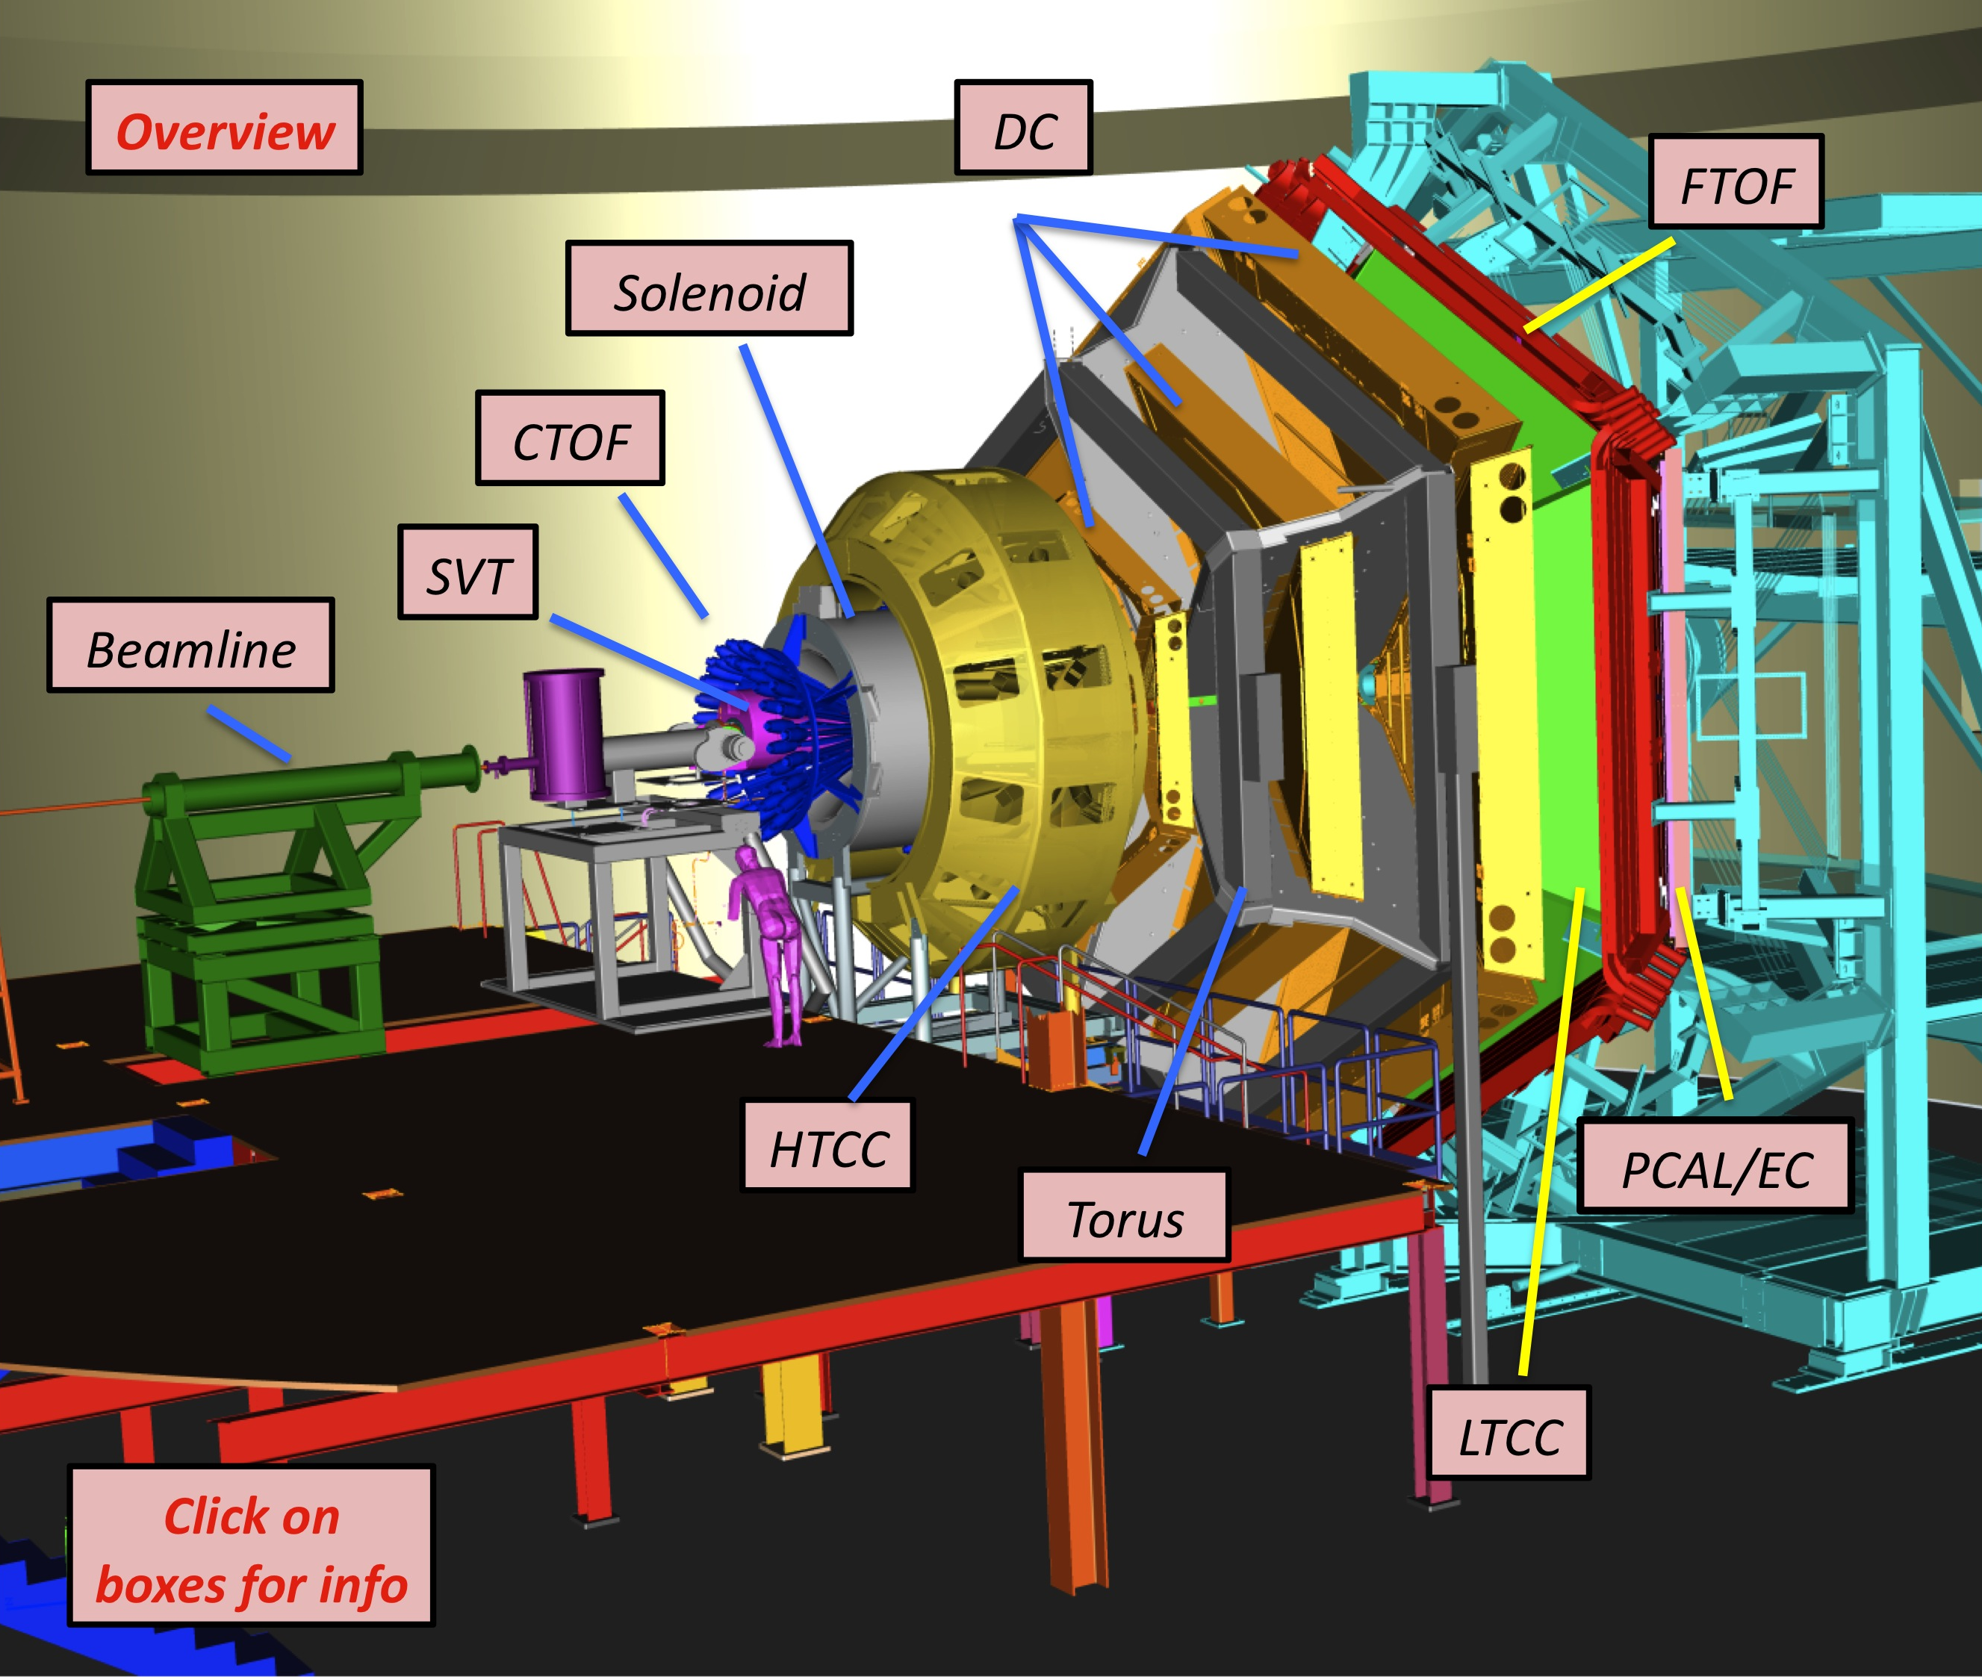
CLAS12
Base equipment
Forward Detector (FD)
  - Torus magnet
  HT Cherenkov Counter
  Drift Chamber system
  LT Cherenkov Counter
  Forward Time-of-Flight
  Pre-shower Calorimeter
  E.M. Calorimeter
Central Detector (CD)
  Solenoid magnet
  Barrel Silicon Tracker
  Central Time-of-Flight
Beamline
  Targets
  Moller Polarimeter
  Photon Tagger
Upgrade to base equipment
- MicroMegas
  Central Neutron Detector
  Forward Tagger
  RICH detector (1 sector)
  Polarized target (long.)
MM
CND
http://www.jlab.org/Hall-B/clas12-web/

Slide 4
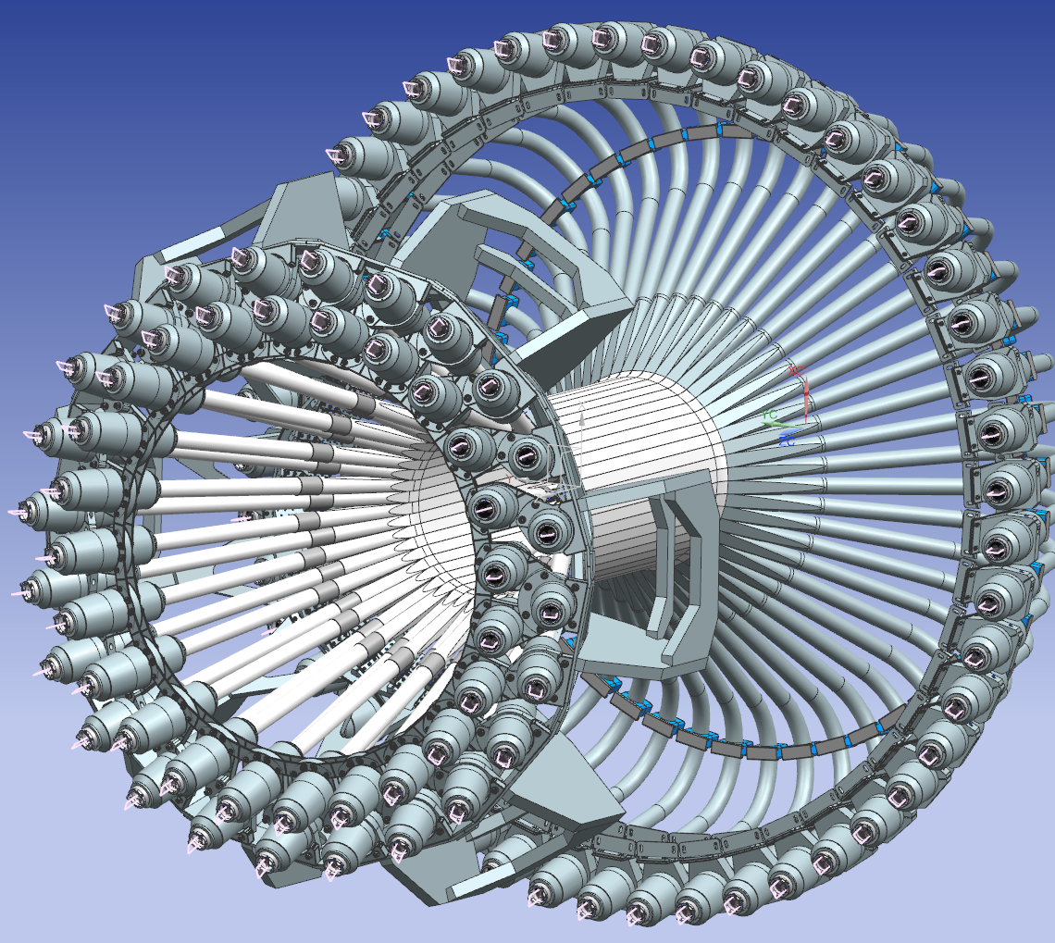
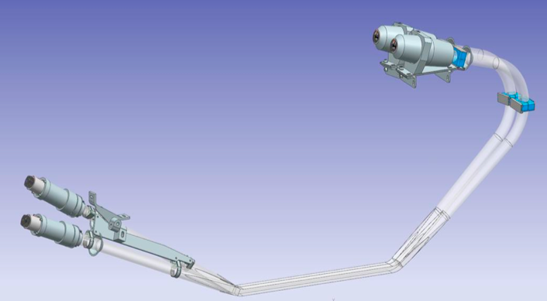
System Overview
CTOF Design:
high-pitch angle
low-pitch angle
PARAMETER | DESIGN VALUE | #
CTOF Barrel | 48 counters; double-sided readout; R=25 cm
Angular Coverage | θ: (35º , 125º) φ: (-180º,180º)
Scint. Dimensions | BC-408 Trap. cross section ~3 x 3 x 92 cm³ | 48
PMTs | R2083 (PC 46 mm, H2431-MOD assembly) | 96
Upstream LGs | OD=2”, 1m-long, focusing design, straight | 48
Downstream LGs | OD=2”,1.6 m-long, focusing design, bent 135º | 48
Magnetic Shields | Triple layer Co-NETIC/Hi-Perm 49/steel with compensating coil around inner layer | 96
Design Resolution | 60 ps
PID:
π/K Separation | to 0.64 GeV (3.3σ)
K/p Separation | to 1.00 GeV (3.3σ)
π/p Separation | to 1.25 GeV (3.3σ)
Operating Environment:
CTOF installed in CLAS12 5-T superconducting solenoid
Fringe field at CTOF PMT location at level of 0.5 - 1 kG
CND outside; SVT inside

Slide 5
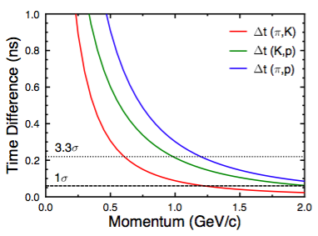
CTOF PID Specifications
CTOF is the primary PID detector in the CLAS12 Central Detector
PID: | 3.3σ Separation
π/K | 0.64 GeV/c
K/p | 1.00 GeV/c
π/p | 1.25 GeV/c
Nominal CTOF average timing specification is 60 ps/counter

Slide 6
Project Status
Counter Assembly
Cosmic Ray Testing
Software Development
Remaining Design/Engineering

Slide 7
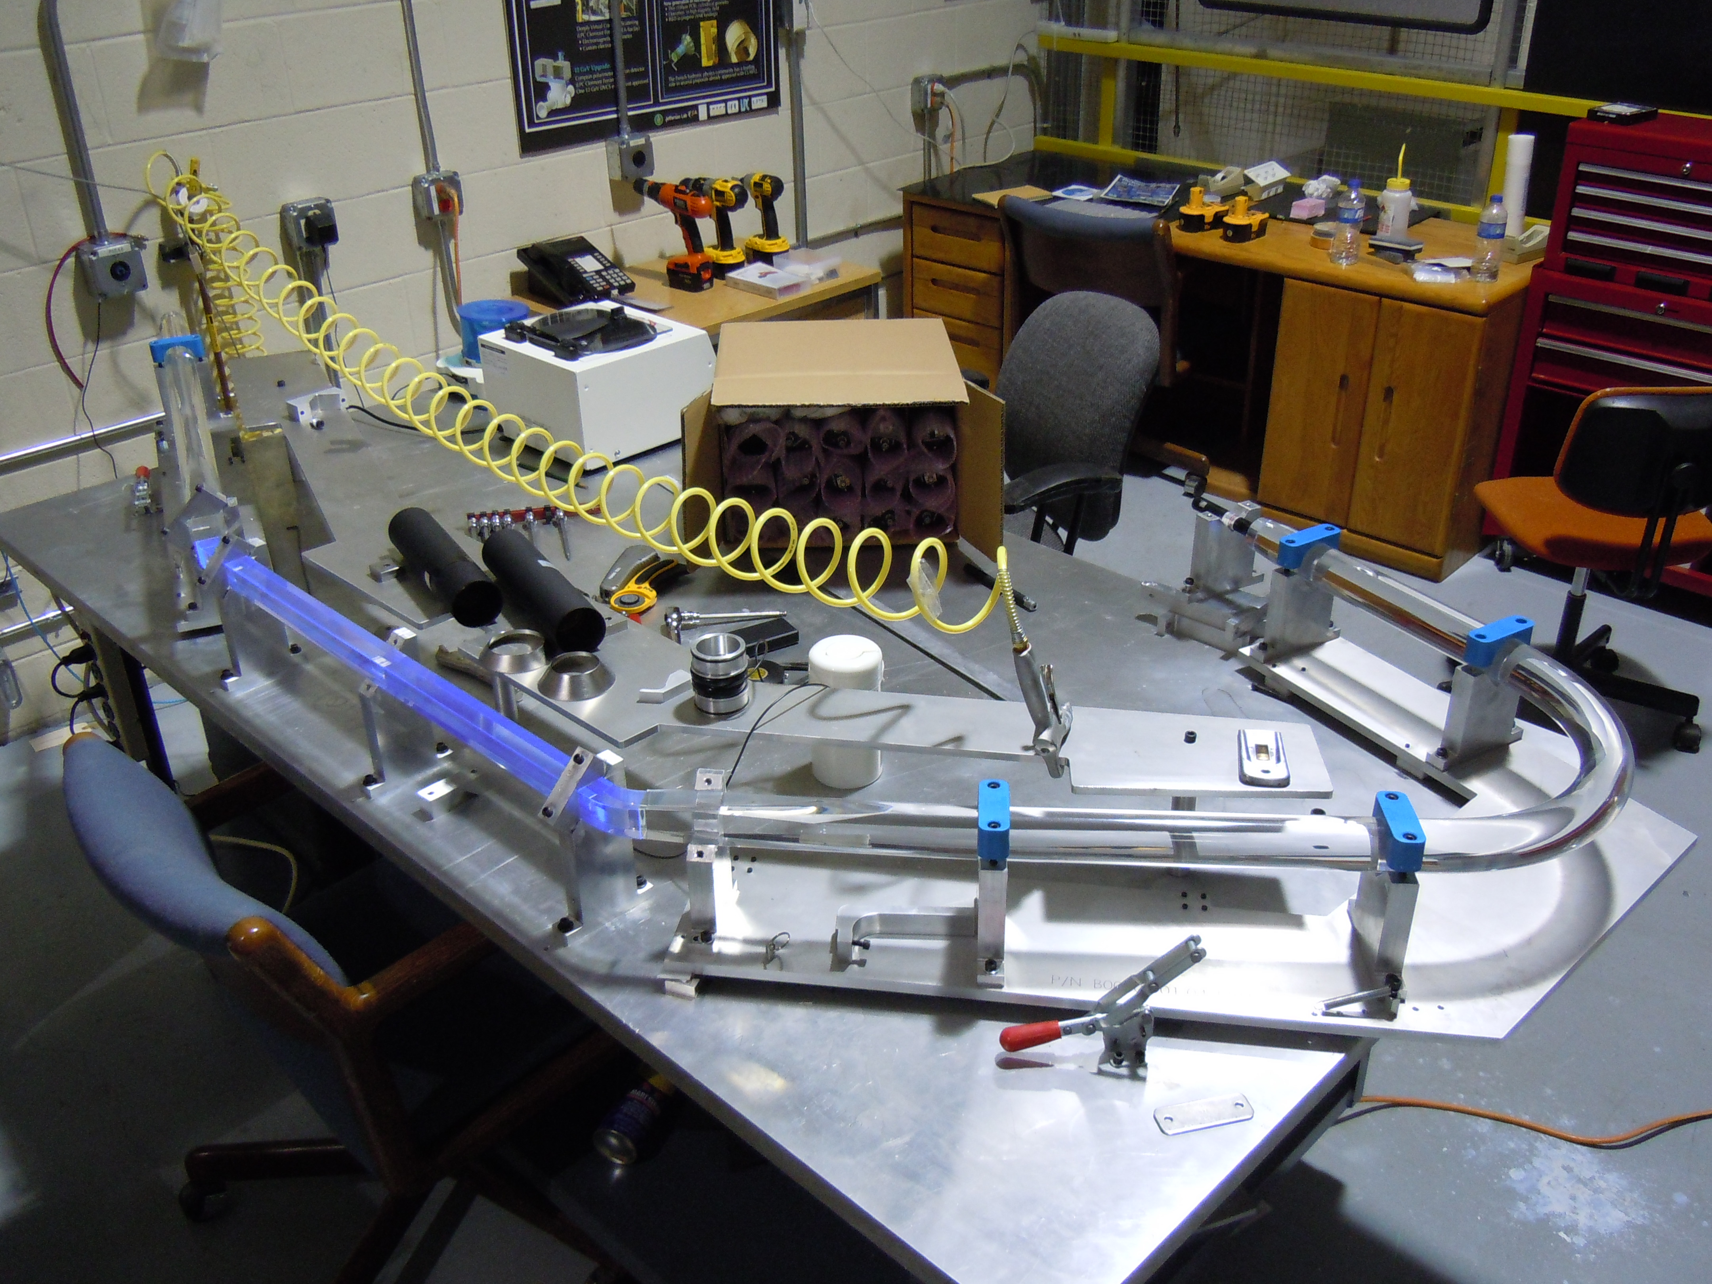
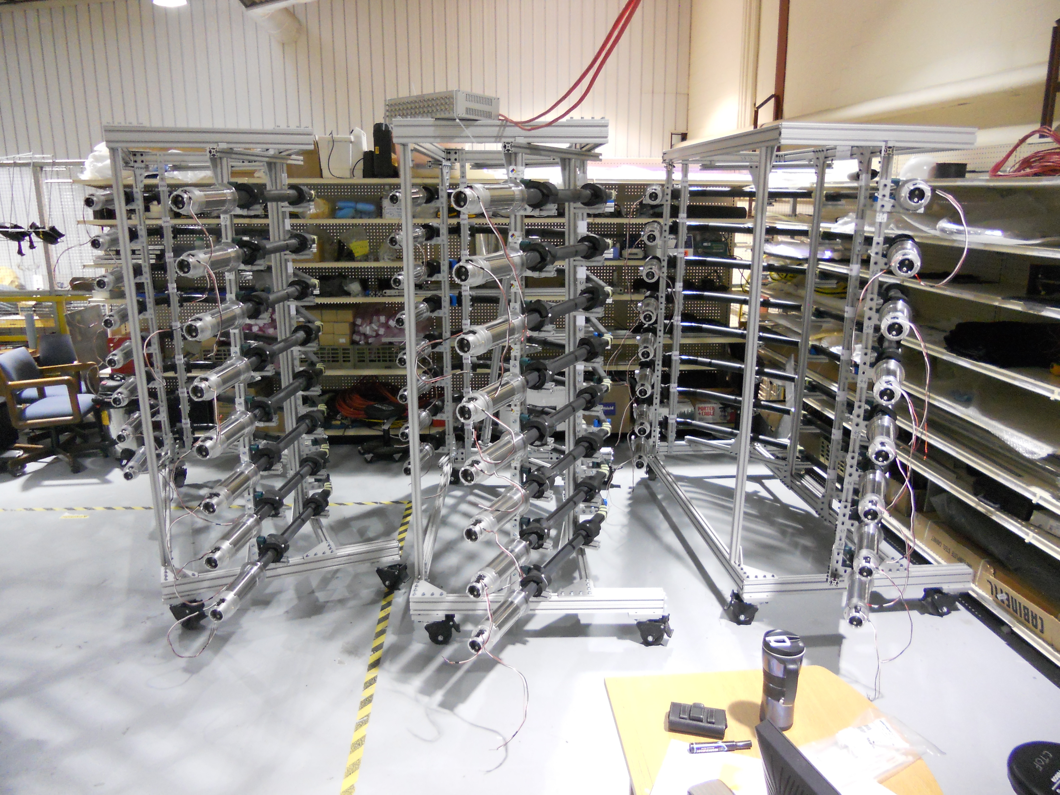

Counter Assembly
Counter Assembly Status:
All 48 counter elements have been polished and then glued together using precision assembly table
Wrapping of all counters complete
VM2002 reflective layer, Tedlar outer wrap
Assembly Table
- Installed in custom storage racks
- Magnetic shields attached
PMTs installed and oriented
Light leak checking complete
Work Complete
Counter Storage Racks

Slide 8
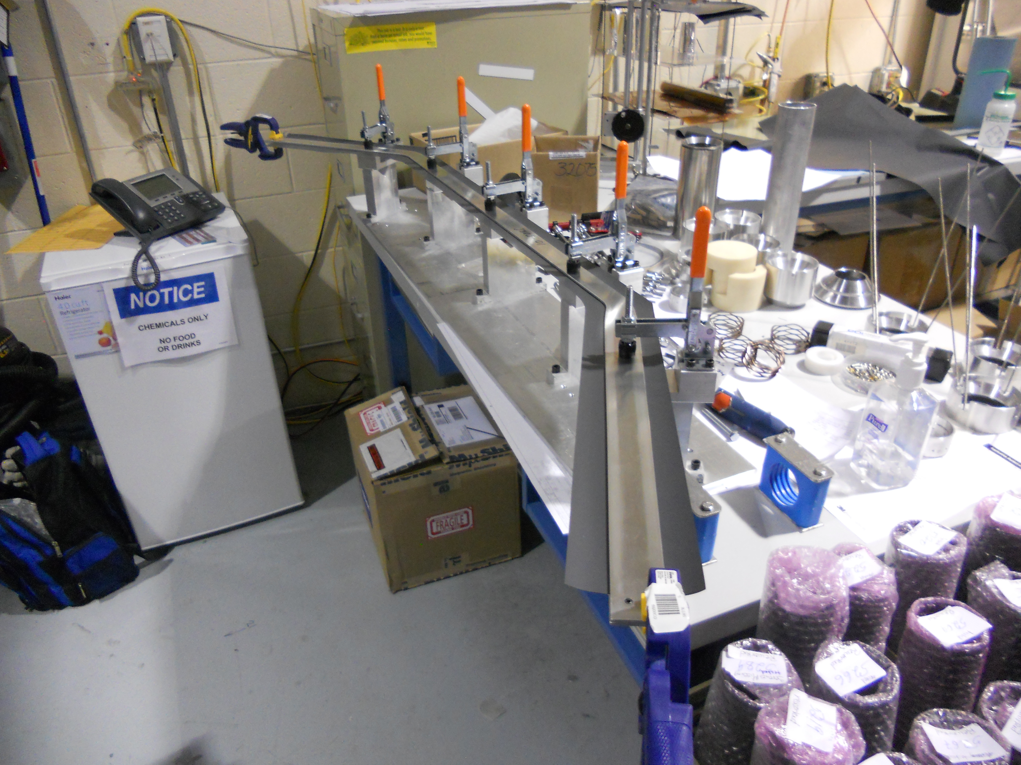
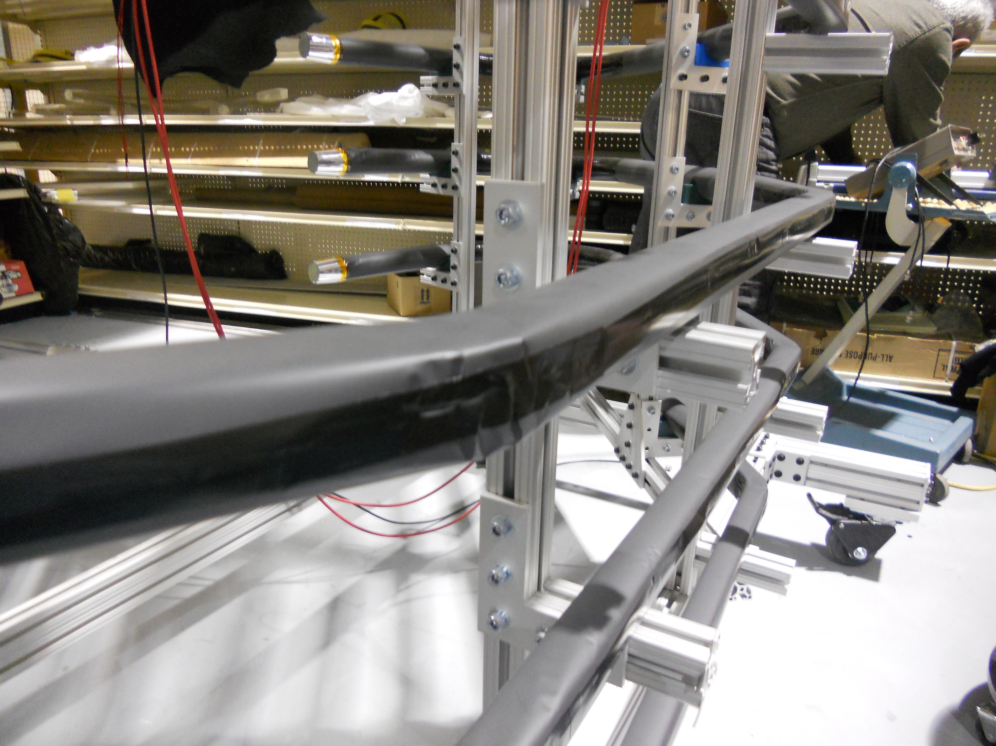
Counter Wrapping
In Jan. 2015 it was discovered that counter Tedlar wrapping had to be redone
New techniques and tooling were developed and tested
Re-wrapping and light-leak testing completed in Mar. 2015
Cold-formed Tedlar using new tooling
Careful attention to material layers given tight counter-to-counter tolerances
  Counter-to-counter spacing < 1 mm
Problems caused 2 month schedule delay
Work Complete

Slide 9
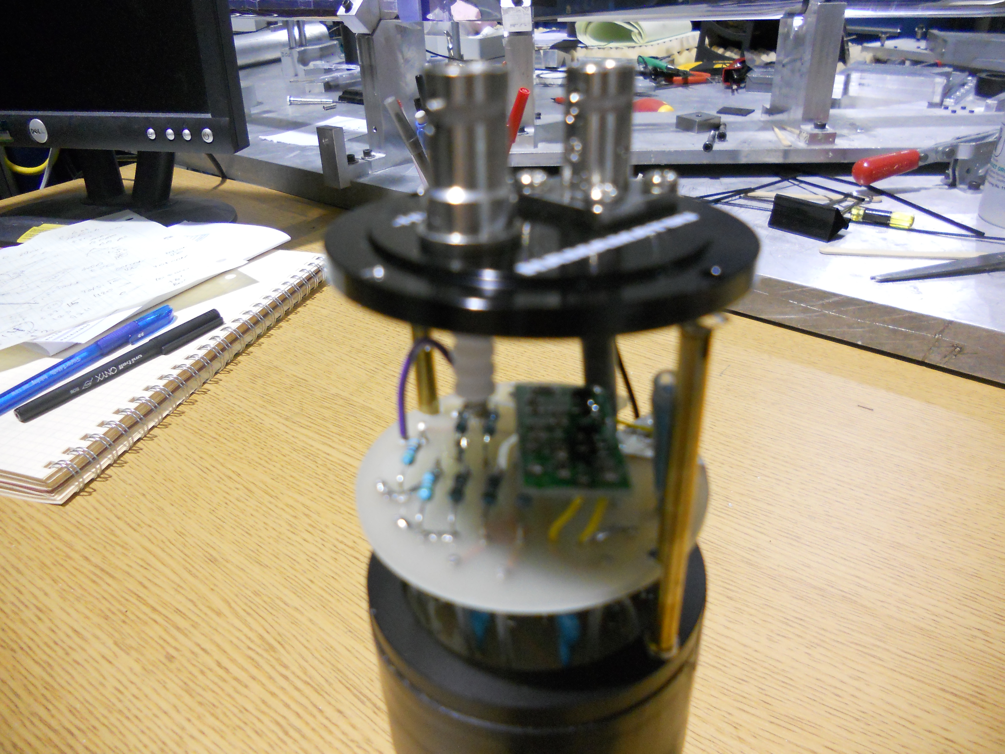
PMT/Voltage Divider Assemblies
Blue points – original Hamamatsu PMT/divider (H2431)
Nominal current limit spec. at 100 μA
Red points – rate-stabilized divider (V. Popov)
Stable timing performance up to 200 μA
PMT Gain vs. Current/Rate
Stabilized Dividers
Pulser Peak Position vs. Current
mezzanine board
Work Complete

Slide 10
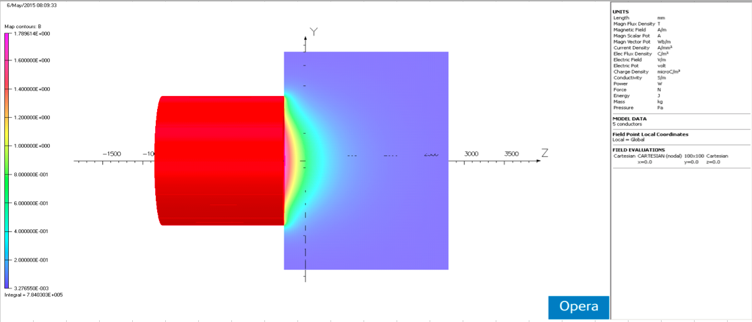

CTOF PMTs in Solenoid Fringe Field
1
2
Renuka Rajput-Ghoshal
Upstream low-pitch PMT: (z,y)₁ = (493 G, 956 G), (z,y)₂ = (193 G, 342 G)
Upstream high-pitch PMT: (z,y)₁ = (192 G, 981 G), (z,y)₂ = (78 G, 337 G)
Downstream PMTs in twice lower field

Slide 11
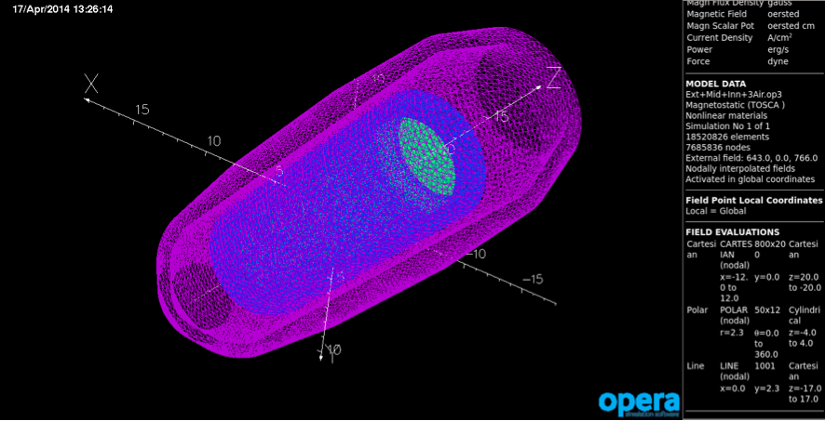
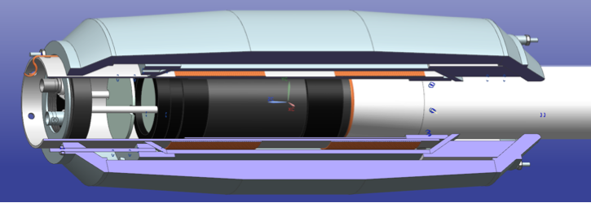
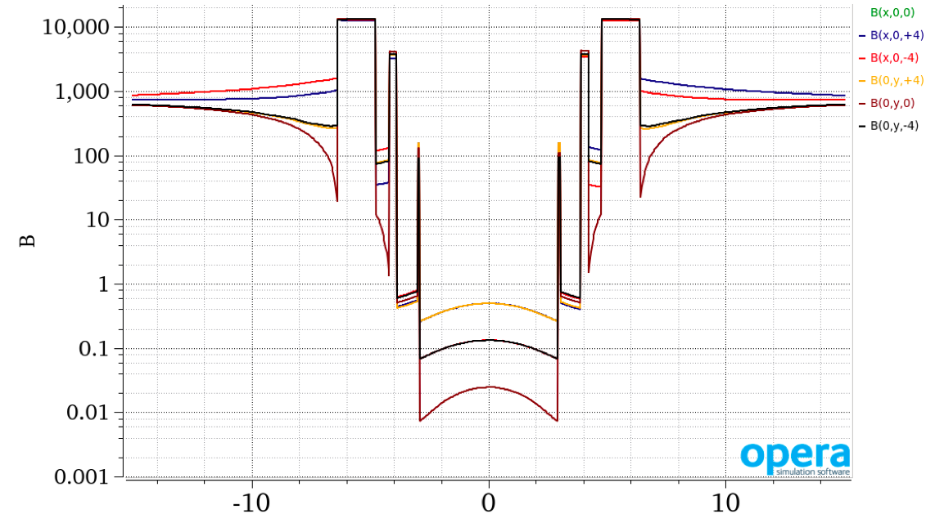
Dynamic Magnetic Shields
Shield design verified by 2D (Poisson) and 3D (Opera) modeling
shield design V. Baturin
- 3 passive layers
  Co-NETIC (inner)
  Hi-Perm 49 (middle)
  Steel 1008 (outer)
1 active layer
  2 compensation coils wound on inner layer for field shaping
V. Baturin et al., Nucl. Inst. Meth. A 664, 11 (2011)
< 1 G at photocathode
coordinate x

Slide 12
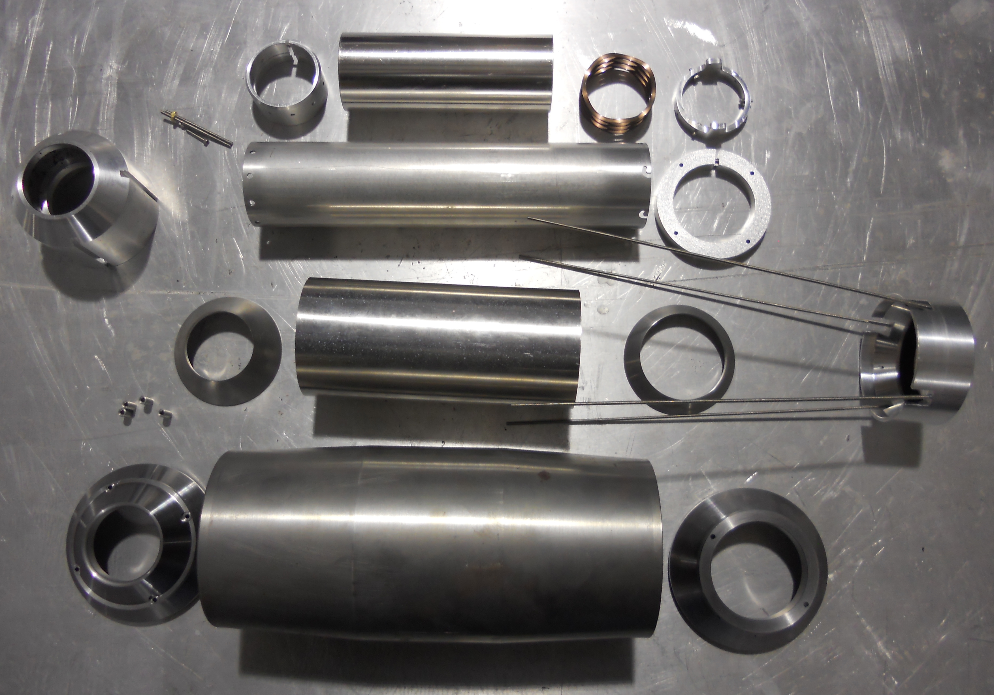
Shield Parts – “Exploded” View
Co-NETIC
Hi-perm
steel

Slide 13
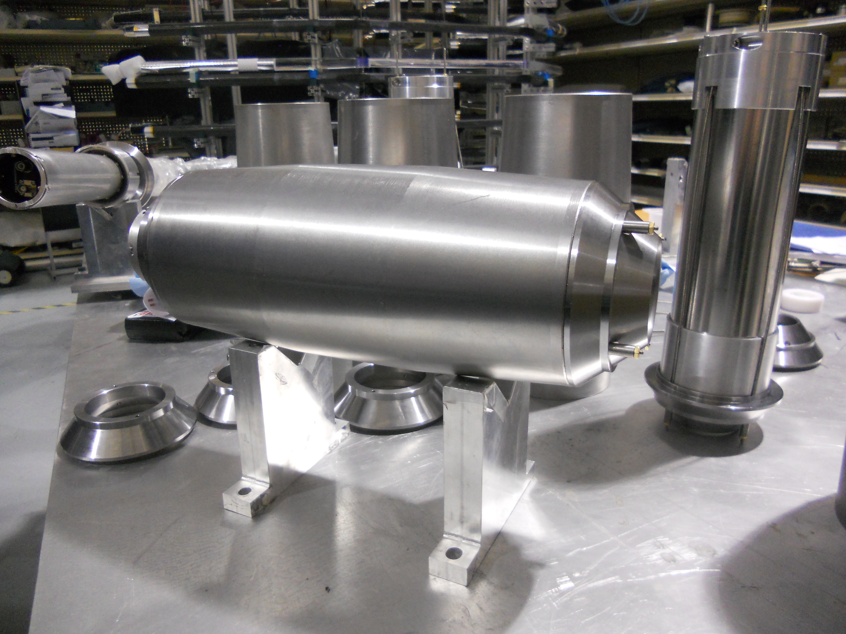
Magnetic Shield Assembly
Bench assembly
Work Complete
Shield weight = 40 lbs

Slide 14
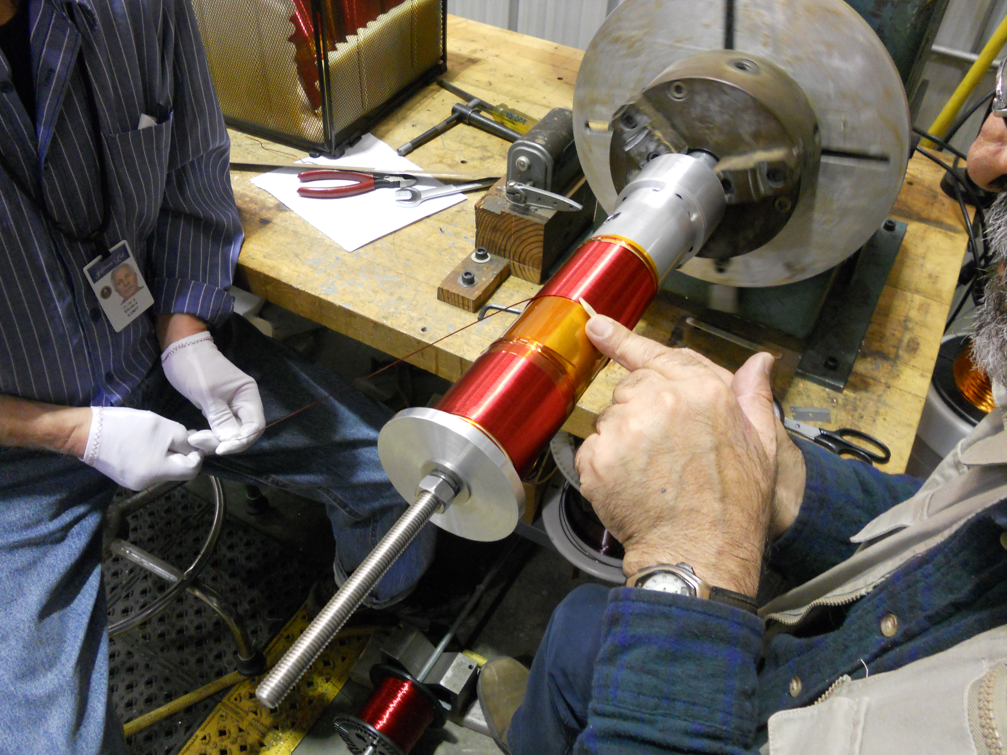
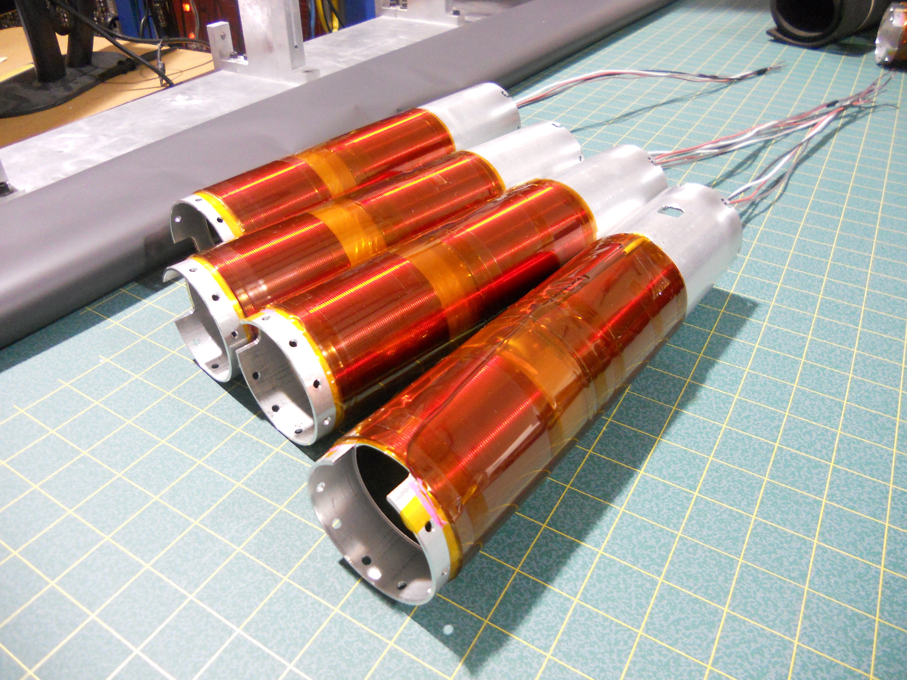
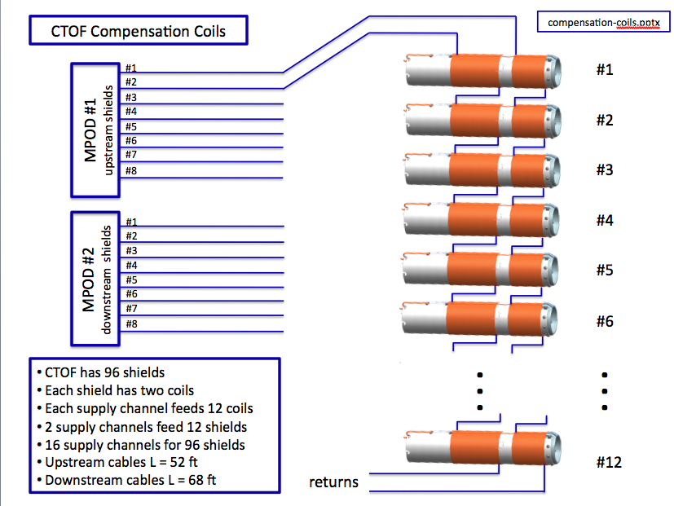
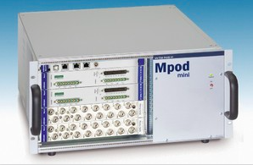
CTOF Compensation Coils
Each coil can produce a cancelling field of up to ~50 G
Work Complete

Slide 15
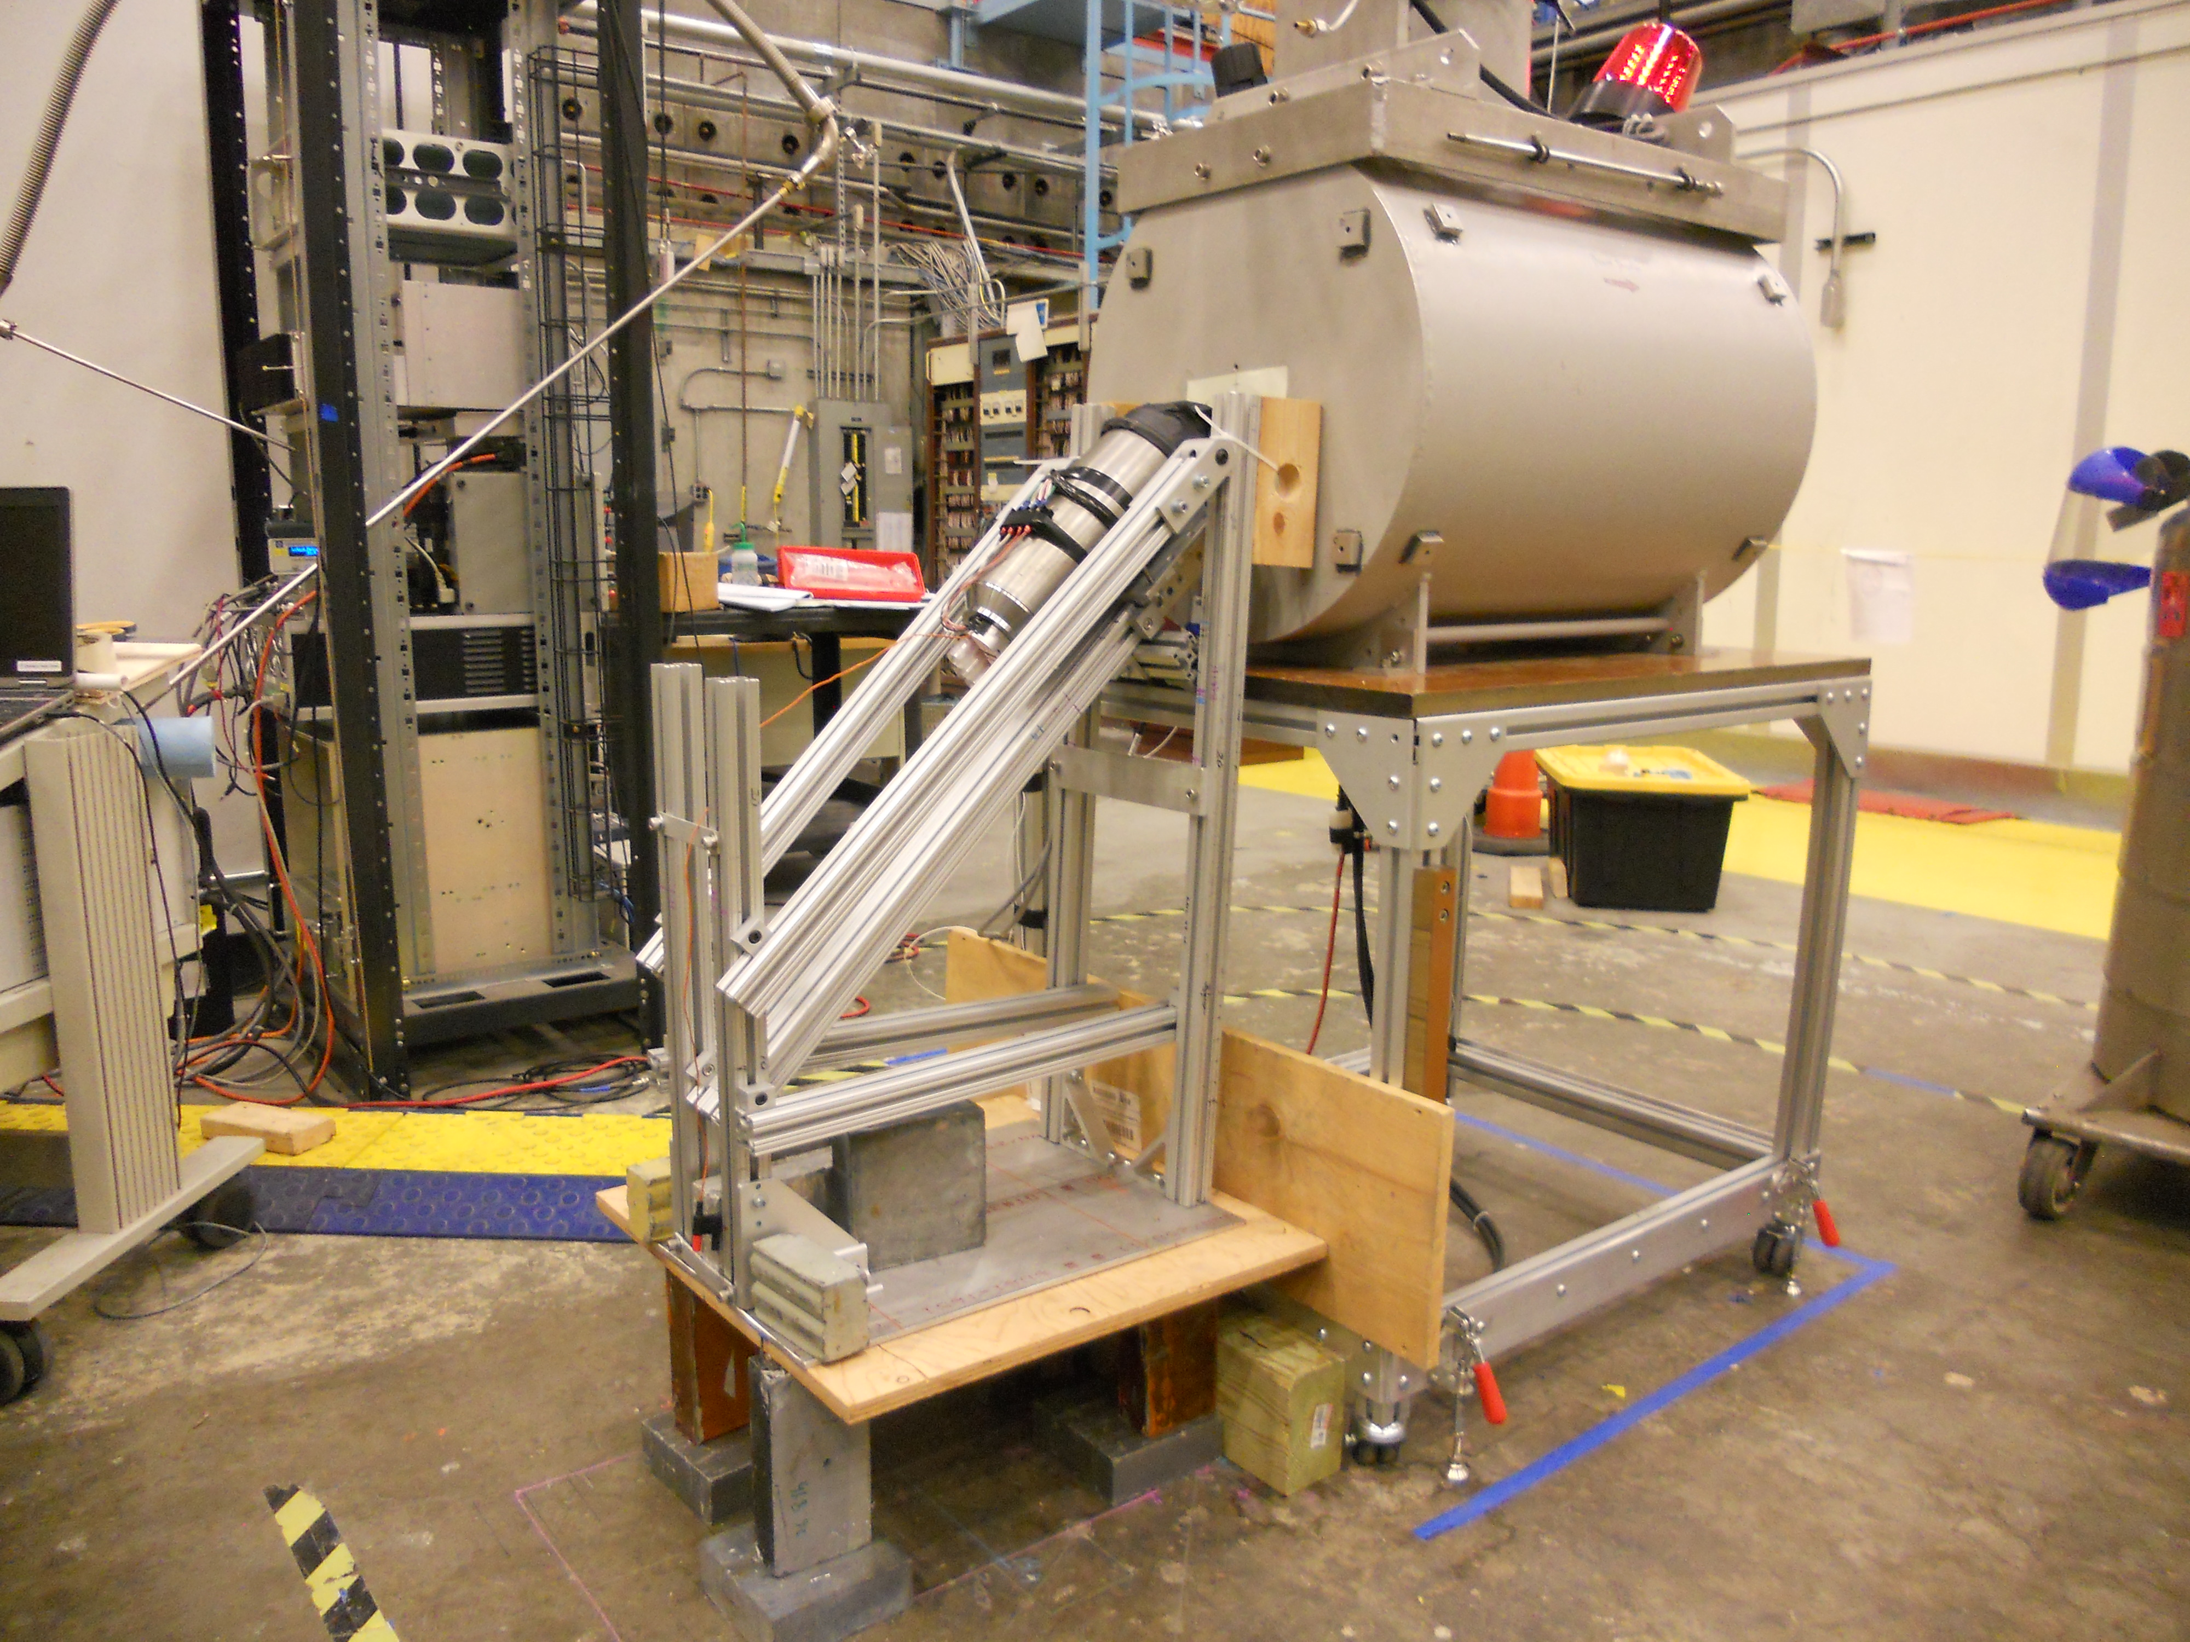
Magnetic Shield Testing
Study final field reduction factor of CTOF production shields:
  Use FROST 5-T superconducting solenoid – fringe field
  Position shield in the same field/gradient as in CLAS12 solenoid field
  Measure internal remnant field vs. operating conditions
Shield Test Plan:
Study field reduction factor relative to design value
Study performance limits of shield design
Understand limits of ferromagnetic saturation
Optimize compensation coil configuration
Study impact of remnant field on PMT pulse shape and azimuthal orientation
Shield tests completed June 8-12

Slide 16
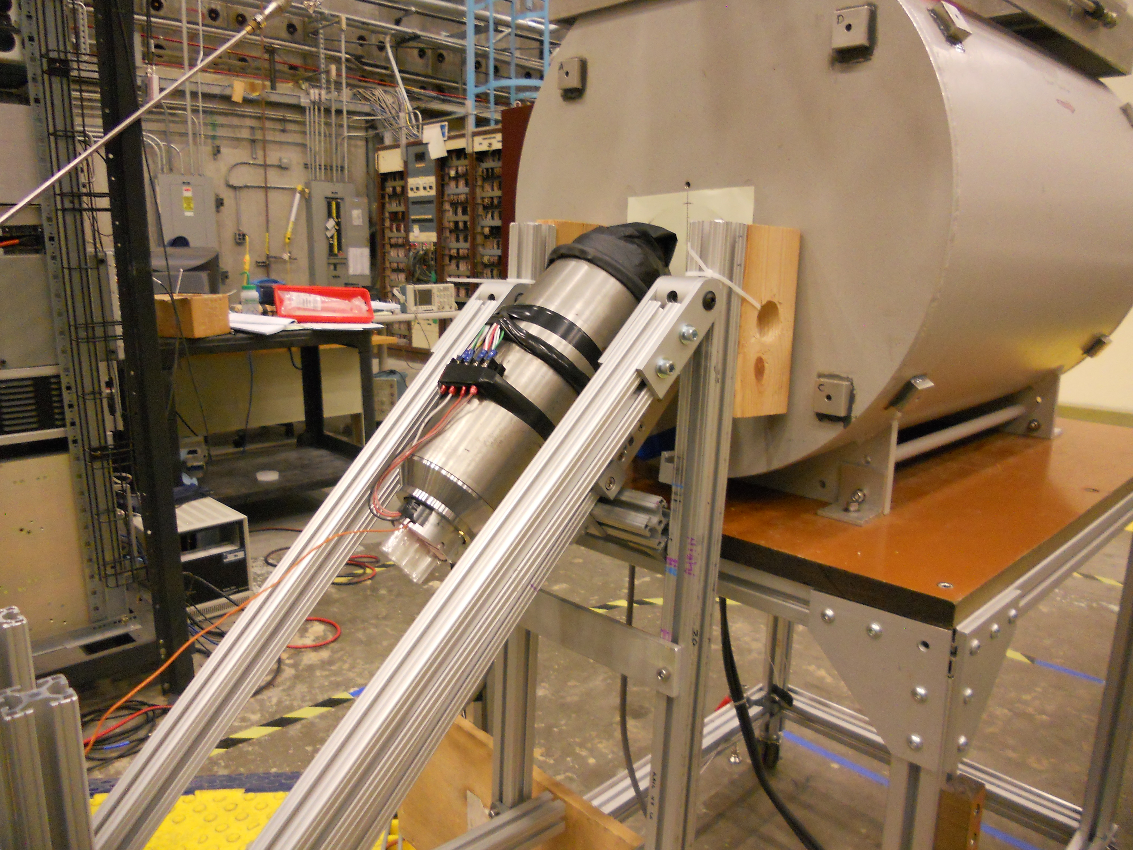
CTOF Magnetic Shield Testing
3 passive layers + 1 active layer
CTOF PMTs positioned in fields up to 1.1 kG
Internal fields at PMT < 0.7 G in fields that matched those expected in CLAS12 Solenoid fringe field
Shield tested in fields up to B_{max} = 2.2 kG with good performance
(G)
ph-cath < 0.7 G
mid-dyn < 0.2 G
1st dyn < 0.1 G
Work Complete
Transverse coordinate (cm)

Slide 17
CTOF Technical Notes
Design and Performance Tests of the CTOF Magnetic Shields
CTOF Geometry Document
CTOF Calibration Constants
CTOF Counter Wrapping Procedures
CTOF Magnetic Shield Attachment Procedures
LMS Design Considerations
TOF Monte Carlo Simulation Details
2015 Monthly Progress Reports
See CLAS12 CTOF web page at:
http://www.jlab.org/Hall-B/ctof
CTOF Documentation
  CLAS-Notes, CLAS12-Notes, Internal Documents, Reports
Photographs of all things CTOF

Slide 18
Project Status
Counter Assembly
Cosmic Ray Testing
Software Development
Remaining Design/Engineering

Slide 19
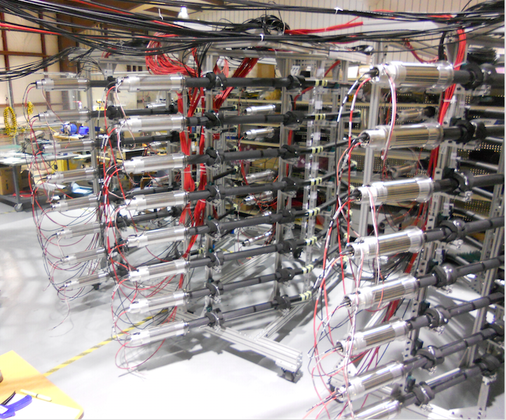
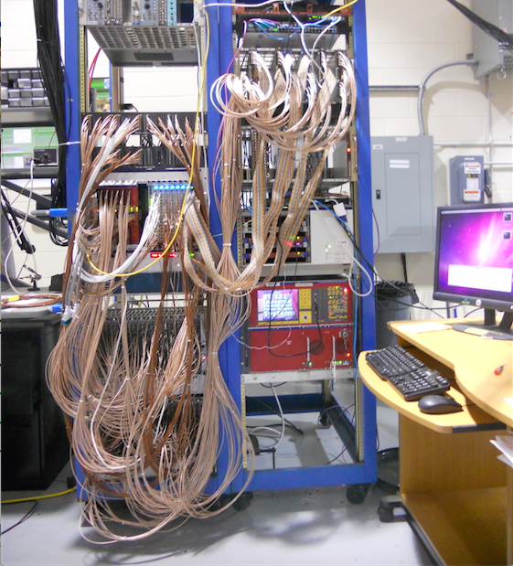
CTOF Cosmic Ray Studies
Counters now connected to DAQ system for cosmic ray studies
gain matching
calibration
time resolution optimization
DAQ setup with production readout:
CFDs (Ortec 935)
High-res TDCs (CAEN 1290A)
FADCs (JLab modules)
CODA readout – EVIO format
CTOF DAQ Test Stand

Slide 20
CTOF Cabling Scheme
CTOF HV Cable Connections
Work Complete
Cable RG-59
(18’ up, 23’ dn)
HV Patch
SHV M
PMT SHV M
SHV F SHV F
CTOF Signal Cable Connections
FADC
Cable RG-316
Flat Lemo M
Cable EML-195
splitter panel
(5’)
PMT BNC F
Anode
BNC M Lemo M
up: 52’, 53.6’, 55.2’
dn: 68’, 69.6’, 71.2’
Cable RG-316
disc
Lemo M Lemo M
(5’)
Other cables: Lemo M Lemo M (disc to TDC); Lemo M Lemo M (CFD delay)
RG-316 (4’) RG-174 (2 ns)

Slide 21
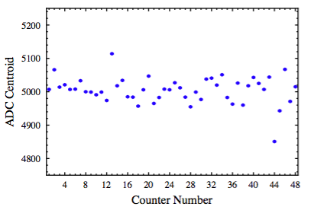
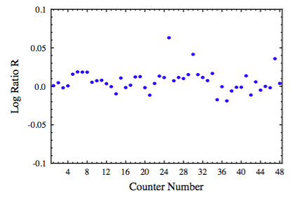
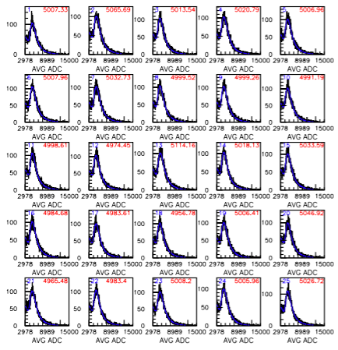
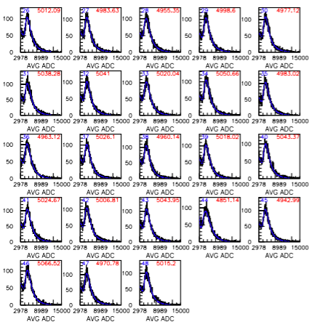
PMT Gain Matching
CTOF counter PMT gain matching complete
Verify PMT settings and eliminate mis-cabling

Slide 22
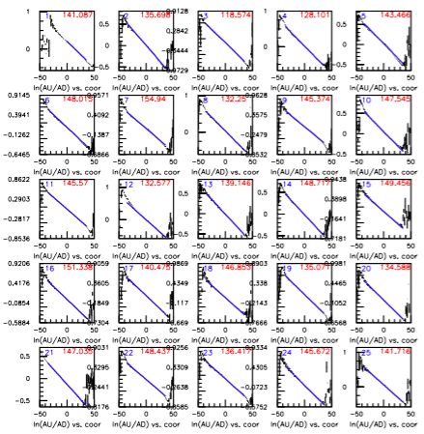
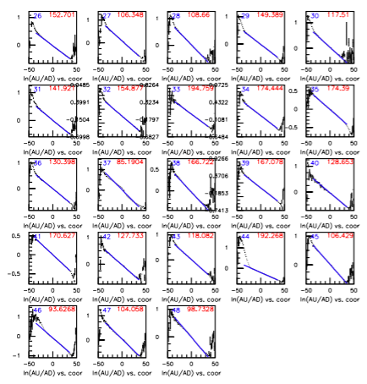
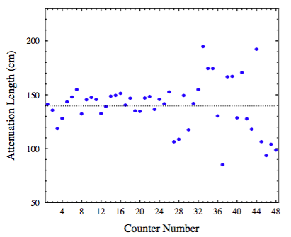
Attenuation Lengths
Attenuation Length λ Data

Slide 23
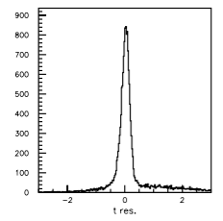
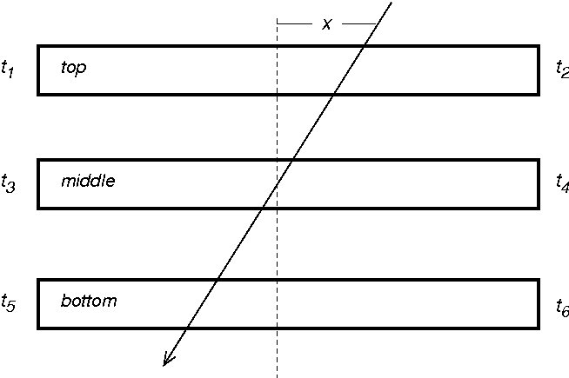
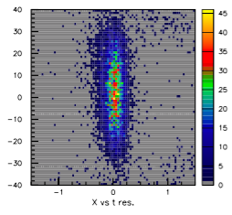
Time Resolution Studies
Setup triplet of assembled CTOF counters:
(ns)
Compute variance:
(cm)
(ns)

Slide 24
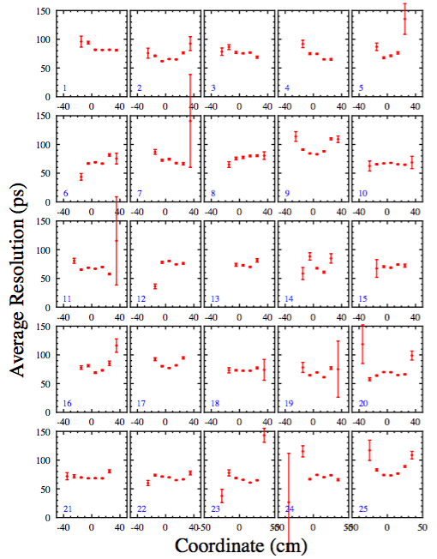
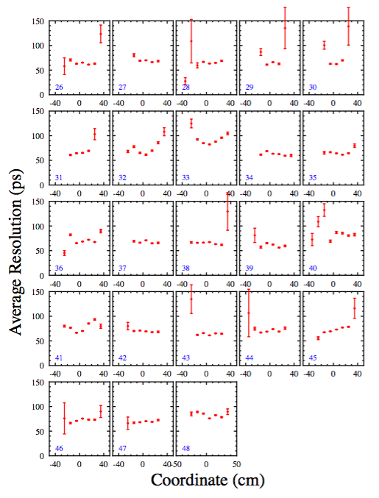
Time Resolution Studies
Preliminary

Slide 25
Project Status
Counter Assembly
Cosmic Ray Testing
Software Development
Remaining Design/Engineering

Slide 26
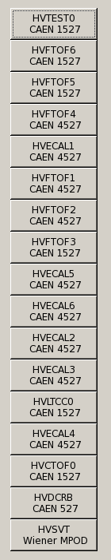
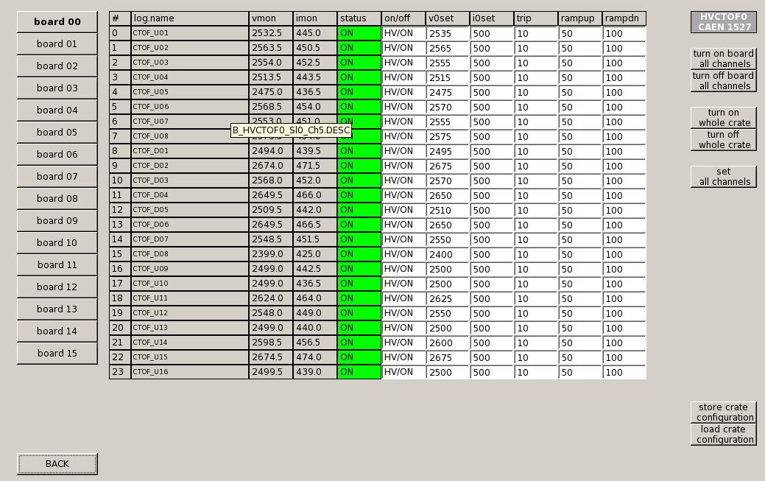
CTOF Slow Controls
Work Complete
CLAS12 HVPS Slow Controls EPICS interface developed by V. Sytnik and K. Livingston (contributed University labor)

Slide 27
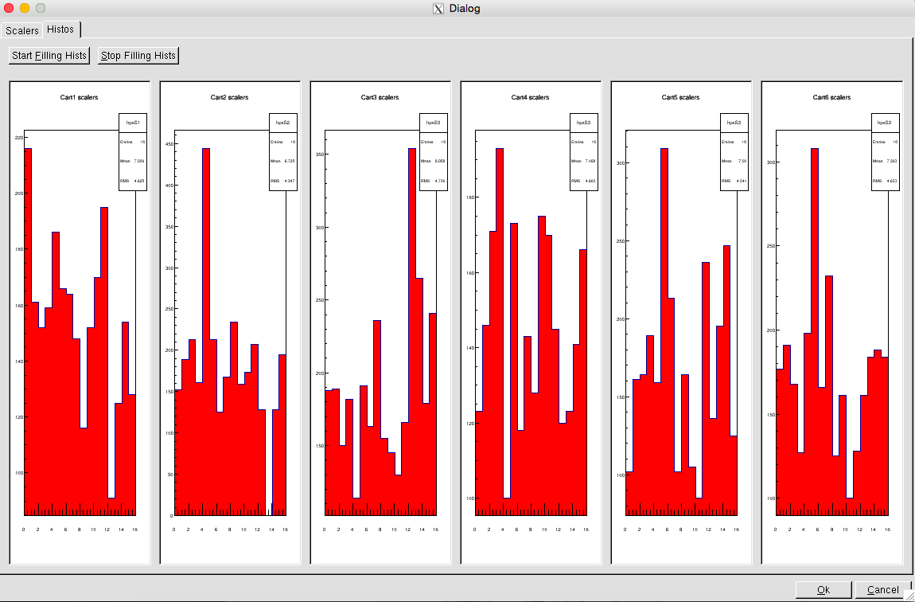
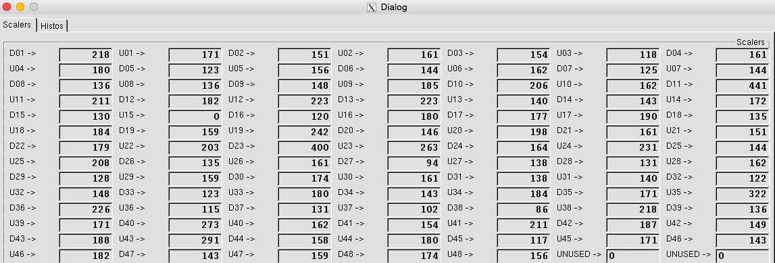
CTOF Monitoring
Trigger scalers
tools now under development – off project
Sergey Boyarinov

Slide 28
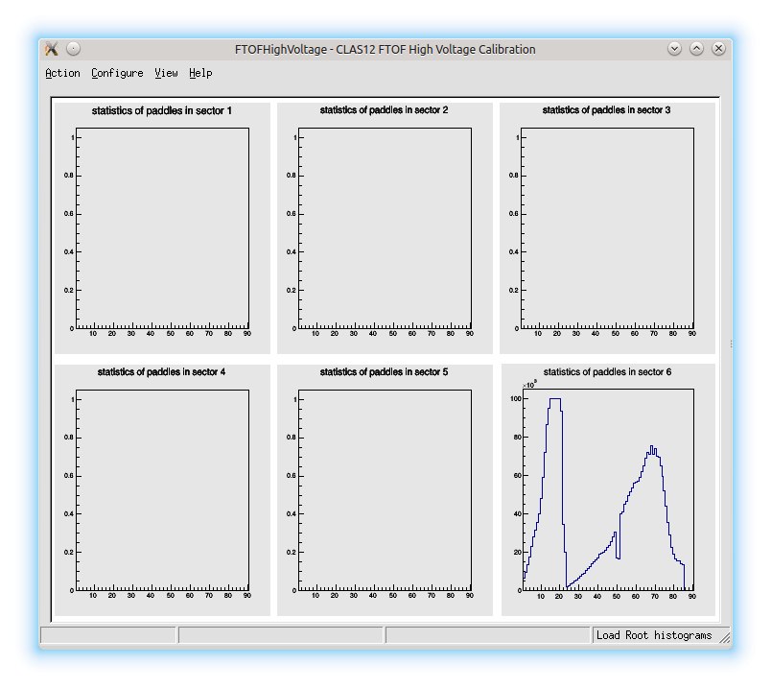

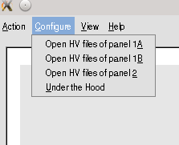
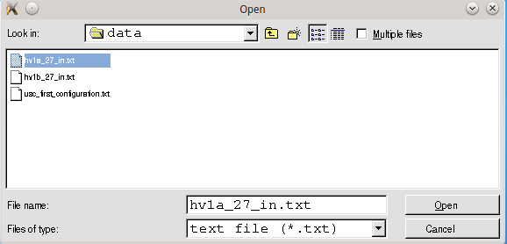
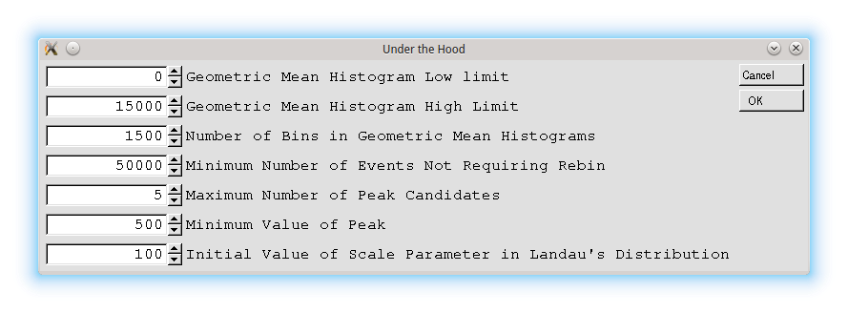
CTOF Calibration Suite
The CTOF calibration suite will be developed directly from the code suite being developed for the FTOF system.
ROOT/c++ implementation:
  H. Lu (Univ. of Iowa)
JAVA implementation:
  L. Clark (Univ. of Glasgow)
GUI development:
  L. Clark (Univ. of Glasgow)
Contributed University Labor – Off Project
Dedicated development of CTOF suite will begin later this year

Slide 29
Project Status
Counter Assembly
Cosmic Ray Testing
Software Development
Remaining Design/Engineering

Slide 30
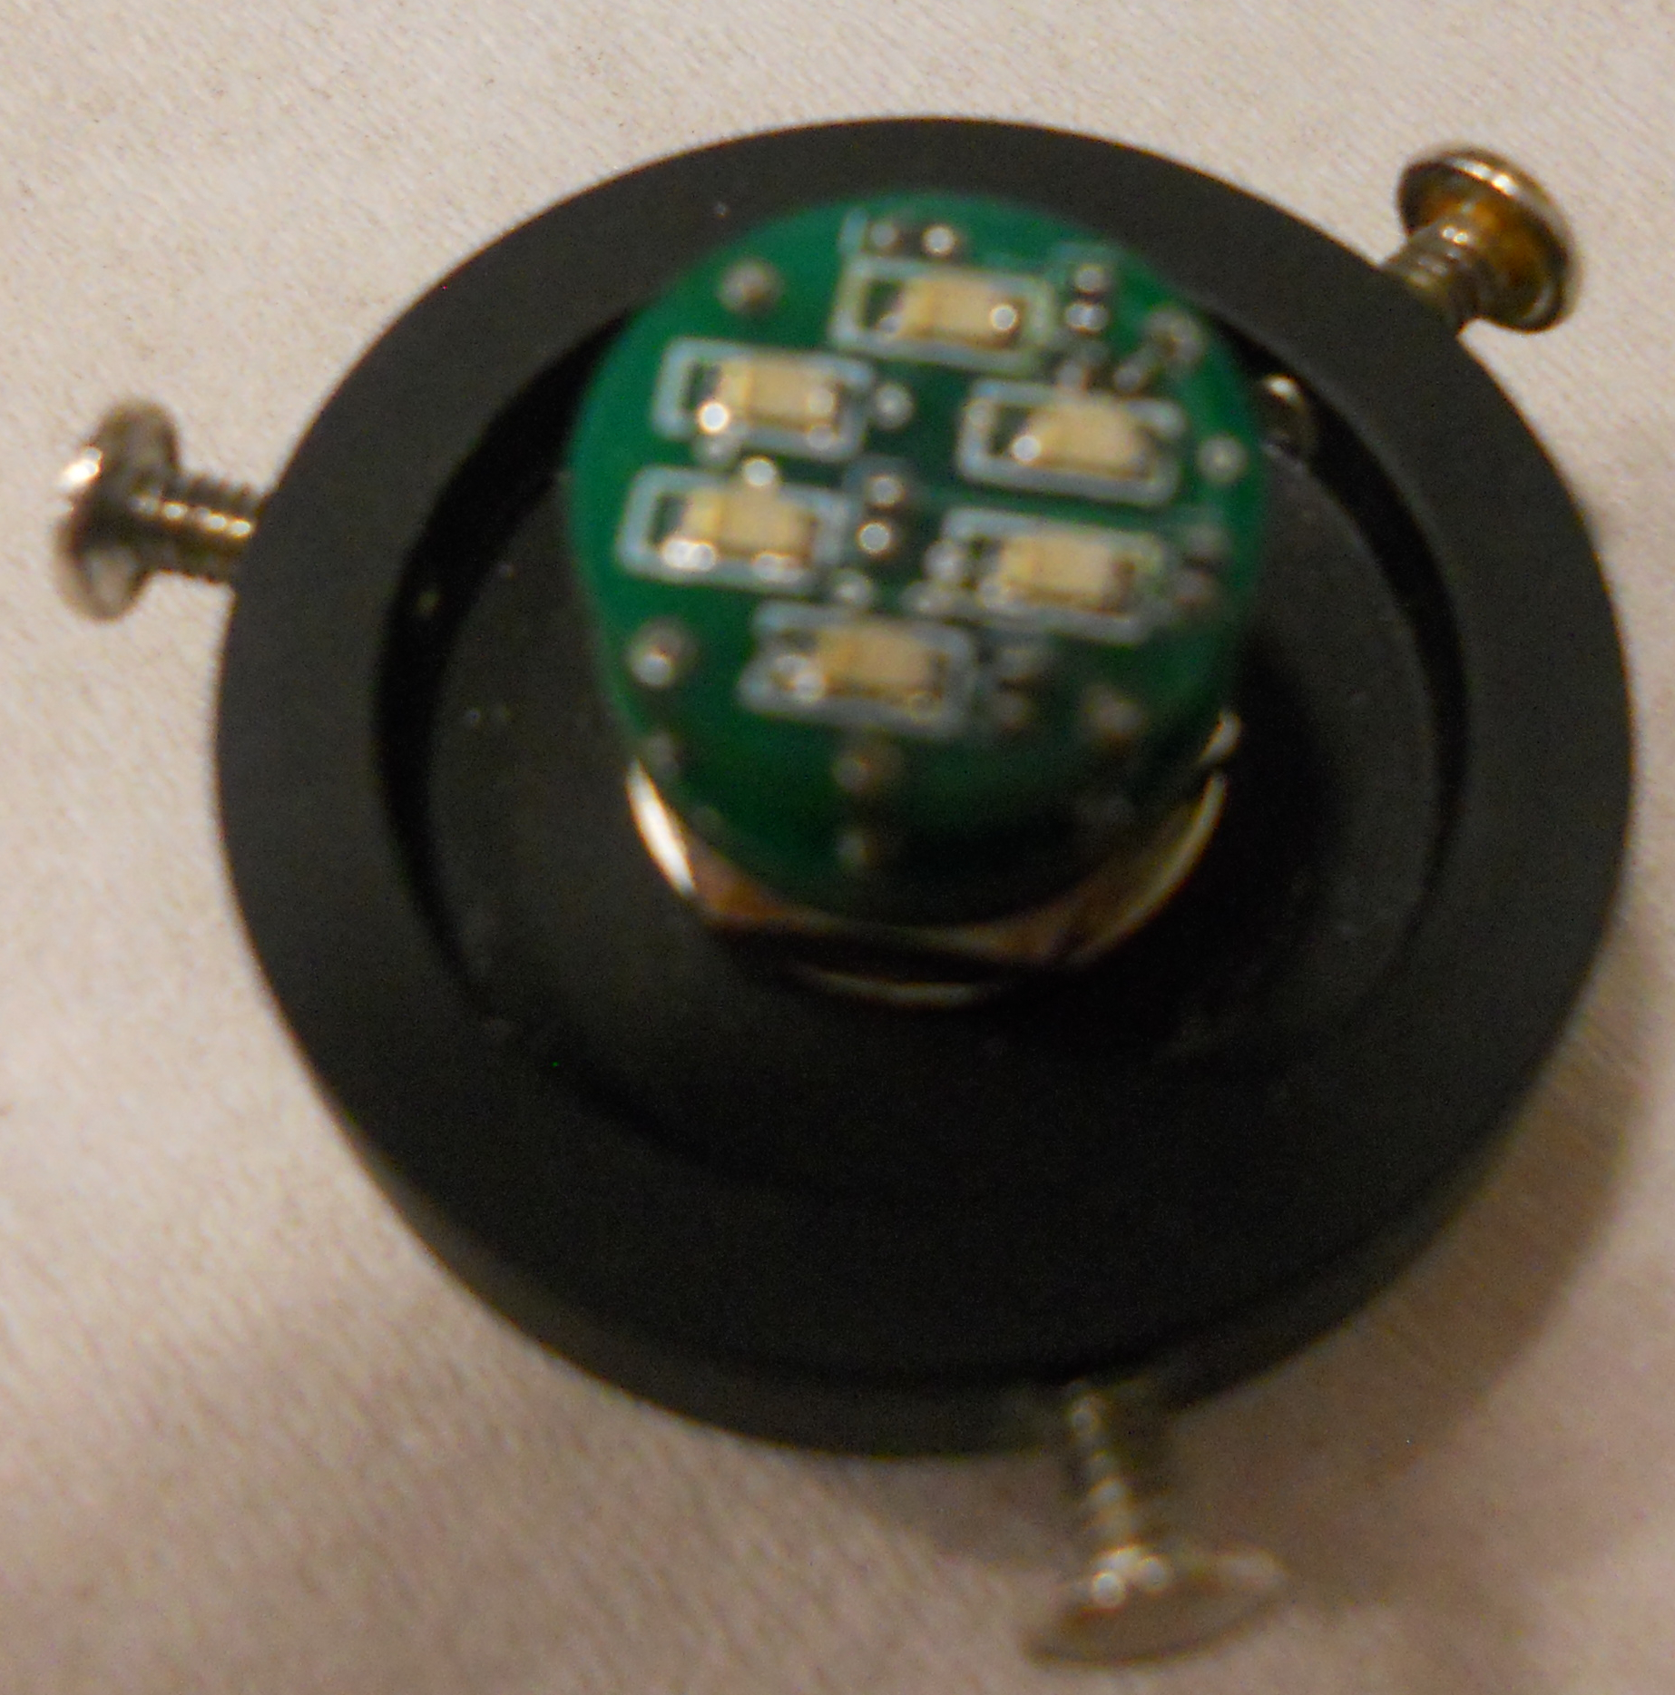
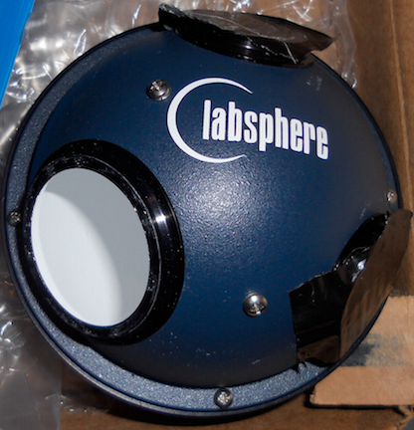
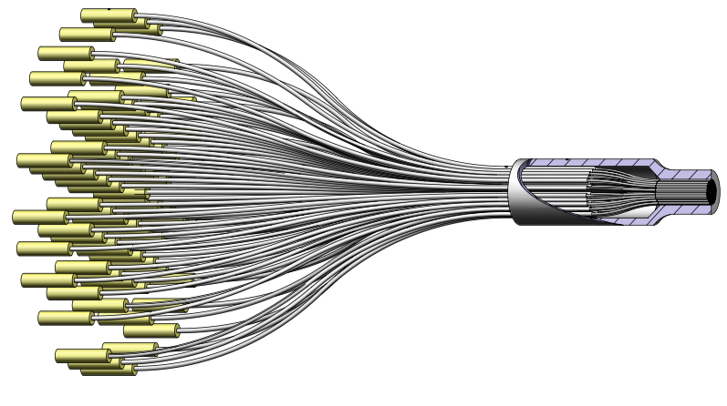
Light Monitoring System
Block Diagram
LED driver
5-m long
A
B
C
D
E
Counter time resolution/gain monitoring system; prescaled part of datastream
Status:
Design of system nearly complete
  (A/B) – light source/driver developed at JLab
  (C) – integrating sphere commercial unit
  (D) – fiber bundle assembly commercial unit
  (E) – fiber mounting blocks from local shop
Fiber Bundle Assembly
Similar system already installed and tested for HTCC
- Procurement to start in July 2015

Slide 31
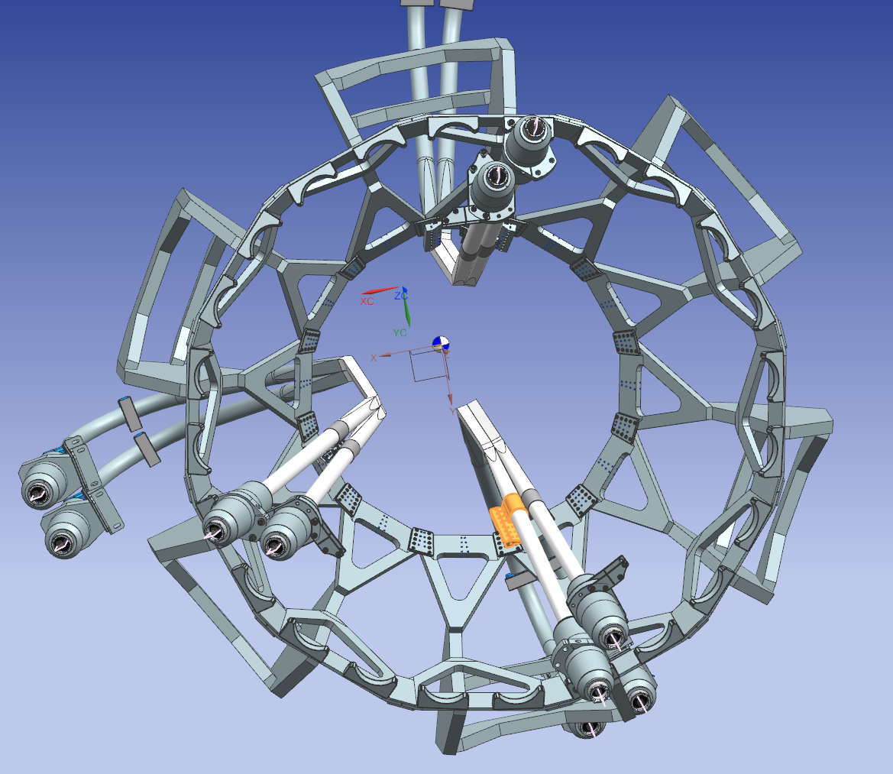
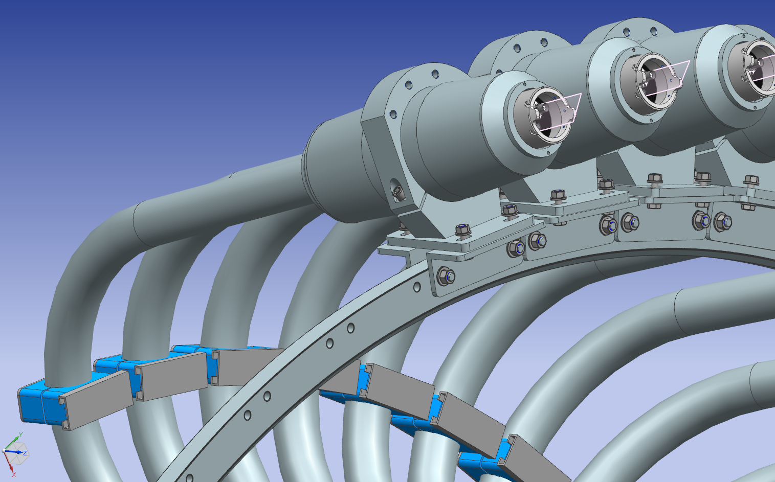
Support Structure
upstream support
downstream support
Status: Main design elements completed; drawing set sent out for RFI in early May
Designed complicated by presence of CND that is installed first in solenoid and weight of magnetic shields
PR submission to begin this week

Slide 32
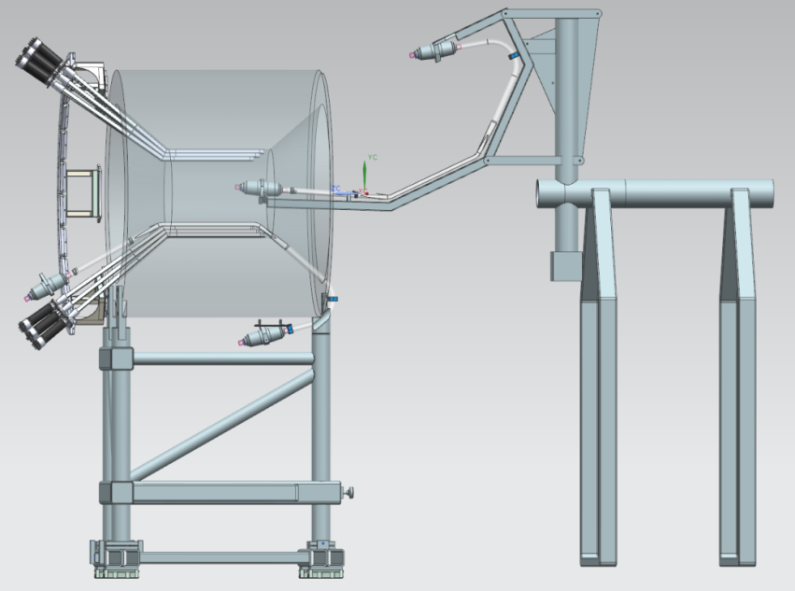



Installation Scheme & Tooling
Step 1: Mount counter to installation tooling
Step 2: Move counter into Solenoid; rotate in azimuth
Step 3: Rotate counter toward Solenoid bore
Step 4: Attach the counter to the support structure
Status: Design (65%) and engineering analysis (33%) in progress (June reporting)

Slide 33

CTOF Installation
Sequence
Cyril Wiggins

Slide 34

Install ANCHOR BRACKETS onto UPSTREAM INTERFACE RING of SOLENOID

Slide 35

Install CENTRAL NEUTRON DETECTOR onto UPSTREAM INTERFACE RING

Slide 36


Slide 37

Install CTOF support structure onto anchor brackets

Slide 38

Install counters #1 & #2;
- Specially assembled, as the first of the array
- Require special installation because of close proximity to the solenoid cart

Slide 39

Install first quadrant of counters from the bottom up

Slide 40

Install second quadrant of counters

Slide 41

Install third and fourth quadrants of counters;
Last 3 counters have special installation

Slide 42

Counters #46 & #47 are special assemblies that mount together at the inner cone

Slide 43

Modified 48th counter installed

Slide 44
Remaining Tasks
On Project
Off Project

Slide 45

CTOF EVMS Chart
>
CTOF project 85.7% complete as of May 2015; 90% as of June 2015
≈

Slide 46
CTOF Schedule
Act. ID | Activity Name | Start | Finish | Expected Finish | % Comp May
242231115 | Light Monitoring System Design | 2-Dec-13 | 31-Jul-15 | 31-Jul-15 | 75
242231260 | Final Drawings CTOF Support Harness | 3-Jan-14 | 31-Jul-15 | 15-Jul-15 | 70
242231265 | CTOF Procure Support Harness | 3-Aug-15 | 5-Oct-15 | 30-Sep-15 | 0
242231270 | Final Drawings Counter Installation Arm | 5-Jan-15 | 30-Sep-15 | 21-Aug-15 | 50
242231272 | Counter Installation Arm – Engineering Analysis | 4-May-15 | 31-Aug-15 | 31-Jul-15 | 33
242231275 | Procure Installation Tooling and Transport Rack | 1-Oct-15 | 3-Dec-15 | 11-Nov-15 | 0
242231300 | Light Monitoring System | 6-Oct-14 | 14-Aug-15 | 31-Aug-15 | 13
242231325 | Assemble Setup for Magnetic Shield Tests | 7-Apr-14 | 22-Jun-15 | 20-Jun-15 | 80
242231335 | Purchase Cables/Connectors (LMS Procure) | 5-Jan-15 | 31-Aug-15 | 15-Jul-15 | 53
242231340 | Fabricate Cables LV and HV | 6-Oct-14 | 30-Jun-15 | 15-Jul-15 | 50
242231355 | Correction Coil Power Harness | 6-Oct-14 | 30-Jun-15 | 30-Jun-15 | 33
242231360 | Fabricate Splitter Parts | 6-Oct-14 | 30-Jun-15 | 15-Jul-15 | 50
242231365 | Assemble CTOF Patch Panels | 15-Jun-15 | 30-Jun-15 | 31-Jul-15 | 0
242231370 | Assemble CTOF Splitters | 26-Jun-15 | 30-Jun-15 | 31-Jul-15 | 0
242231385 | Testing External Magnetic Shields | 13-Apr-15 | 17-Jul-15 | 20-Jun-15 | 32
242231415 | Assemble the DAQ System | 13-Apr-15 | 30-Jun-15 | 15-Jun-15 | 65
242231420 | Standalone CTOF Testing | 3-Aug-15 | 21-Aug-15 | 24-Aug-15 | 0
242231425 | CTOF Storage Rack for Transportation | 4-Dec-15 | 13-Jan-16 | 24-Nov-15 | 0
242231430 | Incidentals | 2-Jul-14 | 1-Jul-15 | 24-Nov-15 | 38
242231470M | CTOF Ready for Installation |  | 13-Jan-16

Slide 47
CTOF Schedule
Act. ID | Activity Name | BL Start | BL Finish | Expected Finish | % Comp May | % Comp June
242231115 | Light Monitoring System Design | 2-Dec-13 | 31-Jul-15 | 31-Jul-15 | 75 | 75
242231260 | Final Drawings CTOF Support Harness | 3-Jan-14 | 31-Jul-15 | 15-Jul-15 | 70 | 90
242231265 | CTOF Procure Support Harness | 3-Aug-15 | 5-Oct-15 | 30-Sep-15 | 0 | 0
242231270 | Final Drawings Counter Installation Arm | 5-Jan-15 | 30-Sep-15 | 21-Aug-15 | 50 | 65
242231272 | Counter Installation Arm – Engineering Analysis | 4-May-15 | 31-Aug-15 | 31-Jul-15 | 33 | 33
242231275 | Procure Installation Tooling and Transport Rack | 1-Oct-15 | 3-Dec-15 | 11-Nov-15 | 0 | 0
242231300 | Light Monitoring System | 6-Oct-14 | 14-Aug-15 | 31-Aug-15 | 13 | 13
242231325 | Assemble Setup for Magnetic Shield Tests | 7-Apr-14 | 22-Jun-15 | 20-Jun-15 | 80 | 100
242231335 | Purchase Cables/Connectors (LMS Procure) | 5-Jan-15 | 31-Aug-15 | 15-Jul-15 | 53 | 53
242231340 | Fabricate Cables LV and HV | 6-Oct-14 | 30-Jun-15 | 15-Jul-15 | 50 | 100
242231355 | Correction Coil Power Harness | 6-Oct-14 | 30-Jun-15 | 30-Jun-15 | 33 | 100
242231360 | Fabricate Splitter Parts | 6-Oct-14 | 30-Jun-15 | 15-Jul-15 | 50 | 100
242231365 | Assemble CTOF Patch Panels | 15-Jun-15 | 30-Jun-15 | 31-Jul-15 | 0 | 100
242231370 | Assemble CTOF Splitters | 26-Jun-15 | 30-Jun-15 | 31-Jul-15 | 0 | 100
242231385 | Testing External Magnetic Shields | 13-Apr-15 | 17-Jul-15 | 20-Jun-15 | 32 | 100
242231415 | Assemble the DAQ System | 13-Apr-15 | 30-Jun-15 | 15-Jun-15 | 65 | 100
242231420 | Standalone CTOF Testing | 3-Aug-15 | 21-Aug-15 | 24-Aug-15 | 0 | 50
242231425 | CTOF Storage Rack for Transportation | 4-Dec-15 | 13-Jan-16 | 24-Nov-15 | 0 | 0
242231430 | Incidentals | 2-Jul-14 | 1-Jul-15 | 24-Nov-15 | 38 | 38
242231470M | CTOF Ready for Installation |  | 13-Jan-16

Slide 48

CTOF Remaining Manpower - May

Slide 49

CTOF Remaining Manpower - June
WBS 1.4.2.2.3.1 – 24.75 m-w remaining
WBS 1.4.2.6.4 - 11.2 m-w remaining

Slide 50
Task #1 - CTOF Procurement I
Solenoid Support Structure:
  Activity ID(242231265); budgeted amount $46,930
  Estimated amount: $59,340
    Upstream support: $41,340 (RFI submission, Vision Machine)
    Support Ring + Hardware: $18,000 (engineering judgment)
  Conceptual design completed (Cyril Wiggins)
  Engineering analysis completed (Saptarshi Mandal)
  Detailed design nearly complete based on significant work to prepare RFI drawing package in May.
Procurement will send drawing package out for bids by the end of June (part #1) and mid-July (part #2).
Expect award of contracts by beginning of August and deliveries by mid-September

Slide 51

Task #2 - CTOF Procurements II
Installation Tooling and Fixtures:
  Activity ID(242231275); budgeted amount $11,353
  Estimated amount: $11,353 (engineering judgment)
  Conceptual design and engineering analysis in progress (Bob Miller)
  Detailed design to be completed (Cyril Wiggins)
  Design & procurement to begin after submission of support structure

Slide 52
Task #3 - CTOF Procurement III
Light Monitoring System:
  Activity ID(242231300)/(242231335); budgeted amount $27,176
  Estimated amount: $48,705
    Fiber bundle assembly: $39,705 (vendor quote for current version)
    LED driver/source: $2,000 (previous procurement HTCC)
    Integrating sphere: $3,000 (previous procurement HTCC)
    Fiber mounting blocks: $2,000 (engineering judgment)
    Hardware: $2,000 (engineering judgment)
    Conceptual design completed (Cyril Wiggins)
    Worked with local company on design and quote (LEONI Fiber Optics, Williamsburg)
    Submit PR for fiber mounting blocks by mid-July; remainder of procurements
    by mid-August
LED driver

Slide 53

Task #4 - CTOF Procurement IV
Modify Counter #48:
  Activity ID(242231430); budgeted amount $2,000
  Estimated amount: $2,000 (engineering judgment)
  Machining work to be completed by JLab or outside Machine Shop
  Machine wedge-shaped counter into rectangular-shaped counter to allow for insertion in the barrel
- Machine shop work to begin by end of July
Counter then needs to be glued, polished, and wrapped
Counter shields and PMTs to be installed
Counter then to be inserted into test stand
(DSC, Gegham Asryan)

Slide 54


Task #5 - CTOF Procurement V
Transportation Crates to Hall B:
  Activity ID(242231425); budgeted amount $17,719
  Estimated amount: $17,719 (previous procurement; engineering judgment)
Design drawings completed
Still need to finalize detailed plans for transport of counters to Hall B
Preparations for procurement are last on the CTOF work list given priorities.

Slide 55
Task #6 - CTOF Cosmic Ray Studies
Cosmic Ray Testing:
  Activity ID(242231420); 1.5 m-w remaining
  Work Plans:
- Study system noise, baseline fluctuations, and stability
HV gain matching of all PMTs using mean ADC spectra
Measurement of average counter time resolution using counter triplets
Investigation of and attention to problematic system elements
Optimization of signal splitter ratios (presently 90/10)
Status:
Claimed as 50% done for June progress
Initial system checkout and gain matching complete
Working to measure initial counter time resolutions
Will complete work by end of July
(DSC, Andrey Ni)

Slide 56
Remaining Tasks
On Project
Off Project

Slide 57
CTOF Off-Project Proposed Work
The cosmic ray testing plans that will take place off project include:
Detailed studies of time resolution vs. coordinate and angle for all counters
Studies to minimize CFD contribution to time resolution
Time-dependent calibration optimization of time resolution
CTOF calibration suite development (in progress)
CTOF reconstruction suite development (in progress)
Preparation of technical reports/papers
Development and optimization of light monitoring system
Long base-line monitoring of system performance and stability
20% FTE scientist level
(DSC)
Calibration development off-project similar in scale to work on FTOF system

Slide 58
CTOF Project Status Summary
The CTOF detector assembly is very nearly complete.
    - Cosmic ray studies are now in progress
The design and engineering work related to CTOF is now coming to its end.
- Solenoid support structure - Light monitoring system
- Installation fixtures and tooling - Counter #48 work
Final procurements are in progress and costs are now well understood. All PRs should be submitted by the end of August.
Project budget: $106,178 Current estimates: $140,117 (+32%)
Scheduled for close-out of WBS 1.4.2.2.3.1 by January 2016; On-project assembly and testing to be completed by end of August 2015.
Cosmic ray testing will continue until the end of calendar year 2015
(off project – 20% FTE) for fine tuning of calibration parameters and understanding LMS settings/operation.
Detector installation scheduled for summer/fall 2016.

