Slide 1
Director’s CLAS12 Detector Assessment
Tuesday, June 30, 2015
Jefferson Lab
CTOF
Glenn R Young

Slide 2
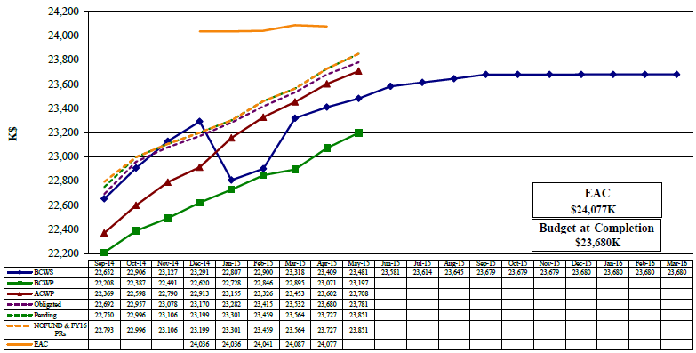
12 GeV 1.4.2.2. Hall B Detectors Earned Value $K
Estimated Cost of All Work at Completion
Actual Cost of Accomplished Work
All Planned Work
Accomplished Work

Slide 3
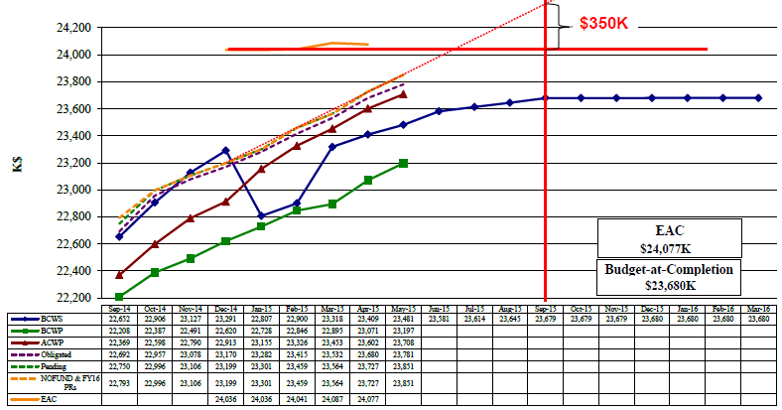
12 GeV 1.4.2.2. Hall B Detectors Earned Value $K

Slide 4
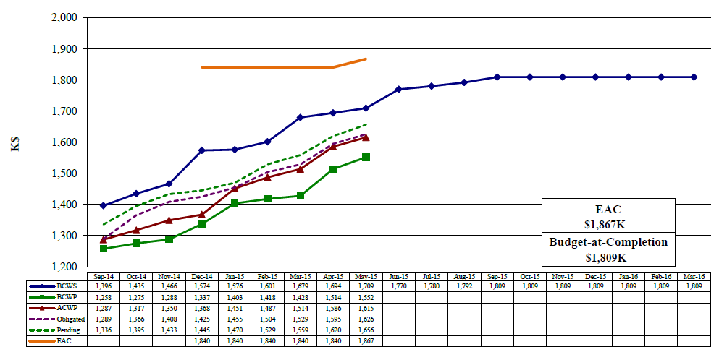
12 GeV 1.4.2.2.3.1 CTOF Earned Value $K
Pending is less than EAC by only $211K, which is $46K less than BAC-P
$30K of PR, open shop, P.Labor remains
$11K of e.g. POs remain
$257K construction remains (BAC-P)
$63K overspent
Obligated is parts that will also add to BCWP. Nearly all of the Pending is for two visitors, which will add to BCWP when costed.

Slide 5
CTOF Remaining Activities as of May 31, 2015
Activity ID | Name | Activity Start | Activity Finish | Remaining Budgeted MWeeks or Proc. Cost
242231115, 300, 335A | Light Monitoring System | 12/2/13 | 8/31/15 | $26,301 + 1.9mw
242231260, 261 | Design Support System | 1/3/14 | 7/31/15 | 3.0
242231265 | Procure Support System | 8/3/15 | 10/5/15 | $46,930
242231270, 270A, 272 | Design Installation Tooling | 1/5/15 | 9/30/15 | 8.7
242231275 | Procure Installation Tooling | 10/1/15 | 12/3/15 | $11,353
242231325, 325A,385 | Setup and Test Magnetic Shielding | 4/7/14 | 7/17/15 | 8.5
242231340, 355, 360, 365, 370 | Fabricate Cables, Splitters, Power Harness | 10/6/14 | 6/30/15 | 21.8
242231410, 415, 420, 425 | In-rack Testing | 4/13/15 | 1/13/16 | 13.6
242231430 | Incidentals | 7/2/14 | 7/1/15 | $11,838
24267385, 390 | Installation, cabling, align | 10/13/16 | 10/28/16 | 24
Total is 81.5 mw, which is estimated at $181.6K direct ($132.4K CTOF, $49.2K Install, $0K Pre-ops) and is planned to be supported by Hall B personnel, including guest postdoc, guest scientist, staff mechanical designer and engineer. Fabrication/procurement estimate in P6 is $96.4K, whereas current vendor estimates are closer to $110K.

Slide 6
Some Observations on CTOF
The CTOF detector elements are built and are in racks taking cosmic ray data
We have two shop tasks outstanding – the support system ($60K) and the insertion tooling ($12K)
The support system is completing drawings
The insertion tooling is still in engineering/design
Completing the cables, splitters, correction coil supplies, and ancillary items in June
The Light Monitoring System needs to be procured ($26K) and installed
The CTOF installation is viewed to be straightforward but needs to be coordinated with Solenoid installation and commissioning

Slide 7
End of April Estimate on Cost

Slide 8
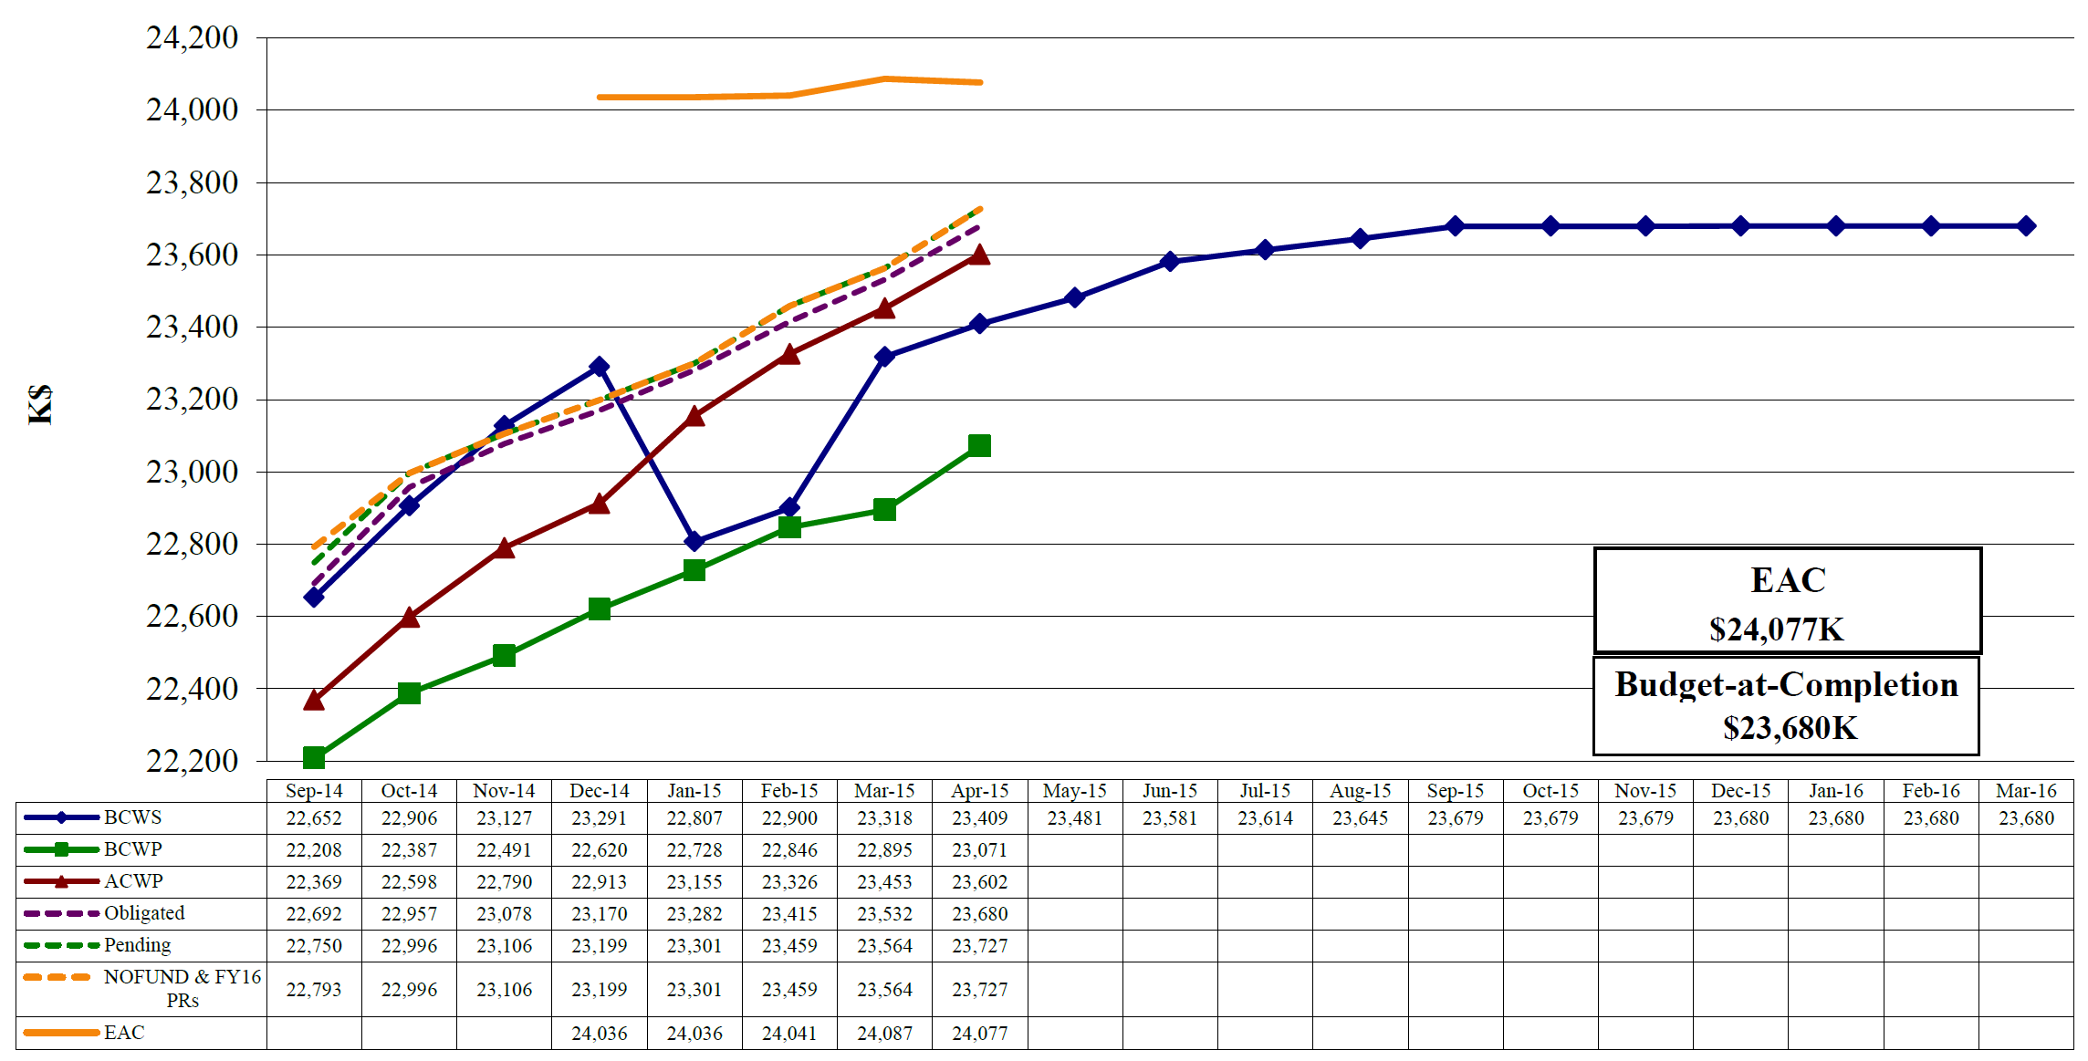
12 GeV 1.4.2.2. Hall B Detectors Earned Value $K
Actual Cost of All Accomplished Work (projected)
~ $24,375K
i.e. $300K over current EAC !
All Planned Work
Estimated Cost of All Work at Completion
Still Just Possible to Accomplish All Work by the End of FY2015 at Present Pace of Work
May Progress
Have been making about $0.77/$ since January
Estimated Cost (EAC) Must cover Planned Cost PLUS Cost Overruns (“CV”) PLUS Foreseen “Adders”

