Slide 1
Director’s CLAS12 Detector Assessment
Tuesday, June 30, 2015
Jefferson Lab
LTCC
Glenn R Young

Slide 2
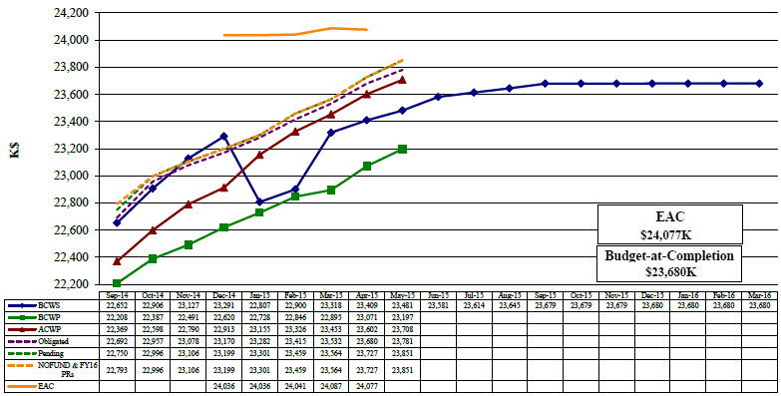
12 GeV 1.4.2.2. Hall B Detectors Earned Value $K
Estimated Cost of All Work at Completion
Actual Cost of Accomplished Work
All Planned Work
Accomplished Work

Slide 3
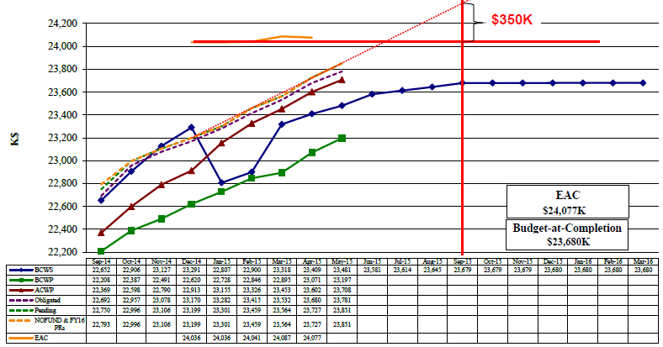
12 GeV 1.4.2.2. Hall B Detectors Earned Value $K

Slide 4
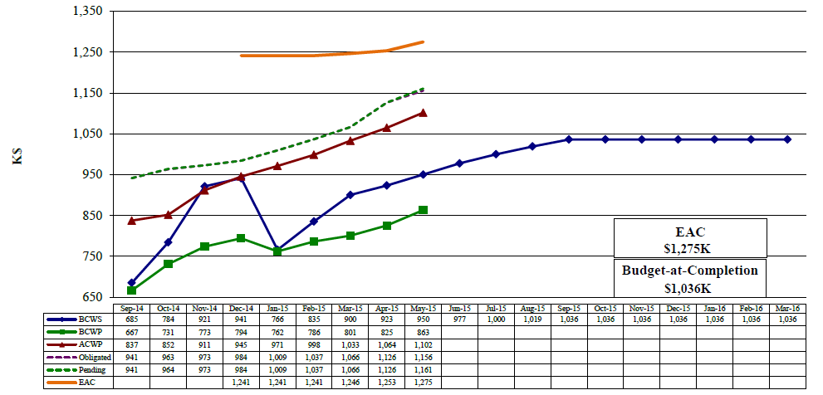
12 GeV 1.4.2.2.4.2 LTCC Earned Value $K
Pending is less than EAC by only $114K, which is $59K less than BAC-P
$5K of PR, open shop, P.Labor remains
$54K of e.g. POs remain
$239K overspent
$173K construction remains (BAC-P)
$53K of the Obligated is WC re-coating; $5K of Pending is Visiting Scientist; both these will add to BCWP

Slide 5
LTCC Remaining Activities as of May 31, 2015
Activity ID | Name | Activity Start | Activity Finish | Remaining Budgeted MWeeks or Proc. Cost
242242512, 517, 525, 530 | Winston Cone and PMT work | 1/5/15 | 9/21/15 | $36,868 + 2.6
242242550-575 | Complete Box 1 | 1/23/15 | 6/30/15 | 3.6
242242590-620 | Complete Box 2 | 1/23/15 | 8/14/15 | 9.5
242242635-665 | Complete Box 3 | 2/19/15 | 9/22/15 | 9.8
242242680-710 | Complete Box 4 | 2/23/15 | 10/29/15 | 9.7
242242725-755 | Complete Box 5 | 2/16/15 | 12/9/15 | 11.0
242242770-805 | Complete Box 6 | 2/16/15 | 1/27/16 | 11.3
24267175, 180, 190, 195, 215 | LTCC Installation Tooling and Mounting | 8/4/15 | 2/19/16 | $5,847 + 15
2822X045, 050 | Calibration Software | 1/5/15 | 6/30/15 | 3
2822X065, 070 | Survey/Cable/Test/Repair | 2/22/16 | 3/2/16 | 5.4
Total is 80.9mw, which is estimated at $229.1K direct ($160.2K LTCC, $50.4 Install, $18.4 Pre-ops) and is planned to be supported by Hall B personnel, including scientist, visiting scientist, MTs, contract designer and engineer

Slide 6
Some Observations on LTCC
The LTCC detector components are ready with the exception of some of the Winston Cones
The Winston Cones have proven time-consuming to re-coat to reach an acceptable reflectivity
216 total, which breaks down as follows:
36 are installed in Box 1
88 are ready to install (enough for next 2 Boxes and 16/36 for the fourth)
1 is AWOL
21 are at ECI (coatings vendor) for re-work
0 (presently) are at Jlab for re-measurement
70 are proving a challenge to de-laminate the existing coating
The first of the six boxes has been refurbished, thus we have worked through an entire first article
All windows are prepared
PMTs, housings, cable routings, mirror mountings and stiffening, and mirror alignment methods are developed and checked out
We need to finish the remaining Winston Cones
We will need to set up a second production line, e.g. in the HTCC clean tent, to have a chance of meeting the September 30 deadline for completion
The LTCC installation is viewed to be straightforward by Hall B staff
The LTCC pre-ops work is largely focused on software issues and is nearly complete; a last pair of activities in early CY2016 supports survey in place plus cabling/testing/fixes

Slide 7
End of April Estimate on Cost

Slide 8
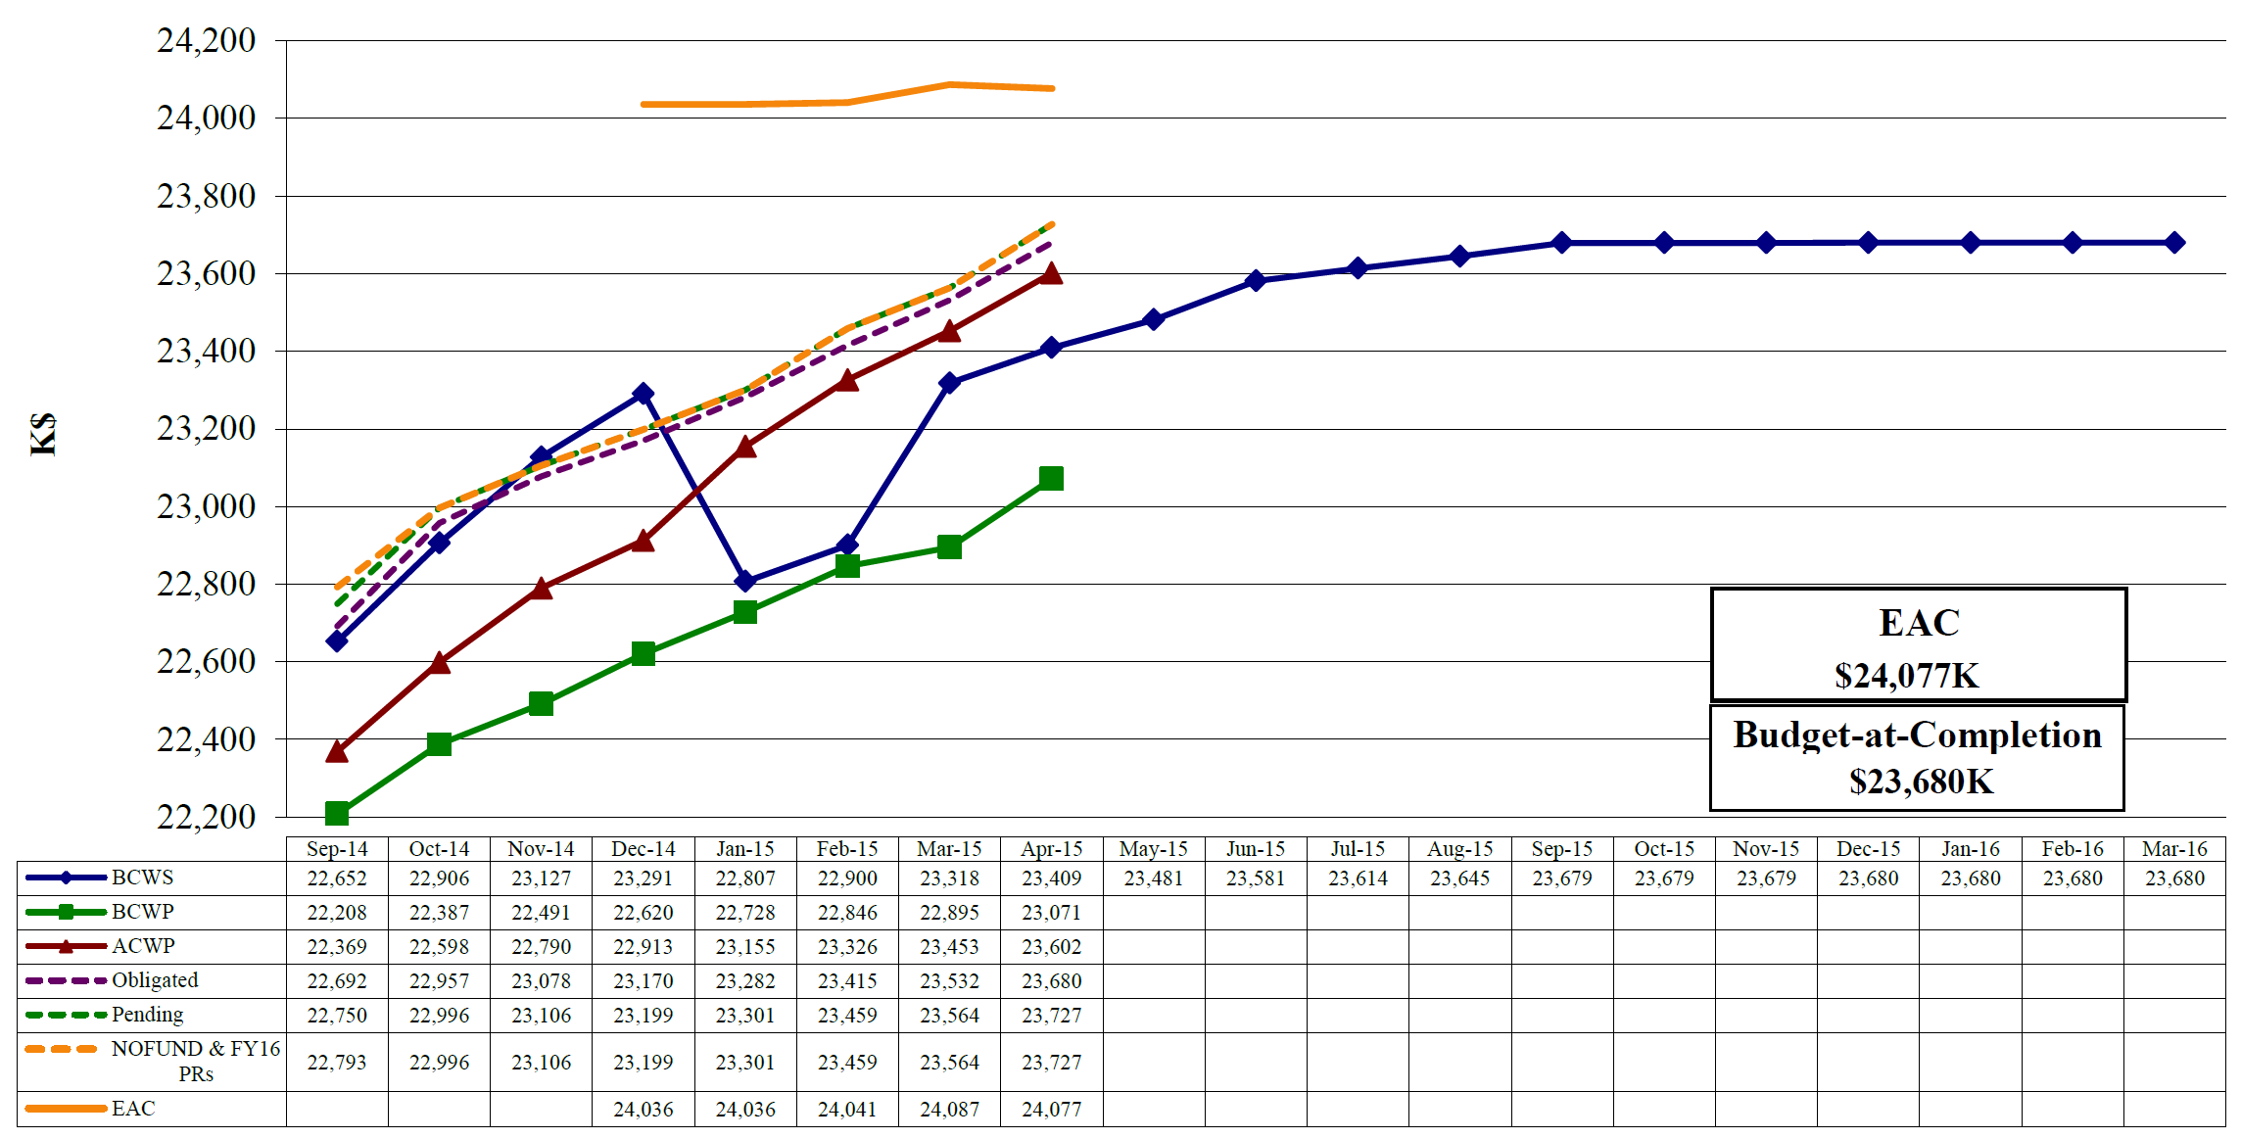
12 GeV 1.4.2.2. Hall B Detectors Earned Value $K
Actual Cost of All Accomplished Work (projected)
~ $24,375K
i.e. $300K over current EAC !
All Planned Work
Estimated Cost of All Work at Completion
Still Just Possible to Accomplish All Work by the End of FY2015 at Present Pace of Work
May Progress
Have been making about $0.77/$ since January
Estimated Cost (EAC) Must cover Planned Cost PLUS Cost Overruns (“CV”) PLUS Foreseen “Adders”

