Slide 1
CLAS12 Low Threshold Cherenkov Counter
LTCC Overview
  Technical Parameters
  CLAS6 Performance
  Physics Motivation
  Project Scope
Work Completed
  Box Cut, Nose, Mirrors re-location
  Back-wall, Connectors
  Mirror Coating
  Winston Cones Coating
  PMT coating
  PMT Divider
  Window fabrication
  Mirror Support
  Mirrors Alignment
  Calibration
Work Remaining
  Procurement
  Labor
  Commissioning
Turbo
  How to meet FY15
Assessment of the LTCC Project
Group Leader: Maurizio Ungaro
Tech Leader: David Anderson
Eng. Leader: Bob Miller

Slide 2
Outline
  Overview
  Work Completed
  Work Remaining
  Turbo
LTCC Overview

Slide 3
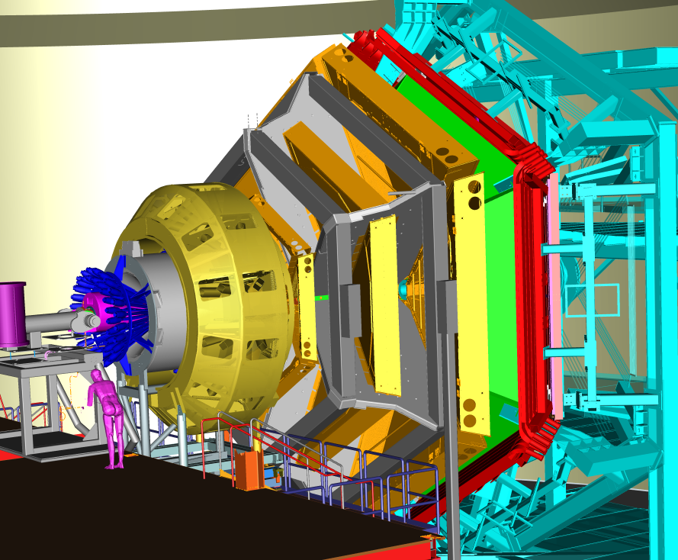
LTCC Overview
LTCC Overview
  Technical Parameters
  CLAS6 Performance
  Physics Motivation
  Project Scope
FTOF
PCAL, EC
LTCC
DC
Central Detector
BST, BMT, FMT, CTOF, CND
HTCC

Slide 4
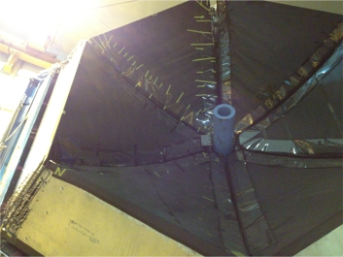
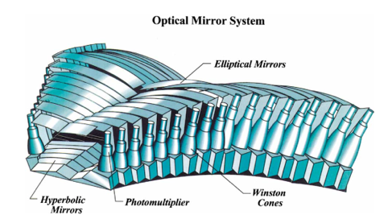
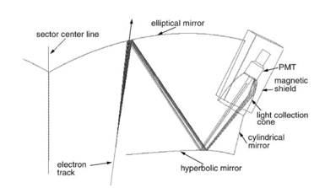
LTCC Overview
LTCC Overview
  Technical Parameters
  CLAS6 Performance
  Physics Motivation
  Project Scope
108 lightweight mirrors
36 Winston Cones
36 5’’ Photonis X4500B PMT
36 Magnetic Shields
C4F10 Gas, r.i. 1.00134
CLAS6: e-/π discrimination
π threshold: 2.6 GeV
One
Sector

Slide 5
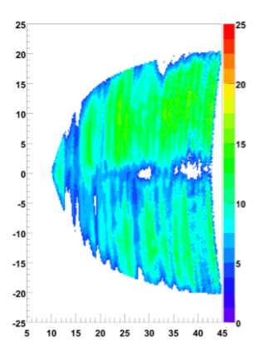
LTCC CLAS6 Performance
LTCC Overview
  Technical Parameters
  CLAS6 Performance
  Physics Motivation
  Project Scope
17 years of “all on” PMTs (last 2 years just 1 dead)
good electron ID:
most: 10-20 nphe
some region: 5-10 nphe
PMT gain low (x10 multiplier was necessary)
Lower efficiency in the mid-sector
$50K / year in gas leaks
Mirror support malfunction
lab ɸ
lab θ
LTCC was used for e-/π discrimination

Slide 6
LTCC: from CLAS6 to CLAS12
LTCC Overview
  Technical Parameters
  CLAS6 Performance
  Physics Motivation
  Project Scope
HTCC will do
e-/π discrimination
LTCC could do
π/K discrimination
Fit between DC and FTOF: box is too large
Decrease inefficient regions
Increase PMT gain, split output (FADC, TDC)
Minimize gas leaks
Better mirrors support
Re-fabricate windows
Increase light yield for π
Refurbishment
Challenges:

Slide 7
12CBLT Project Overview
LTCC Overview
  Technical Parameters
  CLAS6 Performance
  Physics Motivation
  Project Scope
5. Better mirrors support
Design new spine
6. Re-fabricate windows
Lamination (company)
Seaming (in house)
7. Increase light yield for π
Fit between DC and FTOF: box is too large
Cut Sides
Relocate segments 16-17-18
Redesign, replace back-wall frame
2. Decrease inefficient regions
Add mirror pieces to cover gaps
3. Increase PMT gain, split output (FADC, TDC)
Vladimir Popov base modification: 2 x10 output
4. Minimize gas leaks
Use Hermetical signals, HV connectors
Seal the box from the inside
Window: glue + sealant
Re-coat all mirrors
Re-coat WCs
Wavelength shifting coating of the PMTs
Add “nose” to increase gas volume

Slide 8
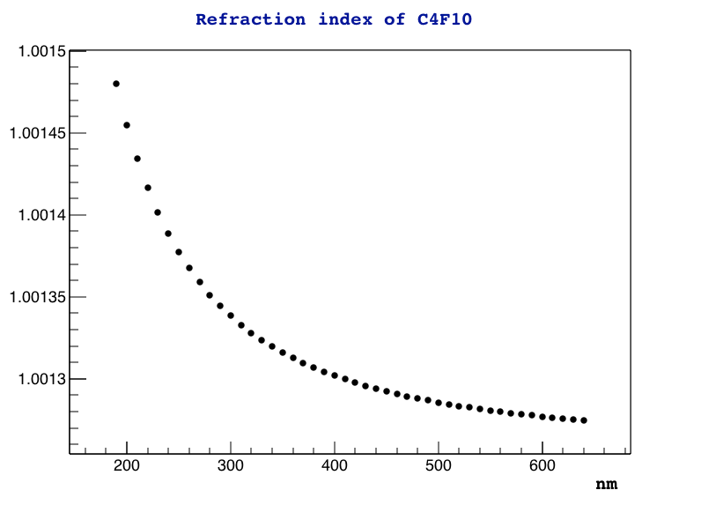
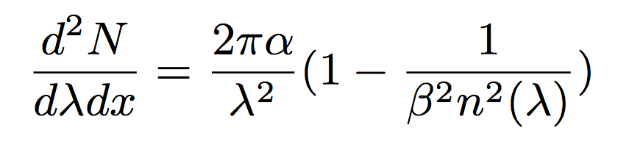
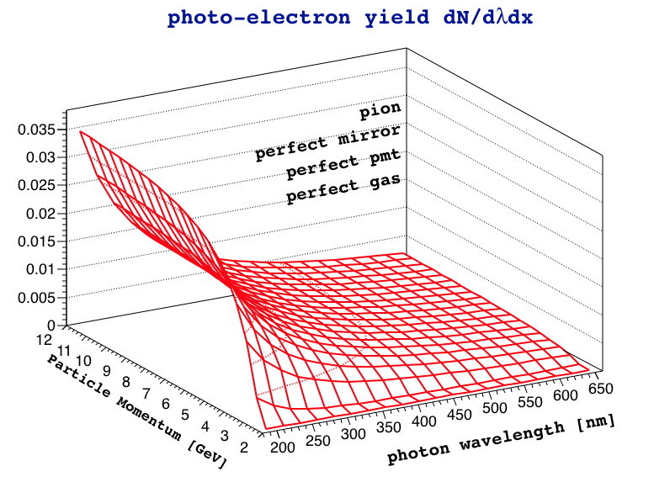
Photo-electrons yield
LTCC Overview
  Technical Parameters
  CLAS6 Performance
  Physics Motivation
  Project Scope
1.5m of C4F10 (with its transparency)
Mirrors, WC reflectivity: original, refurbished
PMT type: original, refurbished

Slide 9
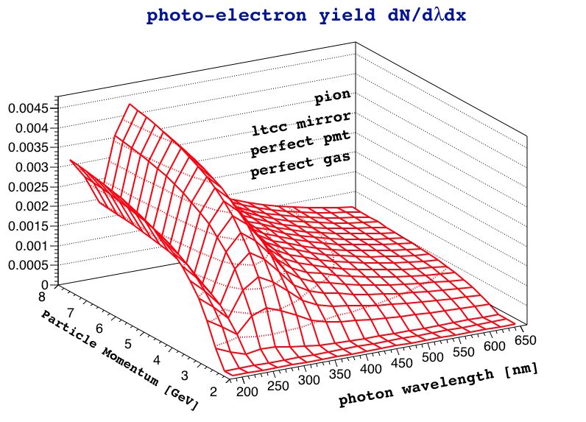
Photo-electrons yield
LTCC Overview
  Technical Parameters
  CLAS6 Performance
  Physics Motivation
  Project Scope
1.5m of C4F10 (with its transparency)
Mirrors, WC reflectivity: original, refurbished
PMT type: original, refurbished

Slide 10
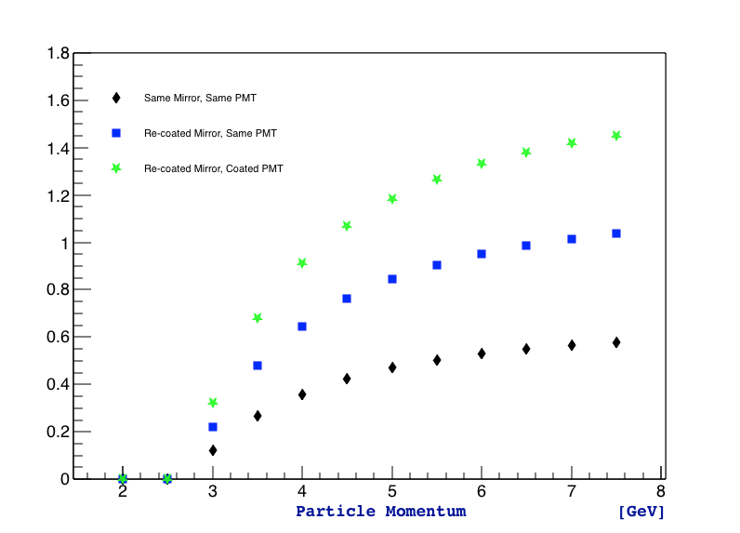
Photo-electrons yield
LTCC Overview
  Technical Parameters
  CLAS6 Performance
  Physics Motivation
  Project Scope
Purpose: obtain same light yield (for pions) as we had for electrons
CLAS12 light yield / CLAS light yield
1.5m of C4F10 (with its transparency)
Mirrors, WC reflectivity: original, refurbished
PMT type: original, refurbished

Slide 11
Outline
  Overview
  Work Completed
  Work Remaining
  Turbo
Work Completed

Slide 12
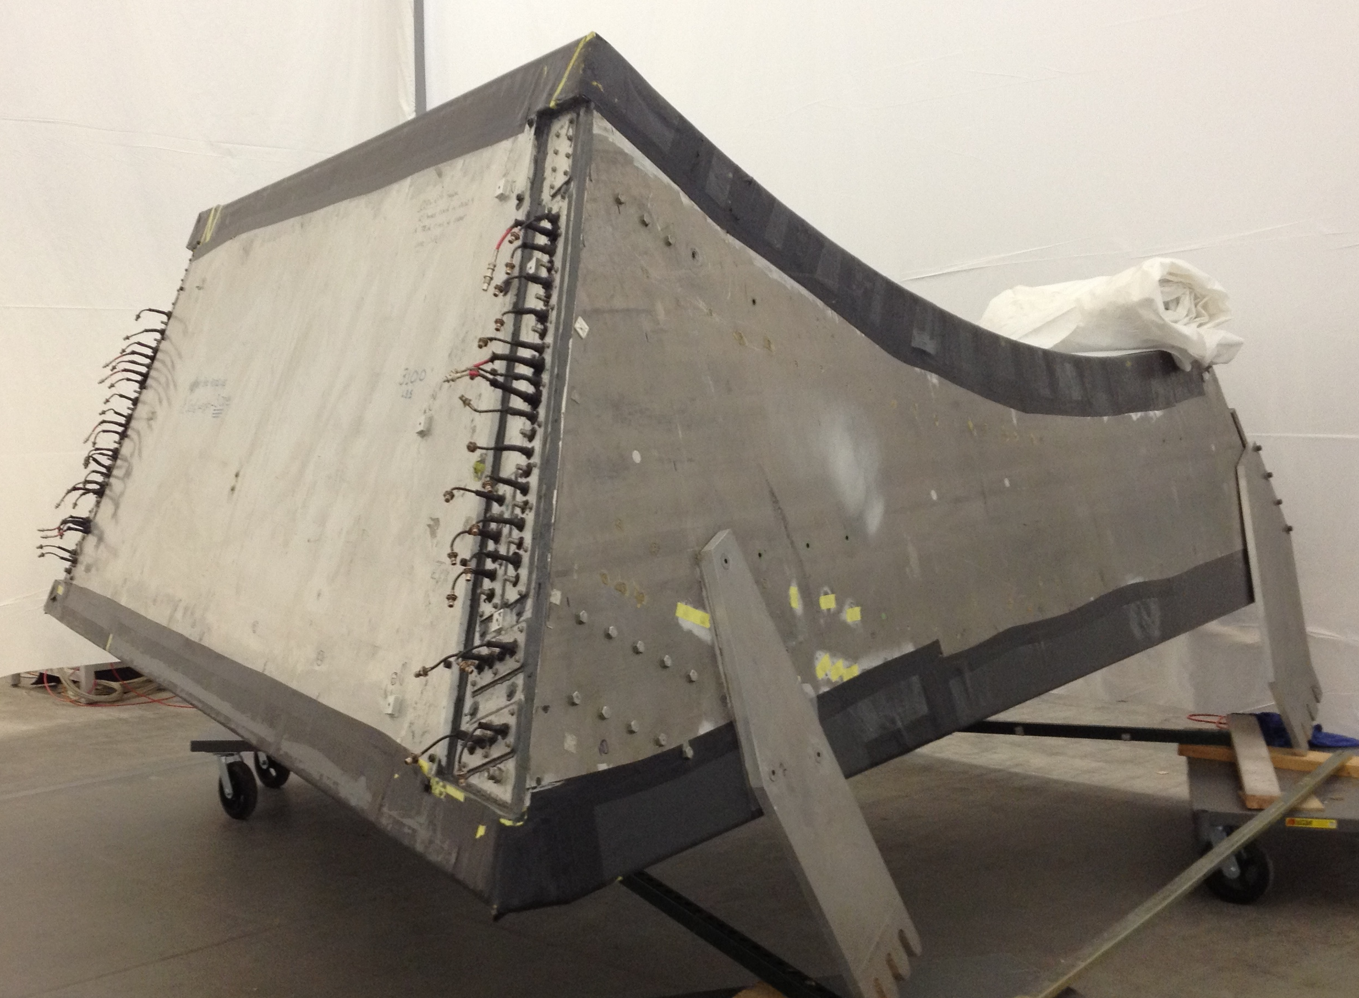
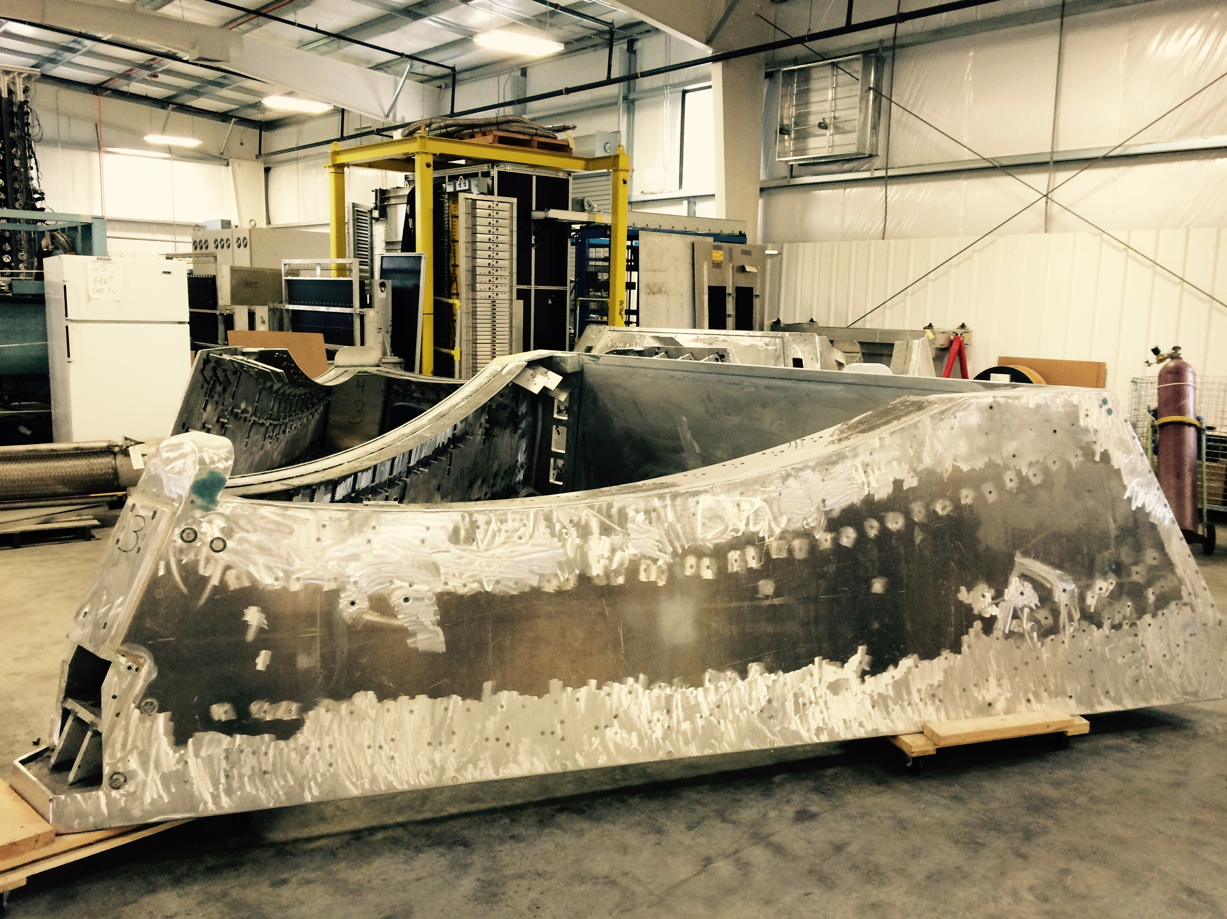
Box Cut, Nose, Mirrors relocation
  Overview
  Work Completed
  Work Remaining
  Turbo

Slide 13
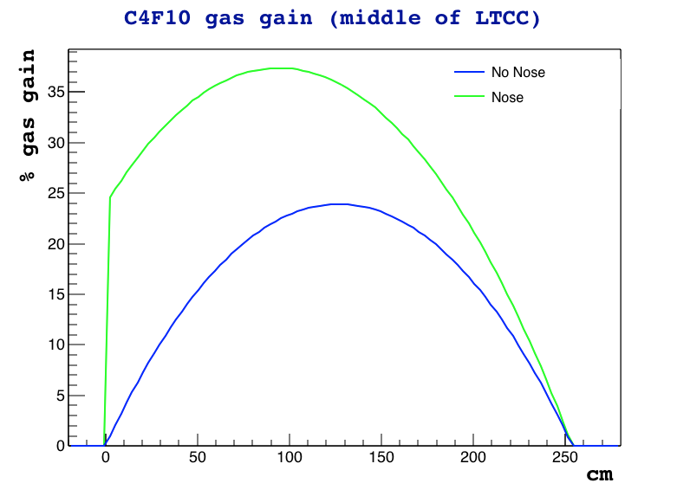
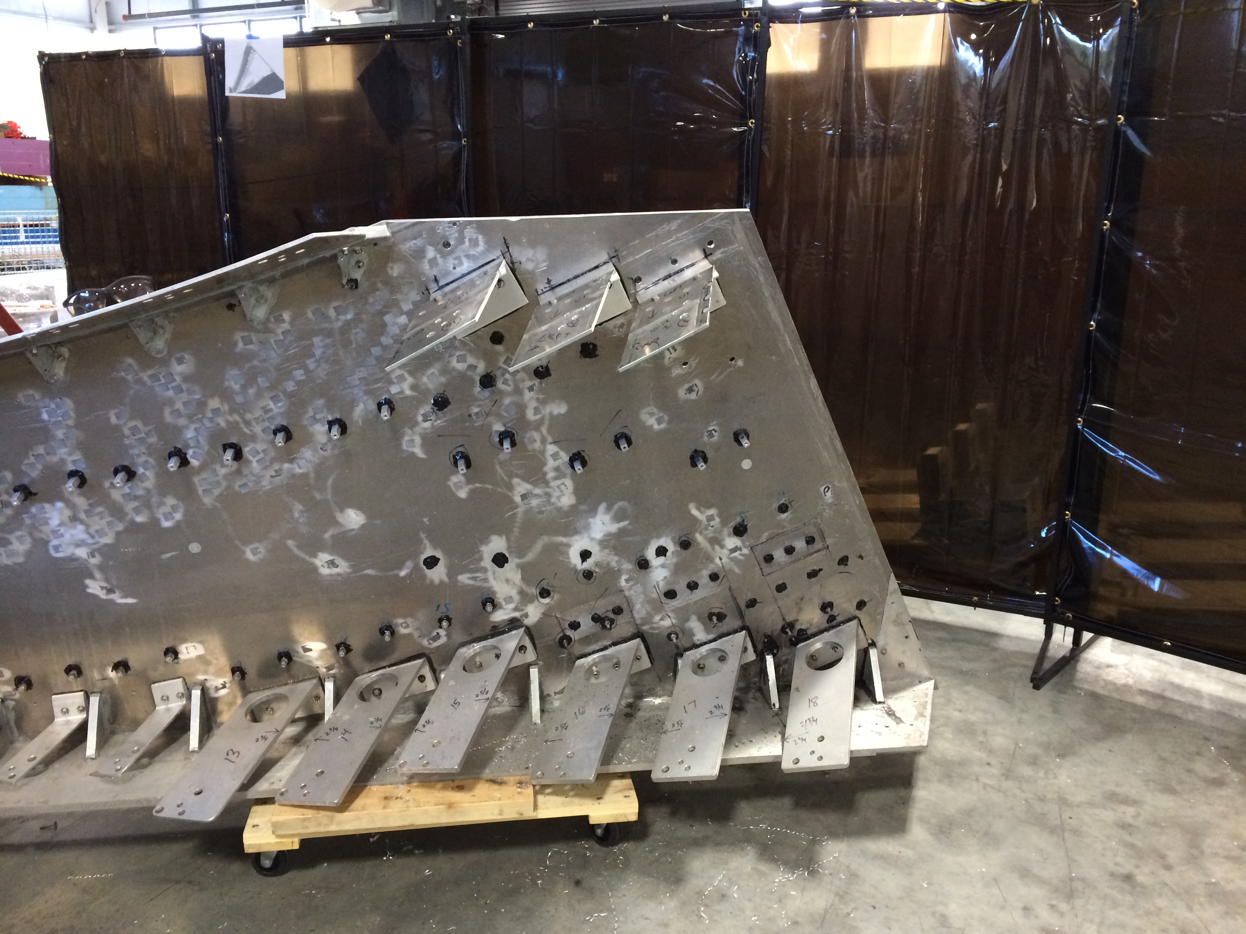
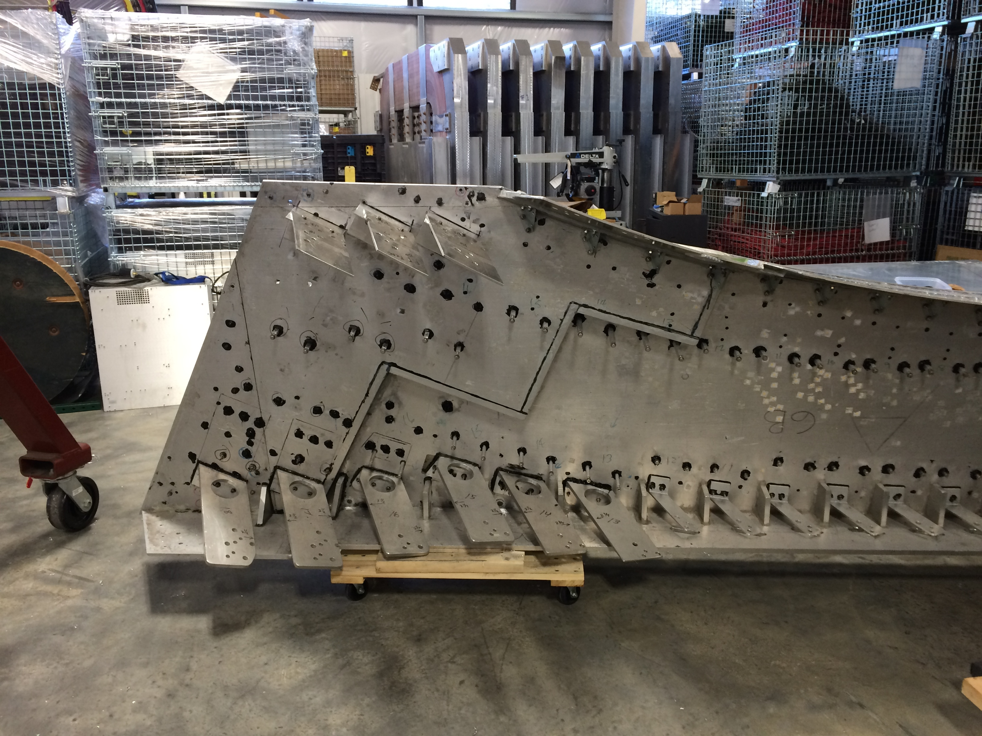
Box Cut, Nose, Mirrors relocation
  Overview
  Work Completed
  Work Remaining
  Turbo
x
x

Slide 14
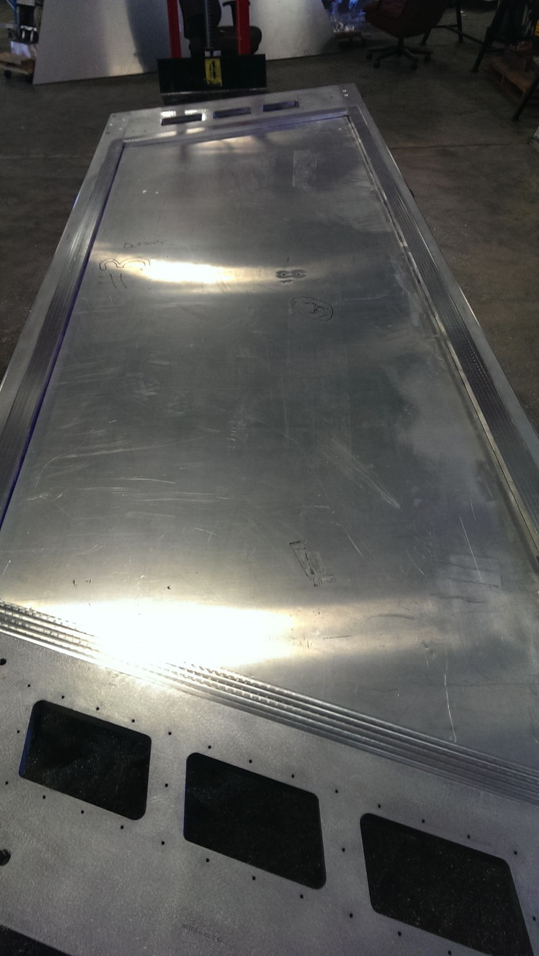
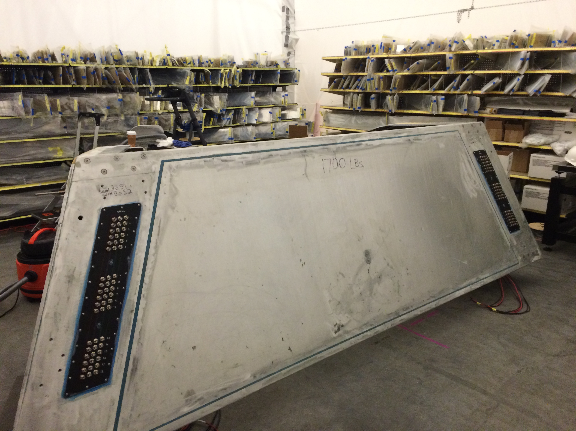
Back-wall, Connectors
  Overview
  Work Completed
  Work Remaining
  Turbo
Back-wall re-designed:
New frame
Old back-wall fitted on new frame, sealed
New hermetical connectors
One more PMT output
Back-wall: COMPLETED
Frame: $45,436.00
Connectors: $7,566.50

Slide 15
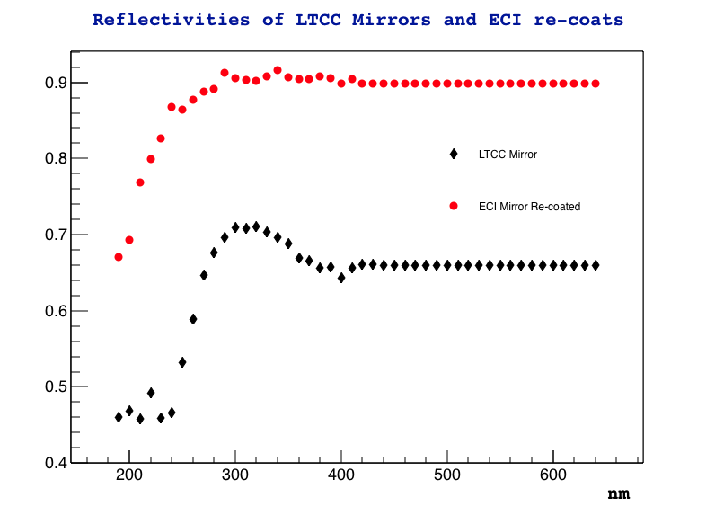
Mirrors
  Overview
  Work Completed
  Work Remaining
  Turbo
2 reflections only: 30% of the time
3 reflections ~40% of the time
4 reflections ~30% of the time
3 reflections visible:
~27.5% (original, 65% 1 reflection)
~68.1% (recoated, 88% 1 reflection)
3 reflections UV:
~9.1% (original, 45% 1 reflection)
~31.3% (recoated, 70% 1 reflection)
X ~2.4 better
X ~3.7 better

Slide 16
Cylindrical Mirrors
  Overview
  Work Completed
  Work Remaining
  Turbo
Cylindrical Mirrors Coating: COMPLETED
36 / box, 216 total
3 companies considered, tests from all
Awarded to ECI
Process: mirror in vacuum chamber, Al + MgF2 evaporation
Project Complete. Cost: $11,942.50

Slide 17
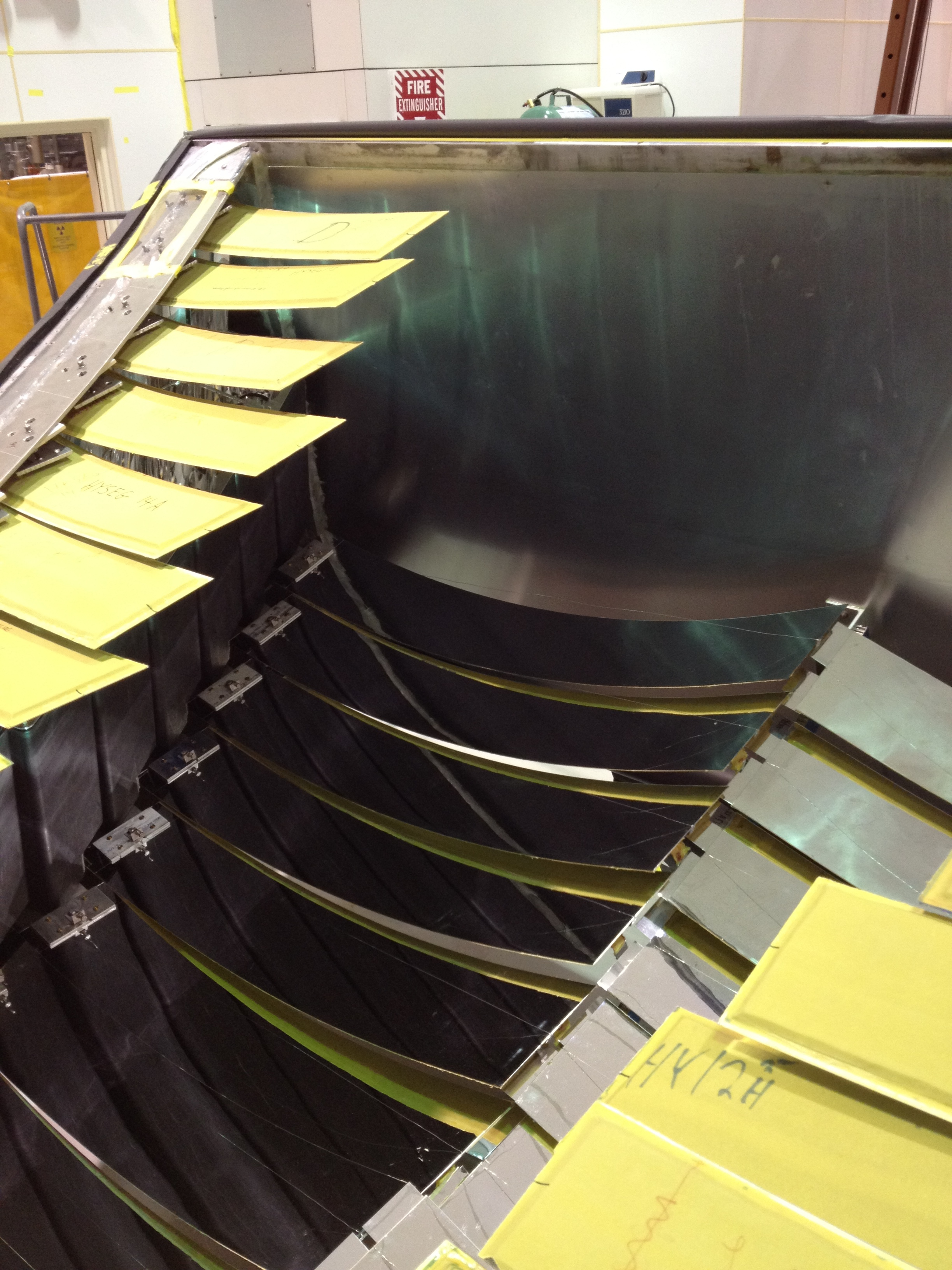
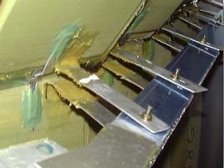
Elliptical, Hyperbolic Mirrors
  Overview
  Work Completed
  Work Remaining
  Turbo
Elliptical Mirrors: 36 / box, 216 total
Hyperbolic Mirrors: 36 / box, 216 total
Problem: cannot be re-coated:
Mirror outgas in vacuum chamber.
Many mirrors do not fit vacuum chambers.
All 3 companies failed on re-coating.

Slide 18
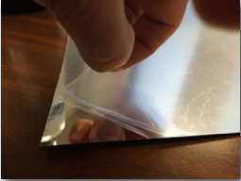
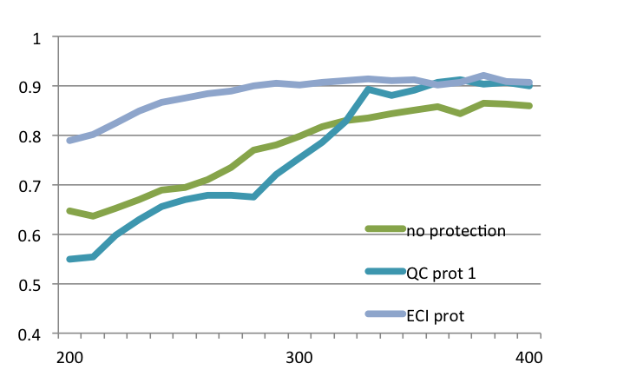
Elliptical, Hyperbolic Mirrors
  Overview
  Work Completed
  Work Remaining
  Turbo
Challenge:
Protect lexan strips while gluing to mirror
Final Product:
Only ECI could deliver lexan with layer of protection that did not degrade reflectivity
Elliptical Mirrors: 36 / box, 216 total
Hyperbolic Mirrors: 36 / box, 216 total
Problem: cannot be re-coated:
Solution:
Coat lexan strips
Glue lexan strips on top of mirror

Slide 19
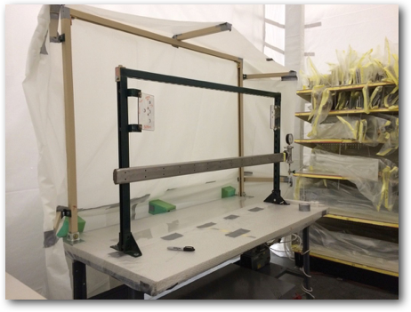
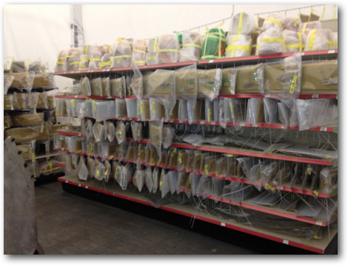
Elliptical, Hyperbolic Mirrors
  Overview
  Work Completed
  Work Remaining
  Turbo
Clean room environment
Spray glue pumped outside
Mirrors vaccum-holded
Lexan Strips rolled on mirror

Slide 20
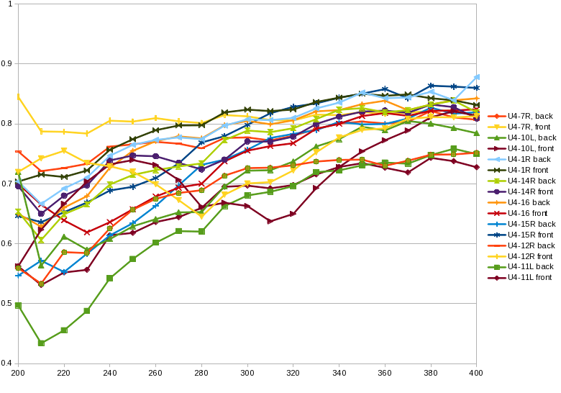
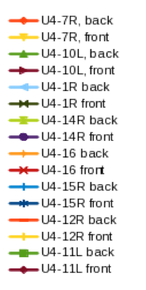
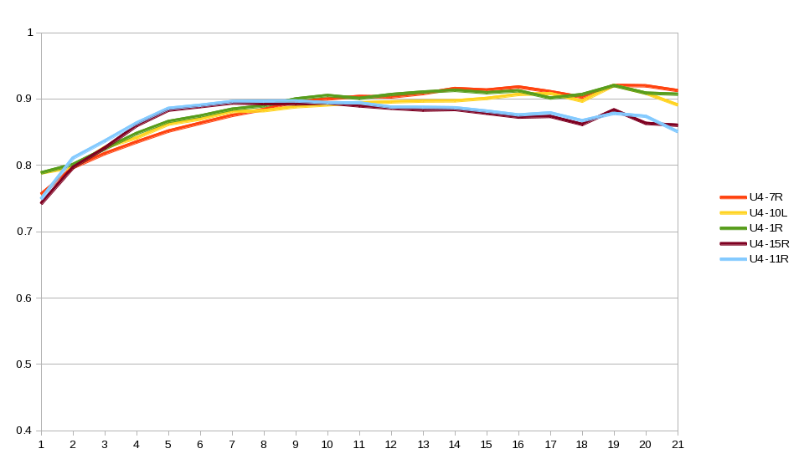
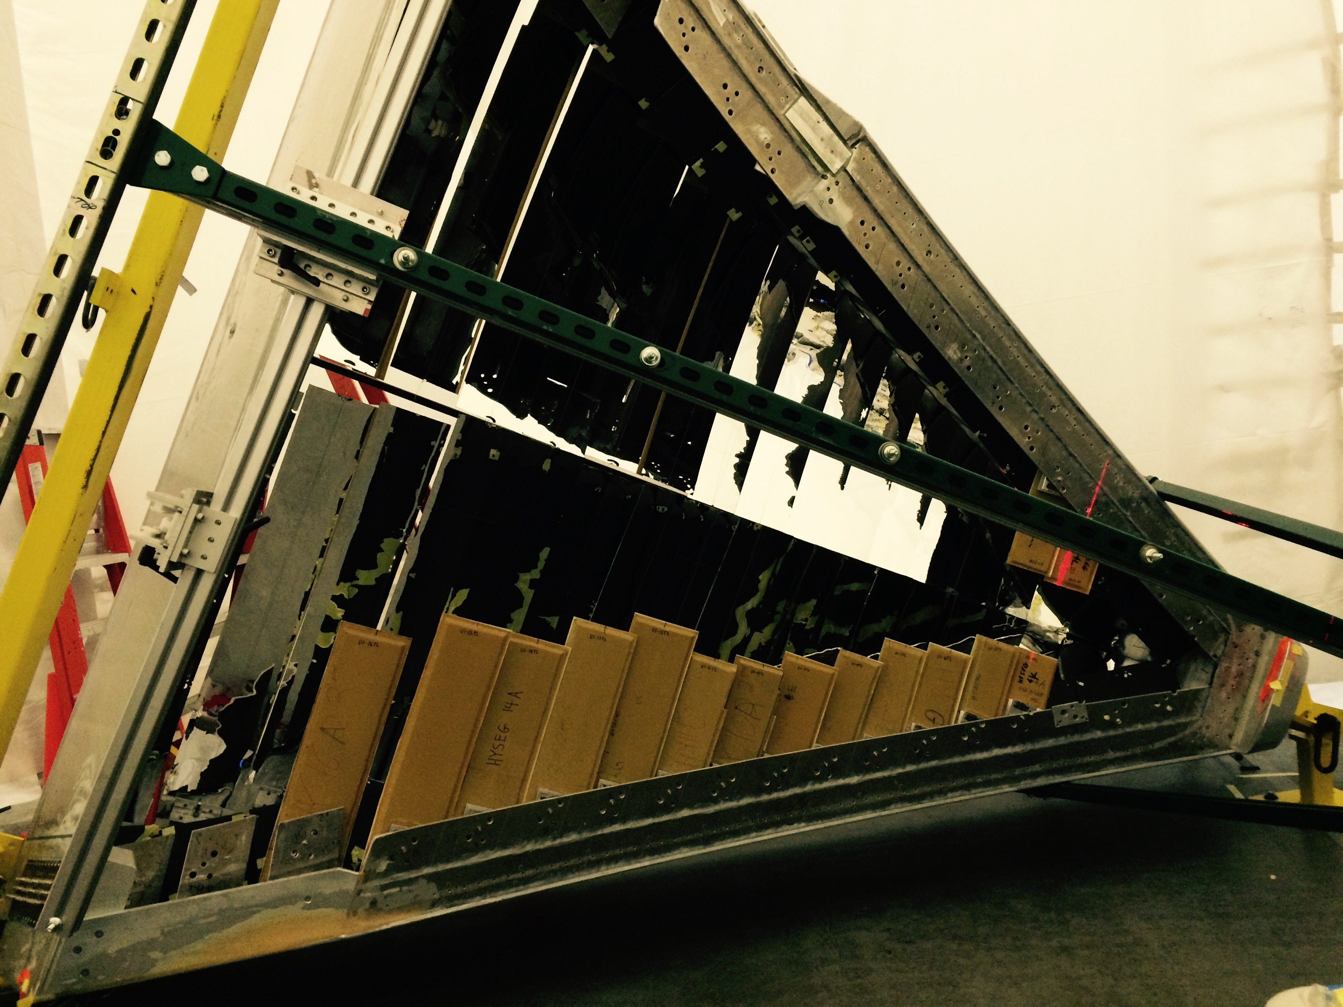
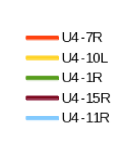
Elliptical, Hyperbolic Mirrors
  Overview
  Work Completed
  Work Remaining
  Turbo
Project Complete
Materials Cost: $53,100.00
Item Quantity Part Description USD Price
A 190 9" x 36" x 0.010” coated sheet $ 133.65 each
B 150 10" x 36" x 0.010” coated sheet $ 195.10 each
C 6 10" x 36" x 0.050” coated sheet $ 368.90 each
B
E
F
O
R
E
A
F
T
E
R

Slide 21
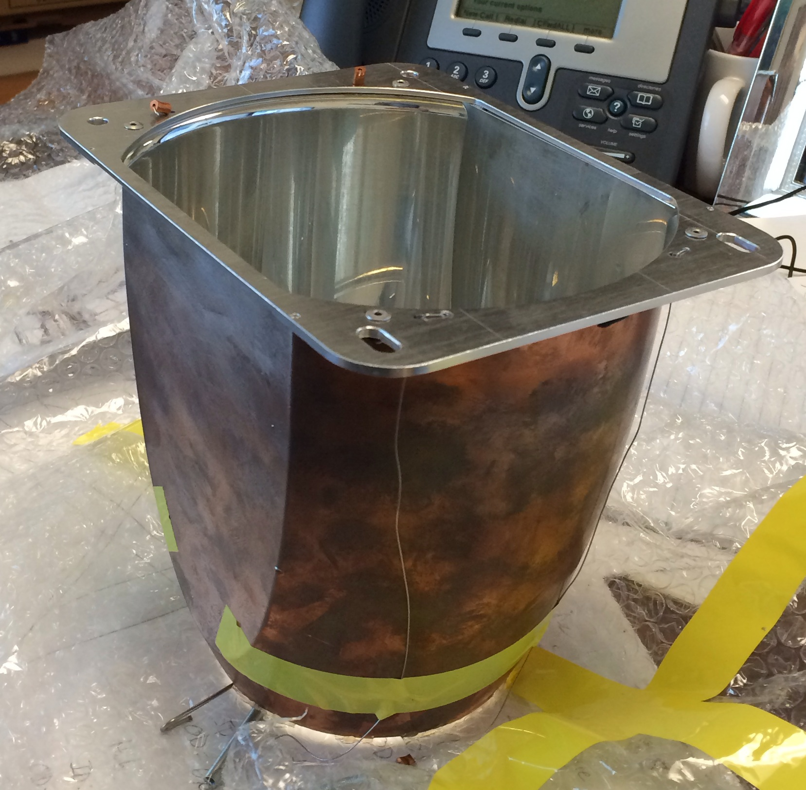
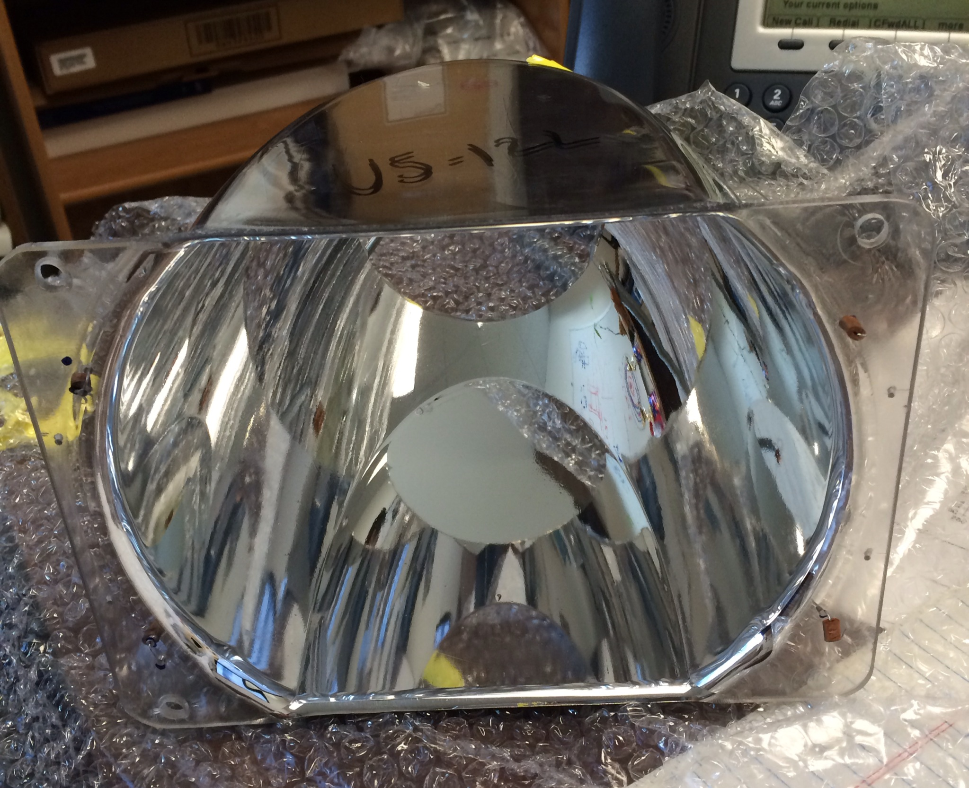
Winston Cones Coating
  Overview
  Work Completed
  Work Remaining
  Turbo
• Small:
  o Height: 18cm
  o Parallel Plate distance: 14cm
  o Radius at the top: 20cm
  o Radius at the bottom: 11cm
  o Material: copper (electro-formed)
• Medium:
  o Height: 22cm
  o Parallel Plate distance: 15cm
  o Radius at the top: 20cm
  o Radius at the bottom: 11cm
  o Material: 0.2” plastic (vacuum pressed)
• Large:
  o Height: 30cm
  o Parallel Plate distance: 18cm
  o Radius at the top: 22cm
  o Radius at the bottom: 11cm
  o Material: copper (electro-formed)
ECI Awarded: $500 / apiece
Budget: ~80K, or 160 cones out of 216.

Slide 22
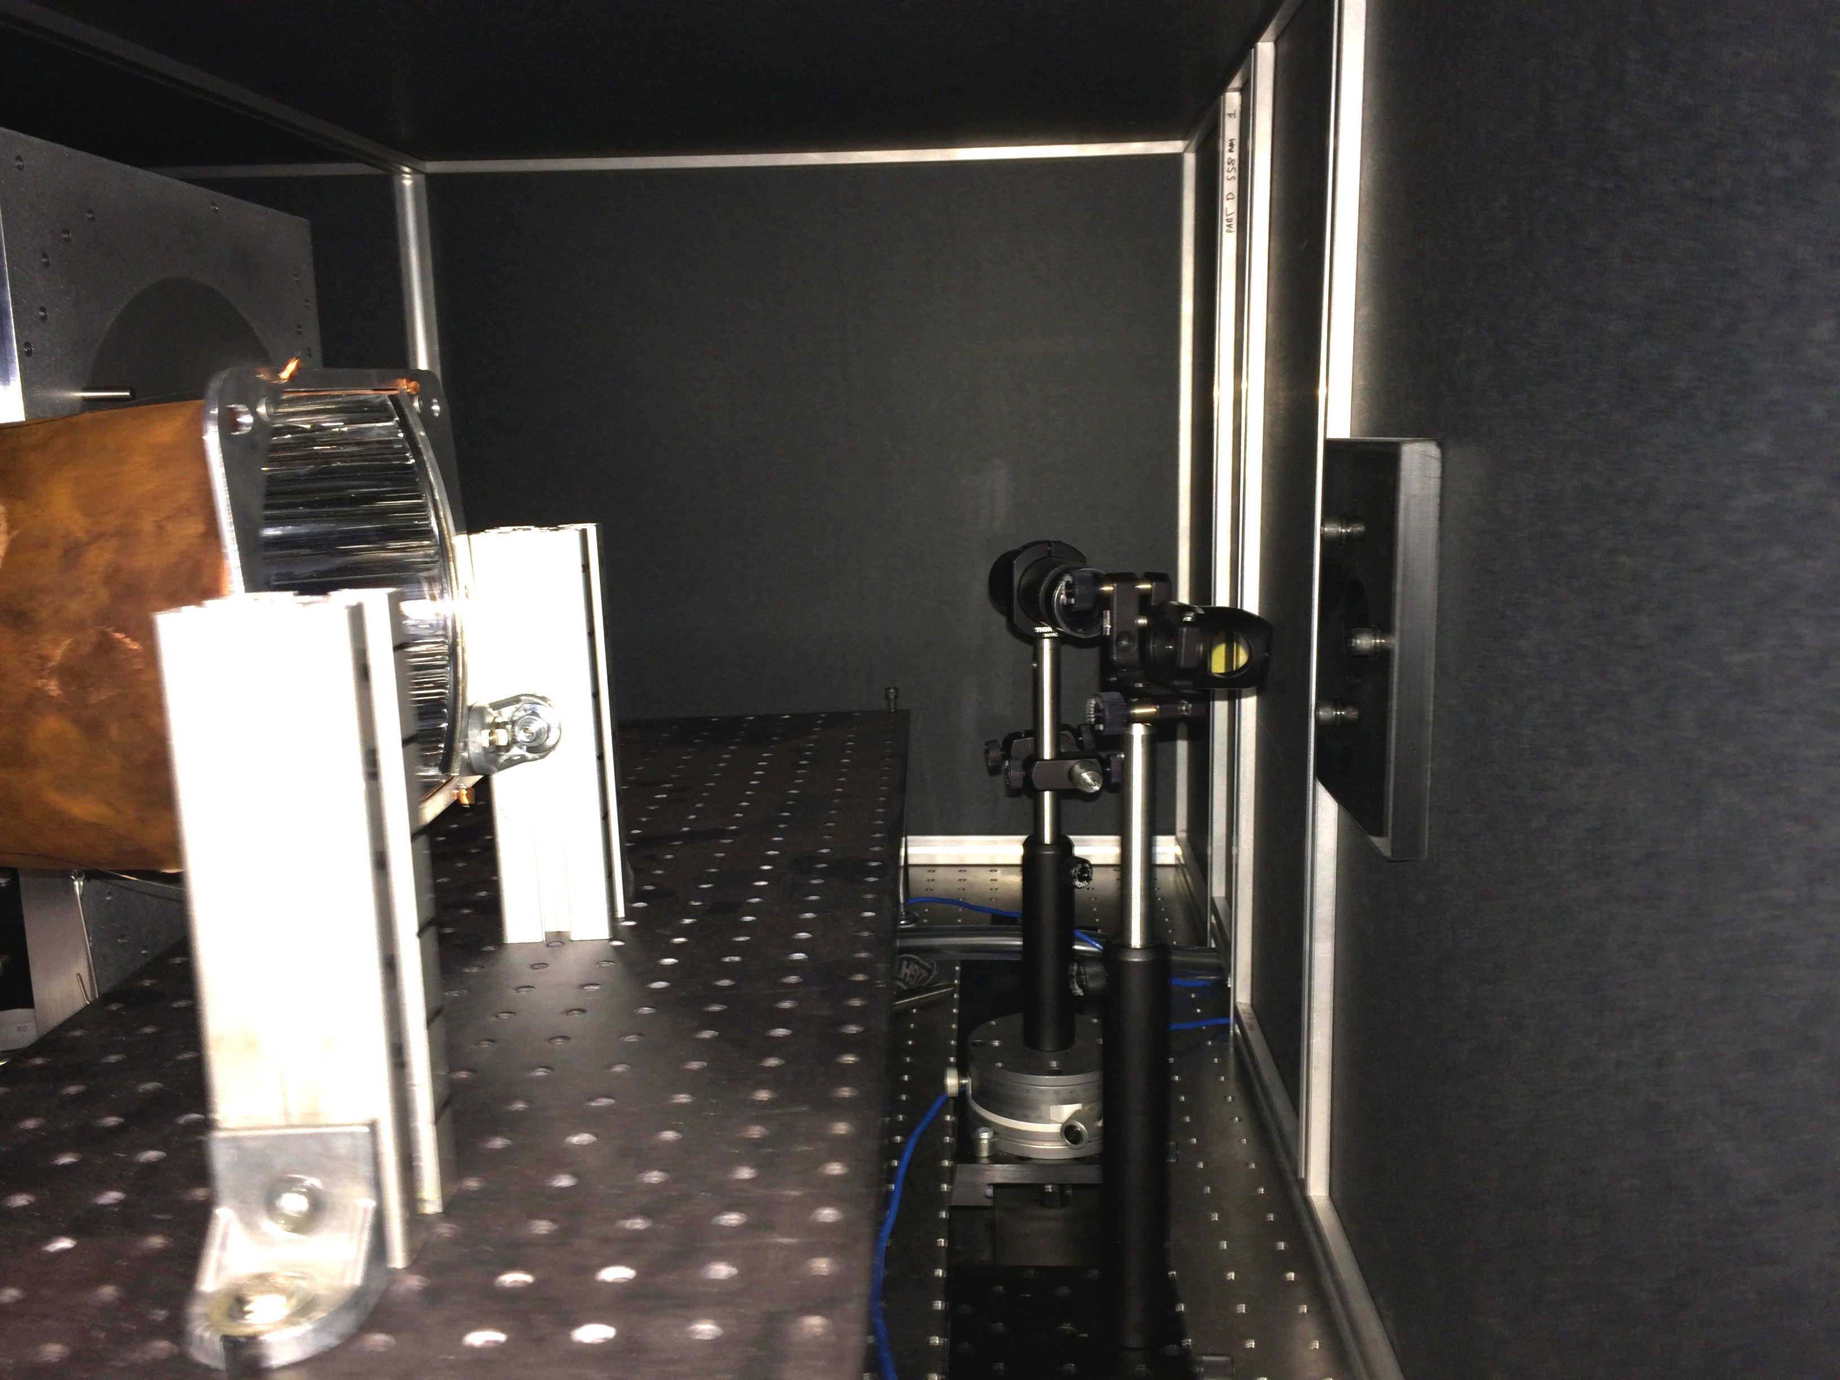
Winston Cones Coating
  Overview
  Work Completed
  Work Remaining
  Turbo
Original WCs Reflectivity UV Average
DSG Group Performed Tests
Setup:
Monochromator, splitter
Incident beam ~10-20 degrees
Reference photodiode
Labview to control wavelength
Labview to read two nanoAmmeters

Slide 23
Winston Cones Coating
  Overview
  Work Completed
  Work Remaining
  Turbo
Original WCs Reflectivity UV Average
Sector 1 |  | Sector 2 |  | Sector 3 |  | Sector 4 |  | Sector 5 |  | Sector 6
Left | Right | Left | Right | Left | Right | Left | Right | Left | Right | Left | Right
0.67 | 0.30 | 0.67 | 0.70 | 0.56 | 0.56 | 0.51 | 0.81 | 0.40 | 0.44 | 0.72 | 0.80
0.26 | 0.36 | 0.62 | 0.59 | 0.64 | 0.63 | 0.86 | 0.65 | 0.37 | 0.37 | 0.77 | 0.38
0.70 | 0.45 | 0.64 | 0.65 | 0.38 | 0.71 | 0.42 | 0.51 | 0.33 | 0.39 | 0.50 | 0.47
0.33 | 0.27 | 0.79 | 0.76 | 0.57 | 0.76 | 0.75 | 0.64 | 0.32 | 0.81 | 0.46 | 0.41
0.32 | 0.27 | 0.70 | 0.72 | 0.71 | 0.51 | 0.73 | 0.69 | 0.45 | 0.65 | 0.89 | 0.24
0.57 | 0.45 | 0.69 | 0.65 | 0.59 | 0.61 | 0.55 | 0.78 | 0.33 | 0.42 | 0.44 | 0.57
0.31 | 0.49 | 0.68 | 0.65 | 0.71 | 0.81 | 0.75 | 0.83 | 0.40 | 0.41 | 0.37 | 0.54
0.33 | 0.459029627 | 0.53 | 0.56 | 0.76 | 0.76 | 0.78 | 0.74 | 0.43 | 0.50 | 0.52 | 0.32
0.69 | 0.54 | 0.47 | 0.78 | 0.67 | 0.75 | 0.74 | 0.72 | 0.45 | 0.47 | 0.55 | 0.47
0.33 | 0.30 | 0.68 | 0.71 | 0.71 | 0.75 | 0.68 | 0.83 | 0.08 | 0.39 | 0.42 | 0.44
0.78 | 0.59 | 0.79 | 0.80 | 0.77 | 0.76 | 0.64 | 0.74 | 0.77 | 0.68 | 0.77 | 0.75
0.77 | 0.72 | 0.56 | 0.77 | 0.76 | 0.71 | 0.73 | 0.74 | 0.60 | 0.90 | 0.75 | 0.80
0.22 | 0.73 | 0.72 | 0.69 | 0.46 | 0.48 | 0.72 | 0.68 | 0.69 | 0.75 | 0.50 | 0.64
0.51 | 0.59 | 0.59 | 0.44 | 0.43 | 0.53 | 0.63 | 0.46 | 0.62 | 0.68 | 0.44 | 0.66
0.47 | 0.70 | 0.49 | 0.71 | 0.63 | 0.48 | 0.82 | 0.64 | 0.65 | 0.70 | 0.67 | 0.42
0.72 | 0.66 | 0.72 | 0.77 | 0.75 | 0.66 | 0.71 | 0.52 | 0.70 | 0.70 | 0.57 | 0.62
0.66 | 0.74 | 0.78 | 0.43 | 0.59 | 0.64 | 0.52 | 0.71 | 0.54 | 0.69 | 0.19 | 0.66
0.77 | 0.54 | 0.78 | 0.74 | 0.76 | 0.63 | 0.63 | 0.66 | 0.69 | 0.55 | 0.69 | 0.59
BAD
GOOD
Criteria:
R >= 0.8
10 passed quality tests

Slide 24
Winston Cones Coating
  Overview
  Work Completed
  Work Remaining
  Turbo
Coated WCs Reflectivity UV Average
Sector 1 |  | Sector 2 |  | Sector 3 |  | Sector 4 |  | Sector 5 |  | Sector 6
Left | Right | Left | Right | Left | Right | Left | Right | Left | Right | Left | Right
0.67 | 0.81 | 0.67 | 0.65 | 0.77 | 0.56 | 0.51 | 0.81 | 0.86 | 0.81 | 0.81 | 0.80
0.74 | 0.83 | 0.85 | 0.59 | 0.64 | 0.69 | 0.86 | 0.65 | 0.85 | 0.85 | 0.77 | 0.82
0.70 | 0.84 | 0.64 | 0.65 | 0.83 | 0.71 | 0.85 | 0.73 | 0.73 | 0.81 | 0.82 | 0.79
0.75 | 0.78 | 0.79 | 0.76 | 0.57 | 0.76 | 0.84 | 0.77 | 0.54 | 0.81 | 0.80 | 0.84
0.81 | 0.80 | 0.71 | 0.82 | 0.81 | 0.84 | 0.75 | 0.69 | 0.86 | 0.80 | 0.89 | 0.81
0.86 | 0.83 | 0.69 | 0.65 | 0.81 | 0.81 | 0.78 | 0.78 | 0.82 | 0.84 | 0.79 | 0.57
0.80 | 0.86 | 0.68 | 0.85 | 0.81 | 0.75 | 0.69 | 0.83 | 0.81 | 0.81 | 0.83 | 0.79
0.87 | 0.459029627 | 0.75 | 0.80 | 0.74 | 0.76 | 0.78 | 0.78 | 0.84 | 0.81 | 0.85 | 0.82
0.69 | 0.80 | 0.84 | 0.78 | 0.67 | 0.75 | 0.76 | 0.72 | 0.82 | 0.84 | 0.84 | 0.86
0.83 | 0.30 | 0.82 | 0.71 | 0.81 | 0.75 | 0.68 | 0.83 | 0.08 | 0.78 | 0.80 | 0.81
0.78 | 0.59 | 0.79 | 0.80 | 0.77 | 0.76 | 0.64 | 0.66 | 0.77 | 0.56 | 0.77 | 0.75
0.77 | 0.68 | 0.56 | 0.77 | 0.52 | 0.71 | 0.65 | 0.68 | 0.60 | 0.90 | 0.65 | 0.80
0.55 | 0.82 | 0.72 | 0.85 | 0.53 | 0.50 | 0.89 | 0.68 | 0.70 | 0.75 | 0.50 | 0.75
0.51 | 0.66 | 0.70 | 0.44 | 0.48 | 0.55 | 0.63 | 0.46 | 0.62 | 0.67 | 0.44 | 0.66
0.77 | 0.75 | 0.48 | 0.73 | 0.63 | 0.48 | 0.82 | 0.64 | 0.65 | 0.68 | 0.67 | 0.42
0.86 | 0.91 | 0.81 | 0.77 | 0.82 | 0.81 | 0.69 | 0.52 | 0.89 | 0.67 | 0.45 | 0.62
0.73 | 0.82 | 0.78 | 0.53 | 0.78 | 0.72 | 0.52 | 0.75 | 0.54 | 0.76 | 0.80 | 0.66
0.77 | 0.58 | 0.78 | 0.86 | 0.68 | 0.68 | 0.55 | 0.79 | 0.73 | 0.55 | 0.62 | 0.84
BAD
GOOD
Criteria:
R >= 0.8
75 passed our quality tests, 117 if criteria is R >= 0.75

Slide 25
Winston Cones Coating
  Overview
  Work Completed
  Work Remaining
  Turbo
Issues:
Many plastic and most large cones show same or worse reflectivity.
  Problem #1: previous lamination was flaky.
  Solution: We removed + polished
  The flaky part on and sent back to ECI for re-coat.
  The test back looked good so we went into production:
70 cones were delaminated in-house.
  Out of the 70 sent back, only ~20 show definite improvements.
  10 are so-so and the remaining show degradation.
The problem is the previous lamination prevents a good deposition
In progress:
Researching de-lamination by chemical means
Researching de-lamination by rough polishing (one is completed and ready to test)

Slide 26
Winston Cones Coating
  Overview
  Work Completed
  Work Remaining
  Turbo
WC STATUS:
36 installed (first box)
89 ready to install
21 cones at ECI
70 that would need de-lamination

Slide 27
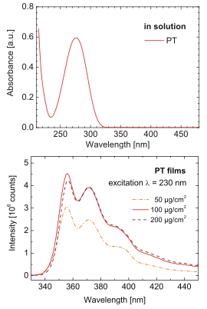
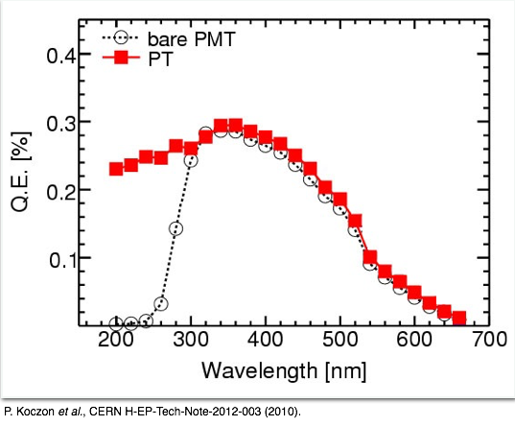
PMT Coating
  Overview
  Work Completed
  Work Remaining
  Turbo
p-terphenyl PMT coating proved successful in many experiments (at JLab as well)
Improve quantum efficiency of UV-glass PMTs to rival that of quartz PMTs

Slide 28
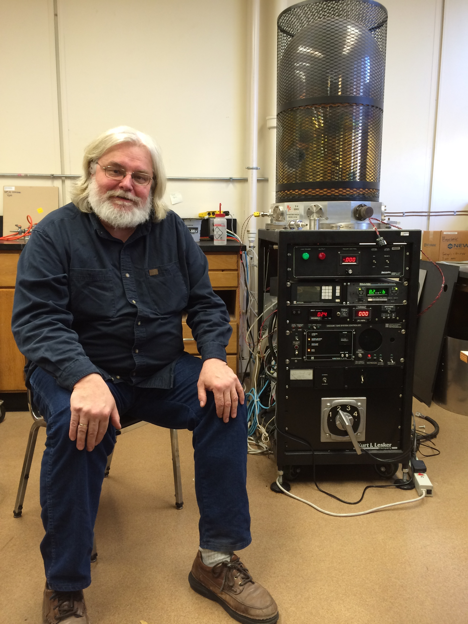
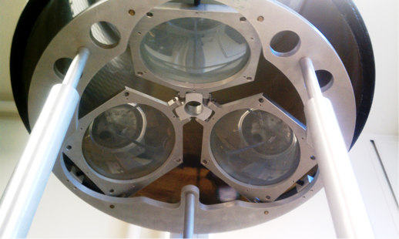
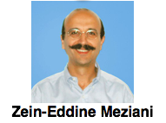
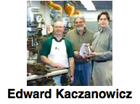
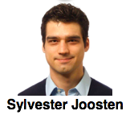
PMT Coating Procedure
  Overview
  Work Completed
  Work Remaining
  Turbo
Vacuum (10⁻⁶) ~a few hours
Clean PMT (acetone, alcohol)
Load p-terphenyl boat (~1.25g)
Heat PT boat, 150⁰C
Shutter close PMTs
Switch Boat
Heat MgF₂ (1200⁰C)
Open Shutter for fast MgF₂ deposition
2 LED (265nm and 290nm) at Temple for QA

Slide 29
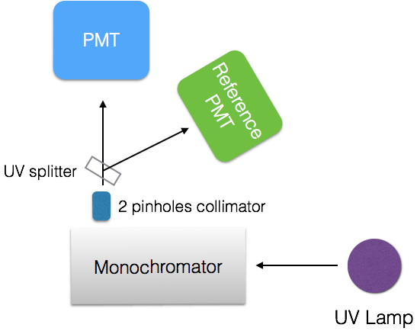
PMT Coating Measurement
  Overview
  Work Completed
  Work Remaining
  Turbo
JLab Monochromator: 200-400nm
2 Coated PMTs
1 Reference PMT
SPE matched
Rates Matched at 400 nm
(~10 HV change from SPE match)
Lamp Intensity so that:
Rates: ~100 KHz
Wavelength range:
200-400nm
Switched PMT / Reference PMTs positions: <10% effect
Shown: gain average between the 2 positions

Slide 30
PMT Coating Measurement
  Overview
  Work Completed
  Work Remaining
  Turbo
Gain Factor average
Points: ALL coated PMTs LED

Slide 31
PMT Coating
  Overview
  Work Completed
  Work Remaining
  Turbo
Project Complete
200 PMTs, $330 apiece
Cost: $66,000.00

Slide 32
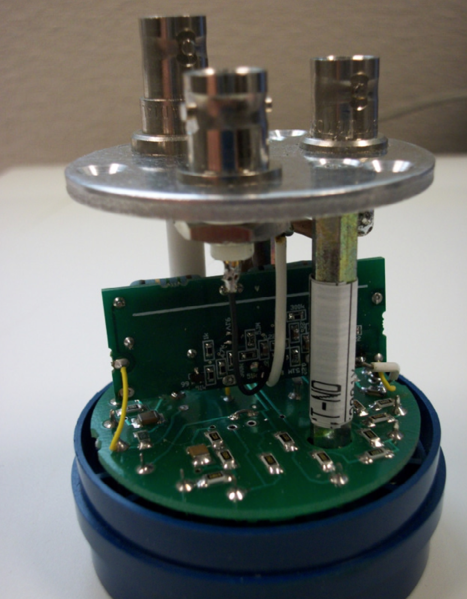
PMT Divider
  Overview
  Work Completed
  Work Remaining
  Turbo
CLAS: PMT signal was divided and amplified by UVA electronics modules no longer available.
Popov’s modification can be used instead
Vladimir Popov Design (Photonis wanted it!)
Provides 2 identical signal: X10 amplification (no penalties)
240 pcp boards populated by Flextron Circuit Assembly
167 divider modifications at JLab

Slide 33
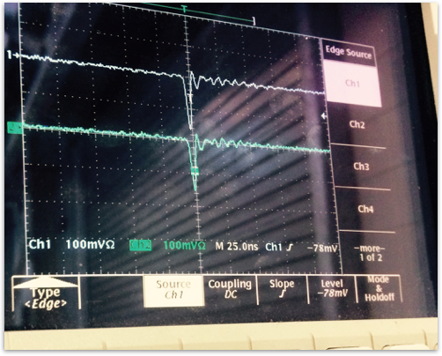
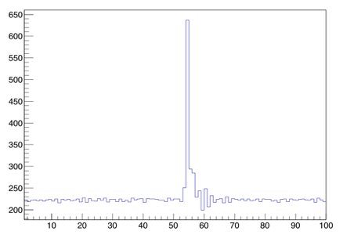
PMT Divider
  Overview
  Work Completed
  Work Remaining
  Turbo
self trigger (10-100 mV)
2 signals are identical
Voltage: 100V LESS than w/o modifier!
Data acquisition (raw mode) to test base AND pmt
integration region
raw FADC Spectrum

Slide 34
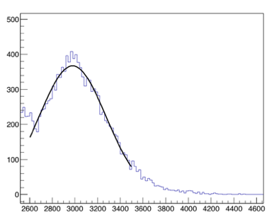
PMT Divider
  Overview
  Work Completed
  Work Remaining
  Turbo
Project: COMPLETED
Project cost:
~$5500 (materials)
6 FTE weeks DSG
3 days Popov’s Time
V.U. will complete mod
FADC Pulse Spectrum: SPE loud & clear!

Slide 35
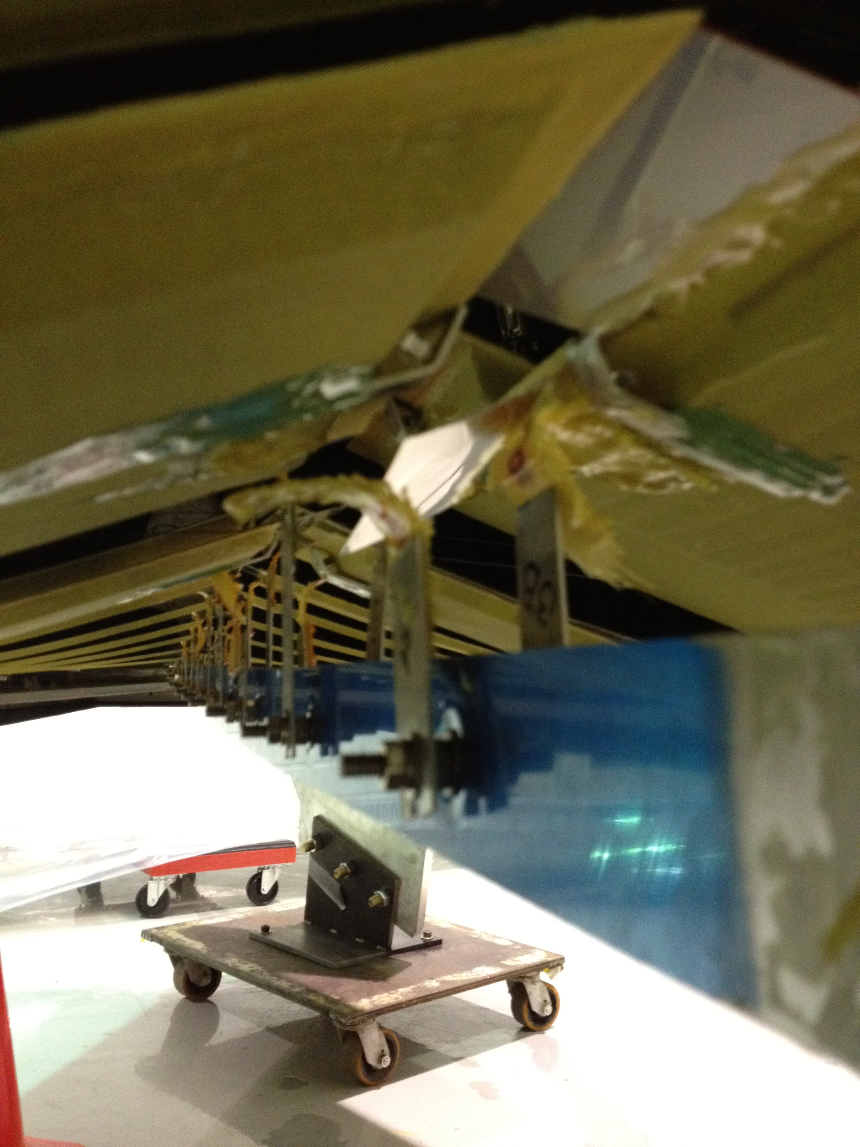
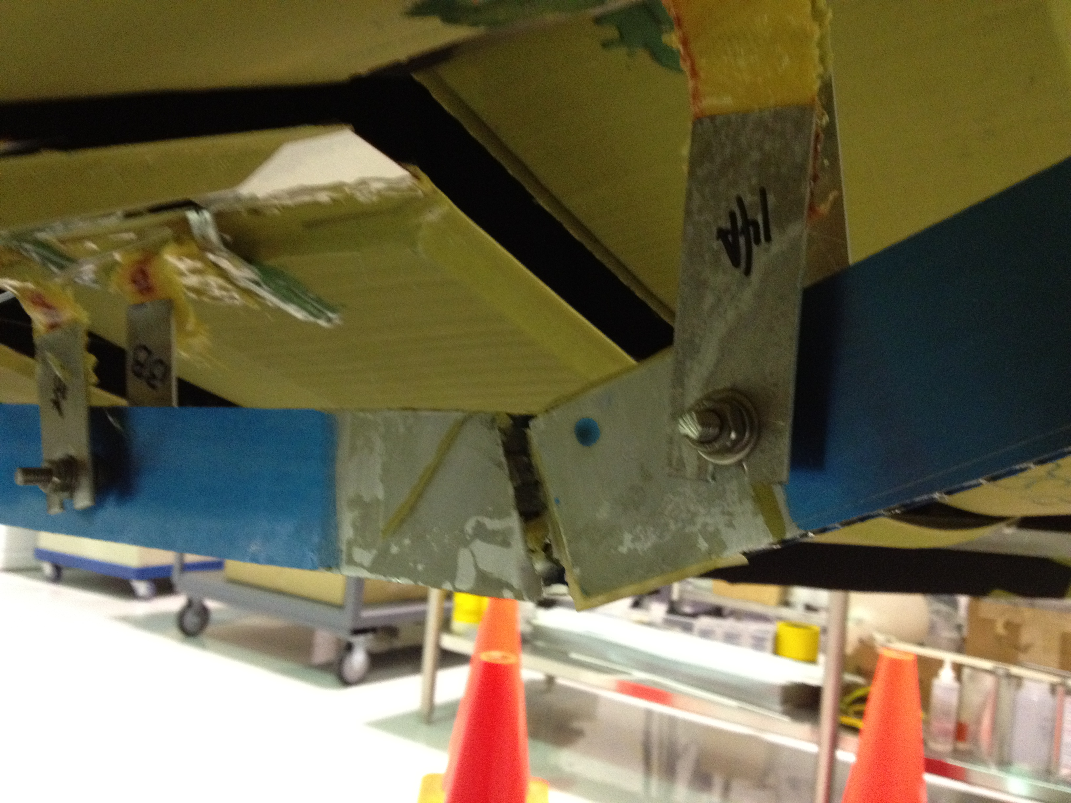
Mirrors Support
  Overview
  Work Completed
  Work Remaining
  Turbo
Aluminum Honeycomb “spine”. Attached with strips, plates and glue

Slide 36
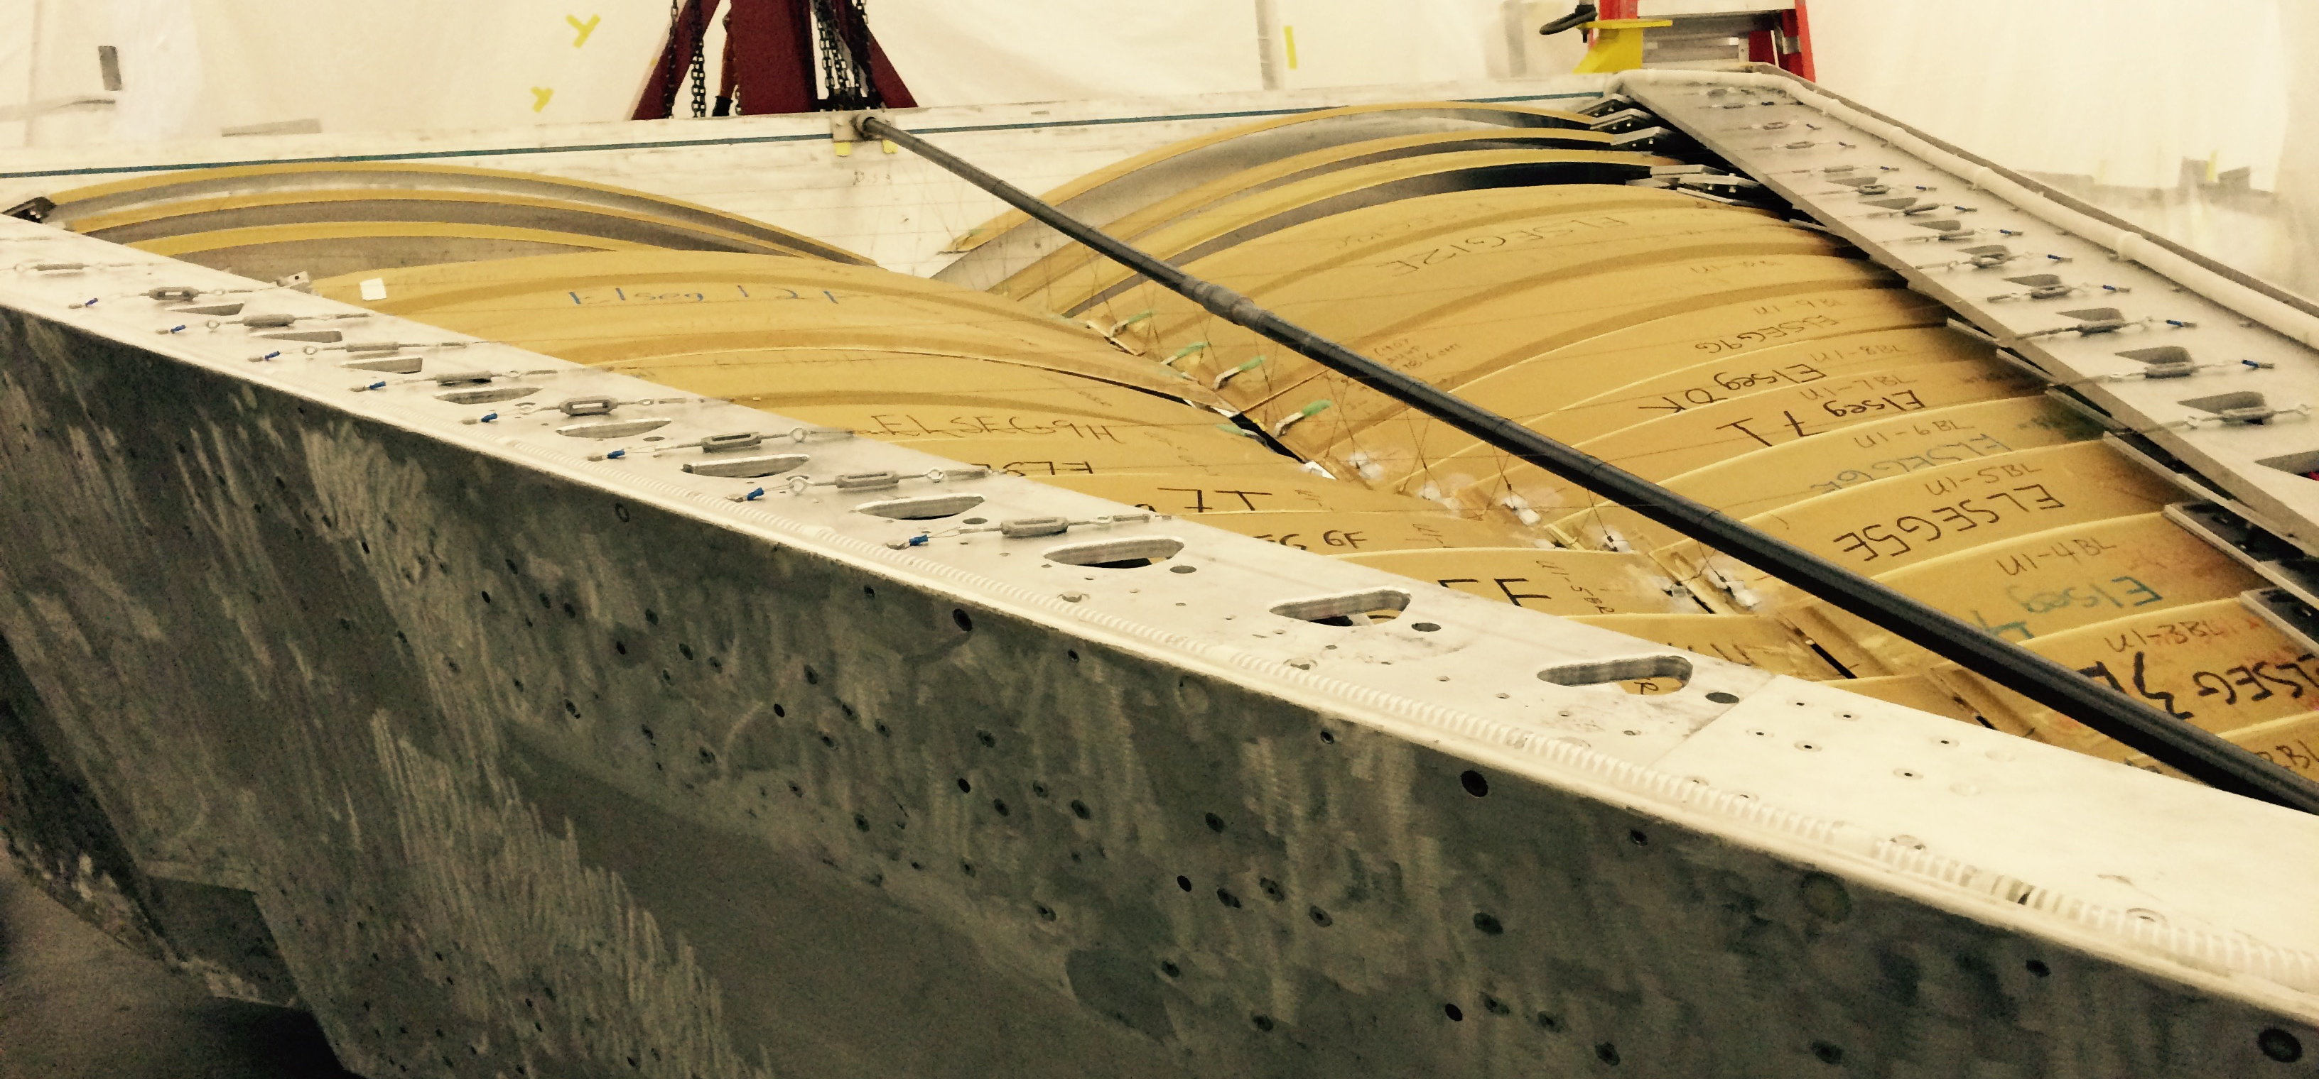
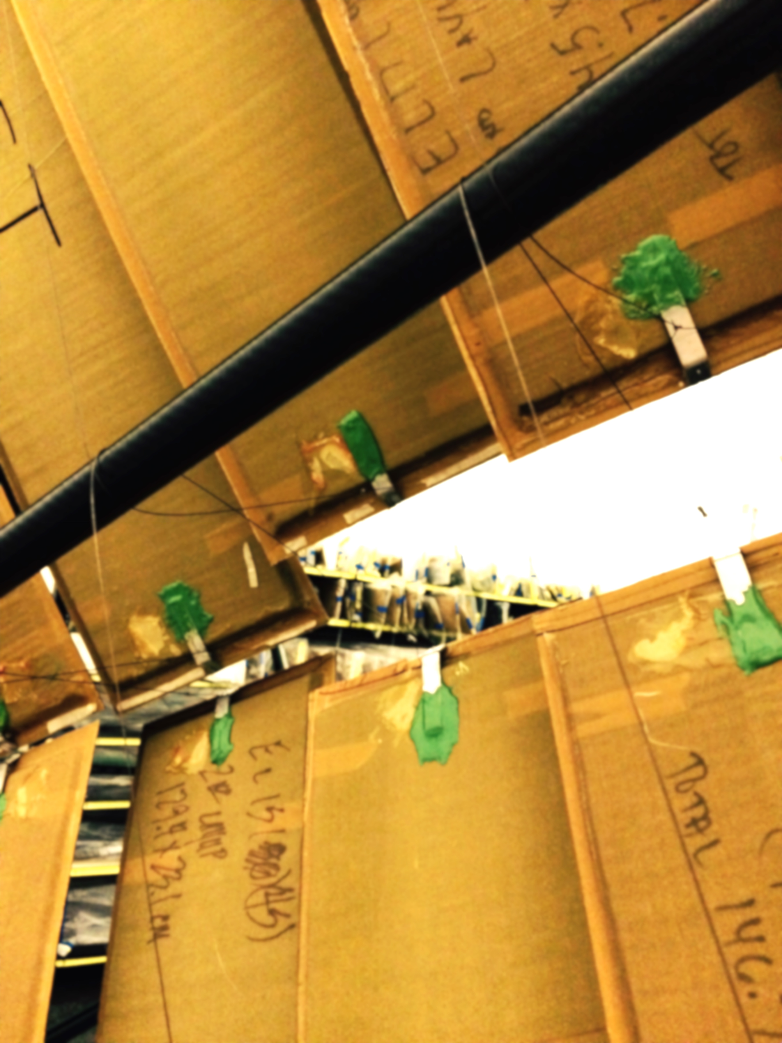
Mirrors Support
  Overview
  Work Completed
  Work Remaining
  Turbo
New Spine:
1” diameter, 1mm thick carbon fiber
22 mils stainless steel cabling to the box sides
Adjustment buckles, springs
Spine is “free to move” inside tube bolted on wall, 1/2” free space to allow for the 8mm movement of the back-wall

Slide 37
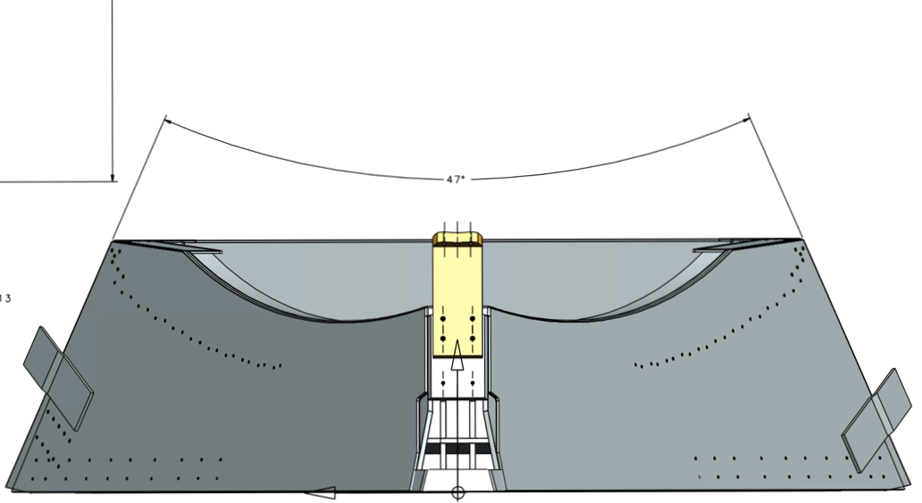
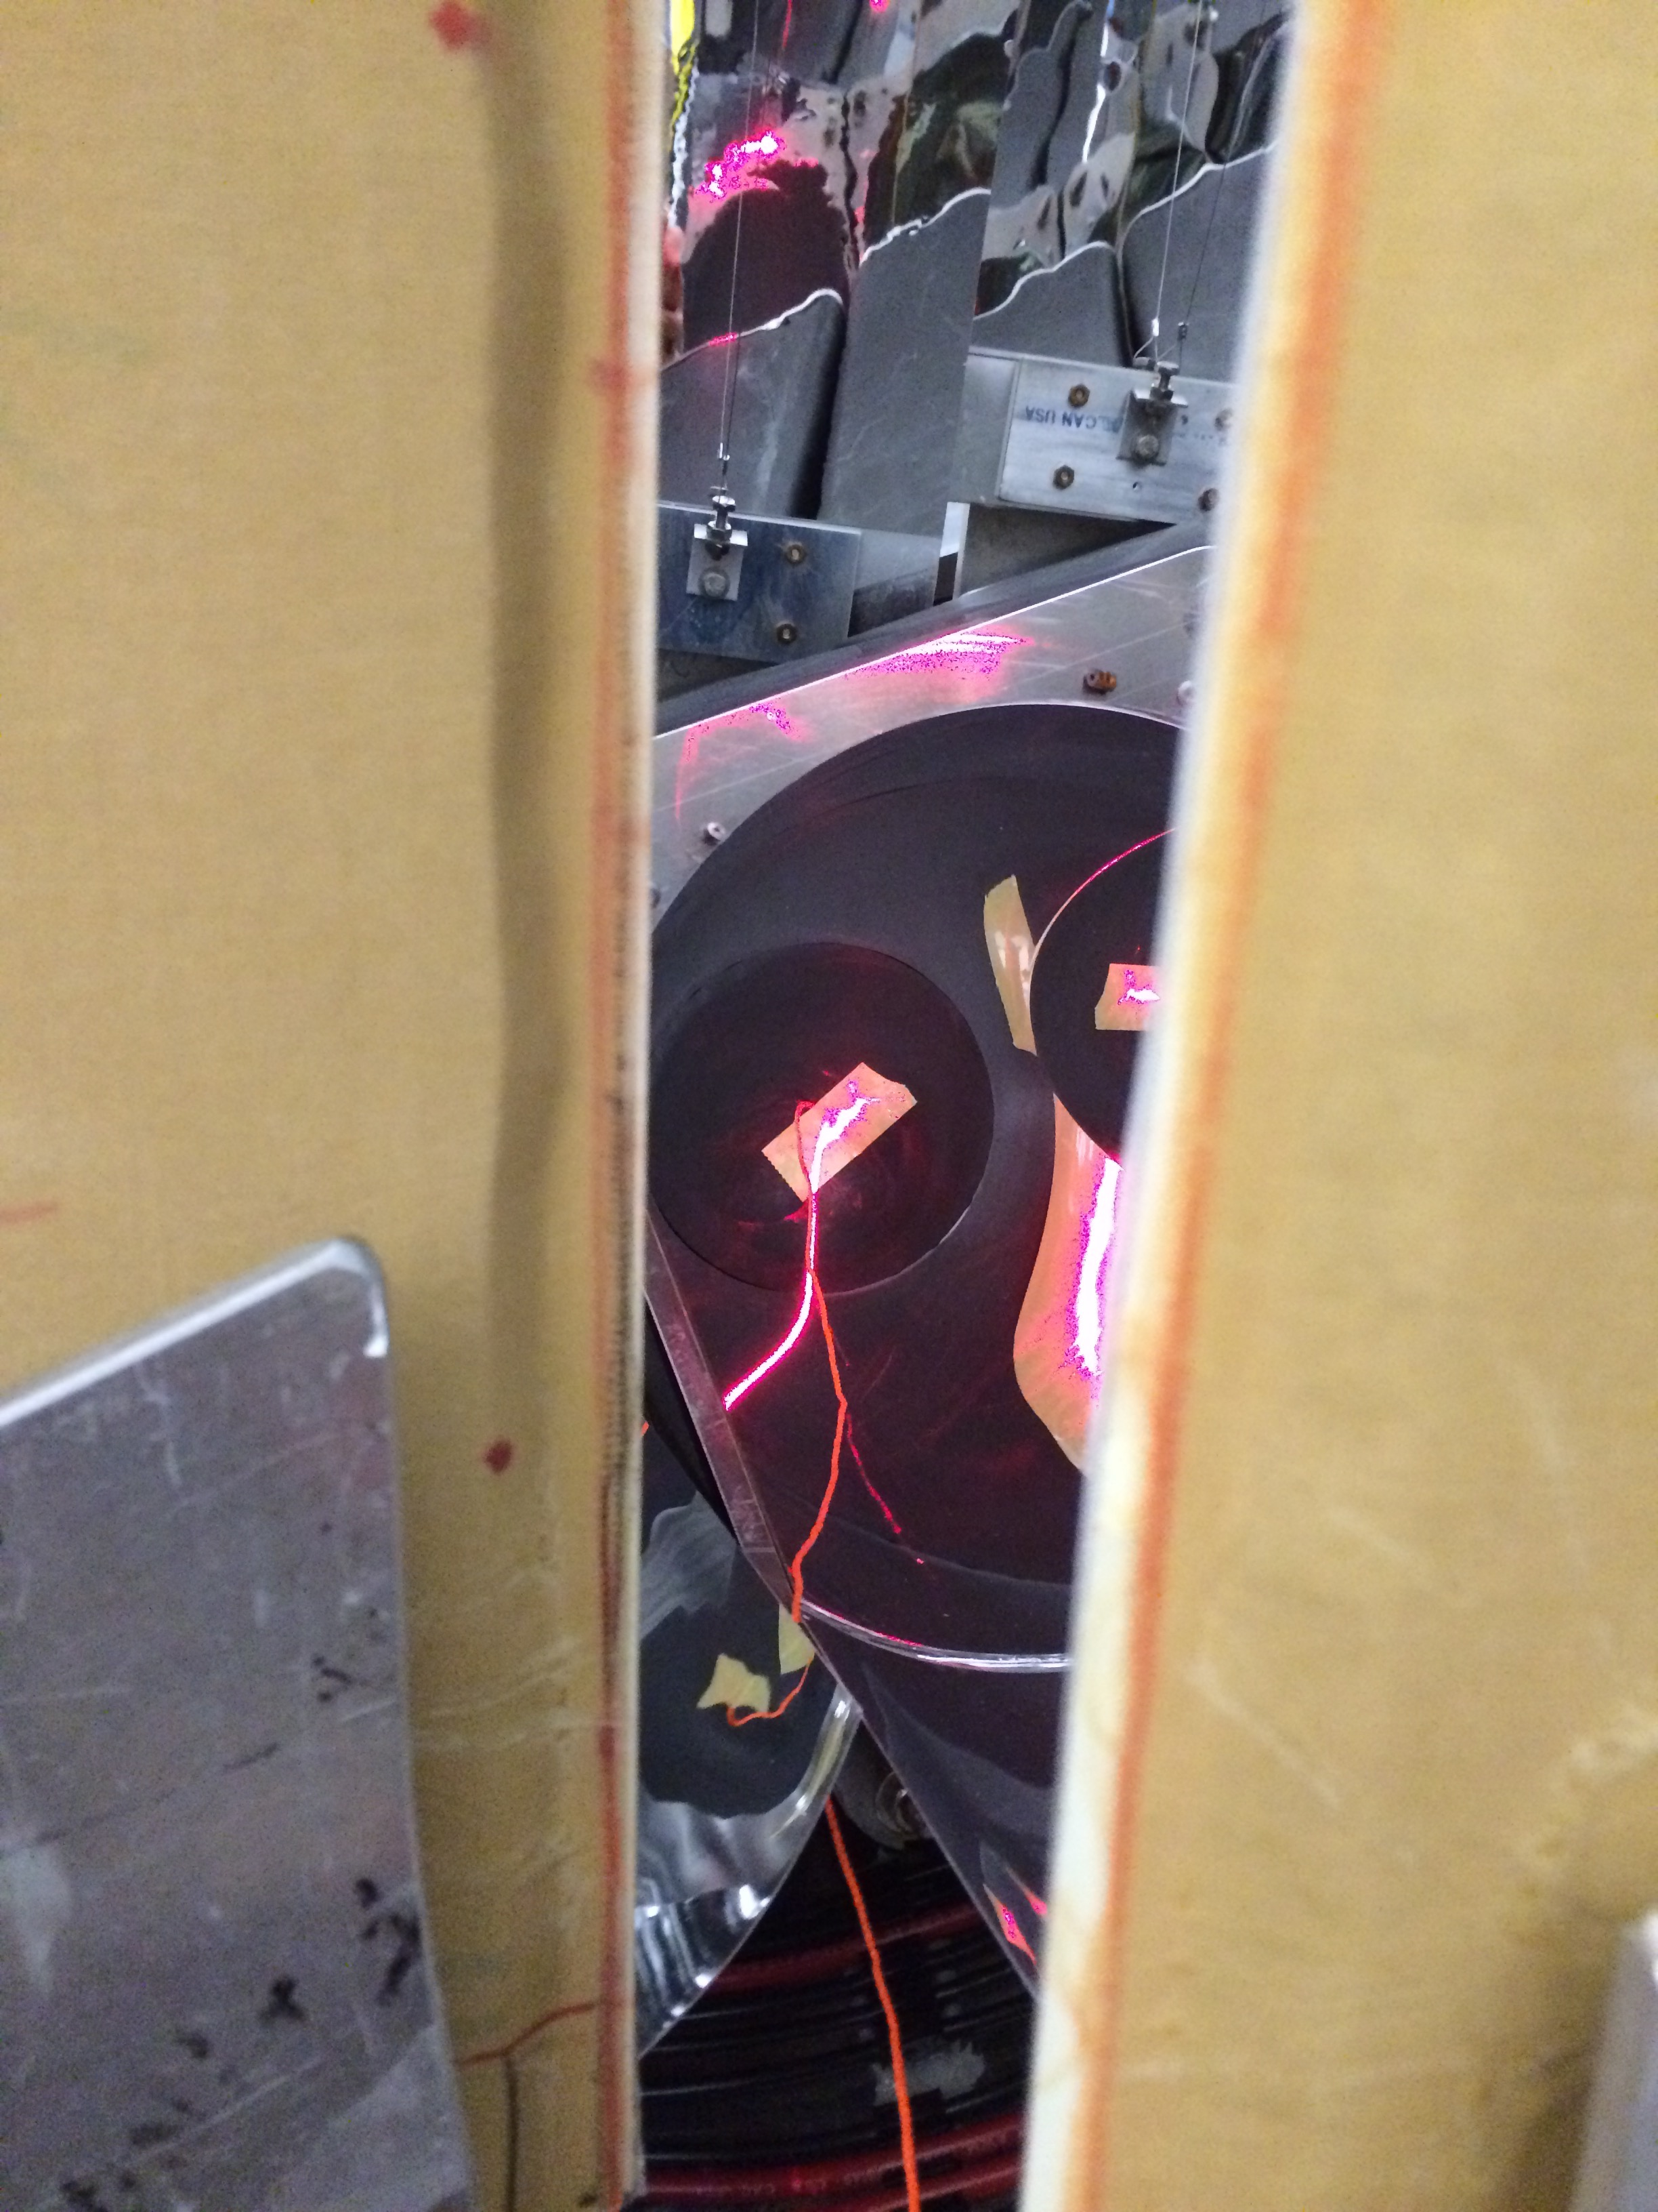

Mirrors Support Test
  Overview
  Work Completed
  Work Remaining
  Turbo
Box is vertical
Box is horizontal

Slide 38


Mirrors Alignment
  Overview
  Work Completed
  Work Remaining
  Turbo
WC missing from simulation
Laser line (20⁰) at the surveyed target position
Laser line (3⁰) on frame near upstream window (virtual pion) give same results
Optimize Elliptical Mirror alignment
Optimize Hyperbolic Mirror alignment
Fix to mirrors support
Optimize both mirrors to collect as much light as possible

Slide 39


Mirrors Alignment
  Overview
  Work Completed
  Work Remaining
  Turbo
Alignment is completed on the first box

Slide 40

Window Fabrication
  Overview
  Work Completed
  Work Remaining
  Turbo
Need: 15’x15’ upstream and downstream windows, for HTCC and LTCC
62” roll of black tedlar, 200 lbs (1300 yards) : $12,600 (HTCC, DuPont Tedlar)
Lamination: $20,000 (LTCC, Madico)

Slide 41


Window Tests
  Overview
  Work Completed
  Work Remaining
  Turbo
Lamination
Force (lbs) | Length | Stretch (in) | Stress (psi)
6 | 9.1250 | 0.0000 | 250.0
37 | 9.1250 | 0.0000 | 1541.7
76 | 9.1250 | 0.0000 | 3166.7
117 | 9.1875 | 0.0625 | 4875.0
160 | 9.2500 | 0.1250 | 6666.7
200 | 9.4375 | 0.3125 | 8333.3
240 | 9.8125 | 0.6875 | 10000.0
280 | 10.5000 | 1.3750 | 11666.7
440 | 12.1250 | 3.0000 | 18333.3
Seam
Weight(lbs) | Length(in.)
0 | 10.31
50 | 10.44
100 | 10.50
150 | 10.56
200 | 10.63
250 | 10.75
300 | 11.06
388 | Failed at seam

Slide 42

Window On LTCC
  Overview
  Work Completed
  Work Remaining
  Turbo
Downstream window sealant curing
Window assembly project:
COMPLETED
All windows + 4 spares
Attachment to box:
Sealant: silicon
Glue: G-Flex
2 layers of silicon sandwich a 4” wide band of g-flex

Slide 43



LTCC Calibrations
  Overview
  Work Completed
  Work Remaining
  Turbo
CLAS12 Calibrations
HTCC and LTCC
HV Matching
SPE analysis
CCDB I/O
CAEN SY4527 HV I/O
ROOT Output
PMT, bases currently being tested using the a beta version of the software
Missing: Reading from ET ring

Slide 44
Outline
  Overview
  Work Completed
  Work Remaining
  Turbo
Work Remaining

Slide 45
LTCC Remaining Procurement
Work Remaining
  Procurement
  Labor
  Commissioning
Winston Cones: $36,868, ~70 cones
Delamination research in progress:
by chemical means ($30-60 apiece, at Nicoform)
  Cost: $4200 – Estimate by Nicoform (company that produced the HTCC WC)
  Budget Increase
by polishing (one is completed and ready to test)
V.U. Labor
No other remaining procurement

Slide 46
LTCC Remaining Labor
Work Remaining
  Procurement
  Labor
  Commissioning
First box being closed up as we speak:
Back-wall installation
Hardware population
Mirror Alignment and support
Window installation
done for first box, need to do it for the remaining 5 boxes.
All procedures checked out.
Issue: alignment, window activities cannot be done at the same time as hardware population
Estimate: 4-5 weeks / box (2 Techs) = 50 Mweeks
1 Tech from Hall-D
1 Visiting User

Slide 47
LTCC Remaining Activities
Work Remaining
  Procurement
  Labor
  Commissioning
Activity ID | Name | Activity Start | Activity Finish | Remaining Budgeted MWeeks or Proc. Cost
242242512, 517, 525, 530 | Winston Cone and PMT work | 1/5/15 | 9/21/15 | $36,868 + 2.6
242242550-575 | Complete Box 1 | 1/23/15 | 6/30/15 | 3.6
242242590-620 | Complete Box 2 | 1/23/15 | 8/14/15 | 9.5
242242635-665 | Complete Box 3 | 2/19/15 | 9/22/15 | 9.8
242242680-710 | Complete Box 4 | 2/23/15 | 10/29/15 | 9.7
242242725-755 | Complete Box 5 | 2/16/15 | 12/9/15 | 11.0
242242770-805 | Complete Box 6 | 2/16/15 | 1/27/16 | 11.3
24267175, 180, 190, 195, 215 | LTCC Installation Tooling and Mounting | 8/4/15 | 2/19/16 | $5,847 + 15
2822X045, 050 | Calibration Software | 1/5/15 | 6/30/15 | 3
2822X065, 070 | Survey/Cable/Test/Repair | 2/22/16 | 3/2/16 | 5.4
~ 60 Mweeks for LTCC

Slide 48
LTCC Commissioning
Work Remaining
  Procurement
  Labor
  Commissioning
OFF PROJECT
Monitoring:
  Straightforward, using CLAS12 tools
Beam ON additional commissioning:
  Timing Calibration (Calibration Suite)
  HV Matching in torus field
C4F10 Gas load test
PMTs commissioning:
  All channels powered, connected to DAQ.
  Calibration suite
SPE Calibration:
  HV Matching to align SPE peaks
Slow Control:
  Straightforward, HV control using CLAS12 tools
1 year: Oct 2015 to Oct 2016
20% FTE Scientist
M. Ungaro

Slide 49
Turbo
  Overview
  Work Completed
  Work Remaining
  Turbo
  How to meet FY15

Slide 50
Turbo
  Overview
  Work Completed
  Work Remaining
  Turbo
To meet FY15
Second production line, in the nearby HTCC clean tent
Alignment can be done in parallel with hardware and window installation (including leak checks).
Nearby location is critical for productivity (other locations would not be worth it)
No MATERIAL COST or MANPOWER increase
HTCC clean room availability ASAP is critical

Slide 51
Summary
All hardware component are in place, except WC.
First box is completed
One remaining procurement: WC. $36,868
  Possible budget increase: $4200
  Research in progress to solve the related problems.
Remaining Labor:
  10 MT MWeeks / box = 50 MT Mweeks
  1.5 Scient. Mweeks / Box = 7.5 Mweeks
  5 Mweeks VU
Second production line necessary to meet FY 2015
Detector Installation scheduled for Spring 2016

Slide 52
Backup
Sector 1 |  | Sector 2 |  | Sector 3 |  | Sector 4 |  | Sector 5 |  | Sector 6
Left | Right | Left | Right | Left | Right | Left | Right | Left | Right | Left | Right
0.67 | 0.81 | 0.67 | 0.65 | 0.77 | 0.56 | 0.51 | 0.81 | 0.86 | 0.81 | 0.81 | 0.80
0.74 | 0.83 | 0.85 | 0.59 | 0.64 | 0.69 | 0.86 | 0.65 | 0.85 | 0.85 | 0.77 | 0.82
0.70 | 0.84 | 0.64 | 0.65 | 0.83 | 0.71 | 0.85 | 0.73 | 0.73 | 0.81 | 0.82 | 0.79
0.75 | 0.78 | 0.79 | 0.76 | 0.57 | 0.76 | 0.84 | 0.77 | 0.54 | 0.81 | 0.80 | 0.84
0.81 | 0.80 | 0.71 | 0.82 | 0.81 | 0.84 | 0.75 | 0.69 | 0.86 | 0.80 | 0.89 | 0.81
0.86 | 0.83 | 0.69 | 0.65 | 0.81 | 0.81 | 0.78 | 0.78 | 0.82 | 0.84 | 0.79 | 0.57
0.80 | 0.86 | 0.68 | 0.85 | 0.81 | 0.75 | 0.69 | 0.83 | 0.81 | 0.81 | 0.83 | 0.79
0.87 | 0.459029627 | 0.75 | 0.80 | 0.74 | 0.76 | 0.78 | 0.78 | 0.84 | 0.81 | 0.85 | 0.82
0.69 | 0.80 | 0.84 | 0.78 | 0.67 | 0.75 | 0.76 | 0.72 | 0.82 | 0.84 | 0.84 | 0.86
0.83 | 0.30 | 0.82 | 0.71 | 0.81 | 0.75 | 0.68 | 0.83 | 0.08 | 0.78 | 0.80 | 0.81
0.78 | 0.59 | 0.79 | 0.80 | 0.77 | 0.76 | 0.64 | 0.66 | 0.77 | 0.56 | 0.77 | 0.75
0.77 | 0.68 | 0.56 | 0.77 | 0.52 | 0.71 | 0.65 | 0.68 | 0.60 | 0.90 | 0.65 | 0.80
0.55 | 0.82 | 0.72 | 0.85 | 0.53 | 0.50 | 0.89 | 0.68 | 0.70 | 0.75 | 0.50 | 0.75
0.51 | 0.66 | 0.70 | 0.44 | 0.48 | 0.55 | 0.63 | 0.46 | 0.62 | 0.67 | 0.44 | 0.66
0.77 | 0.75 | 0.48 | 0.73 | 0.63 | 0.48 | 0.82 | 0.64 | 0.65 | 0.68 | 0.67 | 0.42
0.86 | 0.91 | 0.81 | 0.77 | 0.82 | 0.81 | 0.69 | 0.52 | 0.89 | 0.67 | 0.45 | 0.62
0.73 | 0.82 | 0.78 | 0.53 | 0.78 | 0.72 | 0.52 | 0.75 | 0.54 | 0.76 | 0.80 | 0.66
0.77 | 0.58 | 0.78 | 0.86 | 0.68 | 0.68 | 0.55 | 0.79 | 0.73 | 0.55 | 0.62 | 0.84
BAD
GOOD
Criteria:
R >= 0.75
117 good

