Slide 1
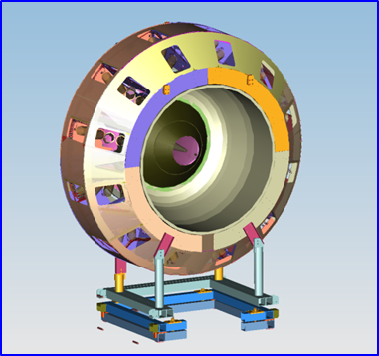
CLAS12 High Threshold Cerenkov Counter
Assessment of the HTCC Construction Project
Youri Sharabian, Jefferson Lab
Collaborating Institutions:
Argonne National Laboratory
California State University
Fairfield University
Institute of Theoretical and Experimental Physics
Rensselaer Polytechnic Institute
University of Connecticut
North Carolina Agricultural and Technical State University
Florida International University

Slide 2
Content
HTCC General Description
Current Construction Status
Ellipsoidal Mirrors
Half-sector Mirrors
HTCC Combined Mirror
Containment Vessel
Combined Mirror Installation
Alignment of the PMT Mounting Units
Light Monitoring System
Project Work Remaining
Status
Schedule
Cost Estimate
Off-project Activities
Status
Schedule
Cost Estimate
Summary

Slide 3
CLAS12 Spectrometer
FTOF
LTCC
Calorimeters
Torus Magnet
Drift Chambers
5T Solenoid
ND
CTOF
SVT
HTCC occupies space between Central Detector and Region 1 Drift Chambers
HTCC provides:
Electron identification in experiments with electron beam
Charged pion identification over momentum range up to ~ 5 GeV (in combination with other detectors)

Slide 4
HTCC Requirements
Requirements for the HTCC are defined to meet/guarantee the main CLAS12 parameters (luminosity, acceptance, momentum and angular resolution).
The feature of the detector is that the HTCC has to be placed between Central Solenoid and Torus superconductive magnets in front of CLAS12 tracking detectors.
The limit for thickness of the Cerenkov Mirror defined to be 200 mg/cm ² or less
(i.e. of the order of radiator gas thickness)
Acceptance coverage:
Polar angle in range of 5 to 35
Azimuthal angle in full range (100%)
Operational in magnetic field of 30 to 35 Gauss
Multichannel detector with minimal number of reflections of Cerenkov light
and minimal number of channels
Electron detection efficiency close to 100%
Rejection of charged pions ~ 500 or better
Improved (simplified) maintenance

Slide 5
HTCC Technical Parameters
PARAMETER | DESIGN VALUE
Working Gas | CO₂@1atm, 25ºC
Angular Coverage | ϑ= 5º – 35º; f= 0º – 360º
Threshold | 15 MeV/c (electrons)
Threshold | 4.9 GeV/c (charged pions)
Rejection of pions at 2 GeV/c | 10³ (99.9% electron detection efficiency)
Rejection of pions at 4 GeV/c | 0.5x10³ (99.9% electron detection efficiency)
Overall Dimensions |  15 ft and L = 6 ft along beam direction
Mirror Type | Combined Ellipsoidal, dimensions of 8 ft in diameter
Mirror Substrate Structure | Acryl (0.01”) + PMI Foam (0.6”) + Acryl (0.01”)
Mirror Thickness | (130 – 135) mg/cm ²
Number of Channels | (12x4) = 48
Photomultiplier Tubes | Electron Tubes 9823QKB (5”, quartz window)
Number of Reflections | 1 (80%) + 2 (20%)
Magnetic Field | 35 Gauss (along PMT axis)
Magnetic Shield | Multilayer with compensation coil

Slide 6
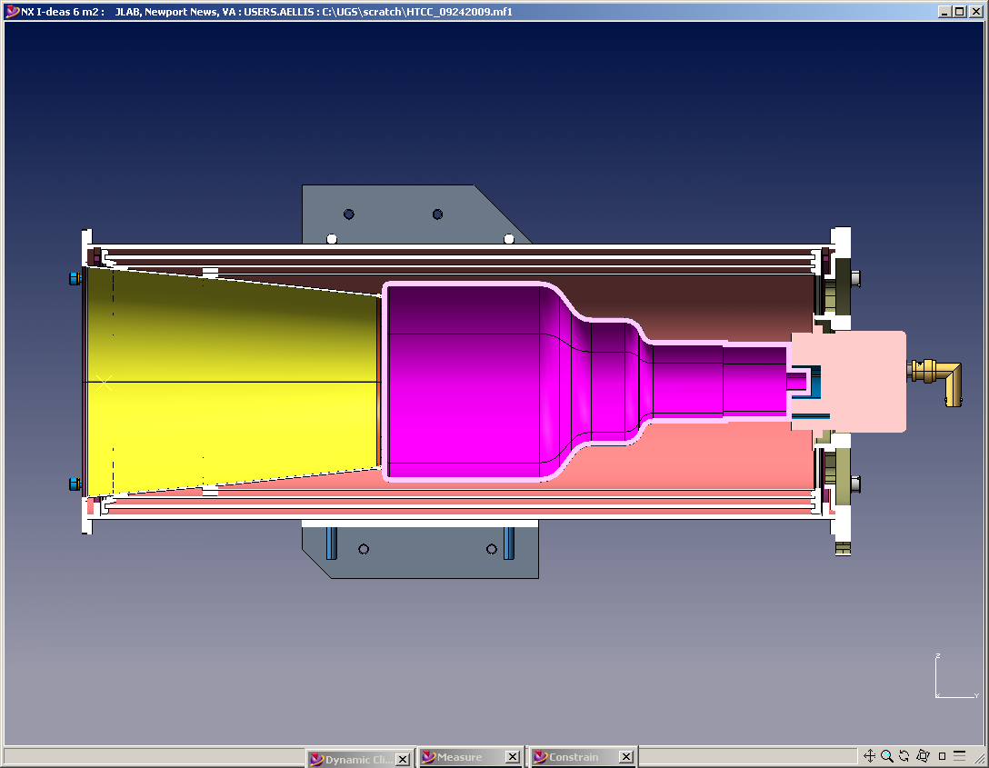
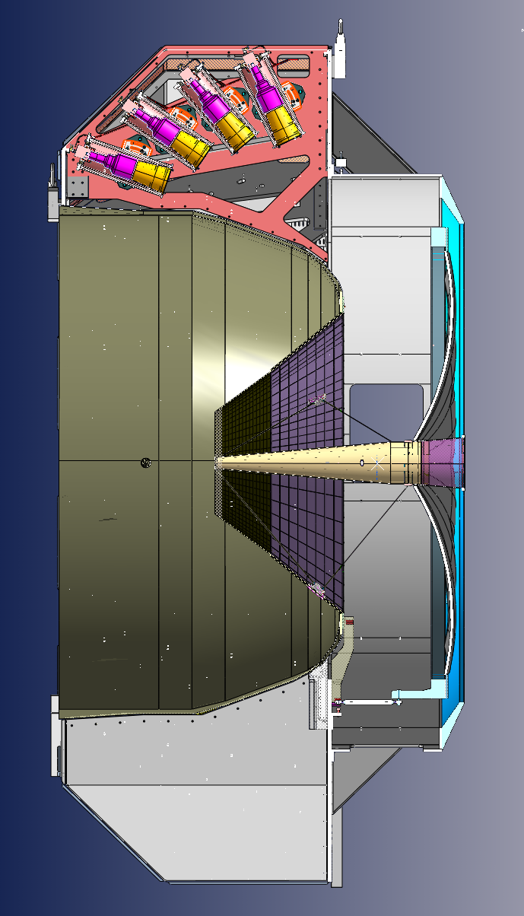
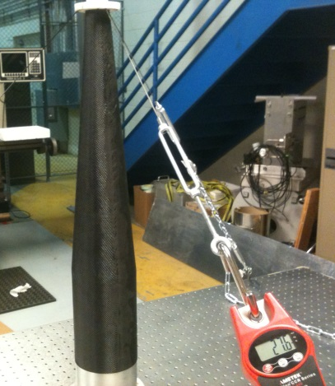
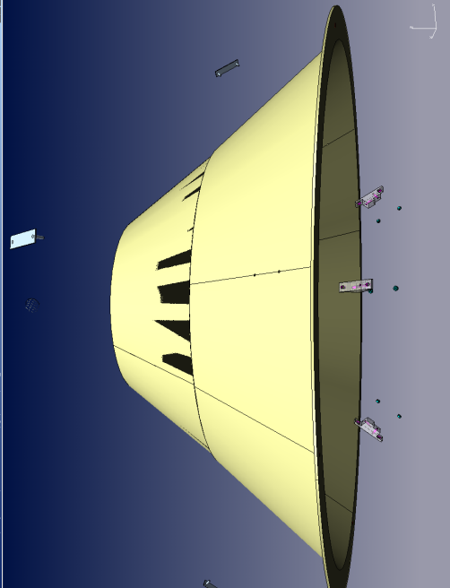
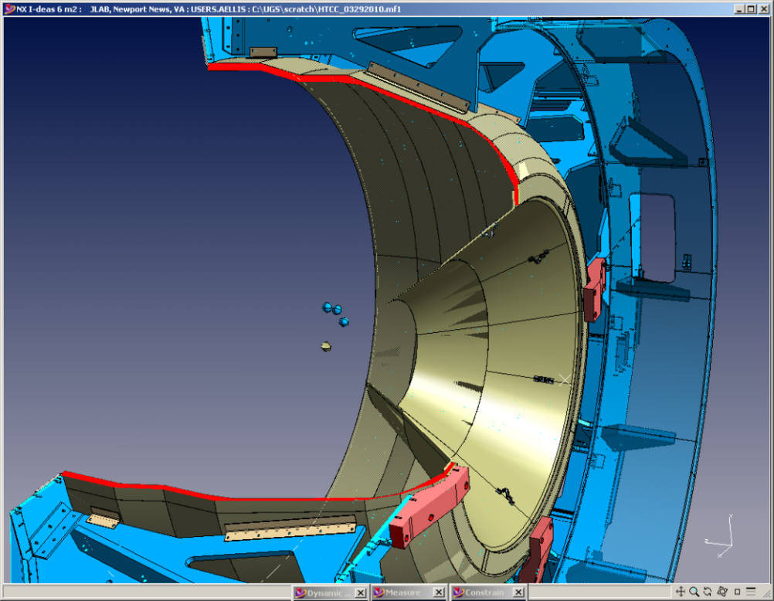
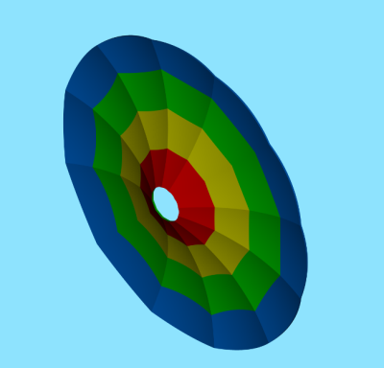
HTCC General Description
3
Main components:
Containment Vessel (Entry Cone and Dish, Moller Cup, thin entry and exit Windows etc.)
Combined Ellipsoidal Mirror (48 focal points)
5″ Quartz PMTs ET- 9823, Winston Cones, Magnetic Shields with Compensation Coils
Light Monitoring System
PMT FRAME PLATE
PMT
WC
MOLLER CUP
The HTCC will be used to generate fast trigger signal. It will provide high rejection of charged π-mesons, low noise for reliable identification of scattered electrons.
The detector will provide efficient acceptance coverage and introduce minimal amount of materials.
The HTCC is a one unit detector with core component of Ellipsoidal Combined Mirror (60 Mirror Facets).
ENTRY CONE
TARGET
Combined Ellipsoidal Mirror
ENTRY DISH
(shown in red)
1
2

Slide 7
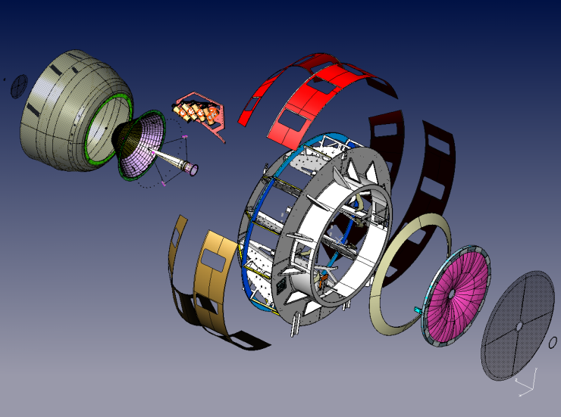
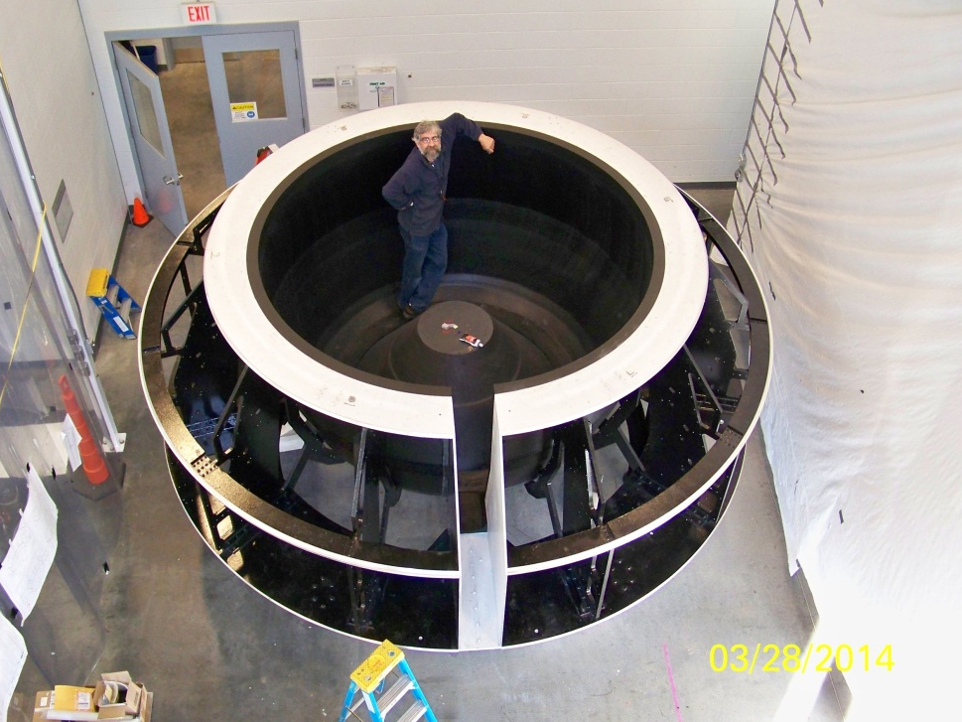
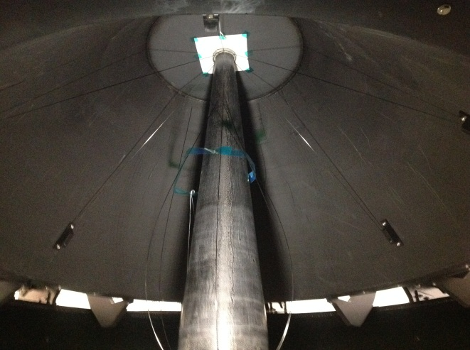
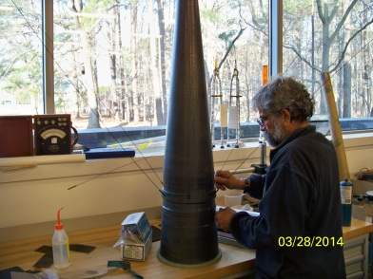
Containment Vessel
STRUCTURE :
COMPOSITE ENTRY WINDOW
ENTRY DISH
ENTRY CONE
MOLLER COP
PMT HOUSING UNITS containing 5-ich PMTs, Winston Cones, Magnetic Shields, Compensation Coils.
WELDEMENT PART
OUTER SHELLS
COMBINED MIRROR
EXIT WINDOW
1
7
2
5
3
4
6
8
9
1
Assembled MOLLER CUP (4) installed along [beam] axis of ENTRY CONE
3
Containment Vessel: In the middle are ENTRY CONE (3) with ENTRY WINDOW (1)
4

Slide 8
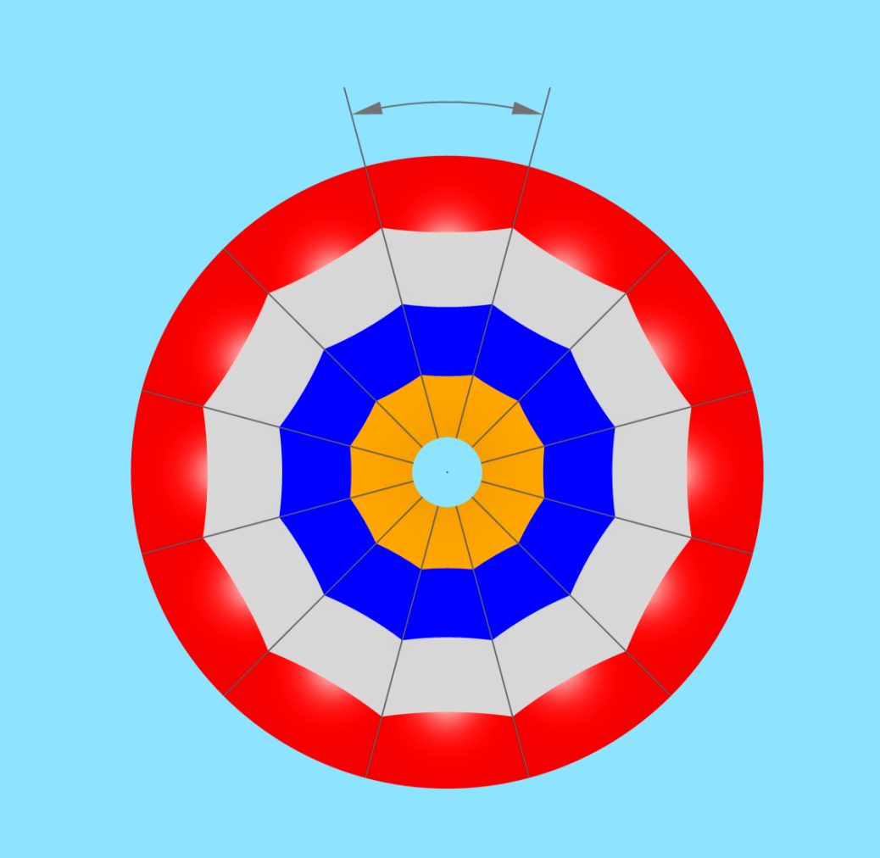
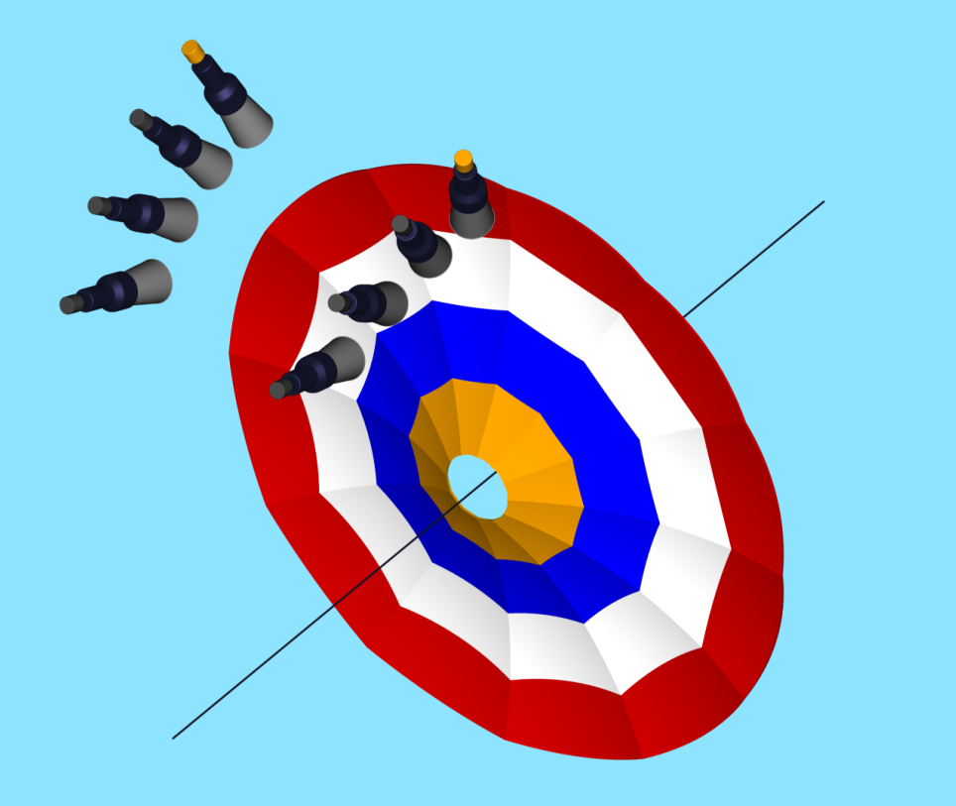
Combined Ellipsoidal Mirror
■ HTCC mirror is multifocal Ellipsoidal mirror
■ Consists of 12 identical sectors
■ Each sector consists of 4 ellipsoidal mirror facets
■ Angular acceptance of one sector:
5° < θ < 35°
Δφ = 30°
Δφ = 30°
8 ft.
# 1
# 2
#3
# 4
■ Mirror is ~ 8 ft. of diameter and ~ 0.62  of thickness
■ Gaps, i.e. the glue joint thicknesses between adjacent
mirrors are designed to be ~ 0.005 
■ Combined mirror assembly tolerance of (0.010 – 0.020)

Slide 9
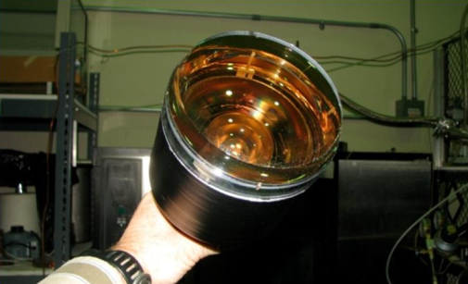
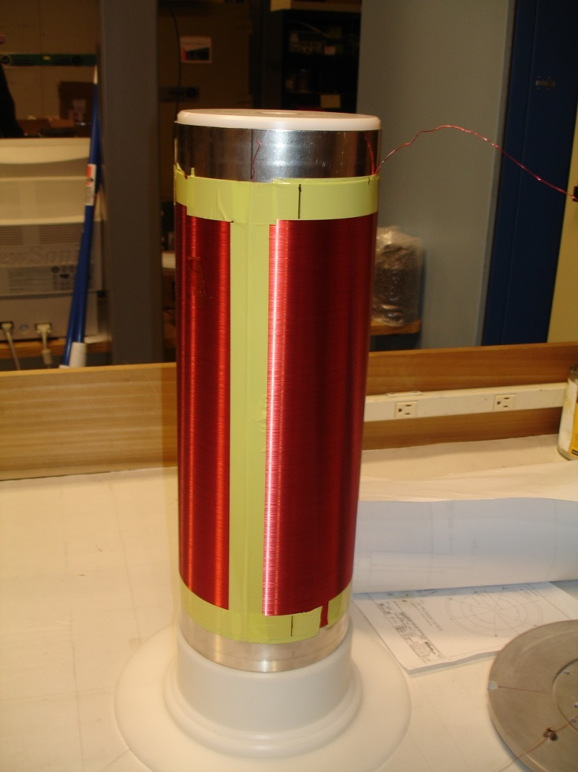
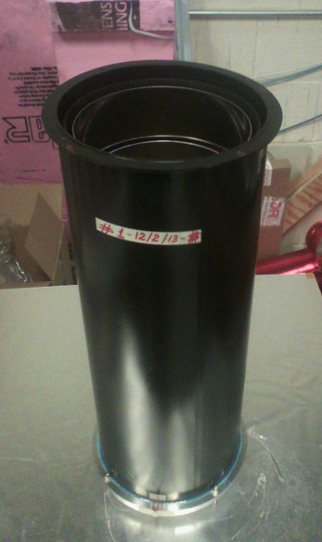
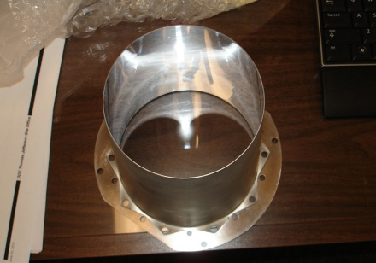
Components (PMTs, Winston Cones, Mag. Shields)
The PMT Mounting Unit consists of:
Cylindrical Case
3-layer concentric Magnetic Shield
Compensation Coil
5″ PMT
Compensation Coil
Assembled Unit
Winston Cone
Along axis of the Mounting Unit will be placed 5″ Quartz PMTs ET- 9823 and Winston Cone.
Shielding with Compensation Coil are designed to attenuate ~35 to 40 Gauss fringe field generated by Central Superconducting Solenoid.
Required residual field of ~0.1 Gauss in the center of PMT photocathode can not be obtained by using of passive magnetic shields only.

Slide 10
Light Monitoring System
1
2
Main components:
Integrating Sphere 4 of diameter
Fast Light Source
Adapter
Fiber bundle Harness
Light Monitoring System
3
4
5

Slide 11
Construction Strategy
Construction plan:
Develop and establish technology of construction of the lightweight light collection mirrors to be done at JLab
Manufacturing of the most critical HTCC components (such as ellipsoidal mirror facets) to be done at JLab
Manufacturing of complete set of tooling for the mirror facets manufacturing, assembly and tests to be done at JLab
Coating of the mirrors, manufacturing of Winston Cones, Passive Magnetic Shields to be done by vendors
Manufacturing parts of the HTCC Containment Vessel to be done by vendors
All assembly work and tests to be performed at JLab
Build when necessary specialized test setups at JLab
Tests and Quality Control
Tests of mirror facets (reflectance, shape), and QA by vendor, JLab and Collaborating Institutions.
Final tests QA of the assembled HTCC half-sector mirrors to be done at JLab and Collaborating Institutions
Tests and Quality Control of 5 phototubes, magnetic shields to be done by JLab and Collaborating Institutions
Alignment checks of components (including composite parts) of the Containment Vessel, establishing fiducial points of reference, tests to be done at JLab
Final assembly and tests and QA of the HTCC detector to be done by JLab and Collaborating Institutions

Slide 12
Content
HTCC General Description
Current Construction Status
Ellipsoidal Mirrors
Half-sector Mirrors
HTCC Combined Mirror
Containment Vessel
Combined Mirror Installation
Alignment of the PMT Mounting Units
Light Monitoring System
Project Work Remaining
Status
Schedule
Cost Estimate
Off-project Activities
Status
Schedule
Cost Estimate
Summary

Slide 13
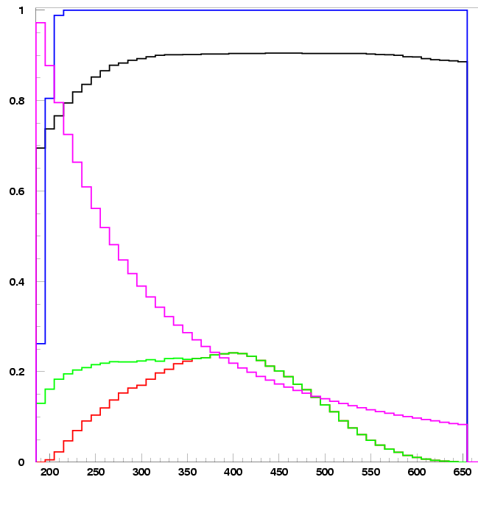
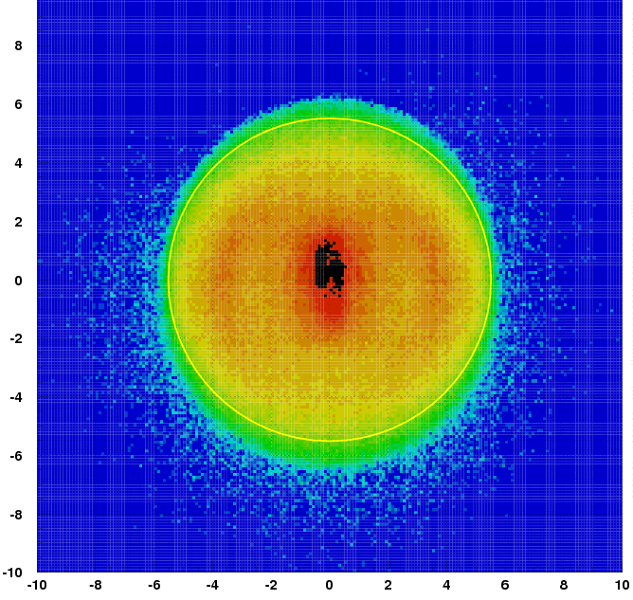
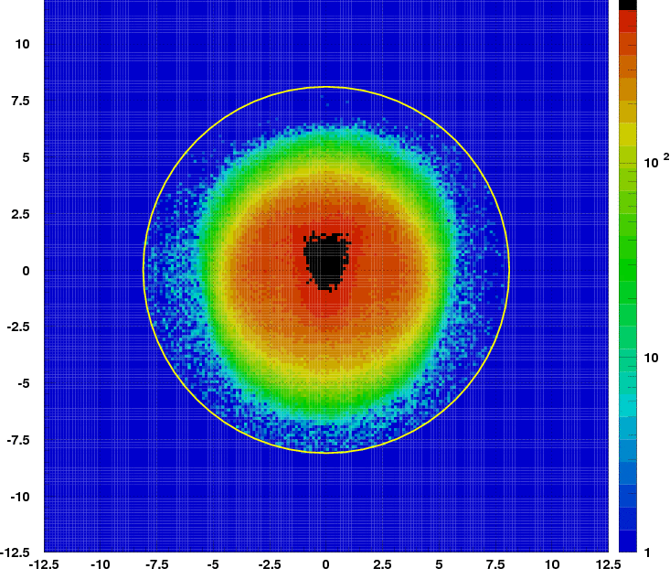
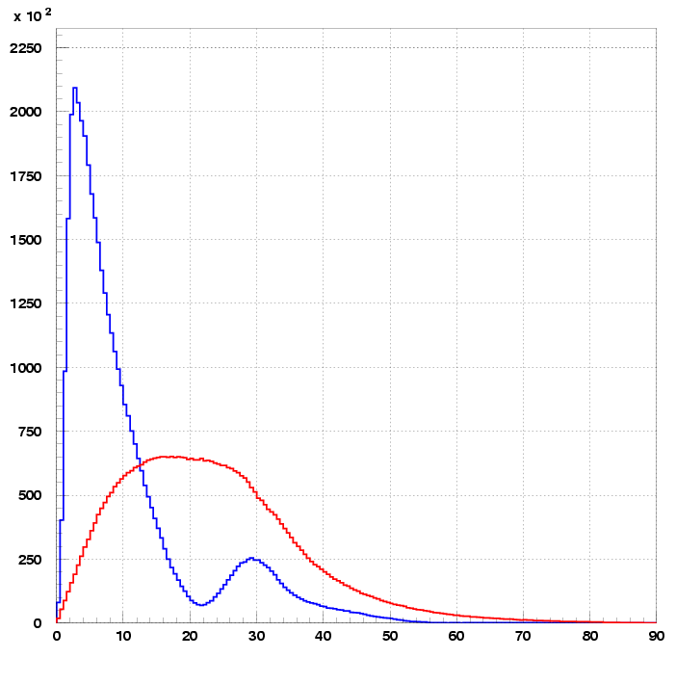
Ellipsoidal Mirrors
MC Simulations
Properties of Components
2 GeV Electrons
Quartz PMT
CO₂
Al+MgF₂
Light collection pattern. Target of 10cm in 5T Field
cm
Quartz
UV-glass
λ, nm
Photons impinging on the 5" PMT
∅ 110mm
161.4mm
Flat
Radiation Length :
Required Designed
CO₂ 0.9% 0.9%
Mirror 0.8% 0.5%
(200mg/cm²) (130mg/cm²)
Convex
Angle of incidence

Slide 14
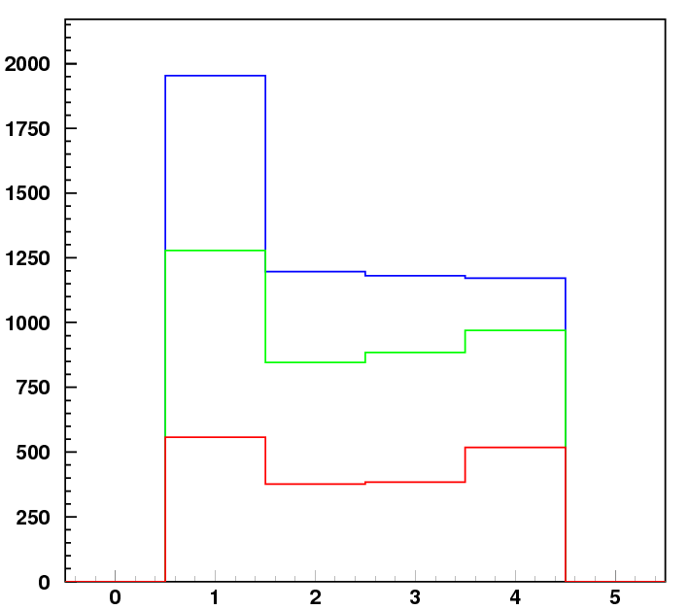
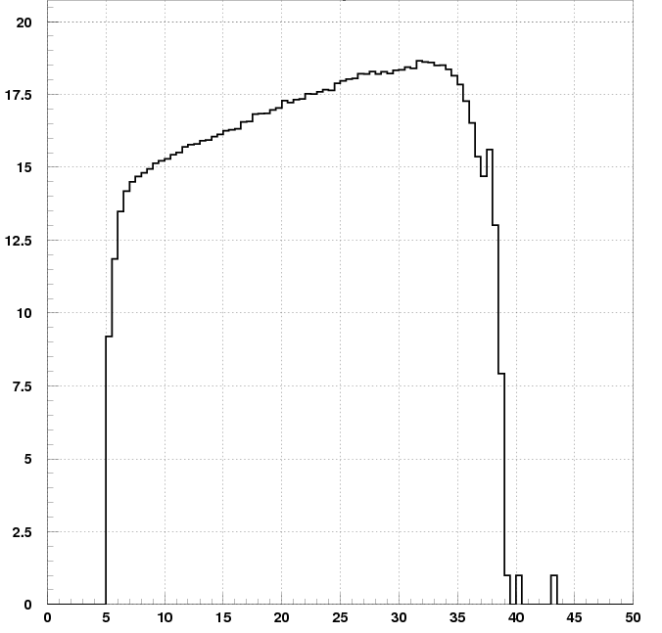
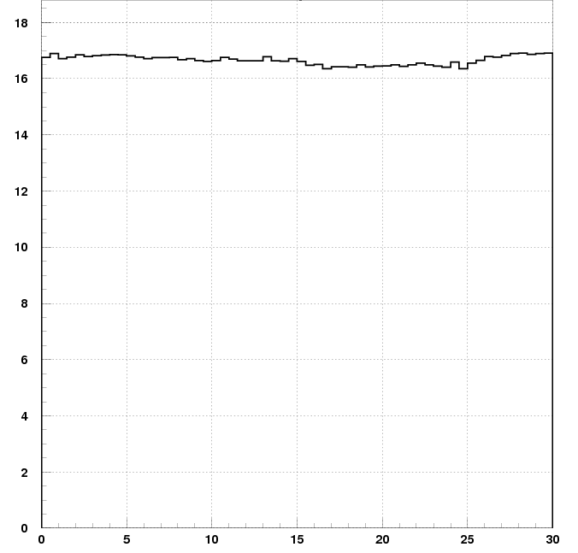
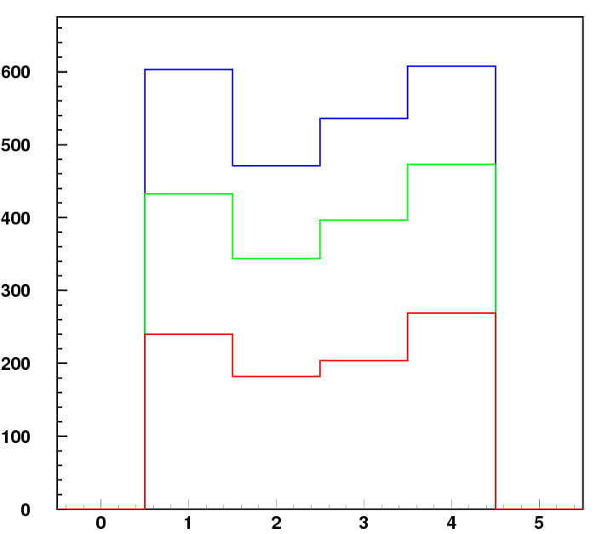
Ellipsoidal Mirrors
2 GeV Electrons
Quartz PMT
MC Simulations
Rejection of π- mesons at 2.0 GeV
Signal strength. Quartz PMT
N_{phe}3(η_{e}=99.90%)
N_{p.e.}2
Photoelectrons
N _{p.e.}1
Channels
Rejection of π- mesons at 4.0 GeV
N_{phe}3(η_{e}=99.90%)
,deg
, deg
N_{p.e.}2
MC Results:
All Designed Parameters of the HTCC meet Technical Requirements
N _{p.e.}1
Channels

Slide 15
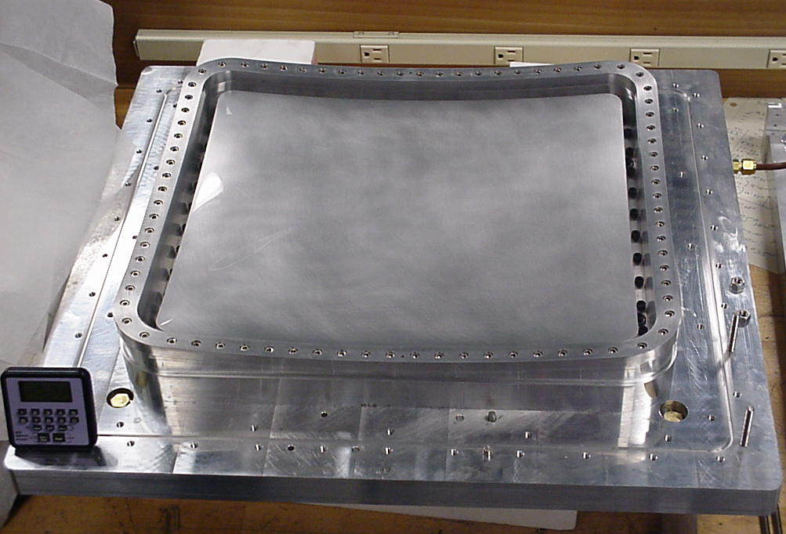
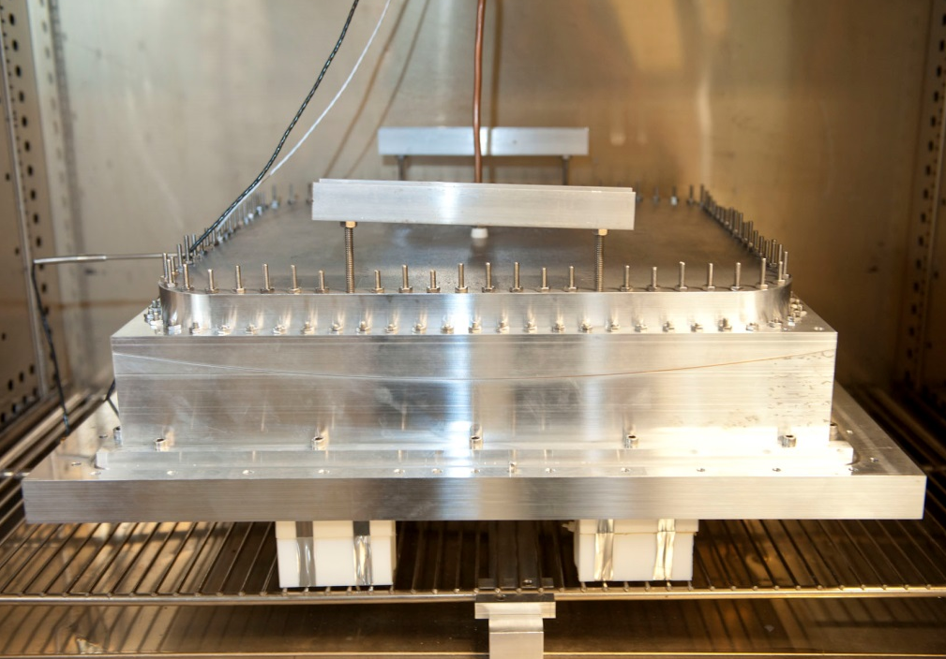
Ellipsoidal Mirrors: Tooling
For the HTCC ellipsoidal mirror construction complete set of necessary tooling has been designed based on technology developed and established at JLab. Following tooling has been manufactured at JLab Machine Shop using 5-axis and 3-axis computer controlled milling machines:
5 sets of tooling for ellipsoidal facet construction
High precision vacuum table for the Half-sector Mirror assembly
Vacuum table for the Ellipsoidal Combined Mirror construction
Thermal shaping
Set loaded with ACRYLM film ready for thermal shaping under pressure in the oven
ACRYLM – FOAM – ACRYL assembly being glued together under pressure

Slide 16
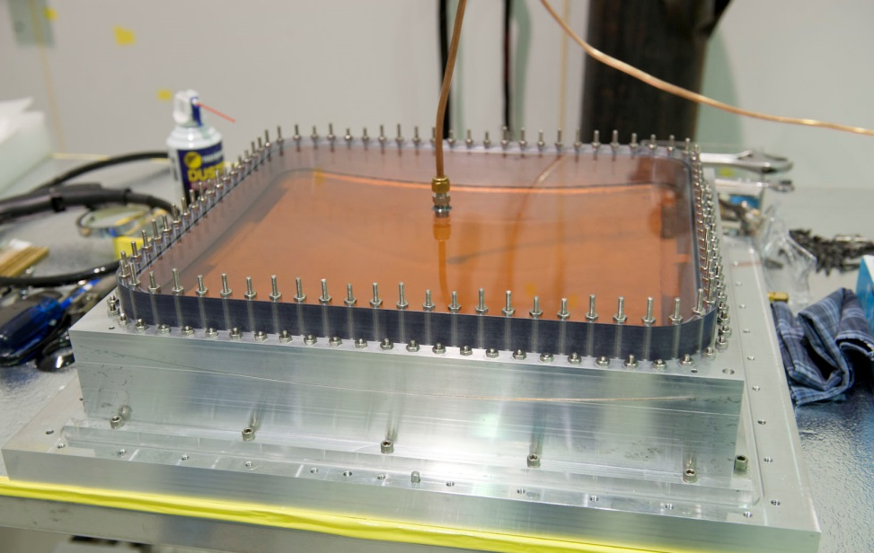
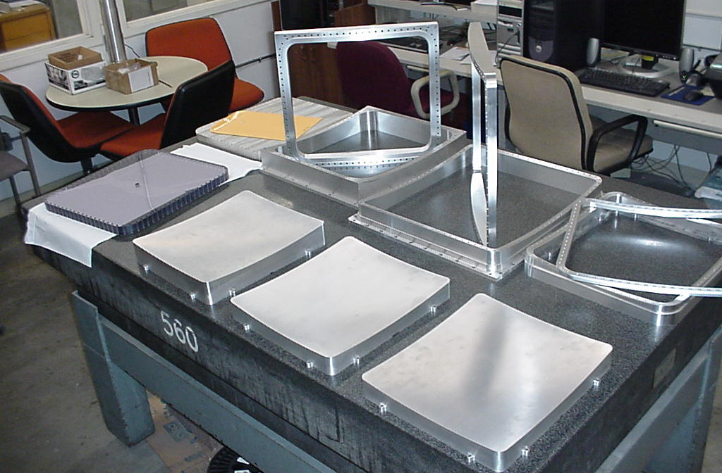
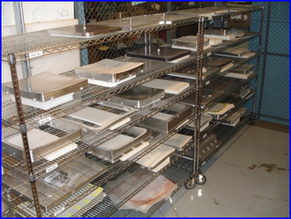
Ellipsoidal Mirrors: Tooling
Assembly
Trimming
ACRYLM – FOAM – ACRYL assembly being glued together under pressure
Assembled mirror substrate being cut out on 5-axis milling machine
Set for construction of the mirror facets of one type (#3)
Sets for construction of the mirror facets of 5 different types

Slide 17
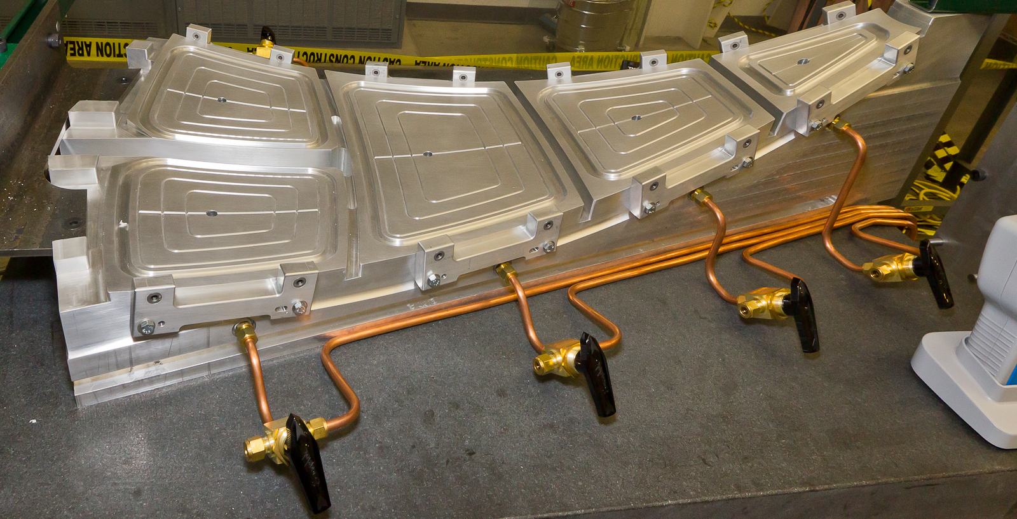
Ellipsoidal Mirrors: Tooling
Design of the high precision vacuum table allows assembly of the Half-sector mirrors that would definitely fit into the final assembly without “overlaps” or leaving gaps. Geometry tests with laser beam also have been performed using the vacuum table.

Slide 18
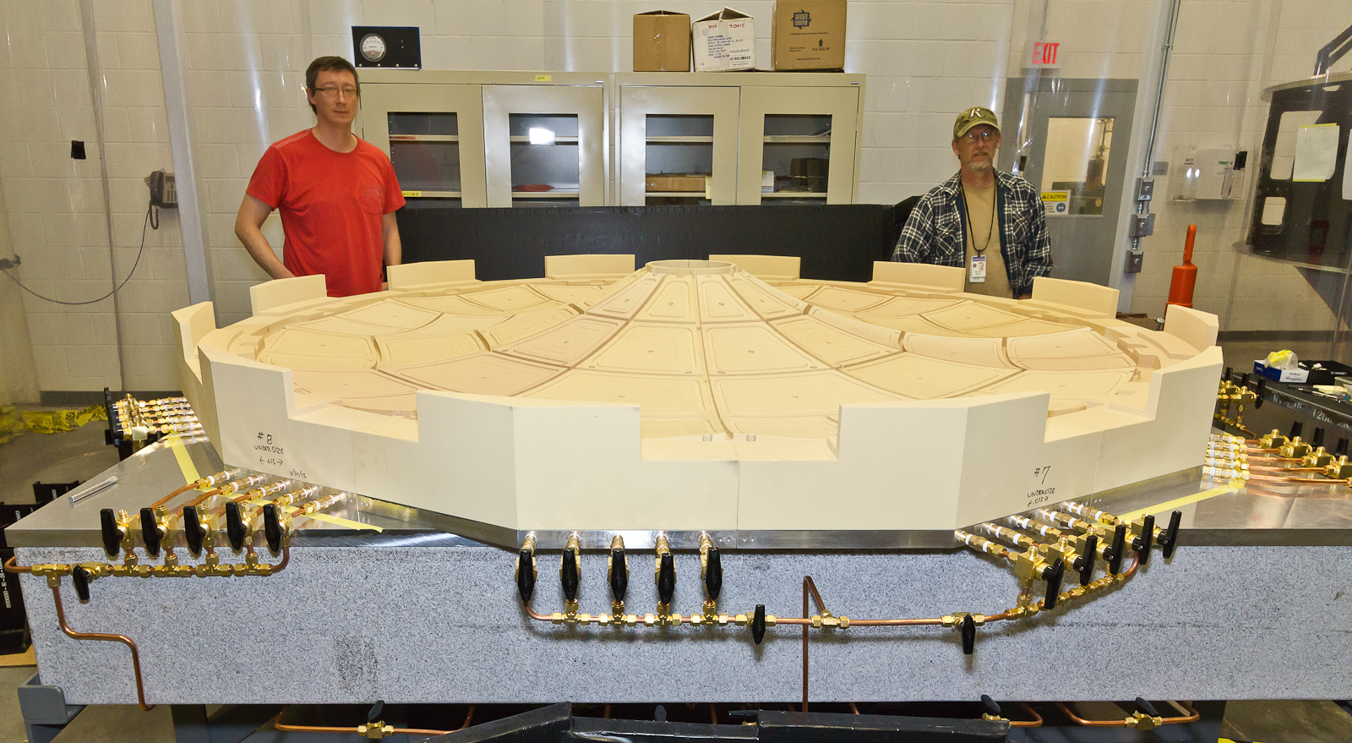
Ellipsoidal Mirrors: Tooling
Vacuum table for the Ellipsoidal Combined Mirror construction consists of 12 half-sector tables identical to table for the Half-sector Mirror assembly. Whole structure is mounted on the 8x8 granite table. Two halves of the vacuum table can slide over the surface of the granite table.

Slide 19
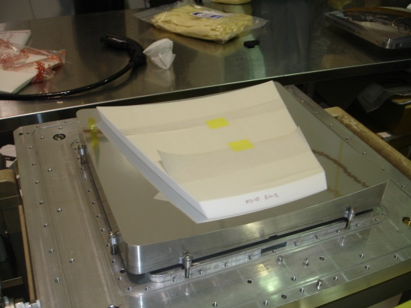
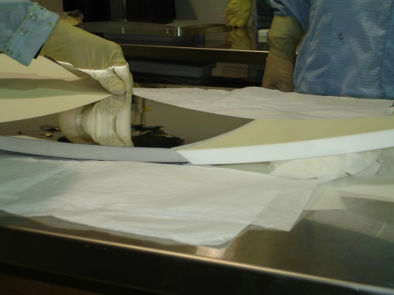
Ellipsoidal Mirrors: Fabrication and Tests
As of today we have all 60 Ellipsoidal Mirror Facets assembled, coated and tested.
We also have built additional ~10% of tested mirrors of each type.
Mirrors 4 (of smallest size) have on average better reflectance. Estimated Number of Photo Electrons for all
Mirrors 4 is in range of 25.3 p.e. to 28.8 p.e. We select 12 best Mirror Facets 4 which have reflectance in
range is of 27.3 p.e. to 28.8 p.e.
Best 12 mirrors of each type have the reflectivity above ~80% in the full wavelength range. Since other
facets, i.e. Mirrors 1L, 1R, 2 and 3, are focusing light generated by electrons traveling larger distances in
CO₂ gas radiator and hence produce stronger signal, we estimate the NPE for all mirrors as follows:
Mirror1L 33.5 – 36.2
Mirror1R 31.8 – 34.9
Mirror2 30.6 – 35.4
Mirror3 27.8 – 32.4
All tested mirrors are suitable for our needs. As a final selection we choose 12 of each facet type with
a highest estimated signal which have least visible defects
STATUS :
71 mirrors inspected visually (for any defects) and tested by measuring reflectance using special setup
Test were carried out in both UV and optical range of 200 to 650 nm.
60 best mirrors (12 of each type) were chosen for the HTCC Combined Mirror construction
In addition 10 mirrors (2 of each type) are accepted and are being kept as a reserve

Slide 20
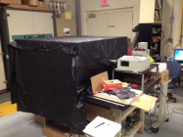
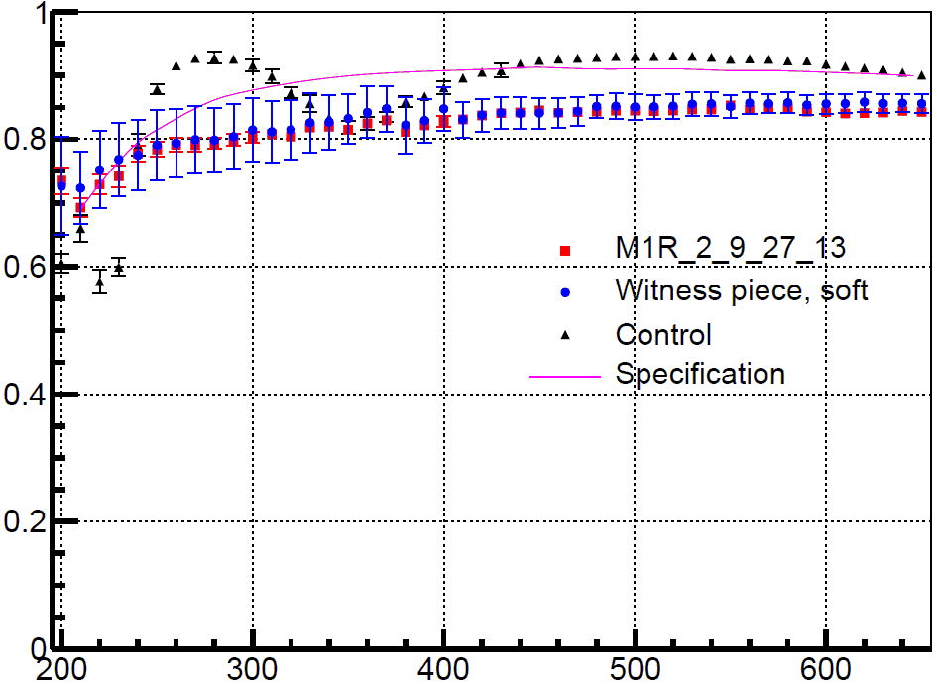
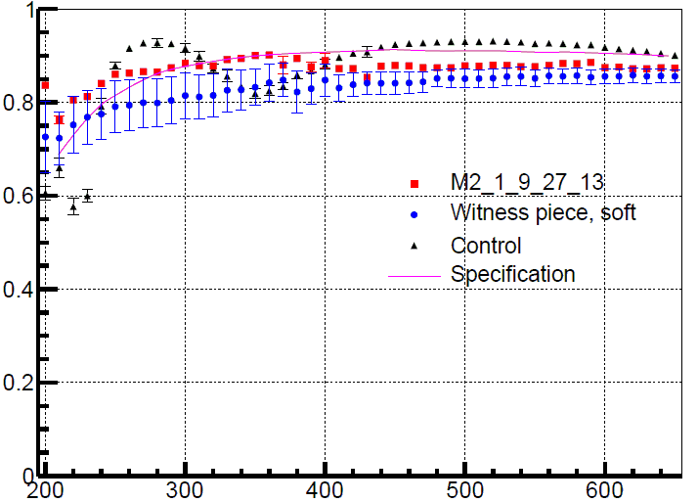
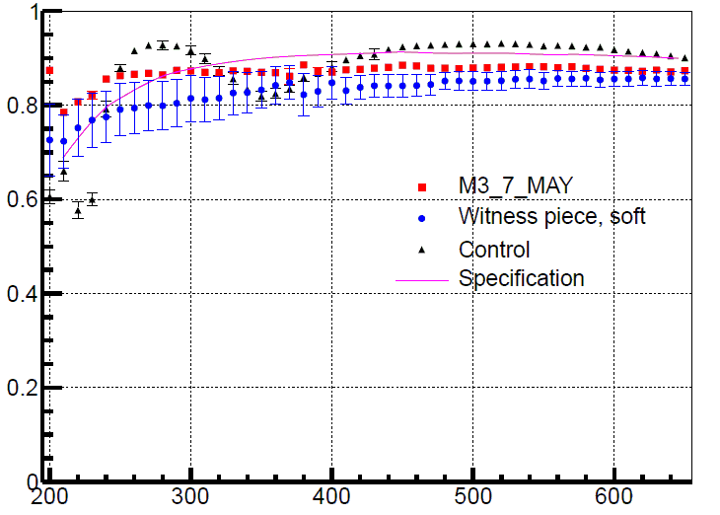
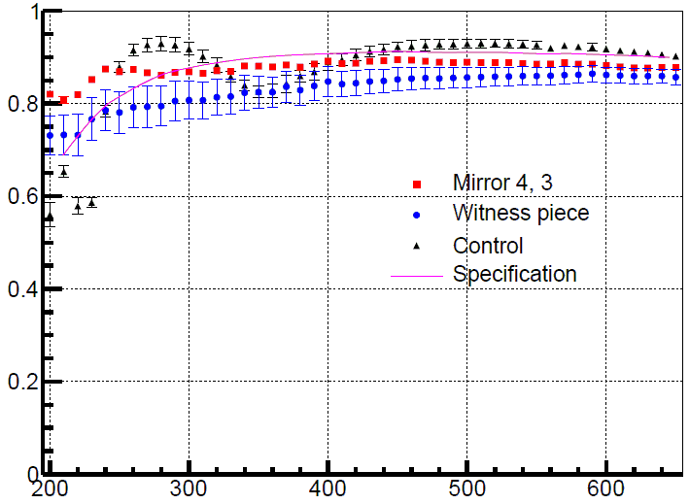
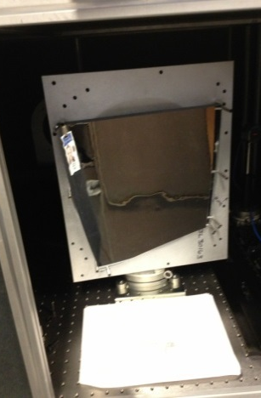
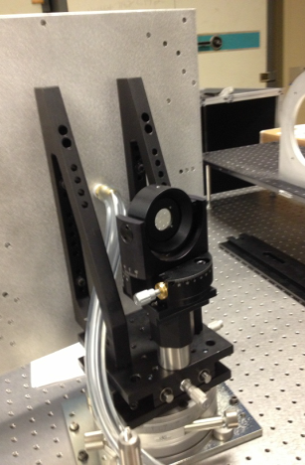
Ellipsoidal Mirrors: Fabrication and Tests
Some typical results of measuring reflectance of mirrors in both UV and optical range are given bellow.

Slide 21
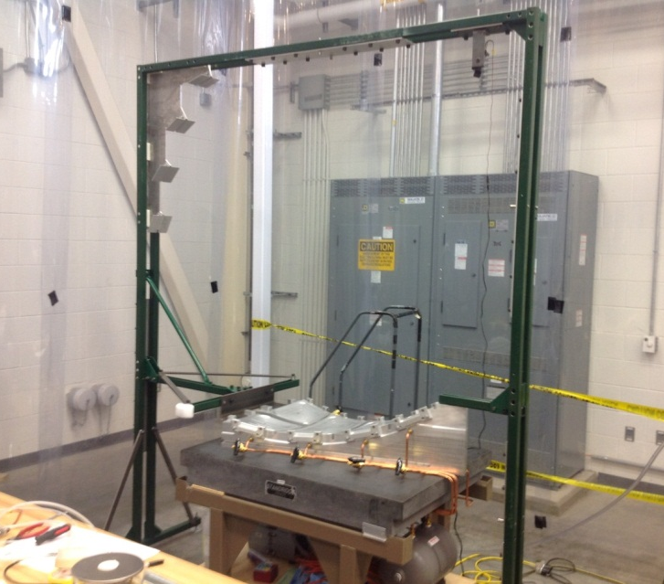
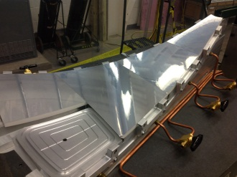
Ellipsoidal Mirrors: Fabrication and Tests
Good mirrors:
1L : 1, 2, 3, 4, 5, 6, 7, 8, 9, 10, 11, 12.
1R : 1, 1_9_12, 2, 2_9_27_13, 3, 4, 5, 6, 8, 9, 10, 11.
2 : 1_9_27_13,1_8_15_12,2,2_8_16_12, 3,4,5,6,7,8,9,11
3 : 1, 2, 2_spare, 3, 4, 5, 6, 7, 7_MAY, 8, 9, 10_spare
4 : 1_2_7_12, 2_8_7_12, 3, 4_8_8_12, 5, 6_8_9_12,
7_8_10_12, 8_8_10_12, 9_8_11_12, 10, 11, 12
Reserve:
1L : 1_10_3_13, 2_10_1_13.
1R : 7, 12.
2 : 10, 12.
3 : 8_spare (rough surface), 1_old,
: 1_9_25_13, 2.
Bad:
3 :10(stain),
M3_10, M4_2, M2_12(gluing problems).
STATUS :
Comprehensive tests successfully completed
Environment control in the CR established
Geometry checks completed successfully
Gluing requirements based on engineering analysis of mechanical integrity defined
Before assembly of the first Half-sector Mirror we needed to :
Test glues and gluing procedures to find best solution (glue joint).
Maintain better environment in the HTCC Clean Room.
Check geometry of facets in standard environment using standard tooling.
Adjustable Laser mount
Focal Planes
Focal plane of Mirror 4
Focal plane of Mirror 3
Focal plane of Mirror 2
Focal plane of Mirror 1R
# 4
Geometry Test with Laser:
Geometry Test Fixture was used in tests.
Mirrors #4, #3, #2 and #1R were placed on the Table.
Laser beam was placed in target location and rasterized along center of mirrors. Images shown on pictures above.
# 3
# 1R
# 2
Table

Slide 22
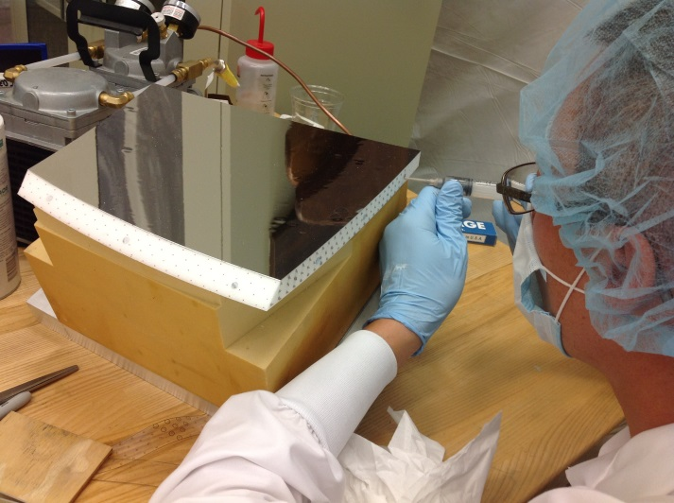
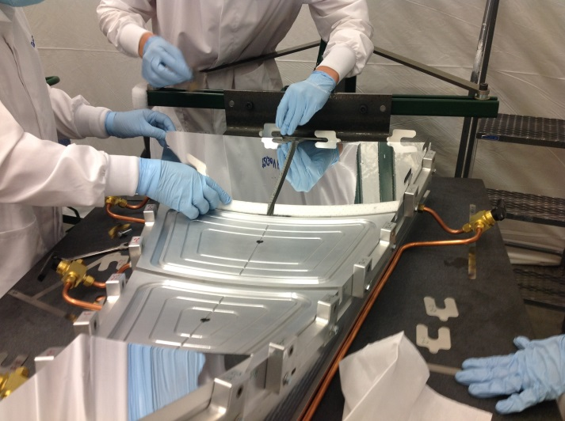
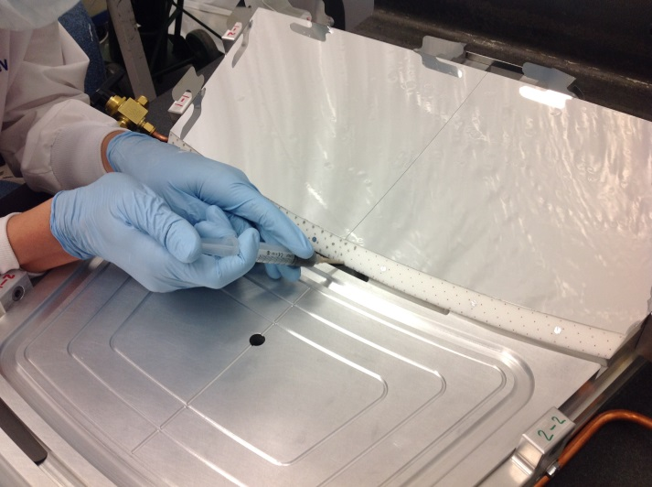
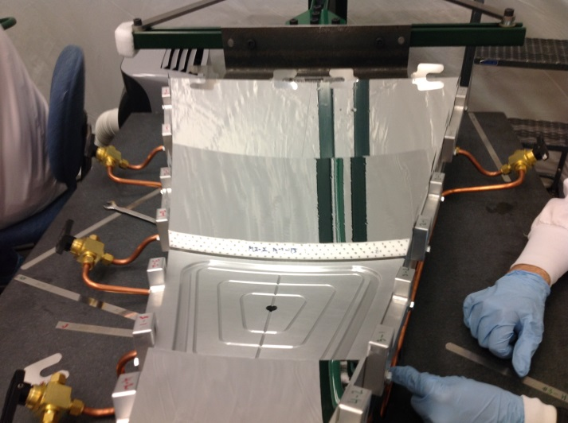
Half-sector Mirrors
Step 1
Step 2
Mirror facets M4, M3, M2, M1L and M1R were used in the assembly of the Half-sector Mirror after assembly procedure have been tested using rejected mirror facets.
Epoxy glue of high viscosity and small shrinkage was applied in dots to one side only covering ~25% of contact area (results of gluing tests) to minimize effects of glue shrinkage.
Geometry was tested before and after facets were glued together.
Environment in the HTCC Clean Room was not higher than RH=40%.
Assembly steps are illustrated in pictures.
Step 3
Step 4

Slide 23
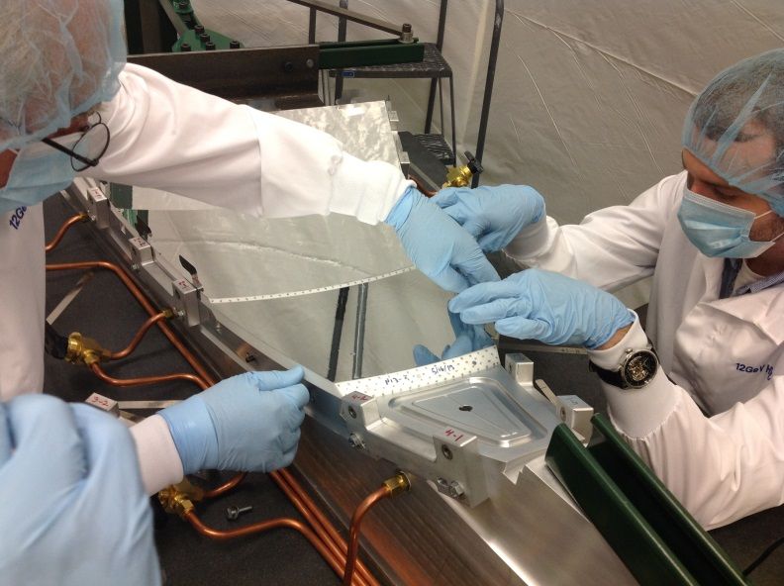
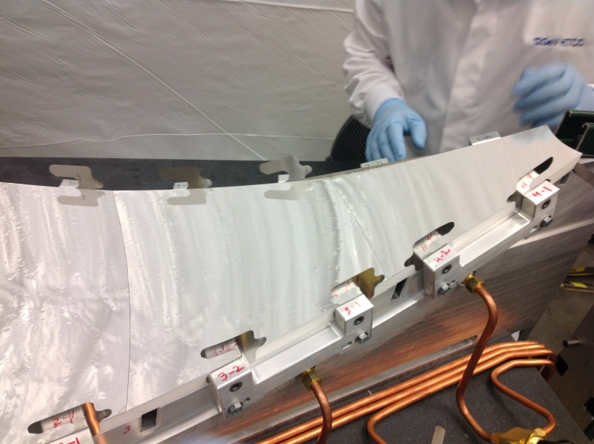
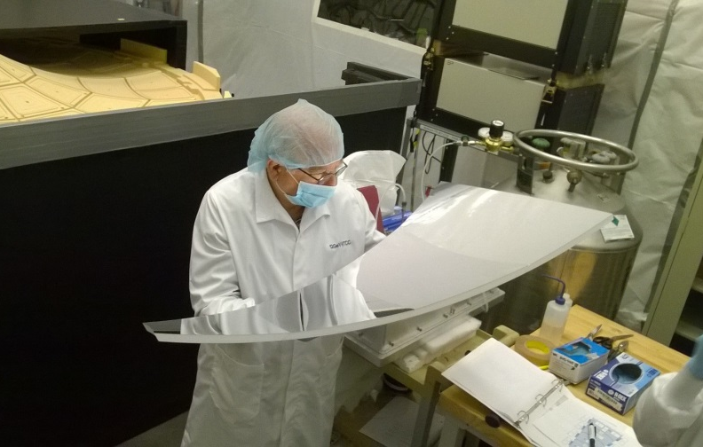
Half-sector Mirrors
Step 5
Step 6
Assembled Half-sector Mirror was kept on the small vacuum table for 24 hours and then tested (next page) and moved onto Vacuum table for the Combined Mirror construction. It would stay off the tables for couple of minutes only in order to control glue polymerization process (full polymerization usually takes weeks)

Slide 24
Half-sector Mirrors
#4
#3
#1
#2
Results of geometry tests of the assembled Half-sector Mirror with laser beam (24 hours after gluing)

Slide 25
HTCC Combined Mirror
Assembly of the Combined Mirror has been done in two stages :
Preliminary assembly
Final assembly
Preliminary assembly is without gluing to check overall structure for
overlaps/gaps and establishing final positions of Half-sector mirrors by
measuring gaps between adjacent Half-sectors. Carbon Central Hub
is in the middle

Slide 26
HTCC Combined Mirror
Final assembly starts after completion (100%) of the Preliminary assembly.
The glue is applying on first Half-sector as shown above same way as during
assembly of Half-sectors.

Slide 27
HTCC Combined Mirror
When all Half-sectors (except of #1 and #7) were glued together then
the Central Carbon Hub has been removed and two halves of the table
separated leaving a gap of ~1.5 wide

Slide 28
HTCC Combined Mirror
Half-sector #1 has been glued to the left portion and #7 to the right portion of
the assembly. Then glue has been applied to them along the gap as shown
above. Last step is bringing the halves to contact leaving certain gap to
prevent glue dots overlapping.

Slide 29
HTCC Combined Mirror
Final assembly of the Ellipsoidal Combined Mirror has been completed in 2 days

Slide 30
Containment Vessel
CV Alignment :
Humidity tests of the HTCC Combined Mirror and Half-sector Mirror in the Clean Room completed . Space for HTCC final alignment available.
Containment Vessel with aluminum shells removed placed in the Clean Room.
Alignment of major structural components of the Containment Vessel completed.
Axis of the HTCC Entry Cone (beam direction) coincides with axis of the Moller Cup (offset less then 100 microns).
Entry Dish is concentric with Entry Cone within design specifications .
Center of the Weldment Part is off the beam direction less than previously reported shift of ~ 9mm .
Checks of alignment of the PMT Mounting Fixtures is unavoidable.
Containment Vessel upstream view
Containment Vessel downstream view
Entry Dish
Entry Cone
Moller Cup
PMT Mounts

Slide 31
Combined Mirror Installation
Installation of the bridge parts
All 12 bridge parts glued to the Mirror
Bridge Parts
Installation of the Mirror Support Ring
Support Ring glued to the 12 bridge parts
Mirror Support Ring

Slide 32
Combined Mirror Installation
Combined Ellipsoidal Mirror has been installed in the Containment Vessel. Set of links holding the Mirror in the position allow fine adjustment with accuracy of ~ 0.01 inch or better.
The Carbon Central Hub has been adjusted to fit the Mirror leaving enough gap for glue and installed. Quality of installation has been checked.

Slide 33
Alignment of the PMT Mounting Units
May 12
RH Normal
May 19
RH = 0%
Ø 1
Ø 3
Ø 5
May 12
RH Normal
May 19
RH = 0%

Slide 34
Alignment of the PMT Mounting Units

Slide 35
Alignment of the PMT Mounting Units
Before alignment
After alignment
STATUS:
Checks of alignment of all 48 channels is complete
36 out 48 channels are aligned
Part of remaining 12 channels might be aligned when HTCC is put horizontally
Work in progress

Slide 36
Light Monitoring System
 | Bare tube | Active base
Leading edge | 2.6ns | 3.8ns
Output range | 2.5V | 3V on each output
Outputs number | 1 | 2
The pulses leading edge is about 1.5ns slower than with passive divider and near perfect output termination with no signs of any ringing or after-pulsing
Size and position of the PCB with active circuit (highlighted)
ET base, external amplifier HV=2.2kV
Modified active base at HV=1.6kV

Slide 37
Light Monitoring System
Fitting the PMT Response :
LMS Components :
(1) Integrating Sphere
(2) LED with Driver Board
Reference PMT with Am²⁴¹ and YAP
(5) Harness and Fiber Bundle
(7) Magnetic Shield
Typical Fit Result at low intensity of LED light

Slide 38
Light Monitoring System
Fitting with Different Intensities :
STATUS:
New driver for the Light Source (LED) providing faster signals adjustable in wide range has been developed, manufactured
Module to operate remotely the LED driver has been developed, manufactured
PMT gain equalization software has been developed
Tests of all components successfully completed
LMS components installed
Fitting function is stable across a wide range of intensities
Fit function accurately describes PMT response at low intensities (µ<1.0)
Position of the Peak stays within 5% of mean

Slide 39
Content
HTCC General Description
Current Construction Status
Ellipsoidal Mirrors
Half-sector Mirrors
HTCC Combined Mirror
Containment Vessel
Combined Mirror Installation
Alignment of the PMT Mounting Units
Light Monitoring System
Project Work Remaining
Status
Schedule
Cost Estimate
Off-project Activities
Status
Schedule
Cost Estimate
Summary

Slide 40
HTCC Remaining Activities as of May 31, 2015
Activity ID | Name | Activity Start | Activity Finish | Remaining Budgeted MWeeks or Proc. Cost
242241528, 630, 635 | Gas System Items | 5/4/15 | 6/30/15 | $24,357
242241610 | Install Window | 5/2/14 | 6/30/15 | 1.1
242241640 | Install/Check Mirror | 2/9/15 | 6/15/15 | 2.0
24267135 | Produce Cart Drawings | 3/9/15 | 7/22/15 | 1
24267140 | Procure Cart | 7/23/15 | 9/18/15 | $37,798
24267355, 360, 365, 370, 375 | Install in Hall B | 7/15/16 | 7/30/16 | 7.9
2822X030 | Install LMS | 2/6/15 | 7/10/15 | 5.7
2822X035 | QA during Mirror Install | 5/4/15 | 9/3/15 | 11
2822X040 | Optical Tests of Mirror | 6/16/15 | 7/15/15 | 6
Total is 34.7 mw, which is estimated at $77.0K direct ($17.4K HTCC, $24.7 Install, $34.9 Pre-ops) and is planned to be supported by Hall B personnel, including visiting postdoc and graduate student, and one contract designer

Slide 41
Project Work Remaining
 | Activity | Percent Remaining | Cost Estimate | Finish Date
1 | Installation of the ellipsoidal mirror | 36% (9%*) | MT 2 mw | 06/30/2015
2 | Installation of the composite exit window | 45% | MT 1.1 mw | 06/30/2015
3 | HTCC - Produce Manufacturing Drawings for transport cart | 40% (1%*) | ME 1mw | 07/22/2015
4 | HTCC - procure transport cart | 100% | $37,798.00 | 09/18/2015
5 | Rig and Transport HTCC to Hall | 100% | MT 1mw | 07/18/2016
6 | Install HTCC cart | 100% | MT 0.5mw | 07/22/2016
7 | Install HTCC | 100% | MT 3mw | 07/26/2016
8 | HTCC-Verify mirror alignment and align detector to beam | 100% | SC 1.2mw, MT 1.2mw | 07/29/2016
9 | HTCC - Installation of LMS | 40% (10%*) | SCI 0.04mw, VU 1.6mw, PDUSTD 2.93mw, EE 0.3mw PDUSTF 0.53mw, ET 0.3mw | 07/10/2015
10 | HTCC - Quality control of the installed items | 50% | SC 3.5mw, VU 3.5mw PDUSTD 2.78mw PDUSTF 1.22mw, MT 0.6mw | 09/03/2015
11 | HTCC - Optical tests of mirror geometry in situ | 100% (25%*) | SCI 2mw, PUSTF 1mw PUSTD 1mw, VU 2mw | 07/15/2015
NOTE: *) status as of today

Slide 42
Construction Project Work Remaining: WBS 1.4.2.2.4.1
Installation of the ellipsoidal mirror
Activity ID 242241640
Budget cost 2mw
Percent Remaining 36%
Percent Remaining* 9%
Finish Date 06/30/2015
Remaining steps, weight, and expected finish date:
Manuf. and installation of the composite limiting
ring on the Moller Cup 2% NA
Run checks of geometry of top 16 channels
while purging separated volume with Mirror
in it with Nitro gas at RH=0% 1% (done*)
Alignment of the Mirror and Final geometry tests 30% (7%*) 06/30/2015
Alignment of the top 16 PMT Mounting Fixtures
using laser beam 3% (2%*) 06/17/2015
NOTE: *) status as of today
Installation of the of the composite exit window
Activity ID 242241610
Budget Cost MT 1.1mw
Percent Remaining 45%
Finish Date 06/30/2015

Slide 43
Installation Project Work Remaining
Produce Manufacturing Drawings for transport cart
Activity ID 24267135
Budget Cost ME 1mw
Percent Remaining 40%
Percent Remaining* 1%
Finish Date 7/22/2015
NOTE: *) status as of today
Procure transport cart
Activity ID 24267140
Budget Cost $37,798
Percent Remaining 100%
Finish Date 09/18/2015

Slide 44
Installation Project Work Remaining
Rig and Transport HTCC to Hall
Activity ID 24267155
Budget Cost MT 1.0mw
Percent Remaining 100%
Finish Date 07/18/2016
Install HTCC cart
Activity ID 24267160
Budget Cost MT 0.5mw
Percent Remaining 100%
Finish Date 07/22/2016

Slide 45
Installation Project Work Remaining
Install HTCC
Activity ID 24267165
Budget Cost MT 3.0mw
Percent Remaining 100%
Finish Date 07/26/2016
HTCC-Verify mirror alignment and align detector to beam
Activity ID 24267170
Budget Cost SCI 1.2mw
MT 1.2mw
Percent Remaining 100%
Finish Date 07/29/2016

Slide 46
Pre-Ops Project Work Remaining
HTCC - Installation of LMS
Activity ID 2822X030
Budget Cost SCI 0.04mw
VU 1.6mw
PDUSTD 2.93mw
PDUSTF 0.53mw
EE 0.30mw
ET 0.30mw
Percent Remaining 40%
Percent Remaining* 10%
Finish Date 07/10/2015
NOTE: *) status as of today

Slide 47
Pre-Ops Project Work Remaining
HTCC - Quality control of the installed items
Activity ID 2822X035
Budget Cost SCI 3.5mw
VU 3.5mw
PDUSTD 2.78mw
PDUSTF 1.22mw
MT 0.6mw
Percent Remaining 50%
Finish Date 09/03/2015
Remaining steps, weight, and expected finish date:
Align remaining 12 channels 4.5% 06/30/2015
Vacuum leak check 8.9% 09/03/2015
Gas leak tests of CV and fixing
possible leaks 8.9% 07/31/2015
Light leak check 8.9% 07/31/2015
Cosmic ray tests 8.9% 09/03/2015
Electronics tests with PMTs 8.9% 09/03/2015

Slide 48
Pre-Ops Project Work Remaining
HTCC - Optical tests of mirror geometry in situ
Activity ID 2822X040
Budget Cost SCI 2.0mw
VU 2.0mw
PDUSTD 1.0mw
PDUSTF 1.0mw
Percent Remaining 100%
Finish Date 07/15/2015
Remaining steps, weight, and expected finish date:
Test 1st sector 7.7% 07/15/2015
Test 2nd sector 7.7% 07/15/2015
Test 3rd sector 7.7% 07/15/2015
Test 4th sector 7.7% 07/15/2015
Test 5th sector 7.7% 07/15/2015
Test 6th sector 7.7% 07/15/2015
Test 7th sector 7.7% 07/15/2015
Test 8th sector 7.7% 07/15/2015
Test 9th sector 7.7% 07/15/2015
Test 10th sector 7.7% 07/15/2015
Test 11th sector 7.7% 07/15/2015
Test 12th sector 7.7% 07/15/2015
Full mirror check 7.7% 07/15/2015

Slide 49
Content
HTCC General Description
Current Construction Status
Ellipsoidal Mirrors
Half-sector Mirrors
HTCC Combined Mirror
Containment Vessel
Combined Mirror Installation
Alignment of the PMT Mounting Units
Light Monitoring System
Project Work Remaining
Status
Schedule
Cost Estimate
Off-project Activities
Status
Schedule
Cost Estimate
Summary

Slide 50
Off-project Activities
Monitor long term stability of the HTCC Combined Mirror’s geometry
Develop ways of the installing laser for alignment checks in the HTCC target position without survey
Finalize calibration software
Integration of the HTCC calibration package incorporating LMS into the CLAS12 monitoring and calibration framework
Tests of PMTs linearity using LMS to define currents for the Compensation Coils of the PMT magnetic shields
Resources:
Scientist 32mw
Mech. Eng. 3mw
Mech. Des. 2mw
Mech. Tech. 25mw
Contributed Labor 22 mw

Slide 51
Summary
Installation of the composite components in the Containment Vessel is completed, the vessel surveyed, components aligned
Assembly and tests of the HTCC Half–sector Mirrors and Combined Ellipsoidal Mirror completed
The HTCC Ellipsoidal Mirror installed, surveyed, tested in working environment
Modification of HV-dividers for 5 PMTs and corresponding upgrade of the HTCC Light Monitoring System is completed. PMT gain equalization software has been developed and tests completed
Final installation of all components, tests and alignment are in progress
Remaining project work defined
Off-project activities defined
Construction Project 99% complete

