Slide 1
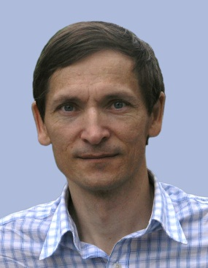
Assessment of the SVT Project SVT technical project lead
CLAS12 Silicon Vertex Tracker
Yuri Gotra
Director’s CLAS12 Detector Assessments
Jefferson Lab
June 5, 2015

Slide 2
Outline
SVT System Overview
Current Project Status: work completed
SVT assembly
Detector Hardware and Cabling
DAQ
Slow Controls
Calibration and Commissioning
Documentation
Project Work Remaining
Status
Schedule
Cost Estimates
Off Project Work Remaining
Status
Schedule
Cost Estimates

Slide 3
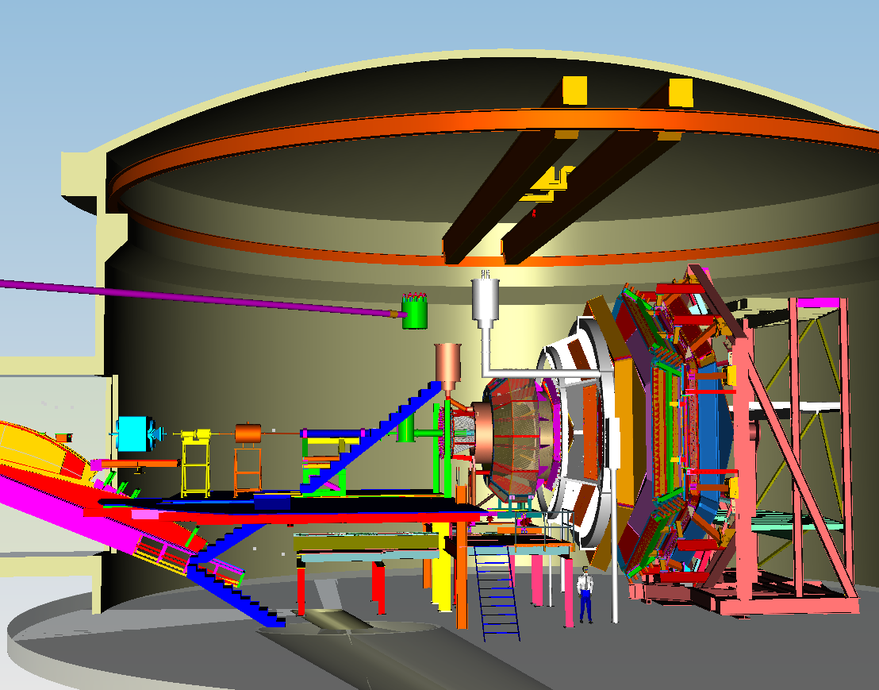
CLAS12 in Hall B
High Threshold
Cerenkov Counter (HTCC)
Low Threshold
Cerenkov
Forward TOF
Pre-Shower
Calorimeter
Electromagnetic
Calorimeter
SC Torus Magnet
Drift Chambers
Moeller Shield
5 T SC Solenoid
Central TOF
Silicon Vertex Tracker (SVT)
Beam-line:
Raster magnets
Beam Position
Targets
Moeller System,
etc.

Slide 4
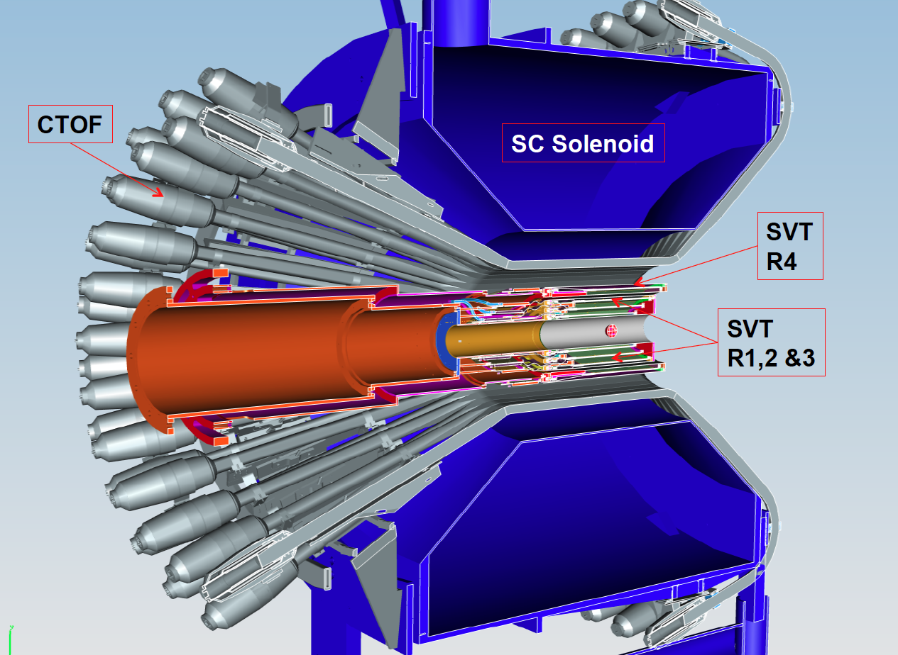
CLAS12 Central Detector

Slide 5
CLAS12 SVT Physics Requirements
Essential parts of the physics program, such as GPD’s, require tracking of low momentum particles with few percent momentum and ~1 degree angle resolution at large angles. This is achieved by the Silicon Vertex Tracker (SVT).
Silicon detector technology makes an excellent match to the central tracking system in the CLAS12 configuration, small space and high luminosity operation of CLAS12 that is needed for accurate measurements of exclusive processes at high momentum transfer.
SVT provides standalone tracking capabilities in the central detector region
Measure recoil baryons & large angle pions, kaons
Polar angle coverage: 35-125º
Azimuthal angle coverage: > 90%
Momentum resolution : δp_{T} < 50 MeV/c for 0.3 < p_{T} < 1.5 GeV/c
Angle resolution: δΘ < 10-20 mr, δΦ <5-10 mr
Tracking efficiency: > 90%
Match up tracks with hits in the CTOF for β vs p measurement (particle ID)
Stable operation in 5 Tesla magnetic field at instantaneous luminosities L=10³⁵cm⁻²s⁻¹ for liquid hydrogen targets, and over periods of several years.
Expected integrated luminosity per year: ∫Ldt ≈ 500 fb⁻¹

Slide 6
SVT Technical Parameters
PARAMETER | DESIGN VALUE
Number of regions (radii, mm) | 4 (65, 93, 120, 161)
Sectors (modules)/region | 10, 14, 18, 24
Module dimensions (L x W x T) | 41.9 cm x 4.2 cm x 0.39 cm
Number of silicon layers/module | 2 (U, V)
Strip layout | (0º— 3º) Graded angle
Sensor thickness | 320 μm
Readout pitch | 156 µm (hybrid side)
Number of readout channels/module | 512
Total number of readout channels | 33,792
Readout ASIC | FSSR2
Backend electronics | Custom-made VXS cards
Angular coverage θ | 35°–125°
Angular coverage Φ | ~2π
Spatial resolution | 50-65 μm
Momentum resolution | ~6%
θ resolution | 10–20 mrad
φ resolution | ~5 mrad
Designed to operate at a luminosity of | 10³⁵ cm⁻²s⁻¹

Slide 7
SVT Overview
Silicon Vertex Tracker (SVT)
Four regions
Sectors (10, 14, 18, 24)
Silicon area ~ 1.5 m²
Channels: ~34,000
Bonds: ~200,000
Beam Line
Module
Mounting Tube
Cold Plate
Downstream Ring
Upstream Ring
Region radii, mm: 65, 93, 120, 161
Hybrid temperature 24C with coolant at 15C

Slide 8
SVT Module Features
Downstream Tab
Carbon fiber skin (.190 mm) with Rohacell 71 core (2.5 mm)
Carbon fiber is K13C2U
Rohacell 71 core replaced by copper core (2.5 mm) under electronics
Bus cable (0.078 mm) used for grounding carbon fiber and passing HV bias to sensor
HFCB: Hybrid Flex Circuit Board with Front End electronics (FSSR2 readout chips)
Carbon fiber skin and bus cable are co-cured
Sensors
Pitch Adapter
HFCB
Rohacell
Co-cured Carbon Fiber/Bus cable
Heat Sink

Slide 9
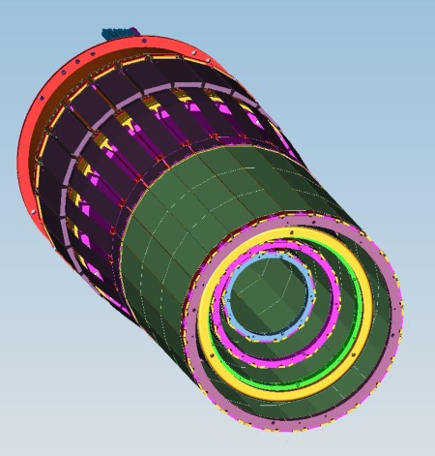
SVT DAQ
VSCM: VXS Silicon Control Module
Each VSCM handles 2 HCFBs (a total of 1,024 strips)
Converts FSSR2 data driven DAQ architecture to JLab triggered event DAQ architecture
SD: Signal Distribution Module
TI: Trigger Interface Module
HCFB<->VSCM cable:
~5m length
CPU
VSCM
VSCM
VSCM
VSCM
VSCM
VSCM
SD
VSCM
VSCM
VSCM
VSCM
VSCM
TI
CPU
VSCM
VSCM
VSCM
VSCM
VSCM
VSCM
SD
VSCM
VSCM
VSCM
VSCM
VSCM
TI
CPU
VSCM
VSCM
VSCM
VSCM
VSCM
VSCM
SD
VSCM
VSCM
VSCM
VSCM
VSCM
TI
66x High Density Round
Shielded (100 Ohm twisted pair)
VXS-Crate
Fiber Optics (from global trigger crate)
VXS-Crate
VXS-Crate
Gigabit Ethernet (to event builder)

Slide 10
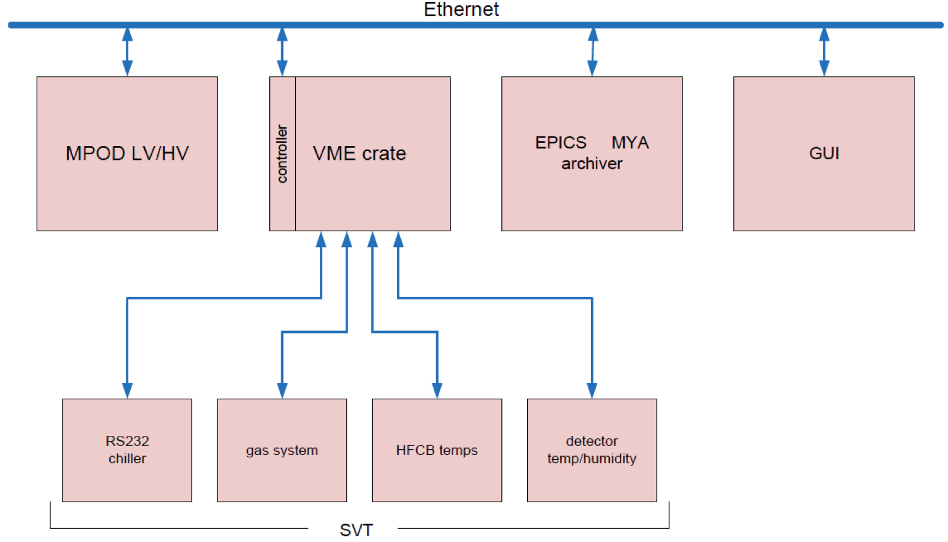
SVT Slow Controls

Slide 11
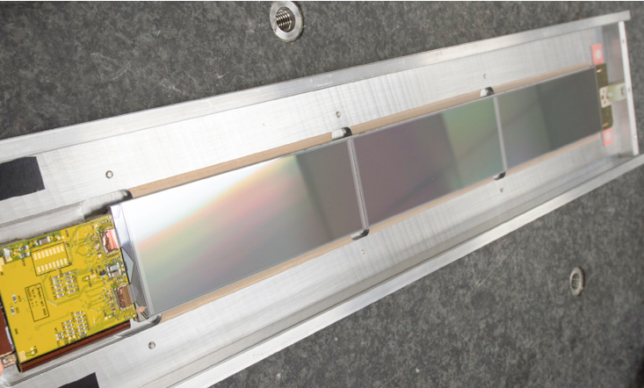
SVT QA/QC and Manufacturing Plan
Responsibilities during manufacturing:
Module components pass vendor QA
Reception QA/QC on module components by JLab @JLab
Sensor QA test by FNAL @FNAL
Module production by FNAL @FNAL
Mechanical surveys during module production by FNAL @FNAL
Module production testing and burn in by JLab @FNAL
Module acceptance test by JLab @JLab
Barrel Integration and testing by JLab @JLab
SVT Commissioning and System Checkout by JLab @JLab
Module testing during production by JLab @FNAL:
Module tested electrically during assembly:
after chips are wire bonded
after chips are encapsulated
after hybrid placement on the backing structure
after wire-bonding the sensors (each side)
Hybrids are burned in after chips are wire bonded
Assembled modules tested
Multi-module burn-in test conducted at SiDet

Slide 12
Outline
SVT System Overview
Current Project Status: work completed
SVT assembly
Detector Hardware and Cabling
DAQ
Slow Controls
Calibration and Commissioning
Documentation
Cost Estimates
Project Work Remaining
Status
Schedule
Cost Estimates
Off Project Work Remaining
Status
Schedule
Cost Estimates

Slide 13
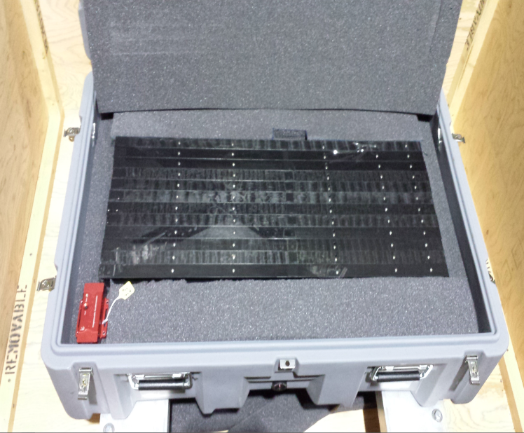
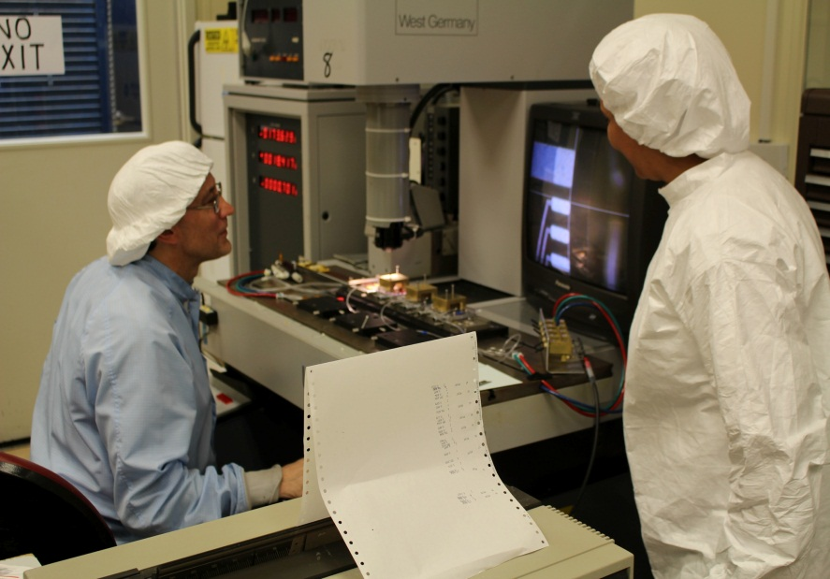
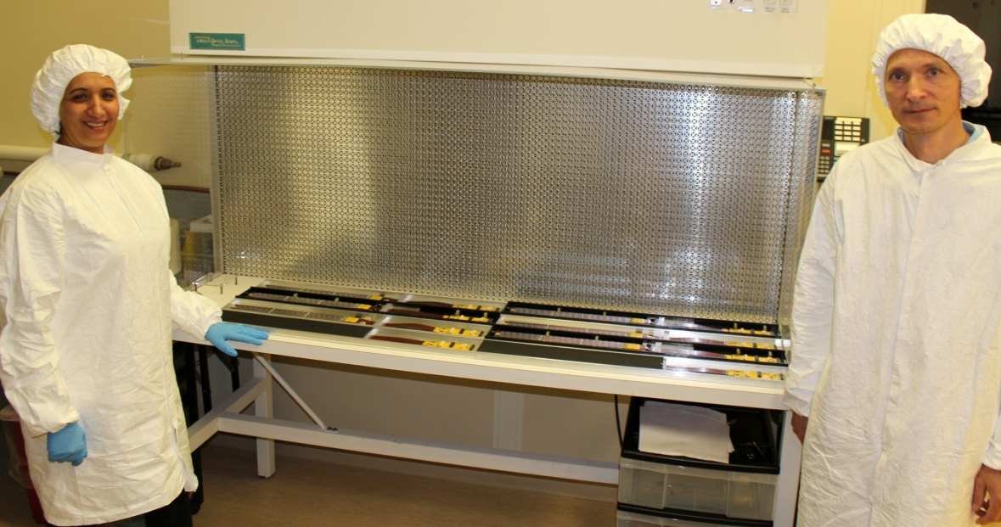
SVT Module Production and QA Complete
Average production rate (2 modules per week) sustained
Good noise performance
Low leakage currents
Precise sensor placement (within few μm)
Passed QA testing and burn-in
Module QA data/plots uploaded to the database
No additional bad channels after burn-in
Modules transported to JLab and tested
Contract with Fermilab completed
Letter sent to FNAL on 04/06/15
Completed by March 2015

Slide 14
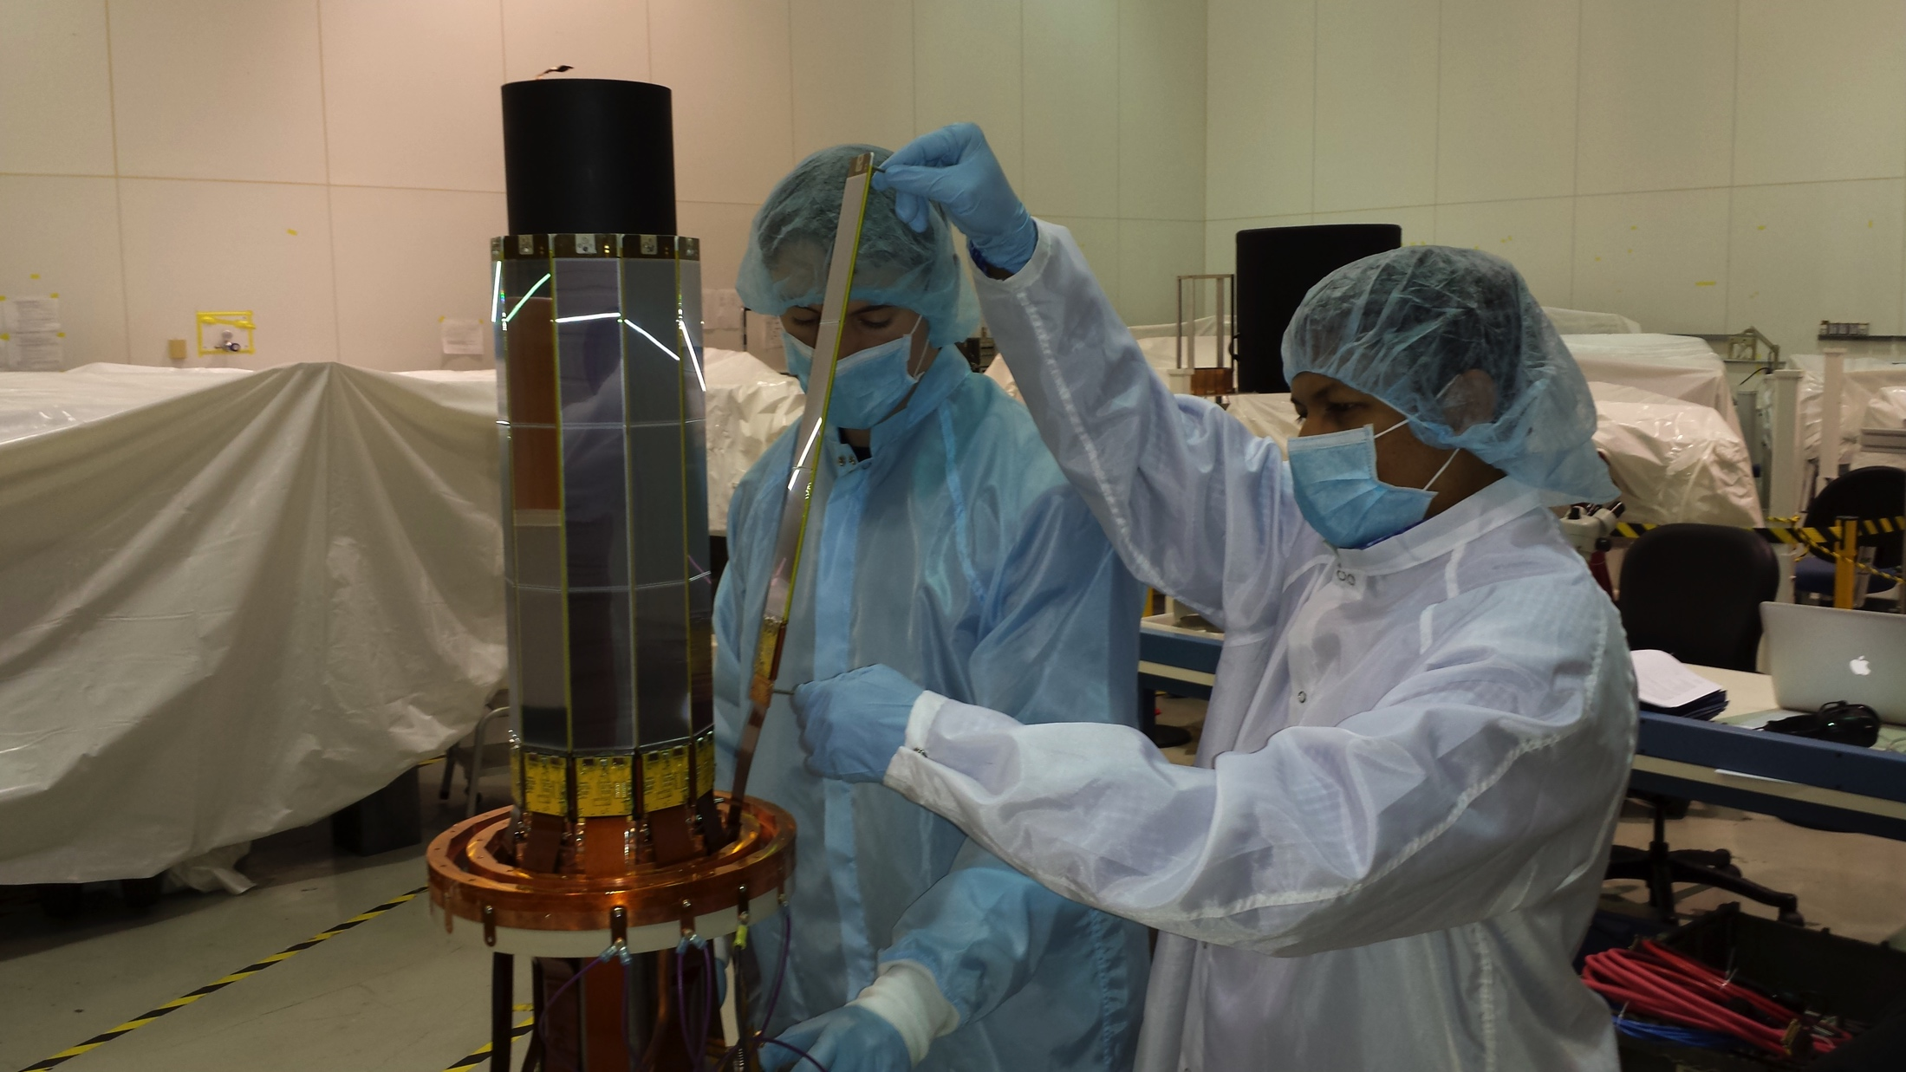
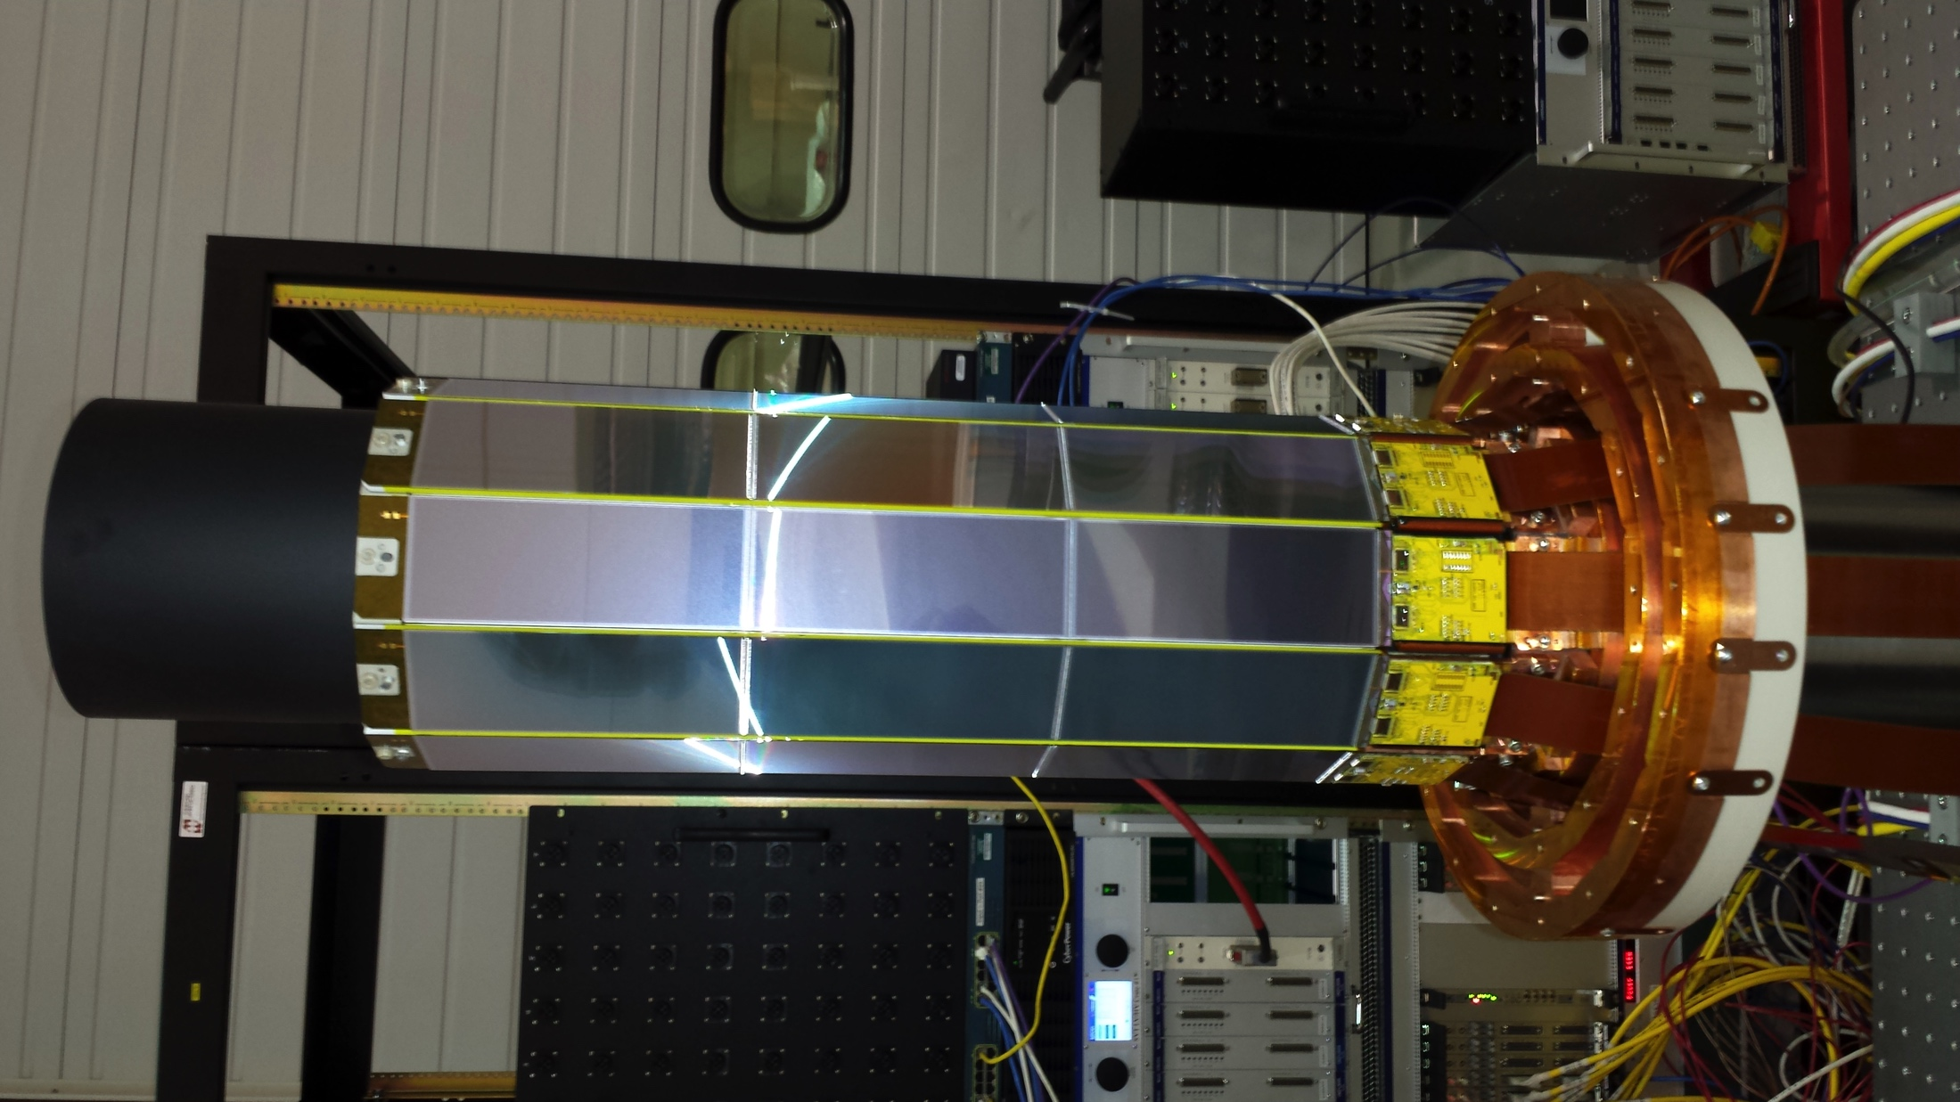
SVT Region 1 assembly

Slide 15
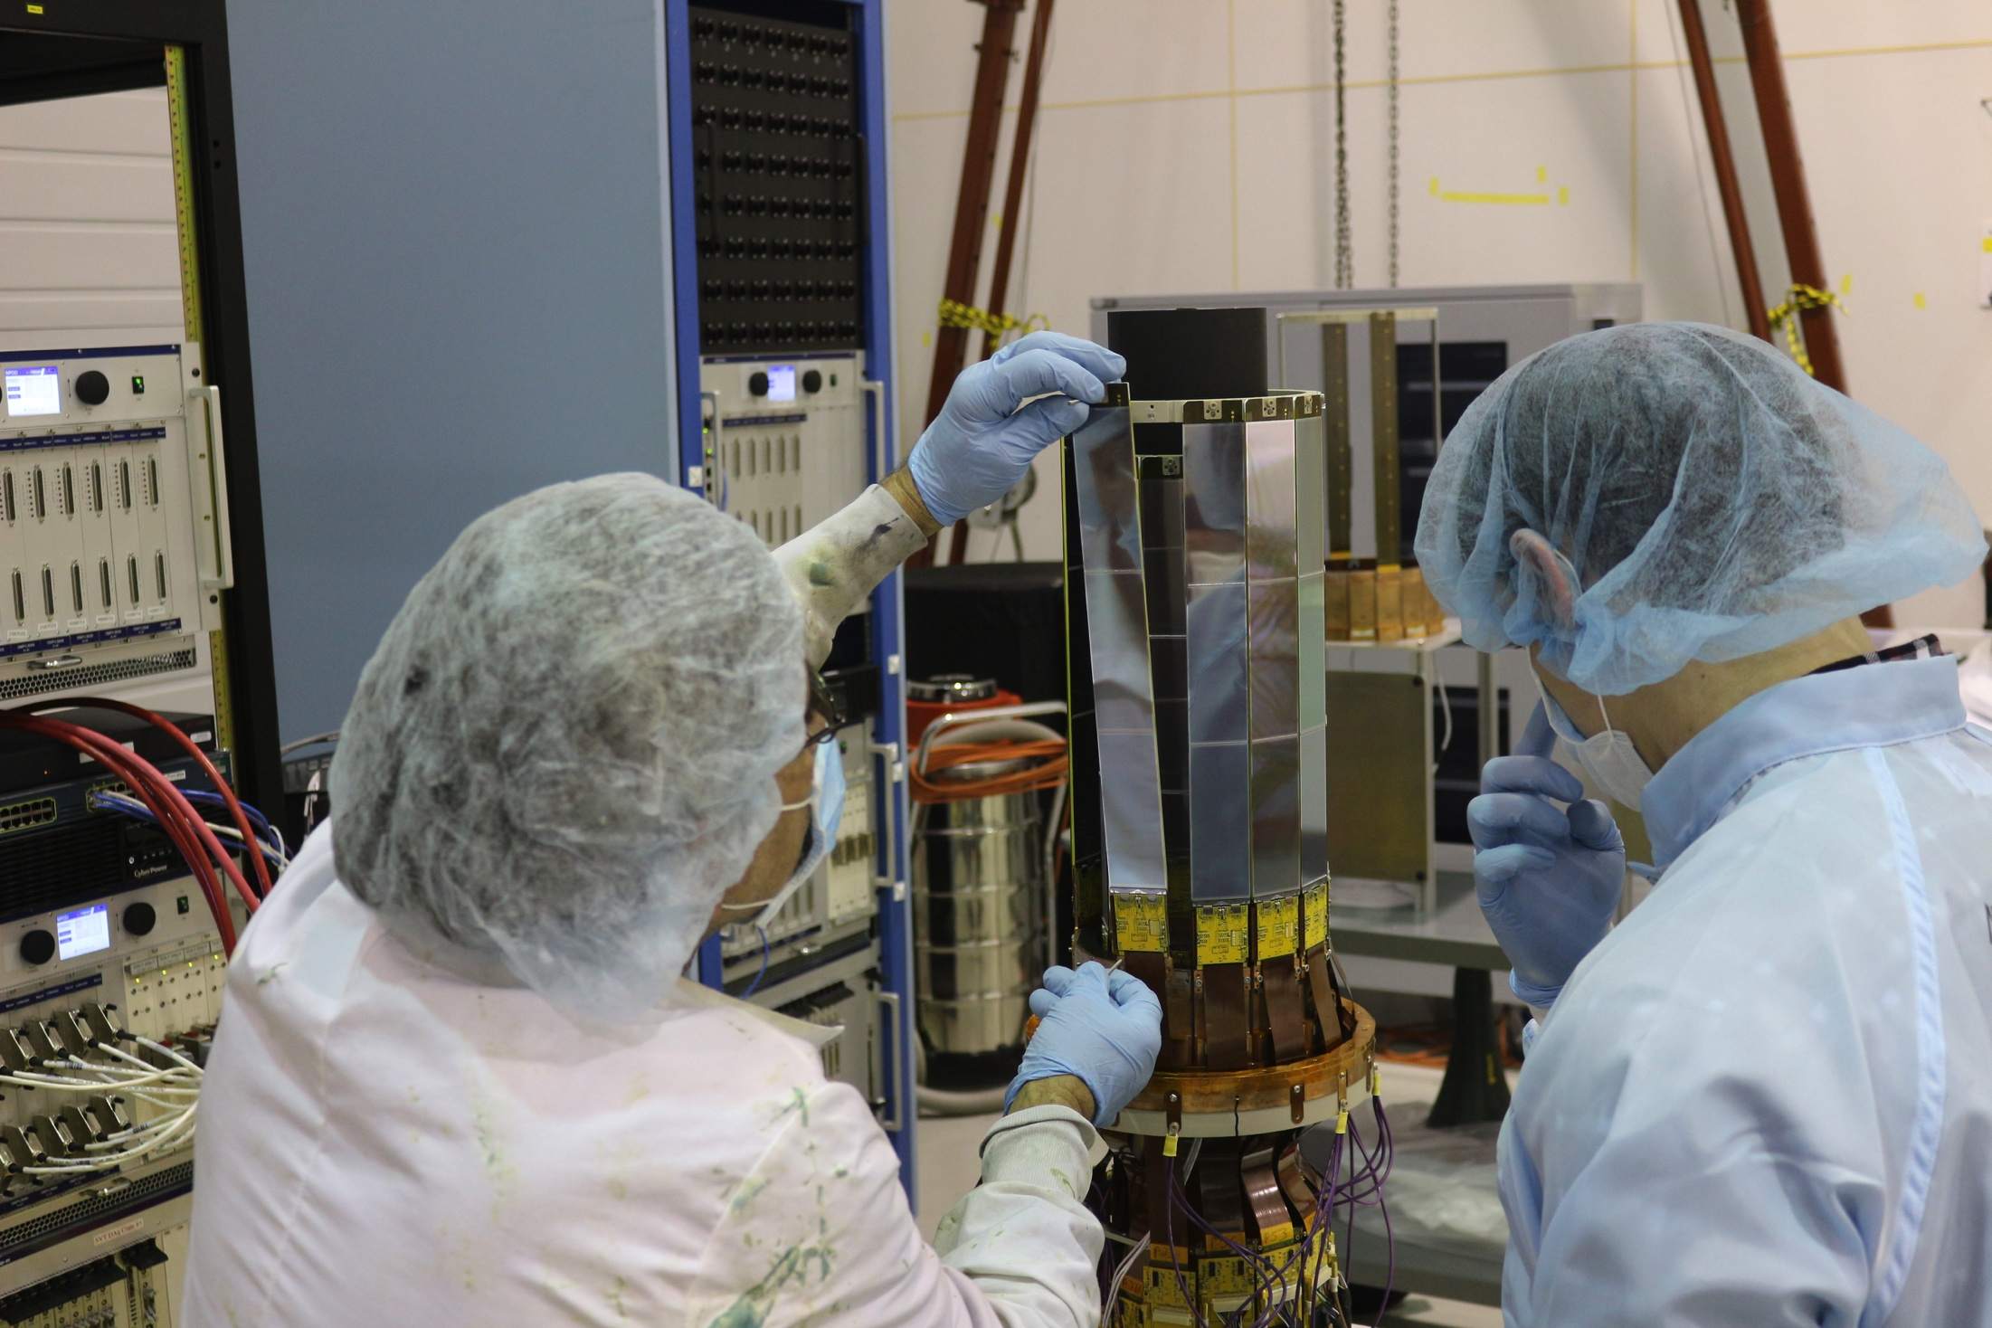
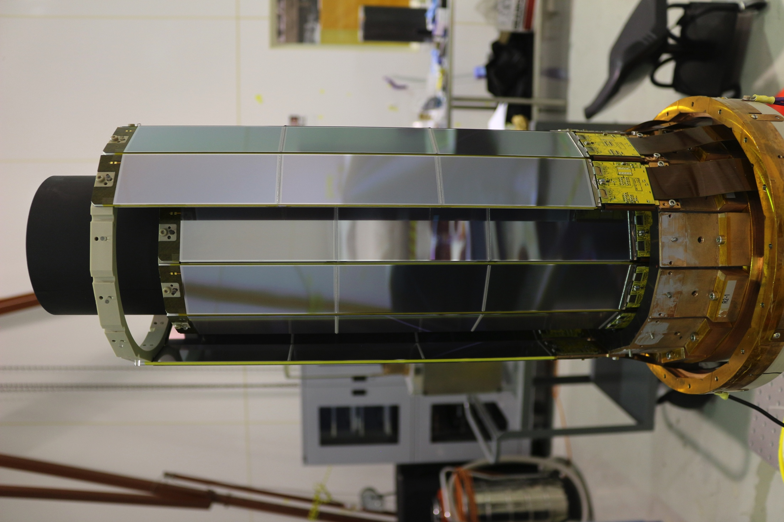
SVT Region 2 assembly

Slide 16
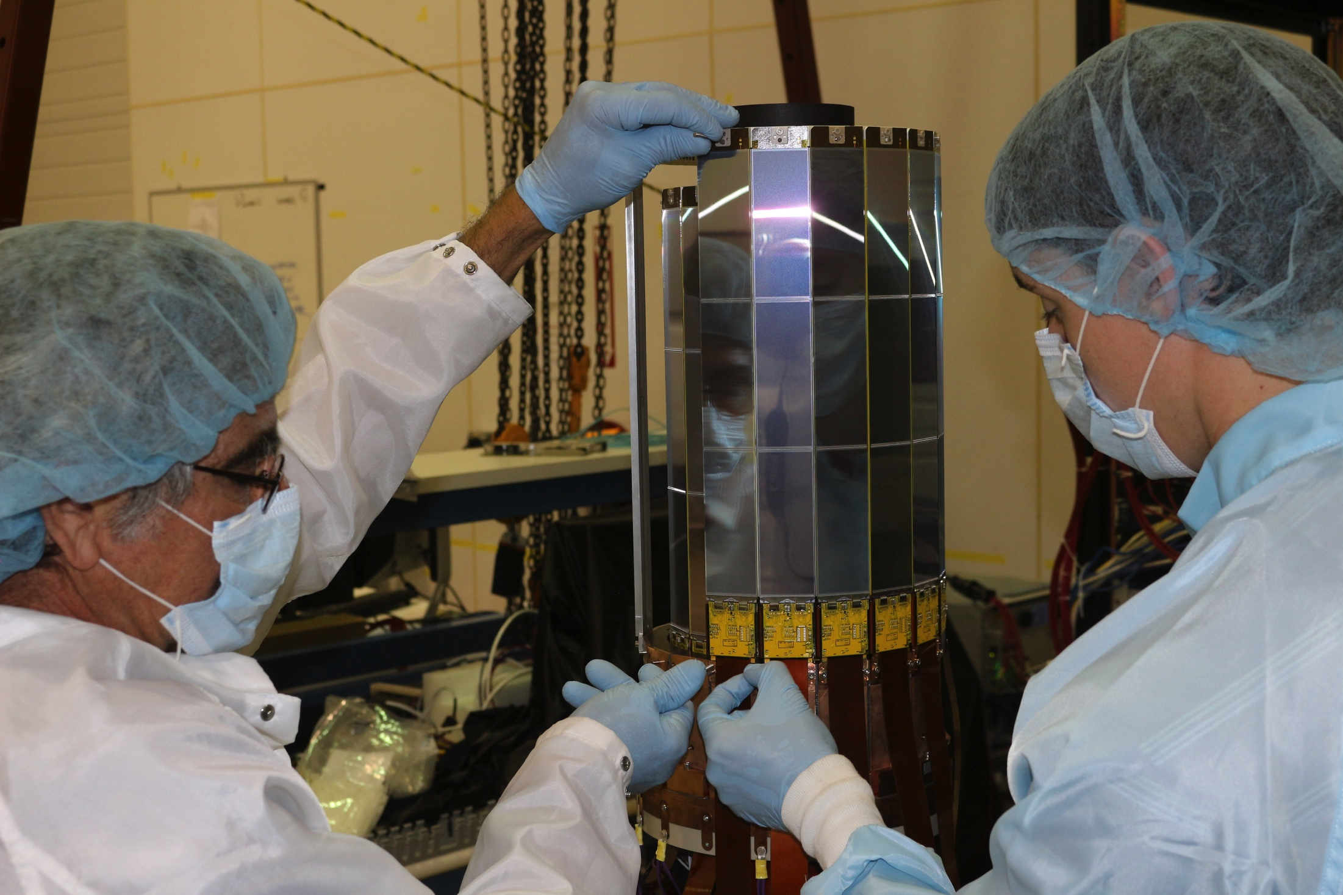
Region 3 Assembly

Slide 17
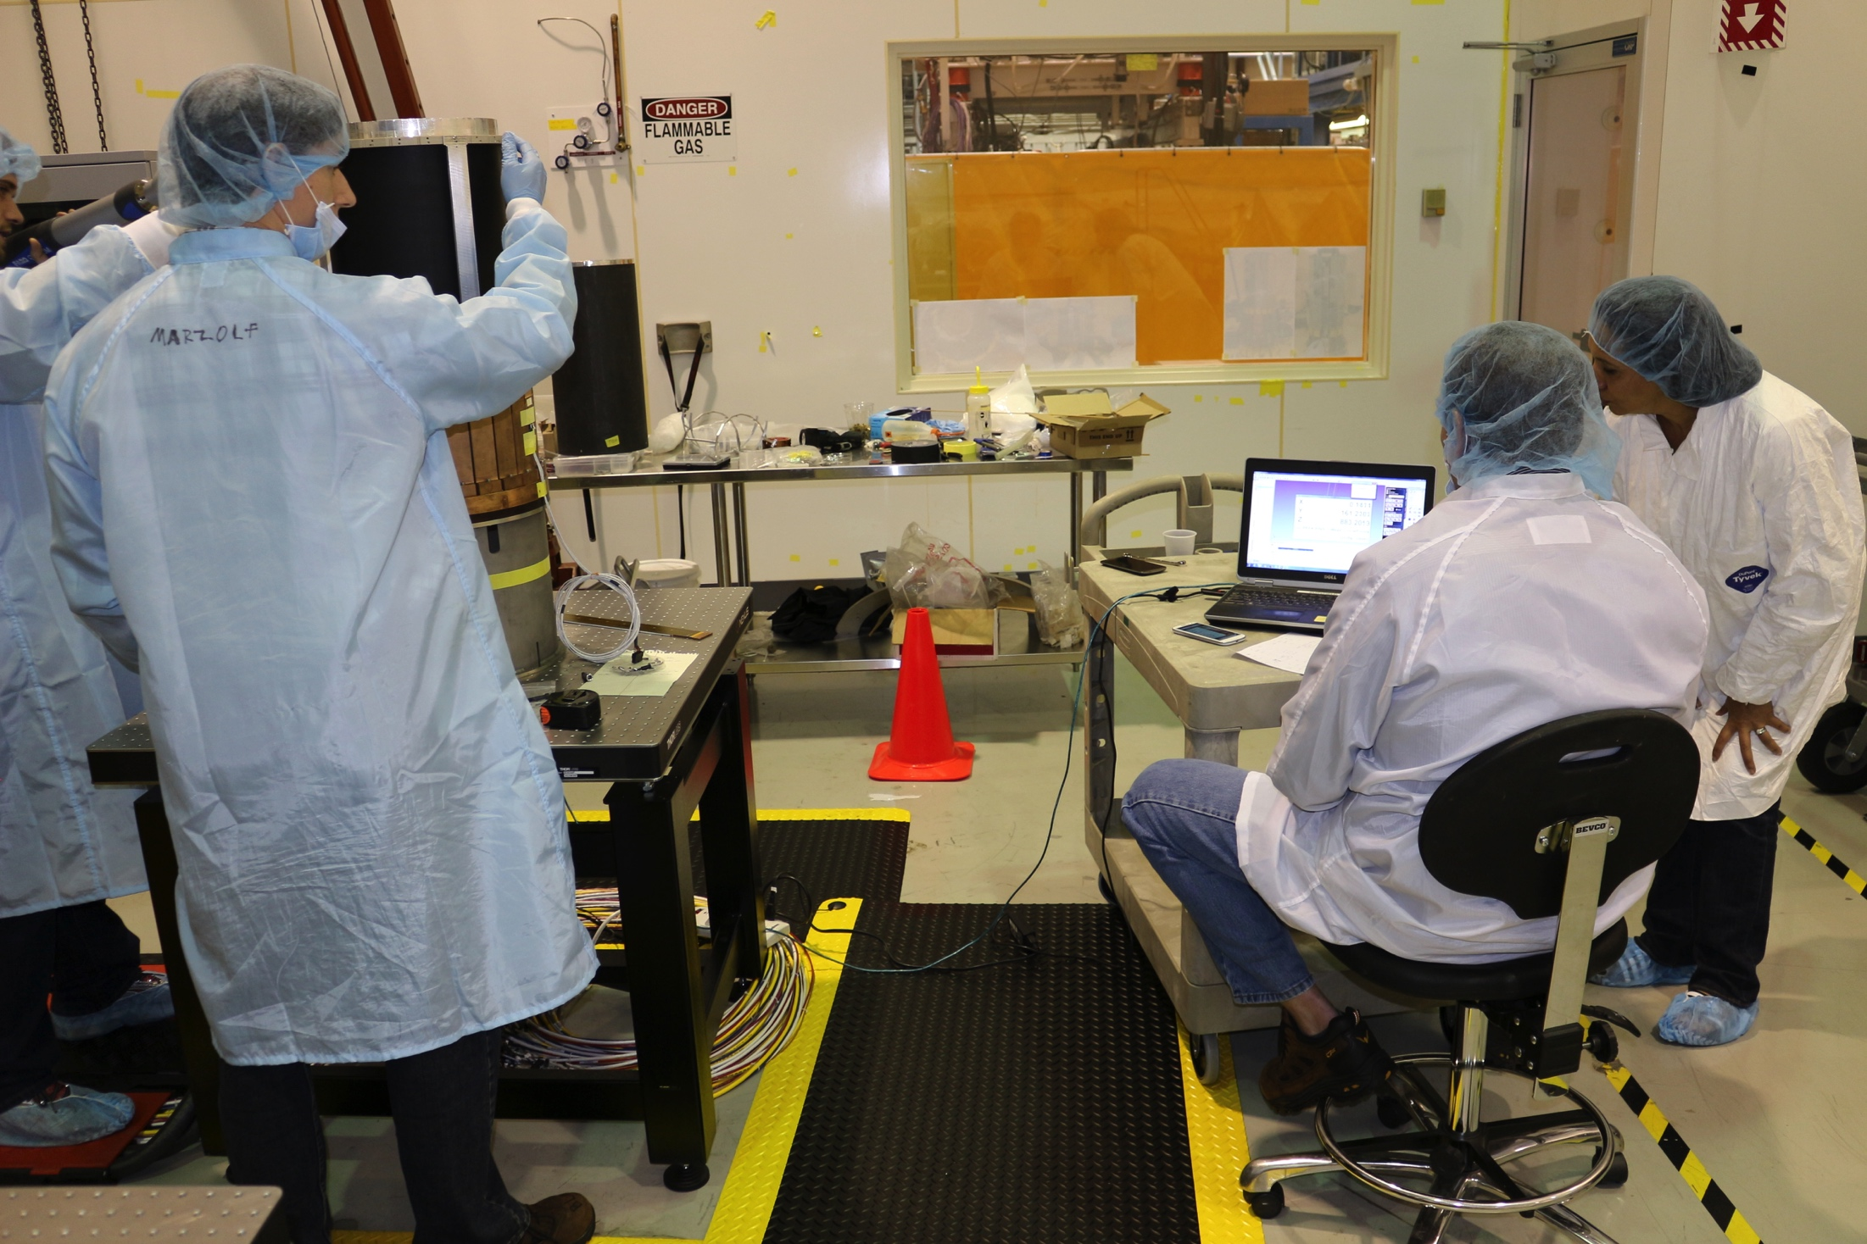
Region 4 Survey and Alignment

Slide 18
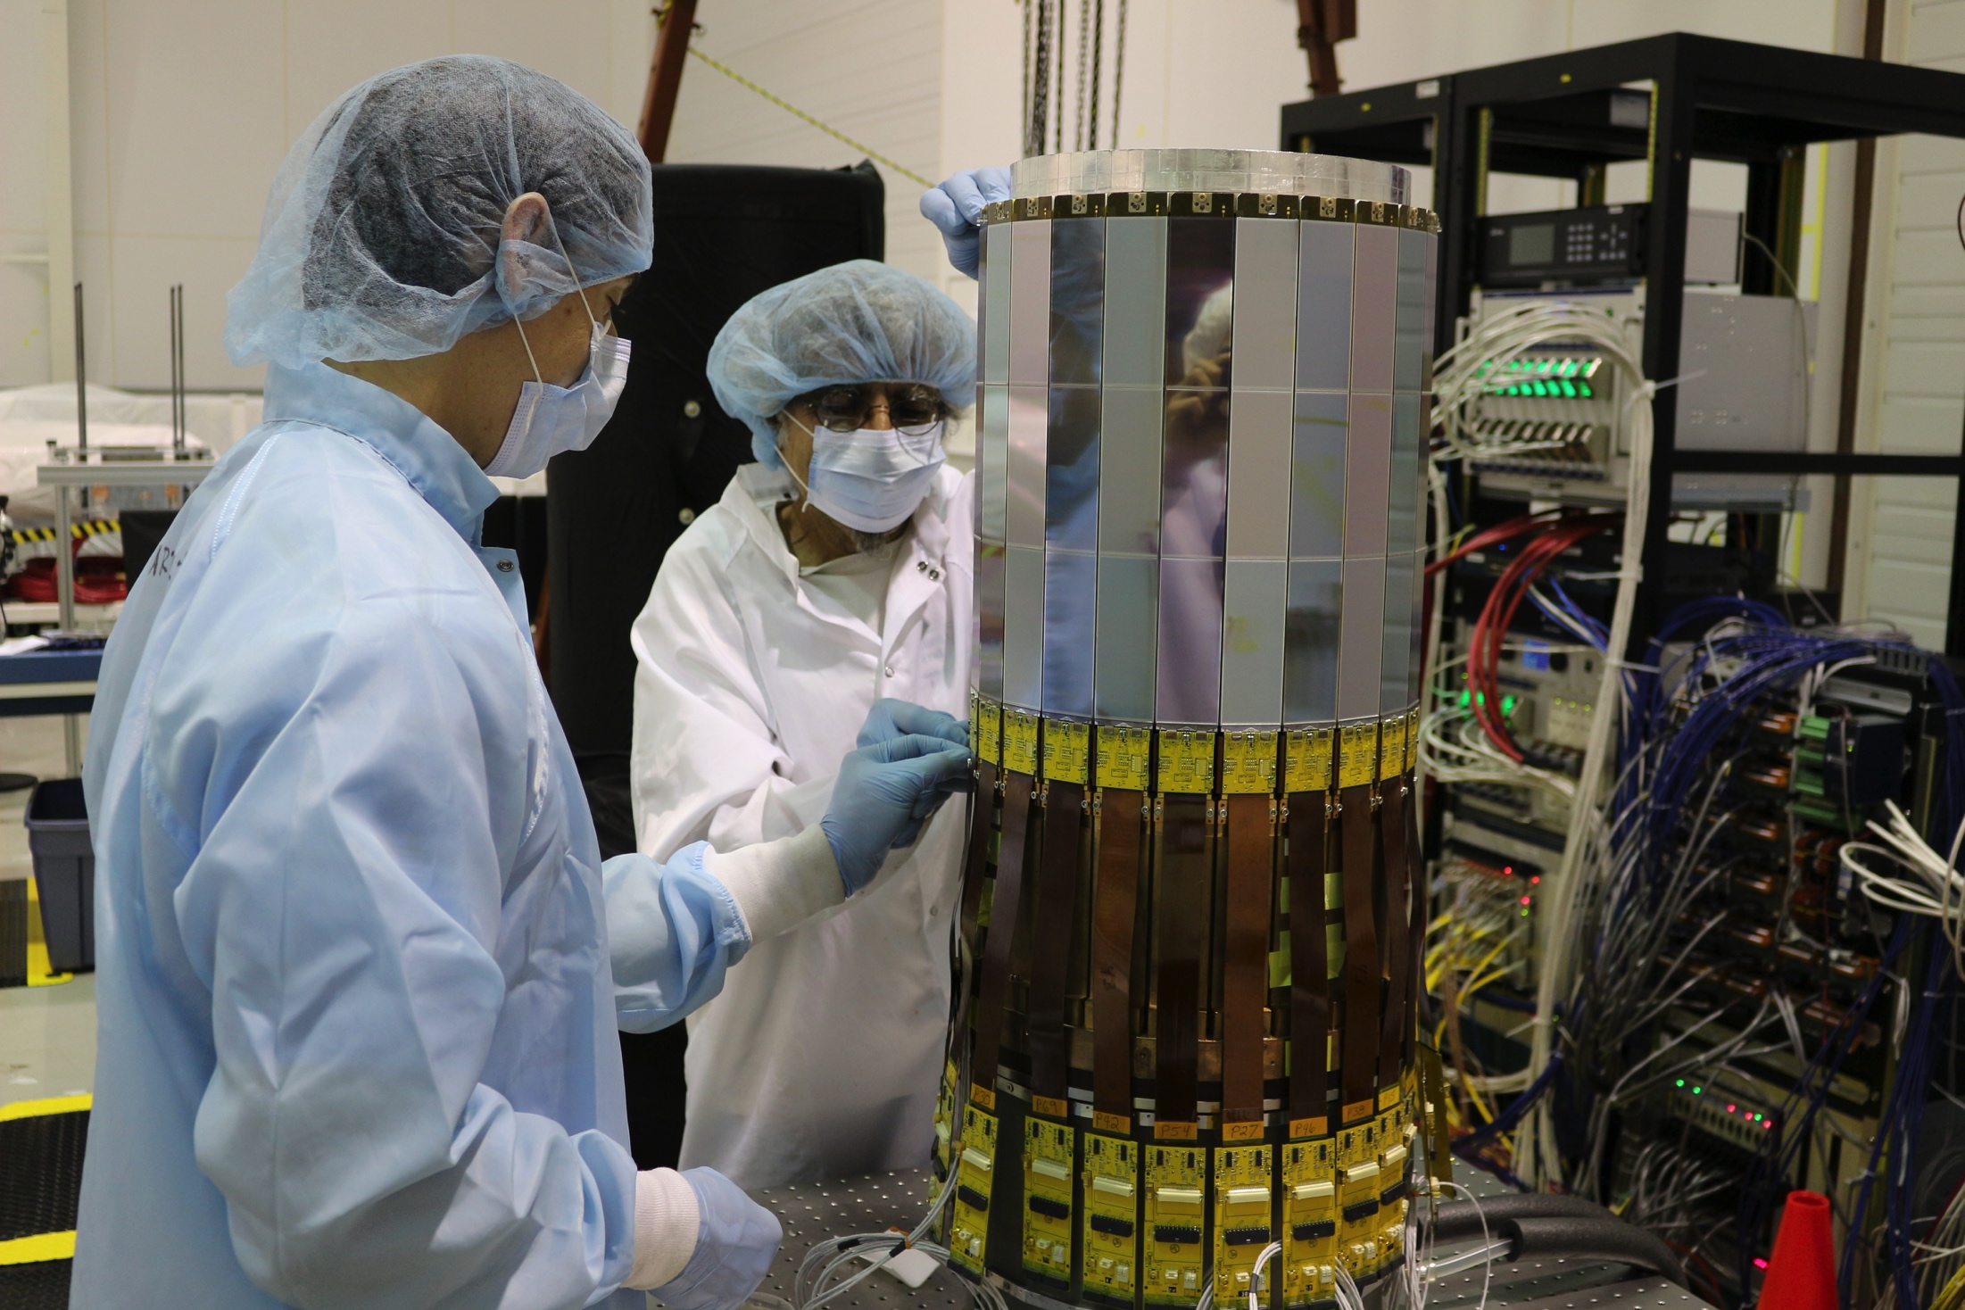
Region 4 Assembly

Slide 19
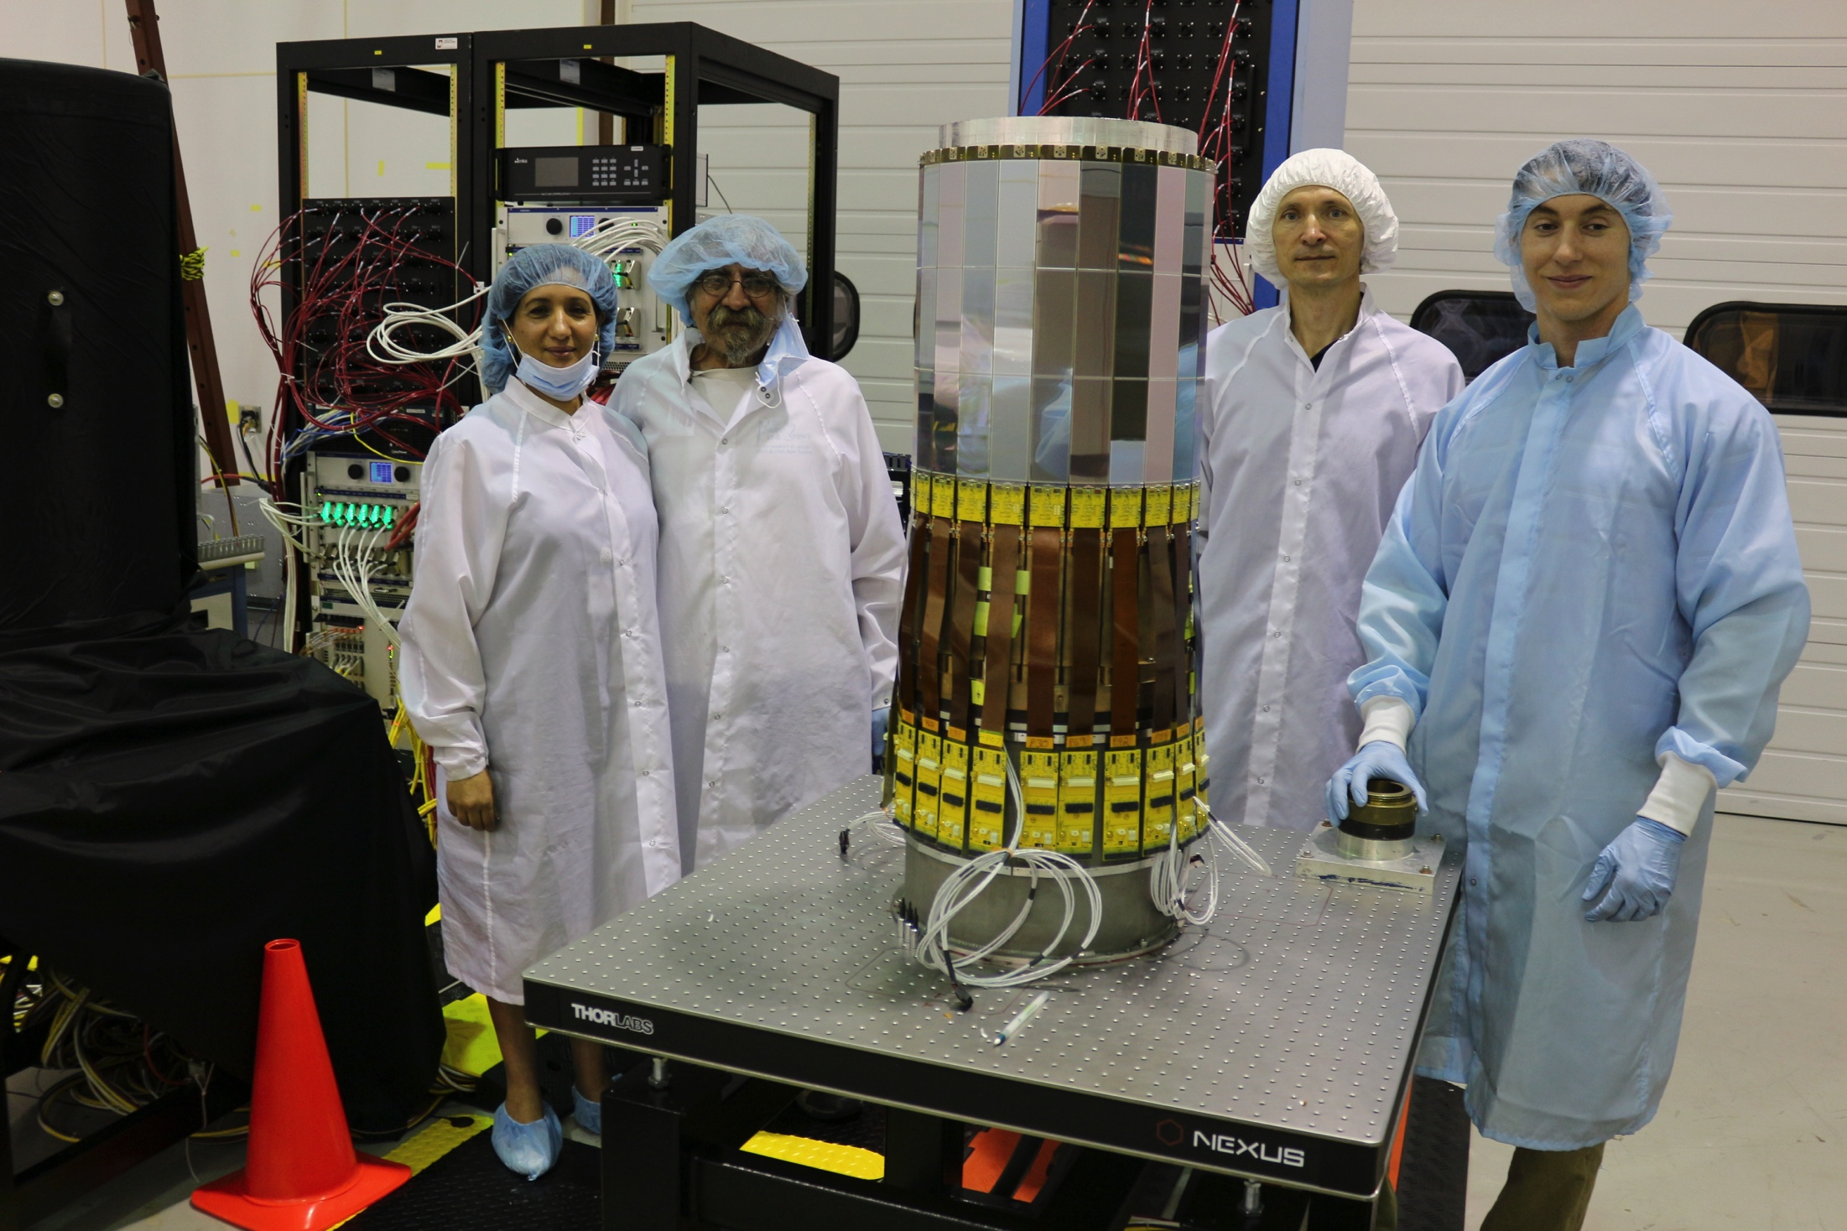
Region 4 Assembled

Slide 20
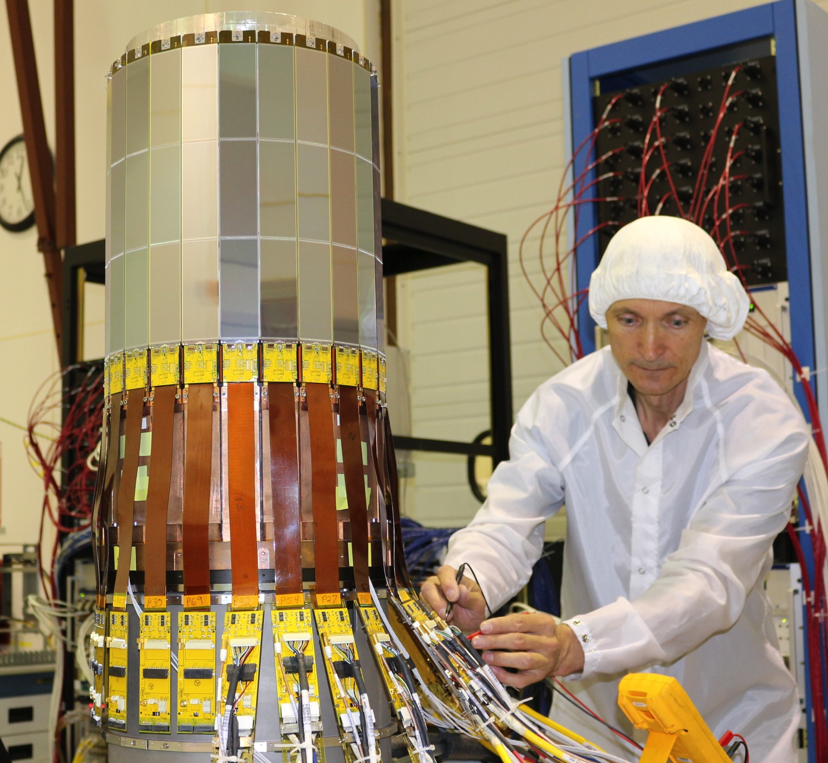
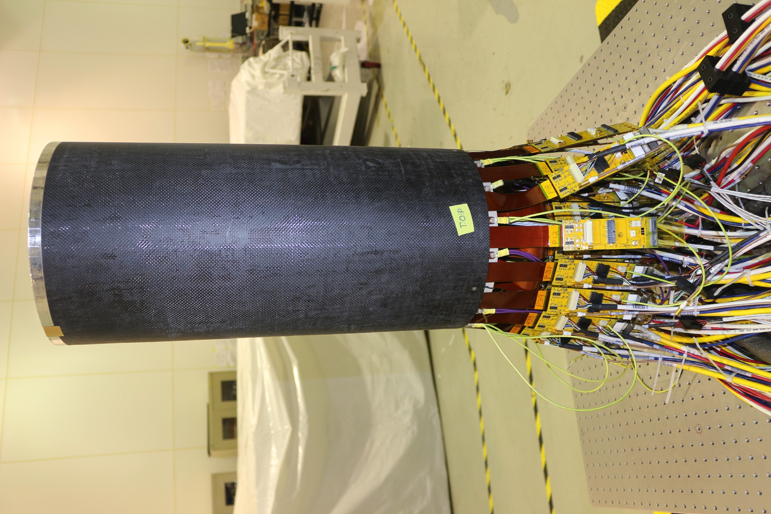
SVT Assembly: Cabling and Faraday Cage

Slide 21
SVT Detector Hardware and Cabling
Power Supplies and crates: LV & HV delivered, tested
HV distribution boxes: assembled and tested, 1 spare
VXS crates: received and tested
VSCM, Crate Controllers, TI, SD boards: received and tested
VME patch panel: assembled, tested
VME ADC boards (450, 4120, 2232, 3122, RS232 for chiller)
received, tested, drivers developed
Cables:
HV/LV/slow control: fabricated and tested
Pulser and Data: delivered, tested
Cables for VME patch panel: 4 types, tested
PCB for temperature and RH monitoring: installed on the R2/R3/R4 rings
COMPLETE

Slide 22
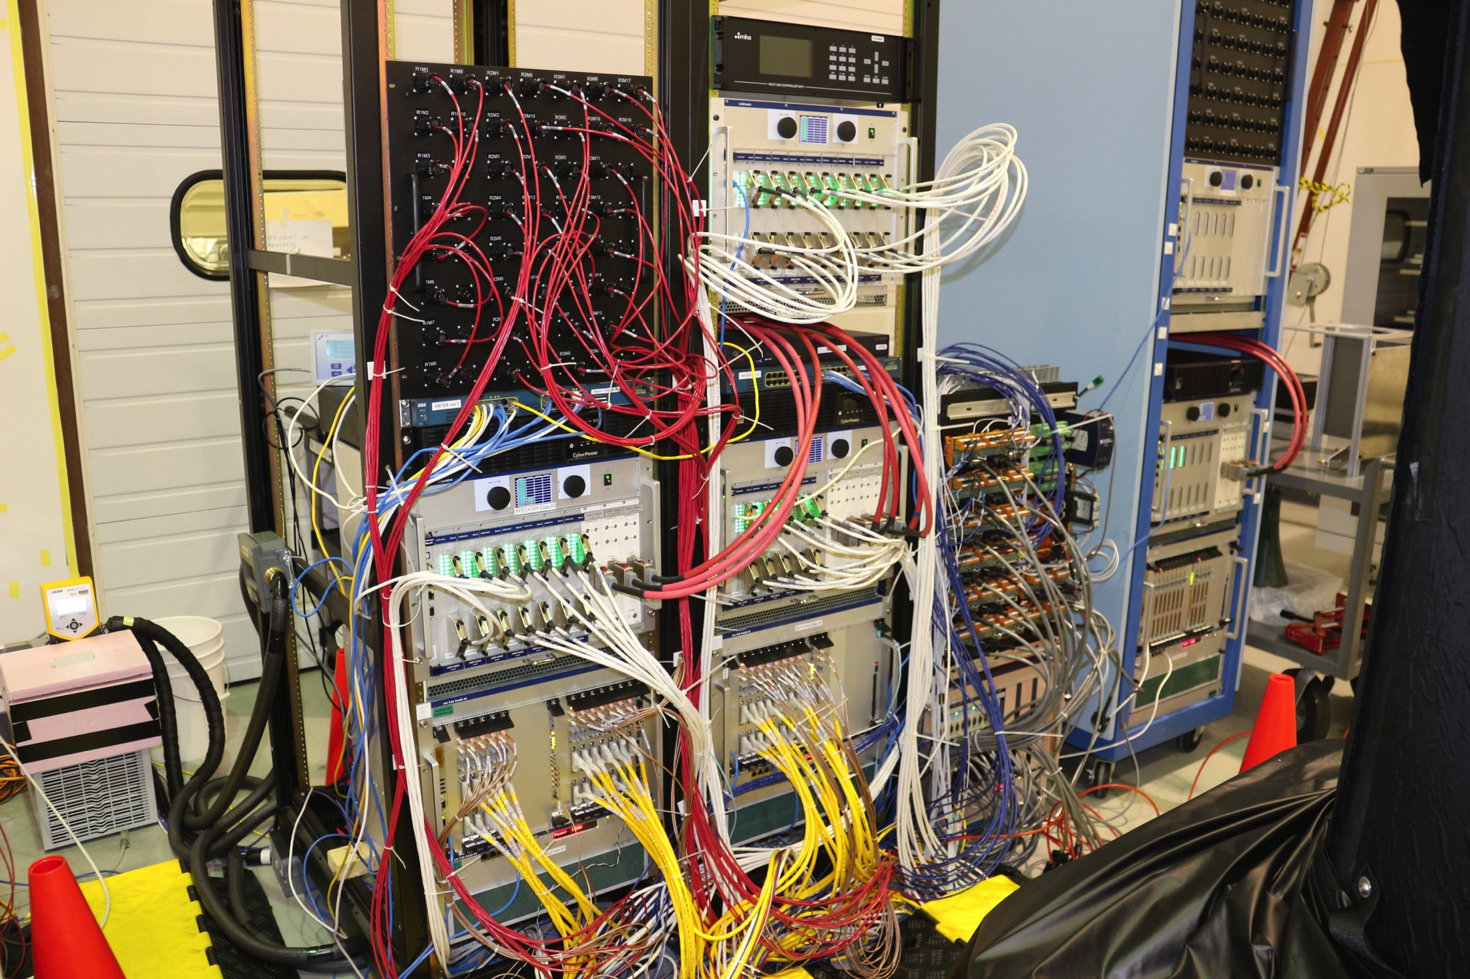
SVT DAQ, Trigger, and PS Checkout in EEL124
COMPLETE

Slide 23
SVT Slow Controls Tasks Complete
Control and Monitoring
Control & Monitor LV & HV to the SVT Modules
Monitor HFCB temperatures
Monitor detector internal temperatures and humidity
Monitor ambient temperatures and humidity
Monitor dew point
Monitor MPOD Crate Status
Monitor DAQ Crate Status
Monitor & control SVT Chiller
Monitor Cold Plate inlet and outlet temperatures
Monitor coolant flow
Monitor gas system
Interlock and Alarms
Provide user settable warning and alarm interlock levels
Provide user enable / disable of alarm control actions
Provide network watchdog timer
User Interface and Data Logging
Provide multi‐level GUI interfaces. (Expert level, User level, DQM, DCS/DSS)
Provide data logger interface & record system values
Provide integrated GUI interface to data logger
Provide real‐time strip‐charts of key system values
Recall / store system initialization values

Slide 24
Checkout the SVT cooling system

Slide 25
SVT Web Monitoring
R1
R3
R2
R4
Alarm Handler

Slide 26
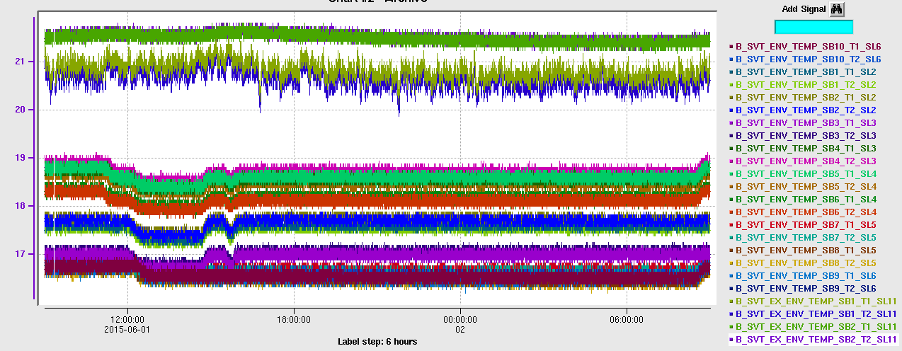
SVT Monitoring: Ambient Temperature
Ambient temperature in the clean room
Temperature, C
R1-R4

Slide 27
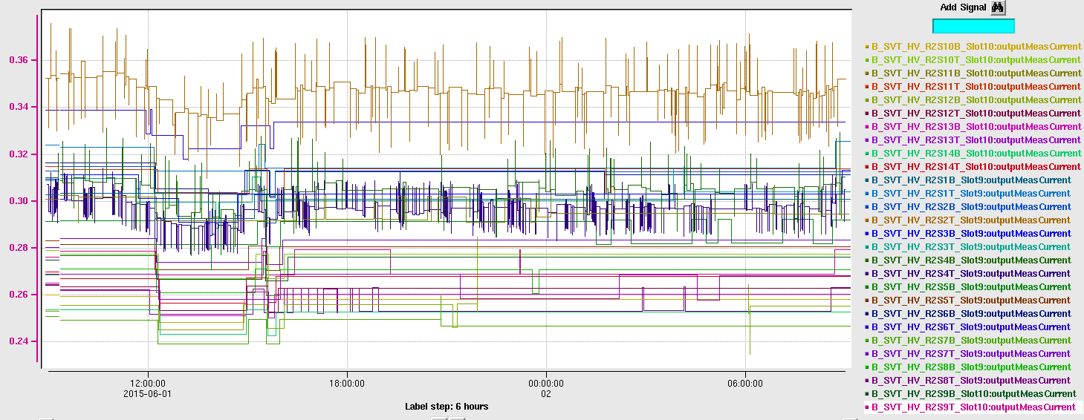
SVT Monitoring: Sensor Leakage Currents
Current, μA
R1
Current, μA
R2

Slide 28
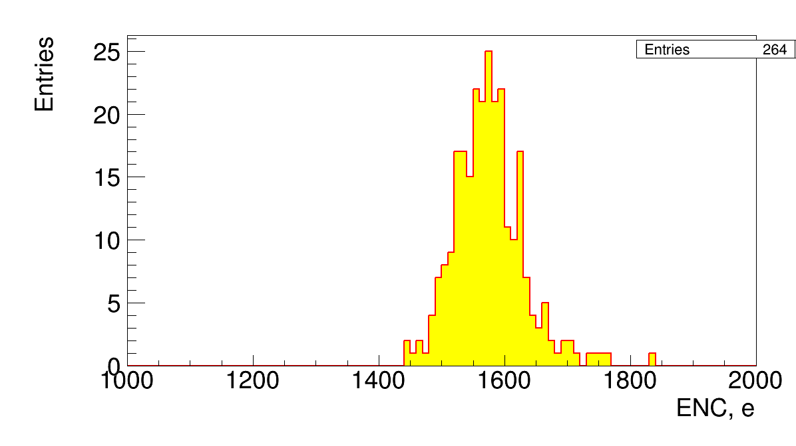
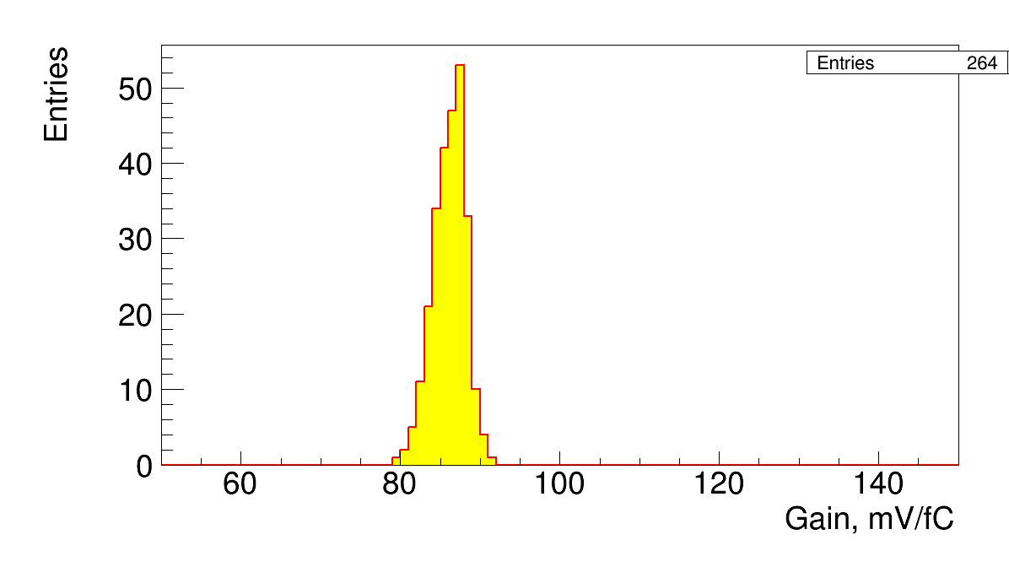
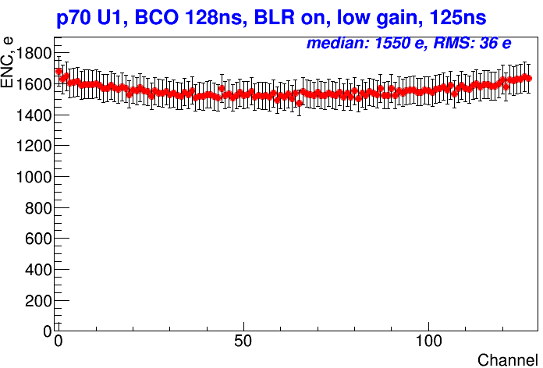
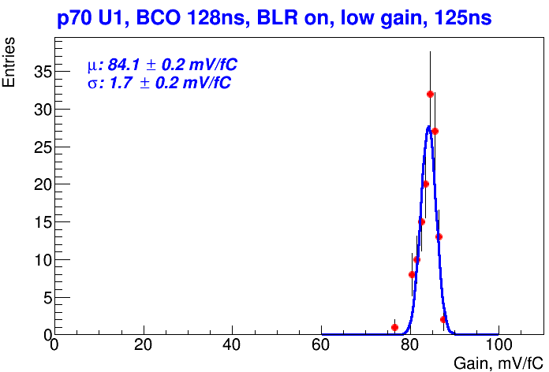
SVT Calibration, R1-R4

Slide 29
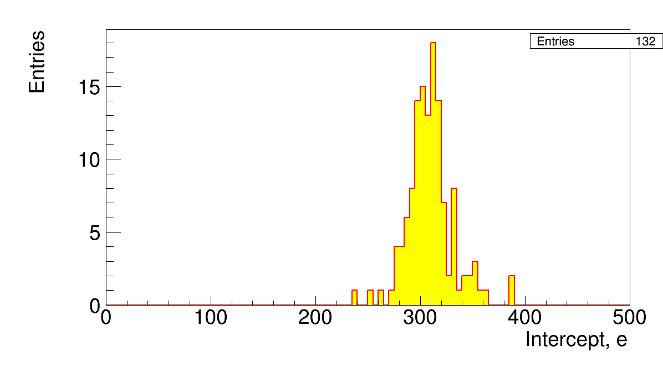
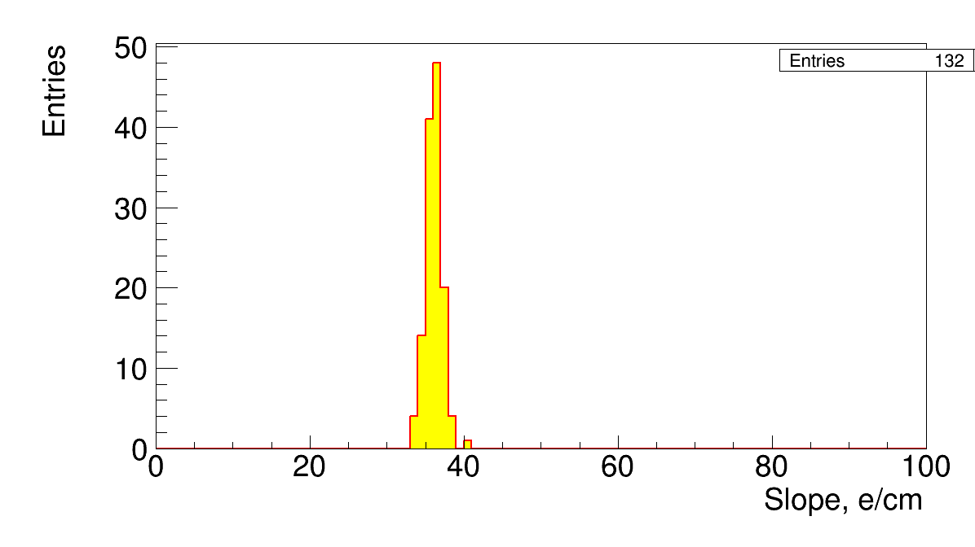
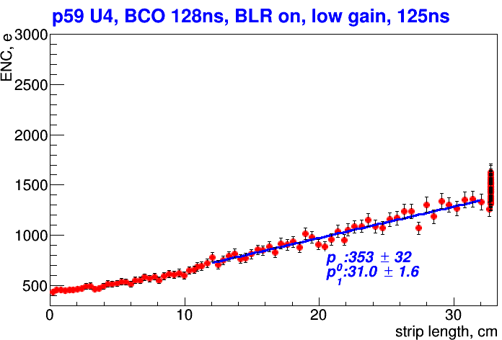
SVT Calibration, R1-R4

Slide 30
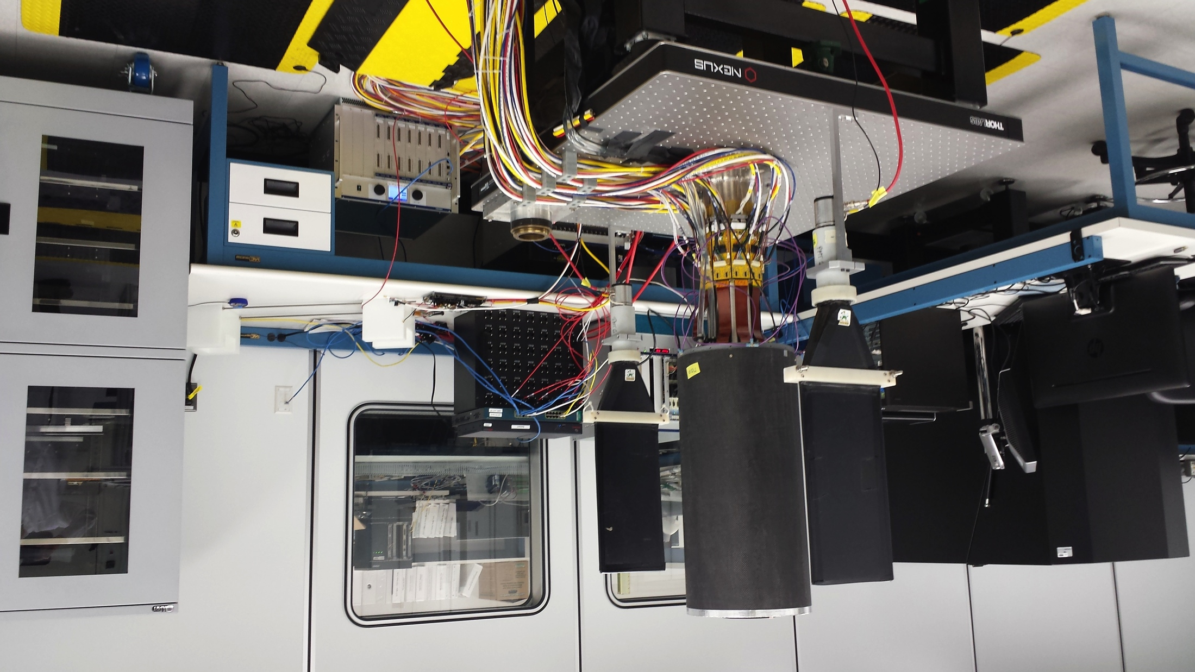
SVT commissioning with cosmic rays
Trigger paddles
Collected data with Regions 1 - 3

Slide 31
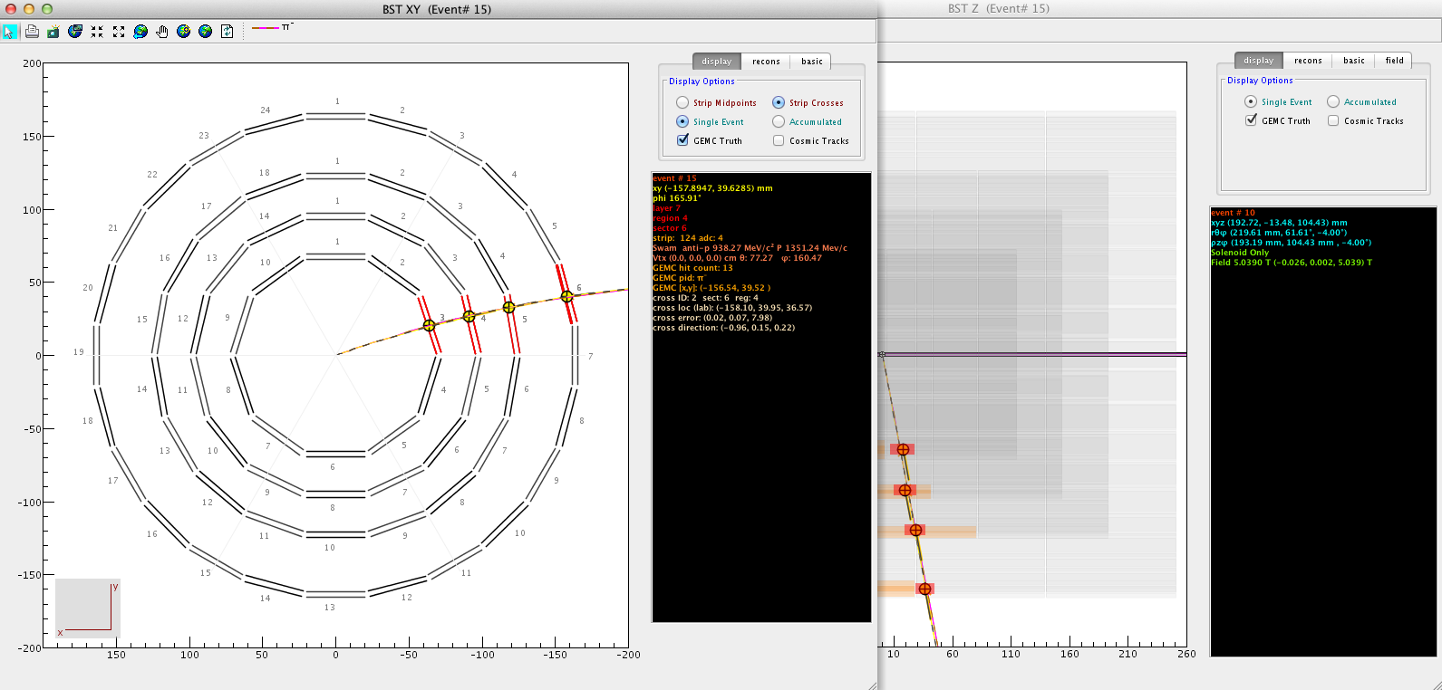
Reconstruction of tracks in the SVT
Determination of space points
Central tracker strip ``intersection’’ determination
1. Clustering of adjacent firing strips (2D hit)
2. Determination of intersections of cluster centroids (double layer)
Pattern Recognition in (r,φ) view
Cut-based algorithm (> 95% efficient)
* require 3 out of 4 intersections
* allows skipped region
Track Fitting
Global Fit to Helix
Kalman Filter
(in development)
Based on CLAS12 software released on 05/22/15
Viewing a reconstructed simulated pi- track propagated in ~5-T solenoidal magnetic field
Notes:
Track in the BST are bent into a helix due to the 5T solenoidal field. So the first step of the reconstruction is to find space points. There are three daisy-chained sensors in each of the 8 layers of the current design. Each layer has 256 strips with linearly varying angles from 0 to 3 degrees. The orientation of the strips in a double layer is such that they are mirror images of each other, so that when superimposed the strips intersect to yield an estimate for the track’s trajectory intersection with the sensor plane. Because depending on the track angle and momentum more than one strip can fire at the region of intersection clustering if adjacent firing strip is first done to get a subsequent estimate of intersecting cluster lines (centroid). The pattern recognition (selection of groups of points consistent with a track) is done in r, phi to select points consistent with a circle and has a loose tandip requirement for r,z. The selected points are then fit. We check the reconstruction using GEMC data. // The strips in the hybrid sensor of Layer B are connected to the pitch adapter and
// and implanted with 156 micron pitch. There are 256 strips oriented at graded angle
// from 0 to +3 deg with respect to the bottom edge of layer B which corresponds to the z-direction.
// Strip number 1 in Layer B is parallel to the bottom of the sensor.

Slide 32
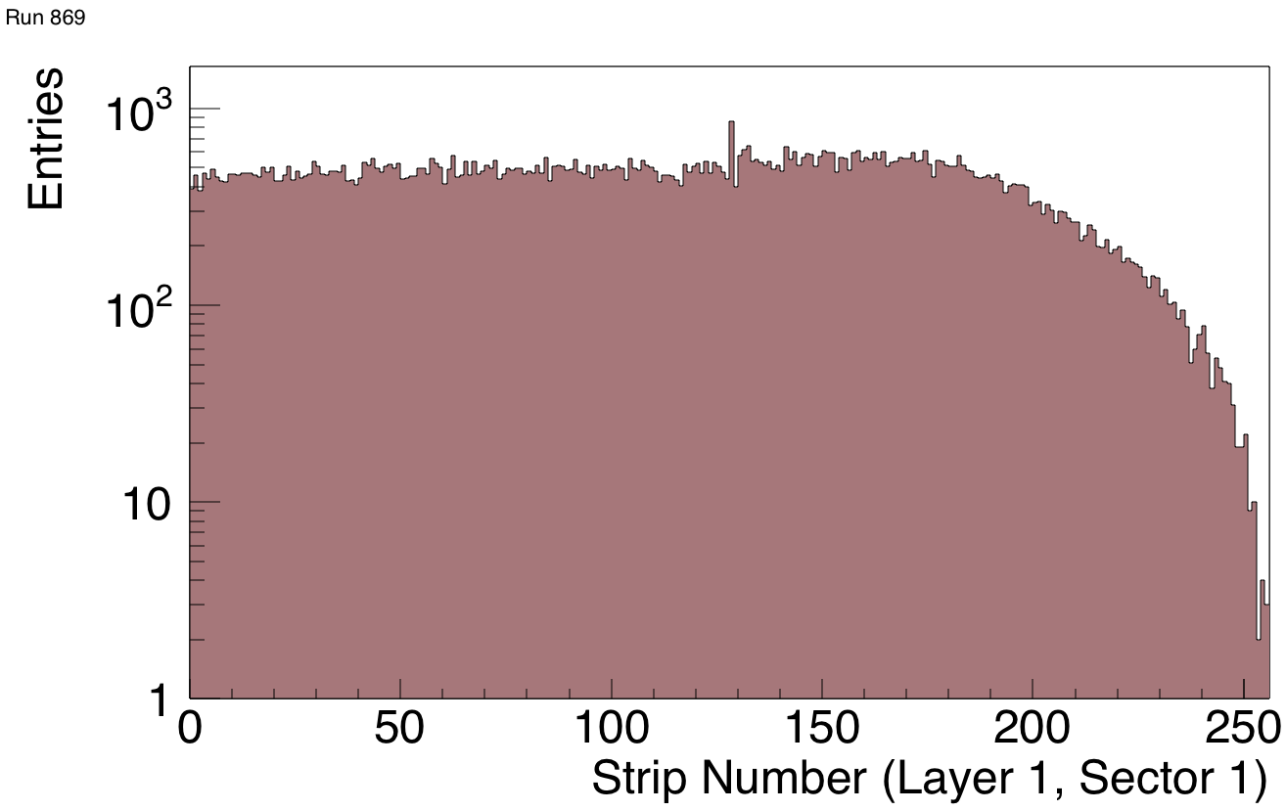
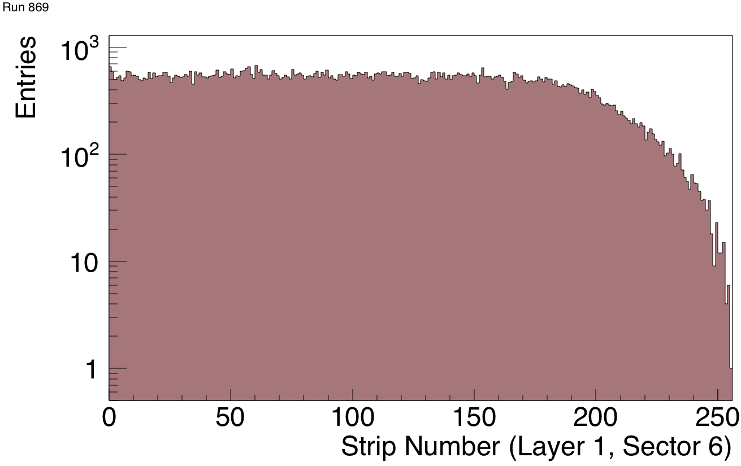
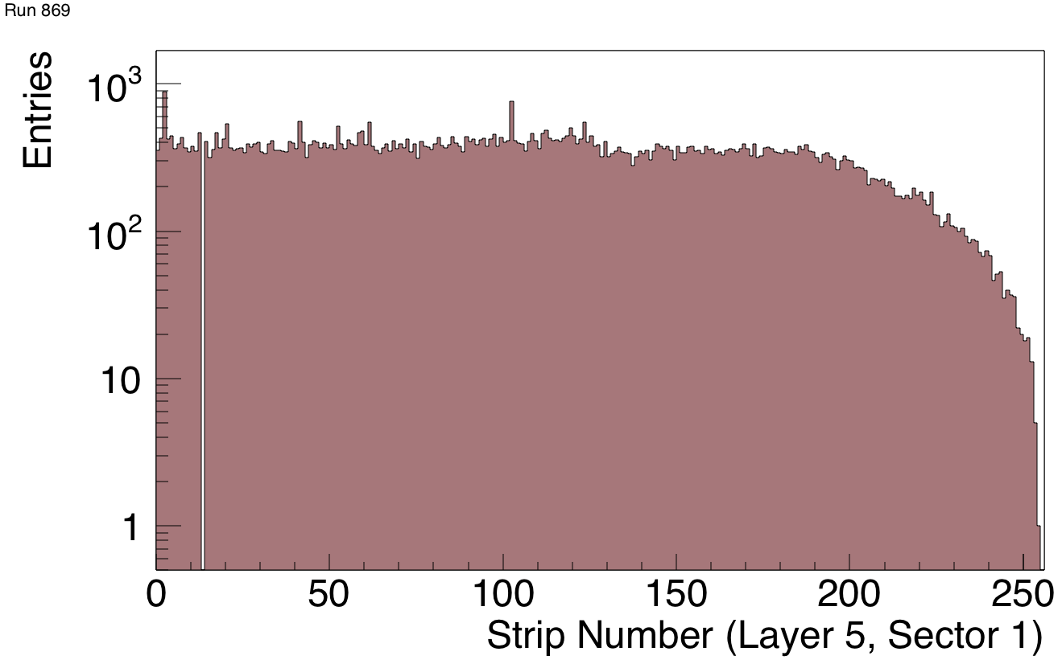
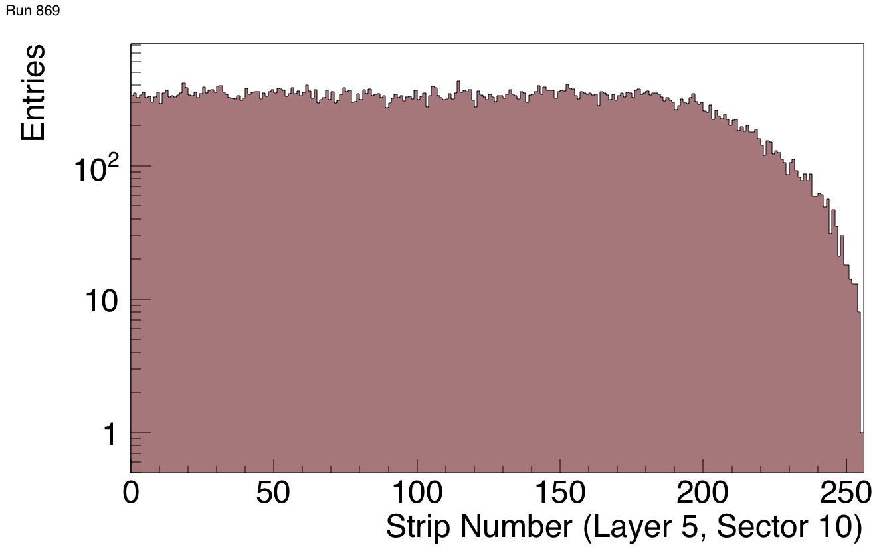
Strip Occupancy

Slide 33
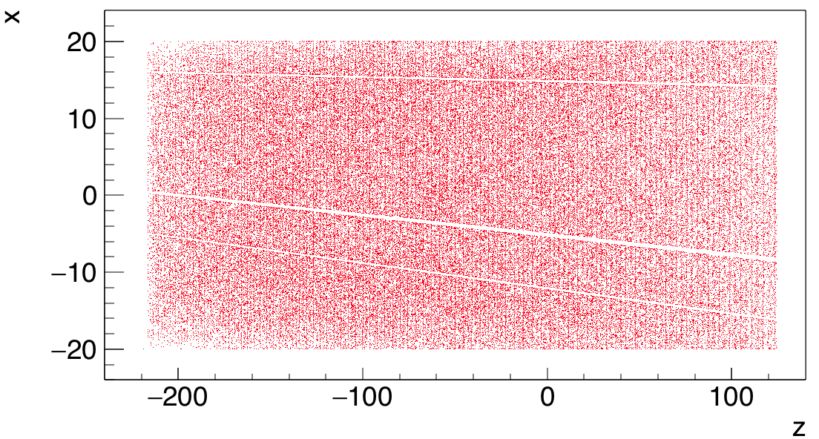
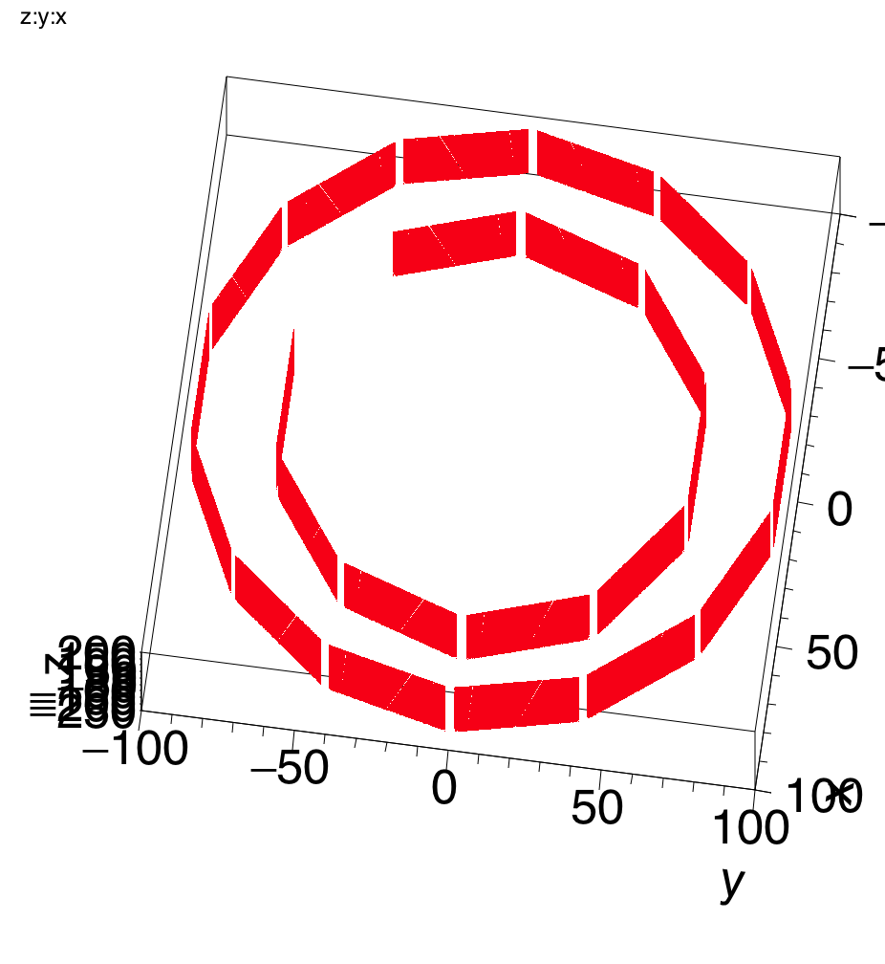
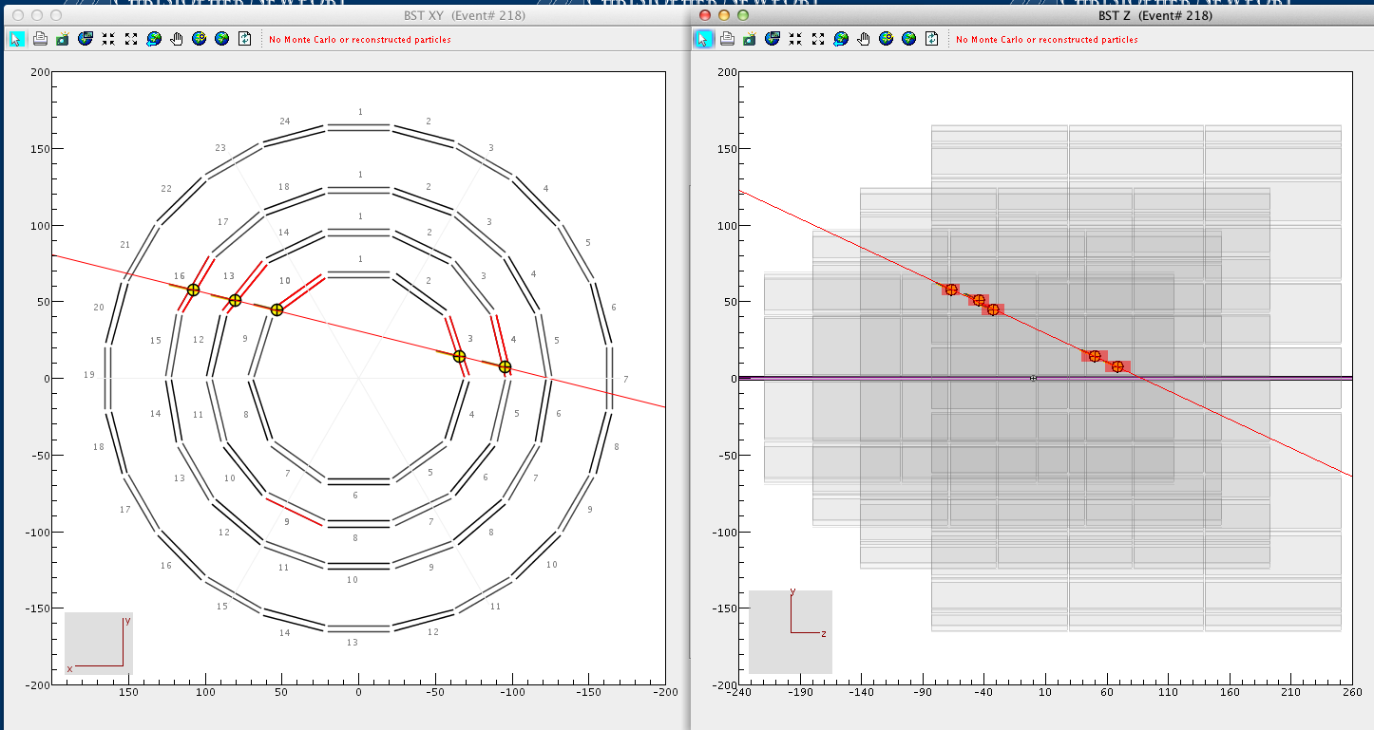
SVT commissioning with cosmic muons
Each point represents position of a reconstructed cross
Channels masked
Module PS off
R1-R3 standalone trigger rate ~50 Hz
Several million events recorded

Slide 34
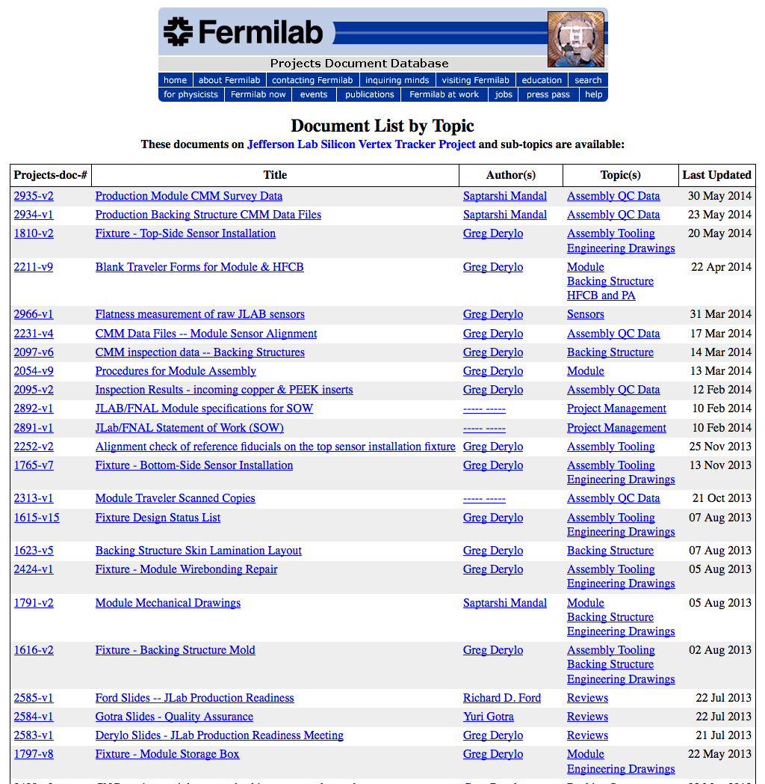
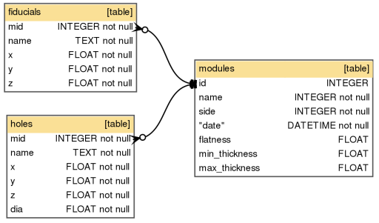
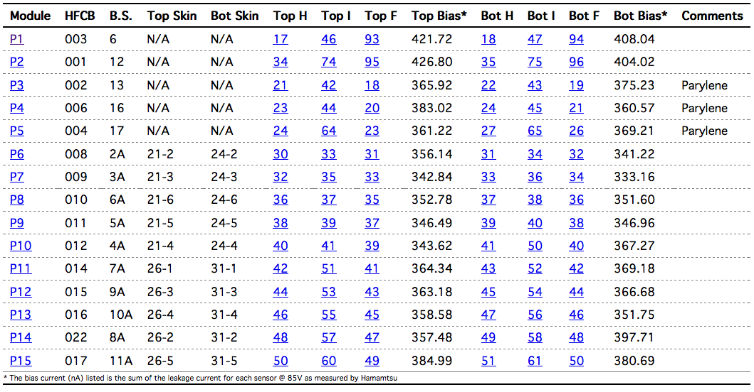
SVT Databases
Fermilab SVT Project Document Database
SVT Module Production Database
SVT Module Testing Logbook
SVT Sensors Database
SVT Construction Database
SVT Configuration Database
SVT Conditions Database
SVT Geometry Database
SVT Calibration Database
SVT Alignment Database
SVT Commissioning Database

Slide 35
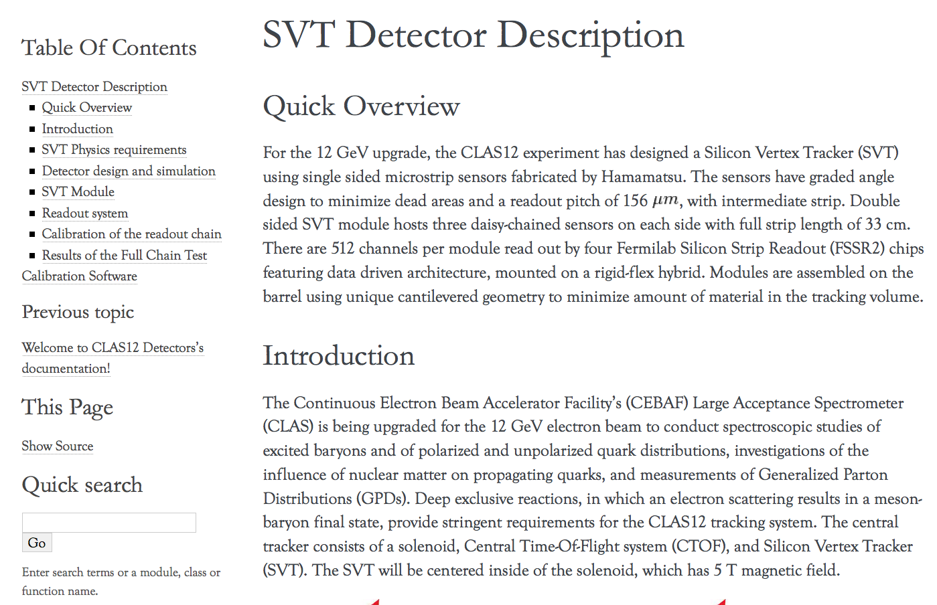
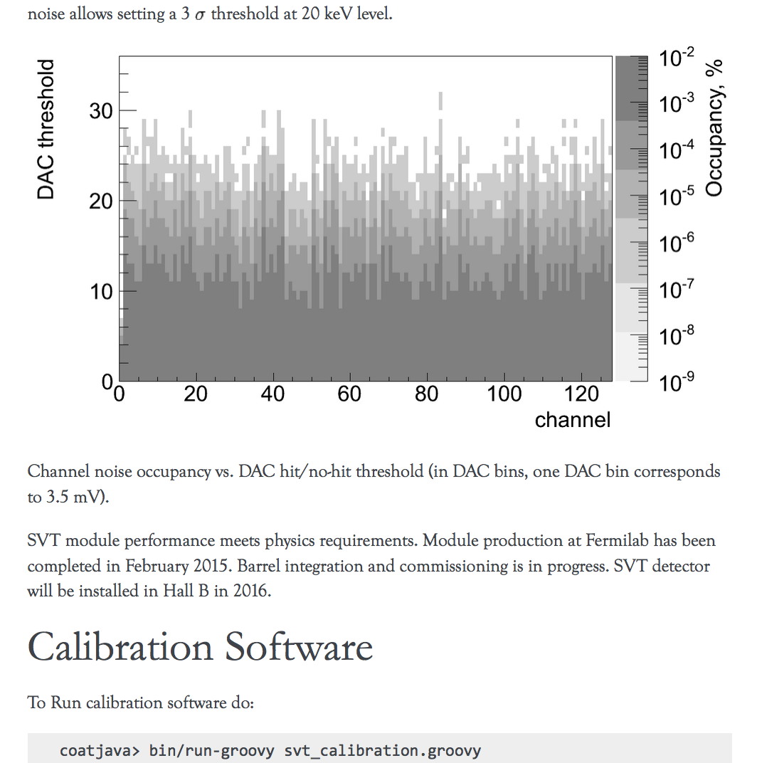
SVT Web page in Clas12Docs
http://clasweb.jlab.org/clas12offline/docs/detectors/html/svt/introduction.html

Slide 36
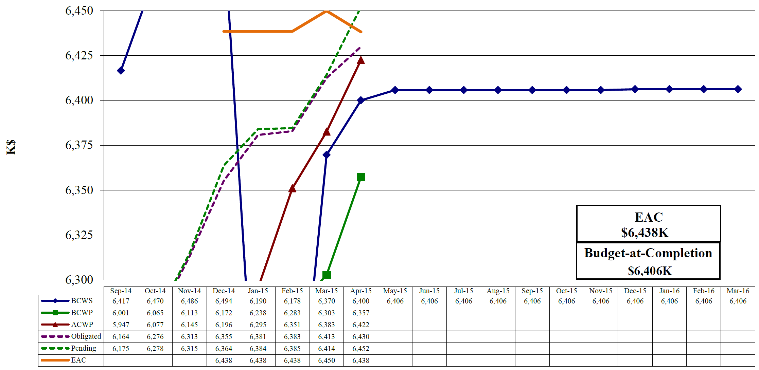
Construction Project Status
Project completion 99.9%

Slide 37
Outline
SVT System Overview
Current Project Status: work completed
SVT assembly
Detector Hardware and Cabling
DAQ
Slow Controls
Calibration and Commissioning
Documentation
Project Work Remaining
Status
Schedule
Cost Estimates
Off Project Work Remaining
Status
Schedule
Cost Estimates

Slide 38
Summary of project work remaining
Activity Percent remaining Cost Estimate Finish Date
Clean Room:
Slow controls software development 26% $5223 06/30/15
Full system test and burn-in, R3 60% ElecEng 0.3 MW, Sci 1.2 MW 06/15/15
Full system test and burn-in, R4 60% ElecEng 1.2 MW, Sci 1.5 MW 06/22/15
Full system test, integration of R3/R4 80% MechEng 0.8 MW, ElecEng 0.8 MW, Sci 0.8 MW 07/22/15
Procure SVT mounts and cart 100% $34194 08/21/15
Hall B:
Initial mount, cable, and check 100% MechTech 6 MW, ElecTech 2 MW, Sci 2 MW 04/20/16
Roll in and align after beam run 100% MechTech 1.2 MW, Sci 0.8 MW 12/20/16

Slide 39
Slow Controls Software Development
Activity ID: 242211402
Budgeted cost: $5223
Percent remaining: 26%
Activity finish date: 06/30/15
Remaining steps, weight, and expected finish date:
Develop user interfaces 15% 06/15/15
Develop backup and restore tool 4% 06/05/15
Integrate and test SC system into CLAS12 7% 12/01/15

Slide 40
Full System Test and Burn-In in the Clean Room: R3
Activity ID: 2822X015
Resources: ElecEng 0.3 MW, Scientist 1.2 MW
Percent remaining: 60%
Activity finish date: 06/15/15
Remaining steps, weight, and expected finish date:
Checkout DAQ and Trigger 50% 06/17/15
Checkout of Safety System 10% 06/30/15

Slide 41
Full System Test and Burn-In in the Clean Room: R4
Activity ID: 2822X020
Resources: ElecEng 1.2 MW, Scientist 1.5 MW
Percent remaining: 60%
Activity finish date: 06/22/15
Remaining steps, weight, and expected finish date:
Checkout DAQ and Trigger 50% 06/22/15
Checkout of Safety System 10% 06/30/15

Slide 42
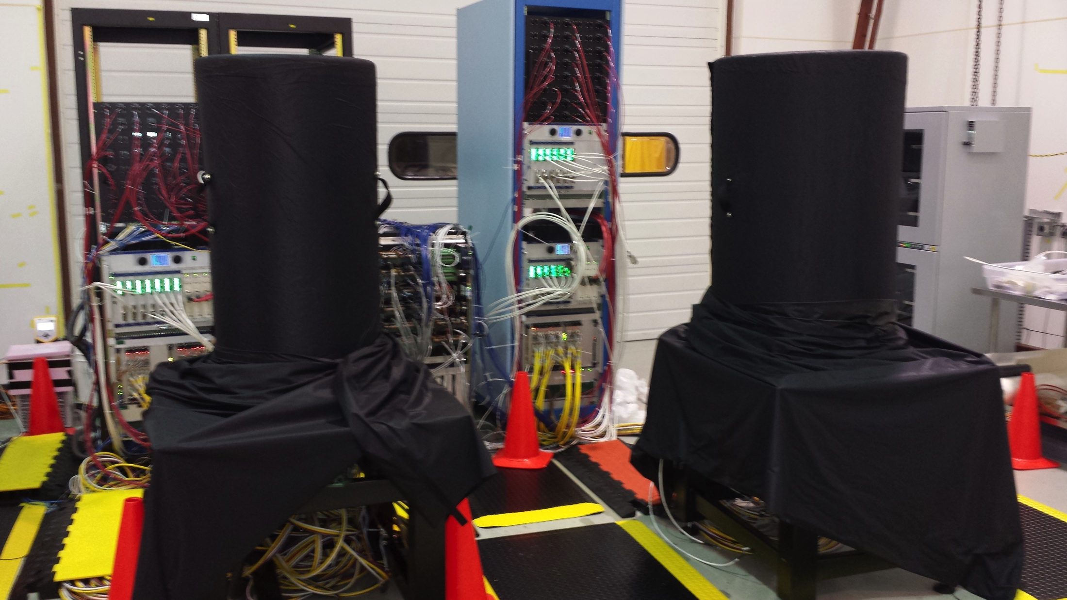
Checkout SVT DAQ and Trigger

Slide 43
Full System Test: Integration of R3/R4
Activity ID: 2822X025
Resources: MechEng 0.8 MW, ElecEng 0.8 MW, Scientist 0.8 MW
Percent remaining: 80%
Activity start date: 07/01/15
Activity finish date: 07/22/15
Expected delivery of integration tooling: 07/05/15
Review of the integration procedures: 06/22/15
Remaining steps, weight, and expected finish date:
Install Faraday cage over R4 20% 07/01/15
Insert and attach R3 to R4 20% 07/14/15
Survey position of R3 with respect to R4 20% 07/16/15
Hook all services 20% 07/22/15

Slide 44
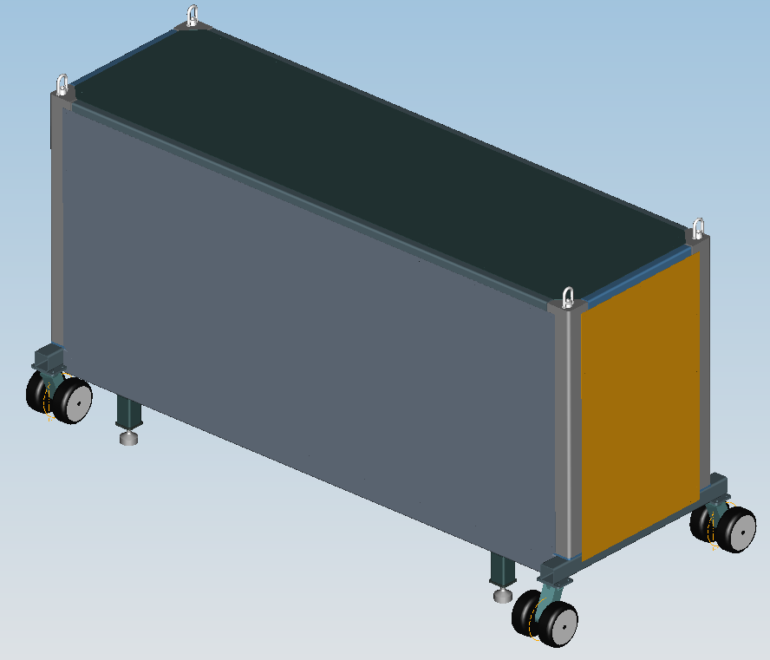
SVT – Region 4 Integration
R4 Integration Adapter
R4 Support Tube
SVT Mounting & Alignment System
Region 4
Support Tube
SVT
Protective Enclosure
Integration and Transport Fixture

Slide 45
Initial Mount, Cable, and Check SVT System in the Hall B
Activity ID: 2822X110
Resources: MechTech 6 MW, ElecTech 2 MW, Scientist 2 MW
Percent remaining: 100%
Activity start date: 03/31/16
Activity finish date: 04/20/16
Delivery of service cart: 06/30/15
Remaining steps, weight, and expected finish date:
Install SVT cart 30% 04/05/16
Install SVT electronics 50% 04/19/16
Place SVT on cart 20% 04/20/16

Slide 46
Central Detector Installation in Hall B
Central Tracker Service Cart
SVT Crates
Solenoid

Slide 47
Roll In and Align SVT System After Beam Run
Activity ID: 2822X115
Resources: MechTech 1.2 MW, Scientist 0.8 MW
Percent remaining: 100%
Activity start date: 12/14/16
Activity finish date: 12/20/16
Remaining steps, weight, and expected finish date:
Assembly setup 10% 12/15/16
Assemble Region 4 50% 12/19/16
Assemble outer shell and Faraday cage 40% 12/20/16

Slide 48
Outline
SVT System Overview
Current Project Status: work completed
SVT assembly
Detector Hardware and Cabling
DAQ
Slow Controls
Calibration and Commissioning
Documentation
Project Work Remaining
Status
Schedule
Cost Estimates
Off Project Work Remaining
Status
Schedule
Cost Estimates

Slide 49
Off Project Activities
Long term stability test
Calibration suite (documentation, benchmarking, integration to CLAS12 framework)
Databasing (conditions, configuration, run)
Commissioning with cosmic muons (local calibration, tracker performance)
Tracker alignment
Validating track reconstruction R1-R3, R1-R4, SVT-MVT)
Monte Carlo Validation suite
Commissioning in the Hall B without beam
Commissioning with beam (magnet on/off)
Resources:
Scientist 30 MW, Senior Staff 10 MW, Elec Eng 22 MW

Slide 50
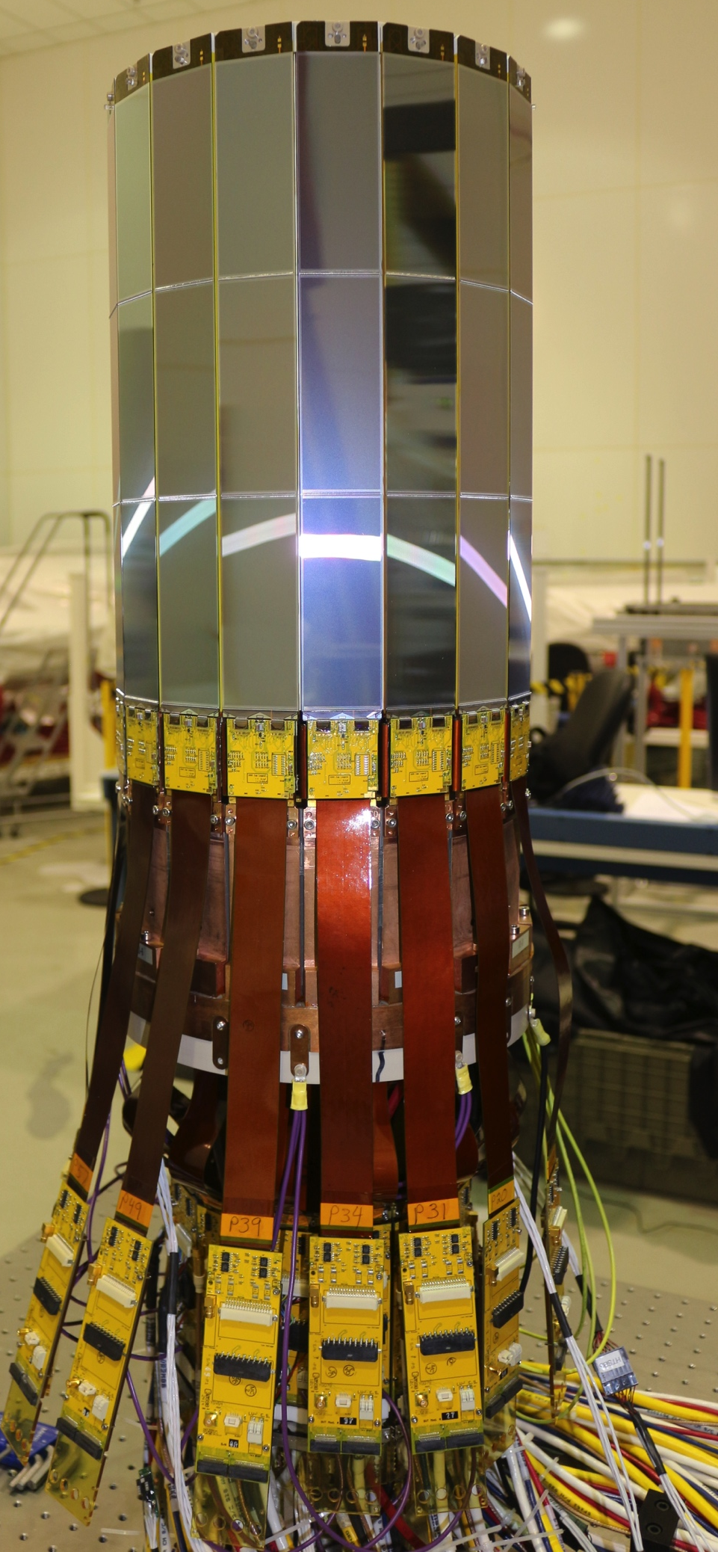
Summary
Assembly of the SVT regions done
Checkout of hardware systems done
Detector performance within the specs
Detector commissioning started
Remaining on project tasks are well defined
Remaining off project tasks are well defined
Project construction completion 99.9%

