Slide 1
Director’s CLAS12 Detector Assessment
Friday, June 5, 2015
Jefferson Lab
SVT
Glenn R Young

Slide 2
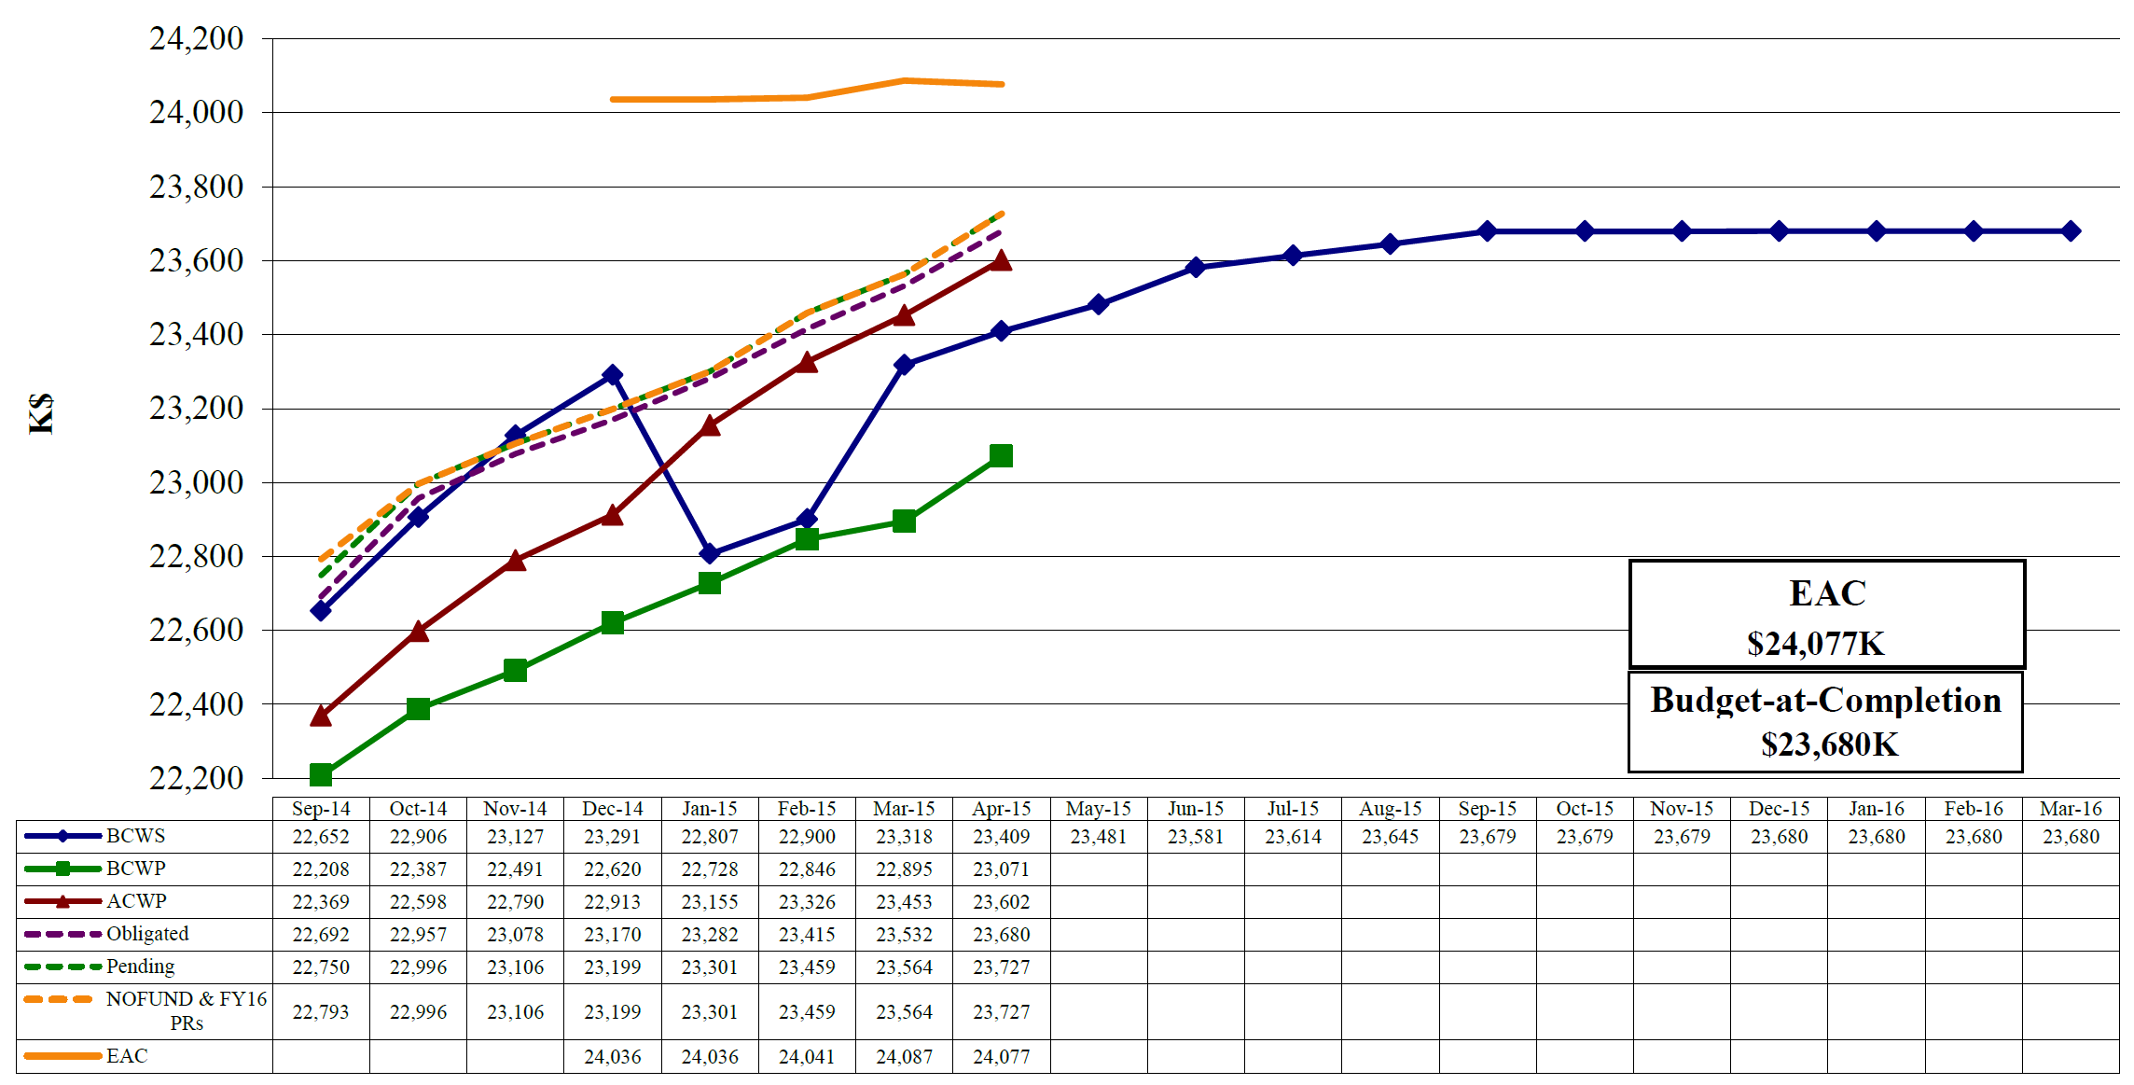
12 GeV 1.4.2.2. Hall B Detectors Earned Value $K
Estimated Cost of All Work at Completion
Actual Cost of Accomplished Work
All Planned Work
Accomplished Work

Slide 3
12 GeV 1.4.2.2. Hall B Detectors Earned Value $K
Actual Cost of All Accomplished Work (projected)
~ $24,375K
i.e. $300K over current EAC !
All Planned Work
Estimated Cost of All Work at Completion
Still Just Possible to Accomplish All Work by the End of FY2015 at Present Pace of Work
May Progress
Have been making about $0.77/$ since January
Estimated Cost (EAC) Must cover Planned Cost PLUS Cost Overruns (“CV”) PLUS Foreseen “Adders”

Slide 4
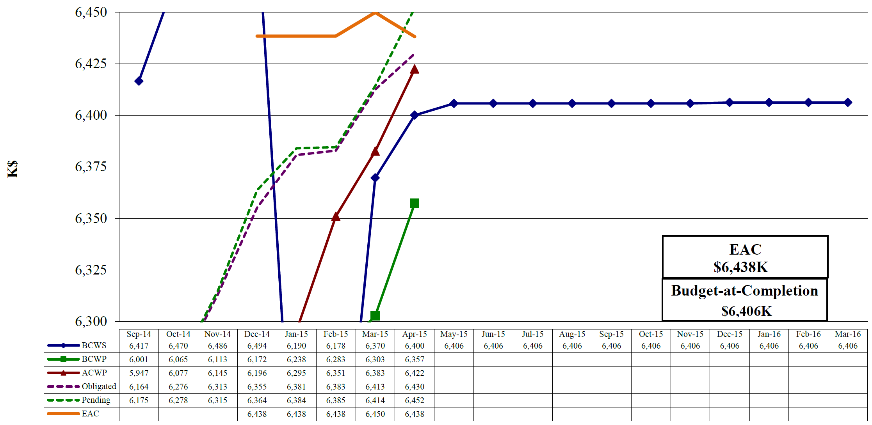
12 GeV 1.4.2.2.1.1 Silicon Detector Earned Value $K
Pending exceeds EAC by $14K
$22K of PR, open shop, P.Labor remains
$8K of e.g. POs remain
$65K overspent
About $6K construction remains
May Progress
$9K of the Obligated/Pending is MechDesigner work that will charge Pre-Ops; $7K is completed shop work

Slide 5
SVT Remaining Activities as of May 31, 2015
Activity ID | Name | Activity Start | Activity Finish | Remaining Budgeted MWeeks or Proc. Cost
242211402 | Slow Controls | 1/5/15 | 6/30/15 | $4,861
24267115 | Build Cart, Fixture | 5/11/15 | 7/6/15 | $34,194
2822X015 | Test R3 | 5/9/15 | 6/15/15 | 1.5
2822X020 | Test R4 | 5/11/15 | 6/22/15 | 2.7
2822X025 | Integrate/Test R3/4 | 7/1/15 | 7/22/15 | 4
2822X110 | Install in Hall B | 3/31/16 | 4/20/16 | 10
2822X115 | Reinstall in Hall B | 12/14/16 | 12/20/16 | 2
Total is 20.2 mw, which is estimated at $50.7K direct and is planned to be supported by Hall B and DSG personnel
The Slow Controls EPICS work is being done by Accelerator personnel; the Slow Controls hardware interlock work is being supported by DSG personnel
The Cart and Fixture have PO amounts totaling $56K

Slide 6
Some Observations on SVT
The SVT detector elements are built, assembled and work well
Some interlock and controls work is left under the construction account, together with two open POs to fabricate the support cart and integration tooling
Testing of R1 and R2 is done; that for R3 and R4 is going well and about to finish; this is all under the Pre-Ops account
We need to show that R1-3 and R4 fit together and operate together
We need to place the detector on the beamline and show it works well in that environment
There are thoughts about this, but the detailed plan is being worked out
We have an open question from DOE-OPA about co-existence with the other central detectors of CLAS12
the question covers mechanics but has noise performance at its core

