Slide 1
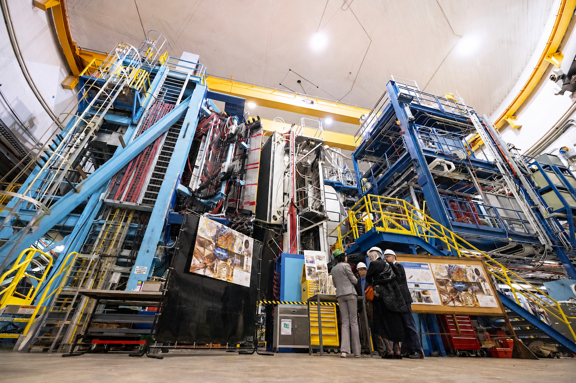
A guide in Hall B

Slide 2
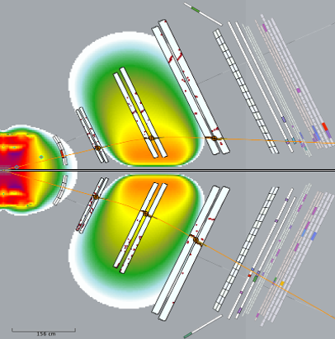
The “typical” event

Slide 3
The DC crop circles
One of the big mysteries of tracking…luckily resolved

Slide 4
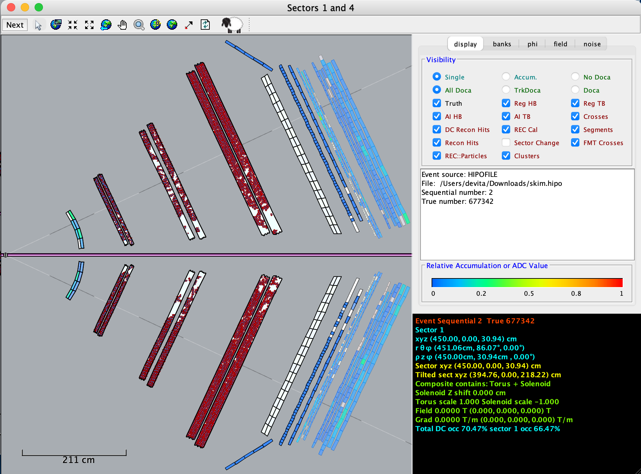
It took 45 minutes to process but tracking didn’t crash

Slide 5
A guide in Hall B

Slide 6
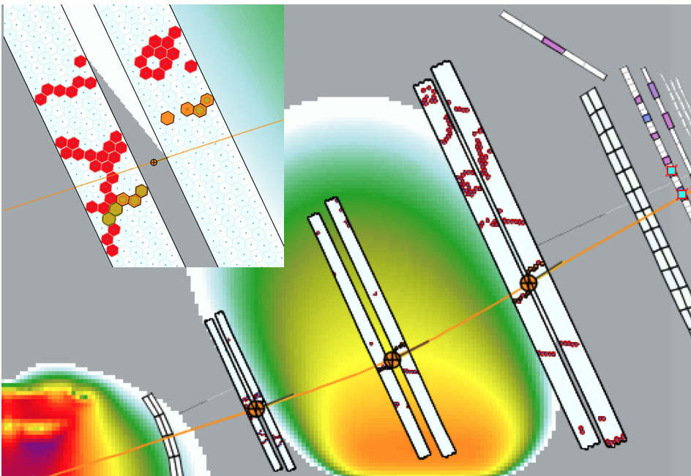
Clustering fun

Slide 7
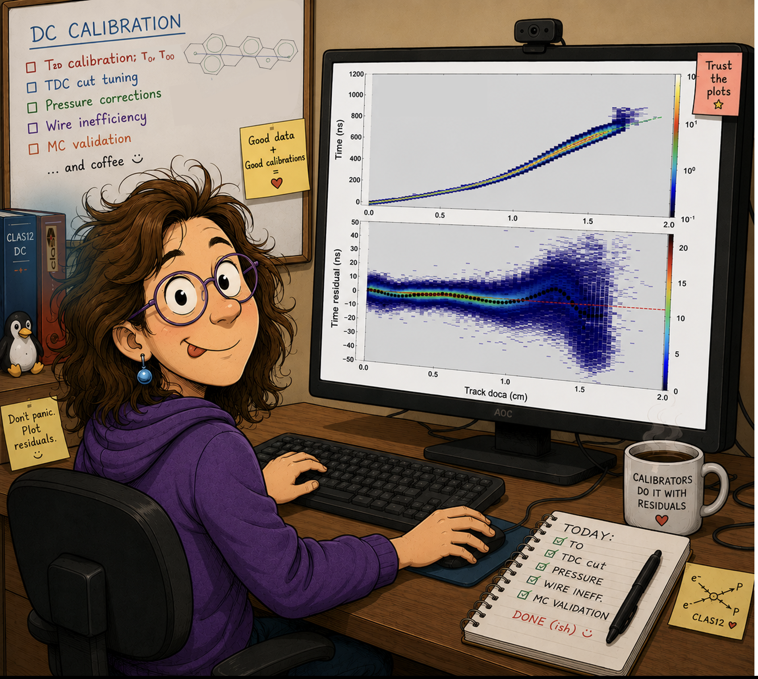
The DC calibrator – Work of Art and Science by V. Ziegler

Slide 8
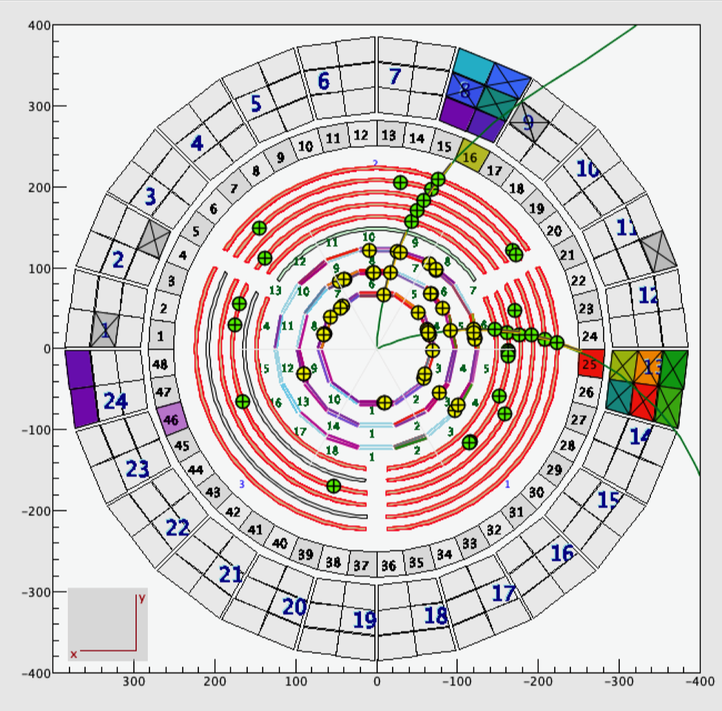
The “typical” event n. 2

Slide 9
“It looks like a Christmas tree”

Slide 10
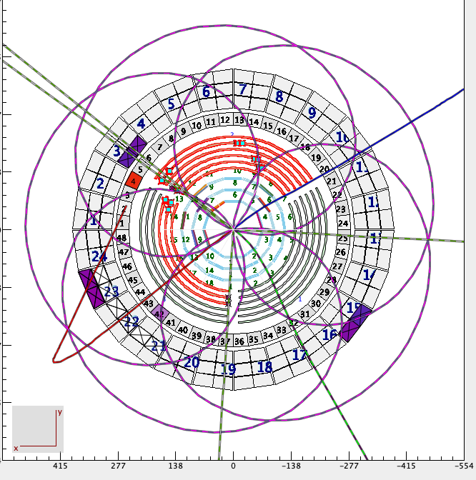
The perfect trajectory

Slide 11
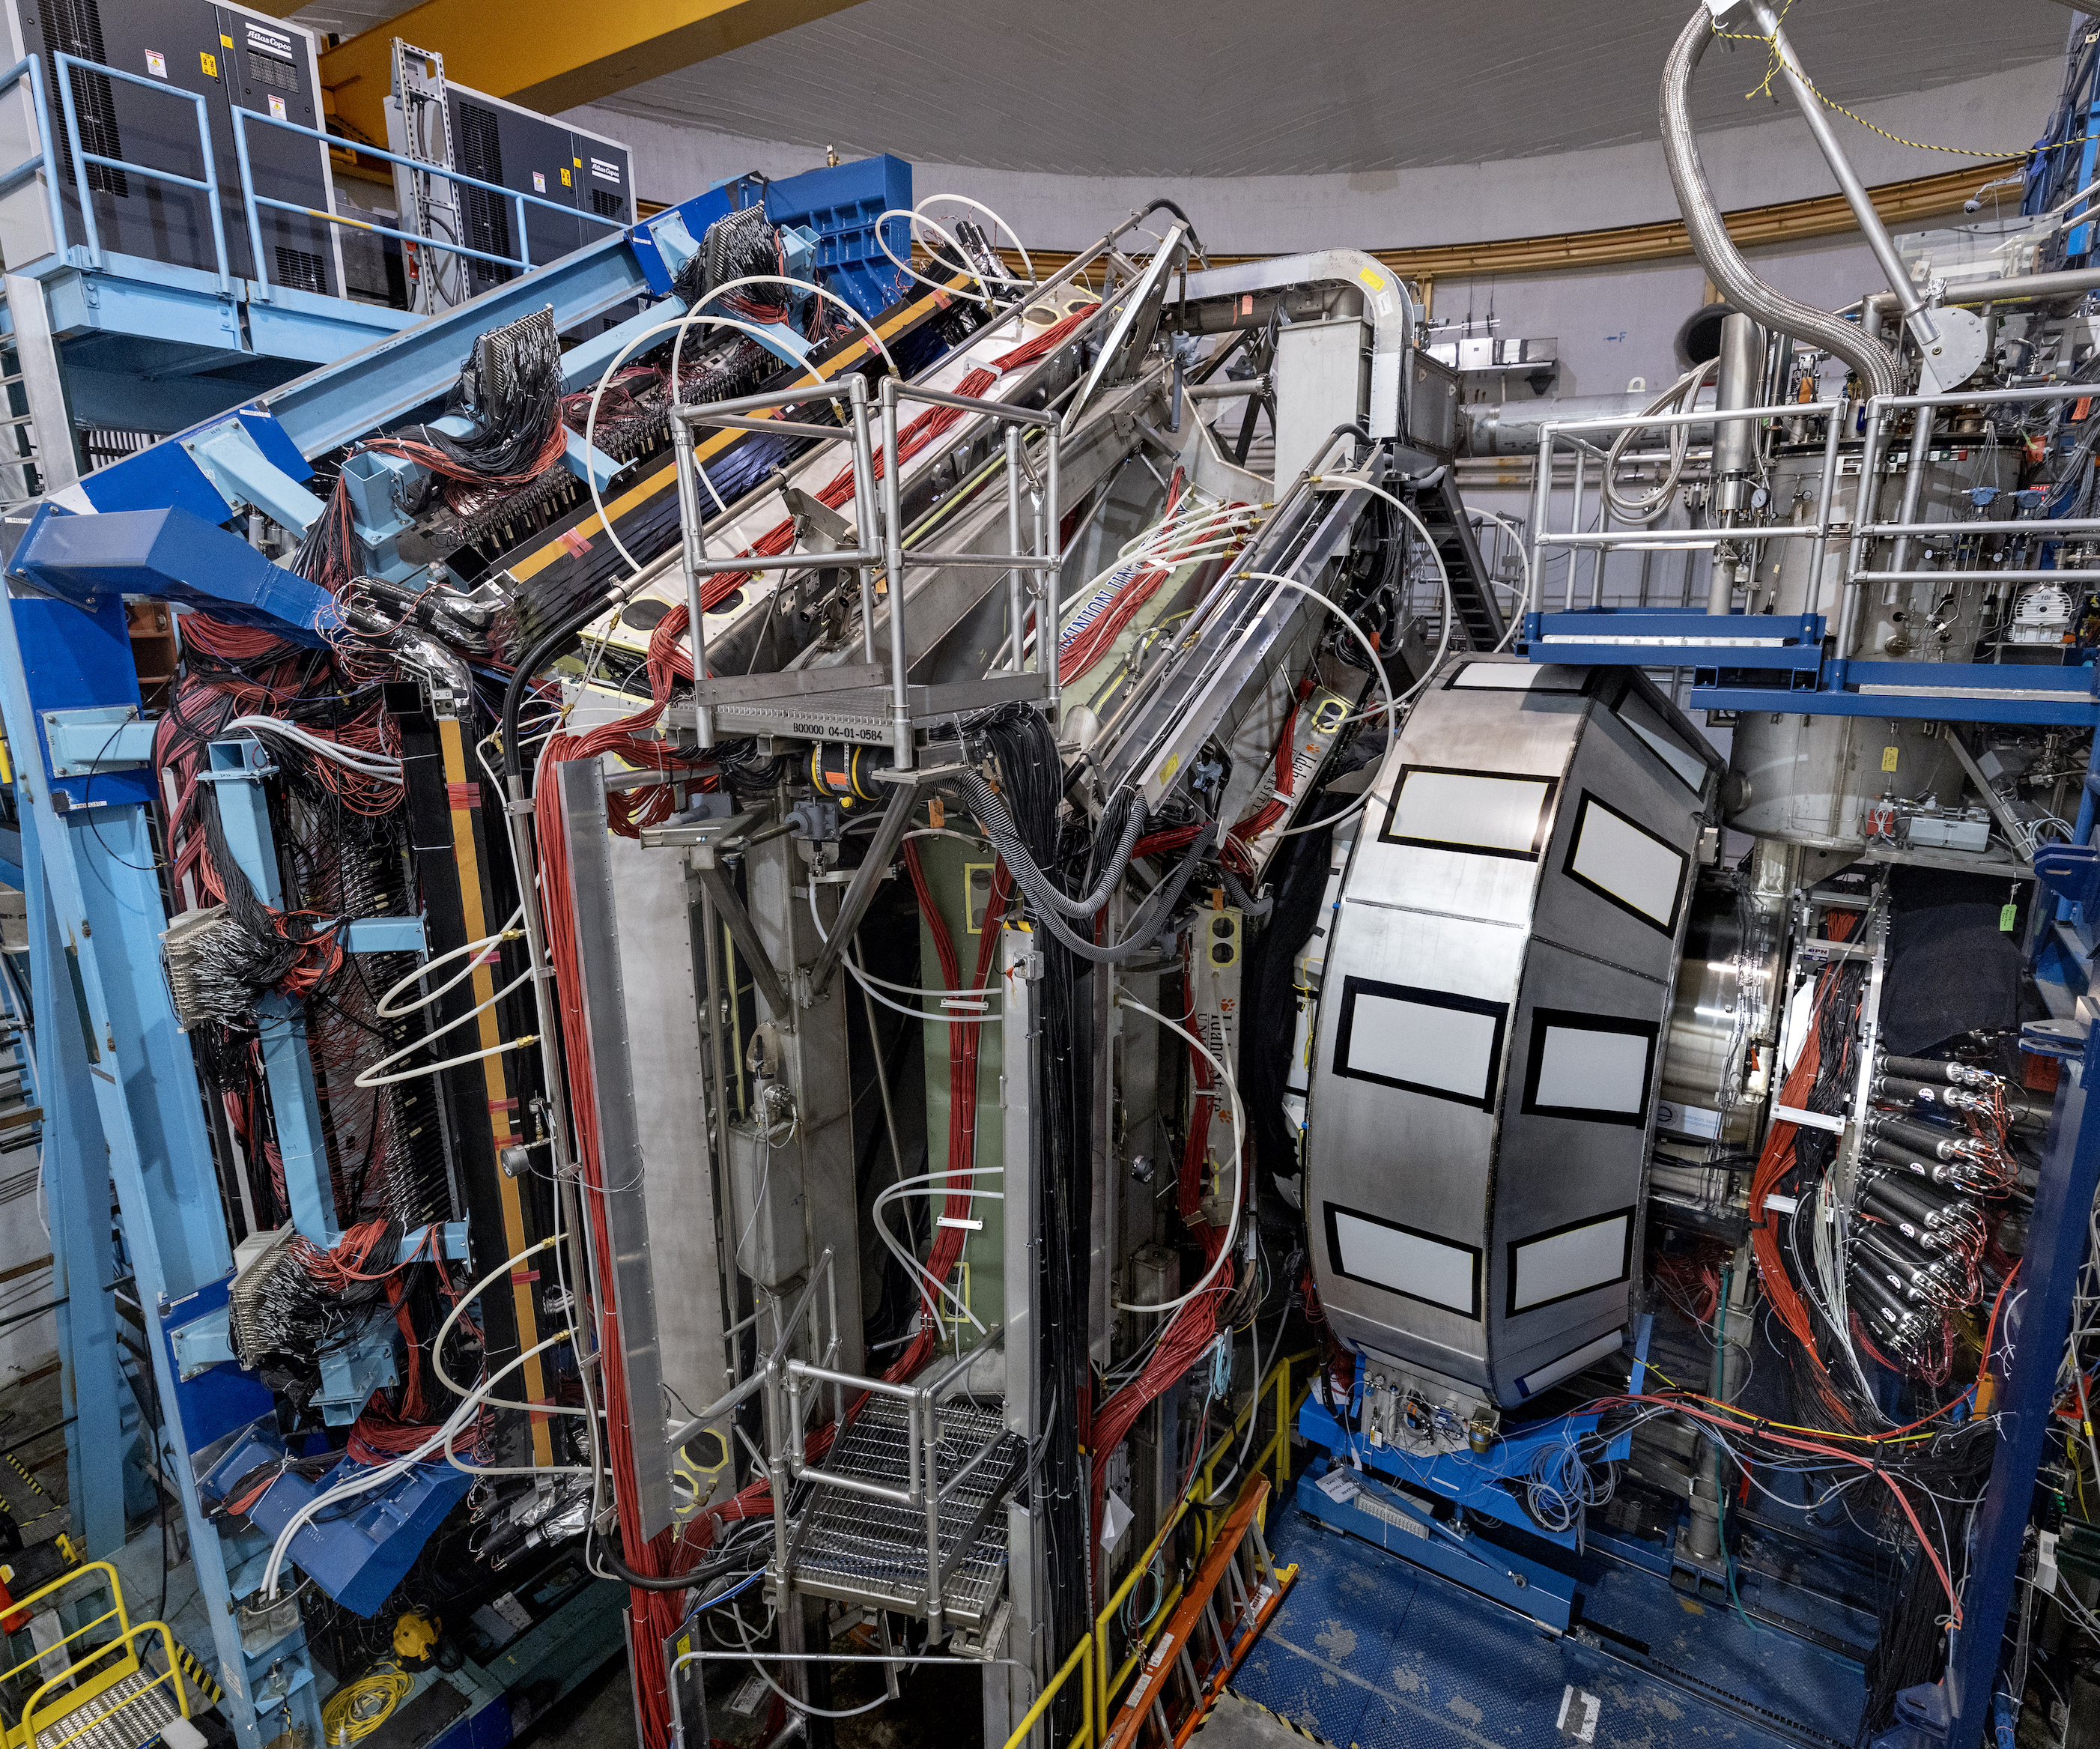
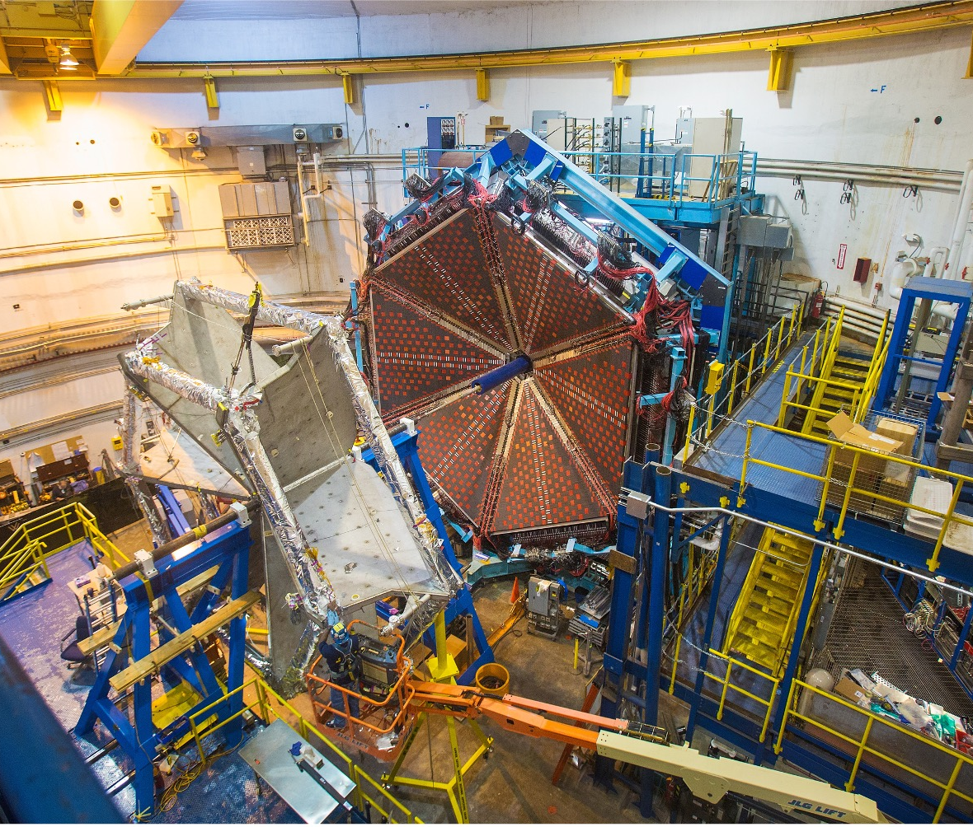
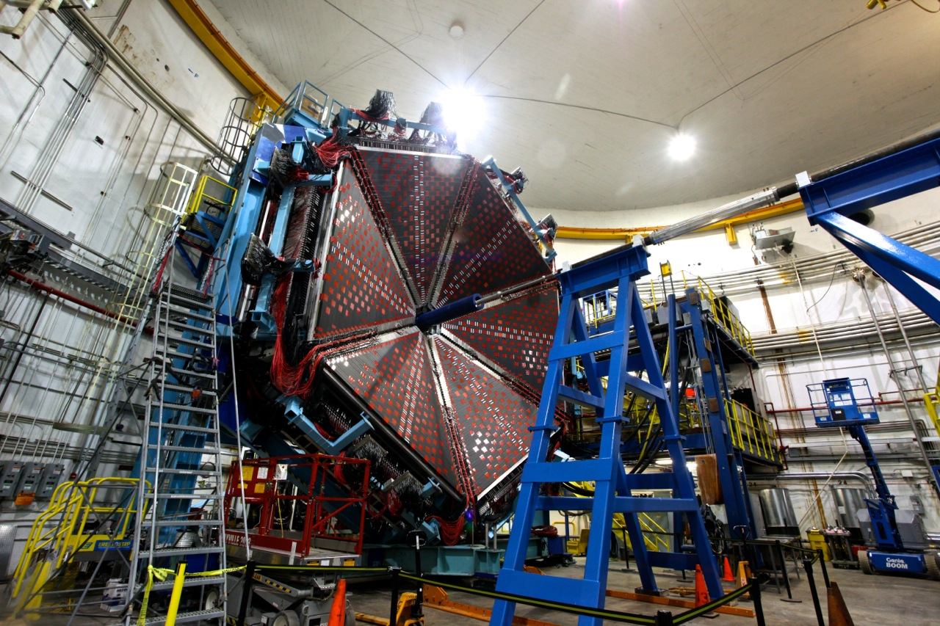
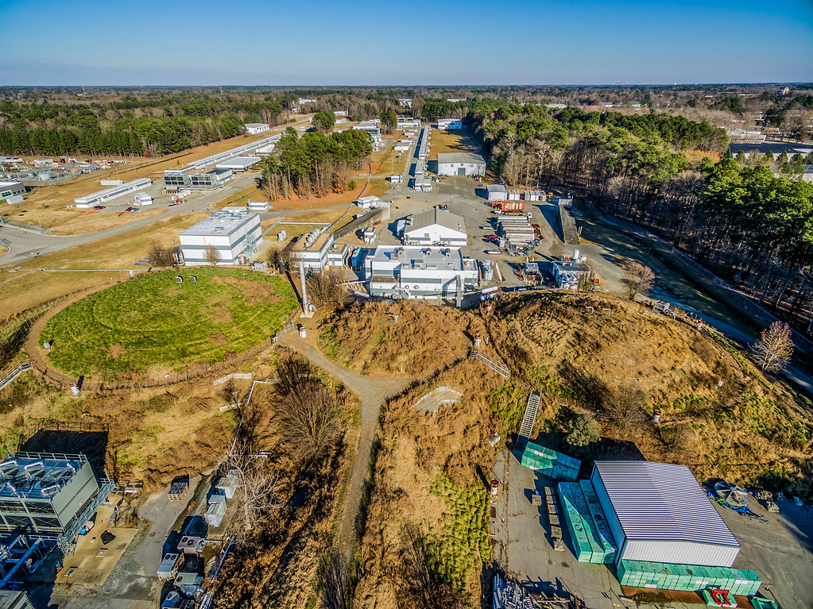
Thank you!

