Slide 1
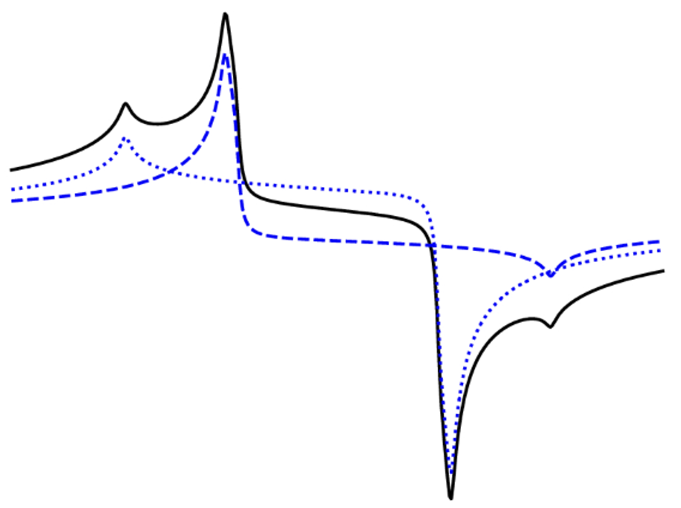


McClellan, Eur. Phys. J. A 61, 176 (2025)
Updates to the JLab Q Meter Software
Fully Imaginary Deuteron NMR signal
Chhetra Lama, Dr. James Maxwell, Dr. Elena Long

Slide 2
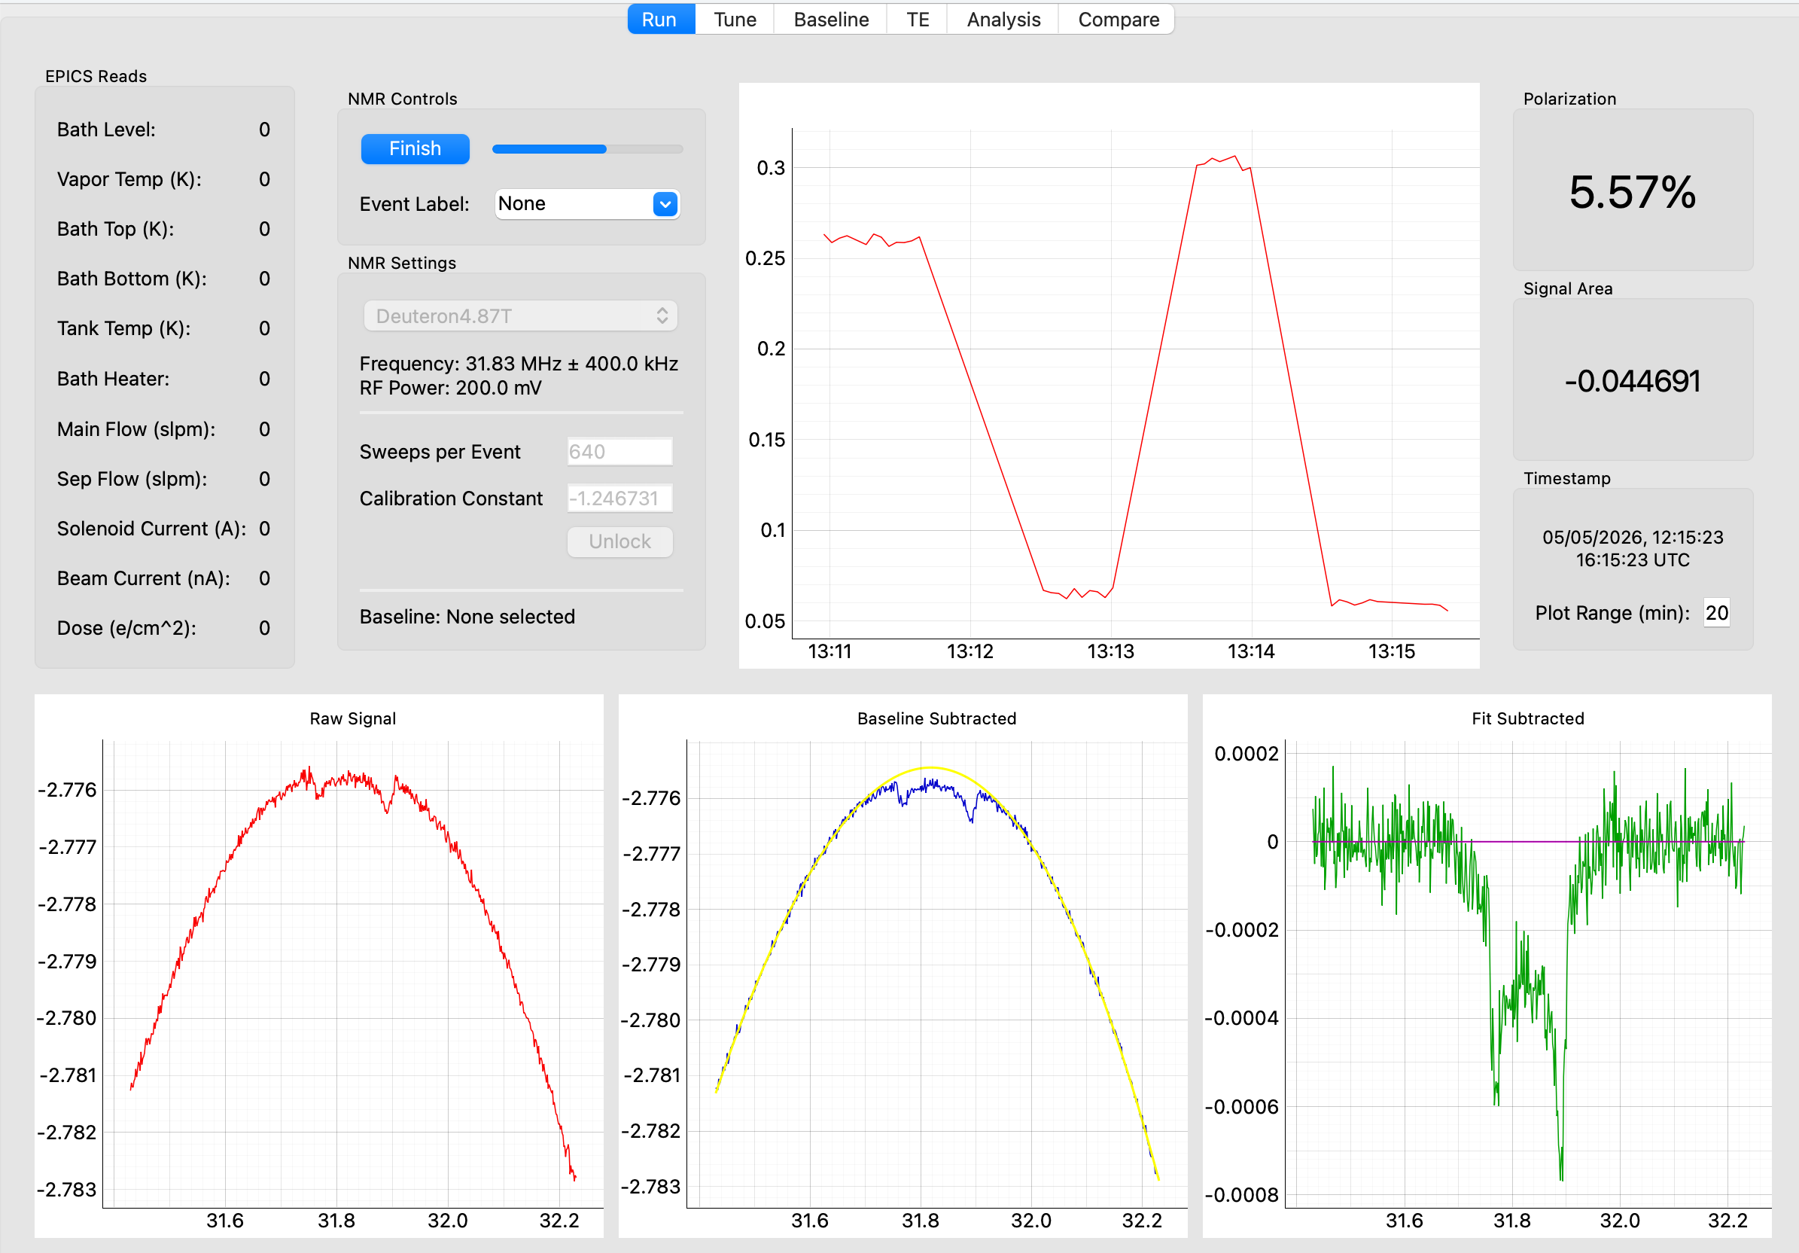

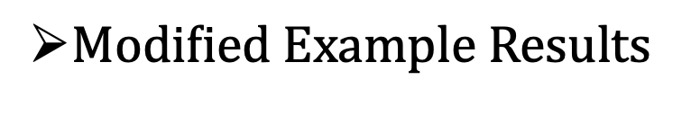
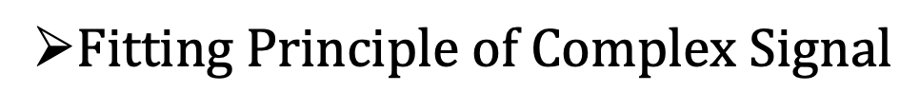
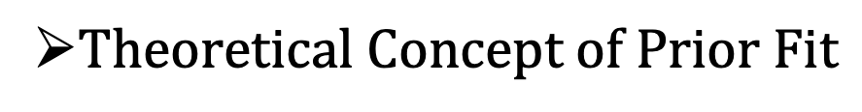
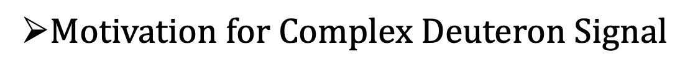
Outline
$Motivation for Complex Deuteron Signal$
$Theoretical Concept of Prior Fit$
$Fitting Principle of Complex Signal$
$Modified Example Results$
Conclusion
James Software
Dulya et al., NIM A 398, 109 (1997)
https://github.com/jdmax/jlab_pynmr
McClellan, Eur. Phys. J. A 61, 176 (2025)
06/30/2026 CLAS Collaboration
08/22/2025 Proposal Defense Chhetra Lama
08/22/2025 Proposal Defense Chhetra Lama

Slide 3
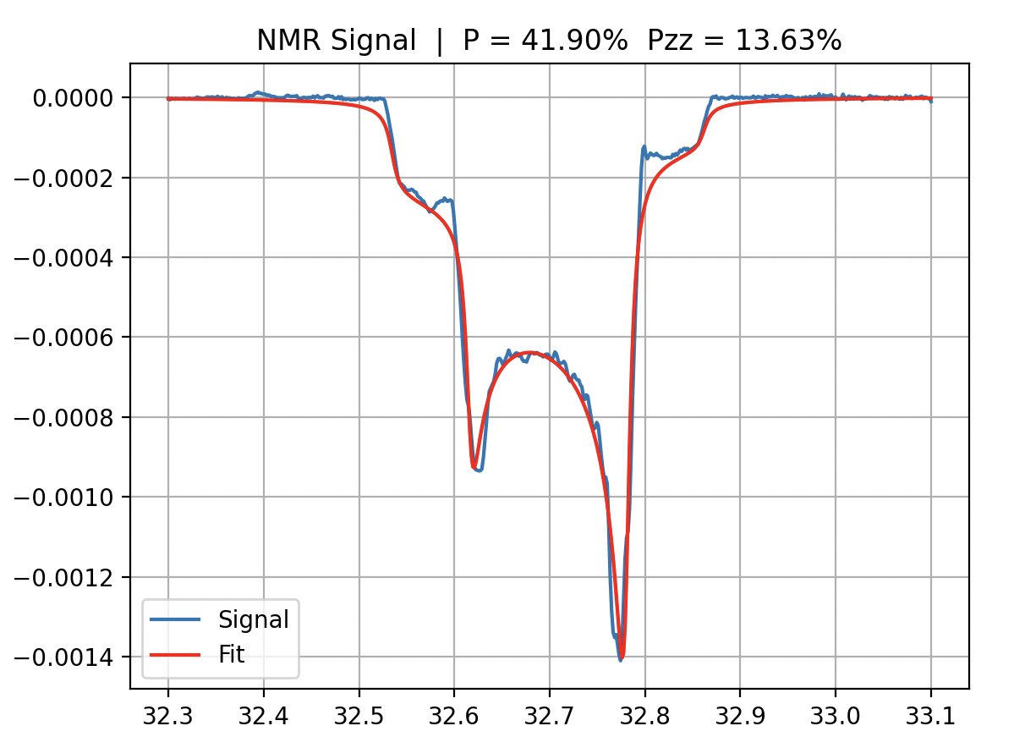
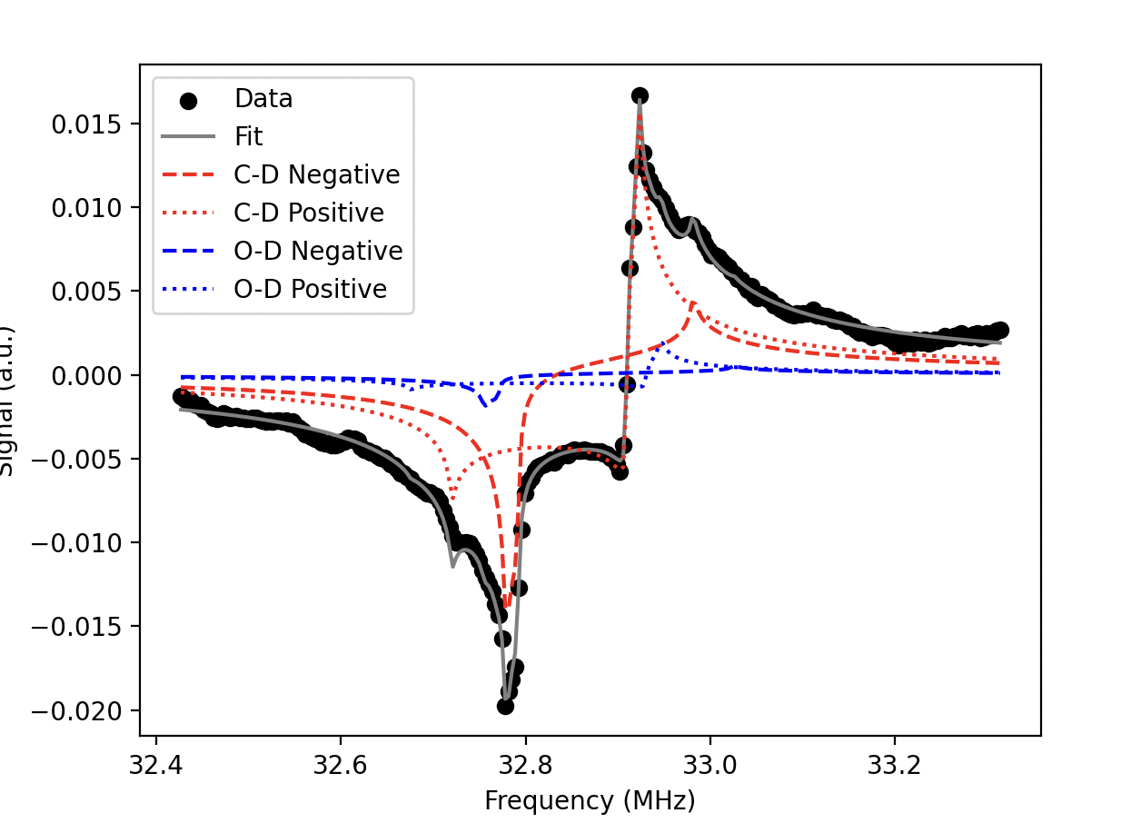
Motivation
Goal: Get more accurate value of Polarization; reduce systematic uncertainties, tackle off-phase signal
Jlab data
UNH data
Current Status:
  Absorptive and dispersive both function are used to analyze the signal
  False asymmetry and scaling both version are used to analyze the Polarization
Dulya et al., NIM A 398, 109 (1997)
https://github.com/jdmax/jlab_pynmr
McClellan, Eur. Phys. J. A 61, 176 (2025)
06/30/2026 CLAS Collaboration
08/22/2025 Proposal Defense Chhetra Lama

Slide 4
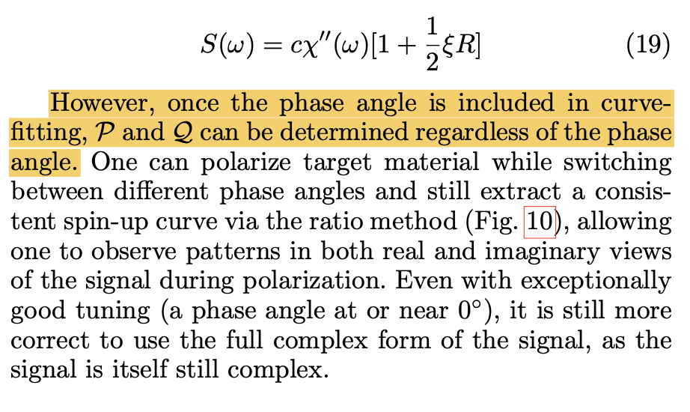
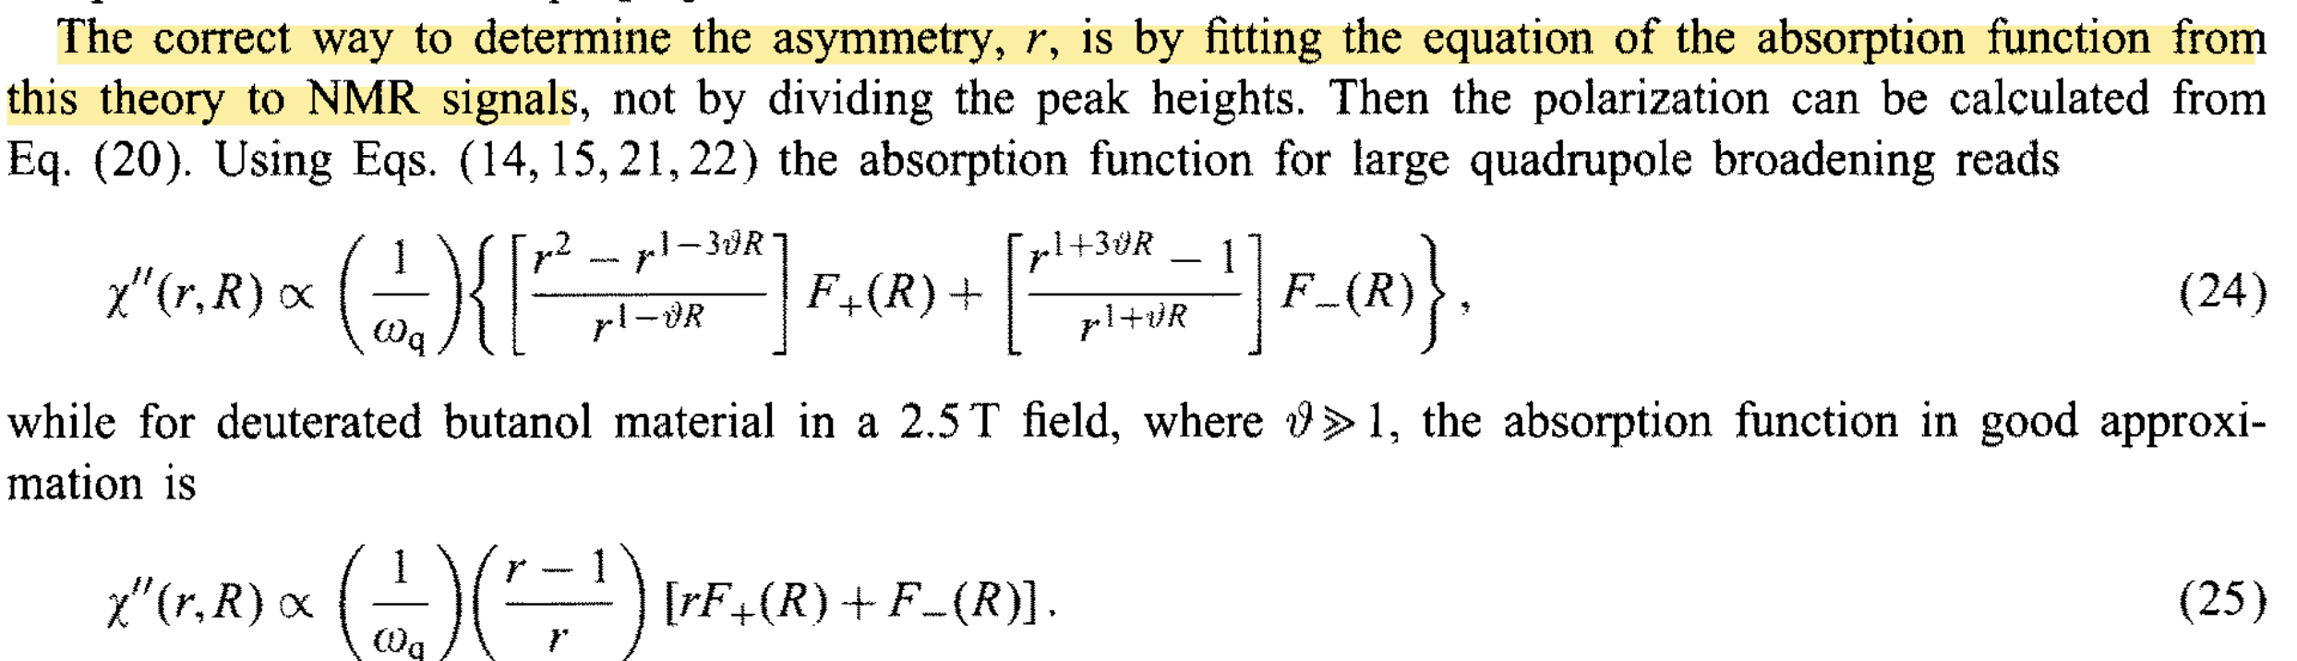
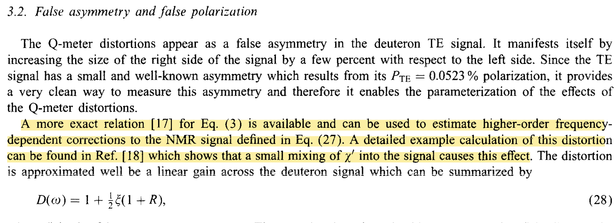
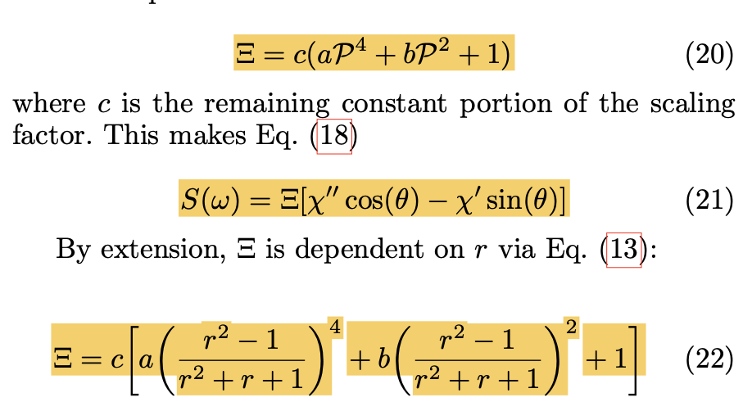
Motivation continued
Dulya et al., NIM A 398, 109 (1997)
https://github.com/jdmax/jlab_pynmr
McClellan, Eur. Phys. J. A 61, 176 (2025)
06/30/2026 CLAS Collaboration
08/22/2025 Proposal Defense Chhetra Lama

Slide 5
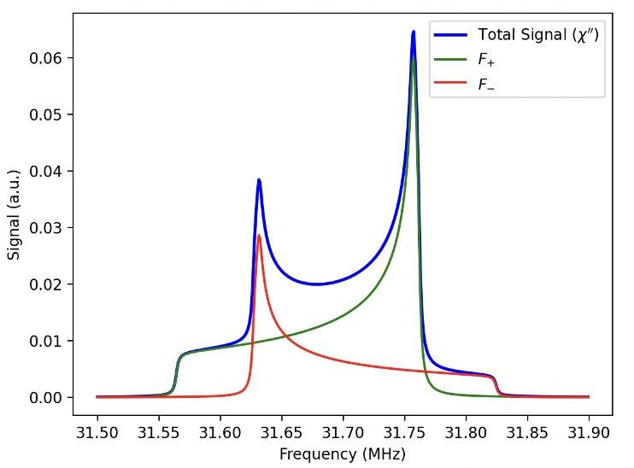
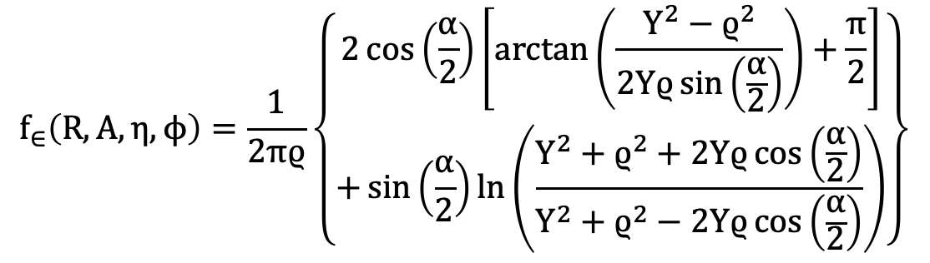
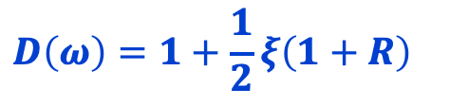

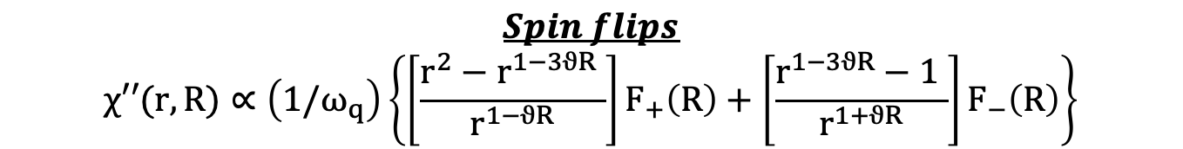


Fitting Principle on Current Software
$$f_{∈}\left(R, A, η,ϕ\right)=\frac{1}{2πϱ}\left\{\begin{aligned}2\cos\left(\frac{α}{2}\right)\left[arctan\left(\frac{Y^{2}−ϱ^{2}}{2Yϱ\sin\left(\frac{α}{2}\right)}\right)+\frac{π}{2}\right] \\ +\sin\left(\frac{α}{2}\right)ln⁡\left(\frac{Y^{2}+ϱ^{2}+2Yϱ\cos\left(\frac{α}{2}\right)}{Y^{2}+ϱ^{2}−2Yϱ\cos\left(\frac{α}{2}\right)}\right)\end{aligned}\right\}$$
$$F_{ε}\left(R,A,η\right)=\frac{1}{J+1} \sum_{j=0}^{J}{\frac{\sqrt{3 }f_{∈}\left(R, A, η,ϕ\right)}{\sqrt{3−ηcos⁡(2ϕ)}}}$$
$$Spin flips$$
$$χ′′(r,R)∝\left(1/ω_{q}\right)\left\{\left[\frac{r^{2}−r^{1−3ϑR} }{r^{1−ϑR}}\right]F_{+}\left(R\right)+\left[\frac{r^{1−3ϑR}−1 }{r^{1+ϑR}}\right]F_{−}\left(R\right)\right\}$$
$$F_{−}$$
$$D\left(ω\right)=1+\frac{1}{2}ξ\left(1+R\right)$$
$$F_{+}$$
Dulya et al., NIM A 398, 109 (1997)
https://github.com/jdmax/jlab_pynmr
McClellan, Eur. Phys. J. A 61, 176 (2025)
06/30/2026 CLAS Collaboration
08/22/2025 Proposal Defense Chhetra Lama

Slide 6
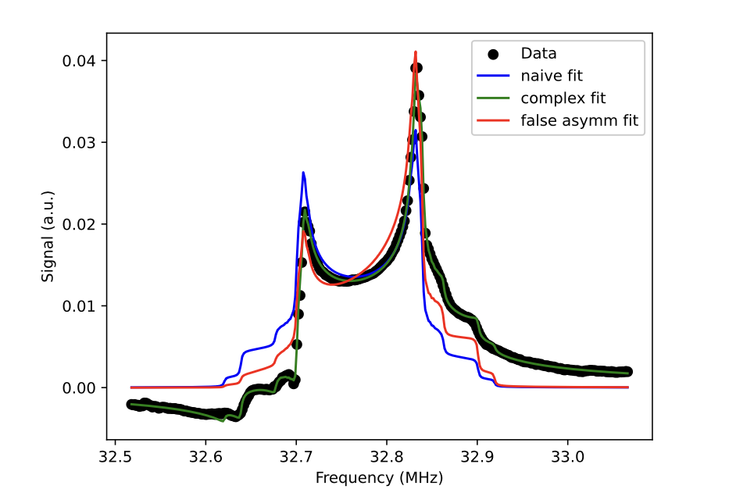
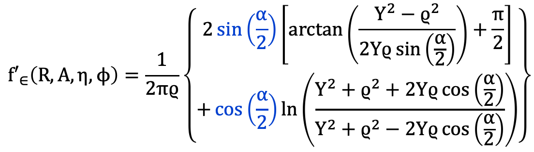
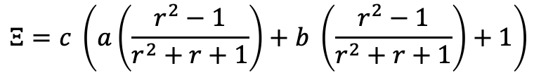
Upgrading to Complex Fit
$${f′}_{∈}\left(R, A, η,ϕ\right)=\frac{1}{2πϱ}\left\{\begin{aligned}2\sin\left(\frac{α}{2}\right)\left[arctan\left(\frac{Y^{2}−ϱ^{2}}{2Yϱ\sin\left(\frac{α}{2}\right)}\right)+\frac{π}{2}\right] \\ +\cos\left(\frac{α}{2}\right)ln⁡\left(\frac{Y^{2}+ϱ^{2}+2Yϱ\cos\left(\frac{α}{2}\right)}{Y^{2}+ϱ^{2}−2Yϱ\cos\left(\frac{α}{2}\right)}\right)\end{aligned}\right\}$$
False asymmetry term is removed with $Ξ$
$$Ξ=c \left(a\left(\frac{r^{2}−1}{r^{2}+r+1}\right)+b \left(\frac{r^{2}−1}{r^{2}+r+1}\right)+1\right)$$
$$F_{complex}=Scale ∗Ξ \left(F_{absorptive}∗\cos\left(phase\right)+F_{dispersive}∗sin⁡(phase)\right)$$
Dulya et al., NIM A 398, 109 (1997)
https://github.com/jdmax/jlab_pynmr
McClellan, Eur. Phys. J. A 61, 176 (2025)
06/30/2026 CLAS Collaboration
08/22/2025 Proposal Defense Chhetra Lama

Slide 7
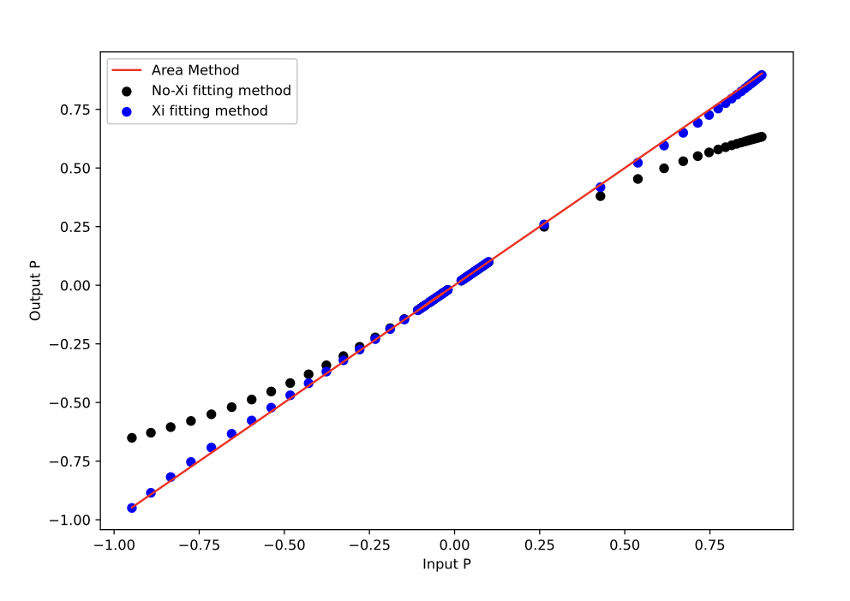
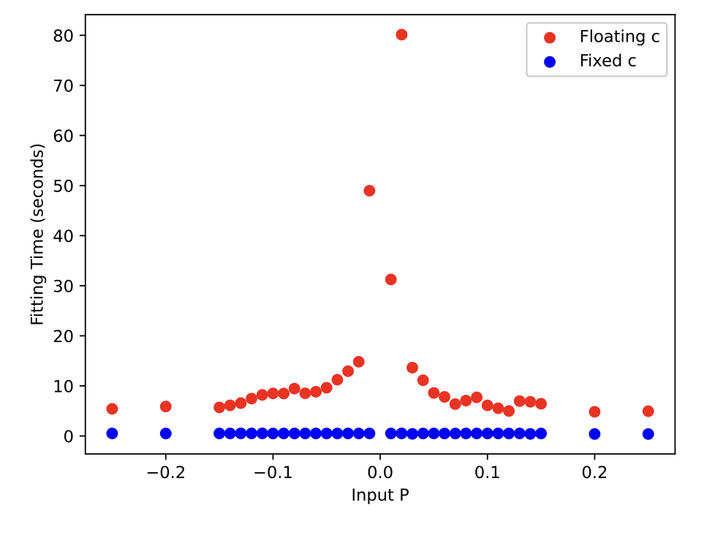

Why $Ξ(xi)$?
More accurate over all range of P
Quicker Computation Time
Dulya et al., NIM A 398, 109 (1997)
https://github.com/jdmax/jlab_pynmr
McClellan, Eur. Phys. J. A 61, 176 (2025)
06/30/2026 CLAS Collaboration
08/22/2025 Proposal Defense Chhetra Lama
08/22/2025 Proposal Defense Chhetra Lama

Slide 8
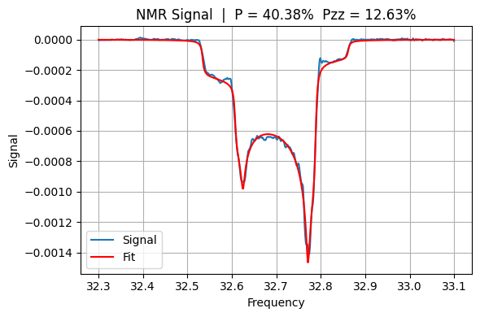
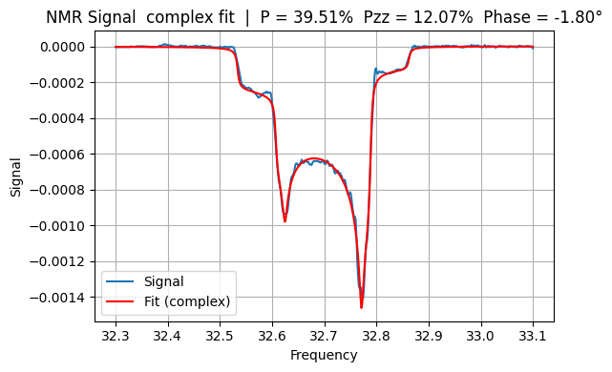
Fit with and w/o dispersive function continued
RGC 2022 data
2 % relative difference
w/o dispersive function
With dispersive function
RGC E12-06-109 Spokespersons
Crabb, Deur, Dharmawardane, Forest, Griffioen, Holtrop, Kuhn, Prok
Dulya et al., NIM A 398, 109 (1997)
https://github.com/jdmax/jlab_pynmr
McClellan, Eur. Phys. J. A 61, 176 (2025)
06/30/2026 CLAS Collaboration
08/22/2025 Proposal Defense Chhetra Lama
08/22/2025 Proposal Defense Chhetra Lama

Slide 9
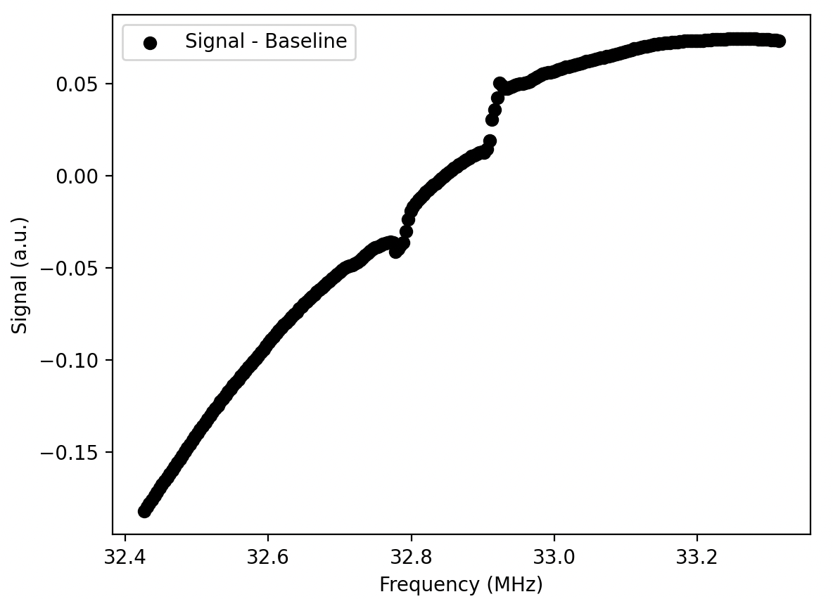
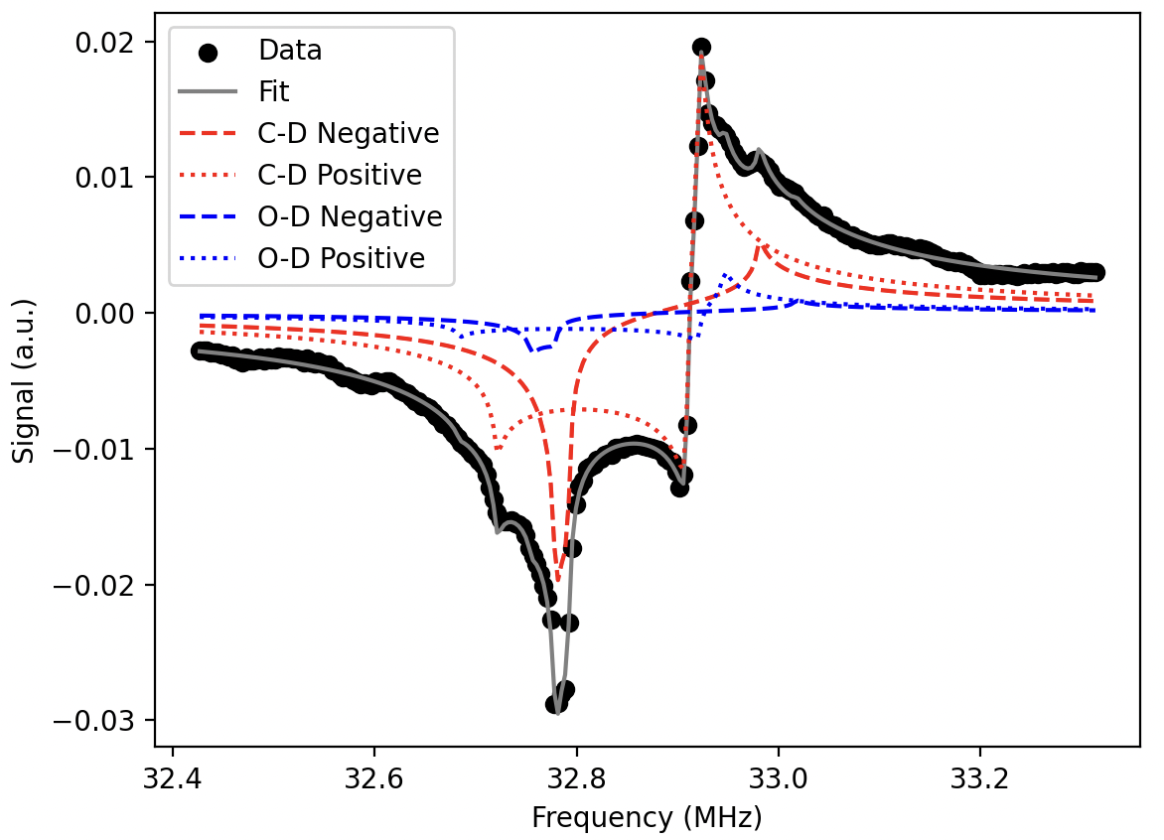
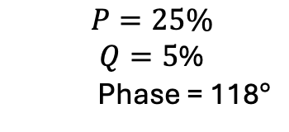
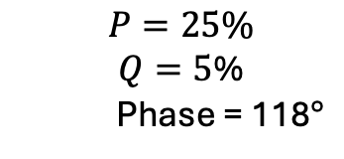
Complex Fit
$$P=25\%$$
$Q=5$%
Phase = 118$°$
$$P=25\%$$
$Q=5$%
Phase = 118$°$
Dulya et al., NIM A 398, 109 (1997)
https://github.com/jdmax/jlab_pynmr
McClellan, Eur. Phys. J. A 61, 176 (2025)
06/30/2026 CLAS Collaboration
08/22/2025 Proposal Defense Chhetra Lama
08/22/2025 Proposal Defense Chhetra Lama

Slide 10
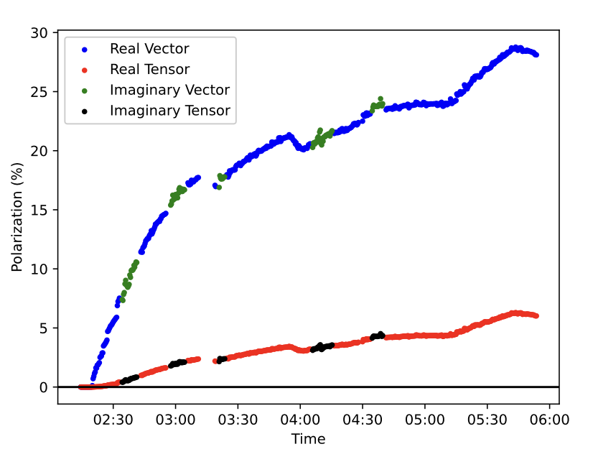
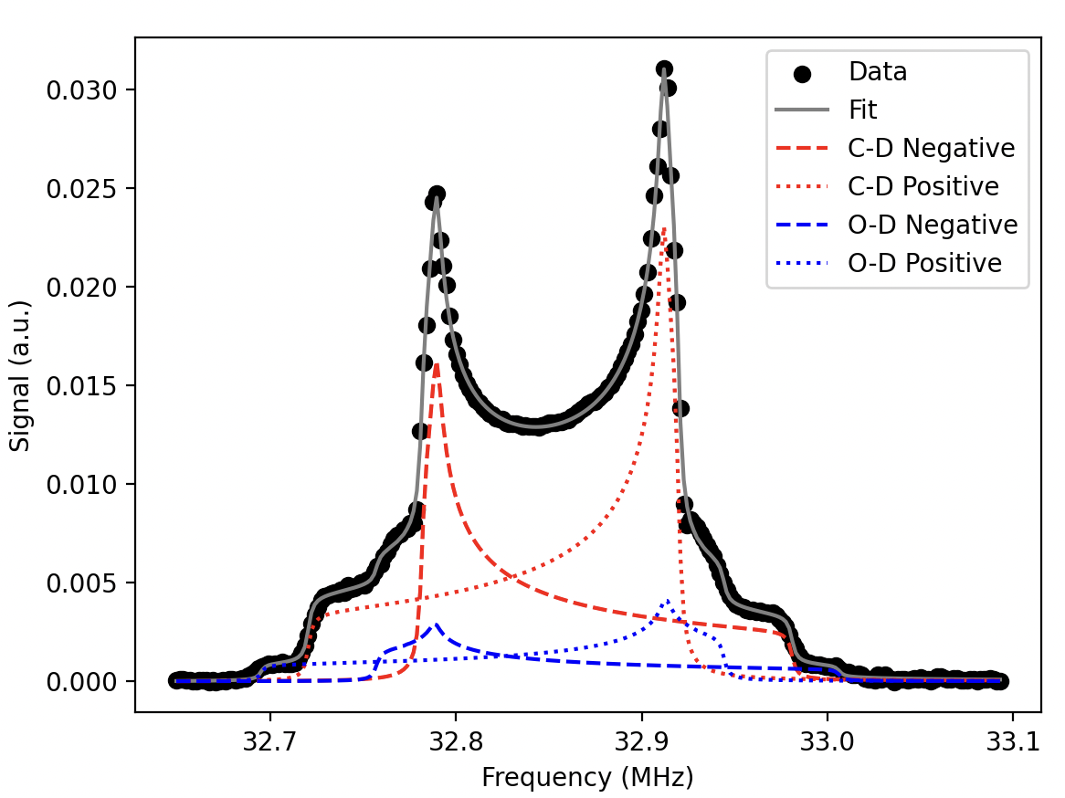
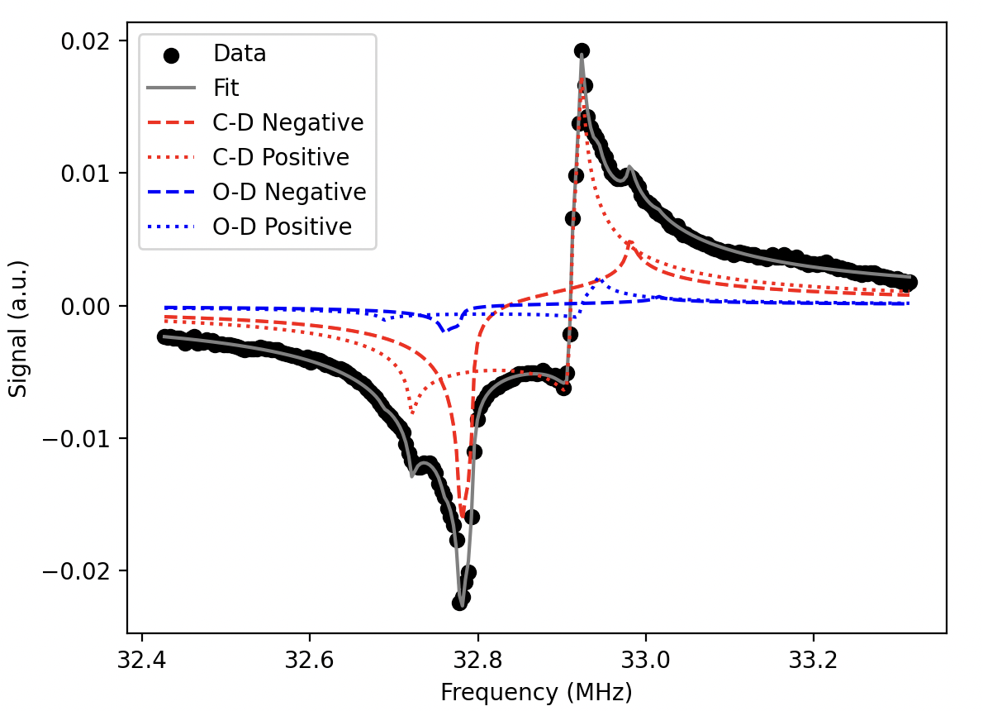
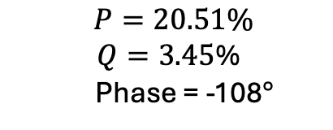
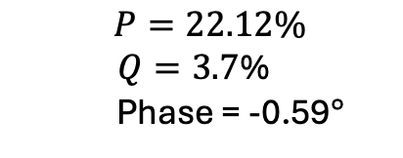
Complex Fit continued
$$P=22.12\%$$
$Q=3.7$%
Phase = -0.59$°$
$$P=20.51\%$$
$Q=3.45$%
Phase = -108$°$
04:19AM
04:15AM
Dulya et al., NIM A 398, 109 (1997)
https://github.com/jdmax/jlab_pynmr
McClellan, Eur. Phys. J. A 61, 176 (2025)
06/30/2026 CLAS Collaboration
08/22/2025 Proposal Defense Chhetra Lama
08/22/2025 Proposal Defense Chhetra Lama

Slide 11
Conclusion
Complex signal implementation will follow data more closely than with out it.
It has more fitting parameters but faster calculation with $Ξ.$
This will help us reduce the systematic uncertainties in the future experiment Run Group C.
This can be found in github.
Dulya et al., NIM A 398, 109 (1997)
https://github.com/jdmax/jlab_pynmr
McClellan, Eur. Phys. J. A 61, 176 (2025)
08/22/2025 Proposal Defense Chhetra Lama
06/03/2026 Tensor SIDIS workshop and b1/Azz Tensor Collaboration meeting
08/22/2025 Proposal Defense Chhetra Lama

Slide 12

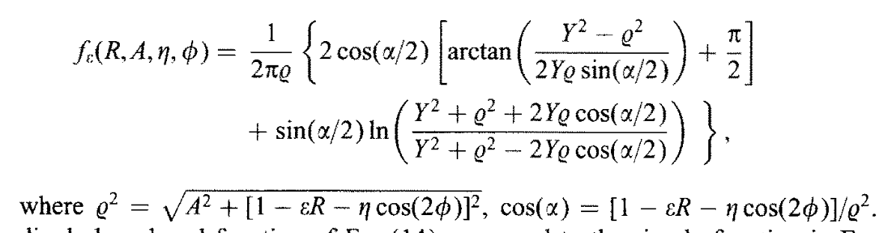
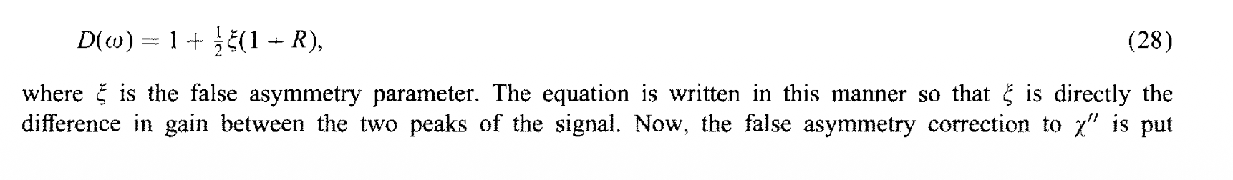
Backup Slides
M. McClellan, Ph.D. thesis, Uninversity of New Hampshire, 2026
Dulya et al., NIM A 398, 109 (1997)

Slide 13
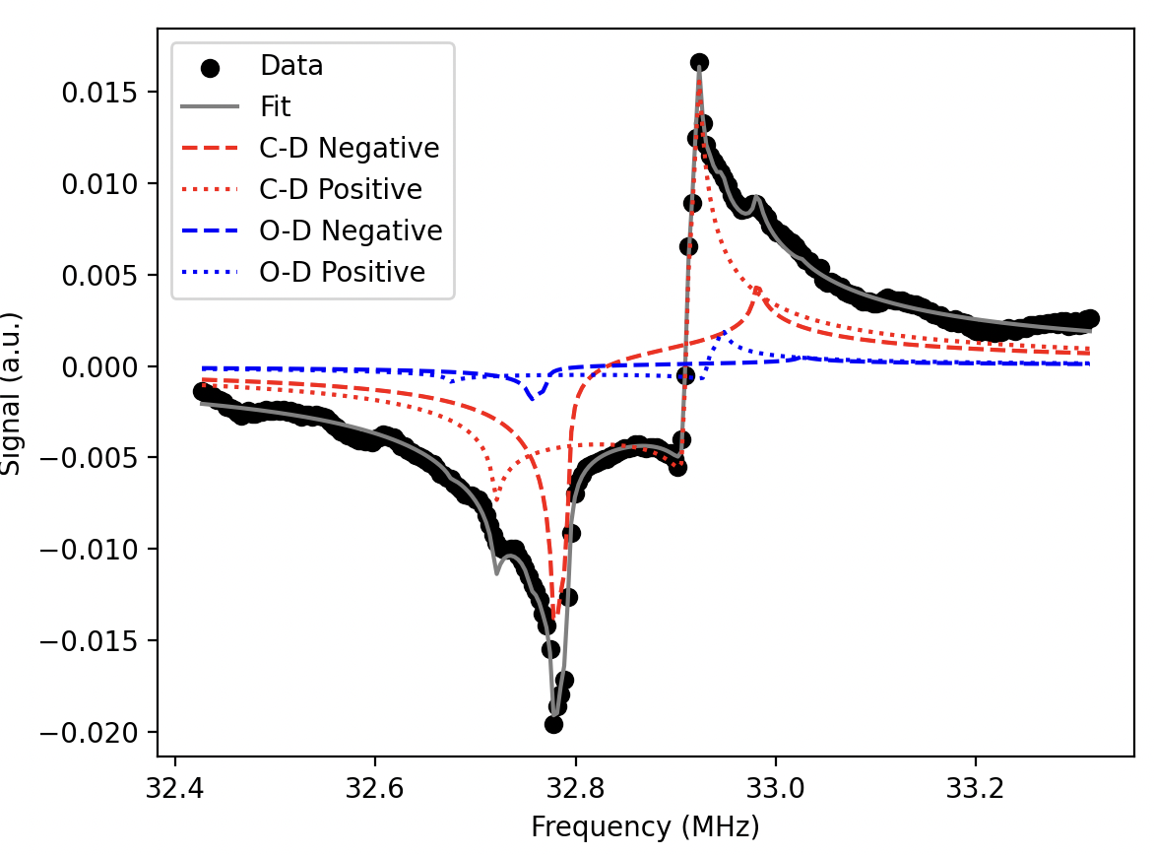
Complex Fit continued
Backup Slides
I will put fit for these two location
Note:I will put real fit also
For this date data
M. McClellan, Ph.D. thesis, University of New Hampshire, 2026
Dulya et al., NIM A 398, 109 (1997)
https://github.com/jdmax/jlab_pynmr
McClellan, Eur. Phys. J. A 61, 176 (2025)
08/22/2025 Proposal Defense Chhetra Lama
06/03/2026 Tensor SIDIS workshop and b1/Azz Tensor Collaboration meeting
08/22/2025 Proposal Defense Chhetra Lama

Slide 14
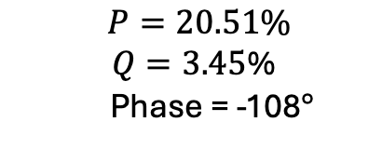
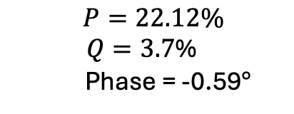
Complex Fit continued
Backup Slides
$$P=22.12\%$$
$Q=3.7$%
Phase = -0.59$°$
$$P=20.51\%$$
$Q=3.45$%
Phase = -108$°$
04:19AM
04:15AM
Dulya et al., NIM A 398, 109 (1997)
https://github.com/jdmax/jlab_pynmr
McClellan, Eur. Phys. J. A 61, 176 (2025)
08/22/2025 Proposal Defense Chhetra Lama
06/03/2026 Tensor SIDIS workshop and b1/Azz Tensor Collaboration meeting
08/22/2025 Proposal Defense Chhetra Lama

Slide 15
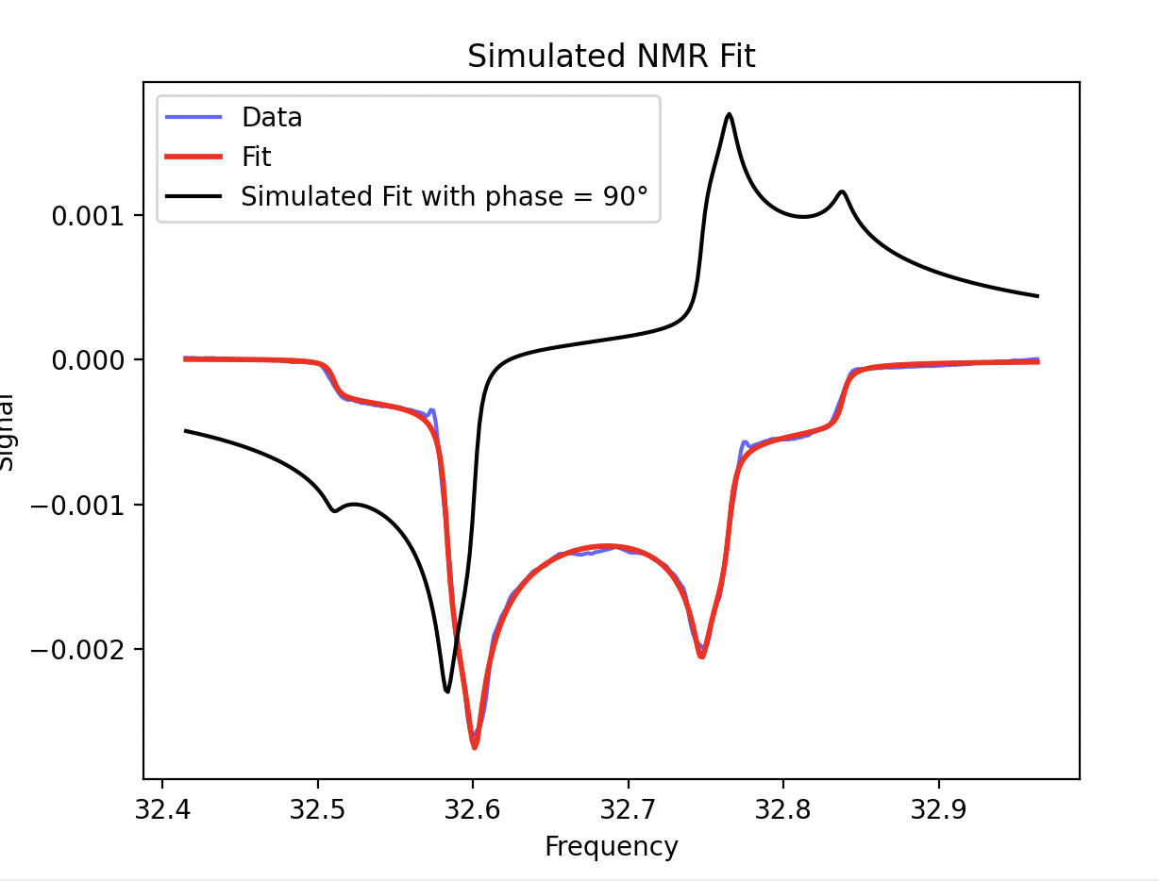
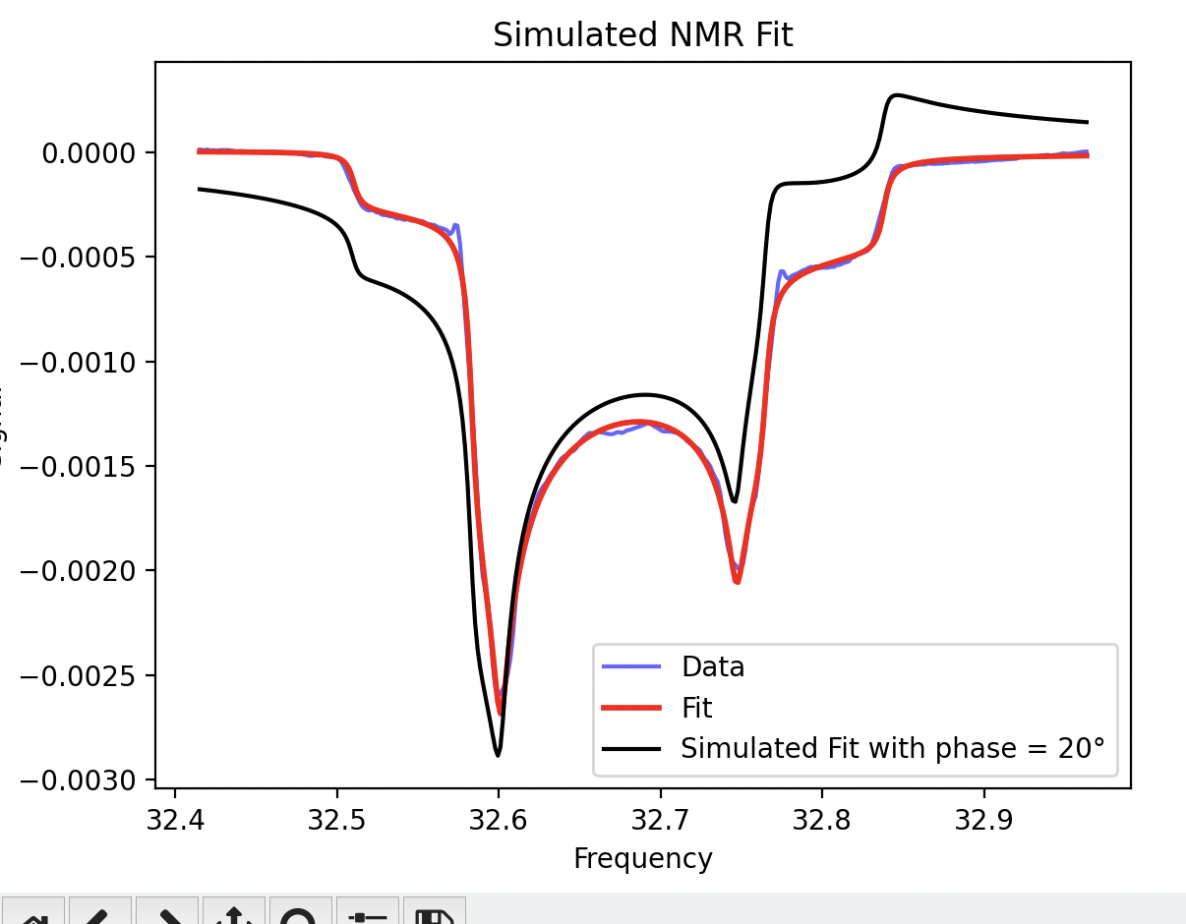
Backup Slides
There are two types of the plots in the simulation I am confused and which one is correct??
From slide number 13 to 17
Dulya et al., NIM A 398, 109 (1997)
https://github.com/jdmax/jlab_pynmr
McClellan, Eur. Phys. J. A 61, 176 (2025)
08/22/2025 Proposal Defense Chhetra Lama
06/03/2026 Tensor SIDIS workshop and b1/Azz Tensor Collaboration meeting
08/22/2025 Proposal Defense Chhetra Lama

Slide 16
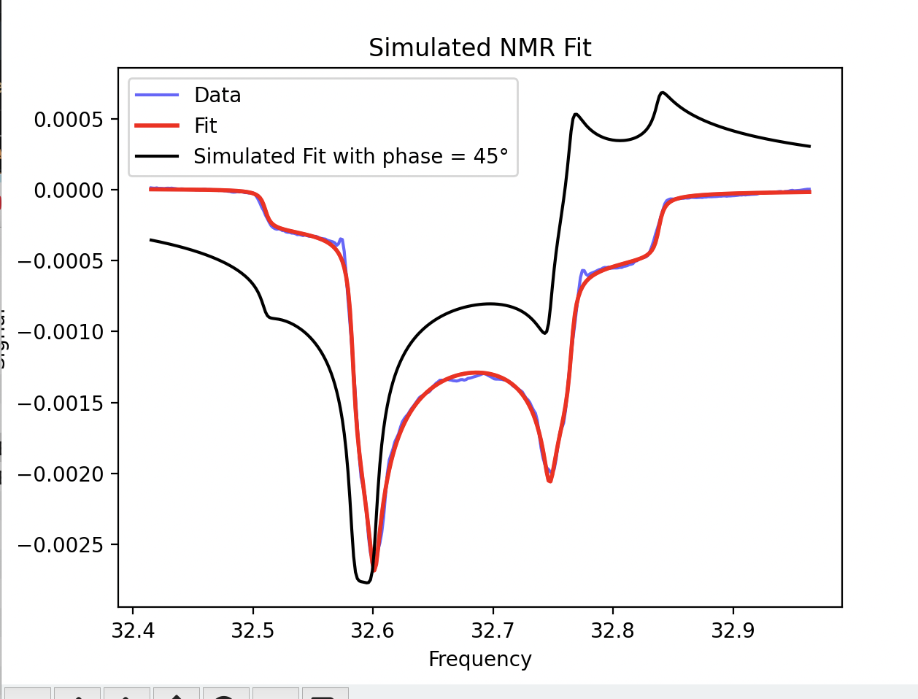
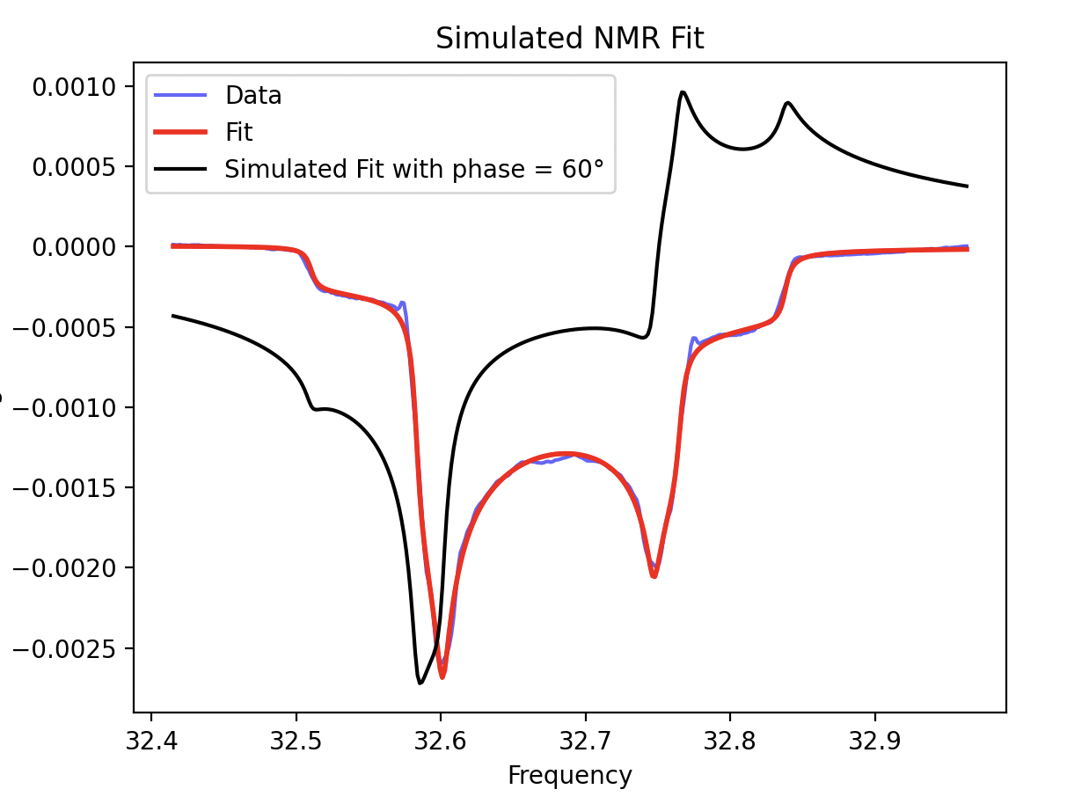
Backup Slides
Dulya et al., NIM A 398, 109 (1997)
https://github.com/jdmax/jlab_pynmr
McClellan, Eur. Phys. J. A 61, 176 (2025)
08/22/2025 Proposal Defense Chhetra Lama
06/03/2026 Tensor SIDIS workshop and b1/Azz Tensor Collaboration meeting
08/22/2025 Proposal Defense Chhetra Lama

Slide 17
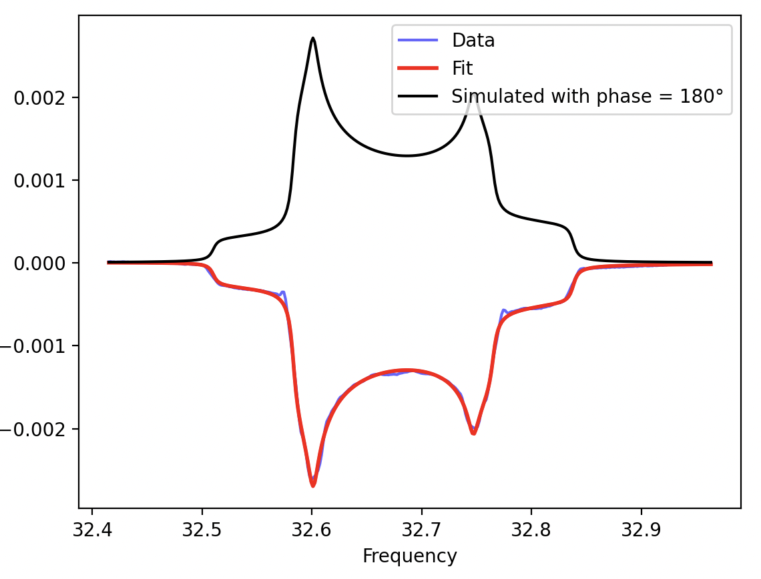
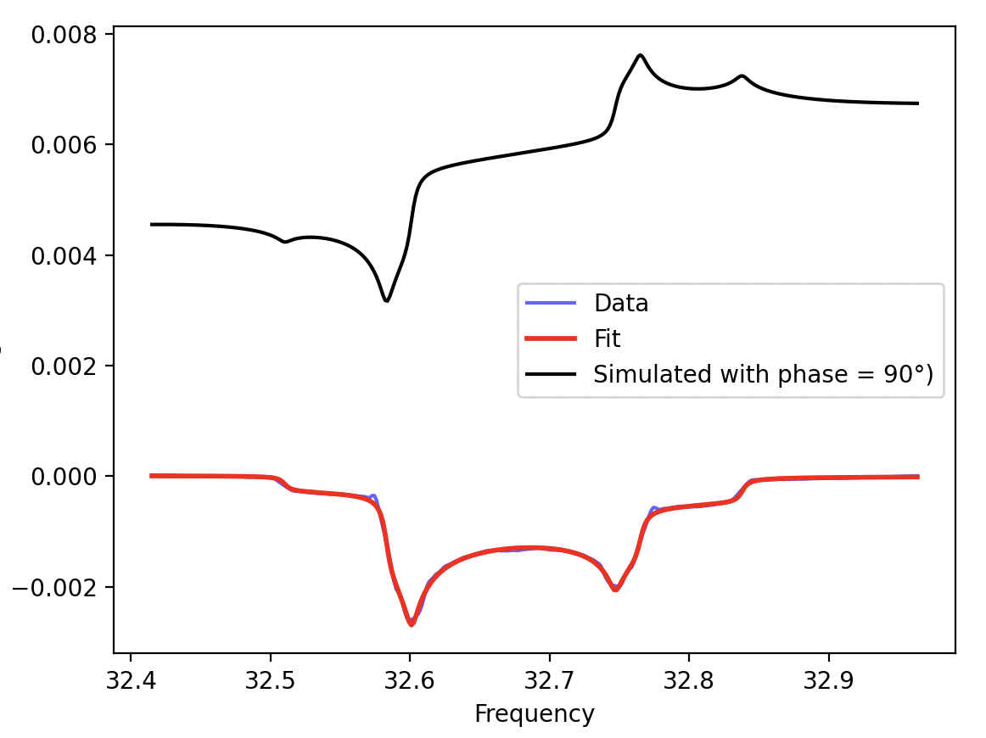
Backup Slides
Backup Slides
Dulya et al., NIM A 398, 109 (1997)
https://github.com/jdmax/jlab_pynmr
McClellan, Eur. Phys. J. A 61, 176 (2025)
08/22/2025 Proposal Defense Chhetra Lama
06/03/2026 Tensor SIDIS workshop and b1/Azz Tensor Collaboration meeting
08/22/2025 Proposal Defense Chhetra Lama

