Slide 1
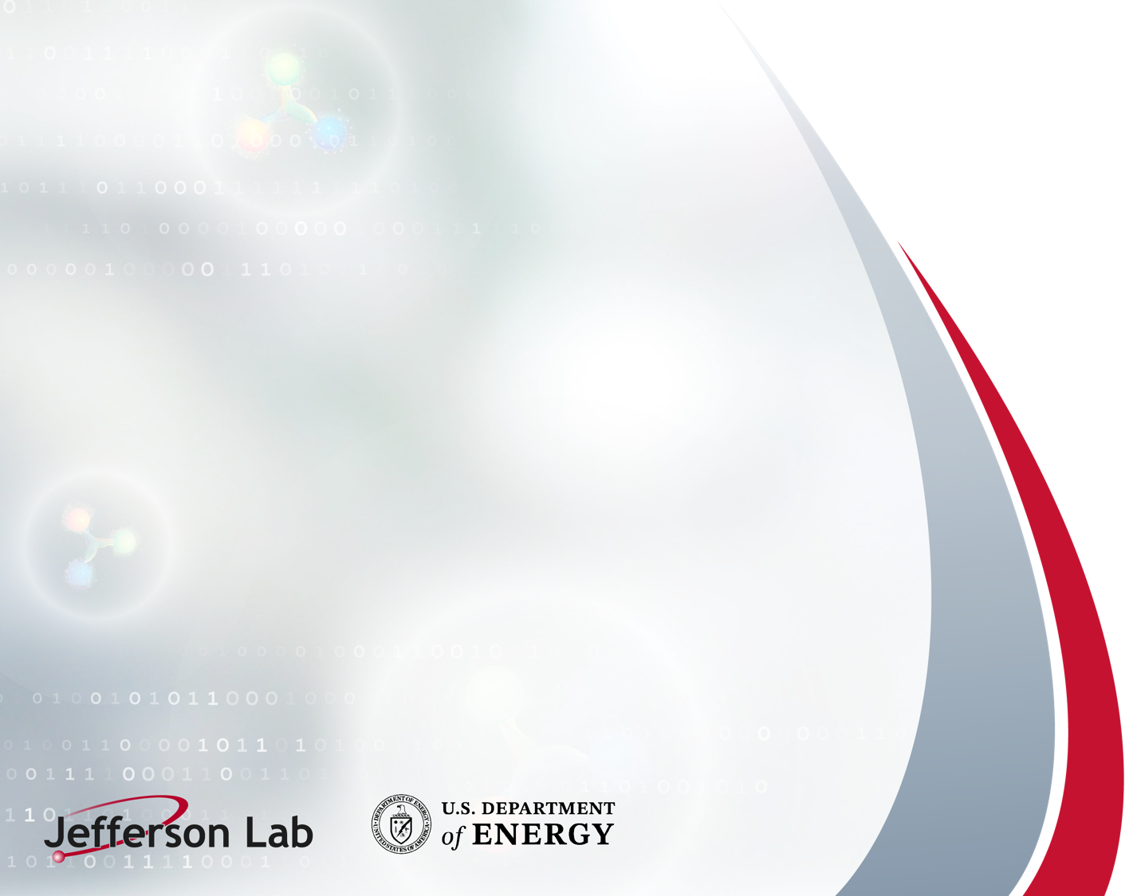
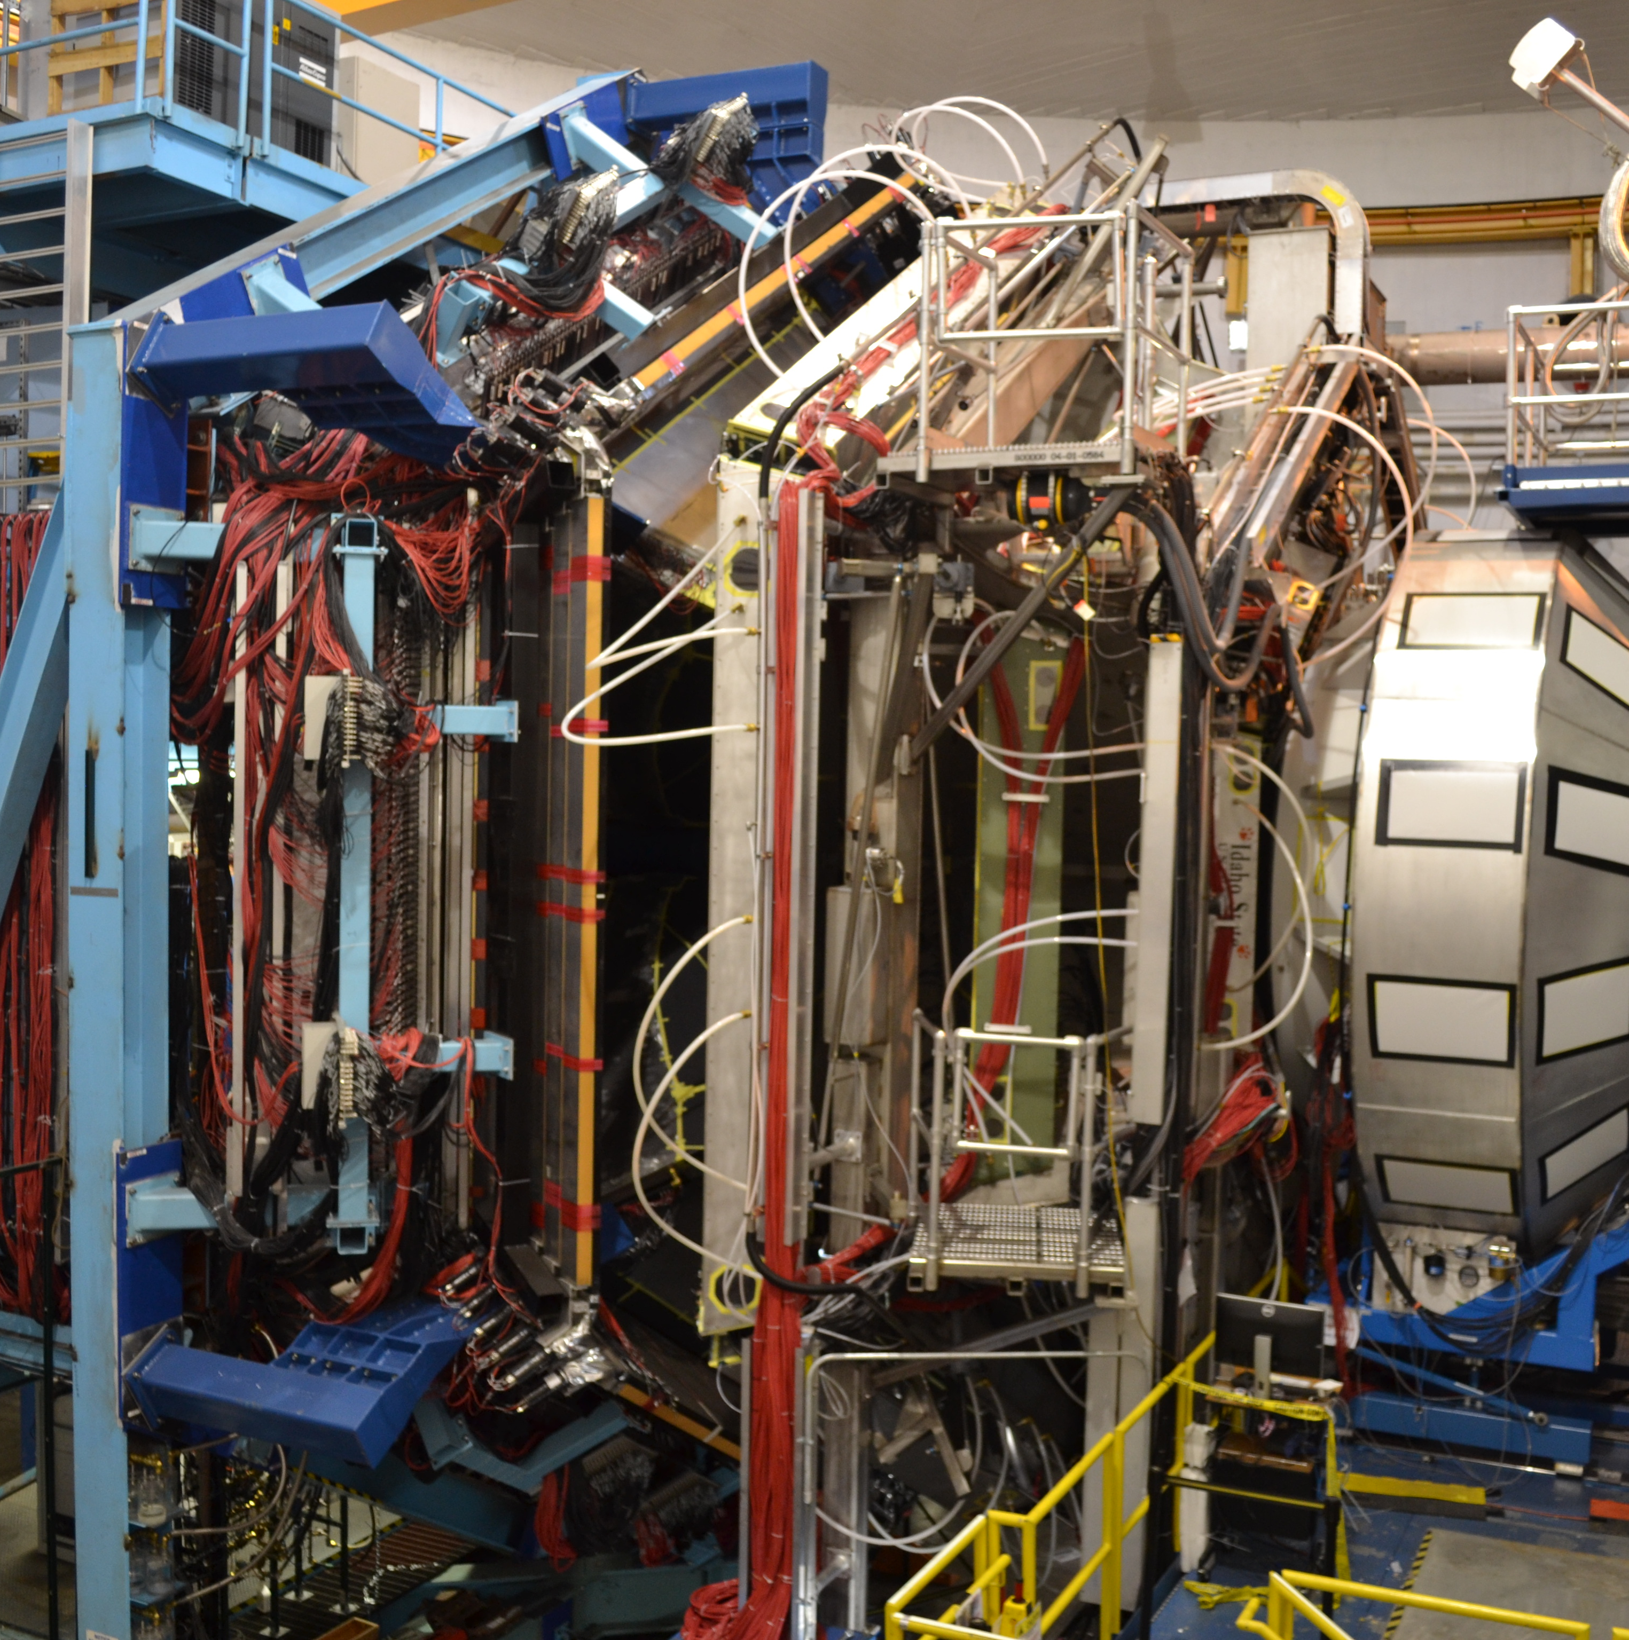

CLAS12 Run Group A
11 GeV Polarized Electrons on an Unpolarized
Liquid Hydrogen Target.
Progress Overview and Path Forward
Wednesday, July 1, 2026
Latifa Elouadrhiri

Slide 2
Outline
RGA Science Program
Run Group Organization
RGA Data Configuration and Processing
Ongoing Analysis, Procedures, and Documentation
Major Accomplishments and Highlights
Remaining Beam-Time Request
Plans for Pass 3 Processing
Summary and Outlook

Slide 3
RGA – Science Program
The CLAS12 RGA program comprises 13 experiments organized into five complementary categories, each designed to explore different aspects of nucleon structure, three-dimensional imaging, gravitational structure, and gluonic excitations. Together, these experiments advance the overarching scientific mission of the CLAS12 program: to understand how protons, neutrons, and nuclei emerge from the fundamental theory of the strong interaction, Quantum Chromodynamics (QCD), and how quarks and gluons give rise to the structure, dynamics, gravitational properties, and emergent behavior of visible matter.
  Study of Generalized Parton Distributions (GPDs), (2 +1)-D imaging of the proton and the study of its gravitational and mechanical structure (E12-06-119, E12-06-108 and E12-12-00)
Deep Exclusive Processes
Study of Time-like Compton Scattering and J/ψ photoproduction (E12-12-001 and E12-12-001A)
Dilepton team
Deep Inclusive & SIDIS
  Study of the Transverse Momentum Distributions (TMDs) and the 3D structure in momentum space (E12-06-112, E12-06-112A and E12-06-112B
Nucleon structure
  Study of nucleon resonance structure in broad range in Q^{2.} (E12-09-003, E12-06-108A, E12-06-108B)
MesonX program &
Strangeness Physics
  Study of meson spectroscopy in search for hybrid mesons including strangeness Program (E12-11-005 and E12-11-005A)

Slide 4
RGA – Organization
Run Group Coordinator: L. Elouadrhiri
Analysis Coordinator: T. Hayward
Chef: N. Trotta
CALCOM: D. Carman
Software Group: N. Baltzell & R. De Vita
  Study of Generalized Parton Distributions (GPDs), (2 +1)-D imaging of the proton and the study of its gravitational and mechanical structure (E12-06-119, E12-06-108 and E12-12-00) – L. Elouadrhiri
Deep Exclusive Processes
Dilepton team
Study of Time-like Compton Scattering and J/ψ photoproduction (E12-12-001 and E12-12-001A) – R. Paremuzyan
Deep Inclusive & SIDIS
  Study of the Transverse Momentum Distributions (TMDs) and the 3D structure in momentum space (E12-06-112, E12-06-112A and E12-06-112B
  – H. Avakian
Nucleon Structure
  Study of nucleon resonance structure in broad range in Q^{2.} (E12-09-003, E12-06-108A, E12-06-108B) – R. Gothe
MesonX Program &
Strangeness Physics
  Study of meson spectroscopy in search for hybrid mesons including strangeness Program (E12-11-005 and E12-11-005A) – D. Glazier and E. Pasyuk

Slide 5
RGA – Data Taking and Data Processing
RG-A has acquired data in three separate running periods, spring 2018, fall 2018, and spring 2019, with the collected beam time amounting to roughly half of the full approved RG-A beam time.
Information on cooking:
RGA Spring 2018 (Inb + Outb), pass-1, coatjava 11.1,September 2025, /cache/clas12/rg-a/production/recon/spring2018/
RGA Fall 2018 (Inb + Outb), pass-1, coatjava 6.5.x
RGA Fall 2018 (Inb + Outb), pass-2, coatjava 10.0.x, /cache/clas12/rg-a/production/recon/fall2018/*/pass2/
RGA Spring 2019 (Inb), pass-1, coatjava 6.5.x
RGA Spring 2019 (Inb), pass-2, coatjava 10.0.x, /cache/clas12/rg-a/production/recon/spring2019/
Fall 2018
Spring2018 &
Commissioning
Spring2019
Important note: Spring 2018 was processed with coatjava 11, while Fall 2018 and Spring 2019 were processed with coatjava 10. It is crucial to use the correct tracking version for MC production on OSG corresponding to the run period of interest.

Slide 6
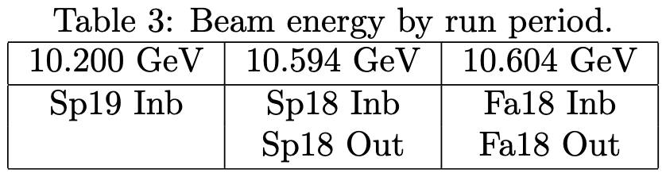
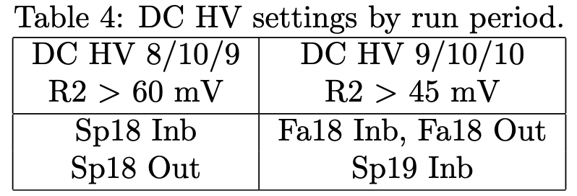
Run Periods & configurations
Five periods: two reconstruction software versions, two polarities, 2(~3) beam energies, 2 DC HV settings.

Slide 7
Run Periods & configurations
Five periods: two reconstruction software versions, two polarities, 2(~3) beam energies, 2 DC HV settings.
The goal is to combine multiple configurations at the cross-section level.

Slide 8
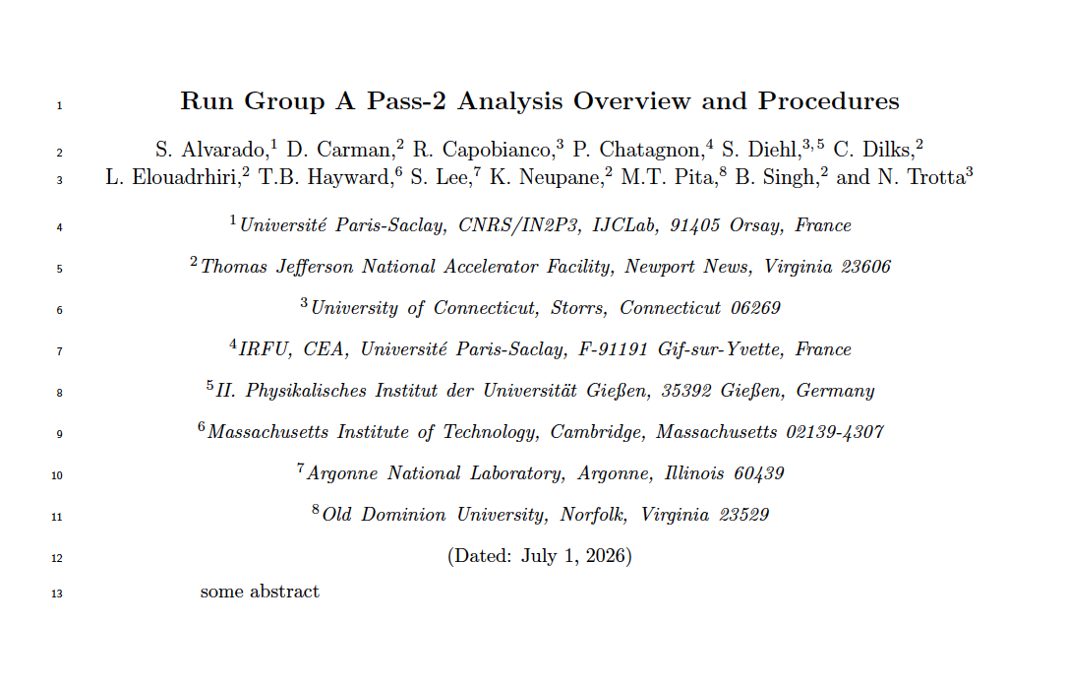
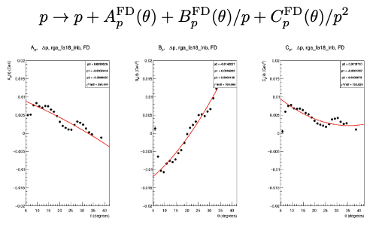
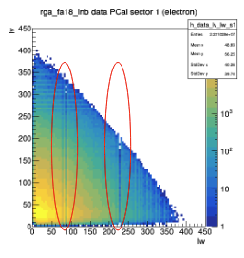
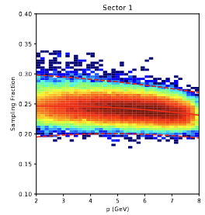
RGA (pass-2) Common Analysis Procedures
Collaborative effort to standardize common analysis procedures and algorithms.
Fiducial cuts, energy loss corrections, momentum corrections, particle identification, QADB strategies, etc. (see links to RGA wiki/analysis notes).
Fiducial cuts available and energy loss corrections in Iguana for all run periods.
(and many others)
Energy Loss Corrections
Fiducial Cuts
Particle Identification

Slide 9
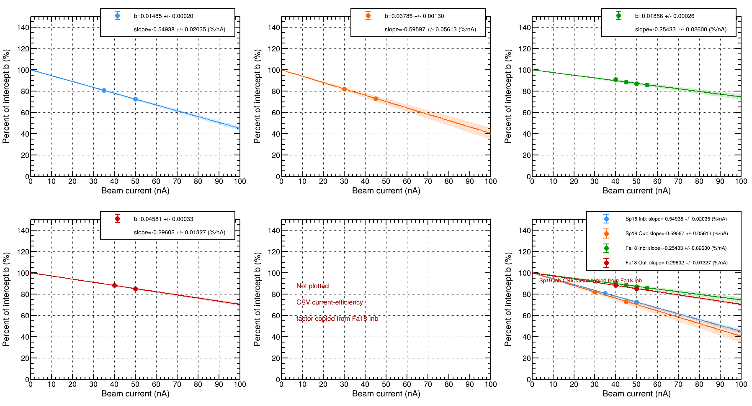
Data Efficiency Results
Efficiency loss determined as a function of current.
Data divided by e(I_{nom}), where I_{nom} is the weighted average current of the run period.
Sp18 Inb ≈ 0.73(1)
Sp18 Out ≈ 0.73(3)
Fa18 Inb ≈ 0.88(1)
Fa18 Out ≈ 0.86(2)
Sp19 Inb
Observed run period difference consistent with cj/DC HV effect, not torus polarity.

Slide 10
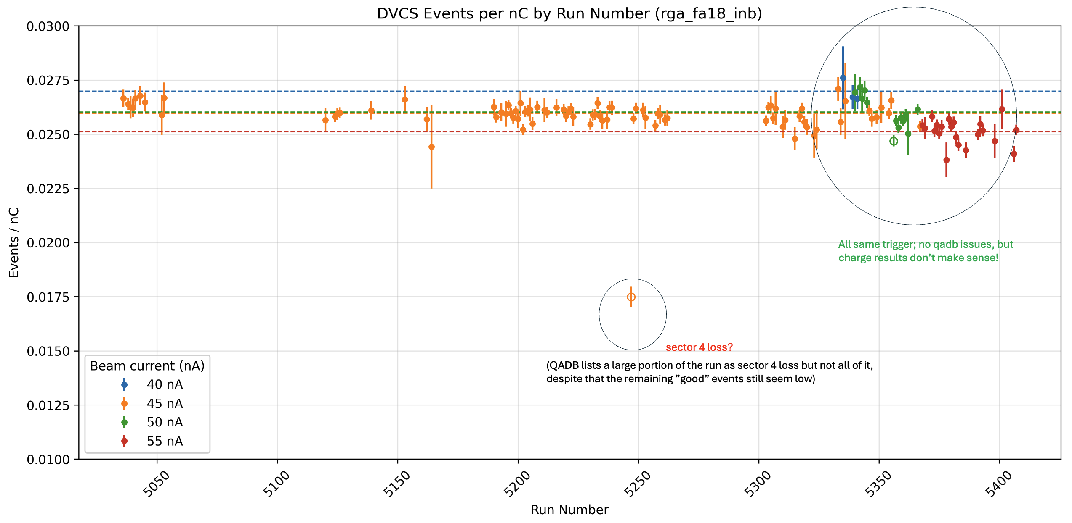
Efficiency as Counts/Charge; RGA Fa18 Inb
5333; logbook entry; “40 nA”
5333-5340; logbook entry; “40 nA”, “MCC explain high Hall A current is causing instability”
5341-5345; logbook entry; “50 nA” “beam very unstable”, “frequent trips”
5345-5347; logbook entry, “45 nA”, “[during run 5345] MCC lowered beam to 20 nA to test stability”.
Runs 5340-5345 reclassified as 40 n.
Run 5345 removed.
Run 5247 removed.

Slide 11
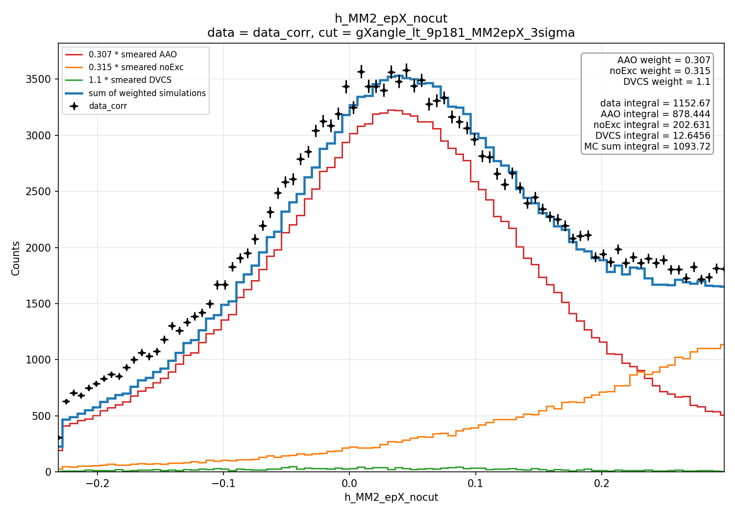
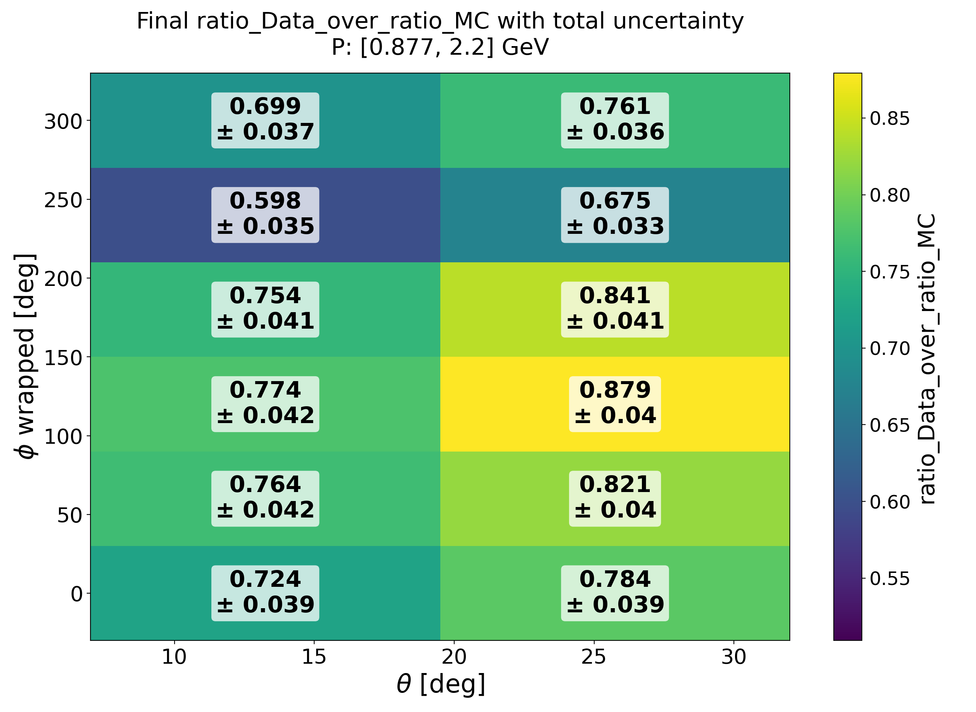
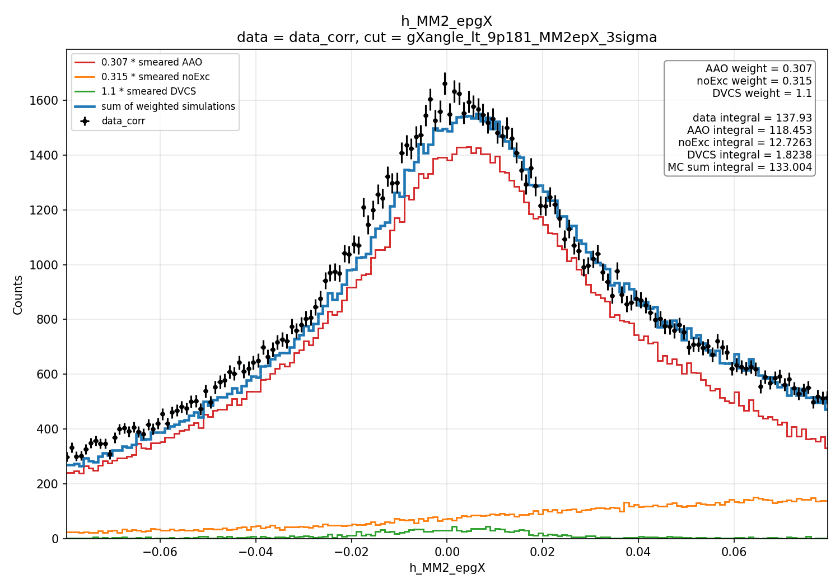



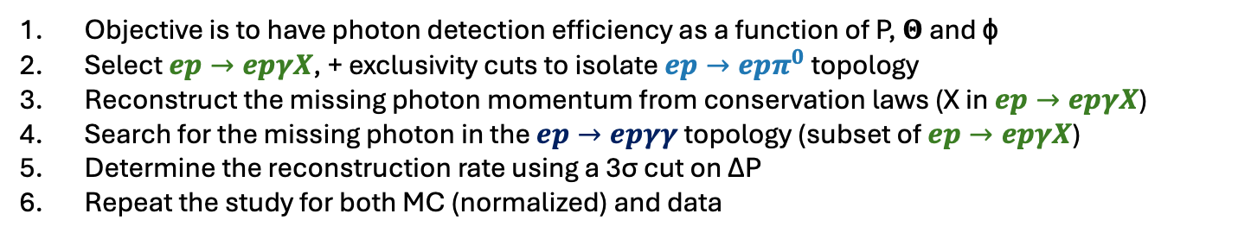

Photon Detection efficiency
Procedure:
# Detected photons
$$\frac{ep→epγγ}{ep→epγX}$$
Objective is to have photon detection efficiency as a function of P, 𝚯 and ɸ
Select $ep→epγX$, + exclusivity cuts to isolate $ep→epπ^{0}$ topology
Reconstruct the missing photon momentum from conservation laws (X in $ep→epγX$)
Search for the missing photon in the $ep→epγγ$ topology (subset of $ep→epγX$)
Determine the reconstruction rate using a 3σ cut on ΔP
Repeat the study for both MC (normalized) and data
# Expected photons
$epγX$normalization:
MM²(epX)
$$Eff. Corr. = \frac{Data(\#epγγ)}{Data(\#epγX)}∙\frac{MC(\#epγX)}{MC(\#epγγ)}$$
Data
MC total
Exclusive AAO_noRad
SIDIS (CLASDIS)
DVCS (DVCSgen)
PRELIMINARY Results:
Correction factors were estimated in three momentum bins, two theta bins, and six sectors.
The MC/data photon efficiency ranges from 60% to 85%.
The total relative uncertainty is below 10%.
The modified approach shows reasonable agreement with Sebastian’s study.
The optimal X-γ matching method is still under investigation.
MM²(epgX)
Preliminary

Slide 12
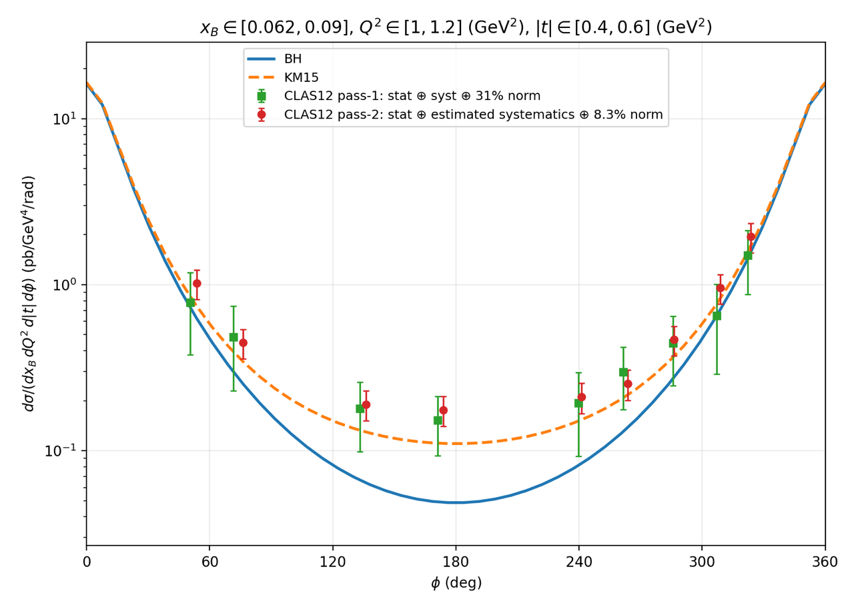
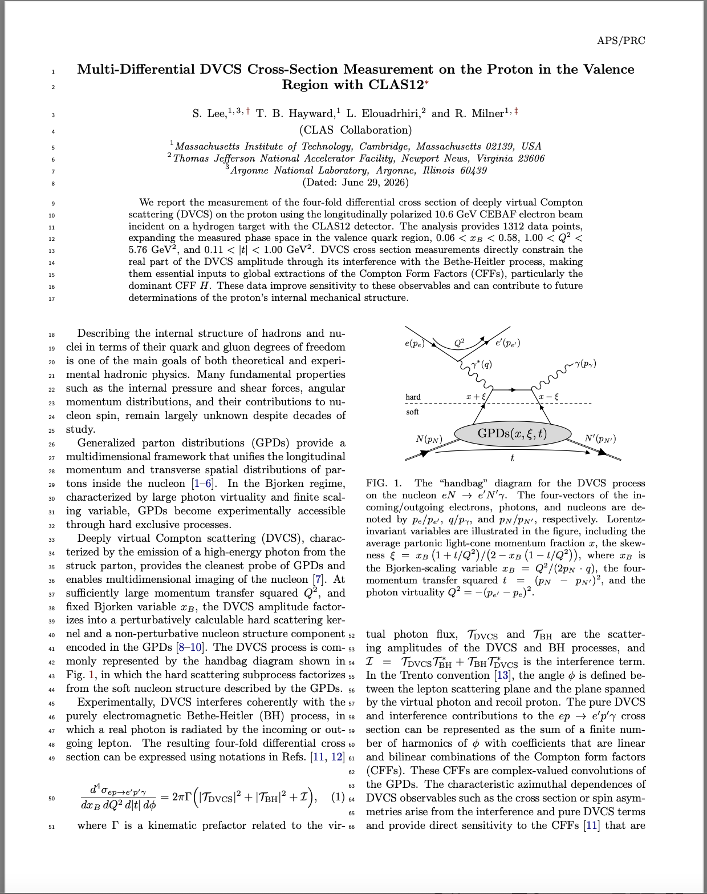
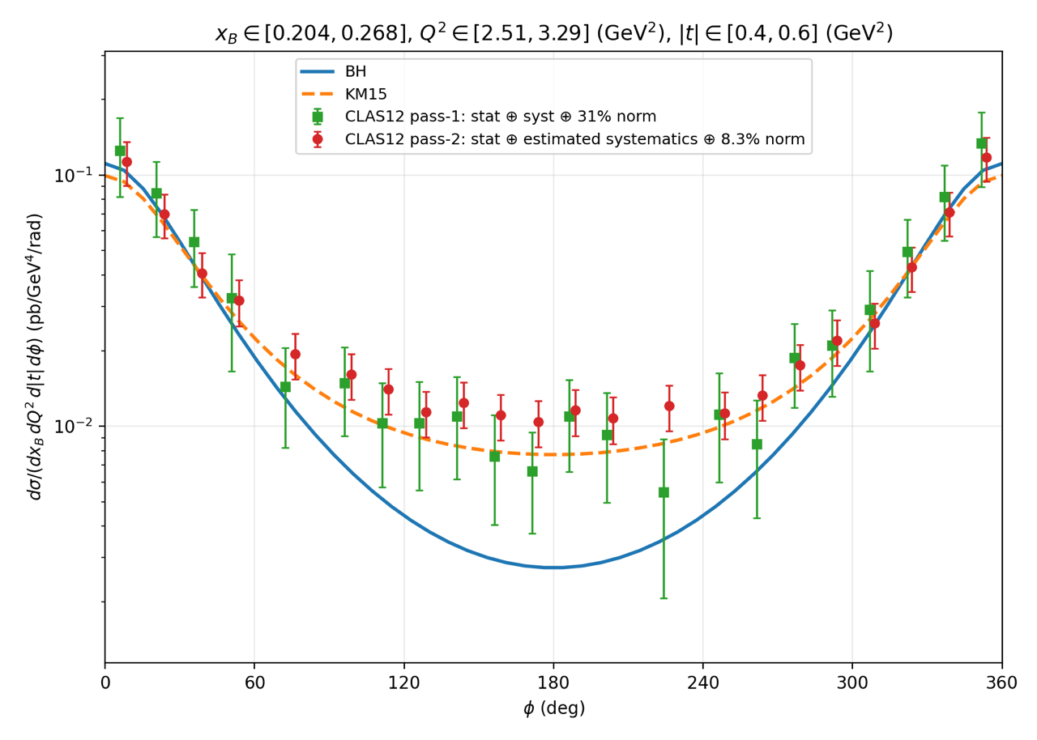
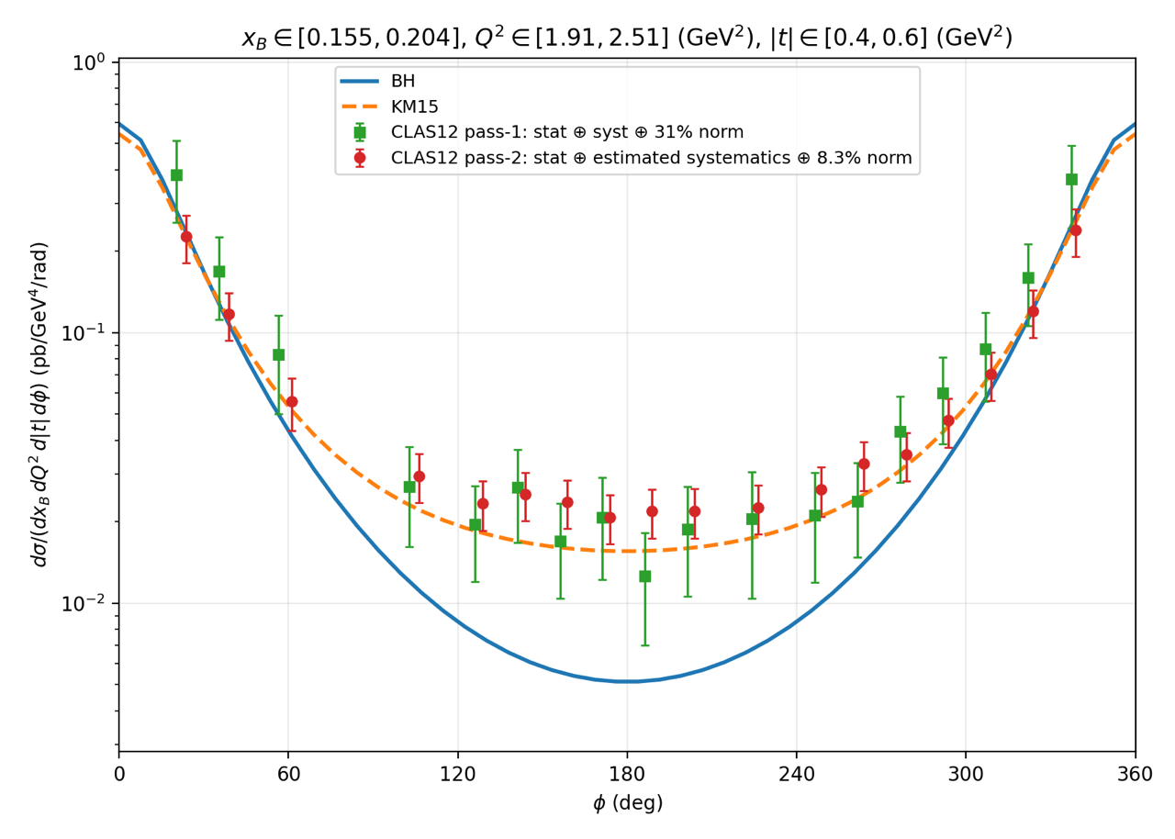
Deeply Virtual Compton Scattering
Pass-1 analysis of unpolarized cross section, using Fa18 Inb+Outb, is approved; paper entering collaboration review.
Pass-2 analysis is in a very advanced stage.
  All available RGA data (Sp18+Fa18+Sp19).
  Simultaneous BSA and cross section measurements.
  Polarized cross sections measured for Fa18+Sp19.
  Ongoing collaboration with RGK for final measurements at 5+ energies.

Slide 13
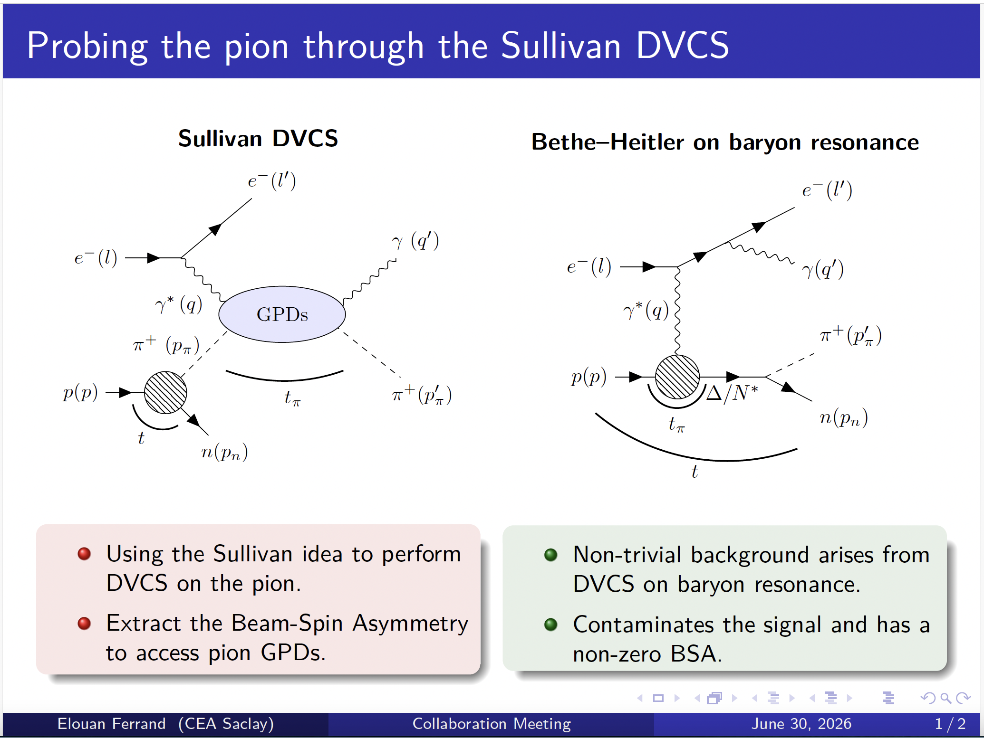

Slide 14
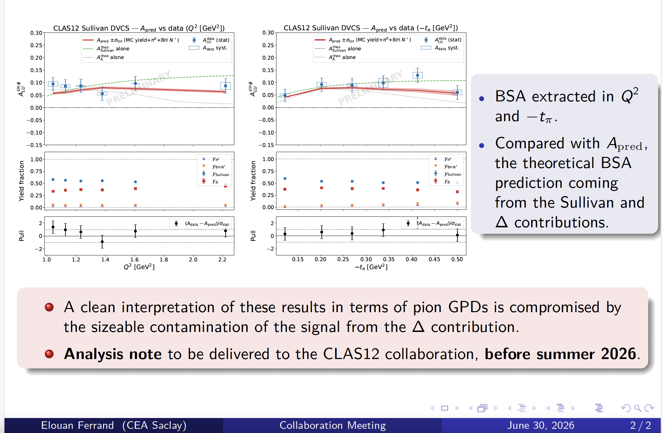

Slide 15
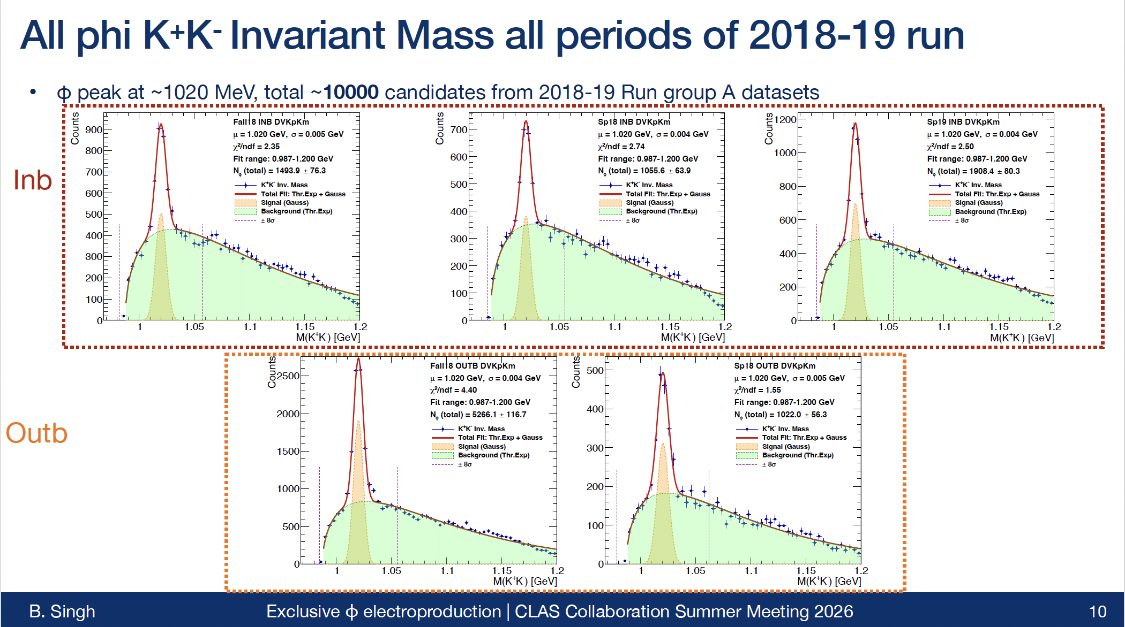

Slide 16
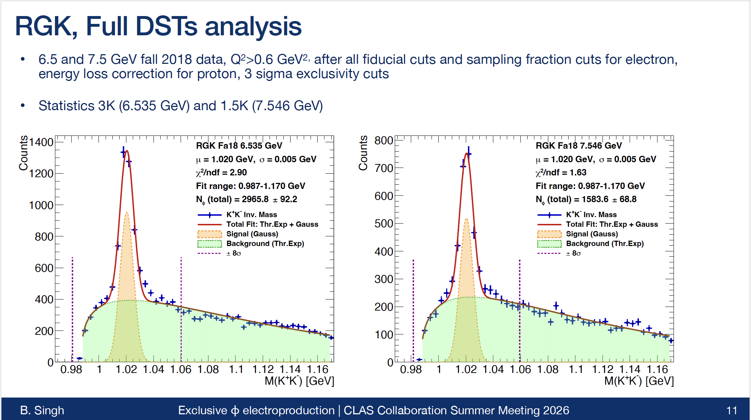

Slide 17
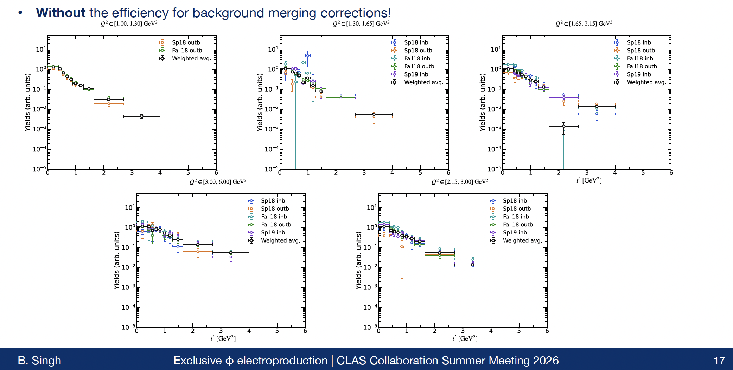
Preliminary

Slide 18
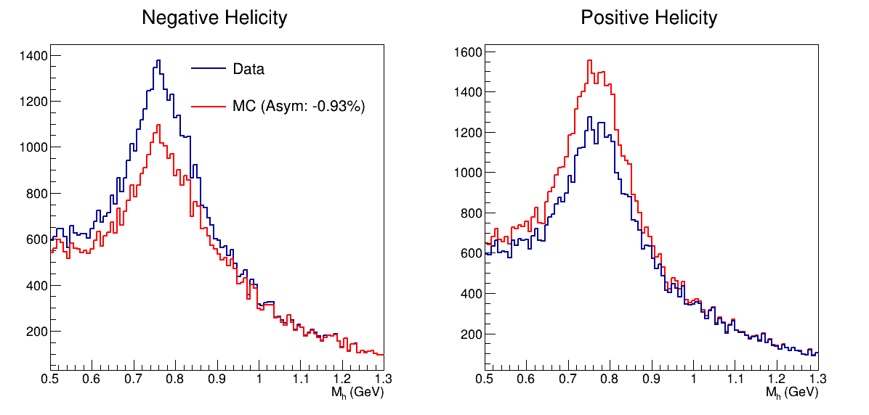

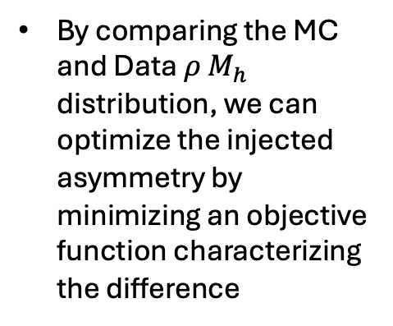

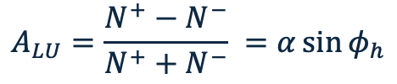
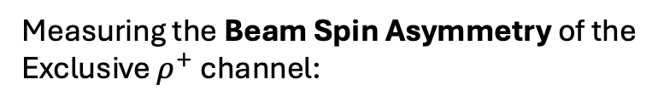
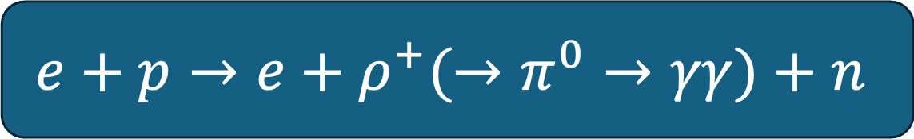
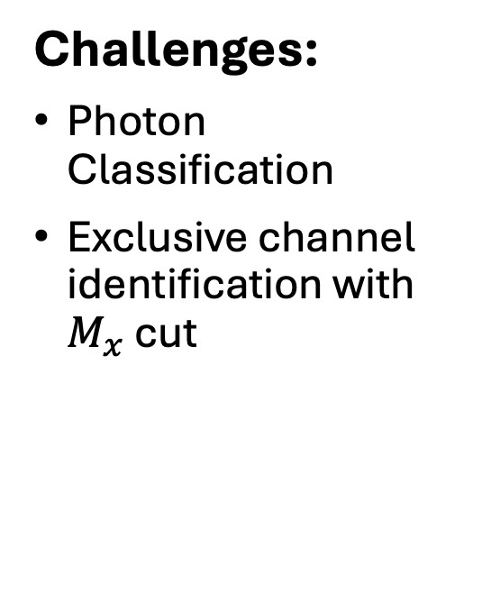
Exclusive $ρ^{±}$ Production
Measuring the Beam Spin Asymmetry of the Exclusive $ρ^{+}$ channel:
$$A_{LU}=\frac{N^{+}−N^{−}}{N^{+}+N^{−}} =α\sin{φ_{h}}$$
Work being done by Tyler Hellstern in Anselm Vossen’s Group
$$e+p→e+ρ^{+}(→π^{0}→γγ)+n$$
Motivations:
GPD Study
Dihadron BSA Background Study
SDME extraction
Challenges:
Photon Classification
Exclusive channel identification with $M_{x}$ cut
Current Work – Bayesian Optimization Extraction:
In addition to using standard BSA extraction techniques (prelim results out soon), Tyler Hellstern is developing an extraction method involving Bayesian Optimization.
By comparing the MC and Data $ρ M_{h}$ distribution, we can optimize the injected asymmetry by minimizing an objective function characterizing the difference

Slide 19
Dilepton team
"Measurement of the near-threshold J/𝜓 photoproduction cross section with the CLAS12 experiment" by
P. Chatagnon et al. Phys. Rev. C 113, 065203 – Published 9 June, 2026
Recent Graduations
Mariana Tenorio Pita : June 22, 2026
Ongoing analysis
Tagged photoproduction of J/𝜓 by M. Tenorio-Pita
F18 In + F18 Out + S19 + S18(In + Out)
  Analysis is close to be finalized: expected to relaese by Summer-Fall 2026
TCS on the Full RG-A dataset by Krishan Gopal and Evrim Gulser
  F18 In + F18 Out + S19 + S18 (In + Out)
  Analysis started in the Fall of 2025
  We expect analysis to be finalized by 2027
Photoproduction of φ in e⁻e⁺ decay channel by Mathieu Ronayette
  His current focus is the φ->K⁻K⁺ on RG-B. The plan is to study dilepton decay channel after finishing RG-B analysis.
  After 2026

Slide 20
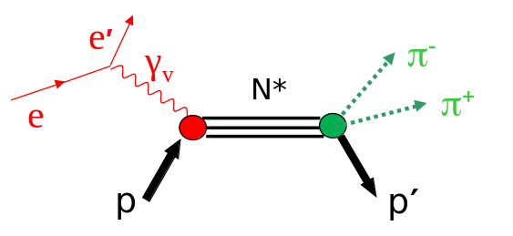
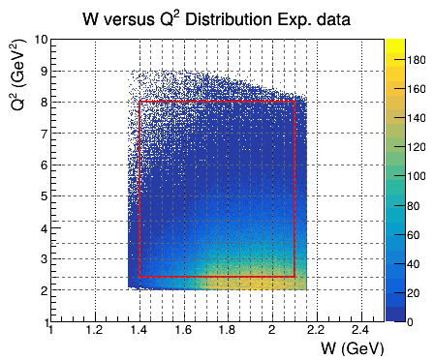



CLAS12 Double-Pion (N π π) Cross Sections in resonance region
K. Neupane
R.W. Gothe
D.S. Carman
V.I. Mokeev
Scientific Goals
☞ N* studies provides key insight into the internal structure of hadrons and the strong interaction dynamics responsible for nucleon resonance formation
☞ This analysis extracts differential cross sections for charged double-pion electroproduction
☞These cross sections will be used as input to the data-driven JM model to extract resonance electrocouplings across still not explored range of Q² = [5.0-8.0] GeV²
☞The evolution of resonance electrocouplings across this Q² range probes the distance scales where the transition from non-perturbative towards perturbative QCD is expected and provides insight into hadron mass generation
Channel of
Interest
Exp. data: - RGA, Fall 2018 data with inbending configuration Simulations: - TWOPEG event generator is used (gemc 5.10)
Topology: Missing π- topology (ep → e’p’ π+)
Kinematic coverage: 1.40 <= W < 2.10 GeV, 2.4 <=Q² < 8.0 GeV²
Cross Section Formulae
Physics Analysis
☞ Particle ID
☞ Fiducial Cuts
☞Energy/Mom. Corr.
☞MC Smearing
☞ Event Selection
☞ Cross-Section Extraction
Cross Section Corrections
☞ Detector Efficiency
☞ Radiative Effects
☞Bin Centering
☞Background Subtraction
☞ Acceptance Holes
☞ Final Cross-Sections

Slide 21
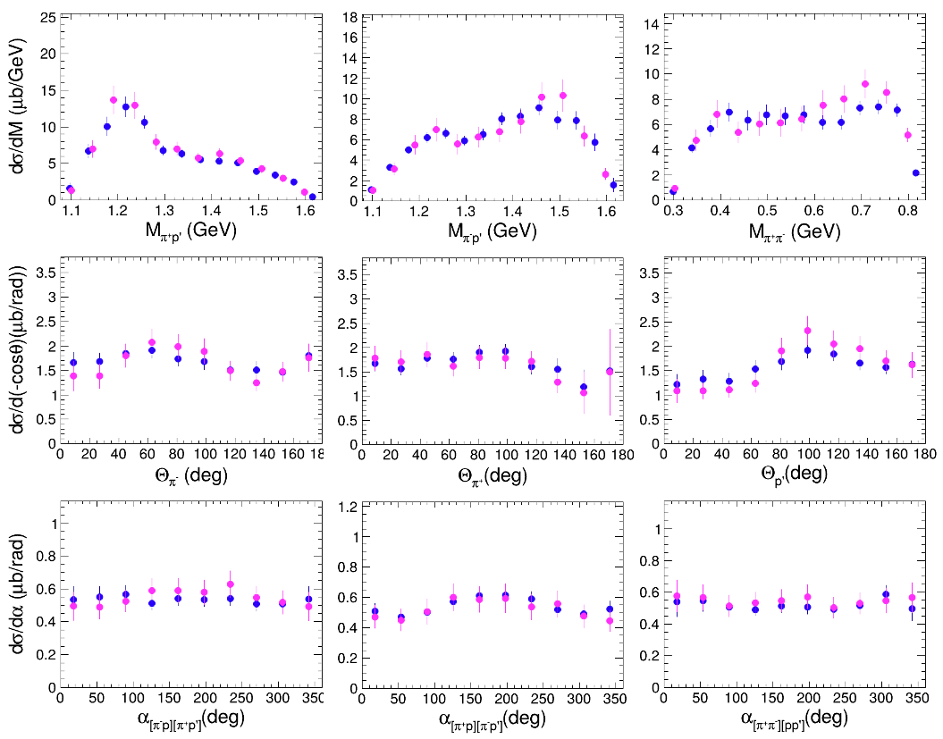
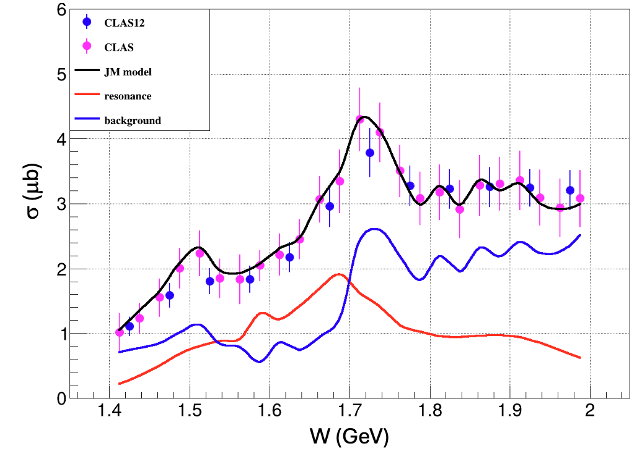
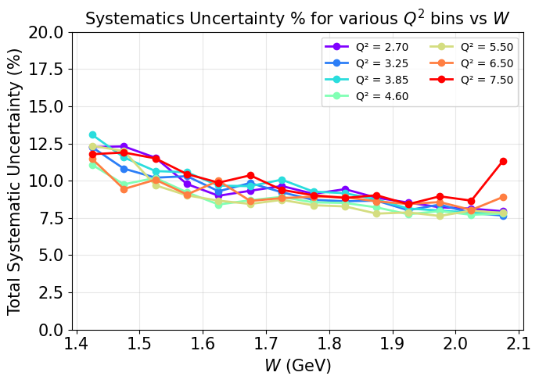
K. Neupane
R.W. Gothe
D.S. Carman
V.I. Mokeev
CLAS12 Double-Pion (N π π) Cross Sections in resonance region
Conclusion:
☞ Exclusive double-pion cross sections extracted from CLAS12 RGA Fall 2018 data
☞ Q² coverage extended to 8 GeV² (first measurement for Q² > 5 GeV²)
☞ Consistent with previous CLAS results within uncertainties
☞ Estimated ~9% systematic uncertainty on Total Cross-sections
☞ Analysis note approved, paper submitted to Ad-hoc committee

Slide 22
Issues and Benefit from Additional improvement – Pass3
Improved Software
  Improved software development (tracking, PID, RICH Detector, kinematical fitting, etc.) for the FD
  Enhanced PID for the Central Detector and improved tracking algorithms
Improved detector alignment
  Sector-to-sector alignment
  Forward Detector to Central Detector alignment
  Better knowledge to the magnetic field
Faster and more efficient codes
Required simulations to support our current plan
  Extensive and coordinated detector-simulation effort.
MC simulations
  Better matching between MC and measured data in terms of resolution, efficiency, and hardware structures.
Streamlined calibrations to accelerate the process
  Within RGA we have all the necessary resources and tools in place to timely validate any improvement and could, for instance, implement and benefit from enhancements for the Forward Detector first, followed by the Central Detector.

Slide 23
CLAS12 RG‑A PhD Theses
22 PhD. Theses Completed!

Slide 24
CLAS12 RGA Publication List
13 publications, with 7 publications in Physical Review Letters.

Slide 25
Ongoing Ad-doc and Analysis Review

Slide 26
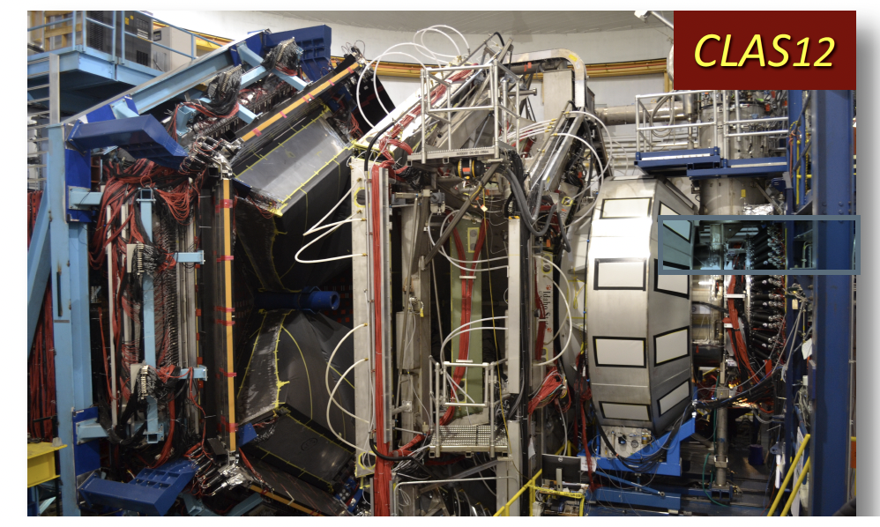
RG-A Experiment beam time request
The experimental setup and configuration overall remain unchanged; however, with the new beam time, we will benefit from optimized parameters for efficient detector operation, resulting in improved resolution and the ability to run at a higher beam current.
To fully achieve the goals of the RG-A science program, the full statistics from the approved beam time are essential. We request that the next data set be taken in one uninterrupted run, supported by improved software and calibration procedures. The team is READY!
26

Slide 27
Summary and Outlook
Excellent progress across the RGA program
  13 publications
  22 Ph.D. theses completed
All RGA data sets calibrated and processed, with the Spring 2018 data set achieving excellent quality
Standardized analysis procedures and a common analysis note developed and being implemented across the collaboration
Several analyses under review or in progress based on Pass2 data
Several publications published/expected in FY26
Ready to implement and capitalize on Pass3 software improvements
Strengthening collaboration and engagement with other run groups
Exploring the application of AI to high-level physics analyses
Leveraging AI to accelerate and enhance high-level physics analyses

Slide 28
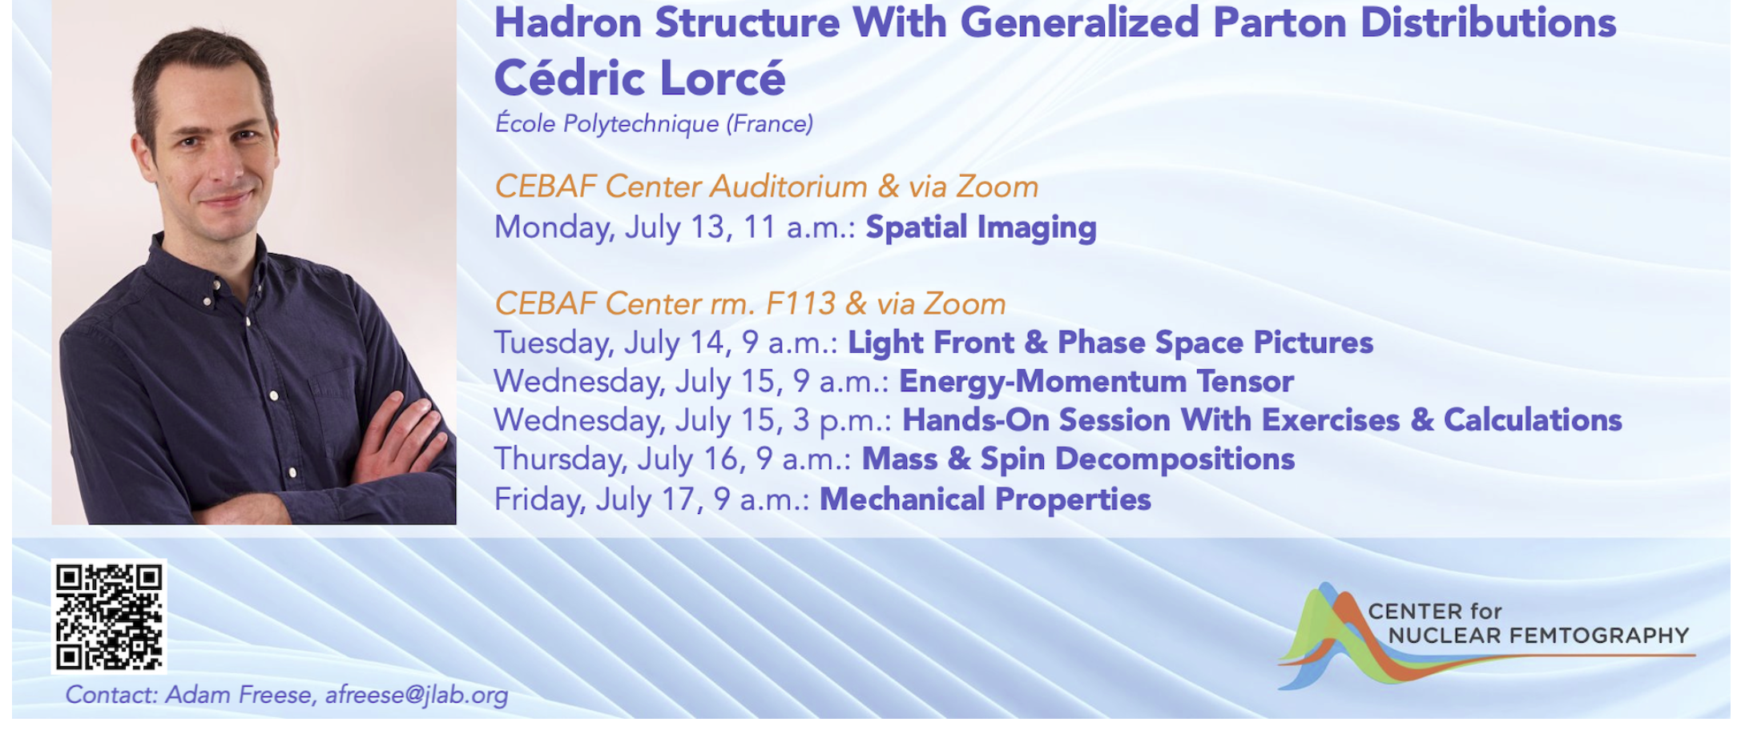

Slide 29
QUESTIONS?
Notes:
Before sharing your presentation, confirm:
Fonts are consistent
Images meet quality standards
Charts use template colors
Footer information is current
Spell check completed
Links are working
File size is optimized

