Slide 1
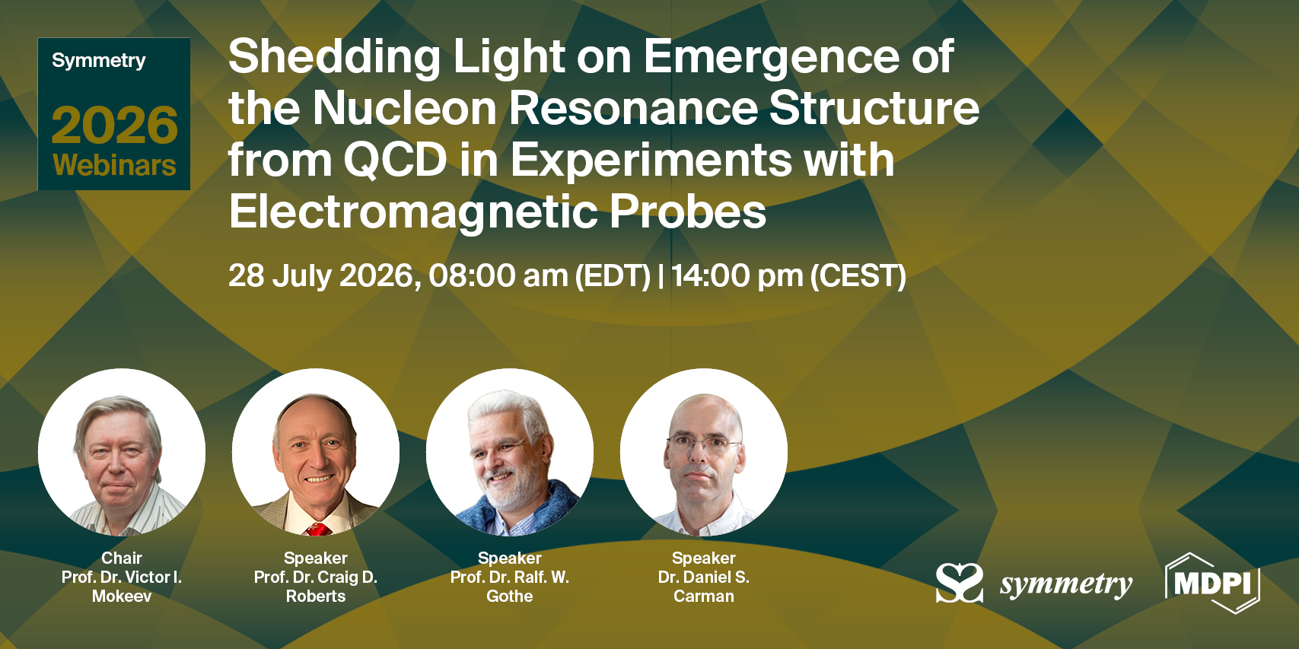
Connection link:
https://urldefense.proofpoint.com/v2/url?u=https-3A__sciforum.net_event_Symmetry-2D20&d=DwIFaQ&c=CJqEzB1piLOyyvZjb8YUQw&r=5d2A05CBcg701rhFXA73zw&m=snpgdZcdBhrBJmg8JV7HDrRQyqhN7lbM_4kts3hk9yk7M2V6UAPc6Qi0FHsEx38U&s=kzNeVNAabf-fiJcGJ1aimIiDQKYtfq3dgcTYdqfw3yc&e=
Topics:
Studies of nucleon resonance electroexcitation amplitudes from exclusive meson electroproduction data obtained in 6-GeV era CLAS experiments
Extension of N* structure studies anticipated from CLAS12 experiments in the 12-GeV era and beyond
Theory framework(s) for understanding the emergence of hadron mass (EHM) and structure from results on the N* electroexcitation amplitudes
1

Slide 2
Emergence of Hadron Mass and the N* Structure in Experiments of
6/12 GeV Eras at Hall B
The experimental program on the studies of N* structure in exclusive meson photo-/electroproduction with CLAS/CLAS12 seeks to determine:
  γ_{v}pN* electrocouplings at photon virtualities Q² up to 10 GeV² for most excited proton states in the mass range < 2.5 GeV through analyzing the data of most meson electroproduction channels in the N* region.
A unique source of information on many facets of sQCD (i.e. QCD at distance scales where α_{s} becomes comparable with unity) in generating N* states with different structural features:
V.D. Burkert et al, Prog. Part. Nucl. Phys. 146, 104214 (2026)
P. Cheng et al., Acta Phys. Polon, B57, 2-A13 (2026)
V.I. Mokeev and D.S. Carman Few Body Syst. 63, 59 (2022)
V.D. Burkert and C.D. Roberts, Rev. Mod. Phys. 91, 011003 (2019)
  Explore EHM by mapping out the dressed quark mass in the transition from almost massless pQCD quarks to fully dressed quarks with dynamically generated ~400 MeV masses at the hadron size distance scale.
An important part of the efforts of EHM exploration from the data on N*/N structure combined with the results on meson structure:
P. Achenbach, D.S. Carman, R.W. Gothe, K.Joo, V.I. Mokeev, and C.D. Roberts, Symmetry 7,1106 (2025)
M. Ding, C.D. Roberts, and S.M. Schmidt, Particles 6, 57 (2023)
D.S. Carman, R.W. Gothe, V.I. Mokeev, and C.D. Roberts, Particles 6, 416 (2023)

Slide 3
Summary of Published CLAS Data on Exclusive Meson Electroproduction off Protons in N* Excitation Region
Hadronic final state | W-range, GeV | Q²-range, GeV² | Observables
π⁺n | 1.1-1.38 1.1-1.55 1.1-1.70 1.6-2.00 | 0.16-0.36 0.3-0.6 1.7-4.5 1.8-4.5 | dσ/dΩ dσ/dΩ dσ/dΩ, A_{b} dσ/dΩ
π⁰p | 1.1-1.38 1.1-1.68 1.1-1.39 1.1-1.80 | 0.16-0.36 0.4-1.8 3.0-6.0 0.4-1.0 | dσ/dΩ dσ/dΩ, A_{b},A_{t},A_{bt} dσ/dΩ dσ/dΩ, A_{b}
ηp | 1.5-2.3 | 0.2-3.1 | dσ/dΩ
K⁺Λ | thresh-2.6 | 1.40-3.90 0.70-5.40 | dσ/dΩ P⁰, P′
K⁺Σ⁰ | thresh-2.6 | 1.40-3.90 0.70-5.4 | dσ/dΩ P′
π⁺π⁻p | 1.3-1.6 1.4-2.1 1.4-2.0 | 0.2-0.6 0.5-1.5 2.0-5.0 | Nine 1-fold differential cross sections
dσ/dΩ−CM angular
distributions
A_{b},A_{t},A_{bt}-longitudinal
beam, target, and
beam-target asym-
metries
P⁰, P′ –recoil and
transferred polarization
of strange baryon
Around 150,000
data points!
Almost full coverage
of the final state hadron phase space
The measured observables from CLAS are stored in the
CLAS Physics Data Base http://clas.sinp.msu.ru/cgi-bin/jlab/db.cgi
Notes:
Исследования процессов электровозбуждения N* во всех эксклюзивных каналах электророждения мезонов в резонансной области стало возможным в экспериментах на детекторе CLAS , где была получена доминирующая чеать результатов по реакциям эксклюзивного электророждения мезонов на нуклонах.

Slide 4
Nucleon Resonance Electrocouplings from Data on Exclusive Meson Electroproduction of 6 GeV Era with CLAS
Exclusive meson electroproduction channels | Excited proton states | Q²-ranges for extracted γ_{v}pN* electrocouplings, GeV²
π⁰p, π⁺n | Δ(1232)3/2⁺ N(1440)1/2⁺,N(1520)3/2⁻, N(1535)1/2⁻ | 0.16-6.0 0.30-4.16
π⁺n | N(1675)5/2⁻, N(1680)5/2⁺,N(1710)1/2⁺ | 1.6-4.5
ηp | N(1535)1/2⁻ | 0.2-2.9
π⁺π⁻p | N(1440)1/2⁺, N(1520)3/2⁻ N(1440)1/2⁺, N(1520)3/2⁻, Δ(1600)3/2⁺, N(1675)5/2⁻, N(1680)5/2⁺, Δ(1700)3/2⁻, N(1720)3/2⁺, N’(1720)3/2⁺ | 0.25-1.50 2.0-5.0 0.5-1.5
The γ_{v}pN* electrocouplings are available from analysis of CLAS data for most N* states in the mass range < 1.8 GeV and in the range of Q² < 5 GeV²
Numerical results can be found at https://userweb.jlab.org/~mokeev/resonance_electrocouplings23/, Ref. A.N. Hiller Blin et al, PRC100, 035201 (2019)

Slide 5
Electrocouplings of N(1440)1/2⁺ and N(1520)3/2⁻ Resonances from πN and π⁺π⁻p Electroproduction off Proton Data
N(1440)1/2⁺
pπ⁺π⁻ CLAS
2023
A_{1/2}
A_{1/2}
N(1520)3/2⁻
Consistent results on the N(1440)1/2⁺ and N(1520)3/2⁻ electrocouplings from independent studies of the two major πN and π⁺π⁻p electroproduction channels with different non-resonant contributions demonstrated the capabilities of the reaction models for their reliable extraction and allow us to evaluate their systematic uncertainties in a nearly model-independent way.

Slide 6
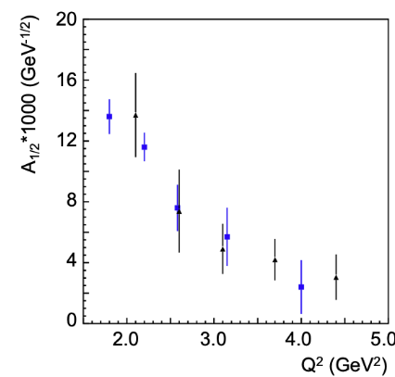
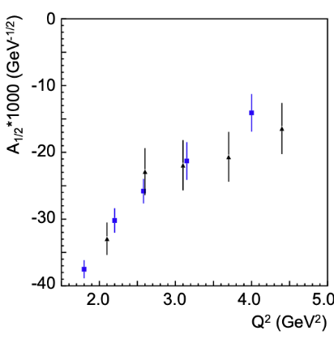
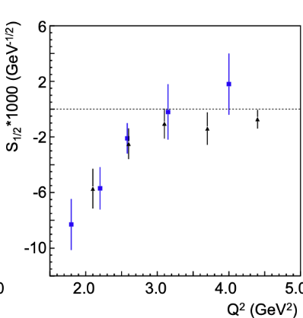
Electrocouplings of N*s in the Third Region from πN and π⁺π⁻p Electroproduction
A_{1/2}
A_{1/2}
S_{1/2}
N(1680)5/2⁺
Preliminary
N(1675)5/2⁻
N(1680)5/2⁺
blue: π⁺n
K. Park et al. (CLAS), PRC 91, 045203 (2015)
UIM/DR-reaction models: I.G. Aznauryan et al. (CLAS), PRC 80, 055203 (2009)
black: CLAS π⁺π⁻p
preliminary, December 2025 (unpublished)
JM23-reaction model: V.I. Mokeev et al., to be submitted to PRC
Consistent results on the N(1675)5/2⁻ and N(1680)5/2⁺ electrocouplings from π⁺n and π⁺π⁻p channels demonstrated the capability of the reaction models UIM/DR and JM23 for the credible extraction of the N* electrocouplings for states in the mass range up to 1.8 GeV for Q²<5.0 GeV²
Electrocouplings of N* in mass range < 1.8 GeV for Q²<5.0 GeV² have become available
from the global coupled-channel analysis ofγ_{r,v}N , πN, ηN, KΛ, KΣ channels:
M. Mai et al., Phys. Rev. C106, 015201 (2022) Julich-Bonn-Washington
Yu-Fei Wang et al, Phys. Rev. Lett. 133, 101901 (2024) Julich-Bonn-Washington
6

Slide 7
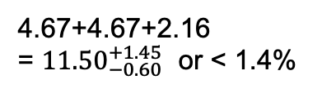
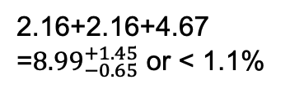
How do the Ground/Excited Nucleon Masses Emerge?
Composition of the Nucleon Mass:
proton
neutron
M_{p}, MeV (PDG23)
M_{n}, MeV (PDG23)
938.2720813
±0.0000058
939.5654133
±0.0000058
Sum of bare quark
masses, MeV
Sum of bare quark
masses, MeV
2.16+2.16+4.67
=${8.99}_{−0.65}^{+1.45}$ or < 1.1%
4.67+4.67+2.16
= ${11.50}_{−0.60}^{+1.45}$ or < 1.4%
$\overline{\text{MS}} \text{scheme}$ at a renormalization scale of 2.0 GeV
The Higgs mechanism only generates the renormalization-group-invariant masses of bare quarks relevant to the pQCD regime.
The dominant part of N/N* masses is generated in processes other than the Higgs mechanism.
Studies of the structure of the nucleon ground state and N* electroexcitation within Continuum Schwinger methods (CSM) over a broad range of Q² shed light on the emergence of N/N* masses and structure.
7

Slide 8
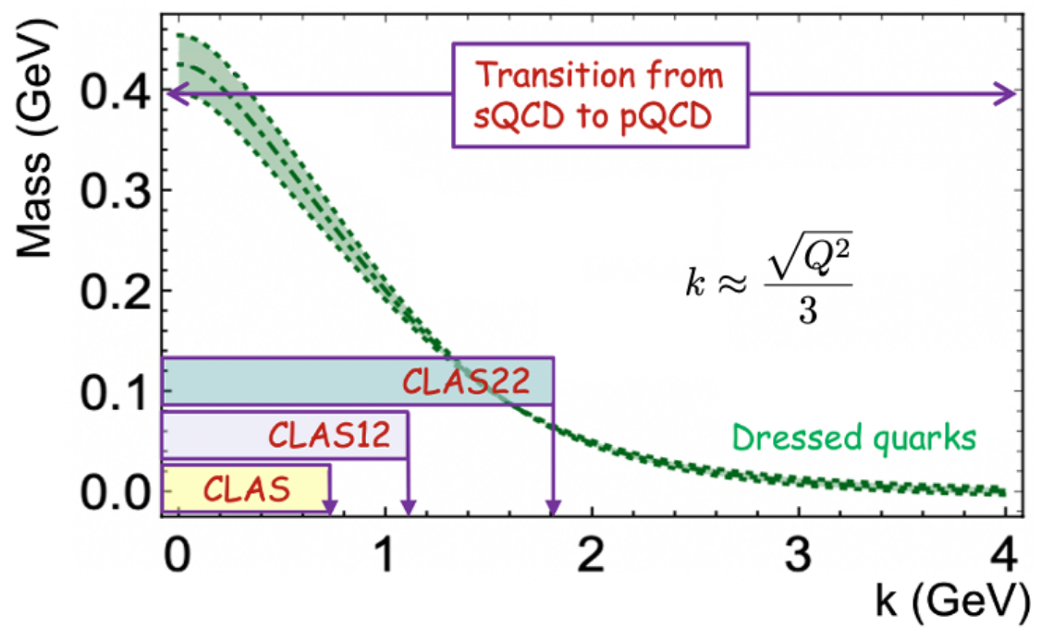
Impact of the γ_{v}pN* Electrocouplings Results on Insight into EHM
P. Achenbach, D.S. Carman, R.W. Gothe, K. Joo, V.I. Mokeev, and C.D. Roberts, Symmetry, 17, 1106 (2025)
The dominant part of hadron mass (>98%) is generated by strong interaction encoded in QCD Lagrangian and evolving with distances in the transition from perturbative to strongly coupled regimes. Studies of the ground and excited state of the nucleon structure within CSM across a broad range of Q² allow us to map out the momentum dependence of dressed quark mass.
The CLAS experiments, limited to Q² < 5.0 GeV², allow exploration of a restricted range of distances where ~30% of hadron mass is generated. Extending the Q² coverage up to 10 GeV² with measurements from CLAS12 will offer insight into the distance scales where ~50% of hadron mass emerges.
The future experiments at facilities capable to measure exclusive meson electroproduction across Q² < 30 GeV² provide a unique opportunity to explore the full range of distances over which the dominant portion of hadron mass and the structure of N/N* states are generated.
8

Slide 9
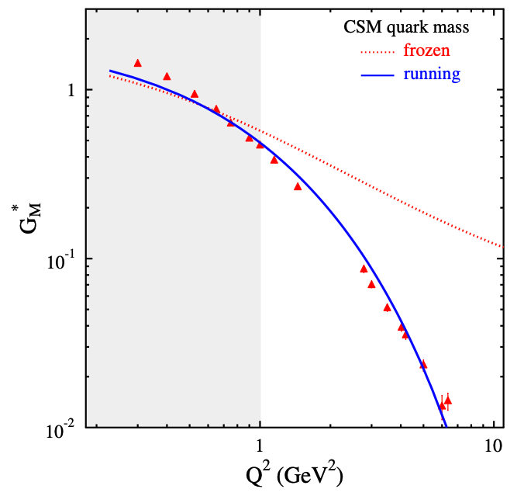
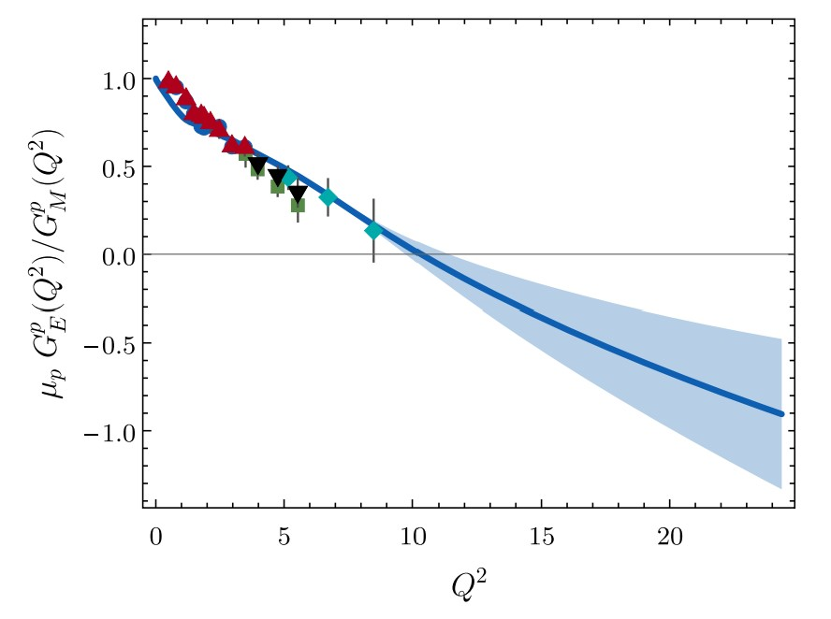
EHM: Concept from CSM vs. Available Experimental Results
CLAS/Hall A/C results vs. CSM expectations
N→Δ(1232)3/2⁺ magnetic FF
N(1440)1/2⁺
A successful description of the pion and nucleon elastic FFs and the electrocouplings of the Δ(1232)3/2⁺ and N(1440)1/2⁺ has been achieved with the same dressed quark/gluon mass functions.
Dressed quarks with dynamically generated masses represent active degrees of freedom in the structure of the pion, nucleon, and the Δ(1232)3/2⁺, N(1440)1/2⁺.
Strong evidence for insight into momentum dependence of dressed quark mass
Substantial contributions from M-B cloud
J. Segovia et al., FBS 55, 1185 (2014)
J. Segovia et al., PRL 115, 171801 (2015)
Pion Elastic FF
C.D. Roberts et al., Prog. Part. Nucl Phys. 120, 103883 (2021)
Nucleon Elastic FF
M. Barabanov et al., Prog. Part. Nucl. Phys. 103835 (2021)
Q² F_{π} / GeV²
μ_{p}G_{E}^{p}(Q²)/G_{M}^{p}(Q²)
Data points: JLab F_{π} Collaboration
Hall A/C data
Q² (GeV²)
Q² (GeV²)
One of the most important achievements in hadron physics of the last decade
in synergistic efforts between experimentalists, phenomenologists, and theorists
9
Notes:
- The picture of a quark inside of a hadron is a dynamical picture - what we effectively see depends on the quark momentum - review the picture and the importance of scale
- Model calculations of form factors and electrocouplings are sensitive to the evolution of the dressed quark mass function.
- Review the model calculations
- The data from CLAS12 will cover for the first time the range of Q2 where the dominant part of the hadron mass is generated addressing the key open problems of what is the nature of confinement and how is more than 98% of the visible mass in the Universe generated?

Slide 10
Δ(1600)3/2⁺ Electrocouplings : CSM Prediction vs. Data Determination
CSM predictions, Ya Lu et al., PRD 100, 034001 (2019)
Electrocouplings from independent analyses of π⁺π⁻p differential cross sections within three W-intervals, 1.46<W<1.56 GeV, 1.51<W<1.61 GeV, and 1.56<W<1.66 GeV for 2.0<Q²<5.0 GeV² [V.I. Mokeev et al., PRC 108, 025204 (2023)].
CLAS results on the Δ(1600)3/2⁺ electrocouplings confirmed the CSM prediction, solidifying evidence for insight into dressed quark mass function and, consequently, into EHM from studies of γ_{v}pN* electrocouplings.
10

Slide 11




Webinar Program
Chair Introduction, Dr. Victor I. Mokeev (USC), July 28, 8.00-8.20 am EST
Insight into EHM from the experimental results on meson/baryon structure analyzed within the common, QCD connected theory framework(s) will be the central topic
Prof. Dr. Ralf W. Gothe (USC), Nucleon Resonance Structure in Exclusive Meson Electroproduction Experiments: From Strong to Perturbative QCD Regimes, (35+5’), July 28, 8.20-9.00 am EST
Dr. Daniel S. Carman (JLab), Studies of Nucleon Resonances at JLab in the 12 GeV Era and Beyond (35+5’), July 28, 9.00-9.40 am EST
Prof. Dr. Craig D. Roberts (Head of INP at Nanjing U.), Insight into the Emergence of Hadron Mass and Structure from N* Electroexcitation (35+5’), July 28, 9.40-10.20 am EST
Discussion session moderated by Dr. Victor I. Mokeev (USC) & Ms. Isabella Theodora Toth’s Instruction for the paper submission to the Symmetry topical issue (TBD), July 28, 10.20-11.00 am EST
11

Slide 12
Webinar’s Follow-Up
Insight into EHM requires experimental results on the structure of both meson and baryon ground and excited states in terms of elastic and transition form factors, PDAs, PDFs, GPDs, TMDs, and the structure functions of the energy-momentum tensor, analyzed jointly within common theoretical framework(s) connected to the QCD Lagrangian.
At present, a common theoretical framework has been developed within the CSM. Further progress toward the development of a multi-pronged theoretical framework is strongly encouraged.
Success in addressing the challenging open problem of the Standard Model related to the emergence of hadron mass and structure relies critically on close synergy between experiment, phenomenology, and theory.
To facilitate these efforts, a topical issue of the Symmetry journal:
”Emergence of Hadron Mass from Experiments at High Luminosity Facilities”
is currently in preparation. Contributions are welcome, with publication anticipated in
2027. More details will be provided during the webinar.
12

