Slide 1
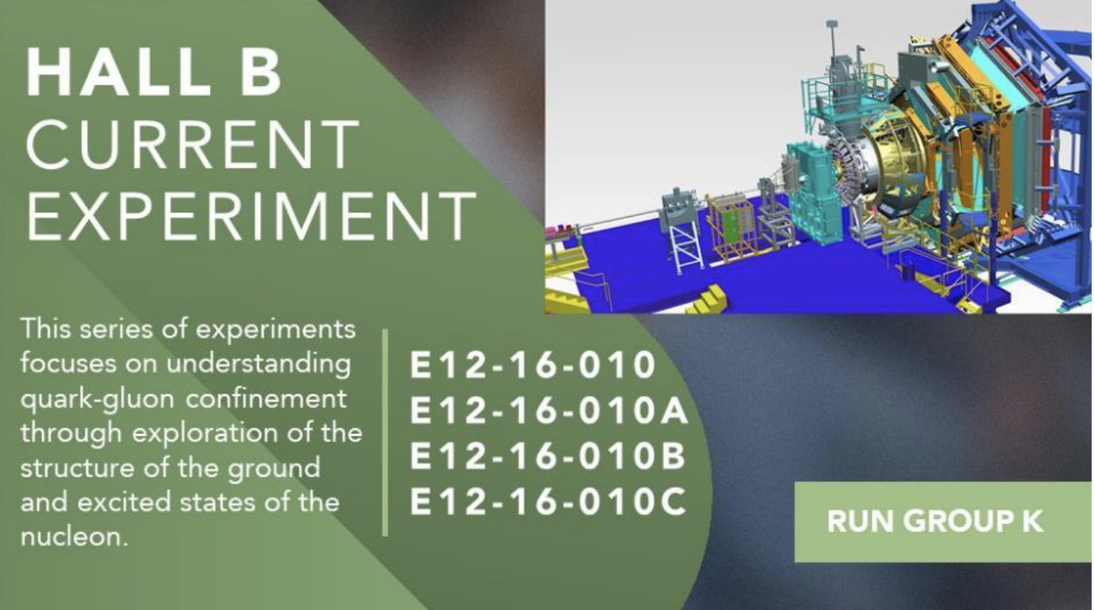
Hall B - Run Group K
Color Confinement and Strong QCD
Status Update
E12-16-010 A Search for Hybrid Baryons in Hall B with CLAS12
Annalisa D’Angelo
E12-16-010A Nucleon Resonance Structure Studies Via Exclusive KY Electroproduction at 6.6 GeV and 8.8 GeV
Daniel Carman
E12-16-010B Deeply Virtual Compton Scattering with CLAS12 at 6.6 GeV and 8.8 GeV
Latifa Elouadrhiri
E12-16-010C Separation of the σ_{L} and σ_{Τ} contributions to the production of hadrons in electroproduction
Tim Hayward, Harut Avakian
Assigned Spring 2024:
2 PAC days commissioning at 6.5 GeV
16.5 PAC days at 6.4 GeV
13.5 PAC day at 8.5 GeV
Approved:
50 PAC days at 8.8 GeV
50 PAC days at 6.6 GeV
Assigned Fall 2018:
5.5 PAC days at 7.5 GeV
4.0 PAC days at 6.5 GeV
Gran Total: 42 PAC days of collected data + 30 PAC days of assigned data $→$ 72 PAC days globally assigned

Slide 2
Main Questions to Address
The N* spectrum: what is the role of glue?
Search for new baryon states - E12-16-010
How does meson-baryon cloud emerge?
Measure the Q² dependence of electrocoupling amplitudes - E12-16-010A
How is color confinement realized in the force and pressure distributions resulting in stable nucleons?
Study GPDs and their moments from DVCS - E12-16-010B
What is the 3D internal structure of the nucleon?
Study the nucleon structure function from SIDIS - E12-16-010C

Slide 3
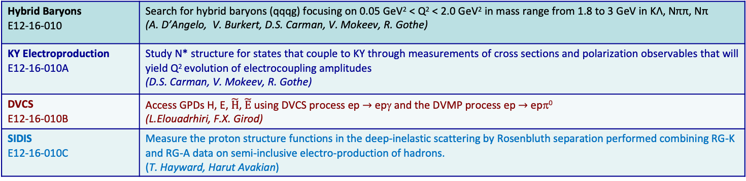
Run Group Proposal (RG K)
“Color Confinement and Strong QCD”
Hybrid Baryons E12-16-010 | Search for hybrid baryons (qqqg) focusing on 0.05 GeV² < Q² < 2.0 GeV² in mass range from 1.8 to 3 GeV in KΛ, Nππ, Nπ (A. D’Angelo, V. Burkert, D.S. Carman, V. Mokeev, R. Gothe)
KY Electroproduction E12-16-010A | Study N* structure for states that couple to KY through measurements of cross sections and polarization observables that will yield Q² evolution of electrocoupling amplitudes (D.S. Carman, V. Mokeev, R. Gothe)
DVCS E12-16-010B | Access GPDs H, E, $\tilde{H}$, $\tilde{E}$ using DVCS process ep $→$ epγ and the DVMP process ep $→$ epπ⁰ (L.Elouadrhiri, F.X. Girod)
SIDIS E12-16-010C | Measure the proton structure functions in the deep-inelastic scattering by Rosenbluth separation performed combining RG-K and RG-A data on semi-inclusive electro-production of hadrons. (T. Hayward, Harut Avakian)
RUN CONDITIONS
Torus Current | 100% (3375 A) - negative out-bending
Solenoid | -100 %
FT | ON @ 7.5 GeV -> OFF @ 6.5 GeV and 8.5 GeV
Beam/Target | Polarized electrons, un-polarized LH₂ target
Luminosity | ~ 5 10 ³⁴ cm⁻²s⁻¹ @ 7.5 GeV ~ 0.87 10 ³⁴ cm⁻²s⁻¹ @ 6.5 GeV 0.87 10 ³⁵ cm⁻²s⁻¹ @ 6.4 GeV 10 ³⁵ cm⁻²s⁻¹@8.5 GeV FULL LUMINOSITY
100 days approved by PAC 44 and confirmed by PAC 48 (Jeopardy)
E_{b} = 6.6 GeV, 50 days – 3 passes
E_{b} = 8.8 GeV, 50 days – 4 passes

Slide 4
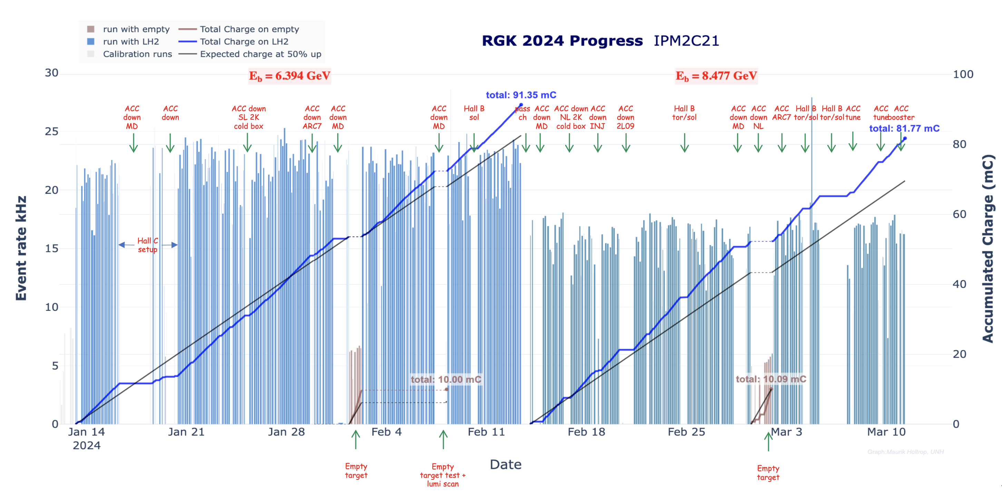
Run Group K - SPRING 2024 Data Taking Overview
January 14 – February 13, 2024 – 33 calendar days
Production @ 3 Passes E_{b}=6.394 GeV
3-passes
E_{e} = 6.39463 GeV
I_{e} = 65 nA
Lum. = 0.87 10³⁵ cm⁻² s⁻¹
Run Range:
19300 – 19659
259 Production Runs
38.3 G prod events
10 Empty tgt runs @ 200 nA
0.41 G ET events (~1% full)
Accumulated
Charge:
Full tgt = 91 mC
Empty tgt = 10 mC
Total = 101 mC
38.3 G events

Slide 5
Run Group K - SPRING 2024 Data Taking Overview
February 13 - March 11, 2024 – 27 calendar days
Production @ 4 Passes E_{b}=8.477 GeV
4-passes
E_{e} = 8.47757 GeV
I_{e} =75 nA
Lum. = 10³⁵ cm⁻² s⁻¹
Run Range:
19660 – 19893
174 Production Runs
21.7 G events
8 Empty tgt runs @ 200 nA
0.32 G ET events (~1.4% full)
Accumulated
Charge:
Full tgt = 81.77 mC
Empty tgt = 10 mC
Total = 91.77 mC
38.3 G events
21.7 G events

Slide 6

Run Group K - SPRING 2024 Data Taking Overview
December 15-19, 2023 – 4 calendar days
Commissioning
January 11 - March 11, 2024 – 60 calendar days
Alignment and Production
30 Assigned PAC days $→$ 37 effective PAC days
Total
433 Production Runs
60 G events
Accumulated
Charge:
Full tgt = 172.77 mC
Empty tgt = 20 mC
Total = 192.77 mC
38.3 G events
21.7 G events

Slide 7
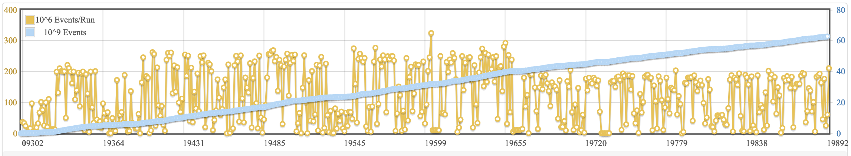
Run Group K - SPRING 2024 Data Production
RUN CONDITIONS
Torus Current | 100% (3375 A) - negative outbending
Solenoid | -100 %
FT | OFF
Beam/Target | Polarized electrons, unpolarized LH₂ target
Target Position | Target center coordinates: x=0 cm; y=0 cm; z=-5 cm
RG-K 2024 EPOCHS
Beam Energy | Beam Current | Tgt | Scope/ Variation | Collected Events
6.4 GeV | 60 nA | LH₂ | Commissioning/RGD | 3.5 G
6.4 GeV | 60 nA | LH₂ | production / RGK | 38.3 G
8.5 GeV | 75 nA | LH₂ | production / RGK | 21.7 G
Events (G) | Data Size (TB)
 | EVIO | Decoded | DST
A total of 63.5 G events have been accumulated
Typical event number/Run 240 M @ 6.4 GeV
200 M @ 8.5 GeV
RG-K 2024 | 63.5 | 1500 | 525 | 105
1.5 PB of EVIO data on tape

Slide 8
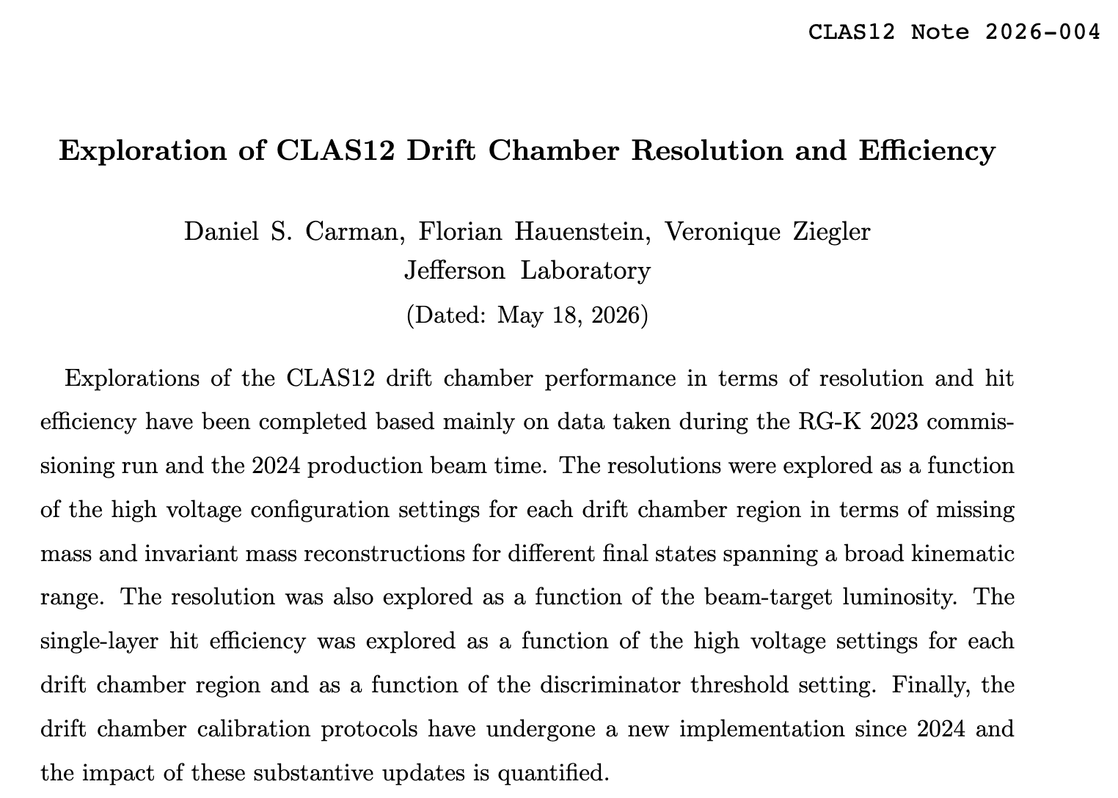
Run Group K - Commissioning and Calibration Runs
December 15-19, 2023
Trigger Studies - Valery Kubarosky
Luminosity Scans
DC HV scans - Florian Hauenstein
Reversed solenoid polarization runs
Service studies useful for all Run Groups
January 11-13, 2024
Warm/cold empty target alignment studies: zero magnetic fields – Raffaella De Vita
DC studies
Empty target runs
Luminosity scans

Slide 9
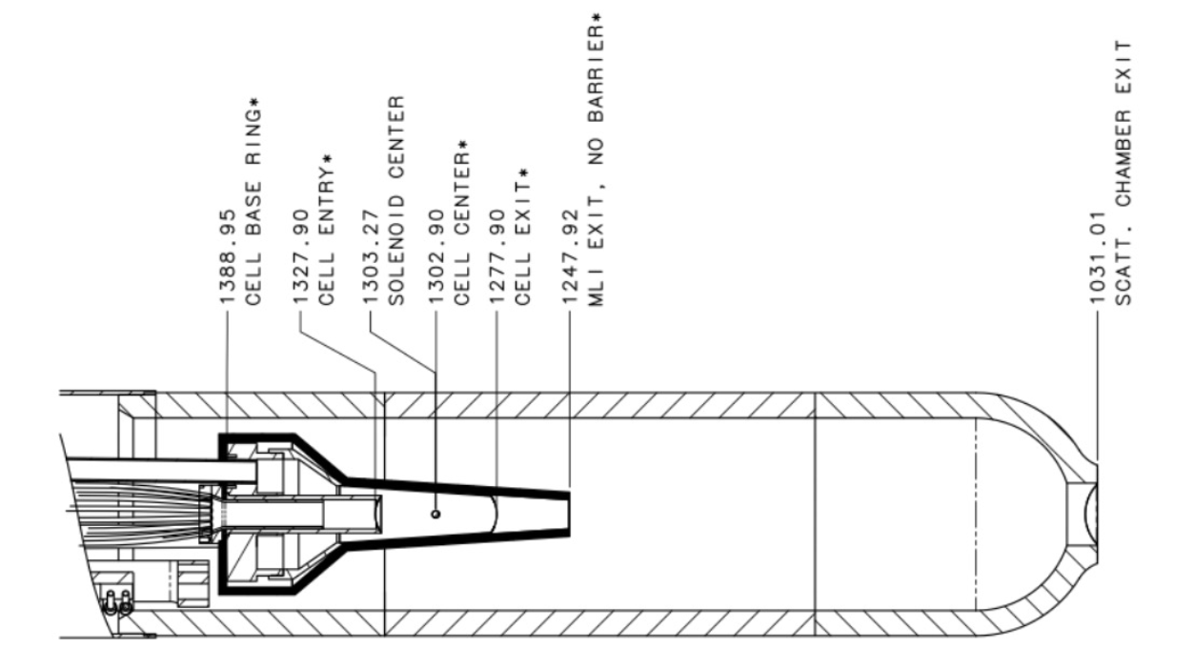
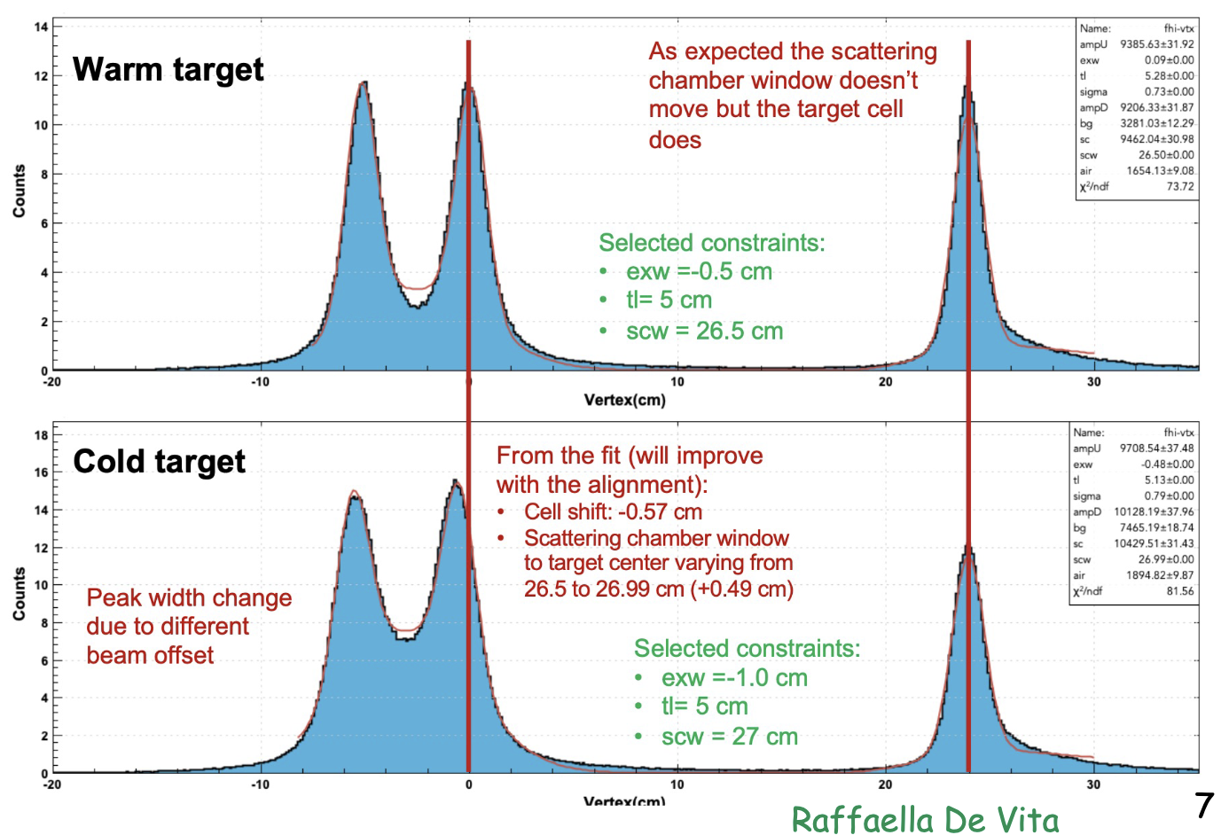
Warm/Cold empty target Alignment
Standard procedure: DC alignment done with empty target (cold) with torus & solenoid @ zero field
• Target “foils”: cryo-target entrance + exit windows, scattering chamber exit window
At start of RG-K run, 1 full day was dedicated to
alignment runs:
• 12 hr with empty/warm target (first time)
• 12 hr with empty/cold target
Alignments have not taken thermal contraction of
cryo-target system into account
FEA computed upstream shift of cell by 5 mm
Data agree with engineering calculation and survey

Slide 10
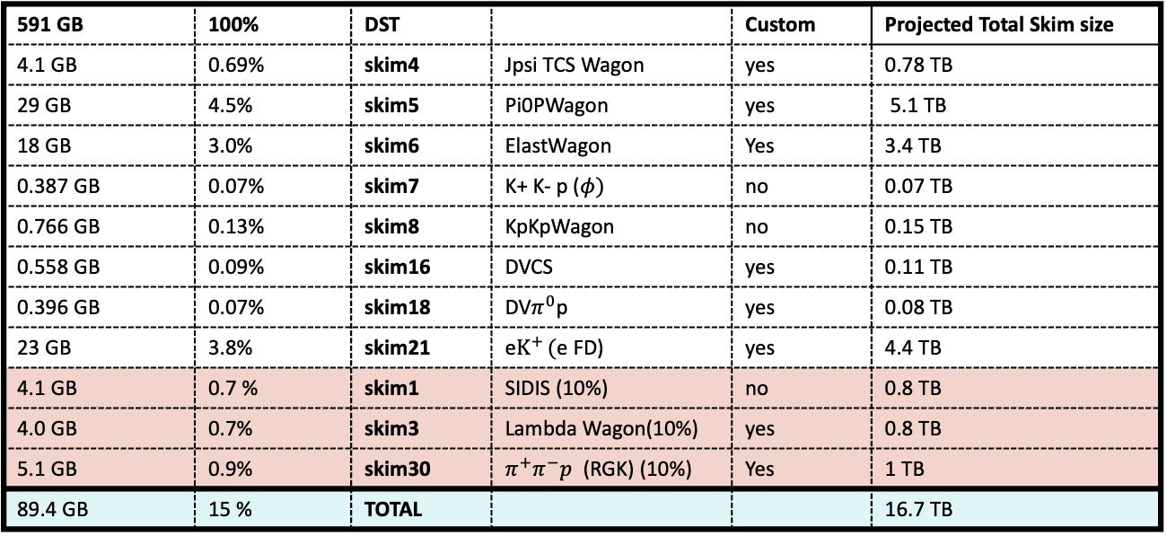
Spring 2024 RG-K trains: total output
3 Passes 6.4 GeV - run 19571. 216 M events (2.73 KB/ev) Total = 114 TB
591 GB | 100% | DST |  | Custom | Projected Total Skim size
4.1 GB | 0.69% | skim4 | Jpsi TCS Wagon | yes | 0.78 TB
29 GB | 4.5% | skim5 | Pi0PWagon | yes | 5.1 TB
18 GB | 3.0% | skim6 | ElastWagon | Yes | 3.4 TB
0.387 GB | 0.07% | skim7 | K+ K- p ($φ)$ | no | 0.07 TB
0.766 GB | 0.13% | skim8 | KpKpWagon | no | 0.15 TB
0.558 GB | 0.09% | skim16 | DVCS | yes | 0.11 TB
0.396 GB | 0.07% | skim18 | DV$π^{0}$p | yes | 0.08 TB
23 GB | 3.8% | skim21 | e$K^{+ }($e FD) | yes | 4.4 TB
4.1 GB | 0.7 % | skim1 | SIDIS (10%) | no | 0.8 TB
4.0 GB | 0.7% | skim3 | Lambda Wagon(10%) | yes | 0.8 TB
5.1 GB | 0.9% | skim30 | $π^{+}π^{−}p$ (RGK) (10%) | Yes | 1 TB
89.4 GB | 15 % | TOTAL |  |  | 16.7 TB
10

Slide 11
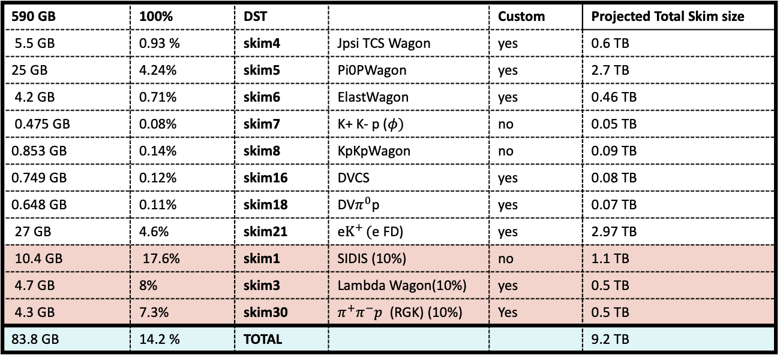
Spring 2024 RG-K trains: total output
4 Passes 8.4 GeV - run 19833 194 M Events. (3 KB/ev) 65 TB
590 GB | 100% | DST |  | Custom | Projected Total Skim size
5.5 GB | 0.93 % | skim4 | Jpsi TCS Wagon | yes | 0.6 TB
25 GB | 4.24% | skim5 | Pi0PWagon | yes | 2.7 TB
4.2 GB | 0.71% | skim6 | ElastWagon | yes | 0.46 TB
0.475 GB | 0.08% | skim7 | K+ K- p ($φ)$ | no | 0.05 TB
0.853 GB | 0.14% | skim8 | KpKpWagon | no | 0.09 TB
0.749 GB | 0.12% | skim16 | DVCS | yes | 0.08 TB
0.648 GB | 0.11% | skim18 | DV$π^{0}$p | yes | 0.07 TB
27 GB | 4.6% | skim21 | e$K^{+ }($e FD) | yes | 2.97 TB
10.4 GB | 17.6% | skim1 | SIDIS (10%) | no | 1.1 TB
4.7 GB | 8% | skim3 | Lambda Wagon(10%) | yes | 0.5 TB
4.3 GB | 7.3% | skim30 | $π^{+}π^{−}p$ (RGK) (10%) | Yes | 0.5 TB
83.8 GB | 14.2 % | TOTAL |  |  | 9.2 TB
11

Slide 12
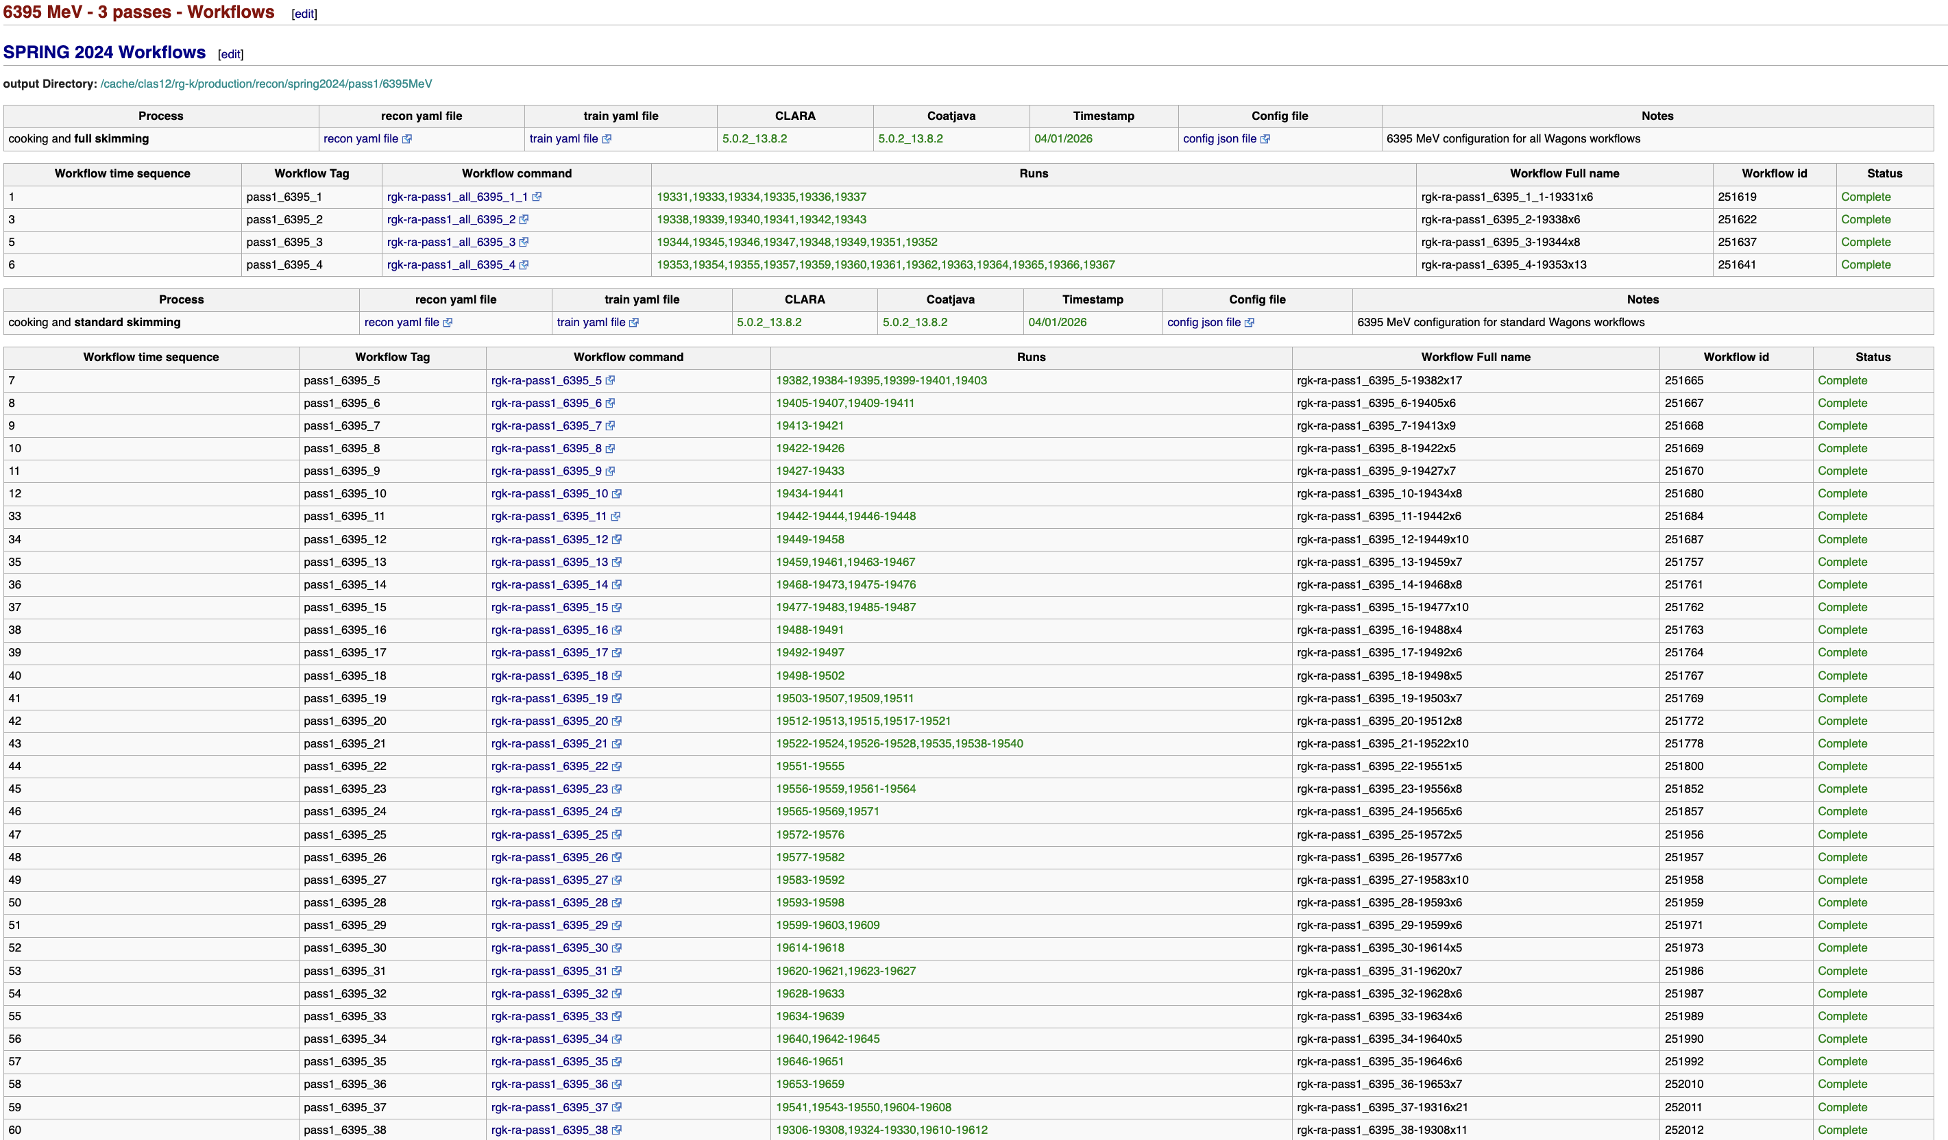
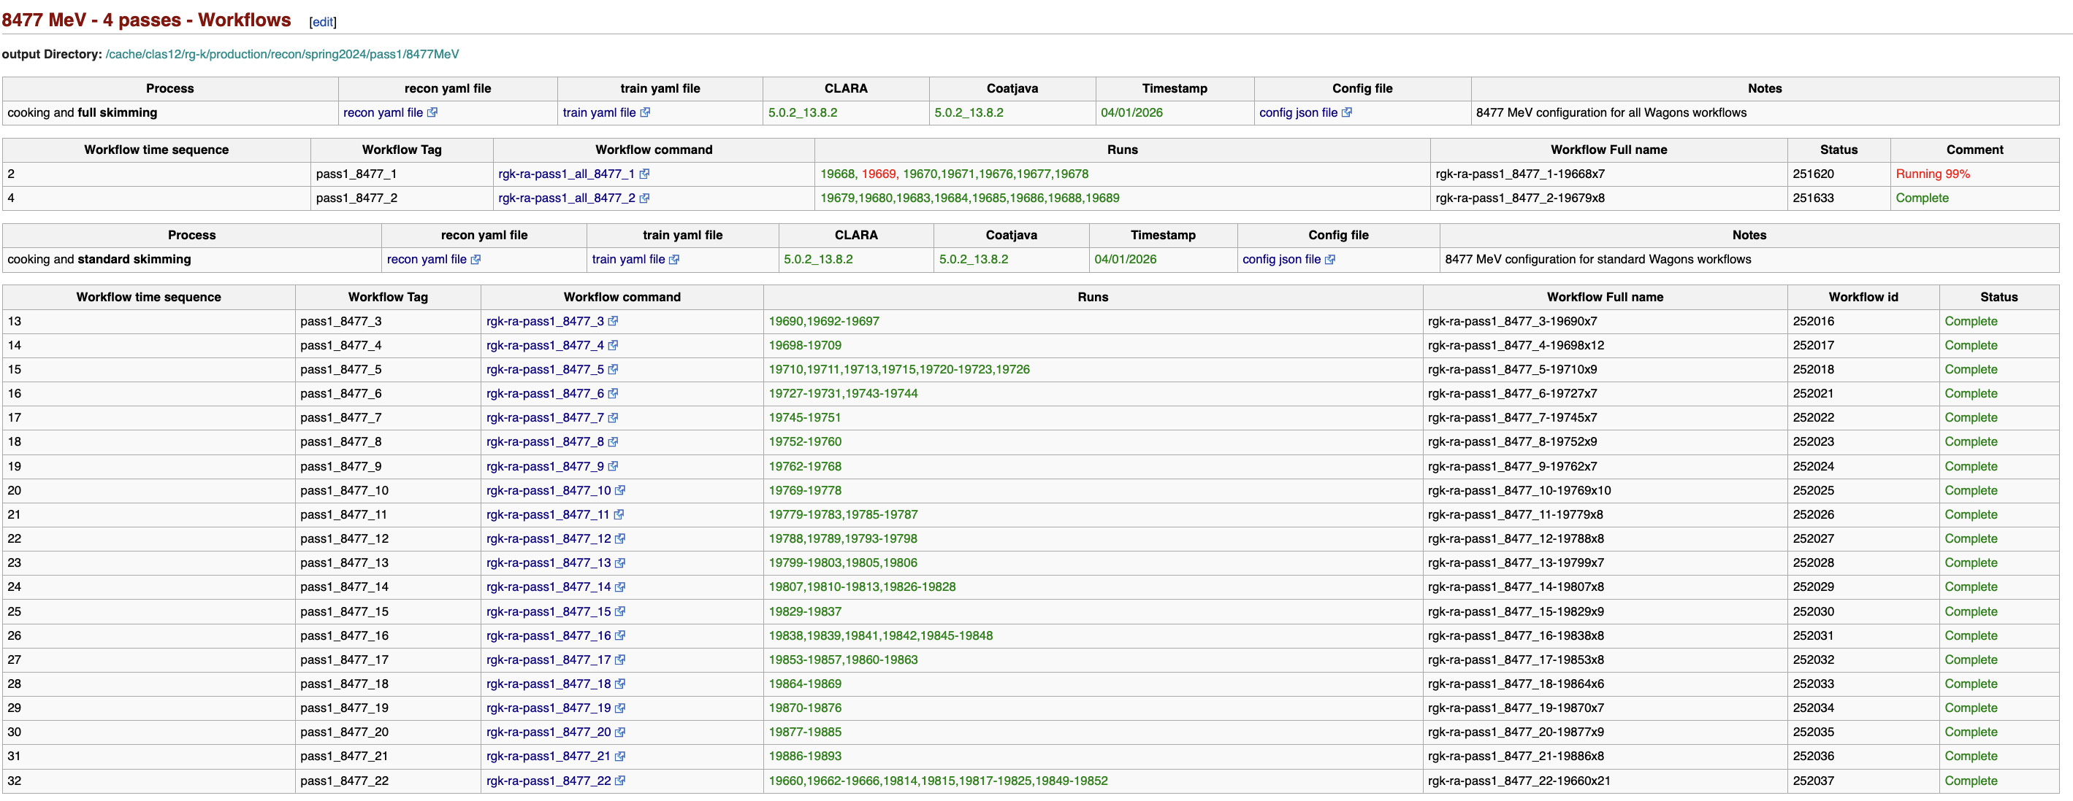
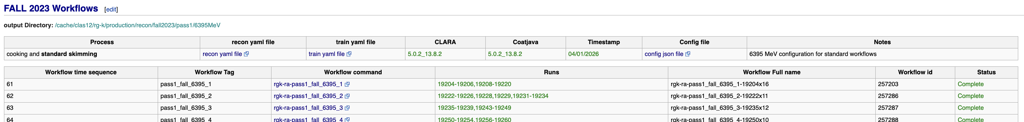
Spring 2024 RG-K Data Processing
Data processing started on April 1st ,2026
Ended on June 7th – (9.5 weeks)
Is 100% completed
With the exception of 1 file
12

Slide 13
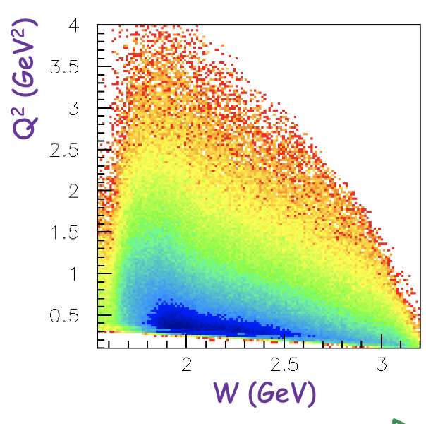
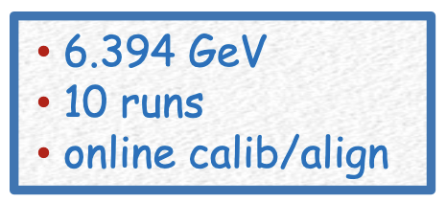
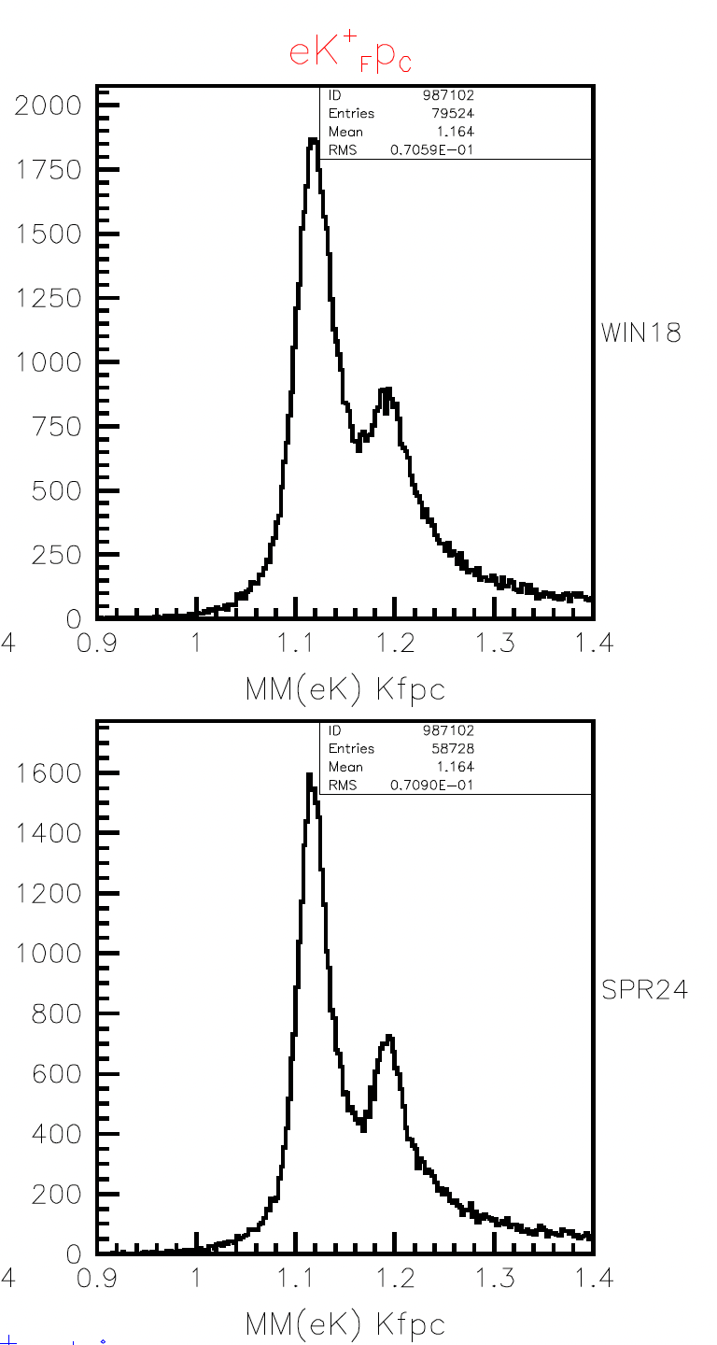
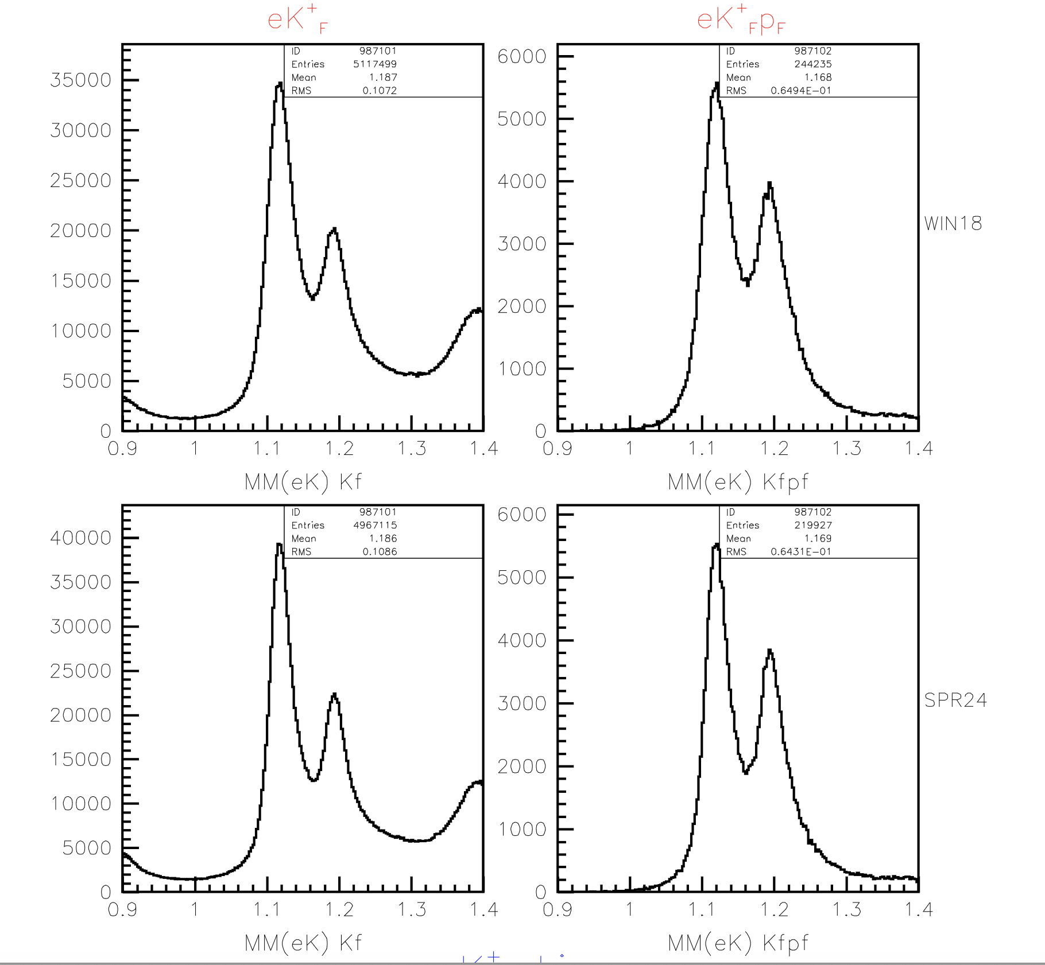
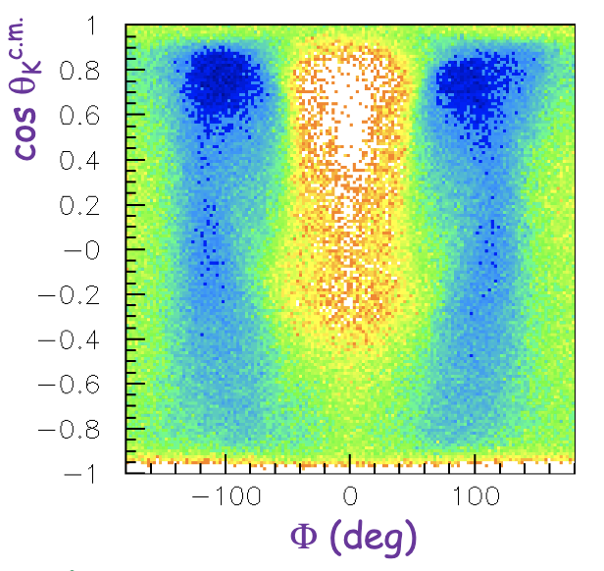
RG-K Production – KY Data analysis
Forward k⁺
forward k⁺ forward p
forward k⁺ central p
Fall 2018
Fall 2018
Fall 2018
Spring 2024
Spring 2024
Spring 2024
By: Daniel Carman
Resolution is improved with higher DC HV settings

Slide 14
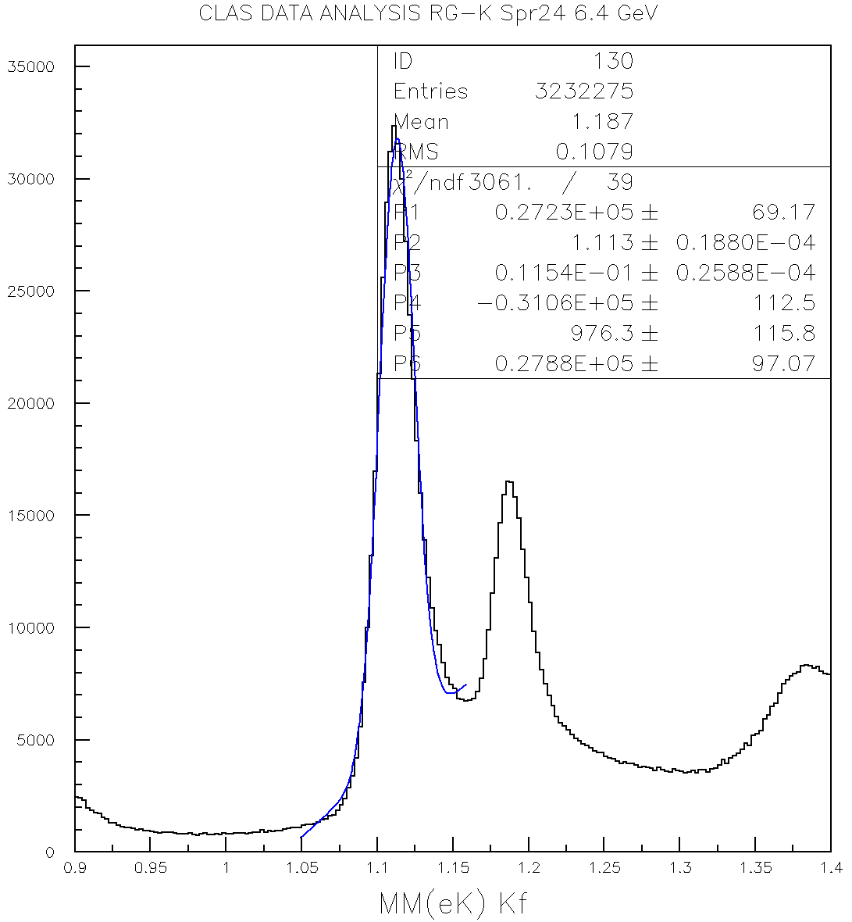
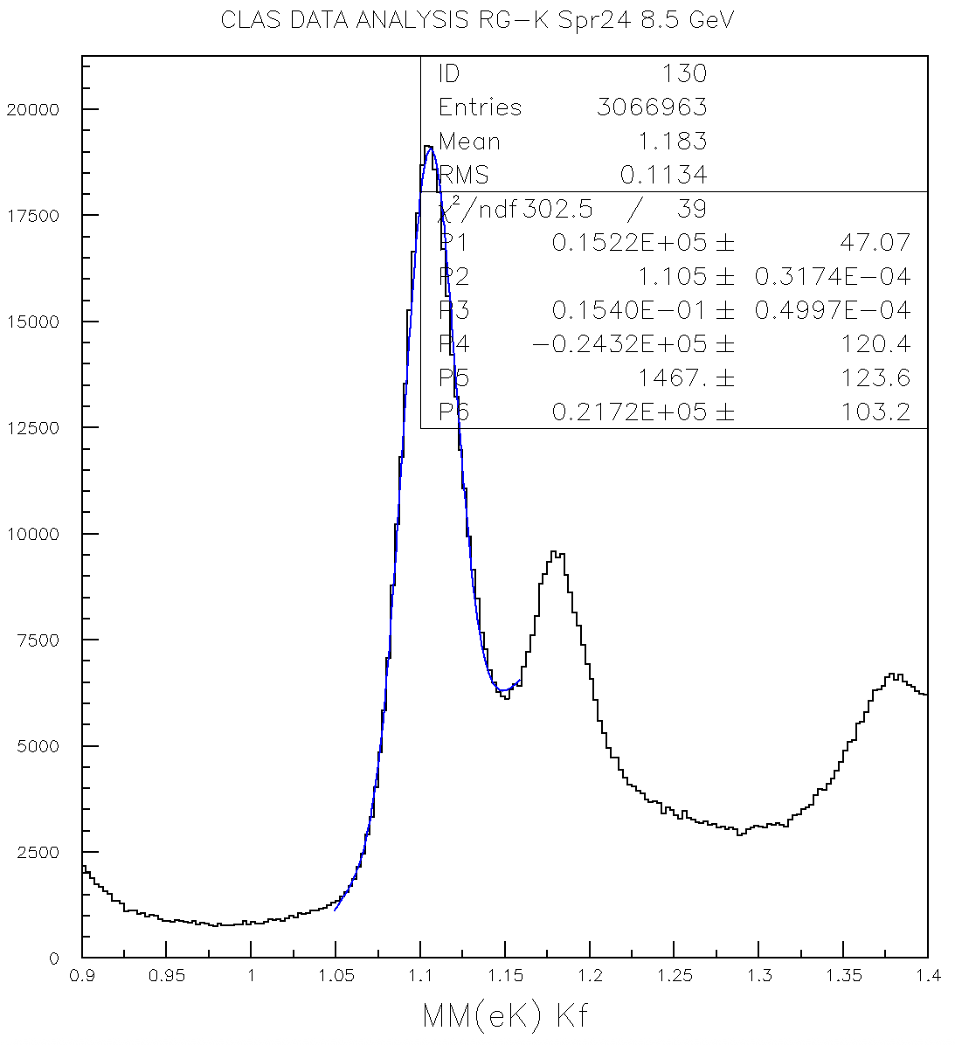
RG-K Spr24 KY Validation Studies
By: Daniel Carman
6.4 GeV
8.5 GeV
11.5 MeV
15.4 MeV

Slide 15
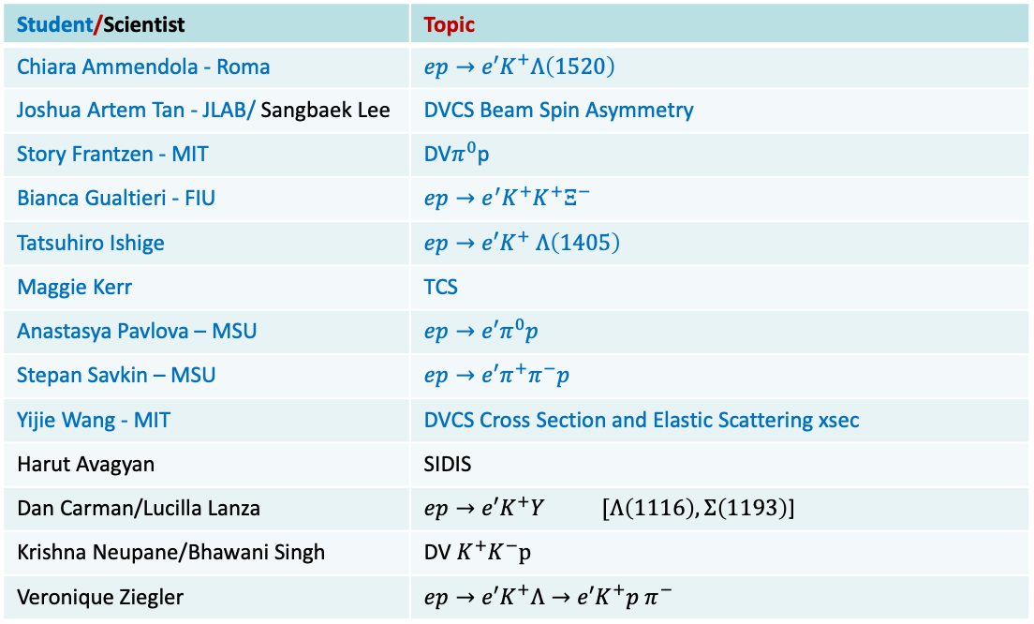
Run Group K On-going analyses
Student/Scientist | Topic
Chiara Ammendola - Roma | $${ep→e′K}^{+}Λ\left(1520\right)$$
Joshua Artem Tan - JLAB/ Sangbaek Lee | DVCS Beam Spin Asymmetry
Story Frantzen - MIT | DV$π^{0}$p
Bianca Gualtieri - FIU | $${ep→e^{′}K}^{+}K^{+}Ξ^{−}$$
Tatsuhiro Ishige | $${ep→e′K}^{+} Λ\left(1405\right)$$
Maggie Kerr | TCS
Anastasya Pavlova – MSU | $${ep→e′π}^{0}p$$
Stepan Savkin – MSU | $${ep→e′π}^{+}π^{−}p$$
Yijie Wang - MIT | DVCS Cross Section and Elastic Scattering xsec
Harut Avagyan | SIDIS
Dan Carman/Lucilla Lanza | ${ep→e′K}^{+}Y [Λ\left(1116\right), Σ\left(1193\right)$]
Krishna Neupane/Bhawani Singh | DV $K^{+}K^{−}p$
Veronique Ziegler | $${ep→e′K}^{+}Λ→e′K^{+}p π^{−}$$
Tuesday Talks
Most analyses profit from the availability of data at 3, 4 and 5 passes combining RGK and RGA data

Slide 16
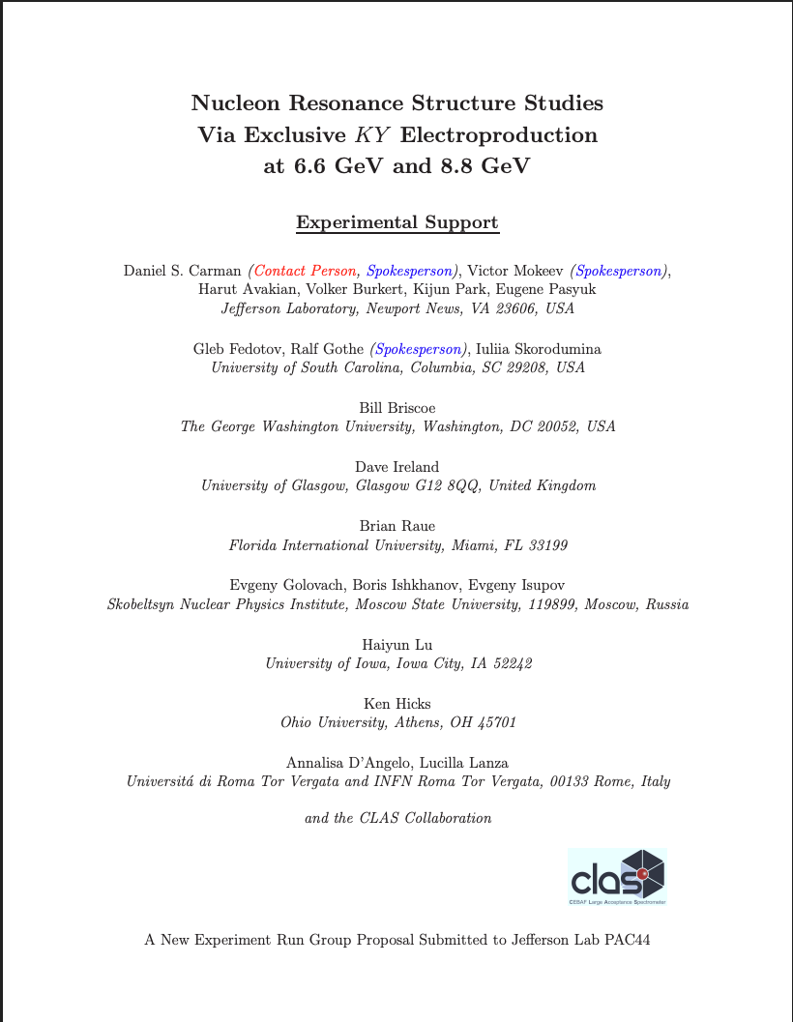
KY Electroproduction Studies with CLAS12 – RG-K Dataset
By Dan Carman
Proposal to PAC44, July 2016
# | Run | E_{b} (GeV) | Trig. (M)
1 | RG-K Win18 | 6.535 | 7.8G
2 |  | 7.546 | 7.8G
3 | RG-K Spr24 | 6.394 | 38.3G
4 |  | 8.478 | 21.7G
5 | RG-K 2027 | 6.6 | TBD
6 |  | 8.8 | TBD
current focus
RG-K Win18 data analysis:
D.S. Carman et al. (CLAS Collaboration), "Recoil Polarization in K⁺Y Electroproduction in the Nucleon Resonance Region with CLAS12", PRC 112, 035206 (2025).
D.S. Carman et al. (CLAS Collaboration), "Beam-Recoil Transferred Polarization in K⁺Y Electroproduction in the Nucleon Resonance Region with CLAS12", PRC 105, 065201 (2022).
Program goal:
Study spectrum and structure of N* states for comparison to πN and ππN channels

Slide 17

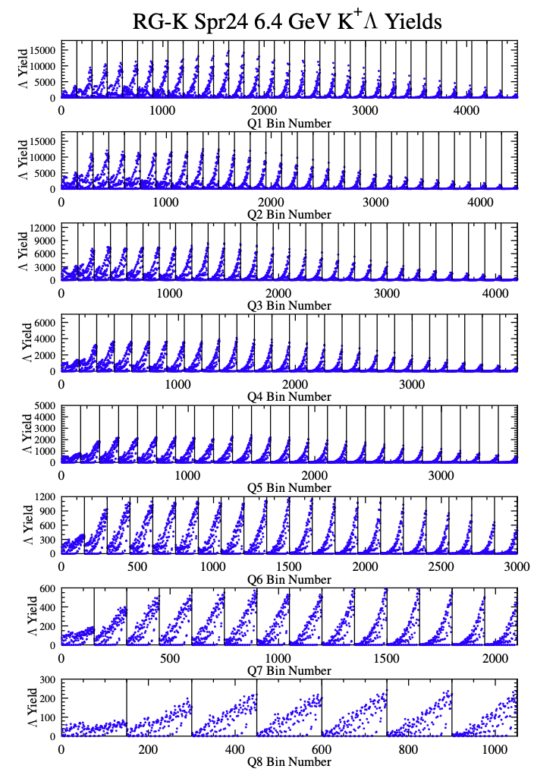
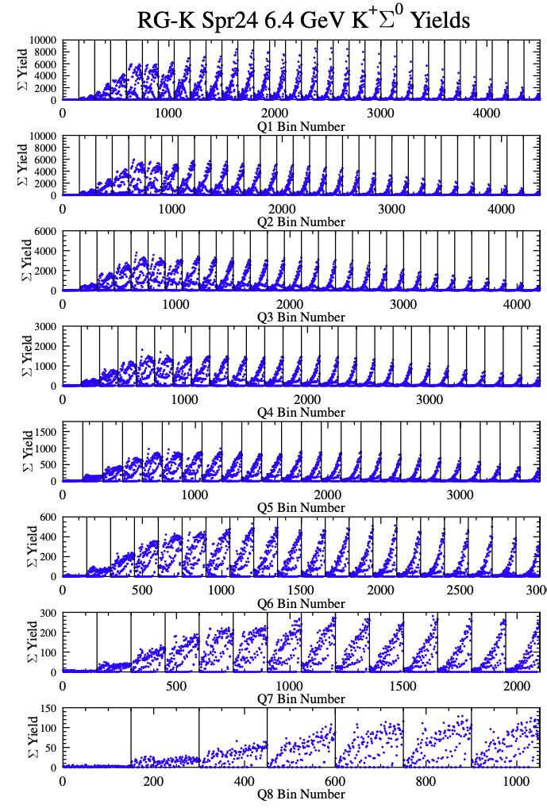
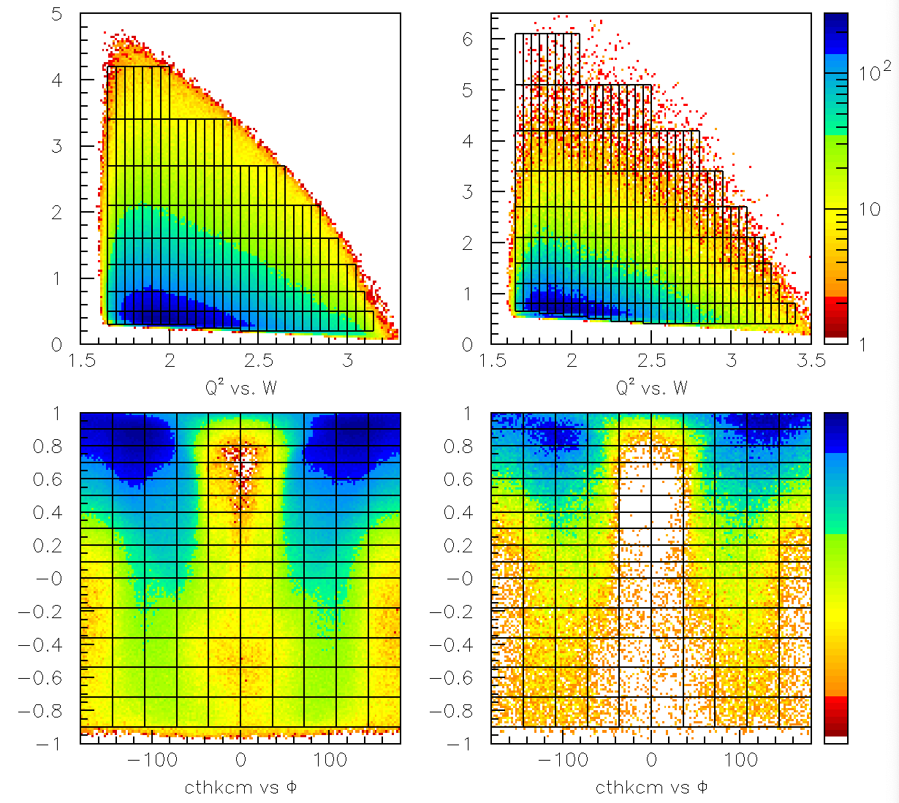
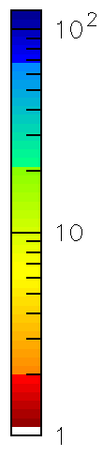
RG-K KY Binning and Yields – 6.4 GeV
By Dan Carman
Spr24 datasets allow fine binning in the relevant kinematic variables:
Q², W, cos θ_{K}^{c.m.}, Φ

Slide 18
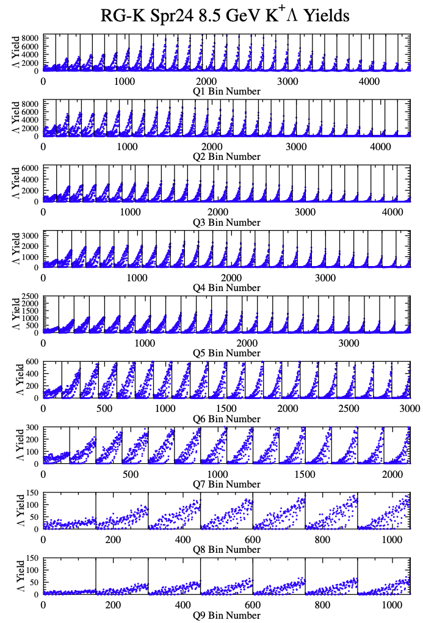
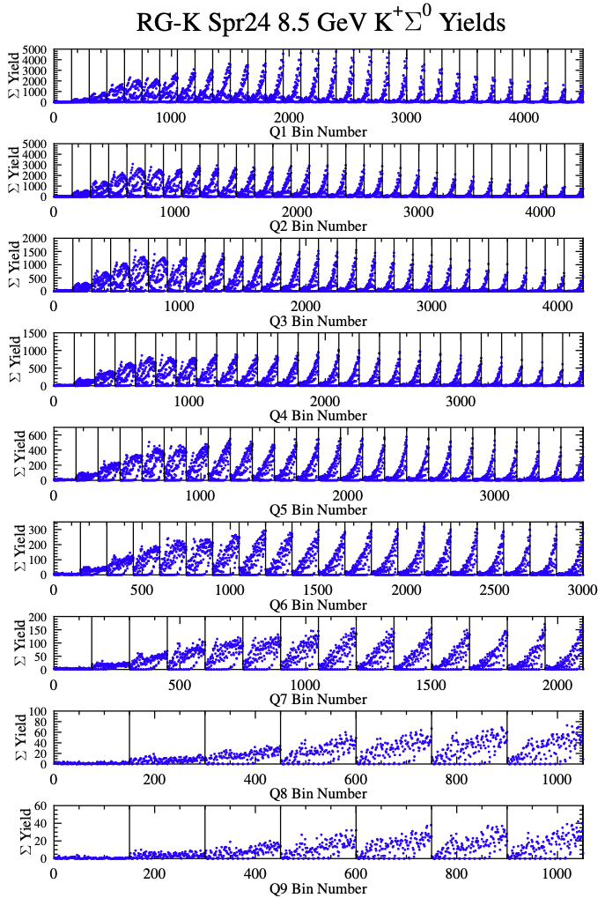
RG-K KY Binning and Yields – 8.5 GeV
By Dan Carman
Spr24 datasets allow fine binning in the relevant kinematic variables:
Q², W, cos θ_{K}^{c.m.}, Φ

Slide 19

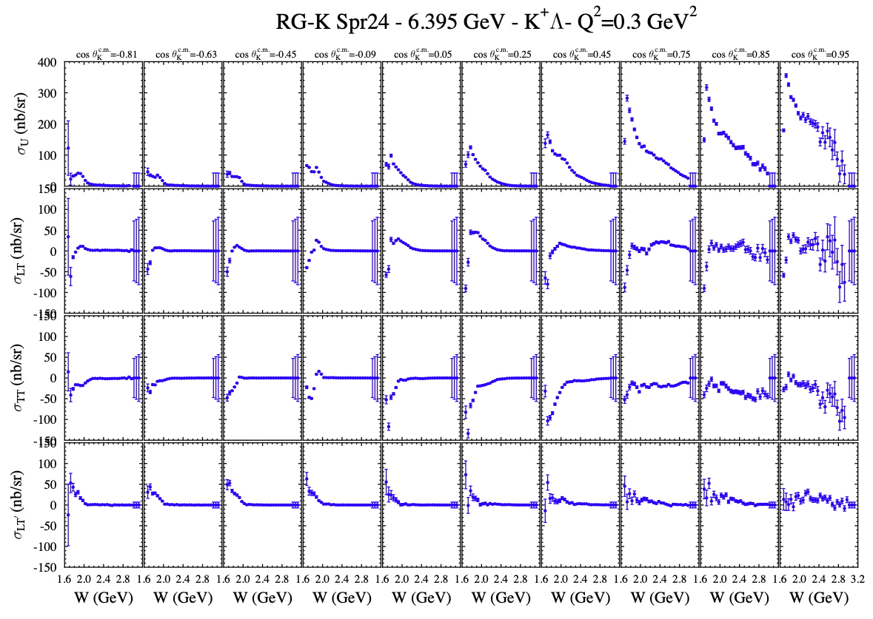
By Dan Carman
K⁺Λ Structure Functions

Slide 20
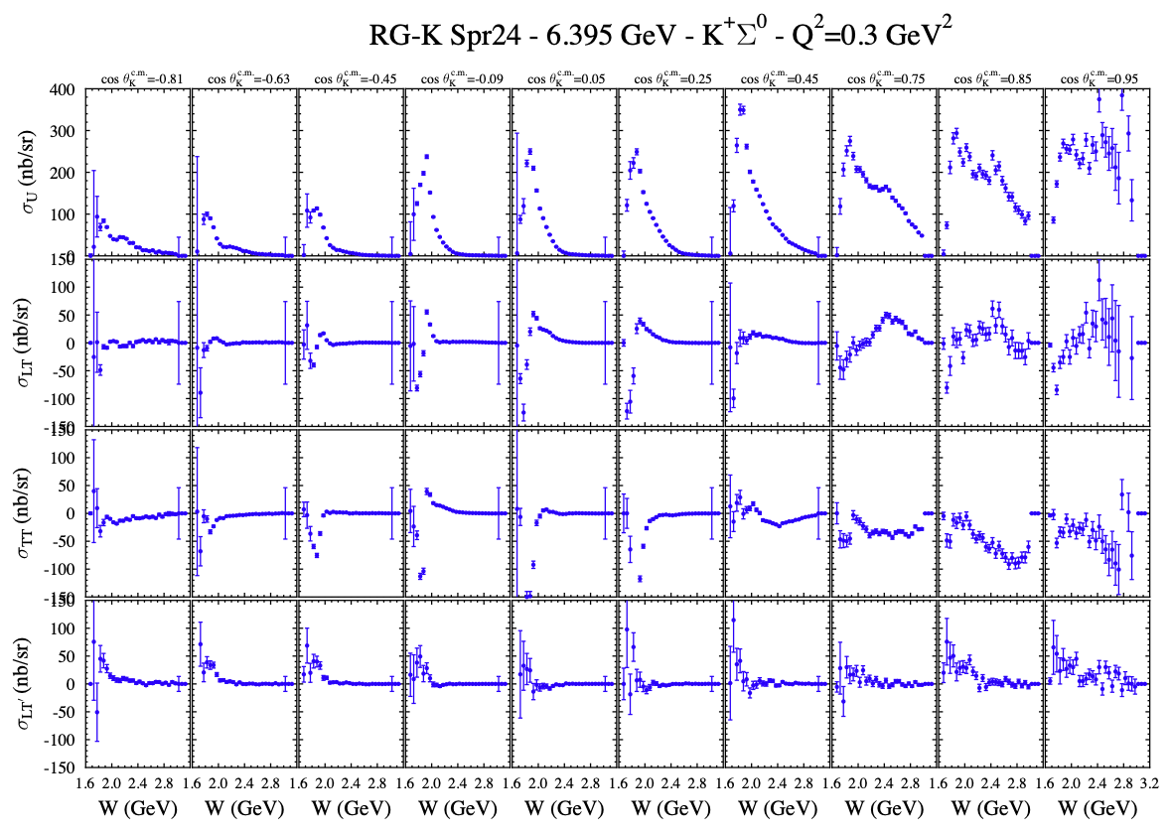
K⁺Σ⁰ Structure Functions
By Dan Carman

Slide 21
By Dan Carman
Summary of KY on-going analysis
Recent work has focused on developing the cross section extraction code/scripts. A preliminary extraction of the K⁺Λ and K⁺Σ⁰ differential cross sections and separated structure functions has been completed for the 6.395 GeV and 8.478 GeV RG-K Spr24 datasets
  Two topologies have been combined: e’K⁺_{F} and e’K⁺_{C}p_{F}
  Note that the proton requirement is necessary in the e’K⁺_{C} topology due to the overwhelming background
From the differential cross sections, a Φ moment analysis was carried out to extract σ_{U} = σ_{T} + εσ_{L}, σ_{LT}, and σ_{TT}
All of this is great for initial data validation but much work ahead:
Yield fitting has not been attempted
Radiative correction model (EXCLURAD) now being integrated into event generator
Event selection and analysis cuts have not been optimized
Momentum corrections have not been developed
Still a long way to go, but a promising start for RG-K Spr24 KY analysis …

Slide 22
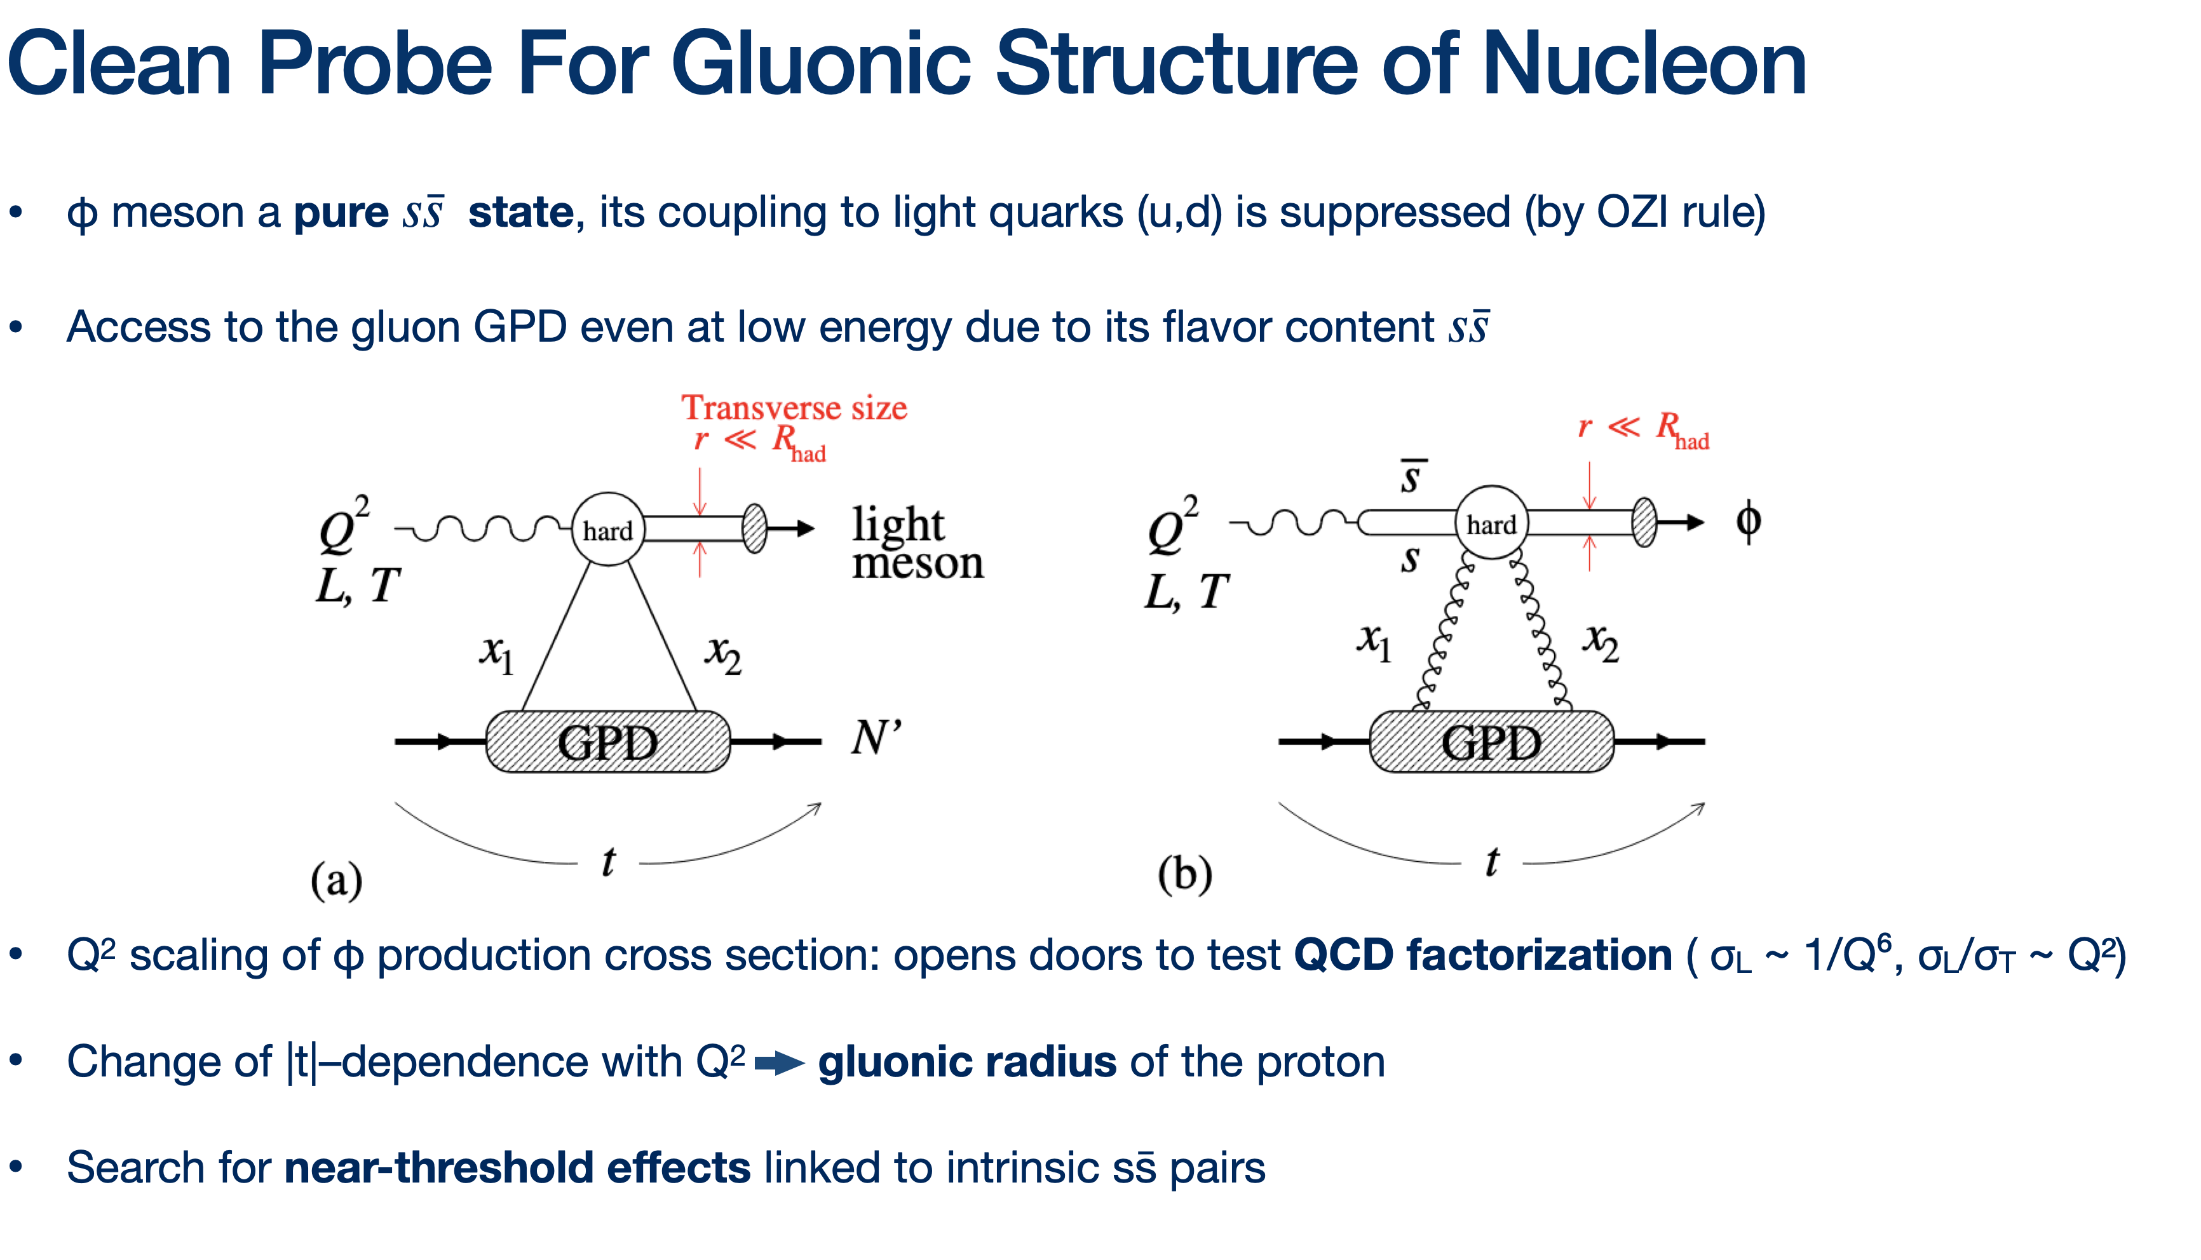
Exclusive ϕ electroproduction
By Bhawani Singh

Slide 23
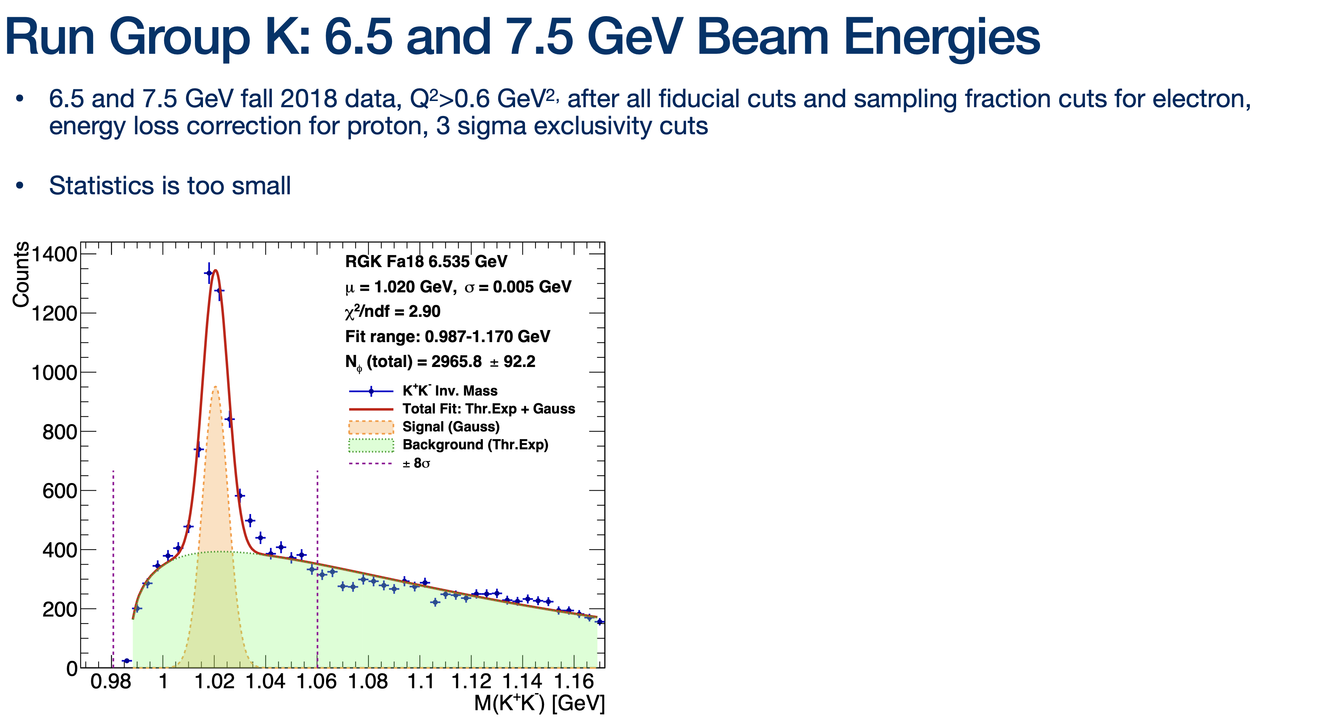
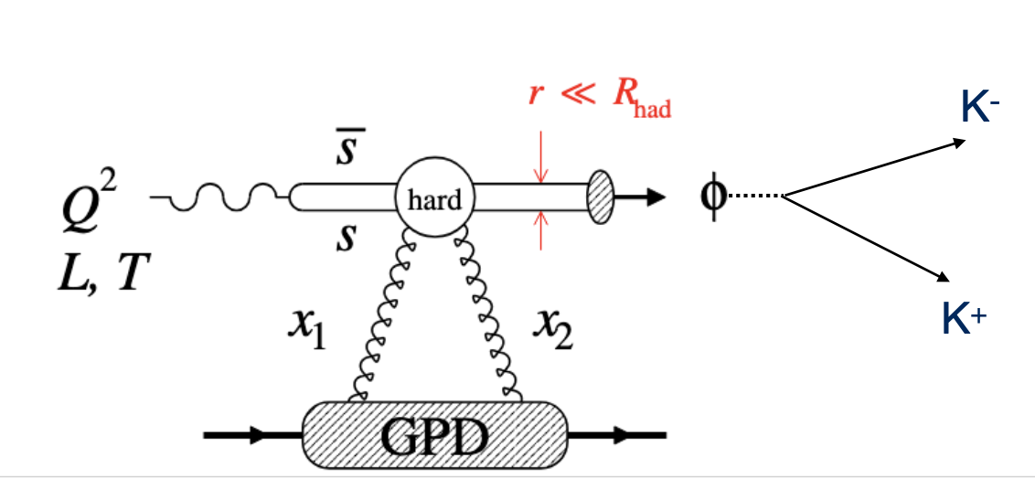
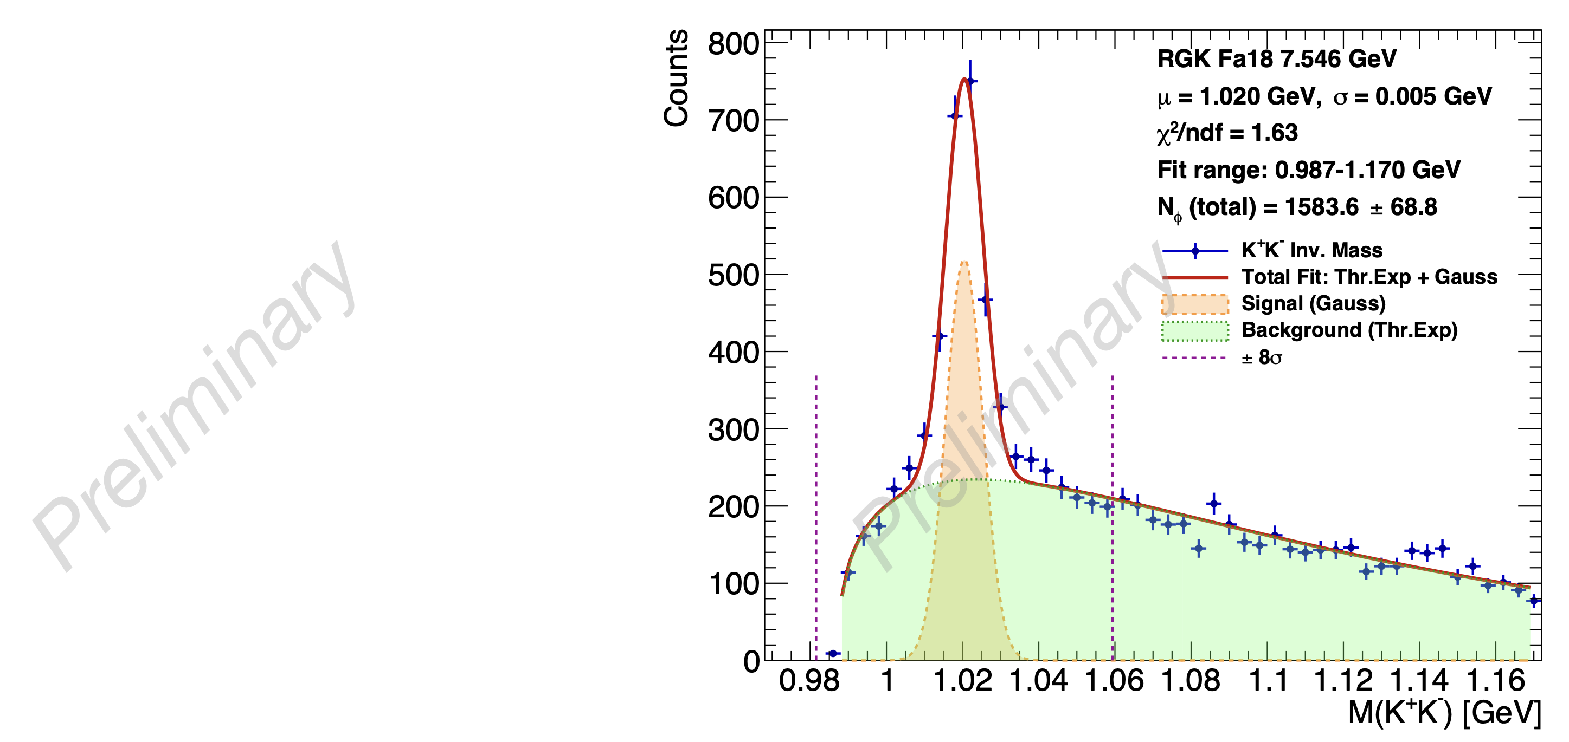
Exclusive ϕ electroproduction
By Bhawani Singh

Slide 24
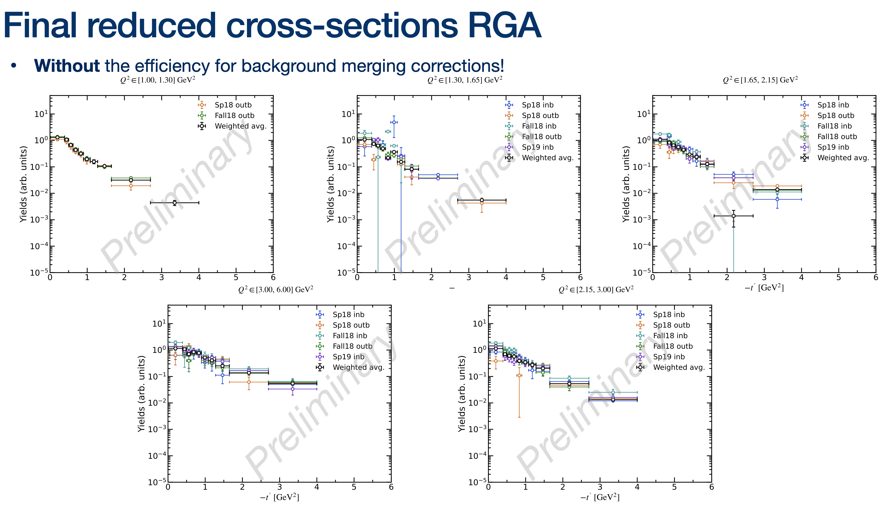
Exclusive ϕ electroproduction
By Bhawani Singh

Slide 25
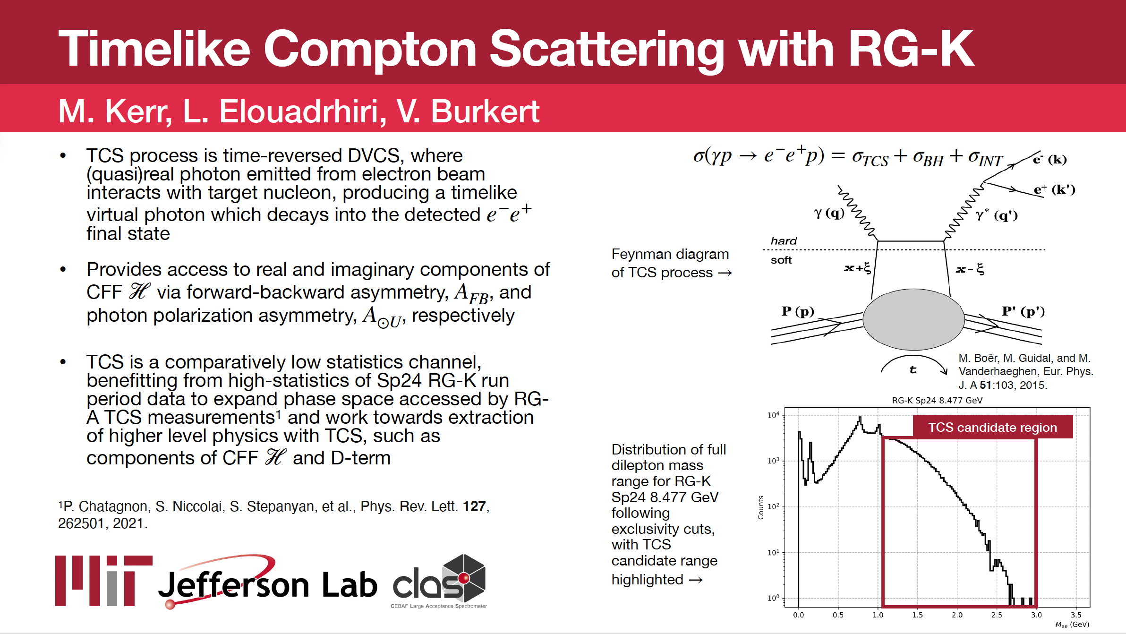

Slide 26
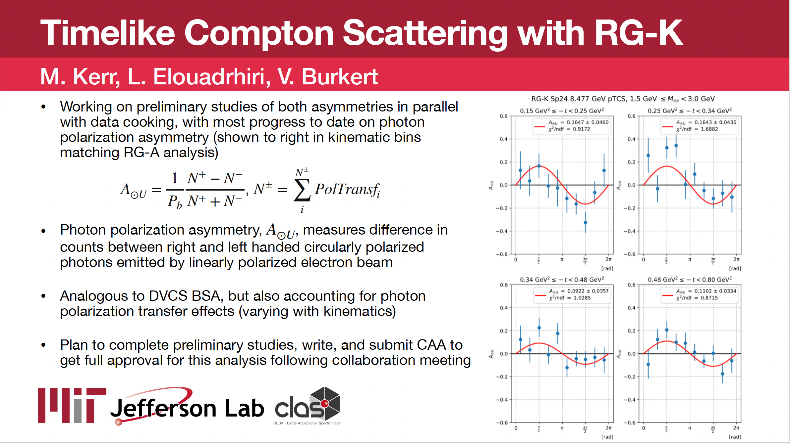

Slide 28
Conclusions
Run group K has successfully collected 50 % of the data at 3 and 4 passes
Full luminosity has been reached at 8.5 GeV with FT - OFF
Fall 2023 and Spring 2024 Pass1 and Train skimming is complete.
Data quality is improved compared with Fall2018 dataset.
Data analysis on several channels, in addition to the flagship proposals, is on-going.

Slide 29
Thank you

Slide 30
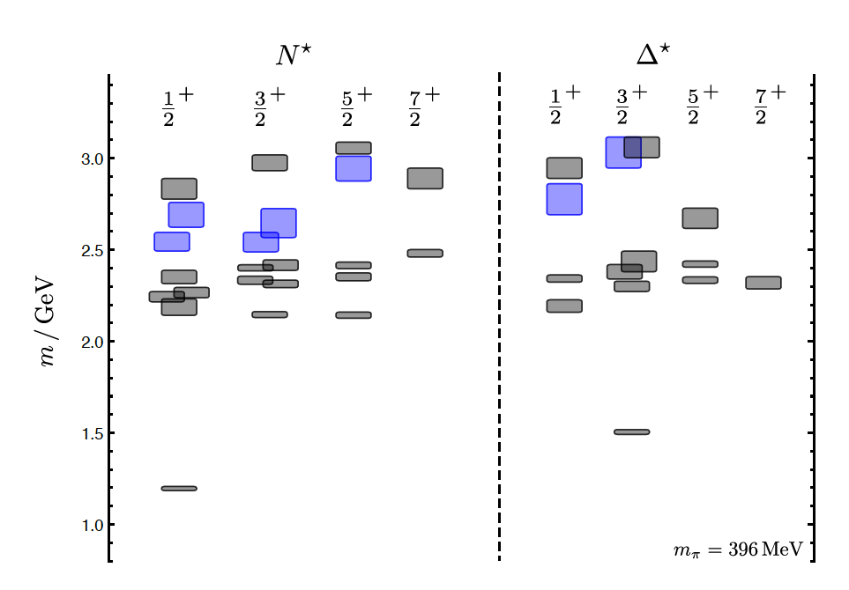
Hybrid Baryons in LQCD
J.J. Dudek and R.G. Edwards, PRD85, 054016 (2012)
LQCD
clustered
in mass
regular states
hybrid states
1.3GeV
The nucleon mass is shifted ~300 MeV to higher masses
N
Hybrid states have same J^{P} values as qqq baryons. How to identify them?
Overpopulation of N 1/2⁺ and N 3/2⁺ states compared to QM projections. ?
A_{1/2} (A_{3/2}) and S_{1/2} show different Q² evolution. Can we do it?

Slide 31
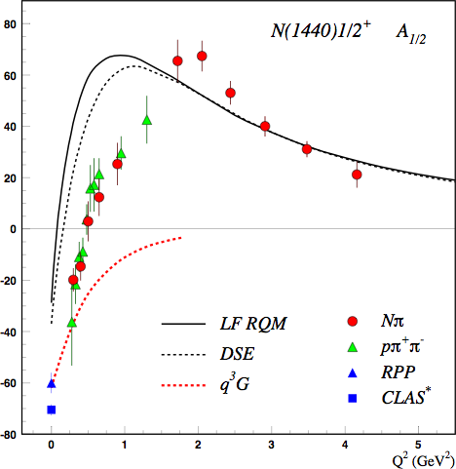
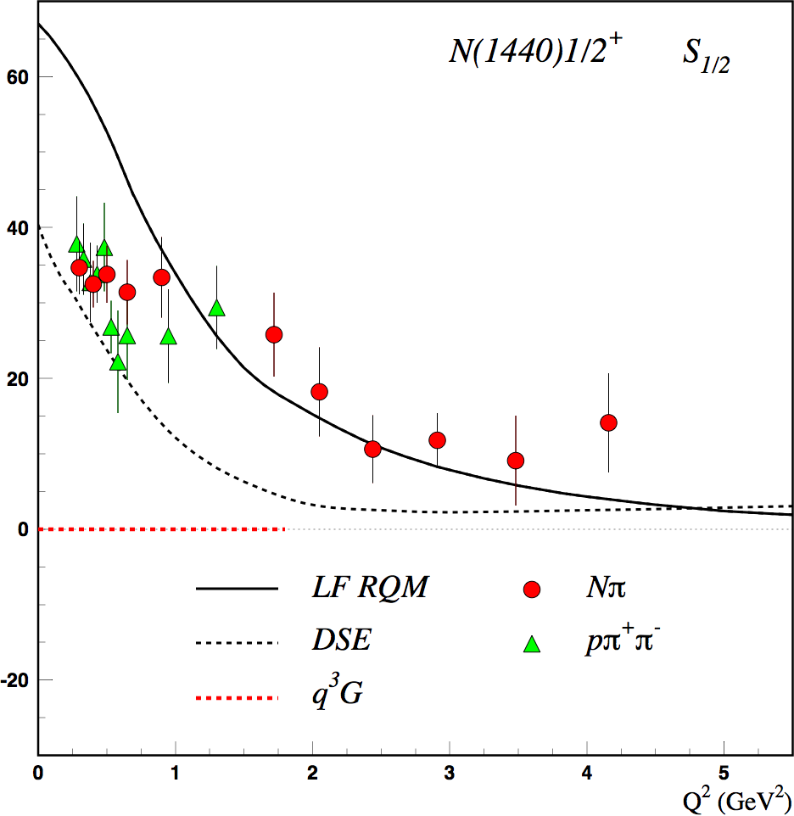
Separating q³g from q³ States?
Precise CLAS results on electrocouplings clarified nature of the Roper
q³
q³
q³g
q³g
q³
A_{1/2} and S_{1/2} amplitudes at high Q² indicate 1st radial q³ excitation
Significant meson-baryon coupling at small Q²
For hybrid “Roper”, A_{1/2}(Q²) drops off faster with Q² and S_{1/2}(Q²) ~ 0.

Slide 32
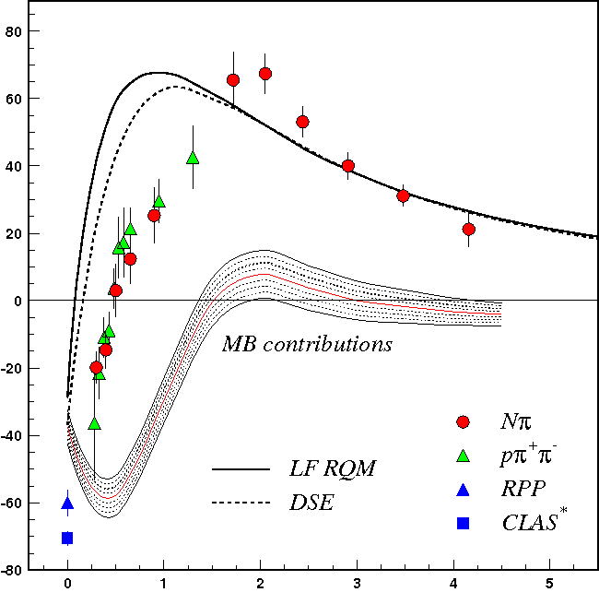
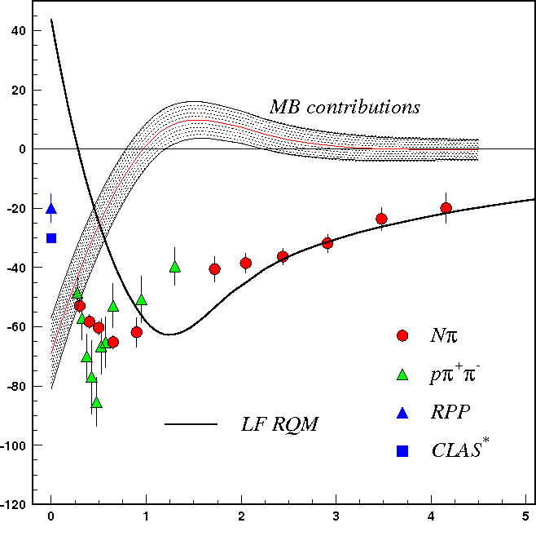
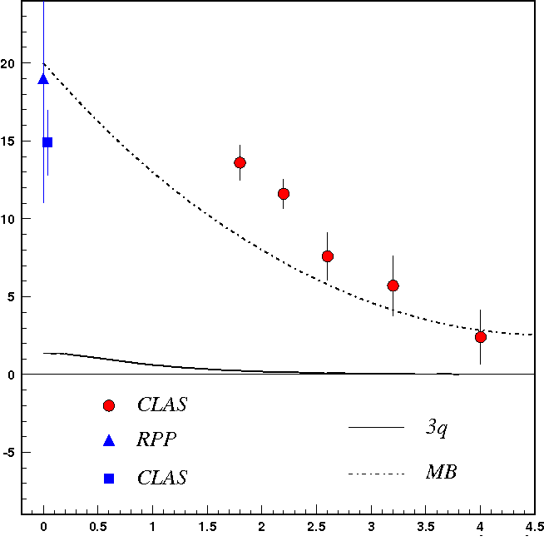
Q² Evolution of N* Electrocouplings
A_{1/2}
N(1440)1/2⁺
A_{1/2}
N(1520)3/2⁻
A_{1/2}
N(1675)5/2⁻
Q² (GeV²)
Q² (GeV²)
Q² (GeV²)
Electrocouplings reveal different interplay between meson cloud and quark core:
  Important to study different N* states vs. distance scale
Good agreement of the extracted N* electrocouplings from Nπ and Nππ:
Compelling evidence for the reliability of the results
Channels have very different mechanisms for the non-resonant background
Data from the KY channels is critical to provide an independent extraction of the electrocoupling amplitudes for the higher-lying N* states

Slide 33
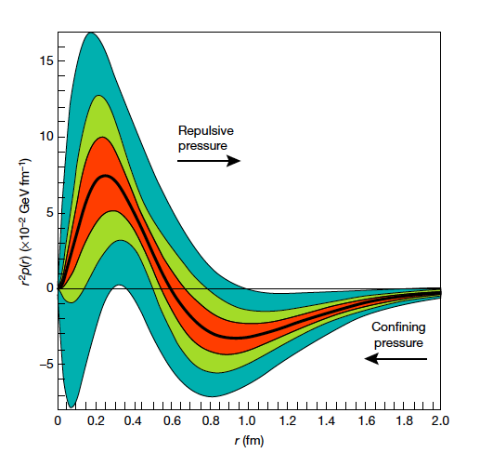

Accessing the Forces & Pressure on Quarks
Nucleon matrix element of EMT contains:
M₂(t) : Mass distribution inside the nucleon
J (t) : Angular momentum distribution
d₁(t) : Shear forces and pressure distribution
Separate M₂(t) and d₁(t) through measurements at small/large ξ.
V. D. Burkert, L. Elouadrhiri & F. X. Girod
Nature, 557 396-399 (2018)
Measuring these form factors, we learn about confinement forces.
Notes:
The nucleon matrix element of the energy-momentum tensor is known to contain 3 form factors. They describe ….. and can only be measured directly in elastic graviton-nucleon scattering. However, these form factors appear as moments of the unpolarized GPDs as shown here. The quark angular momentum in the nucleon is given by the 2nd moment of the sum of GPD H and E. The mass and pressure distribution of the quarks are given by the 2nd moment of H where the pressure is probed by parameter xi.

Slide 34
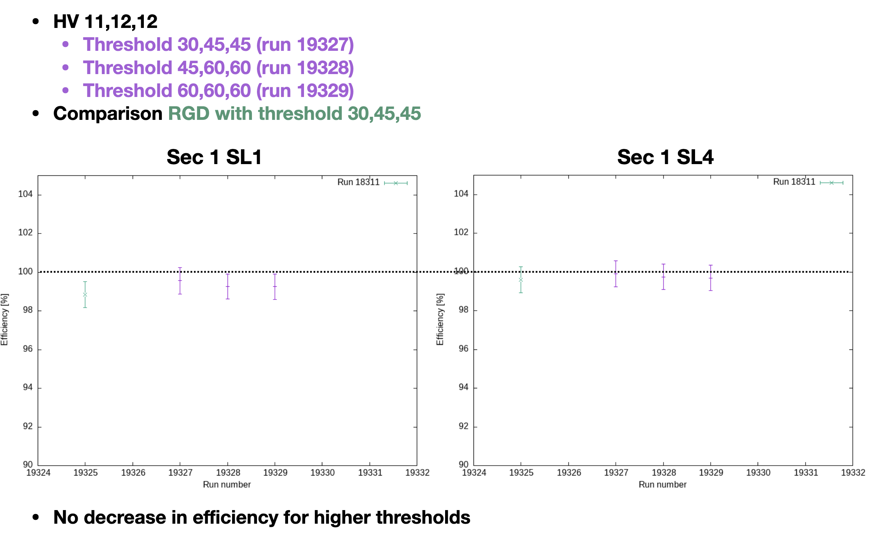
DC HV Scans
R1 DC HV setting | R2 DC HV setting | R3 DC HV setting | Current
10 | 11 | 11 | 40 nA
11 | 12 | 12 | 40 nA
9 | 10 | 10 | 40 nA
10 | 10 | 10 | 40 nA
10 | 10 | 11 | 40 nA
10 | 10 | 11 | 40 nA
10 | 12 | 11 | 40 nA
10 | 11 | 10 | 40 nA
10 | 11 | 12 | 40 nA
12 | 13 | 13 | 40 nA
11 | 11 | 11 | 40 nA
10 | 12 | 10 | 40 nA
(11, 12, 12) – SPRING 2024 – 3-passes configuration
By Florian Hauenstein
(10, 12, 11) – SPRING 2024 – 4-passes configuration
(9, 10, 10) – FALL 2018 configuration

Slide 35
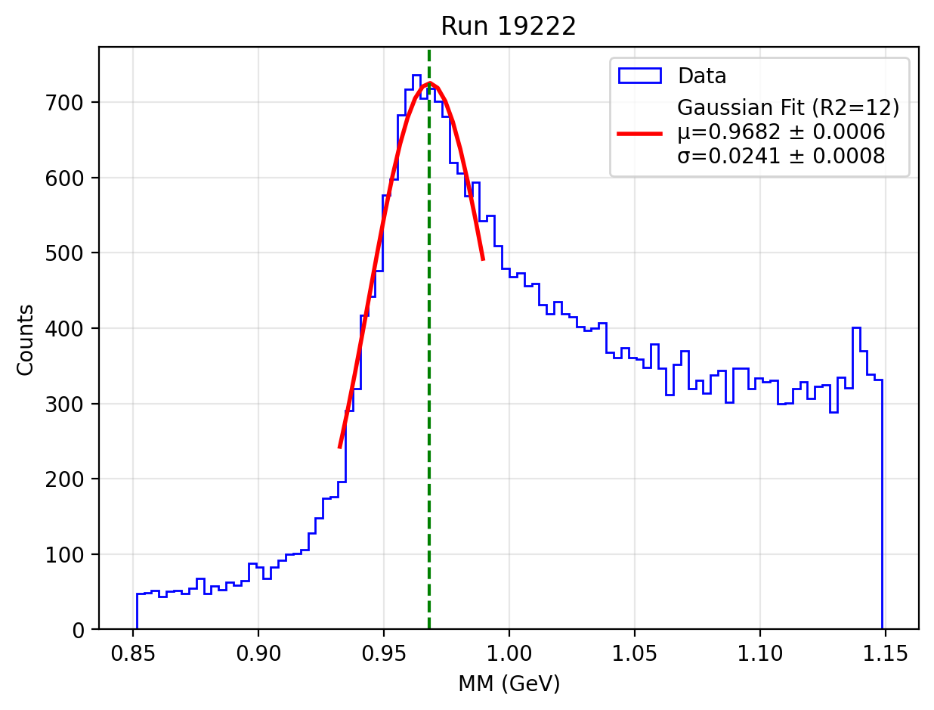
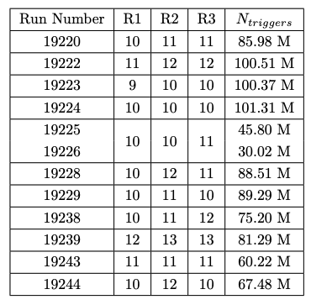
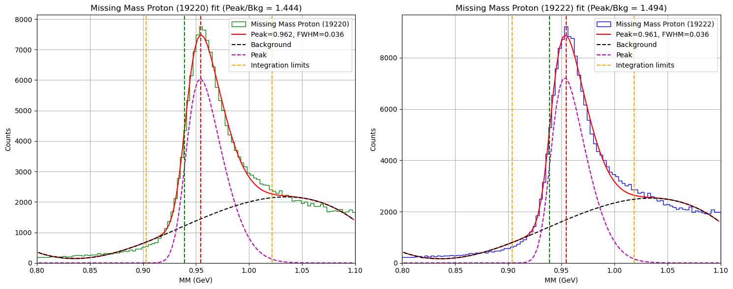
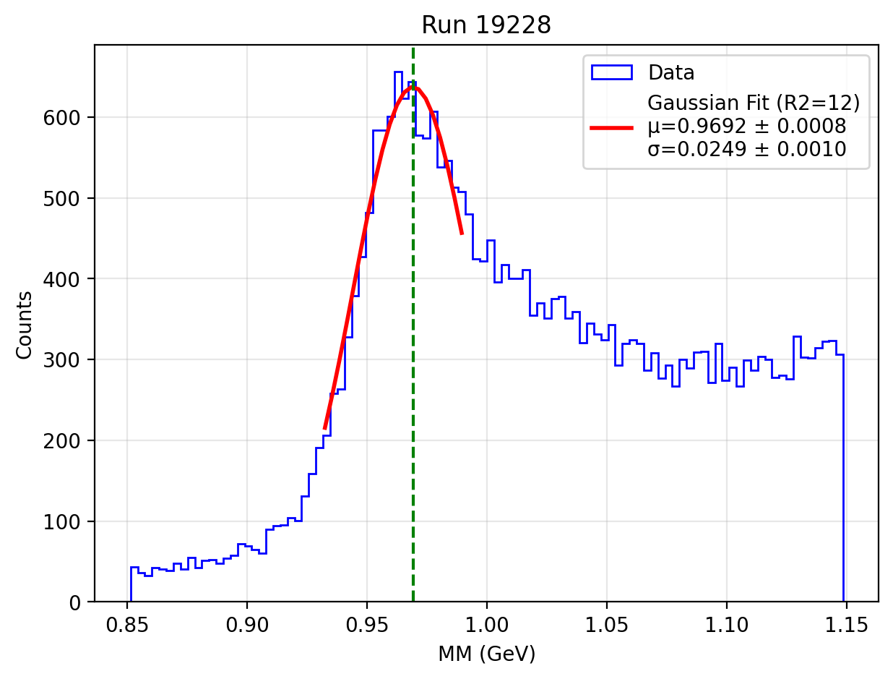

DC HV Scans
(11, 12, 12) – SPRING 2024 – 3-passes configuration
ep$→epπ^{+}π^{−}$
By Krishna Neupane
Proton missing mass
(10, 12, 11) – SPRING 2024 – 4-passes configuration

Slide 36
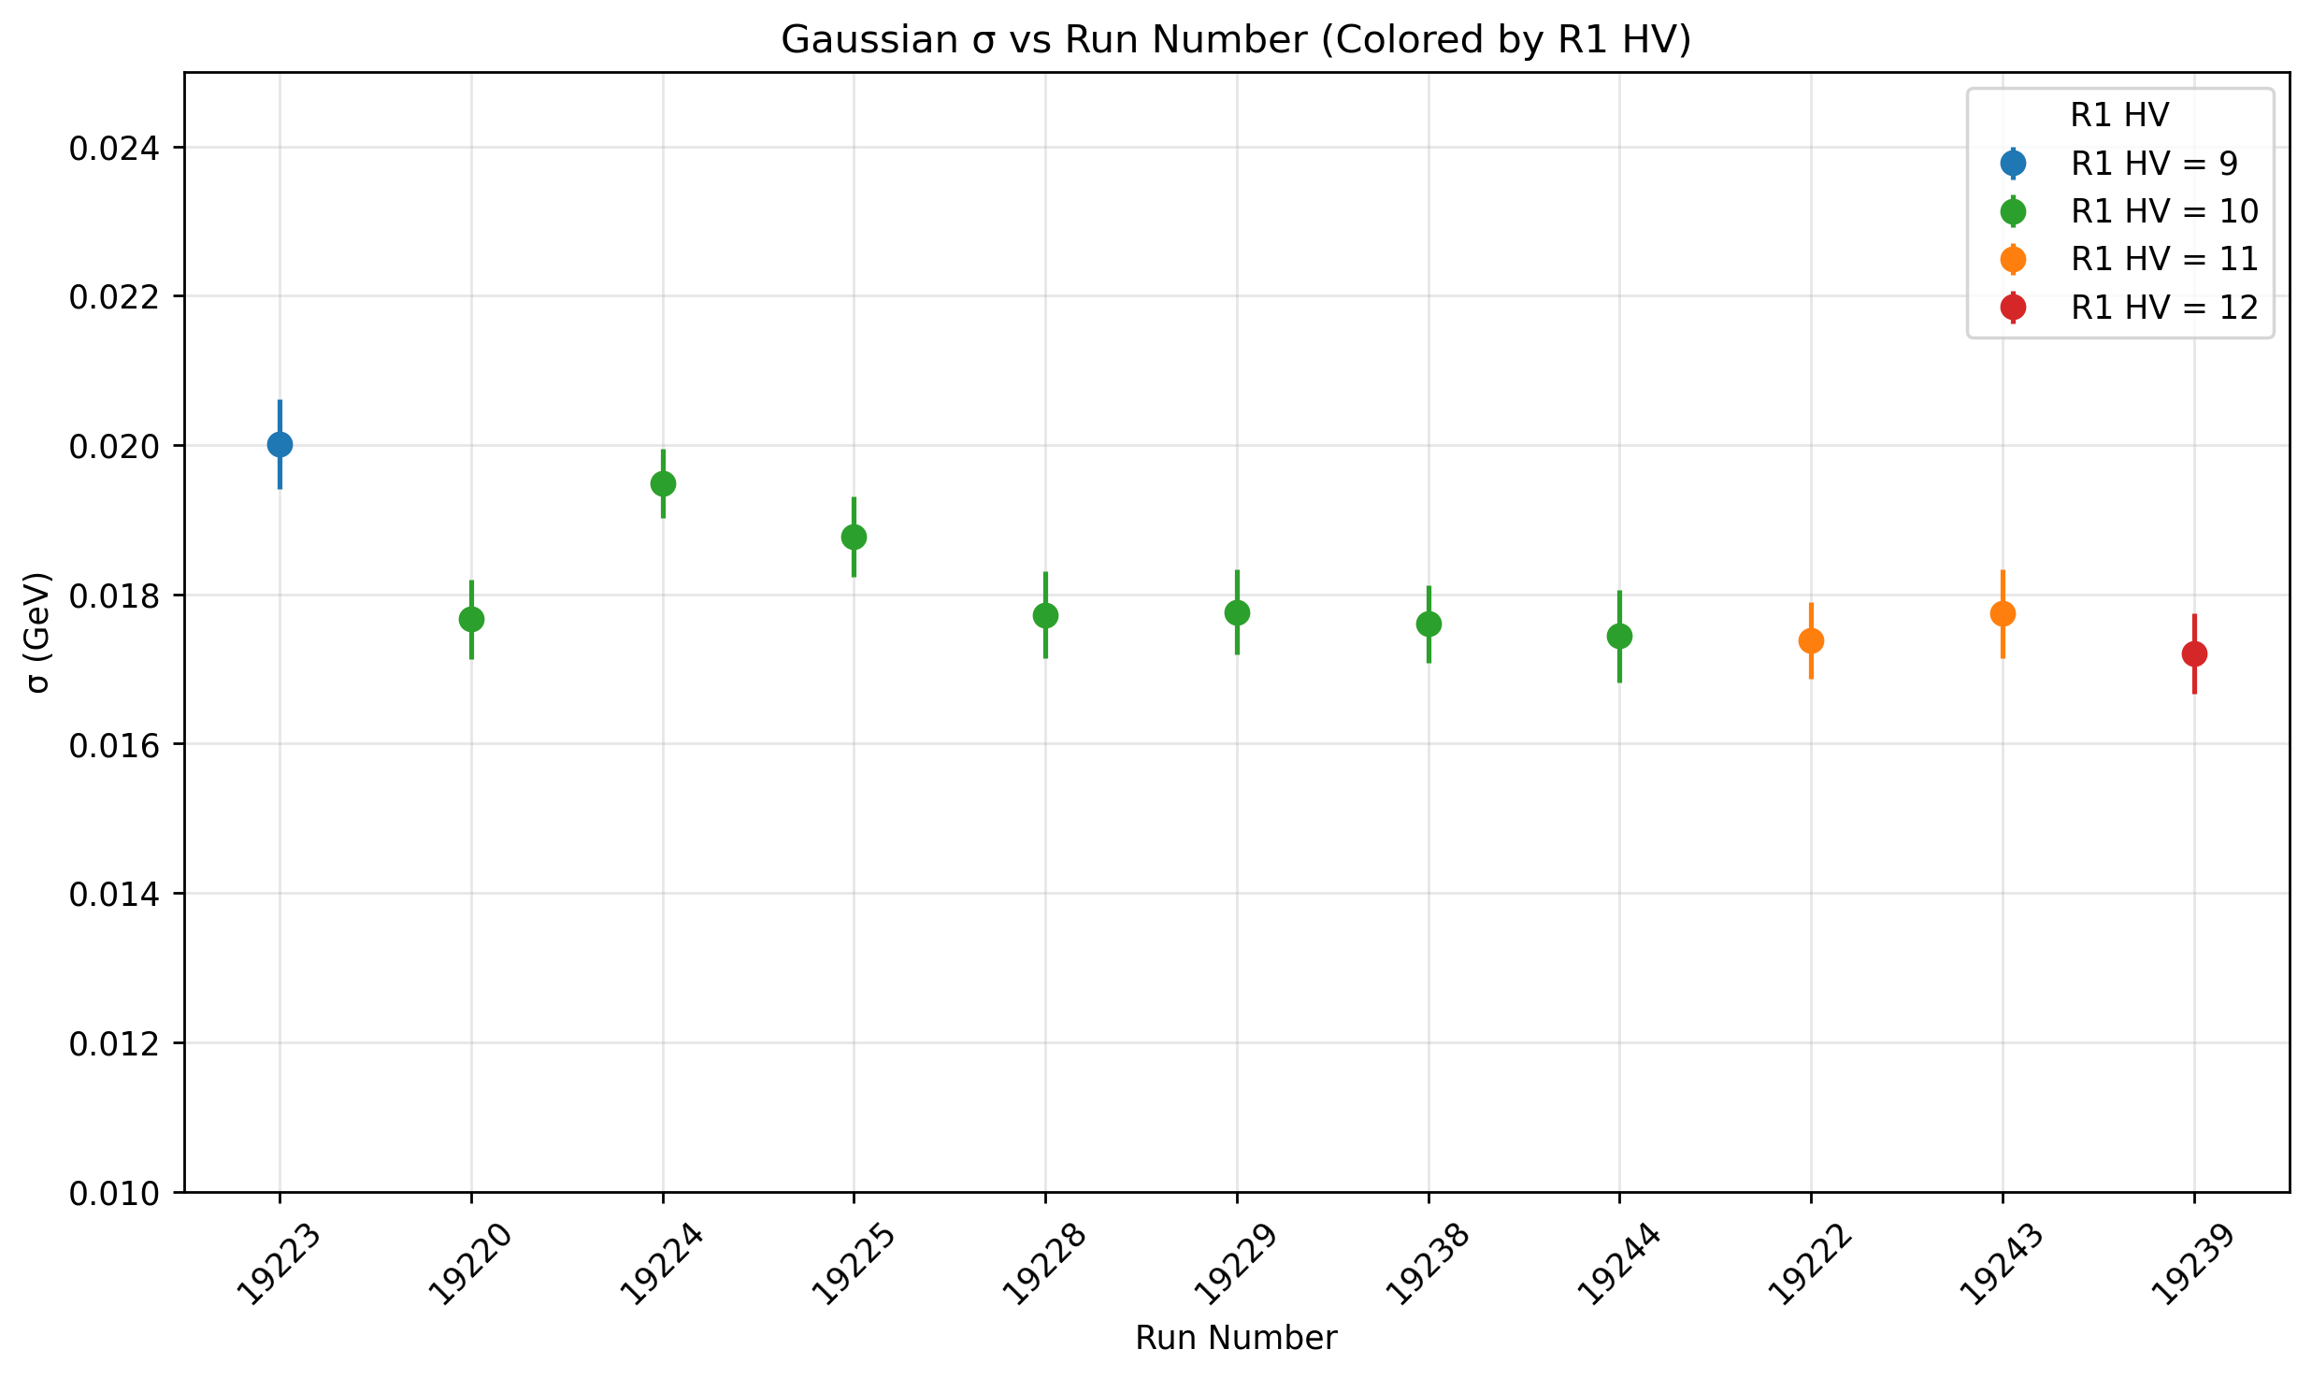
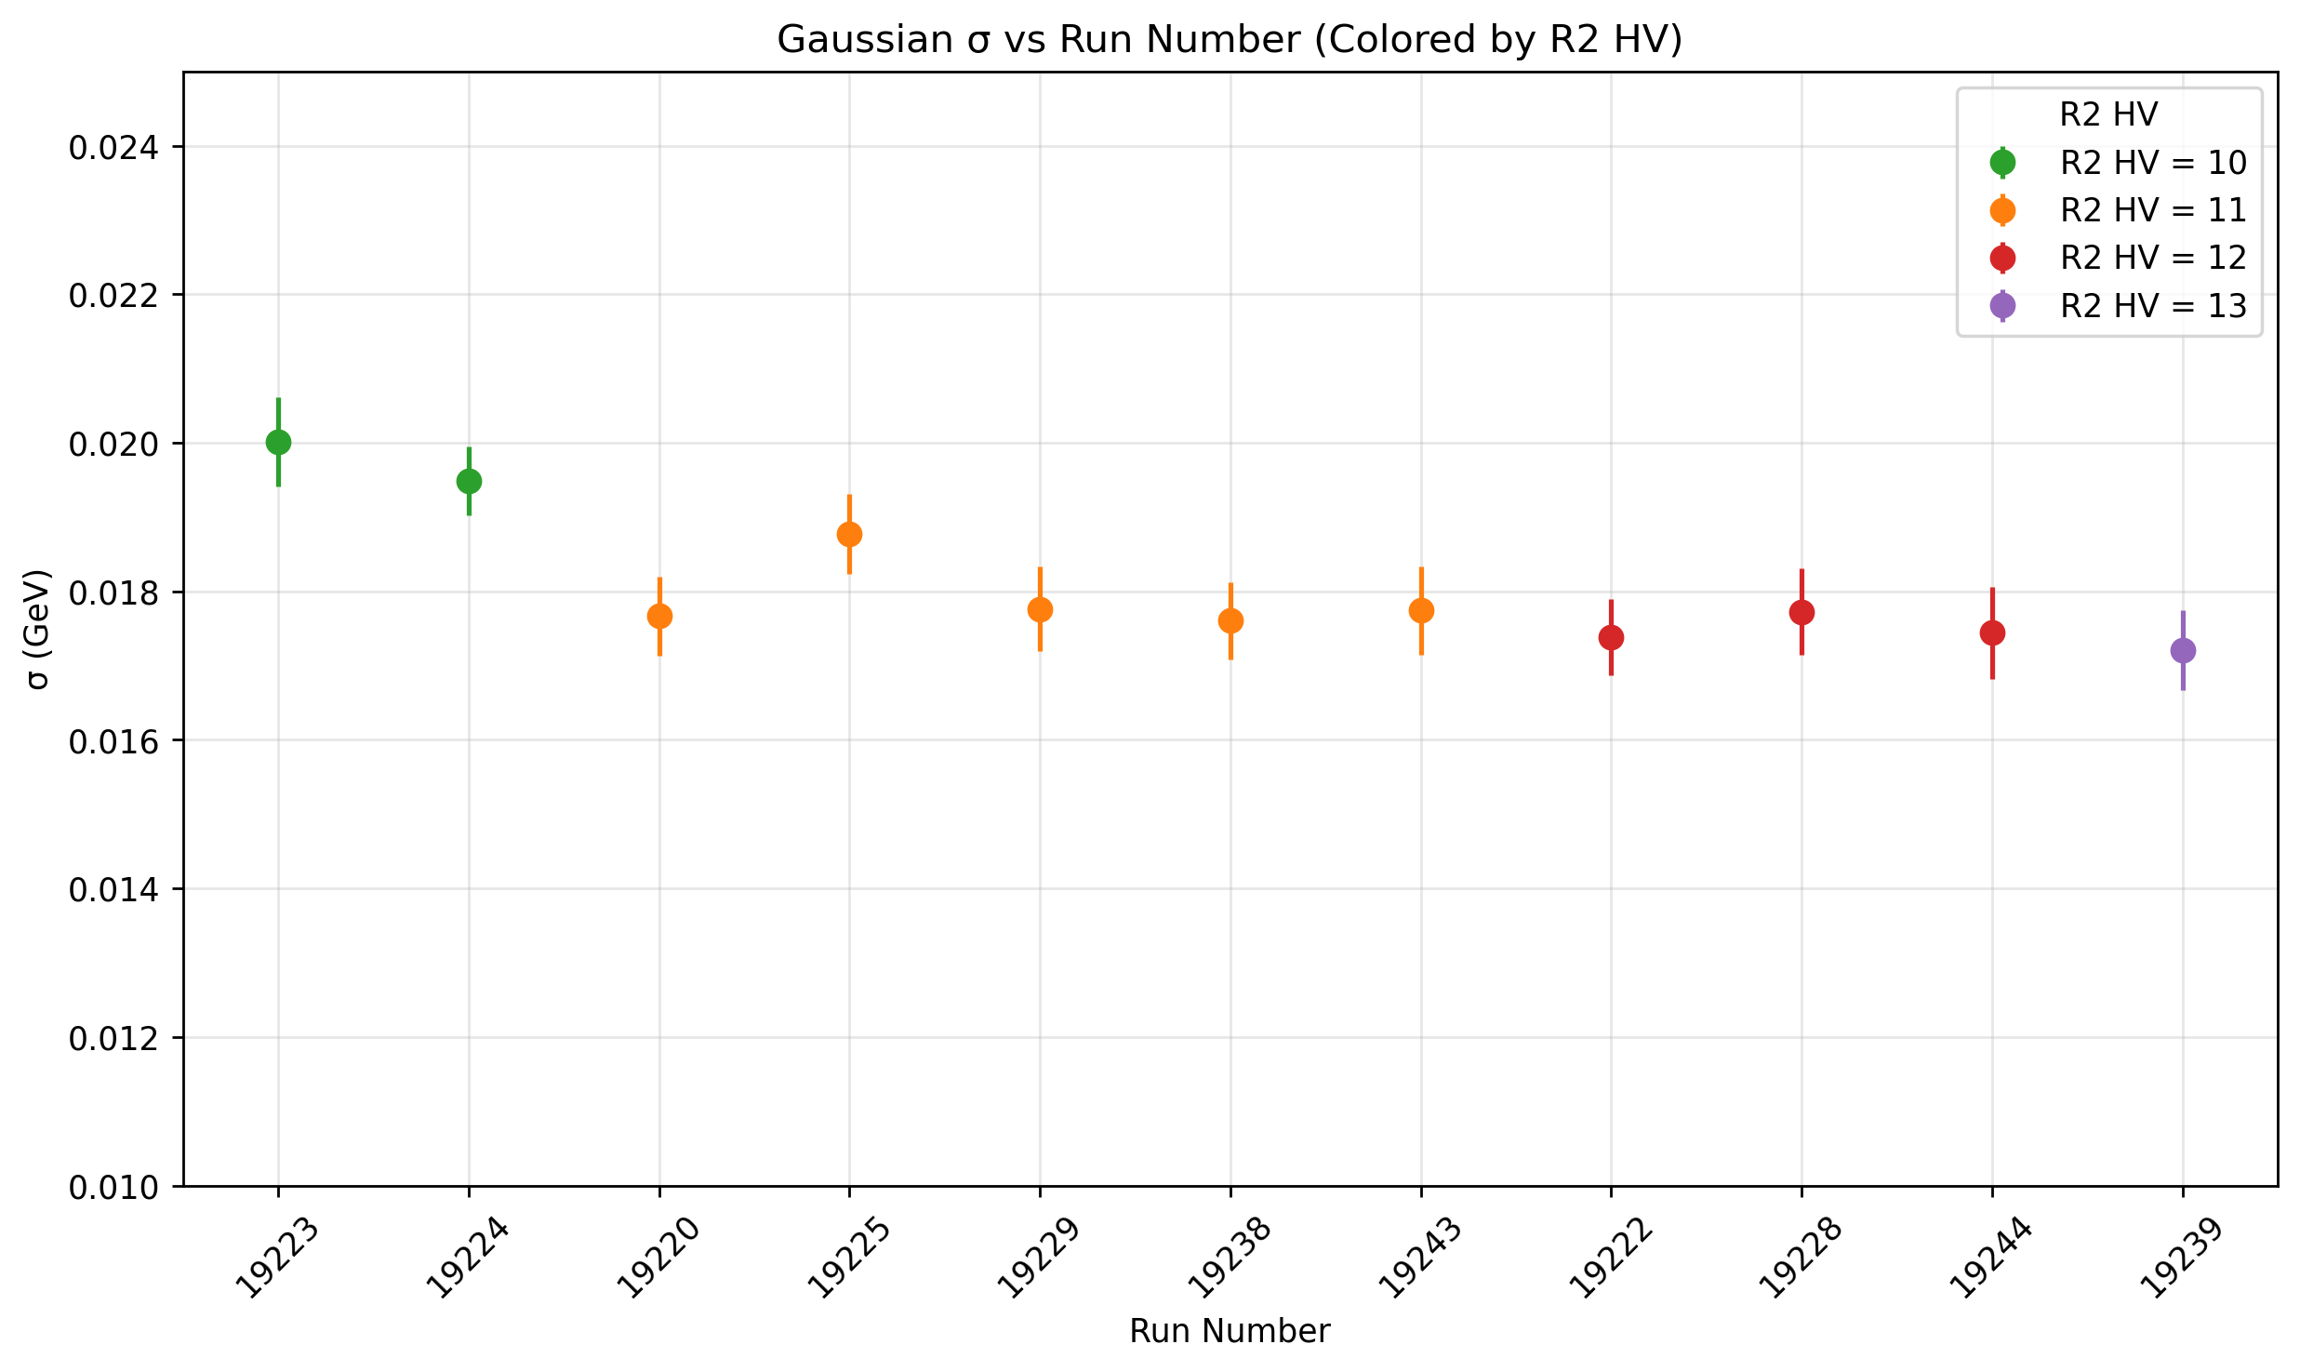

DC HV Scans
By Krishna Neupane
3 passes
DC HV has been optimized
4 passes

Slide 37
DC HV Scans
By Krishna Neupane
3 passes
DC HV has been optimized
4 passes

Slide 38



Trigger Validation Studies
Optimized trigger was chosen: no DC roads, PCAL+ECAL threshold at 300 MeV, 2 $μs$holdoff time
Trigger rates: 30 kHz @ 6.4 GeV and 20 kHz @8.5 GeV – Live times > 90%

Slide 39



RG-K Production – on-line timelines
Physics Timelines
Beam spin asymmetry $π+ π−$
Detectors Timeline
ECAL sampling
Spring 2024 data have been fully calibrated – in preparation for the PASS1 Review

Slide 40

RG-K Production – on-line reconstruction
Thanks to Gagik Gavalian !

Slide 41


RG-K Production – KY Data analysis
Forward k⁺
forward k⁺ forward p
forward k⁺ central p
Comparison of 10 cooked files
E= 6.4 GeV
E= 8.5 GeV
By: Dan Carman

Slide 42

RG-K Production – on-line Data analysis
Harut Havakian

Slide 43

RG-K Workforce
Analysis Coordinator:
Annalisa D’Angelo
Data Chef:
Lucilla Lanza
Run Coordinators:
Bill Briscoe
Dan Carman
Axel Schmidt
Susan Schadmand
Thanks to the Hall-B scientific staff
Thanks to all the Hall-B Engineers and Technicians
Thanks to all the Shift Takers
Thanks to the PD: Daniel Carman

Slide 44

Equipment
CLAS12
Hall B
Forward Detector (FD)
  - TORUS magnet
  HT Cherenkov Counter
  Drift chamber system
  LT Cherenkov Counter
  Forward TOF System
  Pre-shower calorimeter
  E.M. calorimeter
Central Detector (CD)
  SOLENOID magnet
  Silicon Vertex Tracker
  Central Time-of-Flight
Beamline
  Cryo Target
  Moller polarimeter
  - Shielding
  Photon Tagger
Upgrade to the baseline
- Central Neutron Detector
  MicroMegas
  Forward Tagger
  RICH detector
  Polarized target
MM
CND
FT
RICH

