Slide 1


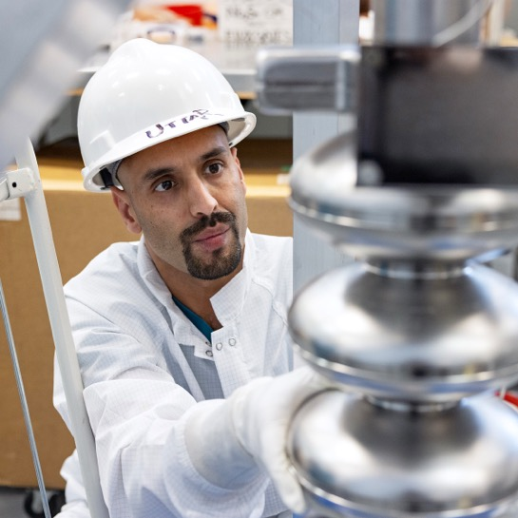
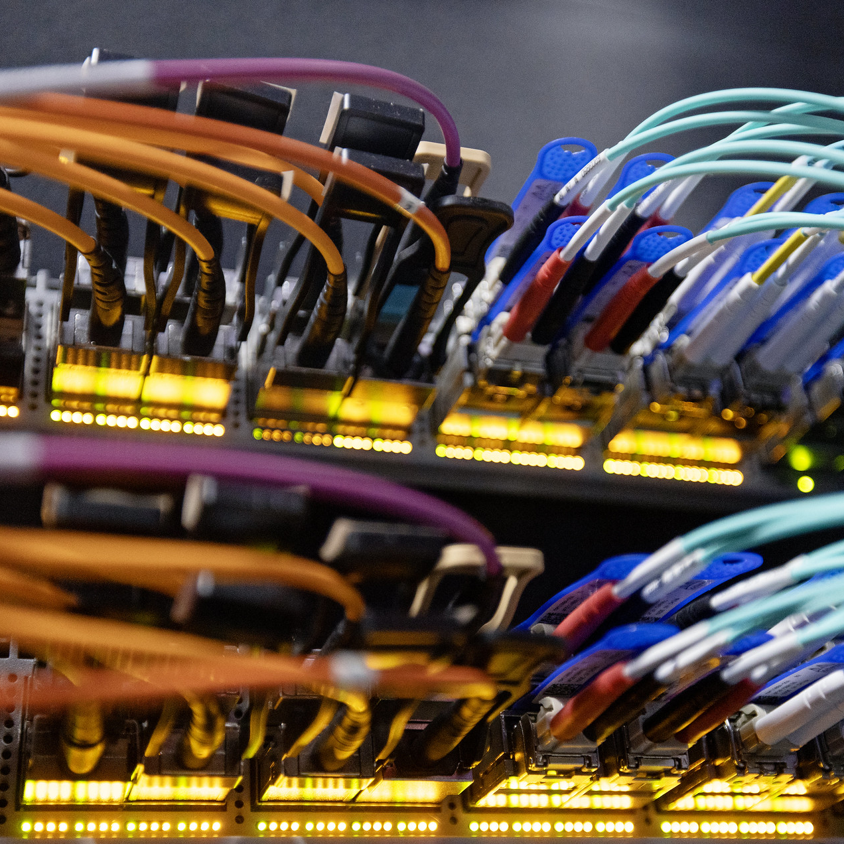


Thomas Jefferson National Accelerator Facility
CLAS Collaboration Meeting
Jens Dilling, Lab Director
June 29, 2026

Slide 2



Deliver a thriving multi-program laboratory with world-leading scientific capabilities and User Facilities driven by safety and excellence in Laboratory Operations that enables discoveries in three science pillars aligned with the lab’s core capabilities and national priorities:
Nuclear Physics
Data and Computational Science
Energy and Applied Sciences
Our
Vision

Slide 3

Structured to Achieve the Vision
June 1, 2026
Chief Audit Executive
Major 413.3B Projects
EIC
HPDF
SURA
Board Chair
Virginia Tech
Vice-Board Chair
Deputy COO (Transformation Director)
Contractor Assurance & Quality Office
Legal & Ethics, Export Control Office
Information Technology (Cybersecurity) Office
Andy Kowalski (Interim Chief Information Officer)
Project Management Office
Communications & Community Engagement Office
Jens Dilling
Laboratory Director
Strategic Planning & Partnerships Office
David Dean​​
Eric Brown
CRO/DDS&T
Johnathon Huff
COO/DDO
Fernanda G. Garcia
ALD, CEBAF
David Lawrence
Interim ALD, Data & Computational Science
Johnathon Huff
Interim ALD, Business Services
Paul Gubanc ALD, Environment, Safety & Health
Ken Baggett
Interim ALD, Energy and Applied Science & Technology
Jianwei Qiu
Interim ALD, Fundamental Physics
Kent Hammack ALD, Facilities & Operations
Rhonda Barbosa
ALD, Human Resources
Notes:
Organizational Highlights
Capitalizes on positive momentum in S&T and operations
New S&T leadership
Two additional key ALDs (Data and Computational Science and CEBAF)
Dedicated organization for 413.3B projects

Slide 4

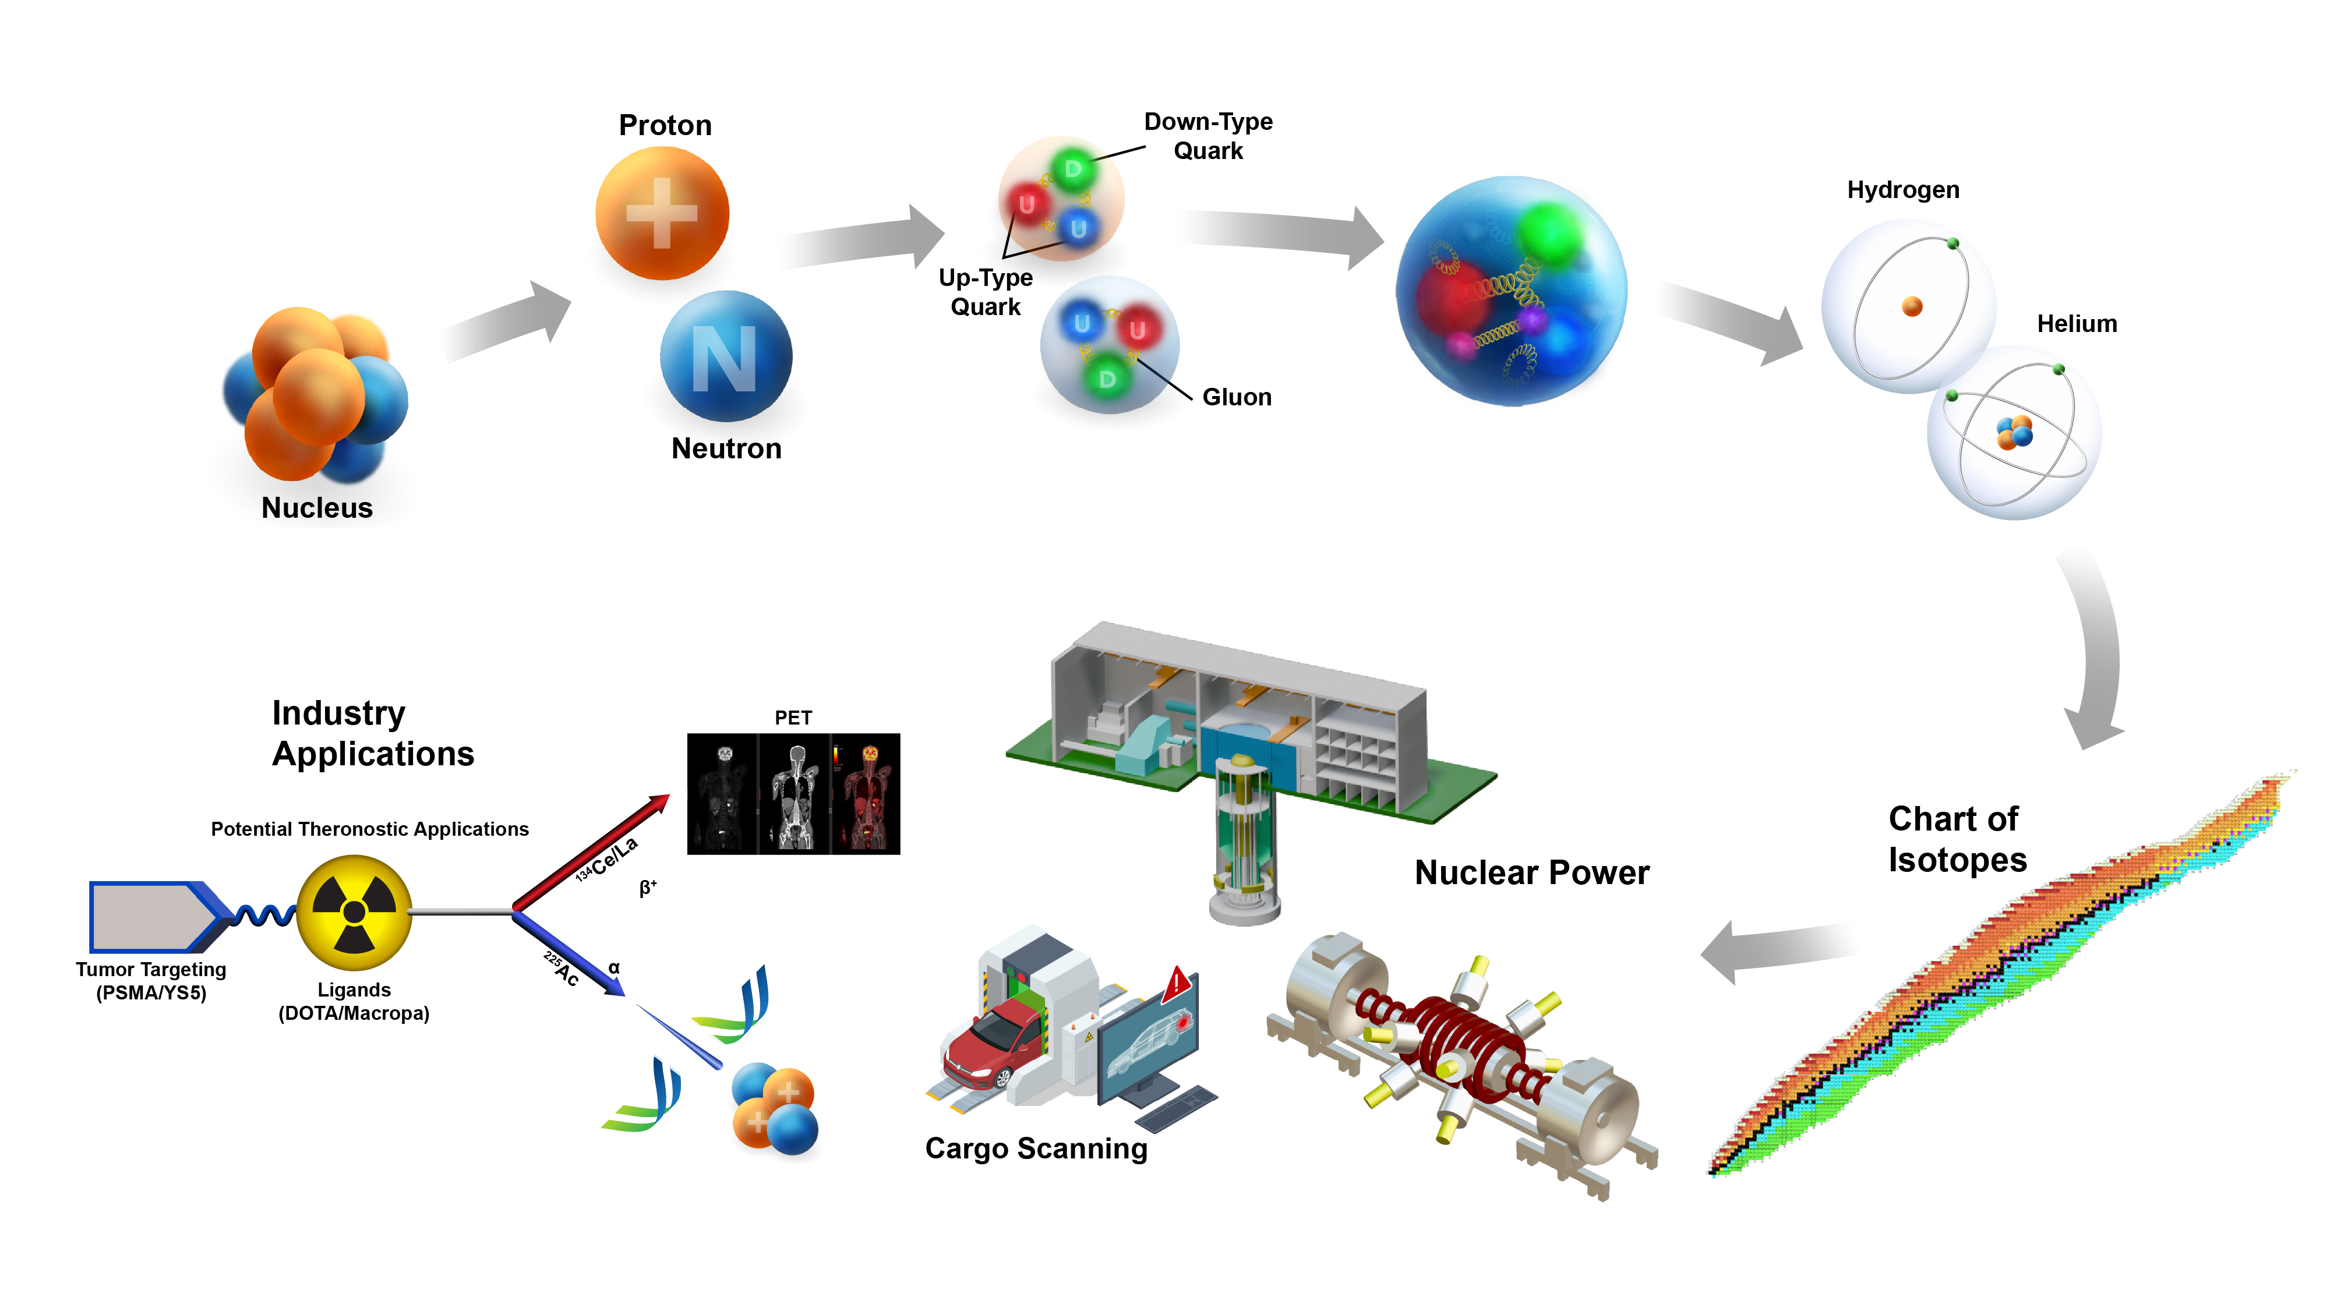

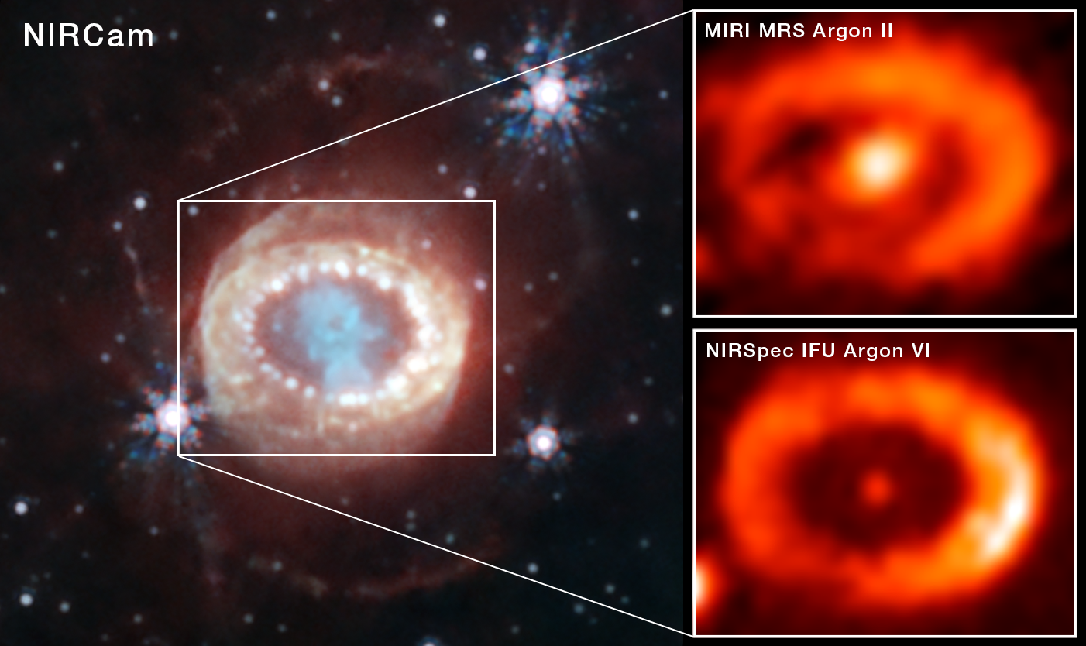
Exploring the Nature of Matter
Developing a predictive theoretical framework from quarks to complex nuclei
Neutron Stars

Slide 5
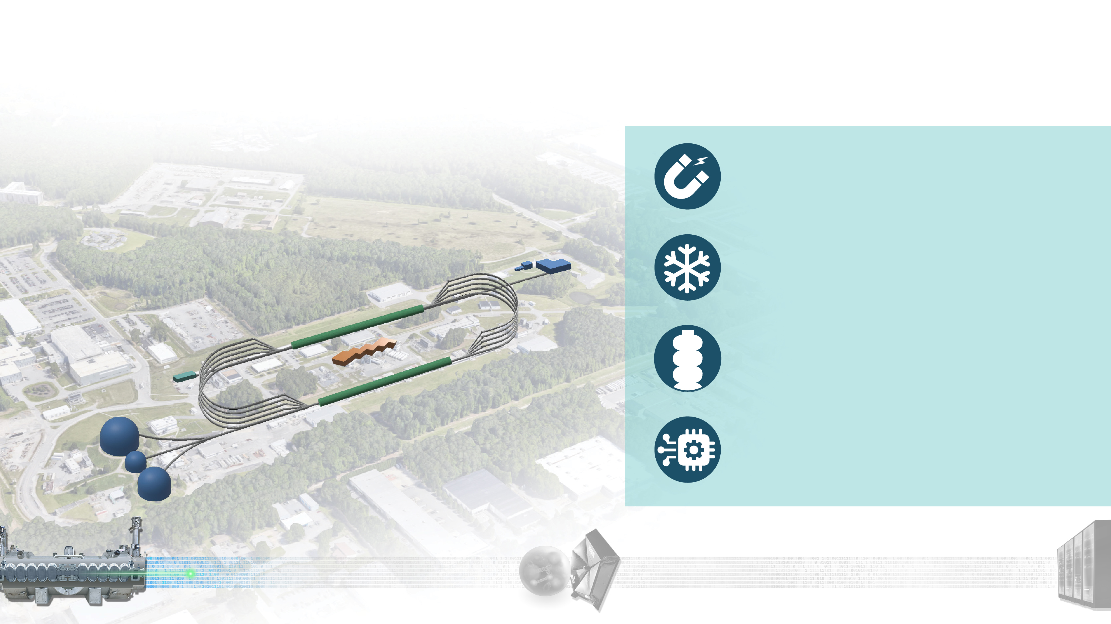





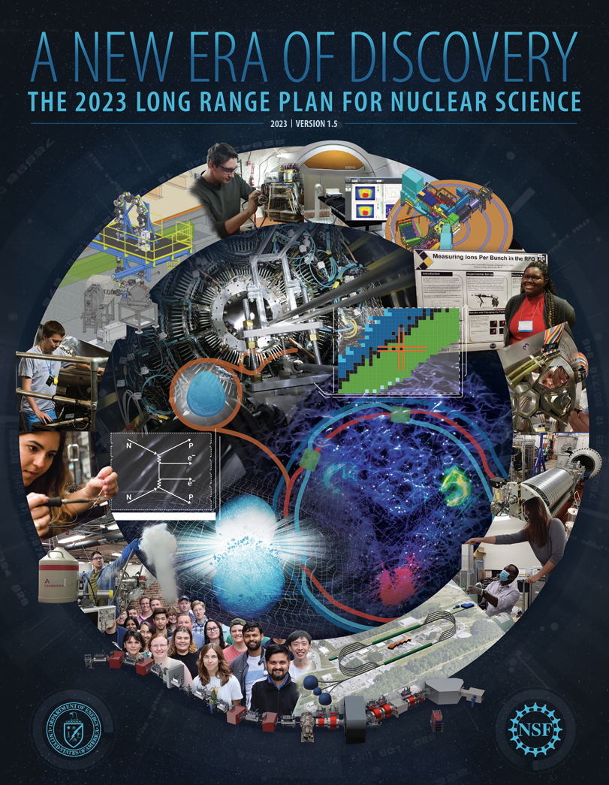

Our Discovery Machine:
Advancing Nuclear Physics Research for the Nation
The Continuous Electron Beam Accelerator Facility is the highest throughput research accelerator in the world.
The Continuous Electron Beam Accelerator Facility (CEBAF) superconducting machine, is unique in the world – the only high-energy accelerator for nuclear physics for the next several years (RHIC, CERN LS3, 2026-30).
Half-million accelerator control points
monitored by AI, improving operation & reliability (86.7% in 2025).
Largest pair of 2 Kelvin cryogenics refrigerators in the world, unique capabilities for the DOE complex.
12 GeV electron beams at up 10³⁹ electrons/second/cm², making it the highest luminosity electron accelerator in the world.
We use polarized beams and targets.
Supporting LRP priorities for the user communities in NP.
5

Slide 6

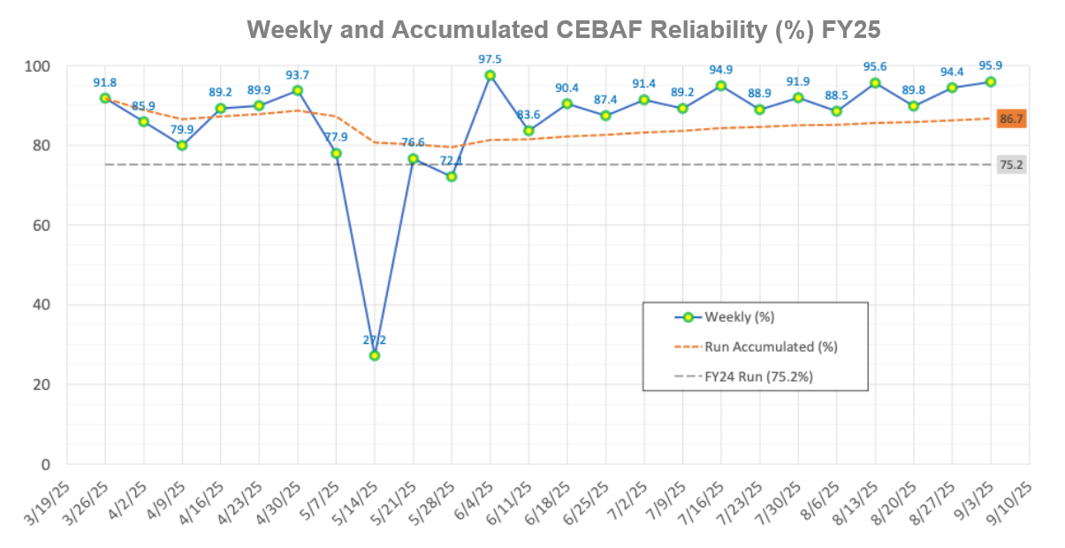
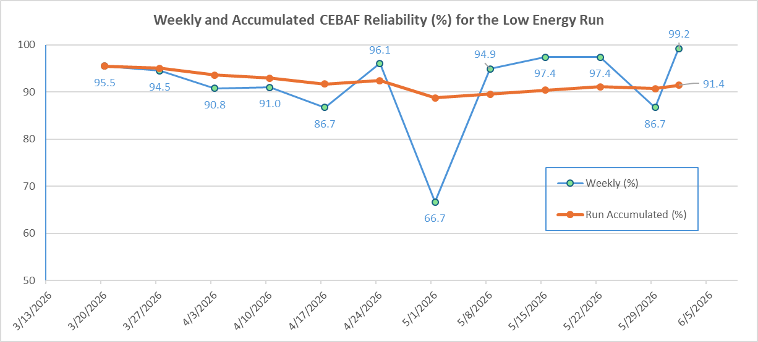

CEBAF Operations
CEBAF delivers the highest polarized electron luminosity in the world (10³⁹ e/cm²/s)
FY25 CEBAF Operations
FY26 CEBAF Operations Low energy run
Run 2025
Run length, weeks | 22+2
Average Run Reliability | 86.7%
Total Delivered Beam Hours | 3,249
Meeting DOE goals (first time since 12 GeV upgrade!)
Run 2026 (In Progress)
Run length, weeks (planned) | 20+2+2
Average Run Reliability (as of 6/1/26) | 91.4%
Total Delivered Beam Hours | In progress
6

Slide 7
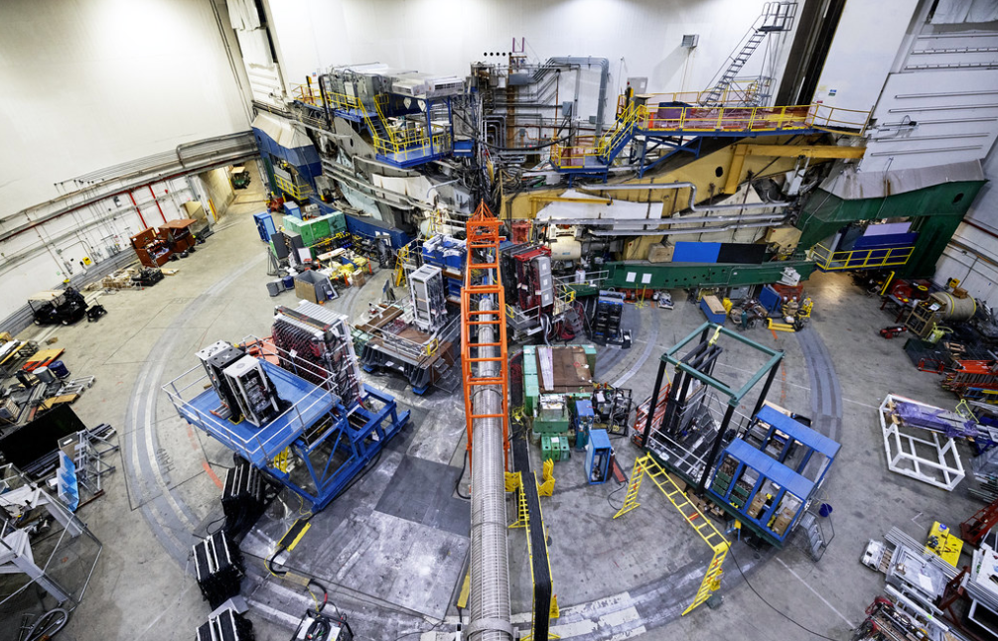
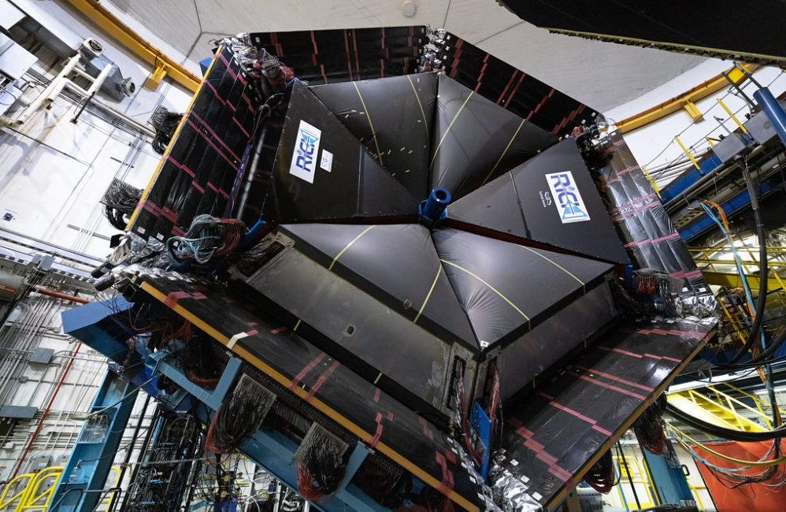
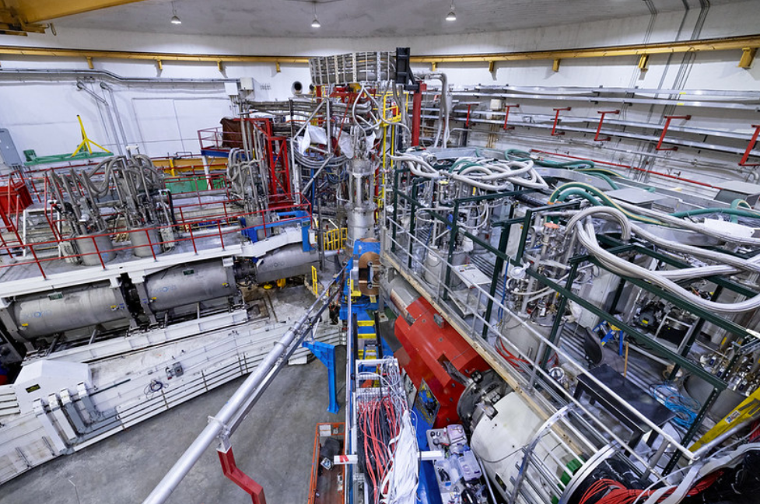
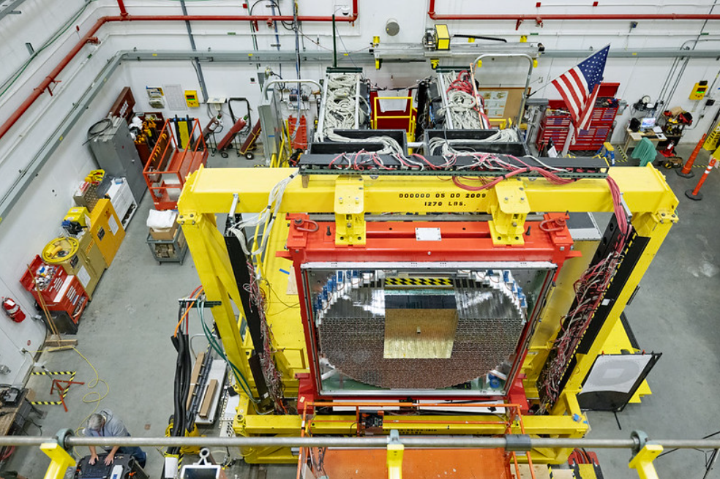
CEBAF Operation Plans for FY26
20+ weeks physics run starting on March 27, 2026
- divided into two periods
Completing MOLLER installation in Hall A
CEBAF: preparing upcoming high priority programs
  First period: A low energy run with approximately 360 MeV/linac.
  Second period: A high-energy run at 1060 MeV/linac. (same energy as the FY25 run and the design energy for the upcoming MOLLER experiment)
  Two-weeks to rescale and restore CEBAF in the middle of the run period.
  Hall B: Proton Radius & Dark Matter Search.
  Hall C: cryo-target experiments including Rosenbluth separations that require the low energy running along with high energy runs.
  Hall D: Finishing the GlueX-II high energy run as well as a newly approved low energy GlueX run.
  Parity Quality Beam studies in support of the MOLLER experiment.
  Beam Degrader studies to baseline large emittance beam transport in CEBAF consistent with expected positron beam quality.
  Beam energy spread measurement required for the upcoming Hyper-nuclear experiment.

Slide 8
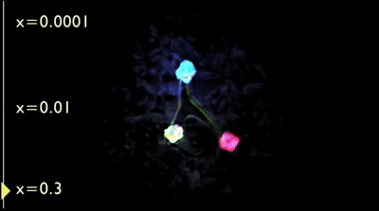

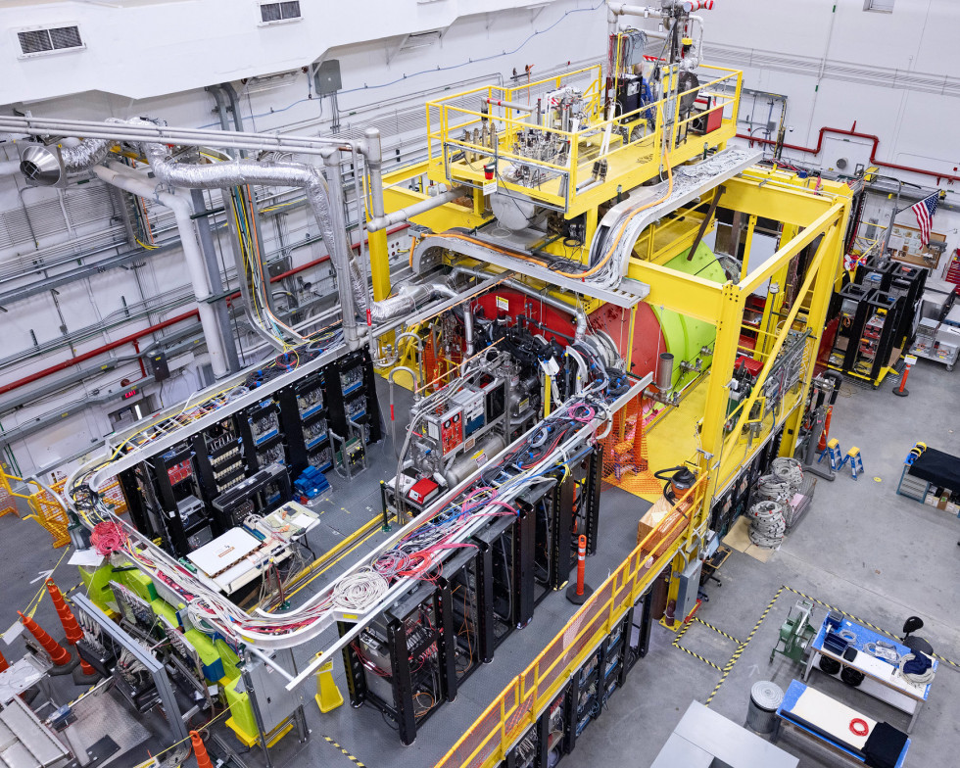
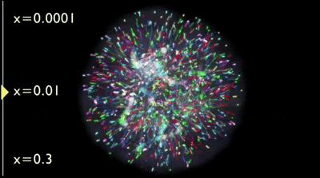
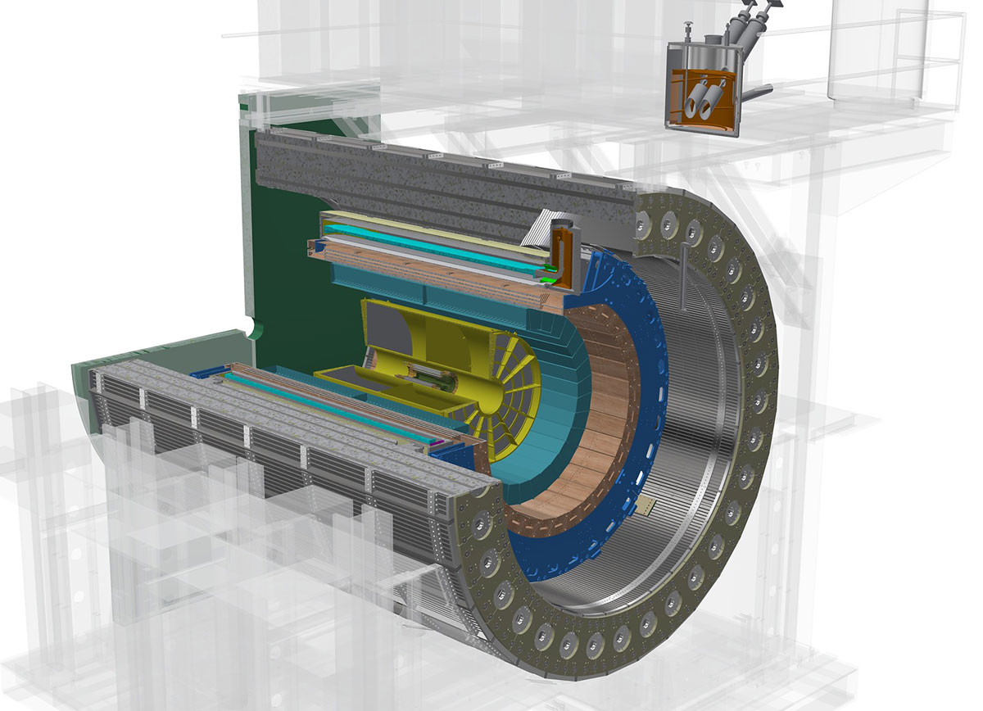

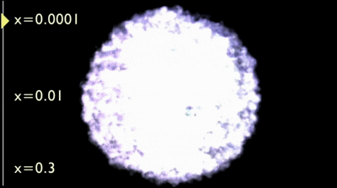
Smarter Particle Accelerators & Nuclear Physics
nucleon visualization at different Bjorken x values
Experimental Nuclear Physics (NP) seeks to understand the internal structure and dynamics of nucleons
Large detectors with high sensor density produce increasingly larger datasets (O(10) PB/yr for a single experiment) which are needed to search for increasingly rare reactions
Workflows that match large datasets with large compute and advanced analysis techniques enable faster, more efficient insight to the science
Accelerator operation with high intensity, precision, and reliability is required to obtain clean signals for next-gen subatomic discovery
https://www.jlab.org/news/releases/pioneering-nuclear-glue-frontier-0
https://www.bnl.gov/rhic/sphenix.php
General Visualizations of a Nucleon

Slide 9
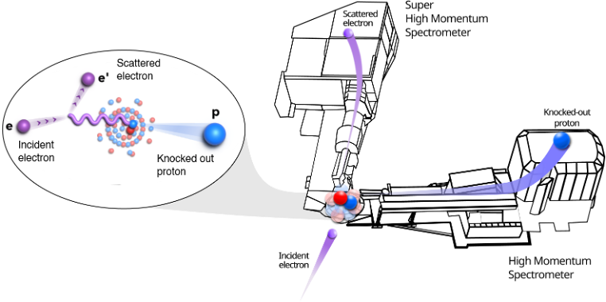
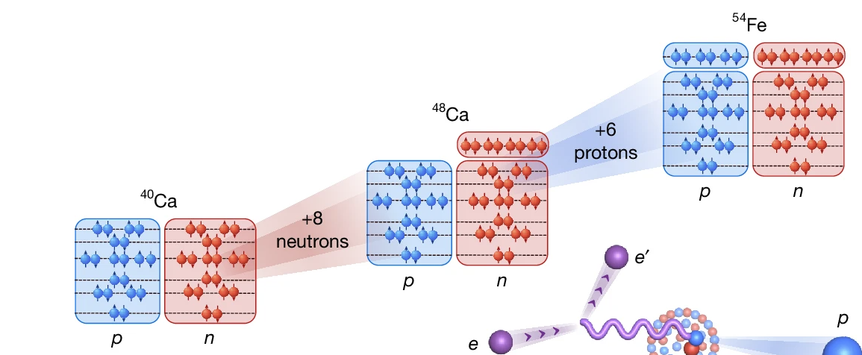
Nature Publication Reveals Quantum Rule
Governing Nuclear Structure
Why it Matters
CaFe experiment examined how protons and neutrons pair inside atomic nuclei
Demonstrates the unique capabilities of Jefferson Lab's 12-GeV CEBAF accelerator
Achieved a major scientific result from only a few days of beam time employing AI
Builds on nearly two decades of Jefferson Lab expertise in studying short-range correlations
Advances understanding of the strong force that binds atomic nuclei together
Nguyen, D., Yero, C., Szumila-Vance, H. et al. Nuclear shell structure governs short-range nucleon pairing. Nature (2026). https://doi.org/10.1038/s41586-026-10616-2
Significant scientific result provides new insight into the structure of atomic nuclei ● Published June 3, 2026

Slide 10
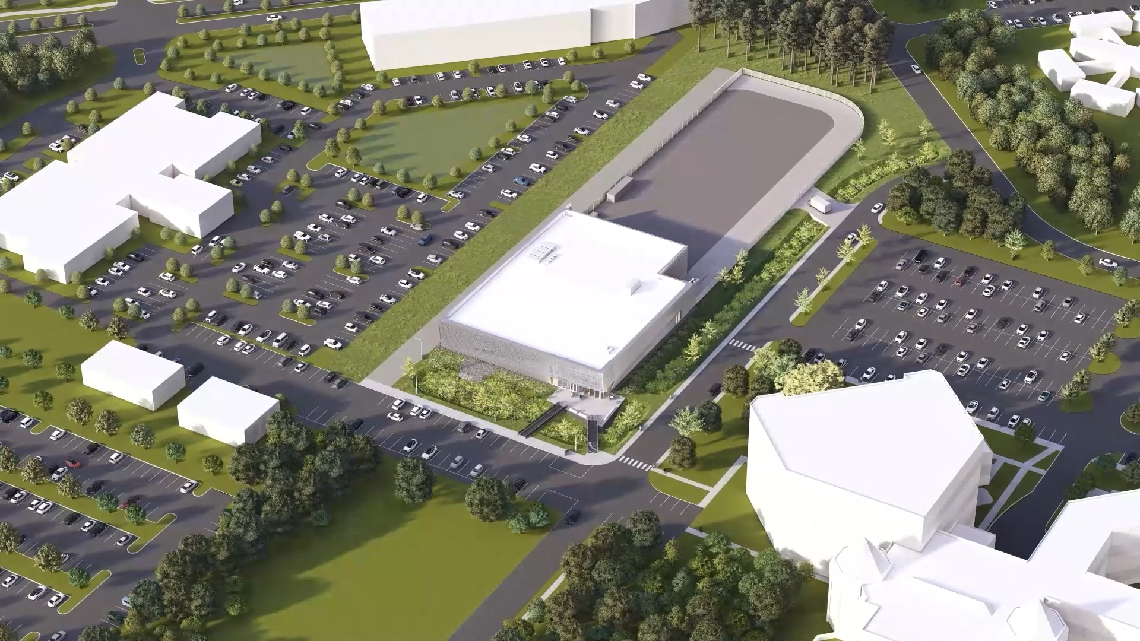
A Future Data Science Facility to Advance DOE Research
HPDF IMPACTS
Steward and facilitator of safe and secure access to AI-ready data/meta-data from and for the Office of Science
Central to advance Genesis Mission and positions DOE as a leader in data and AI-driven science
TIMELINE
2020
CD-0 Mission Need
2026
Rapid Deployment
Early-Early Access System
2028
Hybrid Cloud
On-site Integration
In 2023, DOE selected Jefferson Lab as the site
for the High Performance Data Facility (HPDF),
a scientific user facility, led by Jefferson Lab in partnership with Lawrence Berkeley National Laboratory, specializing in advanced infrastructure for data-intensive science
2023
Site Selection
Today
2027
CD-1 Target
2030
CD-4
Full Operational Scale
Mature Production Environment

Slide 11
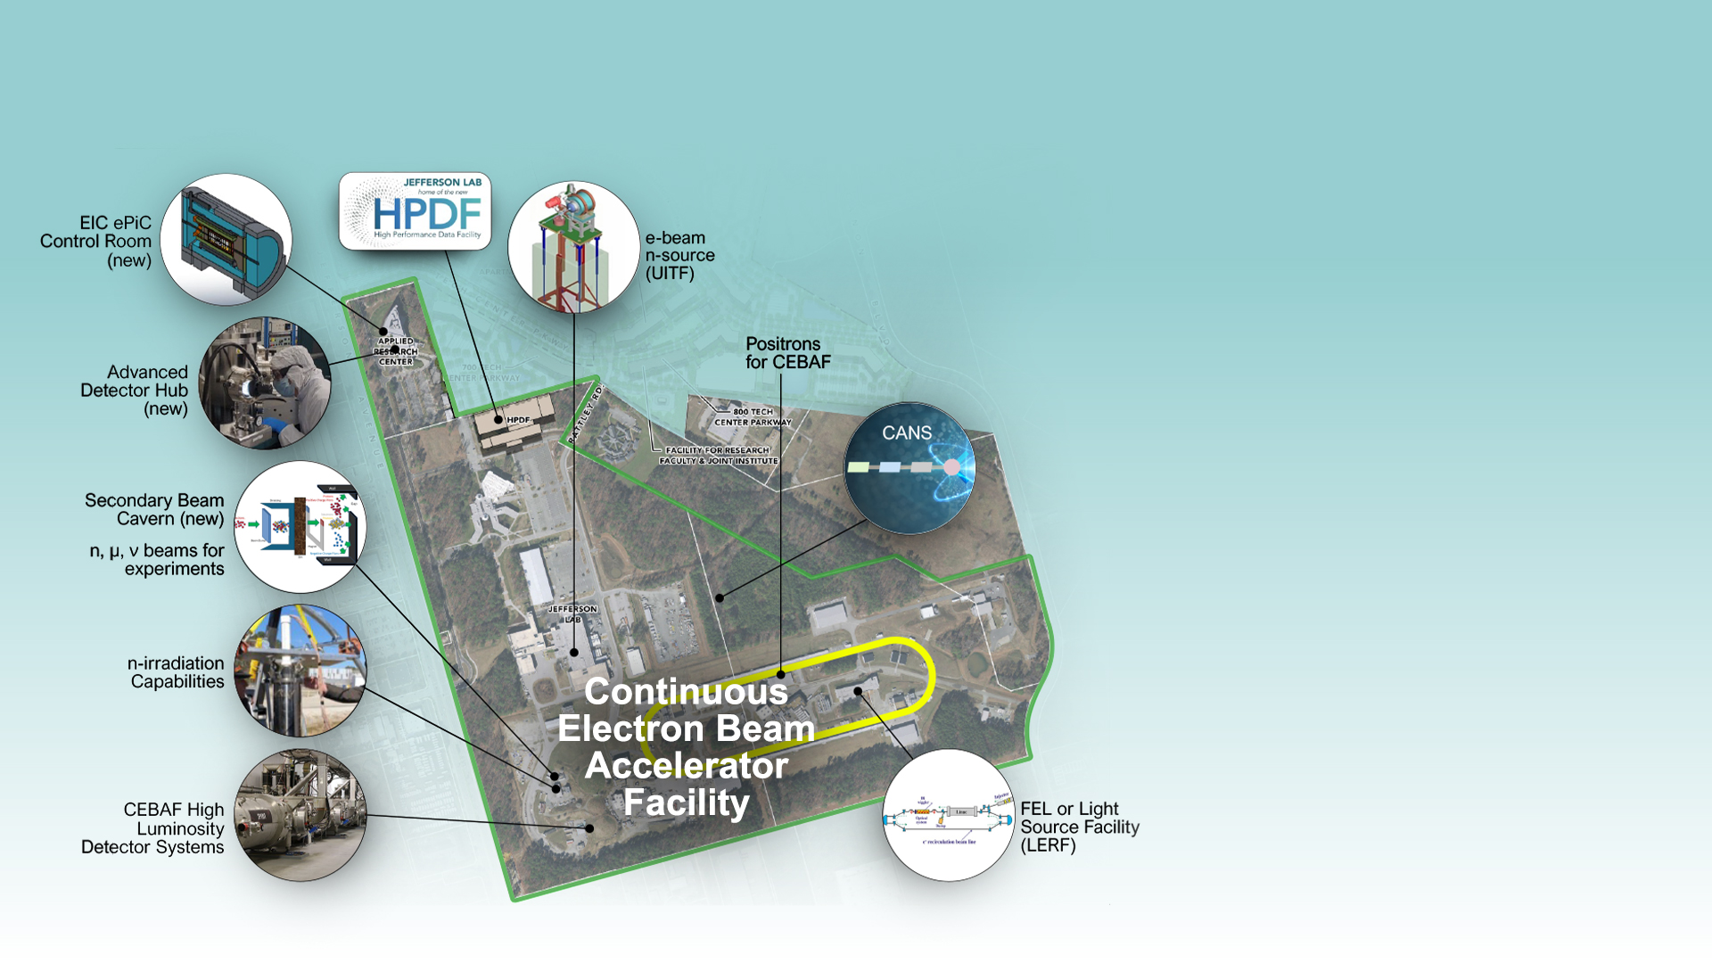
Jefferson Lab: 10/20-Year Outlook
Continuation of CEBAF Nuclear Physics Program
Growing to a multi-program laboratory
Future expansions proposed over the next 20 years supported by:
  working with the scientific
  user community for buy
  in on priorities
  We are planning community-oriented strategy planning exercises, for CEBAF and other sectors
    CEBAF 2037 and beyond
    Beam Dump opportunities in fundamental and applied sciences
    FEL, n-sources…
11

Slide 12
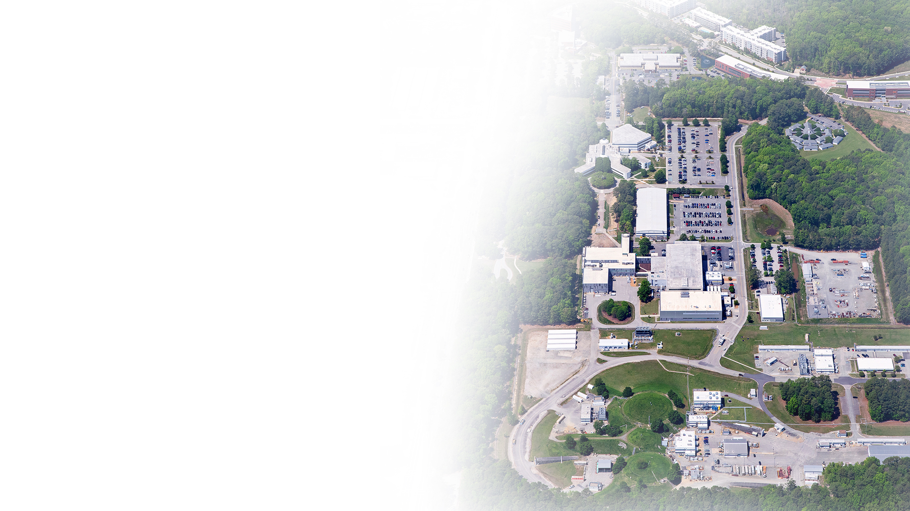




Jefferson Lab: A Dynamic Future
Focus on National Priorities we are continuing to:
Focus on CEBAF User Facility and deliver science and discovery in NP
Operate the laboratory safe, secure, and with high efficiency, upgrade where needed
Execute EIC and HPDF in partnership
Planning exercises for the future, with the community and sponsors
Notes:
Slide 16 – Jefferson Lab: A Dynamic Future
Jefferson Lab has developed, grown and accomplished a great deal over its lifetime thus far, however, the best is yet to come.
We will continue to build on the expertise and capabilities we have developed to achieve our core nuclear physics mission.
We will enhance our utilization of AI to improve our operations and scientific outcomes and amplify the capabilities of AI, advancing our data science capabilities as we move toward realization of the HPDF.
We will partner with industries and universities to develop and realize applications of our technology
We will continue to be good neighbors and a reliable partner with our local community, region and state.

Slide 13


Thomas Jefferson National Accelerator Facility is managed by
SURATech, LLC, for the U.S. Department of Energy

