Slide 1



Precision Møller Polarimetry and the MOLLER Experiment at Jefferson Lab
Addison Arcuri, 11 June 2026

Slide 2
Outline
Background:
What is MOLLER?
What is Møller polarimetry?
Møller Polarimetry in Hall A:
What are the systematics?
What does the data acquisition look like?
Dead Time Model:
How did previous experiments correct for dead time?
How will that change for MOLLER?
Accidental Model:
How did previous experiments correct for accidental coincidences?
How will that change for MOLLER?
Model Testing:
How well do our updated models correct a known asymmetry?

Slide 3
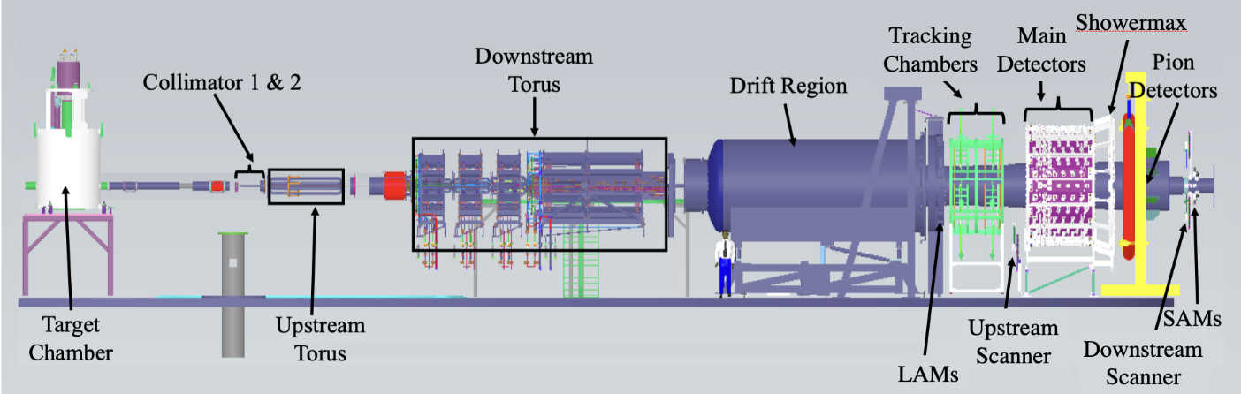
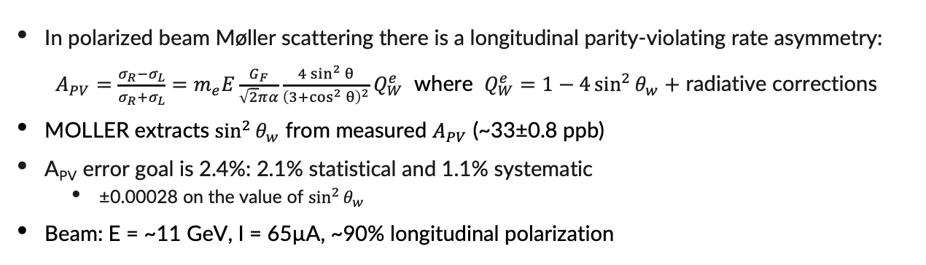
Background: The MOLLER Experiment
In polarized beam Møller scattering there is a longitudinal parity-violating rate asymmetry:
$A_{PV}=\frac{σ_{R}−σ_{L}}{σ_{R}+σ_{L}}=m_{e}E\frac{G_{F}}{\sqrt{2}πα}\frac{4\sin^{2}{θ}}{{\left(3+\cos^{2}{θ}\right)}^{2}}Q_{W}^{e}$ where $Q_{W}^{e}=1−4\sin^{2}{θ_{w}}+$ radiative corrections
MOLLER extracts $\sin^{2}{θ_{w}}$ from measured $A_{PV}$ (~33±0.8 ppb)
A_{PV} error goal is 2.4%: 2.1% statistical and 1.1% systematic
  ±0.00028 on the value of $\sin^{2}{θ_{w}}$
Beam: E = ~11 GeV, I = 65µA, ~90% longitudinal polarization
Measured A_{PV} is proportional to beam polarization
Polarimetry is one of the largest systematics with a budget of 0.40%!
This is an ambitious precision goal: Previous Hall A experiments (e.g., CREX) had 0.85% systematic uncertainty for polarimetry
The MOLLER beamline. Møller Polarimeter behind target. Image from [1].
Notes:
In polarized beam Møller scattering there is a longitudinal parity-violating rate asymmetry: $A_{PV}=\frac{σ_{R}−σ_{L}}{σ_{R}+σ_{L}}=m_{e}E\frac{G_{F}}{\sqrt{2}πα}\frac{4\sin^{2}{θ}}{{\left(3+\cos^{2}{θ}\right)}^{2}}Q_{W}^{e}$
$Q_{W}^{e}=1−4\sin^{2}\left(θ_{w}\right)+$ radiative corrections
The MOLLER experiment will measure $A_{PV}$ and thus $\sin^{2}\left(θ_{w}\right)$
A_{PV} error goal is 2.4%: 2.1% statistical and 1.1% systematic
Corresponds to ±0.00028 on the value of $\sin^{2}{θ_{w}}$
Beam: E = ~11 GeV, I = 65µA, ~90% longitudinal polarization
The MOLLER beamline. Møller Polarimeter is not pictured, several meters behind the target chamber.
In actuality, A_{PV} is proportional to longitudinal beam polarization
Polarimetry is one of the largest systematics with a goal of 0.40% accuracy!
This is an ambitious goal: Previous Hall A experiments (e.g., CREX) had 0.85% systematic uncertainty for polarimetry

Slide 4
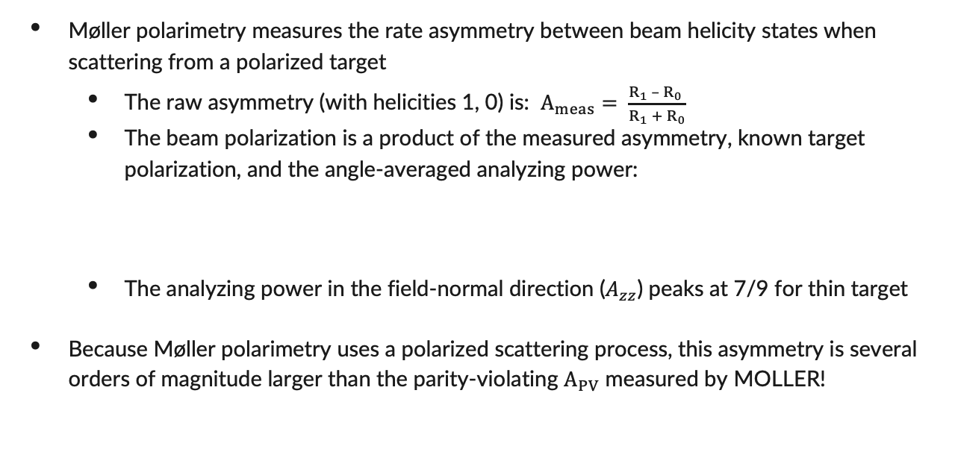

Background: Møller Polarimetery Basics
Møller polarimetry measures the rate asymmetry between beam helicity states when scattering from a polarized target
  The raw asymmetry (with helicities 1, 0) is: $A_{meas}= \frac{R_{1} –{ R}_{0} }{R_{1} + R_{0}}$
  The beam polarization is a product of the measured asymmetry, known target polarization, and the angle-averaged analyzing power:
  The analyzing power in the field-normal direction ($A_{zz}$) peaks at 7/9 for thin target
Because Møller polarimetry uses a polarized scattering process, this asymmetry is several orders of magnitude larger than the parity-violating $A_{PV}$ measured by MOLLER!
$$P_{beam}=\frac{A_{meas}}{P_{targ}\left\langle A_{zz}\right\rangle } A_{zz}=\frac{\left(7+ \cos^{2}{θ}\right)\sin^{2}{θ}}{{\left(3+\cos^{2}{θ}\right)}^{2}}$$
Notes:
Møller polarimetry measures scattering asymmetry from a polarized electron target: A thin magnetized iron foil.
A meas is measured, P targ and Azz are known, P beam is what’s being determined
Angle averaged Azz is determined from Azz formula via well-characterized Monte Carlo simulations
Diagram: Pass thr target, defocus and focus mags, collimators, detectors. Two side b side blocks of 4. Møller stripes. L/R sums, Coincidences. Accidentals use delayed line to get real time measure of coincidences from backgrounds.
Measured Asymmetry is not simply rate difference between states divided by sum, we apply corrections
When describing separate runs: These are differences between the Møller polarimeter and the Compton polarimeter. Compton has no beam current issues and runs using beam deviated from MOLLER beamline during runs

Slide 5
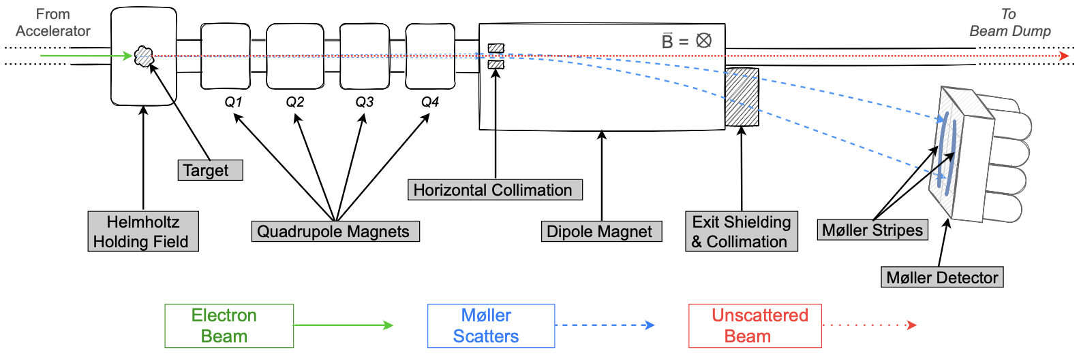
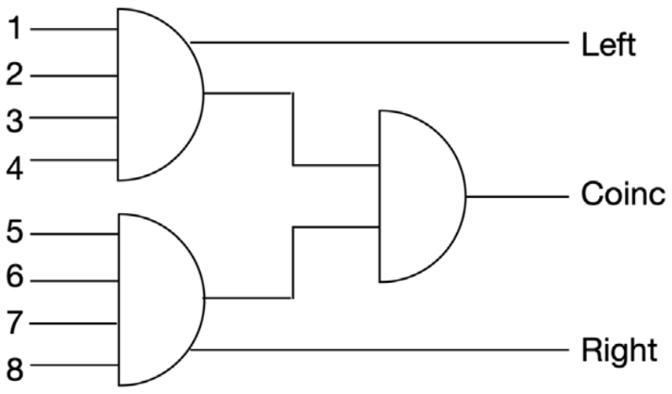
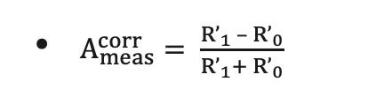
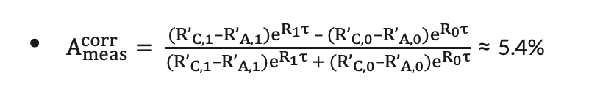
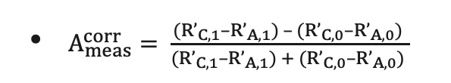
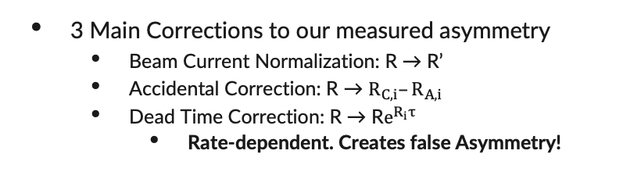
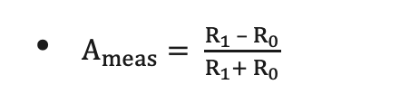
Møller Polarimetry in Hall A
1
5
6
7
8
Asymmetry is found pattern-by-pattern as helicity changes:
Basic Scaler DAQ coincidence logic. Not shown is Accidental channel, which ANDs a delayed Left signal with Right.
The separate FADC DAQ forms coincidences in software. Not subject of this talk.
Image credits: From [2,3]
$A_{meas}^{corr}= \frac{({R’}_{C,1}–{R’}_{A,1})e^{R_{1}τ} – ({R’}_{C,0}–{R’}_{A,0})e^{R_{0}τ}}{({R’}_{C,1}–{R’}_{A,1})e^{R_{1}τ} + ({R’}_{C,0}–{R’}_{A,0})e^{R_{0}τ}}$ ≈ 5.4%
$A_{meas}^{corr}= \frac{({R’}_{C,1}–{R’}_{A,1}) – ({R’}_{C,0}–{R’}_{A,0}) }{({R’}_{C,1}–{R’}_{A,1}) + ({R’}_{C,0}–{R’}_{A,0}) }$
$A_{meas}^{}= \frac{R_{1} – R_{0}}{R_{1}+ R_{0}}$
$A_{meas}^{corr}= \frac{{R’}_{1} – {R’}_{0}}{{R’}_{1}+ {R’}_{0}}$
3 Main Corrections to our measured asymmetry
  Beam Current Normalization: R → R’
  Accidental Correction: R → $R_{C,i}–R_{A,i}$
  Dead Time Correction: R → R$e^{R_{i}τ}$
    Rate-dependent. Creates false Asymmetry!
Notes:
The target for our polarimeter is a thin, 10-micron iron foil. Both scattered electrons exit. They are separated from unscattered beam by dipoles and directed onto the detectors.
We have 2 detectors, each segmented into 4 blocks. Our DAQ counts Left events, Right events, Coincidences, and Accidental Coincidences. Accidentals
Measured Asymmetry is not simply rate difference between states divided by sum, we apply corrections
When describing separate runs: These are differences between the Møller polarimeter and the Compton polarimeter. Compton has no beam current issues and runs using beam deviated from MOLLER beamline during runs

Slide 6
Møller Polarimetry Systematics
Foil Saturation Polarization is global knowledge of iron saturation
A_{zz}+Levchuk improvements from better simulation/iron wavefunctions
Current Dependence and Aperture Transmission will require dedicated studies during MOLLER
Null Asymmetry, Electron Source Variation, and Leakage Currents will be measured during MOLLER runs
Foil Degree of Saturation, Radiative Corrections, Dead Time, and Accidentals have ongoing or planned pre-MOLLER studies.
  Dead Time and Accidental improvements are focus of this talk
Problem | CREX (%) | MOLLER Goal (%)
Foil Saturation Polarization | 0.28 | 0.24
Foil Degree of Saturation | 0.50 | 0.10
Azz + Levchuk | 0.16 | 0.15
Radiative Corrections | — | 0.10?
Dead Time | 0.15 | 0.10
Accidentals | 0.04 | 0.10
Current Dependence | 0.50 | 0.15
Aperture Transmission | 0.10 | 0.10
Null Asymmetry | 0.22 | 0.10
Electron Source Variation | 0.06 | 0.02
Leakage Currents | 0.18 | 0.10
Overall | 0.85 | 0.42
*
*
*
Møller Polarimetry systematics for CREX (2019) and MOLLER goals
Notes:
Foil Saturation Polarization: Limited by global knowledge of the saturation curve of iron.
A_zz + Levchuk: A_zz is accuracy of simulations used to determine <A_zz> over acceptance. Levchuk refers to the uncertainties in the iron wavefunctions used to account for the Levchuk effect, which refers to the wider angular momentum distribution for unpolarized inner orbital iron electrons. Since the polarimeter has a finite acceptance, the unpolarized electrons in the momentum “tails” are more likely to be cut off by the limited acceptance, which has the effect of increasing the analyzing power.
Current Dependence: For higher beam current more laser is needed on photocathode. This causes greater heating, which could in principle change the strain in the strained GaAs superlattice. This could change the polarization of the output electrons. This uncertainty is currently dependent on a 2007 test.
Aperture Transmission: Reducing leakage currents sometimes requires narrowing the “main aperture in the source” to limit the effect. This aperture reduction could introduce uncertainty if there is a polarization gradient on the electron pulses. This has not been observed. The uncertainty is the size of the error on that test.
Null Asymmetry: Null asymmetry measurements are used to monitor for helicity-correlated beam properties unrelated to polarization. Pure copper foil target is used. Uncertainty represents upper bound (meas at 0.12±0.10 for 0.22 uncert for CREX).
Electron Source Variation: Pockels cell.
Leakage Currents: Laser alternates pulses for each of the 3 halls ABC in turn, generating electron bunches for each of the 3. Time between pulses is much longer than the pulses themselves, but there is low-level residual light (and therefore current) after the end of each planned bunch. Given the low current of a Mol pol run these residual currents that leak through from the previous hall bunches are not negligible.
Foil Degree of Saturation: Incomplete saturation of the iron foil. Estimate of incomplete polarization caused by foil misalignment from field normal.
Dead Time: Dead time of the DAQ can result in a false asymmetry
Accidentals: A real-time measure of uncorrelated background events.

Slide 7
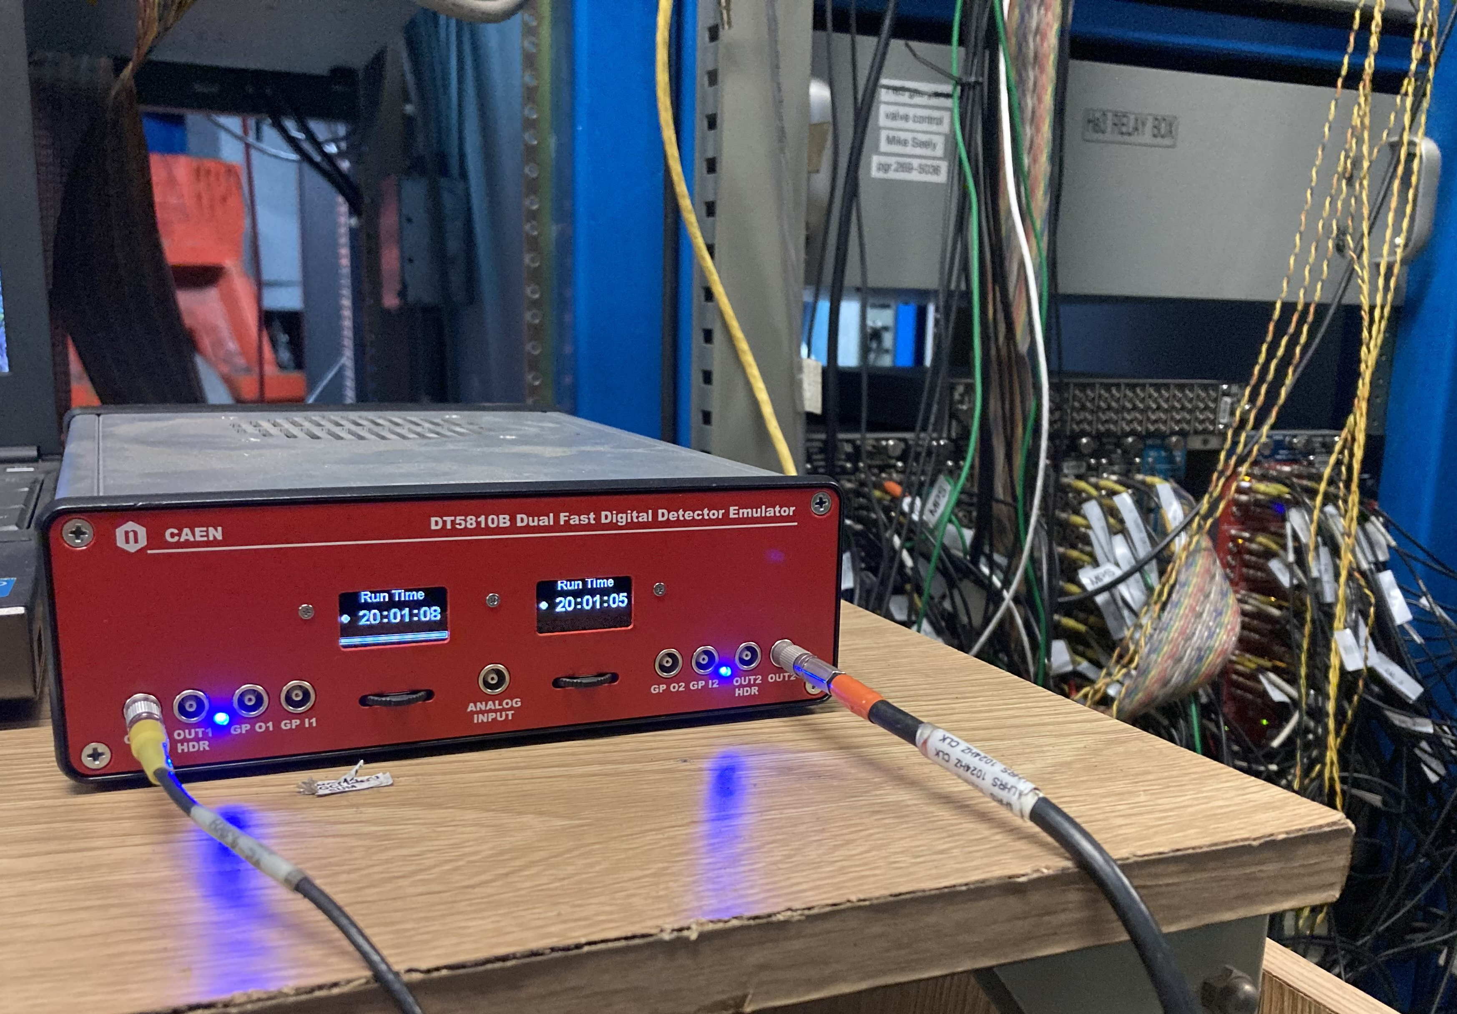
DAQ Tuning With Emulator
Our CAEN 5810b detector emulator simulates detector events
  Two physical output channels + coincident pulse injection into both channels
  Feeds into DAQ in place of inactive PMTs
  Very useful in tuning the DAQ
Ex: Emulator revealed problem with accidentals
  With uncorrelated singles only, DAQ measured ~1.20x more coincidences than accidentals
  Solved by adding discriminator immediately before the delayed left signal is ANDed, tuning until rates are equal
Detector emulator in use. The two physical outputs are plugged into the polarimeter DAQ FIFO where the detector PMT signals enter the system.
Notes:
CAEN 5810b detector emulator simulates detector events. Two physical outputs channels + coincident pulses on both channels.
Very useful in tuning the DAQ
Testing revealed a problem with the accidental channel
With uncorrelated singles only, DAQ measured ~1.20x more coincidences than accidentals.
Solved by adding discriminator immediately before the delayed left signal is ANDed, tuning until rates are equal.
This sensitivity issue had not been noticed previously. Can now make corrections.

Slide 8
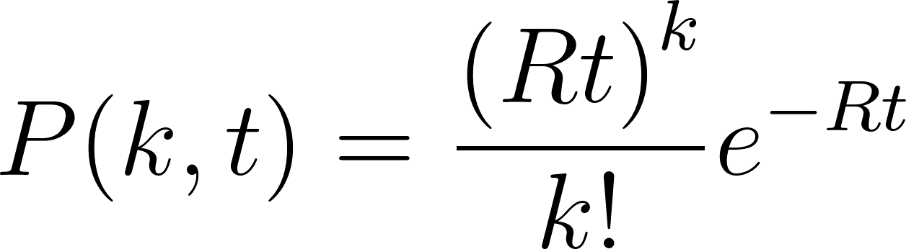
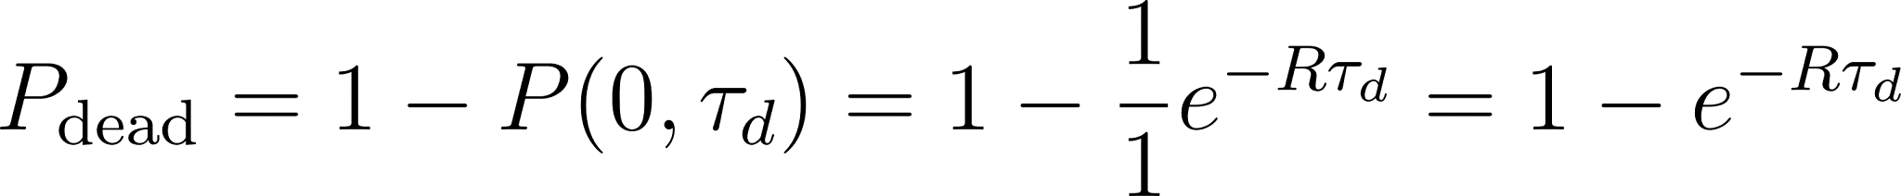
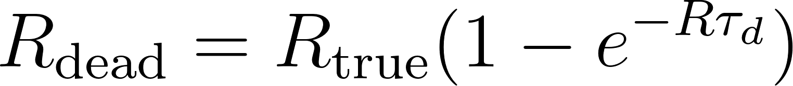
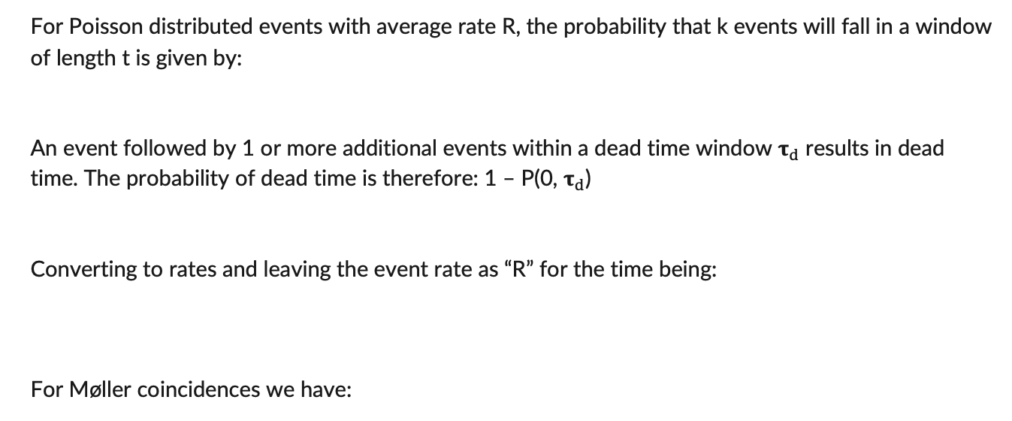
Scaler DAQ Dead Time: Old Model & Shortfalls
For Poisson distributed events with average rate R, the probability that k events will fall in a window of length t is given by:
An event followed by 1 or more additional events within a dead time window ${\text{τ}}_{d}$ results in dead time. The probability of dead time is therefore: 1 – P(0, ${\text{τ}}_{d}$)
Converting to rates and leaving the event rate as “R” for the time being:
For Møller coincidences we have:

Slide 9
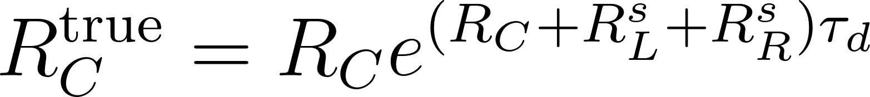
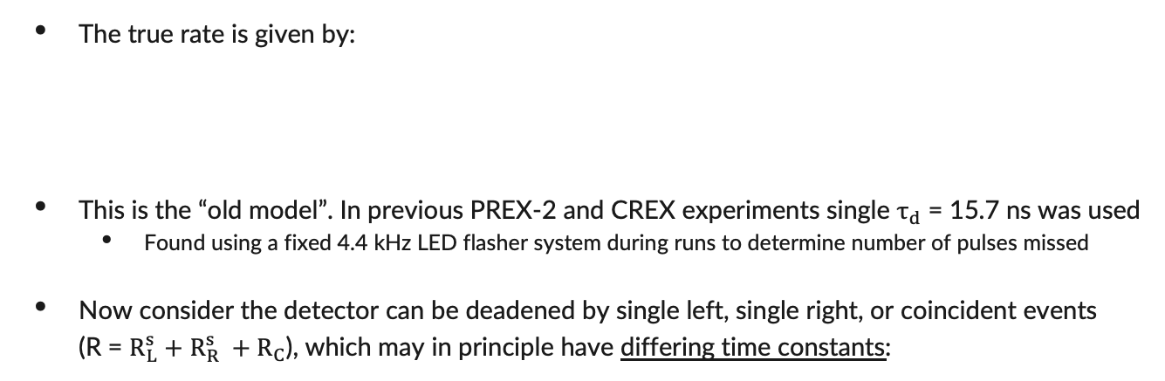
Scaler DAQ Dead Time: Old Model & Shortfalls
The true rate is given by:
This is the “old model”. In previous PREX-2 and CREX experiments single $τ_{d}$ = 15.7 ns was used
  Found using a fixed 4.4 kHz LED flasher system during runs to determine number of pulses missed
Now consider the detector can be deadened by single left, single right, or coincident events (R = $R_{L}^{s}+$ $R_{R}^{s} +R_{C}$), which may in principle have differing time constants:
The New Model

Slide 10
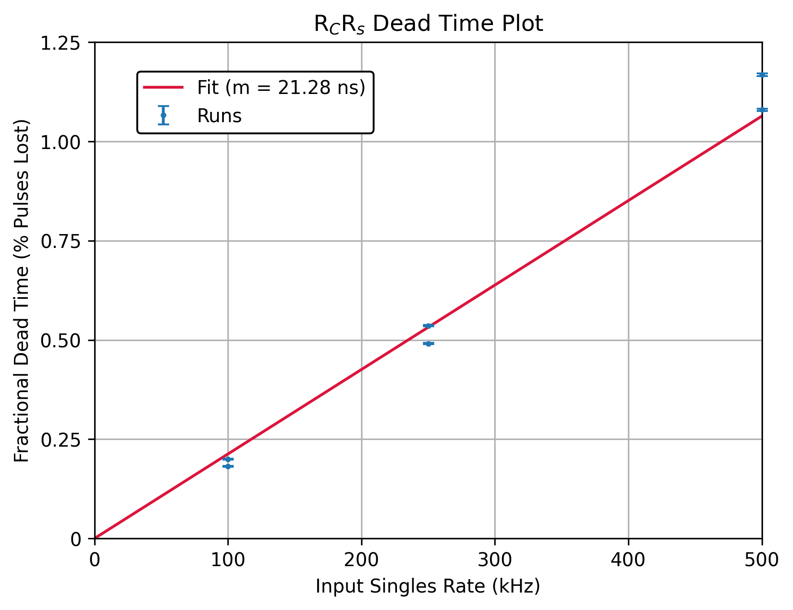
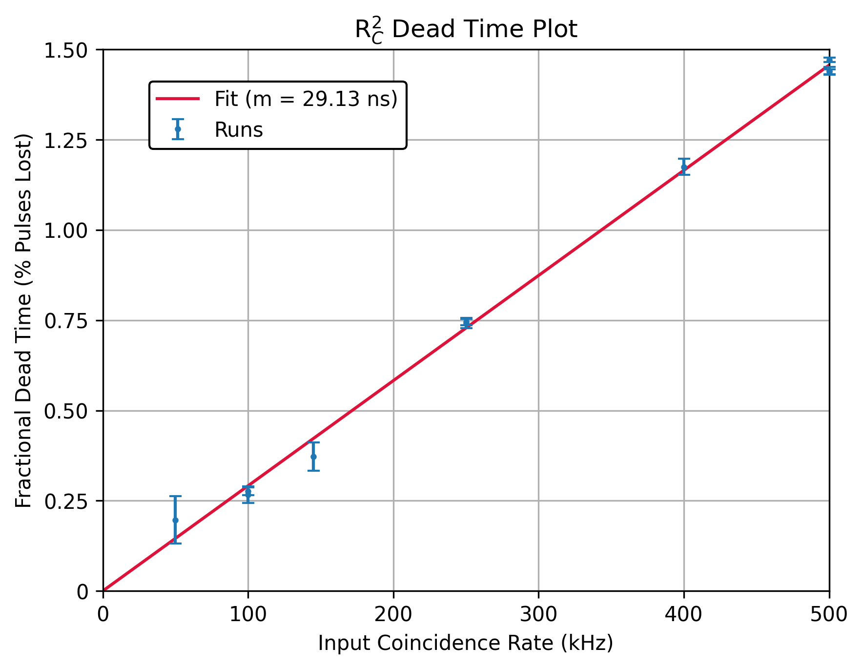
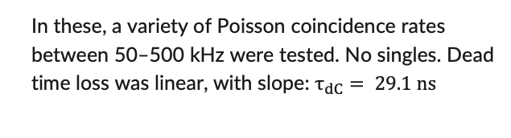
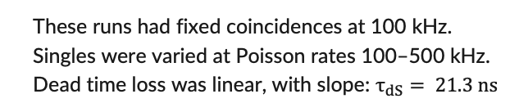
Scaler DAQ Dead Time Constants
Using the detector emulator, we were able to isolate the individual dead time constants $τ_{dS}$ and $τ_{dC}$ and show that they do differ. Both are greater than the previous $τ_{d}=15.7 ns$.
These runs had fixed coincidences at 100 kHz. Singles were varied at Poisson rates 100–500 kHz. Dead time loss was linear, with slope: $τ_{dS}= 21.3 ns$
In these, a variety of Poisson coincidence rates between 50–500 kHz were tested. No singles. Dead time loss was linear, with slope: $τ_{dC}= 29.1 ns$

Slide 11
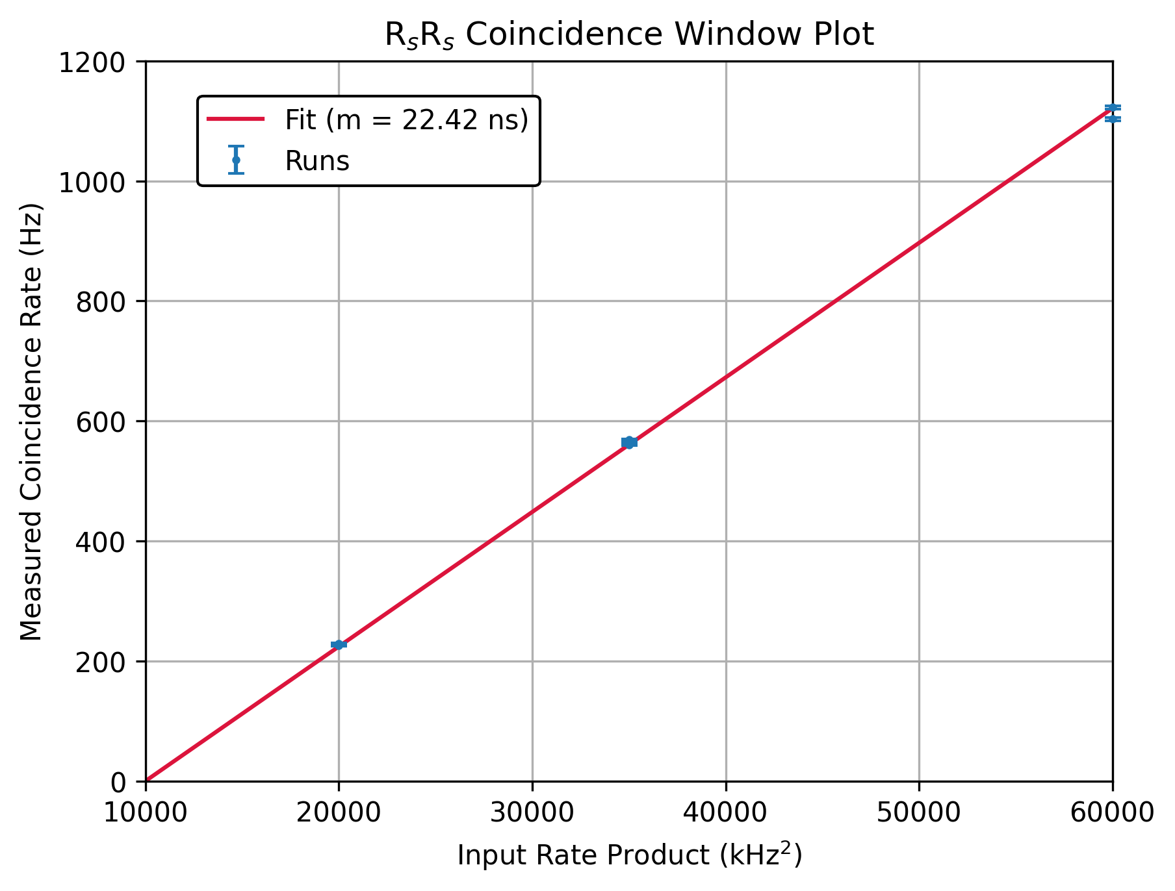
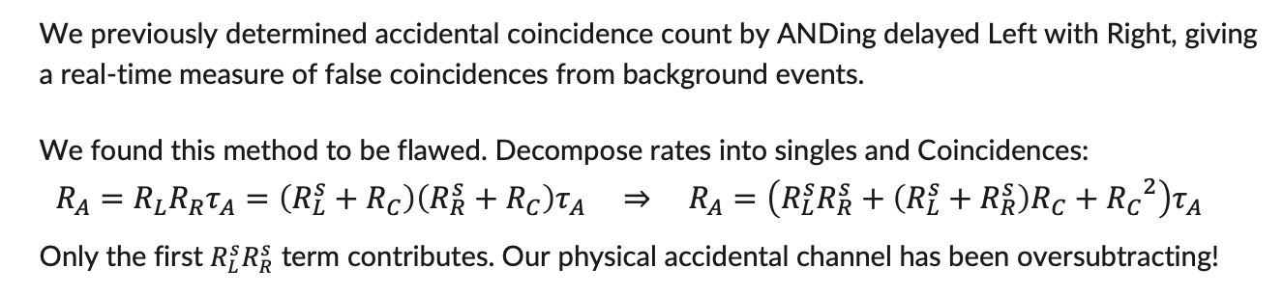
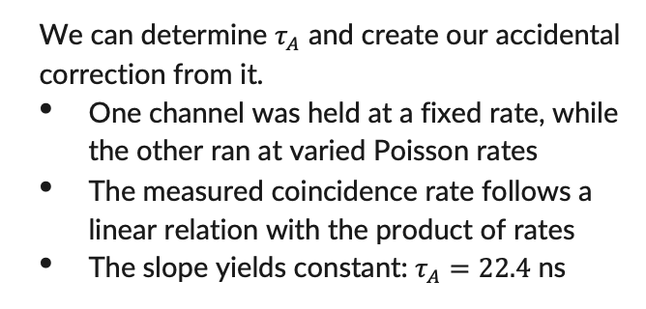
Scaler DAQ Accidental Corrections
We previously determined accidental coincidence count by ANDing delayed Left with Right, giving a real-time measure of false coincidences from background events.
We found this method to be flawed. Decompose rates into singles and Coincidences:
$$R_{A}=R_{L}R_{R}τ_{A}=\left(R_{L}^{s}+R_{C}\right)\left(R_{R}^{s}+R_{C}\right)τ_{A} ⇒ R_{A}=\left(R_{L}^{s}R_{R}^{s}+\left(R_{L}^{s}+R_{R}^{s}\right)R_{C}+{R_{C}}^{2}\right)τ_{A}$$
Only the first $R_{L}^{s}R_{R}^{s}$ term contributes. Our physical accidental channel has been oversubtracting!
We can determine $τ_{A}$ and create our accidental correction from it.
One channel was held at a fixed rate, while the other ran at varied Poisson rates
The measured coincidence rate follows a linear relation with the product of rates
The slope yields constant: $τ_{A}=22.4$ ns

Slide 12
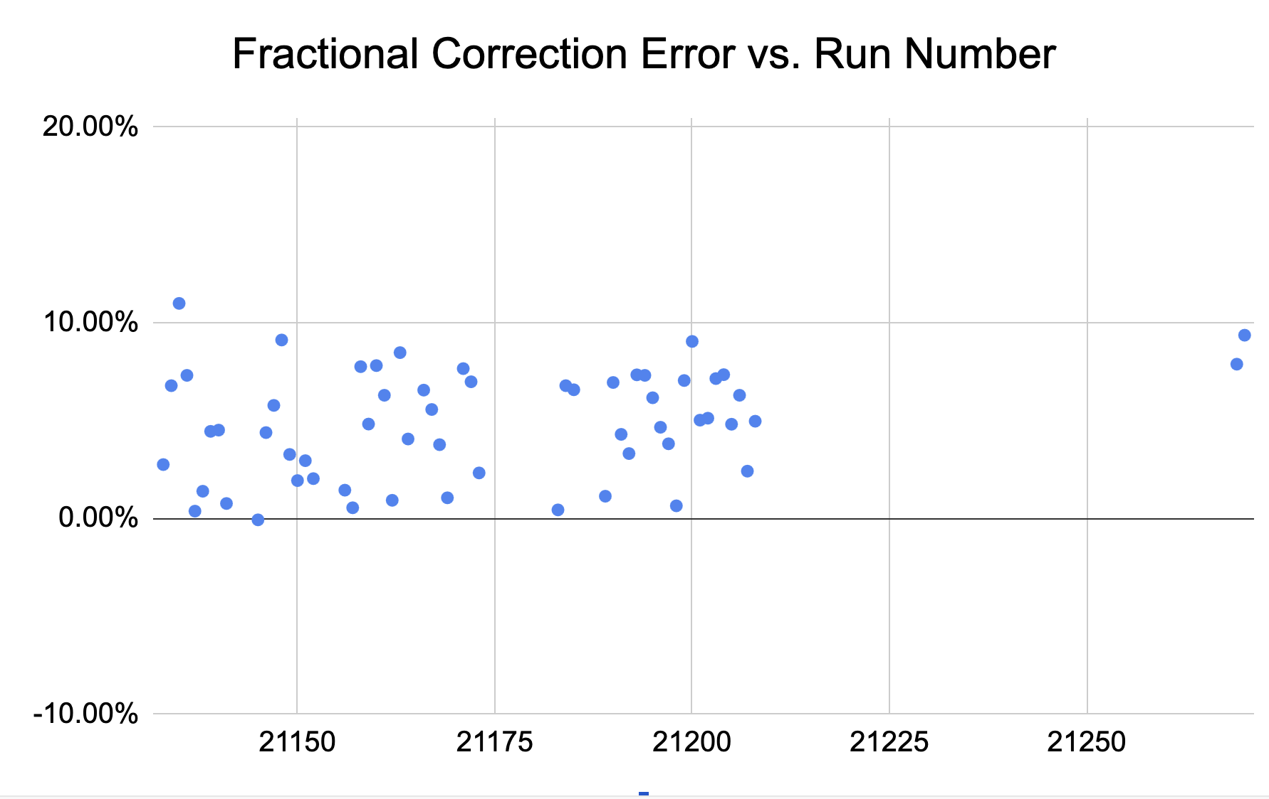
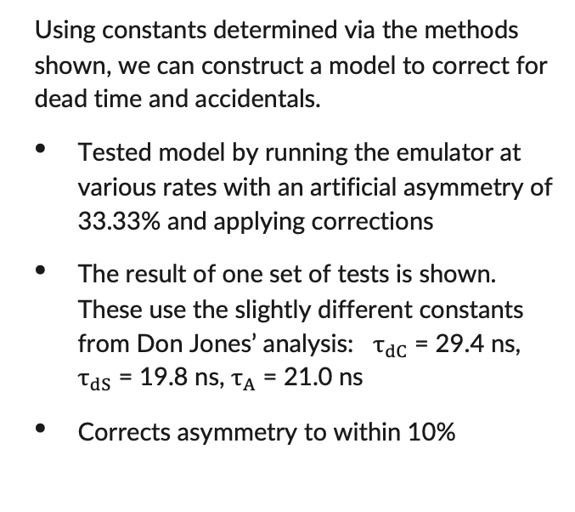
Scaler DAQ Dead Time + Accidentals Model Test
Using constants determined via the methods shown, we can construct a model to correct for dead time and accidentals.
Tested model by running the emulator at various rates with an artificial asymmetry of 33.33% and applying corrections
The result of one set of tests is shown. These use the slightly different constants from Don Jones’ analysis: $τ_{dC}$ = 29.4 ns, $τ_{dS}$ = 19.8 ns, $τ_{A}$ = 21.0 ns
Corrects asymmetry to within 10%
Fractional error of correction for several test runs. The input left, right, and coincidence rates took a variety of values in the range from 25–500 kHz.
Credit: Don Jones, internal presentation.

Slide 13
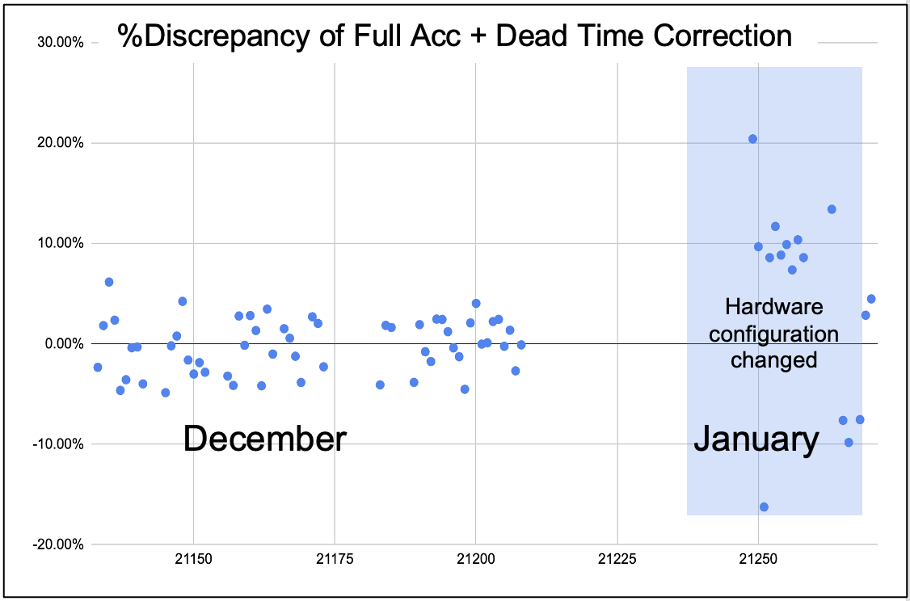
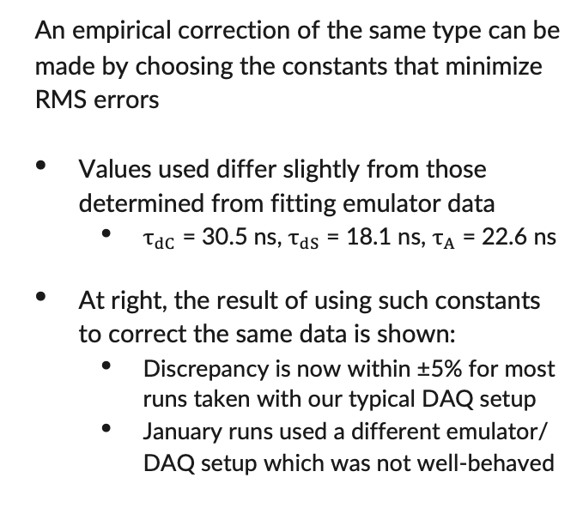
Scaler DAQ Dead Time + Accidentals Model Test
An empirical correction of the same type can be made by choosing the constants that minimize RMS errors
Values used differ slightly from those determined from fitting emulator data
  $τ_{dC}$ = 30.5 ns, $τ_{dS}$ = 18.1 ns, $τ_{A}$ = 22.6 ns
At right, the result of using such constants to correct the same data is shown:
  Discrepancy is now within ±5% for most runs taken with our typical DAQ setup
  January runs used a different emulator/ DAQ setup which was not well-behaved
The empirical correction on the same test runs.
Plot credit: Donald Jones, internal presentation.

Slide 14
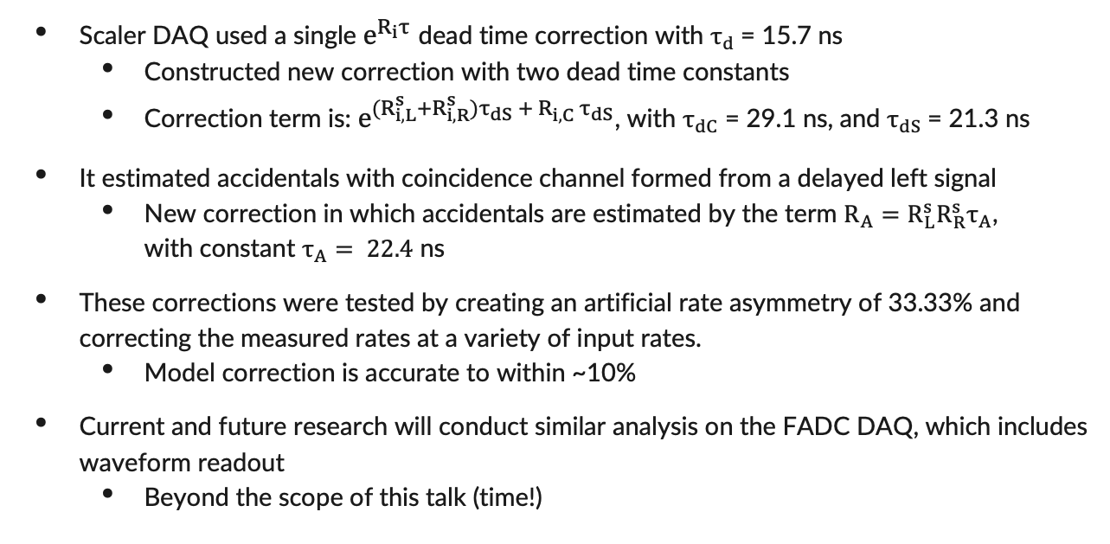
Conclusions
Scaler DAQ used a single $e^{R_{i}τ}$ dead time correction with $τ_{d}$= 15.7 ns
  Constructed new correction with two dead time constants
  Correction term is: $e^{(R_{i,L}^{s}+R_{i,R}^{s})τ_{dS} + R_{i,C}^{} τ_{dS}}$, with $τ_{dC}$ = 29.1 ns, and $τ_{dS}$= 21.3 ns
It estimated accidentals with coincidence channel formed from a delayed left signal
  New correction in which accidentals are estimated by the term $R_{A}=R_{L}^{s}R_{R}^{s}τ_{A}$, with constant $τ_{A}= 22.4$ ns
These corrections were tested by creating an artificial rate asymmetry of 33.33% and correcting the measured rates at a variety of input rates.
  Model correction is accurate to within ~10%
Current and future research will conduct similar analysis on the FADC DAQ, which includes waveform readout
  Beyond the scope of this talk (time!)

Slide 15
Figure Credits
[1]: MOLLER Collaboration, MOLLER Technical Design Report
[2]: D. E. King, Utilizing Parity Violating Electron Scattering As a Probe to Measure the Neutron Radius of 208-Pb
[3]: D. E. King et al, Precision Møller polarimetry for PREX-2 and CREX

Slide 16
Backup/Extra Slides

Slide 17
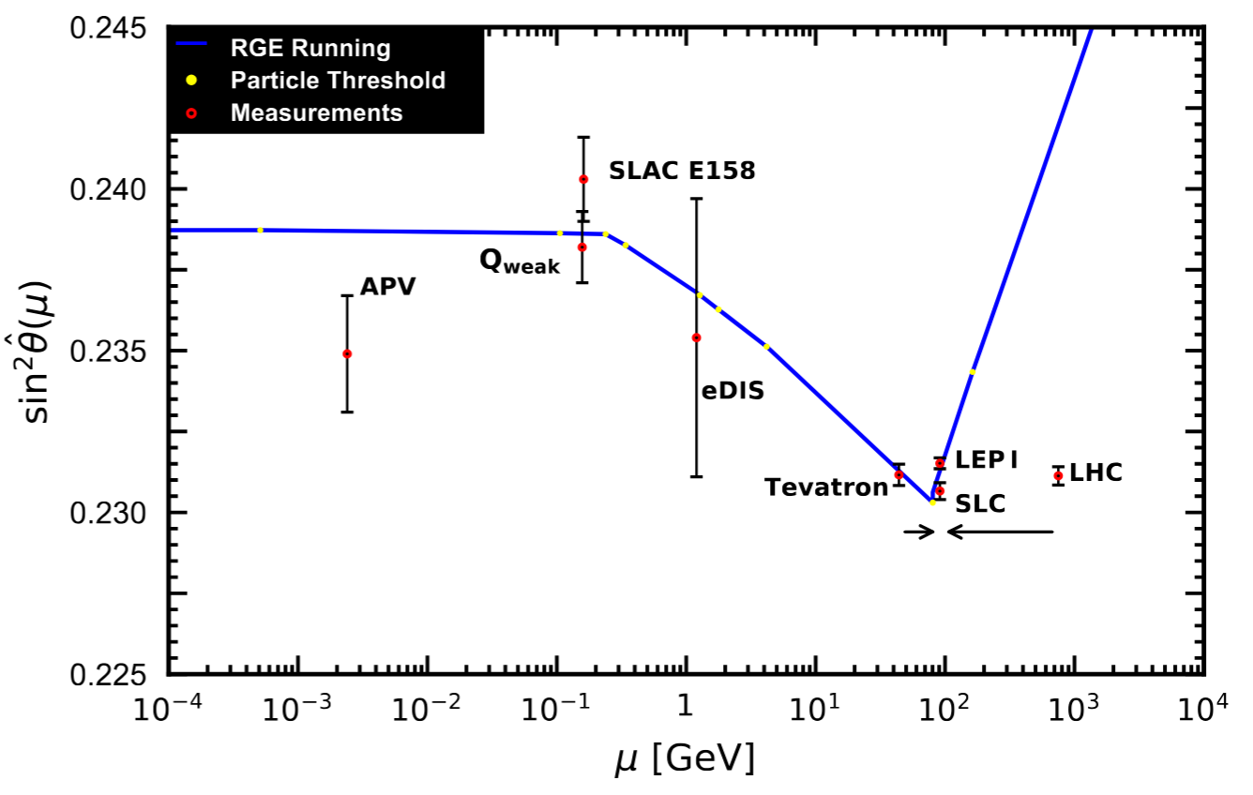
Prior Weak Mixing Angle Measurements
Previous measurements of the weak mixing angle, including the projected measurement for MOLLER.
Plot Credit: PDG Book 2024, modified by Eric King.
MOLLER
(Goal)
Image adopted from: Particle Data Group, PDG Book 2024
All 4 measurements taken at Z-pole

Slide 18
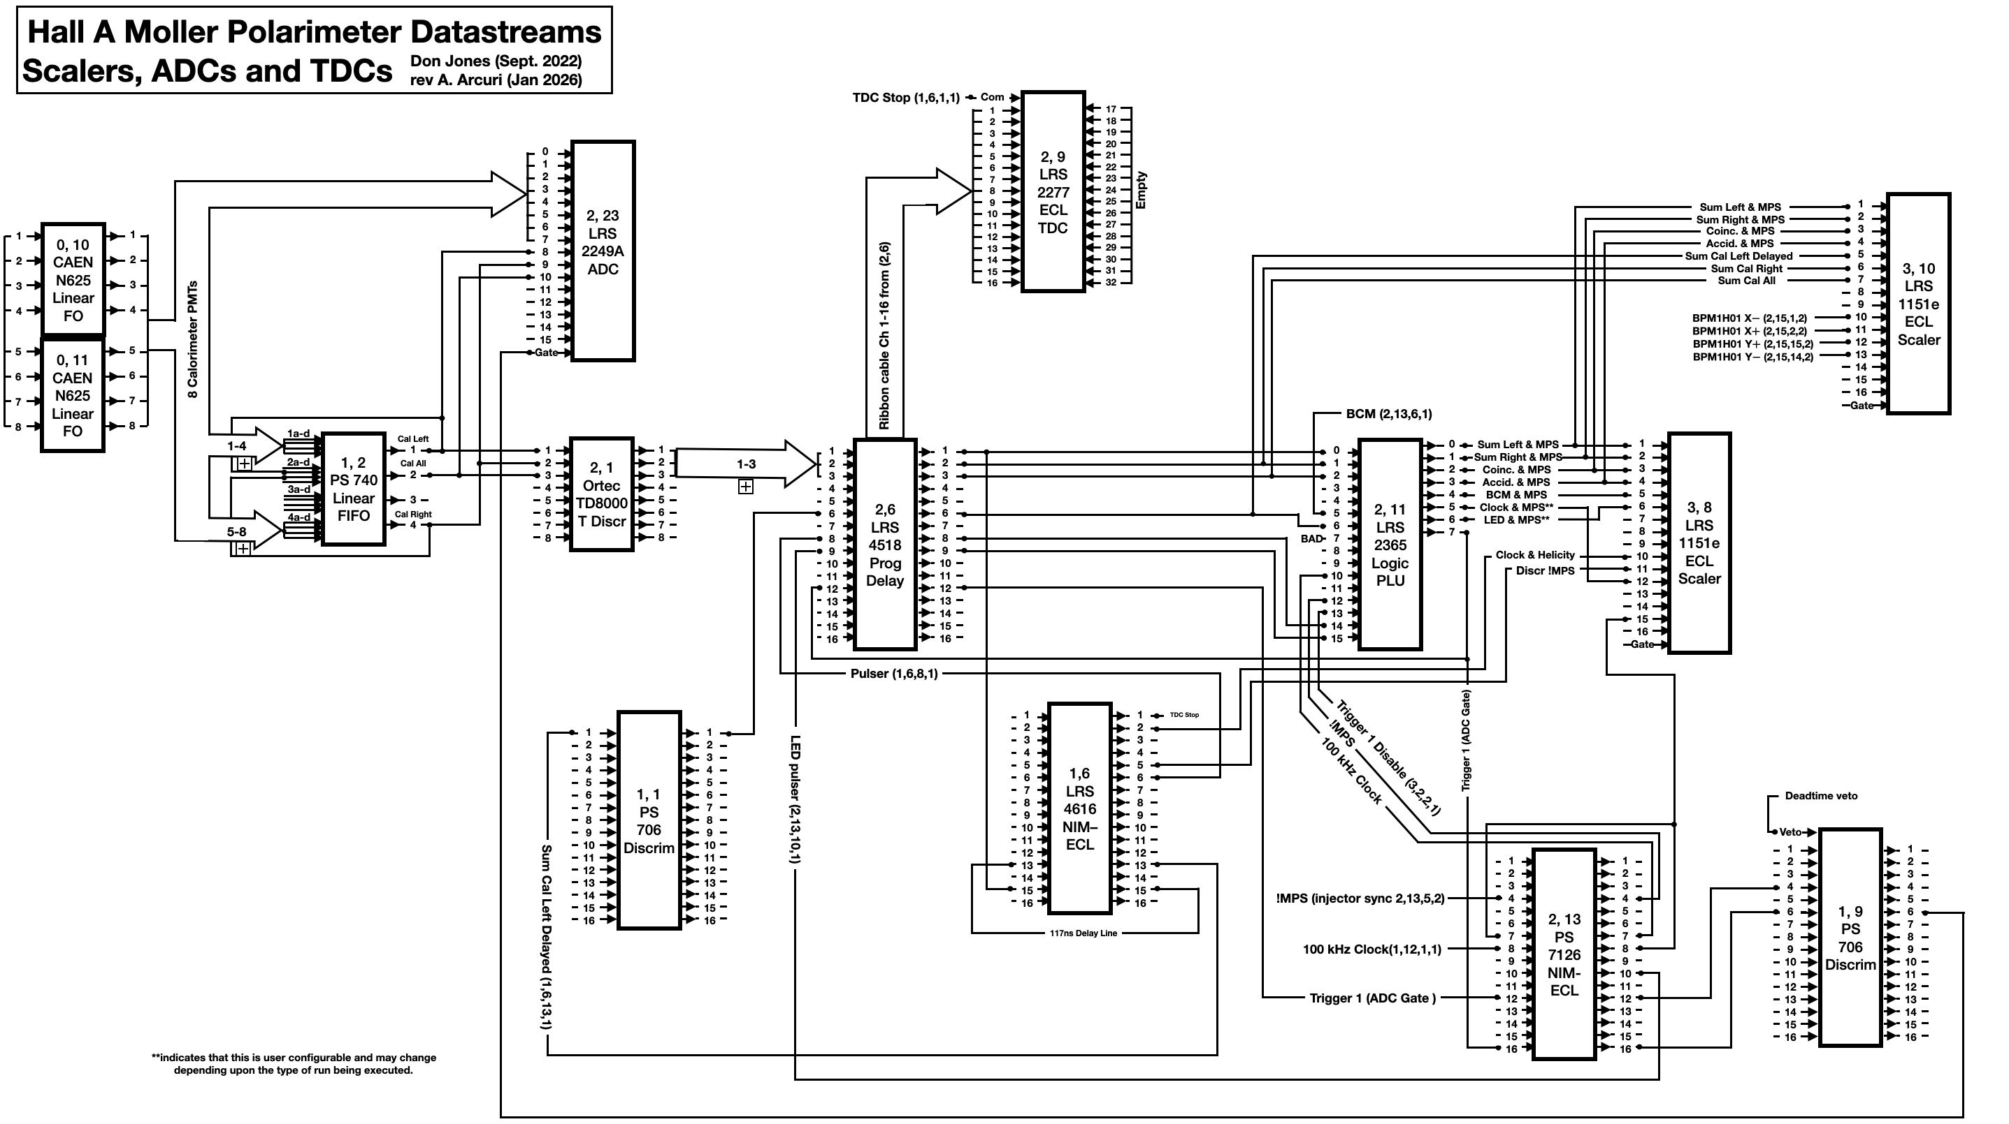
Hall A Møller Pol Scaler DAQ Diagram (Simplified)

Slide 19
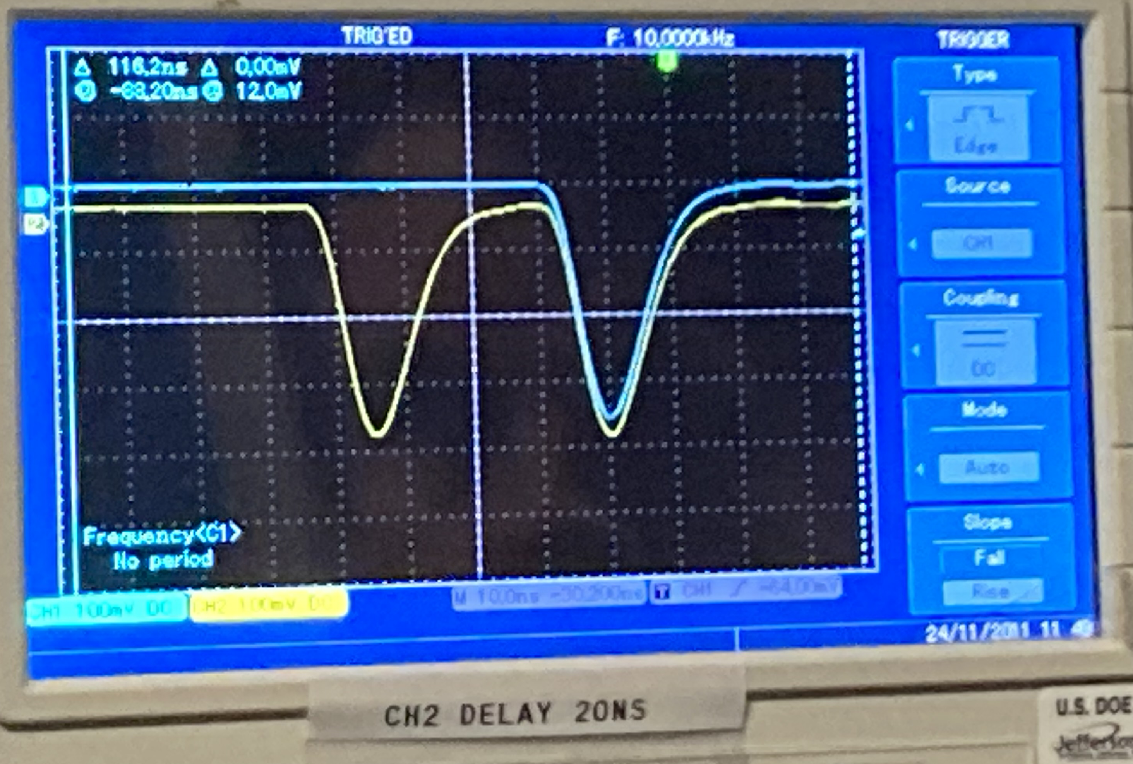
Dead Time Constant $τ_{dS}$: Physical Interpretation
Consider the case of a single Right pulse (yellow) preceding a Coincidence pair (yellow & blue) by some time.
2 Right pulses, 1 Left pulse, and 1 Coincidence are counted.
Good!

Slide 20
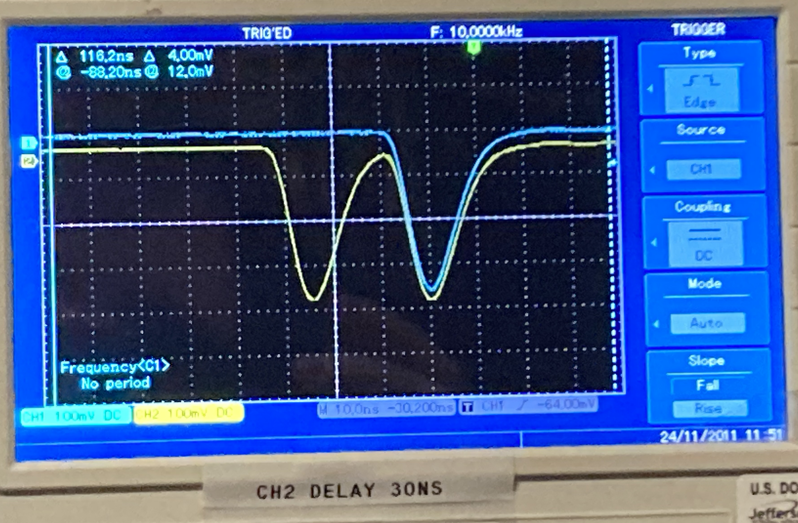
Dead Time Constant $τ_{dS}$: Physical Interpretation
Decrease the separation between the Right single pulse and Coincidence pair.
1 Right pulse, 1 Left pulse, and 0 Coincidences are counted.
Not good! Second Right pulse is missed entirely, meaning we lose our Coincidence!

Slide 21
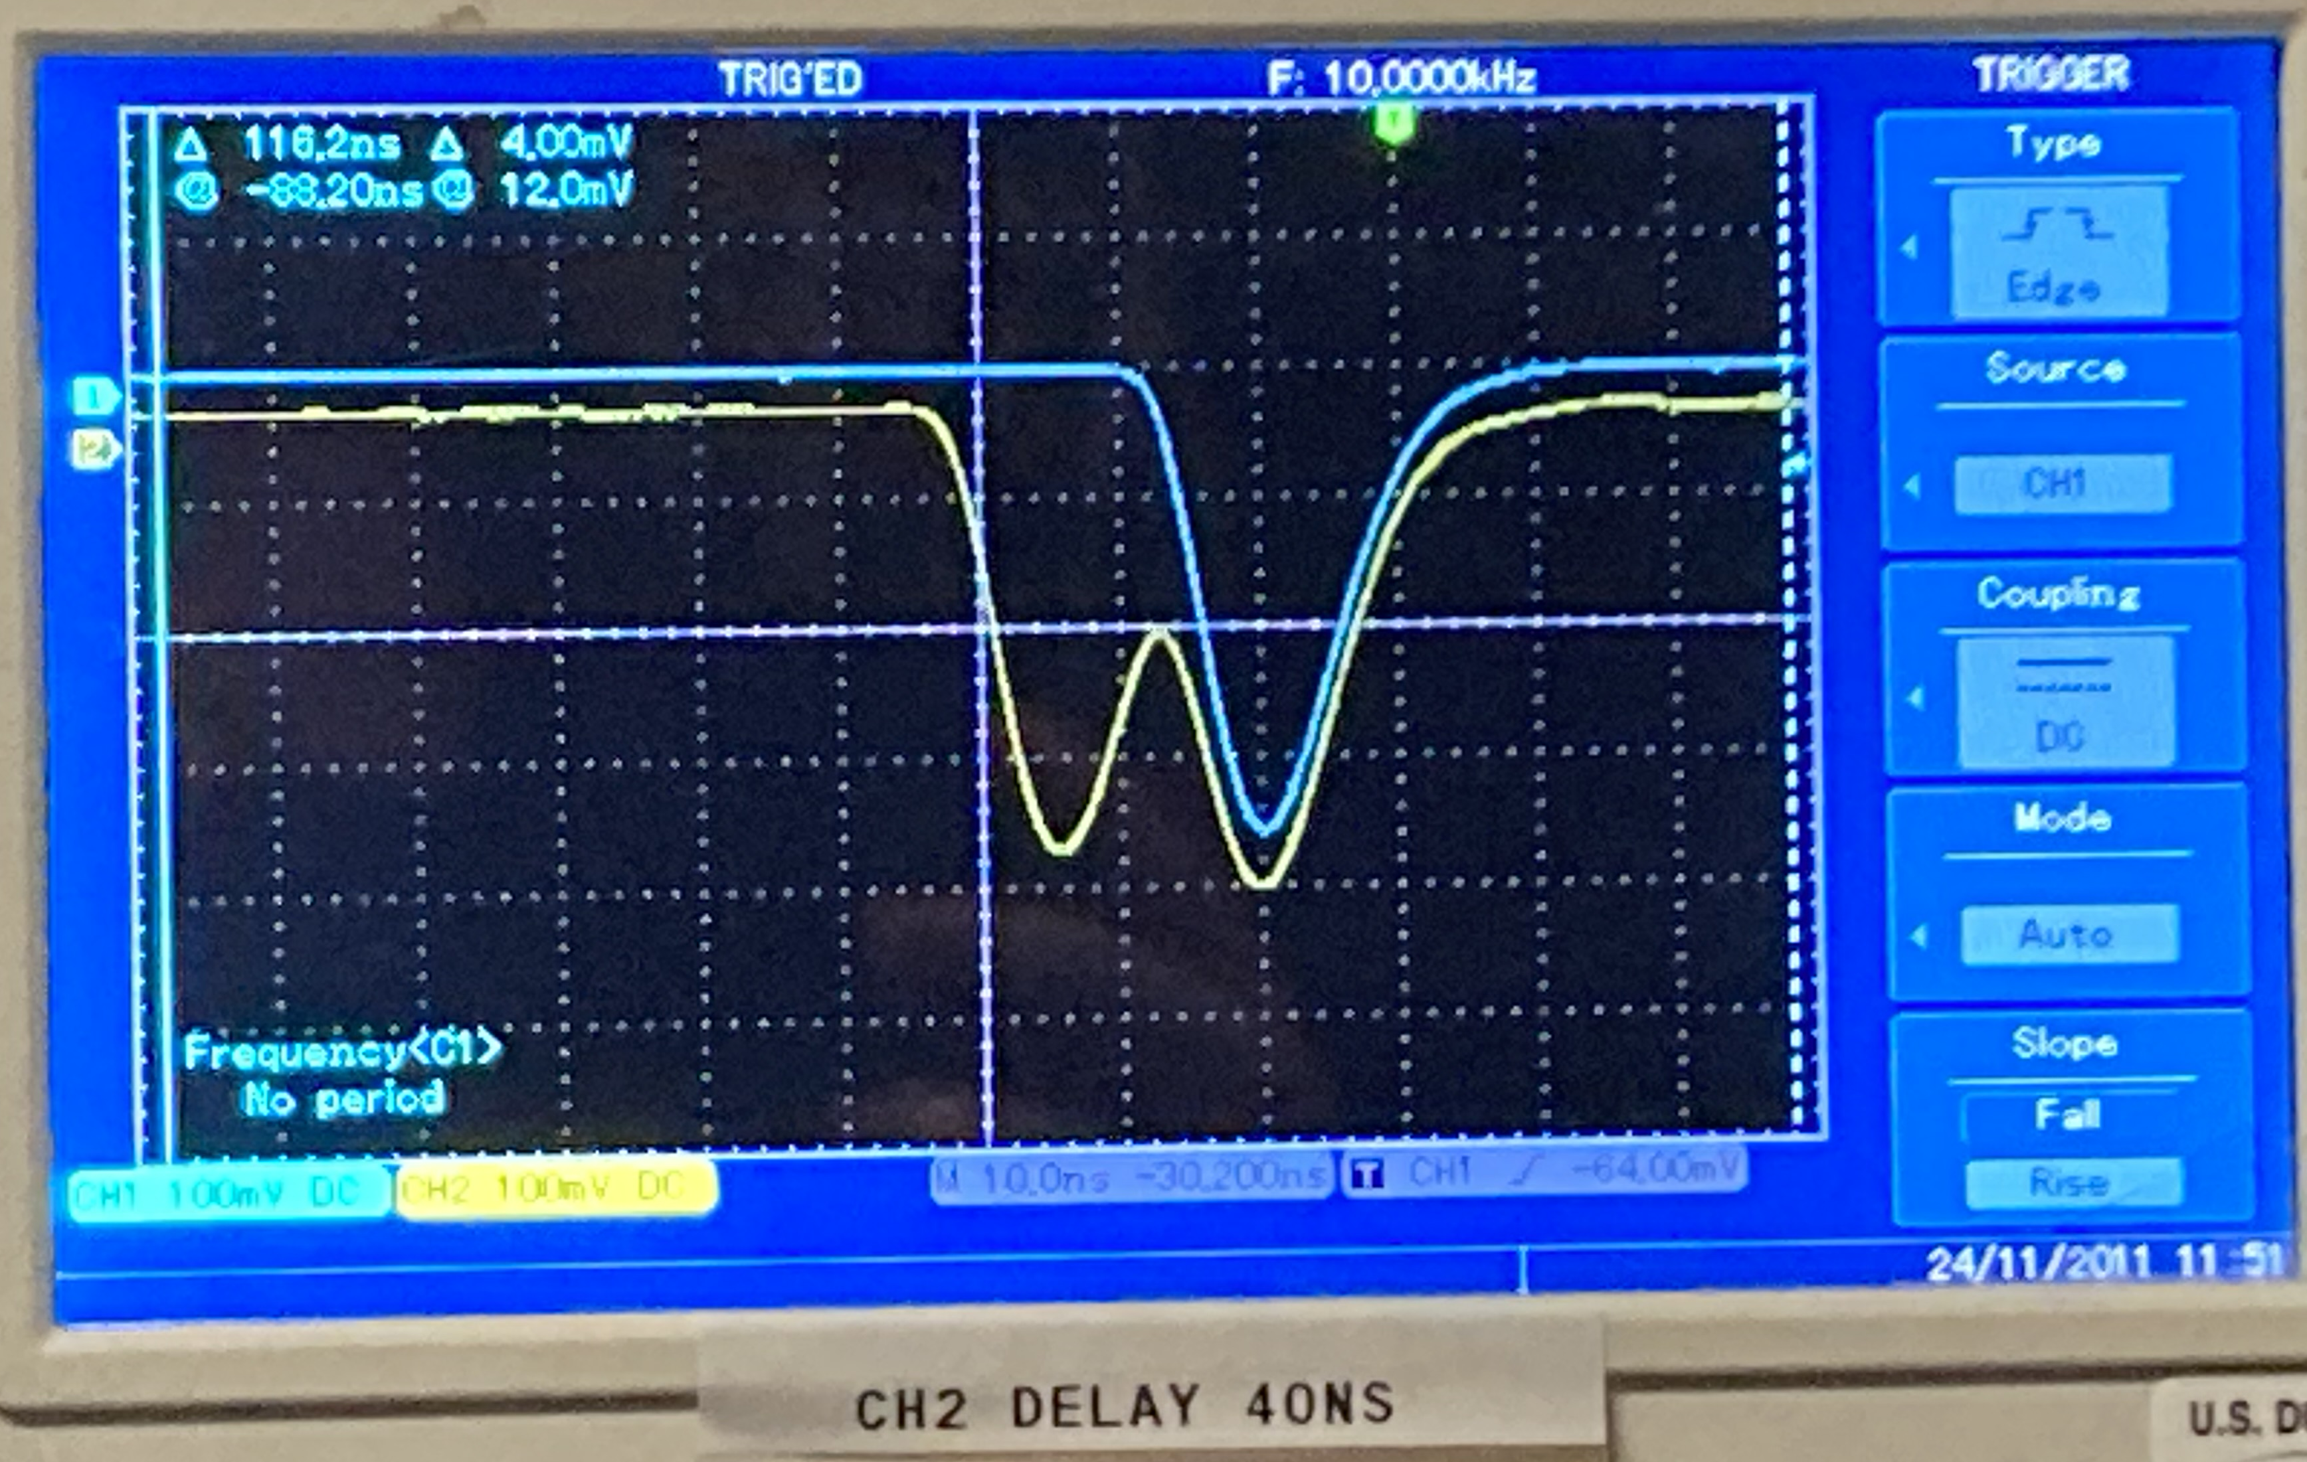
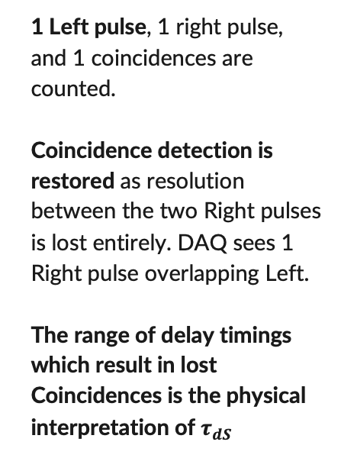
Dead Time Constant $τ_{dS}$: Physical Interpretation
1 Left pulse, 1 right pulse, and 1 coincidences are counted.
Coincidence detection is restored as resolution between the two Right pulses is lost entirely. DAQ sees 1 Right pulse overlapping Left.
The range of delay timings which result in lost Coincidences is the physical interpretation of $τ_{dS}$

Slide 22
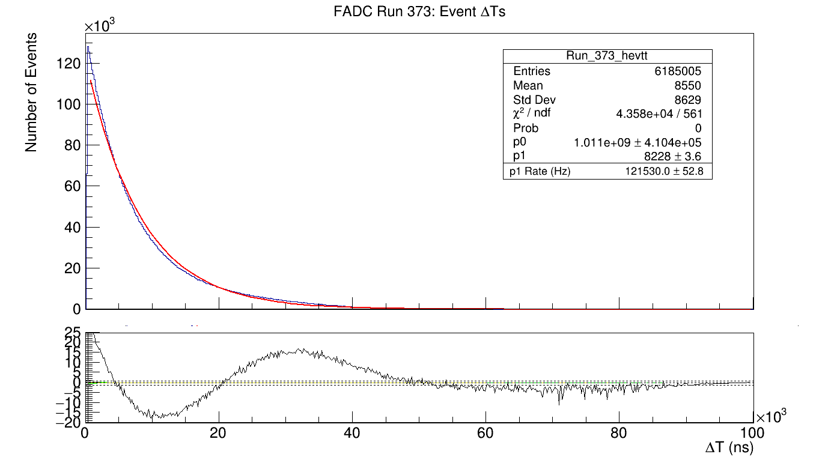
FADC DAQ Dead Time (Event Spacing)
Run 373 DT Plot
Block and buffer level 5, Left/Right/MPS trigger, no prescaling, waveform readout
CODA readout live time of ~80%
Overall coincidence dead time was 20.68% ± 0.02%.
Due to the readout dead time a simple exponential distribution is not seen. 10–30 µs deviation.

Slide 23
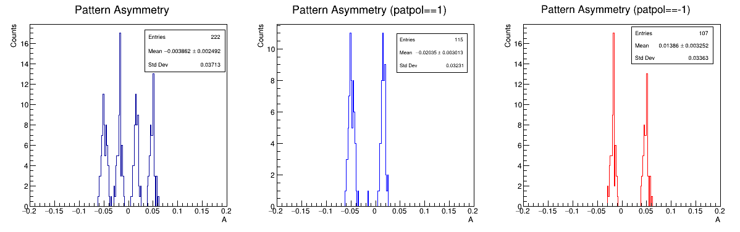
FADC DAQ False Asymmetry on Emulator Data
Ran at settings where issue is known to occur: Block/Buffer level of 5, MPS or Left or Right trigger, waveform readout, Left, Right, Coincidence rates of 50 kHz.
CODA readout live time was ~80% overall. Not surprising at these block and buffer levels.
The unexpected issue is clear in the asymmetry plots. The difference between the pol=1 asymmetry and pol=-1 asymmetry is 7.72σ.

